Slide 1
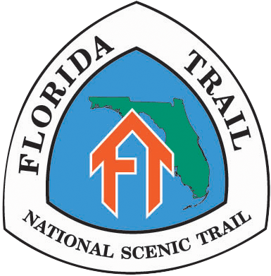
Close the Gaps
Florida National Scenic Trail
1/9/2014 FNST GAP 3

Slide 2



Florida National Scenic Trail History
& Congressional Background
Florida Greenways & Trails Foundation, Inc.
& The US Forest Service
Congressional criteria—1983 & original 20 mile wide study corridor
  Three decades of public land acquisition in Florida
  (State & local governments) add over one million acres to
  parks and conservation land base
  Result: alternate routes exist today that did not exist in 1980s

Slide 3
Florida Greenways & Trails Foundation
Florida Greenways & Trails Foundation, Inc.
& The US Forest Service
  501c3 and CSO (Citizen Support Organization) for OGT
  Mission: “Advocate for and help create a statewide system of trails and greenways”
  “Close the Gaps” endeavor, initially for shared-use paths but also for other corridors such as paddling, equestrian and hiking trails

Slide 4
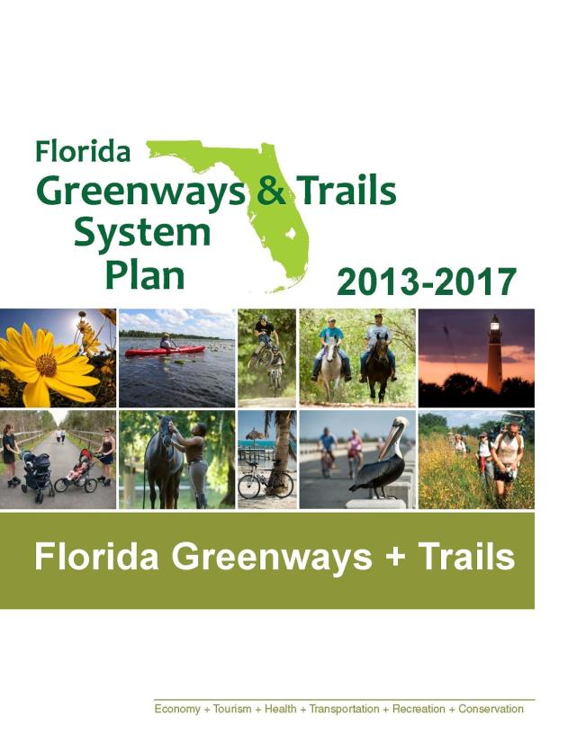
Florida’s Comprehensive Statewide Greenway and Trail System managed
by OGT
Original “Opportunity Maps”
2012 Priority Trails Map (includes FNST)

Slide 5
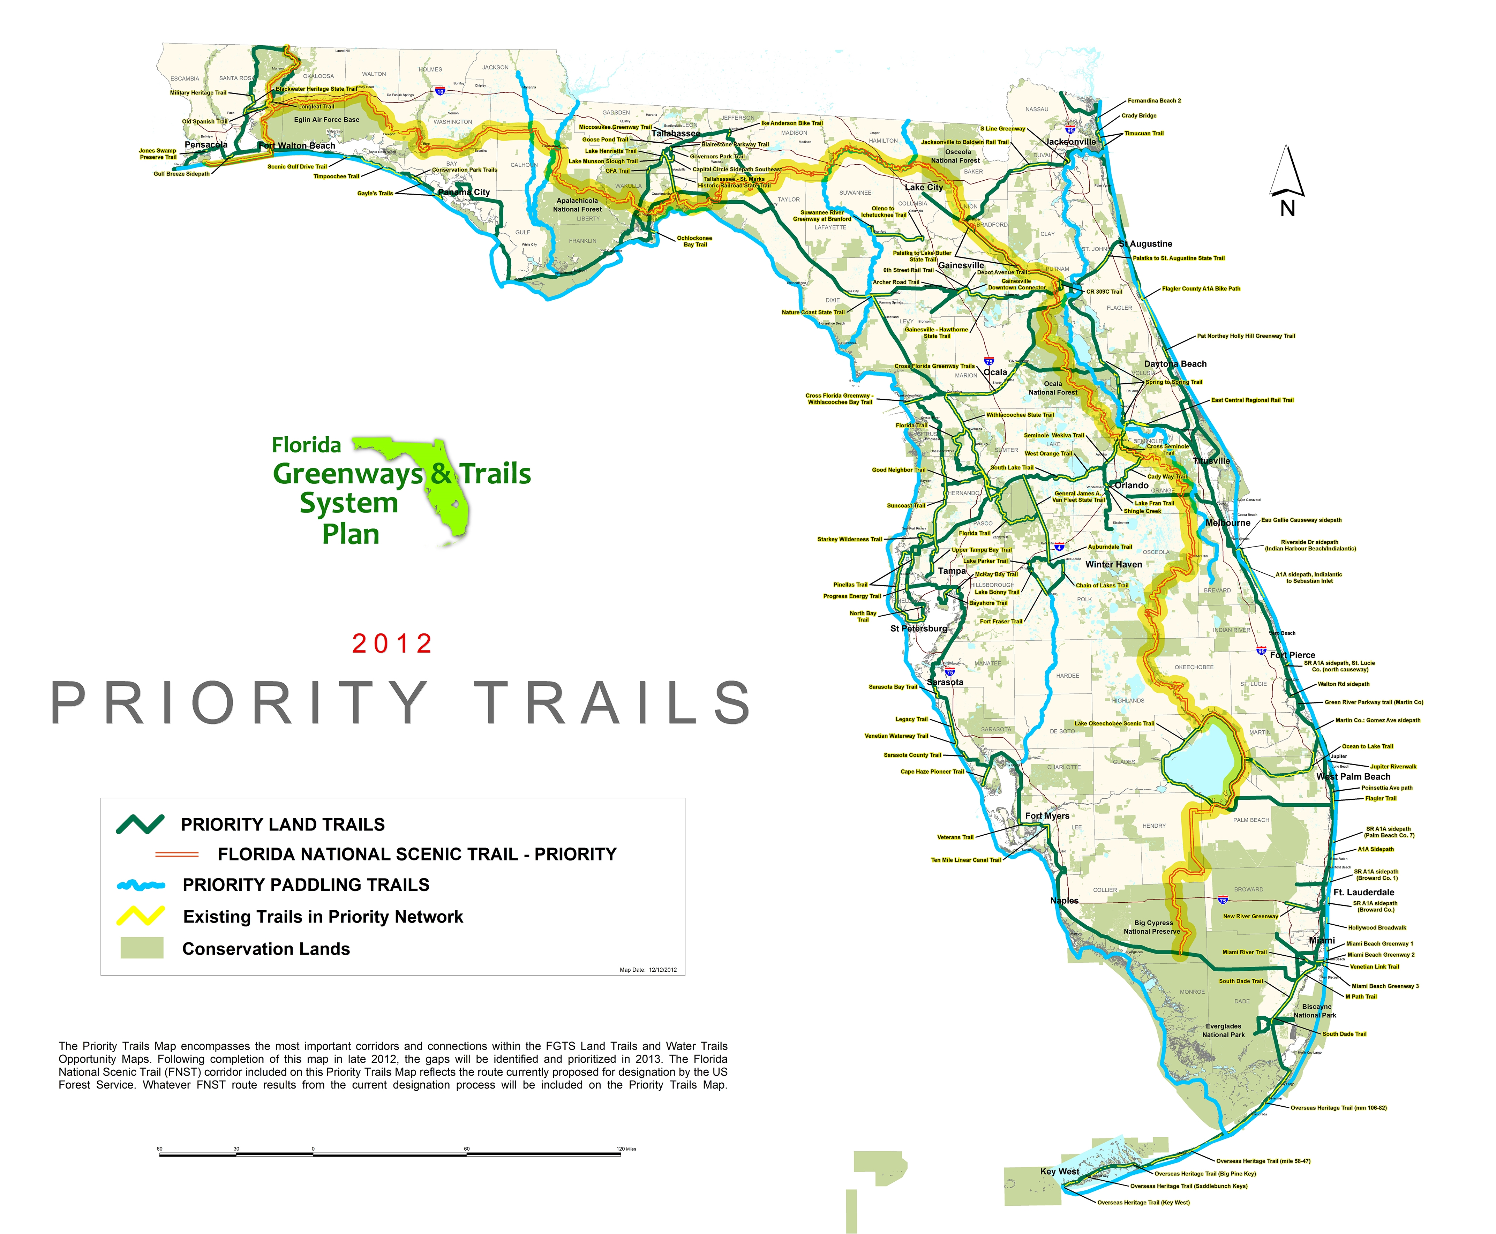
2013 OGT Top Tier Gaps Map
includes Three Gaps in FNST
Selection criteria:
Not more than 3 significant gaps
Long-standing gaps
Geographic variety
GAP 2
GAP 3
GAP 1

Slide 6
Study Area Gap #3
Study Area Gap #3 Selected to establish evaluation format for gap analysis
Potential “future” gap due to private land ownership of entire corridor
USFS & FTA have 30 year history on corridor—understand vulnerability and challenges
Good sense of alternate routes available (initial presentation to FTA 2010)
OGT Opportunity and Priority Map information available on alternate routes (local government awareness and involvement)

Slide 7
Study Area Gap #3
Preliminary Major Criteria for evaluating
“Close the Gaps” FNST alternatives
Total number of miles (est) across gap—most direct and alternate routes
Areas of existing public land & future public land in gaps
Private land ownerships and difficulty of establishing corridor along each route
Major obstacles that could complicate route selection and costs (ie, rivers, highways, military bases, etc.)
Special scenic, cultural, recreational and/or historic areas along routes
Public access opportunities along alternate routes
Communities and facilities for supplies/overnights along alternate routes
Potential for expanded recreational use associated with alternate routes (ie., spurs and/or loop trails possible)
Preliminary estimates of costs to acquire land/easements and establish public corridor

Slide 8
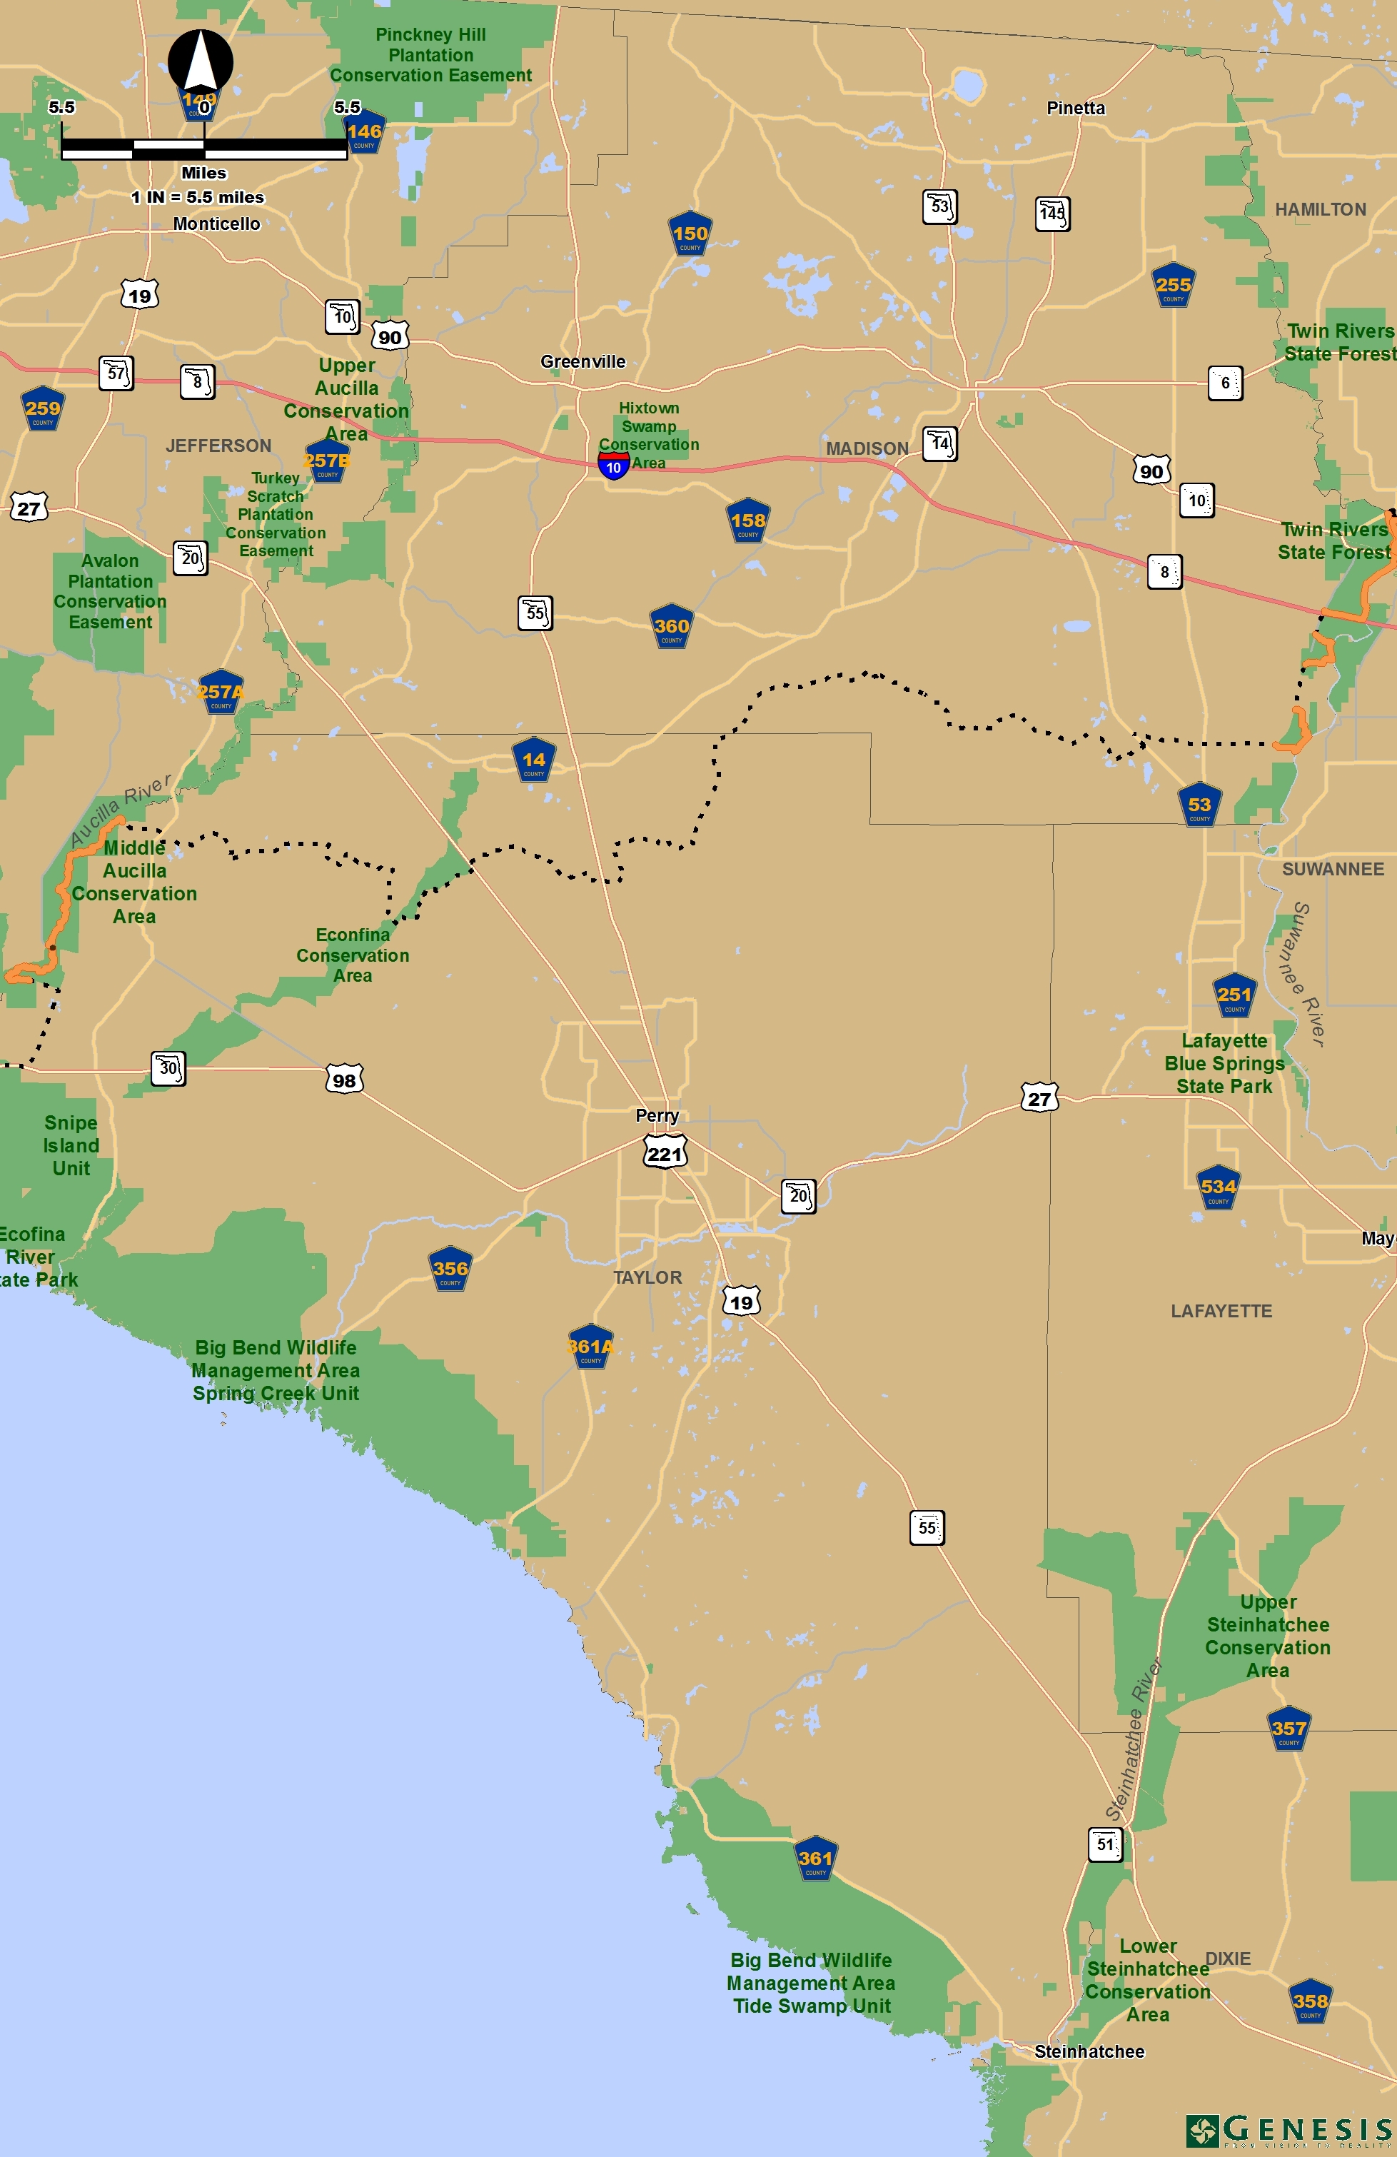
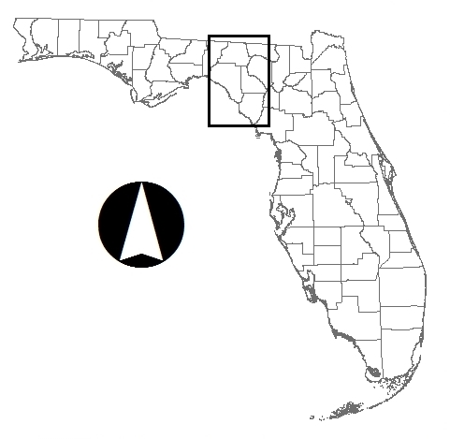

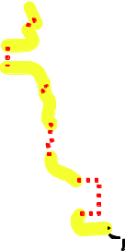
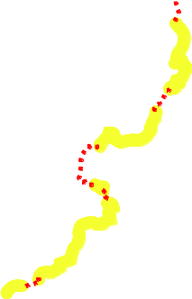
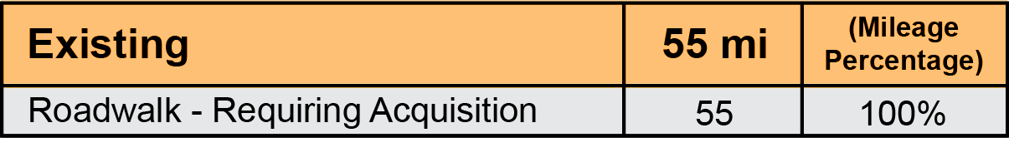


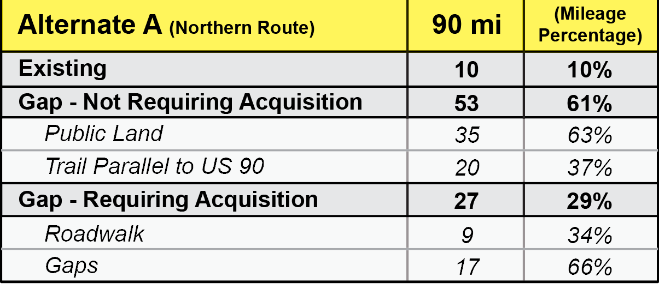

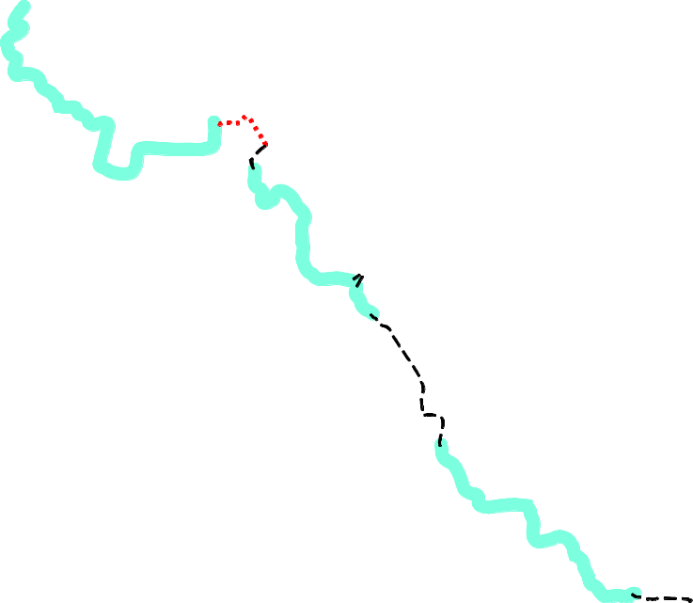


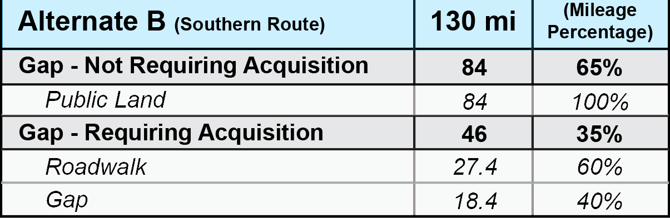

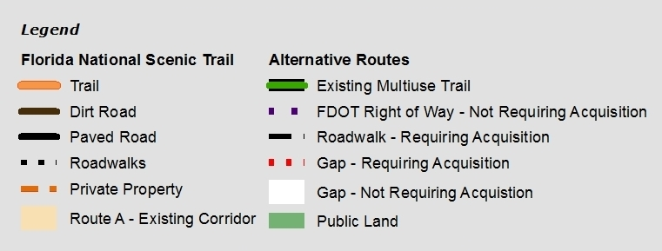
Study Area Gap #3
Suwannee River to the Aucilla River
Alternate A Northern Route
Existing FNST Unofficial Connector
Alternate B
Southern Route

Slide 9
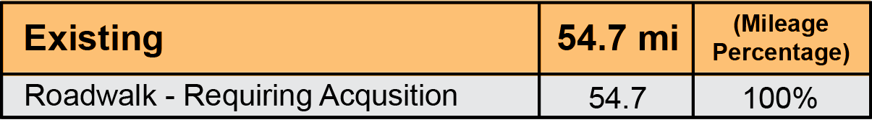
Study Area Gap #3
Suwannee River to the Aucilla River
ASSETS
Shortest distance between rivers
“Trail” established and blazed
Trail on logging roads / easy to maintain
Cost under ”existing agreements”
One area of public land (Econfina) exists
LIABILITY
No OGT priority corridors in proximity
100% of existing “trail” on private property
Permission agreements for trail are old/expired
Agreements are short term (30 day cancellation)
Low to moderate scenic value due to logging use
Very low public use ( est. 20+ users a year
Very difficult to relocate off logging roads (wetlands)
No identified public land(s) project currently in area
Very isolated area/no communities or facilities
Very low prospects for additional trails
Very restricted public access/mostly private roads
Existing FNST certified
& non-certified

Slide 10
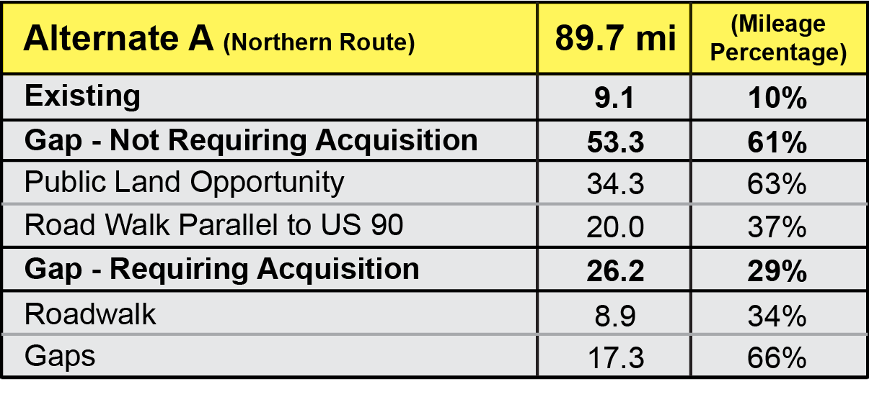
Study Area Gap #3
Suwannee River to the Aucilla River
Alternate A Northern Route
ASSETS
Long segments of public land along route
  US 90 R/O/W four lane highway; 2 in use
  SRWMD acquiring lands along both rivers
  US 90 route is on OGT Opportunity Map
  Moderate to very scenic route along two rivers and rolling hills and farmland of Madison County
  Good to excellent prospects for alternative recreational trails and recreational use via loops
  Excellent public access along entire corridor
  Several communities and good facilities exist
LIABILITY
Trail corridor longer/not as direct as existing
Extra trail miles to construct and maintain
US 90 route would be shared-use probably paved
US 90 route is not currently a “priority trail” corridor
I-10 underpass/overpass required

Slide 11
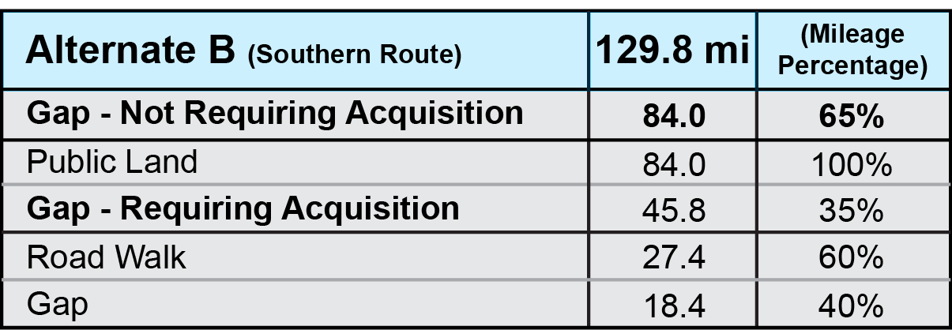
Study Area Gap #3
Suwannee River to the Aucilla River
ASSETS
Long segments of public land along route
  Additional trail miles along Suwannee River
  New trail along Steinhatchee River
  Trail along Big Bend Coast
  Trail along Big Bend could use restricted roads and reduce trail construction and maintenance
  Two communities (Mayo and Steinhatchee) and facilities availible
  Excellent potential for additional recreational use and loop trails
LIABILITY
Trail corridor much longer (3x)/not as direct as existing
Trail construction and management cost higher
Trail outside of original 20 Mile study corridor
Public access is excellent in some areas/poor in others
Possible increased conflict with hunters/other users
US 27 4-lane road crossing
Road walk between Suwannee River, Mayo and south of Mayo to Steinhatchee River lands
10 mile gap in public ownership on Big Bend Coast
ASSETS
Long segments of public land along route
  US 90 R/O/W four lane highway; 2 in use
  SRWMD acquiring lands along both rivers
  US 90 route is on OGT Opportunity Map
  Moderate to very scenic route along two rivers and rolling hills and farmland of Madison County
  Good to excellent prospects for alternative recreational trails and recreational use via loops
  Excellent public access along entire corridor
  Several communities and good facilities exist
LIABILITY
Trail corridor longer/not as direct as existing
Extra trail miles to construct and maintain
US 90 route would be shared-use probably paved
US 90 route is not currently a “priority trail” corridor
I-10 underpass/overpass required
Alternate B
Southern Route

Slide 12
Questions for FNST Coalition
Florida Greenways & Trails Foundation, Inc.
& The US Forest Service
  Is this format helpful?
  Are the selection criteria useful?
  How can both format and criteria be improved from your perspective?

Slide 13
Next Steps in “Close the Gaps
FNST” Analysis
Florida Greenways & Trails Foundation, Inc.
& The US Forest Service
  FGTF will prepare power point presentations on Study Area Gaps #1, #2 & #3 and present at June 2014 Coalition meeting
  Coalition will recommend to USFS preferred route and secondary route in each Gap
  USFS will inform OGT as to selected route
  OGT will conduct public hearings and make changes to Priority Trail Map and Top Tier Gaps during 2016 update

Slide 14
About the Foundation
Florida Greenways & Trails Foundation, Inc.
& The US Forest Service
The Florida Greenways & Trails (FTG) Foundation is Florida's chief advocacy organization for non-motorized trails & greenways. The Foundation supports greater use of trails for for and for for for for and for
recreation,
fitness,
health,
reducing carbon emissions,
attracting leisure travelers,
building community,
beautification,
a larger role in evolving multi-modal transportation policy.
The FGT Foundation supports greenways in particular for their value in connecting land and water bodies in public ownership and expanding public access for all Florida residents and visitors.
The FGT Foundation supports non-motorized trails that promote safe transportation routes for pedestrians and bicyclists, encourages local economic development, and provides connections to public parks and conservation lands.
We welcome your interest, your financial support and your active participation.
www.FGTF.org

