Slide 1
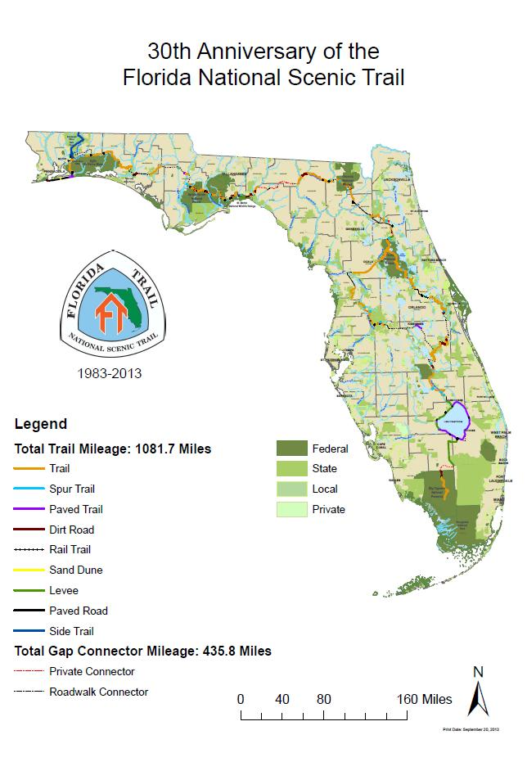
Framing Our Community
“Embracing advanced engineering and global innovation to address FNST needs.”

Slide 2
Working in four dimensions:
Land, Air, In & Under Water, In the Mind
Uniqueness of our work on state and Federally managed lands provides such an attraction that we have always had global expertise available
Expertise – Innovation
Partnerships & Networks
Notes:
Professional divers, Japanese temple builders, Loggers from Tasmania, and skyline riggers from Switzerland who are here to learn and to share their knowledge and specialized tools

Slide 3
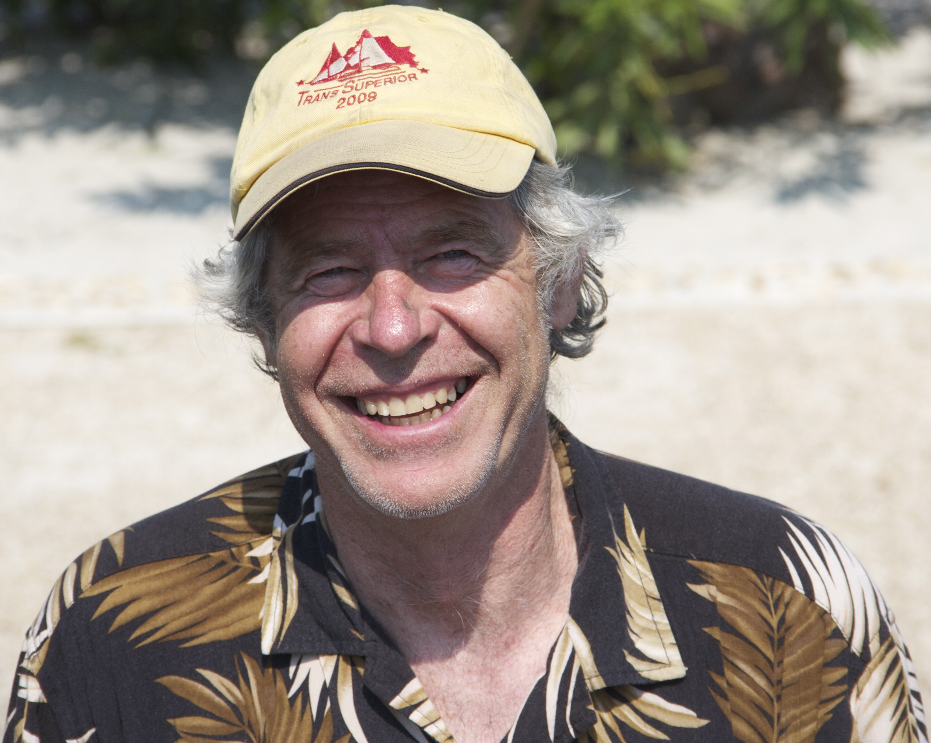
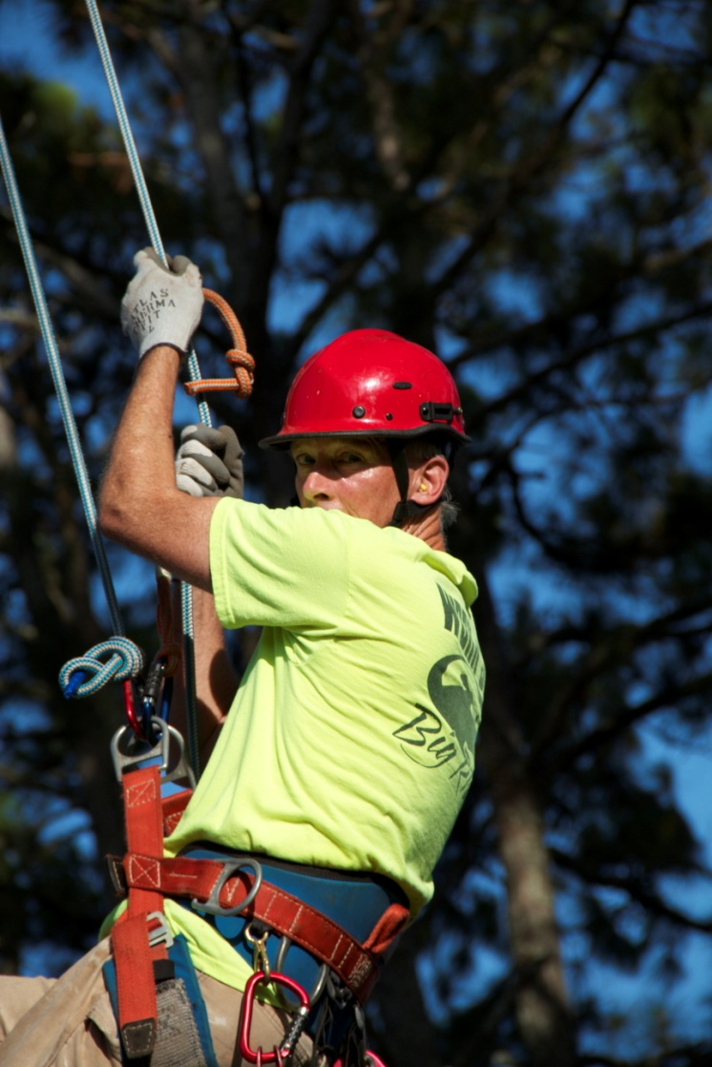
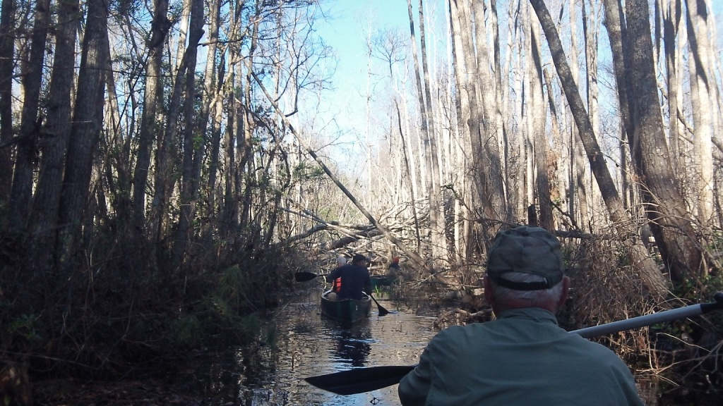
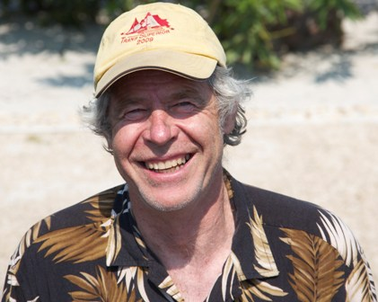
FOC TEAM
Leader &
Program Administrator
Engineer
Safety
Demolitions
Historic Preservation
Trail Crew
Youth & Veterans
Traditional Skills Innovation & Fabrication
Problem Solving Broad Network
Teaching International Experience
Notes:
Ian has been honored 3 times by the Smithsonian Institute in Washington, DC for his expertise in using non-mechanized tools and construction methods - Traditional Skills.
I administer FOC’s programs, coordinates projects, and networks with others
Art has designed new structures and redesigned bridges and historic structures in the US and abroad.
All of our professionals are Safety conscious and our programs exceed Forest Service requirements.

Slide 4
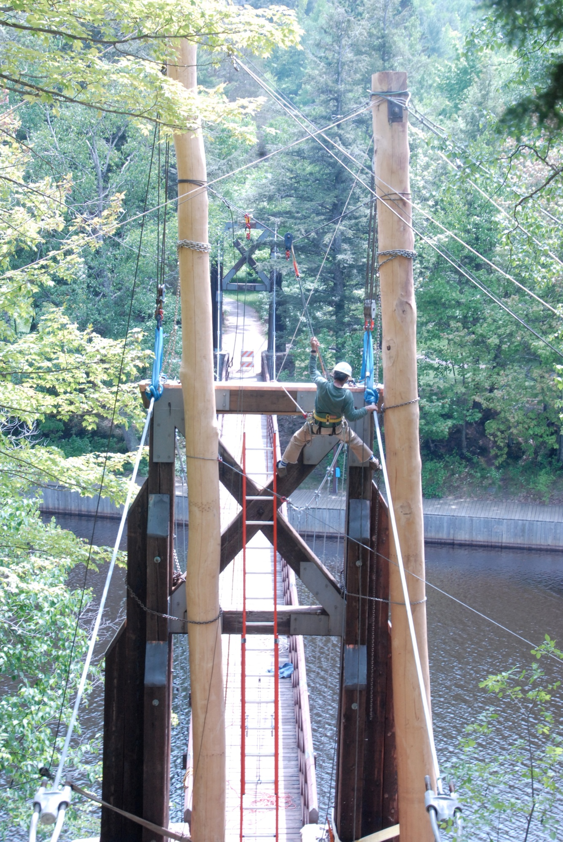
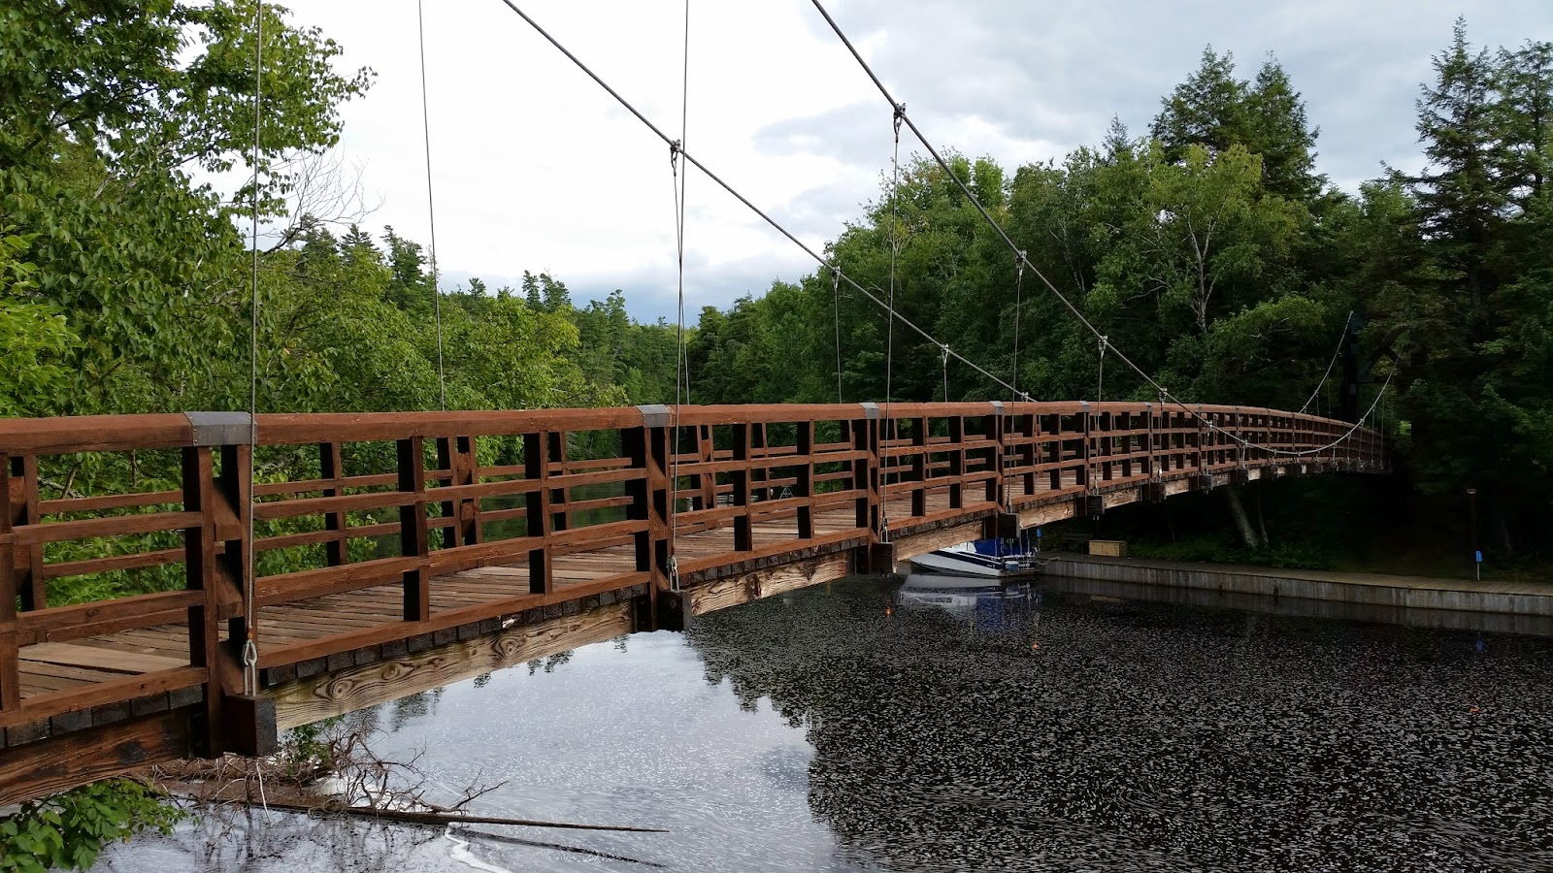
Engineering
Bridge Design in the US and Internationally
Notes:
This is the Black River Harbor bridge in Michigan – it is a 210’ suspension bridge across the only US Forest Service managed, navigable harbor. There is no direct road access and they used primarily non-motorized means for lifting the bridge, replacing the suspender cables and replacing the tower caps. They lifted 60,000 lbs. at each end of the bridge by hand and replaced all the necessary components. The project cost was about $55,000 including supplies, which was considerably less than the estimated cost of over $200,000.
The redesigned needed was done by Art Johnston and Ian Barlow leading the demolition and reconstruction

Slide 5
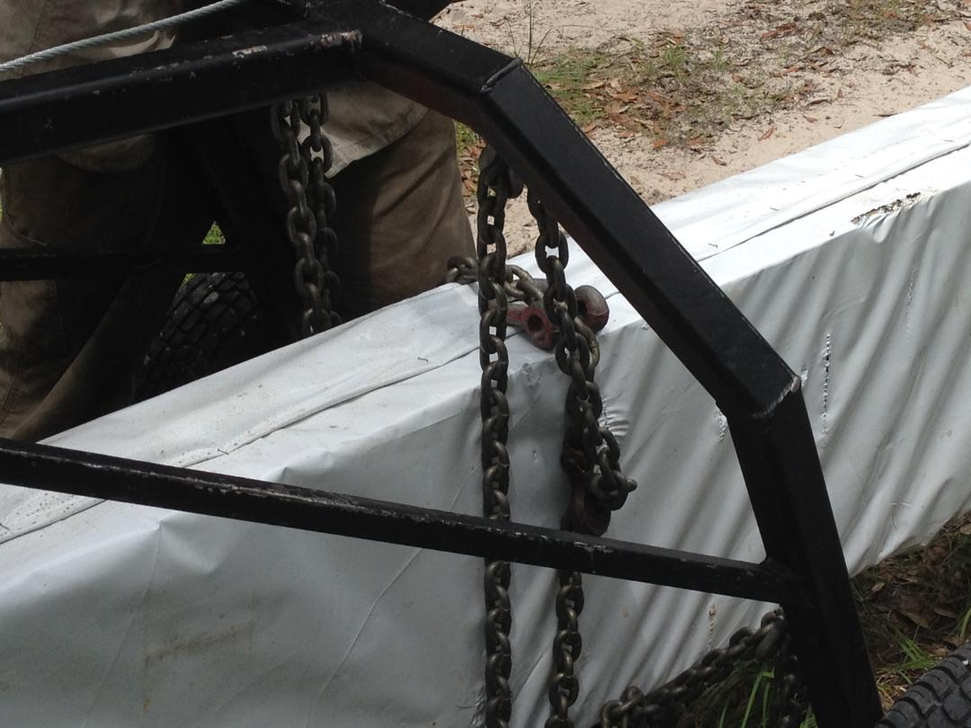
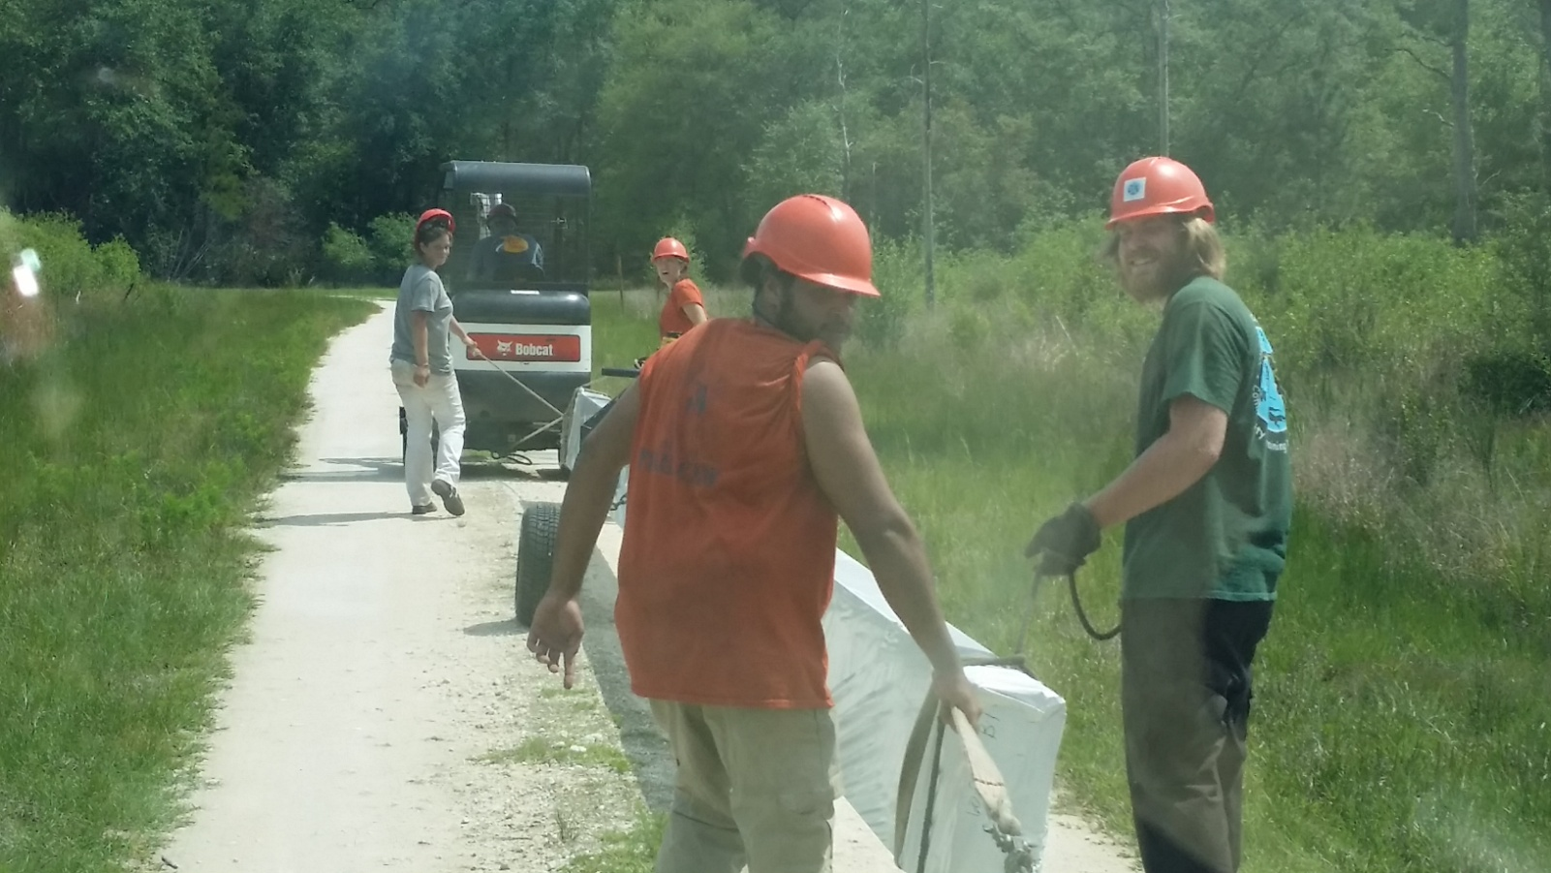
2015 Innovation Designed by Richard Hull
Notes:
Our fabricator, Richard Hull designed and built the arch in the upper left hand corner to transport the 45’ long, 3,000 lb. bridge stringers 2 miles from the delivery drop off site to the Swift Creek bridge site

Slide 6
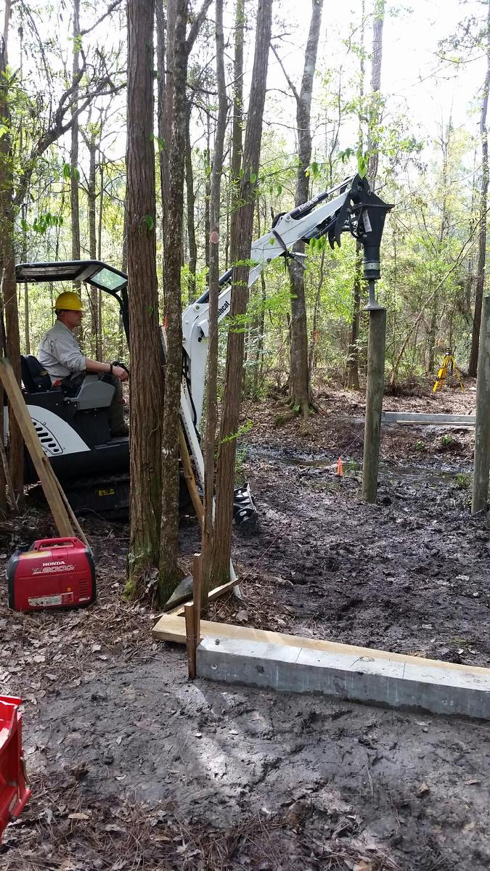
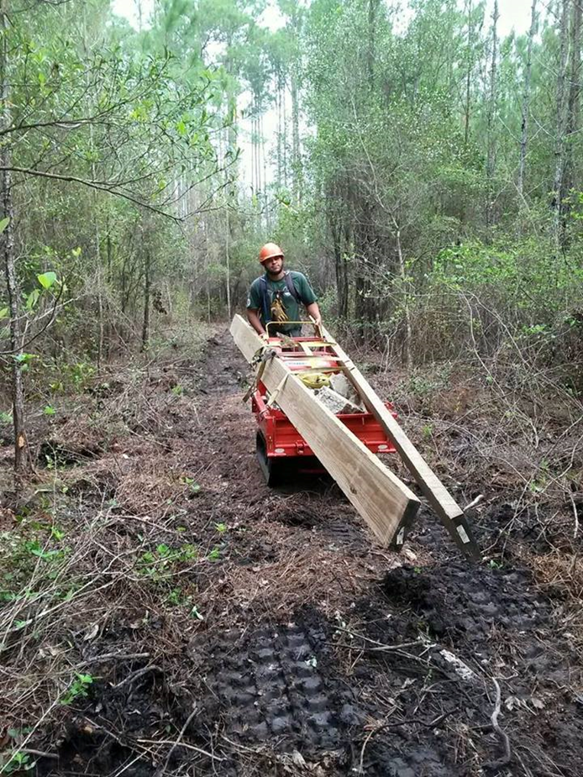
Building Boardwalk
Using the right tools to get the job done
Notes:
FOC uses the tools be suited to the project, mechanized as well as traditional tools, here Chris Doupnik uses a mini-excavator to pound in supports for a board walk.
This is the first project that was designed and built by the younger, yet experienced members of the FOC Crew along with the Community Training Works crew leaders who worked and trained under FOC supervision this past season.
They learned that there is a decided difference between theory and on the land application.

Slide 7
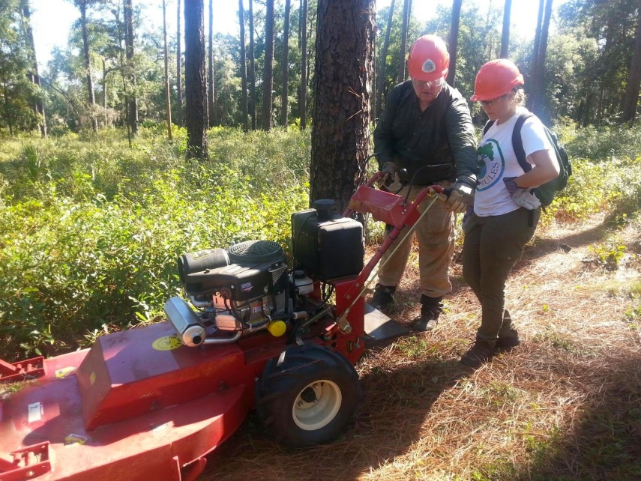
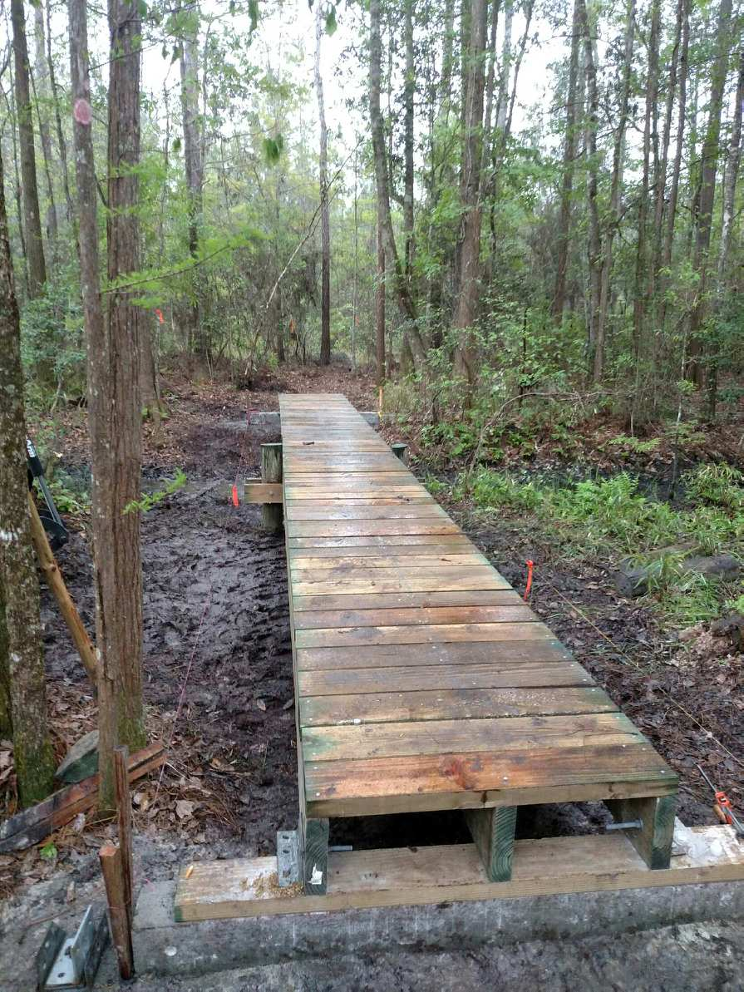
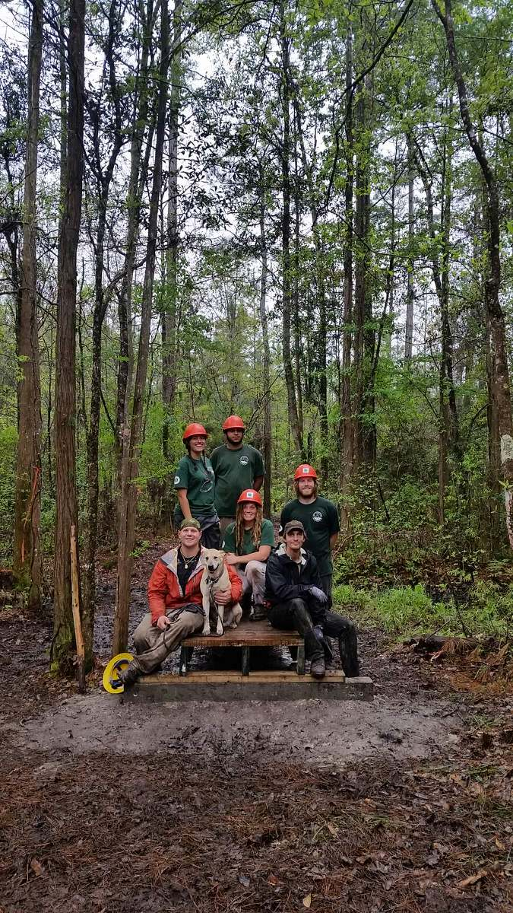
FOC Field Crew & CTW
Training the next generation for different levels of skills to assist in keeping the trail open and usable
Brushing Trail
Nokuse
Notes:
Richard is teaching one of the CTW members how to handle a 25 horsepower mower that can cut up to 4” branches and work in water up to 18” deep
These mowers were modified by Rich, working with manufacturers representatives, to function better under our trail conditions by adding a winch and counter weights and modifying the flaps

Slide 8
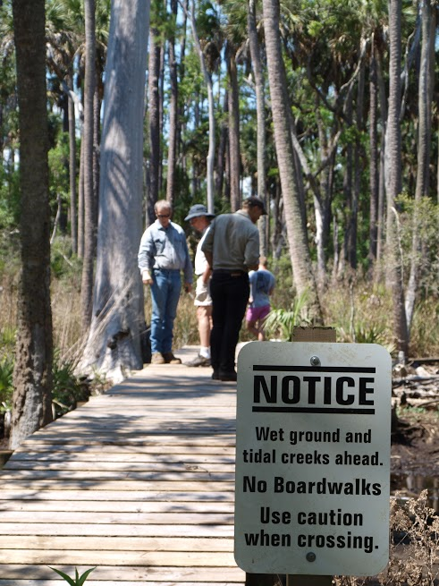
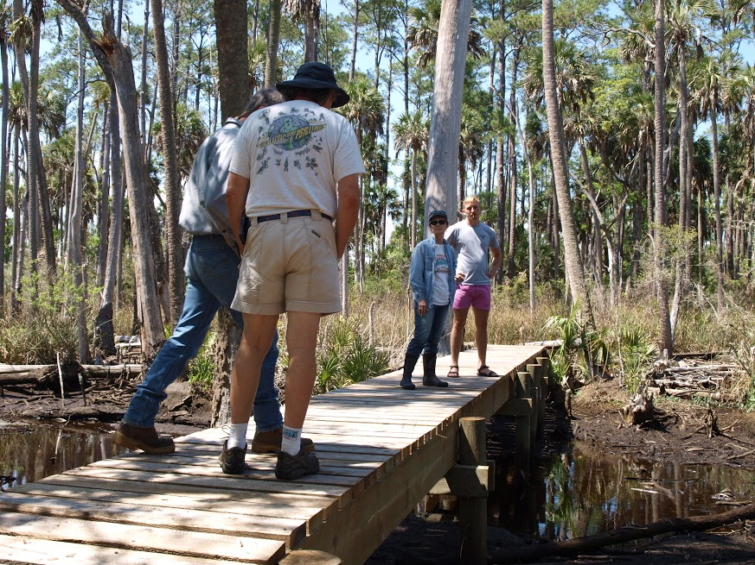
2016 Swift Creek, Nukose,
Spring Creek & Ocean Pond
Bridges and Boardwalks
Notes:
We are estimating the construction of 3,200 feet of new structures and the repair and replacement of about another 600 feet of incidental

Slide 9
“Increased Power in Partnership”
Coalition FOC Forest Service
There is incredible power in cooperative partnerships where differing skill sets combine the strengths of each to improve the whole

Slide 10
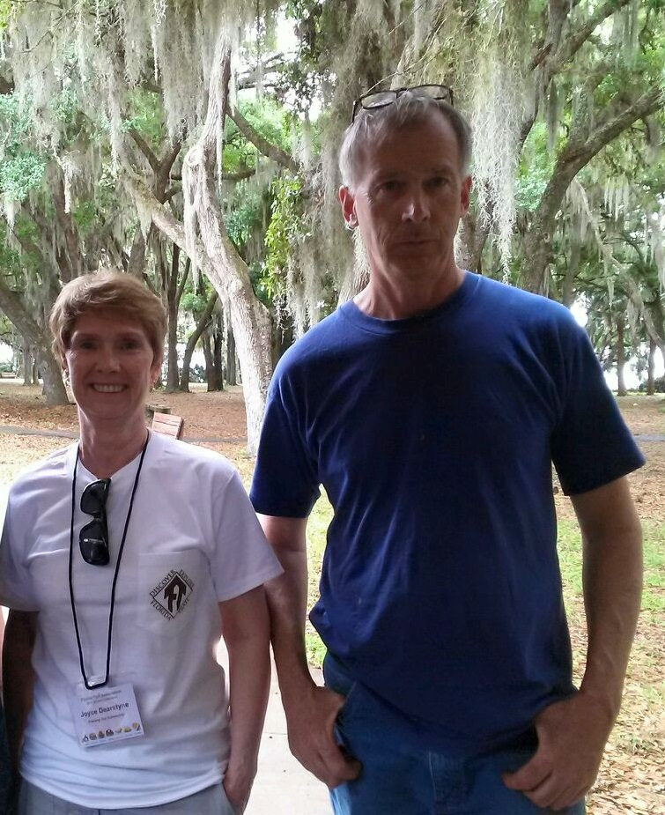
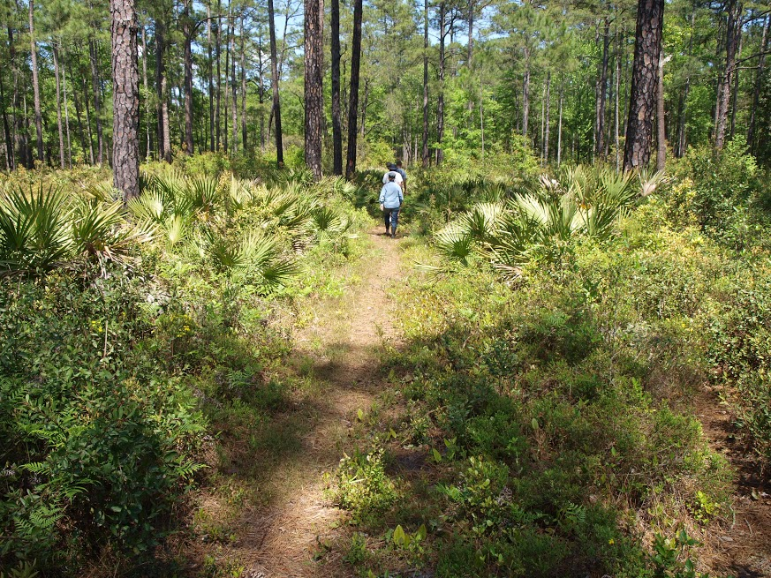
See You On The Trail

