Slide 1
The FNST and Health
Examining the Health Effects of the Little Big Econ—FNST Relocation
Notes:
In my time working with the Forest Service and researching NEPA processes, I noticed the human health impacts of federal projects are often not considered in the federal decision-making process. This is why I decided to conduct a health impact assessment on an FNST relocation project.

Slide 2
Why be concerned with health?
NEPA says that
  “Each person should enjoy a healthful environment”
  People should be permitted to enjoy “high standards of living”
  People should live without “risk to health or safety” (National Environmental Policy Act of 1969)
Many environmental impact statements neglect these requirements
Notes:
The Act specifically says that “each person should enjoy a healthful environment” and be permitted to enjoy “high standards of living” without “risk to health or safety” (National Environmental Policy Act of 1969, 2000), yet many environmental impact statements neglect this requirement.
A study of 42 environmental impact statements found that “more than half (62%) of the EISs (26/42) contained no mention of a health impact. In the other EISs (38%, or 16/42), health impacts were mentioned, but inadequately supported by analysis.”

Slide 3
Background on Health Impact Assessment (HIA)
The World Health Organization defines health impact assessment as:
  “A combination of procedures, methods and tools by which a policy, program or project may be judged as to its potential effects on the health of a population, and the distribution of those effects within the population” (European Centre for Health Policy, WHO Regional Office for Europe, 1999).
HIAs typically involve:
  Multi-disciplinary teams of stakeholders
  Both qualitative and quantitative data
Notes:
HIAs can occur:
Over different timescales
Using different levels on information, data, and stakeholder input
Due to time and other constraints, I decided to conduct a rapid health impact assessment, which relies on information already available “off the shelf” and requires limited consultation with stakeholders (Parry & Stevens, 2001, p. 1181).

Slide 4
Health Impact Assessment (HIA) continued…
Health impact assessments typically follow a six-step process:
  Screening
  Scoping
  Assessment
  Recommendation development
  Reporting
  Monitoring
Notes:
Screening: determine whether an HIA would be a useful tool for evaluating the project, program, or policy in question.
Scoping: determine the health effects to be considered during analysis.
Assessment: identify who may be affected by the action in question and how said action will affect them.
Recommendation development: develop suggestions that can promote positive health impacts or mitigate negative impacts of a project.
Reporting: results are presented to decision-makers.
Monitoring: evaluate the effect that the HIA had on the decision or project (Center for Disease Control and Prevention, 2015).

Slide 5
The Health Impacts of Nature
Synergistic benefit to participating in physical activities while exposed to nature (“green exercise”)
Natural amenities (i.e. climate, vegetation) & outdoor recreation opportunities are associated with physical activity
Twin study found green space and depression are inversely associated
Green views through a window were associated with faster recovery and fewer pain meds for post-operative surgical patients
Notes:
There are many ways in which green space and natural environments can positively influence the health of people in nearby communities. Green spaces have been associated with higher physical activity, less stress, lower rates of depression, improvements in ADD symptoms for adults and children, and faster recovery from illness and surgery.
Five groups of 20 people were exposed to a variety of scenes (rural pleasant, rural unpleasant, urban pleasant, and urban unpleasant) while running on a treadmill. The researchers measured blood pressure and two psychological measures – self-esteem and mood – before and after exercise. Overall, the pleasant rural and urban nature scenes were associated with significant reductions in blood pressure and a greater positive effect on mood.
In a U.S. study of nonmetropolitan areas, researchers found that the prevalence of obesity decreased and the likelihood of participating in physical activity increased with increasing levels of recreational opportunities, such as hiking trails, and natural amenities, such as climate or vegetation.
Researchers looked at the amount of green space near the home for twin pairs living in different locations. They found that the twin living in the greenest setting was less likely to have depression.

Slide 6
Health Impacts (continued)
Green space is associated with decreased rates of all-cause mortality and circulatory disease mortality
  Also, associated with reduced inequality in all-cause and circulatory mortality
Association between presence of recreational facilities/trail use and decreased likelihood of obesity vs. overweight
Green play settings may improve children’s symptoms of ADD
Notes:
In a study that classified the working-age population of England into groups based on their exposure to green space and level of income deprivation, researchers found
An association between exposure to green space and decreased rates of all-cause mortality and circulatory disease mortality after controlling for above listed confounders
A reduction in inequality in all-cause and circulatory mortality due to income deprivation is lower in populations with more exposure to green space
Researchers randomly sampled both active and inactive residents of a southeastern community. They found that among those who were not meeting minimum recommendations for physical activity, residents were twice as likely to be overweight as opposed to obese if they had access to recreational facilities and used walking trails.
Parents were surveyed regarding their child’s attentional functioning after activities in several settings. Results indicate that children function better than
usual after activities in green settings and that the “greener” a child’s play area, the less severe their attention deficit symptoms.
Because of the relationships I just described between nature and health, I believe it is important to consider human health in the decision-making process of land management agencies.

Slide 7
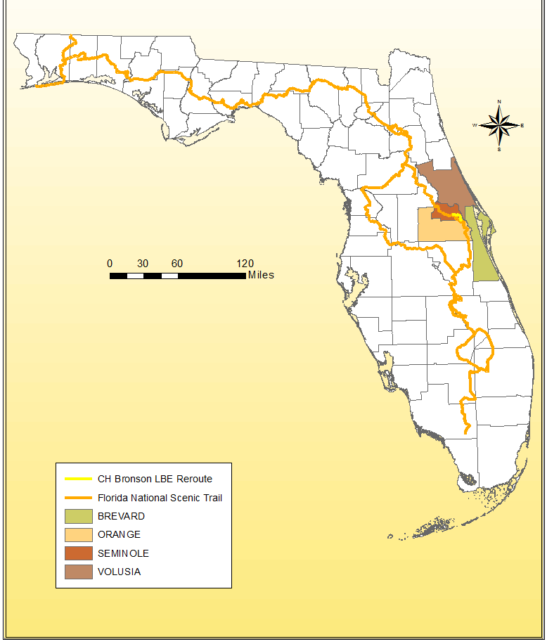
The HIA Study Area
2010 Population
Brevard: 543,378
Orange: 1,145,954
Seminole: 422,718
Volusia: 494,597
Study Area: 2,606,647 (14%)
Florida: 18,804,623
Notes:
The focus of the HIA is a trail relocation occurring in Little Big Econ State Forest. One of the alternative routes being considered would involve partially moving the Trail into the neighboring Charles H. Bronson State Forest.
LBE State Forest is located in Seminole County northeast of Orlando, FL. Charles H. Bronson State Forest begins at the southern border of LBE State Forest, and is located in both Seminole and Orange Counties. Brevard and Volusia counties were also included in the analysis due to the proximity of their populations to the FNST.
The location of this portion of FNST is significant because it is next to a very populous area. As of 2010, the combined population of Brevard, Seminole, Orange, and Volusia Counties equaled 2.6 million people or about 14% of Florida’s population. Because this trail relocation is occurring around a populous area, there is potential for a large impact on the health of Floridians.

Slide 8
Health Overview of the Study Area
Area of Interest | Percentage of adults who are overweight | Percentage of adults who are obese | Percentage of adults who are overweight or obese | Percentage of adults who have ever been told they had diabetes
Brevard | 31.8% | 25.6% | 57.3% | 13.2%
Orange | 36.2% | 25.0% | 61.2% | 10.3%
Seminole | 31.6% | 26.8% | 58.4% | 9.0%
Volusia | 33.7% | 24.4% | 58.1% | 12.4%
Florida | 36.4% | 26.4% | 62.8% | 11.2%
Area of Interest | Percentage of adults who are sedentary | Percent of adults who have ever been told they had angina or coronary heart disease | Percentage of adults who have ever been told they had high blood cholesterol | Percentage of adults who have ever been told they had a depressive disorder
Brevard | 24.3% | 5.2% | 36.2% | 18.1%
Orange | 26.0% | 3.4% | 25.6% | 15.3%
Seminole | 22.4% | 3.0% | 37.4% | 17.2%
Volusia | 25.2% | 5.7% | 39.3% | 16.7%
Florida | 27.7% | 5.0% | 33.4% | 16.8%
Notes:
In general, the study area is roughly the same as or better than the state of Florida in many health indicators. The numbers highlighted in red indicate health factors where the study area fares worse than the state of Florida. While the counties in the study area may have slightly lower percentages of adults who are obese, overweight, or sedentary, that does not mean that Brevard, Orange, Seminole, or Volusia counties are doing well in any of these categories. Almost 2/3 of adults in the study area counties are at an unhealthy weight, and roughly ¼ quarter of adults in the study area are sedentary.
Brevard and Volusia counties have higher rates of diabetes than the state, and 3 out of 4 study area counties have increased occurrence of high blood cholesterol.

Slide 9
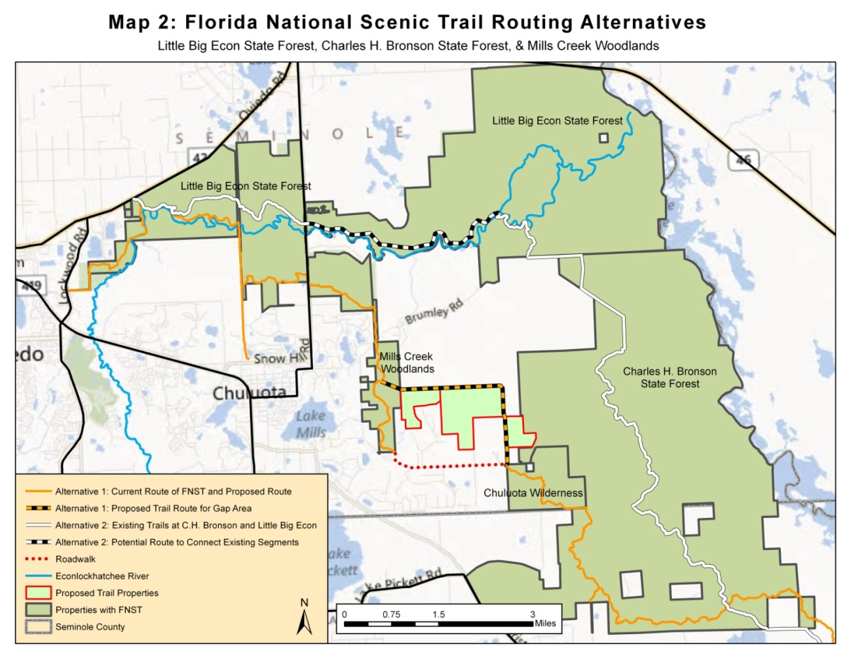
Overview of FNST Alternatives

Slide 10
Pros & Cons of Alternatives
Population Completely within 5, 10, and 20 Mile Radius of Trailheads
 | Current | LBE & CH Bronson | Loop Alternative
5 Mile | 38,042 | 8,593 | 38,042
10 Mile | 288,947 | 130,707 | 291,291
20 Mile | 1,215,556 | 1,063,454 | 1,215,556
Notes:
This is not an exhaustive list, and I encourage to write in your own pros and cons on the survey provided.

Slide 11
 | Pros | Cons
Alternative 1 (Current Route) | Close to large population centers, i.e. Orlando | Includes a 2-mile roadwalk
 | Ample water sources | Closer to state roads, ↑ noise pollution
 | Multiple, easily accessible trailheads
 | Day hike options available
Alternative 2 (Reroute through CH Bronson) | Further from state roads --> less noise pollution | Smaller population nearby
 | Day hike options available | Uses a 3-mile section of forest road
 | Fairly close to population centers, such as Orlando | About 4 miles of trail in open pasture --> greater exposure to sun/heat
 | Several trailheads | Fewer water sources
 | No roadwalk | Primitive camping required north of county line unless new site is proposed
Alternative 3 (Current route w/ land acquisition) | Close to large population centers, i.e. Orlando | Closer to state roads, ↑ noise pollution
 | Ample water sources
 | Day hike options available
 | No roadwalk
Alternative 4 (Loop Trail) | ~30-mile loop, opportunity for backpacking | Includes a 2-mile roadwalk
 | Close to large population centers, i.e. Orlando | Fewer water sources in some sections
 | Day hike options available | Primitive camping required in sections
 | Multiple, easily accessible trailheads | 4 miles of trail in open pasture

