Slide 1
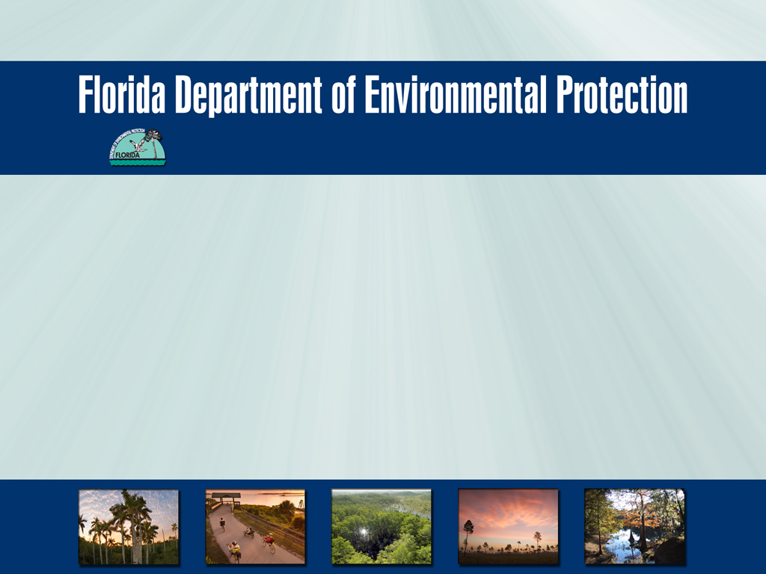


Division of Recreation and Parks
Office of
Greenways and Trails
Florida National Scenic Trail Coalition, June 8, 2015
Doug Alderson, Assistant Bureau Chief

Slide 2

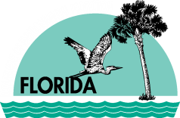
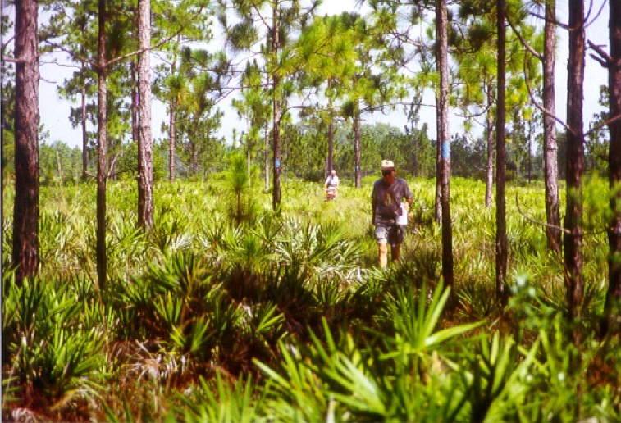
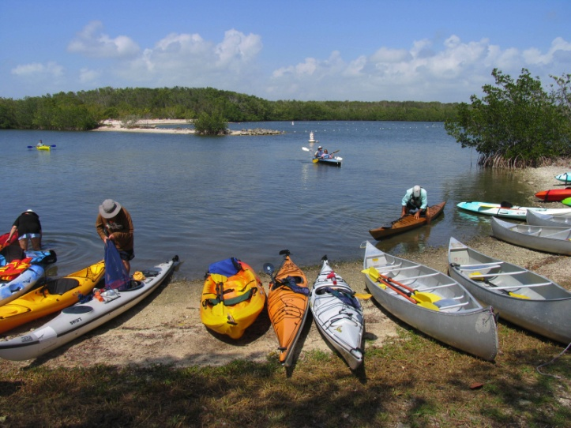
Office of Greenways and Trails
The Office of Greenways and Trails within the Division of Recreation and Parks provides statewide leadership and coordination to establish, expand and promote the Florida Greenways and Trails System (FGTS) pursuant to the Florida Greenways and Trails Act (Ch. 260, F.S.).

Slide 3
OGT Functions
An Overview…
  Planning
  Identification and Prioritization
  Coordination
  Project Development
  Acquisition
  Designation
  Promotion and Information
  Staff to Florida Greenways and Trails Council

Slide 4
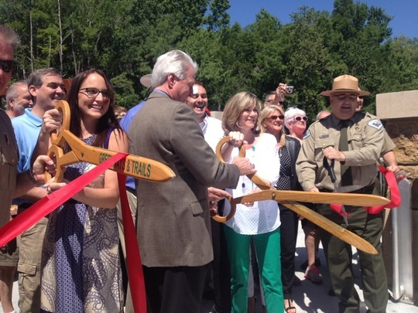
The Merger
The Office of Greenways & Trails merged with
the Division of Recreation & Parks in 2011
Notes:
Implementing the FGTS plan advances Complementary Plans.
Florida continues provide leadership in:
enhancing the quality of life of its citizens and visitors
a forward-looking approach to eco-tourism to provide much-needed economic benefits
providing resources for to improve the overall health of the population
connecting trails to communities and helping develop alternative routes of transportation
Trails are helping change the landscape of tourism in today’s Florida as they create connections between the state’s natural beauty and the places people choose to live, work and play.

Slide 5
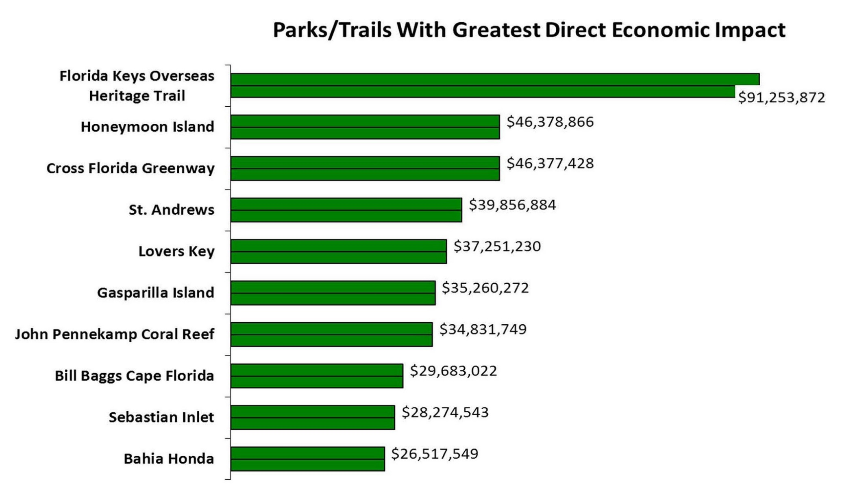
Long-distance Trails
Florida Park Service 2012-2013 Economic Impact Assessment

Slide 6

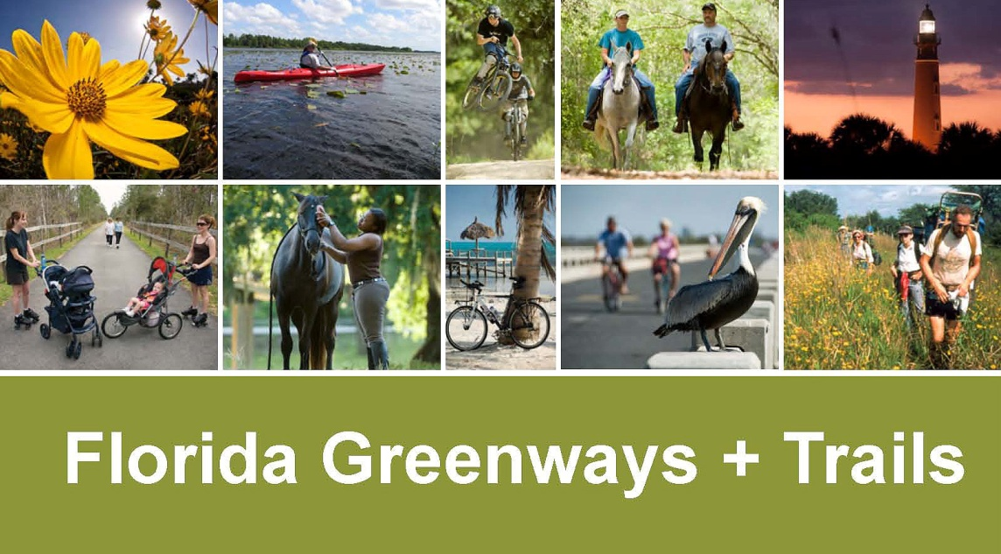
FGTS Plan
Outlines the vision for the Florida Greenways and Trails System (FGTS).
2013-2017
Identifies clear linkages, establishes priorities, and provides a framework for closing key trail gaps.

Slide 7
Opportunity Maps = Vision
Land Trails Opportunity Map – Existing, planned and conceptual non-motorized trails that form a land-based trail network of state and regional significance.
Paddling Trails Opportunity Map – A comprehensive water based trails system.
Ecological Greenways Opportunity Map – The areas necessary to protect a statewide network of conservation land and connecting wildlife corridors designed to maintain large landscape-scale ecological functions. A direct outcome of this map is the publicly promoted Florida Wildlife Corridor.

Slide 8
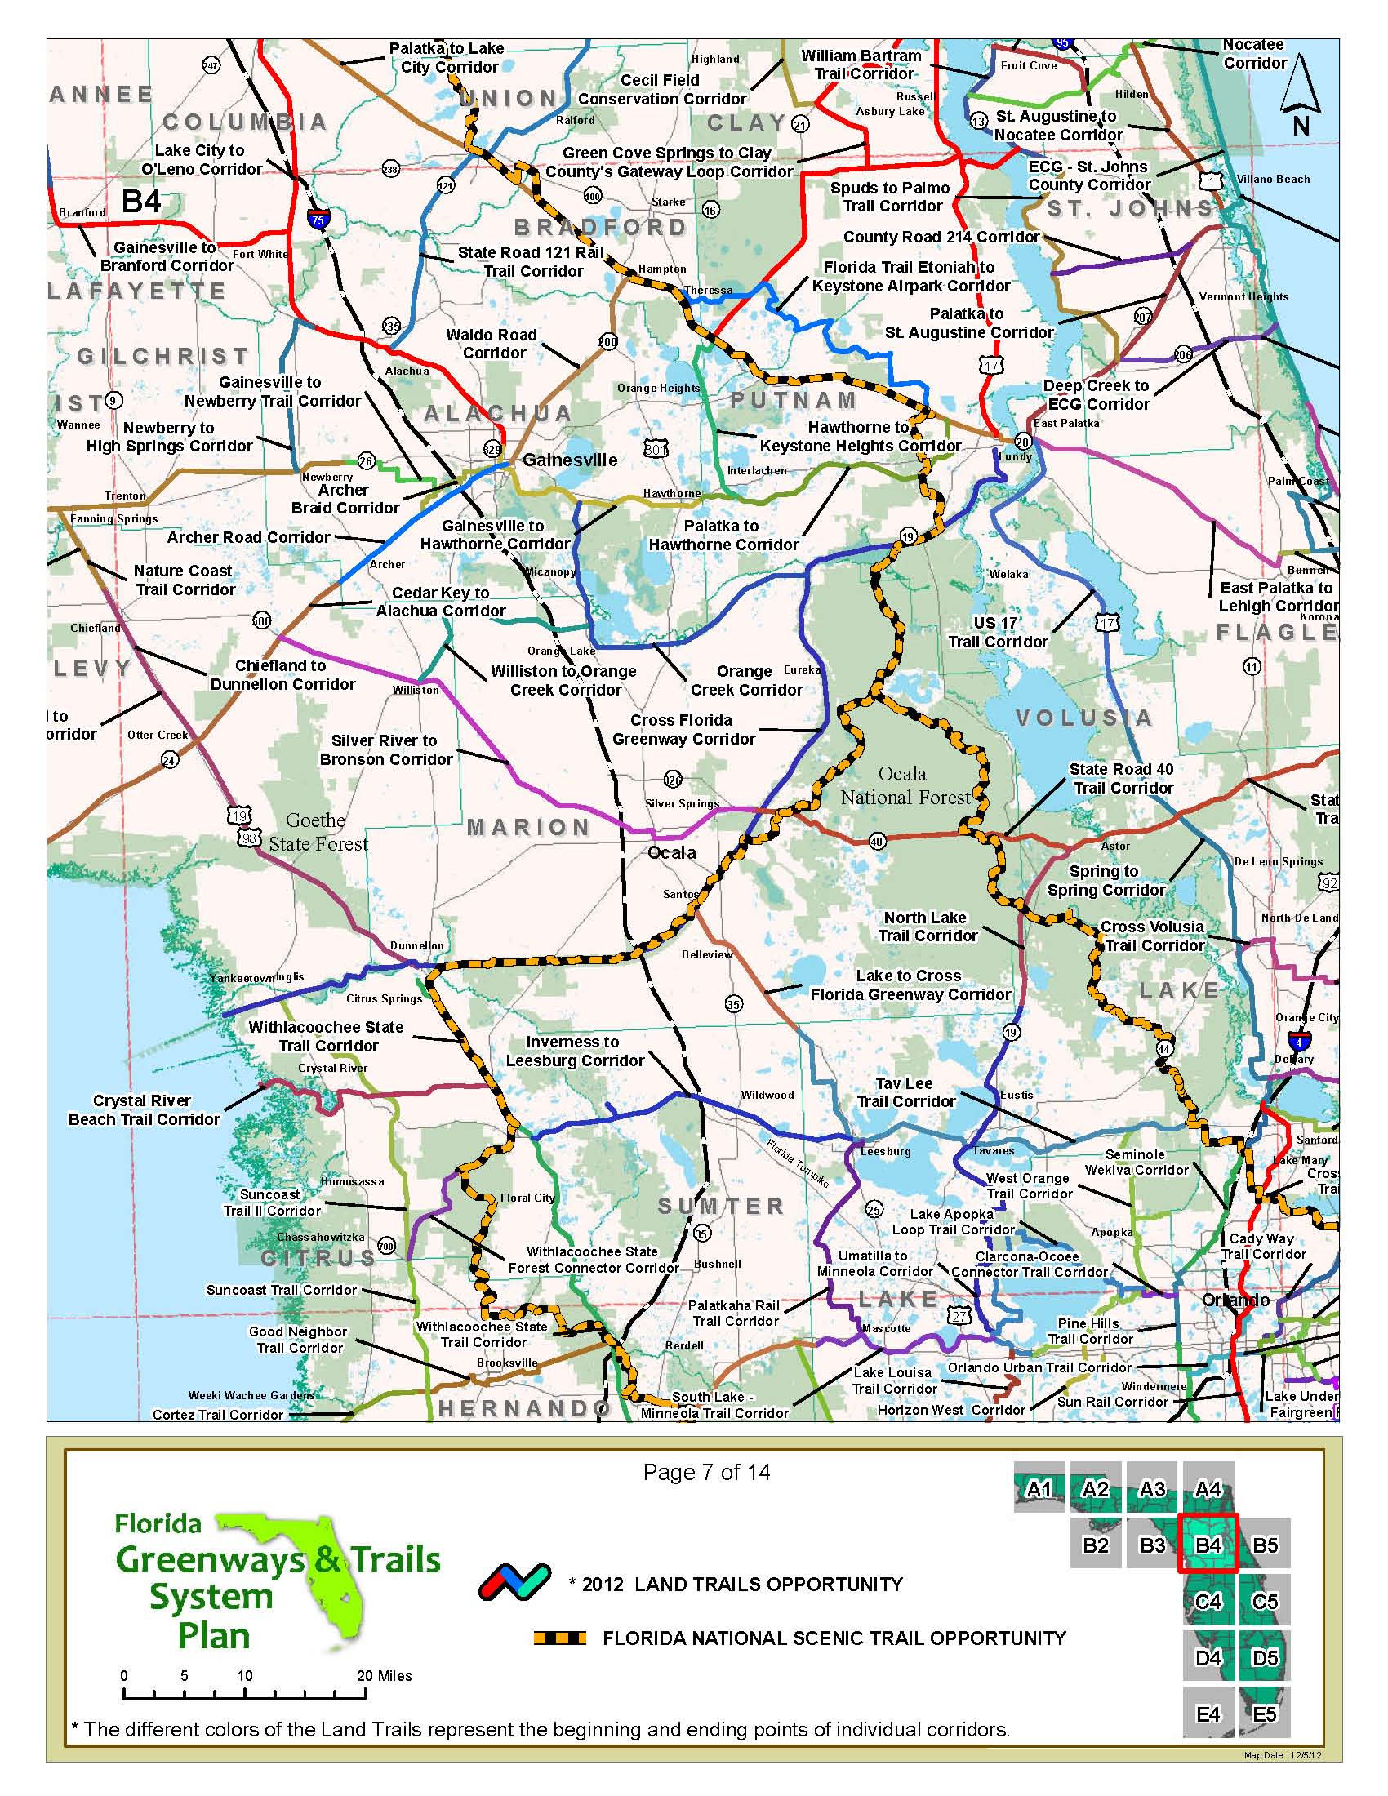
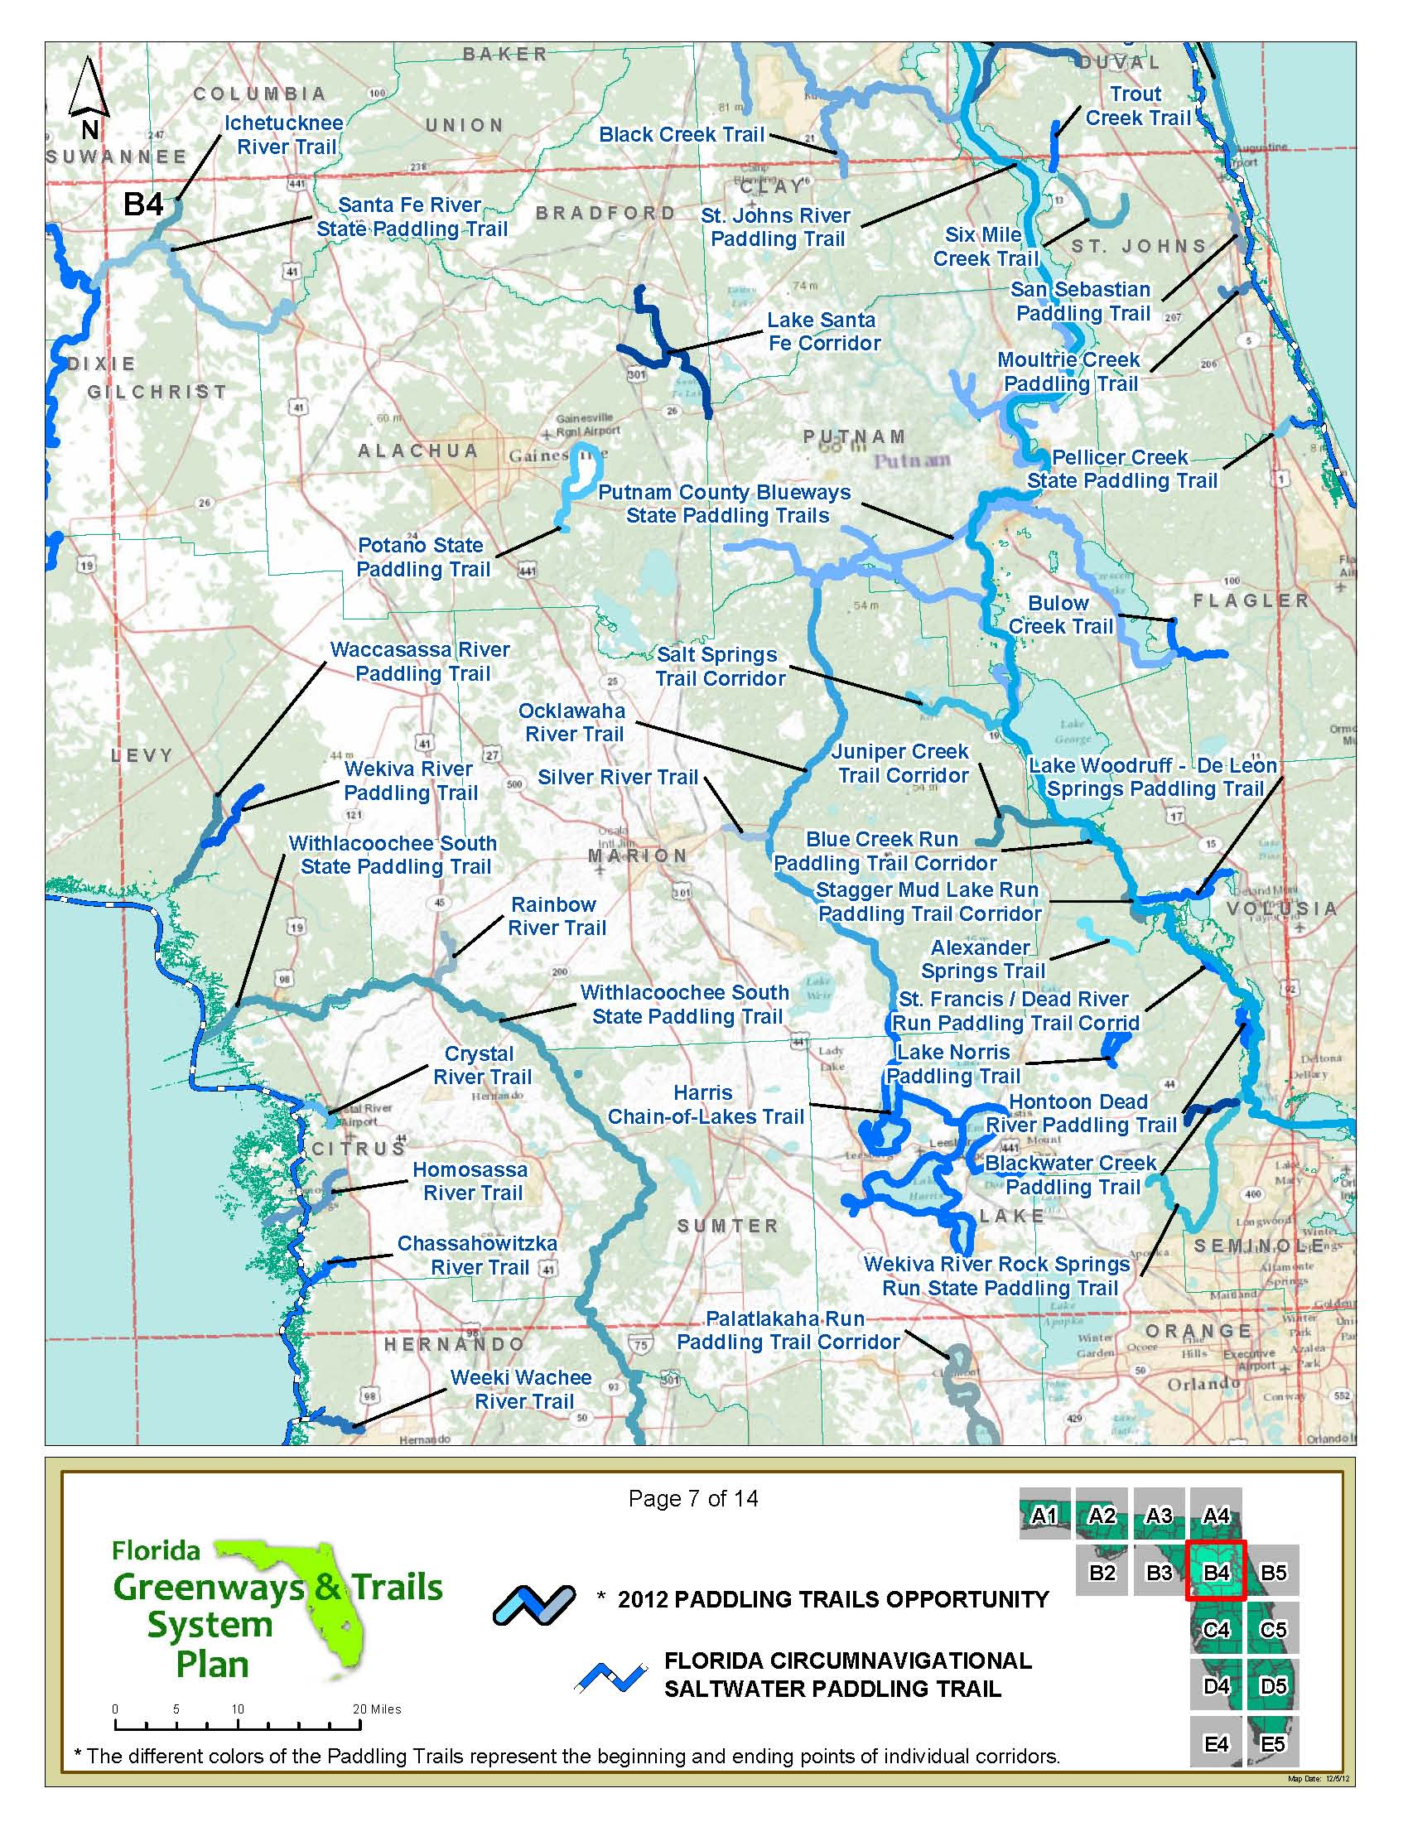
Opportunity Maps
Land Trails Opportunity Map
Paddling Trails Opportunity Map
In 2012, OGT worked with planning partners and trail users to document
existing, planned and conceptual trails.

Slide 9
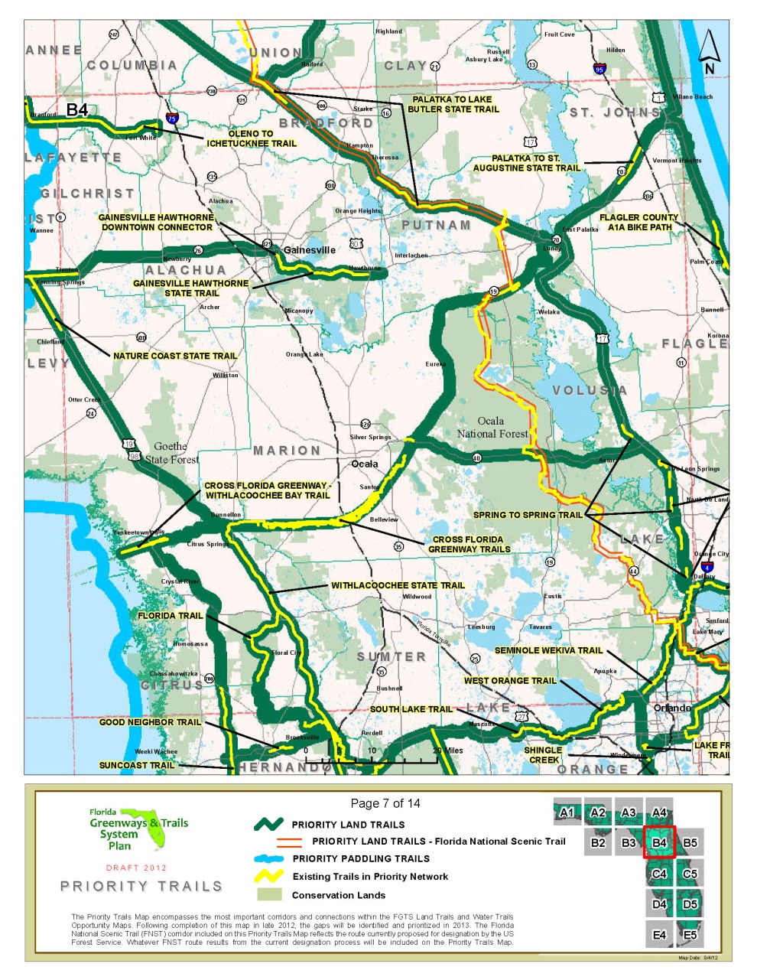
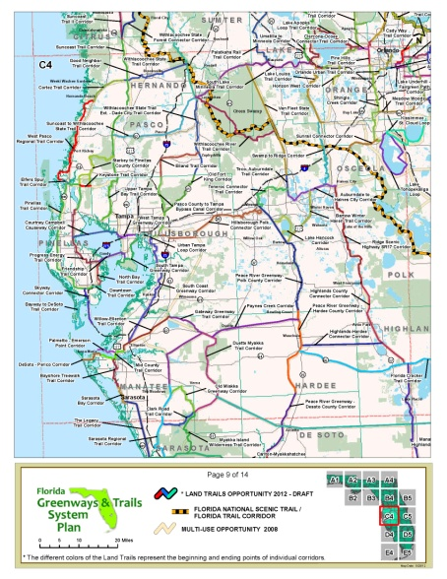
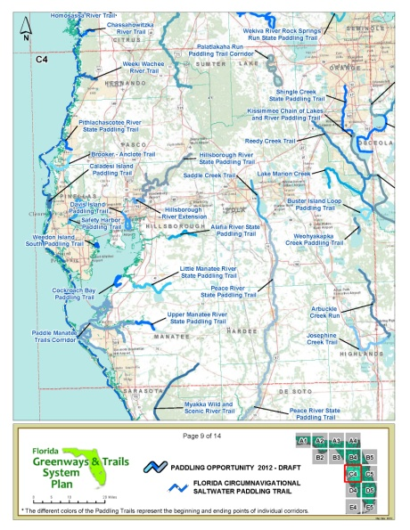
Determining Priority Maps
Land Trails Opportunity Map
Priority Trails Map
Paddling Trails Opportunity Map
Six public workshops were held throughout the state. After public comment and an evaluation process, OGT staff delineated the Priority Trails Network.

Slide 10
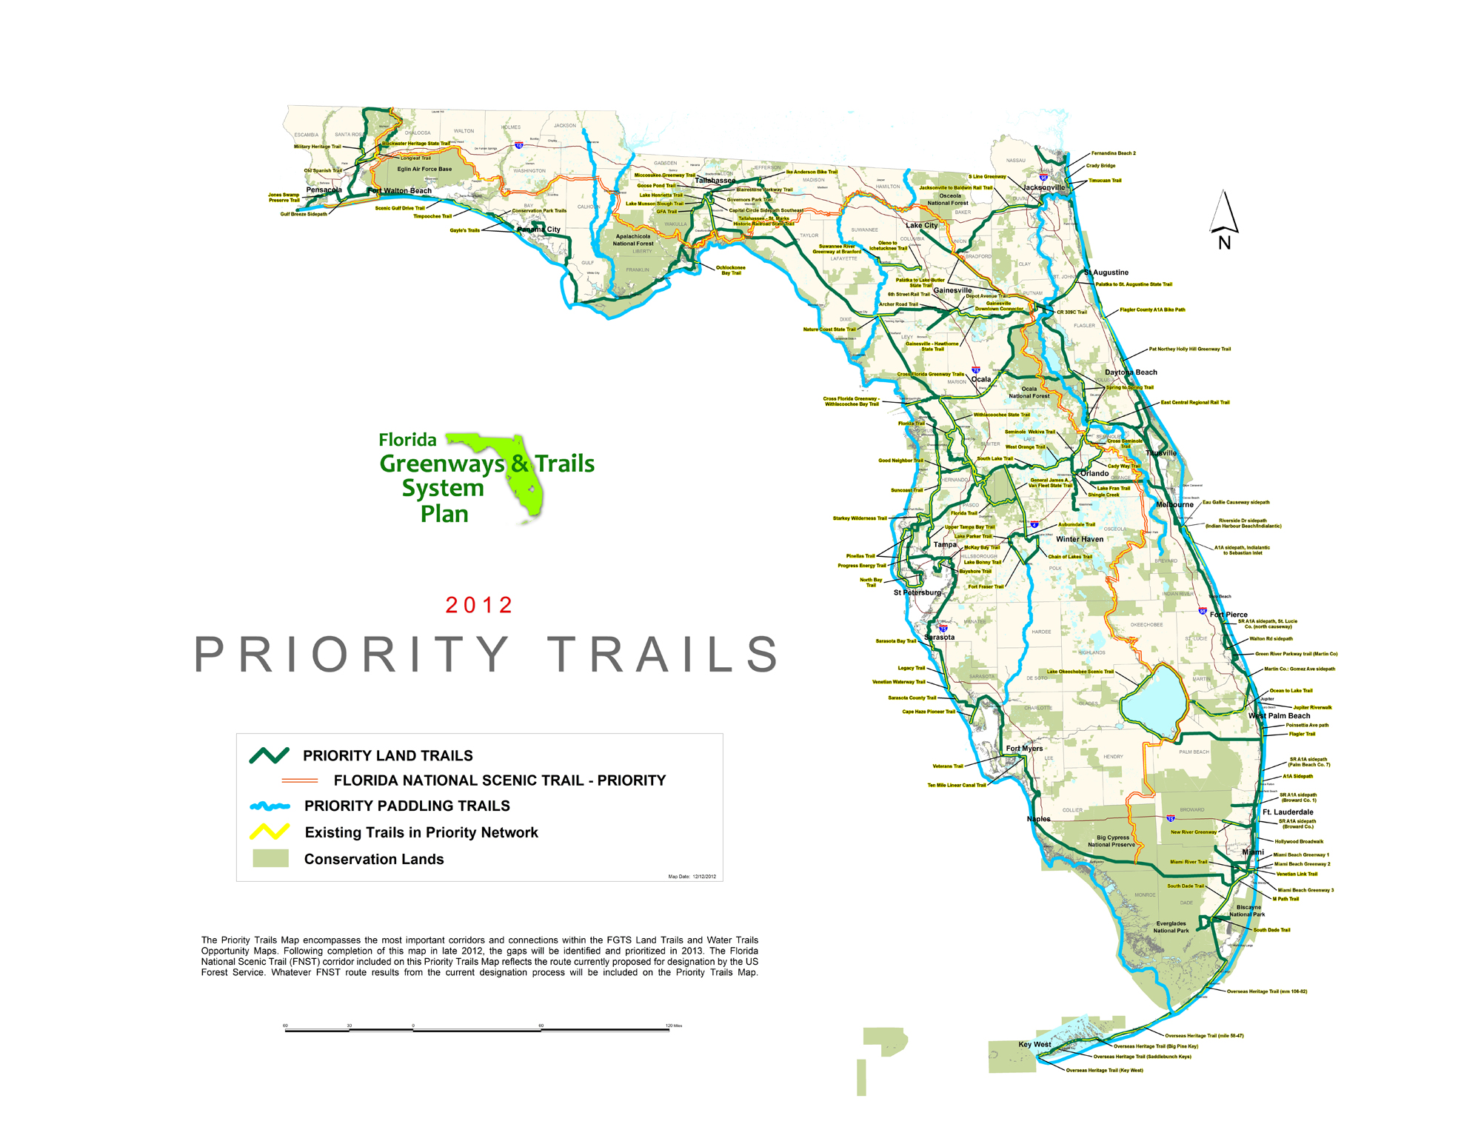
Priority Trails Network
The priority trails network builds on previous state investments, supports long-distance and loop trails, increases access to resources and connects populations.

Slide 11
Map Progression
The FGTS maps consist of the following:
Highest Needs
  Level 3 - The Gaps: Priority Trail Gaps and Ecological Greenway Strategic Protection Areas
  Level 2 - The Priorities: Priority Trails and Ecological Greenway Critical Linkages
  Level 1 - The Vision: Land Trail, Paddling Trail and Ecological Greenway Opportunities
Focused System
Complete System

Slide 12
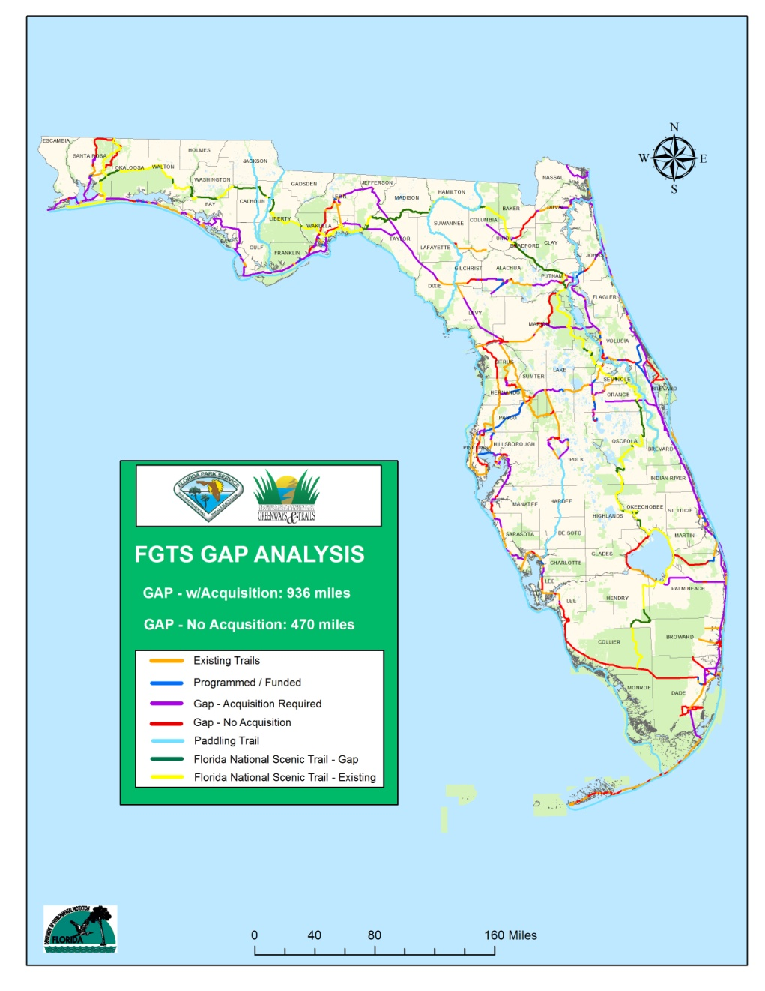
Priority Trails Gap Map
The Priority Trails Gap Map delineates the segments within the Priority Trails Map that are not acquired, developed or funded.

Slide 13
Process to Close Gaps
Identifying a champion to lead efforts for funding for trail acquisition, development and management is the most critical component.
Identify Funding and other Resources
  Data, Information and Knowledge is collected on project
  Analyze project readiness to determine eligibility
  Lead entity will implement project
Determine Project Readiness
Acquire and Develop

Slide 14

Primary Sources of Funding for the
Florida Greenways and Trails System (FGTS) [Ch. 260, F.S.]
FEDERAL
Transportation
Alternatives
STATE
Specific
Appropriations
DEVELOPMENT
OTHER
Local Government
Private
ACQUISITION
STATE
Florida Forever/FGTS
Sources of funding may be allocated towards trails, but not specifically to the FGTS

Slide 15
2015 Opportunity Update
OGT is currently conducting an update of the Opportunity Maps
Land Trails Opportunity Map
Paddling Trails Opportunity Map
Notes:
Implementing the FGTS plan advances Complementary Plans.
Florida continues provide leadership in:
enhancing the quality of life of its citizens and visitors
a forward-looking approach to eco-tourism to provide much-needed economic benefits
providing resources for to improve the overall health of the population
connecting trails to communities and helping develop alternative routes of transportation
Trails are helping change the landscape of tourism in today’s Florida as they create connections between the state’s natural beauty and the places people choose to live, work and play.

Slide 16
Why Update?
The Opportunity Corridors represent the conceptual, planned and existing statewide network of trails…
Meaning…
The Priority Network
Land Acquisition
The immediate vision for implementing a statewide trail network
Opportunity Corridors are used to determine projects for the OGT work program
Notes:
Make a graph of the update types.

Slide 17
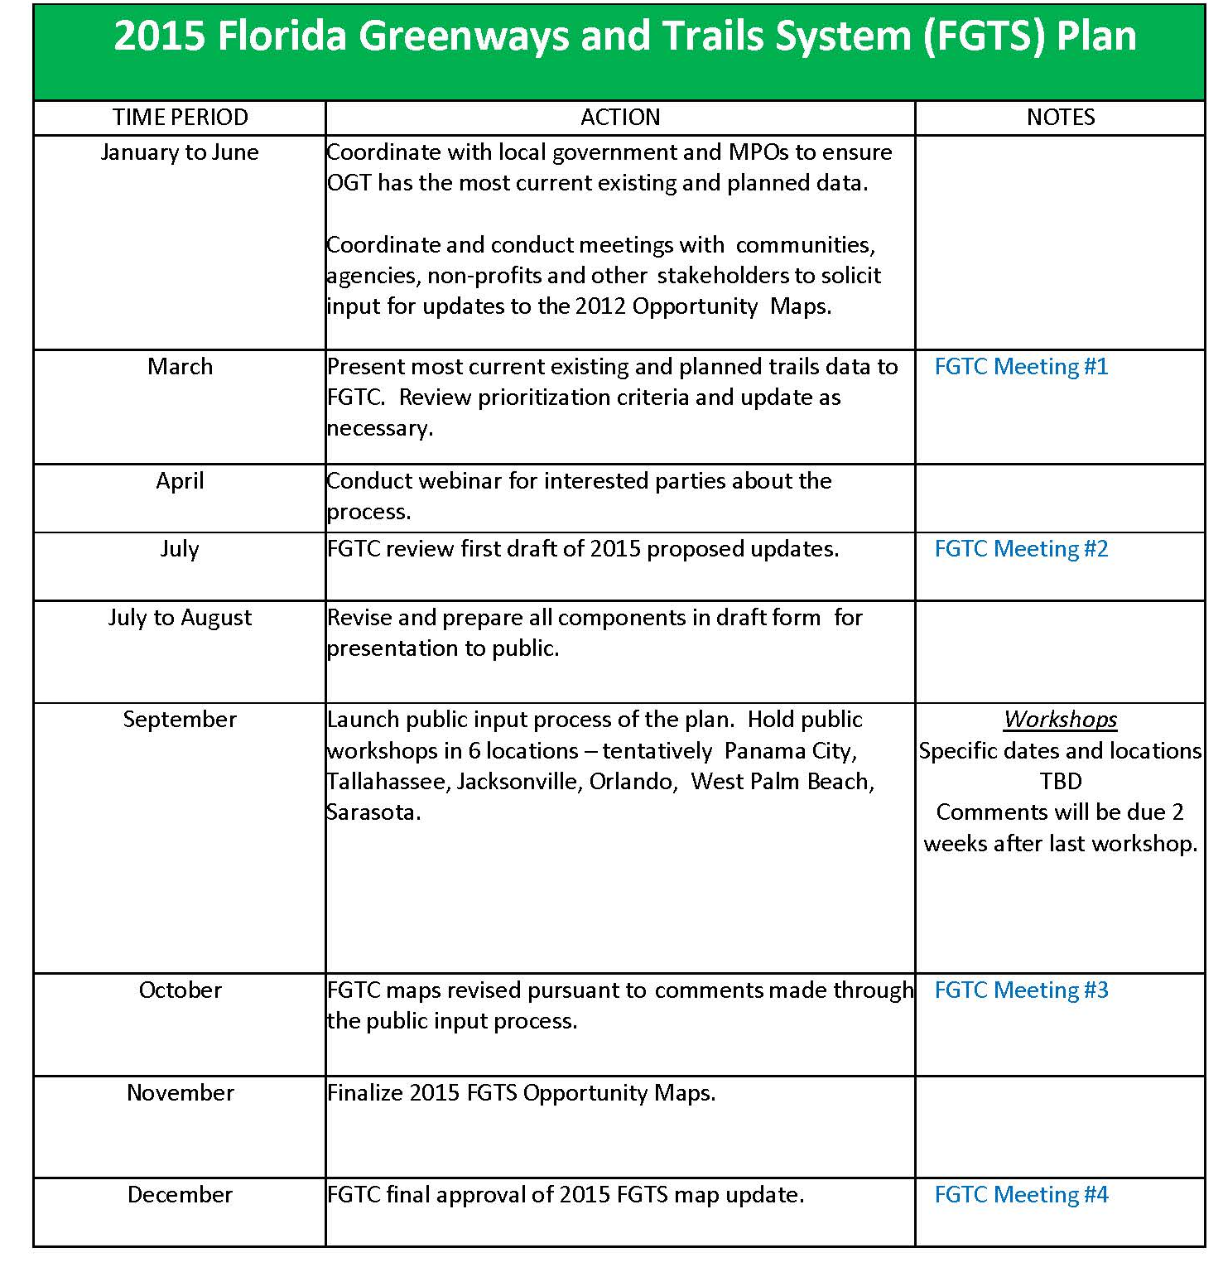
2015 Update Schedule

Slide 18
How you can help?
There are a number of ways to assist OGT in updating the Opportunity corridors…
Review the alignments online, or through mapping software (ARCGIS and Google Earth)
  2012 Map Books
Provide information on corridors directly to OGT Staff
Submit shapefiles or KML files to OGT with suggested changes
Attend public workshops (dates and locations TBD)
Notes:
Make a graph of the update types.

Slide 19
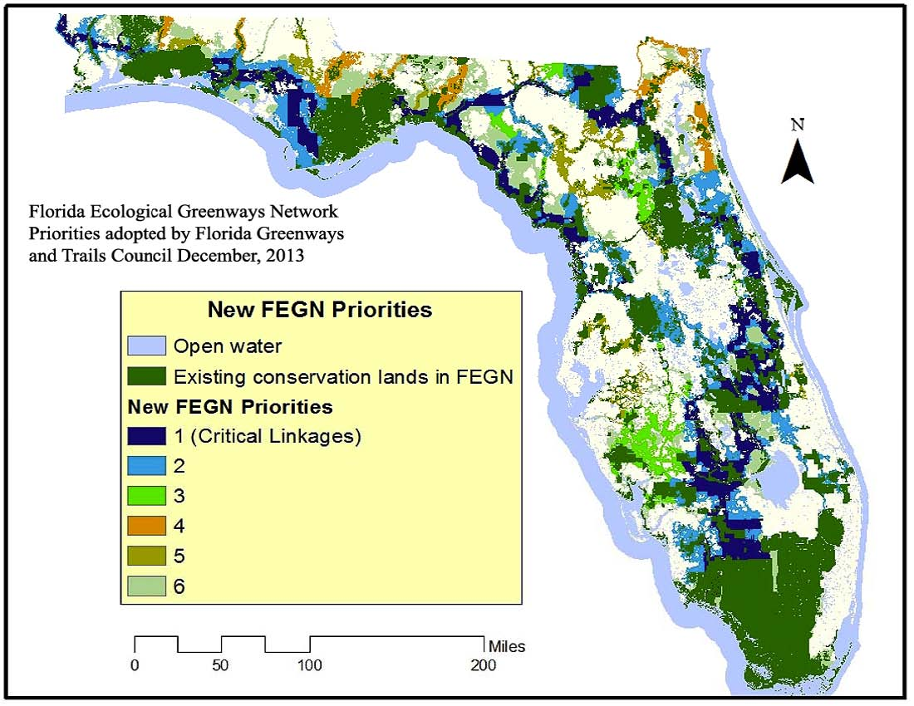

Slide 20
OGT Acquisitions
OGT receives 1.5% of FL Forever $ to “acquire greenways and trails or Greenways and trail systems” (FS 259.105 FL Forever Act).
To date, acquired 9,218 acres for $67,897,141 million.
New acquisition cycle begins July 1st and runs through August.

Slide 21
What Qualifies?
Project must be located within or adjacent to at least 1 opportunity segment on 1 or more of the Recreational Prioritization Maps contained in the Prioritization of Recreational Trail Opportunities for the State of Florida developed by OGT in coordination with the University of Florida, and approved by the Florida Greenways and Trails Council on May 18, 2002.
Preference may also be given to those projects identified on the 2013 FGTS Gap Maps.

Slide 22
Submission Process
Submit candidates for acquisition by sending in a "Certificate of Eligibility".
Once deemed eligible, submit your application during the open acquisition cycle by April 25th.
OGT staff reviews applications and may conduct site visits and solicit input from other agencies or groups. Reviews must take place within 30 days after April 25.
Incomplete applications shall be returned to the sponsor for completion and resubmission within 21 days from the date of the letter.

Slide 23
PROJECT ELIGIBILITY
A Certificate of Eligibility will be provided for a proposed project if it meets all of the following criteria:
(a) The project meets the definition of a “greenway” or “trail” in Section 260.013, Florida Statutes;
(b) The planned project corridor is located within or adjacent to at least one opportunity segment on one or more of the Recreational Prioritization Maps;
(c) At least 80% of the planned project corridor has a landowner or landowners willing to negotiate the Department’s acquisition of their property; and
(d) The project has a willing manager.

Slide 24
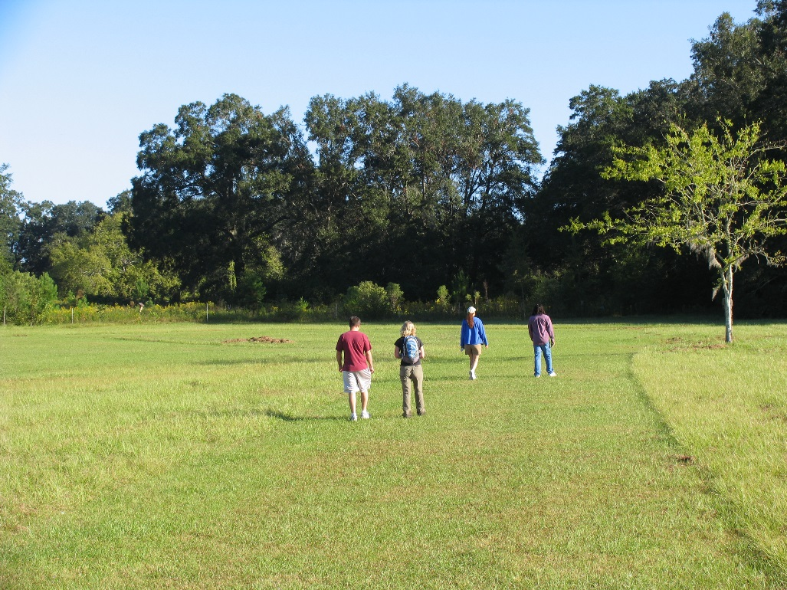
“Greenway”
linear open space along a natural corridor (riverfront, streambed, ridgeline, etc.), a railroad right-of-way converted to recreational use, a canal, a scenic road, or other;
natural or landscaped area for pedestrian or bicycle passage;
open space connector linking parks, nature reserves, cultural features, or historic sites with each other and populated areas;
local strip or linear park designated as a parkway or greenbelt.

Slide 25
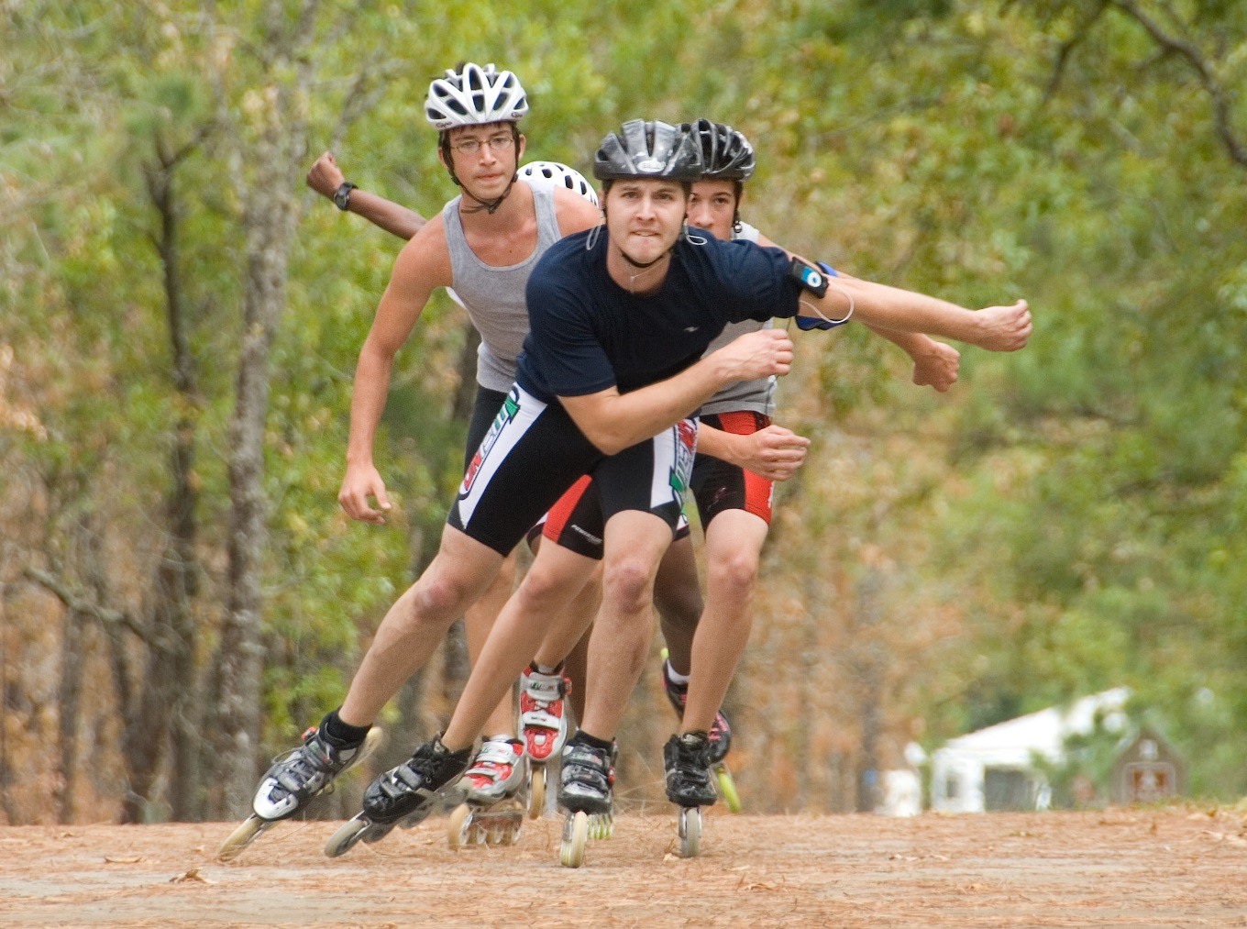
“Trail”
linear corridor and any adjacent support parcels on land or water providing public access for recreation or authorized alternative modes of transportation.

Slide 26
Voluntary Nature of Acquisitions
The DEPs acquisition of lands for the Florida Greenways and Trails program is accomplished only through voluntary arms-length transactions, based on a landowner’s willingness to sell his or her real property to the state for its fair market value. The Florida Greenways and Trails Act does not authorize the Department to acquire lands through the use of condemnation proceedings (eminent domain). Therefore, the owners of real property upon or over which a proposed greenway or trail will pass must be willing to negotiate with representatives of the Department (or its designee) regarding the potential sale of their lands to the State of Florida.

Slide 27
Final Approval Process
A written evaluation report is provided to members of the Florida Greenways and Trails Council for the December, 2016 meeting.
Council submits its recommendations to DEP Secretary.
The Secretary may modify the Council recommendations before approving list.
Approved projects submitted to Division of State Lands to begin the acquisition process.

Slide 28
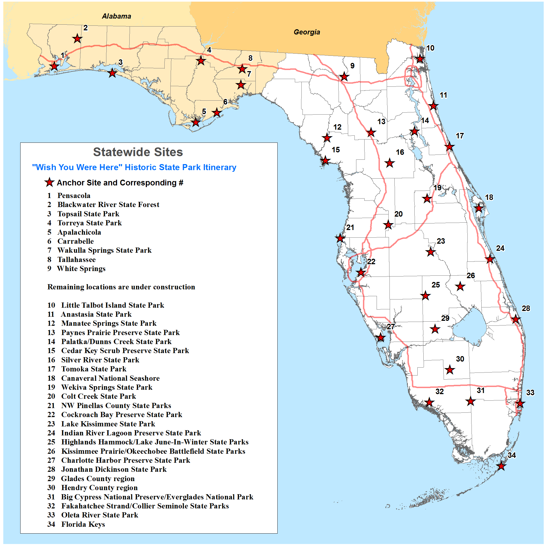
State Park/Gateway Community Itineraries

Slide 29
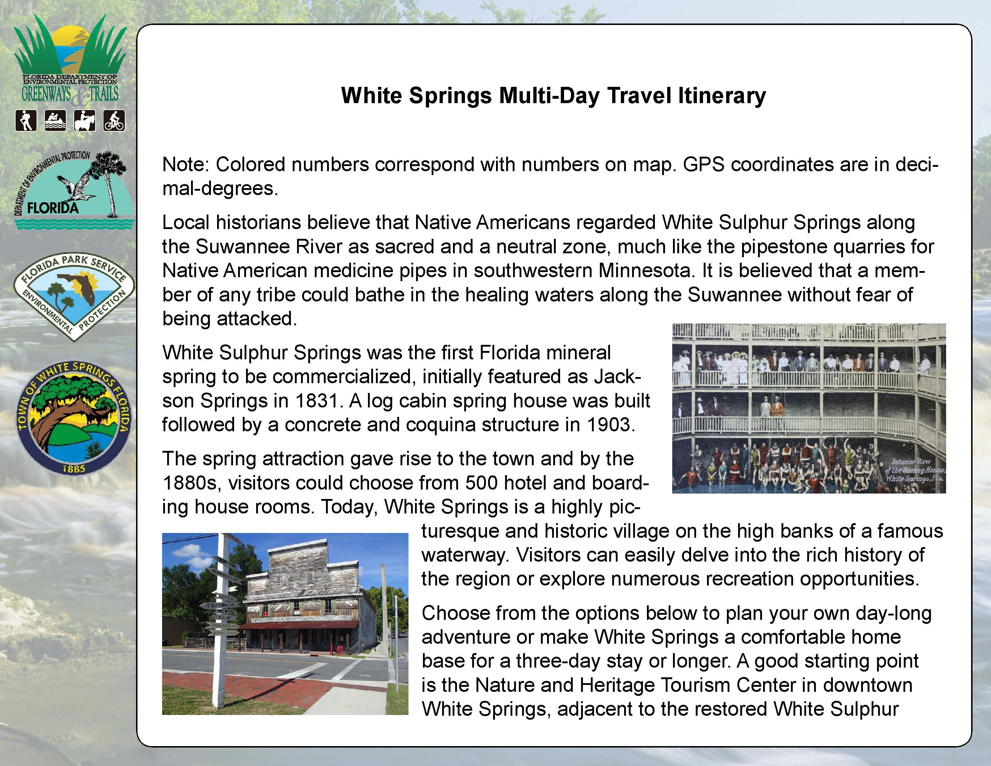
State Park/Gateway Community Itineraries

Slide 30
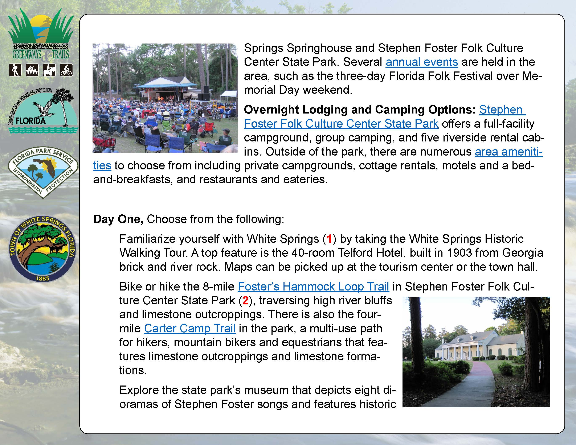
State Park/Gateway Community Itineraries

Slide 31
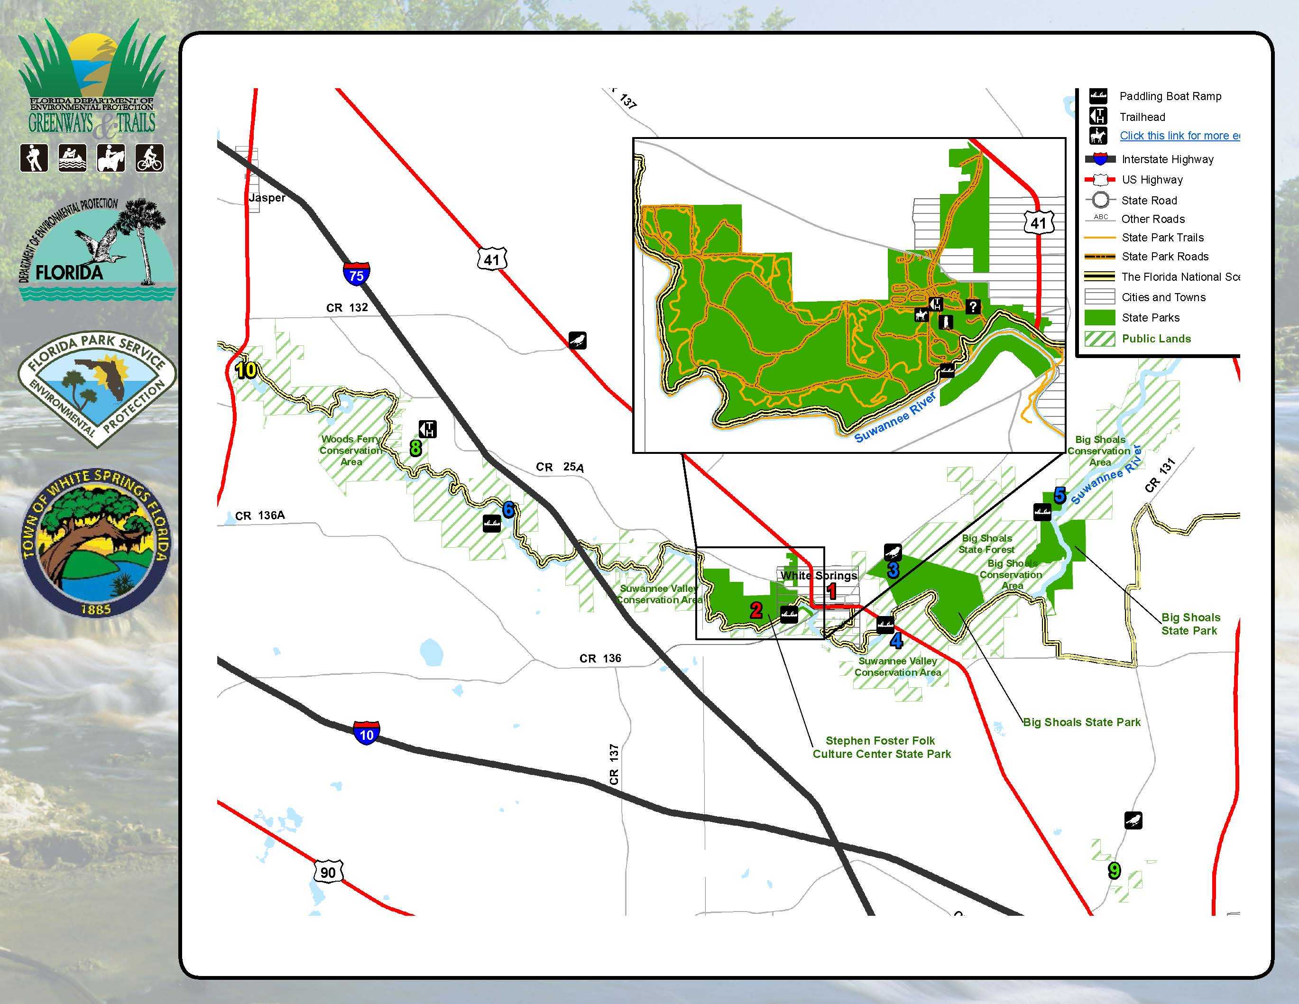
State Park/Gateway Community Itineraries

Slide 32
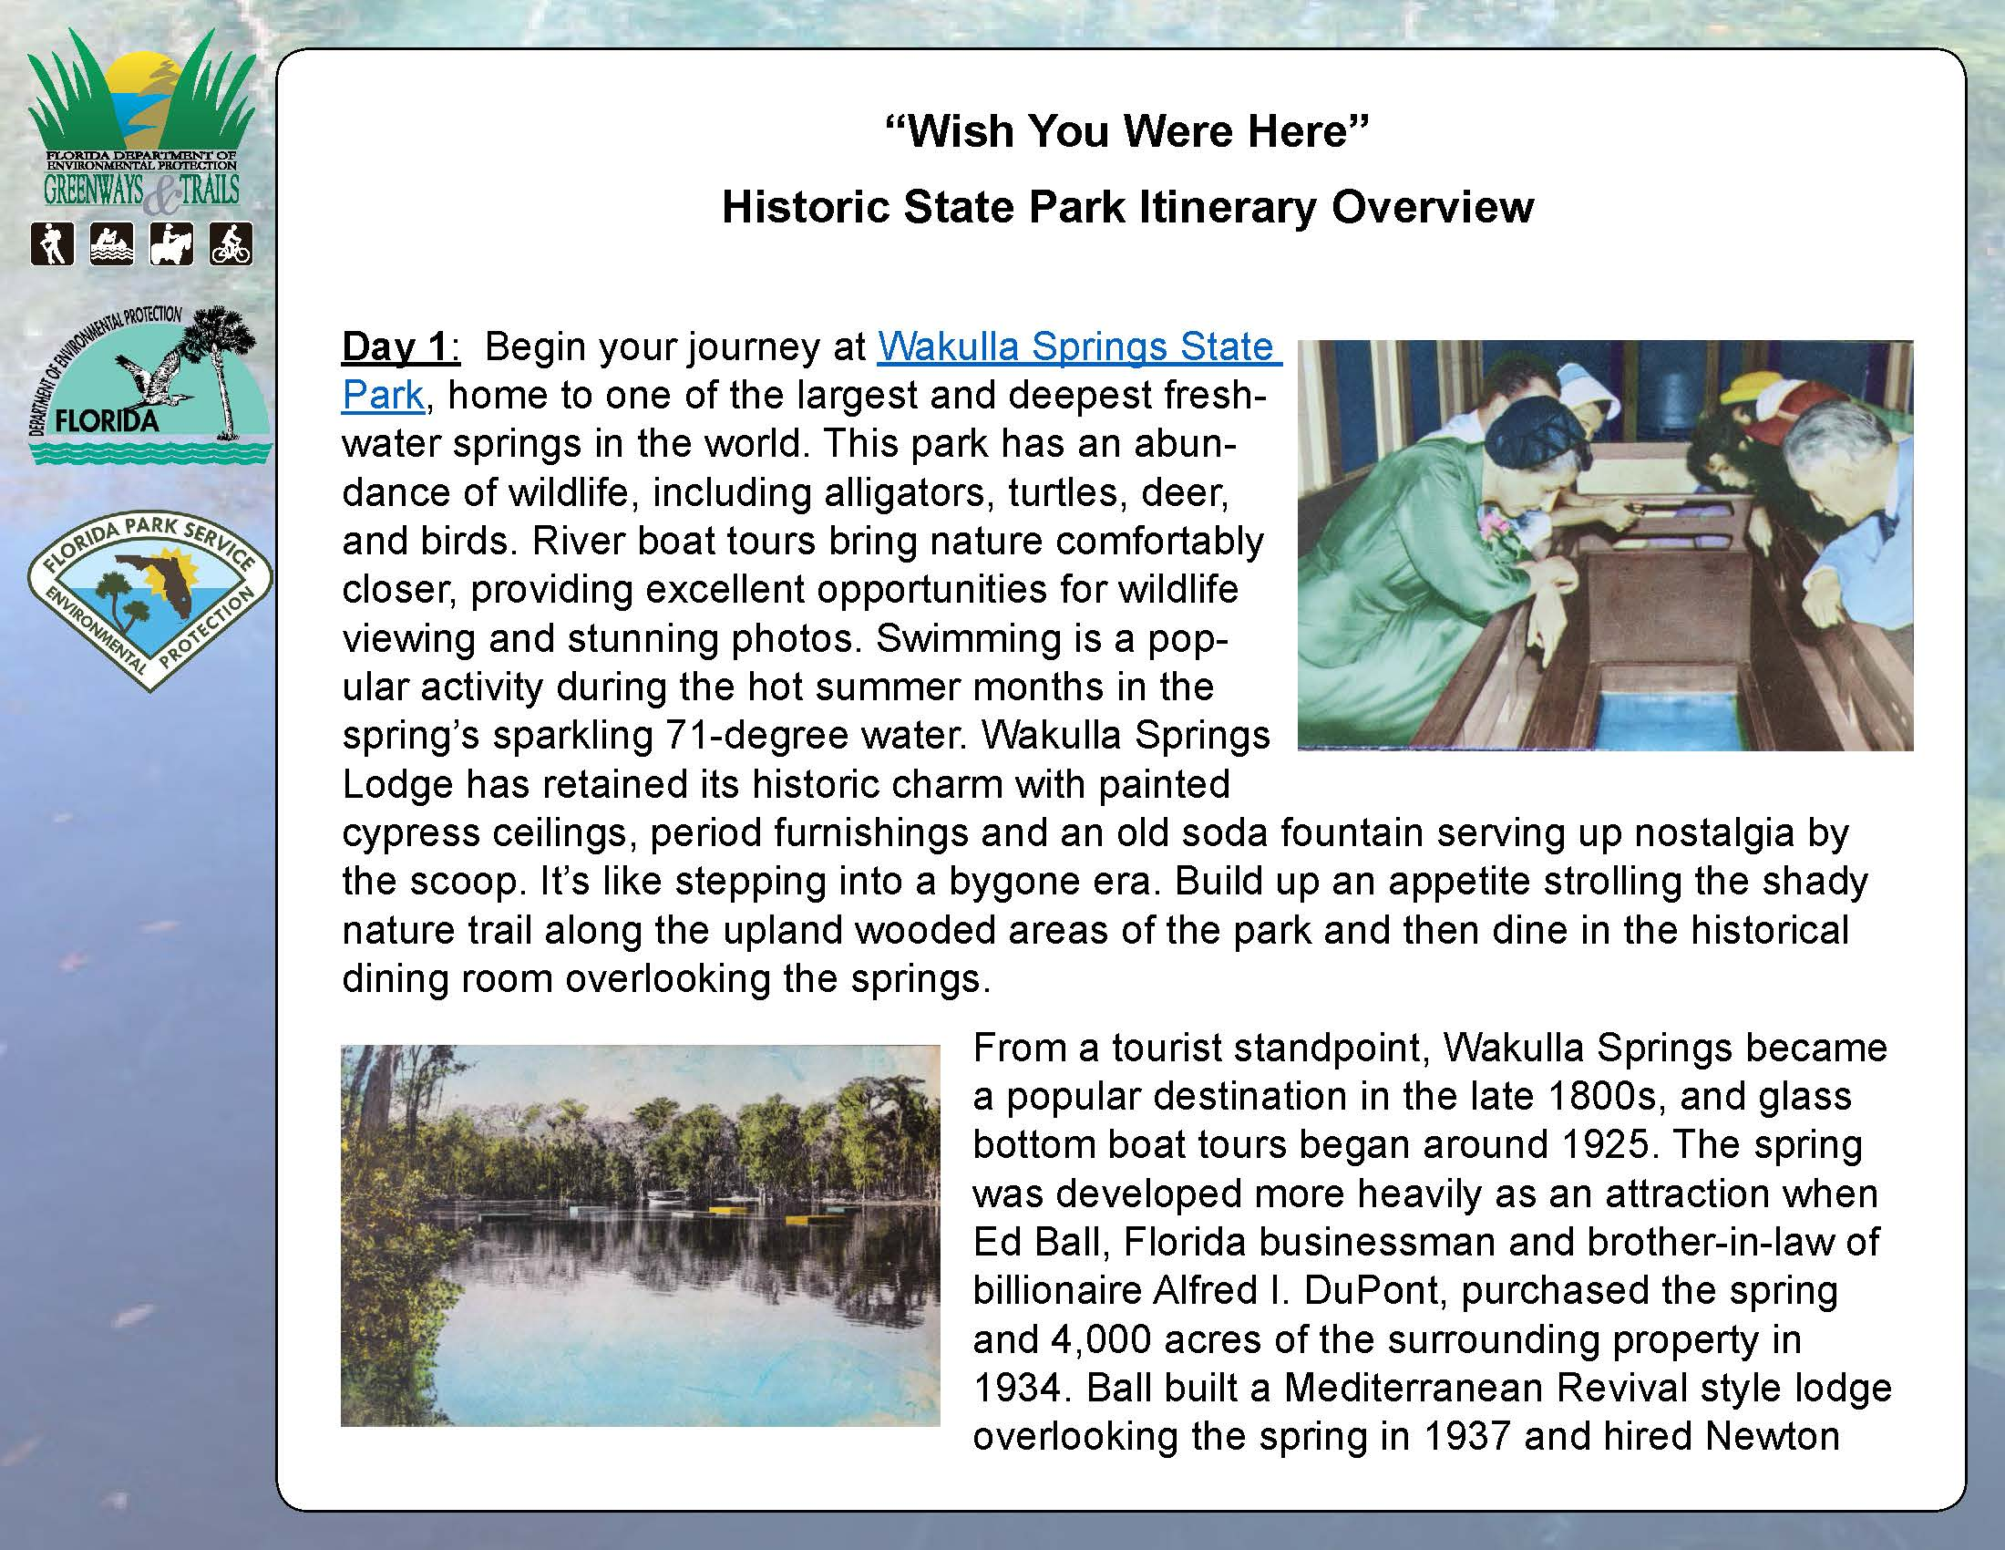
State Park/Gateway Community Itineraries

Slide 33
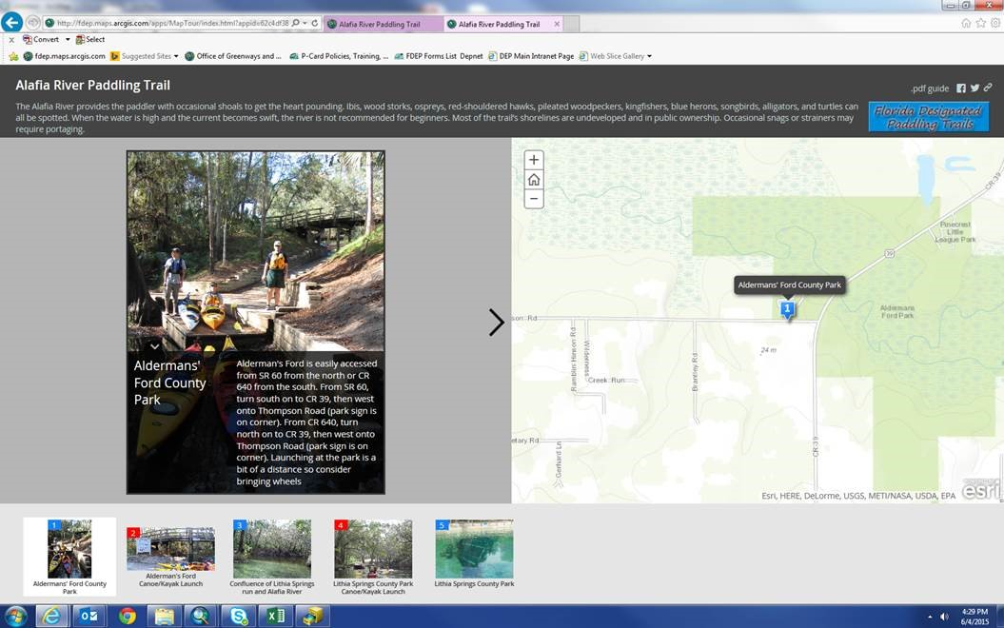
Story Maps

Slide 34
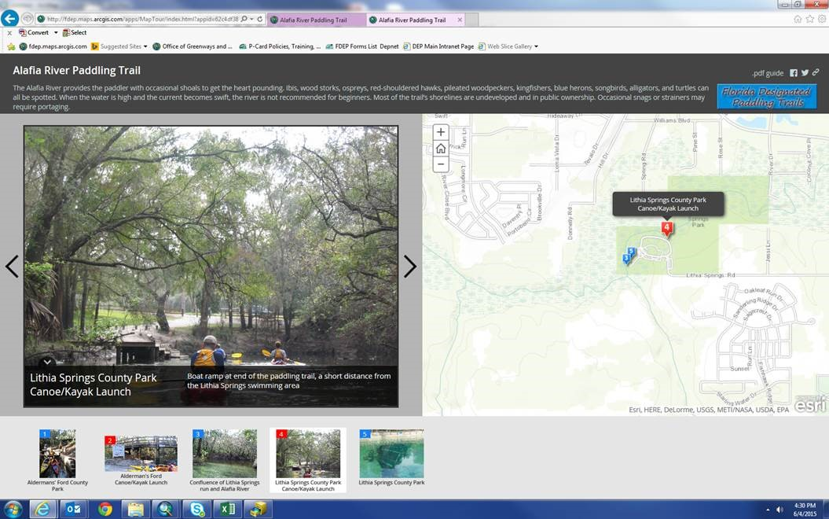
Story Maps

Slide 35
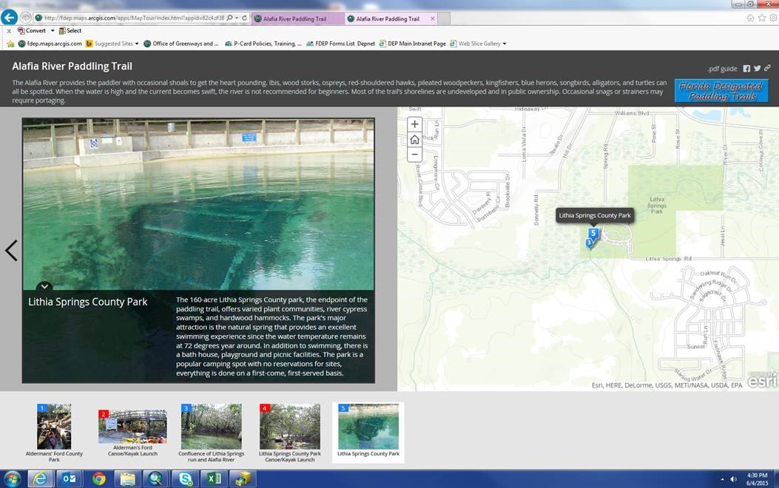
Story Maps

Slide 36
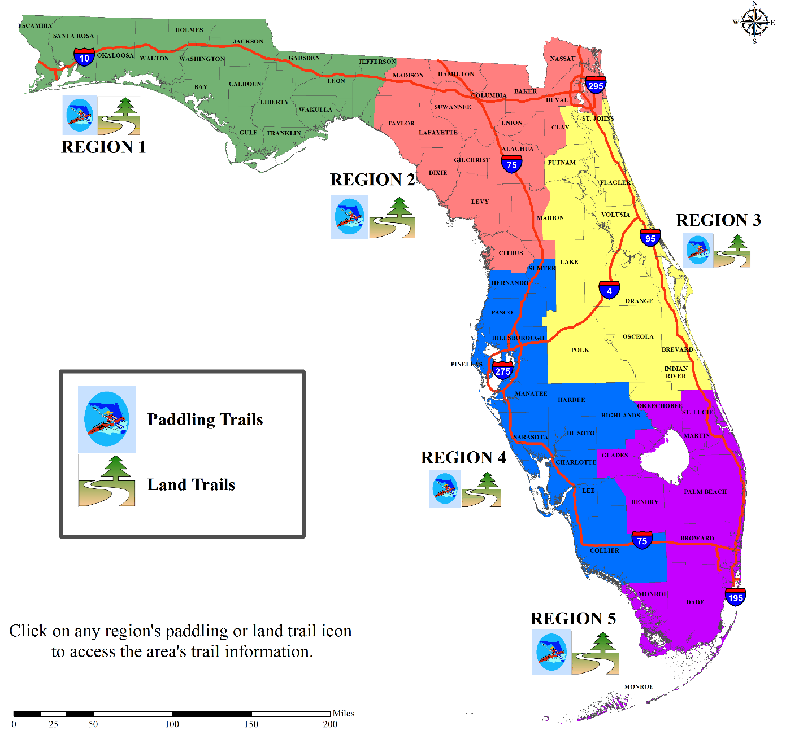
Online Trail Guide
OGT recently launched the Greenways and Trails Online Trail Guide. It features both land and water trails, 429 total.

Slide 37
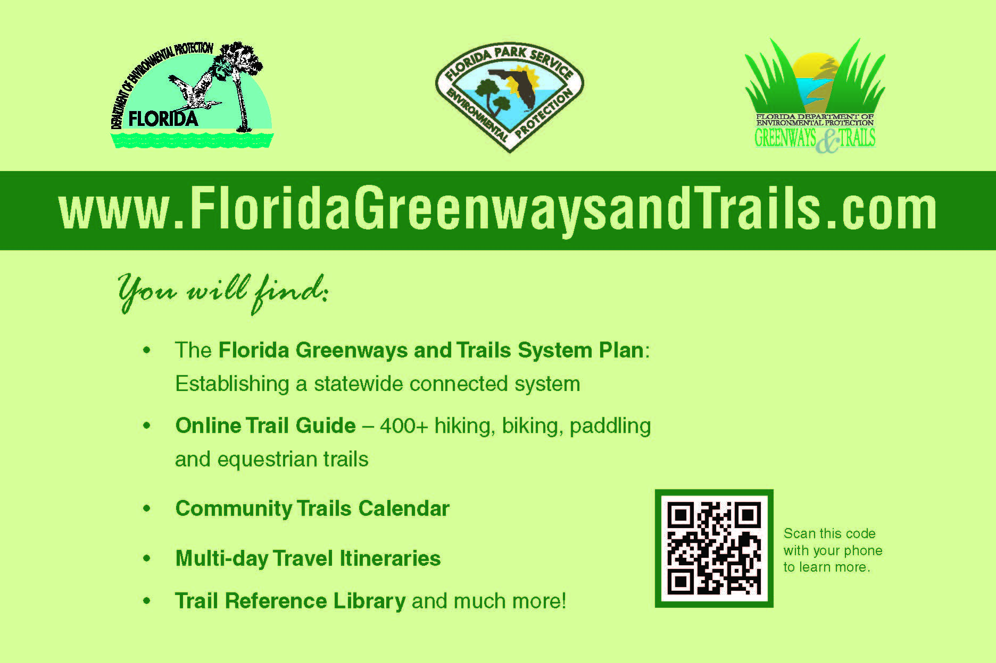
OGT Website

Slide 38
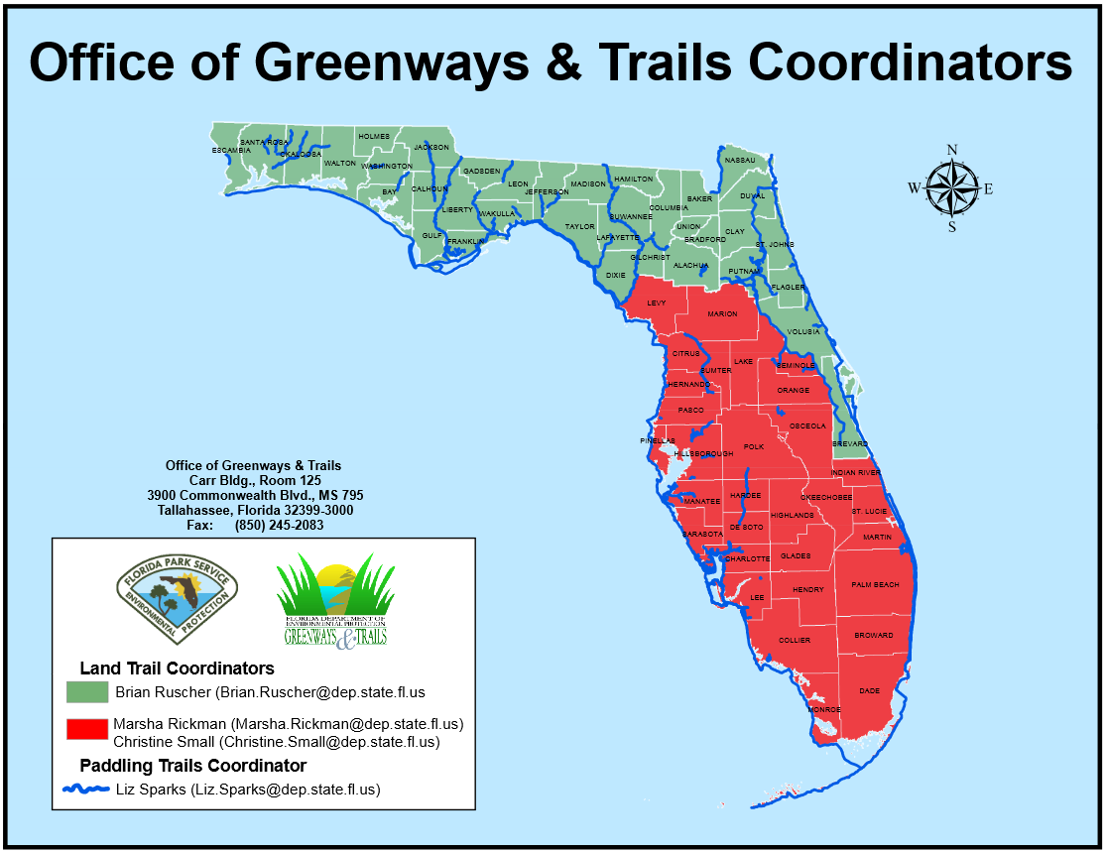
OGT Full-time Staff
Samantha Browne, Bureau Chief Samantha.Browne@dep.state.fl.us
Doug Alderson, Assistant Bureau Chief Doug.Alderson@dep.state.fl.us
Marsha Rickman, Regional Land Trail Coordinator Marsha.Rickman@dep.state.fl.us
Christine Small, Regional Land Trail Coordinator Christine.Small@dep.state.fl.us
Brian Ruscher, Regional Land Trail Coordinator Brian.Ruscher@dep.state.fl.us
Britney Moore, Acquisition Coordinator Britney.Moore@dep.state.fl.us
Liz Sparks, Paddling Trails Coordinator Liz.Sparks@dep.state.fl.us
Daniel Diaz, GIS Coordinator Daniel.Diaz@dep.state.fl.us

Slide 39

Questions?

