Slide 1


FNST Visitor Assessment
Taylor Stein, Ph.D., Principal Investigator
Bin Wan, Ph.D., Research Associate
Ramesh Paudyal, Graduate Research Assistant

Slide 2
Acknowledgements
US Forest Service
Florida Trail Association
Special thanks to the land managers who made this study possible.

Slide 3
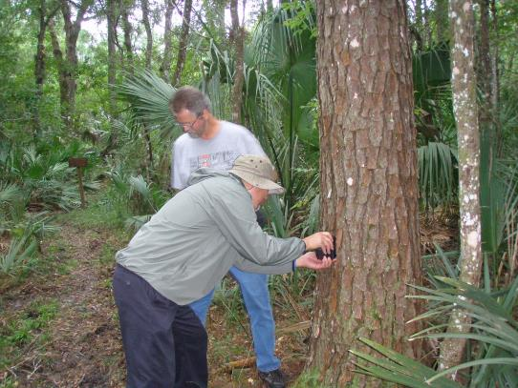
What to Expect
How many FNST Visitors?
Who are the FNST Visitors?
Reconsidering Trail Standards.

Slide 4
How Many
FNST Visitors?

Slide 5
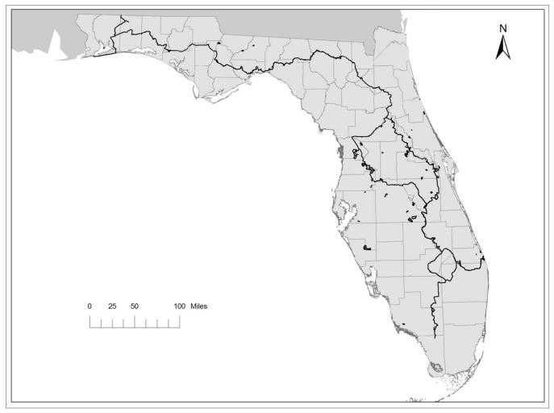
2013-2014 Study Sites & Use Level
1
2
3
1. Apalachicola NF 1,338
- Sopchoppy
- Bradwell Bay West
2. St. Marks NWR 1,888
- Shepard Spring
3. Osceola NF 562
- Battle Field
-Turkey Run
4. Ocala NF 5,932
- Lake Delancy
- Juniper Rec. Area
- SR 19
5. Tosohatchee WMA 1,428
- Woodbridge/Powerline Rd.
6. Big Cypress NP 3,139
- Oasis North
4
5
6

Slide 6
2013-2014 Study Site Use by Month
High use sites: greater variation by season
Low use sites: less variation by season

Slide 7
2013-2014 Trail-Wide Use Estimates
355,317 – total use
52% (185,982) - pedestrians
48% (169,335) - other users

Slide 8
2013-2014 Use Estimate by Segments

Slide 9
FNST Visitors by Area (NF and NP)
Visitation to all three national forests mostly small but steady increase since 2007/2008
Volatile fluctuations in early years due to weather and technical difficulties
Visitations to Big Cypress NP increase first time after continuous declining since 2007/2008
Apalachicola NF
Ocala NF
Osceola NF
Big Cypress NP

Slide 10
Refinement of Visitor Use Estimates
New Access Points/Segments: thousands counts added to the total use over the years: Shepard Spring, Woodbridge/Powerline Rd., Red Rock, Little Shoals, Latus…
Counter rotations: more counter data less mathematical inferring.
Re-assess areas with other traffic: Lake Okeechobee, St. Marks, Withlacoochee, Little Big Econ, Gulf Islands…

Slide 11
Who Are the
FNST Visitors?

Slide 12
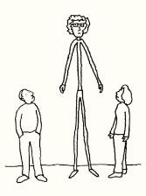
Demographics (n=328)

Slide 13
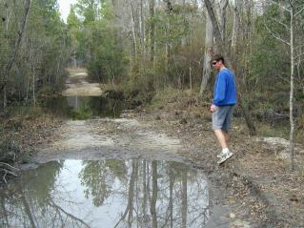
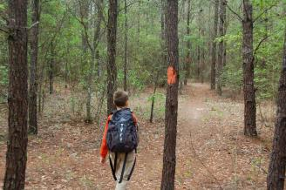
Demographics (n=328)
Characteristics |  | %
Education | High school or below | 10
 | Some College | 27
 | College Graduate | 38
 | Some Graduate School | 6
 | Graduate degree or beyond | 19
Employment | Full time | 63
 | Part time | 8
 | Unemployed | 7
 | Home maker | 2
 | Retired | 12
 | Student | 11
HH income | Less than 30,000 | 19
 | 30,000 - 60,000 | 26
 | 60,000 - 90,000 | 25
 | 90,000 or more | 30

Slide 14
Trip characteristics (n=328)

Slide 15
Trip Characteristics (n=328)
Alone: 22%, Group of two or three: 55%, Family or friends: 63%

Slide 16
Source of trail information
How far the visitors came from?
Distance from home zip code | %
5 miles or less | 6
5 - 10 miles | 5
10 - 20 miles | 13
20 - 50 miles | 31
50 - 100 miles | 20
100 - 250 miles | 12
250 - 500 miles | 3
500 miles or more | 9

Slide 17
Preferences and motivations
Attractions (Pull factors) | Mean
Wilderness and undisturbed nature | 4.5
Good environmental quality of air, water, and soil | 4.2
Chance to see wildlife/birds | 4.1
To see the natural water features | 3.8
Easy access to the area/being easy to get to | 3.6
Motivation (push factors) | Mean
To enjoy the scenery | 3.6
To experience nature | 3.5
To be close to nature | 3.4
To get exercise | 3.4
To relax physically | 3.3
All items measured in a scale of 1 (Not at all important) – 5 (Very important)

Slide 18
Trail experience and feedback
Reasons/suggestions (n = 213) | %
Maps, sign, marking, and blazes are not sufficient | 21
Expected to see more wildlife, water features, diversity of vegetation, and scenery | 14
Personal reason, bugs, bad weather, and wrong season | 13
Increase drinking water facilities and bathrooms | 11
Clear fallen dead trees and brush piles and minimize burning on the trail | 10
Too much of litter, trash, and poop on the side of the trail | 9
Clear dense bush, rocks, gravels, roots, and other obstacles and maintain shade on the trail | 8
Other | 26

Slide 19
Reconsidering
Trail Standards:
Think Large Scale

Slide 20




People visit the FNST for different reasons.
Desire different things.
Site attributes | Mean (N=282) | Subgroups based on pull factors
 |  | Low Enthusiastic (22%) | Convenience & Non-consumptive (26%) | Non-consumptive (31%) | Opportunistic (21%)
Fishing | 2.1 | 1.3 | 1.6 | 2.0 | 3.7
Big game | 1.6 | 1.1 | 1.2 | 1.1 | 3.4
Small game | 1.7 | 1.1 | 1.4 | 1.2 | 3.4
Natural water features | 3.8 | 3.3 | 3.2 | 4.4 | 4.1
Wilderness | 4.5 | 4.1 | 4.5 | 4.7 | 4.4
Wildlife | 4.1 | 3.3 | 4.3 | 4.4 | 4.0
Camping | 3.6 | 1.6 | 4.0 | 4.4 | 4.0
Easy access | 3.6 | 3.2 | 4.3 | 3.0 | 4.0
Close to home | 3.2 | 2.8 | 4.2 | 2.2 | 4.0
Parking | 3.2 | 2.5 | 3.9 | 2.9 | 3.6

Slide 21
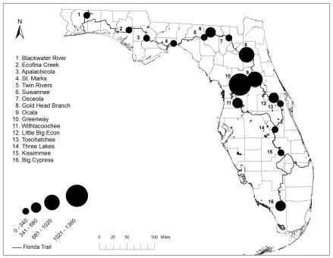
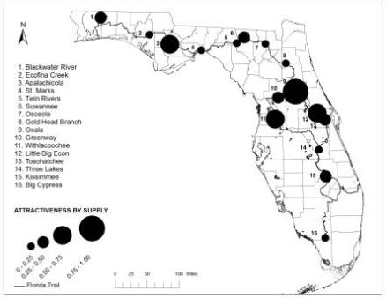
What’s An Attractive Segment?
High use correlates high level of attractiveness of the surrounding area
High use areas (Ocala, Withlacoochee, Suwannee) have more attraction features to offer: tourism support facilities, landscape features, and outdoor recreation activities
PEAK USE LEVEL

Slide 22
What Do They Want?
Surrounding Attractions
Use is focused in a few key areas
  Areas close to urban areas (Little Big Econ, Cross Florida Greenway)
  Areas with more attraction features to offer (Ocala NF, Suwannee segments)
Consistent use (approximately 350,000 visits)
  Many areas could accommodate more users
  Expanding visitation is very possible

Slide 23
What if area is not “attractive”?
Areas like St. Marks, Big Cypress…
  Perceived more attractive than what areas can deliver
  Creation/improvement: attraction features
  Expectations should be matched by supply
Areas like Apalachicola, Tosohatchee and others
  Perceived less attractive than what areas possess
  Untapped potential
  Promote attraction features
  Awareness

Slide 24
Things to Monitor/Improve
Improving Experience
  Communication!!!
    Highlight water and wildlife attractions
    Highlight surrounding amenities
Higher Use Sites
  Diverse amenities surrounding section
  Close to water
  Close to residential areas
    Middle income has higher rates of use
Lower Use Sites
  “Isolated” areas
    But, communication could remove isolated perception
  Sand hills
    Potential trail “improvements” could improve use

Slide 25
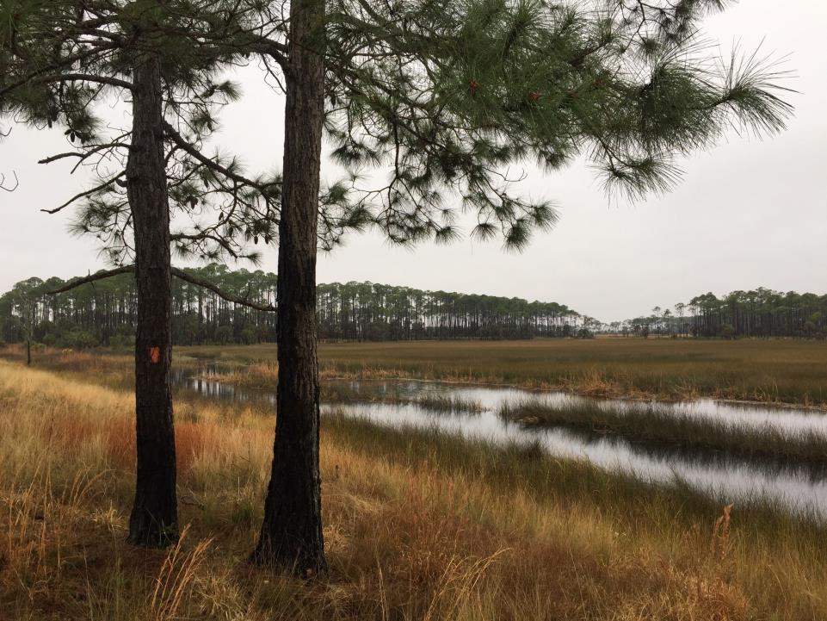
Thank you
Thank you
FNST by St. Marks NWR
FNST by Lake DeLancy, Ocala NF

