Slide 1
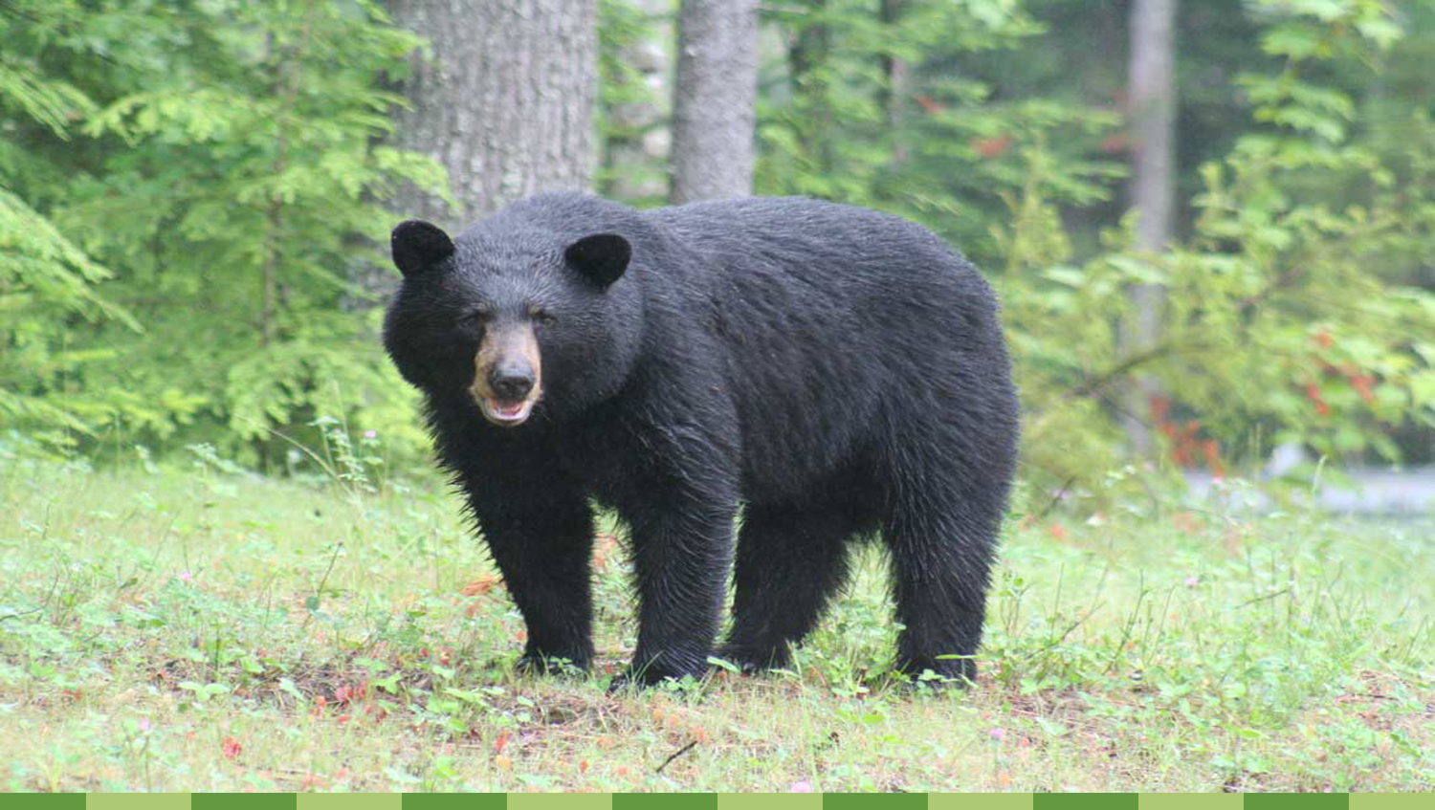


Florida National Scenic Trail:​
Economic Impact & Apalachicola National Forest to Econfina Creek Gap Analysis
Florida Planning & Development Lab​
Spring 2017​

Slide 2


Studio Members​
Lindsay Stevens – Director​
Jeremy Crute – Project Manager​
​
Isaac Anderson​
Peter Barrilleaux​
Ryan Brown​
Ashley Killough​
Taurean “T.J.” Lewis​
Mengyuan Ma​
Jeremy Norsworthy​
Michael Schilling​
Kukhyun Synn​
Kun Wu ​
​
1

Slide 3
Agenda
Our Purpose
FNST Economic Impact Analysis
  Methodology
  Literature Review
  Equation Creation
  Results
Florida National Scenic Trail (FNST) Gap Analysis
  Methodology
  Four Alternatives
  Optimal Decision
Conclusion and Moving Forward
2

Slide 4
Scope of Work
Deliverable 1: Identify economic impacts of the FNST
Deliverable 2: Provide alternatives and recommendation for the Apalachicola National Forest to the Econfina Creek Water
Management Area FNST gap.
3

Slide 5
Florida National Scenic Trail
Authorized by the National Trails Act of 1968
Jim Kern and the Florida Trail Association
Designated as the National Scenic Trail in 1983
Four Primary Regions
  Southern
  Central
  Northern
  Panhandle
1300 miles with 300 in unofficial connectors (gaps)
USDA’s Forest Service is the current administrator
4

Slide 6

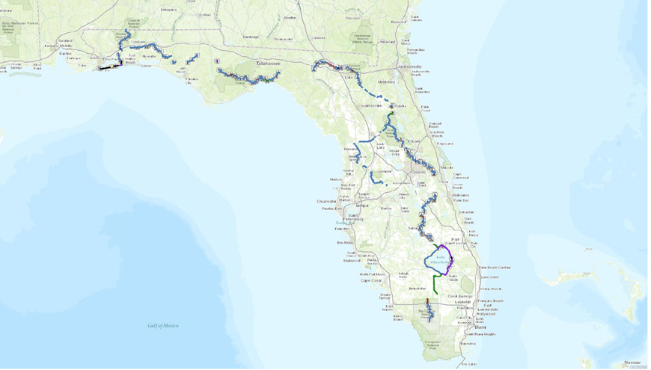
5

Slide 7
Intro to Economic Impact Analysis
The need for Economic Impact Analysis
FNST as a vital contributor to rural economies in Florida?
Lack of economic impact research on FNST
The purpose of the study
Determining the possible economic effect of the FNST
Helping guide research moving forward for more accurate results
6

Slide 8
Methodology Outline
Determination of methodology
  Literature Review
  Formula Development
Setting each component for methodology
  Annual Visitation
  Average Personal Expenditure
    FPDL Survey
  Percent of Outside Visitors
  Annual Fiscal Expenditure
Results
7

Slide 9
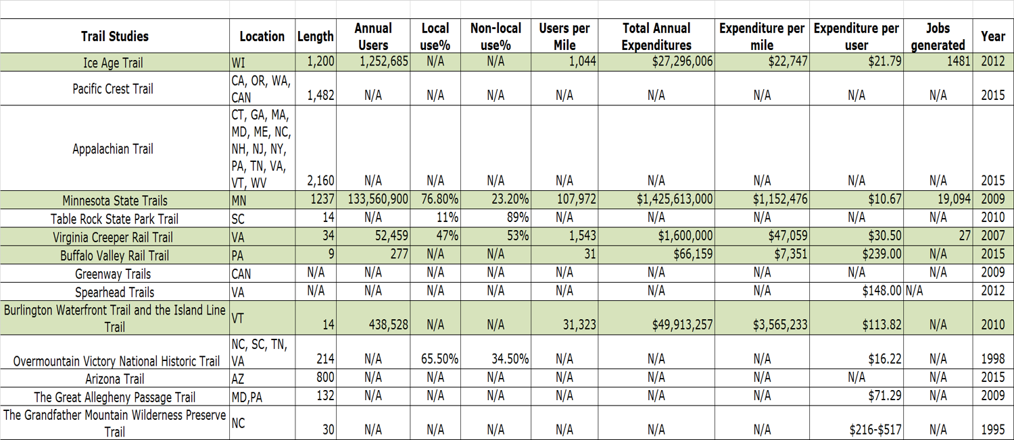
Literature Review
8

Slide 10
Change in Scope
Generated information on how to measure economic impact of trails
But data not applicable to FNST context
- Geographical features
- Climate
- User data
Focus on Florida specific inputs
9

Slide 11
FDEP/FPS Formula
APE
(Average
Personal
Expenditure per Trip)
%OV
(Percent of
Outside
Visitors)
AFE
(Annual Fiscal Expenditures)
Economic
Impact
AV
(Annual
Visitation)
=
X
X
+
Source: Florida Park Service (FPS)
10

Slide 12
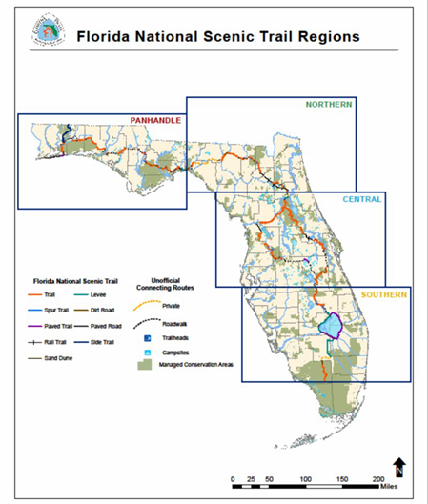
APE
(Average
Personal
Expenditure per Trip)
%OV
(Percent of
Outside
Visitors)
AFE
(Annual Fiscal Expenditures)
Economic
Impact
AV
(Annual
Visitation)
=
X
X
+
Annual Visitation
2013-2014 FNST Visitor Assessment
Overall visitation rate for FNST: 355,317
The Southern Region: 209,753
The Central Region: 86,106
Panhandle Region: 47,235
The Northern Region: 12,223
11

Slide 13
APE
(Average
Personal
Expenditure per Trip)
%OV
(Percent of
Outside
Visitors)
AFE
(Annual Fiscal Expenditures)
Economic
Impact
AV
(Annual
Visitation)
=
X
X
+
Average Personal Expenditure per Trip
Lack of applicable data for FNST
Used range of guiding values
  FDEP and Visit Florida database
  Ice Age Trail
  FPDL Survey
Created three individual economic impact estimates
12

Slide 14
APE
(Average
Personal
Expenditure per Trip)
%OV
(Percent of
Outside
Visitors)
AFE
(Annual Fiscal Expenditures)
Economic
Impact
AV
(Annual
Visitation)
=
X
X
+
Average Personal Expenditure per Trip
FDEP and Visit Florida database ($116 per person average)
Official APE for all Florida trails and parks
Too high (including lodging and camping cost)
The Ice Age Trail ($21.79 per person average)
The most similar trail as FNST (Length, National Scenic trail, and several
urbanized areas)
Not entirely justifiable (different visitation rate, geography, and topography)
13

Slide 15
APE
(Average
Personal
Expenditure per Trip)
%OV
(Percent of
Outside
Visitors)
AFE
(Annual Fiscal Expenditures)
Economic
Impact
AV
(Annual
Visitation)
=
X
X
+
Average Personal Expenditures Based on Survey Results
Main expenditure Categories
Gas/Travel
Food
Equipment
Lodging
Tours
Souvenirs
9 Organizations and 47 respondents
(Panhandle Region)
$24.48
Variations in equipment cost
Expenditures outside of Study Area
Limited population groups
14

Slide 16
APE
(Average
Personal
Expenditure per Trip)
%OV
(Percent of
Outside
Visitors)
AFE
(Annual Fiscal Expenditures)
Economic
Impact
AV
(Annual
Visitation)
=
X
X
+
Percent of Outside Visitors
2016 FDEP Economic Impact Assessment on state parks and trails
Percentage of outside dollars spent in community
74%
15

Slide 17
APE
(Average
Personal
Expenditure per Trip)
%OV
(Percent of
Outside
Visitors)
AFE
(Annual Fiscal Expenditures)
Economic
Impact
AV
(Annual
Visitation)
=
X
X
+
2014-2015 FTA Trails Operation Report
(Quantified volunteer work figures)
FNST: 1314 miles ($599,127)
  Southern: 222 miles ($101,222)
  Central : 456 miles ($207,916)
  Northern: 351 miles ($160,041)
  Panhandle: 285 miles ($129,947)
16

Slide 18
Results
Three expenditure estimations:
FDEP/Visit Florida Fiscal Year 2015-2016 Economic Impact Assessment
Ice Age Trail Economic Impact Assessment
Florida Planning and Development Lab Survey
17

Slide 19
Visit Florida
FDEP/Visit Florida Average Personal Expenditure Method
Table 1: FNST Economic Impact Estimates, FDEP/Visit Florida Average Personal Expenditure
Equation: Economic Impact Estimate (EIE) = Average Visitation (AV) * Average Personal Expenditure (APE) * Percentage of Outside Visitors (%OV) + Annual Fiscal Expenditures (AFE)
Scale | AV | APE | %OV | AFE | EIE
State | 355,317 | $116 | 0.74 | $ 599,127 | $31,099,538
Southern | 209,753 | $116 | 0.74 | $ 101,222 | $18,106,420
Central | 86,106 | $116 | 0.74 | $ 207,916 | $ 7,599,255
Northern | 12,223 | $116 | 0.74 | $ 160,041 | $ 1,209,263
Panhandle | 47,235 | $116 | 0.74 | $ 129,947 | $ 4,184,600
18
Notes:
IMPLAN (Impact analysis for planning) started in the late 1970s as a mainframe computing tool at the U.S. Forest Service (USFS) to
assess the economic impact of its activities.
With continuing support from the U.S. Forest Service, IMPLAN was enhanced by research studies and newer data in the field.
At the core of the model are procedures to derive a local input-output model by applying local
demographic, economic and fiscal data to the latest available U.S. input-output model.

Slide 20
Ice Age
Ice Age National Scenic Trail Average Personal Expenditure Method
Table 2: FNST Economic Impact Estimates, Ice Age National Scenic Trail Average Personal Expenditure
Equation: Economic Impact Estimate (EIE) = Average Visitation (AV) * Average Personal Expenditure (APE) * Percentage of Outside Visitors (%OV) + Annual Fiscal Expenditures (AFE)
Scale | AV | APE | %OV | AFE | EIE
State | 355,317 | $21.79 | 0.74 | $ 599,127 | $ 6,328,471
Southern | 209,753 | $21.79 | 0.74 | $ 101,222 | $ 3,483,405
Central | 86,106 | $21.79 | 0.74 | $ 207,916 | $ 1,596,341
Northern | 12,223 | $21.79 | 0.74 | $ 160,041 | $ 357,132
Panhandle | 47,235 | $21.79 | 0.74 | $ 129,947 | $ 891,593
19
Notes:
IMPLAN (Impact analysis for planning) started in the late 1970s as a mainframe computing tool at the U.S. Forest Service (USFS) to
assess the economic impact of its activities.
With continuing support from the U.S. Forest Service, IMPLAN was enhanced by research studies and newer data in the field.
At the core of the model are procedures to derive a local input-output model by applying local
demographic, economic and fiscal data to the latest available U.S. input-output model.

Slide 21
Survey
Florida Planning & Development Lab Average Personal Expenditure Method
Table 3: FNST Economic Impact Estimates, Florida Planning & Development Lab Average Personal Expenditure
Equation: Economic Impact Estimate (EIE) = Average Visitation (AV) * Average Personal Expenditure (APE) * Percentage of Outside Visitors (%OV) + Annual Fiscal Expenditures (AFE)
Scale | AV | APE | %OV | AFE | EIE
State | 355,317 | $24.48 | 0.74 | $ 599,127 | $ 7,035,766
Southern | 209,753 | $24.48 | 0.74 | $ 101,222 | $ 3,900,940
Central | 86,106 | $24.48 | 0.74 | $ 207,916 | $ 1,767,743
Northern | 12,223 | $24.48 | 0.74 | $ 160,041 | $ 381,463
Panhandle | 47,235 | $24.48 | 0.74 | $ 129,947 | $ 985,619
20
Notes:
IMPLAN (Impact analysis for planning) started in the late 1970s as a mainframe computing tool at the U.S. Forest Service (USFS) to
assess the economic impact of its activities.
With continuing support from the U.S. Forest Service, IMPLAN was enhanced by research studies and newer data in the field.
At the core of the model are procedures to derive a local input-output model by applying local
demographic, economic and fiscal data to the latest available U.S. input-output model.

Slide 22
Conclusion
Three FNST economic impact estimates
FDEP/Visit Florida
Ice Age
The Florida Planning & Development Lab Survey
Resulted in a range from approximately $6 million to $31 million in economic impact
21

Slide 23
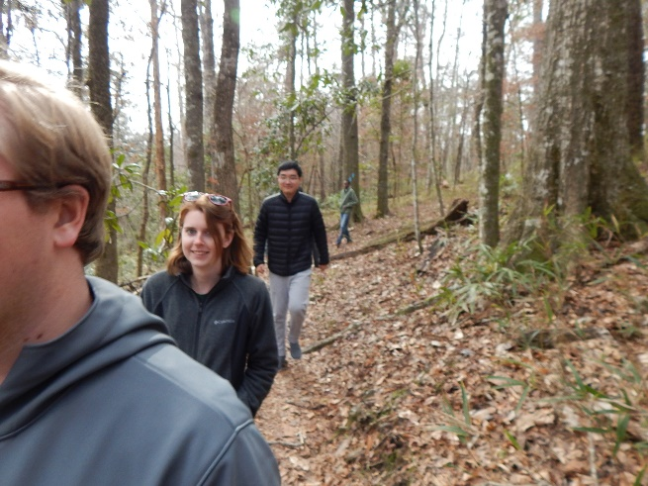
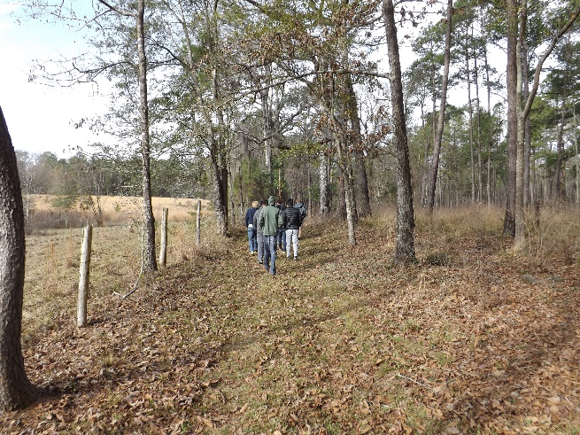
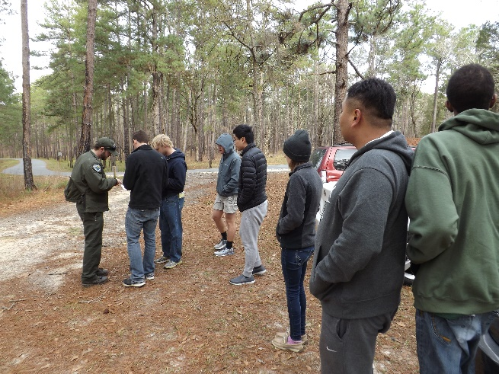
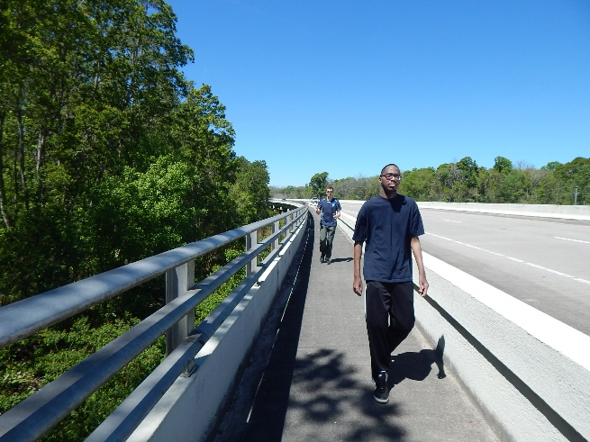
Alternative Analysis
22
Notes:
NOTE ALL MAP NUMBERS COORDINATE WITH DOCUMENT!!
NOT IN ORDER OF PP, BUT RATHER PAPER

Slide 24
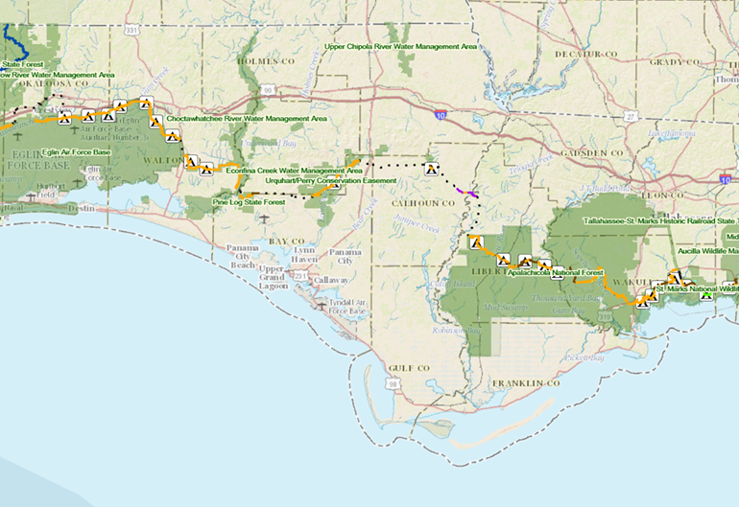
The
Gap
23

Slide 25
Methodology
Context analysis of the area to identify possible routes
  Demographics and land ownership analysis
Extensive analysis to identify routes
  Site Visits
  Spatial Analysis
  Interviews
Four routes chosen
  Existing route
  Four Mile Creek
  Marianna
  Dead Lakes
Criteria and weight guidelines from the FNST Comprehensive Plan
Subcriteria used to better analyze routes
Ranges to quantify score
24

Slide 26
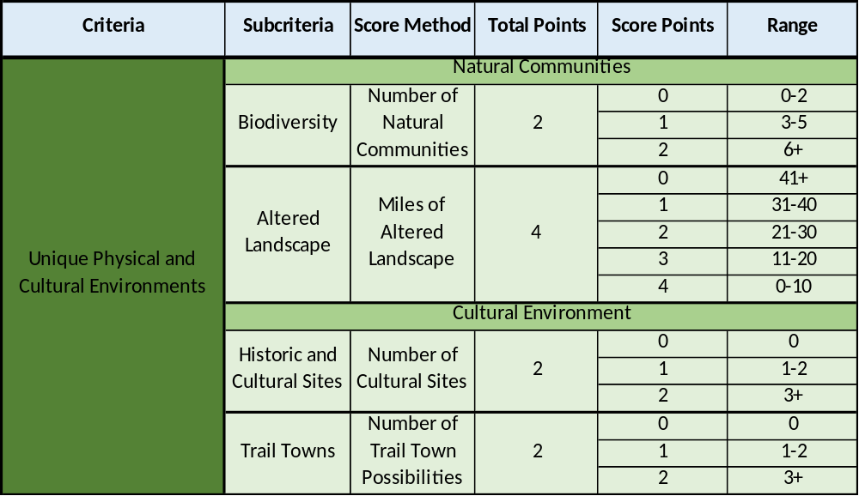
Criteria | Subcriteria | Score Method | Total Points | Score Points | Range
Unique Physical and Cultural Environments | Natural Communities
 | Biodiversity | Number of Natural Communities | 2 | 0 | 0-2
 |  |  |  | 1 | 5-Mar
 |  |  |  | 2 | 6+
 | Altered Landscape | Miles of Altered Landscape | 4 | 0 | 41+
 |  |  |  | 1 | 31-40
 |  |  |  | 2 | 21-30
 |  |  |  | 3 | 20-Nov
 |  |  |  | 4 | 0-10
 | Cultural Environment
 | Historic and Cultural Sites | Number of Cultural Sites | 2 | 0 | 0
 |  |  |  | 1 | 2-Jan
 |  |  |  | 2 | 3+
 | Trail Towns | Number of Trail Town Possibilities | 2 | 0 | 0
 |  |  |  | 1 | 2-Jan
 |  |  |  | 2 | 3+
25

Slide 27
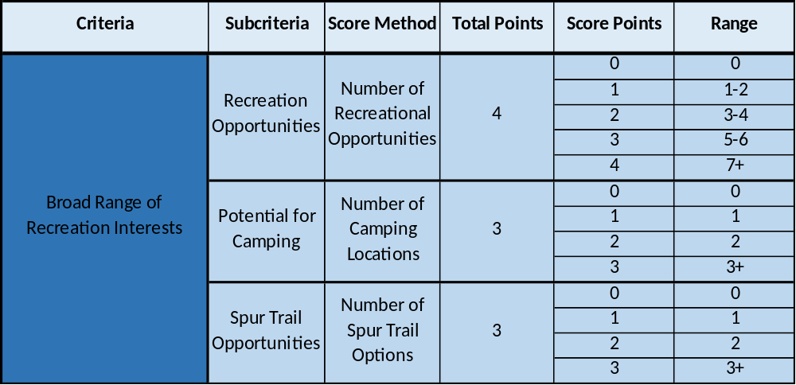
26

Slide 28
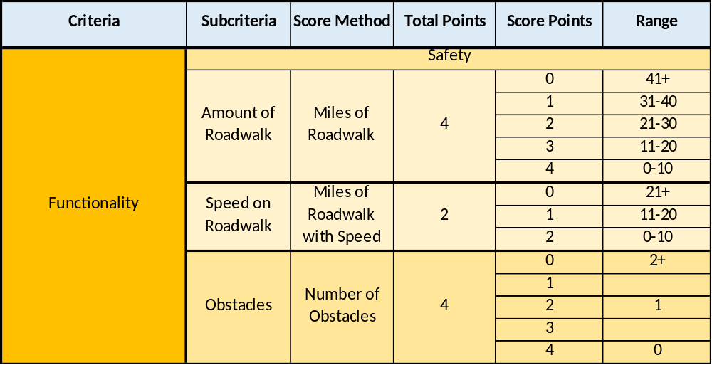
27

Slide 29
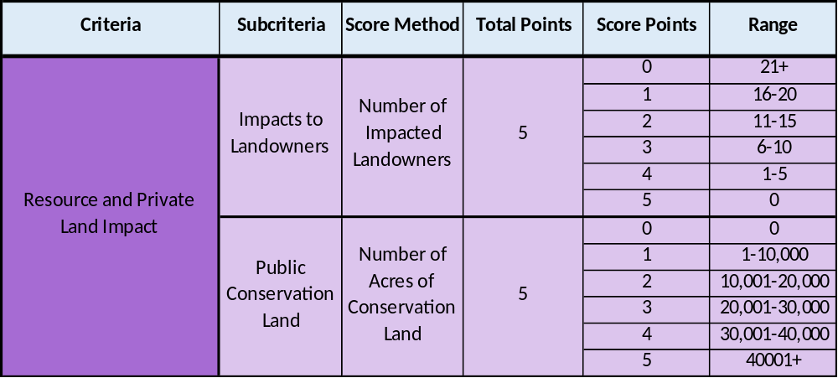
28

Slide 30
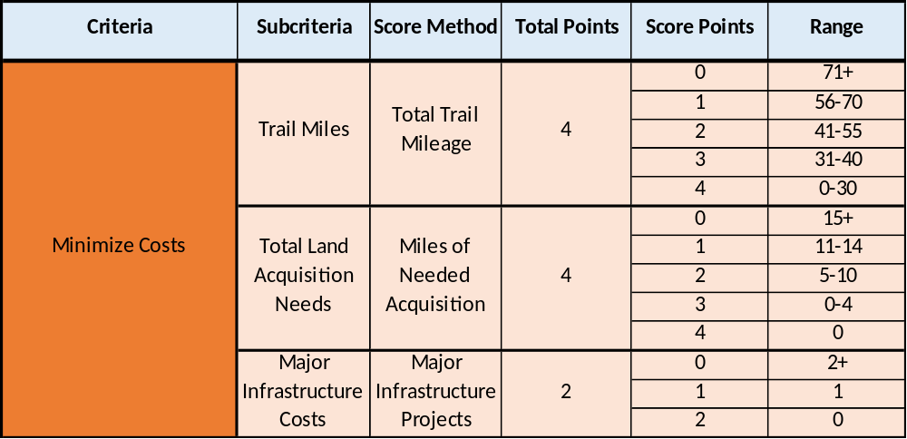
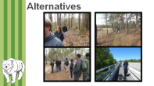
29

Slide 31
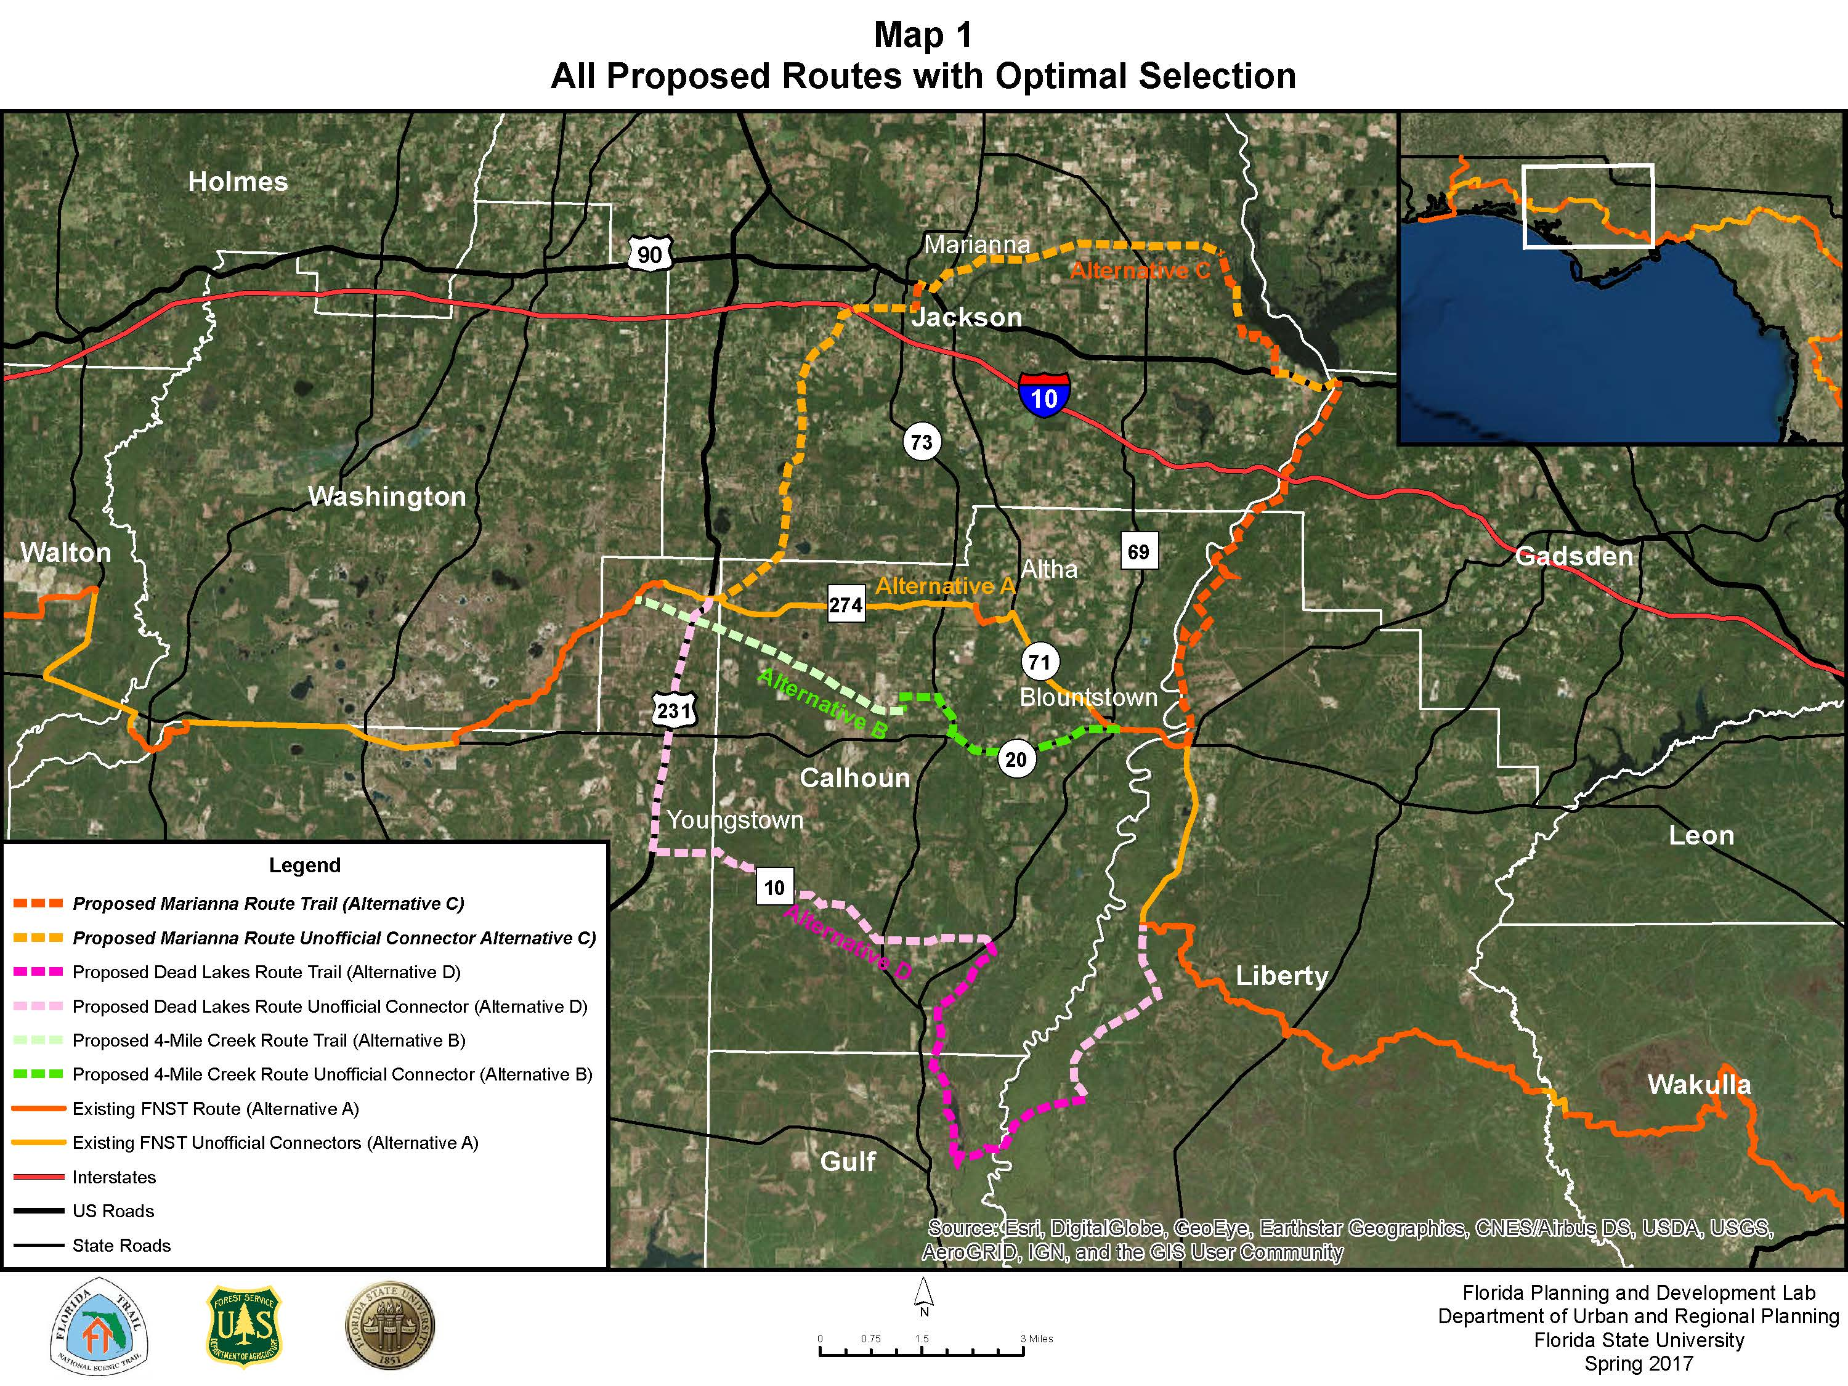
30

Slide 32
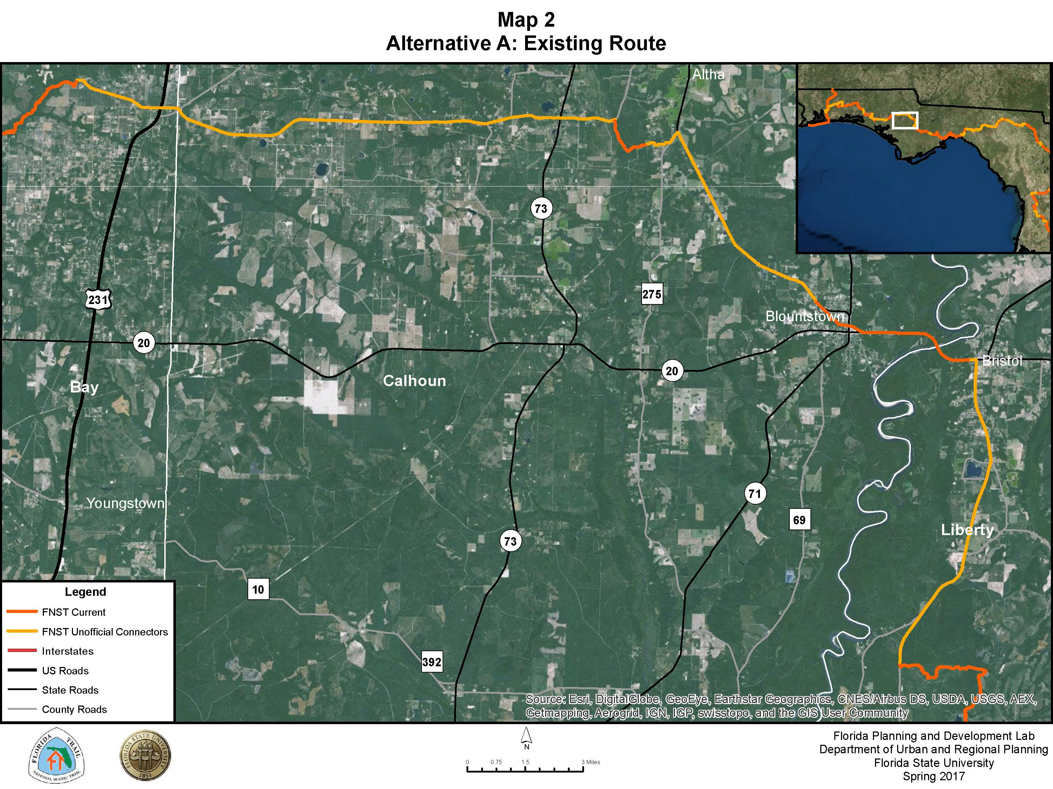
31

Slide 33
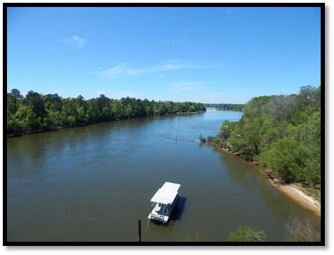
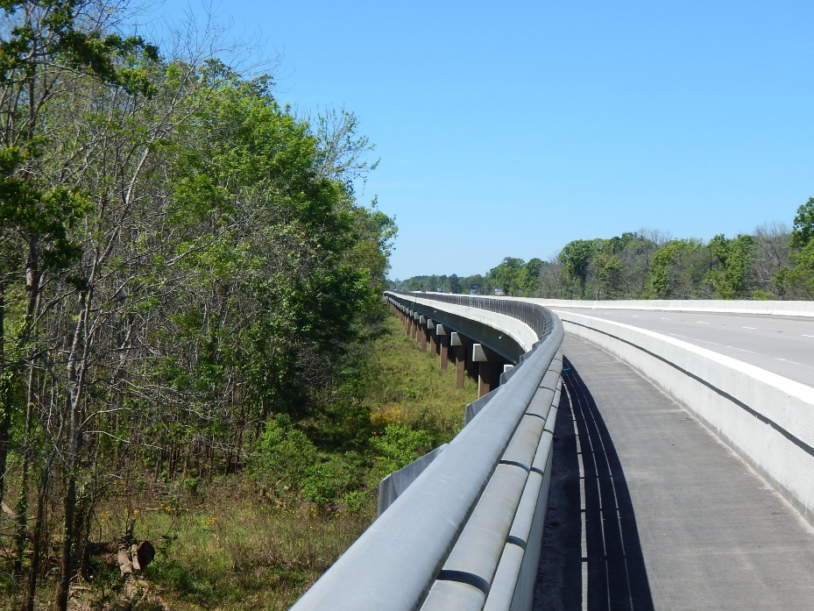
Alternative A: Existing Route
Apalachicola River/SR 20
Apalachicola River/SR 20
32

Slide 34
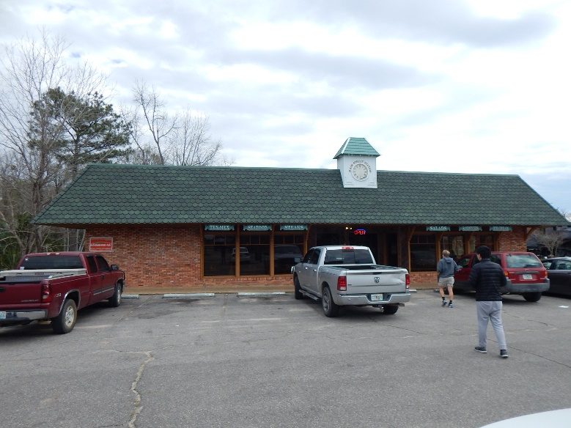
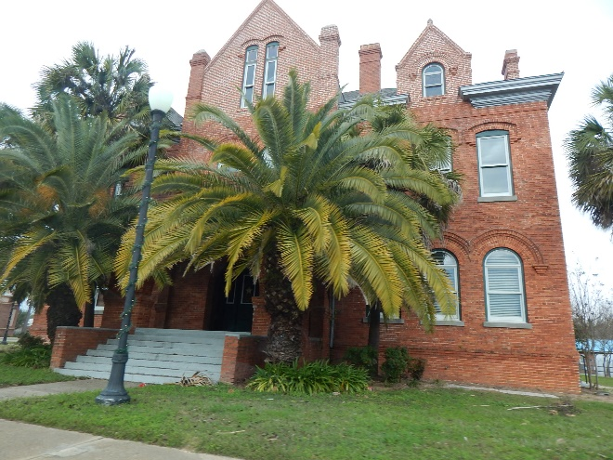
Alternative A: Existing Route
Blountstown
Blountstown
33
Notes:
Current Road Walk – Current, Non-Certifiable
Land Use:Corporate, Family Owned
43.4 Miles
42.79 FDOT
Pro: 20 mile Coordior, existng
Con: No significant exposure to nature, sig. Public holdings

Slide 35
Alternative A: Existing Route
Mileage Summary
Total Route Mileage | 43.30
Public Land | 43.30
Private Land | 0
FDOT Right of Way | 42.70
Location Criteria Summary
Must
Meet Laws, Regulations & Higher Order Plans | Yes
Meet Objectives of P.L. 90-543 National Scenic Trails Act | No
Wants
Unique Natural and Cultural Environments | 4
Broad Range of Recreation Opportunities | 2
Functionality | 3
Resource and Private Land Impacts | 6
Minimize Costs | 8
Total Points | 23
34

Slide 36
Optimal Decision
Location Criteria "Wants" | Weight | Alternative A: Existing Route
Unique Physical and Cultural Environments: 10 Total Points Natural Communities: 6 Points Biodiversity: 2 Points (# of Natural Communities Crossed) Altered Landscape: 4 Points (# of miles of altered landscape) Cultural Environment: 4 Points Historic & Cultural Sites: 2 Points (Prominence of Historical and Cultural Sites) Trail Towns: 2 Points (# of Potential Trail Communities) | 10 | Biodiversity: 1 Point - There is 1 unique natural community crossed. Altered Landscape: 1 Point - There is 28.3 miles of altered landscape. Historic & Cultural Sites: 1 Point -There are 2 sites with historical or cultural significance. Trail Towns: 1 Points -Bristol , Blountstown, and Altha are 3 towns that could function as trail towns. 4/40
Resource and Private Land Impact: 10 Total Points Number of Land Owners Impacted: 5 Points (# of Land Owners) Public Conservation Land: 5 Points (# of acres) | 8 | Recreation Opportunities: 1 Point Recreational opportunities consist of swimming, paddling, or fishing the various waterways along the route. Potential for Camping: 0 Points There are no registered camping grounds. There is a primitive campsite near the Chipola River WMA. Spur Trail Opportunities: 1 Point There is 1 spur trail opportunity with the Garden of Eden Trail north of Bristol. 2/16
Functionality: 10 Total Points Safety: 6 Points Amount of Roadwalk: 4 Points Speed on Roadwalks: 2 Points Obstacles: 4 Points | 7 | Amount of Roadwalk: 1 Point There is over 35 miles of road walk, which is a significant portion of the route. Speed on Roadwalks: 0 Points The speed limit ranges from 55 mph along the State Roads to 30 mph along the County Roads. Obstacles: 2 Points The major obstacle on this route is the US 231 crossing.
35

Slide 37
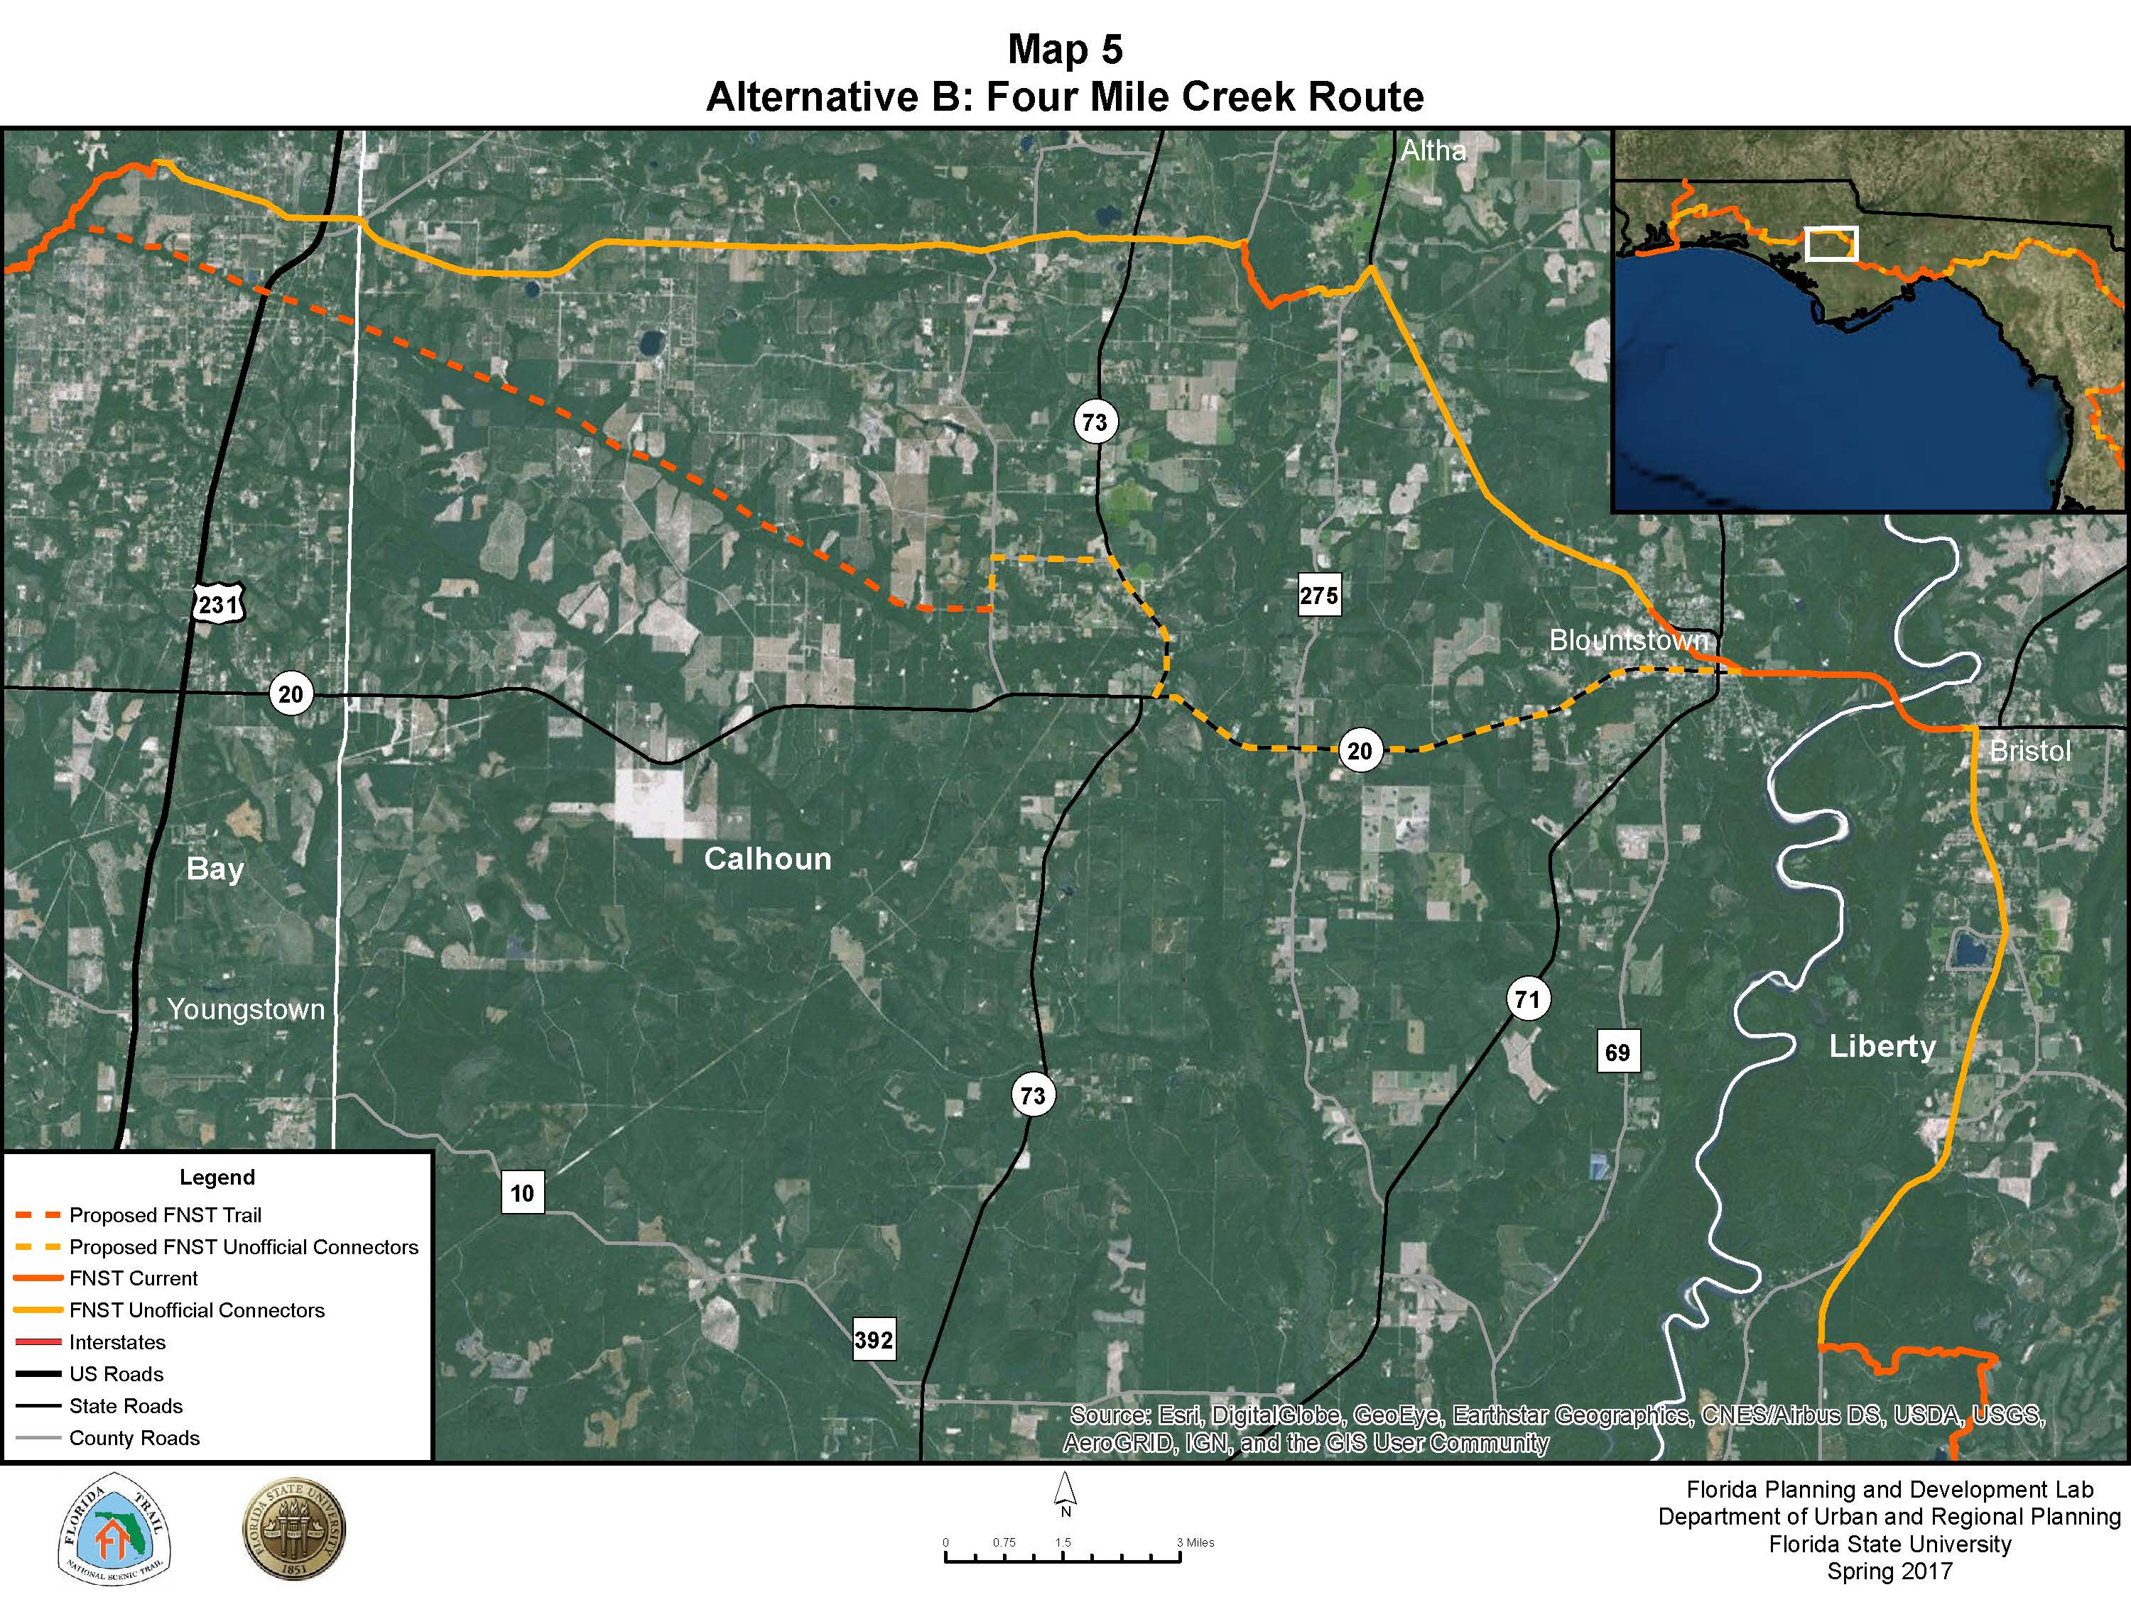
36

Slide 38
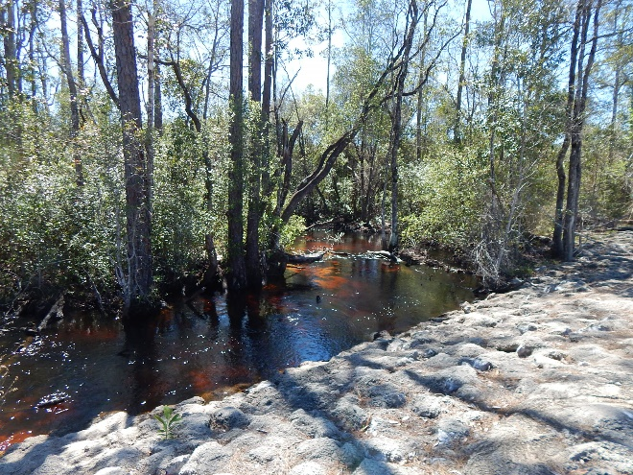
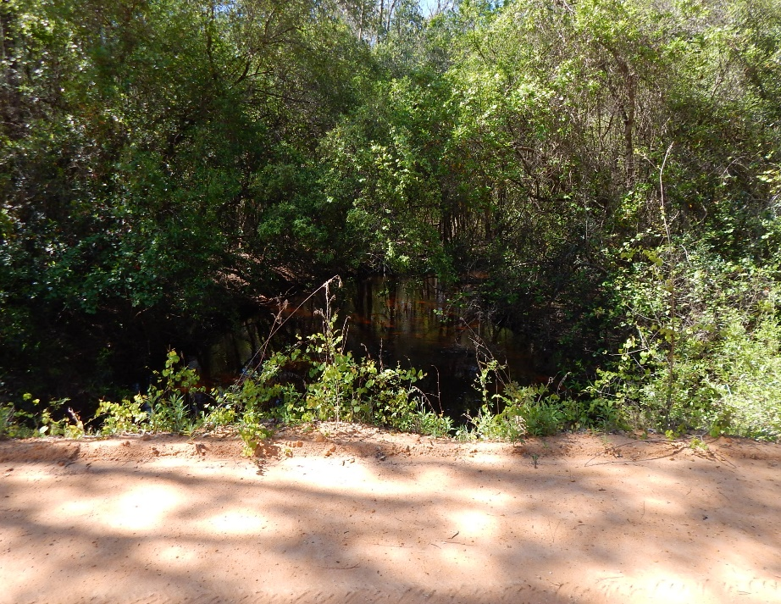
Alternative B: Four Mile Creek
Four Mile Creek
Four Mile Creek
37
Notes:
Land Use: Private Property:
29 Landowners
33 Parcels
37.6 Miles –17.67 Private
Pros: Within 20 mile Cooridor, Natural Exposure
Cons: No campgrounds, Landowner Issues

Slide 39
Alternative B: Four Mile Creek
Mileage Summary
Total Route Mileage | 37.57
Public Land | 19.90
Private Land | 17.67
FDOT Right of Way | 19.90
Location Criteria Summary
Must
Meet Laws, Regulations & Higher Order Plans | Yes
Meet Objectives of P.L. 90-543 National Scenic Trails Act | Yes
Wants
Unique Natural and Cultural Environments | 5
Broad Range of Recreation Opportunities | 2
Functionality | 6
Resource and Private Land Impacts | 0
Minimize Costs | 5
Total Points | 18
38

Slide 40
Optimal Decision
Location Criteria "Wants" | Weight | Alternative: B Four-mile Creek Route
Functionality: 10 Total Points Safety: 6 Points Amount of Roadwalk: 4 Points Speed on Roadwalks: 2 Points Obstacles: 4 Points | 7 | Amount of Roadwalk: 3 Points - There is 15.4 miles of roadwalk, which is less than half the distance of the route. Speed on Roadwalks: 1 Point - The speed limits along the State Roads are 55 mph. The speeds along the county roads are around 30 mph. Obstacles: 2 Points - The only obstacle on this route is the lack of a pedestrian crossing at US231. 6/42
Resource and Private Land Impact: 10 Total Points Number of Land Owners Impacted: 5 Points Public Conservation Land: 5 Points | 5 | Number of Landowners Impacted: 0 Points – Land acquisition will affect 29 landowners. Public Conservation Land: 0 Point - There is no public conservation land near this route. This region is primarily composed of privately owned parcels. 0/0
Minimize Costs: 10 Total Points Trail Miles: 4 Points Total Land Acquisition Needs: 4 Points Major Infrastructure Costs: 2 Points | 5 | Trail Miles: 3 Points -The total mileage is 37.60 miles with 15.04 miles of road walk and 17.67 miles of footpath. Total Land Acquisition Needs: 0 Points - Thirty-seven different parcels with 29 different landowners would have to be acquired for this route. 17.60 miles of land acquisition would be required. Major Infrastructure Costs: 2 points - There are no significant infrastructure changes need along this route. 5/25
39

Slide 41
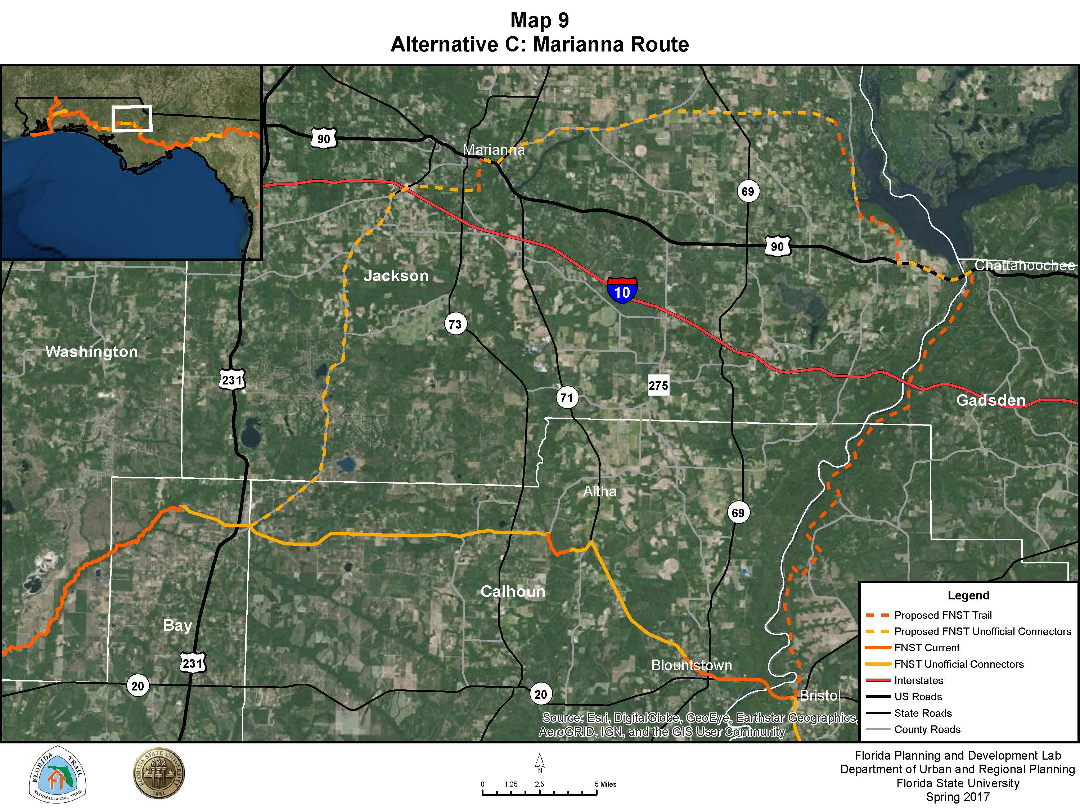
40

Slide 42
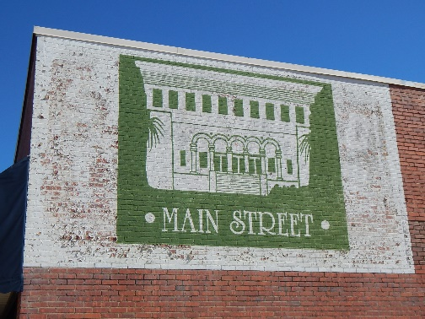
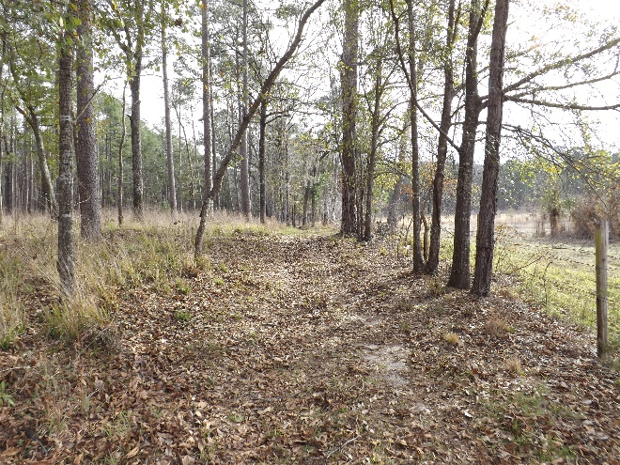
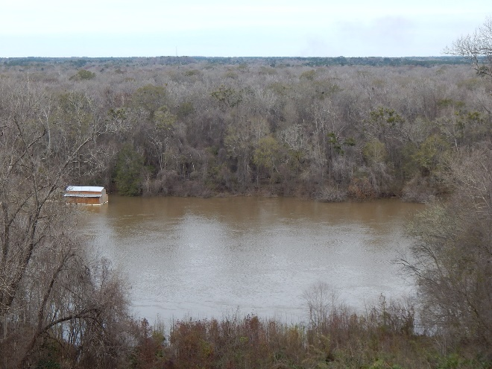
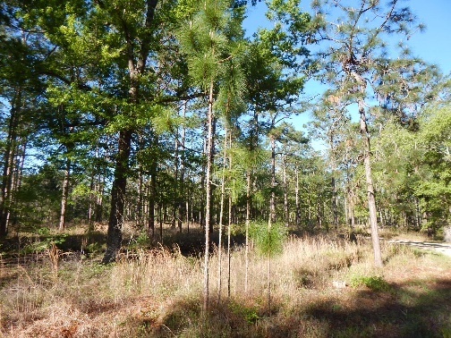
Alternative C: Marianna
Main Street Marianna
Three Rivers State Park
View from Torreya State Park
Longleaf Pine in AWMA
41
Notes:
Land Use: ST- No Private Property
66,720.8 acres of Public Holdings
Adjacent Land Use: Prodominately Timberlands
LT- 8 Property Owners, 21 parcels
1 small land owner
74.60 Miles --- roughly half road walk
Pros: Most Public Land/Exposure to Nature, Rec Opportunities, Connectivity
Cons: Outside Coordidor, Time Aspect

Slide 43
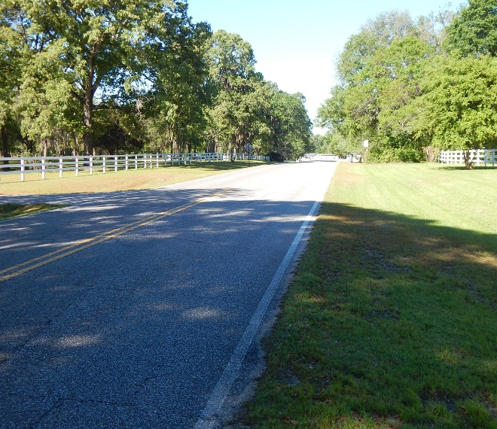
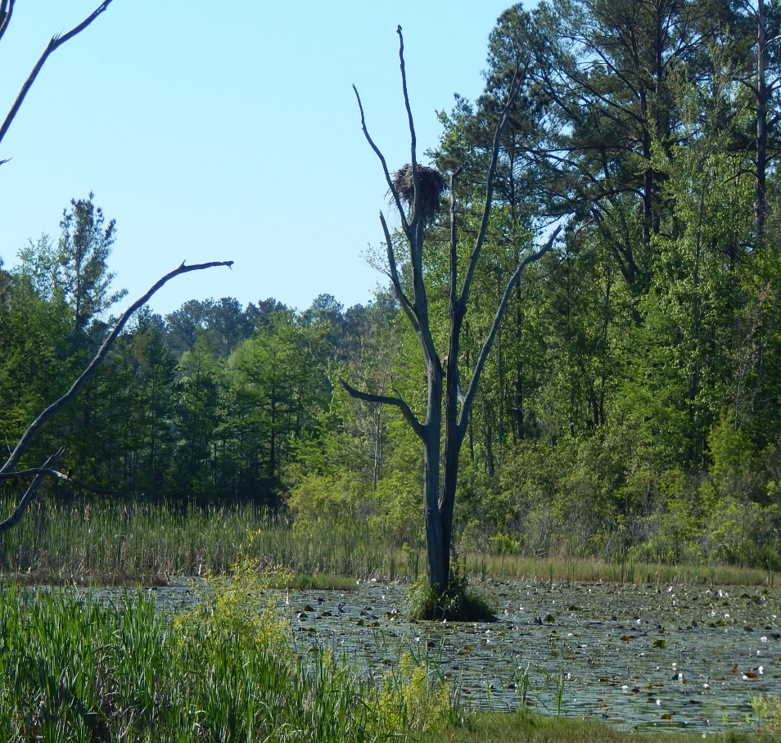
Alternative C: Marianna
Section of Butler Road
View in AWMA
42
Notes:
Land Use: ST- No Private Property
66,720.8 acres of Public Holdings
Adjacent Land Use: Prodominately Timberlands
LT- 8 Property Owners, 21 parcels
1 small land owner
74.60 Miles --- roughly half road walk
Pros: Most Public Land/Exposure to Nature, Rec Opportunities, Connectivity
Cons: Outside Coordidor, Time Aspect

Slide 44
Alternative C: Marianna
Mileage Summary
Total Route Mileage | 76.65
Public Land | 76.65
Private Land | 00.00
FDOT Right of Way | 45.97
Location Criteria Summary
Must
Meet Laws, Regulations & Higher Order Plans | Yes
Meet Objectives of P.L. 90-543 National Scenic Trails Act | Yes
Wants
Unique Natural and Cultural Environments | 7
Broad Range of Recreation Opportunities | 10
Functionality | 2
Resource and Private Land Impacts | 10
Minimize Costs | 5
Total Points | 34
40

Slide 45
Optimal Decision
Location Criteria "Wants" | Weight | Alternative C: Marianna Northern Route
Broad Range of Recreation Interests: 10 Total Points Recreation Opportunities: 4 Points Potential for camping: 3 Points Spur Trail Opportunities: 3 Points | 8 | Recreation Opportunities: 4 Points - There are 7 or more recreational opportunities including wildlife viewing, paddling, and swimming. Potential for Camping: 3 Points - Primitive camp site established, privately owned sites near Marianna, easily implementable sites on public land. Spur Trail Opportunities: 3 Points -There are numerous spur trail opportunities in the state parks as well as the Marianna Caverns State Park. 10/80
Functionality: 10 Total Points Safety: 6 Points Amount of Roadwalk: 4 Points Speed on Roadwalks: 2 Points Obstacles: 4 Points | 7 | Amount of Roadwalk: 0 Points - There is 49.41 miles of roadwalk. Speed on Roadwalks: 0 Points - 34 miles of roadwalk speeds above 40 mph Obstacles: 2 Points - There are no major obstacles along the route. 2/14
Resource and Private Land Impact: 10 Total Points Number of Land Owners Impacted: 5 Points Public Conservation Land: 5 Points | 5 | Number of Landowners Impacted: 5 Points - There are no private landowners impacted. Public Conservation Land: 5 Points - Utilizes roughly 66k acres of public lands. 10/50
Minimize Costs: 10 Total Points Trail Miles: 4 Points Total Land Acquisition Needs: 4 Points Major Infrastructure Costs: 2 Points | 5 | Trail Miles: 0 Points – Total trail length is 76.65 miles. Total Land Acquisition Needs: 4 Points - No land acquisition needed. Major Infrastructure Costs: 1 Point - The US 90 bridge over the Apalachicola River is unsafe for pedestrians and would need to be altered to be certifiable for the FNST. 5/25
44

Slide 46
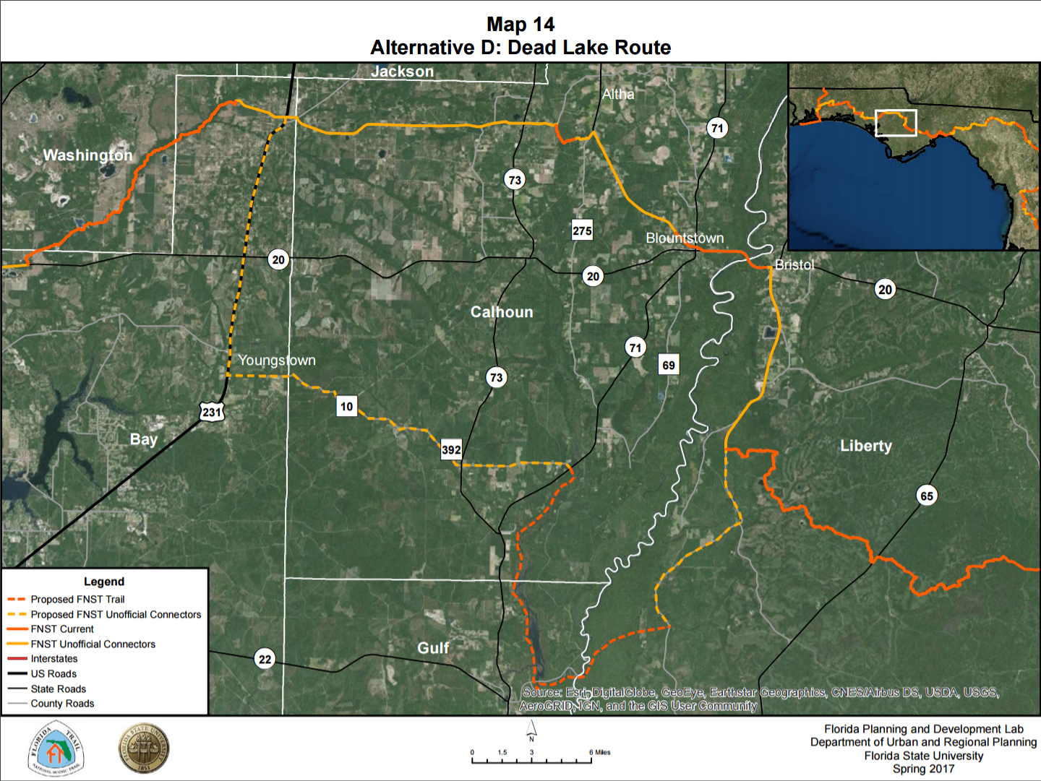
45

Slide 47
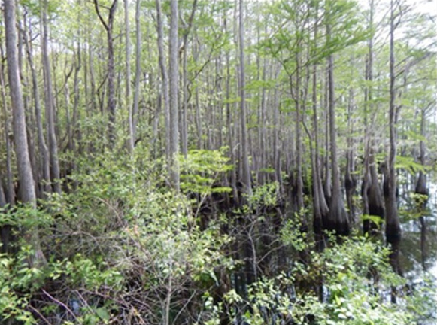
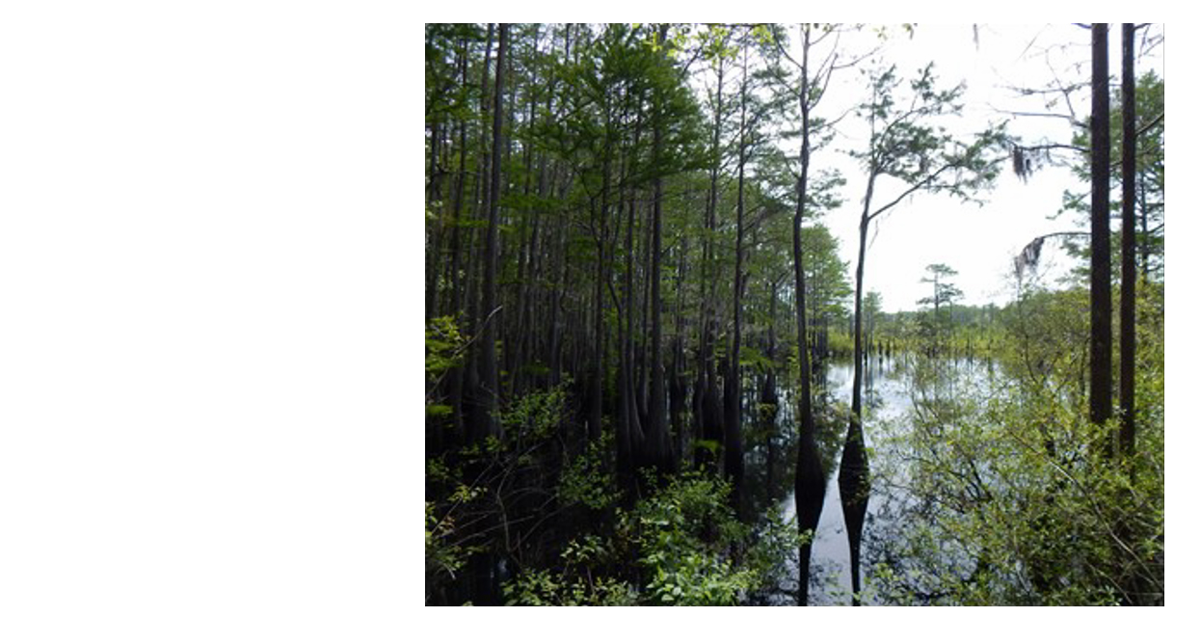
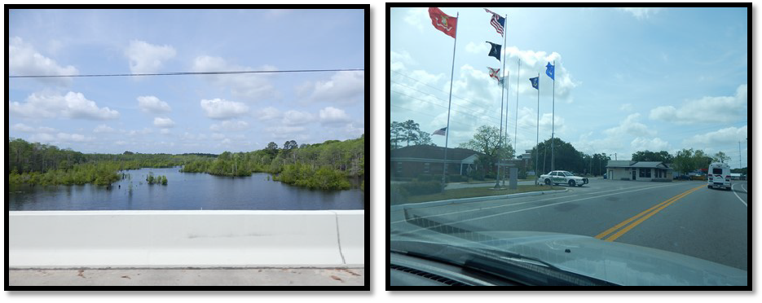
Alternative D: Dead Lake
Dead Lakes
Apalachicola River
Dead Lakes
46

Slide 48
Alternative D: Dead Lake
Mileage Summary
Total Route Mileage | 63.70
Public Land | 18.50
Private Land | 0
FDOT Right of Way | 45.20
Location Criteria Summary
Must
Meet Laws, Regulations & Higher Order Plans | No
Meet Objectives of P.L. 90-543 National Scenic Trails Act | No
Wants
Unique Natural and Cultural Environments | 6
Broad Range of Recreation Opportunities | 5
Functionality | 0
Resource and Private Land Impacts | 7
Minimize Costs | 5
Total Points | 23
47

Slide 49
Optimal Decision
Location Criteria "Wants" | Weight | Alternative D: Gulf County Southern Route
Broad Range of Recreation Interests: 10 Total Points Recreation Opportunities: 4 Points Potential for camping: 3 Points Spur Trail Opportunities: 3 Points | 10 | Biodiversity: 1 Point - There are 3 natural communities crossed. Altered Landscape: 2 Points - There is 23.2 miles of altered landscape, primarily along road walks. Historic & Cultural Sites: 1 Point - Fountain and Youngstown feature Native American historical and cultural sites. Trail Towns: 2 Points - Youngstown, Fountain, and Wewahitchka could function as trail towns. 6/60
Broad Range of Recreation Interests: 10 Total Points Recreation Opportunities : 4 Points Potential for camping : 3 Points Spur Trail Opportunities: 3 Points | 8 | Recreation Opportunities: 3 Points - Floating , fishing, boating, occasionally swimming, and sightseeing are five recreational opportunities along the route. Potential for Camping: 2 Points - Pine Lakes and Dead Lakes are two potential camping sites. Spur Trail Opportunities: 0 Points - There are no spur trail opportunities. 5/40
Functionality: 10 Total Points Safety: 6 Points Amount of Roadwalk: 4 Points Speed on Roadwalks: 2 Points Obstacles: 4 Points | 7 | Amount of Roadwalk: 0 Points - There is 45.2 miles of roadwalk. Speed on Roadwalks: 0 Points - Speed limits over 40 mph affect 34.4 miles of roadwalk. Obstacles: 0 Points - There are two major obstacles along this route: A new pedestrian bridge would need to be built across the Apalachicola River and there is no safe pedestrian crossing US 231. 0/0
Resource and Private Land Impact: 10 Total Points Number of Land Owners Impacted: 5 Points Public Conservation Land: 5 Points | 5 | Number of Landowners Impacted: 5 Points - There are no private landowners impacted. Public Conservation Land: 2 Points-There is roughly 12,000 acres of public conservation land, primarily around the Apalachicola River WMA and the Dead Lakes Recreation Area. 7/35
Minimize Costs: 10 Total Points Trail Miles: 4 Points Total Land Acquisition Needs: 4 Points Major Infrastructure Costs: 2 Points | 5 | Trail Miles: 1 Point - The total mileage for this trail is 63.7 miles. Total Land Acquisition Needs: 4 Points - No land acquisition would be acquired. Major Infrastructure Costs: 0 Points - A roughly 700-feet bridge crossing the Apalachicola River would need to be constructed. 5/25
48

Slide 50
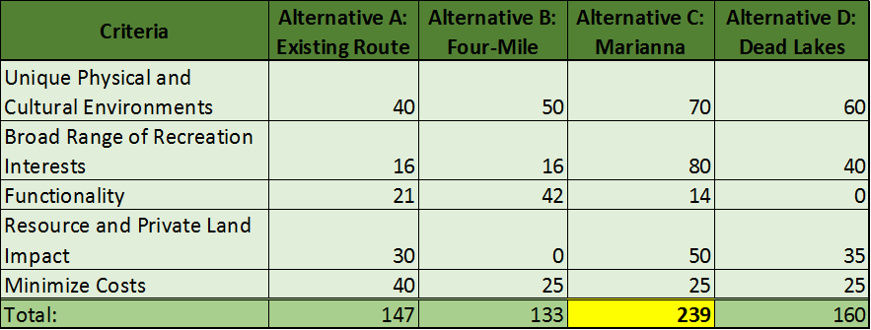
Optimal Decision
49

Slide 51
Moving Forward
Forest Service and Regional Approval
Published to the Federal Register
Approval by the U.S. Forest Service Supervisor
NEPA compliance met
Federal Action and possible approval by the U.S. Congress
Office of General Council concurrence
50

Slide 52
Moving Forward
Further develop FPDL survey if needed
Implementation of survey
  Targeted audience
51

Slide 53
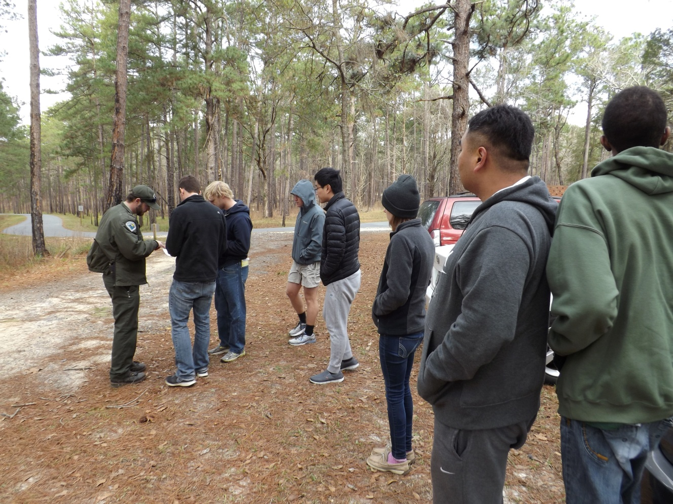
Questions & Comments
52

