Slide 1
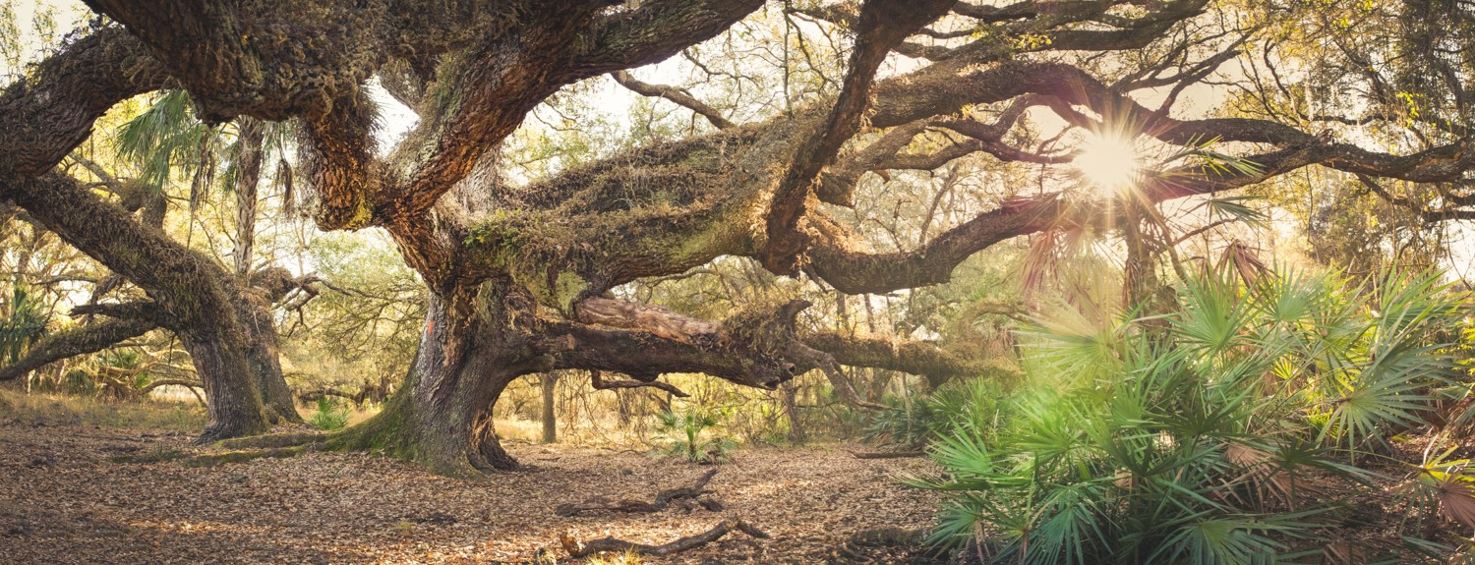

FLORIDA NATIONAL SCENIC TRAIL COALITION MEETING
19 JANUARY 2018

Slide 2

AGENDA 9:30 AM - 3:00 PM
9:30
10:15
11:30
12:30
1:00
2:15
3:00
Welcome and Introductions
Coalition Member Updates
2012 Strategic Plan Achievements and Challenges
Lunch Courtesy of the Florida Trail Association
Implementation Guide Overview:
Promote Connections & Strategic Partnerships
Complete the Trail & Sustainable Management
Meeting Wrap Up

Slide 3
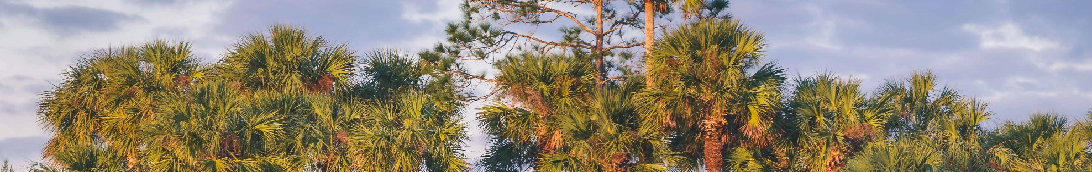
FEDERAL ADVISORY COUNCIL ACT
The 1972 Federal Advisory Committee Act (FACA) was passed to make certain that citizen involvement in federal decisions is equitable, and that no one individual or group has undue influence over government decisions.
The Florida National Scenic Trail Coalition is not a decision making body, but rather a gathering of land managers, partners and users of the FNST to seek out information regarding, and to regularly discuss, issues and needs surrounding the Florida National Scenic Trail. The Forest Service will inform members of the group by reading this statement prior to meetings and also inform new
members in writing that the agency cannot obtain the group’s consensus advice
or recommendations without triggering FACA.
Meetings are open to the public and summaries are available on-line at www.fs.usda.gov/fnst
Notes:
Obligatory?

Slide 4
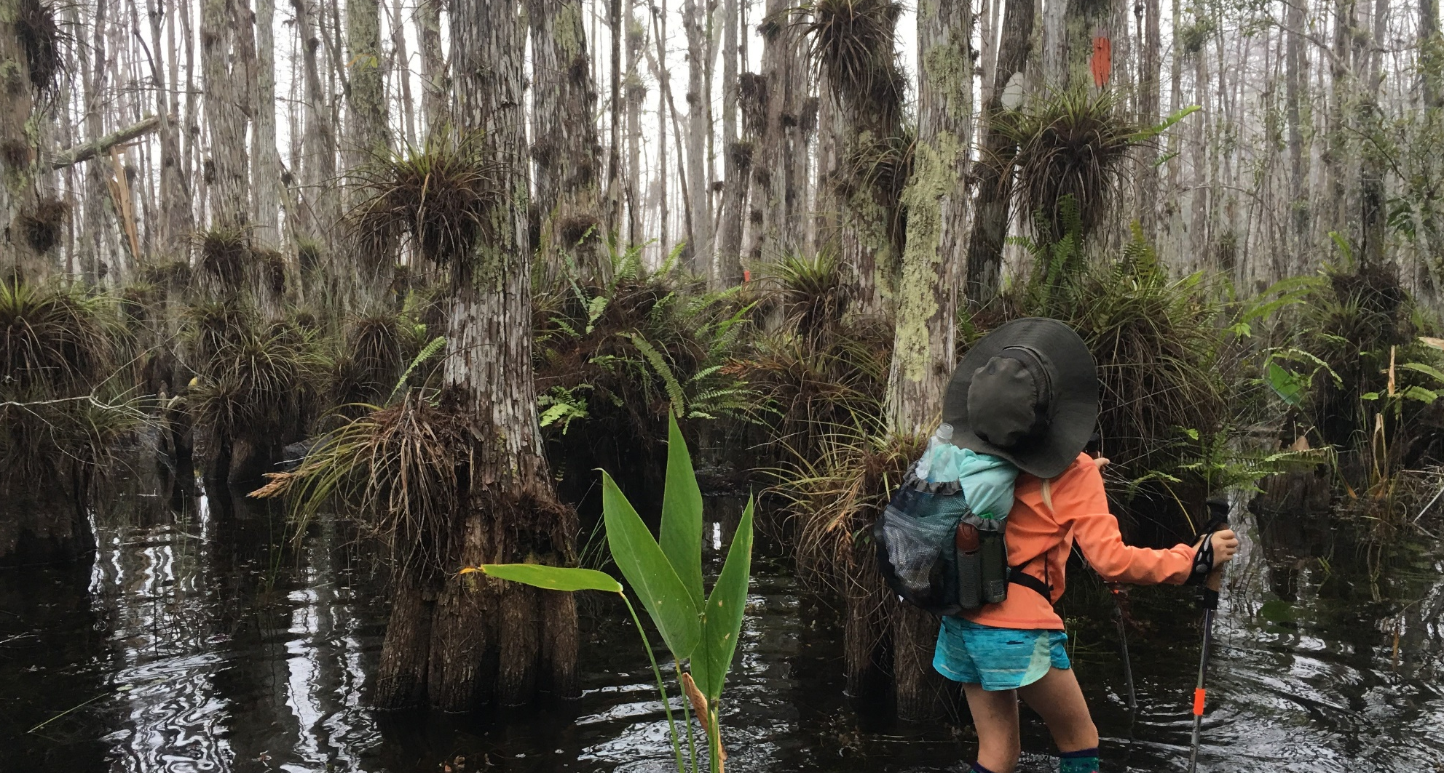
INTRODUCTIONS
Notes:
Icebreaker – introduce self and add fun fact

Slide 5
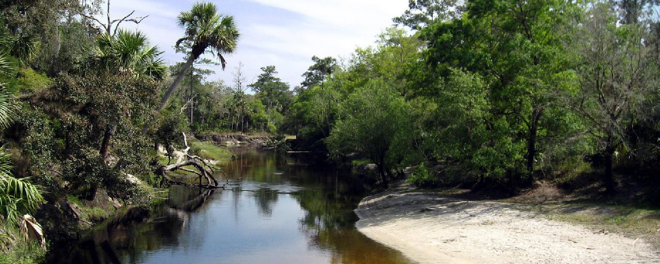
COALITION MEMBER UPDATES
ROUND ROBIN

Slide 6

15 MINUTE BREAK

Slide 7

COALITION BACKGROUND

Slide 8
PURPOSE OF THE COALITION
The FNST Coalition is dedicated to:
The development, maintenance, and promotion of the Florida Trail to ensure an optimum recreation experience.
Ensuring that the Trail is a truly public asset, accessible and enjoyed by diverse constituents.
Informing better decisions, attracting greater resources, and creating Trail advocates across the State.
Notes:
Summary of pg. 4 Role

Slide 9
ROLE OF THE COALITION
Ensure accountability to and implementation of the goals and outcomes of the FNST Strategic Plan;
Oversee adherence to trail standards for access, safety, signage, and interpretation to achieve the optimum recreation experience;
Serve as Trail advocates attracting the financial and human resources necessary for Trail development, maintenance and promotion;
Foster coordination among various interests, networks, and
stakeholders throughout the State.
Notes:
Pg. 4 roles

Slide 10
COALITION MISSION

Slide 11
MISSION STATEMENT
The Florida National Scenic Trail Coalition meets as a collaborative body to inform better decisions and attract greater resources to advance, protect and connect people to the Florida Trail.
Notes:
It’s okay if our mission has changed, typically it will.
What do the members feel the mission of the coalition is? (Jot down some notes of themes)

Slide 12
COALITION VISION

Slide 13
VISION STATEMENT
From the Emerald Coast to the Everglades, the Florida Trail is a fully-designated corridor, actively supported by a network of partners dedicated to the advancement and protection of the Trail. The Trail is widely-valued as a national treasure and used by current and future generations to connect with the outstanding scenic, natural, cultural and historic resources of Florida.

Slide 14
2012 Strategic Plan Achievements and Challenges

Slide 15
Goal 1: Complete the Trail
Add 100 new scenic and designated miles of FNST towards completion of a high quality trail.
Notes:
80 miles added

Slide 16
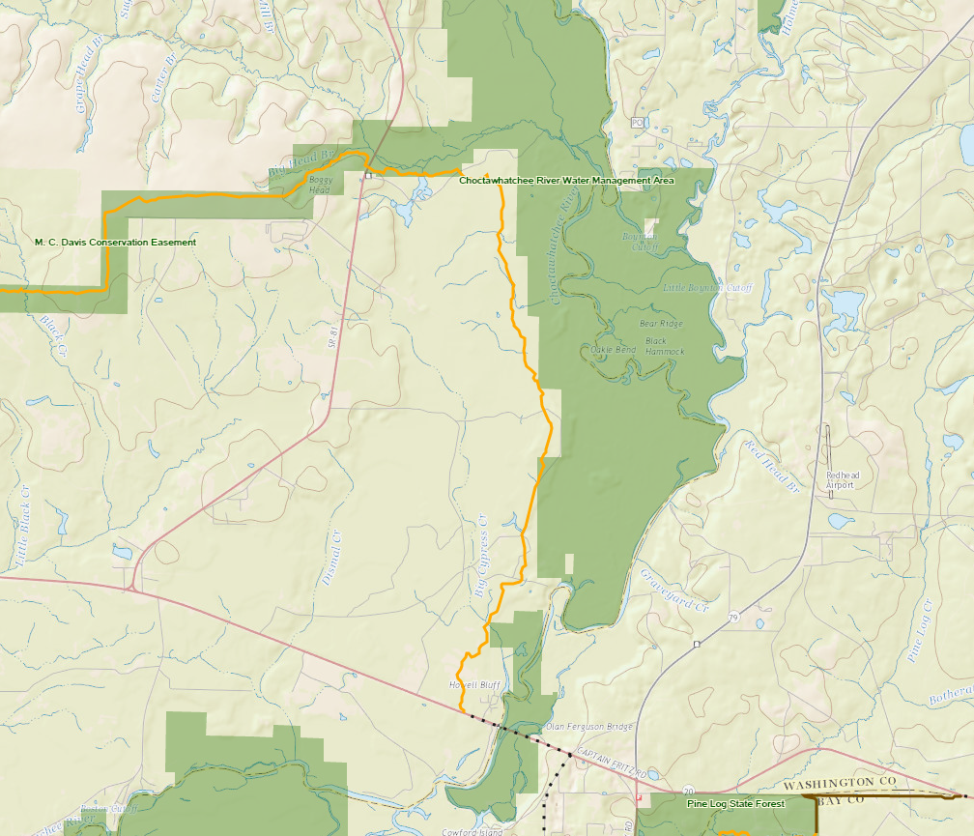
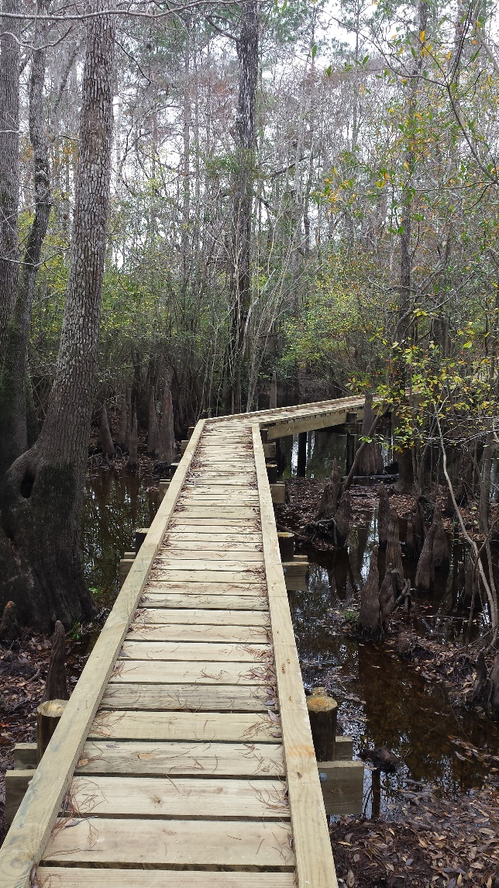
Notable Accomplishments
  In 2012, there were 982 miles of designated Trail and in 2016 there were 1,062.7 miles of dedicated Trail.
  Addition of the Choctawhatchee River Section
Developed 8.3 Miles of Scenic Trail
Removed 9.2 Miles of Road Walk
Notes:
Under past 5 year plan, added roughly 80 miles of trail.

Slide 17
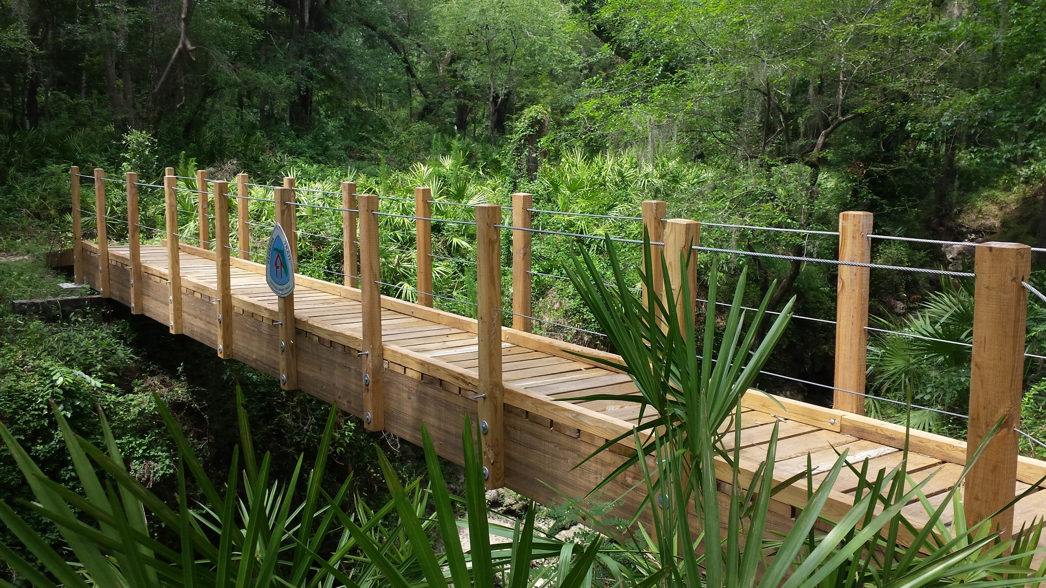
Swift Creek Bridge
Review of Infrastructure Projects

Slide 18
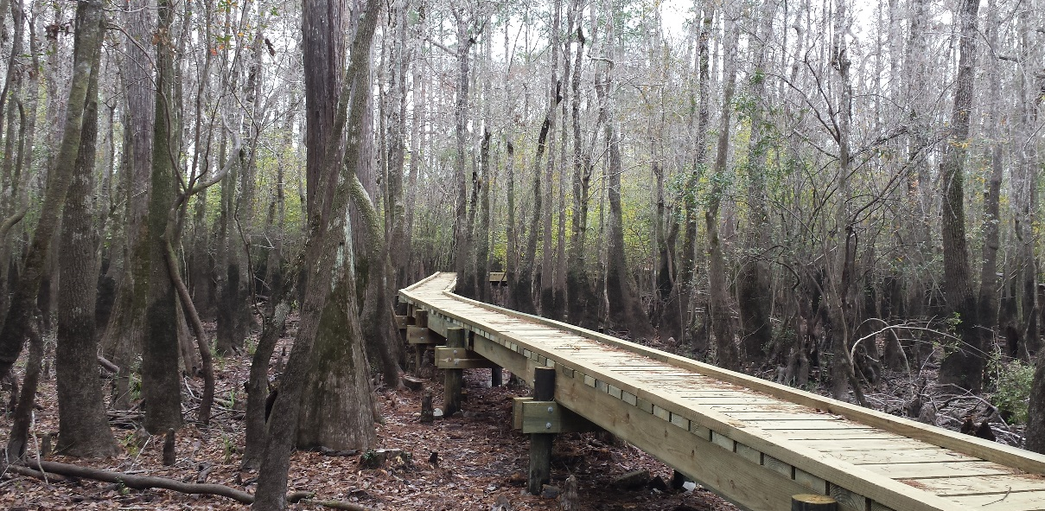
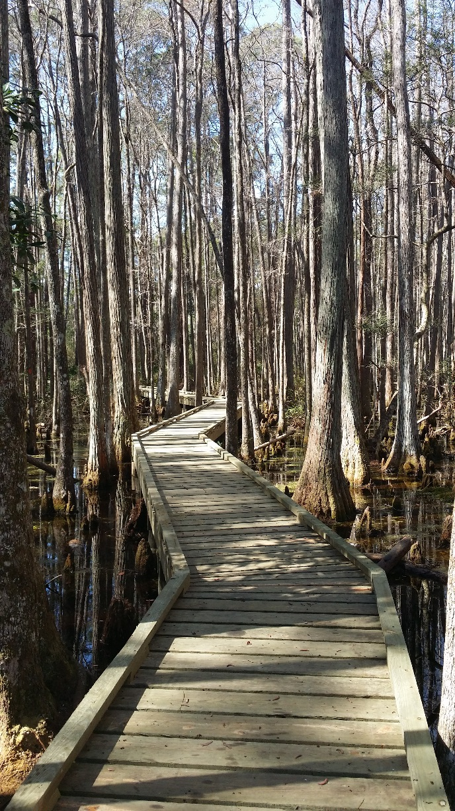
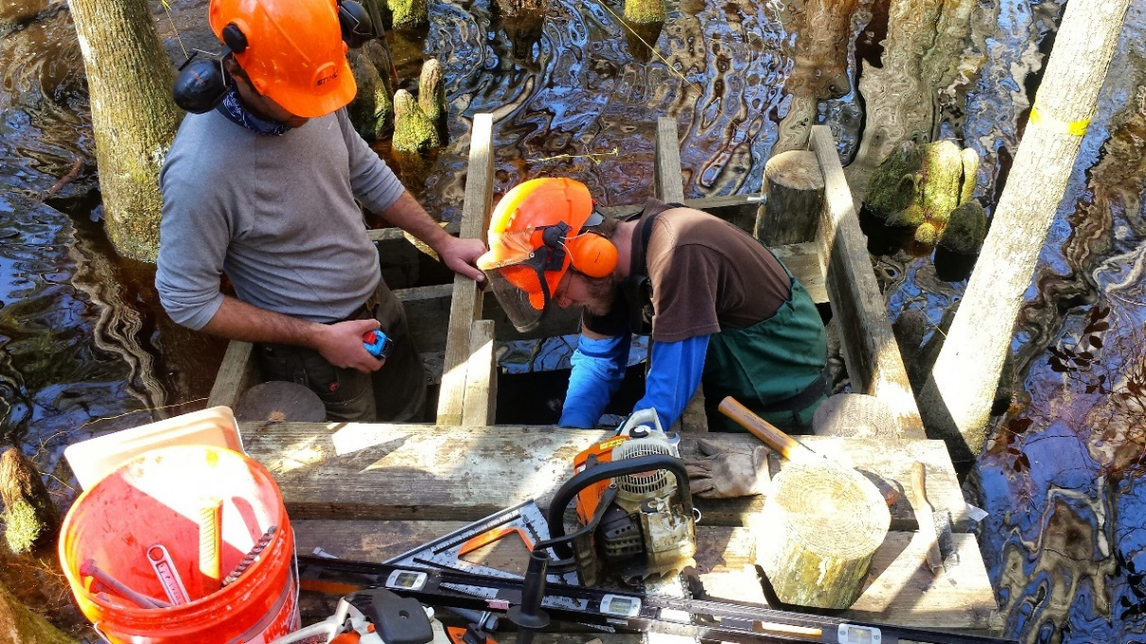
Completed Infrastructure
Cypress Creek Boardwalk
Ocean Pond Boardwalk

Slide 19
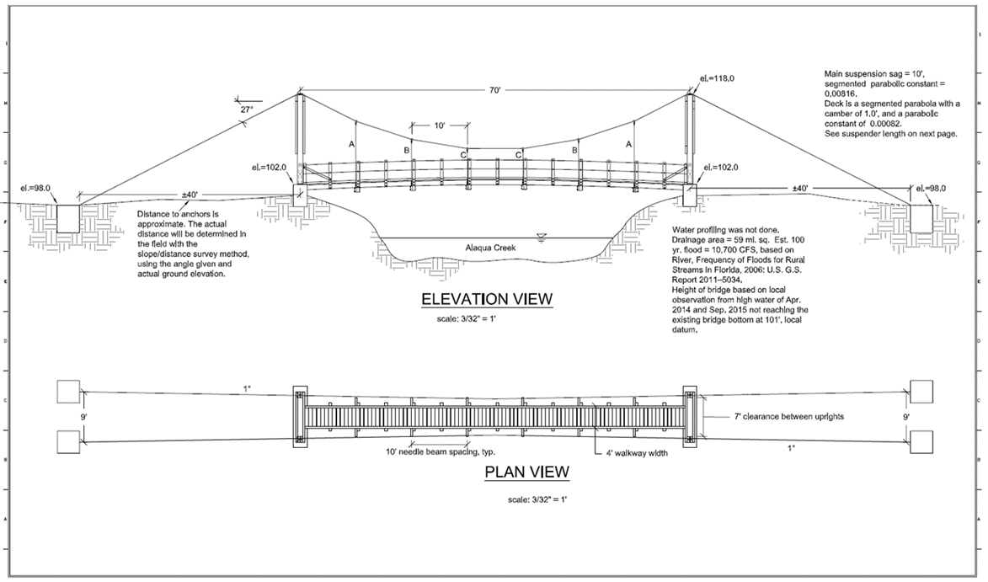
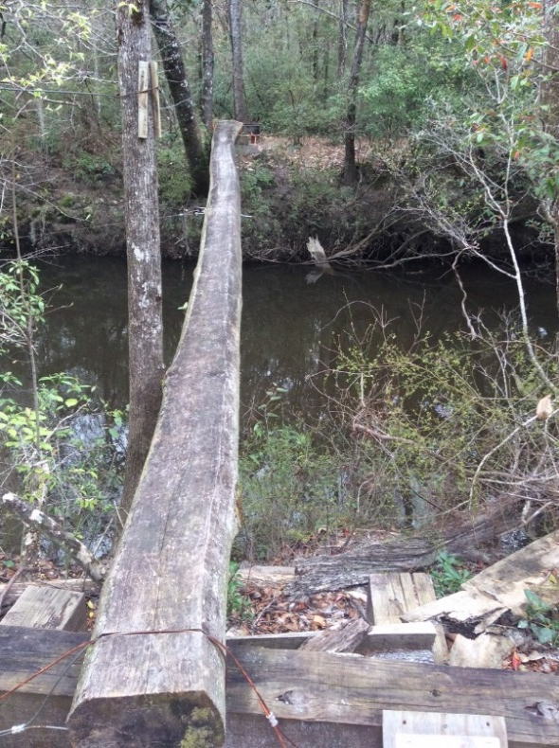
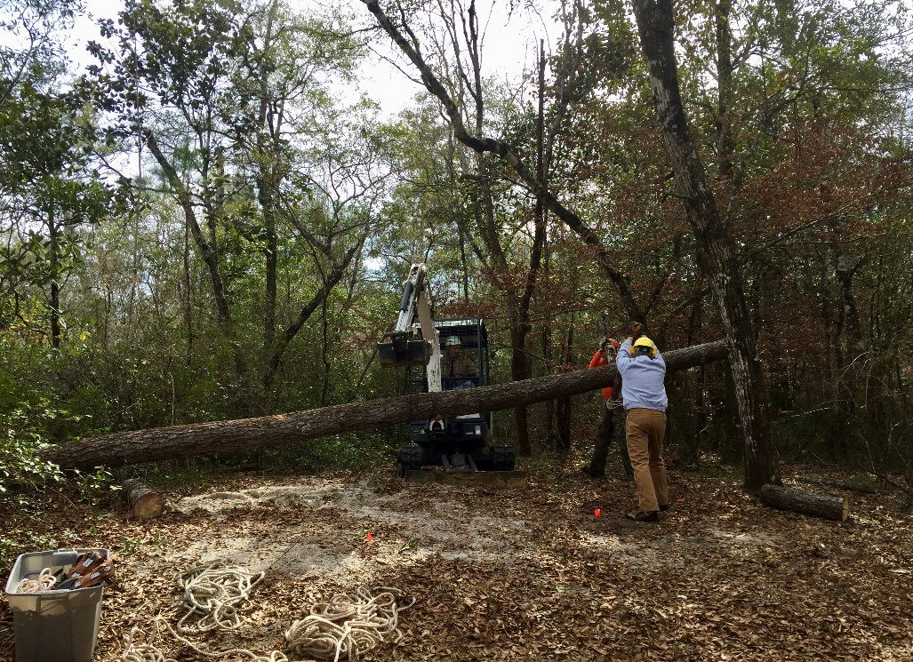
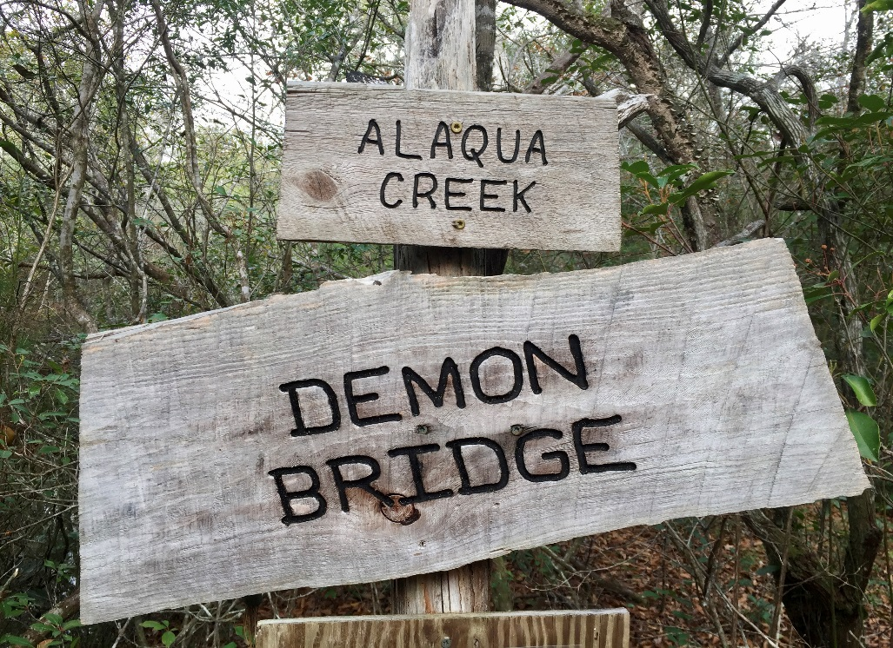
Alaqua Bridge – Eglin Air Force Base

Slide 20
Goal 2: Standards
100% of existing designated FNST meets the recreation, information, and interpretive Trail standards within its resource classification category of 1-5.

Slide 21
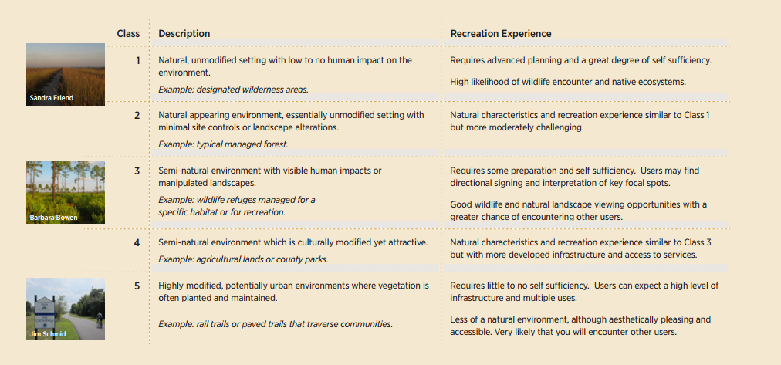
Notable accomplishments
100% Trail Classes Implemented and Maintained to Standard

Slide 22
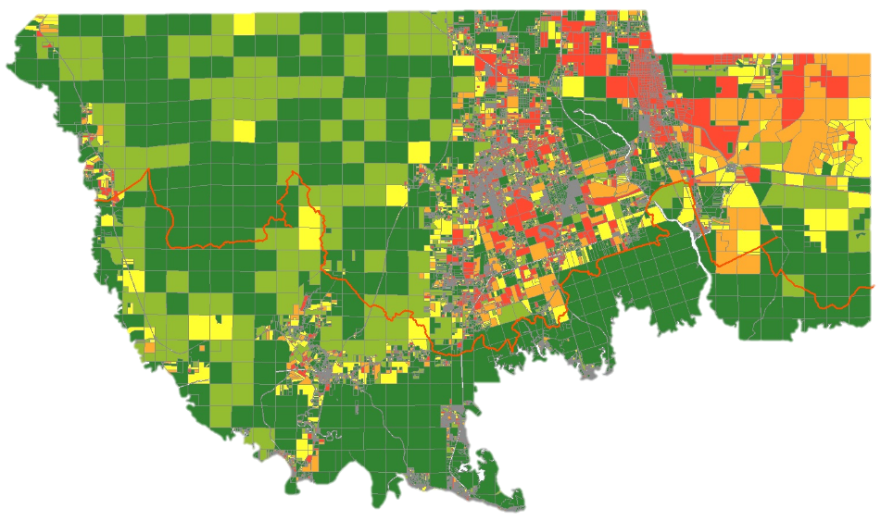
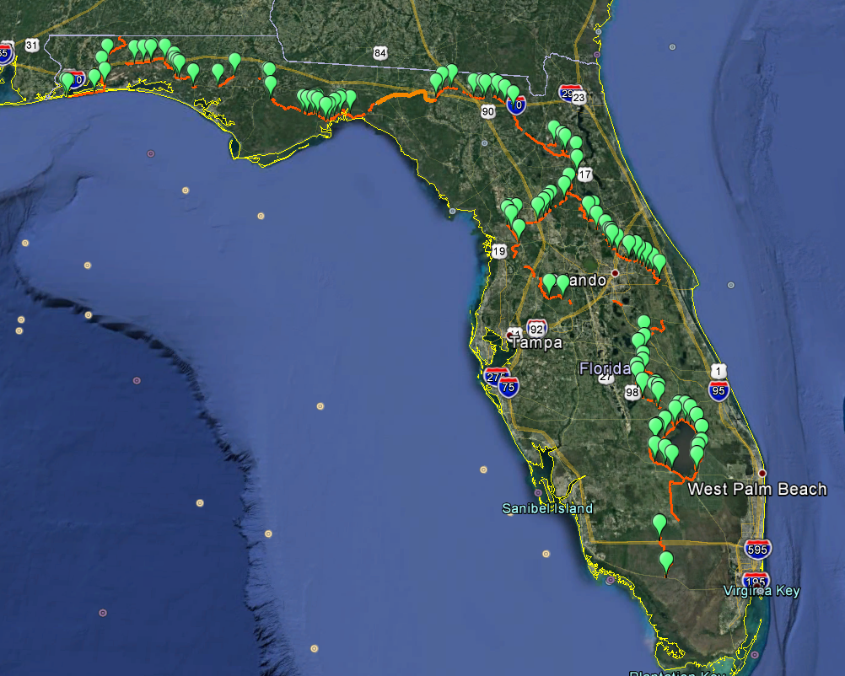
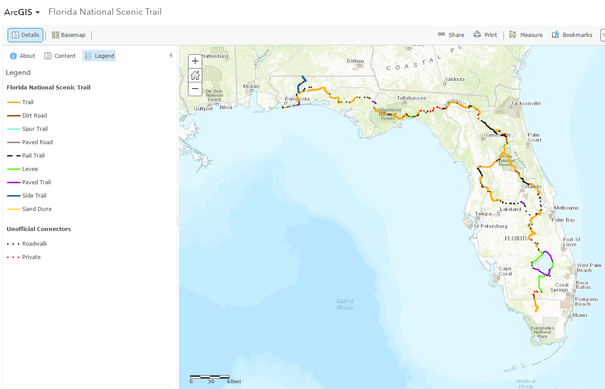
Mapping and inventories
ArcGIS Online Interface
Statewide Highway and Railroad Crossings Inventory
Trailhead and Kiosk Inventory
Notes:
Add harry’s trailhead/kiosk

Slide 23
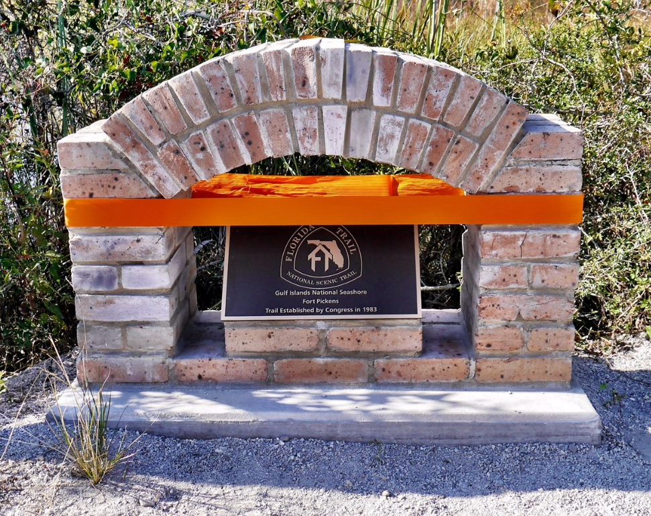
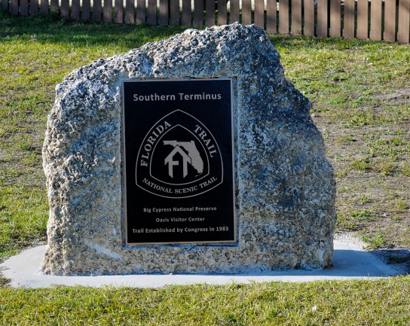
Signage and permitting
Northern and Southern Termini
Statewide Signage, Crossings and Permitting with FDOT
Developed Standard Trailhead Kiosk Information

Slide 24
Goal 3: Partnerships
  Each of the FNST land managers proactively contribute to Trail development, maintenance and promotion of their segment as part of a larger whole.

Slide 25
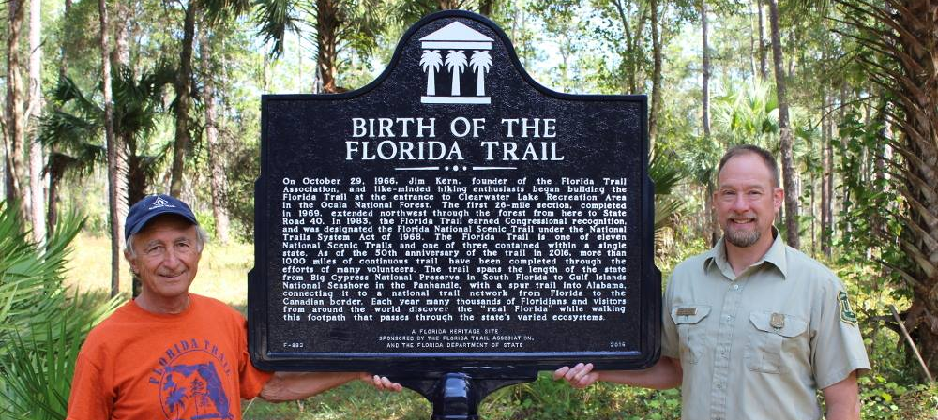
Notable accomplishments
Transition from Certification Agreements to U.S. Forest Service MOUs
Streamlined Infrastructure Review Process

Slide 26
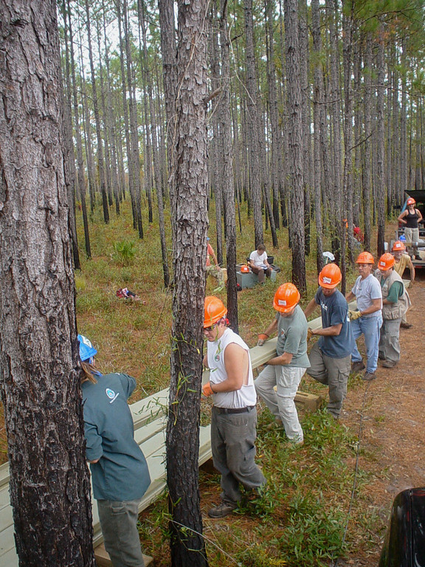
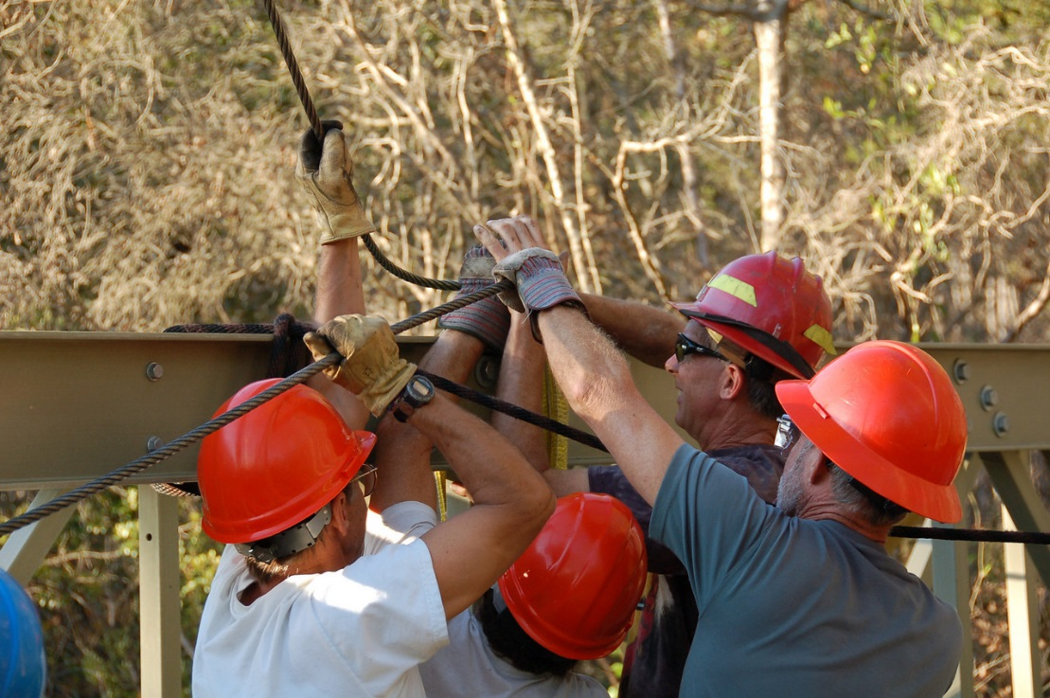
Notable accomplishments
Florida Trail Association
Framing Our Community
FNST Project Requests
AmeriCorps/Vets Work
Notes:
Picture of historic marker (Karl)

Slide 27
Goal 4: Promotion
100% of Trail recreationists know they are on the FNST, know the significance of the Trail, and know how their experience is part of the large whole.

Slide 28
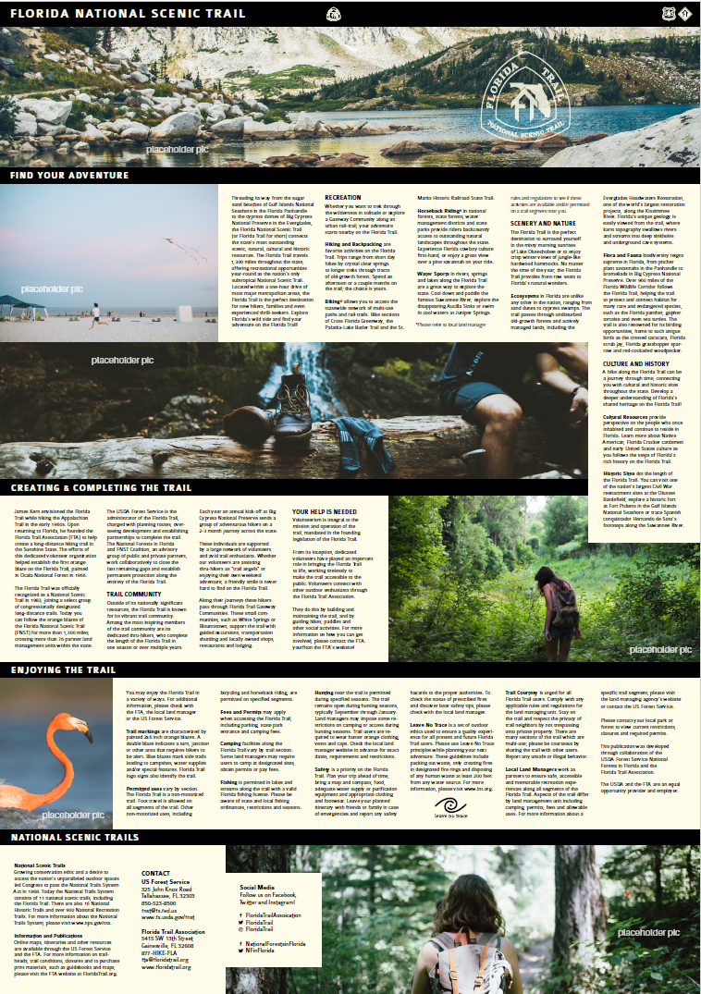
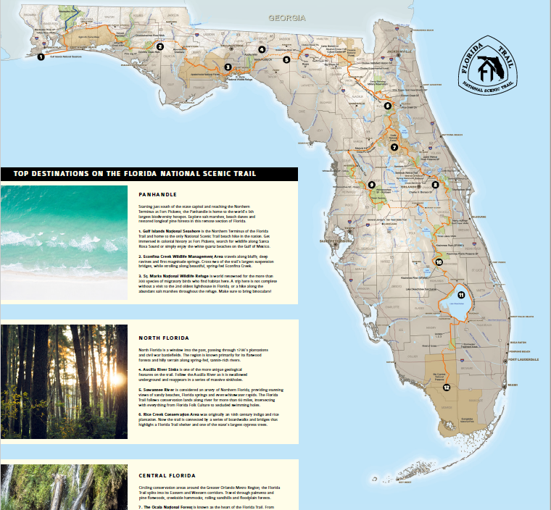
Notable accomplishments
FNST Brochure
Iconic Photographs of the FNST
Top Destinations

Slide 29
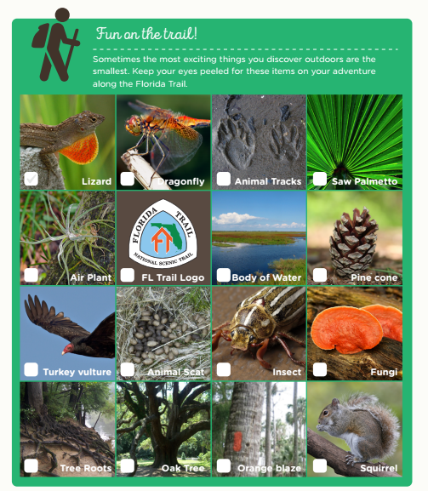
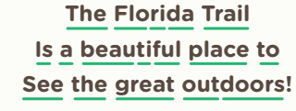
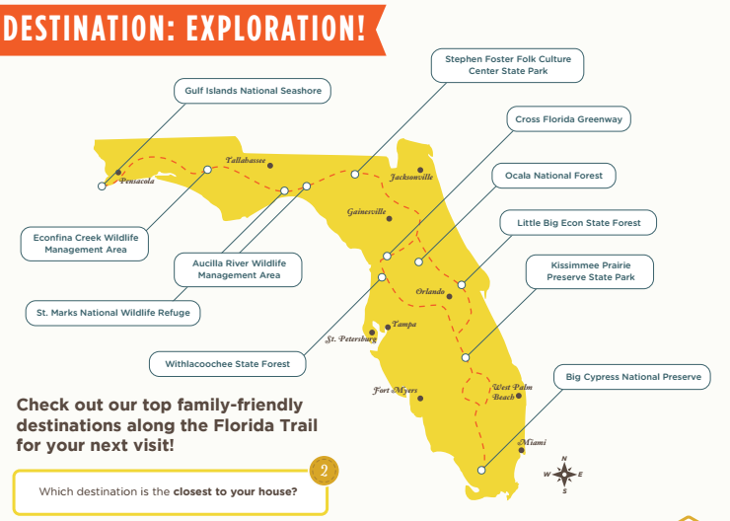
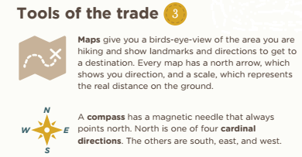
Florida Trail Junior Explorer

Slide 30
Summary of Accomplishments
32.4 Net Miles
83.4 Total Trail Miles Developed
100% of FNST Meets Trail Maintenance Standards
10% of Agreements Transitioned to USDA Forest Service Standards
60-70% Know they’re on the FNST

Slide 31
Strategy Moving Forward
2018 Strategic Plan Update and Completion of Implementation Guide
  Goal 1: Promote Connections
  Goal 2: Complete the Trail
  Goal 3: Sustainable Management
  Goal 4: Strategic Partnerships
Branding shift from ‘FNST’ to ‘Florida Trail’
Gap Updates:
  Big Bend Coastline
  Osceola/Orange County
Notes:
If time allows discuss Appendix II page 71

Slide 32
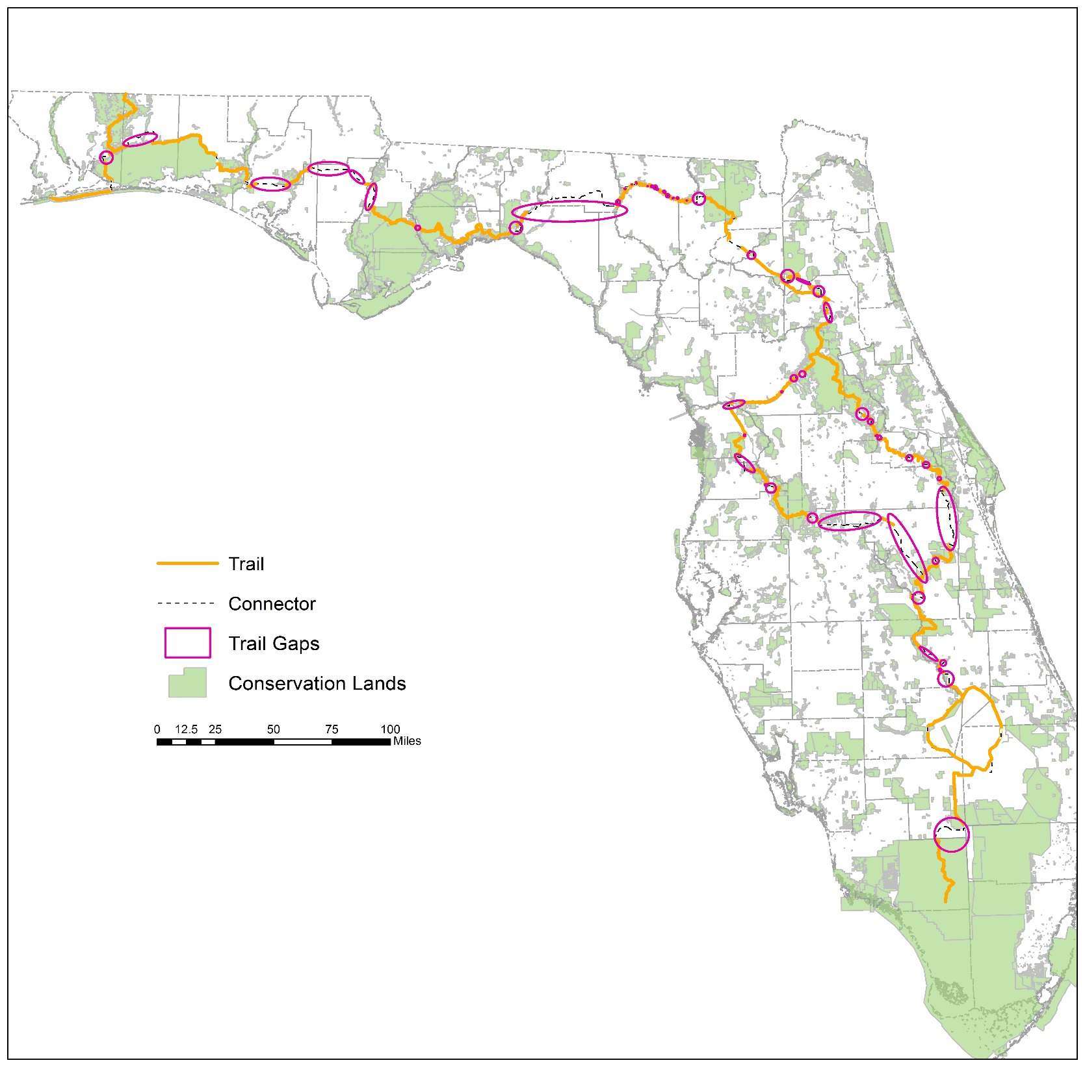
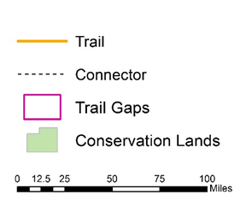
Trail Gaps on the
Florida Trail
7
Panhandle
N
26
North
  Road walk gaps are areas of trail that are on paved roadways
  There are 60 road walk gaps along the Florida Trails, which is approximately 311 miles of connector trail
  There are approximately 286 miles of gap as the crow flies
21
Central
6
South

Slide 33
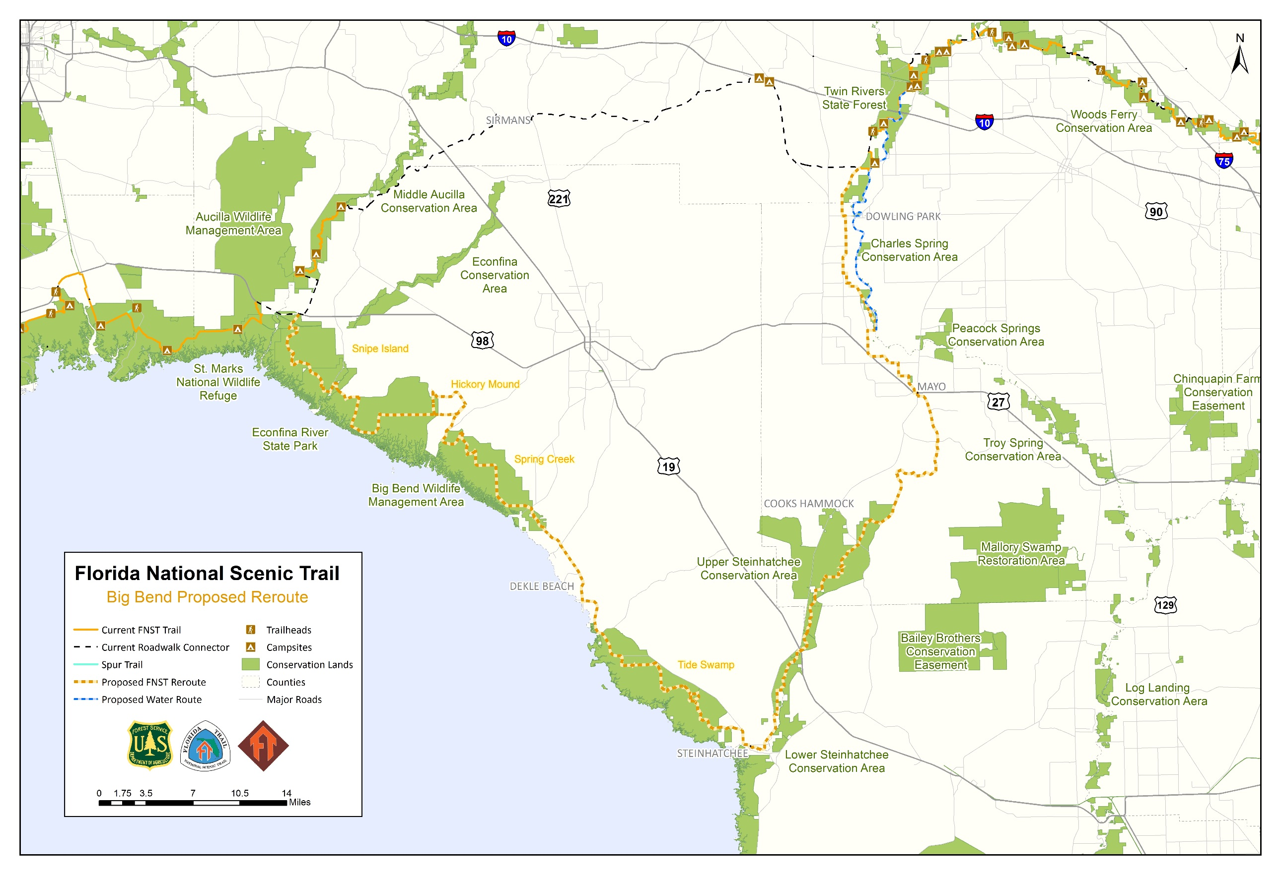
Notes:
Introduce Dale to talk about how we got to Osceola/Orange reroute

Slide 34
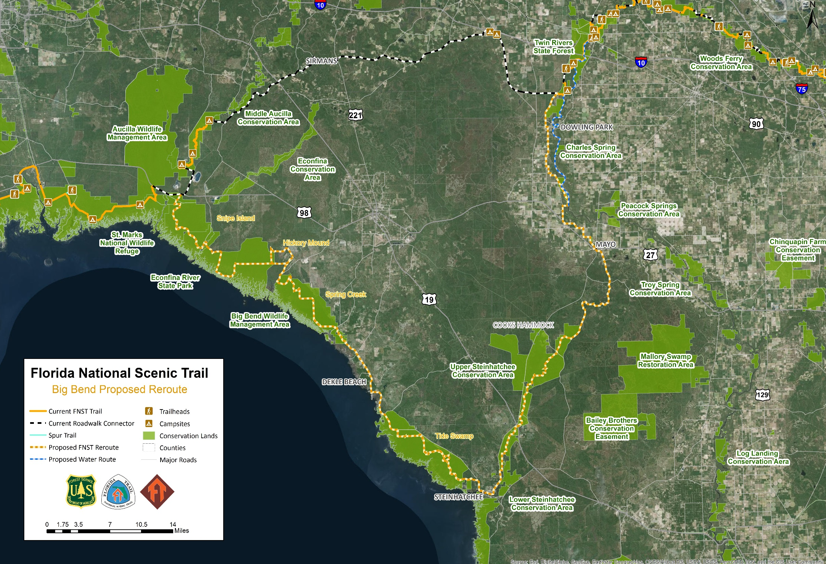

Slide 35
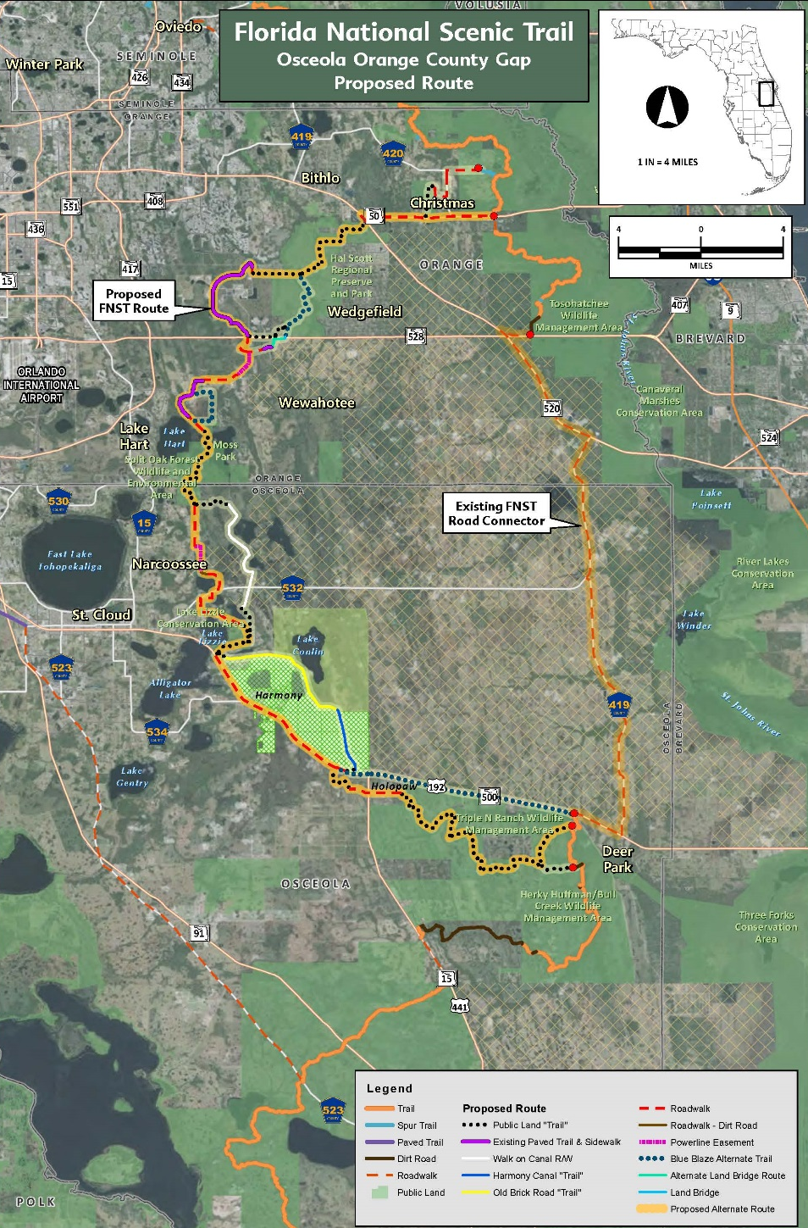




Slide 36
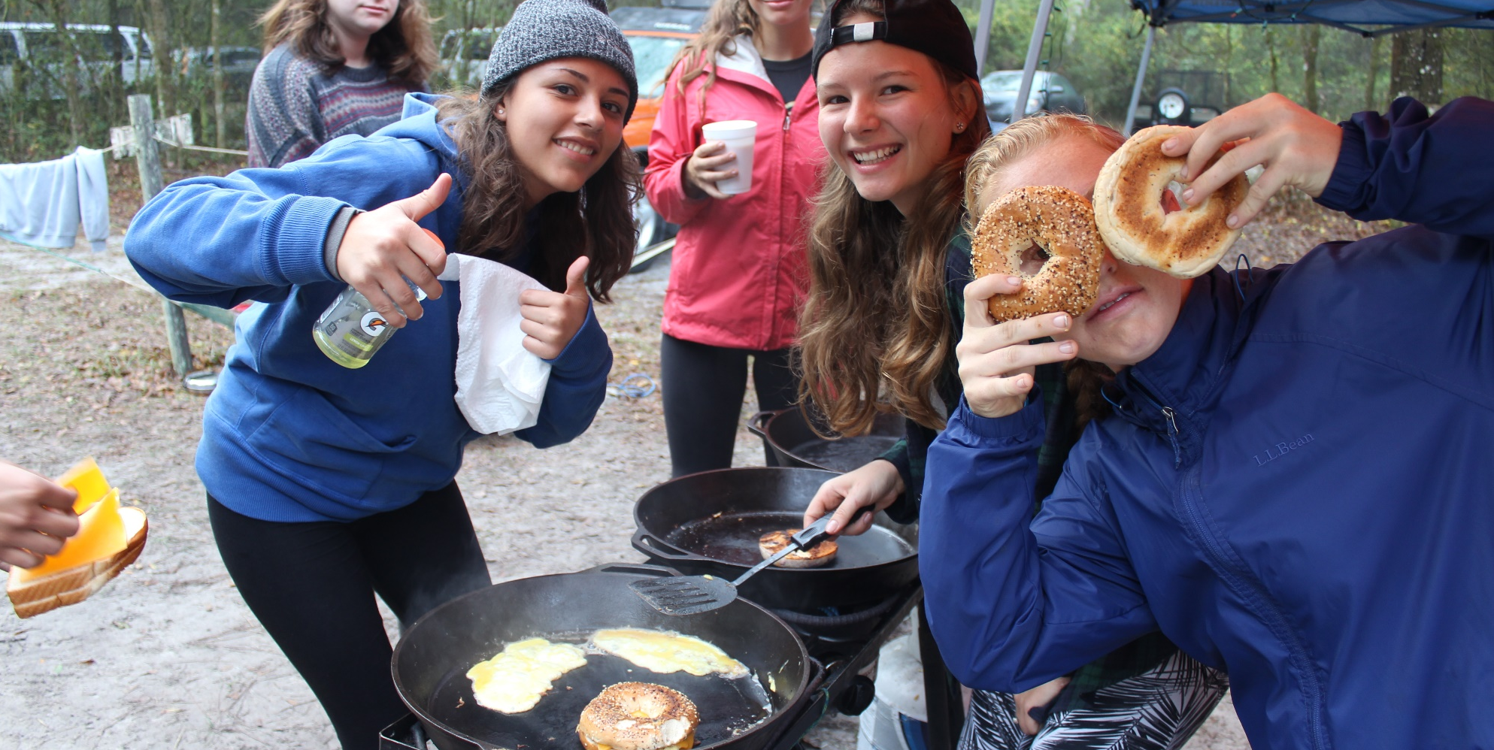
LUNCH
Provided by the Florida Trail Association

Slide 37
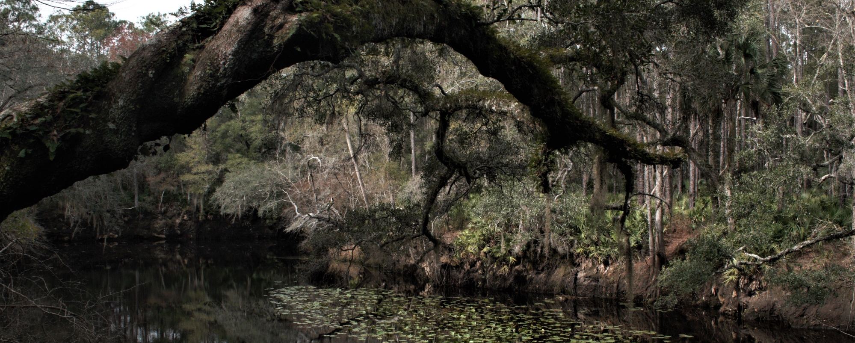
2018 STRATEGIC PLAN
Implementation Guide Overview

Slide 38
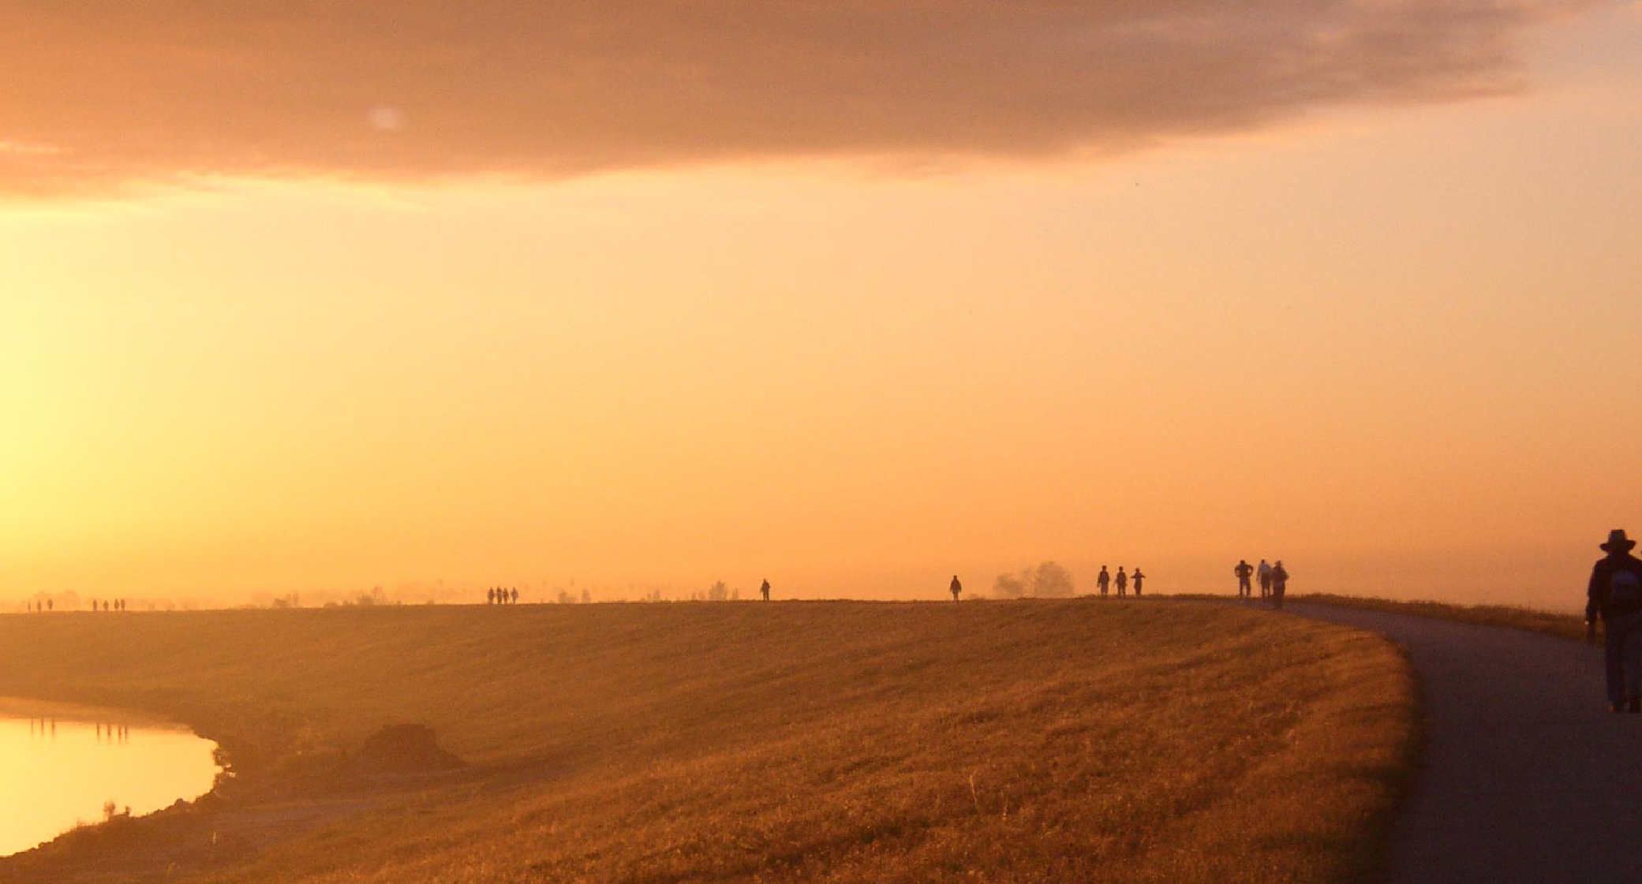
Connect citizens with the natural and cultural heritage of Florida through increasing awareness, use and protection of the Florida Trail.
GOAL: PROMOTE CONNECTIONS

Slide 39
2018 UPDATE
Promote Connections
Major Performance Measure- Increase number and diversity of Florida Trail recreationists by 15% over 5 years.
Long Term Outcome- The Florida Trail is widely valued and used as a means for connecting people with the nationally significant resources of Florida.

Slide 40
Objective 1: Promote
Connect people to the Florida Trail through coordinated promotion efforts
Associated projects include:
  Public Relations Campaign
  Regional Trip Brochures and Itineraries
  Improved User Access to Print and Web Content

Slide 41
Objective 2: Engage
Cultivate community and cultural relevance through engaging new and non-traditional trail users
Associated projects include:
  Next Generation Trail Ambassadors Program
  Roundtable on Diversity
  Improved Trailheads, Parking, Amenities
  Social Media and Outreach
  Florida Trail Gateway Communities Program

Slide 42
Objective 3: Educate
Provide education and interpretation opportunities to encourage learning, enjoyment and attachment to the Florida Trail
Associated projects include:
  Trailhead Interpretation & Interpretive Displays
  Junior Explorer Programs

Slide 43
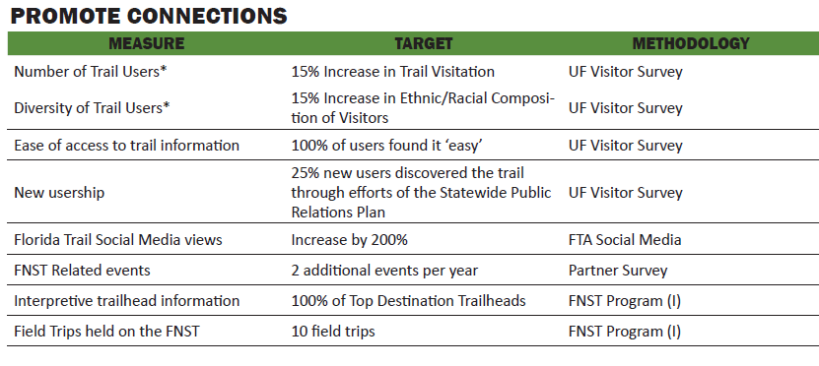
Summary of Performance Measures

Slide 44
Engaging Diversity in the Outdoors
FTA Strategic Plan on Diversity
Van Tran
  Community Outreach Coordinator, Florida Trail Association

Slide 45
Engaging Diversity in the Outdoors
The Issue
  Low participation rates of minority groups in outdoor rec
  Racial and ethnic minority groups represent less than 5% of total recreationists on the Florida Trail
Why It Matters
  Engaging ethnically and racially diverse audiences in outdoor recreation is essential to the future stewardship of public lands
  Joining the movement to establish a more diverse and inclusive community of outdoor recreationists

Slide 46
2016-17 FTA Volunteer Demographic Data
Ethnicity and Race
Ethnicity/Race | Male | Female | Total | Percentage | Florida (2005)
White (Non-Hispanic) | 106 | 66 | 172 | 50.15% | 60.01%
Hispanic or Latino | 4 | 3 | 7 | 2.04% | 20.00%
Black or African American (Non-Hispanic) | 0 | 1 | 1 | 0.29% | 17.00%
Asian/Pacific Islander | 3 | 3 | 6 | 1.75% | 1.04%
Native American/Alaskan Native | 0 | 0 | 0 | 0.00% | Below 1%
Other | 1 | 0 | 1 | 0.29% | Below 1%
Unknown | 98 | 58 | 156 | 45.48% | 0.00%
Total | 212 | 131 | 343 | 100.00% | 100.00%

Slide 47
Current FTA Volunteer Demographic Data
Age
Age | Male | Female | Total | Percentage | Florida
Under 15 | 0 | 0 | 0 | 0.00% | 17.47%
15-18 | 2 | 0 | 2 | 0.58% | 3.81%
19-24 | 7 | 13 | 20 | 5.83% | 9.25%
25-35 | 6 | 9 | 9 | 2.62% | 12.18%
36-54 | 9 | 3 | 12 | 3.50% | 27.50%
55 Plus | 29 | 17 | 46 | 13.41% | 29.79%
Unknown | 159 | 95 | 254 | 74.05% | 0.00%
Total | 212 | 131 | 343 | 100.00% | 100.00%

Slide 48
FTA Methods for Engaging New and
Non-Traditional Users
FTA website (floridatrail.org)
  Include USFS & FTA Diversity Plan
  Statement of commitment to enhancing diversity on the FNST
  Share stories
  Promote inclusive events
  Platform for capturing Roundtable on Diversity and Next Generation Trail Ambassadors

Slide 49
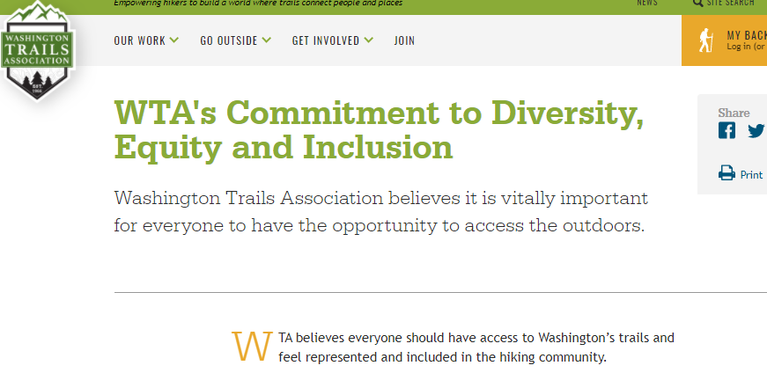
Washington Trails Association (WTA) as Example

Slide 50
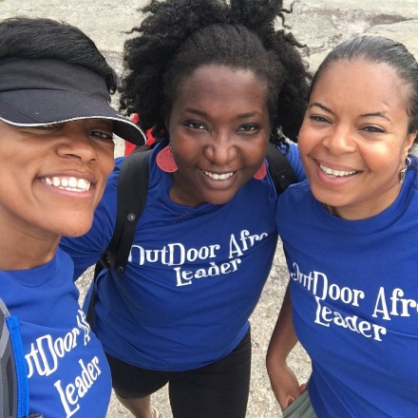
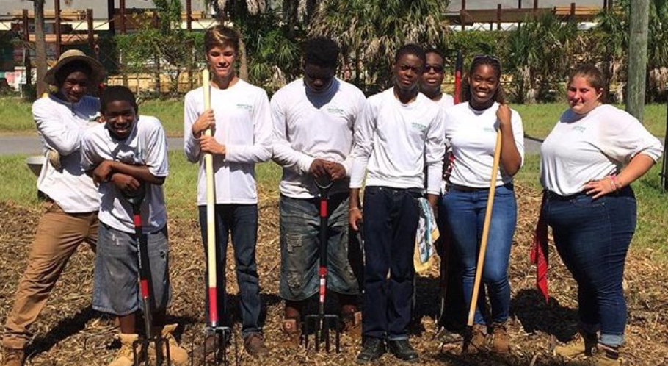
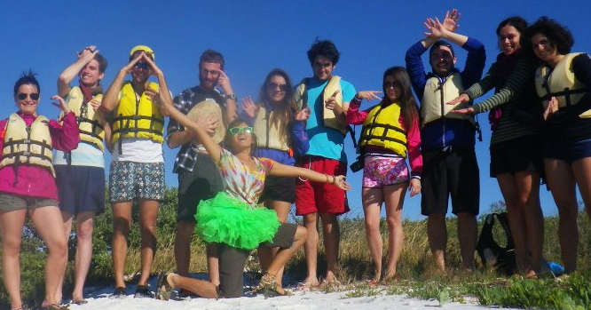
FTA Methods for Engaging New and
Non-Traditional Users
Building Partnerships
  Partner with diverse organizations to provide educational & inclusive opportunities for trail maintenance and recreation of the FNST

Slide 51




FTA Methods for Engaging New and
Non-Traditional Users
Upcoming Collaborative Events:
  Feb. 2018: UF Center for Outdoor Recreation (CORE), Ocala NF
  Mar. 2018: Groundwork Jacksonville, Juniper Wilderness
  Mar. 2018: Outdoor Afro Tallahassee, Apalachicola NF
  Fall 2018: REI Winter Park &
  Seminole State College, Spring Hammock
  Preserve

Slide 52
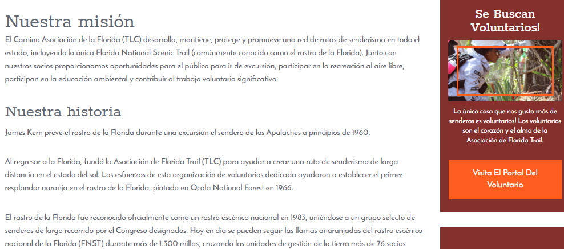
FTA Methods for Engaging New and
Non-Traditional Users
Improving accessibility of FTA and FNST info
  Language Translator for FTA Website (floridatrail.org)

Slide 53


FTA Methods for Engaging New and
Non-Traditional Users
Roundtable on Diversity &
FNST Next Generation Trail Ambassadors Program
  Supporting engagement, inclusivity and advocacy of underrepresented groups on the FNST
  Program Development: Jacksonville Diversity in Action Roundtable “Building Bridges to Promote Inclusion”

Slide 54
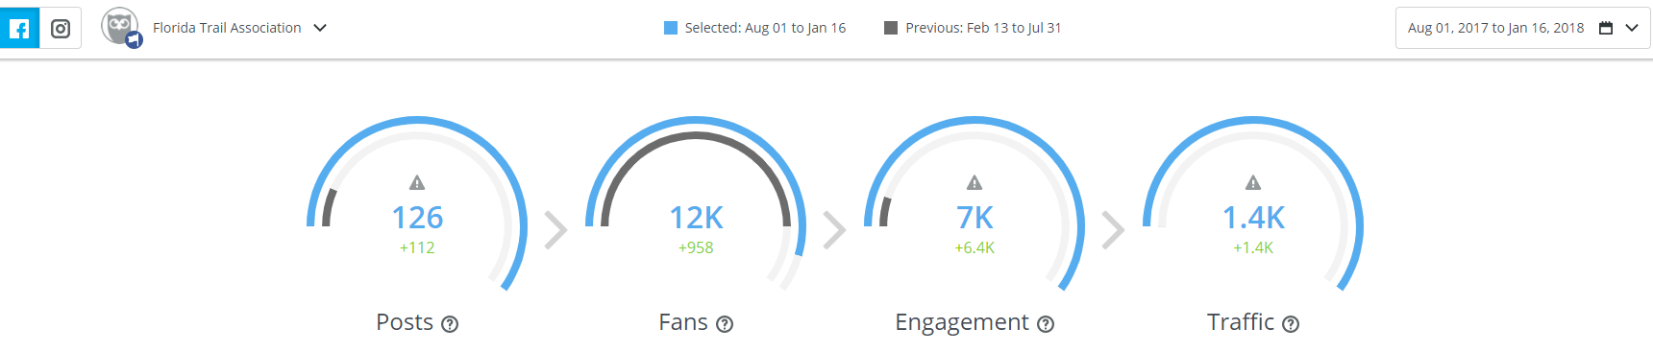
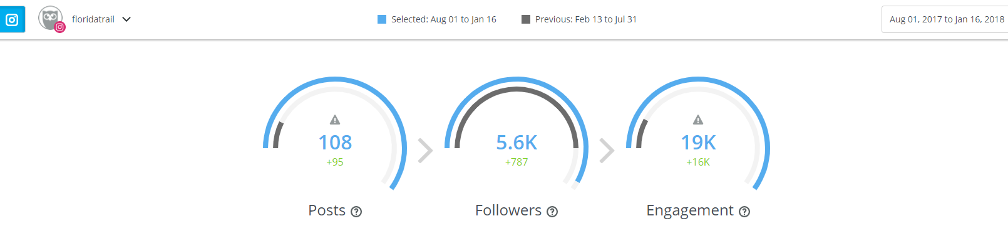
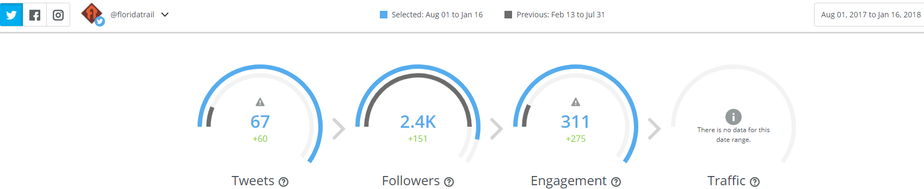
FTA Methods for Engaging New and Non-Traditional Users
Enhance social media outreach for strengthening engagement on FNST

Slide 55



Social Media Outreach
Instagram Analytics Overview
Aug 01, 2017 - Jan 16, 2018
Followers
The number of people who are following the Florida Trail Instagram account

Slide 56
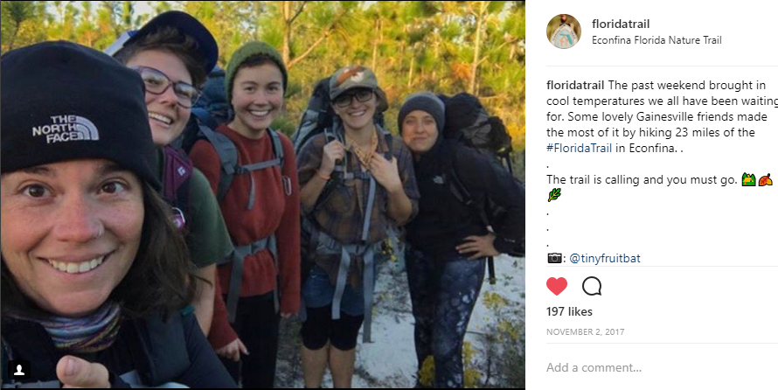
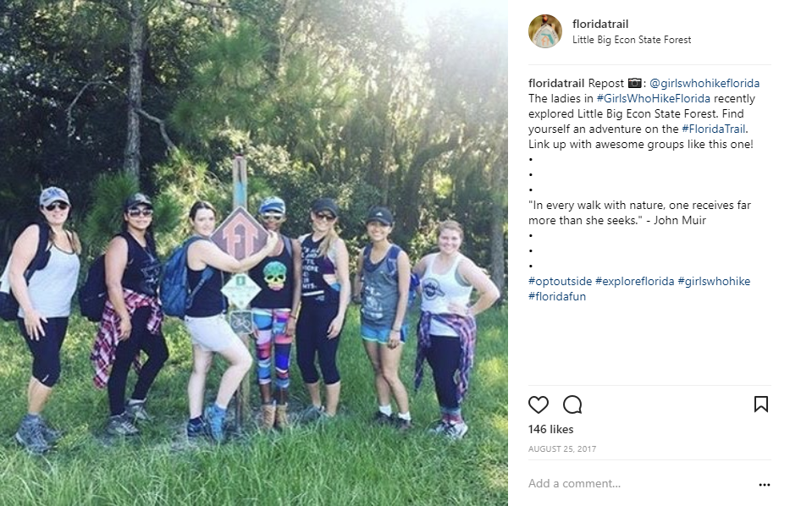

Social Media Outreach
Encouraging Women in the Outdoors

Slide 57
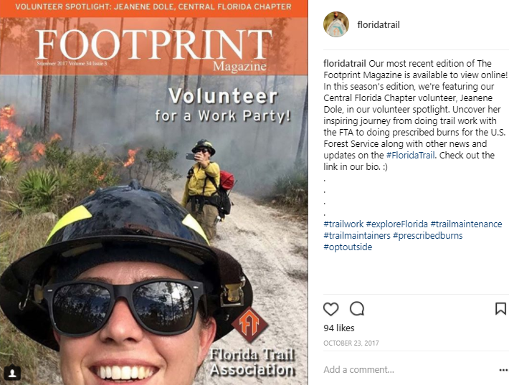
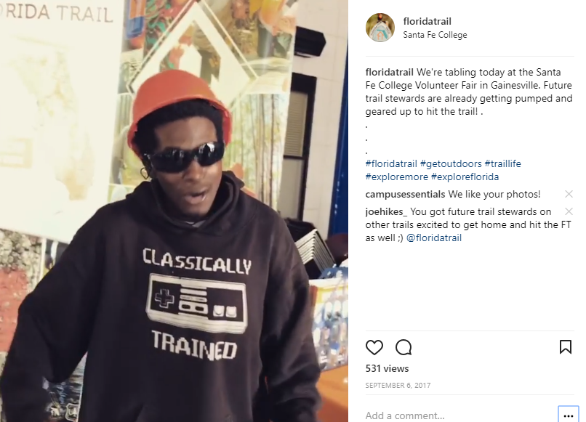

Social Media Outreach
Supporting and Engaging
Non-Traditional Users and Volunteers

Slide 58

Engaging New and Non-Traditional Users
Advocacy

Slide 59

Encourage and develop a diverse community of partners in the management, promotion and completion of the Florida Trail.
GOAL: STRATEGIC PARTNERSHIPS

Slide 60

2018 UPDATE
Strategic Partnerships
Major Performance Measure- The Florida Trail Partnerships Program maintains high performing relationships that proactively contribute to development, maintenance or promotion of the Florida Trail.
Long Term Outcome- The Florida Trail is supported by a network of land management, conservation and stewardship partners dedicated to the protection of the Florida Trail.
Notes:
Focus conversation on major performance measure

Slide 61
Objective 1: Collaborate
Foster coordination among interests, networks and stakeholders to further the goals of the Florida Trail.
Associated projects include:
  Bi-annual FNST Coalition Meetings
  Collaboratively-developed Projects
  Land Manager E-blaze, Contribution to Partners Publications
  Improved Communication Channels

Slide 62
Objective 2: Steward
Enhance partnerships to share stewardship of the Florida Trail and ensure access for future generations
Associated projects include:
  Building FTA Capacity
  Veteran, Job and Youth Corps Partnerships
  Diversity Focus for Event Development and Trail Information

Slide 63
Objective 3: Complete
Engage partners in the development and protection of the Trail corridor.
Associated projects include:
  MOUs and Certification Agreements
  Land Trust Partnerships
  Mutually Beneficial State/Federal Land Acquisition Proposals

Slide 64

Summary of Performance Measures
Notes:
See page 83-84 this goal is 84

Slide 65

15 MINUTE BREAK

Slide 66

Close the gaps in the Florida Trail through long-range planning, acquisition and agreements for long term protection of the Trail corridor.
GOAL : COMPLETE THE TRAIL

Slide 67
2018 UPDATE
Complete the Trail
Major Performance Measure- Remove 30 miles of trail connectors and add 50 designatable miles of trail to close critical gaps within the Trail corridor.
Long Term Outcome- The Florida Trail is a fully designated corridor, through ownership or agreement, from the northern terminus in Gulf Islands National Seashore to the southern terminus in Big Cypress National Preserve.

Slide 68
Objective 1: Plan
Define the route of a complete Florida Trail that reflects on the ground conditions.
Associated projects include:
  Corridor Location Reviews
  Optimal Location Reviews
  OGT Priority and Opportunity Mapping
  Land Acquisition Plan
  Large-Scale Infrastructure Planning
  FNST Planning Corridor
Notes:
National effort of gap analysis w/NPS NTAR

Slide 69
Objective 2: Acquire
Acquire segments necessary for completing the Trail through fee-simple acquisition, easements or formal agreements.
Associated projects include:
  MOUs and Agreements
  LWCF Grant Applications
  Willing Sellers List
  Land Acquisition

Slide 70
Objective 3: Protect
Preserve the long term integrity of the Trail corridor and surrounding resources.
Associated projects include
  Trail Corridor Model
  At-Risk Trail Segment Matrix
  Trail Corridor Protection Plan

Slide 71

Summary of Performance Measures

Slide 72
Manage, monitor and maintain the Florida Trail and its associated infrastructure to ensure a high-quality recreation experience for current and future generations.
GOAL : Sustainable Management

Slide 73
2018 UPDATE
Sustainable Management
Major Performance Measure- 100% of the Florida Trail is managed to standard annually to provide maximum potential for recreation, conservation and enjoyment.
Long Term Outcome- The Florida Trail is maintained as a high-quality, iconic, long-distance trail enjoyed by current and future generations.

Slide 74
Objective 1: Monitor
Champion an integrated approach to collecting and sharing trail information that better serves land managers and the public.
Associated projects include:
  Infrastructure Database
  FNST Resource Atlas
  Trail Inspection Protocol

Slide 75
Objective 2: Manage
Collaboratively and sustainably manage the trail tread and associated resources to standard
Associated projects include:
  Annual Priority Project List
  Statewide Up-to-Date MOU’s
  Stewardship Agreements with Land Management

Slide 76
Objective 3: Maintain
Maintain the Florida Trail for recreation, conservation and enjoyment.
Associated projects include:
  Trail Maintenance
  Annual Reporting of Maintenance Activities

Slide 77

Summary of Performance Measures

Slide 78

A Look at the Florida Trail
Through GIS

Slide 79


Slide 80

BACKGROUND
From Gulf Islands National Seashore to Big Cypress National Preserve the Florida Trail is 1,548 miles long
This includes:
  Total designated trail length: 1,105 miles
  Total connector length: 443 miles
Notes:
Connectors that are Trail w/o agreements: 15.43 miles; up until 2012 there were 982 miles of designated Trail and in 2016 there were 1062.7 miles of dedicated Trail

Slide 81

Florida National Scenic Trail
1983-2012
Trail Line
Road walk

Slide 82

Florida National Scenic Trail
2013-2017
Prior to 2012
Past 5 Years
Road walk

Slide 83
The Florida Trail on Conservation Lands
  Conservation lands are a vital component of the Florida Trail. Currently, the Trail goes through 86 different managed lands totaling 912 miles.
    FT on National Forest Lands: 210 miles
    FT on State Forests: 146.2 miles across 8 forests
    FT in State Parks: 45 miles in 11 state parks
    FT on FWC Lands: 65.34 miles on 6 properties
    FT on Water Management areas: 165.7 miles

Slide 84

Trail and Roadwalk Additions and Removals
  Through reroutes and maintenance the Florida Trail is constantly undergoing changes
  There was a net gain of 6.4 miles of trail and 4 miles of road walk removal

Slide 85

WRAP UP & NEXT MEETING

Slide 86

THANK YOU FOR YOUR PARTICIPATION

