Slide 1
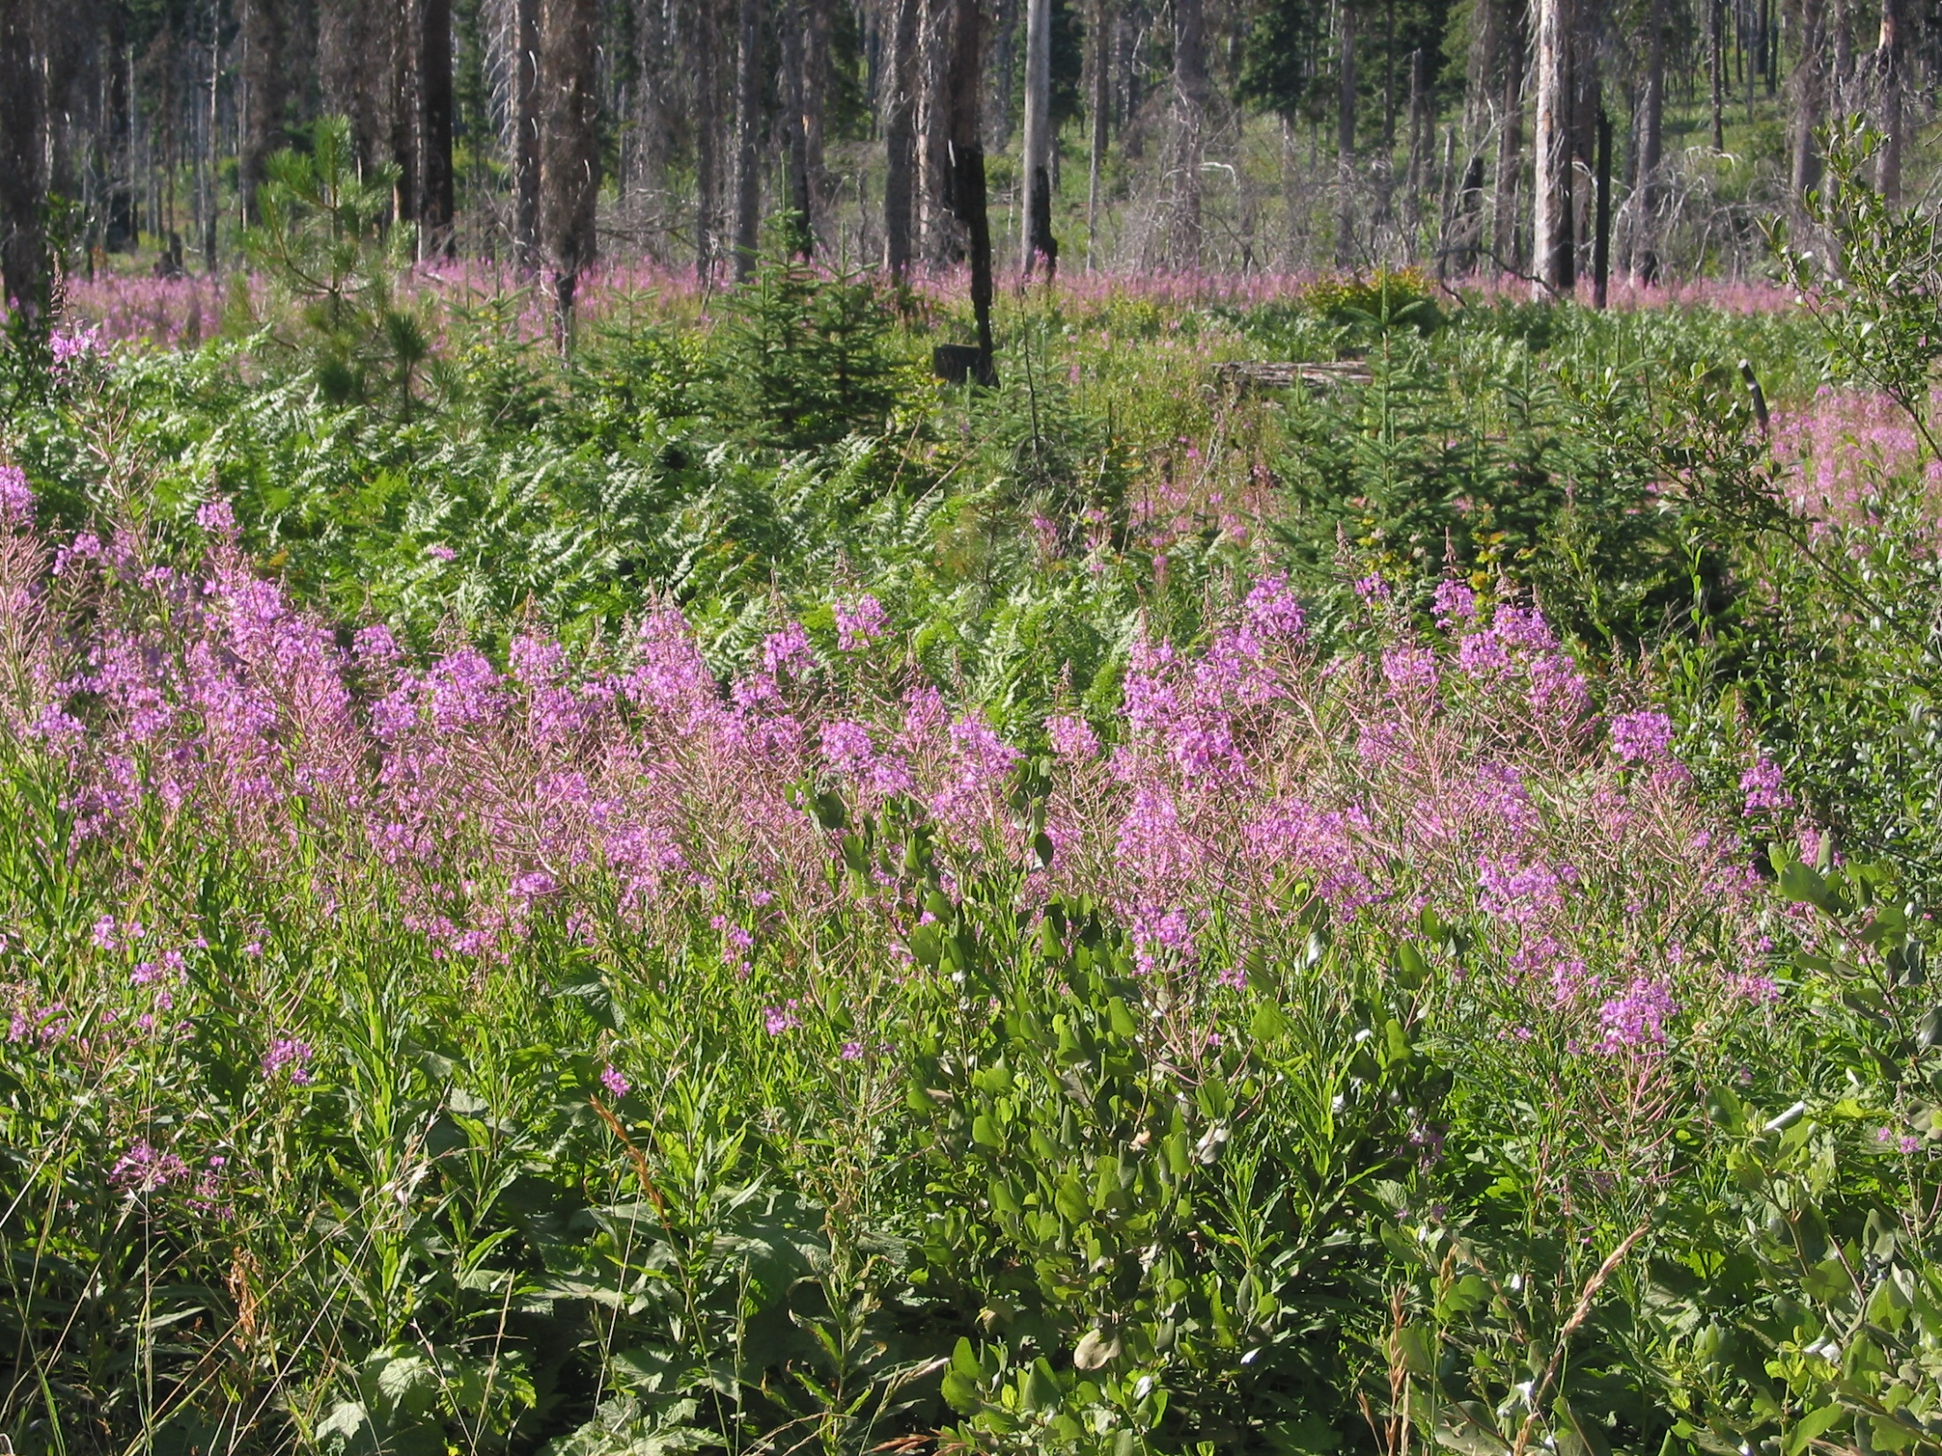
Finding the Best Available Science on Fire Effects and Fire Regimes
Rocky Mountain Research Station
Fire, Fuel, and Smoke Science Program
Fire Modeling Institute
United States Department of Agriculture n Forest Service
Notes:
This presentation is intended to be used by instructors to teach students about how to find fire effects and fire regime information in the Fire Effects Information System (FEIS).

Slide 2
Seeking Information on Fire
How might the use of prescribed fire affect a species?
How can I find information on historical fire regimes?
How have fuels changed in the past 100 years?
How does wildland fire affect nonnative, invasive plants?
How might climate change affect fire regimes in the future?
The Fire Effects Information System (FEIS)
can help answer these questions and many more!
Notes:
Have ever asked yourself questions like these?
-How might the use of prescribed fire affect a species I am interested in?
-How can I find information on historical fire regimes in my area?
-How have fuels changed in the past 100 years or more?
-How does wildland fire affect nonnative, invasive plants?
-How might climate change affect fire regimes in the future?
(Enter) The Fire Effects Information System was designed to help answer these questions.

Slide 3
>1,200
Native and nonnative species
Online collection of peer-reviewed syntheses
on fire ecology and fire regimes in the United States
designed to meet needs of managers
Plants, lichens, and animals
Primary audience
Fire management
Fuels management
General planning
NEPA documents
www.feis-crs.org/feis/
Notes:
FEIS is an online collection of peer-reviewed syntheses on fire ecology and fire regimes.
There are (Enter) >1,200 syntheses in the collection, which cover (Enter) native and nonnative (Enter) plants, lichens, and animals in the United States.
FEIS is designed to meet the needs of (Enter) land and resource managers seeking the best available science for use in
(Enter) fire management,
(Enter) fuels management,
(Enter) general land management planning, and
(Enter) NEPA documents.

Slide 4
Synthesis
Literature review
Describe patterns or lack of patterns
Explain what is known, or not known
Describe implications for management
www.feis-crs.org/feis/
Notes:
To write syntheses for FEIS, a team of ecologists:
Conduct thorough literature searches and critical analyses of the available information.
They describe patterns or lack of patterns,
Explain what is known and not known, and
Describe implications for management.

Slide 5
Why go to FEIS for syntheses?
www.feis-crs.org/feis/
Notes:
So why go to FEIS for syntheses when you can just Google it? (Enter)
Well, a Google Scholar search or any citation database search gives you a grocery list of publications. The Google Scholar search for “lodgepole pine” and “fire” yields a grocery list that is 20,000 citations long! With a synthesis, an ecologist has done the search for you, filtered out what is relevant, and spent months, in many cases, describing patterns.

Slide 6
Why go to FEIS for syntheses?
Data from FRAMES Resource Catalog, 2014 May 11
www.feis-crs.org/feis/
Notes:
And the grocery list is getting longer each year. (Enter) The amount of fire research is growing. This graph shows that publications on fire have quadrupled since the 1960’s. There’s more information available than ever before and yet there is not enough staff or financial resources to deal with it.
FEIS helps managers be more efficient at finding and using information on fire.

Slide 7
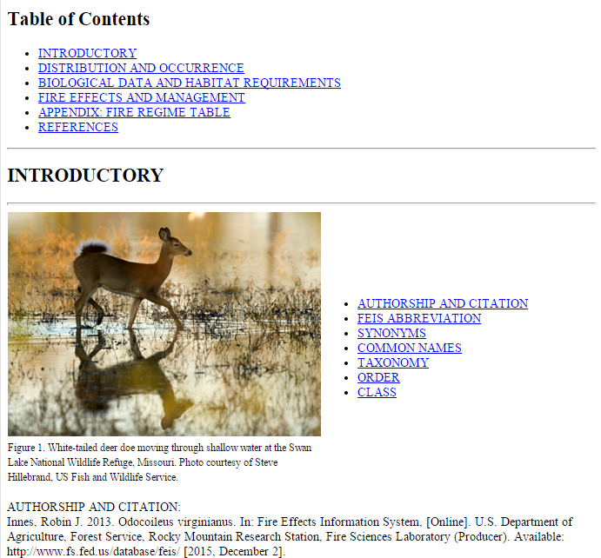
FEIS Publications
Species Reviews
Fire Regimes
Syntheses
Reports
Fire Studies
Notes:
FEIS provides 4 types of publications.
Species Reviews are our staple and have been published in FEIS since 1985. They synthesize information on plant, lichen, and animal species’ life history, ecology, and relationships to fire.
Here is an example of a Species Review. This one is on the white-tailed deer.
(Enter) Each Species Review covers the species’ distribution, basic biology and ecology, as well as information on fire effects and management.

Slide 8
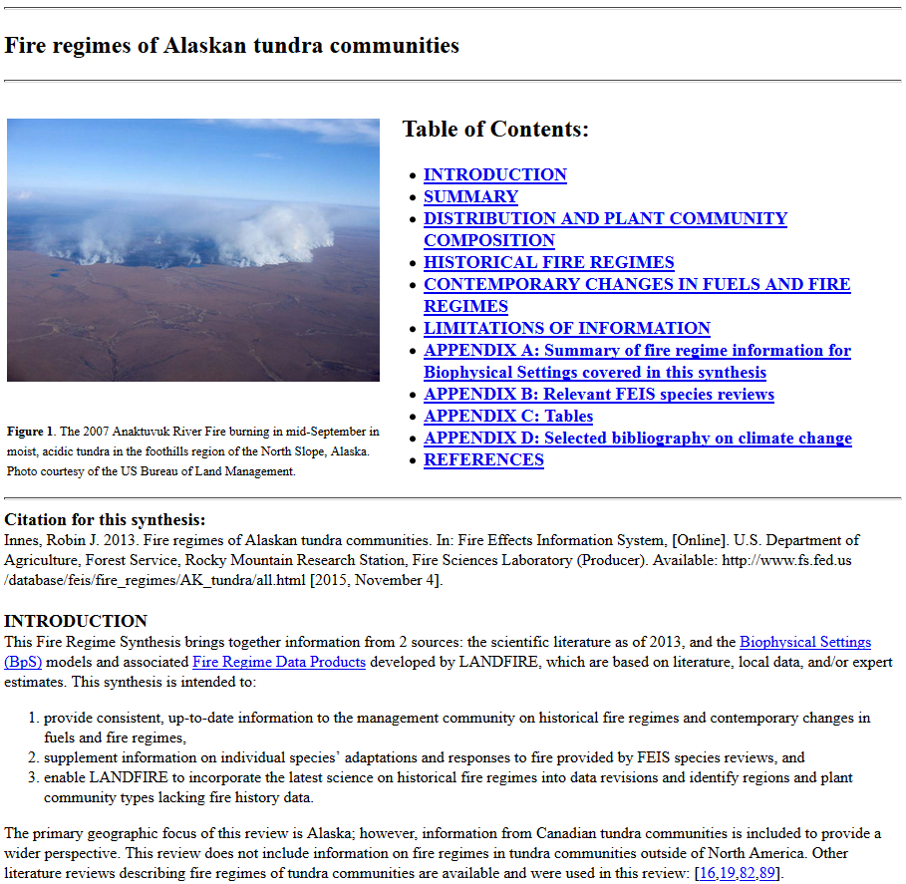
FEIS Publications
Species Reviews
Fire Regimes
Syntheses
Reports
Fire Studies
Species Reviews
Fire Regimes
Syntheses
Reports
Fire Studies
Notes:
FEIS has 2 new types of publications on Fire Regimes: Fire Regime Syntheses and Fire Regime Reports. Between the 2 of them, there is information on fire regimes for every plant community in the United States.
(Enter) Here is an example of a Fire Regime Synthesis. This one is on Alaskan tundra communities.
(Enter) Fire Regime Syntheses provide an in-depth analysis of published literature on historical fire regimes in individual plant communities, and address contemporary changes in fuels and fire regime characteristics for those communities.

Slide 9
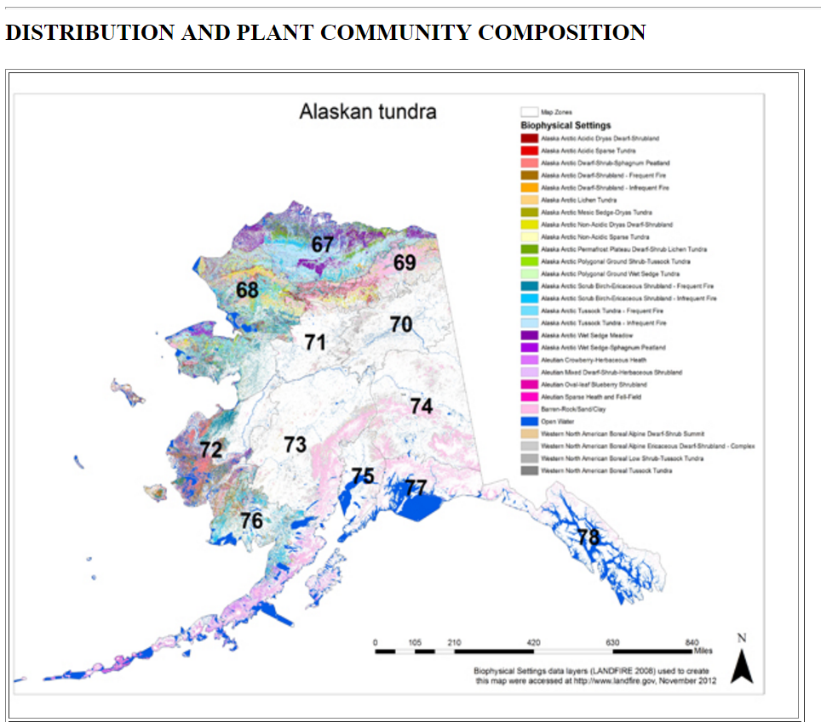
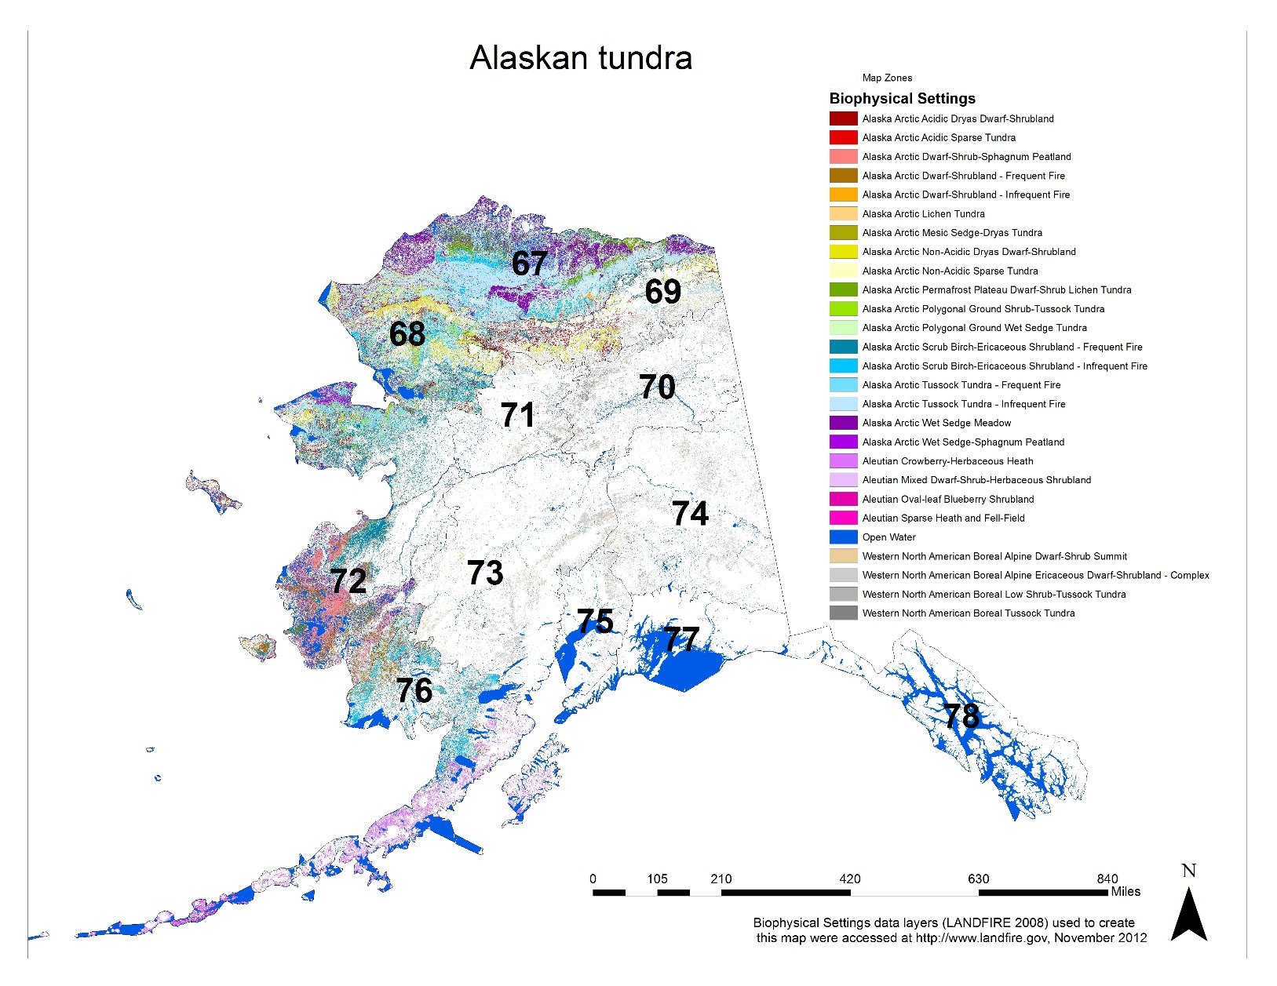
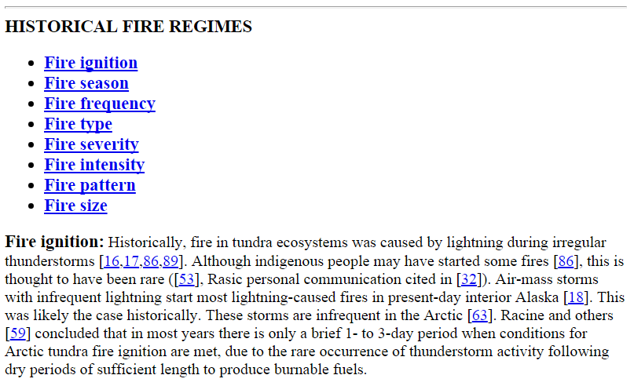
Notes:
Each Fire Regime Synthesis includes…
a section covering the distribution and plant communities discussed,
(Enter) a section covering historical fire regime characteristics, which provides specific details on fire ignition, season, frequency, type, severity, intensity, pattern, and size,
(Enter) and a section on Contemporary changes in fuels and fire regimes, which discusses the effects of climate change, invasive species, and disturbances other than fire.
(Enter) There is also a Limitations of Information section, which analyzes knowledge gaps and areas of uncertainty and identifies regions and plant community types lacking fire history data.

Slide 10
FEIS Publications
Species Reviews
Fire Regimes
Syntheses
Reports
Fire Studies
Species Reviews
Fire Regimes
Syntheses
Reports
Fire Studies
Notes:
In addition to the synthesis of the scientific literature, Fire Regime Syntheses provide information about LANDFIRE’s Biophysical Settings.
In fact, Fire Regimes in FEIS are comprised of Biophysical Settings.
Biophysical Settings represent the vegetation that is thought to have been dominant on the landscape prior to European Settlement.
(Enter) To view the list of individual Biophysical Settings models covered by the Fire Regime, you can click on the link to the Appendix A in the synthesis.

Slide 11
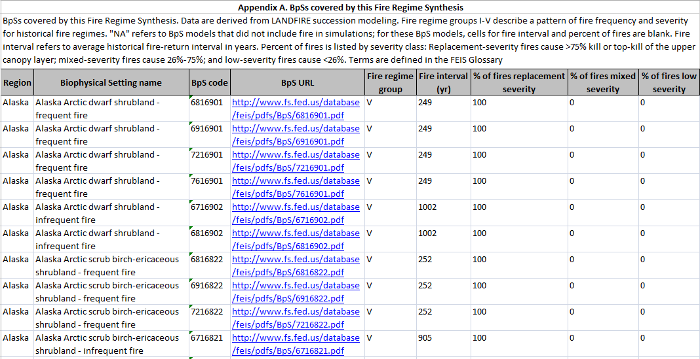
Notes:
To access the LANDFIRE data in the Appendix, you can click on the URL (Enter) and it opens a pdf.

Slide 12
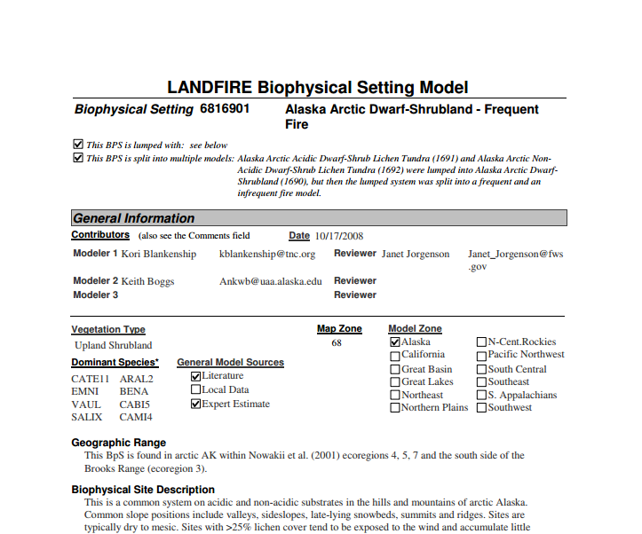
Notes:
The pdf provides information on the Biophysical Setting’s geographic range, site characteristics, vegetation, and natural disturbances, including fire.

Slide 13
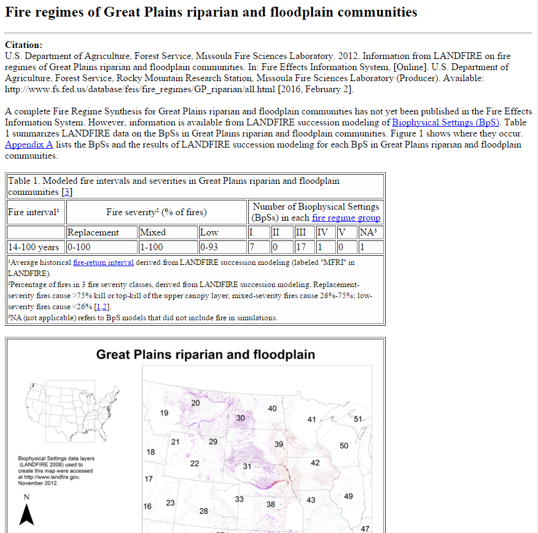
FEIS Publications
Species Reviews
Fire Regimes
Syntheses
Reports
Fire Studies
Species Reviews
Fire Regimes
Syntheses
Reports
Fire Studies
Notes:
Fire Regime Reports (our other fire regime product) provide only brief summaries of LANDFIRE information on fire frequency and severity for the group of Biophysical Settings covered by the fire regime, but does not include an in-depth analysis of the published literature.
Here is an example of a Fire Regime Report on Great Plains riparian and floodplain communities. Right now, most of the fire regimes in FEIS are described by a Fire Regime Report.
(Enter) Reports include a summary table with modeled ranges of fire-return intervals, fire severities, and fire regime groups, as well as (Enter) a distribution map and (Enter) the appendix, which lists the individual Biophysical Settings models covered by the Report.
Fire Regime Syntheses include all of the information contained in Fire Regime Reports in addition to the synthesized published literature.
The FEIS team hopes to eventually convert all Fire Regime Reports into Fire Regime Syntheses.

Slide 14
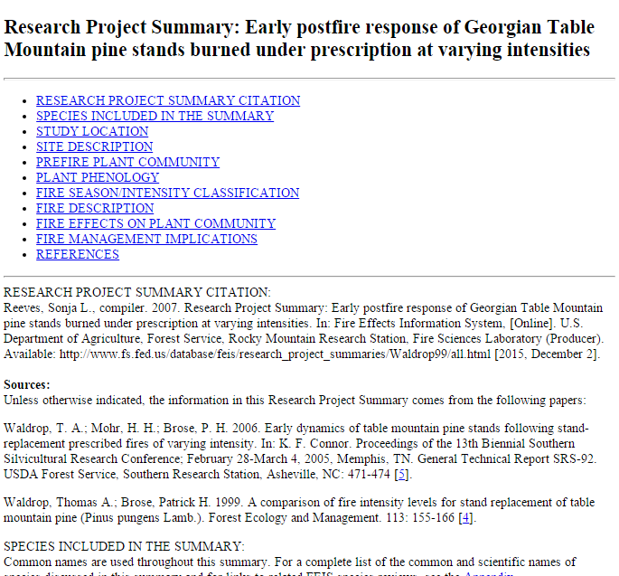
FEIS Publications
Species Reviews
Fire Regimes
Reports
Syntheses
Fire Studies
Notes:
The last of FEIS’s publication types, Fire Studies, are summaries of 1 or more related research studies that occur in the same location. (Enter) They provide detailed results on vegetation, fire characteristics, and fire effects.
Here is an example of a Fire Study that summarizes the research of 2 studies by Waldrop, Mohr, and Brose that occurred at the same location in Georgia.
Fire Studies were developed to supplement FEIS’s other publications.
---------------------------------------------------------------------------

Slide 15
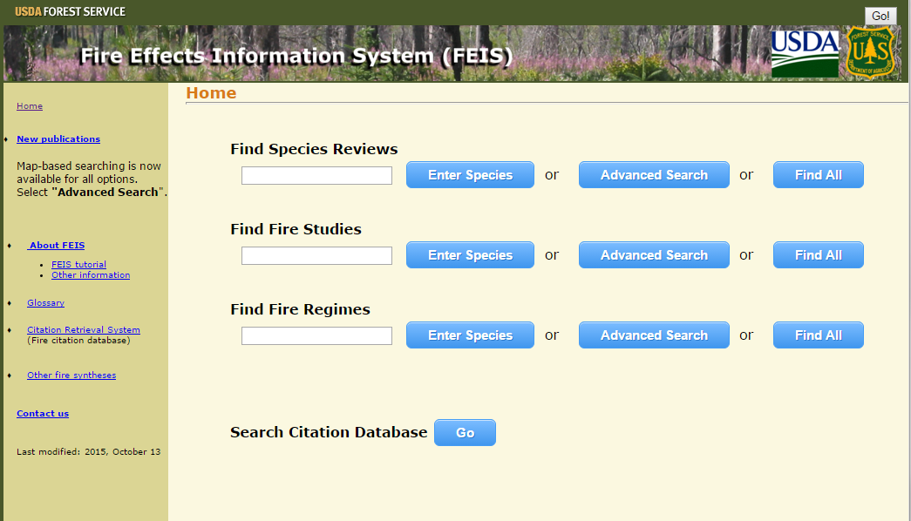
Notes:
All FEIS publications can be accessed using the FEIS user interface.
(Enter) You can do a basic search for a particular species right on the home page by entering a species scientific or common name in the box and clicking on “Enter species”. This is a great option if you know what you are looking for.

Slide 16
Notes:
You can browse all of certain kind of publication by selecting “Find All”. There are over 1,000 Species Review, 150 Fire Studies, and 180 Fire Regimes in FEIS.

Slide 17
Notes:
You can also narrow your search for a particular publication type by using the advanced search option. This is a great option is you are looking for information in a particular location or plant community type.

Slide 18
Florida scrub-jay
Notes:
Let’s say you wanted information on how prescribed fire might affect the Florida scrub-jay, a threatened species in Florida. You can find what you are looking for by (Enter) entering the species name in the search box and (Enter) clicking on “Enter Species”.

Slide 19
Notes:
You can see that FEIS has a review of the Florida scrub-jay that was (Enter) published in 2012.
(Enter) The acronym has a link to the publication.
All Species Reviews have fire regime information available directly from the results page. (Enter) Clicking on the available link under “Fire Regimes” brings you to a list of fire regimes associated with the Florida scrub-jay. This is valuable information if you need to know what fire regimes this species may have been historically adapted to.

Slide 20
Notes:
What if you are interested in information on historical fire regimes in plant communities in your area? Back on the home page, (Enter) let’s click on the Advanced Search option for Fire Regimes…

Slide 21
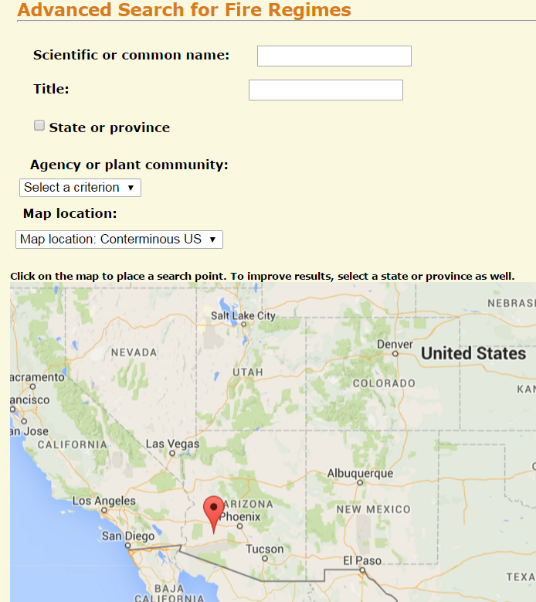
Notes:
As you can see, we have the option of searching for fire regimes using a variety of criteria including searching my state, agency, or plant community.
In this case, let’s search for fire regimes of plant communities in Arizona by selecting a location on the map.

Slide 22
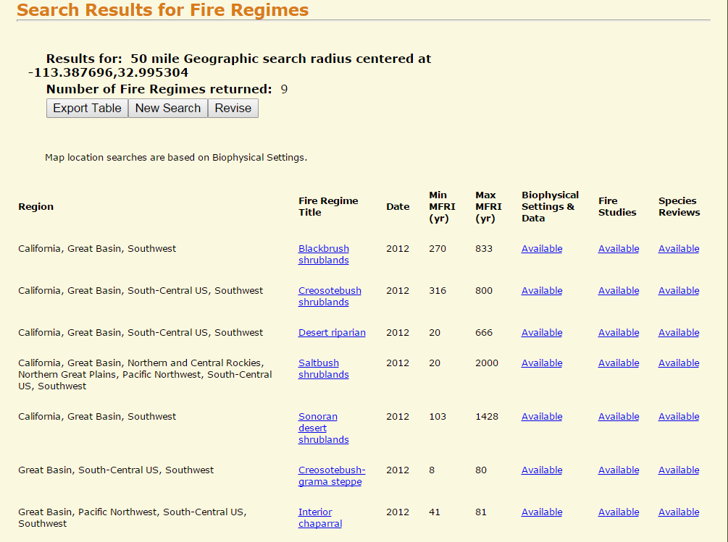
Notes:
We get 9 fire regimes (Enter) within a 50-mile radius circle centered at that location. The Fire Regime Syntheses or Reports can be accessed (Enter) by clicking on the links under Fire Regime Title.
With a glance, we can see (Enter) the historical minimum and maximum mean fire-return intervals. The information displayed in these columns is that provided by LANDFIRE modeling unless a synthesis was published for that Fire Regime. In that case, it is selected by FEIS staff from information found in published literature.
(Enter) The “Biophysical Settings & Data” column provides links to the Appendix with the LANDFIRE information. (Enter) There are also links to the Fire Studies and Species Reviews that are associated with those Fire Regime Titles.
Like all results pages, these results can be exported (Enter) into an excel table for you to access at any time.

Slide 23
Notes:
Well, what if a species you are interested in does not have a Species Review or a Fire Regime associated with it? Looking for Fire Studies is a great option. (Enter) Let’s look at the Advanced Search option for Fire Studies.

Slide 24
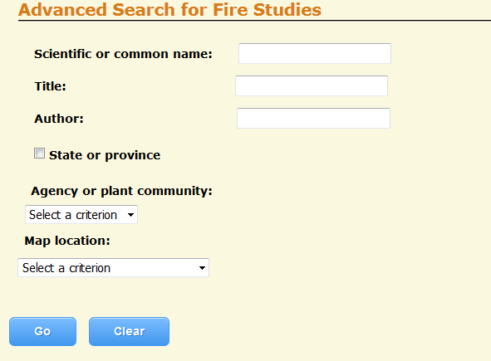
Prickly lettuce
Notes:
Prickly lettuce is not reviewed in FEIS and it is a common, nonnative forb introduced into every state in the country. If you did a search for prickly lettuce in the user interface (Enter) you would find…

Slide 25
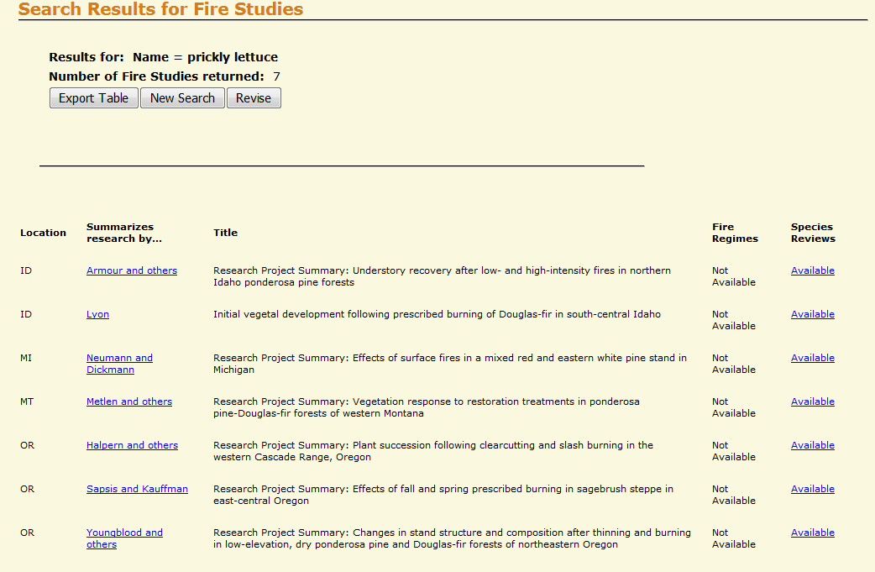
Notes:
…7 Fire Studies that have fire effects information on this species. The Fire Study can be accessed using the author links.
(Enter) Let’s click on “Armour and other” to access this Fire Study.

Slide 26
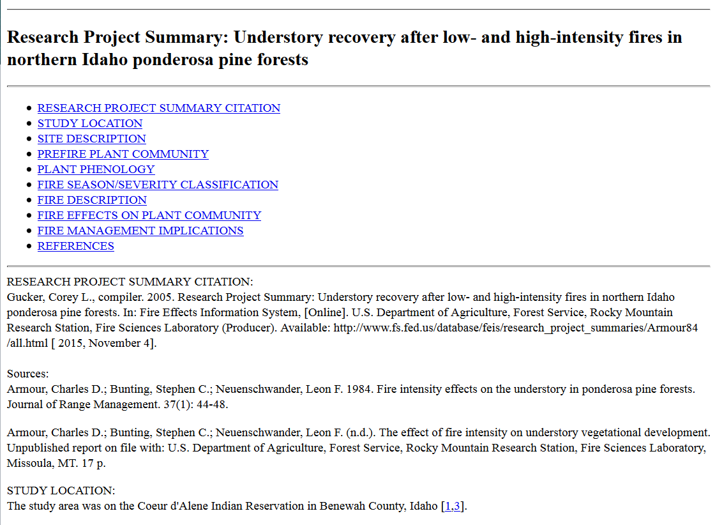
Notes:
This Fire Study summarizes (Enter) 2 studies by the same authors that occurred in the same location in Idaho. One is published and the other is not. So FEIS is has some potentially hard-to-find information.
Let’s use the find function to “find” prickly lettuce in the text.

Slide 27
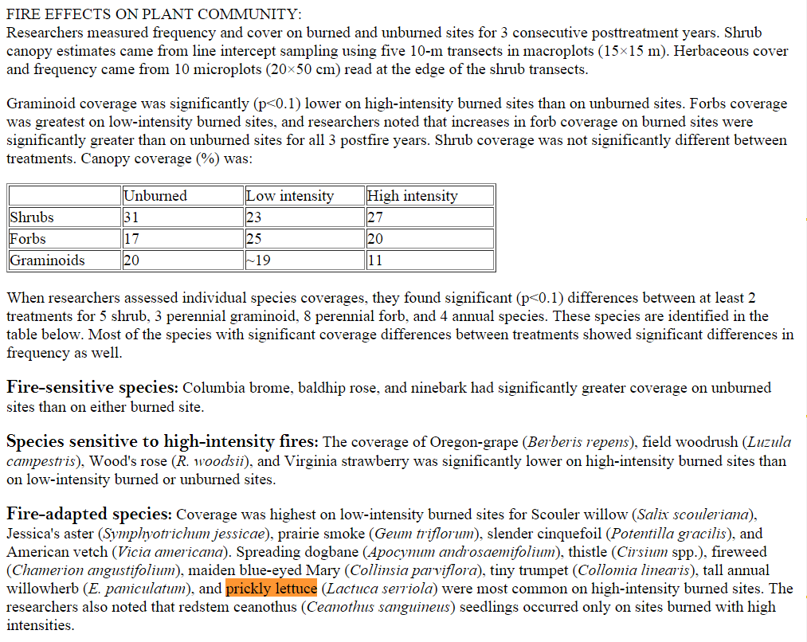
Notes:
Here is an excerpt from the Fire Study. (Enter) You don’t need to look at it very long to find out that prickly lettuce was considered (Enter) a “fire-adapted species” by these authors and was “most common on high-intensity burned sites”.

Slide 28
Seeking Information on Fire
How might the use of prescribed fire affect a species?
How can I find information on historical fire regimes?
How have fuels changed in the past 100 years?
How does wildland fire affect nonnative invasive plants?
How might climate change affect fire regimes in the future?
Species Reviews & Fire Studies
Fire Regime Reports & Syntheses
Fire Regime Syntheses
Species Reviews & Fire Studies
Fire Regime Syntheses
The Fire Effects Information System (FEIS)
can help answer these questions and many more!
Notes:
As you can see, we can answer all kinds of different questions using FEIS and the new user interface is a powerful tool for accessing that information.
As a recap, (Enter) Species Reviews and Fire Studies are great resources for syntheses of information on fire effects and fire ecology and (Enter) Fire Regime Syntheses and Reports are great resources for syntheses of information on historical and contemporary fire regimes.

Slide 29
Notes:
If after examining the publications that FEIS offers and you still don’t find the information you need, FEIS has one more resource for you.
On the home page there is a link to a citation database. (Enter) Click go and you will be taken to the Citation Retrieval System, or CRS.

Slide 30
Notes:
CRS is one of the references databases that FEIS writers use to find documents to review. It contains more than 60,000 citations.
CRS is continually being updated with the most recent publications on fire. So CRS is a great place to go if you are looking to supplement syntheses in FEIS with the most up-to-date literature on fire. CRS also contains rare, historical documents.
(Enter) We encourage users to contact us for help with searches.

Slide 31
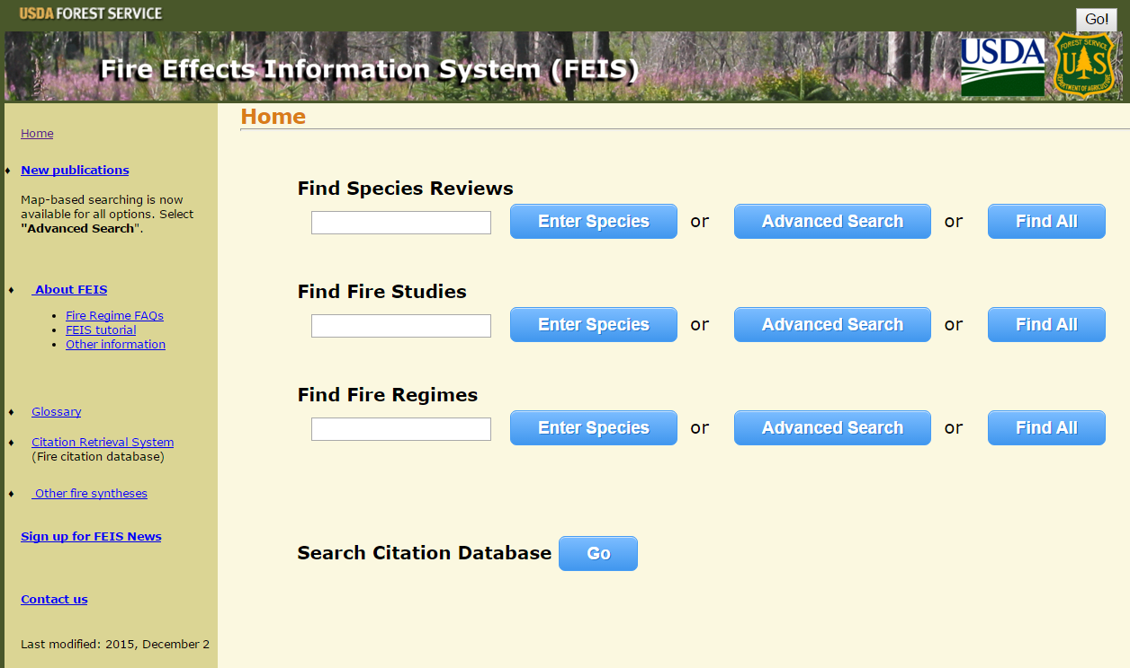
Rocky Mountain Research Station
Fire, Fuel, and Smoke Science Program
Fire Modeling Institute
United States Department of Agriculture n Forest Service
Notes:
For practice using the functions outlined in this webinar, (Enter) look for the FEIS tutorial on the FEIS home page. You can also contact us with any questions (Enter) using the “Contact us” link. We hope you also sign up (Enter) for “FEIS News” to stay up-to-date with the latest information about FEIS. Thank you!

