Slide 1
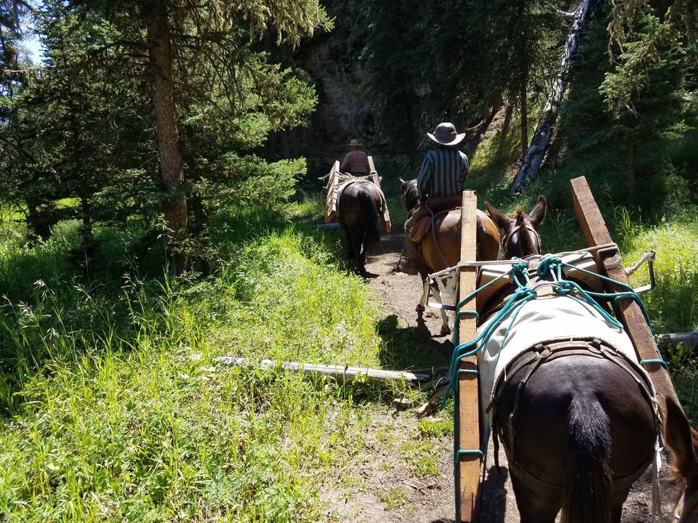
Project Updates from 2021 Approved Projects
GALLATIN RAC

Slide 2
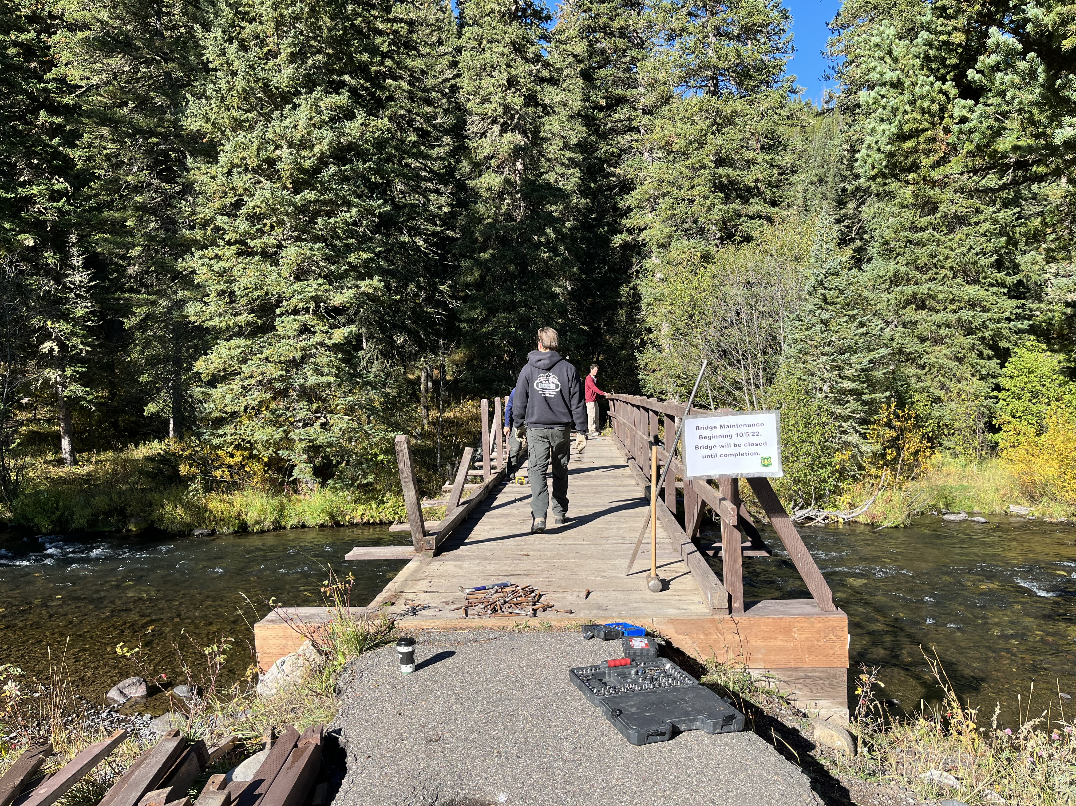
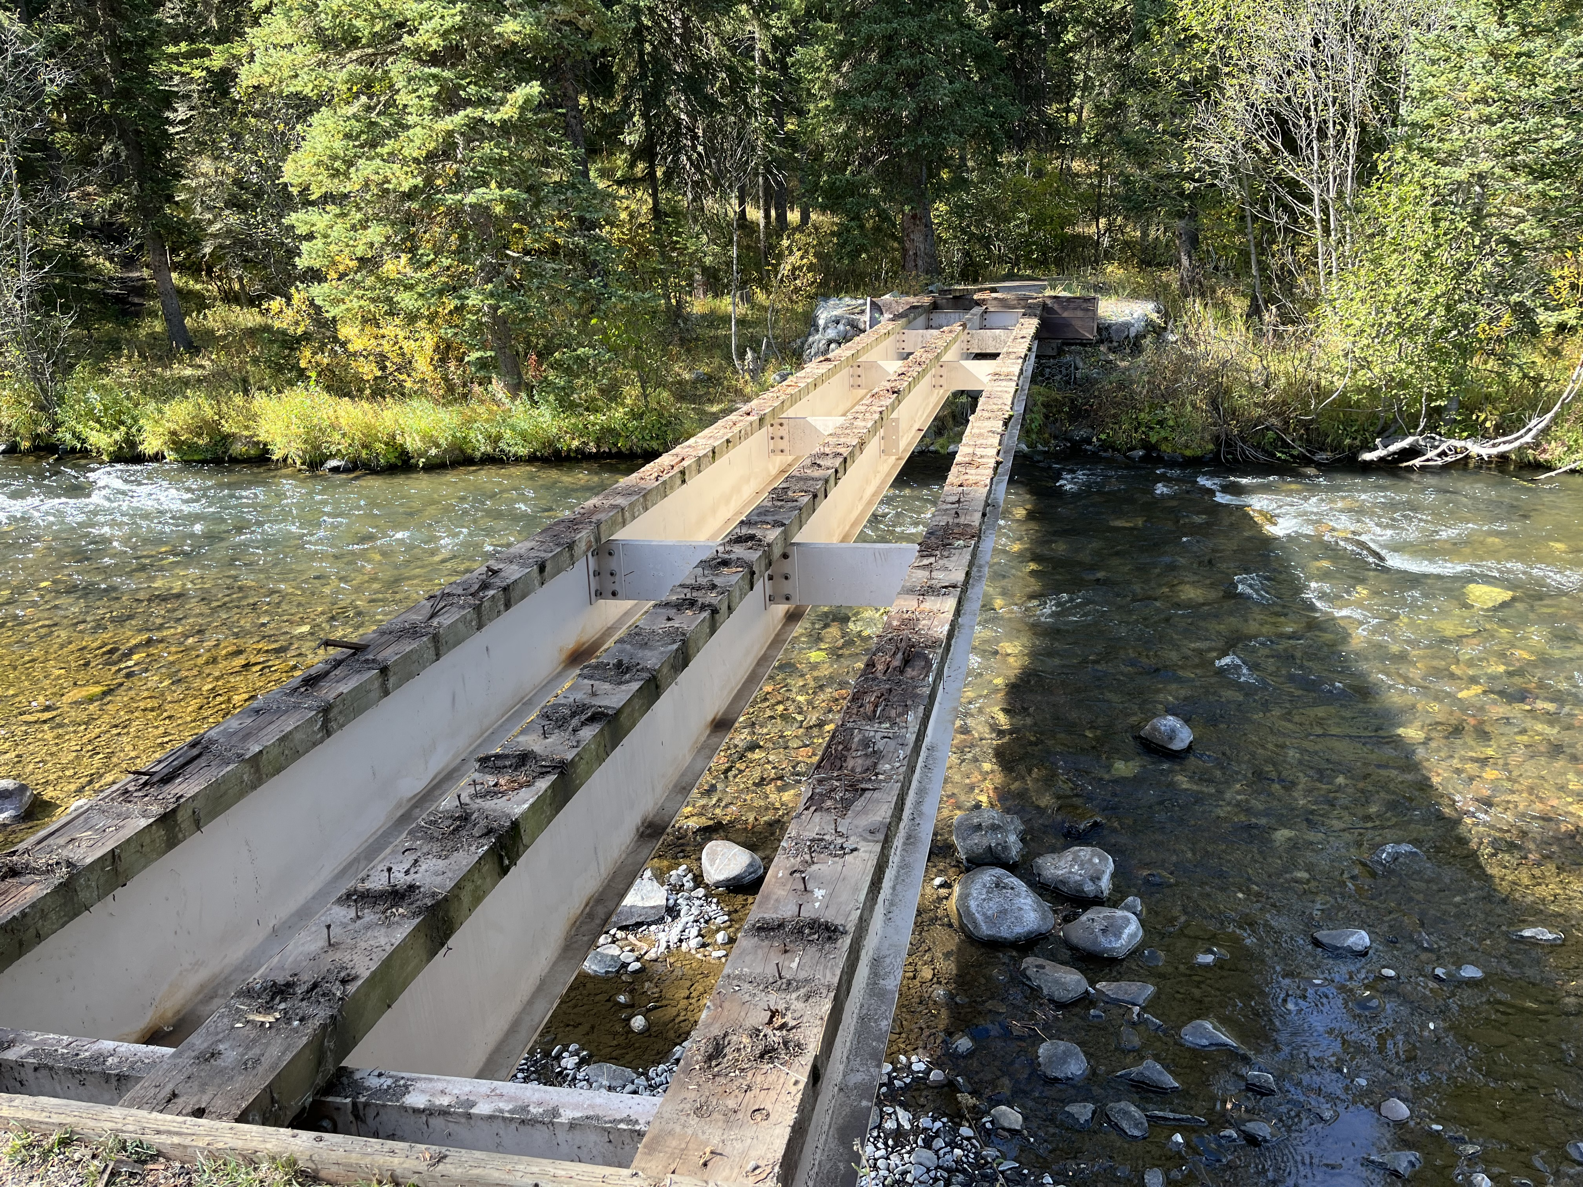
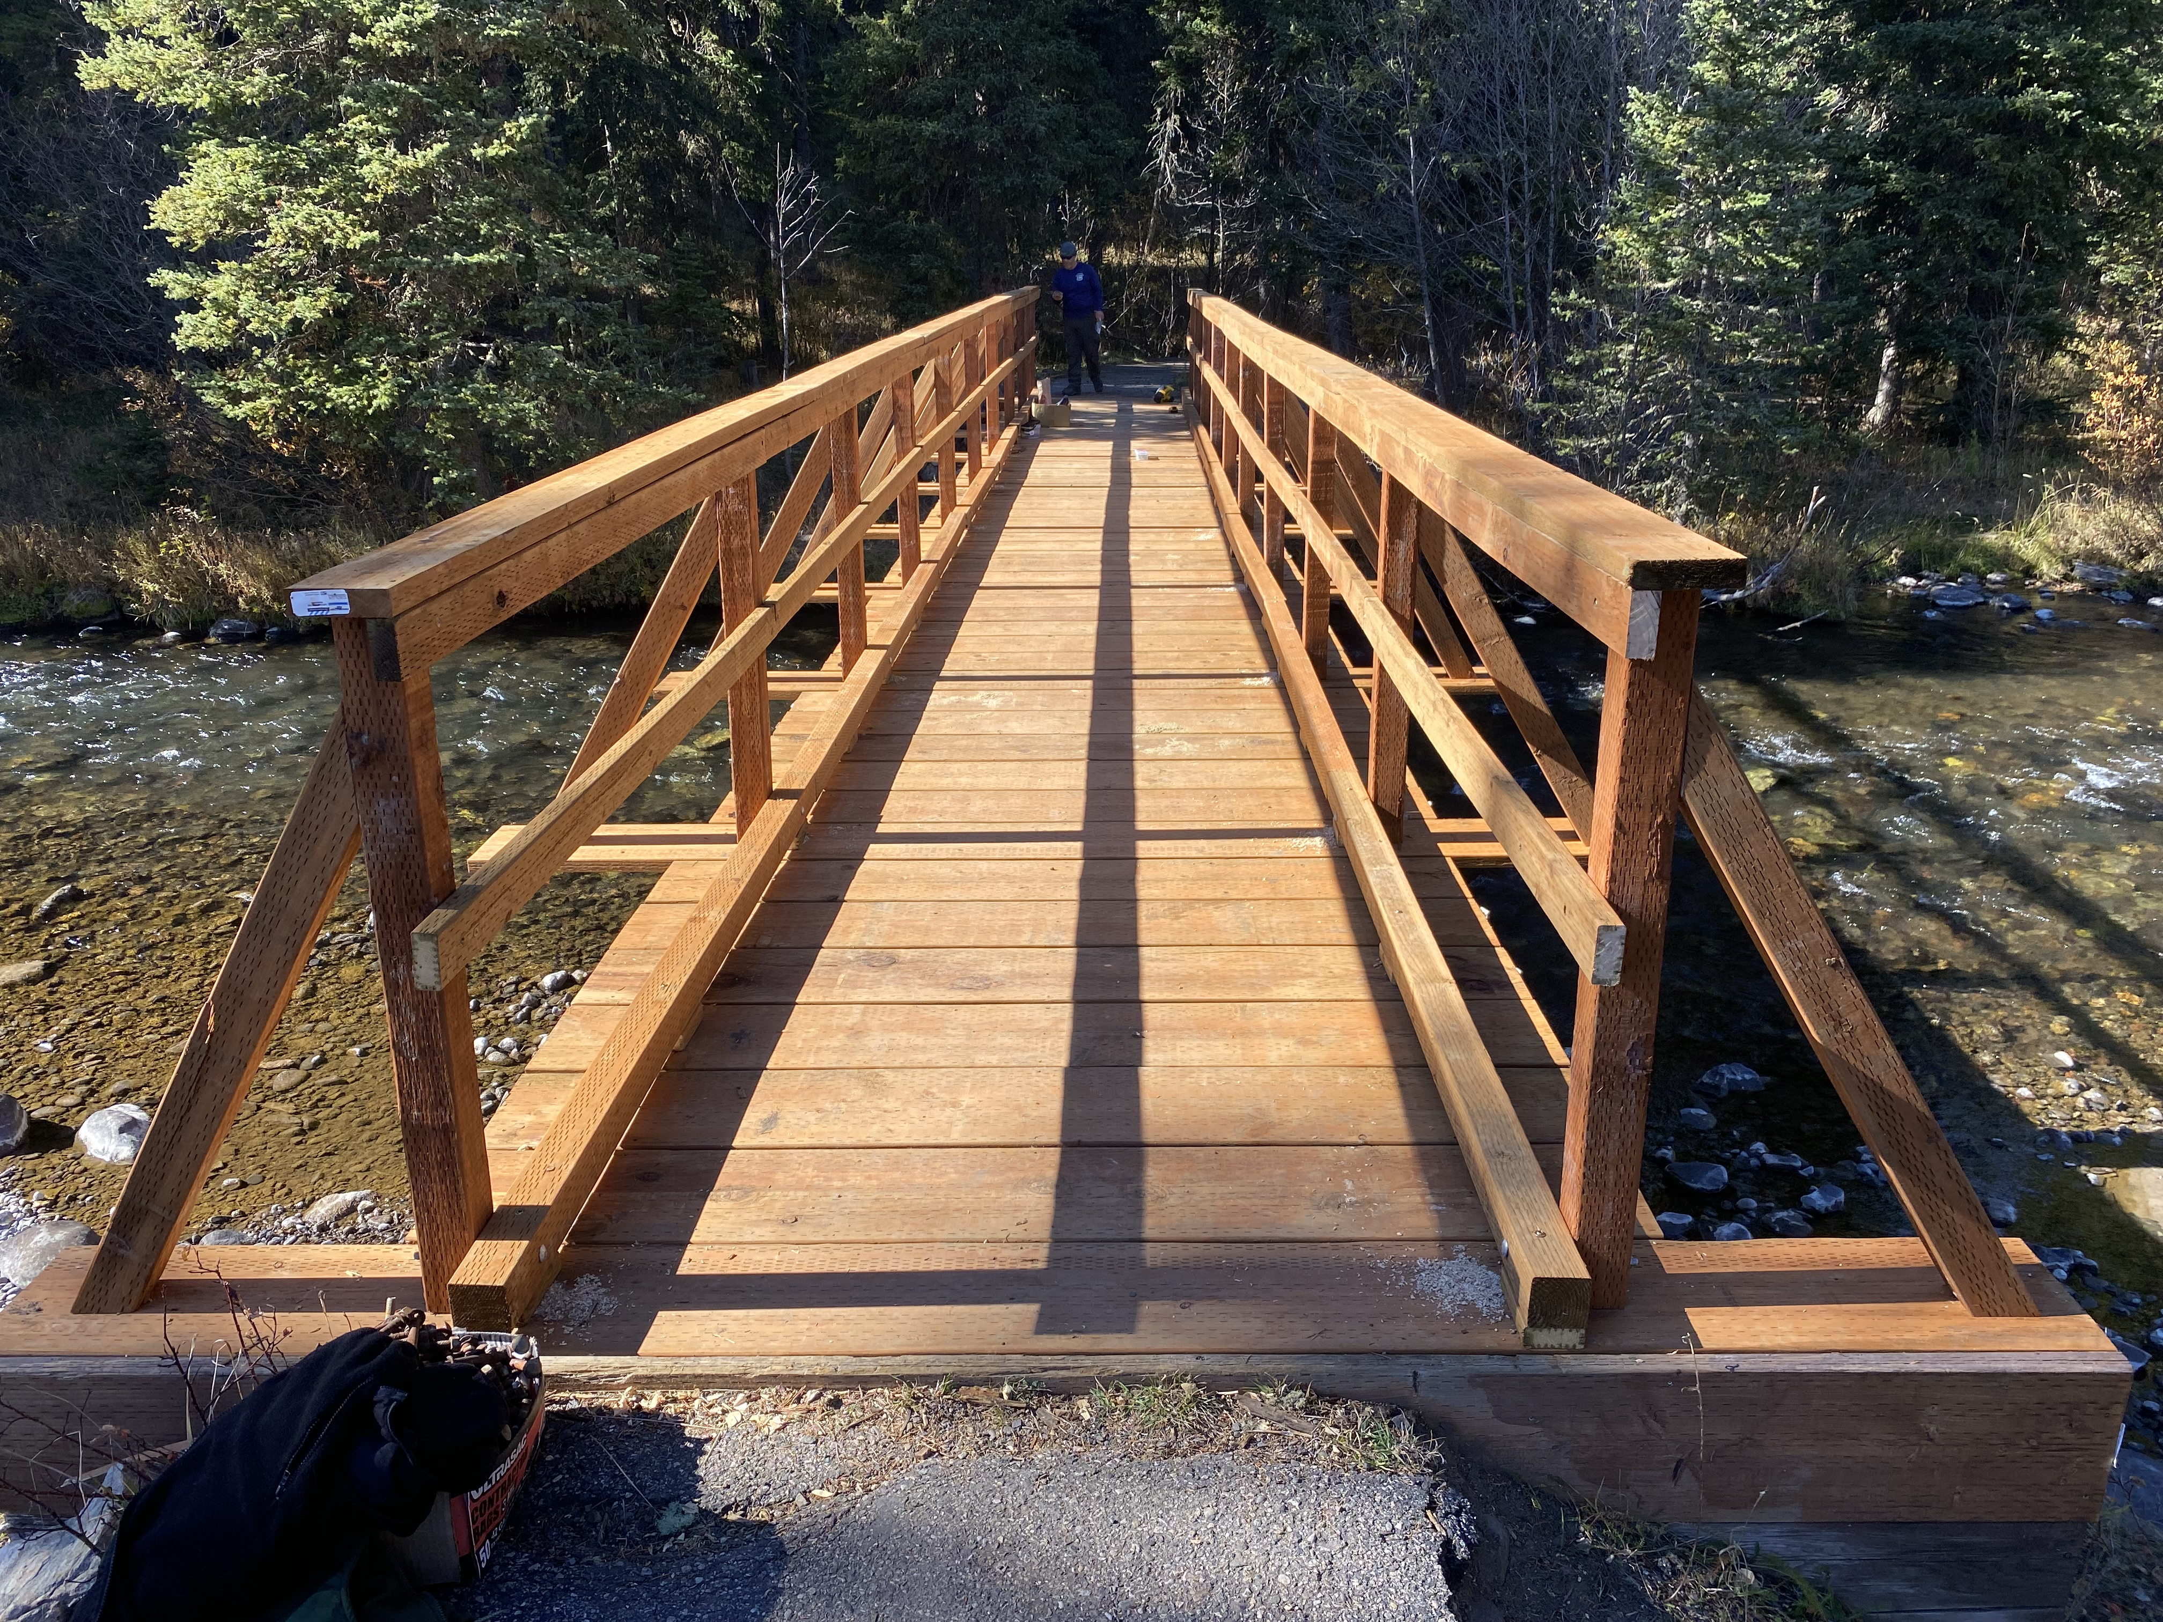
Friends of Hyalite
Awarded: $7,000
Project: Langohr Campground bridge repair and accessible trail improvements

Slide 3
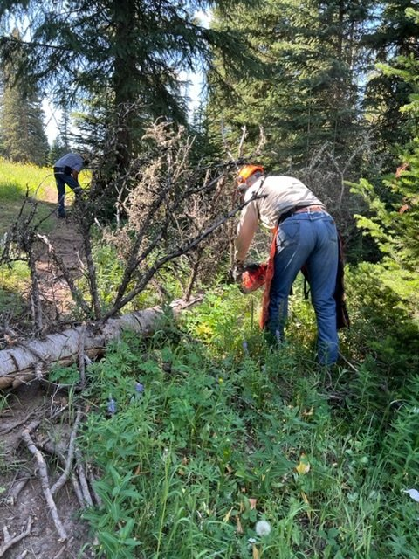
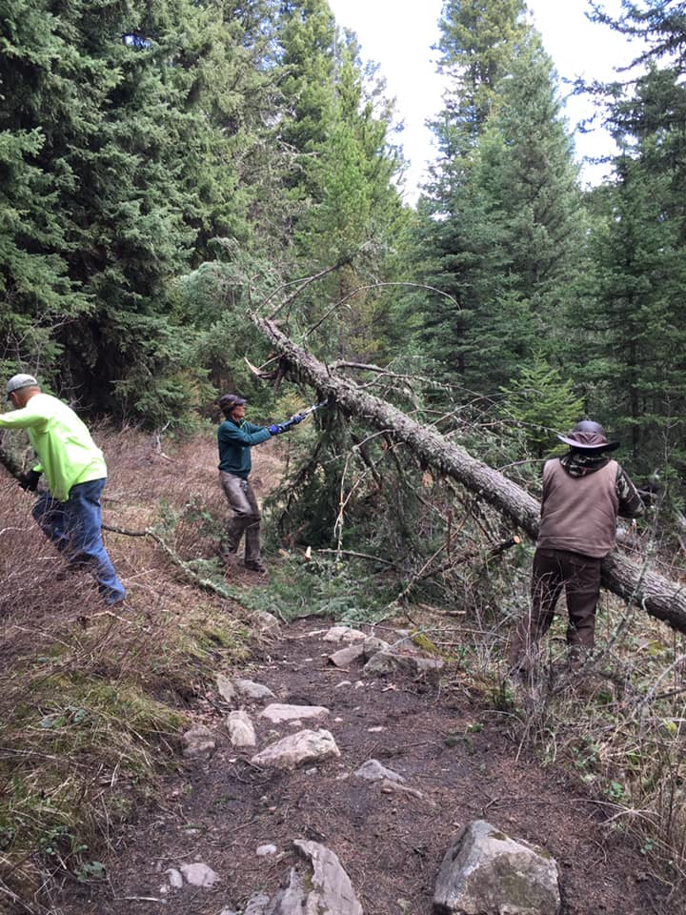
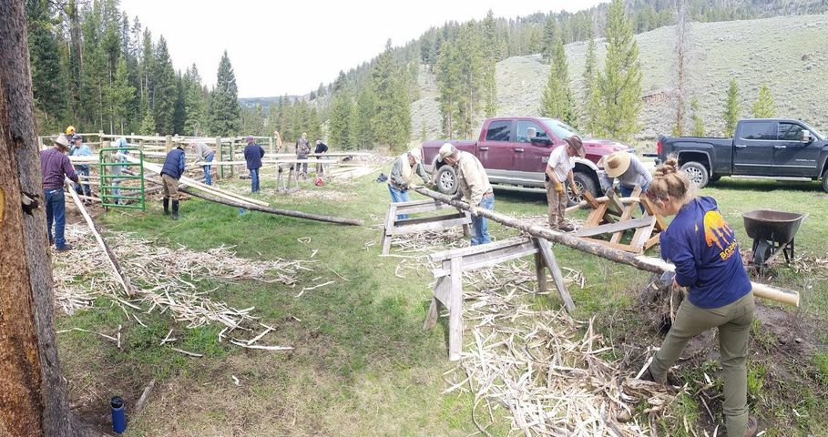
Gallatin Valley Backcountry Horsemen
Awarded: $5,000
Project: Trail maintenance, clearing and other projects supporting Bozeman RD

Slide 4
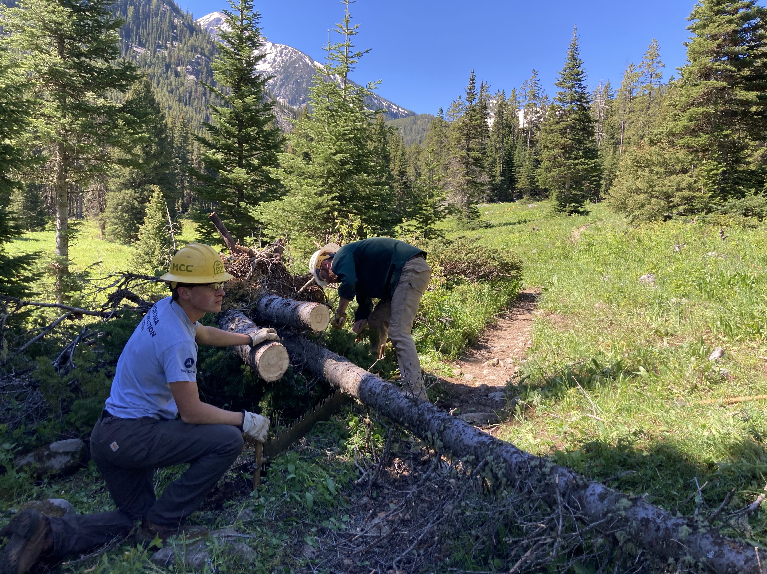
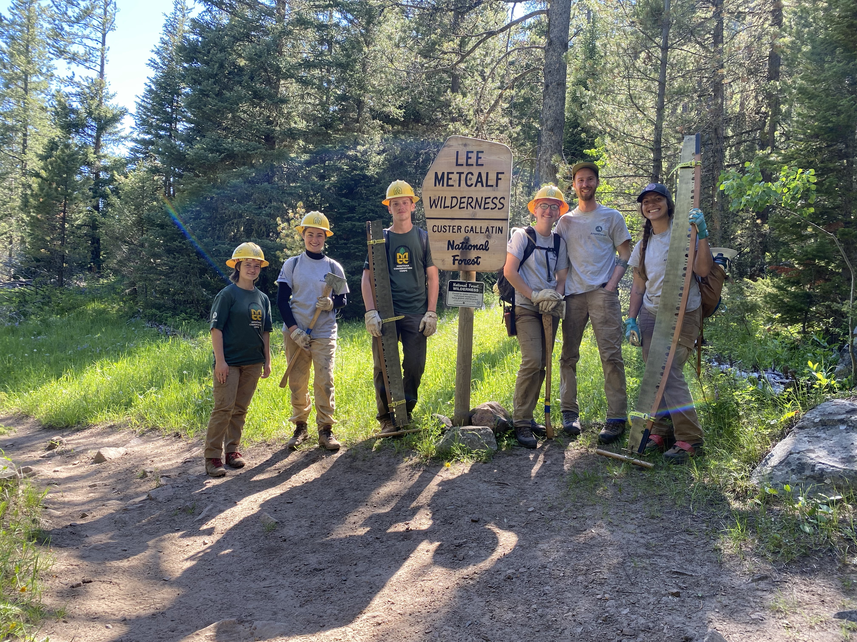
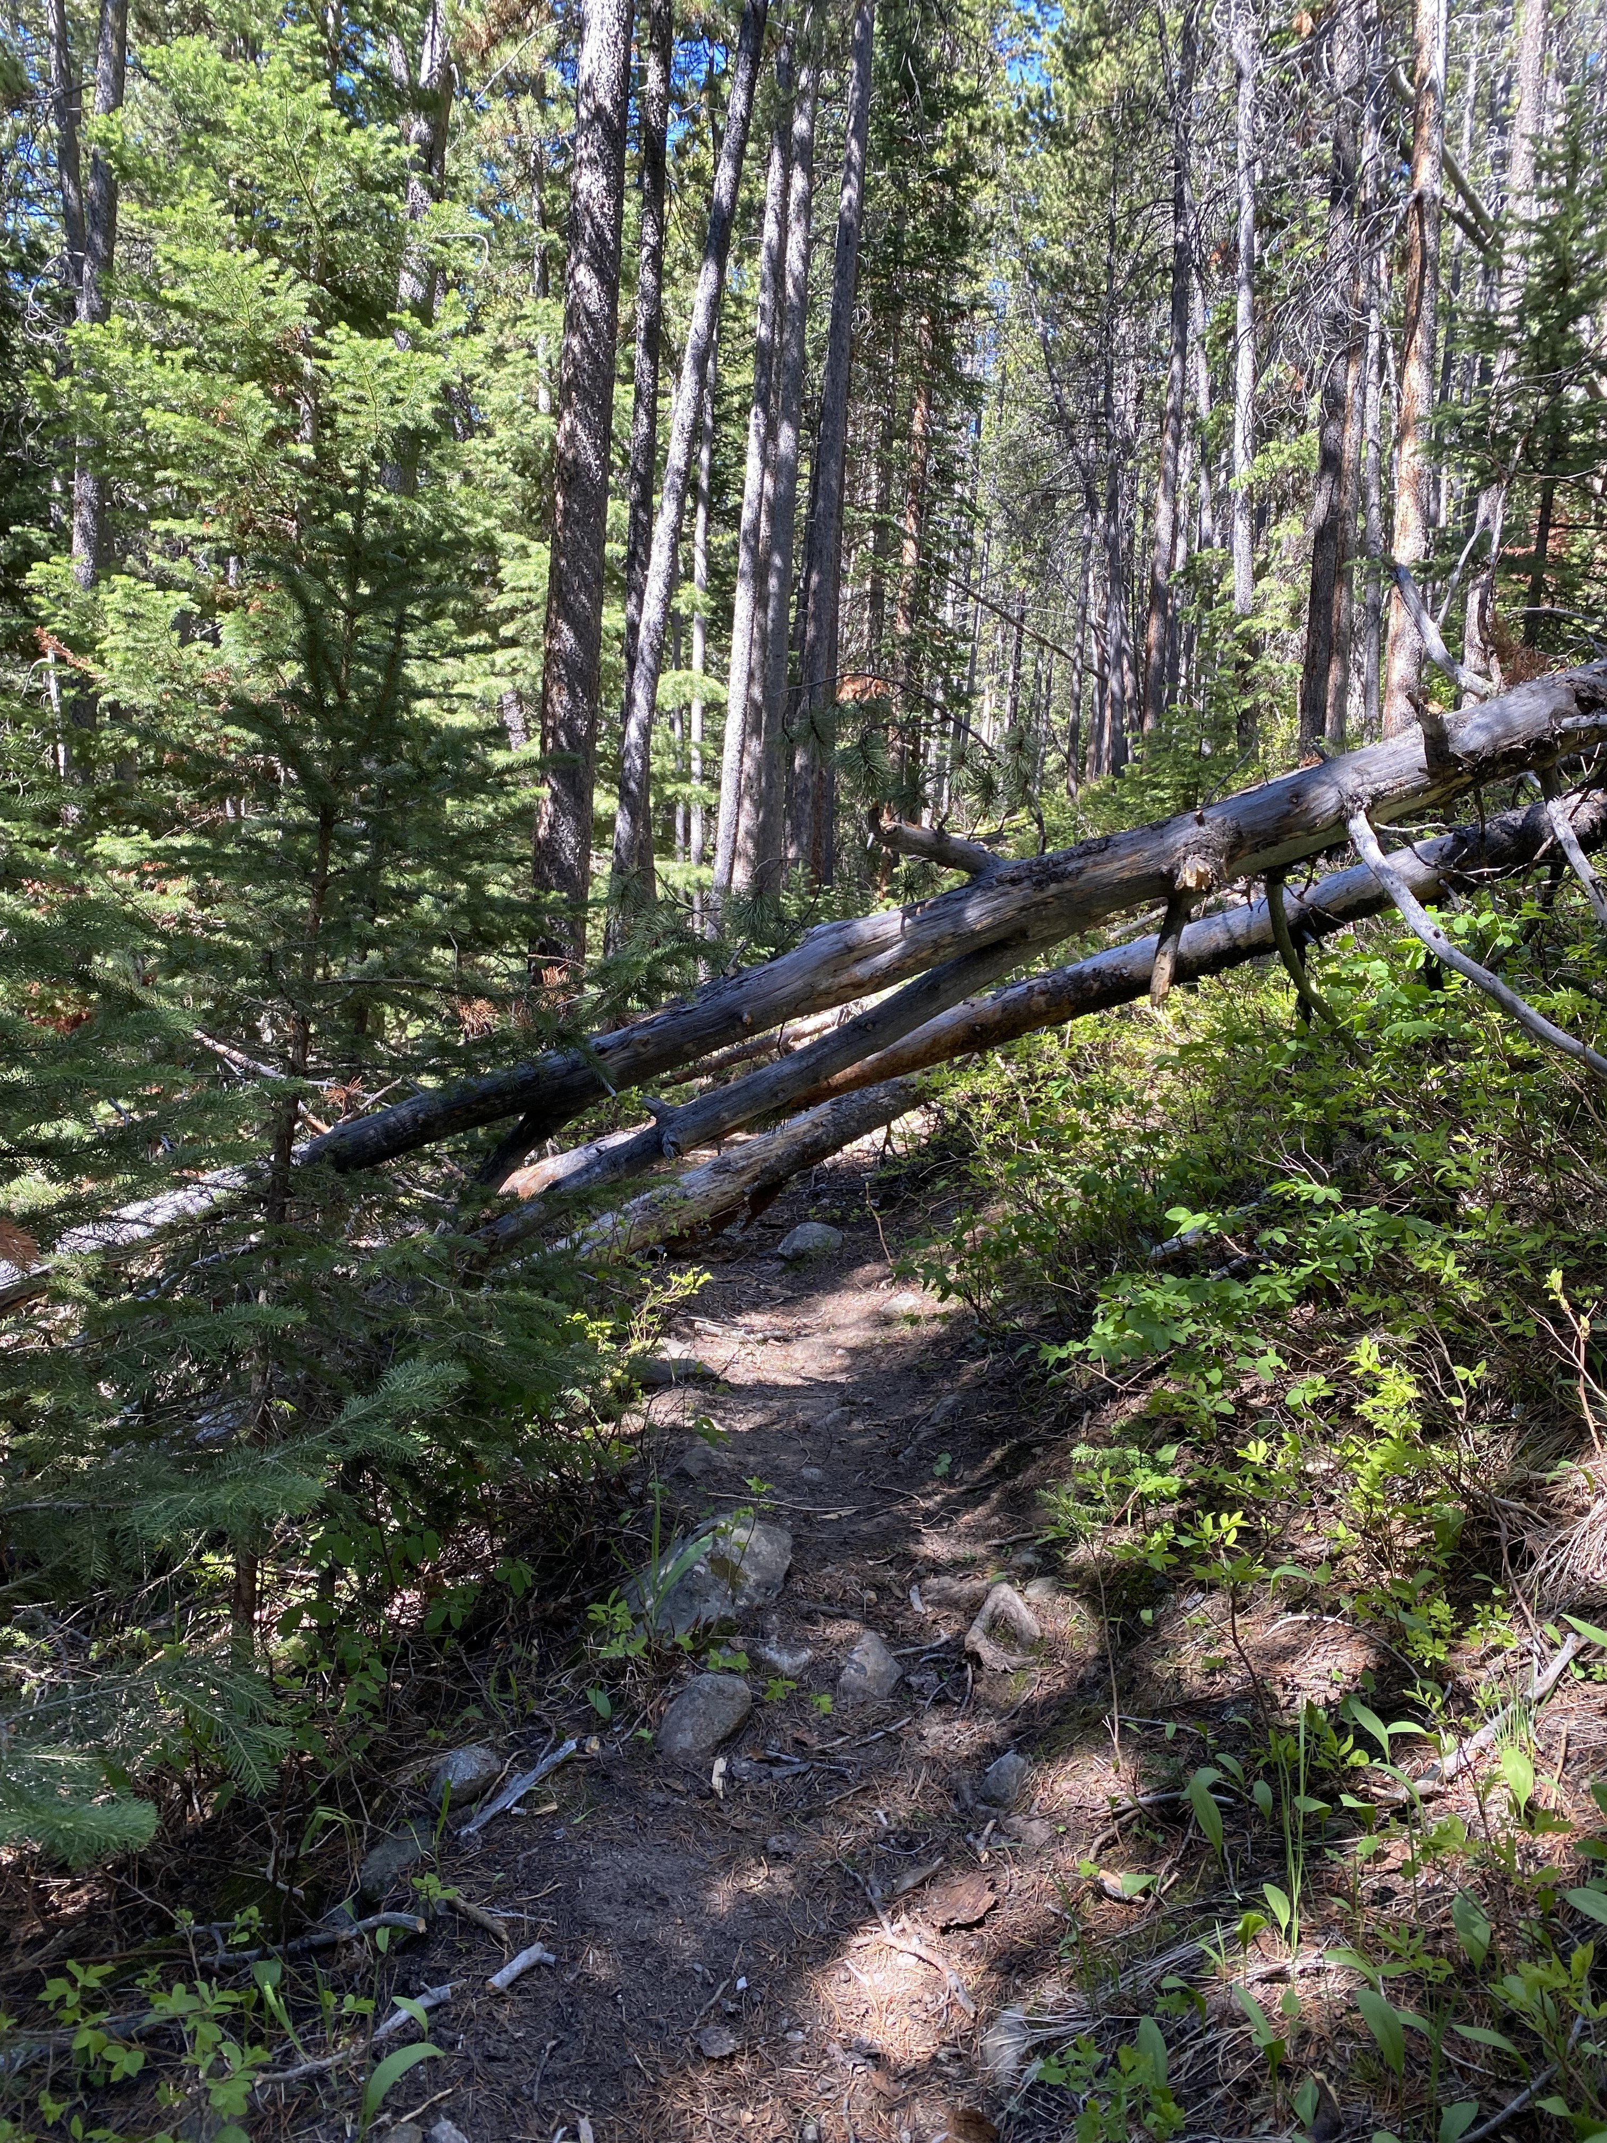
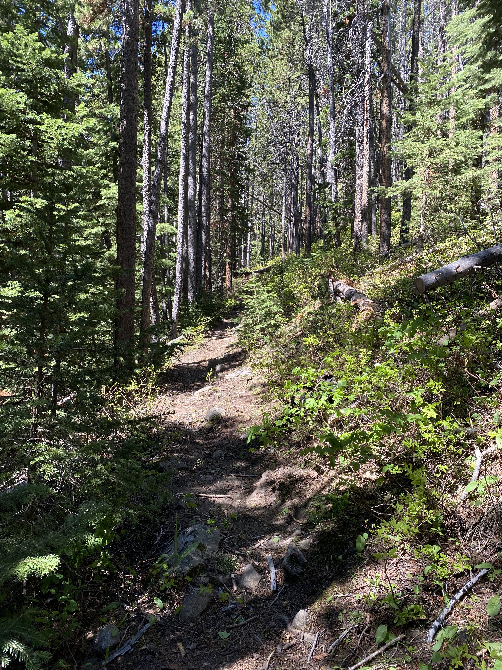
Montana
Conservation
Corps
Award: $19,000
Project: MCC crews perform trail maintenance on Little Hellroaring, Gallatin River Trail and Bridger Foothills Trail

Slide 5
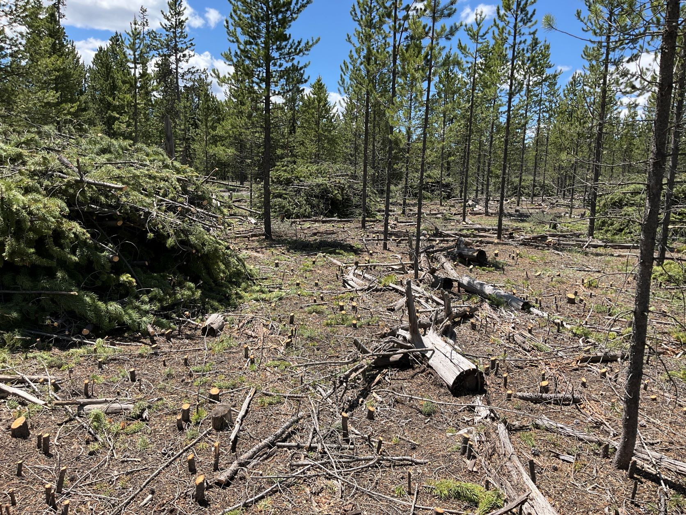
North Hebgen Fuels Project
Awarded: $6498
Project: 11.2 acres of roadside thinning and fuels reduction in the Wildland urban interface near structures and primary residences.

Slide 6
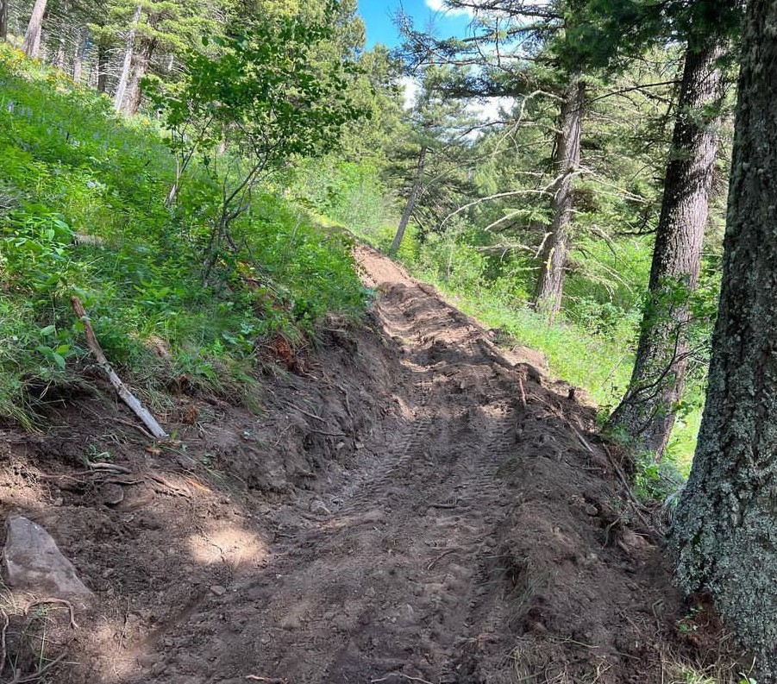
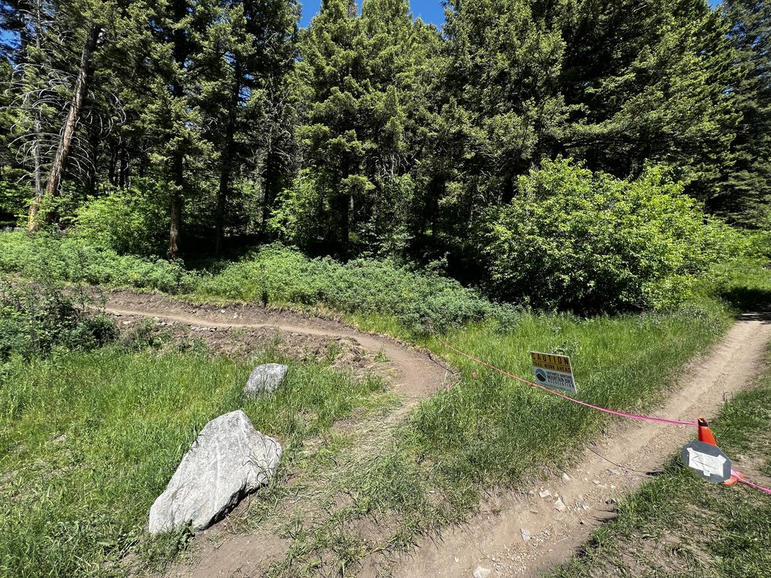
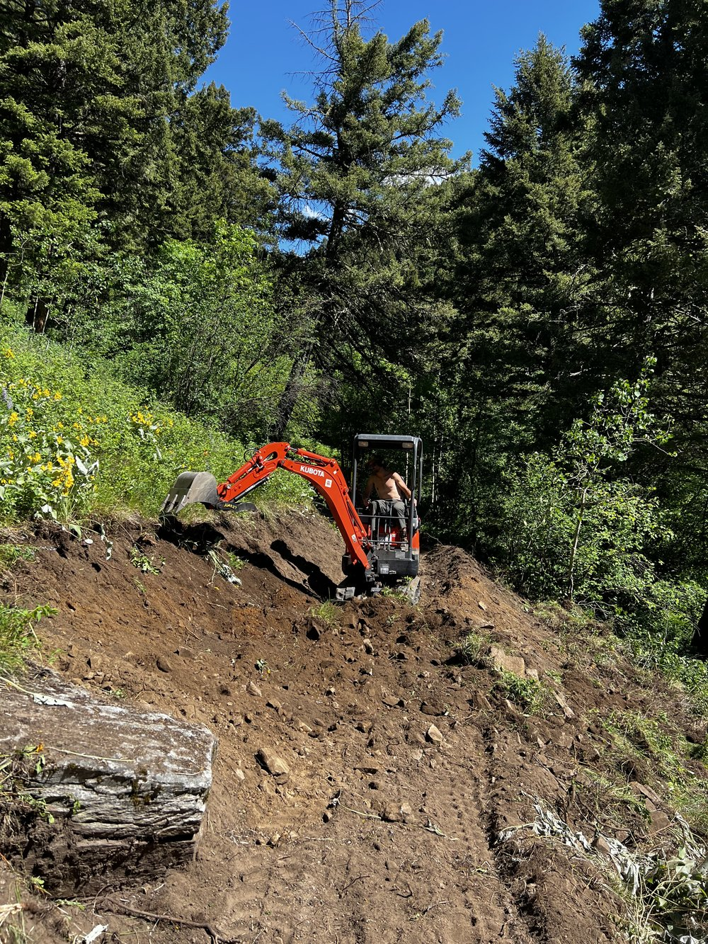
Southwest Montana
Mountain Bike
Association
Award: $9,000
Project: complete roughly 2 miles of trail rehabilitation on the downhill section of Leverich Canyon.

Slide 7
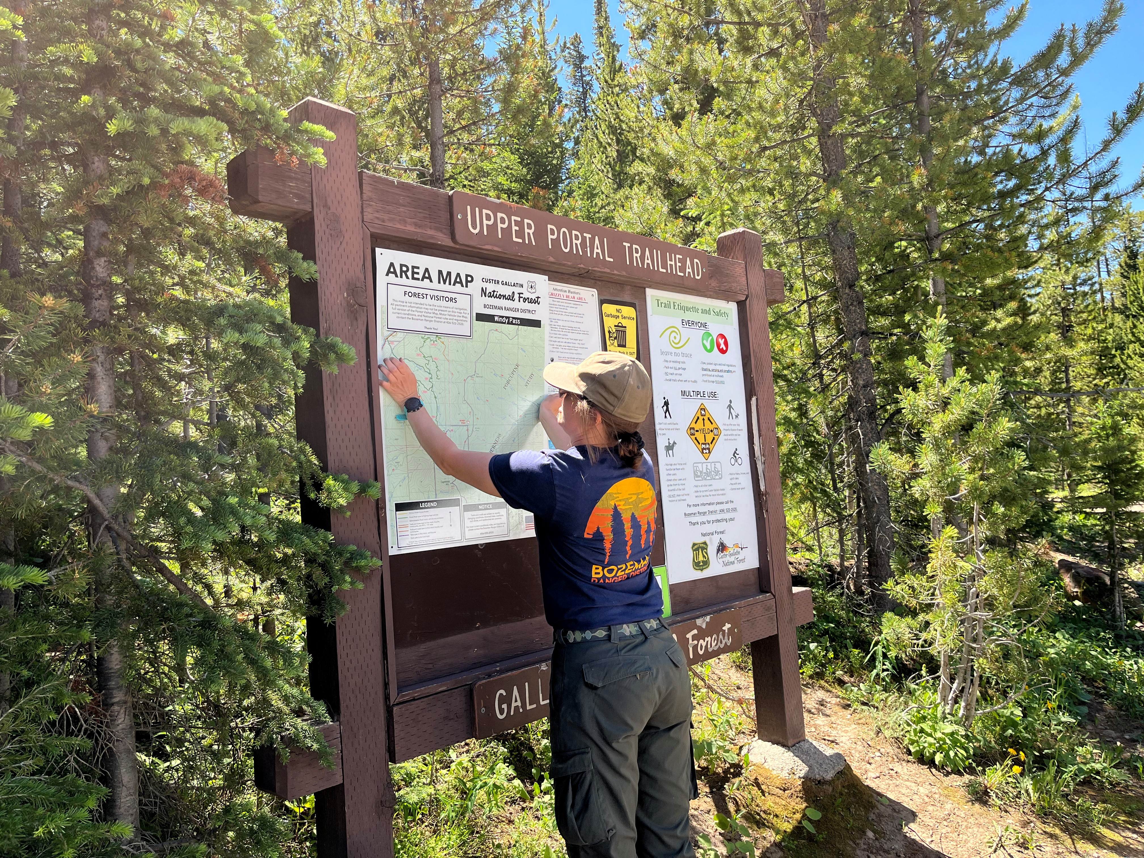
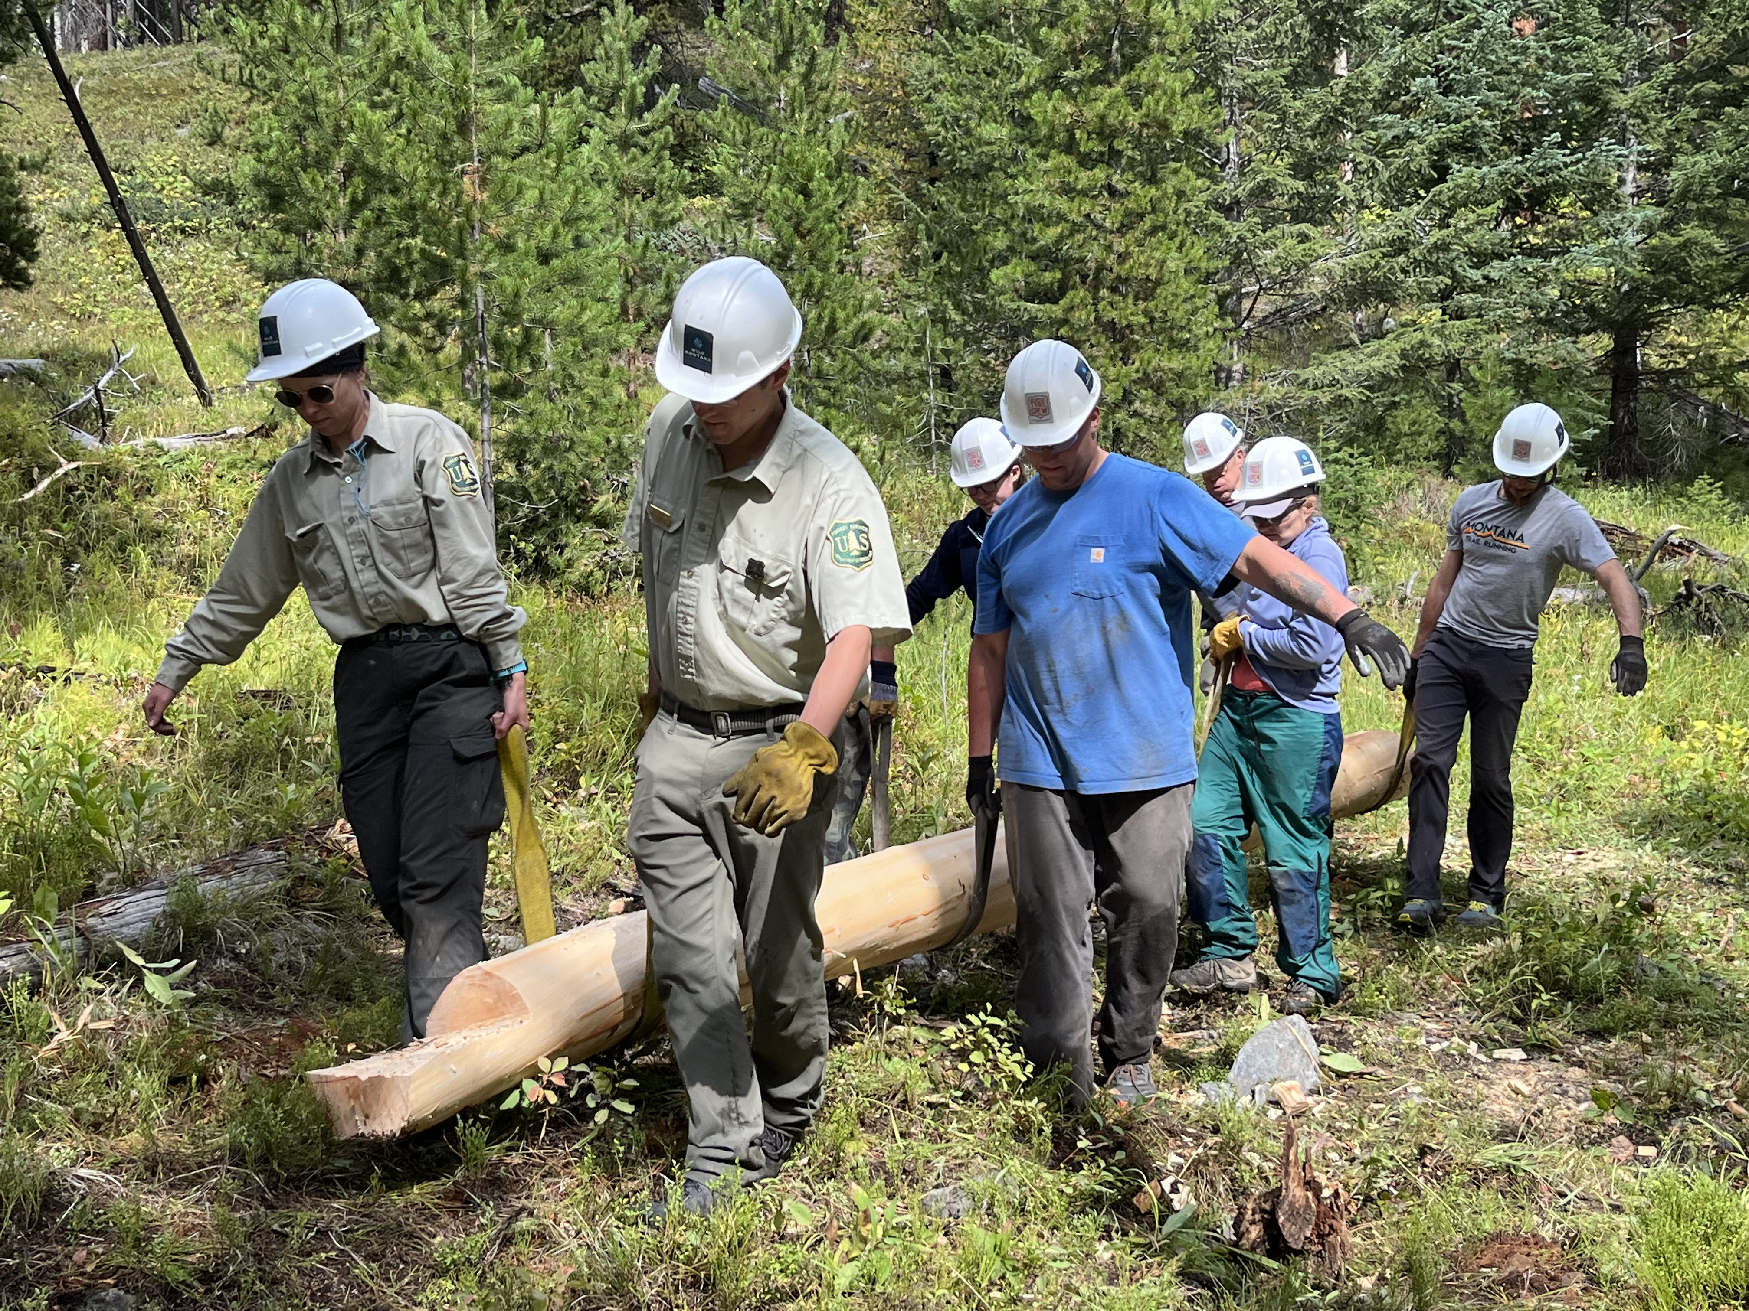
Wild Montana
Award: $7,500
Project: to support partial salary of a second Wilderness Ranger for the Spanish Peaks Wilderness and Hyalite Porcupine Buffalo Horn Wilderness Study Area

Slide 8
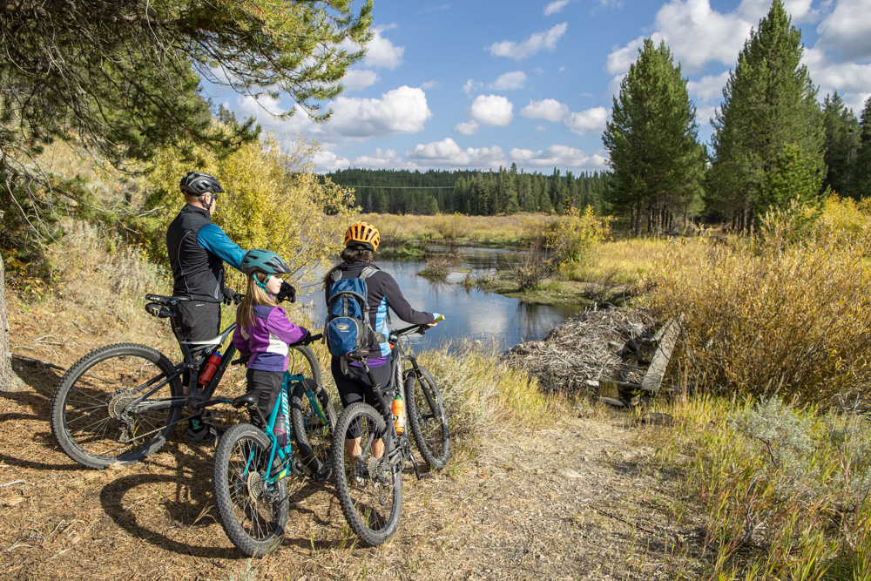
Past Projects and Committee Accomplishments
North Cottonwood Bridges
Hyalite Day Use Improvements
Gallatin Invasive Species Alliance
Yellowstone Shortline Trail

Slide 9
Past Projects and Committee Accomplishments
Pioneer Lakes trail
Battle Ridge Campground Improvements
MCC Trail Work
Gallatin Valley Backcountry Horsemen
2021 RAC projects $128,288

Slide 10
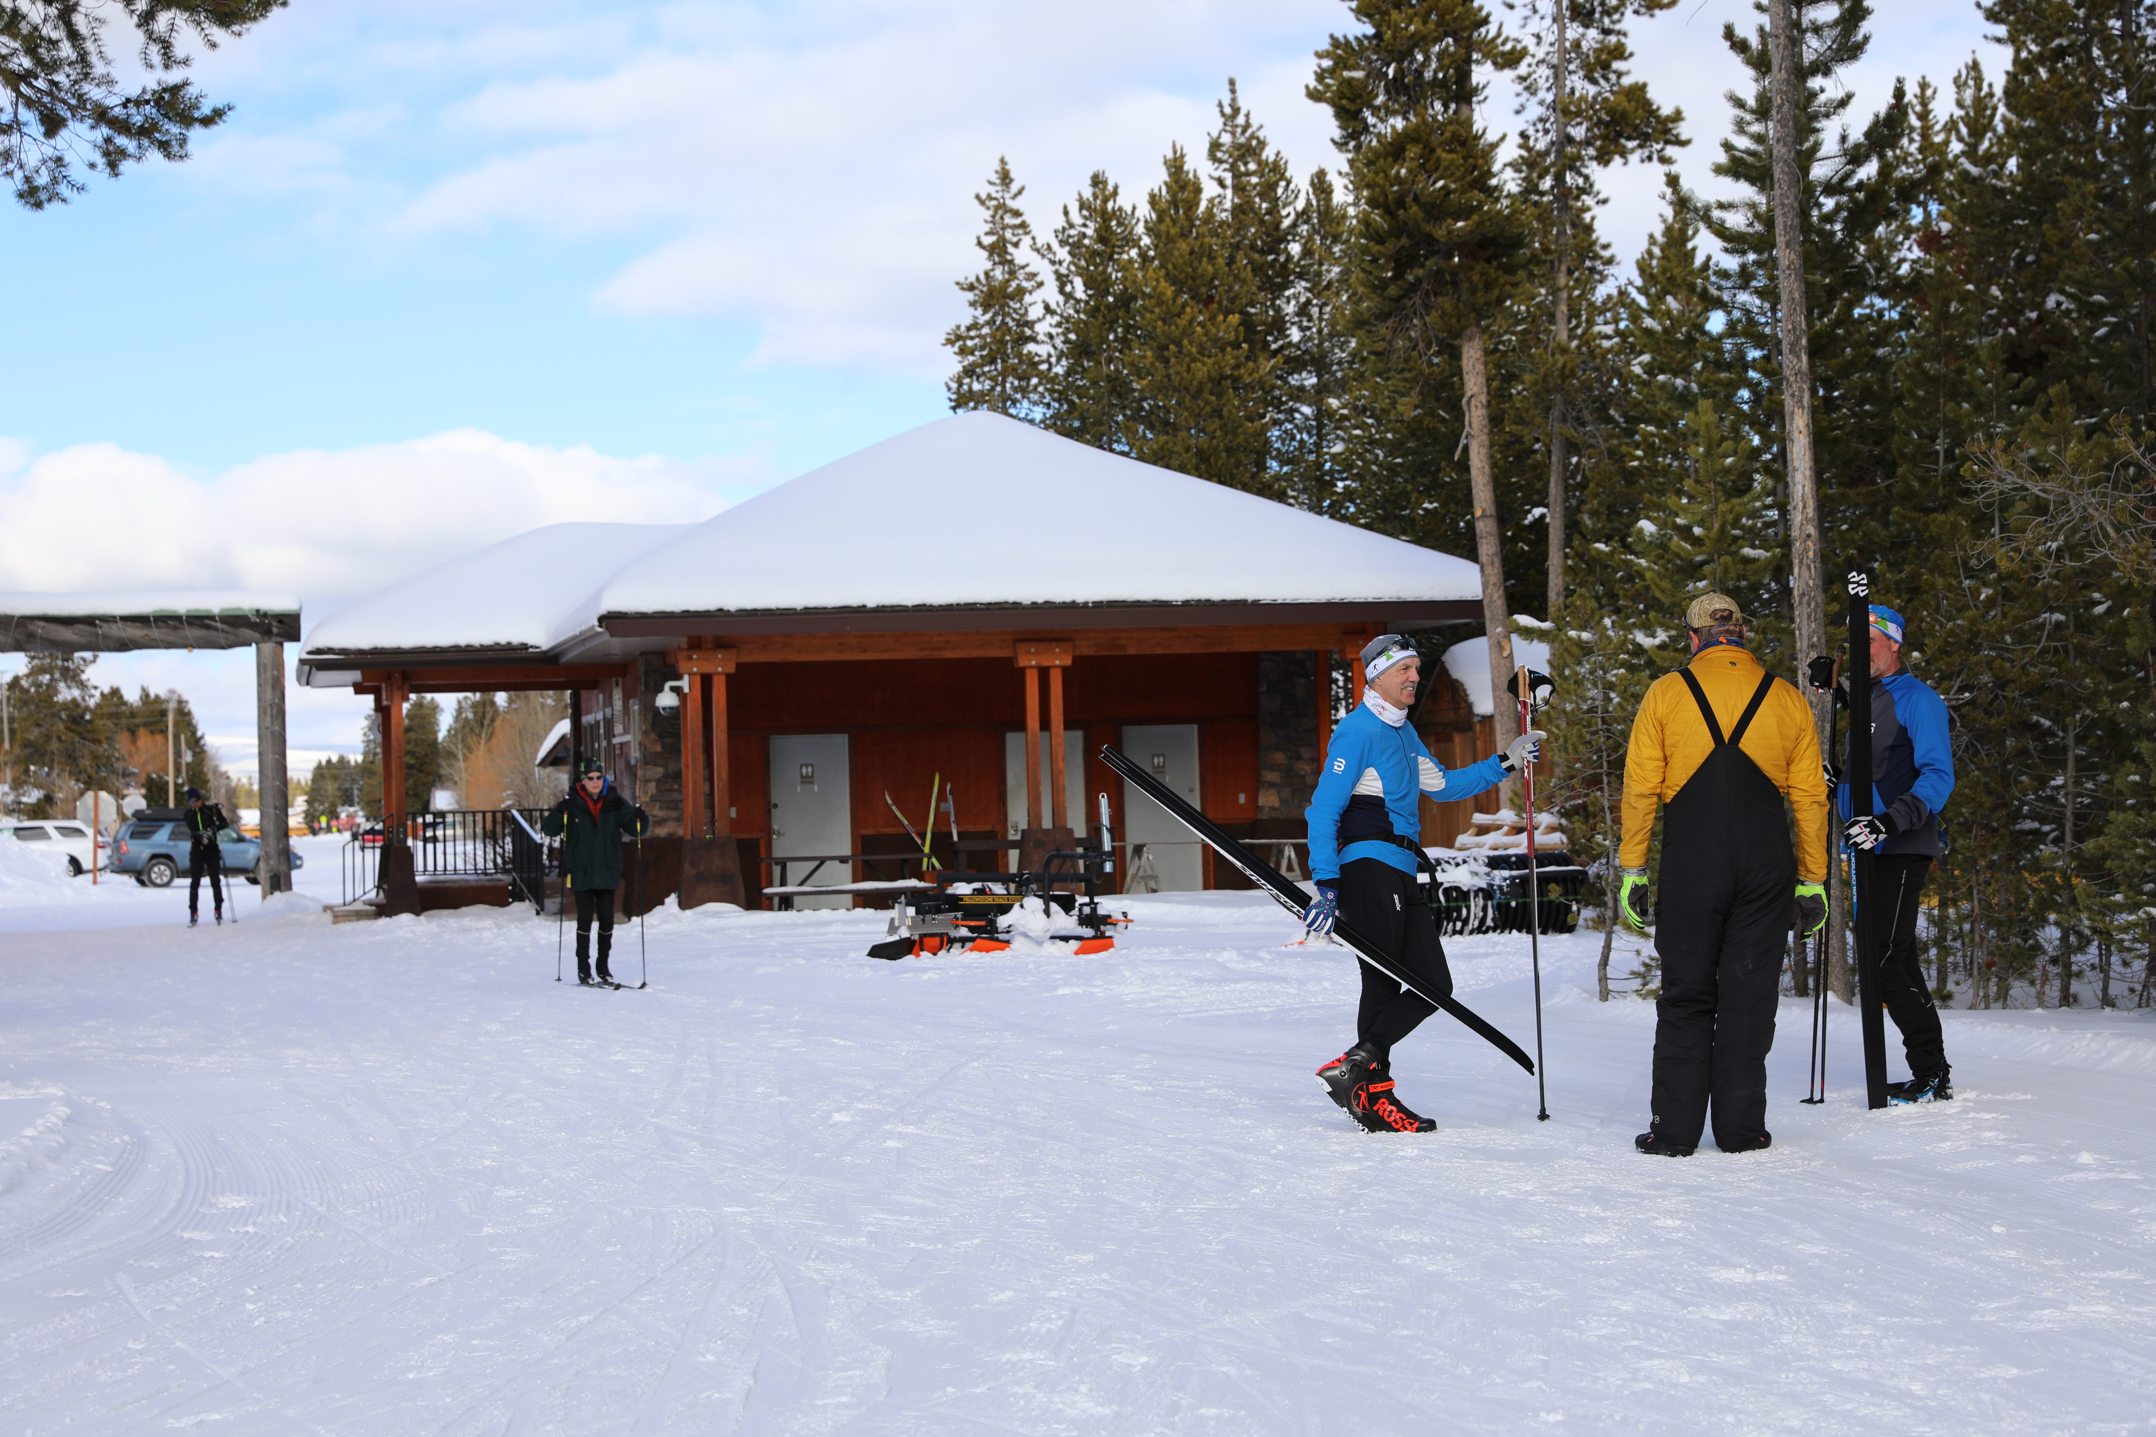
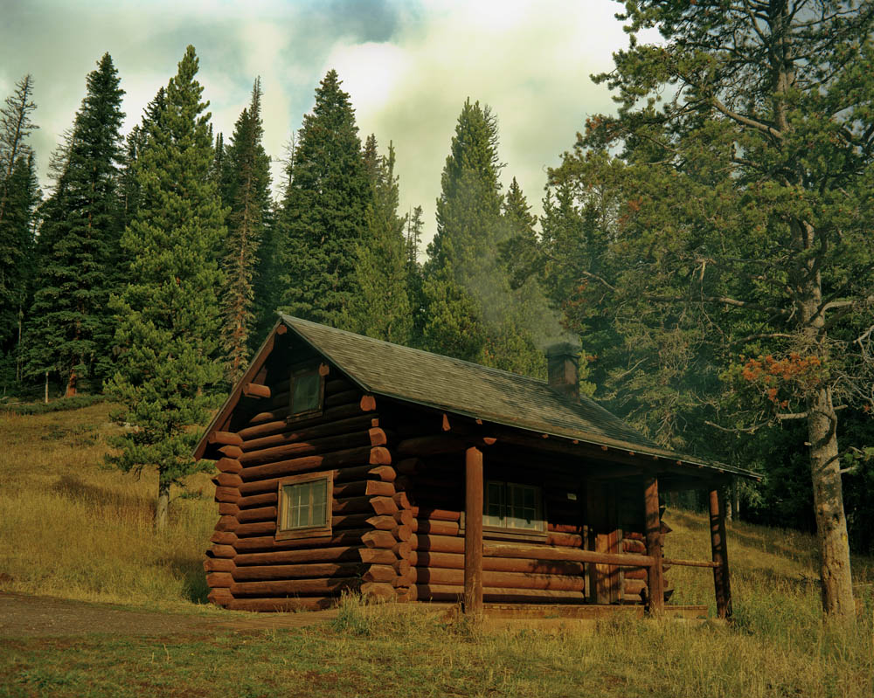
Dec 2020 Fee Review
The RAC Recommended increasing fees at 19 Developed recreation sites, including rental cabins, 3 campgrounds and Rendezvous Ski Area. This has resulted in additional revenue, a large majority of which comes directly back to our forest for:
Staffing
Cabin Improvements Examples
Rendezvous Ski Area
$217,500 goes into salary for permanent and seasonal employees
Conversion of permanent seasonal employees into permanent full time
Funds go toward hiring summer MCC interns
Funds go toward funding vehicles for program
Funded a winter employee to focus on Rendezvous
Increased contribution to WYSEF for grooming from $20k to $30k this year, plans to contribute $40k next year
New firewood shelters (HLRD)
New roof on Fox Creek (BRD)
Purchase firewood supply (BRD)

Slide 11
Fee Collection Amounts:
2019 $316,248
2020 $331,569
Fee Increase Implemented spring 2021
2021 $471,819
2022 $535,143
* note numbers are for collections forest-wide and were impacted by variables like covid and 2022 flooding. We also still have one cabin and campground to open with a fee next year, so we anticipate even higher collections.

Slide 12
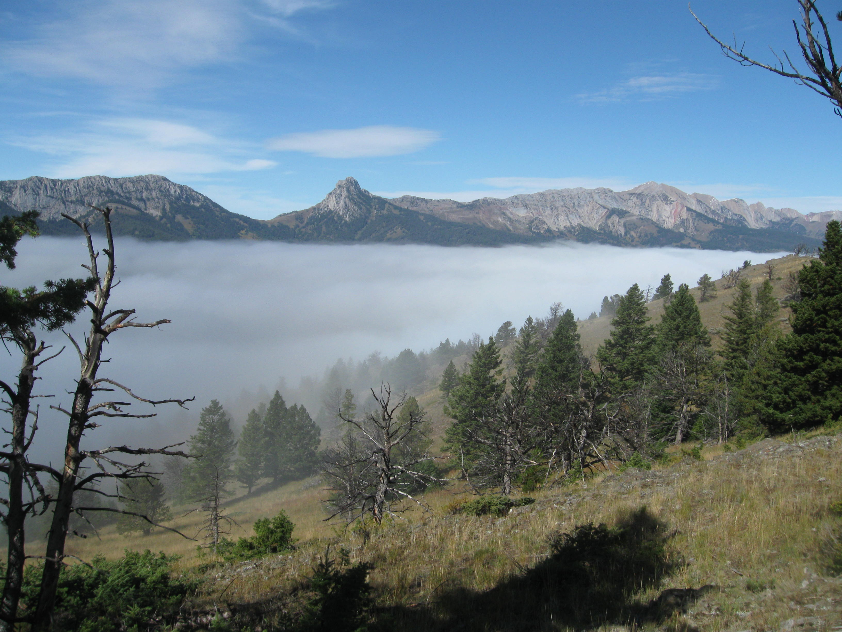
Thank. You.
For your time and energy, the effort and care that you put into serving on the RAC. This is a responsibility you each volunteered to take on and we are immeasurably thankful for that dedication. Your roles were essential in spending these dollars on beneficial projects across our portion of the Custer Gallatin. Thank you!

