Slide 1
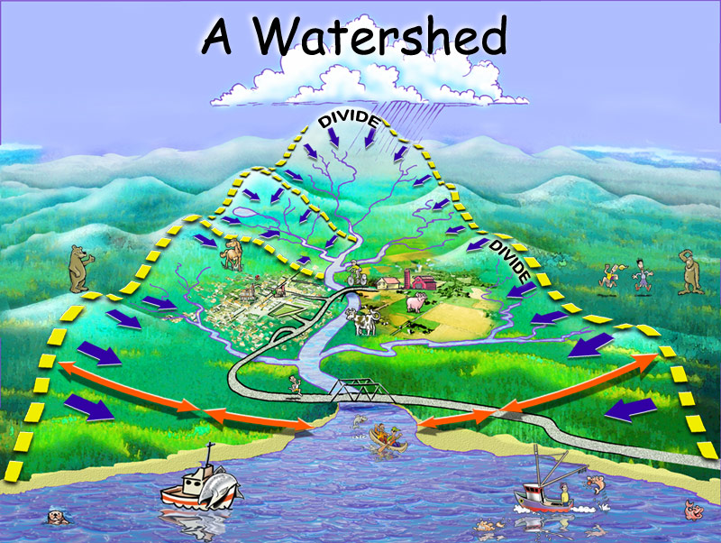
Lidar Use for NHD Layer Update
Siuslaw NF – Lidar point cloud colorized with RGB
Notice the water is flowing DOWN the hill.

Slide 2
Topics for Today
Lidar Availability
Stream Development Methods
  Overall Process
  Required Skills – Who can do it?

Slide 3
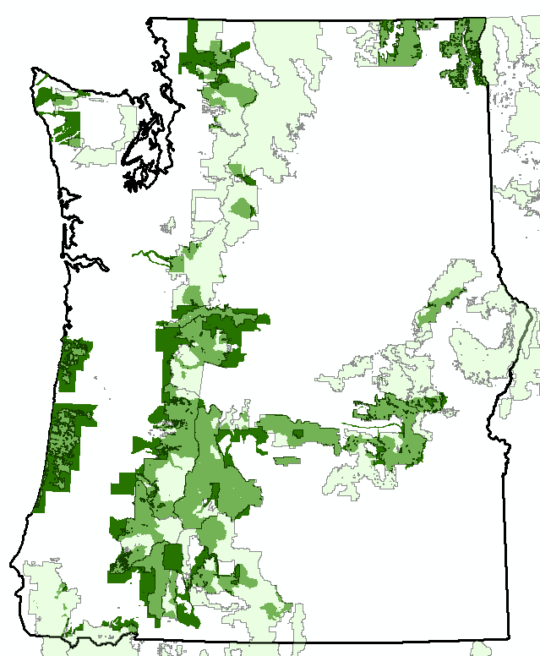
Lidar Availability
T:\FS\Reference\GIS\r06\LayerFile\ImageryAndClassifiedImagery\

Slide 4
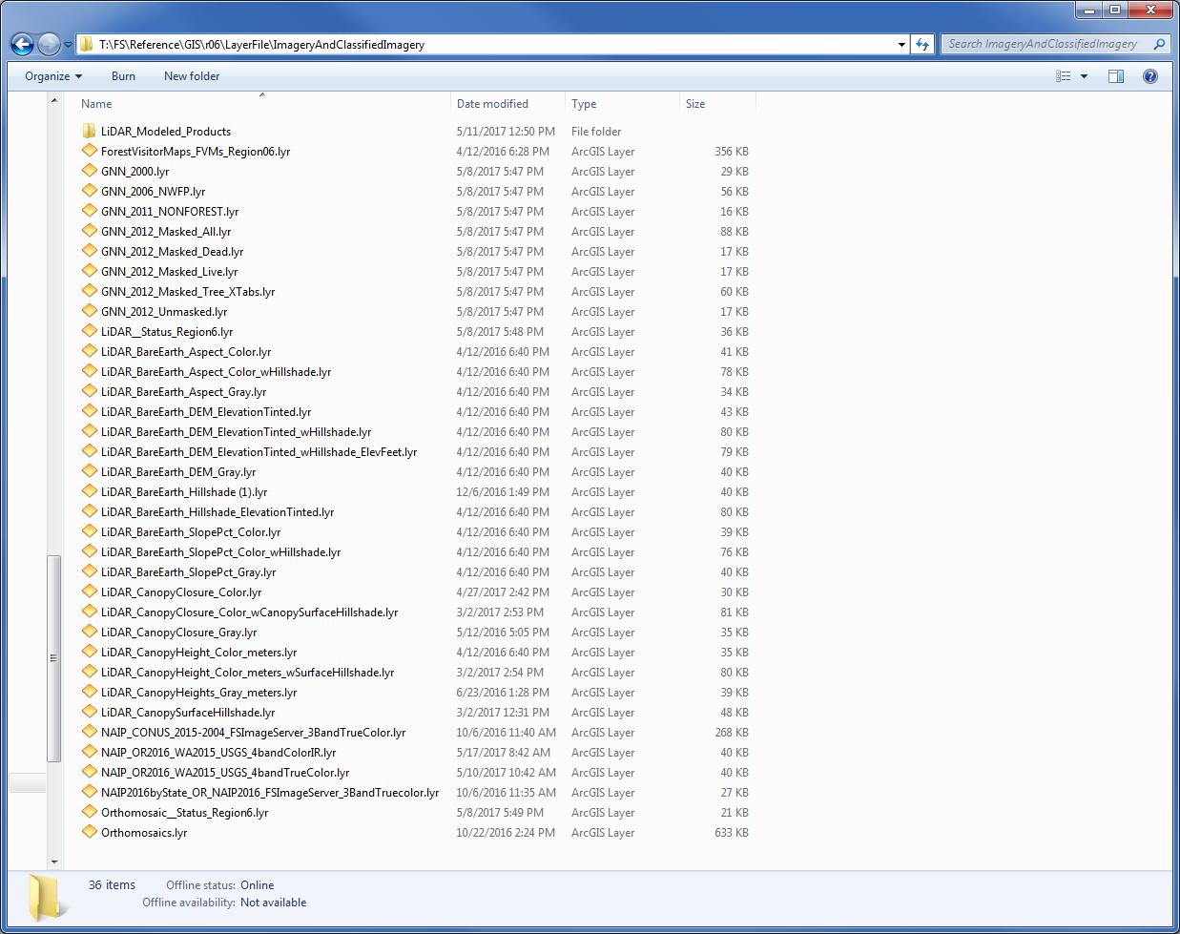
Lidar Availability

Slide 5
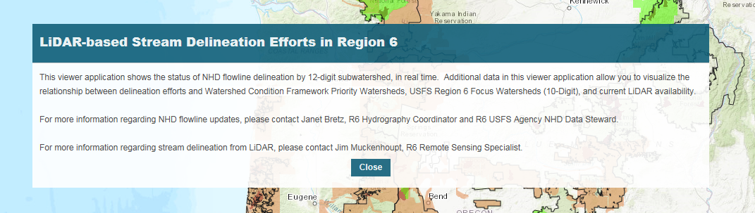
NHD Update Status
https://usfs.maps.arcgis.com/apps/View/index.html?appid=c597c56df3e14155a6a08445c07a7f56

Slide 6
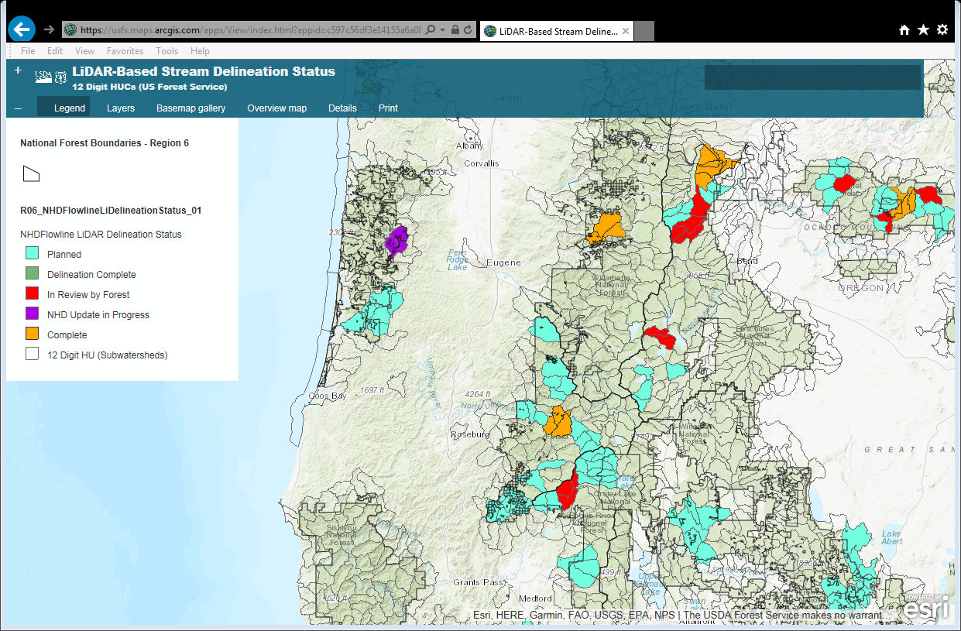
NHD Update Status

Slide 7
Hurdles – Stream Starting Points
In a perfect world there would be a constant threshold of upslope area that creates a stream.
In our world that threshold will vary across a watershed.
4 out of 5 hydrologists agree that streams will begin where the visible channel begins on the dem.

Slide 8
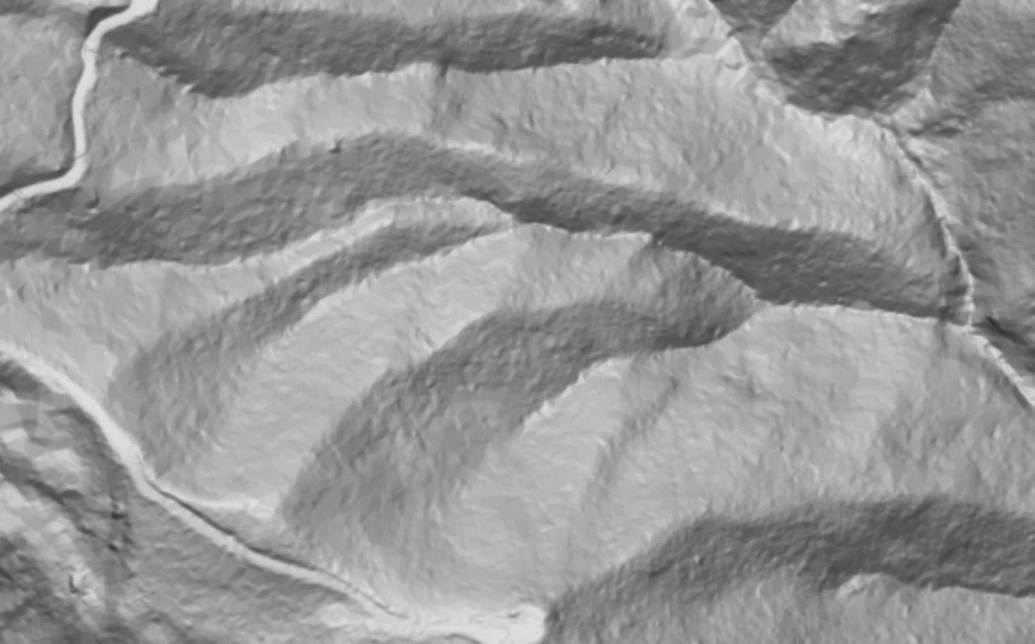
Hurdles – Stream Starting Points

Slide 9
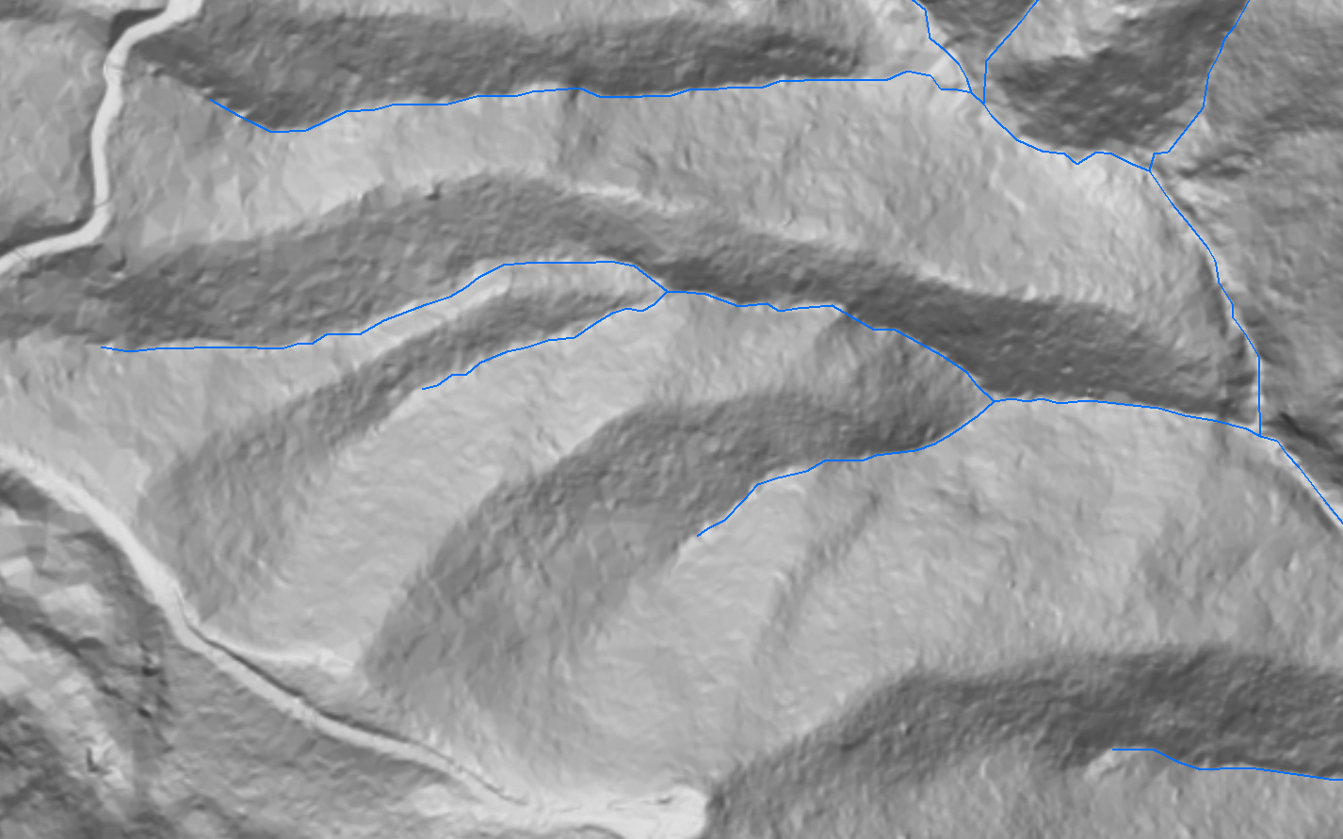

Hurdles – Stream Starting Points

Slide 10
Hurdles – Culverts
The high resolution of the dem results in water accumulating and sometimes running down a road where there is a culvert.

Slide 11
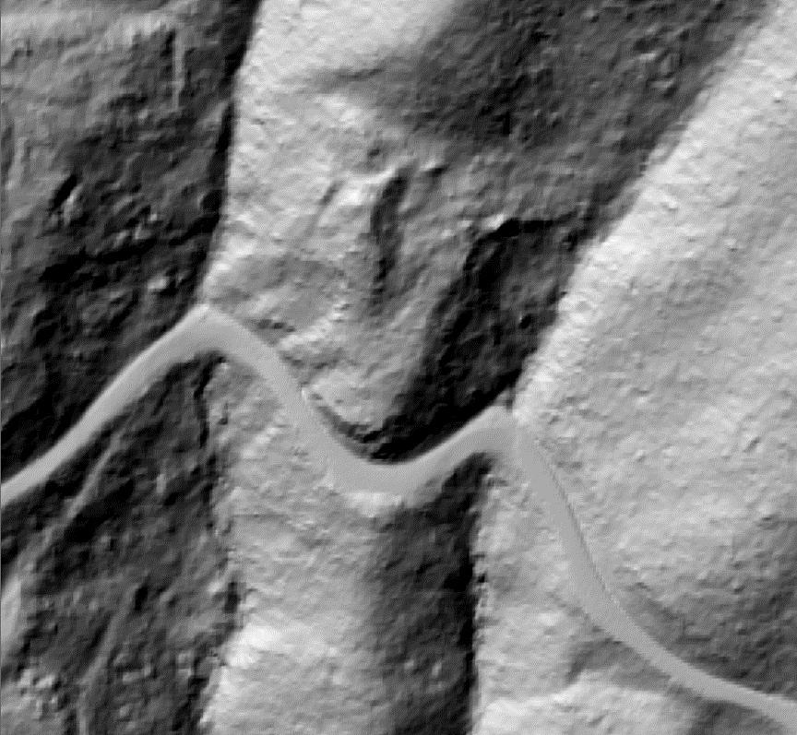
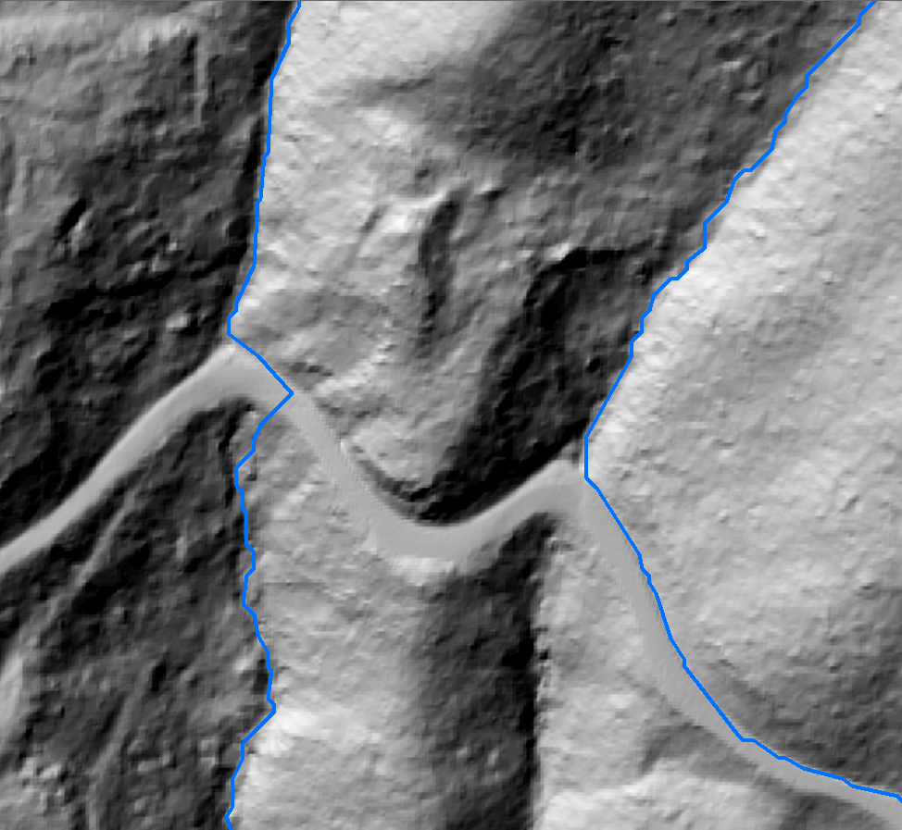
Hurdles – Culverts
Stream channels evident before and after it reaches the road
Water not flowing through culverts and being diverted down the road

Slide 12
Stream Development Methods
Background for this method
  Software Availability
    ArcGis with Spatial Analyst is all you need.
  GIS data not accurate enough for roads and culverts
  Stream threshold accumulation varies across a subwatershed.

Slide 13
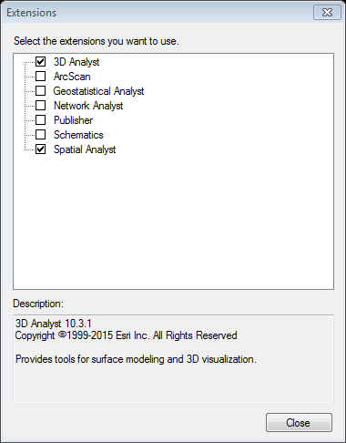
ArcMap – Setup
Customize – Extentions
  Turn on 3d Analyst and Spatial Analyst

Slide 14
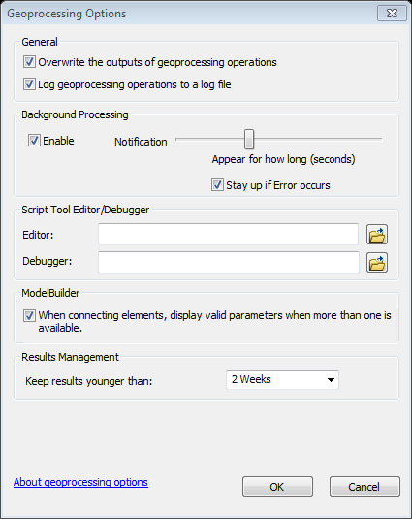
ArcMap – Setup
Geoprocessing-Geoprocessing Options
  Turn on Overwrite outputs

Slide 15
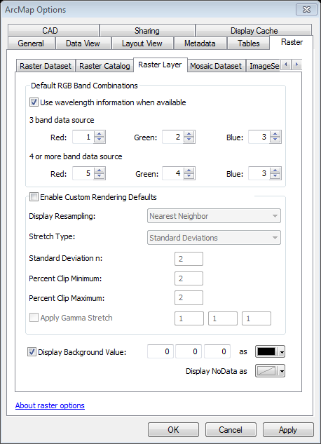
ArcMap – Setup
Add Editor and Topology toolbars
  Right click in an empty space in your toolbar area and click
Set ArcMap options to display background 0,0,0 as black.
  Hillshades will have “holes” without.

Slide 16
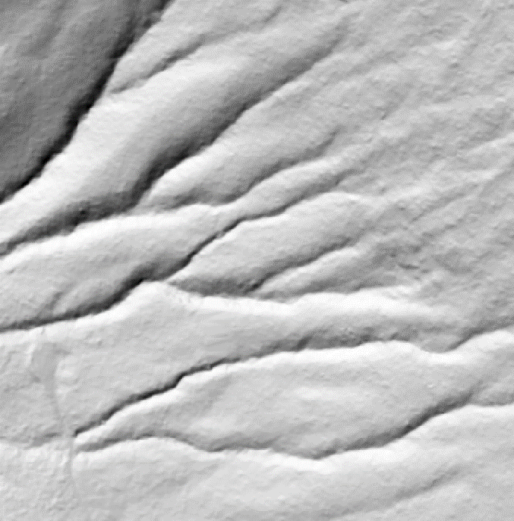
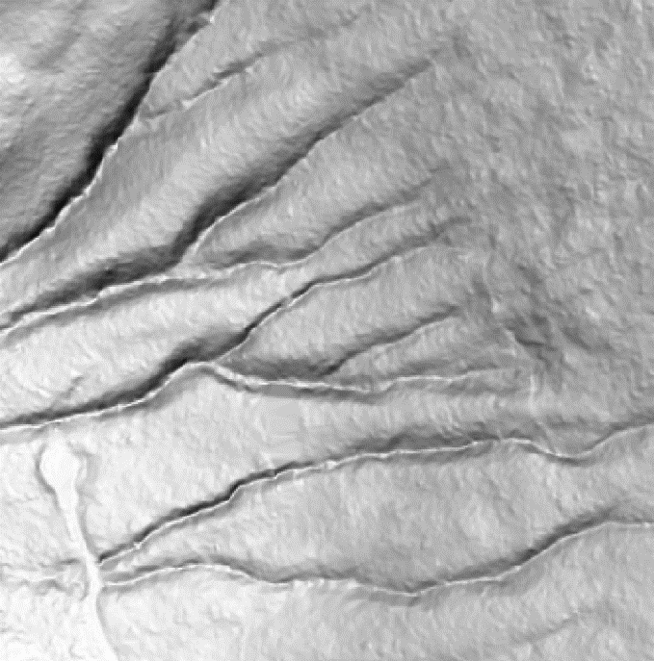
ArcMap – Setup(Optional)
Multi Directional Hillshade
http://www.arcgis.com/home/item.html?id=403a846855f14539a2c15ff09398e8e5
Regular-guy hillshade
Multi directional hillshade

Slide 17
ArcMap – Setup(Optional)
GTAC Image Services
1. Launch ArcMap.
2. If needed activate Catalog by either clicking on Windows | Catalog or by clicking on the Catalog icon in the main toolbar.
3. Dock the toolbar if desired.
4. Find the GIS Servers item, and click the plus sign next to it to expand the list.
5. Double-click on Add ArcGIS.
6. In the box next to Server URL:, type (or copy and paste) the following address: https://image-services.gtac.fs.usda.gov/arcgis
7. Leave the User Name and Password boxes blank, and click Finish.

Slide 18
ArcMap – Setup (Optional)
Google Earth
Sync ArcMap with Google Earth
  Will sync Google Earth to an ArcMap session.
  Can export your shapefiles to .kmz to display in Google Earth

Slide 19

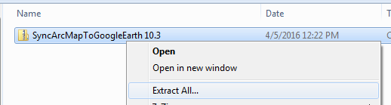
ArcMap – Setup (Optional)
Google Earth
Download the ESRI Add-in
  https://github.com/ChrisStayte/ArcMap_To_Google_Earth/releases
  Unzip the file

Slide 20
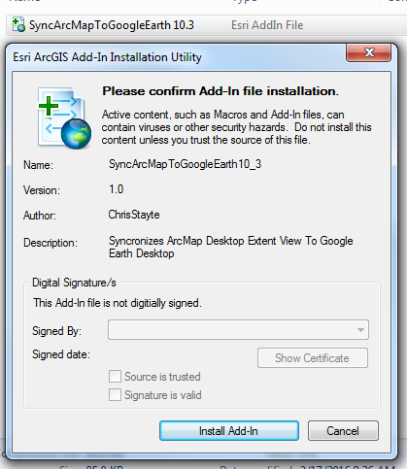
ArcMap – Setup (Optional)
Google Earth
Install the file

Slide 21
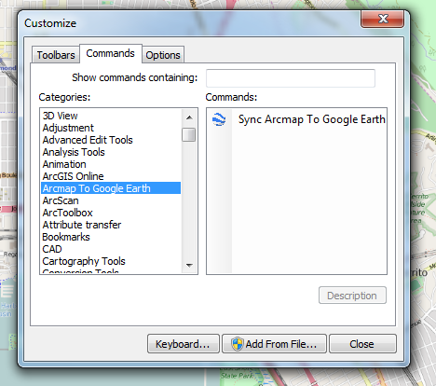
ArcMap – Setup (Optional)
Google Earth
Open ArcMap and Navigate to the Customize Menu
Look for the “Arcmap to Google Earth” category
Add the button to any toolbar

Slide 22
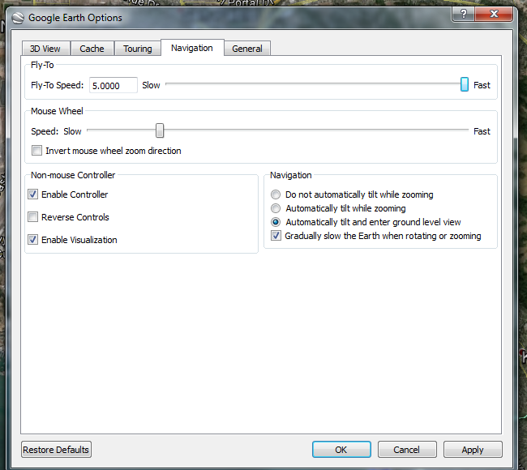
ArcMap – Setup (Optional)
Google Earth
Next is to configure Google Earth
Open Google Earth and go to Tools -> Options
Then go to the Navigation Tab
Change the Fly-To Speed to fast
*This only needs to be done once per user / per machine

Slide 23
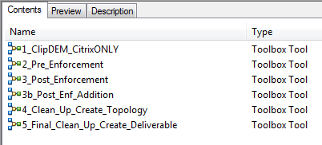
Methods - Overview
Can be done with or without supplied models, they are for your convenience
R6 Hydro Toolbox can be found here:
  T:\FS\Reference\RSImagery\ProcessedData\r06\Hydro

Slide 24
Methods - Overview
Get Lidar DEM
Create prelim streams
Create line file of culverts
  Prelim streams used to indicate where needed
Burn culverts into DEM
Create new streams
Edit

Slide 25
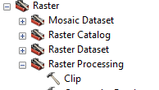
Methods – Prepare DEMs
  Create mosaic dataset of dems or use the R6 mosaic layerfile on the T:drive
  Buffer current NHD boundaries by 1000m.
  Use the Clip tool in DataManagementTools

Slide 26
Methods – Prepare DEMs - Model
1_ClipDEM_CitrixONLY
  This can only be used in Citrix. It utilizes the region’s lidar dem mosaic and NHD layers.
  Enter folder workspace location
    Model will create subdirectories used in other models and clip the current NHD for reference
  1000 meter buffer has worked well

Slide 27
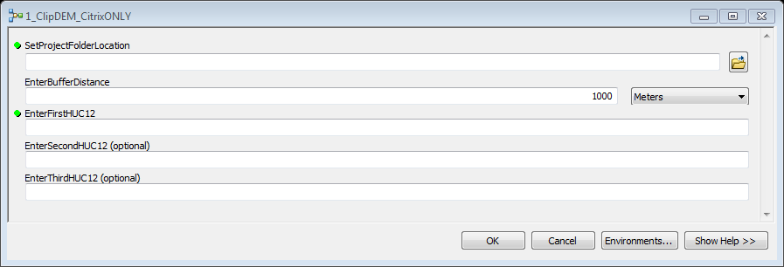
Methods – Prepare DEMs - Model

Slide 28
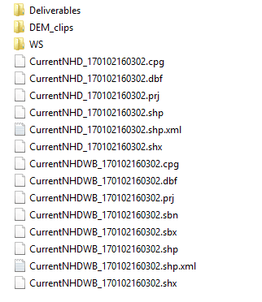
Methods – Prepare DEMs - Model
This model will create a workspace structure used with subsequent models.
It will also subset your watershed boundary and the current NHD for reference.
You can now copy this folder to your local hard drive

Slide 29
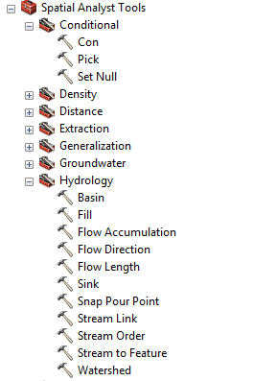
Methods – Pre-Enforcement
Run initial delineation to find where enforcement is needed
  Outputs a stream layer
  Creates empty shapefiles for enforcement and pour points
Step 4
Step 1
Step 3
Step 2
Step 5

Slide 30
Methods – Pre-Enforcement Manual Steps
Step 1 – Fill
  Input = dem clip
    No Z limit
Step 2 – Flow Direction
  Input = Fill output
    Check force cells to flow outward
    No drop raster needed
Step 3 – Flow Accumulation
  Input = Flow Direction output
    No input weight raster needed
    Output file type = float

Slide 31
Methods – Pre-Enforcement Manual Steps (cont.)
Step 4 – Con
  Input = Flow Accumulation output
    Expression = "VALUE" > 25000
    Input true raster = 1
    Input false raster – leave blank
Step 5 – Stream to Feature
  Input Stream Raster = Con output
  Input Flow Direction Raster = flow direction output
    Check Simplify Polygons

Slide 32
Methods – Pre-Enforcement - Model
In the model all that needs to be changed is the input shapefile and dem
Threshold should be set somewhere near the target, 25000 works well for most.
Outputs include pre-enforcement streams and an empty enforcement shapefile.

Slide 33
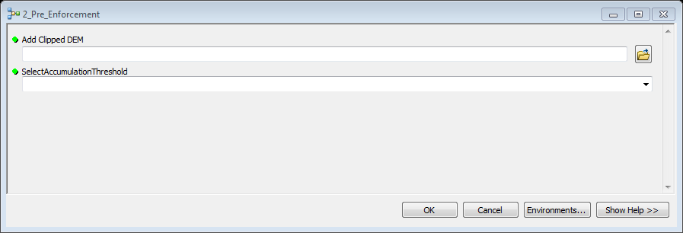
Methods – Pre-Enforcement - Model

Slide 34
Methods - Enforcement
Display the pre-enforcement shapefile on your hillshade and add the empty line shapefile.
I start at the bottom of the watershed and work follow the streams up add a line where needed.
Anytime you see the streams go in a straight line, most likely it is because there is a water build up.

Slide 35
Methods - Culverts
Water not flowing through culverts and being diverted down the road
Enforcement lines will be “burned” into the dem in the next step

Slide 36
Methods – Pour Points
Pour points are needed to calculate the watershed boundaries.
A point needs to be created in the pour point shapefile wherever a stream is entering or leaving a watershed.

Slide 37
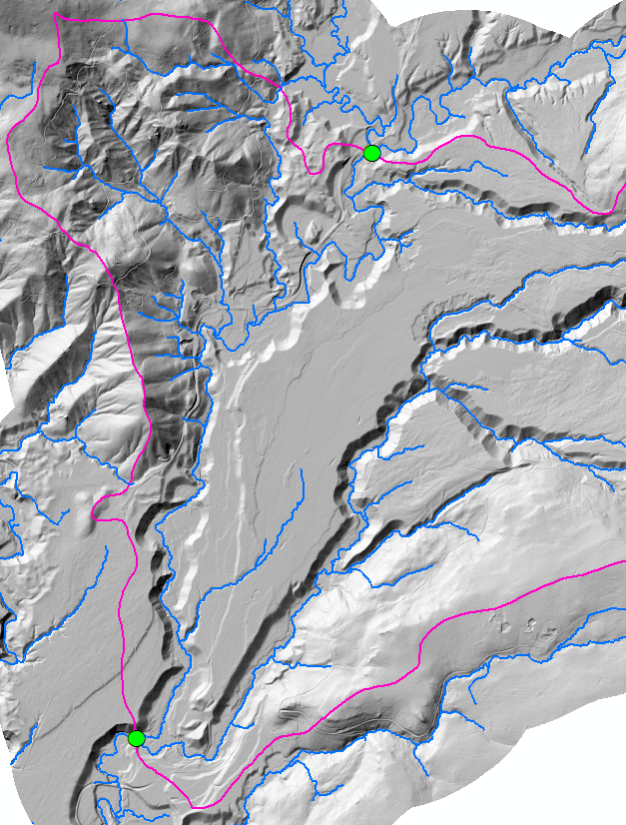
Methods – Pour Points
Pour points are needed to calculate the watershed boundaries.
A point needs to be created in the pour point shapefile wherever a stream is entering or leaving a watershed.

Slide 38
Methods – Enforce DEM
Buffer enforcement shapefile .5m
Create a field and calc all to 1
Convert to img using the “1” field for value.
Mosaic on top of DEM
Repeat steps from pre-Enforcement
  Fill will bring the newly burned in culverts to just below the surface.
  Can run multiple accumulation thresholds to get various starting points
Run Snap Pour Point using your pour point file and run the output in the Watershed tool.

Slide 39
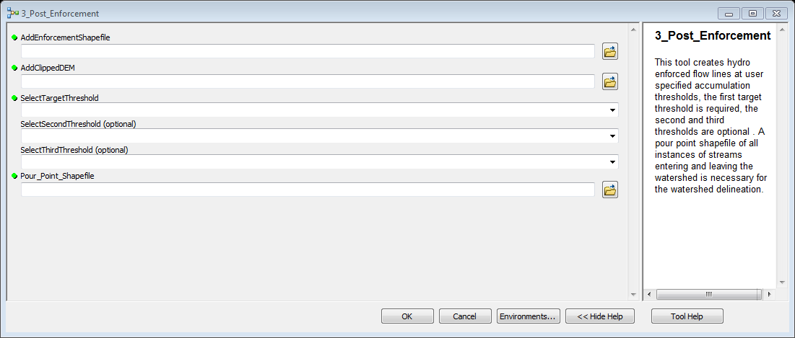
Methods – Enforce DEM - Model

Slide 40
Methods – Enforce DEM - Model
The target threshold is what you think will be what you think will cover most of the area
The second and third would be used to aid in editing. Usually longer (lower thresholds)
  An example would be a target of 50000 sq m, with second and third at 25000 and 10000 for an average forest.
    Wet forest may be 25000, 10000, and 5000
    Dry may be 80000, 50000, 30000

Slide 41
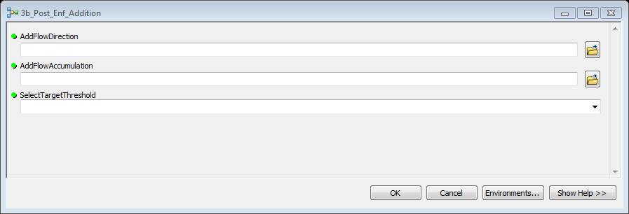
Methods – Enforce DEM - Model
If you need additional thresholds run, you can use the 3b model. The flow accumulation and flow direction will be in your WS directory.

Slide 42
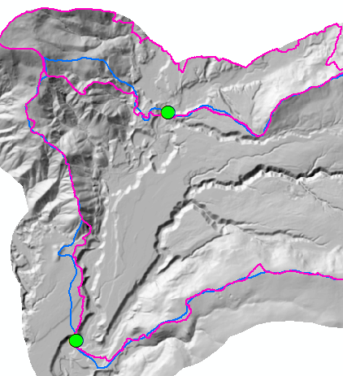
Methods – Watershed Boundary
The Watershed output will consist of as many polygons as there are pour points.
Delete the unneeded polys and check the new poly for any errors. Edit if necessary.
Old watershed
Lidar watershed

Slide 43
Methods – Watershed Boundary
You can use any combination of the hillshade and aspect to help you edit.
Display your longest stream shapefile where you have questions.
Edge match with adjacent watersheds when you are updating multiple watersheds.

Slide 44
Methods – Editing Streams
Use newly created shapefile with the e1 extension to edit.
  There is a backup without the e1.
  If you decide to use a different threshold for editing, you may want to make a copy.
Delete all lines outside of the watershed boundary.
  Can be achieved using the selection by location
Copy and Paste streams from different thresholds where needed
  It is best to delete current line if lengthening
Shorten streams with the split line tool.

Slide 45
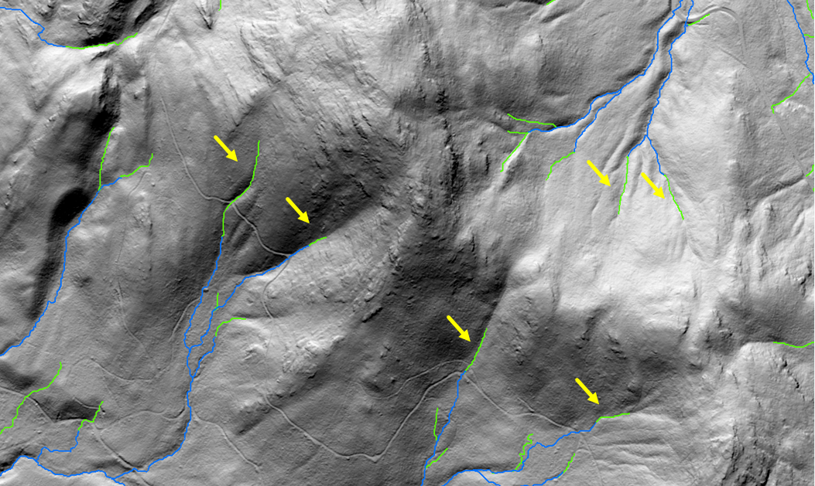
Methods - Editing
In this example a base layer accumulation of 50k (blue) is being used. The 25k (green) is copy and pasted to the 50k where needed.

Slide 46

Methods - Editing
If we were using the 25k cutoff we’d have a lot of deleting to do.
6 additions vs. 18 deletions in this example.

Slide 47
Methods – Editing
Common Problems
Open water and wide rivers are not handled well and will be needed to be digitized.
  Can be added in the enforcement, I’ve had mixed results.
  Be sure to digitize in the direction of the water flow.
Unexplained errors in the analysis resulting in straight lines resembling a back up. Will need to be digitized.

Slide 48
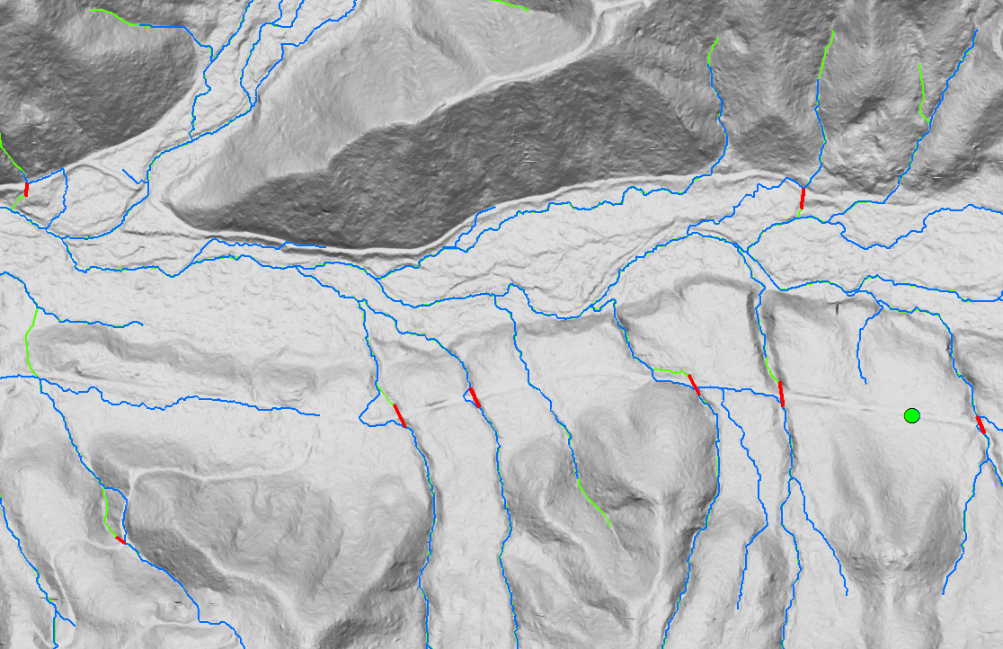
Methods – Results
Blue = pre-enforcement Red = Enforcements Green = final product

Slide 49
Methods – Clean-Up
In preparation for NHD, reducing the errors greatly decreases the amount of time NHD editors need to spend.
Need to make sure all streams are only split at junctions, and are split at junctions.
Need to delete all erroneous dangles.
Need to make sure all segments are pointing in the right direction

Slide 50
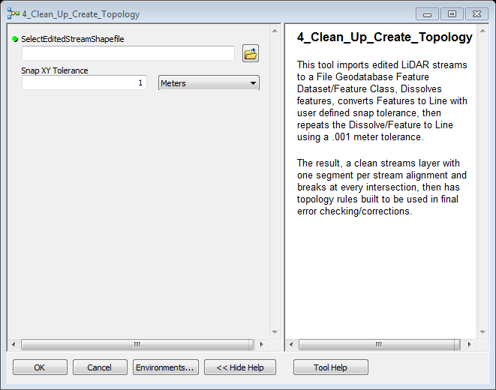
Methods – Clean-Up - Models
4_Clean_Up_Create_Topology

Slide 51
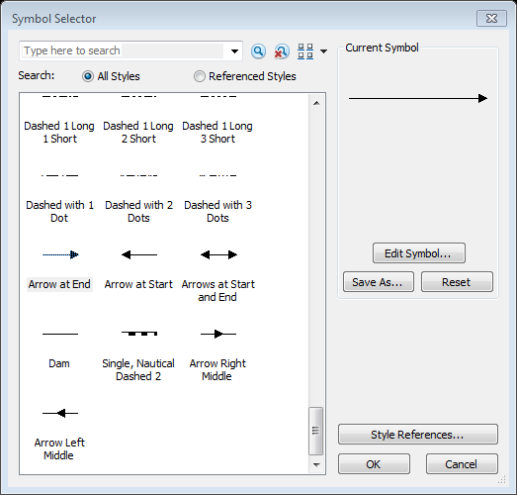
Methods – Clean-Up - Models
4_Clean_Up_Create_Topology
Make symbology of using “Arrow at End” to check directionality.
  You can edit the symbol

Slide 52
Methods – Clean-Up - Models
4_Clean_Up_Create_Topology
Sort by length and delete erroneous dangles
  I look at them one at a time and after the delete merge the stream
Make final check of the stream network

Slide 53
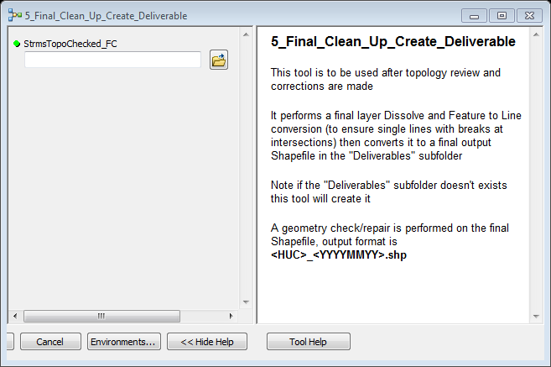
Methods – Clean-Up - Models
5_Final_Clean_Up_Create_Deliverable

