Slide 1

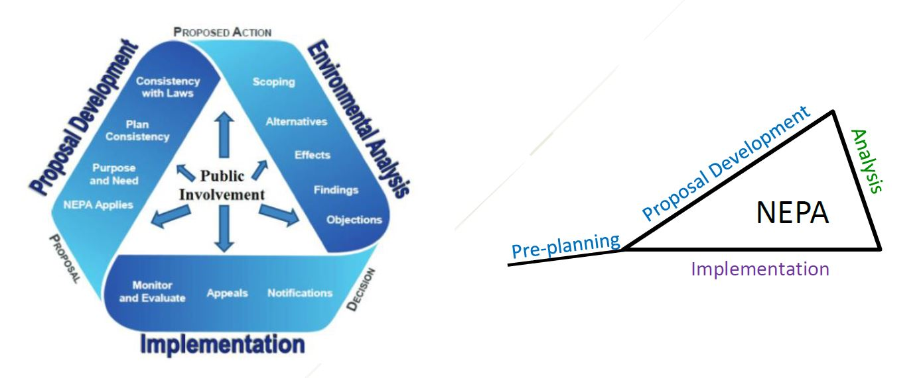
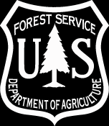
Modified NEPA Triangle
United States Department of Agriculture
Forest Okanogan-Wenatchee
Service National Forest
Notes:
The idea here is to utilize the landscape evaluation process and collaborative involvement early in the planning process in order to shorten analysis time and increase the likelihood of project implementation.
Do what’s right and needed for the landscape. Don’t eliminate needed action just because it appears difficult to get through the planning process.
Landscape Analysis informs the NEPA planning process

Slide 2
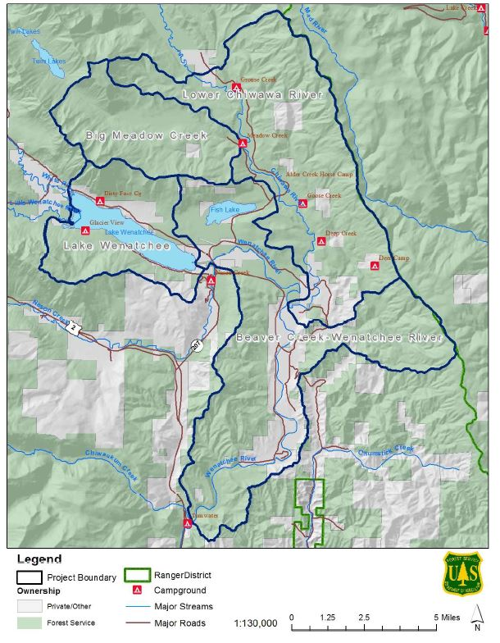
Upper Wenatchee Pilot Project
United States Department of Agriculture
Forest Okanogan-Wenatchee Wenatchee, WA
Service National Forest
Notes:
The Okanogan-Wenatchee National Forest (OWNF) developed the Upper Wenatchee Pilot Project (UWPP) in partnership with the North Central Washington Forest Health Collaborative (NCWFHC). The NCWFHC is a diverse group of local stakeholders represented by the timber industry, conservation groups, tribal government, elected officials, and local, state and federal land managers working together to obtain the resources and community support to accelerate
landscape-scale forest restoration on the OWNF in Chelan and Okanogan counties. The UWPP was funded to complete collaborative planning and environmental analyses for approximately 75,000 acres of USFS lands
These sub-watersheds contain a variety of aquatic and terrestrial resource and conservation values, including but not limited to habitat for federally listed Upper Columbia spring Chinook; Upper Columbia Steelhead; Columbia River bull trout; gray wolf; grizzly bear; northern spotted owl; and numerous rare late successional vascular and non-vascular plant species.

Slide 3
Project Goals
United States Department of Agriculture
Through scientifically-sound restoration treatments, the UWPP will create a more resilient terrestrial and aquatic landscape in the Lower Chiwawa, Big Meadow, Lake Wenatchee, and Beaver Creek-Wenatchee River subwatersheds to:
Address conditions that have departed from the historic range of variability to reduce the risk of uncharacteristic wildfire and other disturbances to protect lives, communities, and ecological values and analyze the effects of restorations treatments used for advancing the landscape toward the desired condition such as thinning and prescribed fire
Promote better outcomes for a broad spectrum of ecological, social, and community resources and values in a manner that recognizes and responds to the important role of natural fire and helps mitigate risk in the wildland urban interface while providing for sustainable user access
Protect and restore watershed conditions that maintain uplands, late-successional habitat and large old trees, riparian and instream habitat, and water quality and quantity for the benefit of communities and native fish and wildlife
Design and implement treatments to support the recovery of threatened, endangered, and sensitive species such as restoring historical patchwork forest structures, addressing fish-passage barriers, and facilitating natural watershed process to improve aquatic habitat.
Optimize the production of ecosystem services and forest products to fulfill the stewardship mandate of the Forest Service in a manner that reflects a broad spectrum of ecological, cultural, and socio-economic values.
Forest Okanogan-Wenatchee Wenatchee, WA
Service National Forest

Slide 4
United States Department of Agriculture
Additionally, the UWPP seeks to develop an effective model for collaboration among the FS, other federal, state and local agencies, local Tribes, the North Central Washington Forest Health Collaborative and member organizations, as well as a wide range of local landowners, community partners and stakeholders.
This collaborative planning effort will increase the shared stewardship of the forest and watershed restoration vision and will result in greater support for all management tools needed to implement terrestrial and aquatic treatment actions on this landscape.
Forest Okanogan-Wenatchee Wenatchee, WA
Service National Forest

Slide 5
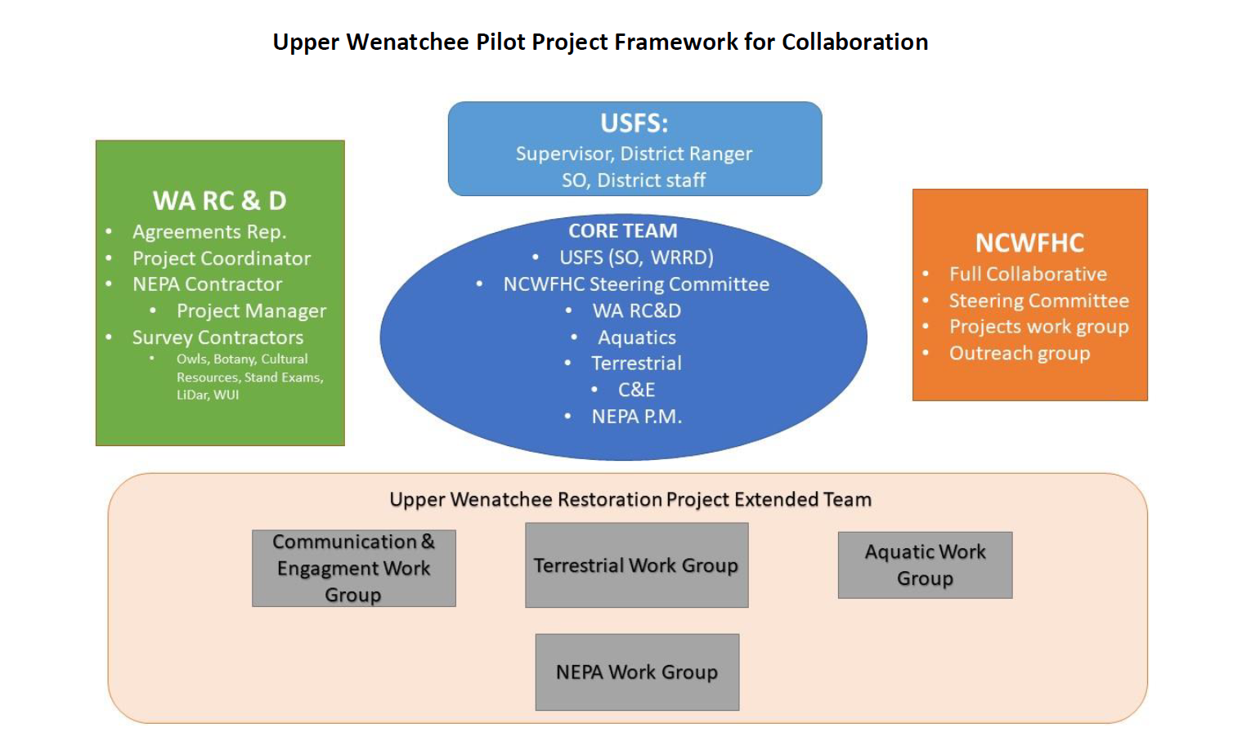
United States Department of Agriculture
Forest Okanogan-Wenatchee Wenatchee, WA
Service National Forest
Notes:
Being aware of FACA
Sub groups have avoided this potential pitfall by self-forming and maintaining business processes that involve Forest Service employees but not as voting members.

Slide 6
Purpose and Need
United States Department of Agriculture
The primary purpose of this project is to create a more resilient terrestrial and aquatic landscape to:
  Address conditions that have departed from the historical range of variability to reduce the risk of wildfire and other disturbances to protect lives, communities, and ecological values.
  Promote better outcomes for a broad spectrum of ecological, social, and community resources and values in a manner that recognizes and responds to the important role of natural fire and helps mitigate risk in the wildland urban interface while providing for sustainable user access.
  Protect and restore watershed conditions that maintain uplands, late-successional habitat and large and old trees, riparian and instream habitat, and water quality and quantity for the benefit of communities and native fish and wildlife.
  Design and implement treatments to support the recovery of threatened, endangered, and sensitive species.
Forest Okanogan-Wenatchee Wenatchee, WA
Service National Forest

Slide 7
Need
United States Department of Agriculture
Create and maintain successional pathways that provide the amount and spatial arrangement of forest conditions that increase resilience to natural disturbance and sustainability.
Improve habitat conditions within Late-Successional Reserves while reducing risk to stand replacing fires.
Maintain, enhance, or accelerate the development of large and old trees and increase proportion of old forest structure.
Conserve the existing spotted owl and old forest habitat, and identify and implement vegetation treatments to develop additional habitat in the most sustainable landscape location.
Support biodiversity by restoring, enhancing, and/or maintaining unique habitats including aspen, white bark pine, meadows, and huckleberry fields.
Reduce impacts from fire and return fire as a natural element of the landscape.
Reduce risk of fire on National Forest System lands in the Wildland Urban Interface.
Improve habitat connectivity for Chinook Salmon, Bull Trout, and Steelhead by removing barriers to fish passage.
Improve aquatic habitat, including instream, riparian, banks, and floodplains
Reduce road related impacts to improve terrestrial and aquatic habitat quality (connectivity, disturbance, sediment).
Forest Okanogan-Wenatchee Wenatchee, WA
Service National Forest

Slide 8
Condition-Based Management Strategy
United States Department of Agriculture
“Flexible toolbox approach” is a condition-based management strategy that allows predetermined treatments to be aligned, prior to implementation, with current conditions on the ground.
With the flexible toolbox approach, a suite of potential treatment types and intensities are proposed and analyzed as a response to specific resource conditions.
Forest Okanogan-Wenatchee Wenatchee, WA
Service National Forest
Notes:
The flexible toolbox approach is a condition-based management strategy that allows predetermined treatments to be aligned, prior to implementation, with current conditions on the ground. For example, with vegetation treatments, a combination of selection criteria and vegetation conditions are used to determine habitat and forest cover filters and modifiers, as well as the appropriate treatments for each. Using existing stand data, these conditions and criteria are quantified to estimate the acreages of specific treatments to propose in a project area. These estimates are used to analyze the effects from those treatments. Site-specific field reviews are conducted before implementation to verify that ground conditions match those predicted. If they do not, the same selection criteria are applied again based on the actual ground conditions to be sure that the right treatment occurs on the right acre.
While this approach accommodates making changes based on updated information from field reviews, it differs from what is conventionally referred to as adaptive management. With the flexible toolbox approach, a suite of potential treatment types and intensities are proposed and analyzed as a response to specific resource conditions. Additional field review is conducted later before implementation. Using this ground-based information, the most appropriate treatments to move resources toward the desired conditions are selected from the analyzed suite.
Using this approach, a series of current conditions is described and then treatments identified that could be applied to move the landscape toward desired conditions. Decision points, based on conditions at the time of implementation, would be used to help lead to the desired condition.

Slide 9
Why invest in landscape evaluation?
United States Department of Agriculture
Each Landscape Evaluation can support multiple project NEPA decisions.
Purpose and need statements and proposed actions will be better supported with landscape- and patch-level information. This should result in fewer misidentified proposed treatment areas and missed treatment opportunities, improving layout efficiency of projects.
Better integration across resource disciplines will reduce resource conflicts and provide a high level of ownership in restoration projects.
Landscape Evaluations will provide better information on which to base decisions about the location, scope, and priority of various potential projects, so that limited resources for treatments are used where they provide the greatest benefits.
A focused project design and integrated purpose and need statement should simplify the NEPA process by reducing unresolved conflict and limiting alternative development.
Forest Okanogan-Wenatchee Wenatchee, WA
Service National Forest

Slide 10
United States Department of Agriculture
Treatment options can be modeled to show potential outcomes and effects. This should make treatments more effective and simplify NEPA effects analysis.
Integrated Landscape Evaluations across ownership boundaries and resource areas allow for collaboration and funding opportunities to accomplish additional work.
Early involvement in the planning process adds value to collaborative group members, in terms of understanding forest conditions, prospects for successful restoration, and any potential adverse effects that restoration may cause, that then results in improved Forest Service decisions.
Extensive engagement with the NCWFHC during the pre-planning and project development phases ensured that objectives of the project were thoughtfully articulated and broadly supported.
Forest Okanogan-Wenatchee Wenatchee, WA
Service National Forest

Slide 11
United States Department of Agriculture
Questions???
Forest Okanogan-Wenatchee Wenatchee, WA
Service National Forest

