Slide 1
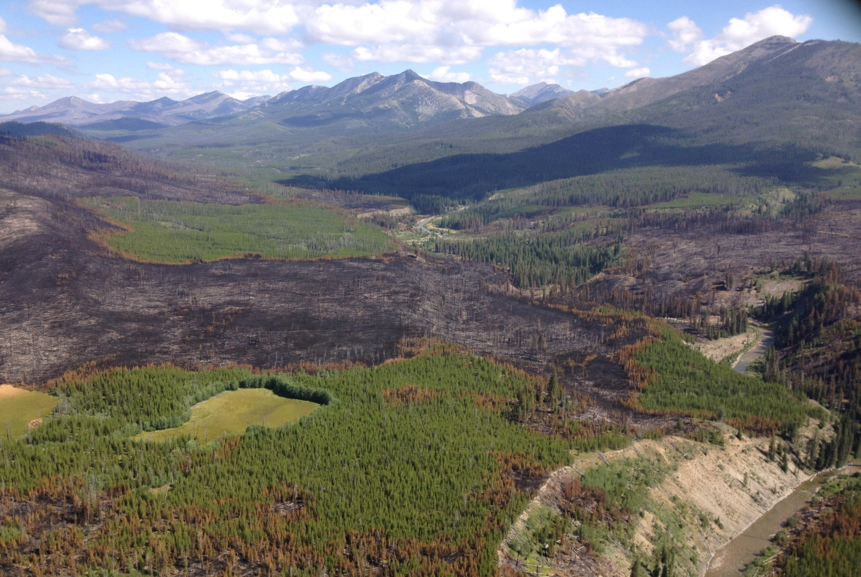
Blackfoot Swan
Landscape Restoration Project
Restoration Needs, Spatial Pattern
and
Lots of Challenges

Slide 2
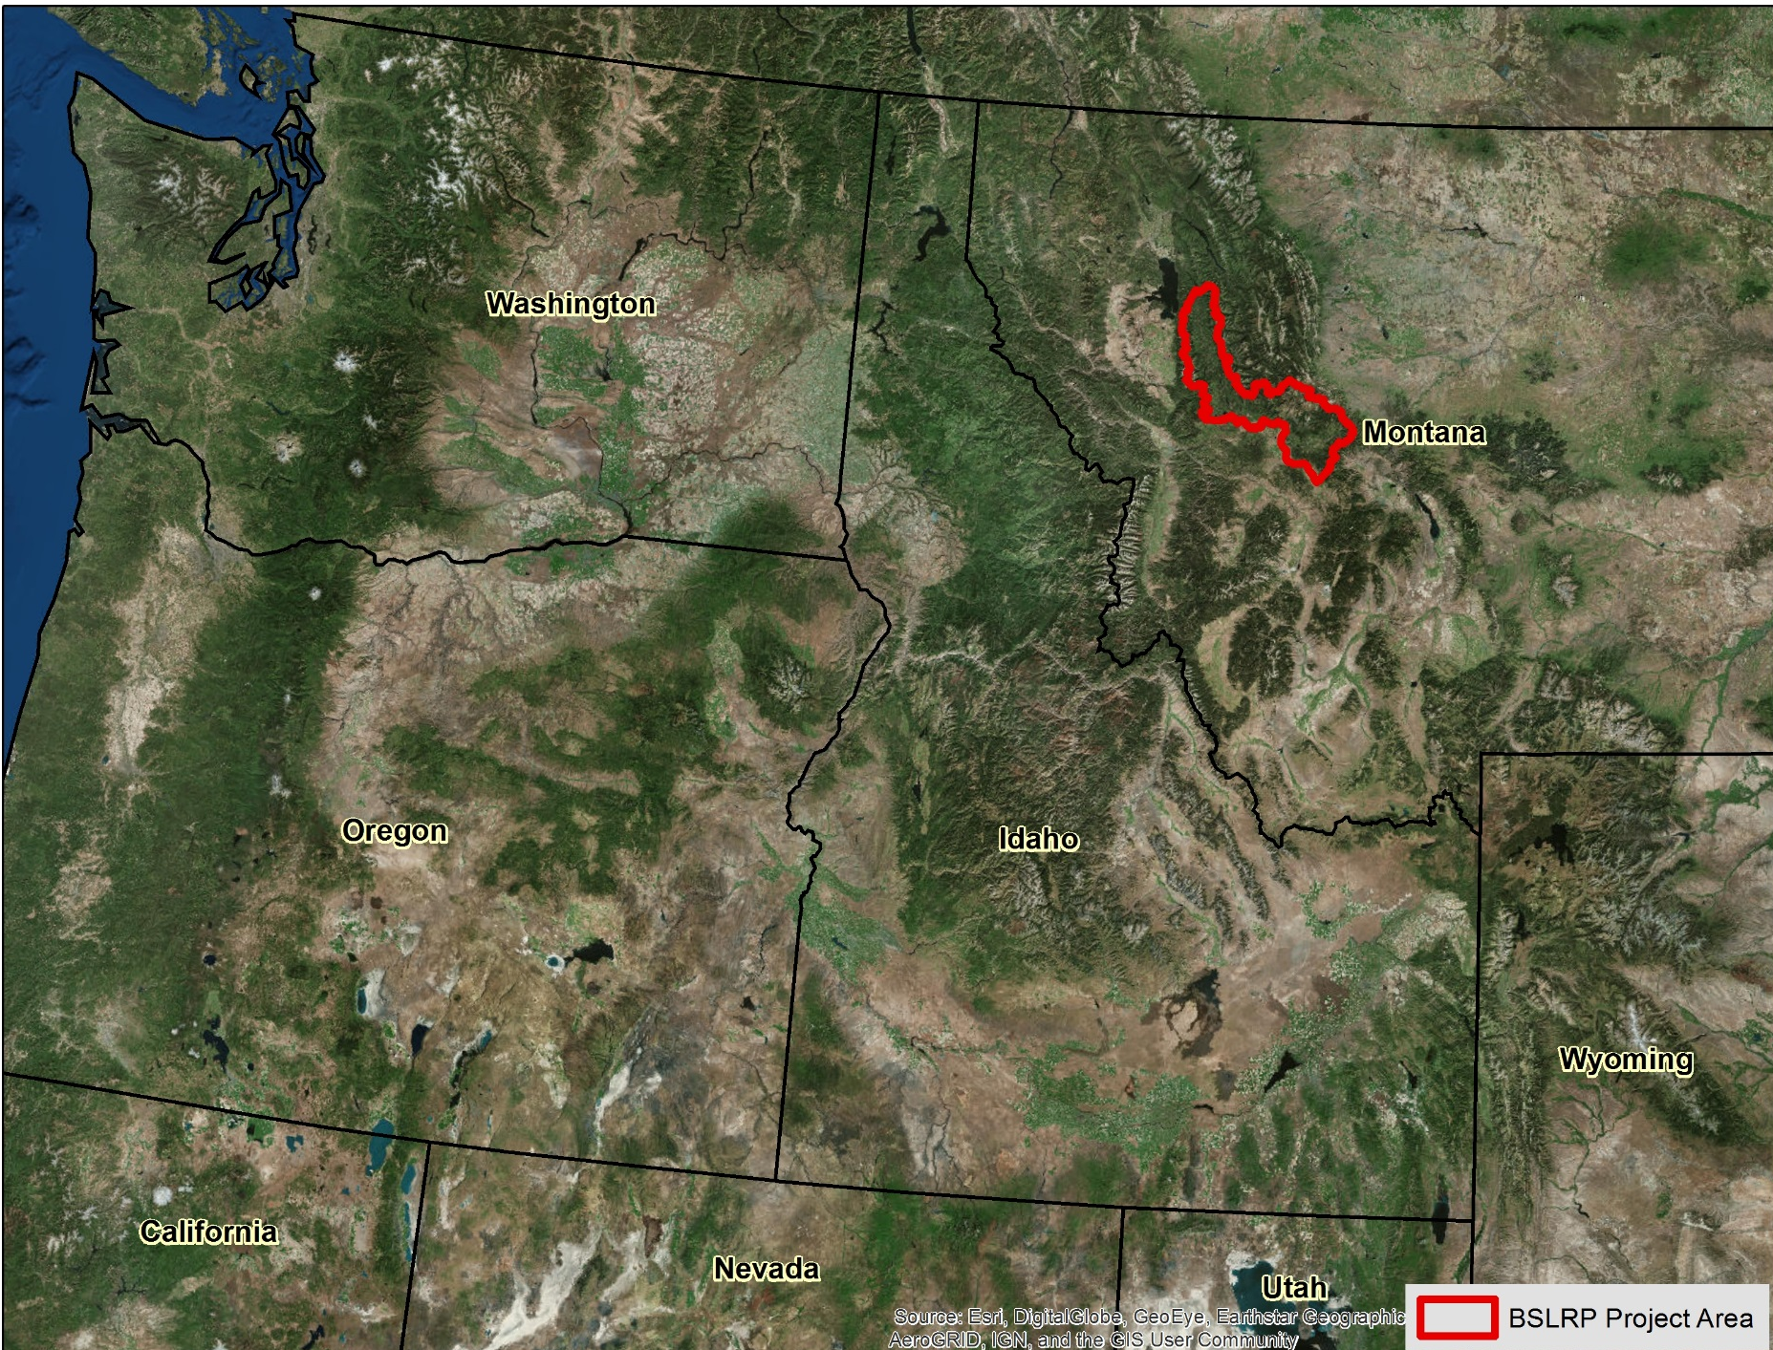
Just for Orientation

Slide 3
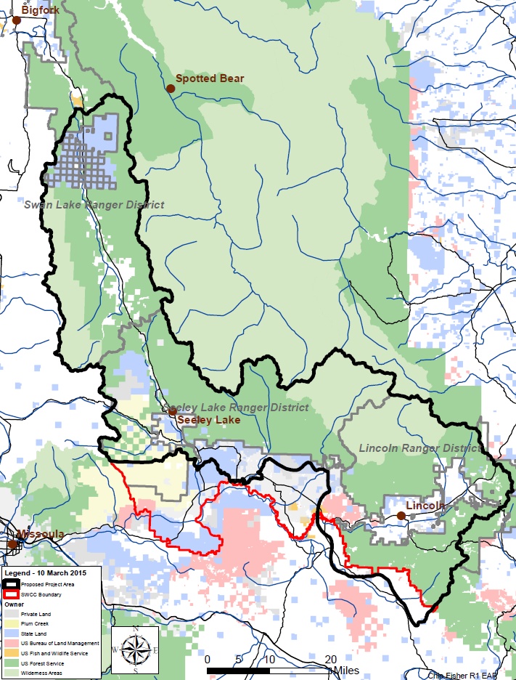
Blackfoot Swan Landscape Restoration Project (BSLRP)
1.2 million acres in the Swan, Blackfoot and Clearwater drainages
Follows boundary for SWCC (mostly)
Flathead, Lolo and Helena and Lewis & Clark National Forests
  Swan Lake, Seeley Lake and Lincoln Ranger Districts

Slide 4
Purpose of Project - Mission
Reduce the risk of uncharacteristic wildfire
Conserve terrestrial and aquatic biodiversity across the Southwest Crown Collaborative (SWCC) landscape
Consider potential influence of climate change
Notes:
Project Initiation Letter

Slide 5
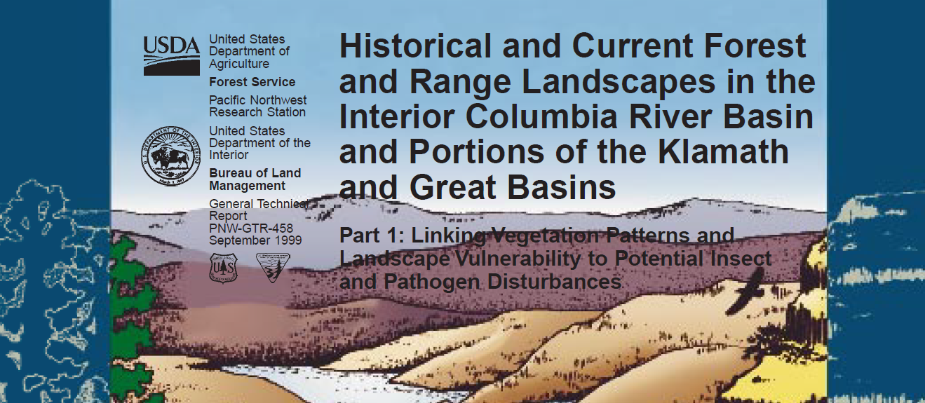
Ecological Departure
Notes:
Team worked for 3 some years, looked at modelling w/ SIMPPLLE, went through leadership changes and changed direction regarding methodology. Adopting the ICBEMP photo interpretation method was not without strong objections from Regional Office. Selling points were spatial pattern analysis and “real data” versus modelling.
ICBEMP used the earliest available air photos to delineate patches and attribute those w/ vegetation type, size and canopy cover. Ecologically similar watersheds are grouped together and provide a reference range – or HRV to compare current conditions to.

Slide 6
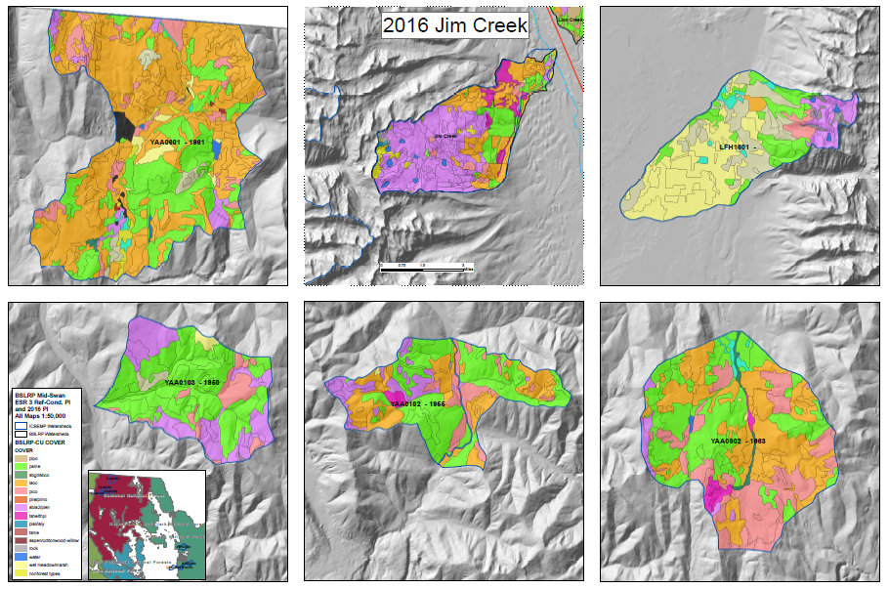
Reference Conditions for Cover Type
Reference
Reference
Reference
Reference
Reference
Notes:
5 reference watersheds in ESR 3 with current conditions of Jim Creek. No one to one comparison!
Space for time substitution!

Slide 7
Range of Variation – Cover Type
Bottom
10%
Top
10%
Notes:
How do we get to a range of variation – an example for Jim Creek
(Range = actual data, distribution = hypothetical)

Slide 8
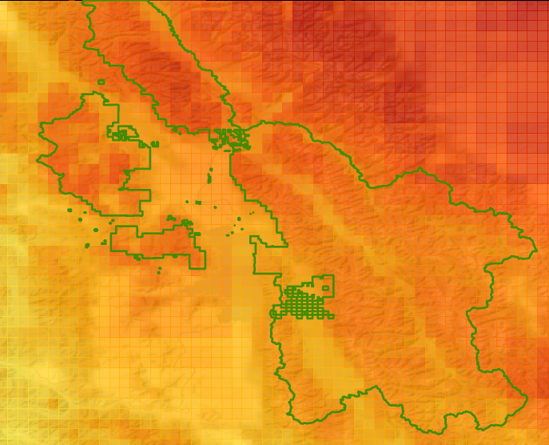
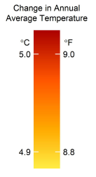

Projected Change in Annual Average Temperature (Historical to 2080s, RCP 8.5)
Flathead NF
Notes:
Product from Rocky Mountain Research Station, National Forest Climate Change Maps.
https://www.fs.fed.us/rm/boise/AWAE/projects/NFS-regional-climate-change-maps/regions/northern-region-r1.html

Slide 9
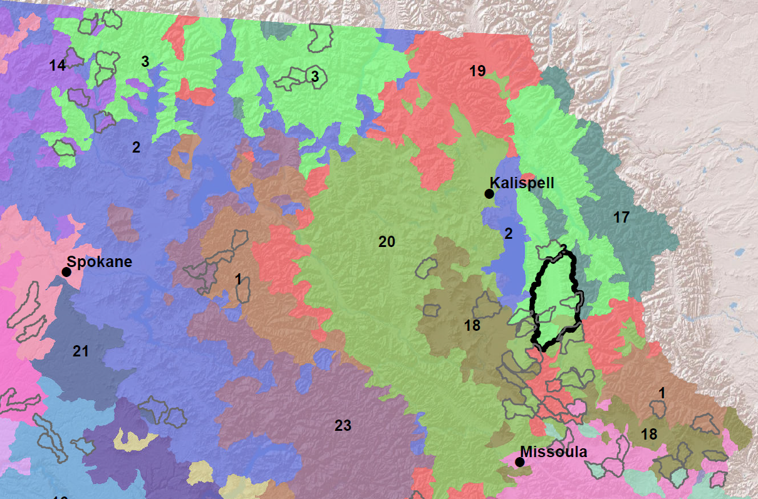
ICBEMP Ecological Subregions (ESRs)
Notes:
Analysis to group similar sample watershed w/ each other – process is documented in GTR

Slide 10
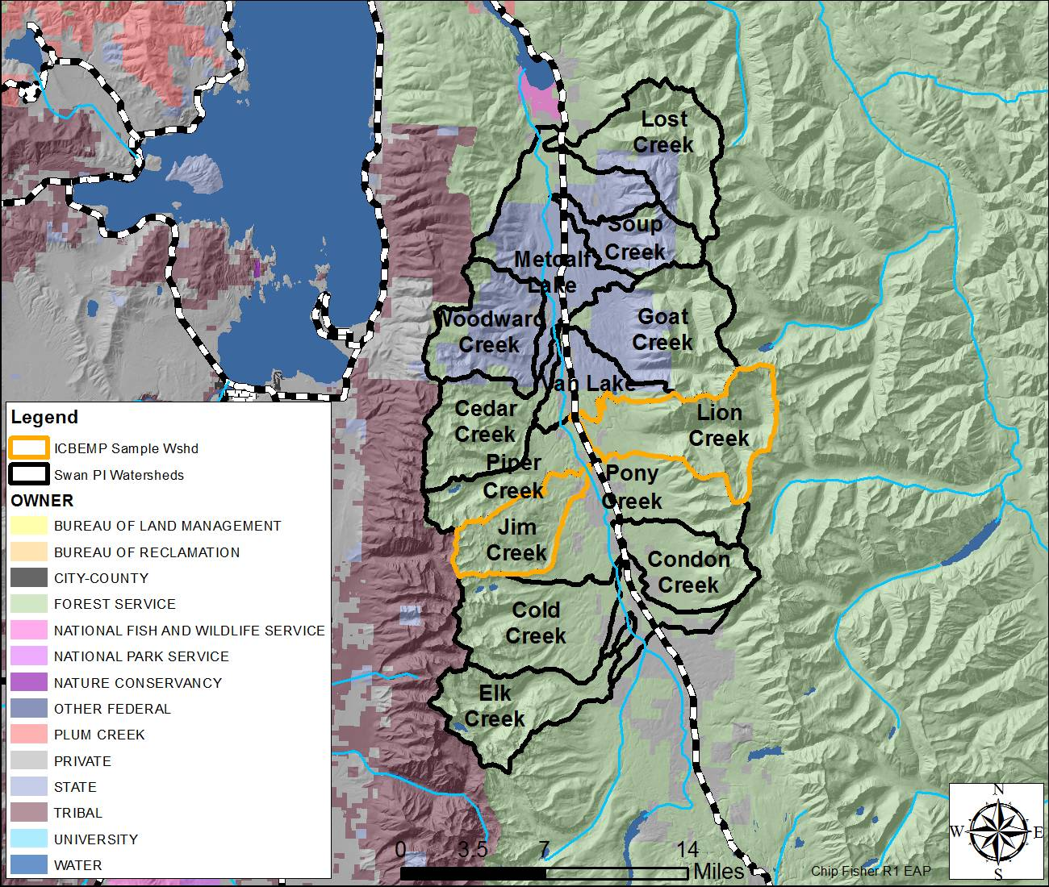
BSLRP Mid-Swan: 14 HUC 6
Notes:
Regional Forester asked Team Lead to reduce time line in exchange for small analysis area (as a trial run).

Slide 11
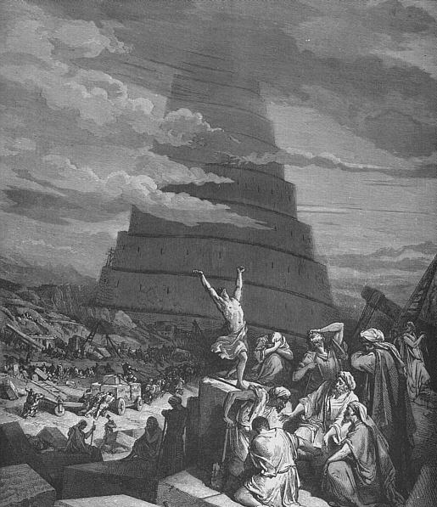
Ready to roll …
Mission:
  reduce uncharacteristic wildfire
  conserve biodiversity
200,000 acre project area
Published methodology
New team …
Notes:
Why is large scale restoration so hard?!?

Slide 12
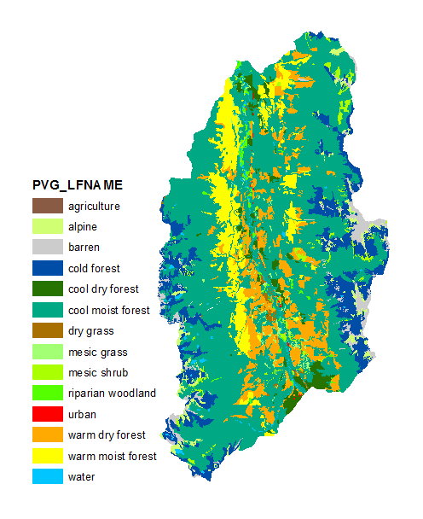
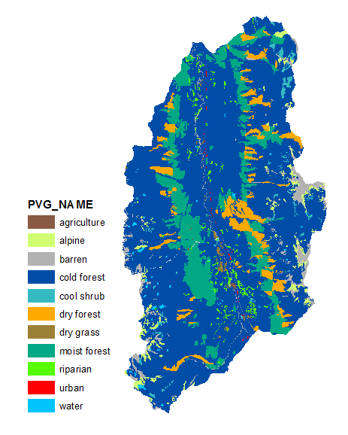
Potential Natural Vegetation
ICBEMP
Region 1
Notes:
Language matters.
Whenever possible, speak the local language.

Slide 13
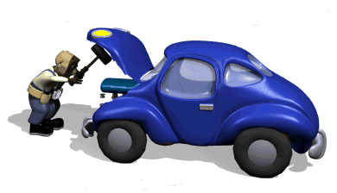
Updating Derived Attributes
Lynx
Fire Behavior Model
Structure
Big Trees
Region 1
Soil Heating
Snowshoe Hare
Fuel Loading
PVG
Notes:
Lesson 1: Re-using another areas product is harder than you think.

Slide 14
Big Tree Imputation
Removing the effect of logging on PI attributes (size classes, tree canopy cover, cover type -> structure, I&D, fire, wildlife)
ESR | Regen. / Clearcut | Selective | Thinned | Patch Clearcut | None apparent
3 | 2.3 | 5.8 | 0.2 | 0.4 | 91.4
20 | 9.7 | 8.9 | 0.0 | 0.2 | 81.2

Slide 15
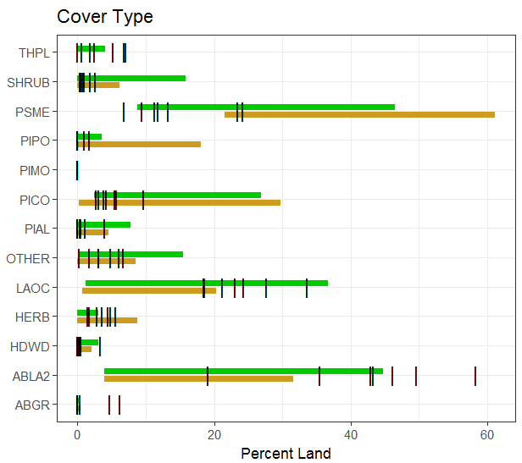
Mid-Swan, Westside
Notes:
7 westside watersheds in the Mid-Swan, yellow-brown bar represents FRV, green bar represents HRV.

Slide 16
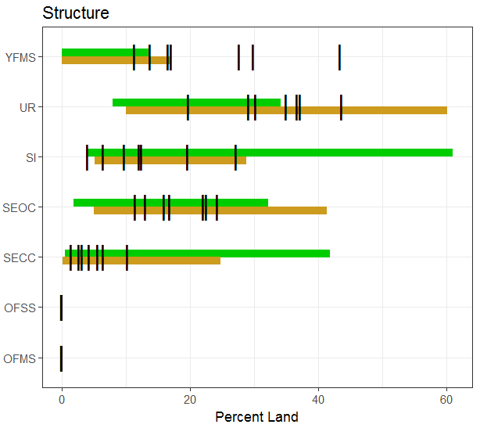
Mid-Swan, Westside

Slide 17
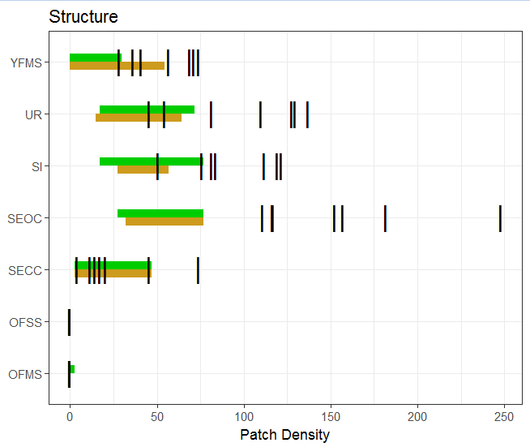
Mid-Swan, Westside
Notes:
Patch density is # of patches per 10K acres

Slide 18
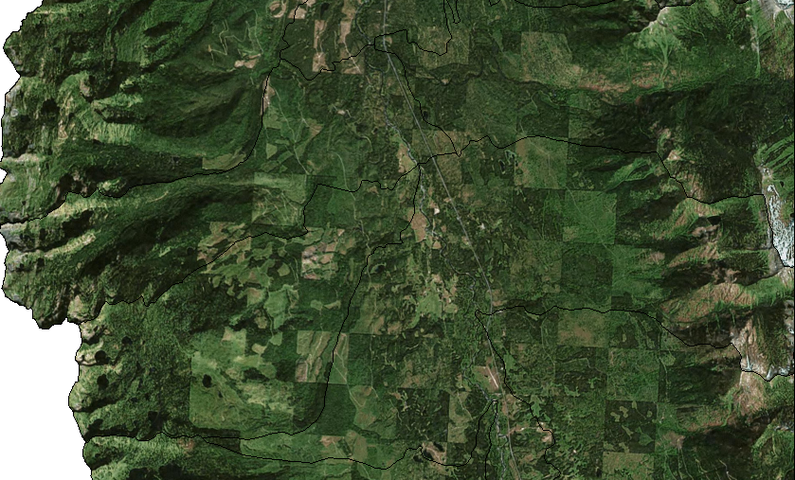
Mid-Swan - Fragmentation
Notes:
Not much analysis needed beyond looking from space.
How can we start over in a checkerboard landscape?

Slide 19
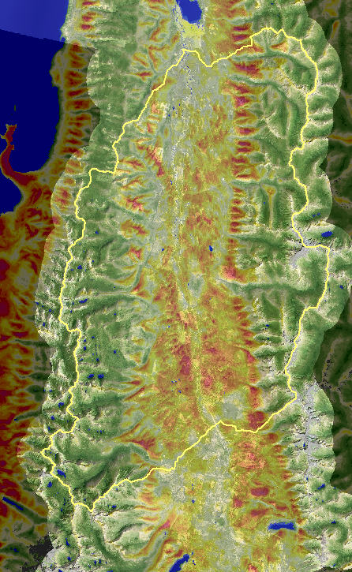
LANDFIRE Historical Mean Fire Interval
green = low
red = high

Slide 20
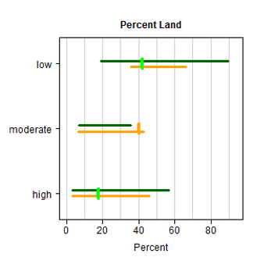
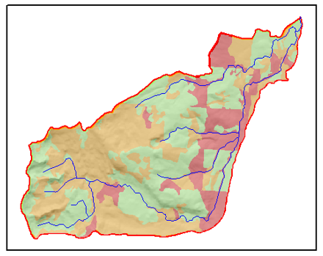

Crown Fire Potential, Jim Creek

Slide 21
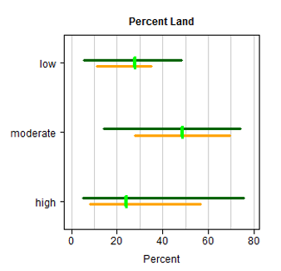
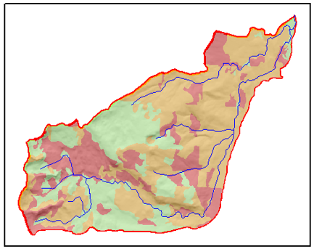
Flame Length, Jim Creek

Slide 22
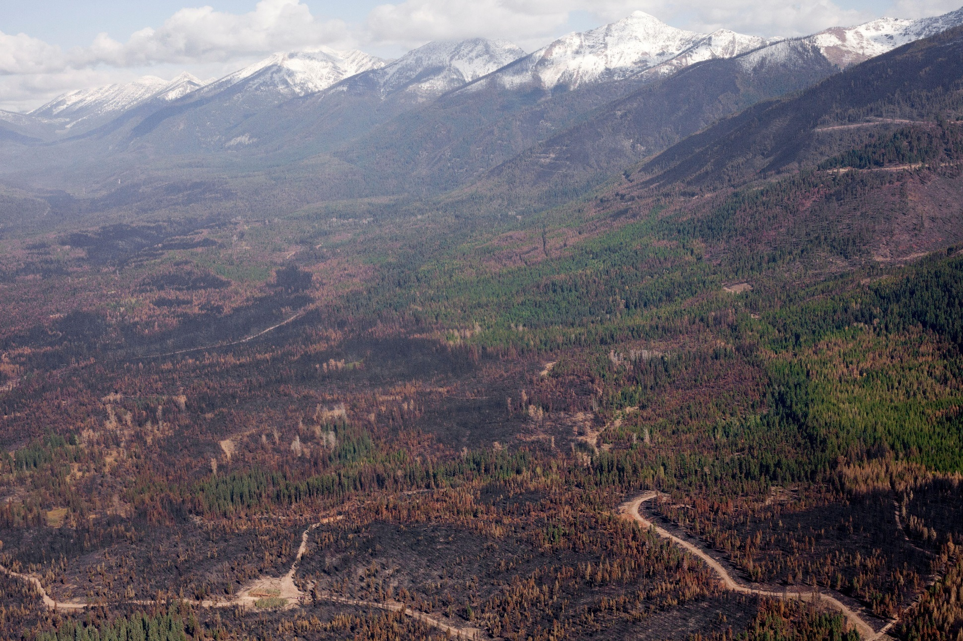
Rice Ridge, September 2017
Notes:
How “natural” is the Rice Ridge fire? 180,000+ acres burned over approx. 10 weeks, with high and moderate severity (proportions yet unknown)
This “was” prime lynx habitat.

Slide 23
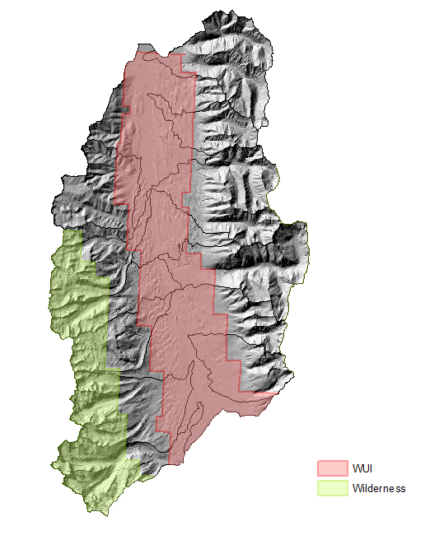
Risk of Uncharacteristic Fire -> Risk from Fire
Notes:
Within the WUI, we are moving away from talking about uncharacteristic fire. It is not about restoration. Or at least it does not have to. It is about protecting social values.

Slide 24
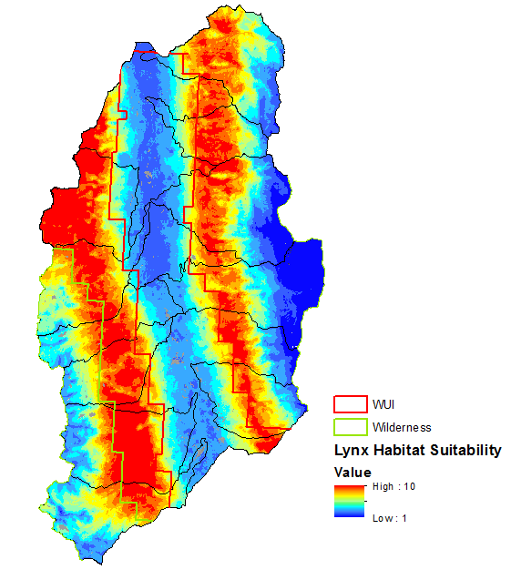
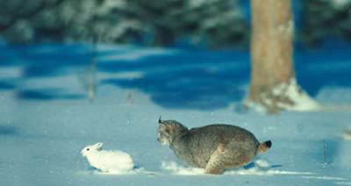
Lynx
What are the trade-offs for no active management?
Is there anything we can do that would not be detrimental
Notes:
Meet the “Spotted Owl” Species of the Rocky Mountains: Probably more habitat within the Swan than historic.
The complication of single species management: Lynx habitat has been “hands off” for management other than in WUI.

Slide 25
Purpose of Project - Mission
from
Reduce the risk of uncharacteristic wildfire in WUI
Conserve terrestrial and aquatic biodiversity across the Southwest Crown Collaborative (SWCC) landscape
Consider potential influence of climate change
Notes:
Project Initiation Letter

Slide 26
Spatial Prioritization – Where?
WUI Integrity
Value
Risk
WUI
Swan Valley Community Wildfire Boundary Def.
Struct. Dens.
Density Zones
Crown Fire Potential
PI derived/ FlamMap
Fire Prob.
Spread FSim
Swan Valley Fire Protection Plan
Priority Rating
Notes:
The WUI portion of spatial prioritization, using EEMS

Slide 27
Spatial Prioritization – Where?
Terrestrial
Ecological Integrity
Pattern
Process
Structure x Cover
Departure
Legacy Trees x PVG
Protect/Enhance
Loss of PIAL & PIMO
Enhance/Restore
Mean FRI
Reintroduce Fire
I & D Risk
Departure
Composition
Configuration
Structure Fragmentation
Departure
- Patch Density
- Contagion
Biophysical Environment
Diversity
- Structure x PVG
- Topography
Insect & disease
Fire
Crown Fire
Departure
Notes:
The Terrestrial Ecological Integrity portion of spatial prioritization, using EEMS

Slide 28
Ecological Needs - What
Watershed | Variable | Needed Treatment Acres | Treatment Type | Comments
Cold Creek | ABLA_UR Dep | 3,000 | Cut/Burn | Convert to PICO_SI
Cold Creek | ABLA_YFMS Dep | 3,000 | Cut/Burn | Convert to PICO_SI
Cold Creek | LAOC_YFMS | 3,000 | Cut/Burn | Advance to
Cold Creek | MFRI Dep | 6,000 | Burn or Cut/Burn | Convert to OFSS
Cold Creek | Patch Density Dep | 2,000 | Consolidate SECC/UR | Focus on SI
Cold Creek | Whitebark Pine | 5,000 | Restore w/ rust res seeds | Cold Forest PVG
Notes:
Example table to quantify ecological needs by watershed and category.
We can come up w/ spatial prioritizations, but treatments have to be designed by hand.

Slide 29
Range of Variation – What is the Goal?
HRV
FRV
Notes:
Freehand drawing of hypothesized frequency distributions.

Slide 30
Desired Range of Variation – Option 3
Future Desired Condition (Shift HRV distribution toward FRV)
Notes:
We could use the range of HRV but move the median of our Desired Range of Variation toward FRV (use median of combine HRV/NRV). If we don’t want to deal w/ the entire distribution of reference watersheds, we could approximate this by calculating the averages of median(HRV) and median(FRV).
This solution might be ecologically most defensible, but is also the most complicated to explain to the public. None of the 3 options are outlined in literature – which makes for more documentation on our side.

Slide 31
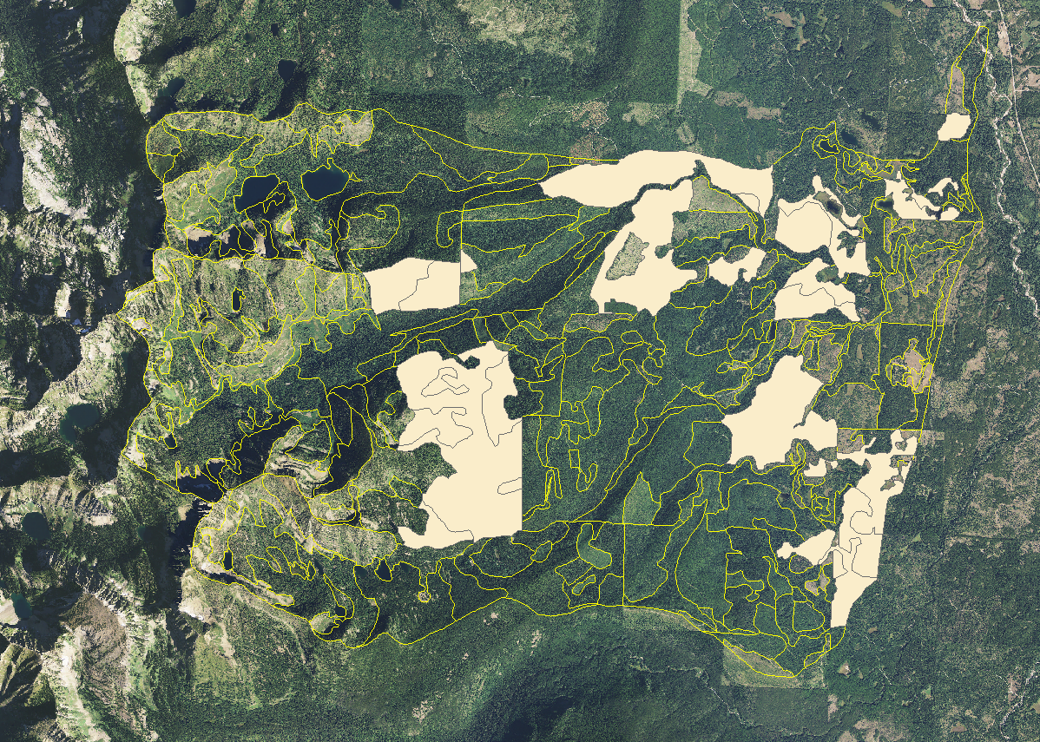
Cold Creek Analysis – “Manual Process”
29 Polygons
3,711 Acres
Assess Departure
ABLA/UR
ABLA/YFMS
ABGR
LAOC/YFMS

Slide 32
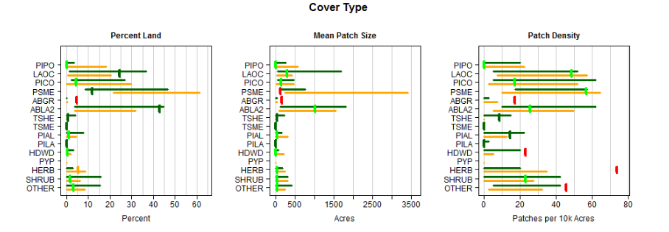
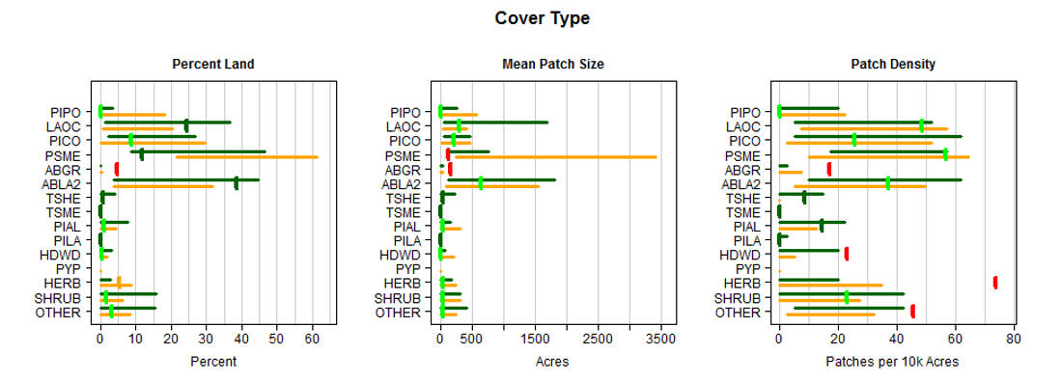
Cold Creek Analysis – “Manual Process”
PRE-TREATMENT
POST-TREATMENT
POST-TREATMENT
Notes:
Imputation nearly finished. Expect results by the end of this month.

Slide 33
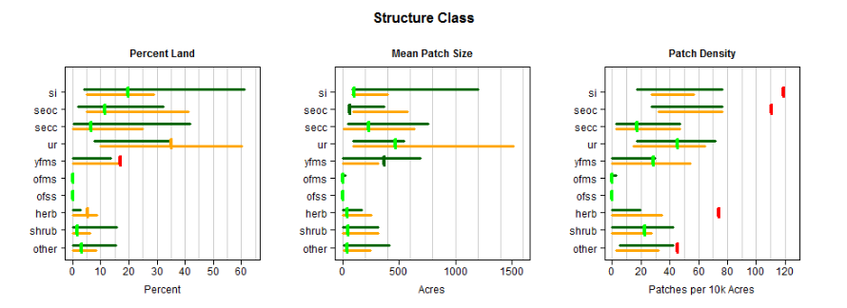
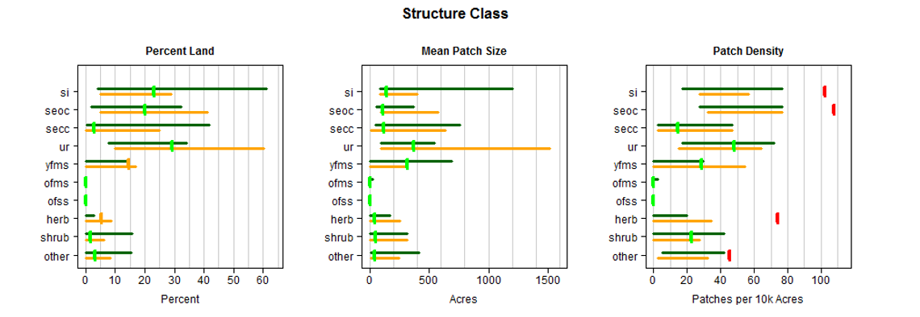
Cold Creek Analysis – “Manual Process”
PRE-TREATMENT
POST-TREATMENT
Notes:
Imputation nearly finished. Expect results by the end of this month.

Slide 34

Complete Entire Landscape
in 3 Decisions by 5th Code HUC in 9 yrs.
Tentative
Swan Hdwtrs. /Blackfoot West ROD (24 HUCs)
Sep 2022
Decision to use PI as Spatial Analysis
Mid Swan ROD (14 HUCs)
Blackfoot East ROD (37 HUCs)
Sep 2016
Oct 2026
Decision to Assess Mid Swan
Sep 2019
Mar 2017
2016
2016
2017
2018
2019
2020
2021
2022
2023
2024
2025
2026
2027
2027
Today
Sep 2016 - Sep 2017
Mid Swan Asmnt Step 1&2
1 yr
Apr 2017 - Mar 2018
Mid Swan Asmnt Step 2&3
0.9 yrs
Apr 2018 - Sep 2019
1.5 yrs
Mid Swan NEPA
Oct 2019 - Oct 2021
Mid Swan Litigation
2 yrs
Oct 2017 - Oct 2019
Swan Hdwtrs/Blackfoot West Asmt steps 1, 2
2 yrs
Jul 2019 - Jun 2020
Swan Hdwtrs/Blackfoot West Asmt steps 2, 3
1 yr
Jul 2020 - Sep 2022
2.2 yrs
Swan Hdwtrs/Blackfoot West NEPA
Oct 2019 - Sep 2022
Blackfoot East Asmt steps 1, 2
3 yrs
Aug 2022 - Jul 2024
Blackfoot East Asmt steps 2, 3
2 yrs
Aug 2024 - Oct 2026
2.2 yrs
Blackfoot East NEPA
DRAFT Deliberative Document 7/31/2017

Slide 35


