Slide 1
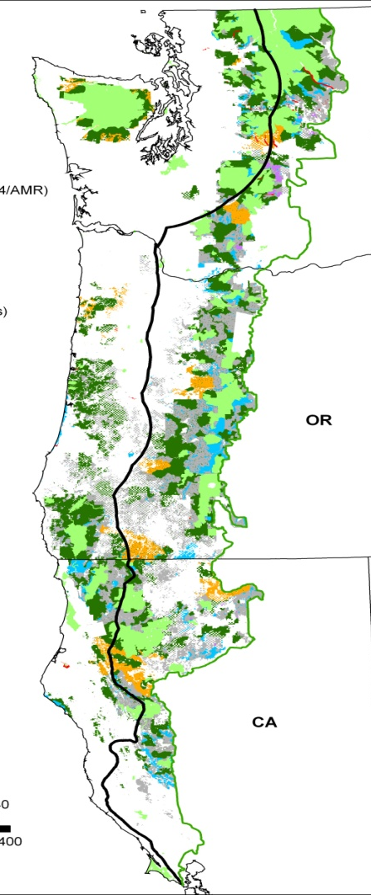
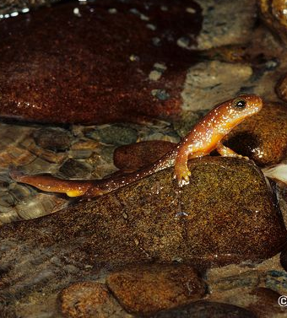

The Function of Riparian Reserves for Terrestrial Species:
What was the Intent?
Martin G. Raphael

Slide 2
A primary objective of the Northwest Forest Plan was to achieve:
“maintenance and/or restoration of habitat conditions to support viable populations, well-distributed across their current ranges, of species known…to be associated with old-growth forest conditions”
--FEMAT 1993:iv

Slide 3
Conservation Biology Principles
Species that are well distributed across their range are less prone to extinction
Larger blocks of habitat are superior to smaller blocks
Closer blocks are better than farther blocks
Connected blocks are better than isolated blocks

Slide 4
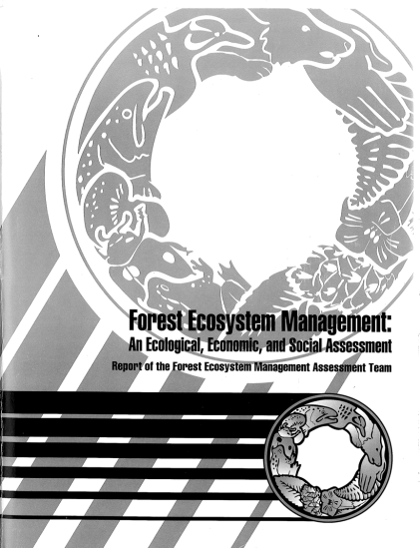
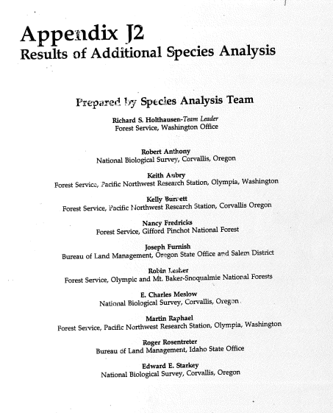


From FEMAT to Record of Decision
Riparian reserve buffer design changed along the way

Slide 5
10 Alternatives Considered
NWFP

Slide 6
Riparian Buffers - FEMAT
Fish-bearing streams - 2 tree heights
Permanent non-fish-bearing streams – 1 tree height
Intermittent streams in key watersheds – 1 tree height
Intermittent streams outside of key watersheds – ½ tree height

Slide 7
Assessment Panel
Describe options
Explain outcome rating scale
  4 outcomes ranging from likely extirpation to stable and well-distributed over next 100 years
Score alternatives
Discuss and revise scores
Summarize as average among panelists
Discuss contributions from non-federal land & cumulative effects from other threats

Slide 8
Red Tree Vole
Likelihood (%)
From panel
NWFP

Slide 9
Viability increased with amount of old forest in reserves and buffers

Slide 10
Additional Species Analysis
Screen species for additional analysis
  Species selected if rating <80 in outcome A
Describe basis for concern
Describe possible mitigation measures
Describe benefits of mitigation
Summarize mitigation measures
All of this is documented in detail in Appendix J2 of FEIS

Slide 11
Consolidated Mitigations
Survey and manage (3)
Riparian reserves (5)
Watershed protections (2)
Matrix management provisions (6)
Other measures (7)

Slide 12
Riparian reserve mitigations
Survey for species and apply Riparian Reserve Scenario 1 where found
Apply RRS1 on intermittent fish-bearing streams and adjust after watershed analysis
Apply RRS1 on intermittent fish-bearing streams
Ensure riparian management in AMAs provides species protection equivalent to RRS1
Provide additional buffers around all wetlands

Slide 13
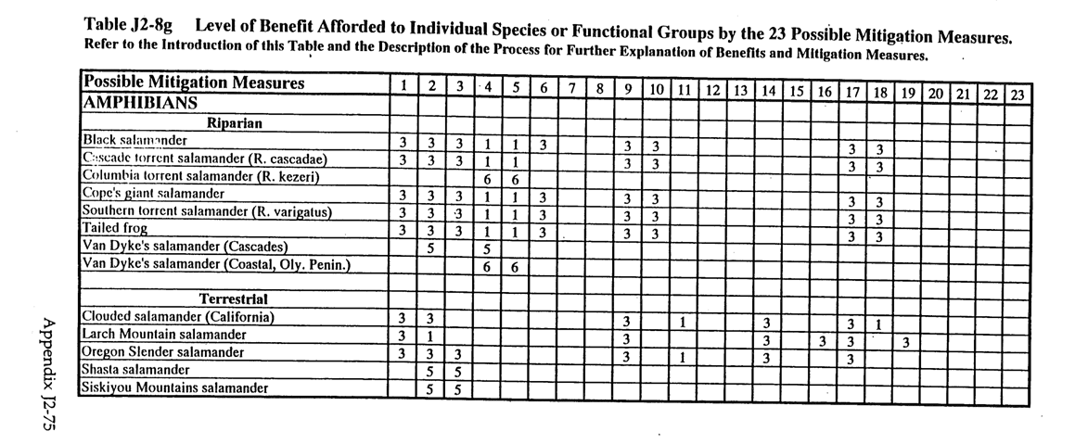
Sample from Appendix J2
Mitigations 4, 5, 6, 7, & 8 apply to riparian reserves; numbers in cells indicate level of benefit (low numbers better)

Slide 14
Additional Species Analysis
Species group | FEMAT | App. J2 | Riparian
Bryophytes | 106 | 9 | 5
Fungi | 527 | 255 | 23
Lichen | 157 | 75 | 32
Vascular plants | 124 | 17 | 5
Arthropods | 15 | 4 | 0
Mollusks | 102 | 97 | 40
Amphibians | 18 | 12 | 8
Fish | 7 | 7 | 7
Birds | 38 | 4 | 1
Bats | 11 | 7 | 6
Other mammals | 15 | 3 | 3
Total | 1120 | 490 | 130

Slide 15
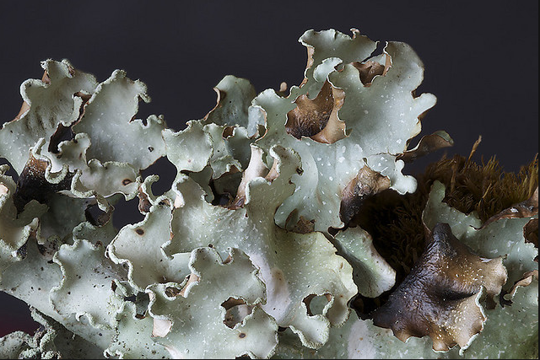
Examples
Riparian lichens (e.g., Cetrelia cetrariodes)
Full buffers would provide connectivity and larger patch sizes of appropriate host trees

Slide 16
Examples
Streamside salamanders
Full buffers would maintain cool, clear water conditions critical for foraging and thermoregulation

Slide 17
Examples
Red tree vole
Full buffers would provide connectivity among patches of old forest in Matrix lands

Slide 18
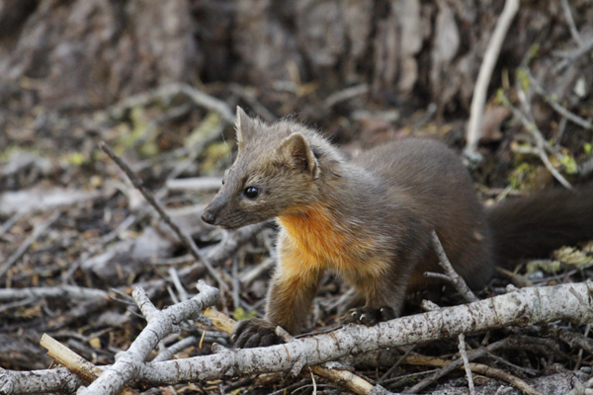
Examples
American marten
Full buffers would provide connectivity among patches of old forest in Matrix lands and foraging, denning habitat along streams

Slide 19

Final Decision
Once the list of proposed mitigations was presented to EIS team, a decision was made to implement Riparian Reserve Scenario 1 on all streams as this option captured most benefit. This was then made part of the Record of Decision for the plan.

Slide 20
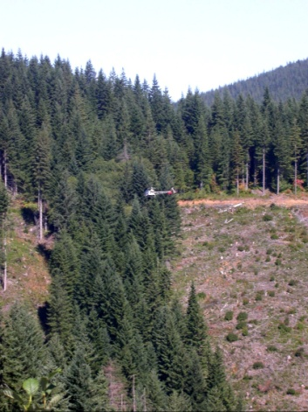
Bottom Line
The added buffer widths were meant to reduce risk of extirpation for the ~130 terrestrial species associated with old forest that would benefit from greater protection of streams and streamside forest.

