Slide 1
WDFW Forest Management Mission
WDFW preserves, protects and perpetuates forests as fish and wildlife habitat, while providing sustainable fish and wildlife recreational and commercial opportunities.
To accomplish our mission we manage for
Ecological integrity
Priority species
Risk (especially severe wildfire).

Slide 2
Seven of the Forested Ecological Systems on WDFW Lands Totaling 148,000 Acres
Require Frequent Fire: 6 of 7 rated as imperiled
    Natural Heritage Program Ratings for WDFW forests
    S1: Western larch savanna (<200 acres)
    S1: North Pacific oak woodland (<200 acres)
    S1S2: Oak-Ponderosa woodland and savanna (11,000 acres)
    S2: Ponderosa pine woodland and savanna (56,000 acres)
    S2: Aspen forest and woodland (400 acres - that satellites can see):
    S2: Dry Douglas fir (madrone) forest and woodland (800 acres)
    S3S4: Dry-mesic montane mixed conifer forest (74,000 acres):
    Why? Succession and timber management strategies.

Slide 3
WDFW Lands and National Fire Protection Association Community Risk Ratings
Extreme: Klickitat, LT Murray, Colockum, Wenas, Sherman Creek and Chief Joseph
High: Oak Creek, Sunnyside, Chelan, Methow, Wooten and LeClerc
Moderate: Sinlahekin and Scotch Creek

Slide 4
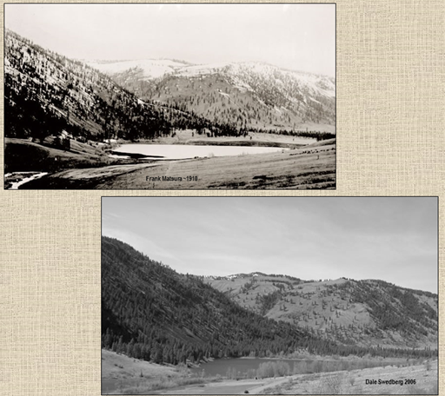
Sinlahekin: 1910 vs 2006

Slide 5
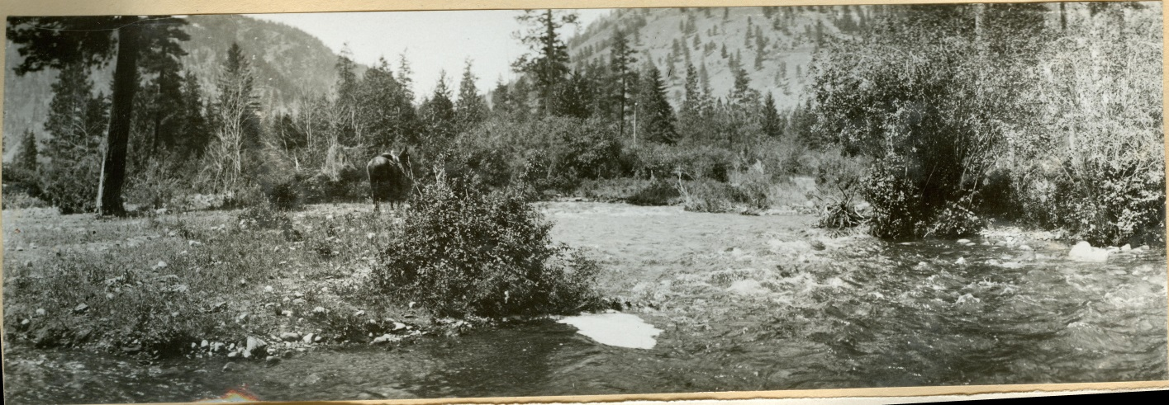
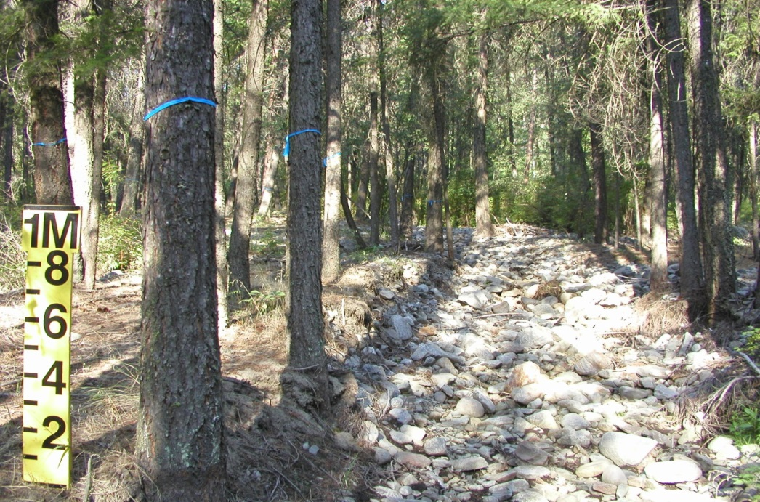
Sinlahekin Ground view
1910 Versus 2014

Slide 6
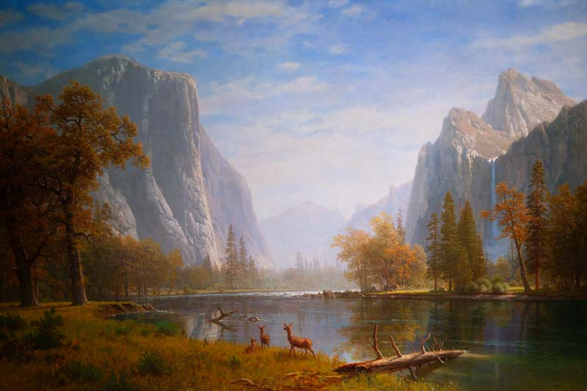

Changes in Fire Regimes have altered Vegetation and Risk
Yosemite (Albert Bierstadt-around 1859)

Slide 7
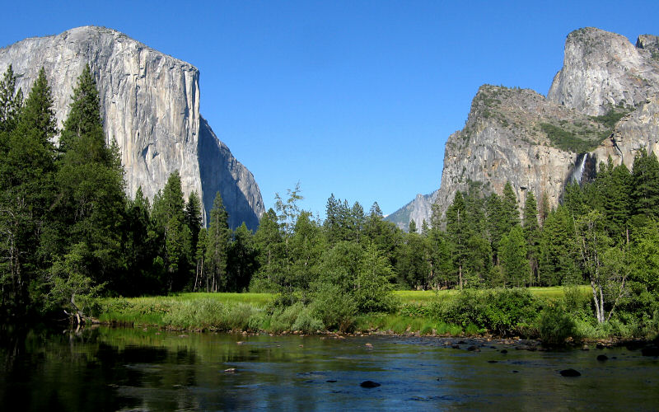
Modern Yosemite

Slide 8
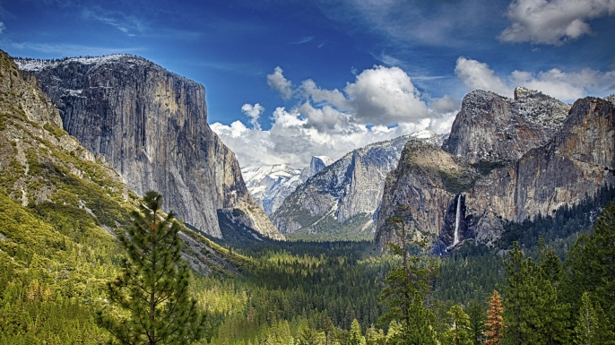
Modern Yosemite

Slide 9
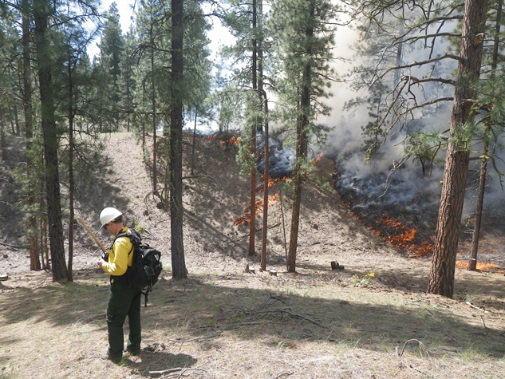
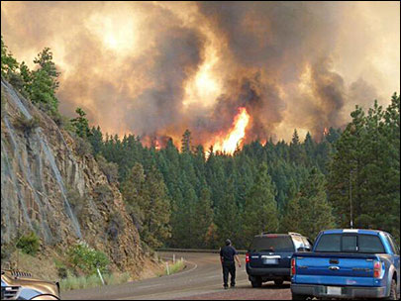

Different Fire Behavior
Prescribed fire following restoration thinning: Sinlahekin Wildlife Area

Slide 10
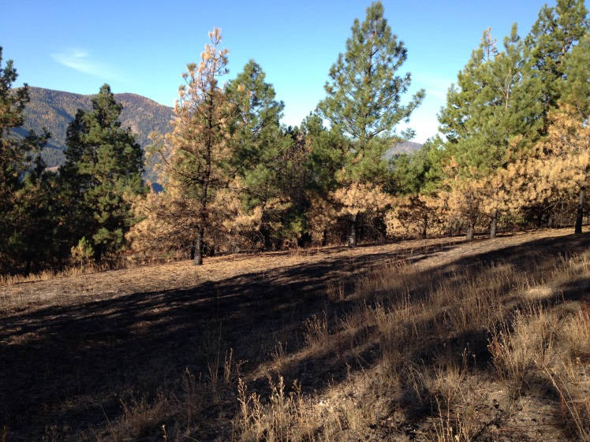
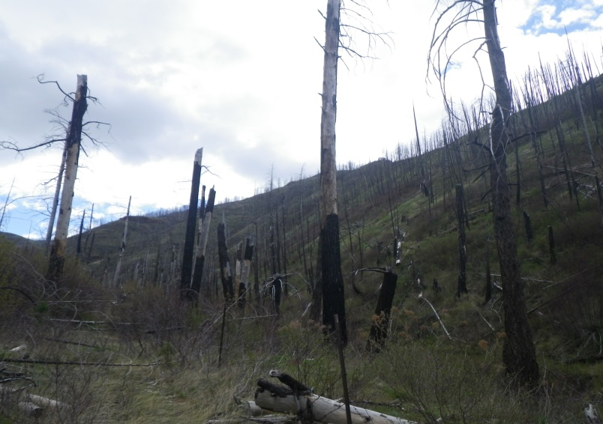
Different Fire Effects
Sherman Creek: Wildfire effects following 50 years of management with Rx fire
Wooten: Ten years post-wildfire. Never treated then burned severely.

Slide 11
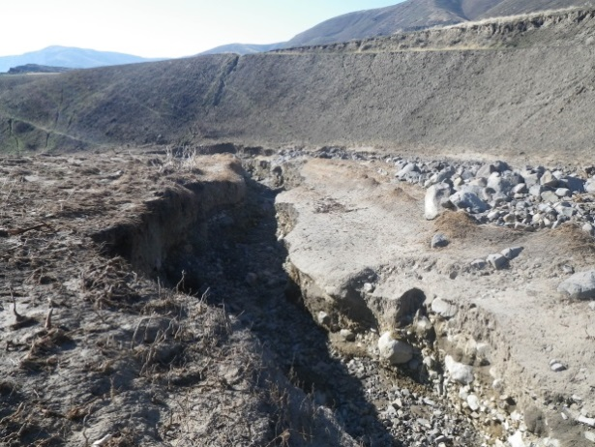
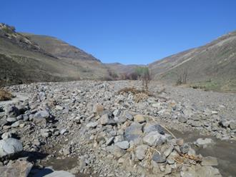
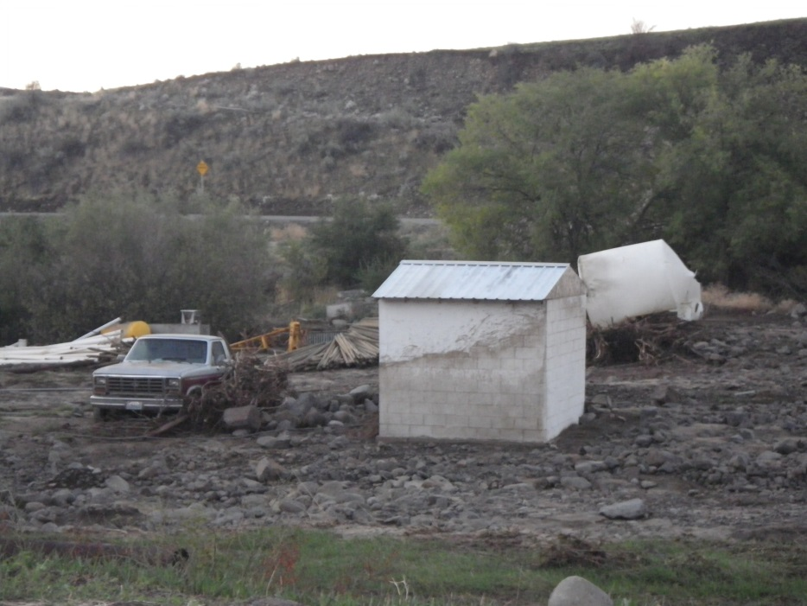
Different Downstream Impacts

Slide 12
Fire - Dependent Forest Condition Drivers and Management Needs
  Drivers
  Baseline: Fire Return Interval 5-30 years: 5,000-30,000 acres/year burned (variable but mostly low severity) Average 11%
  Changes
    High grade logging prior to acquisition
    1960-1990: <0.1% treated/year
    2000-2014: 0.6% Thin 620 acres/year and Rx fire 300 acres/year
    2013-2015: 5-9K acres/year burned (mostly too intense). 3-6%
  Needs
  Dig ourselves out of the fire deficit then
  Treat 10-15K acres/year with ecologically appropriate intensity fire or other treatments.
  Focus on High Risk Areas: Life and property, priority species, ecological integrity

Slide 13
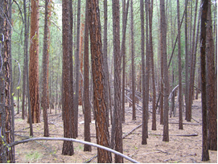
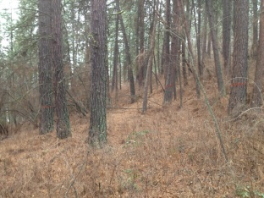
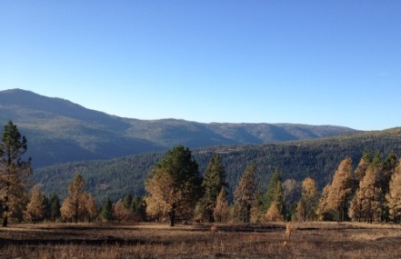
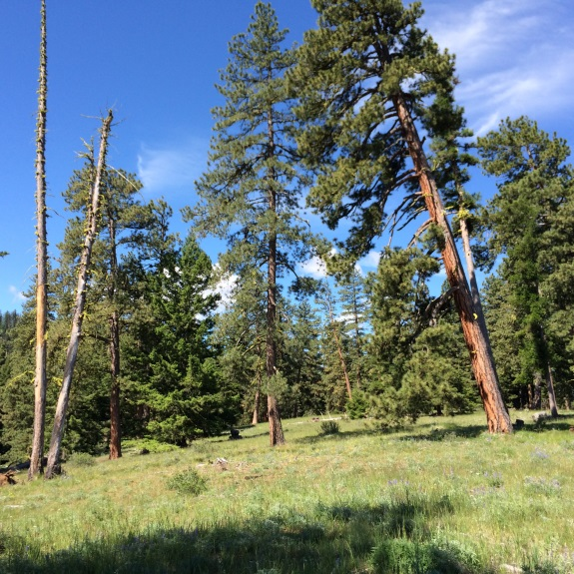
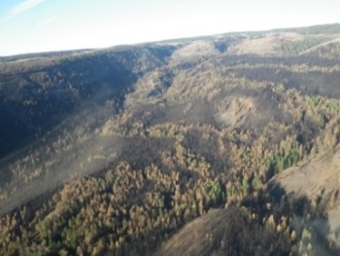

Ecological Integrity Restoration
Ponderosa Pine Woodland and Savanna
Current
Desired future Conditions

Slide 14
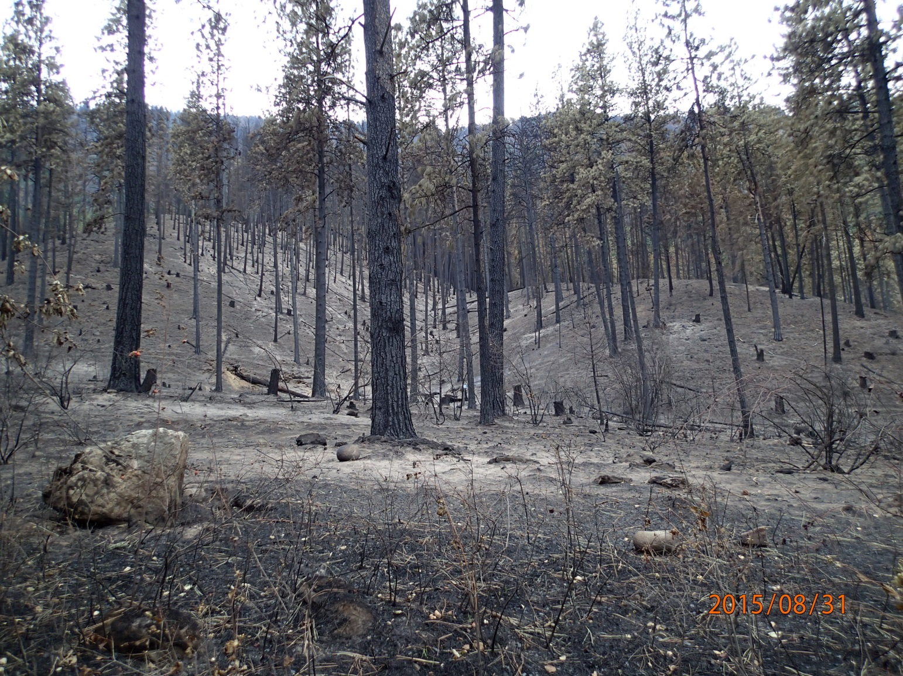

Thinning Alone is Not Enough:
Thinned prior to Okanogan Complex fire
viciity

Slide 15

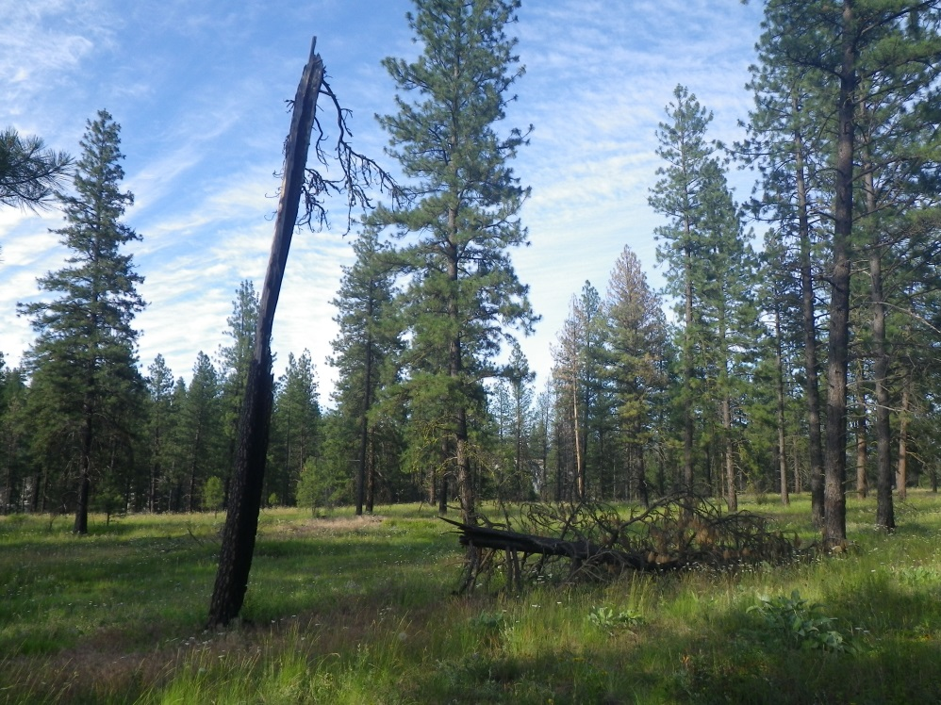
Thinning & Prescribed Fire Sherman Creek
viciity

Slide 16
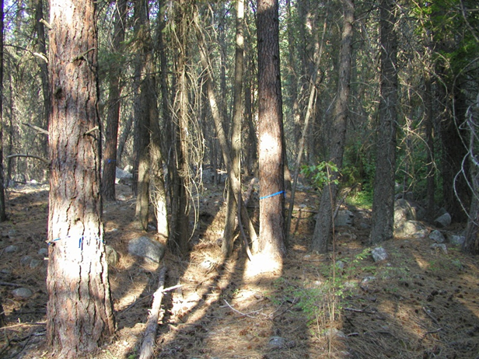
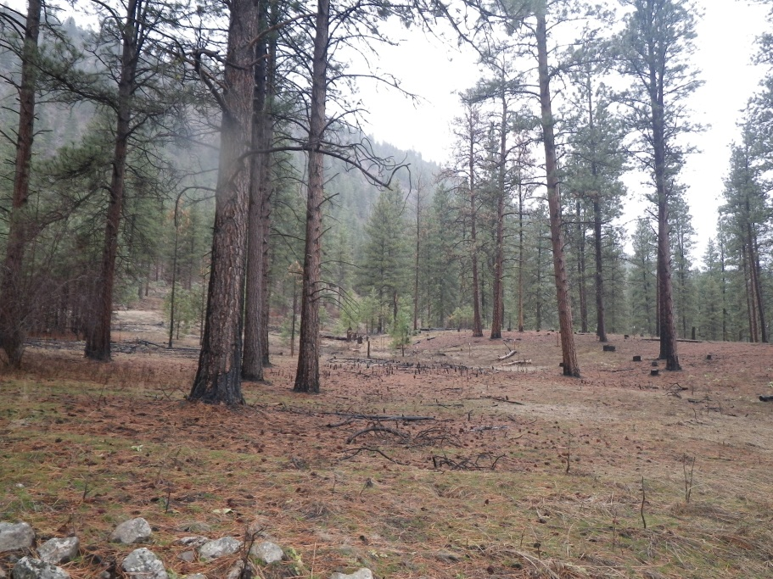
Sinlahekin: Thinning & Prescribed Fire

Slide 17
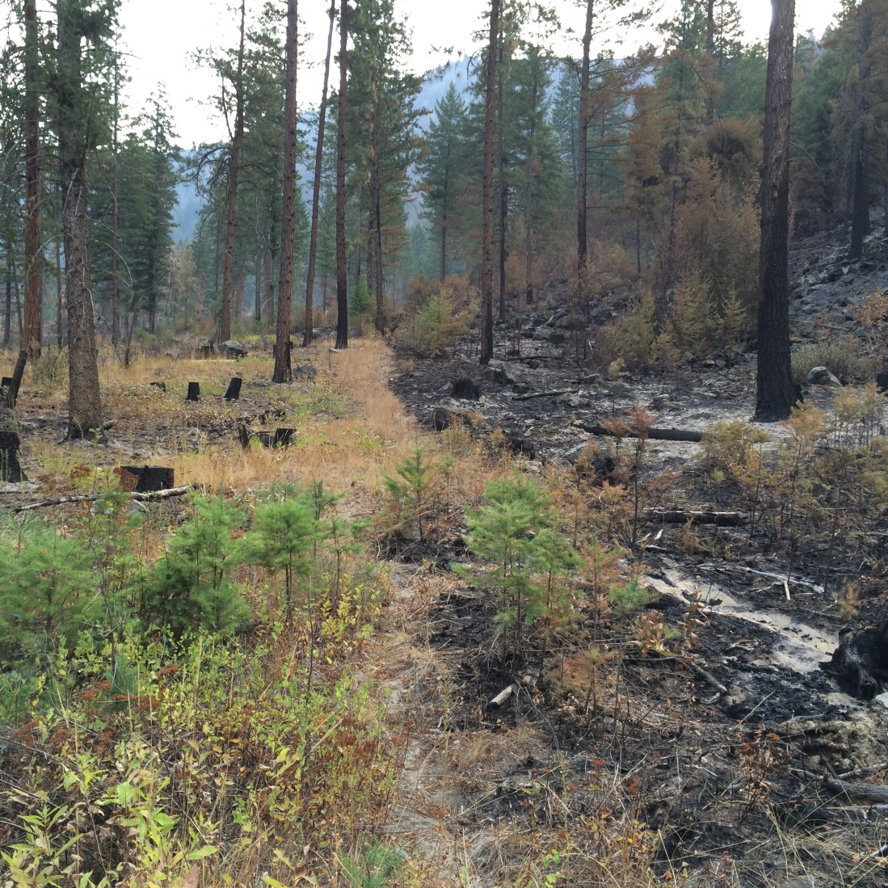
Okanogan Complex: WDFW Thinned + Prescribed Fire Units Were an Effective Fire Break

