Slide 1
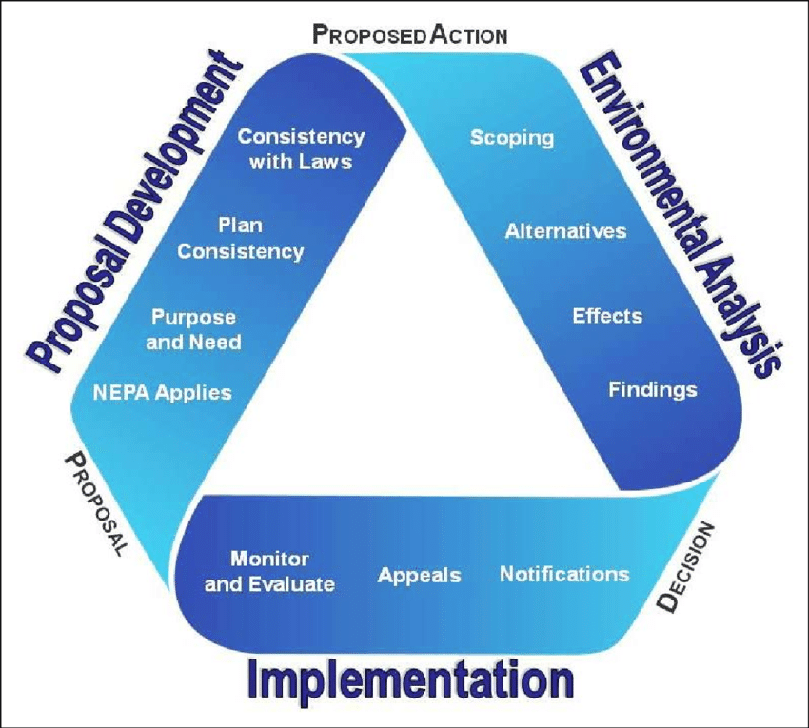


Landscape Ecology and NEPA Planning
Building Credible, Science-Based
Rationale for
“Why Here, Why Now”

Slide 2
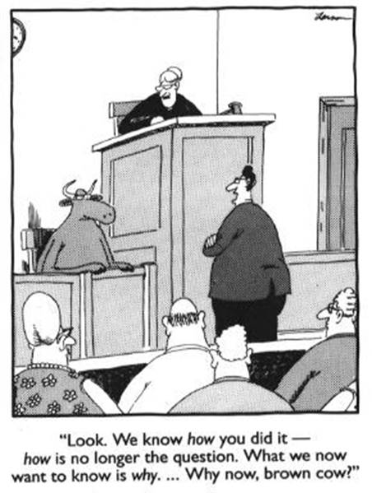

Slide 3
GOALS FOR THE DAY
Explore landscape ecology principles, including geological, terrestrial, aquatic, wildlife, and human systems;
Discover how a landscape perspective can help identify resource management issues and support strong, successful NEPA decisions; THE BIG “WHY”
Build a foundation for integrated, efficient planning; and
EADM
Create a peer network for sharing!

Slide 4
AGENDA
Laying the Science Foundation
State of Planning: the left side
Home Grown Approaches

Slide 5

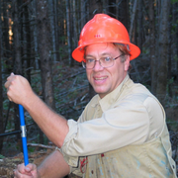

Lisa Northrop
Deputy Regional Forester
USFS R6
Paul Anderson
Acting Station Director
Pacific NW Research Station

Slide 6
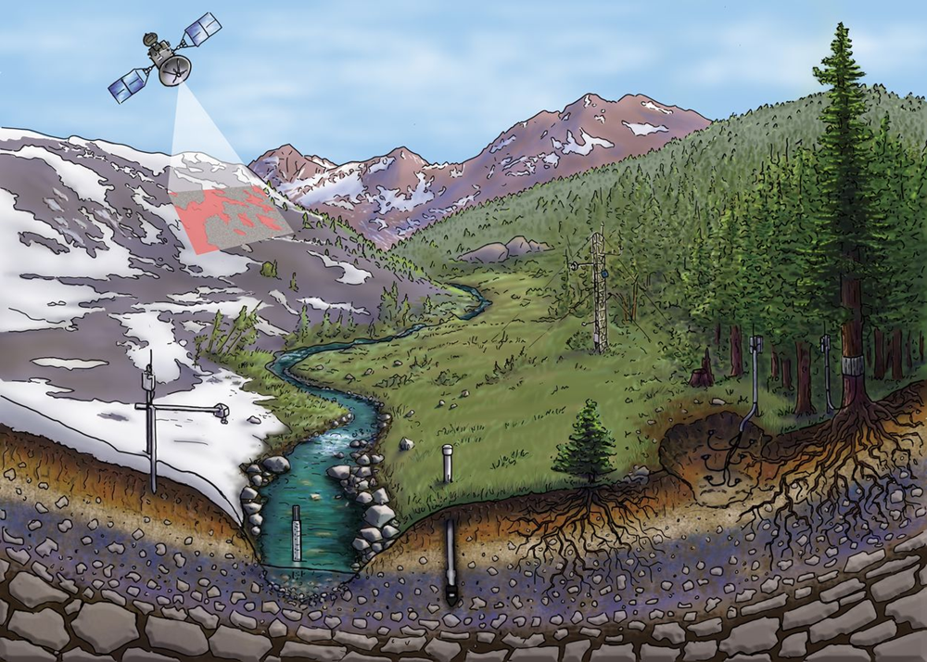

The Critical Zone: Where Rock Meets Life
The Critical Zone lies between rock and sky...where water, atmosphere, ecosystems, soils, and rock interact.
It is essential to life on Earth, including food production and water quality.
From Gordon Grant, PNW

