Slide 1
Integrated Landscape Restoration:
Identifying and Prioritizing Restoration Opportunity
on the Mt. Baker-Snoqualmie National Forest
Kevin James
Western Washington Area Ecologist

Slide 2
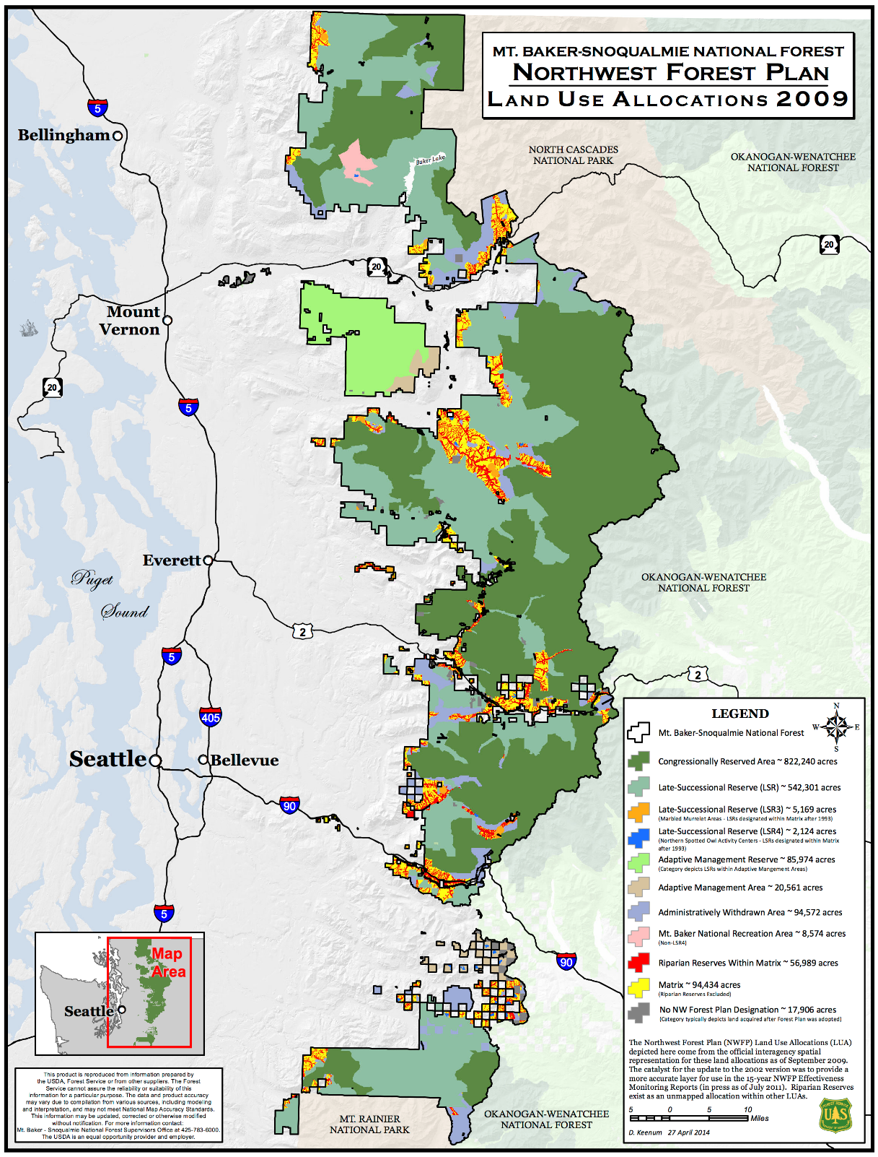
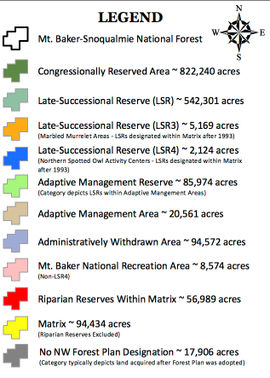
Mt. Baker-Snoqualmie NF (MBS)
- Western slopes of the Cascade mountains
- Extends over 140 miles north to south
- Total area is over 1,724,000 acres
- 9 wilderness areas covering 48% of the forest
- 4 million annual visitors

Slide 3
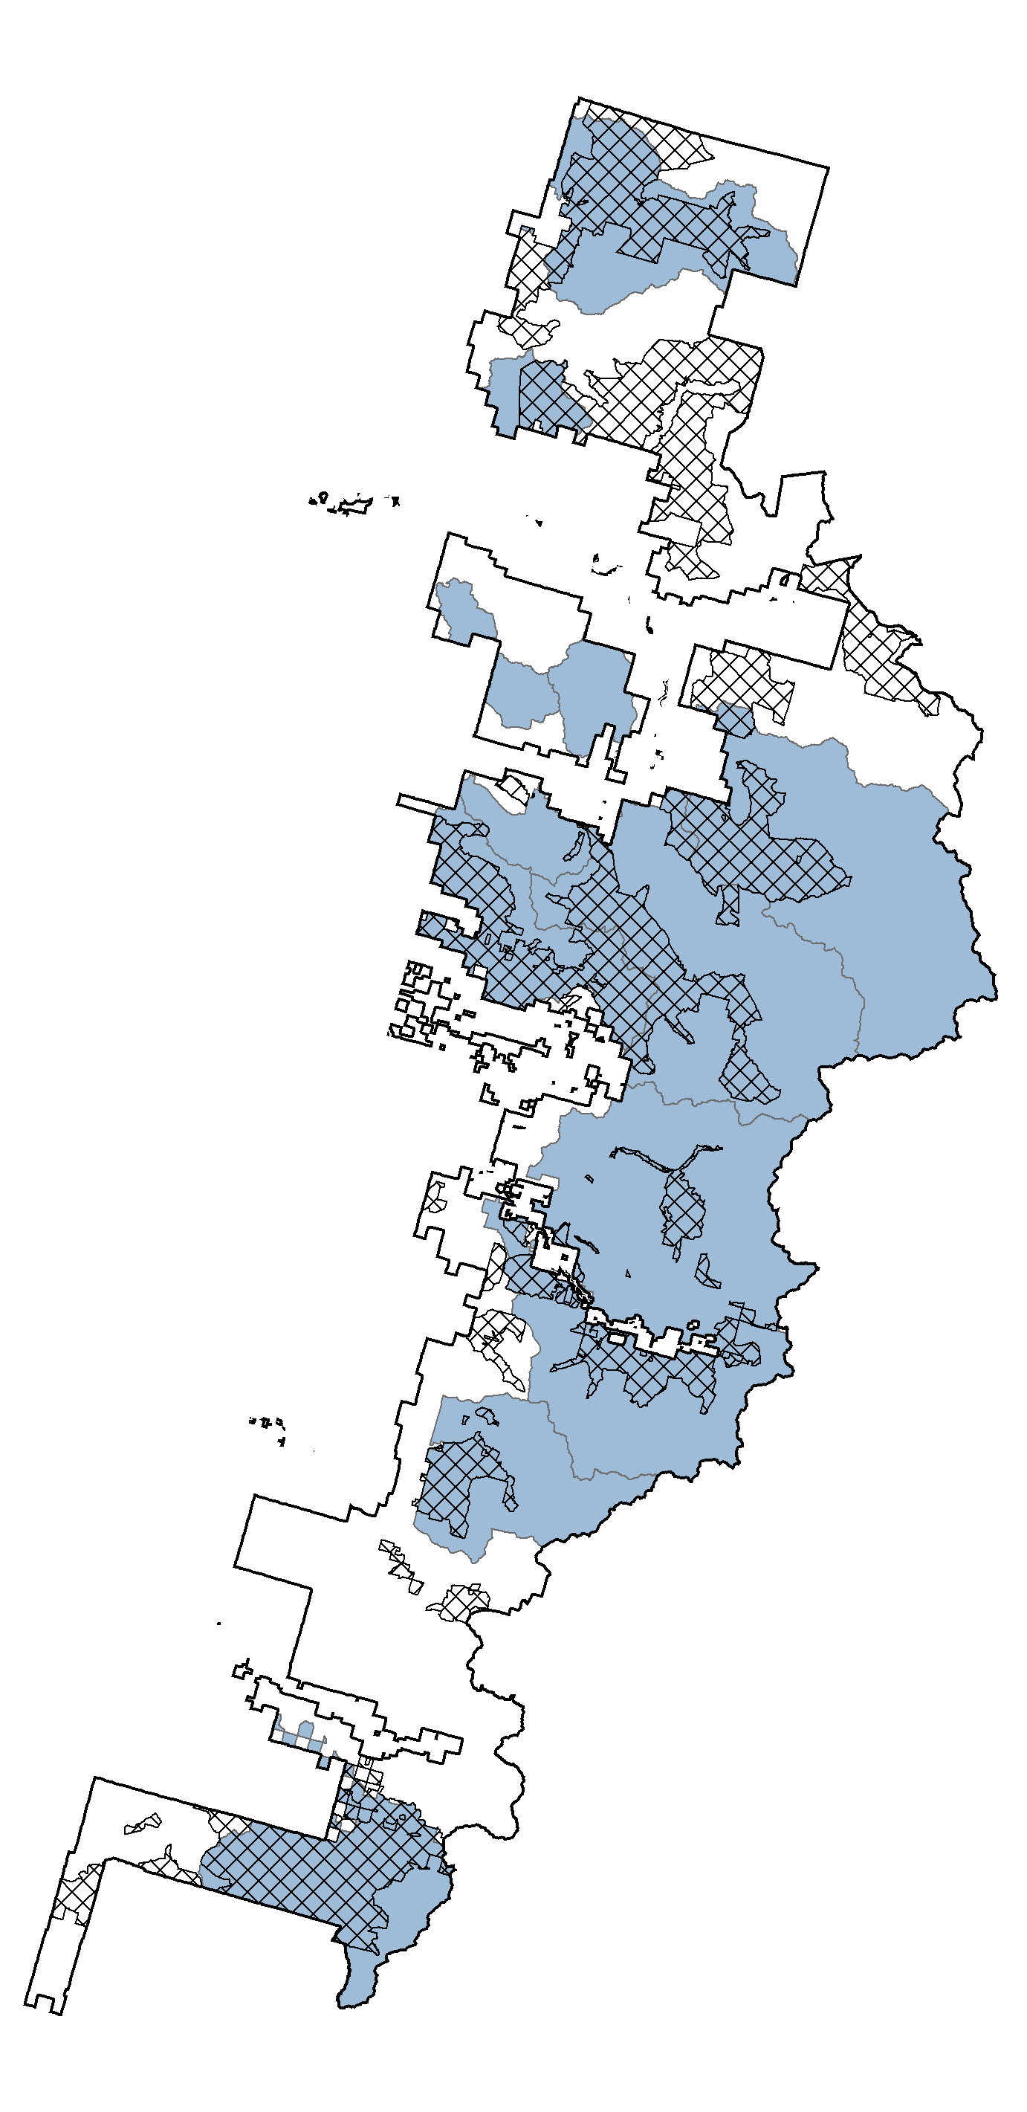
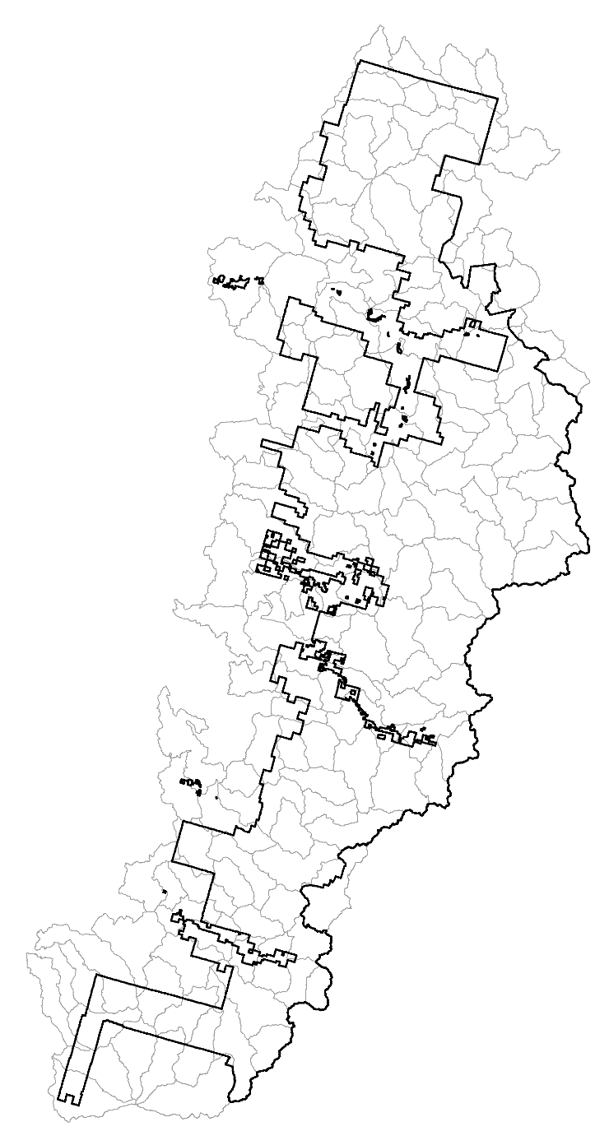
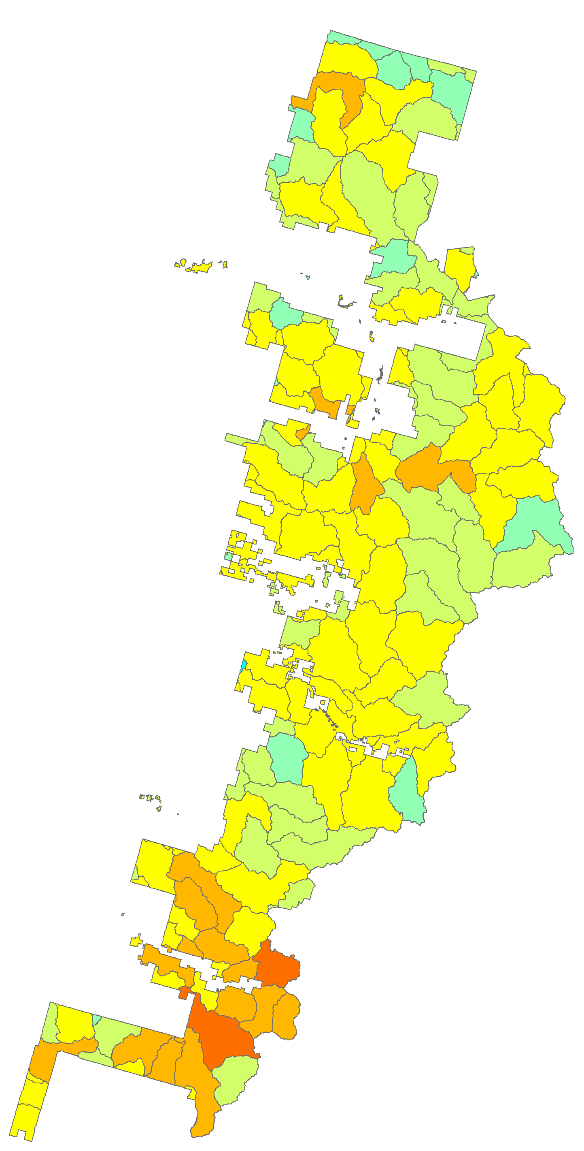
*

Slide 4
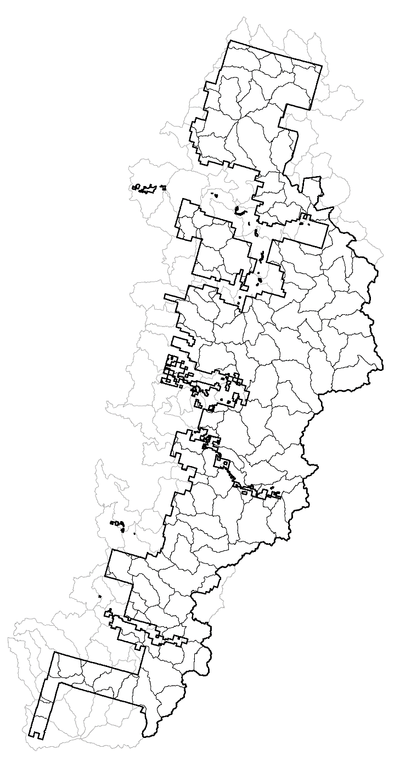
Broad-scale questions:
How much of the subwatershed is within the Forest boundary?
Is active management an option for terrestrial restoration?
Does the current arrangement of forest types benefit wildlife?
Where are roads interacting with fish habitat and aquatic processes?
What are the restoration opportunities based on the current condition?
How can restoration needs be addressed for out-year planning?

Slide 6
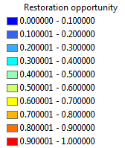
Models is run for each subwatershed
All metrics integrated hierarchically
Higher scores reflects greater opportunity
Opportunity is based on current condition
Prioritize activity across subwatersheds
Able to “drill-down” for project planning

Slide 7
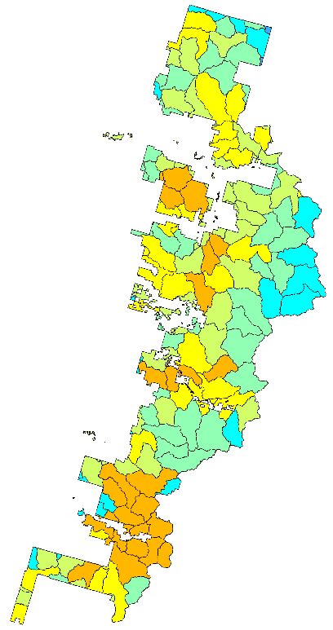
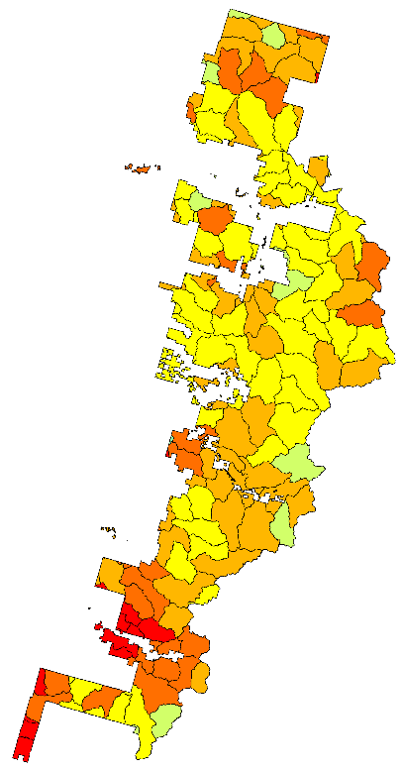
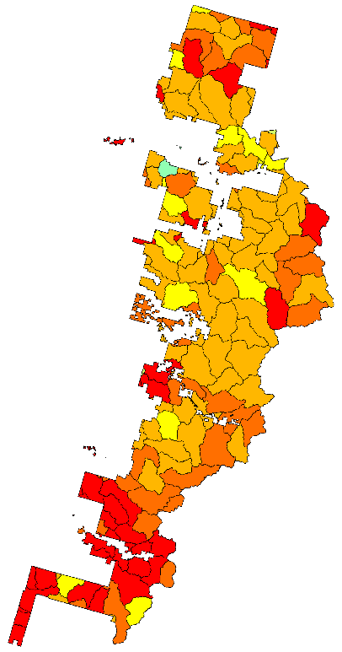
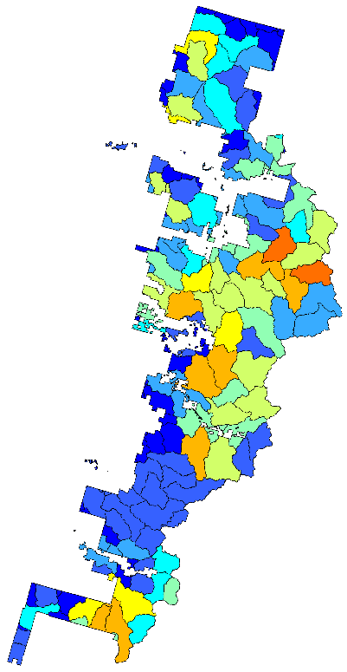
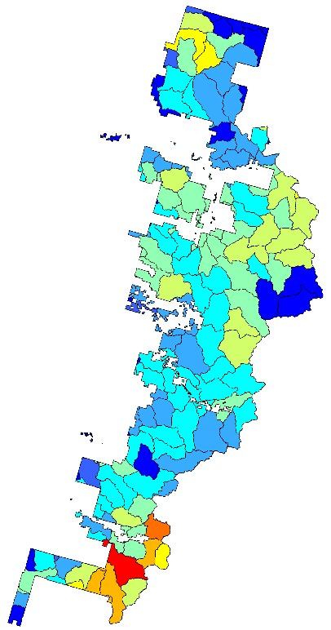
Subwatershed
Land Base
Forest Structure
Wildlife Habitat
+
+
=
+
+
Fish Habitat
Hydrology-
Access

Slide 8

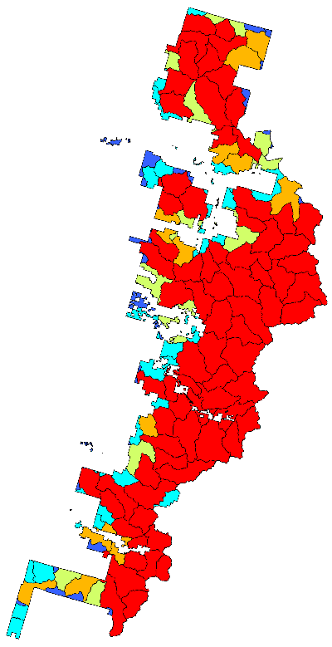
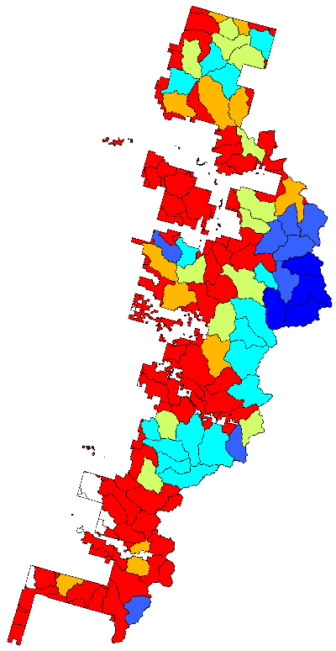
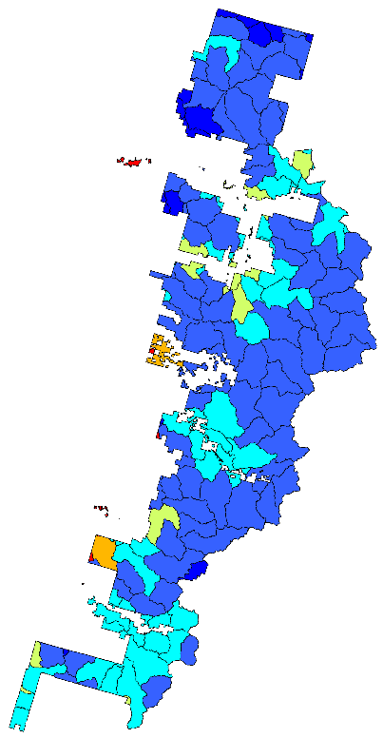
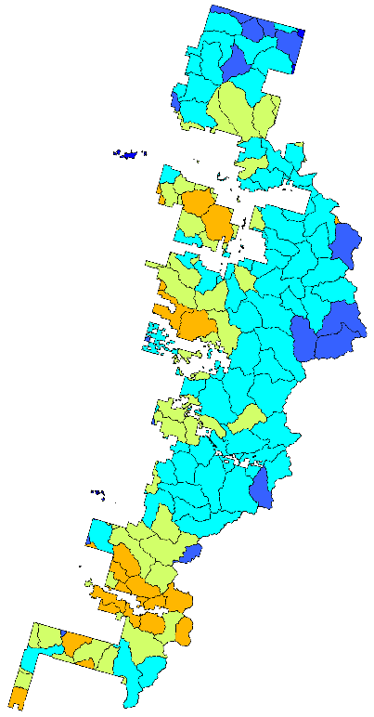
Land Base
Intersect
Wilderness
+
+
=
+
WHZ
PSFZ

Slide 9

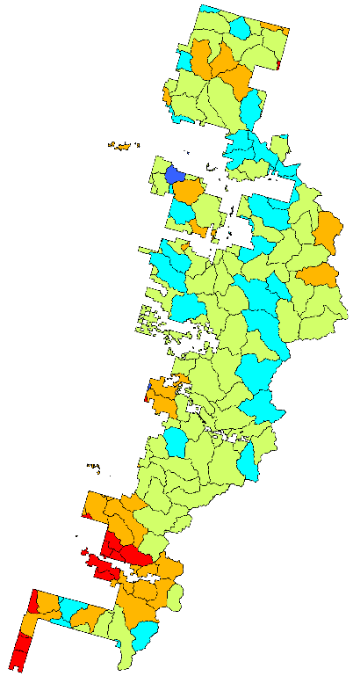
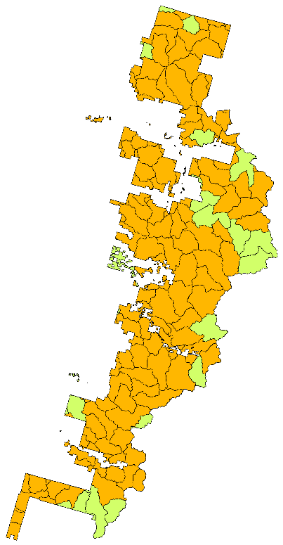
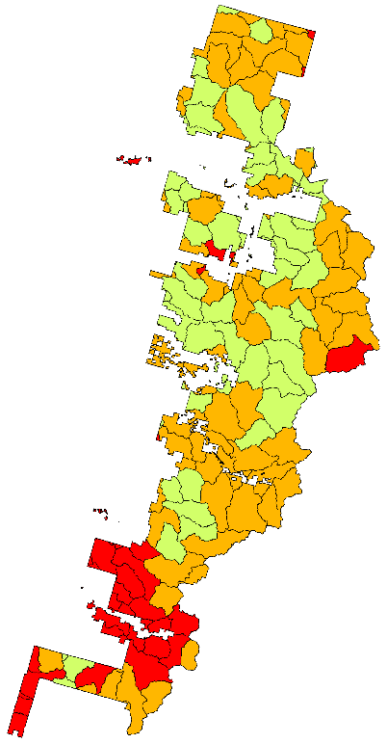
Forest Structure
Managed
Forest
Mature
Forest
+
=
+
Old Forest

Slide 10

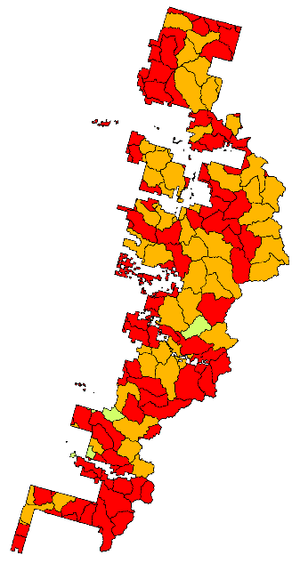
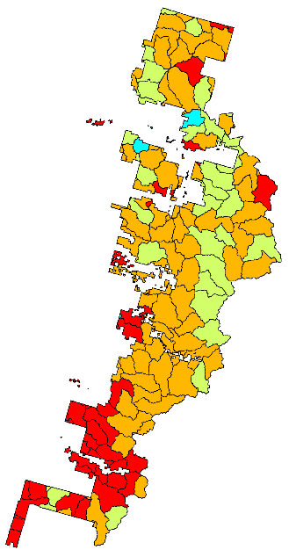

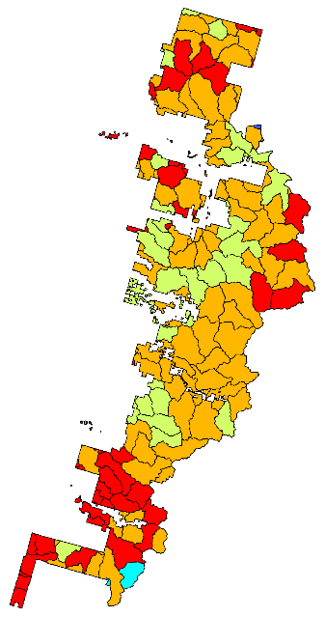
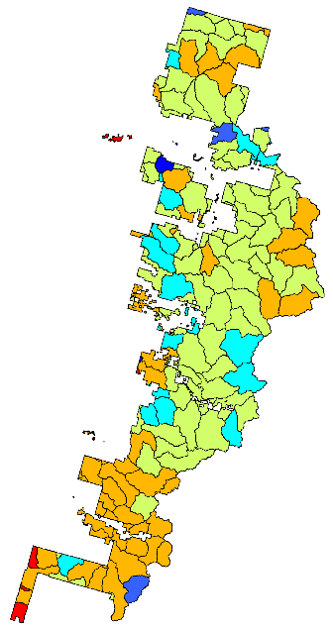
Wildlife Habitat
Recent
Fire
Mature Forest
Patches
Old Forest
Patches
+
+
=
Mature Forest
Stringers
Old Forest
Stringers
+
+

Slide 11

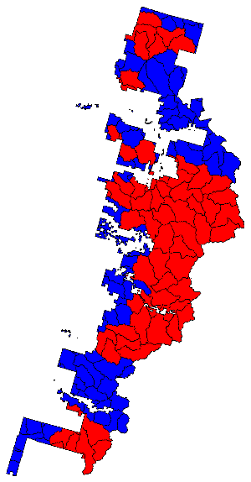
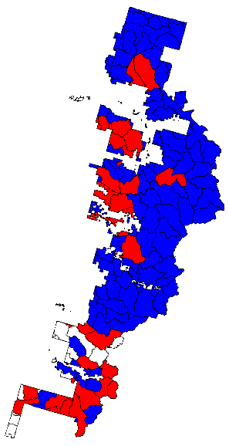
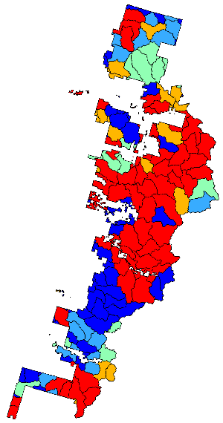
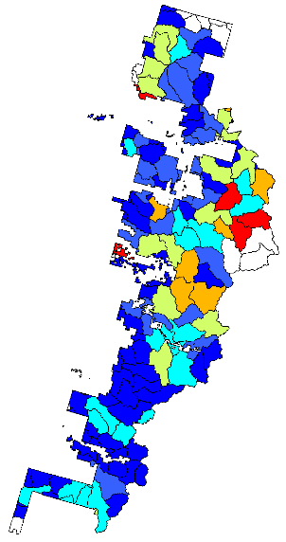
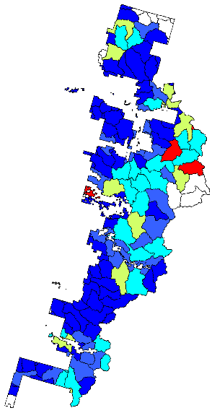
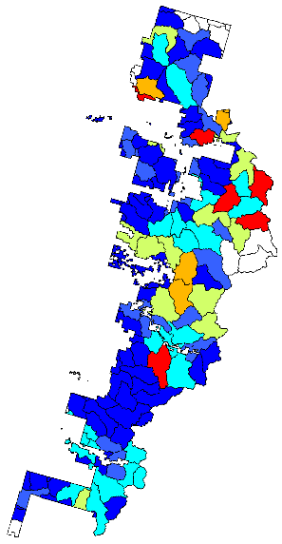
Fish Habitat
Key Watershed
WCF
Listed Fish
Distribution
+
+
=
Roads by Bull Trout
Critical Habitat
Roads by Chinook
Critical Habitat
Roads by Steelhead
Critical Habitat
+
+
+

Slide 12

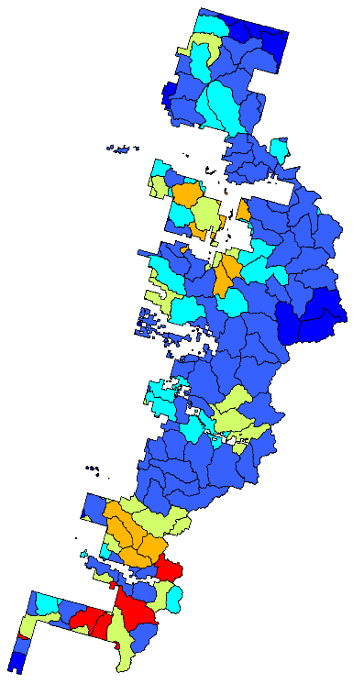
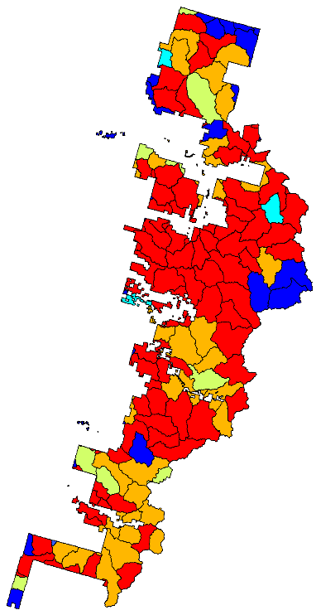
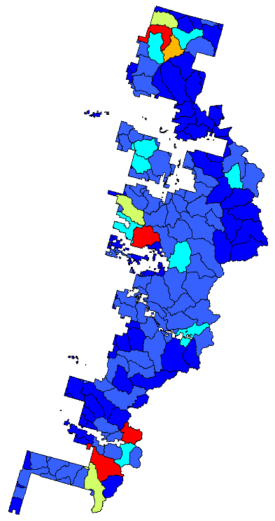
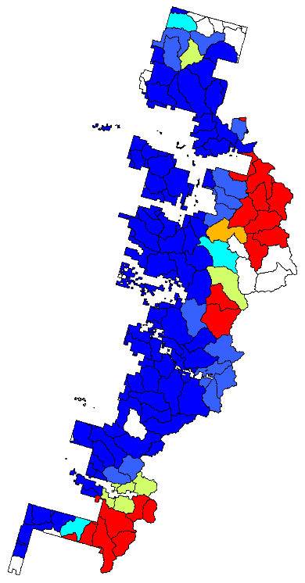
Hydrology-
Access
Road Density
Road Density
by Streams
+
+
+
=
Unstable Soils
by Roads
Roads at Risk
to Climate Change
+

Slide 13
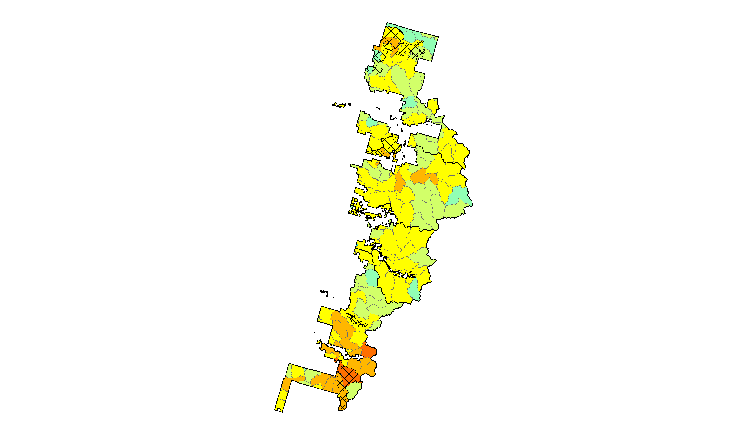
Next step: down-scaling results to project planning level

Slide 14
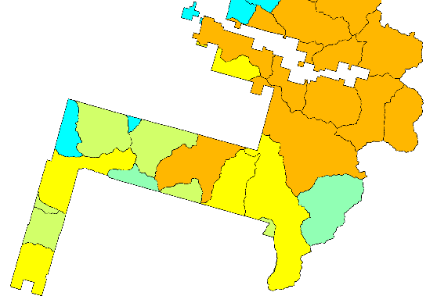
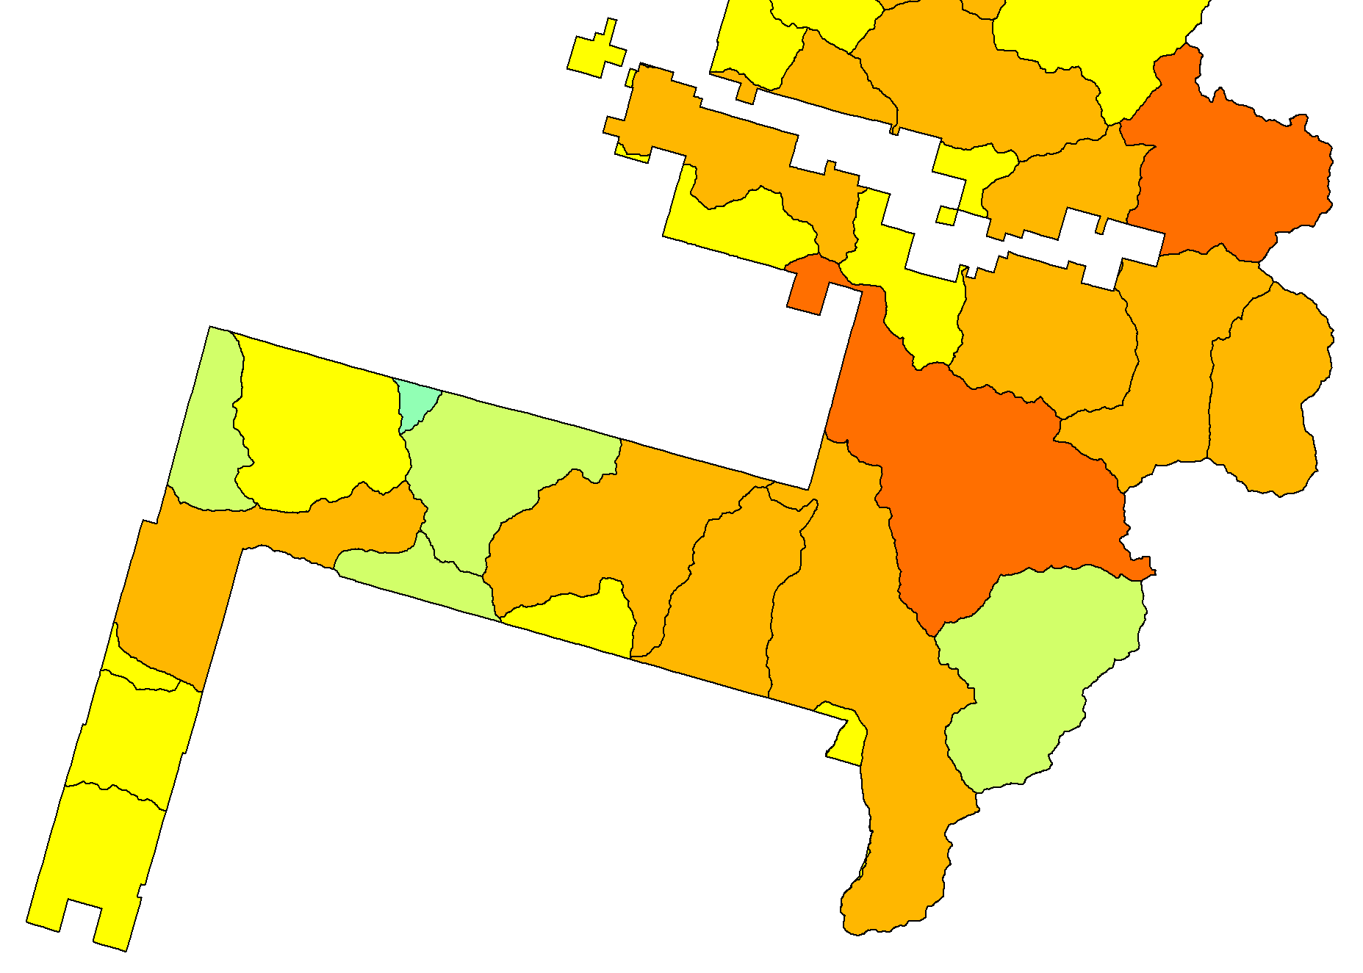
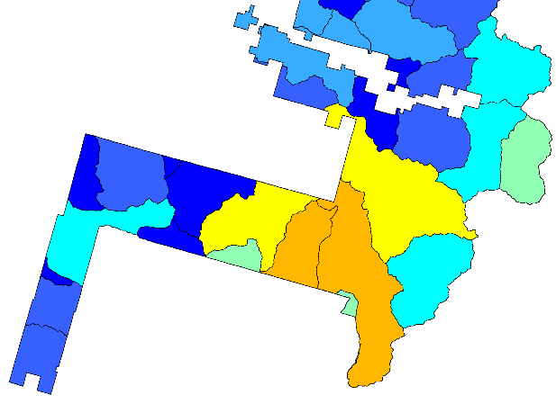
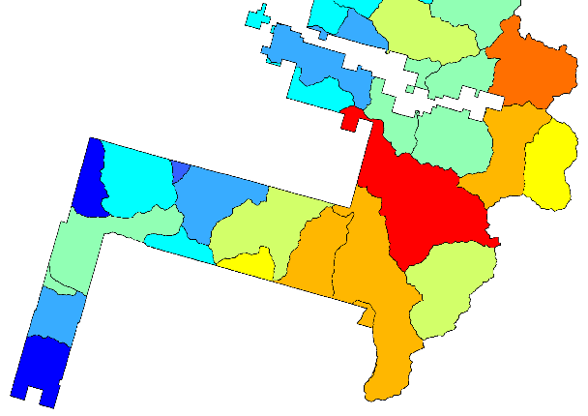
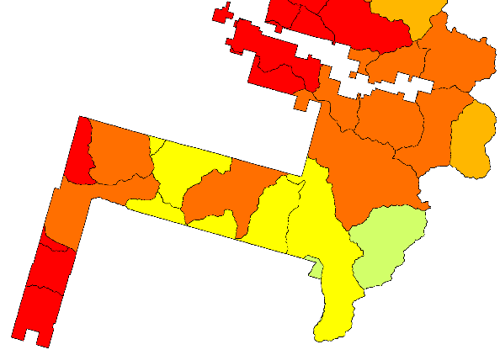
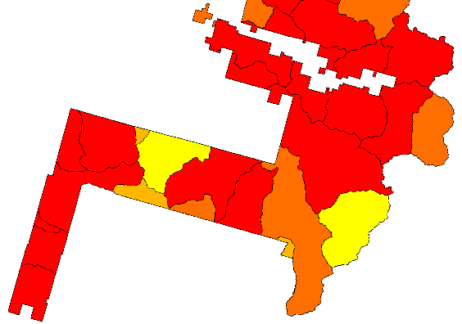
Potential Planning Area: overall score
Land Base
Fish Distribution
Driver: WHZ, PSFZ
Driver: WCF, species richness
Forest Structure
Hydrology-Access
Wildlife Habitat
Driver: roads by streams
Driver: Old growth structure
Driver: patch & connectivity

Slide 15
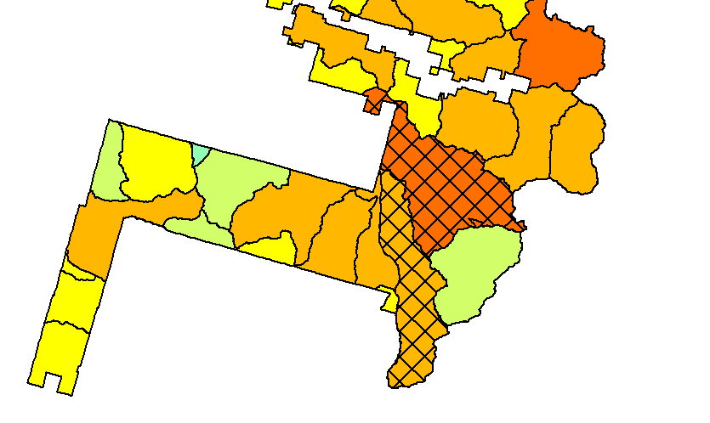
Snoquera

Slide 16
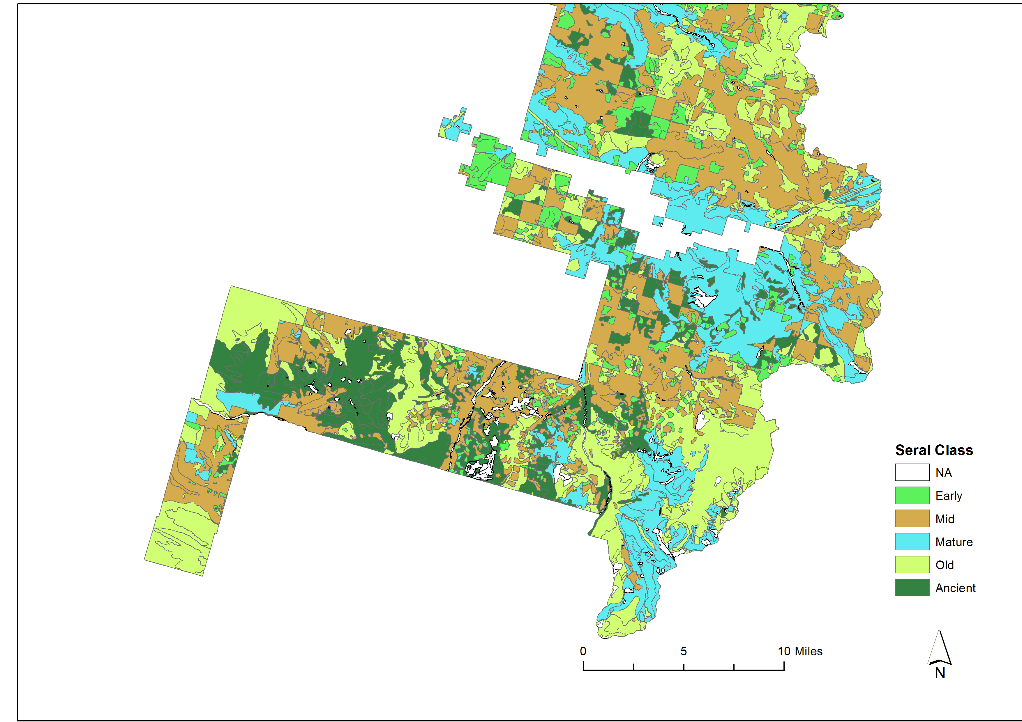
 | Stand Age for Seral Stages
Veg Zone | Early | Mid | Mature | Old | Ancient
WH | 0-30 | 30-80 | 80-250 | 250-450 | >450
PSF | 0-30 | 30-80 | 80-300 | 300-500 | >500
MH | 0-100 | 100-200 | 200-300 | 300-600 | >600

Slide 17
Current and Median 80% range of natural variability of forest seral stages by subwatershed within the LSR

Slide 18
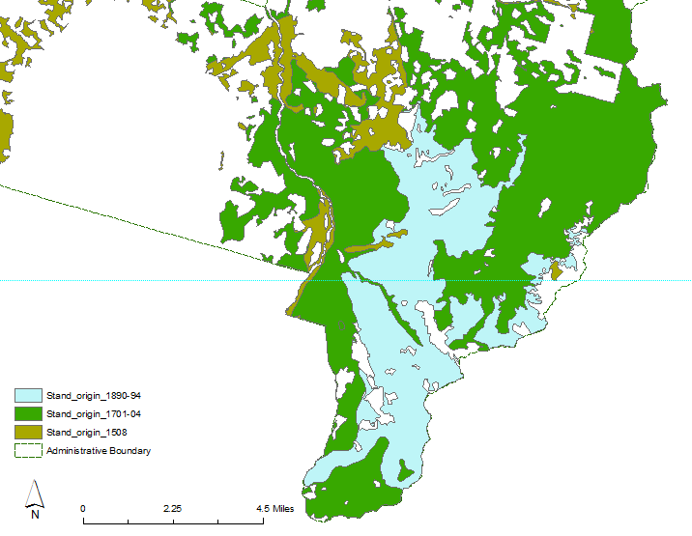

Slide 19
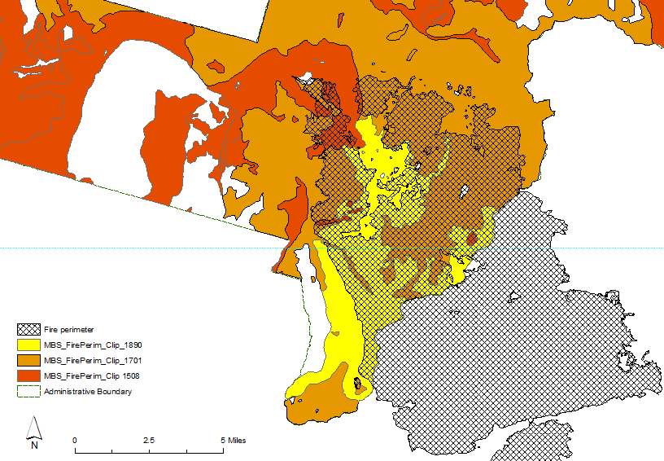

Slide 20
