Slide 1
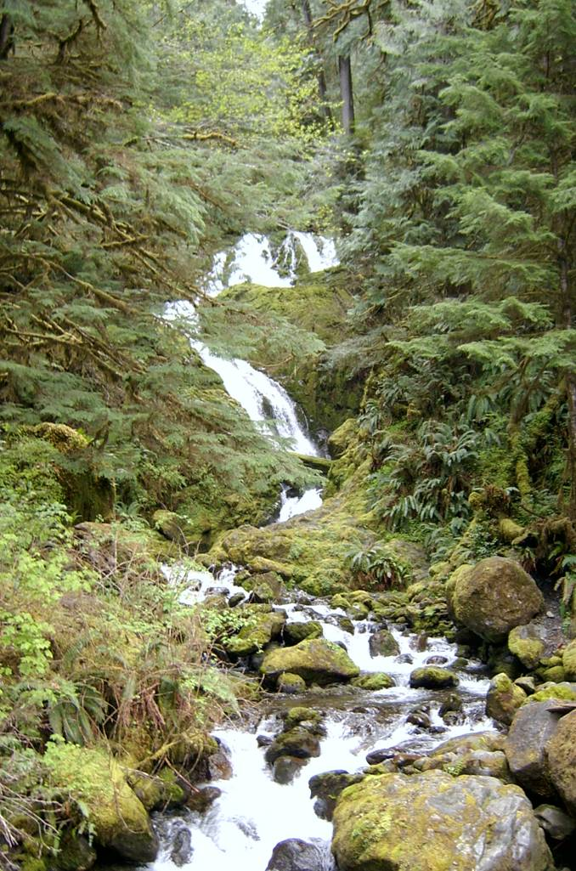
Wood recruitment modeling in NetMap
(or how to see the wood for the trees)
Sam Litschert & Lee Benda
Earth Systems Institute
Mount Shasta / Seattle / Fort Collins

Slide 2
NetMap Analysis Tools developed with collaborators
Watershed Processes
-erosion/sediment supply
-LWD supply
-thermal loading/temp
Aquatic habitat indices
-intrinsic potential (species)
-core areas
-connectivity
-diversity
-floodplains
-bio-hotspots
-classification
USFS
EPA
Vegetation
-forest age
-fire risk
-burn severity
Roads
-density (multi-scale)
-X w/fish
-upstream hab. length/quality
-stability
-drainage diversion
-surface erosion
Query/Overlap tools & others
-menu driven: search & prioritize
e.g., high erosion w/best habitat,
high road density + high
erosion + sensitive habitat
NOAA
Wild Salmon Center

Slide 3
Wood in streams
Legacy of management that reduced supplies of large woody debris
Functional importance of wood:
  create aquatic habitat,
  provide nutrients,
  channel morphology and sedimentation,
Processes that can provide wood are wildfire, insect, disease, wind, mass wasting, and suppression mortality
And now, thinning and tipping.
Harmon et al, 1986; FEMAT, 1993; Meleason et al, 2003

Slide 4
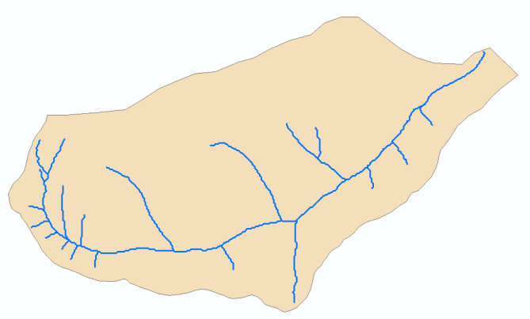
Multi-scale wood modeling in NetMap
Reach scale
  Per 100m reach or project
  For selected piece sizes
  Temporally and spatially explicit
  Up to 3 stands on each bank
  Plots of volume and number of pieces
Watershed scale
  Temporally and spatially explicit
  CE analysis of management scenarios
  Based on RSWM technology
  Plots and maps available

Slide 5
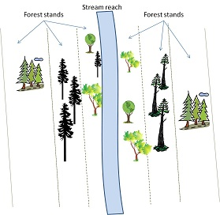
Reach Scale Wood Model (RSWM)
Mortality types include suppression, fire, insect, disease, & wind-throw.
Bells and Whistles:
channel width,
stand width,
hillslope gradient,
bank erosion,
wood decay,
taper equations,
thinned trees that are tipped, and
size of resulting wood pieces
Inputs: stand tables from forest growth models
Outputs: 10 types of plots
Stream reach
Forest stands
Forest stands
Stand
widths
Channel
width
Hillslope gradients
Kozak, 1988; Bilby et al, 1999; Benda and Sias 2003; Sobota et al, 2006; Hibbs et al, 2007; and more.

Slide 6
RSWM Scenarios
Left bank is always no action scenario (70 m)
Right bank treatment scenarios (11)
Double entry thin, 70 TPA: 2010, 2040
All other parameters held constant
Right bank scenarios
Stand1 | Stand2
No action (10 m) | No action (60 m)
No action | Thinned
No action | Thin & tip 5%
No action | Thin & tip 10%
No action | Thin & tip 15%
No action | Thin & tip 20%
Thinned (70 m)
Thin & tip 5%
Thin & tip 10%
Thin & tip 15%
Thin & tip 20%

Slide 7
Scenarios with tipped trees produce higher volumes of wood in the reach than untreated or thinned stands for most of the time simulated.
The buffer reduces the effect of the thin and tip by reducing loss of wood. But in the long term the volume of wood in the stream increased to close to the untreated scenario.

Slide 8
Year = 2010
1st thin
RSWM was run to 70m on both banks, trees are too small to contribute beyond 26m from reach
Untreated stands contributed no wood in 2010

Slide 9
Total volume of cumulative wood over time
(sorted by increasing volume)
Total cumulative wood | Volume (m³ 100 m⁻¹ reach) (percent change from reference )
Untreated/Double thin | 156 (-42%)
Untreated/Double thin, tip 5% | 232 (-14%)
Untreated/Buffer10_Double thin | 243 (-10%)
Untreated/Untreated (reference condition) | 271
Untreated/Double thin, tip 10% | 284 (5%)
Untreated/Buffer10_Double thin tip 10% | 288 (6%)
Untreated/Buffer10_Double thin tip 15% | 299(10%)
Untreated/Buffer10_Double thin tip 20% | 305 (13%)
Untreated/Double thin, tip 15% | 324 (20%)
Tree tipping from thinning operations combined with riparian buffers offer the highest volumes of wood loadings

Slide 10
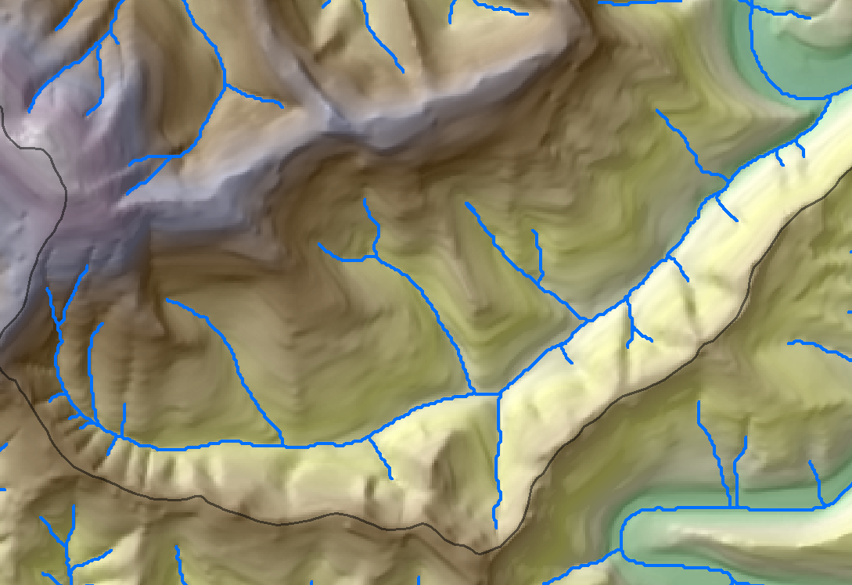
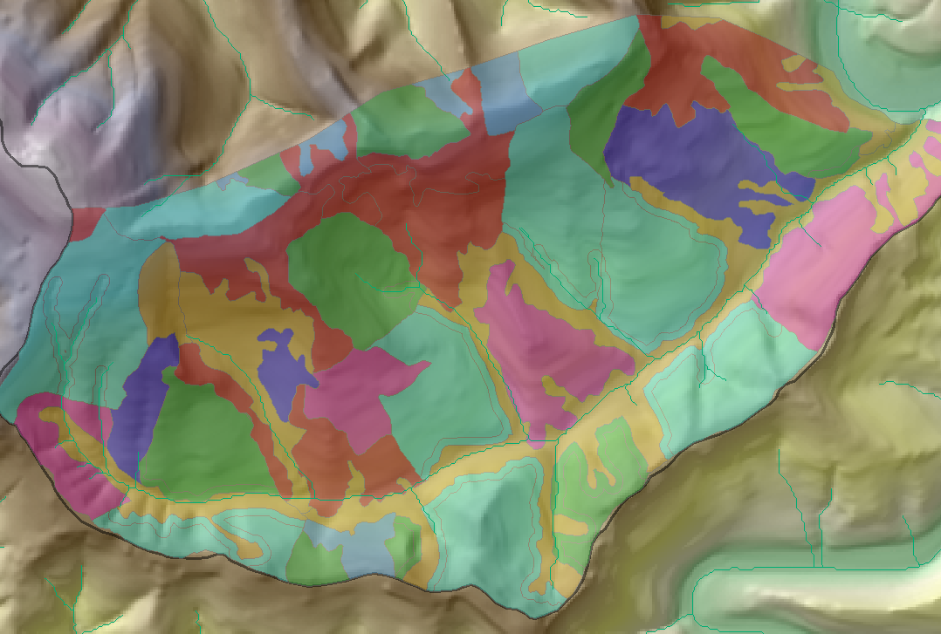
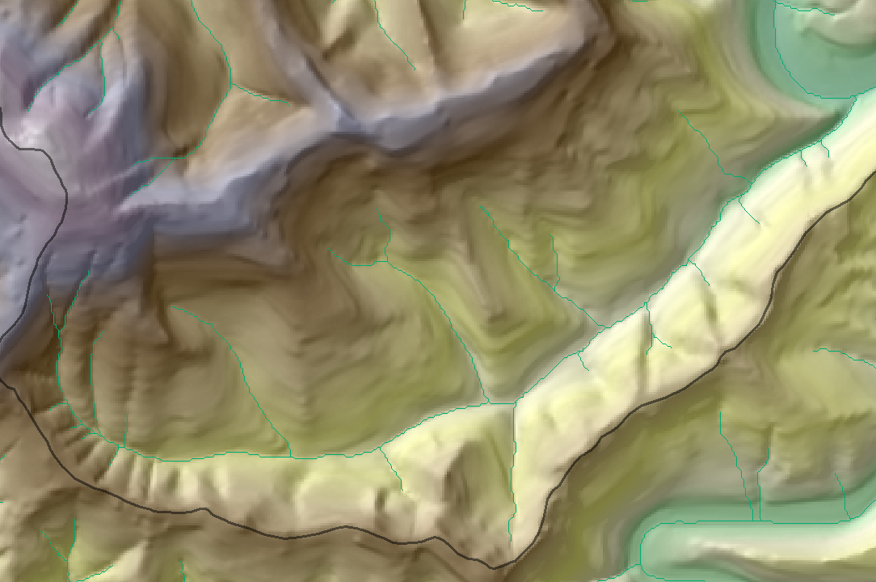
Watershed Scale Wood Model
Stand tables from forest growth models (FVS, Organon and Zelig) pre-processed in RSWM
Tabular data integrated with GIS: stream reaches, stands, and DEM
Generate output:
plots and maps

Slide 11
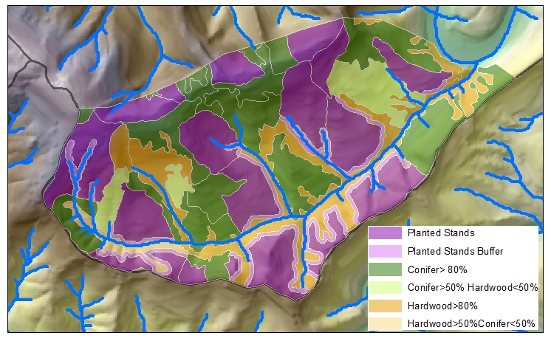
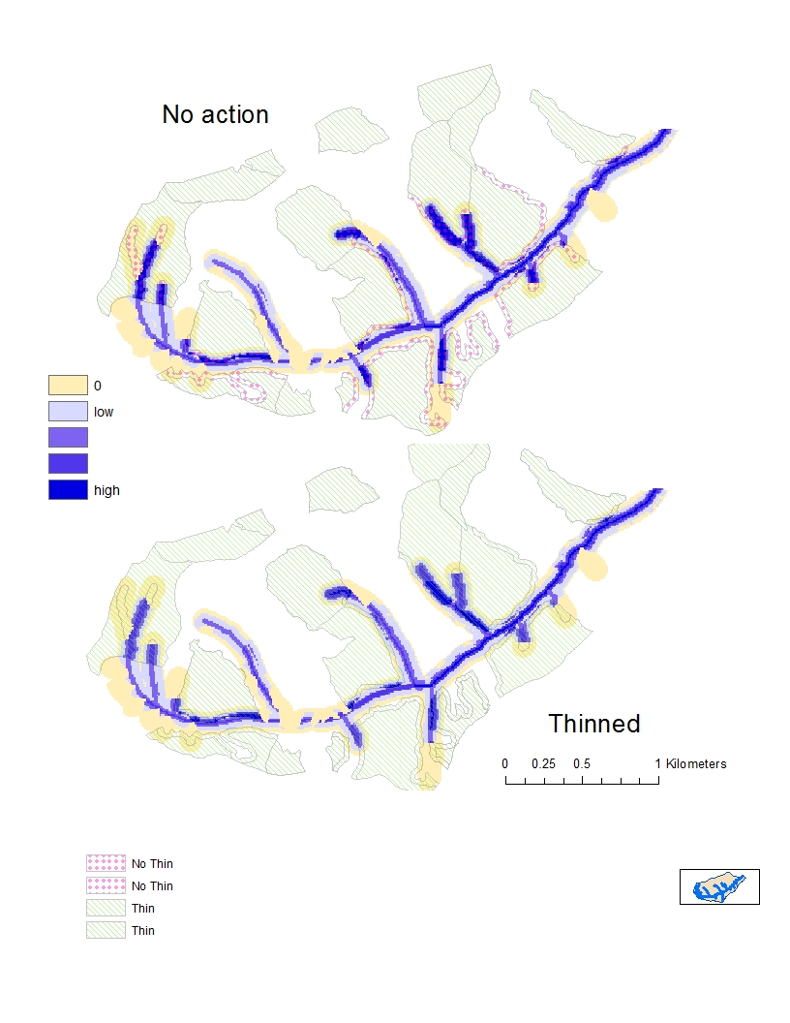
Stand information
Watershed area = 5 km²
Coho and steelhead habitat
Km

Slide 12
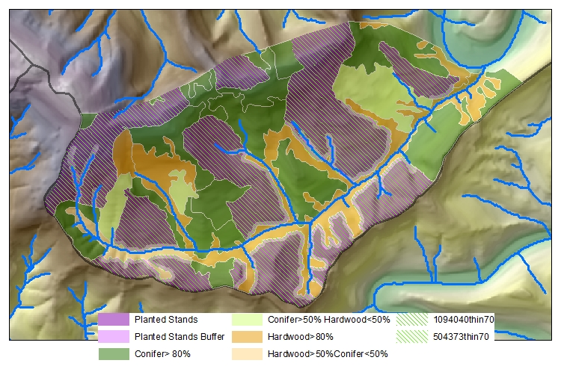
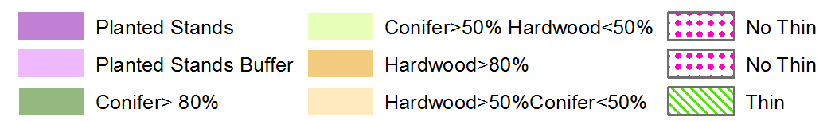
Stand treatments – thin to 70 TPA from the bottom
(47% of watershed thinned)

Slide 13
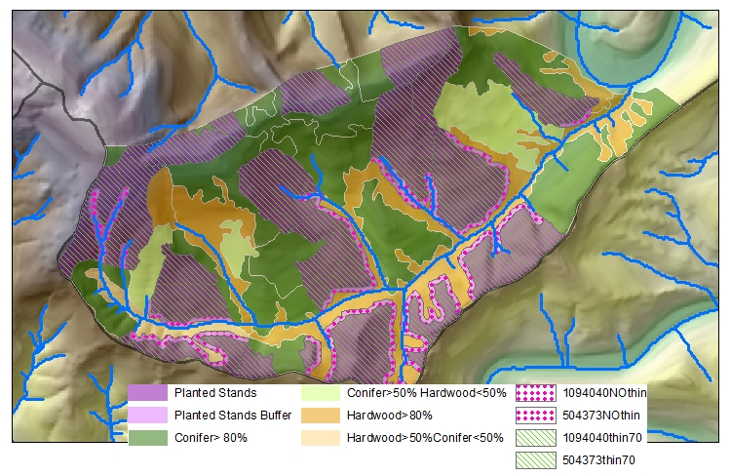
Stand treatments – no action buffer & thin
(39% of watershed thinned)

Slide 14
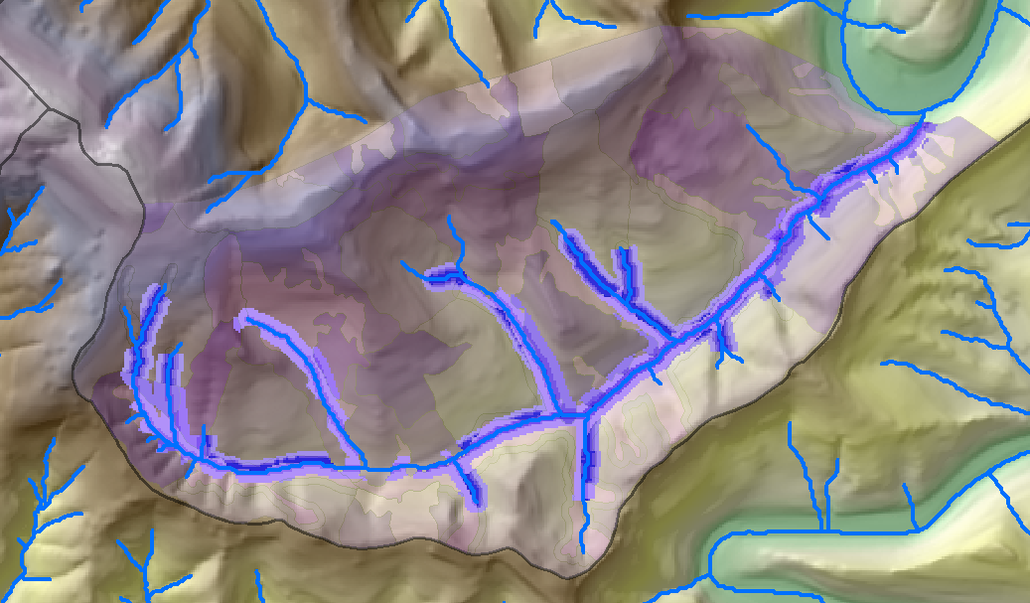
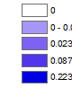
Wood volume (or number of pieces) sources for no action, year = 2065
Low
High
Stand tables not available for all locations, no wood recruited, or pieces too small
Volume per length per year

Slide 15
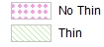
Comparison of wood volume for no action and thinned buffers
Wood
volume

Slide 16
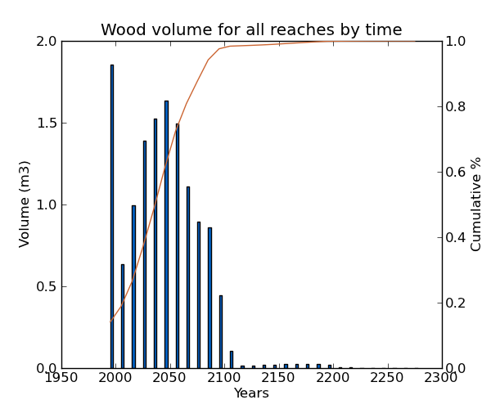
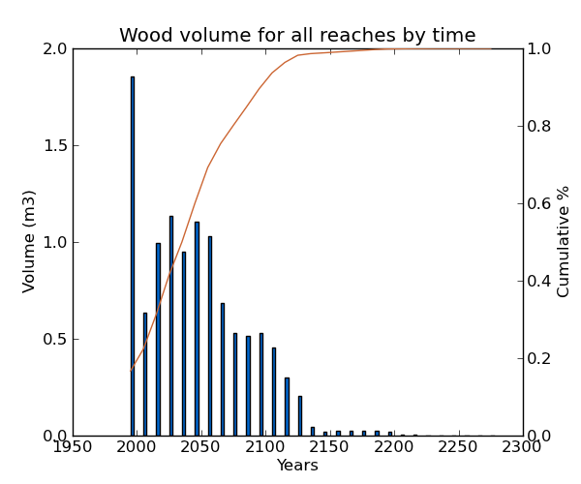
Wood volume by time (m³ 100m⁻¹ yr⁻¹)
Thinned 2015
No action buffer
Thinned buffer
1995: high initial mortality – FVS model parameters?
2015: thinned
2025 – 2085: no action buffer produces more wood
2095+ : thinned buffer scenario produces more wood
Only one stand had data to 2295, others ended at 2195, hence the low values after 2195

Slide 17
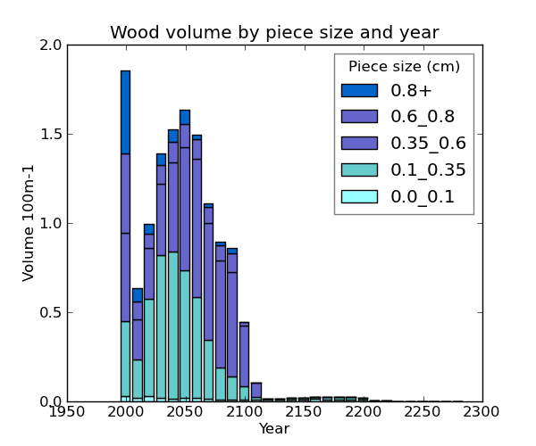
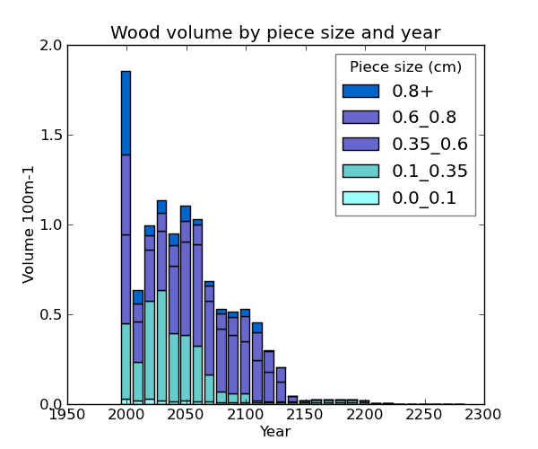
Wood volume by piece size and time (m³ 100m⁻¹ yr⁻¹), thinned 2015
No action buffer
Thinned buffer
Thinned buffers resulted in a 15% decrease in wood volume

Slide 18
Percent changes in wood volume by piece size (cm) from no action to thinned buffer
Decrease in wood of smaller sizes
Increase in wood of larger sizes

Slide 19

Applications for land management
  Multi-scale: reach or project scale v. watershed scale management and analysis;
  Enables spatially variable approach and analysis;
  Designs for riparian treatments – thinning, buffers, habitat;
  Designs for mitigation,
  enhancement, tree tipping

Slide 20
Acknowledgements and thanks to:
USFS-PNW, Gordon Reeves, Stu Johnston, Jack Sleeper, and Dan Miller netmaptools.org earthsystems.net

Slide 21
Large woody debris

Slide 22
Results
Cumulative wood volume over time
Cumulative wood volume by distance to stream of source trees
  For first and second thin treatments
Total cumulative wood volume summed for each scenario

Slide 23
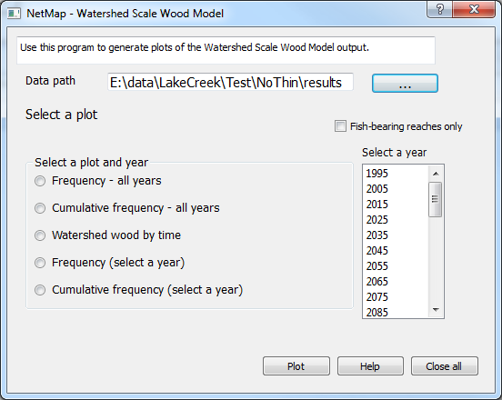

Slide 24
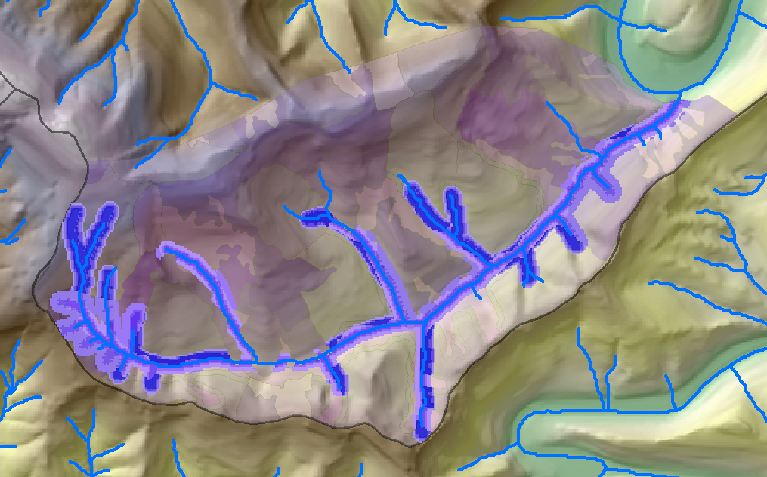
Wood number of pieces
Year = 2065
Low
High

Slide 25
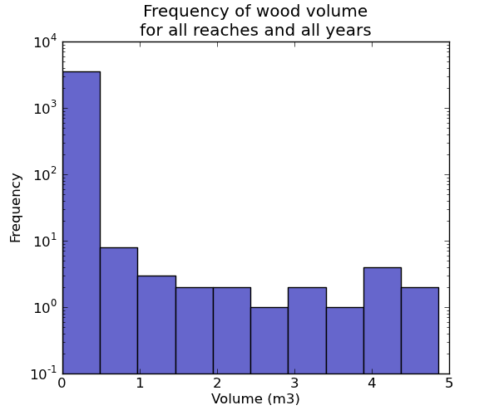
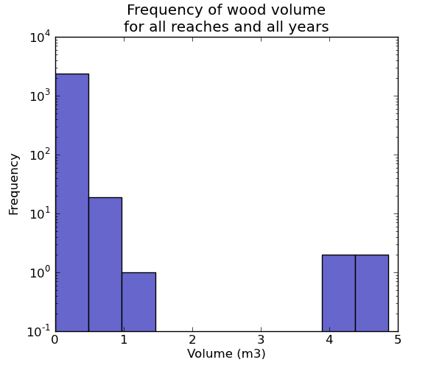
Frequency of Wood volume
No action
Thin
Volume (m³ 100m⁻¹ yr⁻¹)
Volume (m³ 100m⁻¹ yr⁻¹)

Slide 26

What is NetMap and
Why would I want to use it?
Comprised of integrated tools and geospatial data
Standardized GIS data is ready to analyze
Applies science-based models
Built on existing technologies
Developed through collaborative relationships
Increasing area for planning means more time spent on analysis
Overlapping agency jurisdictions
Similar questions, data and analysis needs
(Life without NetMap ;-)

Slide 27
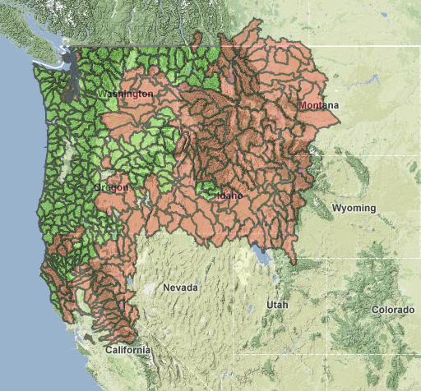
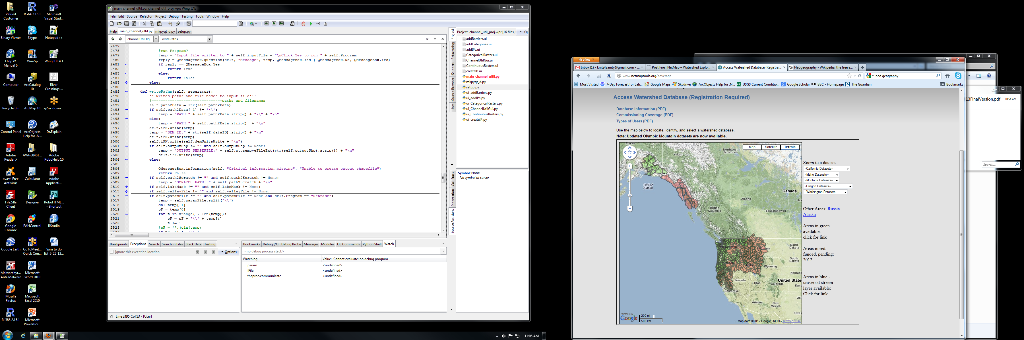
Integrated NetMap Components
NetMap data
Universal digital landscapes
DEM-derived streams
~100 stream attributes
NetMap tools
Channel geomorphology
Riparian management
Aquatic habitat
Basin hydrology
Erosion
Roads
Vegetation
NetMap coverage
S.E. Alaska and
British Columbia
Help
Indexed and searchable
Online videos
Webinars available
One-on-one
Completed
Western US
Pending

Slide 28
Legal challenges to CEs analyses
CEs analyses did not account for disturbances over time;
Models were not sufficiently evaluated with measured data; and
Model assumptions were inadequately disclosed.
From reviews by Smith, 2005; Reid, 2006

Slide 29
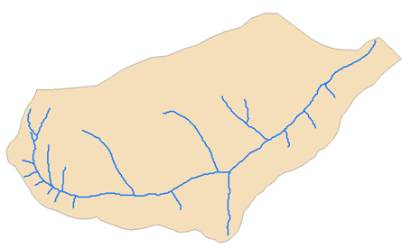
Cumulative Watershed Effects (CEs)
The physical and ecological effects that result from multiple land use disturbances over space and time;
Land managers may be required to:
  Compare the CEs of different forest management scenarios, and
  Account for “past, present, and reasonably foreseeable future” impacts;
Which management scenario results in more CEs?
Watershed
Streams
Treatment polygons
CEQ, 1997

