Slide 1
Connecting the dots: data, simulation, and realism
Bob McGaughey – Pacific Northwest Research Station

Slide 2
Overview
Basic data needs
Changing the initial conditions
Simulation and modeling
The importance of place and scale
Realism
Ethics

Slide 3
What is Visualization?
The act of making a visible presentation of numerical data… particularly a graphical one.
The primary goal is to help the viewer better understand information
Two types of visualization
  Scientific visualization
    Using analysis and graphing tools to classify, summarize, explore, and present large data sets
  Visual simulation or virtual reality (VR)
    Creating images that depict forested landscapes
      Manipulating photographs
      Using large data sets and rendering software to create virtual worlds that can act as surrogates for the real world

Slide 4
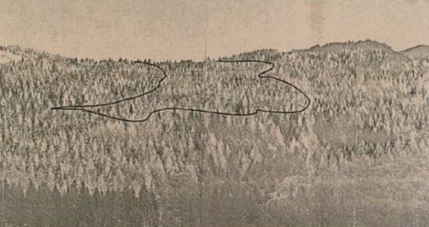
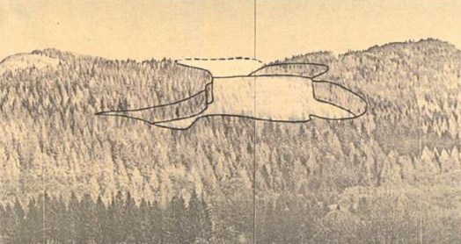
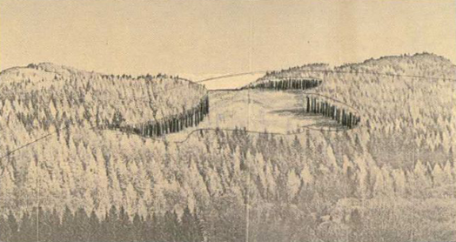
Focus for this presentation
Creating depictions of forested landscapes to help communicate current and future conditions
Produce visual simulations that are accurate and defensible
Computer-assisted methods with little discussion of purely artistic methods (artist’s renditions)

Slide 5
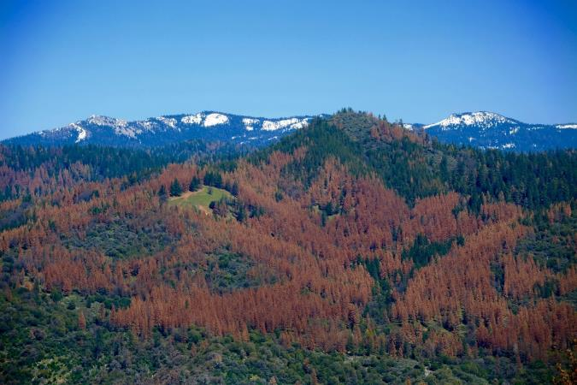

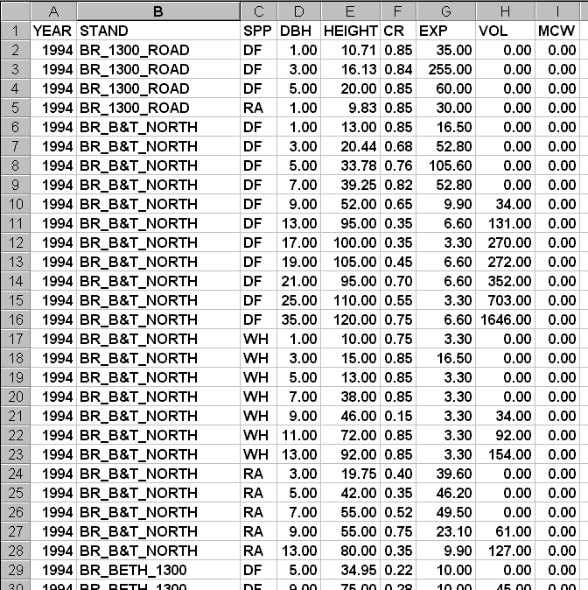
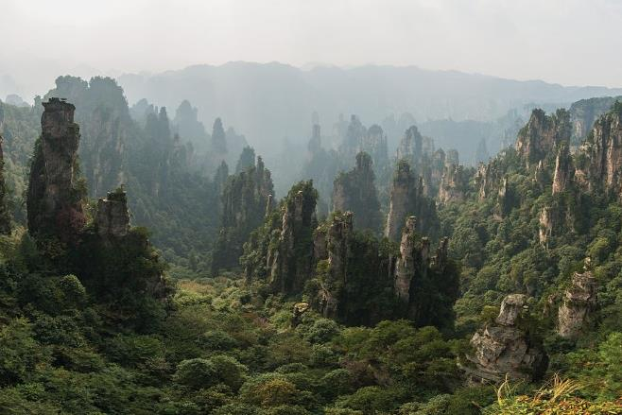
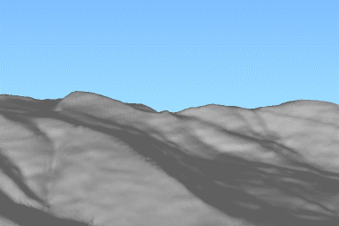
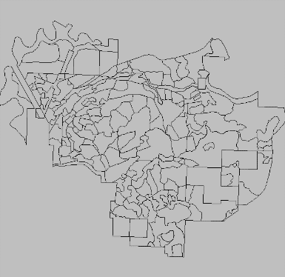
How do we start?
Initial condition
  Photograph, video
    Limited control of lighting, viewpoint, atmospheric conditions
  Artificial environment (e.g. gaming systems)
    May be complete fantasy or based on reality
    Rule-based systems populate an area with features (vegetation, rocks, stumps, logs, buildings)
      Result is a data set representing the environment that may or may not be available for modification
  Data snapshot (terrain, features, vegetation)
    Special tools to work with forest inventory and GIS data
    Full coverage with consistent detail and quality is rare
    How do you deal with missing data or areas?

Slide 6
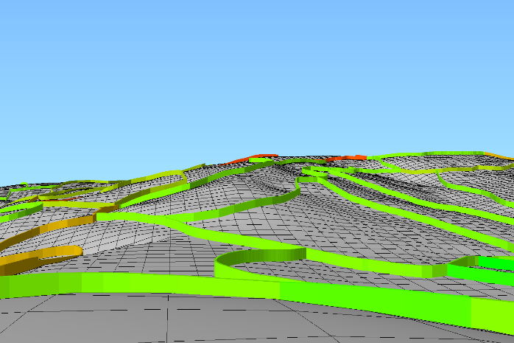
Basic data needs
Artistic manipulation of photos
  Image(s) showing current conditions
  Library of images depicting treatments or disturbances
  3D rendering of terrain and GIS data layers (optional)
Digital methods
  Terrain
  Surface features
  Cultural features
  Vegetation (location and attributes)
  Rendering effects

Slide 7
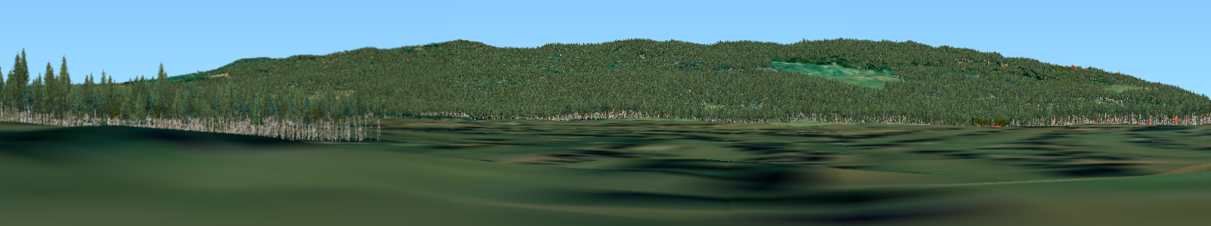
Initial condition

Slide 8
How do we make changes?
Once you have a starting point, we need a way to show changes
  Photos and artist renditions
    This is usually an artistic process
    Can be guided by 3D views of terrain and GIS data
    Difficult to show widespread disturbances or growth

Slide 9
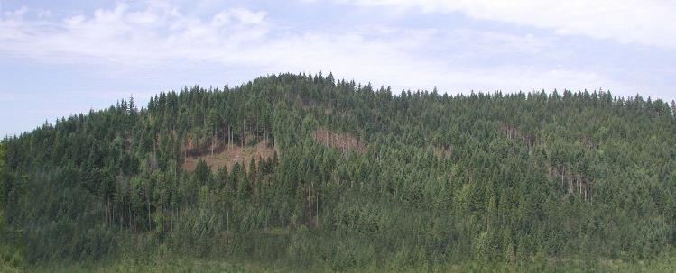
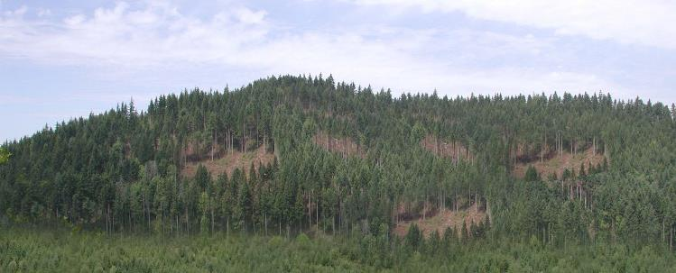
Use computer software (photoshop or other) to modify photographs to represent changes to stand and landscape conditions
Rely on “cut-and-paste” operations to make image changes
Final result is another photograph
Images courtesy of Gordon Bradley
Univ. of Washington

Slide 10
How do we make changes?
Once you have a starting point, we need a way to show changes
  Photos and artist renditions
    This is usually an artistic process
    Can be guided by 3D views of terrain and GIS data
    Difficult to show widespread disturbances or growth
  For a digital methods, you need to simulate:
    Treatment or disturbance effects (generally localized)
    Natural processes
    Growth over time

Slide 11
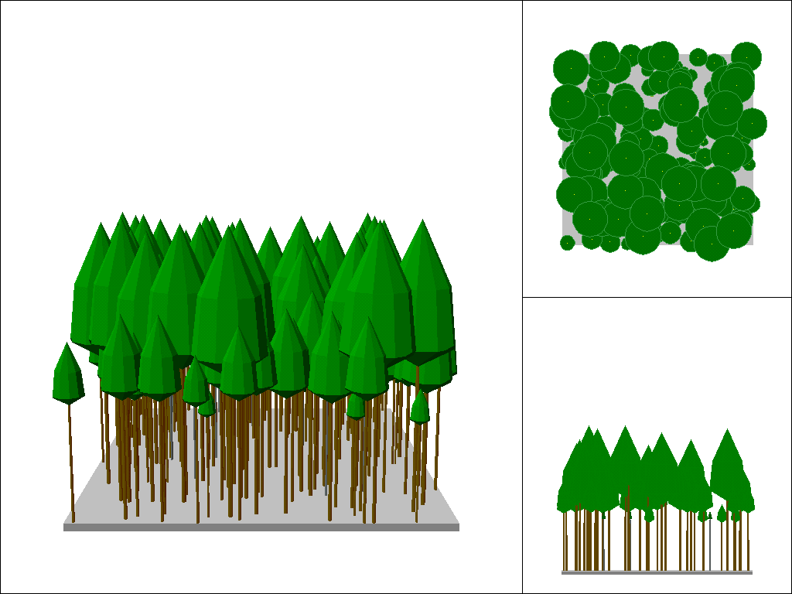
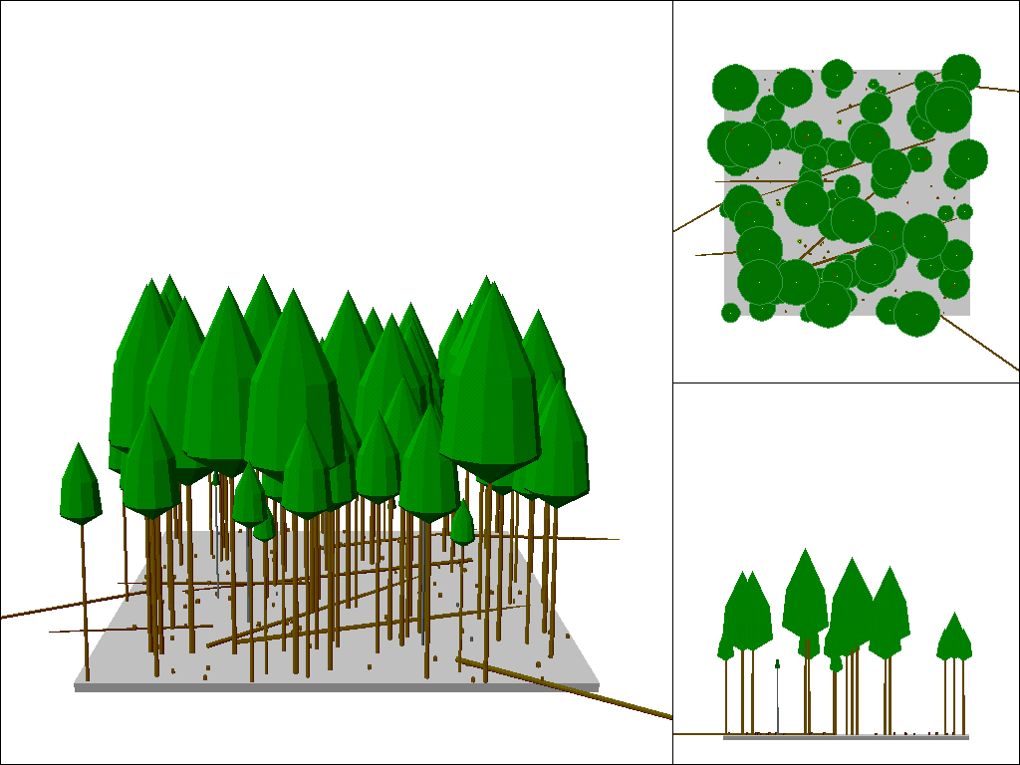
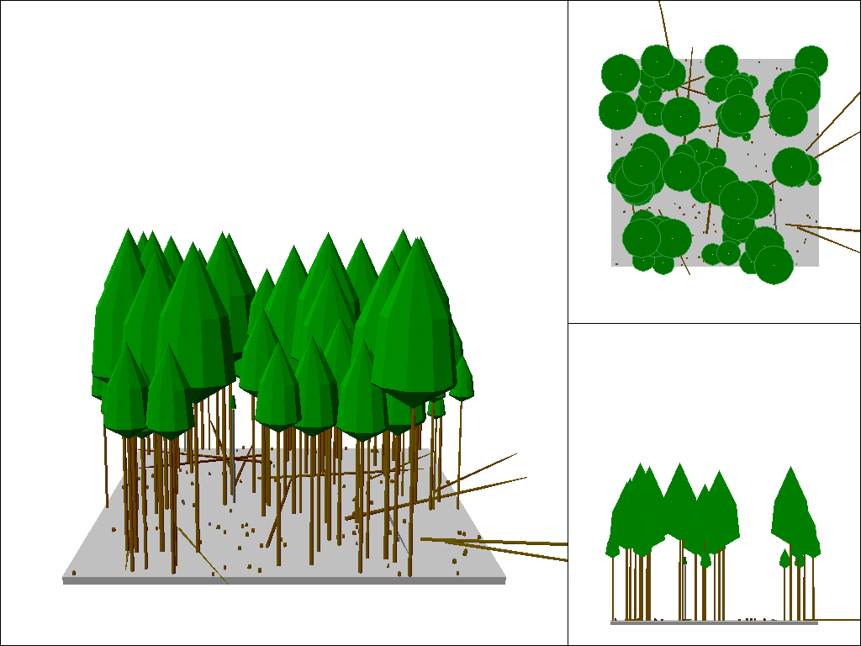
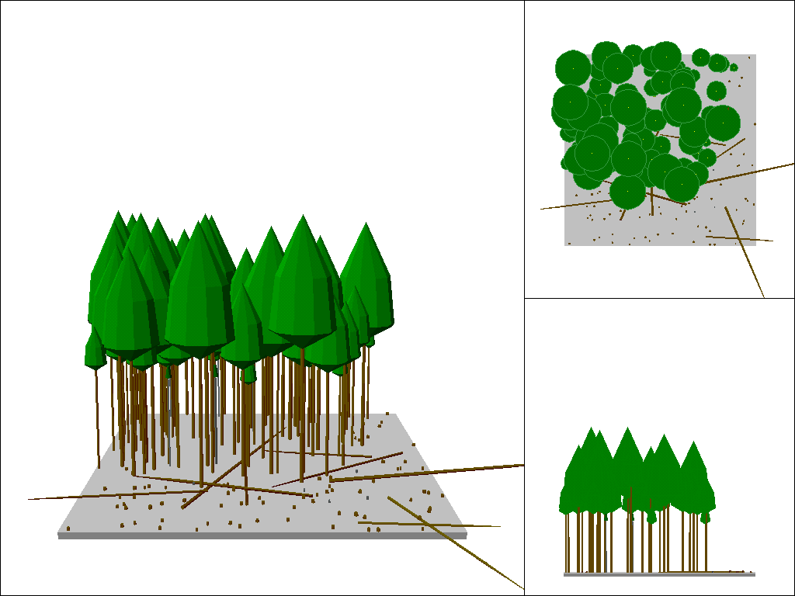
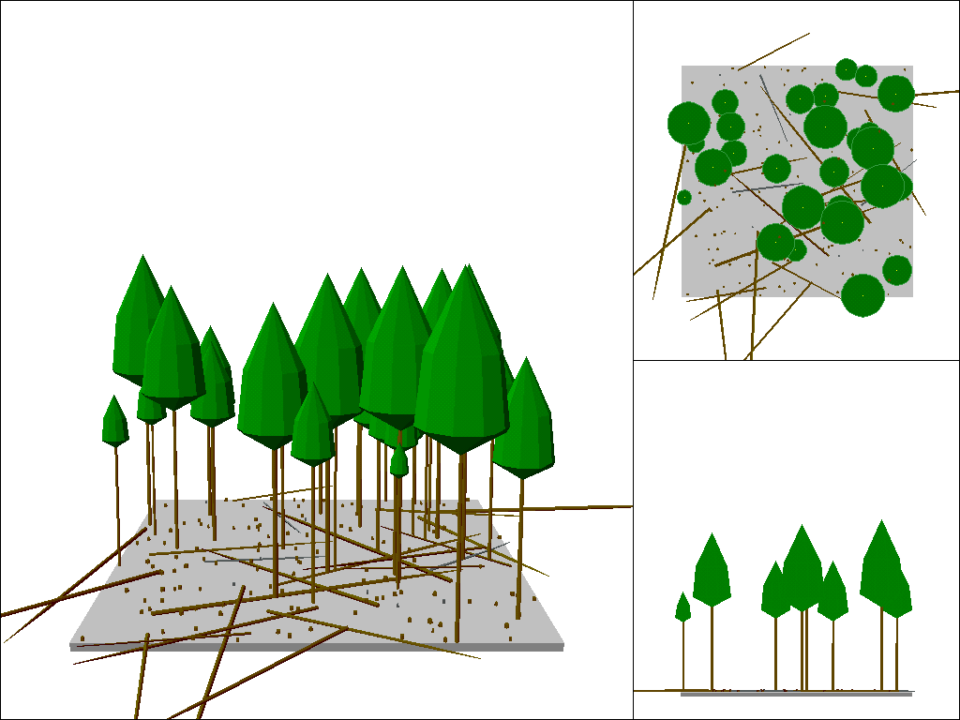
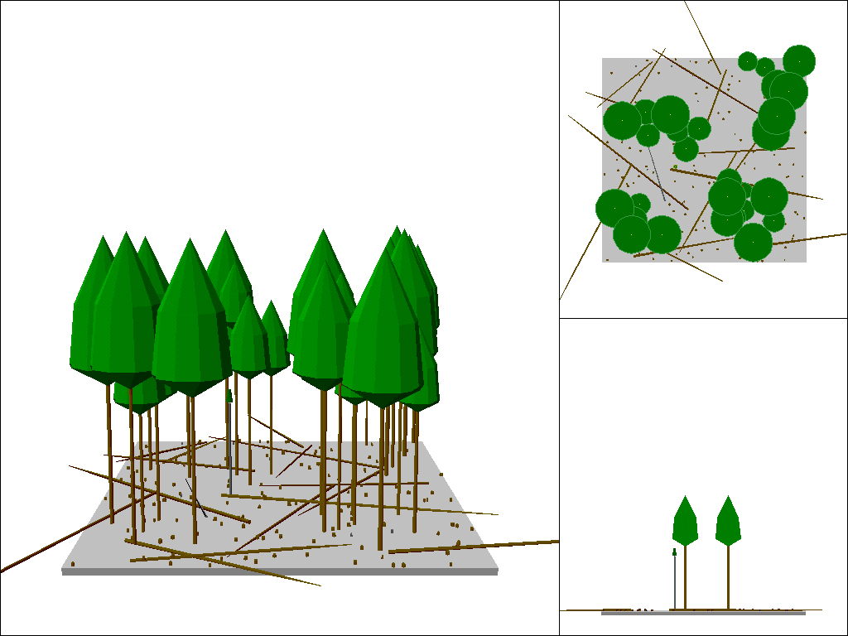
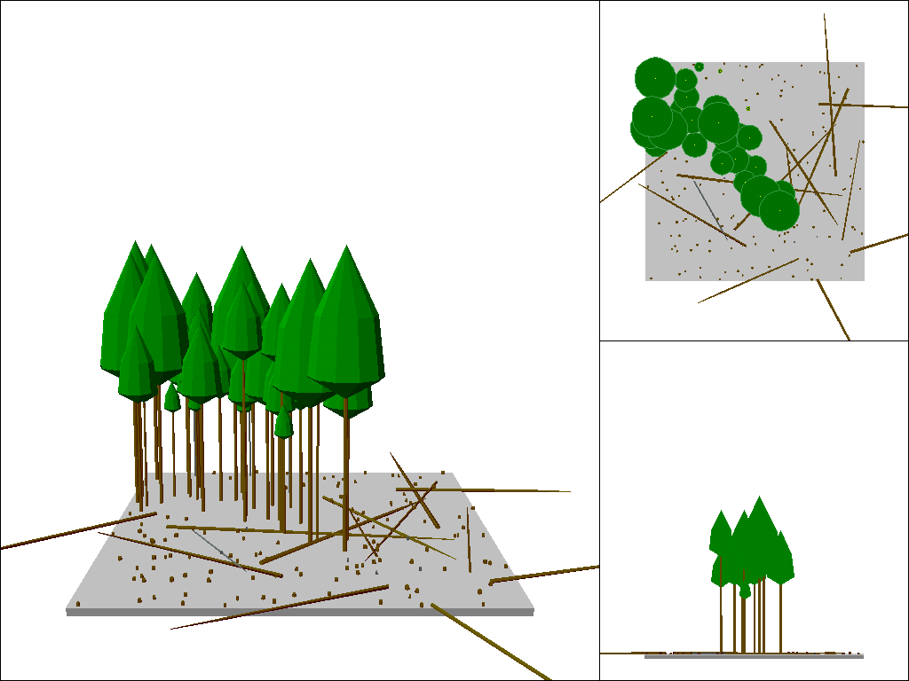
Management alternatives
Variable retention level using three spatial patterns
Initial condition
50% retention
Uniform pattern
Small patches
Large patches
20% retention

Slide 12
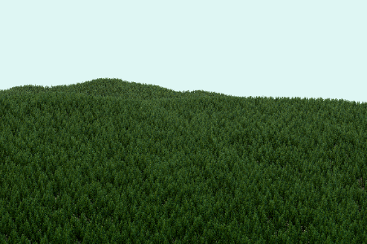
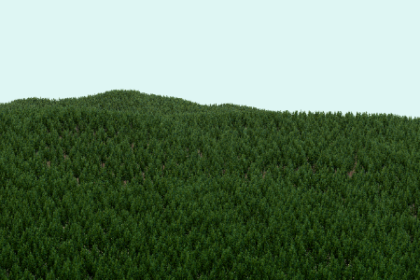
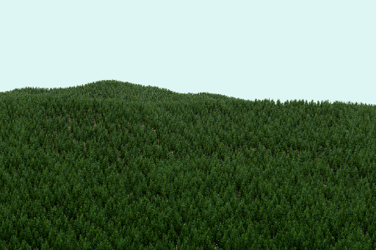
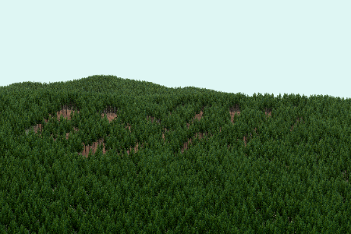
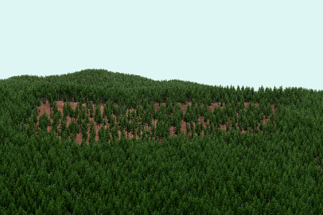
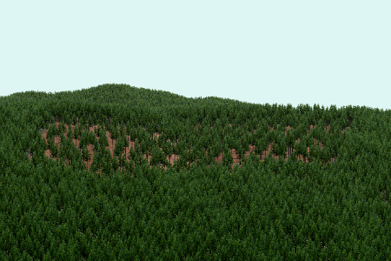
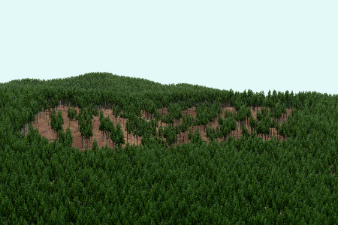
Management alternatives
Variable retention level using three spatial patterns
Initial condition
50% retention
Uniform pattern
Small patches
Large patches
20% retention

Slide 13
Modeling and simulation
Modify data to show the effect of changes
You need several simulation tools to show changes in all parts of the scene
  Roads and other built features
  Treatment or disturbance effects (spatial patterns and changes to appearance of individual plants)
  Forest growth and mortality

Slide 14
Vegetation
Usually the most significant component of visual simulations
Requires large amounts of data to do well
  Spatial patterns (existing and proposed)
  Attributes
Easy to misrepresent…hard to represent without bias
  For a given species, how many variations in appearance do you need?
    Age, vigor, damage, time of year
May be hard to manipulate spatial patterns to accurately show changes

Slide 15
Modeling change
Growth models can deal with larger tree components
  Small trees and regeneration are problematic
  Crown response on residual trees may not be realistic
  Maintaining spatial patterns can be difficult
Are there good ways to model possible disturbances (insects & fire)?
What about non-tree vegetation?
  Difficult to model shrub communities and their response to changes in the overstory

Slide 16
Place and scale matter
It is easier to present illustrations of various conditions if they don’t represent a “real” place
  The goal is to communicate the intent of a treatment or impact of a disturbance
  Do you need to use a real place?
As soon as the place becomes “real”, viewers will start to compare the visual simulation with their own personal experiences involving the same place
  Details and landmarks matter
  Any differences from the viewer’s reality can obscure the intended message

Slide 17
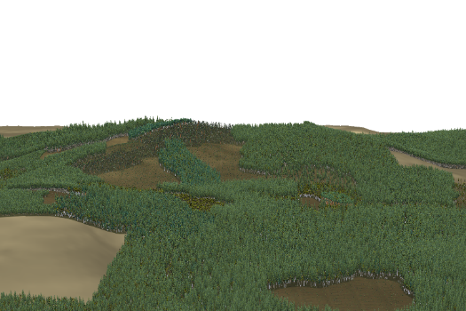
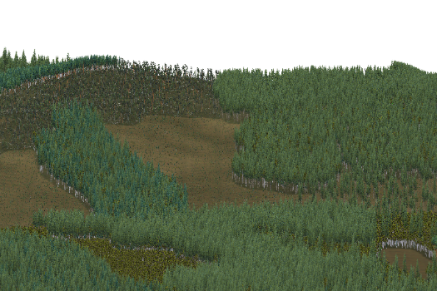
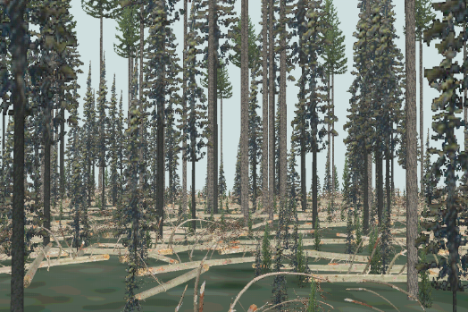
Place and scale matter
The size of the area of interest and the overall extent represented in a view matter
Landscape-scale views can be done with less data compared to views from within a stand
Allowing viewers to “roam” over the landscape presents challenges
1000 ha view
100 ha view
10 ha view

Slide 18
Realism
“showing things as they really are”
  Completeness of data
    Spatial coverage
    Information for all visible components
    Do you really know about condition?
  Amount of detail
    Do you include everything that would be visible in a photograph of the same area?
  Overall appearance of the scene
“as a general rule, the greater the realism in the visualization, the weaker the demonstrable links to underlying resource data or projections” (Brian Orland, 1994)

Slide 19
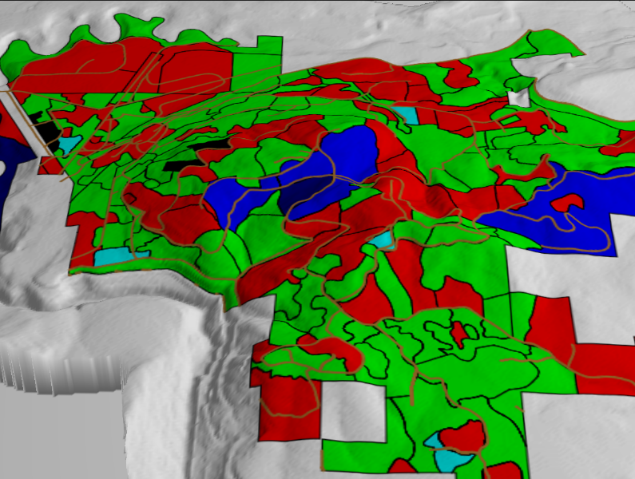
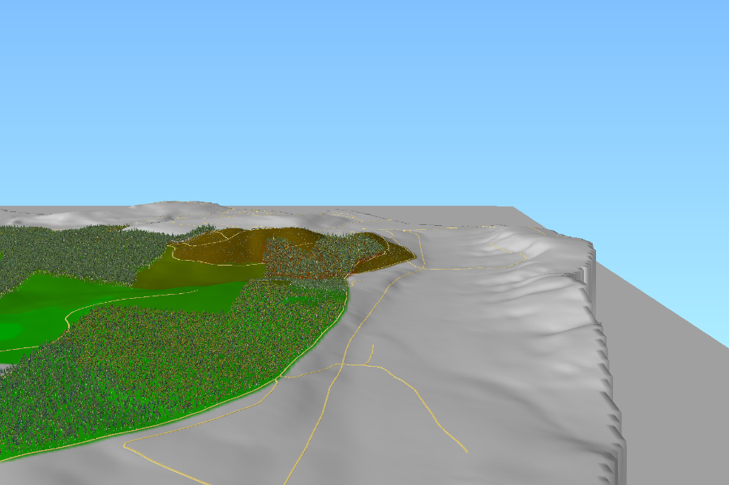
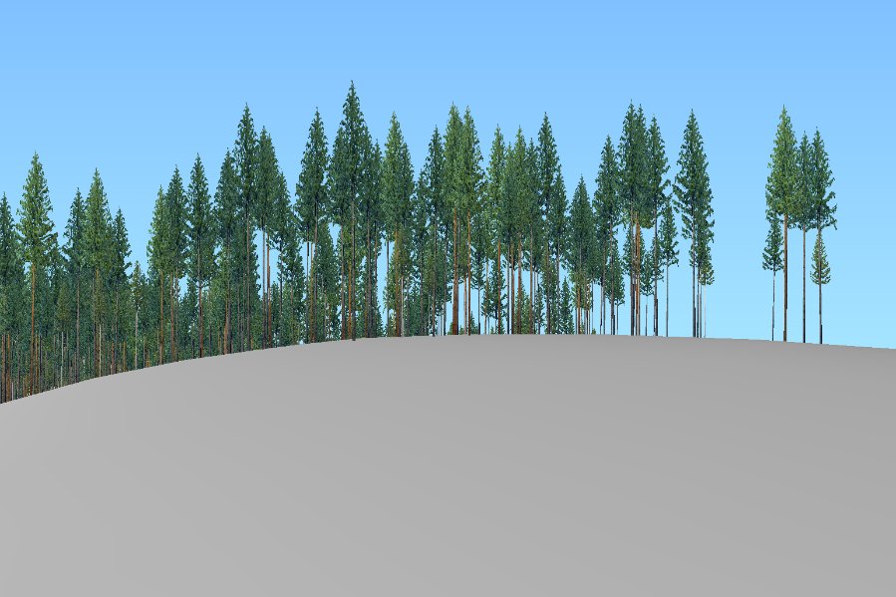

Slide 20
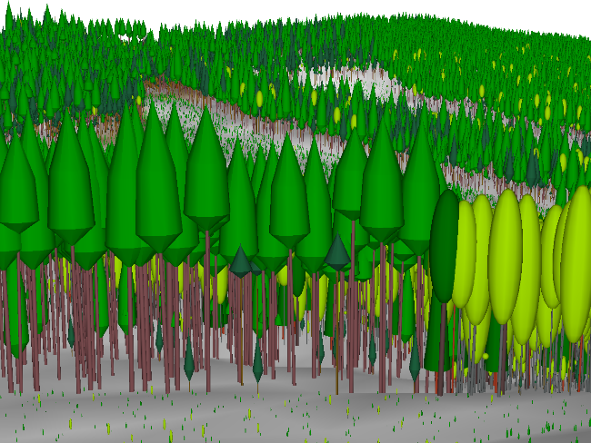
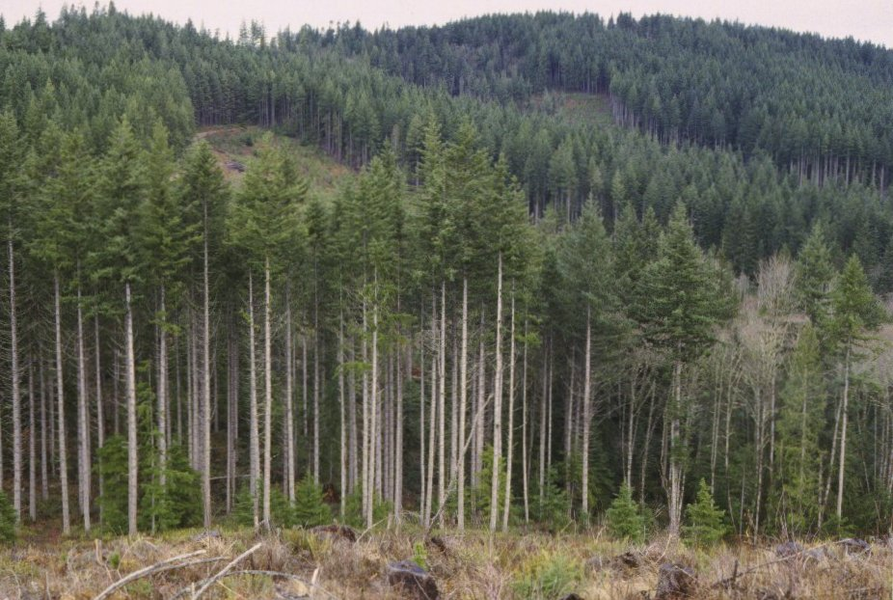
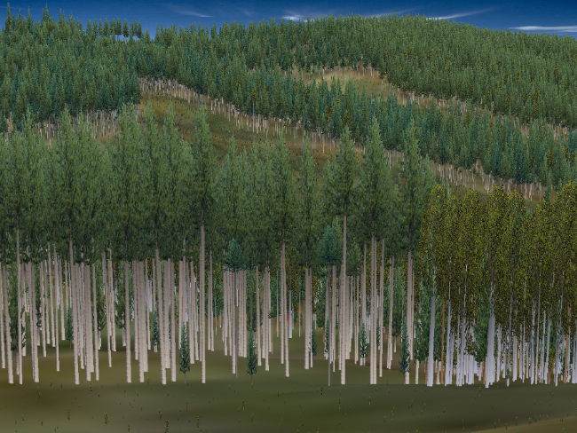

Slide 21
Ethics
When does a visual simulation become a contract?
  You are basically communicating the effect of some action (or non-action)
  What happens when things don’t look like you “promised”?
Practitioners must be careful not to misrepresent conditions
  Could be deliberate or unintentional
    Insufficient data
    Inappropriate methods
    Inadvertent blunders

Slide 22
Ethics
In our current world of high-tech special effects, it is becoming harder to distinguish fantasy from reality
There are very few standards for the creation of visual simulations
The current, somewhat limited, set of tools makes it easy to take shortcuts to produce simulations that rely on almost no “real” data
Consumers of simulations rely on practitioners to present images that are accurate, unbiased and based on the best available information and science
Are we up to this challenge?

