Slide 1
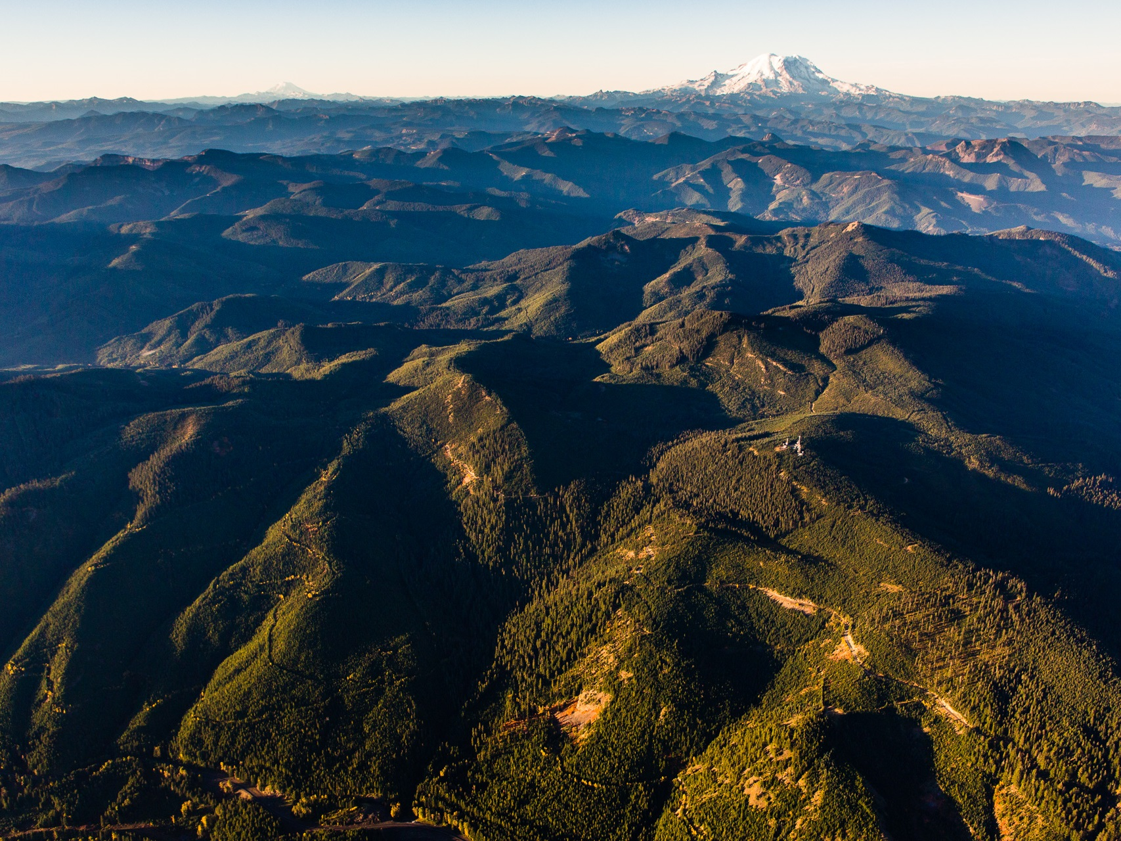
A new approach to evaluate forest structure restoration needs across Oregon and Washington
Photo: Benj Drummond

Slide 2
Co-Authors:
Ryan Haugo, Chris Zanger, Tom DeMeo, Chris Ringo, Ayn Shlisky, Kori Blankenship, Mike Simpson, Kim Mellen-Mclean, Jane Kertis, Mark Stern
Photo: Benj Drummond

Slide 3
THANKS:
Rick Brown, Miles Hemstrom, Kerry Metlen, Darren Borgias, Reese Lolley, Tom Sensenig, Patricia Hochlater, Liane Davis, Darren Kavanagh, Forest Ecology and Management anonymous reviewers, USFS PNW Region, TNC-Oregon, TNC-Washington, The Icicle Fund.
Photo: Benj Drummond

Slide 4
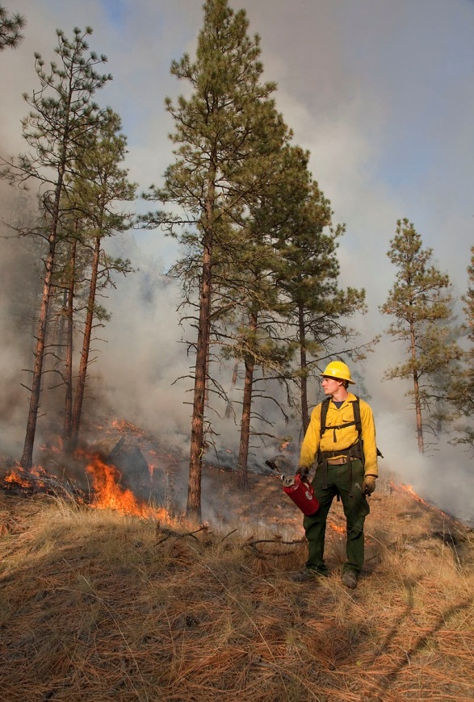
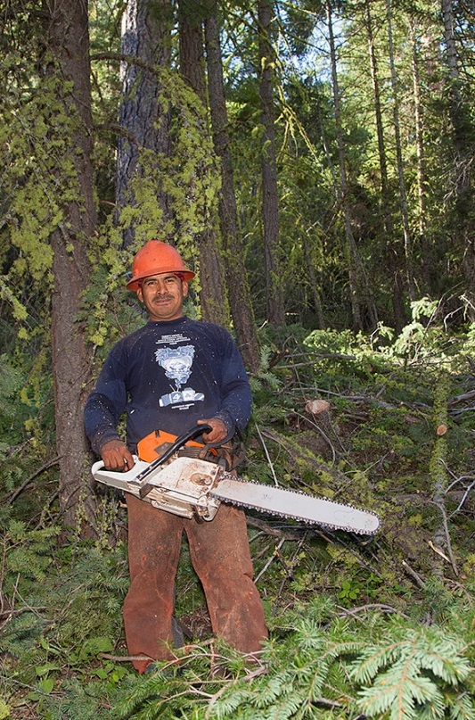
Restoration as management paradigm
Photos: John Marshall

Slide 5
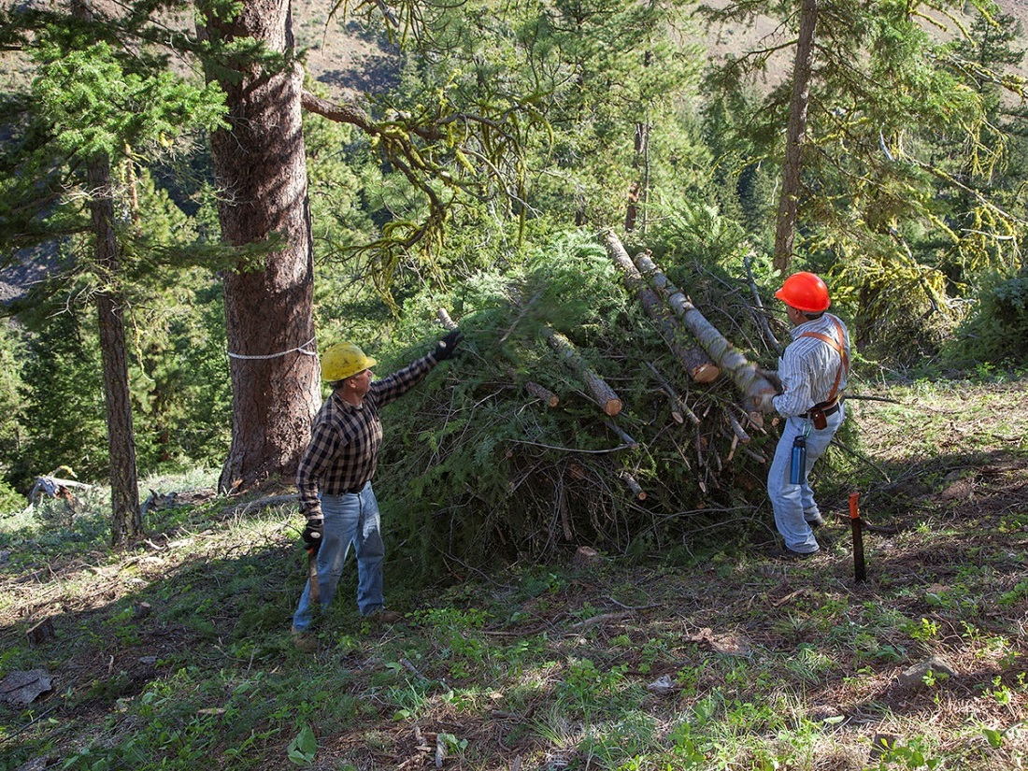
Where, how much, what kinds of forest restoration?

Slide 6
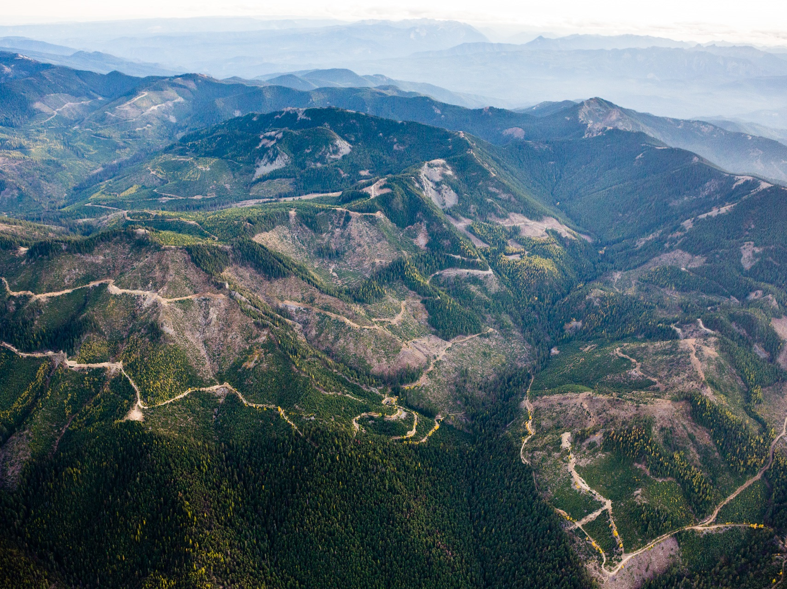
All Forests, All Ownerships

Slide 7
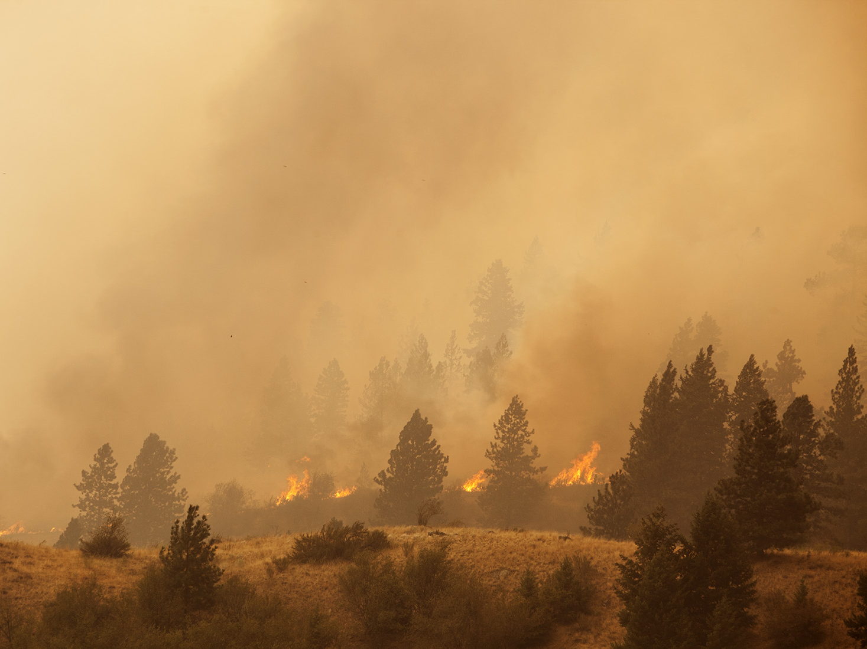
Build upon FRCC
Not just departure – disturbance & succession restoration needs
Photo: John Marshall

Slide 8

Ecoregional / Provincial Scale
(TNC-USFS Restoration Needs Study)
Watershed / Local Landscape Scale
(Oka-Wen Forest Restoration Strategy,
SOFRC Rogue Basin Assessment)
Project Unit / Ind. Patch Scale
(Sivicultural Rx’s, ICO)

Slide 9

Mapping & classification of “forest systems” = ILAP
Modeled NRV reference conditions = LANDFIRE BpS’
Landscape unit delineation = HUCs & ILAP Map Regions
Current conditions = GNN

Slide 10
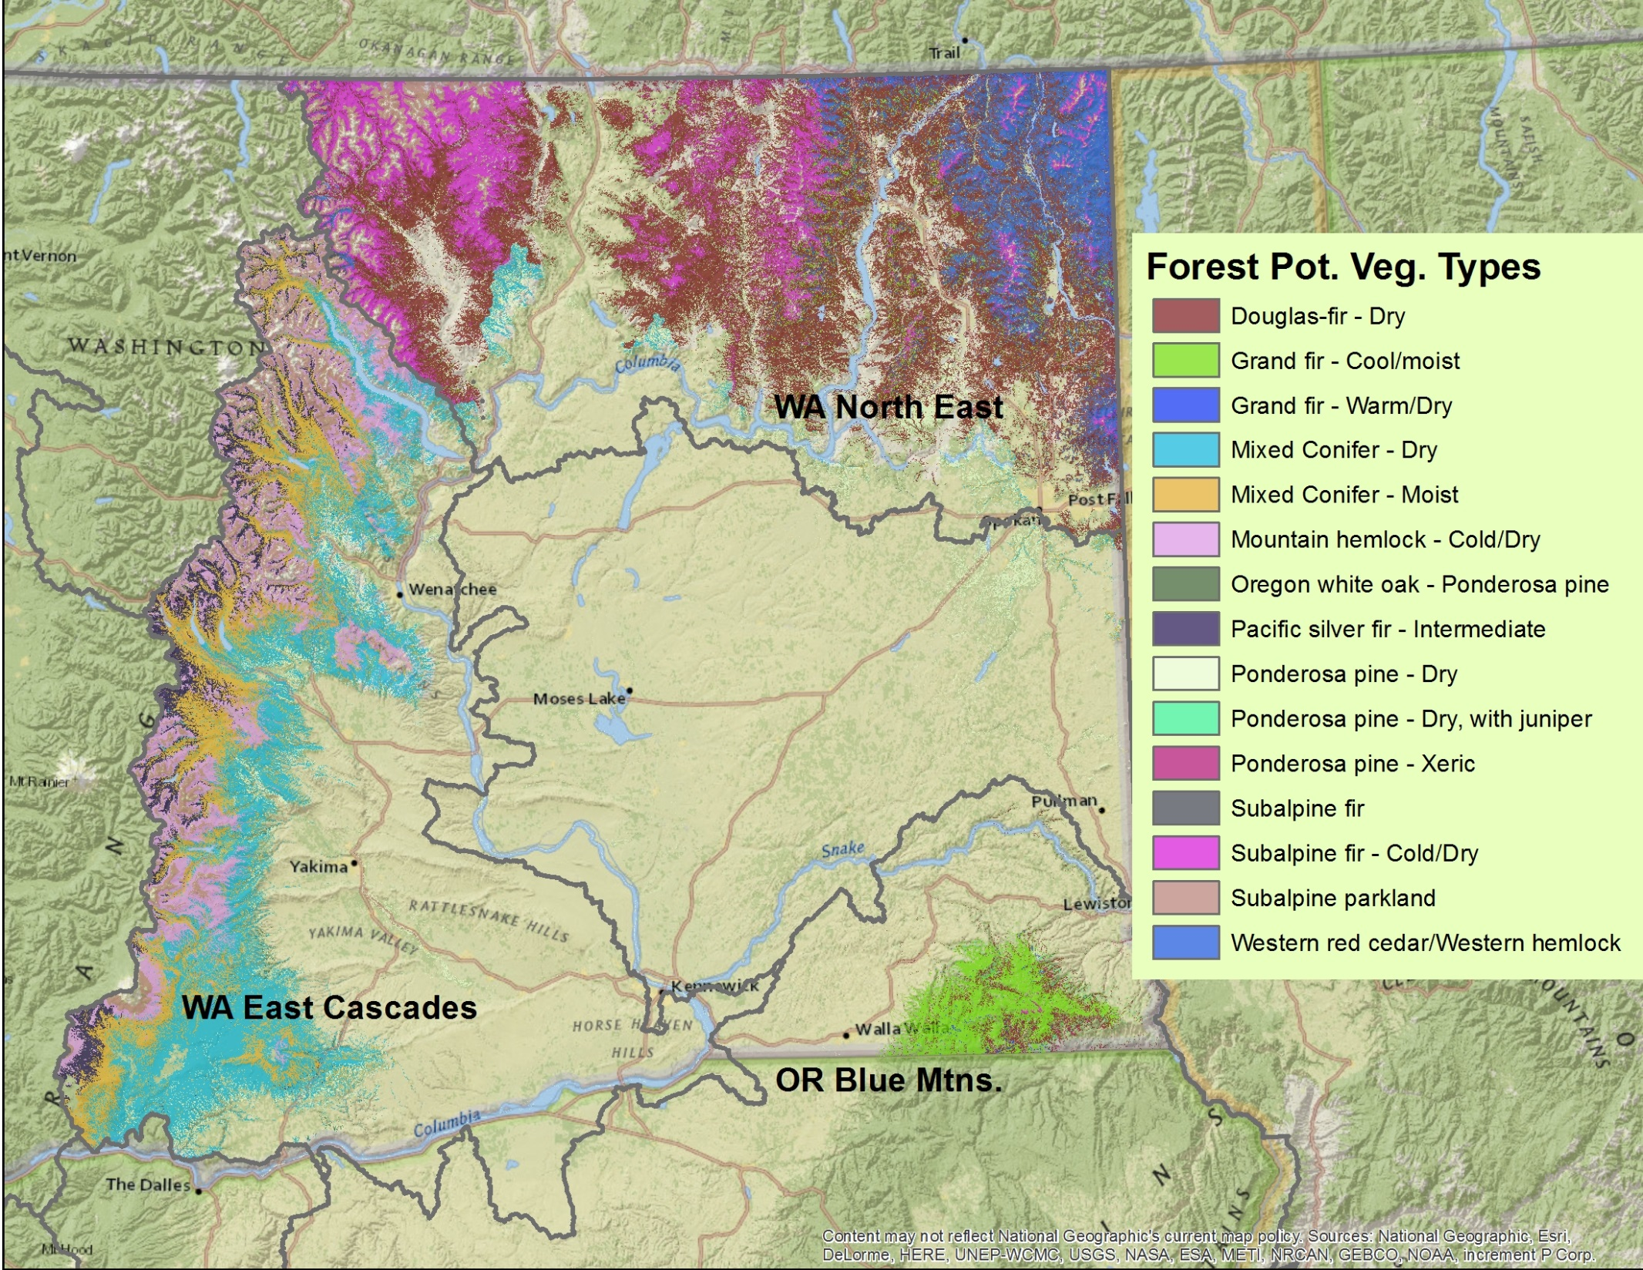

Slide 12
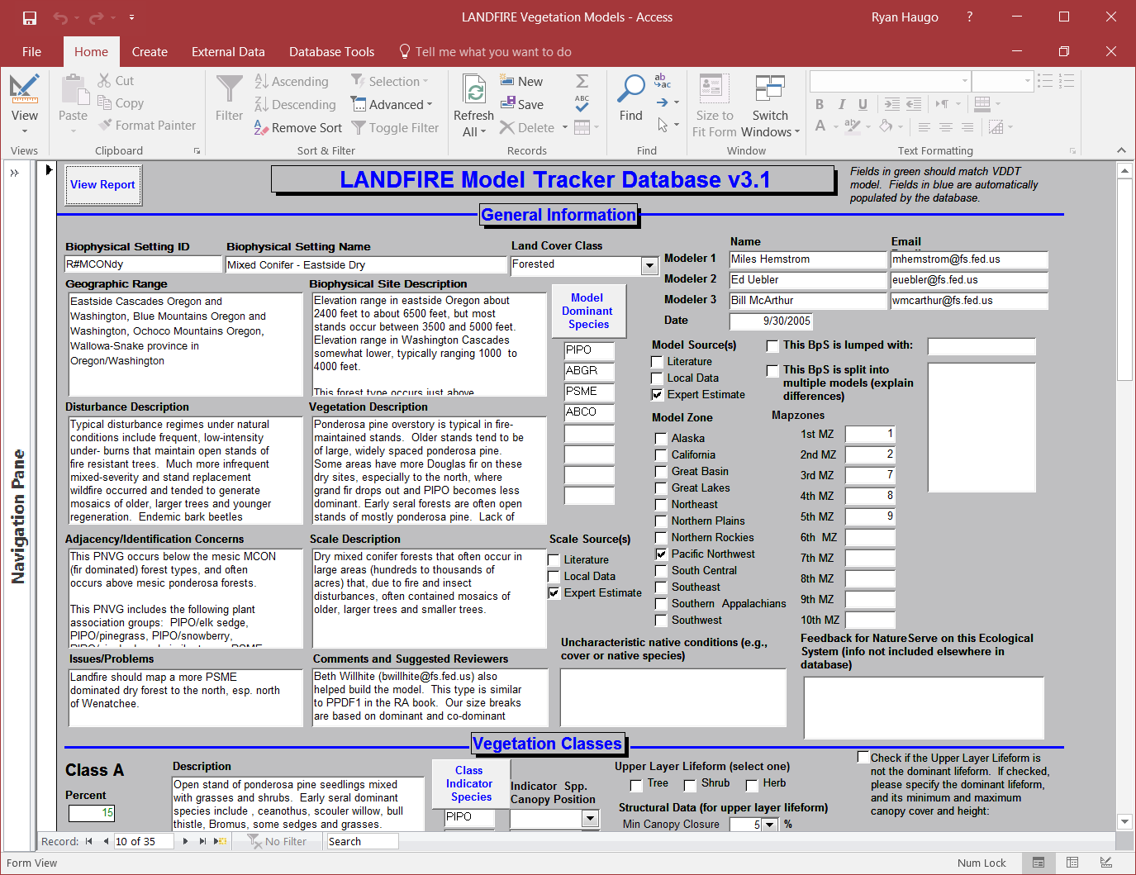

Slide 13
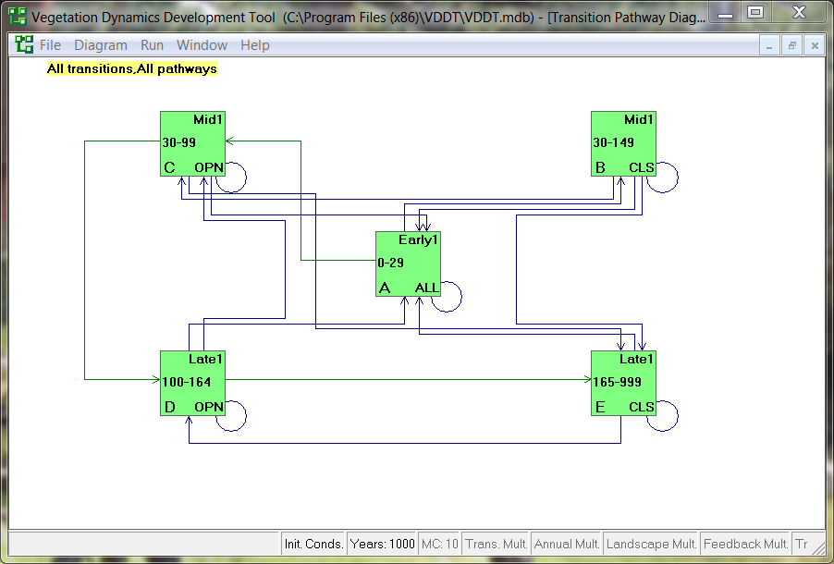

Slide 14
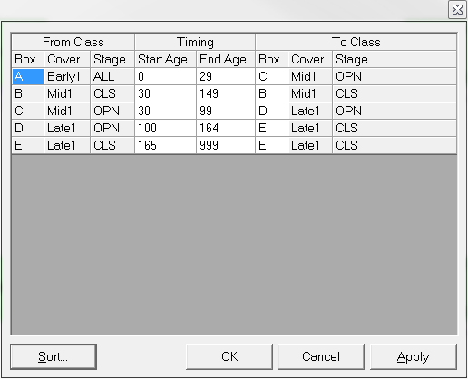

Slide 15
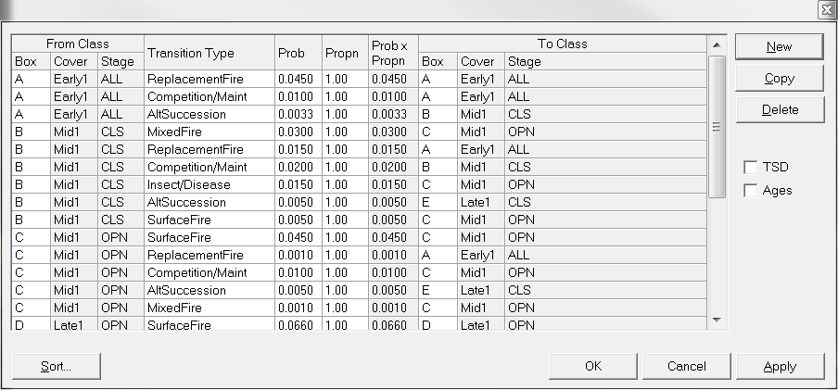

Slide 16
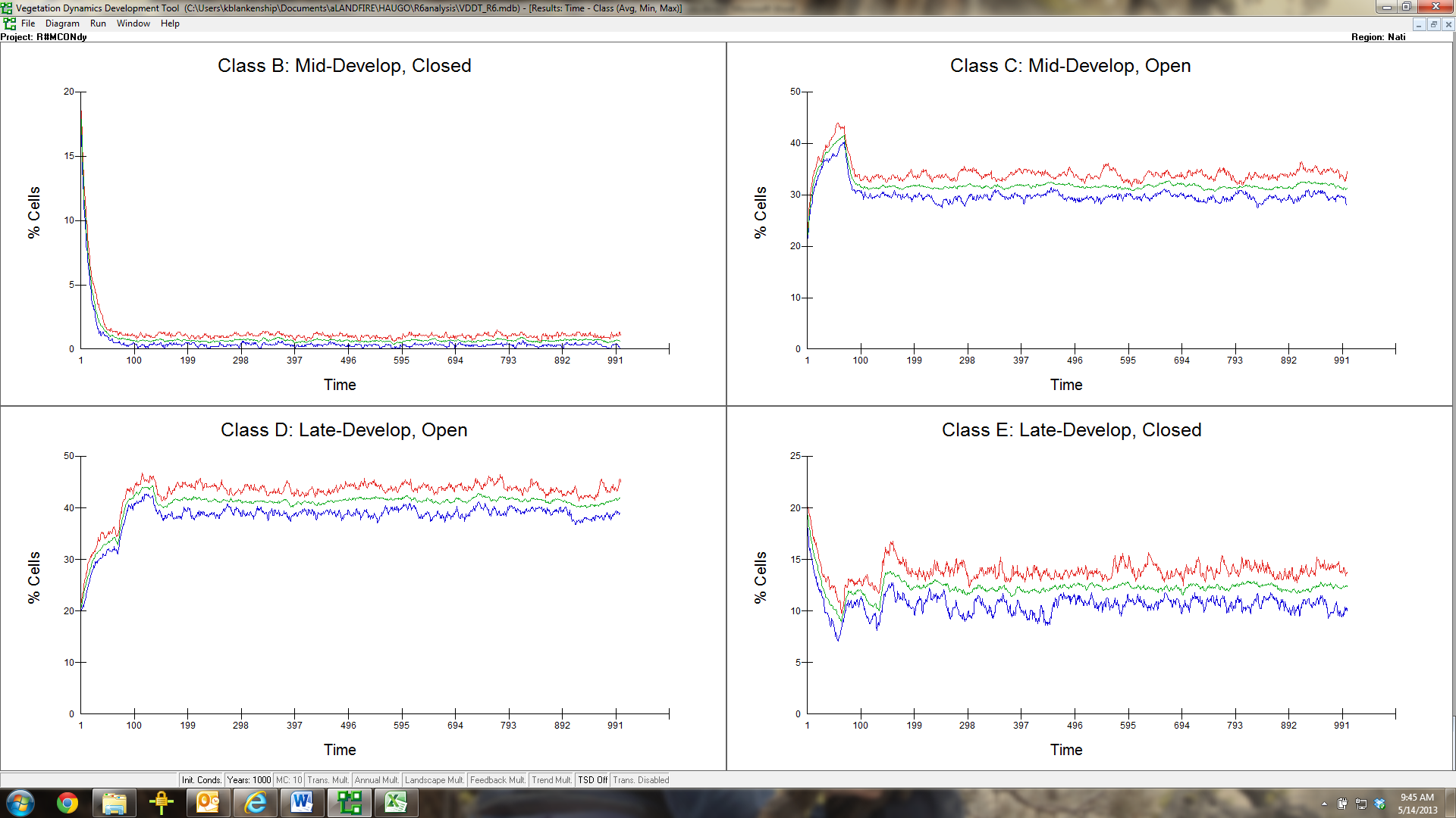

Slide 24
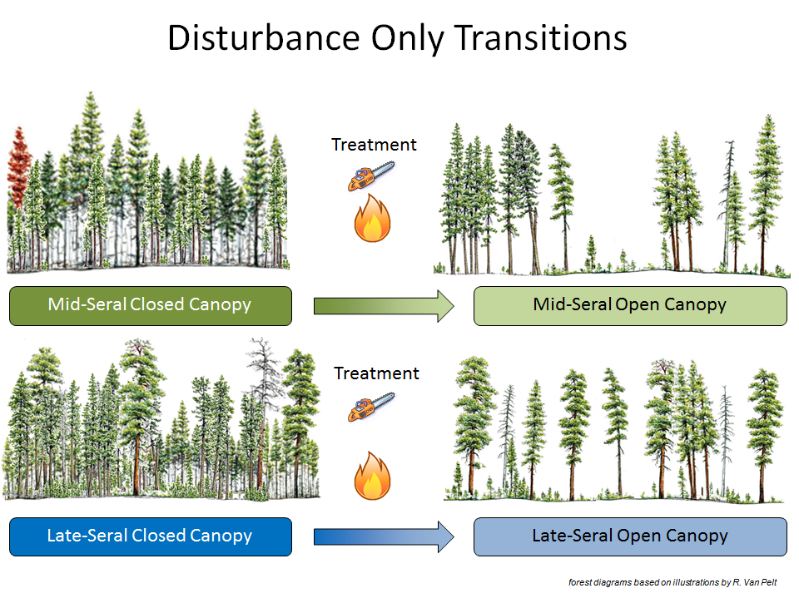
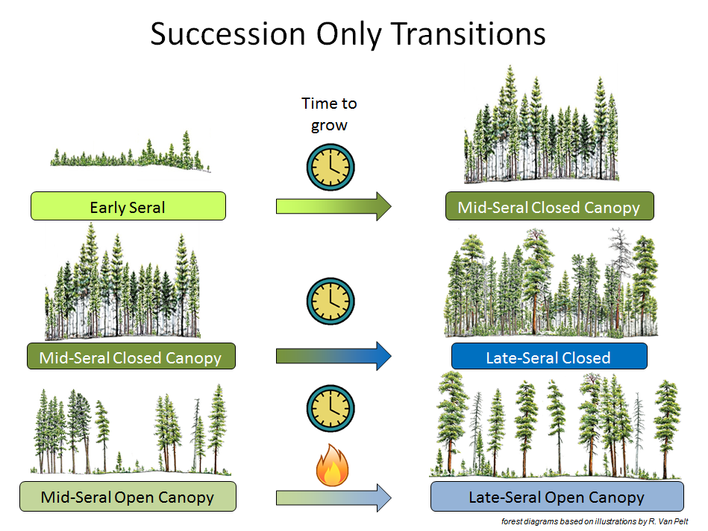
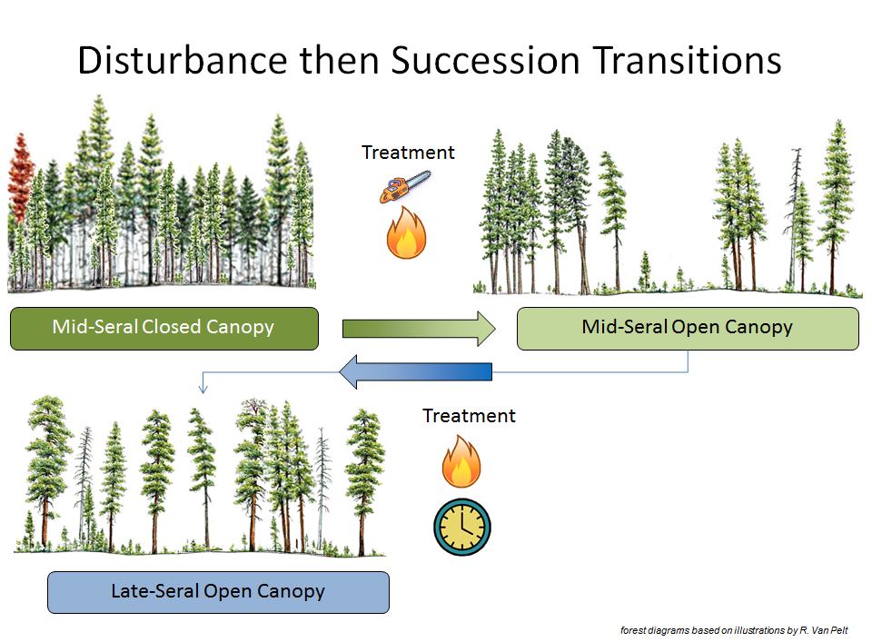

Slide 25
“Disturbance”
Photos: John Marshall

Slide 26
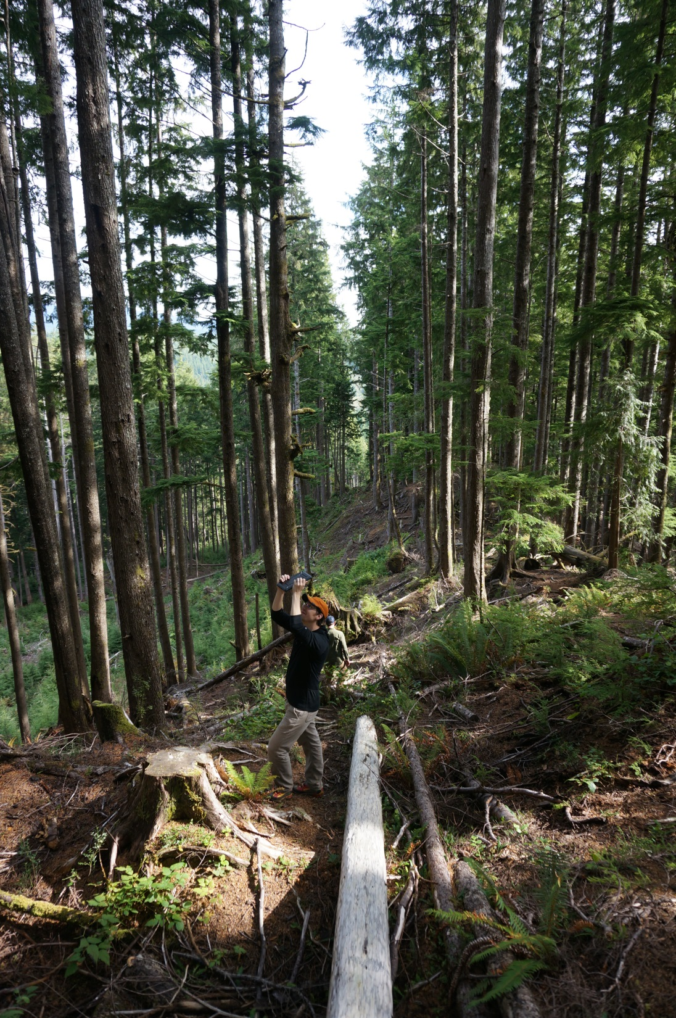
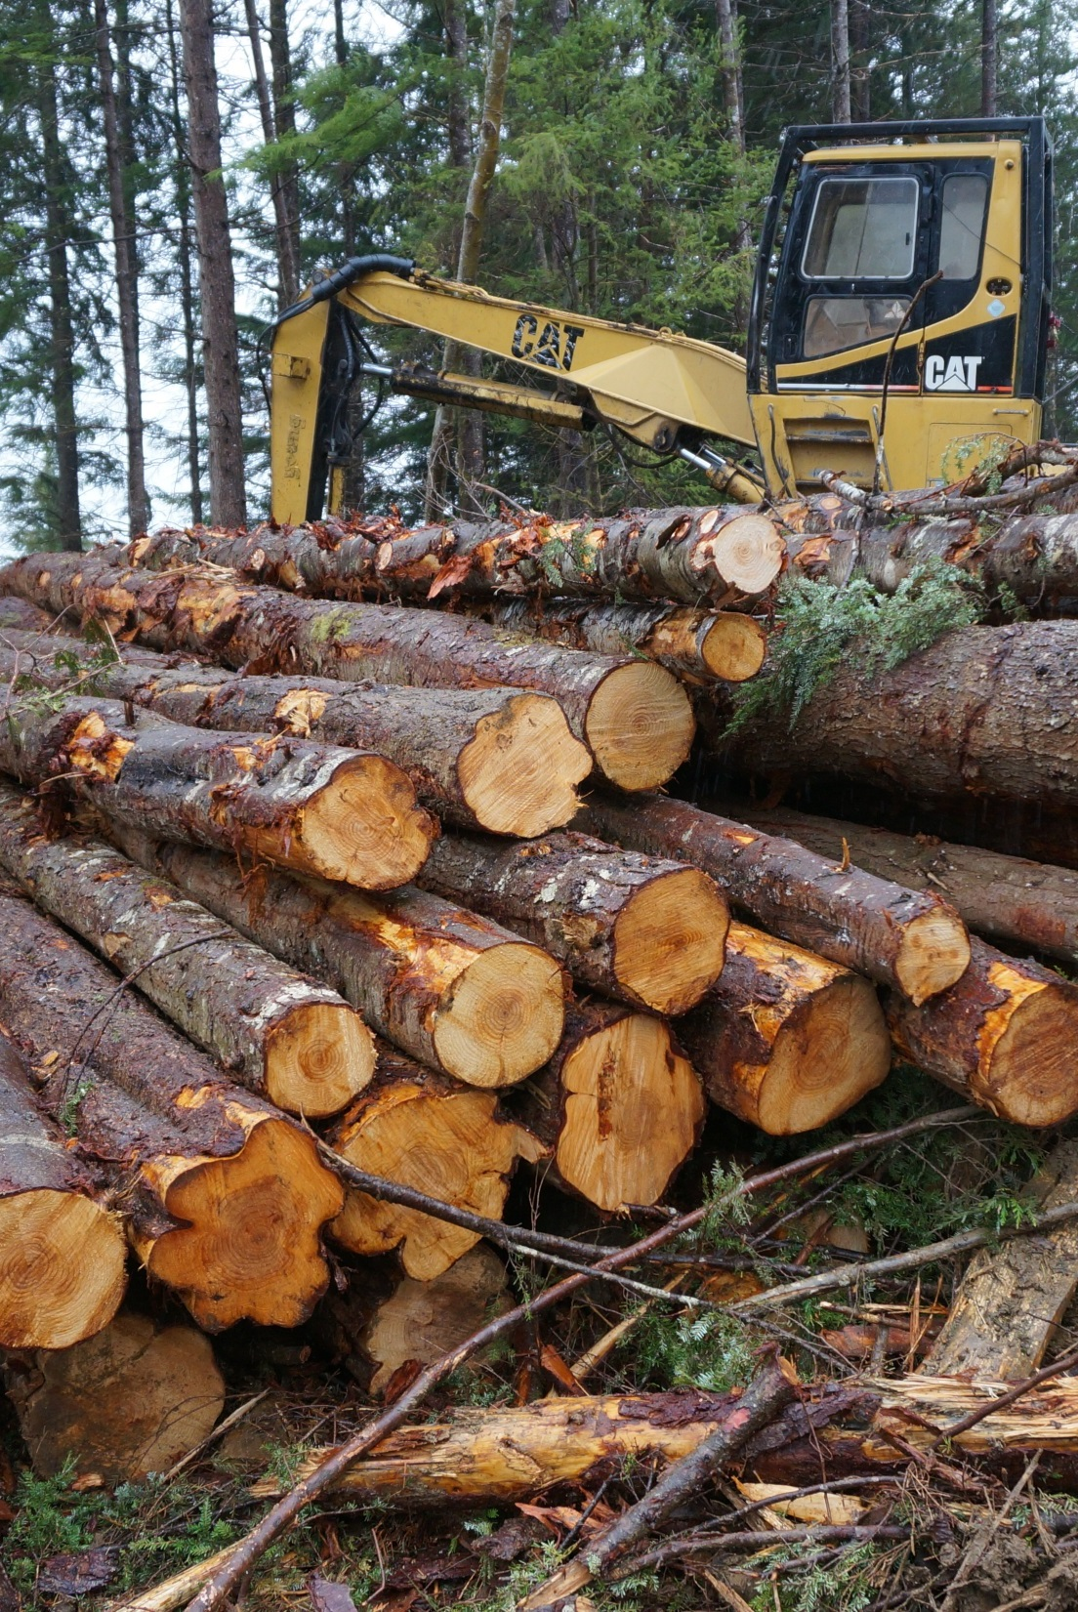
Accelerating Succession

Slide 27
Total Restoration Needs – East WA&OR
40% of all forests – 11.5 million acres
Disturbance Only: 3.7 million acres
Disturbance then Succession: 5.7 million acres
Succession Only: 2.1 million acres

Slide 28
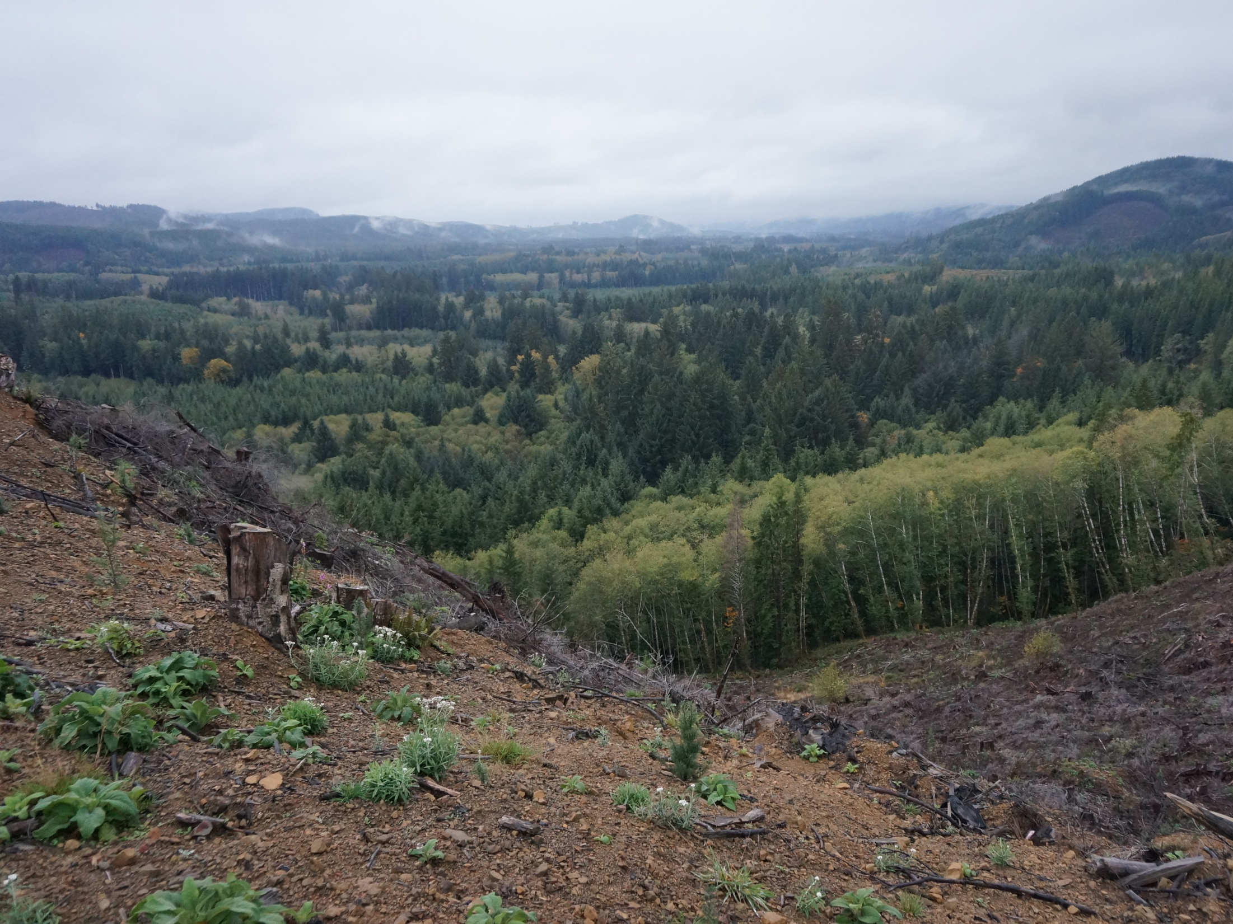
Total Restoration Needs – West WA&OR
30% of all forests – 7.0 million acres
Disturbance Only: 0.5 million acres
Disturbance then Succession: 1.1 million acres
Succession Only: 5.4 million acres

Slide 30
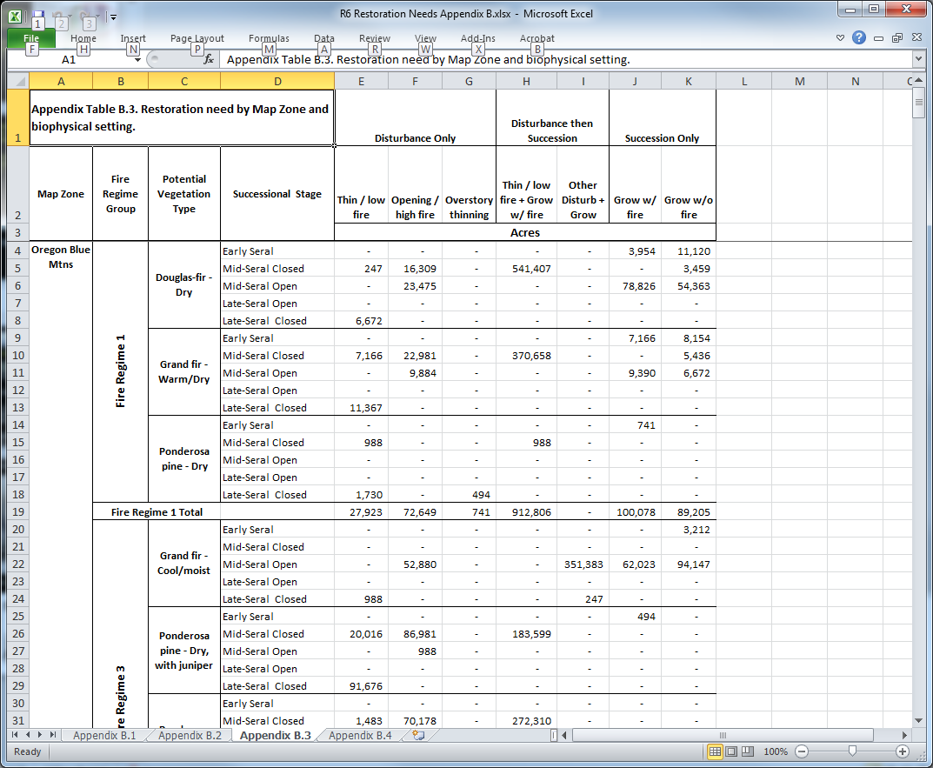
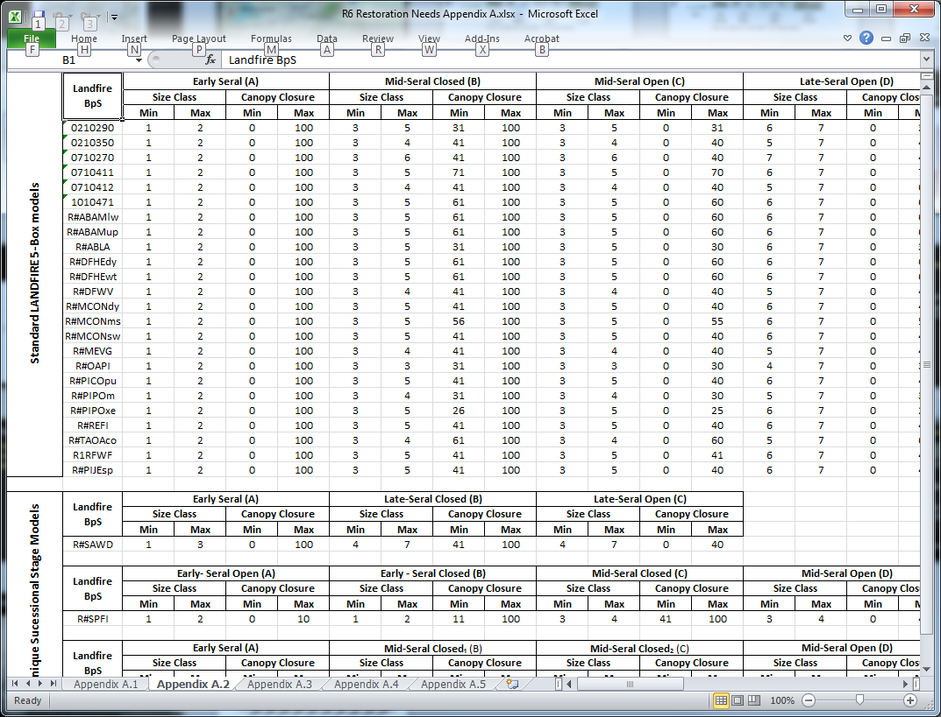
Results: More than just maps and graphs
Appendix A
PVT to BpS X-walk
S-Class Criteria
BpS Modeled RC Range
Size Class Rules
Analysis Order of Operation
Appendix B
Current Conditions and RC
Need by Owner
Need by BpS
Need by HUC 5

Slide 31
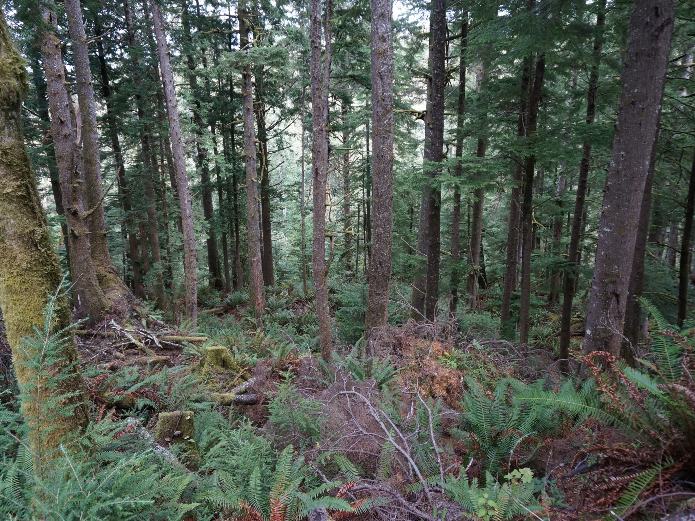
NOT silvicultural prescriptions
NOT risk / hazard evaluation
Local landscape evaluations incl. spatial patterns critical
This is only one input for regional prioritization – aquatics, wildlife, composition, fire, insects and disease…
Updated mapping / reference conditions could change results.

Slide 34
Questions and Discussion
Conservation Gateway: http://bit.ly/1sIDqa1
Ecoshare: http://ecoshare.info/products/r6-analysis/

