Slide 1
Ecology Perspective: Air Quality Plan and Smoke Management Plan Connections
Wenatchee, Washington
February 28 – March 1, 2017
Kathy Taylor, Deputy Air Quality Program Manager
Sean Hopkins, Air Quality Section Manager, Central Region
Laurie Hulse-Moyer, Headquarters Planner
Notes:
Good afternoon! We’re pleased to be here today!
We’ll have three speakers from Ecology,
I’m Kathy Taylor, Ecology’s AQP Deputy director

Slide 2
Introduction
Ecology and DNR have similar goals: different focus, integrated roles
Public health
Minimize smoke impacts
Ecology: state air quality implementation plan (SIP)
Rules, plans and programs
Includes Smoke Management Plan
Kathy Taylor, Deputy Program Manager, Ecology Air Quality Program
Notes:
I’m Kathy Taylor….
We’ll also have Sean Hopkins, whom you all know well who is our Smoke Management Lead out of CRO And currently filling in as the section manager
We’re also joined by Laurie Hulse-Moyer, a SIP and EE event specialist from our Policy and Planning department at HQ
Sean will talk about Ecology’s perspective on the future of smoke management in Washington and Laurie will cover the integration of the smoke management plan within the State Implementation Plan.
Ecology recognizes the benefits of Forest Resiliency Burning and hopes to form willing partnerships to accomplish the goals of healthy forest and healthy air.
We all serve the greater purpose of protecting the health of Washington citizens and natural resources.
The Ecology Air Quality Program mission is to enhance and preserve air quality in Washington State.
Ecology and DNR have the responsibility to ensure the air-sheds in the state stay within the federal standards and that the citizens of WA are not adversely impacted by the burning we all authorize.
In order to fulfill this mission we need to form good partnerships.
Over the next couple days we hope to identify things in smoke management that are working well and to offer workable solutions to the areas we can all agree need improvement.
We have integrated roles as we work to ensure minimum impact from the smoke we create to the communities we serve .
You are the forest management and fire experts, we know that you have the means, knowledge and intent to minimize smoke impacts.
The States Smoke Management Plan is one piece of the large State Implementation Plan (SIP) which Ecology is entrusted to uphold. The goals of the State Smoke Management Plan include:
Protect human health and safety from the effects of outdoor burning
Facilitate the enjoyment of the natural attractions of the state
Provide a limited burning program for the people of this state
Provide the opportunity for essential forest land burning while minimizing emissions
Foster and encourage the development of alternatives methods for disposing, of or reducing the amount of , organic refuse on forest lands
Acknowledge the role of fire in forest ecosystems and allow the use of fire under controlled conditions to maintain healthy forests.
We are committed to continue to work towards these goals and provide guidance and support for recommendations to updating the State Smoke Management Plan.

Slide 3
Future of Smoke Management in WA
Ecology Role in the State SMP
Overview of Ecology Smoke Program
Intro Pollution Prevention Programs
Highlight Areas of concern
Prevent Non Attainment
Sean Hopkins, Acting Central Regional Office Section Manager, Smoke Lead
Notes:
Sean:
For my portion of the presentation I will
Go over Ecology's role in the State SMP
Provide an overview of Ecology's Smoke Management Program
Illustrate some examples of our smoke pollution prevention programs
Show you the most updated map of our Areas of Concern
Introduce you to the concept of community based Prevent Non Attainment Partnerships

Slide 4
Ecology’s Role in SMP
Partner in Developing Plan
Does not apply to AG or Open Burning
Initially establish Designated Areas
Air Quality Standards
Monitoring
Notify for AQ Burn Bans
SIP & Exceptional Events
Notes:
We partnered with the DNR, USFS, National Park Service, BLM, participating Indian Nations the DOD, small and large forest landowners to deal with the effects of outdoor burning on our air.
The DNR is responsible for the overall administration of the SMP
The Smoke Management Plan directs DNR to maintain a close relationship with Ecology when burning is taking place.
The plan does not apply to Agricultural and Open burning.
Ecology was initially responsible for establishing Designated Areas and publishing the Current Air Quality Standards
Ecology and LAA’s are responsible for monitoring the AQ levels in the state, gathering the monitoring data and emissions from permitted sources and notifying DNR when AQ diminishes to the point when we need to call an Air Quality Burn Ban.
AQ Burn Bans prohibit all outdoor burning, including silvicultural burning.
Ecology is responsible for the State Implementation Plan (SIP), - the plan to protect air quality for public health and includes visibility protection of federal Class 1 areas.
We also decide if and when to prepare and submit reports if events can qualify for exceptional event status when Standards are exceeded or violated.
IF ASKED- Designated Areas: Critical Areas designated by Ecology that are otherwise subject to air pollution from other sources. Originally included Port Angeles, Spokane, Grays Harbor, Raymond and the I-5 corridor from Bellingham south to Vancouver.

Slide 5
Ecology’s Smoke Program
Ecology Jurisdiction
Issue Permits
Daily Burn Decision
Issue Air Quality Burn Bans
Track Smoke Complaints
Enforcement Actions
Notes:
Where we have jurisdiction, Ecology is responsible for running a smoke management program. Our program includes:

Slide 6
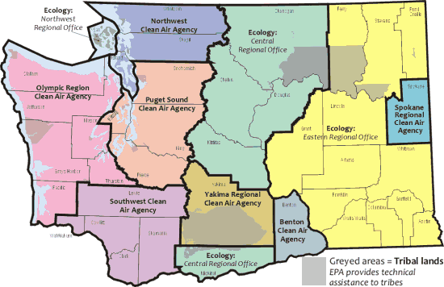
Notes:
This is a breakup of the Air Quality jurisdictions in WA State.
Ecology responsible for most of the Eastern part of State
Exception of Spokane, Yakima and Benton counties
West side of state covered by Local Air Agencies except San Jaun Islands Northwest Regional Office in Bellevue

Slide 7
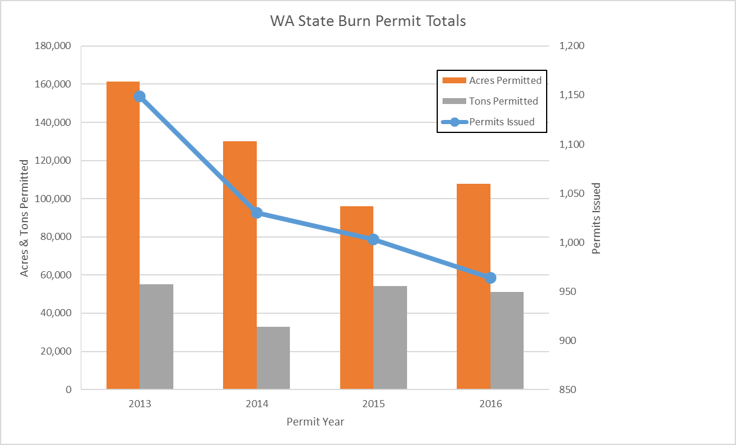
Notes:
Graph of Ag and Open burn permits issued in last 4 years by Ecology and designated permitting authorities which includes many conservation districts on the East Side of the State. Does not include LAA permits.
Issue about 1,000 burn permits/year
Average about 120K acres and around 50K tons from pile burning mostly orchard Tear out

Slide 8
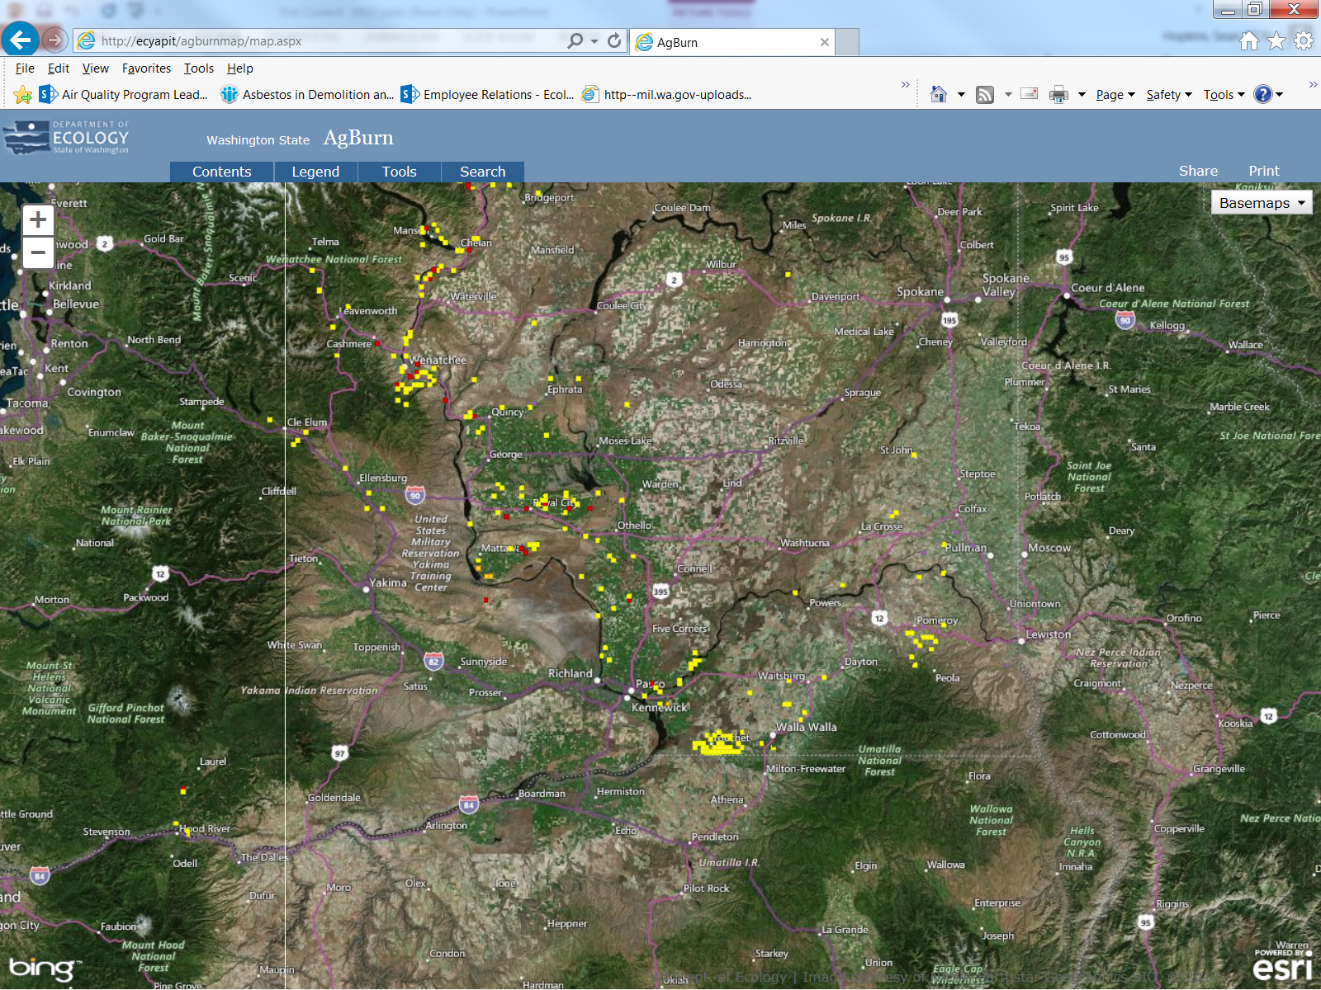
Notes:
GIS database we maintain showing active permits across the landscape.
Screen shot taken last week of active permits
As you can see we issue several permits in and around populated areas so coordination with the burners is the key to a successful program

Slide 9
Other Ecology Smoke Mgmt. Programs
Woodstove Exchange and Bounty
Educational/Outreach
Local Chipping Events
Wildfire Smoke Blog
Prevent Non-Attainment
Notes:
Other things we’re doing to reduce smoke in communities

Slide 10
Notes:
Compete for statewide funds- run the program in counties we have jurisdiction over.
Been running bounties for many years
We’ve recycled over 520 stoves reducing pollution by estimated 2.5 tons/year
We’ve also partnered with DNR and USFS to run bounties on Burn Barrels

Slide 11
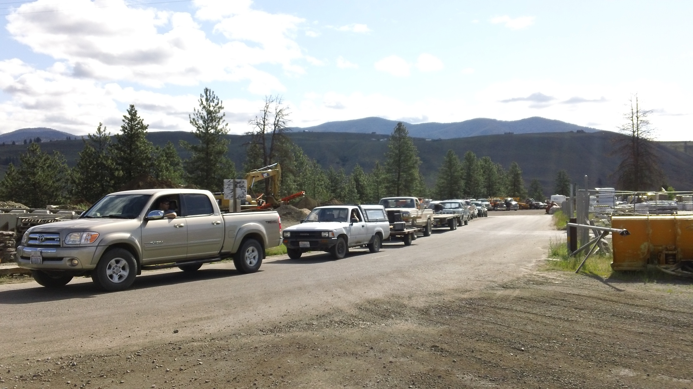
Woodstove Bounty
Notes:
Usually do 1 day events pay up to $250 for old stoves, stoves are crushed and recycled so taken out of local circulation.

Slide 12
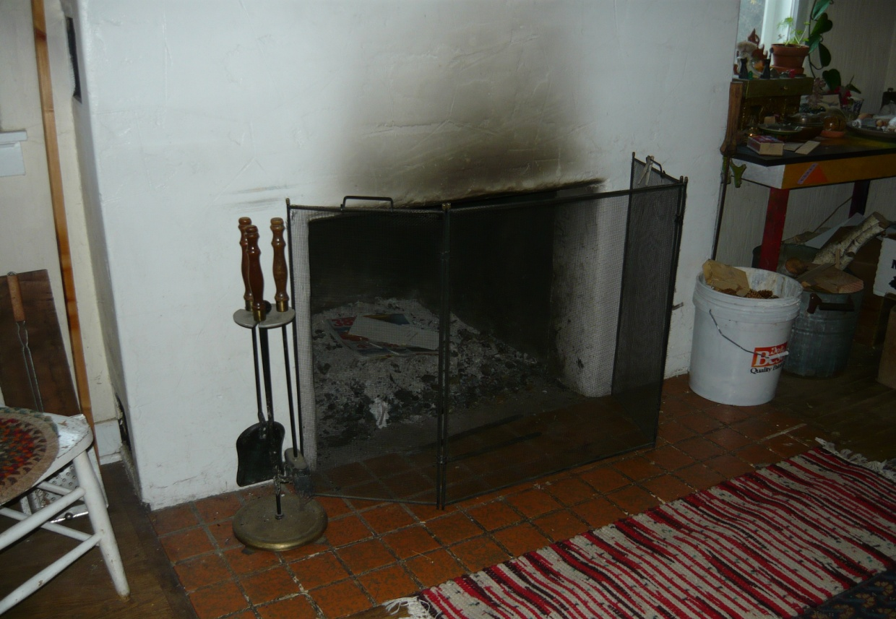
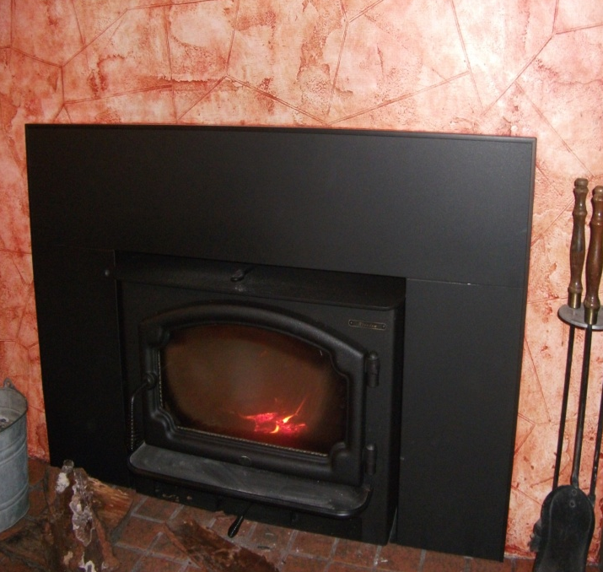
Wood Stove Change Out
Notes:
Compete for statewide grants
Focus has been on low income, sole source users in Ecology jurisdiction but anyone can qualify
To date statewide LAA’s and Ecology have changed out 4300 stoves to cleaner burning devices with estimated pollution reduction of 142 tons/year.

Slide 13
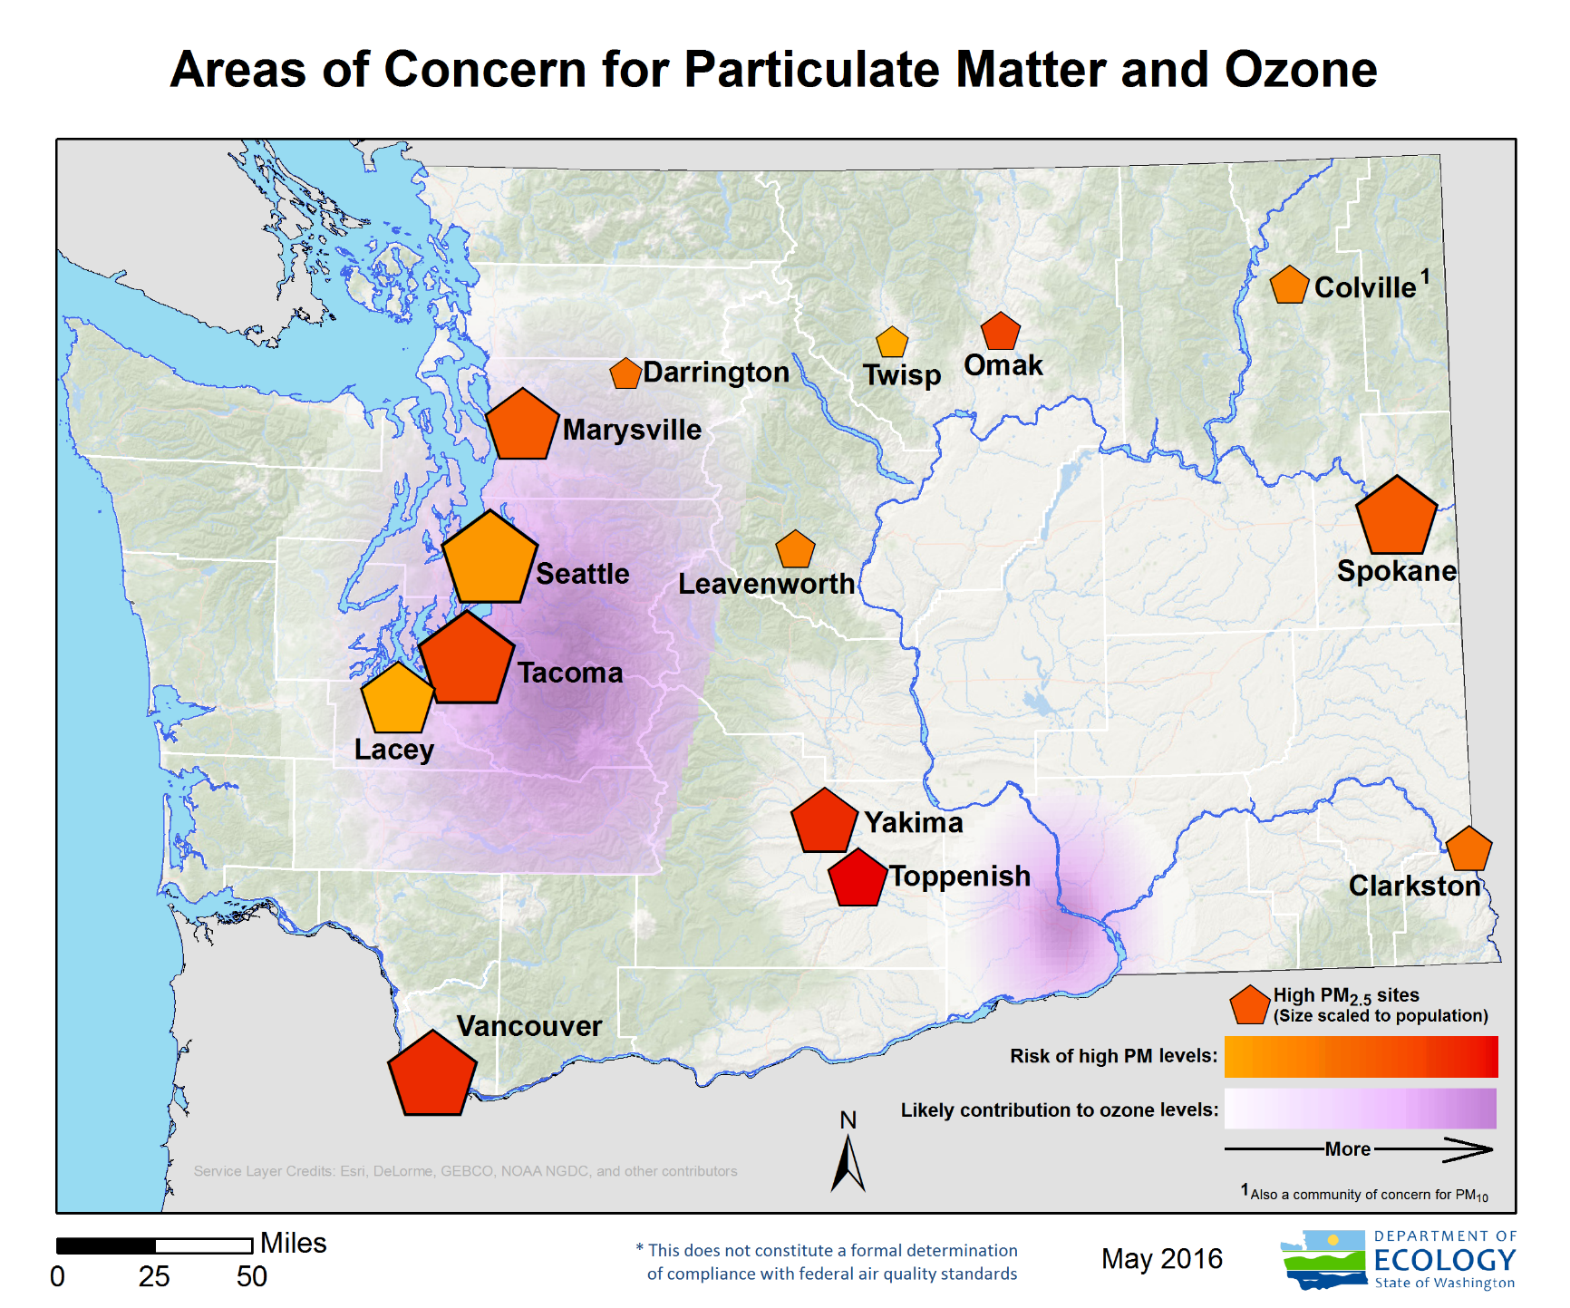
Notes:
Current Areas of concern for Particulate Matter and Ozone based on Monitoring data
As you can see many of these communities are localed on the East Slopes of Cascades
One in Colville is for PM 10
Size of the Pentagon represents population
Color represents Risk of PM2.5 Red = higher risk

Slide 14
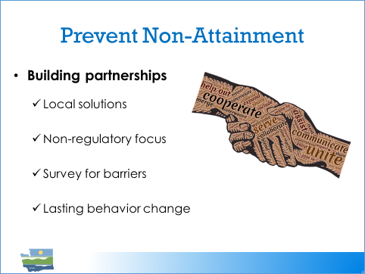
Notes:
We’re working on community based behavior change programs where we invite local communities to form partnerships with us and other agencies to identify all of the contributing smoke sources we can influence or change.
Focus is on Building Partnerships to include
Local Solutions
With Non-regulatory focus
Includes initial surveying to identify local barriers, beliefs and strategies
With the Goal of creating lasting behavior change

Slide 15
SIP and Exceptional Event Rule
SIP: EPA-approved rules, plans and programs
Includes Smoke Management Plan
Exceptional Event Rule
Provides means to exclude data caused by events beyond control
Laurie Hulse-Moyer, AQ Planner
Notes:
Thanks, Sean. I’m Laurie Hulse-Moyer, SIP planner at Ecology
As we’ve said, the SIP contains rules, plans and programs that keep all areas of the state in compliance with the federal air quality standards includes the SMP.
Provisions in the SIP are federally enforceable. Outside groups, like environmental groups, can use legal means to hold us accountable for what we say we’ll do in the SiP
The SMP is a tool to protect public health… And its an important part of the overall state implementation plan.
The exceptional event rule, finalized last October, provides a way for us to have air quality data removed from compliance calculations if the state can demonstrate that the event can meet the criteria in the rule.

Slide 16
Air Quality Standards
Health-based National Ambient Air Quality Standards
Fine particulate – PM2.5
Regional Haze standards - visibility
Notes:
NAAQS – health and welfare standards.
Regional Haze – standards set for visibility from inside national parks, etc.

Slide 17
Exceptional Event Rule
If NAAQS are exceeded…
Rule provides means to exclude events beyond our control -
High speed winds – dust storms
Wildfires
Demonstration:
Must provide evidence
Notes:
Of course, I think we can agree that we want to minimize smoke impacts, whether or not monitored values exceed the federal standards, However, there are options and consequences when the NAAQS are exceeded.
The Exceptional Event rule provides a way for to exclude data from the compliance record - so that qualifying natural events beyond our control do not count against us
A revision to the original 2007 rule was finalized last October and includes some new options, requirements and recommendations.
In order to get exceedances excluded from the compliance calculations, we need develop a demonstration…
…And believe me, this is not a trivial exercise, they are quite complex and with a RX burn demonstration we can expect more scrutiny of the evidence. The demonstrations must be submitted to EPA by Ecology or Local Air Agencies and approved by the EPA.
We would rely on the practitioners to gather the necessary evidence in order to demonstrate the event meets the Exceptional Event requirements.
This final action
promulgates in rule language several
fire-related definitions and the
conditions under which prescribed fires
could qualify as exceptional events,
which include the use of smoke
management programs (SMP) and the
application of basic smoke management
practices (BSMP).
address the controllable
prong of the not reasonably controllable
or preventable criterion. (for EE demo)

Slide 18
Exceedance caused by Rx fire
Rx fires are different than wildfires
Preventable, controllable
If Rx fire causes or contributes to an exceedance of standard, we should expect to provide robust documentation that SMP was followed.
Notes:
So, The exceptional event rule provides a way to exclude data from the record for events beyond our control , like wildfires
But because Rx are anthropogenic, they are man-made, they do not fit easily fit into the EER criteria. A prescribed fire could possibly qualify for exceptional event treatment, but “to be considered under the provisions of the Exceptional Events Rule, prescribed fires must be conducted under an adopted and implemented certified SMP
or using appropriate BSMP”
There are a number of tests that the event has to meet to qualify for exceptional event treatment, but the main burden of proof is to fulfill the ‘not reasonably preventable or not reasonably controllable’ elements. The rule has provided that Rx may qualify for exclusion IF… we can provide evidence that the SMP was followed and that means we should expect to provide detailed evidence that the SMP was followed.
An exceptional event demonstration is not a trivial exercise, they are quite complex and with a Rx-fire exceedance, we can expect particular scrutiny. These demonstrations would require a lot of work and likely won’t be approved if we cannot provide the evidence that the SMP was followed. If we can’t get them approved, we could be looking at a nonattainment area, which has its own set of consequences.
Once an area is designated Nonattainment, a set of requirements are set in motion. During the designation process, sources that cause or contribute to the pollution in the area have to be considered. As you may know for our existing maintenance areas, no burning is allowed inside the area, usually matching up with the UGA boundaries.

Slide 19
Basic Smoke Management Practices: before, during and after the event
Evaluate dispersion/monitor effects
Recordkeeping: burn/smoke journal, after burn report
Communication – public notification
Consider emission reduction techniques
Coordinate burning
Notes:
A well planned and executed Smoke Management Program will minimize smoke impacts and the risk of exceeding an air quality standard. These BSMP were included in the EER and were taken from the USDA Forest Service and Natural Resources Conservation Service, Basic Smoke Management Practices 2011 Tech Note
Washington’s smoke management plan likely contains most of these provisions but a closer review is recommended. The EER requires documentation of the analysis and decisions made before, during and after the fire to qualify the event for exclusion.
, October 2011, http://www.nrcs.usda.gov/Internet/FSE_DOCUMENTS/stelprdb1046311.pdf.

Slide 20
Minimize Smoke Impacts
Awareness of the impact
Info about weather, burn and smoke
helps analyze and address impact
Notify those potentially impacted
Actions taken can reduce impacts
Airshed coordination
Notes:
To get demo approved, we’ll have to provide evidence that the SMP was followed and provide documentation,
Awareness of the impact where smoke is going and degree of impact
Info about the weather…
What we did as far as notification
What actions we might have taken to reduce reducing emissions ,such as reducing fuel loading to reduce downwind impacts.
An
d how we worked together to coordinate the burning in the airshed
This information will be critical to showing that SmP was followed and so should qualify for EER qualification.

Slide 21
Recommendations
Manage to minimize impacts and prevent nonattainment
Ensure SMP includes what is required to document activities
Ensure all burners know what’s expected and follow the SMP
Notes:
So, the SMP is a key element of the plan and… plays a very important role.
We recommend that….
We stand ready to work with you to develop an effective, approvable and defensible plan.

Slide 22
Questions/Discussion
Sean Hopkins,
Central Regional Office,
Acting Air Quality Section Manager,
509-407-6442
Laurie Hulse-Moyer,
Lacey Headquarters, Policy and Planning
360-407-6783

