Slide 1
Gradient Nearest Neighbor methods for regional-scale forest vegetation mapping in the Pacific Northwest
Janet Ohmann, Matt Gregory, Heather Roberts, and
Emilie Henderson

Slide 2
What is Nearest Neighbors Forest Vegetation Mapping?
“Nearest Neighbors” ≈ Imputation
Statistical Imputation
  substitution of some value for a missing data point or a missing component of a data point
Imputation in a forest vegetation modeling context
  data point: measured (inventory) forest plot
  missing data point: pixel or polygon in region of interest

Slide 3
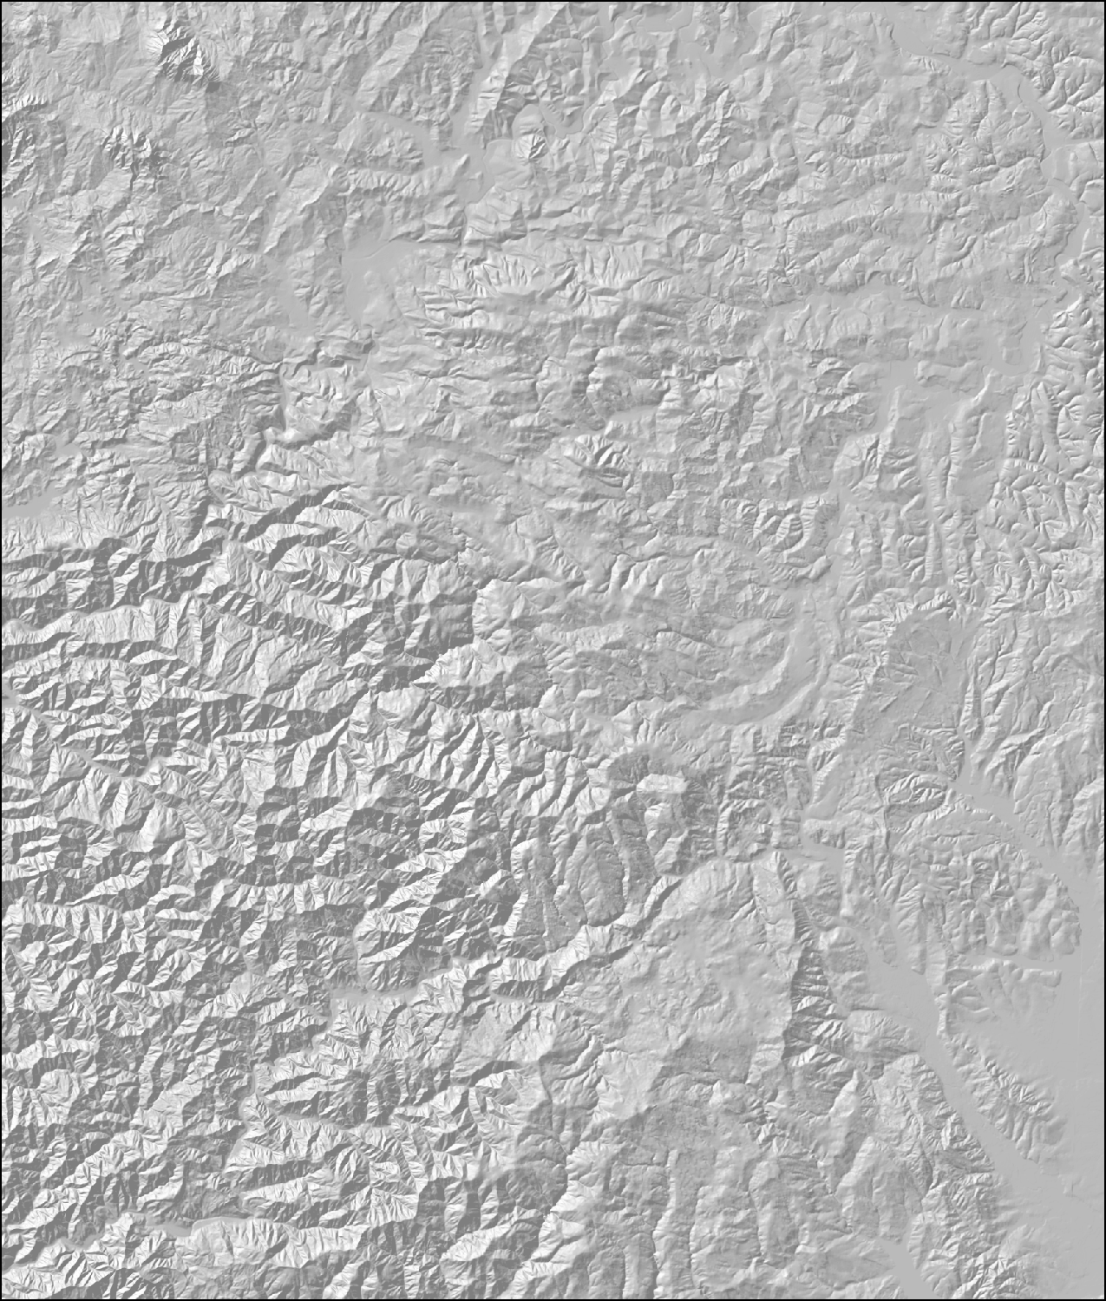
Setting for Forest Mapping using Nearest Neighbors
Gridded sample of forest inventory plots with measured forest attributes (live and snag trees, down wood, shrub/forb cover)
Not spatially complete

Slide 4
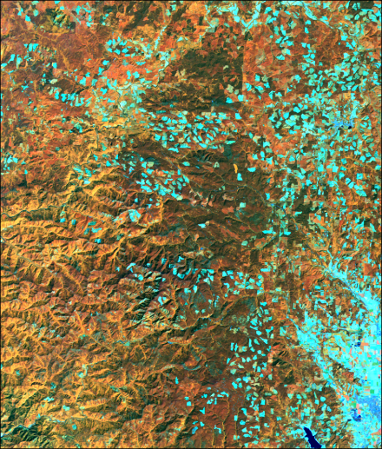
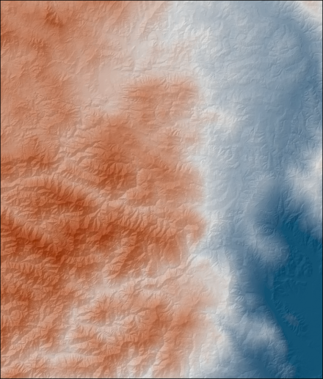
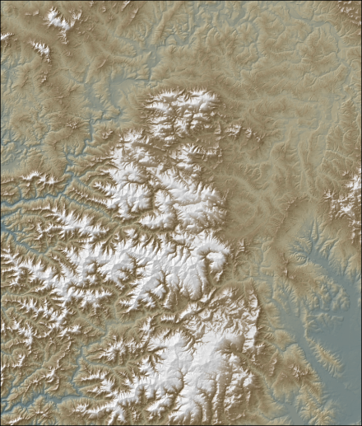
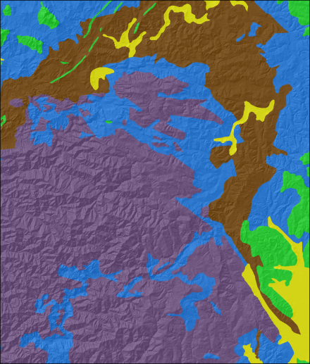
Setting for Forest Mapping using Nearest Neighbors
Set of remote sensing and GIS data layers that relate to forest composition and structure
No direct information about actual forest vegetation
Landsat TM
Climate
Elevation
Soils / Geology

Slide 5
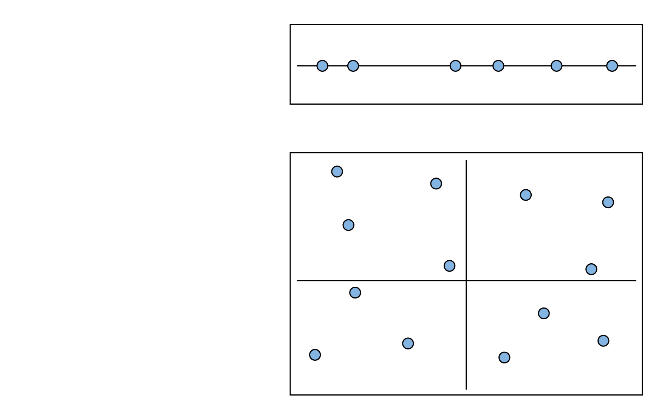
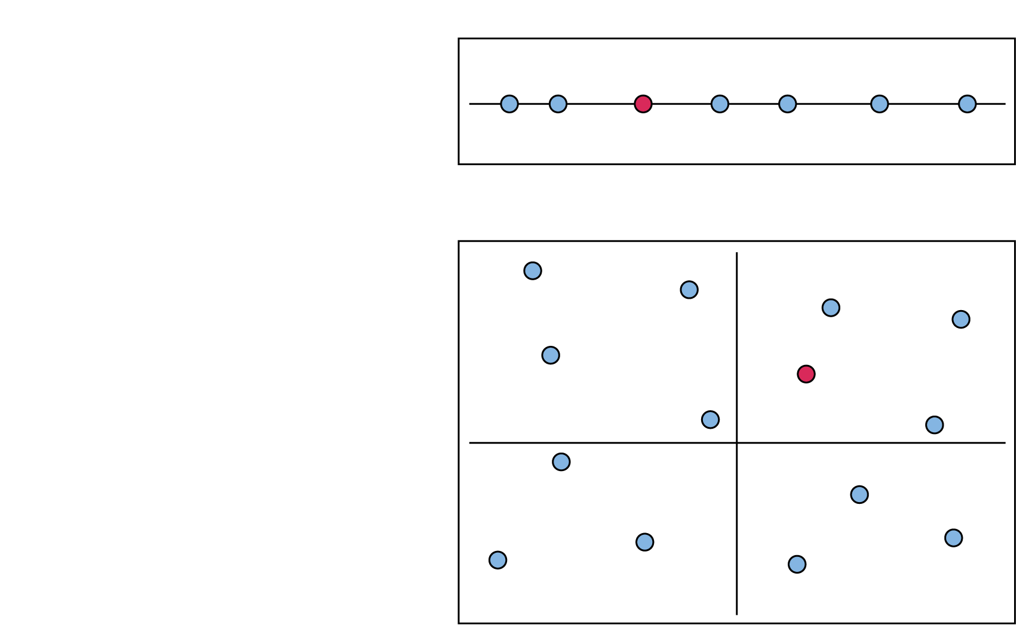


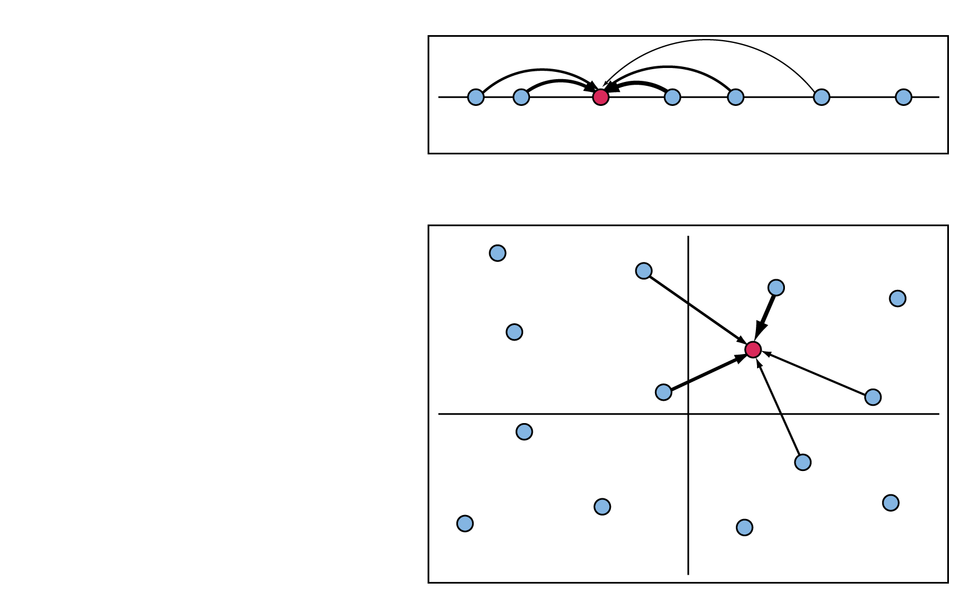
Simple Imputation Example
One dimension
Imputation occurs in d dimensions
When k=1, nearest neighbor is chosen
When k>1, nearest neighbors are chosen based on weighting
Two dimensions

Slide 6

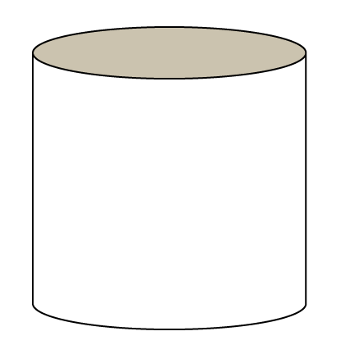



The Gradient Nearest Neighbor (GNN) Method
Plot Database
Plots X “Species”
Plots X Environment
Gradient Analysis (CCA)
Environmental Variables
geographic space
plot ID number
Axis 1
Axis 2
gradient space

Slide 7
Why Canonical Correspondence Analysis?
Interest in species composition
Grounded in ecological theory, widely used by ecologists
A way to quantify relations between two multivariate matrices:
  spatial predictors (explanatory variables)
  species abundances (response variables)
Robust to many challenges of ecological community data:
  non-linear responses of species along environment gradients
  sparse data matrices (species on plots)
  Multi-collinearity

Slide 8
Using nearest neighbors for species/community mapping
Advantages:
Non-parametric, flexible modeling framework
Useful for many species, plant communities
  Maintains covariance structure (species assemblages) for k=1 imputations
  Flexibility for post-mapping classification, analysis, modeling
Information on ecological gradients
Limitations:
Fitting all species simultaneously => less accurate for some individual species especially less common species
Future:
Using random forests in NN context for community mapping

Slide 9
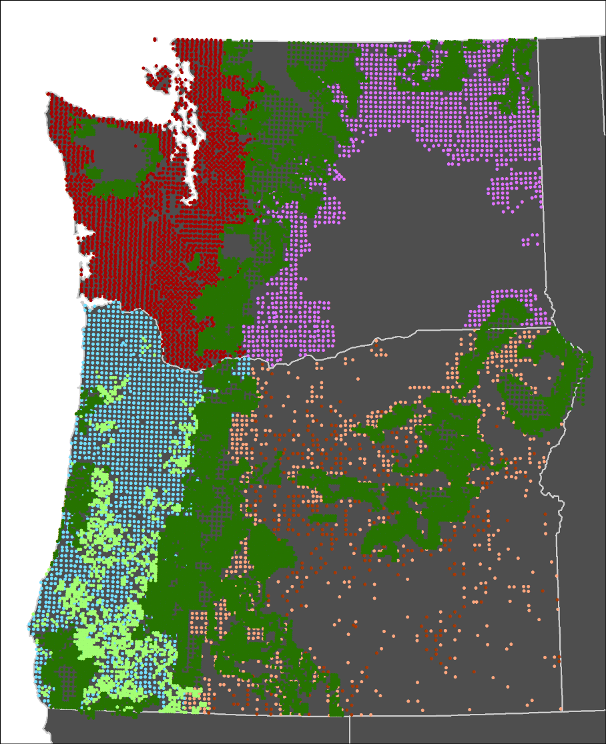
Plot Inventories in 1984-2012 GNN Imputations
Source | No.
Forest Inventory and Analysis periodic inventories (nonfederal) | 4,688
Bureau of Land Management (BLM) | 1,695
Current Vegetation Survey (National Forest) | 21,205
Forest Inventory and Analysis annual inventories (All Lands) | 16,742
Plot Inventories in 1986-2017 GNN Imputations
Source | No.
Forest Inventory and Analysis annual inventories - # Locations (All Lands) | 17,564
Forest Inventory and Analysis annual inventories - # Plot Observations (All Lands) | 26,719
Notes:
The 1984-2012 version of GNN had 36,607 plot observations (FCIDs) on 20,370 locations. These plots came from many different sources and used 3 different plot designs. The 1986-2017 GNN version has 26,719 FCIDs on 17,564 locations with 1 single plot design (FIA-Annual). The older plot data and designs were still used to inform the PNV map where the plots occur on the same location as the FIA-Annual plots used in the 2017 GNN version.

Slide 10
Explanatory variables in GNN
Landsat 30m | TC transformations (TC1-Brightness, TC2-Greenness, TC-Wetness)
Climate Raw Prism Data 800m | Means, seasonal variability (Precipitation, Temperature)
Topography 10m DEM | Elevation, slope, aspect, solar
Disturbance | Past fires, harvest, I&D
Soils | Parent materials
Location | X, Y
Ownership | Federal, state, forest industry, other private
>100 rasters
Source data vary:
spatial resolution
extent and accuracy
relevance to hypotheses
Resample to 30 m x 30 m resolution

Slide 11
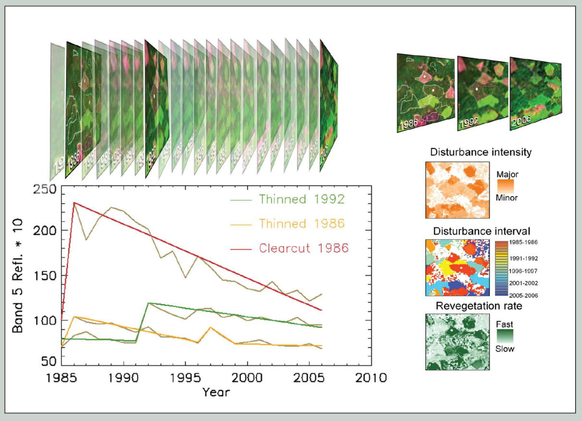
Landsat Detection of Trends in Disturbance and Recovery (LandTrendr)*
Temporal normalization and segmentation
at pixel level
Minimizes noise from sun angle, phenology
Segments describe sequences of disturbance, regrowth
Normalized imagery for multiple years for GNN modeling
*Kennedy et al. (2010), Rem. Sens. Env.

Slide 12
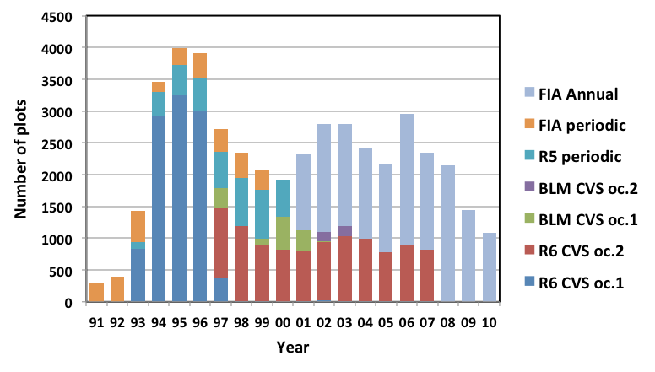
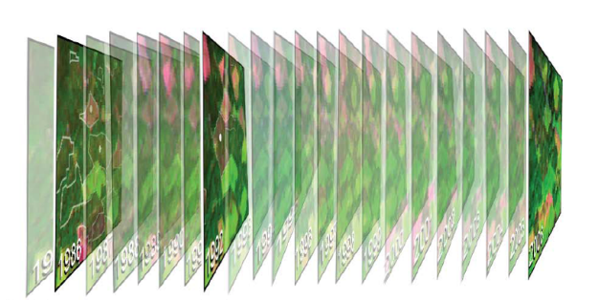
Matching plots to LandTrendr imagery for 2012 GNN modeling
Unbalanced in time and space, 1 to 3 per location
Match plots to imagery of same year
Single gradient model from all plots, applied to each imagery year
Imagery is only change – assumes normalization
Response vars.: basal area by species + size-class
30-m
Landsat
pixels
2
1
4
3
Yearly matching of plot and spectral data
FIA Annual plot

Slide 13
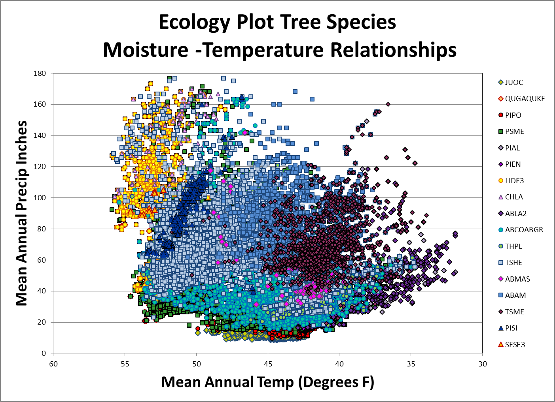
Ecology Plot Tree Species
Moisture-Temperature Relationships

Slide 14
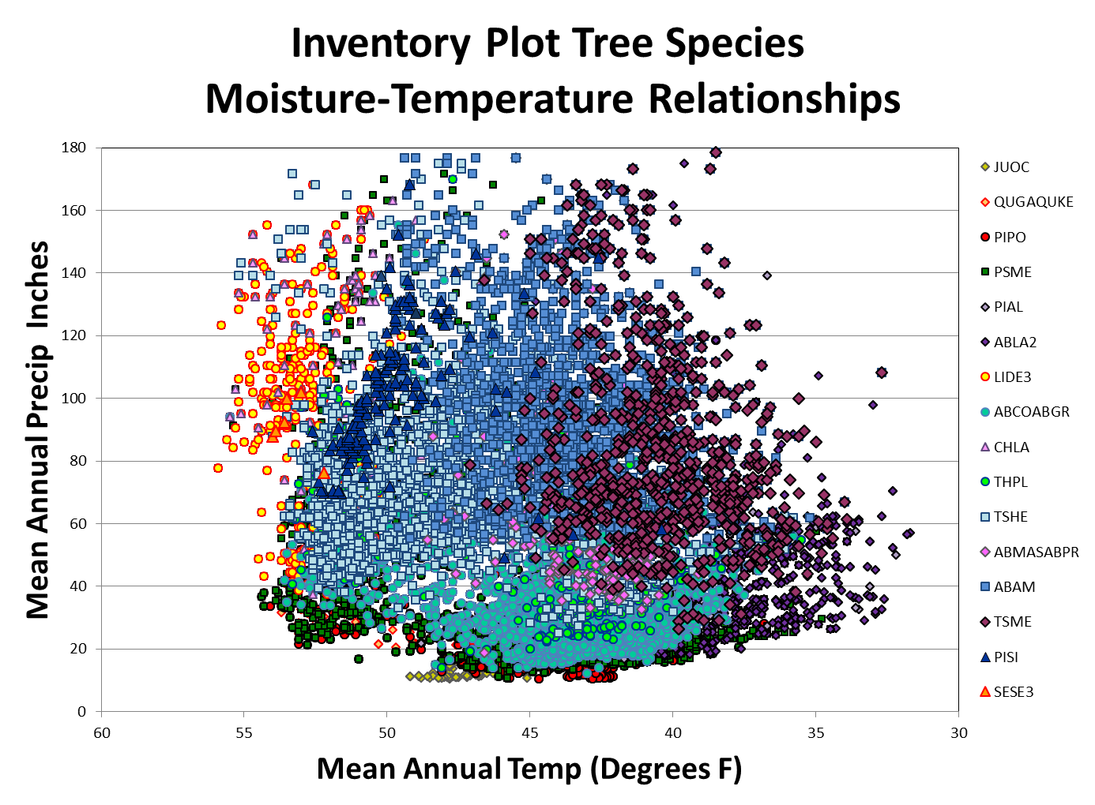
Inventory Plot Tree Species
Moisture-Temperature Relationships

Slide 15
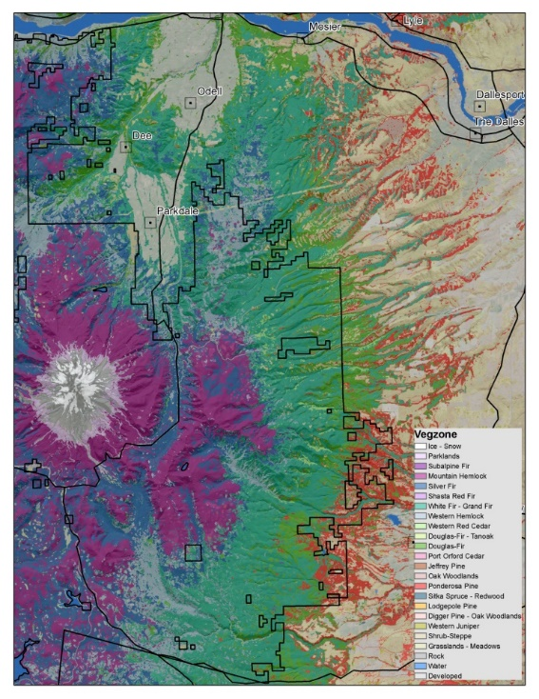
How do you get consistent PVT estimates from Existing Species Composition?
Stratify the input plot set based on presence and abundance (>=10%) of the “inferred” Climax tree species using species characteristics.
    Predominant Series order in existing Plant Association Classification Keys
    Shade Tolerance
    Longevity
Use entire 1986-2017 (32 yrs) GNN imputation stack to reduce disturbance effects.
Develop Alt. Spp. cover thresholds for plots on disturbed sites.
Notes:
Look at Species Composition from imputations before major disturbances… On plots with significant or repeated disturbance relax cover thresholds.

Slide 16

Original Tree Species Order of Precedence for Vegetation Zone Classification
PISI or SESE3
TSME
ABAM
TSHE or THPL
ABCO or ABGR
ABLA2 or PIEN
ABMAS
CHLA
LIDE3
PSME
PIJE
PIPO
PICO
Hardwoods (Oaks, Aspen etc)
JUOC
Min Threshold for zone assignment >=5% Cover

Slide 17
2019 Tree Species Order of Precedence for Vegetation Zone Classification
PIJE
PISI
SESE3
TSME (10% Threshold)
ABAM or ABPR
TSHE or THPL
ABLA2 or PIEN
ABCO or ABGR
ABMAS or ABMA
CHLA (10% Threshold)
LIDE3 (20% Threshold)
PSME
PIPO
Parklands (PIAL, PIFL2, LALY, PILO, PIBA)
PICO
PISA2 or PICO3
Rip. Hardwoods (BEPA, POBAT, POTR5 etc.)
Oak Woodlands
Other Hardwoods
Con. Woodlands (Pinyon, JUOC, Cypress)
Min Threshold for zone assignment >=5% Cover

Slide 18
2020 Tree Species Order of Precedence for Vegetation Zone Classification
Min Threshold for zone assignment >=5% Cover
PISI
SESE3
TSME (10% and 20% Thresholds )
ABAM or ABPR
TSHE or THPL (2 zones in the N. Rockies)
ABLA2 or PIEN
ABCO or ABGR
ABMAS or ABMA
CHLA (10% Threshold)
LIDE3 (20% Threshold)
PSME or PSMA
PIJE
PIPO
Parklands (PIAL, PIFL2, LALY, PILO, PIBA)
PICO
PISA2 or PICO3
Rip. Hardwoods (FRLA, POBAT, POTR5 etc.)
Oak Woodlands
Other Hardwoods
Con. Woodlands (Pinyon, JUOC, Cypress)

Slide 19
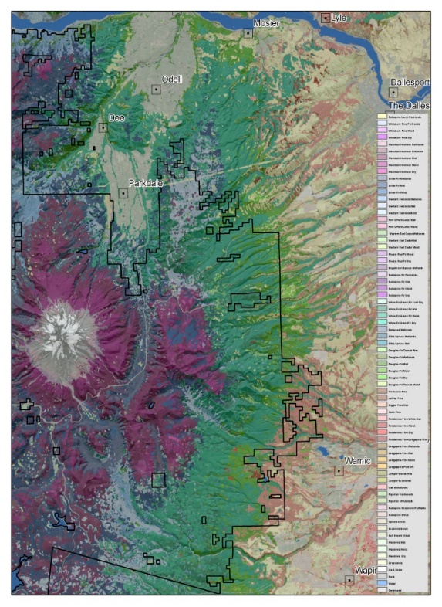
How do you get consistent Subseries PVT estimates out of existing Species Composition Info?
Subdivide the Vegzone level classification based on minimum cumulative abundance or occurrence of a minimum number of species within an understory “indicator” species group
Indicator Species Groups are based on relative species affinities to major explanatory variables.
    Moisture
    Temperature
    Seasonal Variability
Notes:
On sites with depauperate understories may need to relax minimum abundance thresholds.

Slide 20
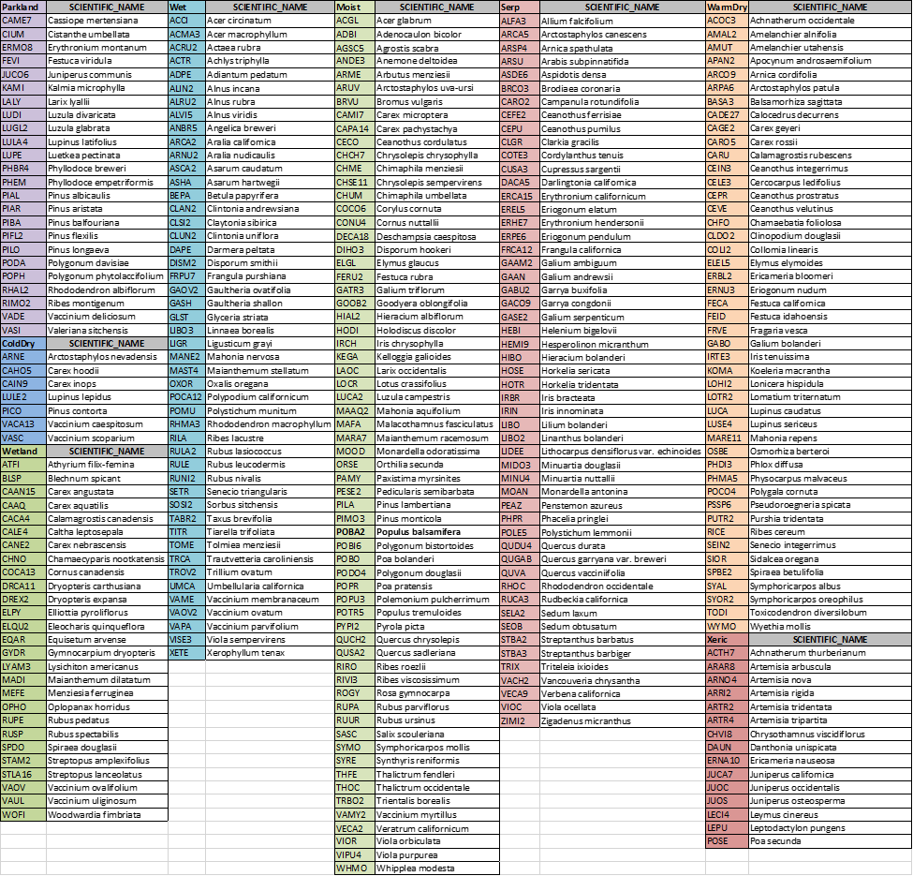
2019 Subzone Species Bins
Species Bin # Species Order
Wetland 26 Species 1
Wet 48 Species 2
Parklands 24 Species 3
Moist 64 Species 4
ColdDry 7 Species 5
WarmDry 46 Species 6
Xeric 15 Species 7
Serpentine 52 Species Y/N
Use >=25% Threshold of a single species in each bin or >=10% Threshold if >=2 species.
If total understory is Depauperate (Cover < 25%) use Relative cover of Species Bins instead of Absolute cover.

Slide 21
2021 Subzone Species Bins
Species Bin # Species Order
Wetland 32 Species
WaWt 23 Species 1a
CdWt 9 Species 1b
Wet 48 Species
WaWM 37 Species 2a
ClWM 10 Species 2b
Parklands CdWM 24 Species 3
Moist WaMe 54 Species 4
ColdDry ClMe 7 Species 5
WarmDry WaDr 53 Species 6
Xeric WaXe 23 Species 7
Serpentine 53 Species Y/N
Use >=25% Threshold of a single species in each bin or >=10% Threshold if >=2 species.
If total understory is Depauperate (Cover < 25%) use Relative cover of Species Bins instead of Absolute cover.
Notes:
The species bin lists were developed from R5/R6 Ecology Indicator species used in Plant Association Classifications and compared to the Inventory Plot species lists. Not all species used in the Ecology Indicator lists occur in the Inventory Plot species dataset.

Slide 22
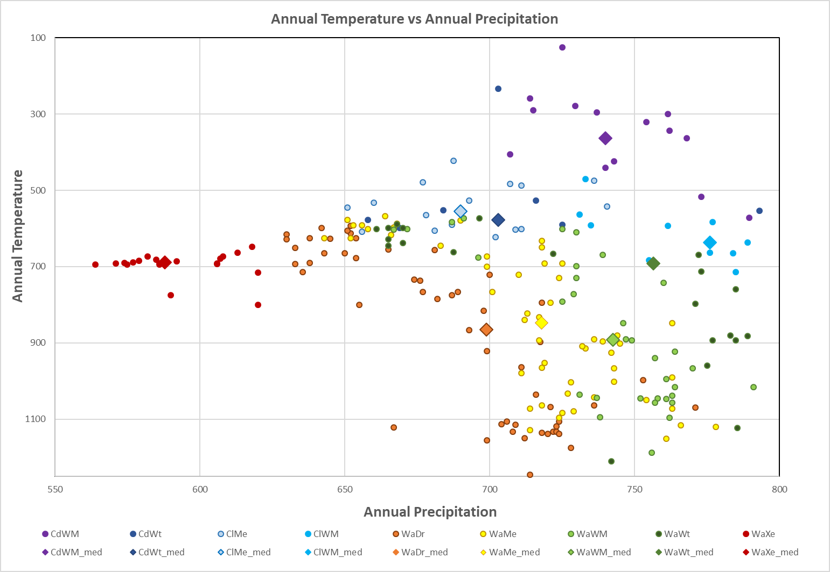

Slide 23
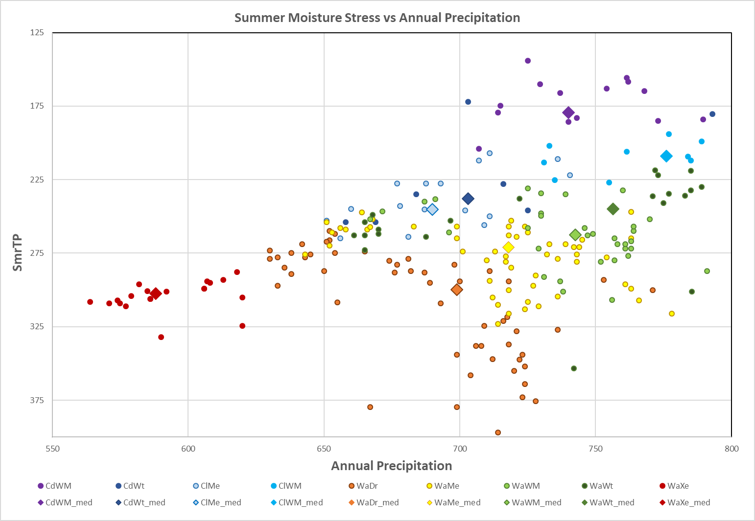

Slide 24
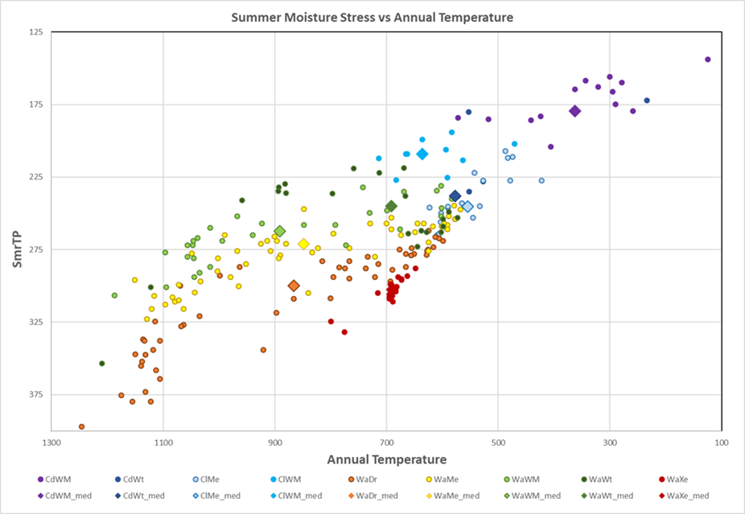

Slide 25
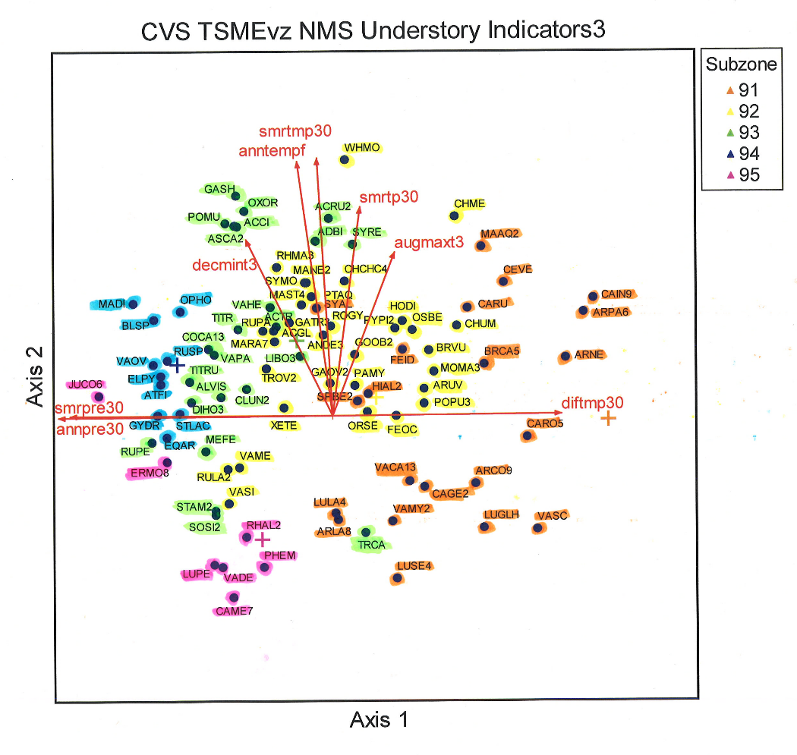
Example Ordination of Inventory Plot Understory Species in Environmental Space
Order of Subzone Bin Precedence for Mtn. Hemlock Zone
  94 - TSME Wetlands CdWt & WaWt
  93 - TSME Wet ClWM & WaWM
  95 - TSME Parklands CdWM
  92 - TSME Moist WaMe
  91 - TSME Dry ClMe
Groups are ordered by moisture-temperature gradients
  wet to dry
  warm to cold
Notes:
Species locations in the ordination space represent the centroid of each species occurrence. Each species group used to define a Subzone is highlighted in a separate color. Subzone centroids are indicated by colored +’s that match the species group color.

Slide 26
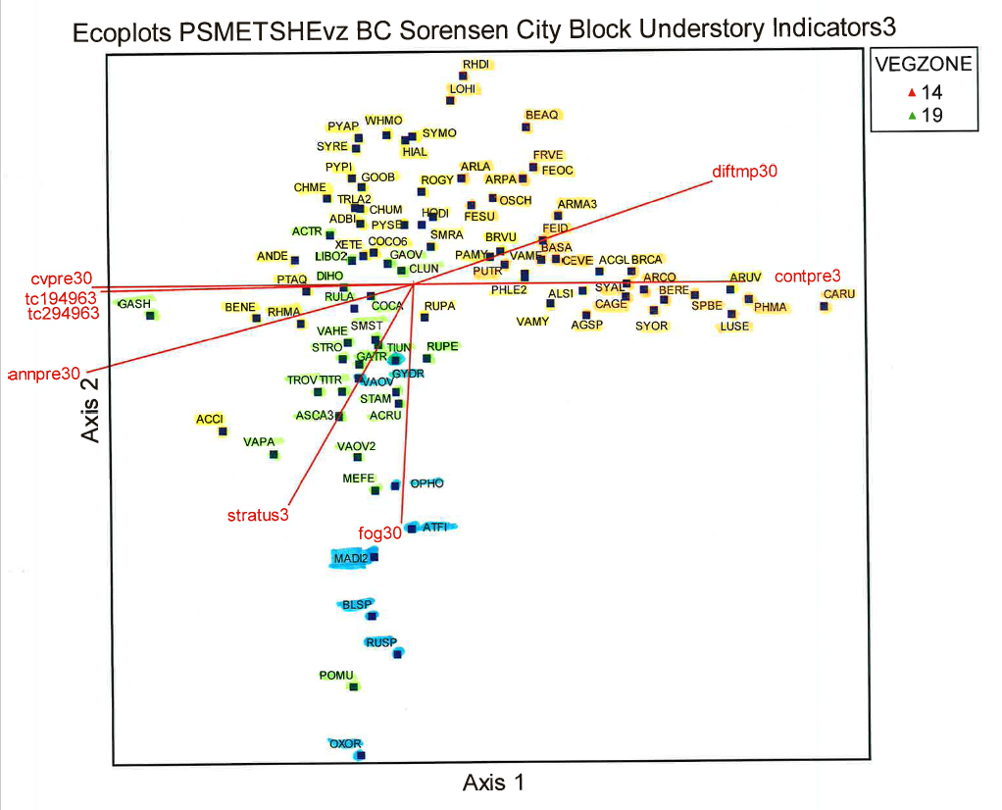
R6 Ecology Plot PSME & TSHE Vegzone Understory Species in Environmental Space
Moist Subzone Spp.
Dry Subzone Spp.
Wet Subzone Spp.
Wetland Subzone Spp.
Notes:
Species locations represent the centroid of each species occurrence. Each species group used to define a Subzone is highlighted in a separate color. Subzone centroids are indicated by colored +’s that match the species group color.

Slide 27
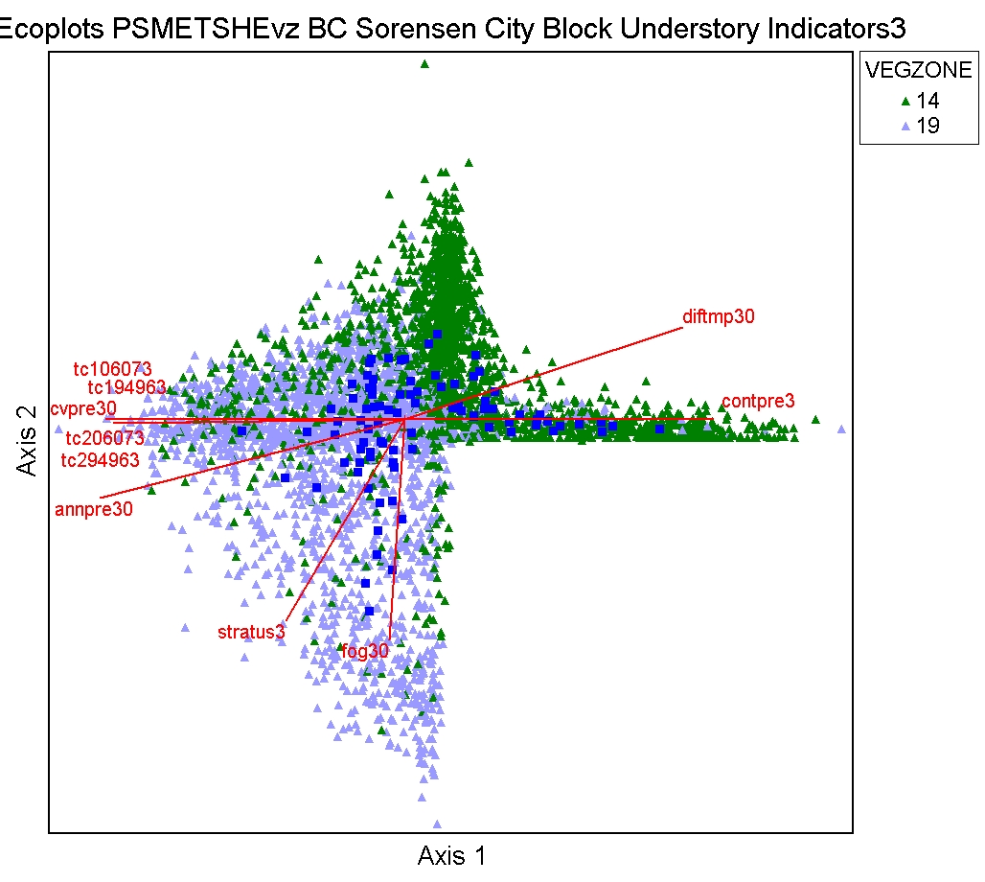
Example Ordination of R6 Ecology Plots
Understory Species & Plots in Environmental Space
Moist Subzone Spp.
Dry Subzone Spp.
Wet Subzone Spp.
Wetland Subzone Spp.
Notes:
Species locations represent the centroid of each species occurrence (Dark Blue squares). Species groups from the previous slide are highlighted in a separate colors. Individual plots assigned to TSHE vegzone are shown as light blue triangles and plots assigned to PSME vegzone are displayed in green triangles.

Slide 28
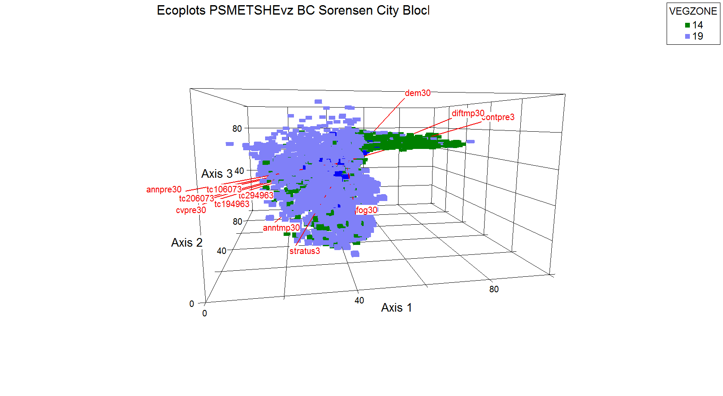
3D Bray-Curtis Ordination of PSME & TSHE Understory Species & Plots in Environmental Space
Notes:
3 dimensional representation of the plots and species centroids in Ordination space. Major explanatory variables are displayed as red vectors.

Slide 29
Non-Forest Mask Development
Iterative Process: Base layer = 2012 GNN Non-Forest Mask
USGS-Landfire BPS/ESP/GAP layers (Includes Ecological Systems attributes)
2019 Non-Forest Mask
GNN 2012 Non-Forest Mask – Adjusted by the following Data Sources:
USGS National Land Cover Database
USGS Continuous Forest Cover estimates 1992 & 2011 (<20% Tree Cover)
GNN Maximum Forest Cover estimates 1984-2017 (<20% Tree Cover)
Lidar Tree Cover Estimates (2009-2017) excludes recent Disturbance (Fire, Harvest)
2021 Non-Forest Mask
2019 Non-Forest Mask – Adjusted by the following Data sources:
USGS National Wetlands Inventory

Slide 30
Process Steps
Apply Vegzone/Subzone Ruleset to each Plot Location in the GNN Dataset
Reclass each GNN Raster in the Time Series w/ Subzone
Rank Subzones at each raster cell by Precedence Order (Min. Rank)
Determine Majority, Variety, & Minimum Rank at each cell
Use Majority value where Variety is less than 4 Subzones (plots) assigned to the cell through the time series
Use Minimum Rank where the Variety of cell values is >=4 (Disturbed Plot indicator) or where Majority is null
Apply Non-Forest Mask
Post Process TSME issues in Wallowa and Blue Mtns.

Slide 31
Accuracy Assessment: 3-Pronged Approach
Model stability/uncertainty check: Compare 2nd-5th neighbors to observed subzone
Subzone realizations using the k=2,3,4,5 neighbors. Use the GNN predictions from each year, get the kth neighbor, crosswalk to subzone call and then use the subzone aggregation logic to create a single subzone raster for each value of k
Get the majority subzone call among the first 5 neighbors for each pixel at a yearly timestep, then use the subzone aggregation logic to create a single subzone raster
Both of these rasters can be compared against the k=1 raster
Local Scale Accuracy: Observed vs Predicted by Location
At each model plot location, extract the first independent nearest neighbor for each year and at each of the nine pixels that make up the plot footprint on a yearly basis. Take the majority subzone callon the footprint and apply subzone aggregation logic across the Time Series to get a single subzone per model plot location for all years in the 1986-2017 Time Series.
Create error matrix of observed vs. predicted subzones for all model plot locations and calculate overall and fuzzy accuracy based on this error matrix.
Area Based Regional Accuracy: Design-based vs Model-based Area Estimates
Create a paired histogram of plot-based and GNN-based area estimates for each subzone.
Use the Error Matrix from the Local Scale Accuracy test to adjust model-based area estimates to generate adjusted area estimates and 95% confidence intervals (Olofsson 2013).

Slide 32
Minimum Scale and Scope of Assessments?
Current Recommendations:
Since many of the dominant gradients are derived from PRISM climate data sets, minimum assessment areas for species composition should be related to the resolution of the climate data sets (800m rasters = 150-160 acres; roughly stand scales).
Landscape Departure Assessments should be scaled based on a multiple 5-10x of the Average Stand Replacement Disturbance sizes (10,000-1,000,000 acres).
Final Recommendations may change based on outcomes from the Accuracy Assessment

Slide 33
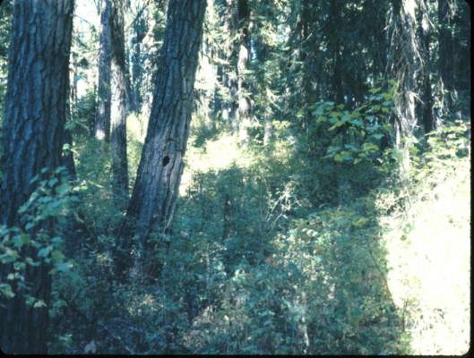
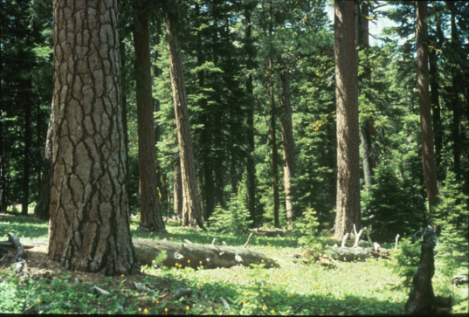
Key Components for Success
Abco-Abgr Series
Consistent approach to Zone – Subzone stratifications across Area boundaries
  Need agreement on indicator species group membership for each Subzone
Subseries strata ideally should incorporate major differences in disturbance regimes and rate of response to disturbance
Consistent logical naming convention for the subseries strata
Mixed Severity Fire Regime
Frequent Low Severity Fire Regime

Slide 34
Naming subzones
Earlier approach applied adjectives based on medians of annual temperature and annual precipitation
Generated some confusion, especially across ecoregions
Lower limit (≥) | Upper limit (<) | Descriptor term
47.5 | n/a | VeryWarm
45 | 47.5 | Warm
43 | 45 | Mild
41 | 43 | Cool
n/a | 41 | Cold
Lower limit (≥) | Upper limit (<) | Descriptor term
80 | n/a | VeryWet
70 | 80 | Wet
60 | 70 | VeryMoist
30 | 60 | Moist
20 | 30 | Dry
n/a | 20 | Xeric

Slide 35
Naming subzones
New approach, more nuanced, still uses climate adjectives for some veg. zones, new VeryMoist/Moist limit
Also used quartiles or more extreme percentiles in a few cases
Veg. zone group | Examples | Subzone names
One subzone | Developed, Water, Port Orford Cedar, Giant Sequoia
Labels from physiognomy, composition, or habitat | Pinyon-Juniper-Cypress | Juniper Scablands, Juniper Woodlands, Pinyon Woodlands, Cypress Woodlands
Consistent temperature | Western Hemlock | Moist, VeryMoist, Wet
Medians of temp., precip. | Mountain Hemlock | ColdVeryMoist, CoolVeryMoist, CoolWet, CoolVeryWet

