Slide 1
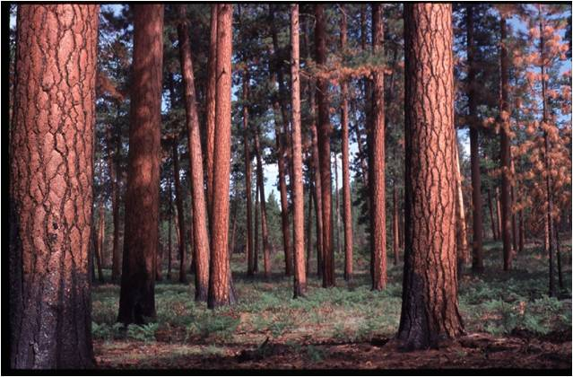
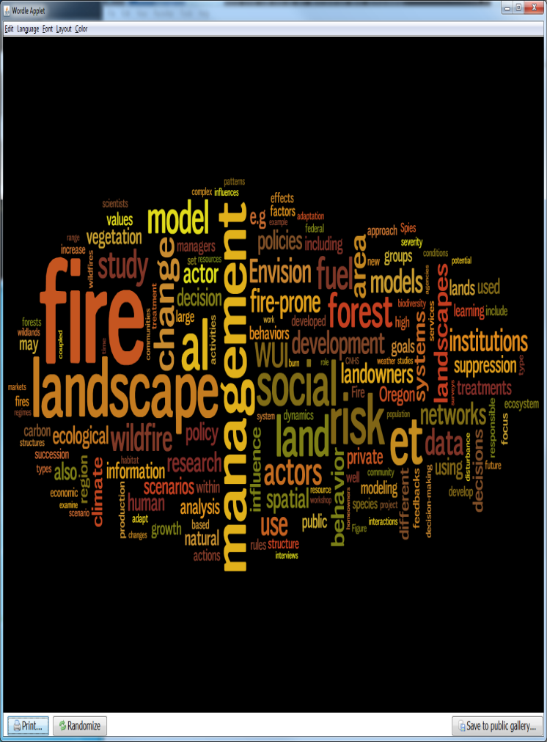
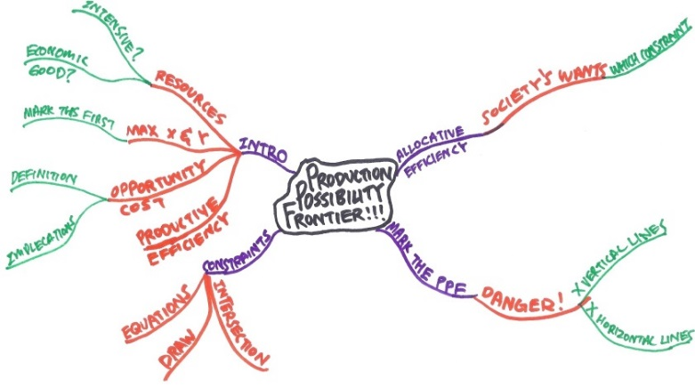
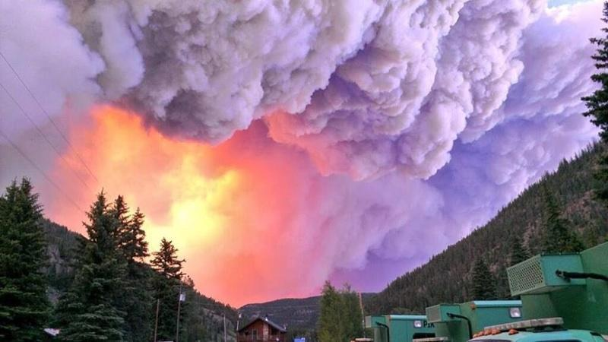
Prioritizing forest restoration investments and understanding management tradeoffs
Alan Ager, Missoula Fire Sciences Lab, Rocky Mountain Research Station, Missoula MT aager@fs.fed.us

Slide 2
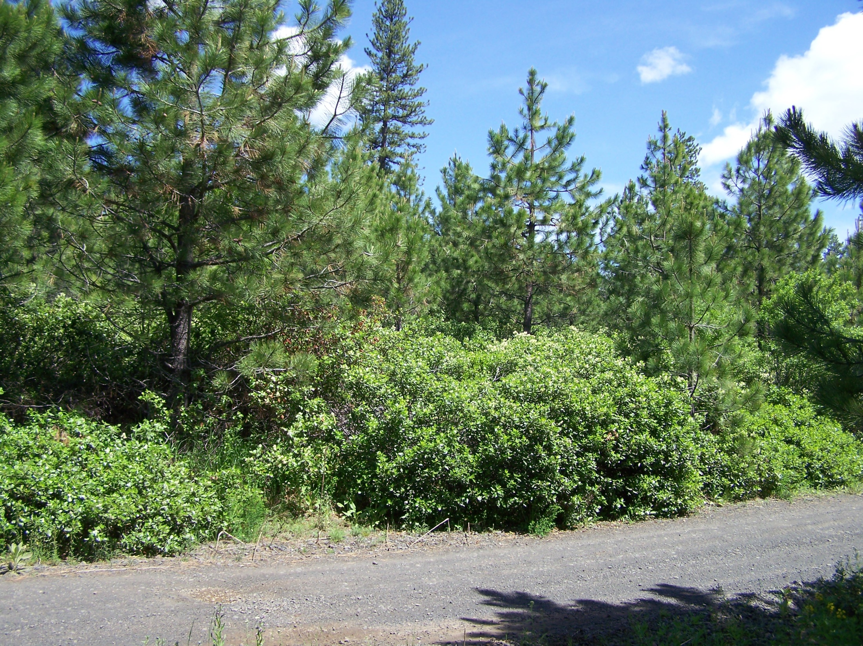
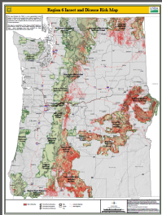
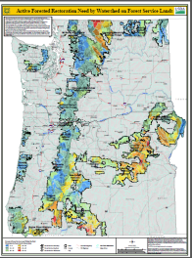
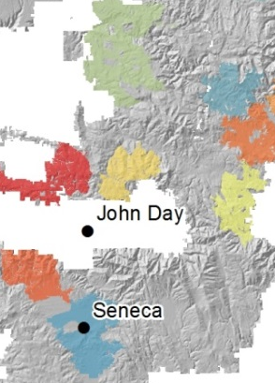
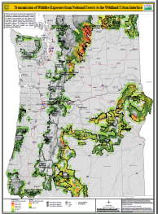
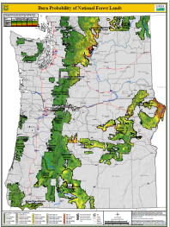
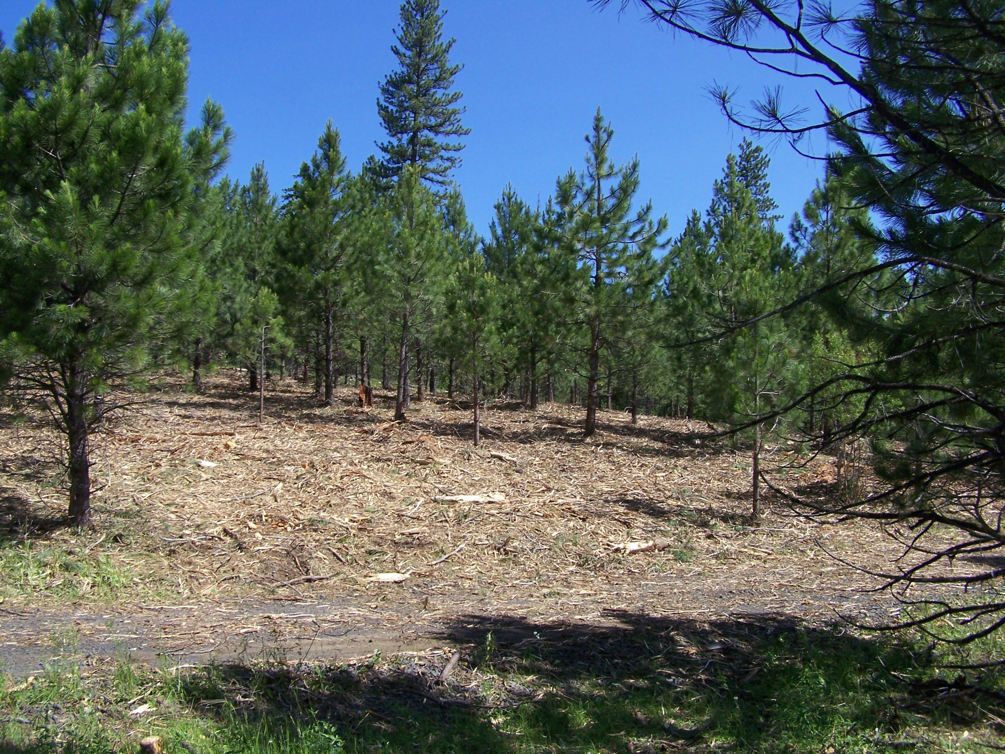
Analytical Gaps
How do we translate assessments into projects and priorities?
Optimal mix of restoration goals?
Unique restoration storylines on different landscapes and forests?

Slide 3
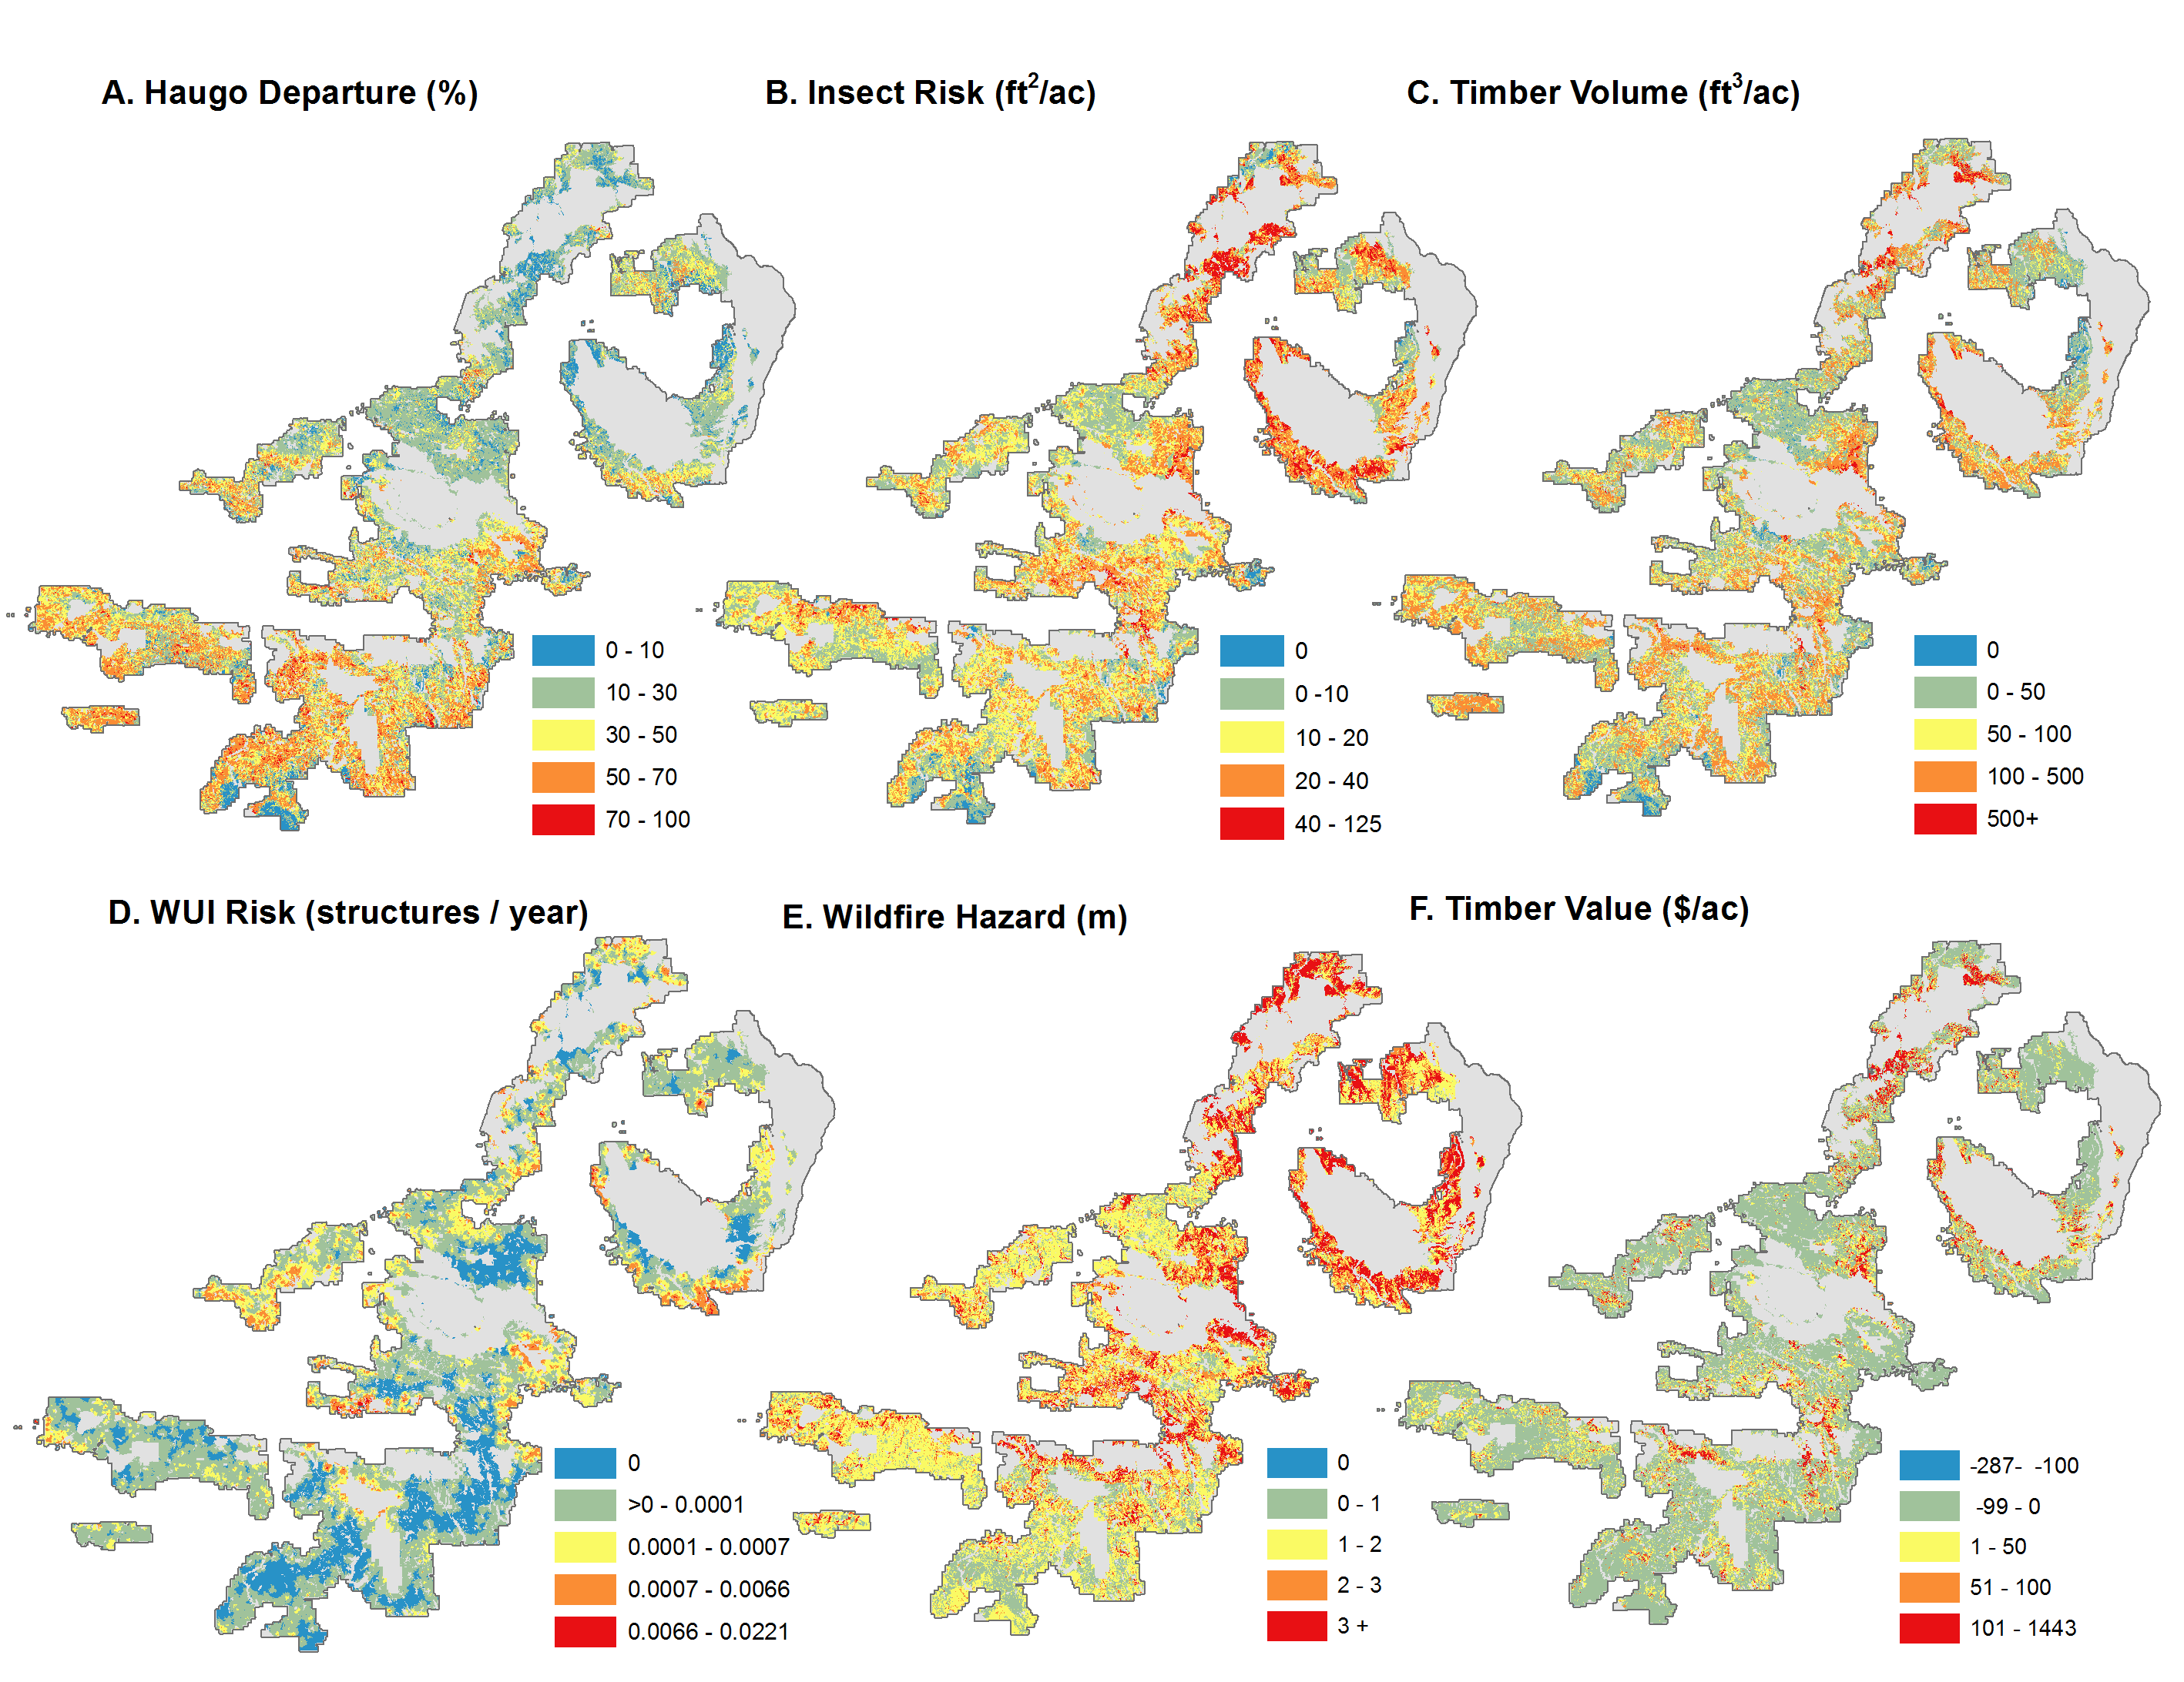
Example restoration objectives

Slide 4
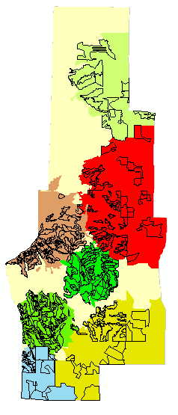
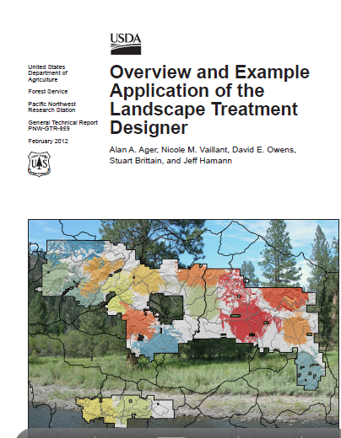
The Landscape Treatment Designer
Translates restoration goals into optimized project areas and treatment units
Multiple scales (stands, watersheds, districts, forests, regions)
Notes:
Spatial optimization tool, exploits landscape varition and patterns and grain

Slide 5
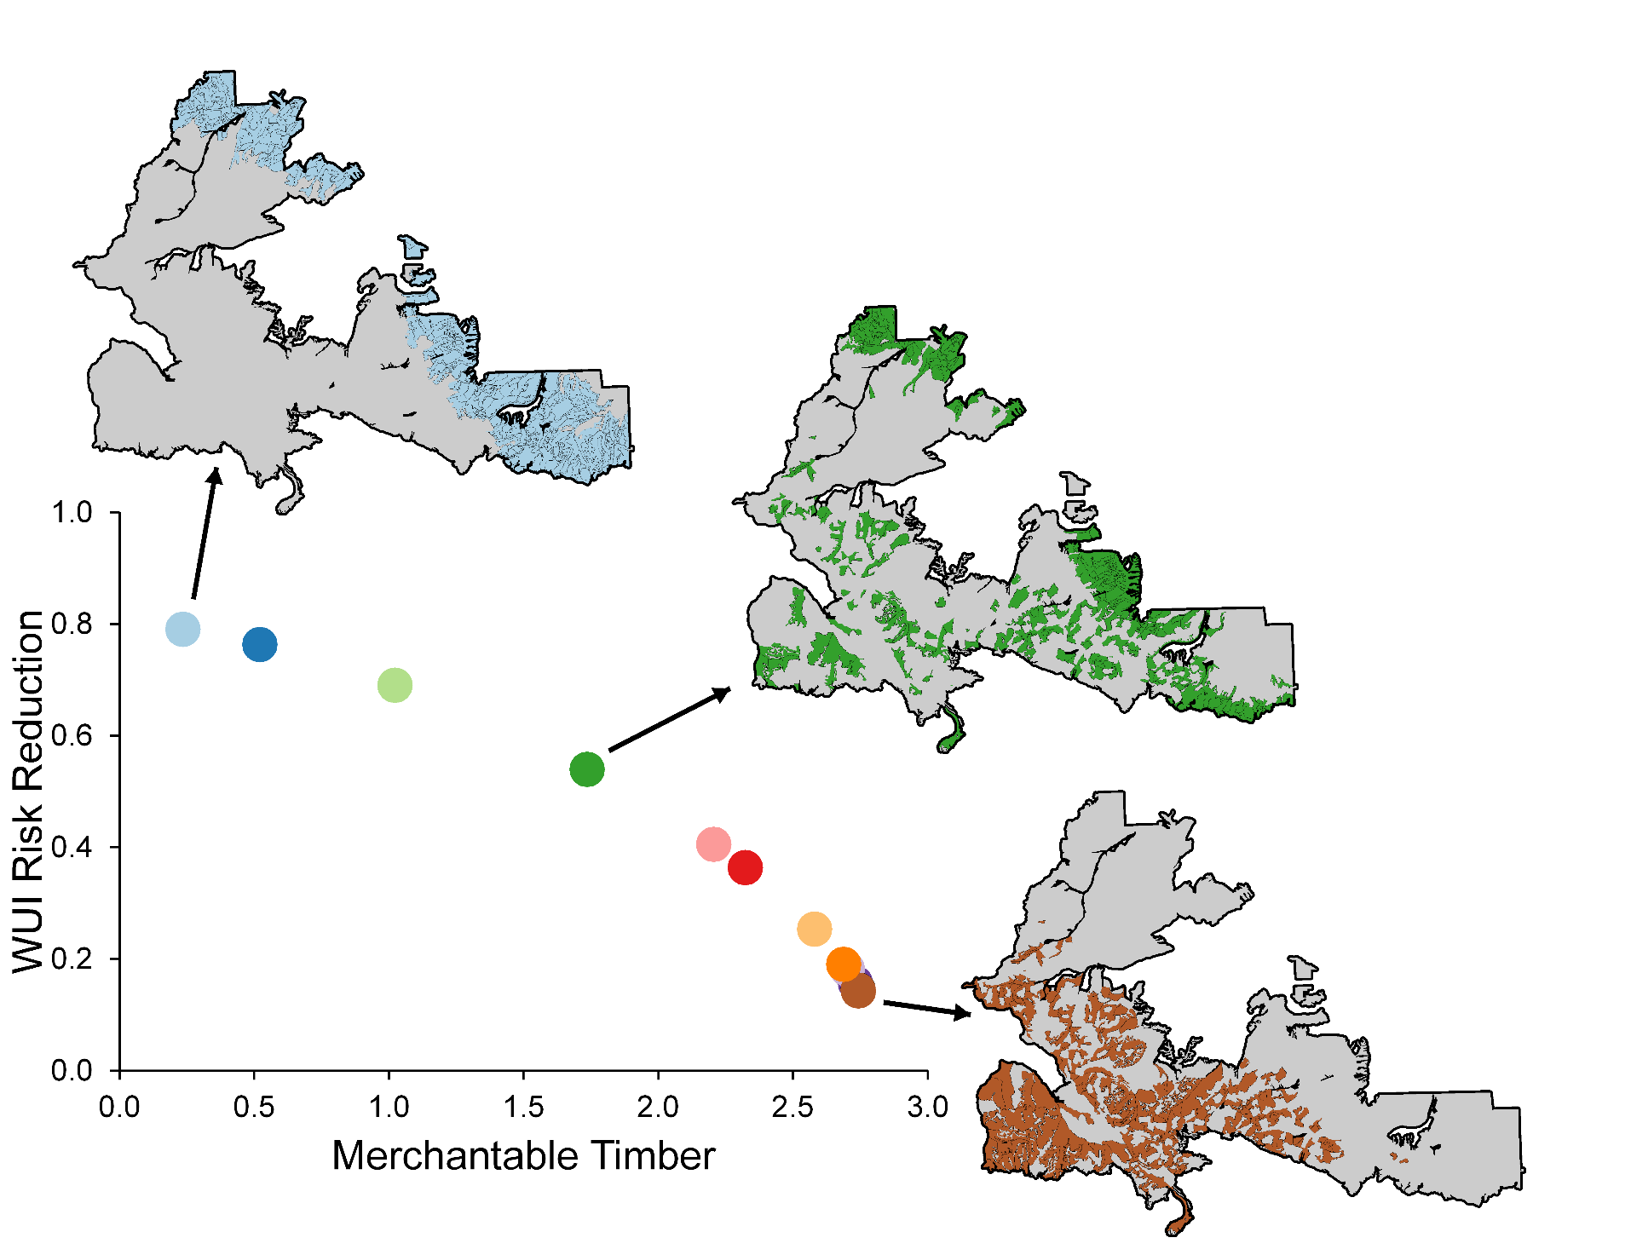
Priorities and tradeoffs
“Production possibility frontier”
Each dot represents a potential project design

Slide 6
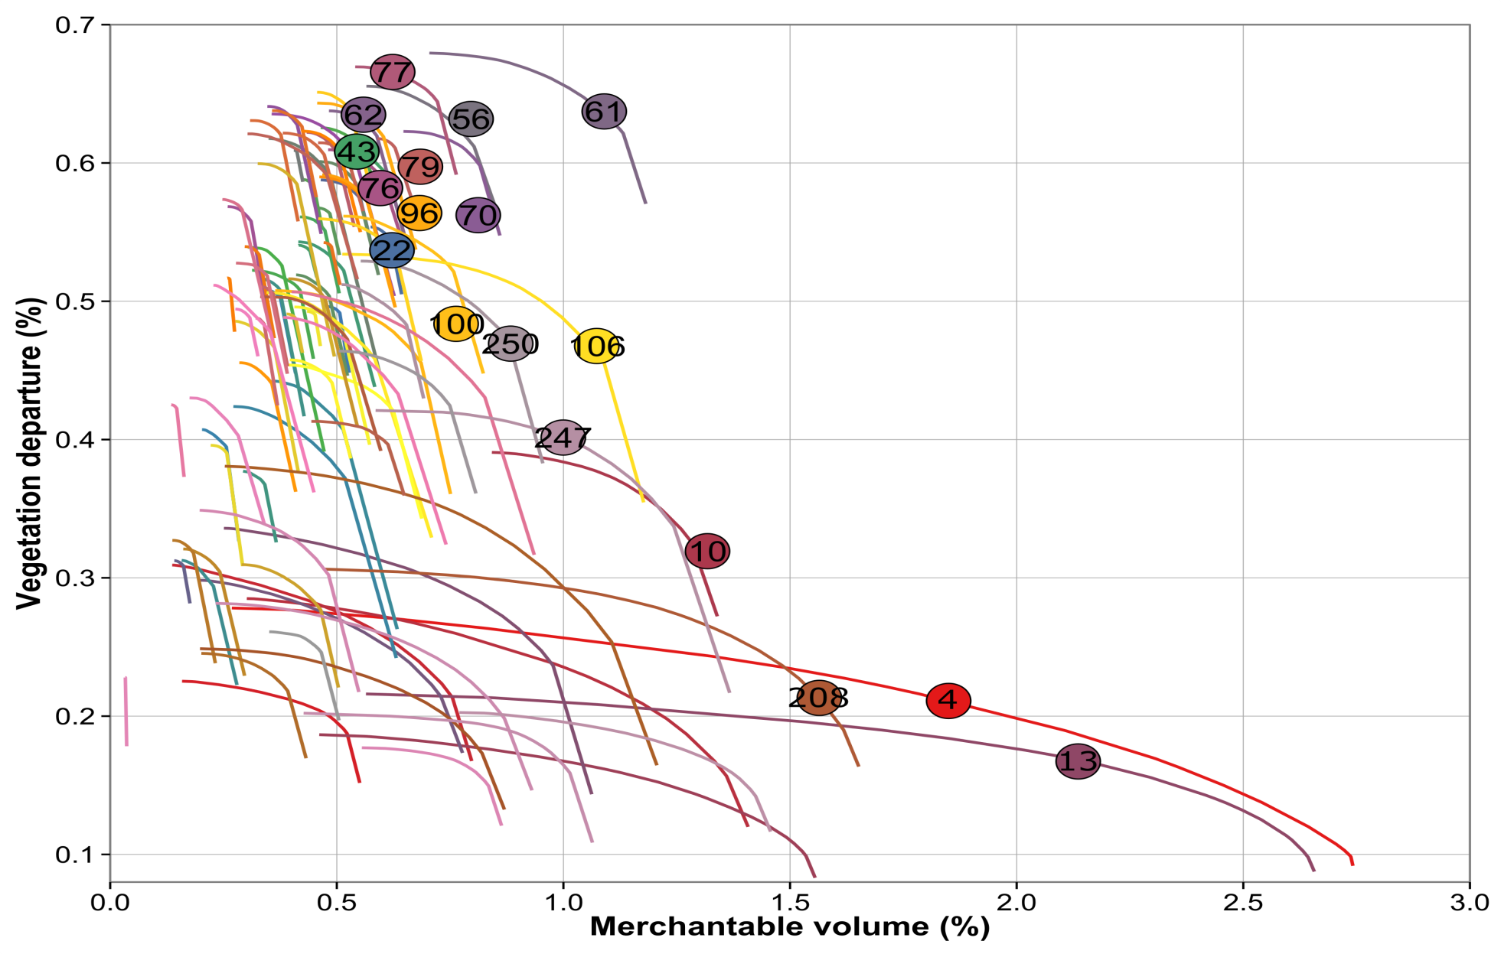
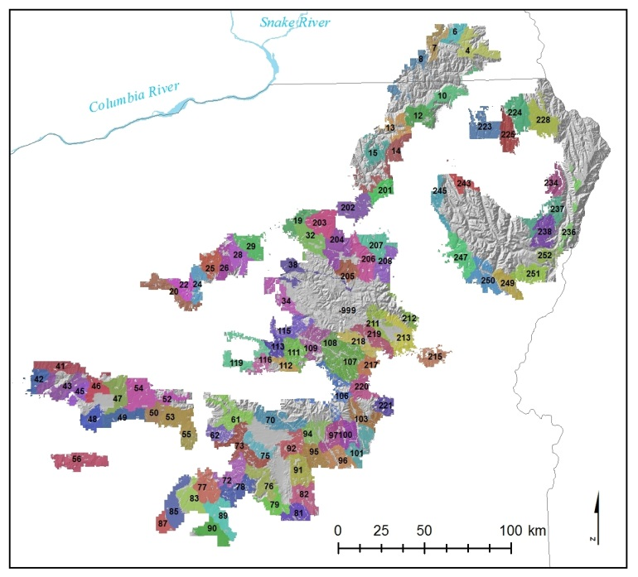
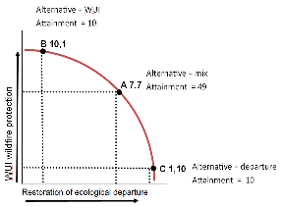

Tradeoffs and priorities by planning area
Blue Mountains NE Oregon
Treatments simulated on 12000 acres per planning area

Slide 7
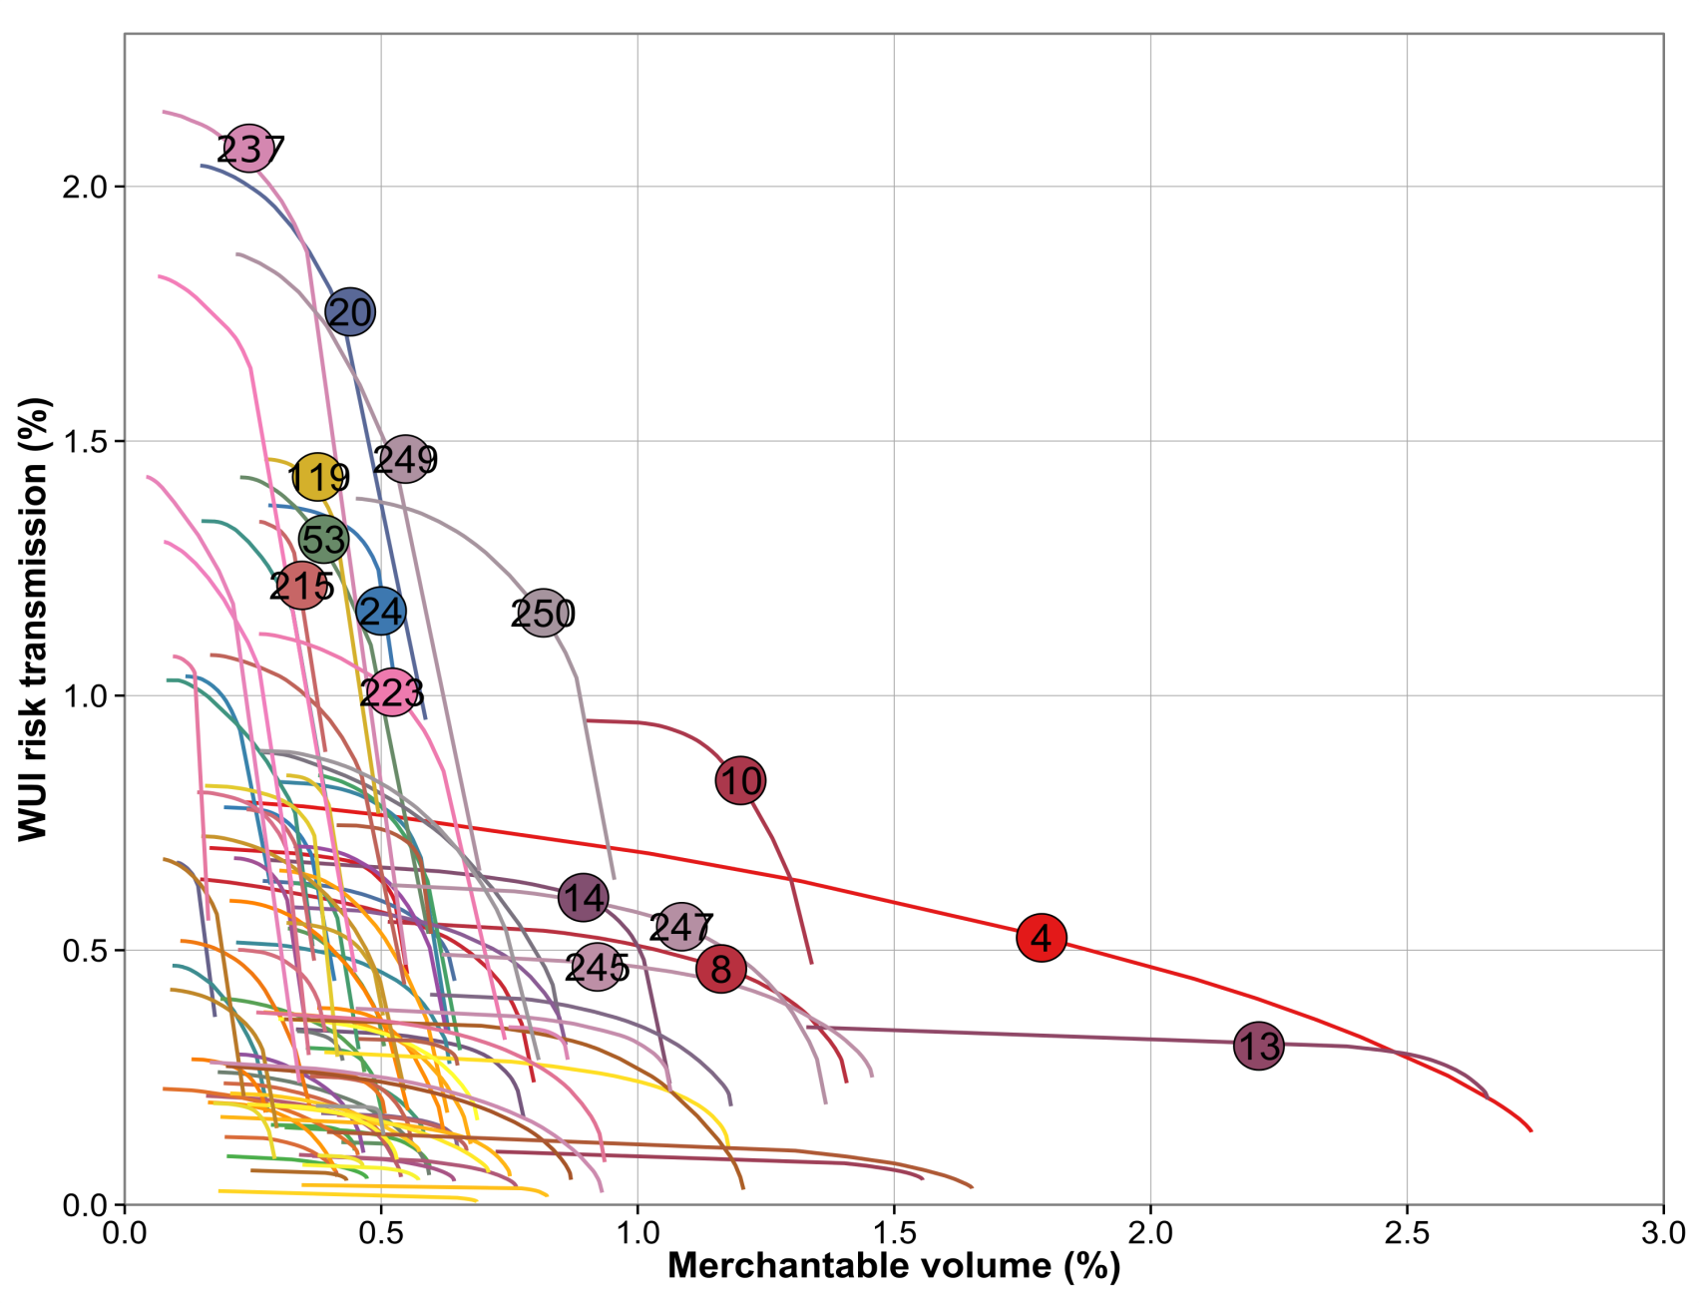
Tradeoffs and priorities by planning area
Blue Mountains NE Oregon
Treatments simulated on 12000 acres per planning area

Slide 8
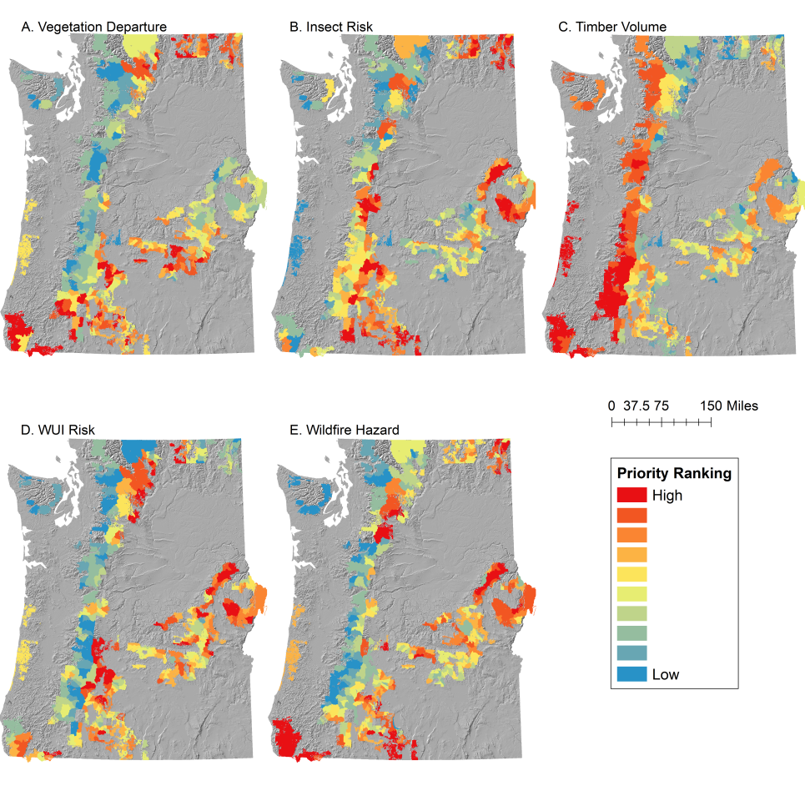
Map of planning areas prioritized for each restoration metric

Slide 9
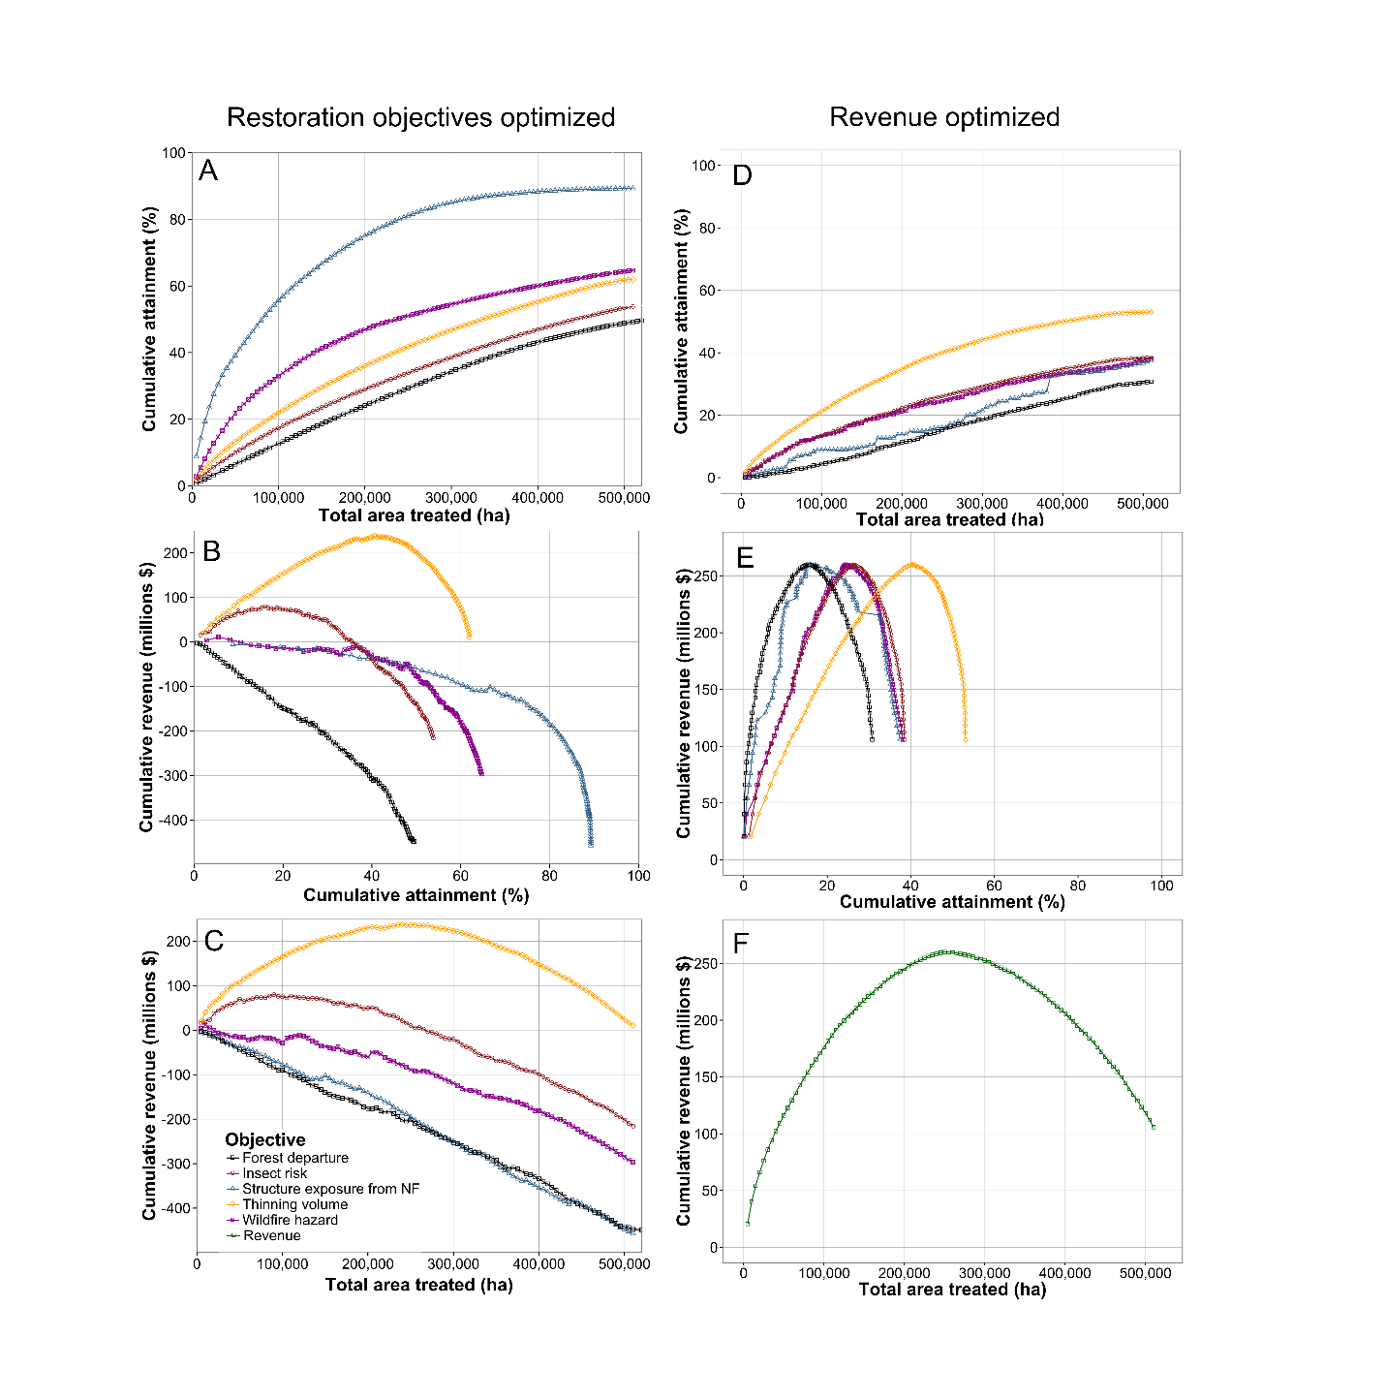
Cumulative revenue from different priorities at increasing scales of treatments
Blue Mountains NE Oregon

Slide 10
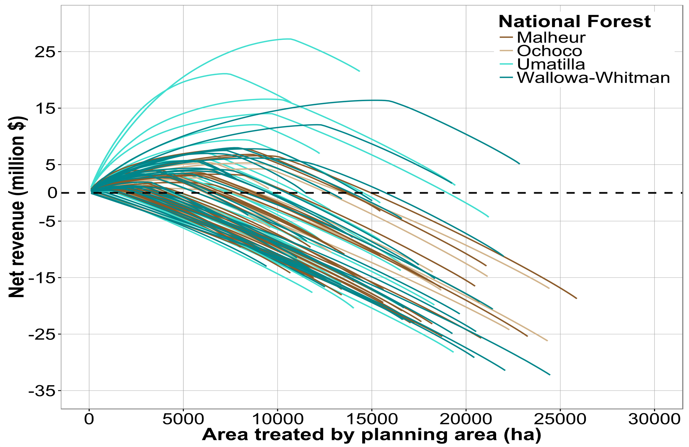
Cumulative revenue by planning area for economic scenario
Planning areas are optimized for revenue under a range of treatment intensities
As stands are added to the project, revenue peaks then declines
Max revenue
Treatments generate revenues
Treatments require investments
Maximum leverage at 0 revenue

Slide 11
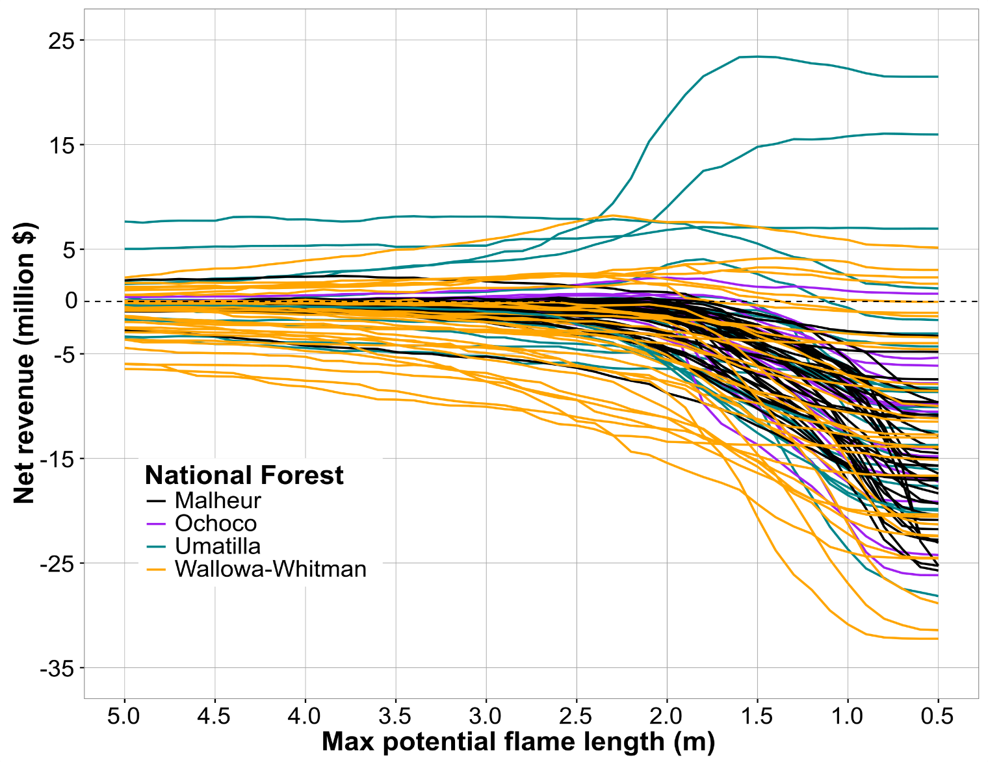
Cost to create fire resilient planning areas
Post treatment max flame length

Slide 12
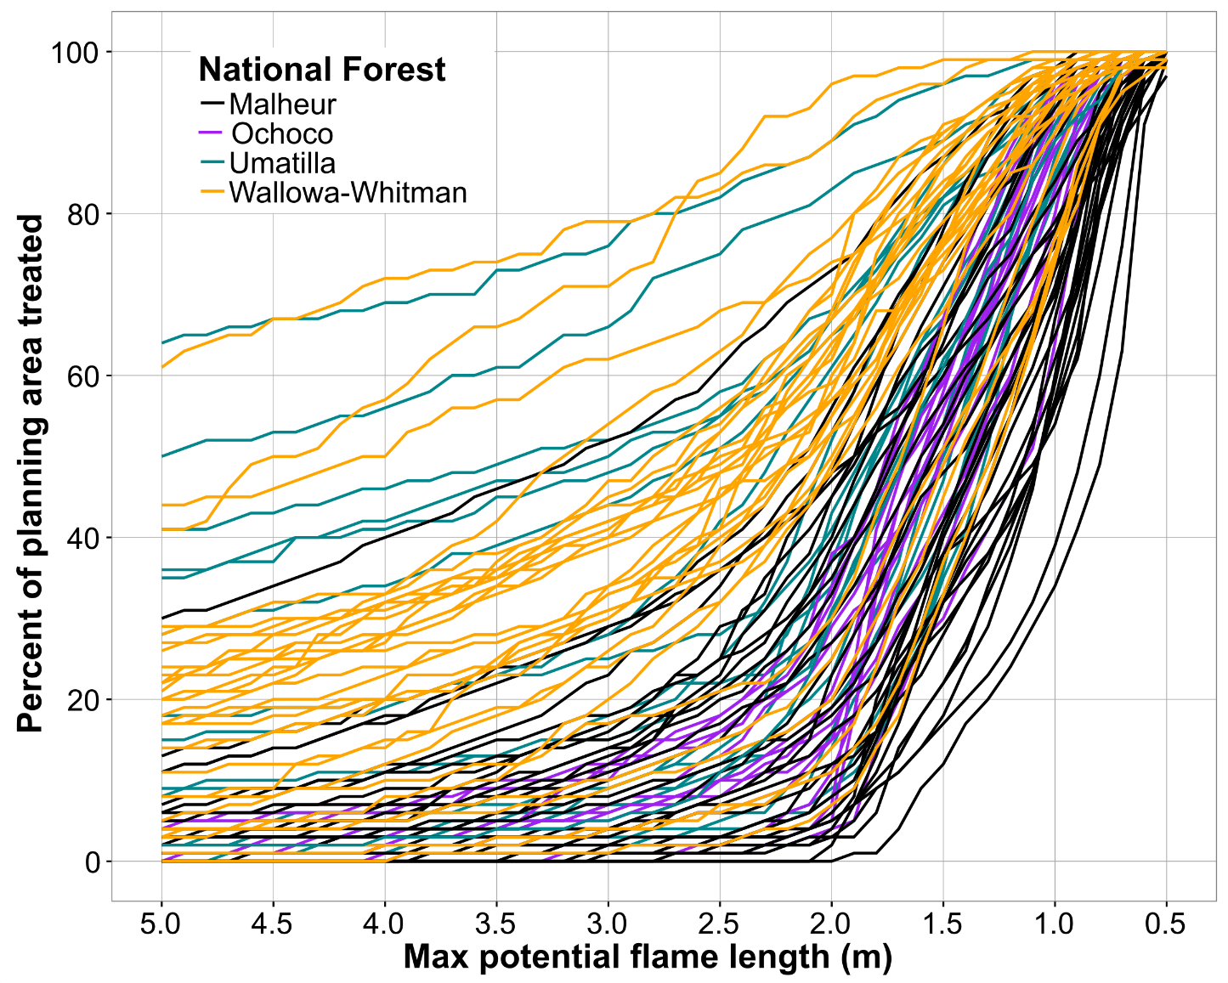
Treatment area to achieve fire resiliency
Post treatment maximum flame length

Slide 13
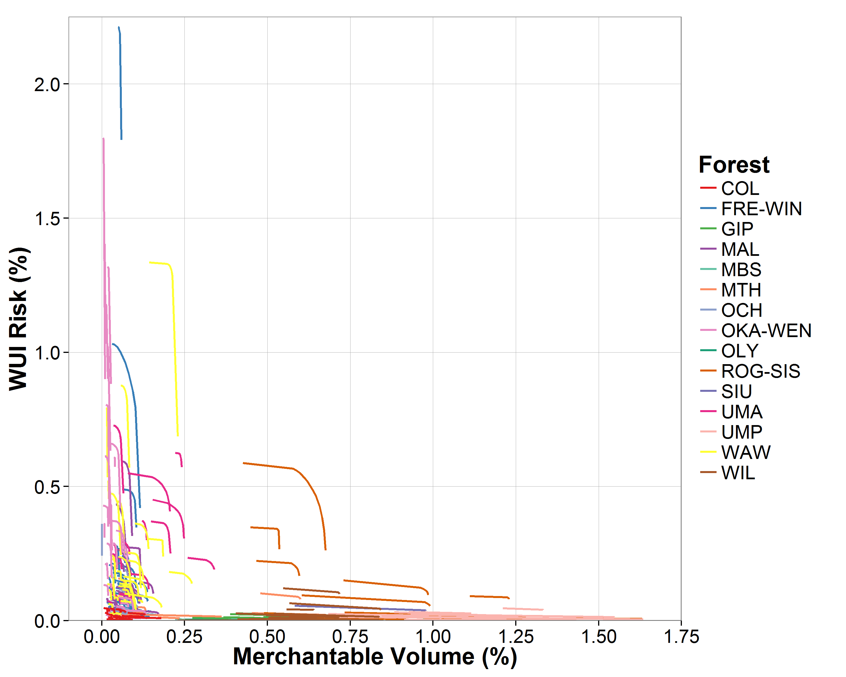
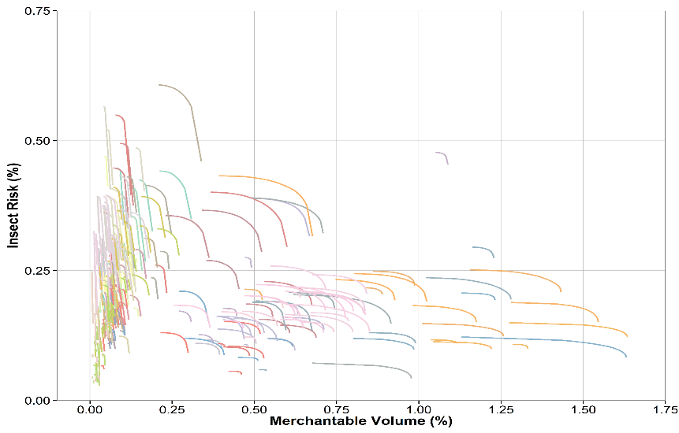
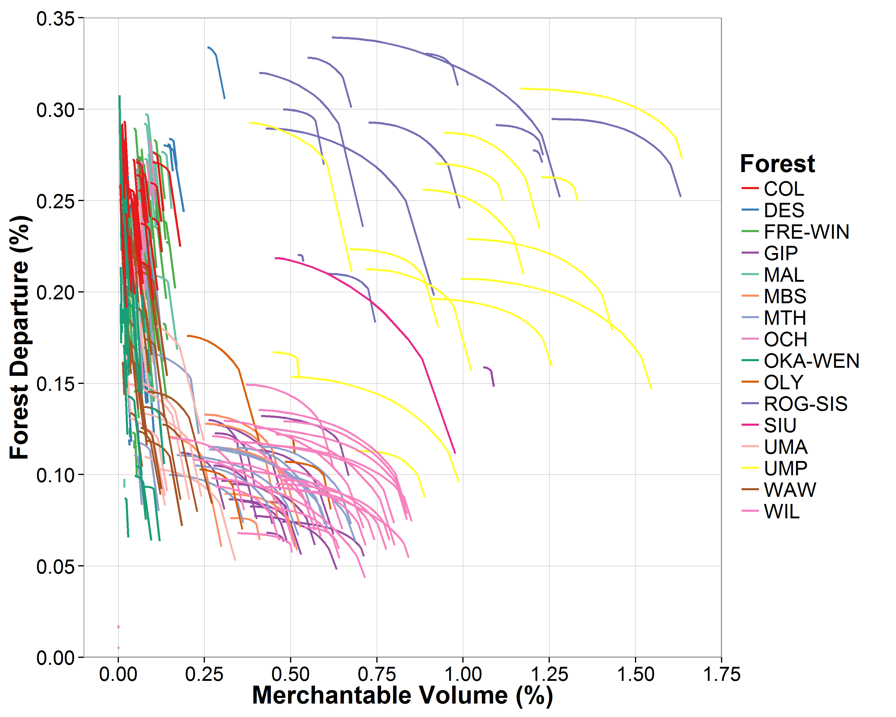
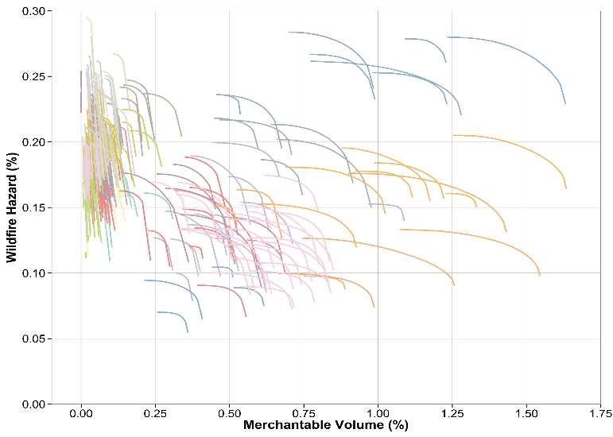
Scaling up to PNW region
Tradeoffs exist at multiple scales – planning areas, forests, regions.
367 planning areas

Slide 14


Slide 15
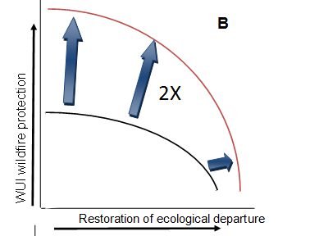
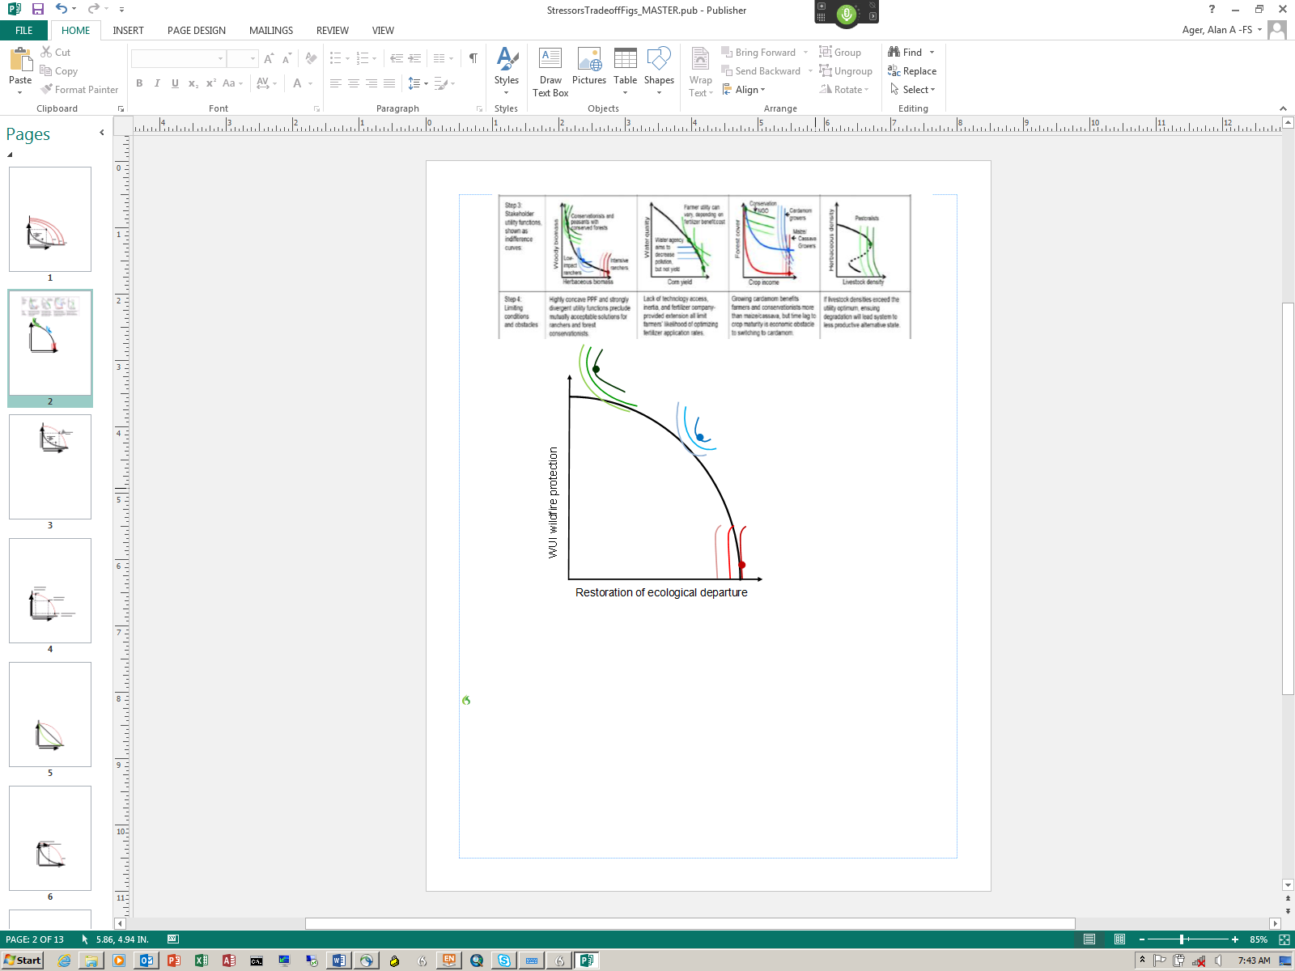
Application and future work
  Prioritization case studies at different scales
  Restoration storylines for each national forest
  Test pace and scale assumptions in national assessments
  Analyze economic leverage to increase scale with re-investment strategies
  Optimal strategies for building fire resilient landscapes for beneficial fire
  Facilitate dialog about tradeoffs
    Compare stakeholder preferences with production frontiers
Shortages change tradeoffs
Stakeholder preferences and production frontiers define feasible outcomes

Slide 16
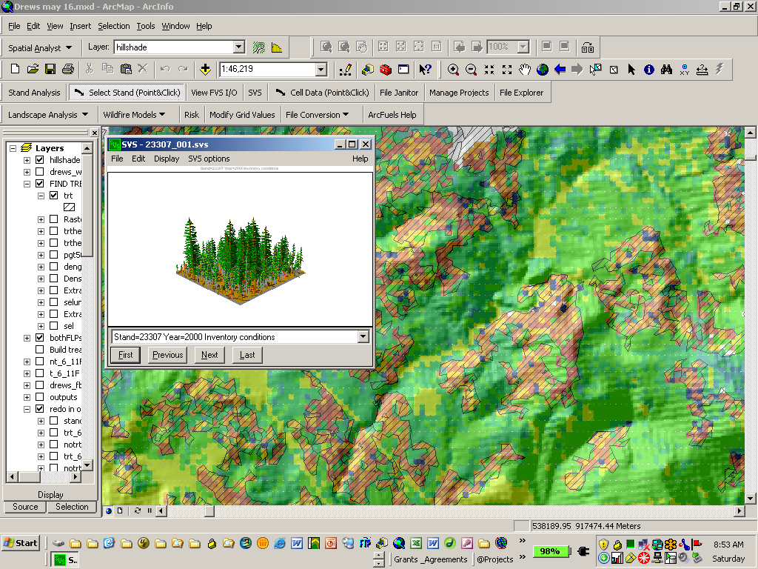
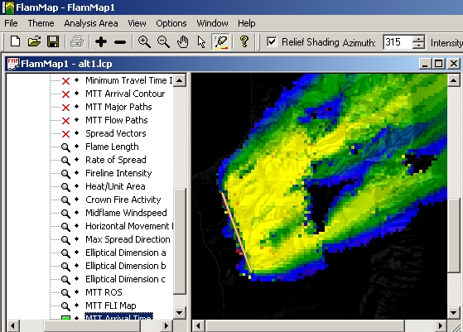
ArcFuels

Slide 17
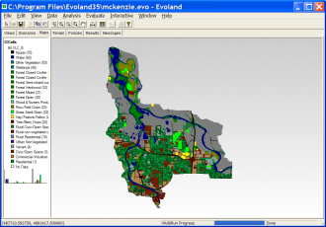
Agent-based landscape modeling – Envision
Actors
Decision-makers managing the landscape by selecting policies responsive to their objectives
Landscape Production Models
Ecosystem Service & Economic Productions
Landscape
Feedbacks
Multi-agent
Decision-making
Select policies and generate land management decision affecting landscape
Scenario
Definition
Policies
Constraints and actions defining land use management
Autonomous Change Processes
Succession, wildfire, climate change

Slide 18
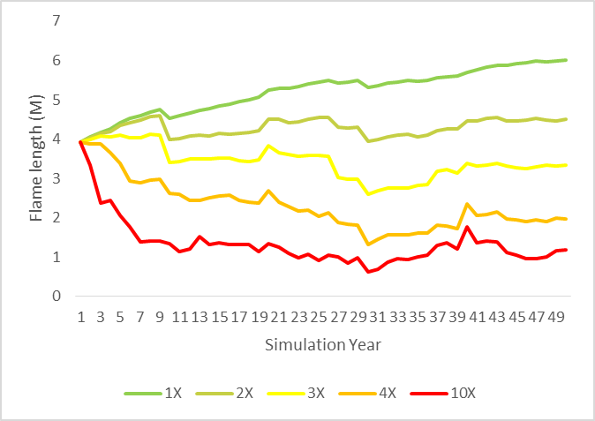
Change in fire intensity over time from increasing levels of fire

Slide 19
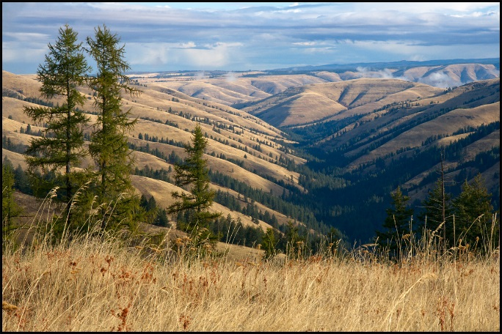
Additional information
Ager, A.A., Day, M, Vogler, K. 2016. Production possibility frontiers reveal socioecological tradeoffs for restoration of fire adapted temperate forests. Journal of Environmental Management 176 (2016) 157-168
Vogler, K, Ager, A.A., Day, M. Bailey, J. 2015. Prioritization of forest restoration projects: tradeoffs between wildfire protection, ecological restoration and economic objectives. Forests: 4403-4420
Ager, A. A., N. M. Vaillant, and A. McMahan. 2013. Restoration of fire in managed forests: a model to prioritize landscapes and analyze tradeoffs. Ecosphere 4:1-19.
Ager, A. A., N. Vaillant, D. E. Owens, S. Brittain, and J. Hamann. 2012. Overview and example application of the Landscape Treatment Designer. Gen. Tech. Rep. PNW-GTR-859, USDA Forest Service, Pacific Northwest Research Station, Portland, OR.
Photo by Miles Hemstrom

Slide 20

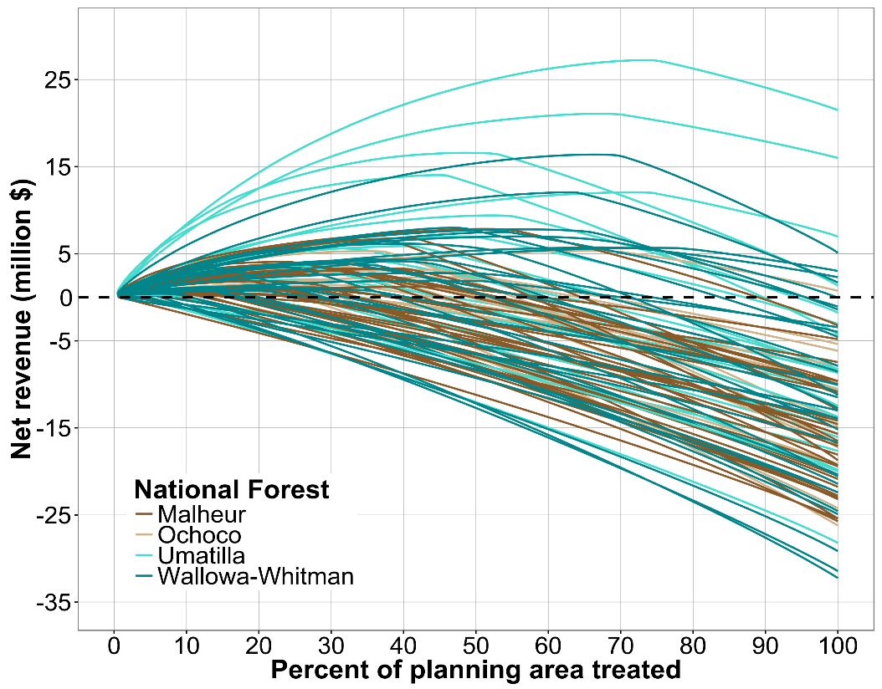

Slide 21
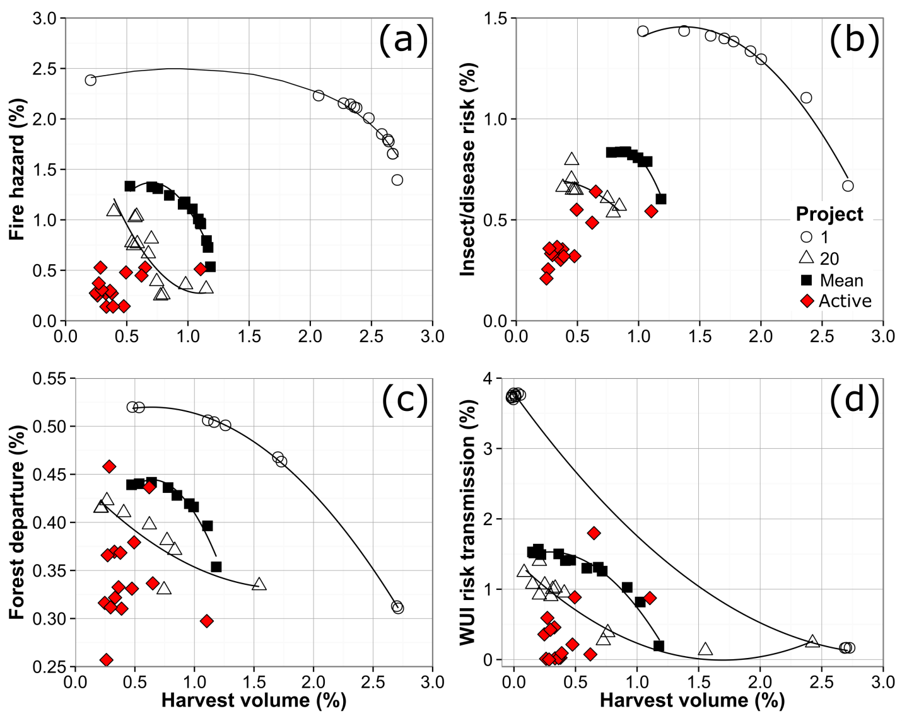
Efficiency of current restoration
PPF’s for the top and 20th project (and mean of top 20) compared to actual projects.

Slide 23
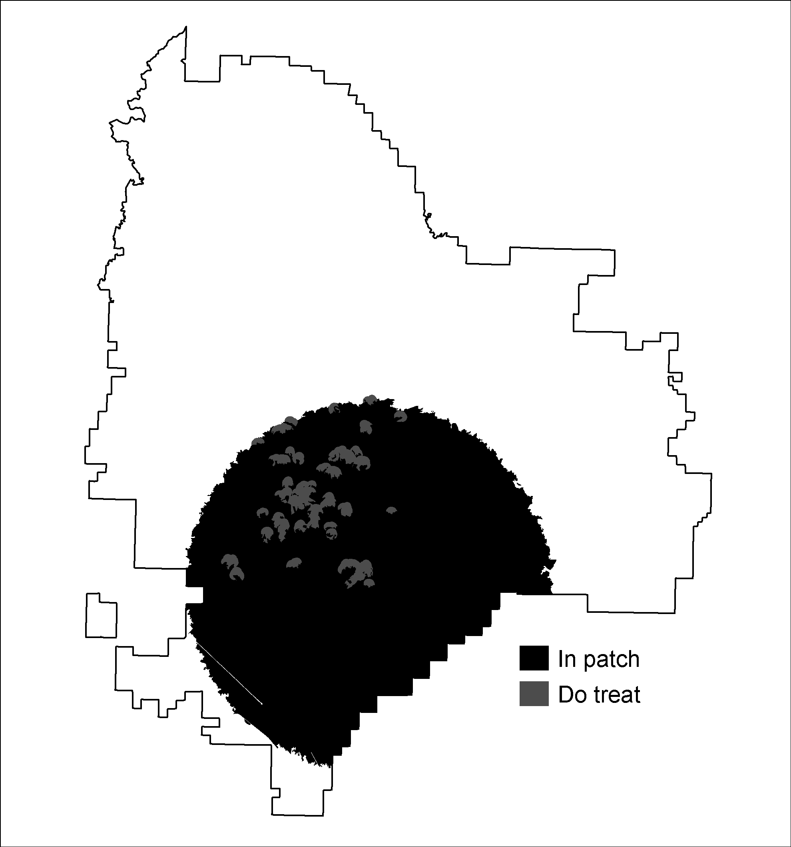
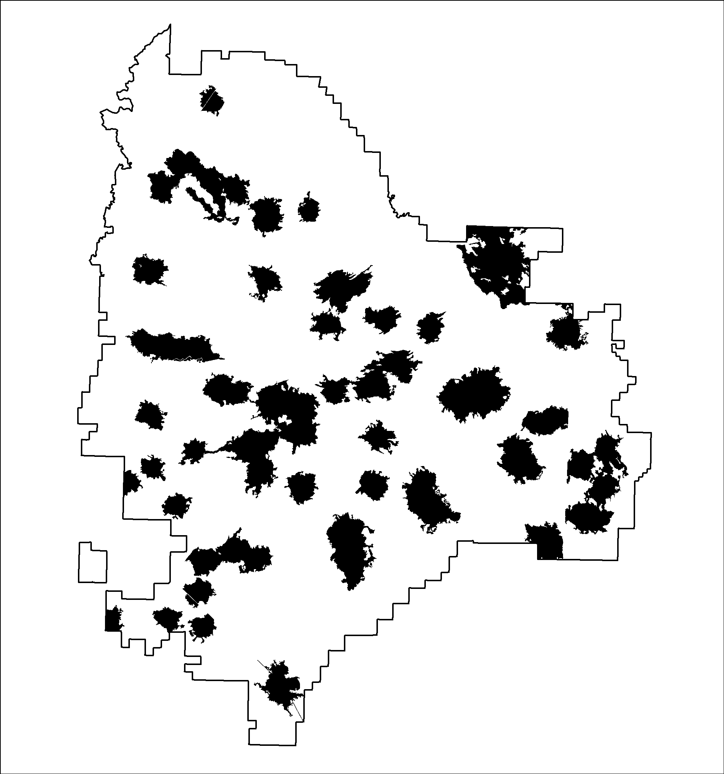
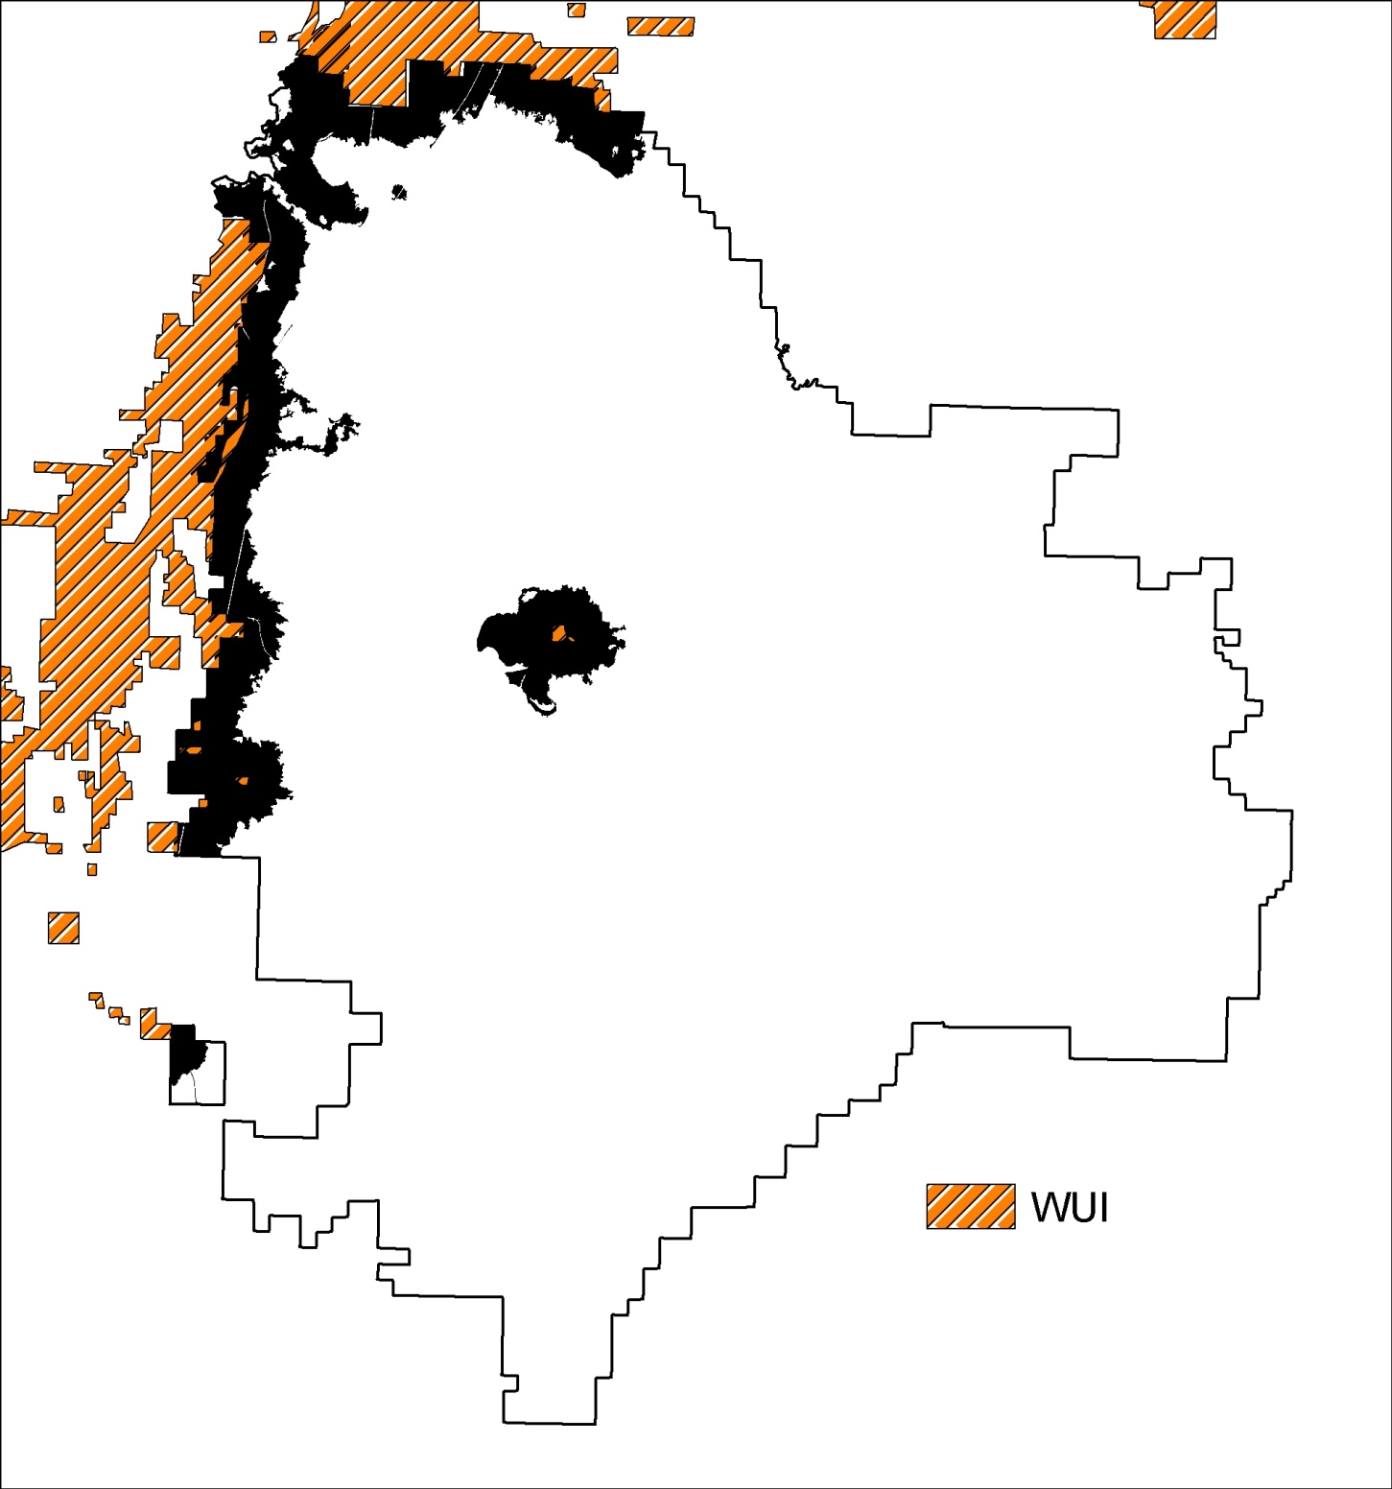
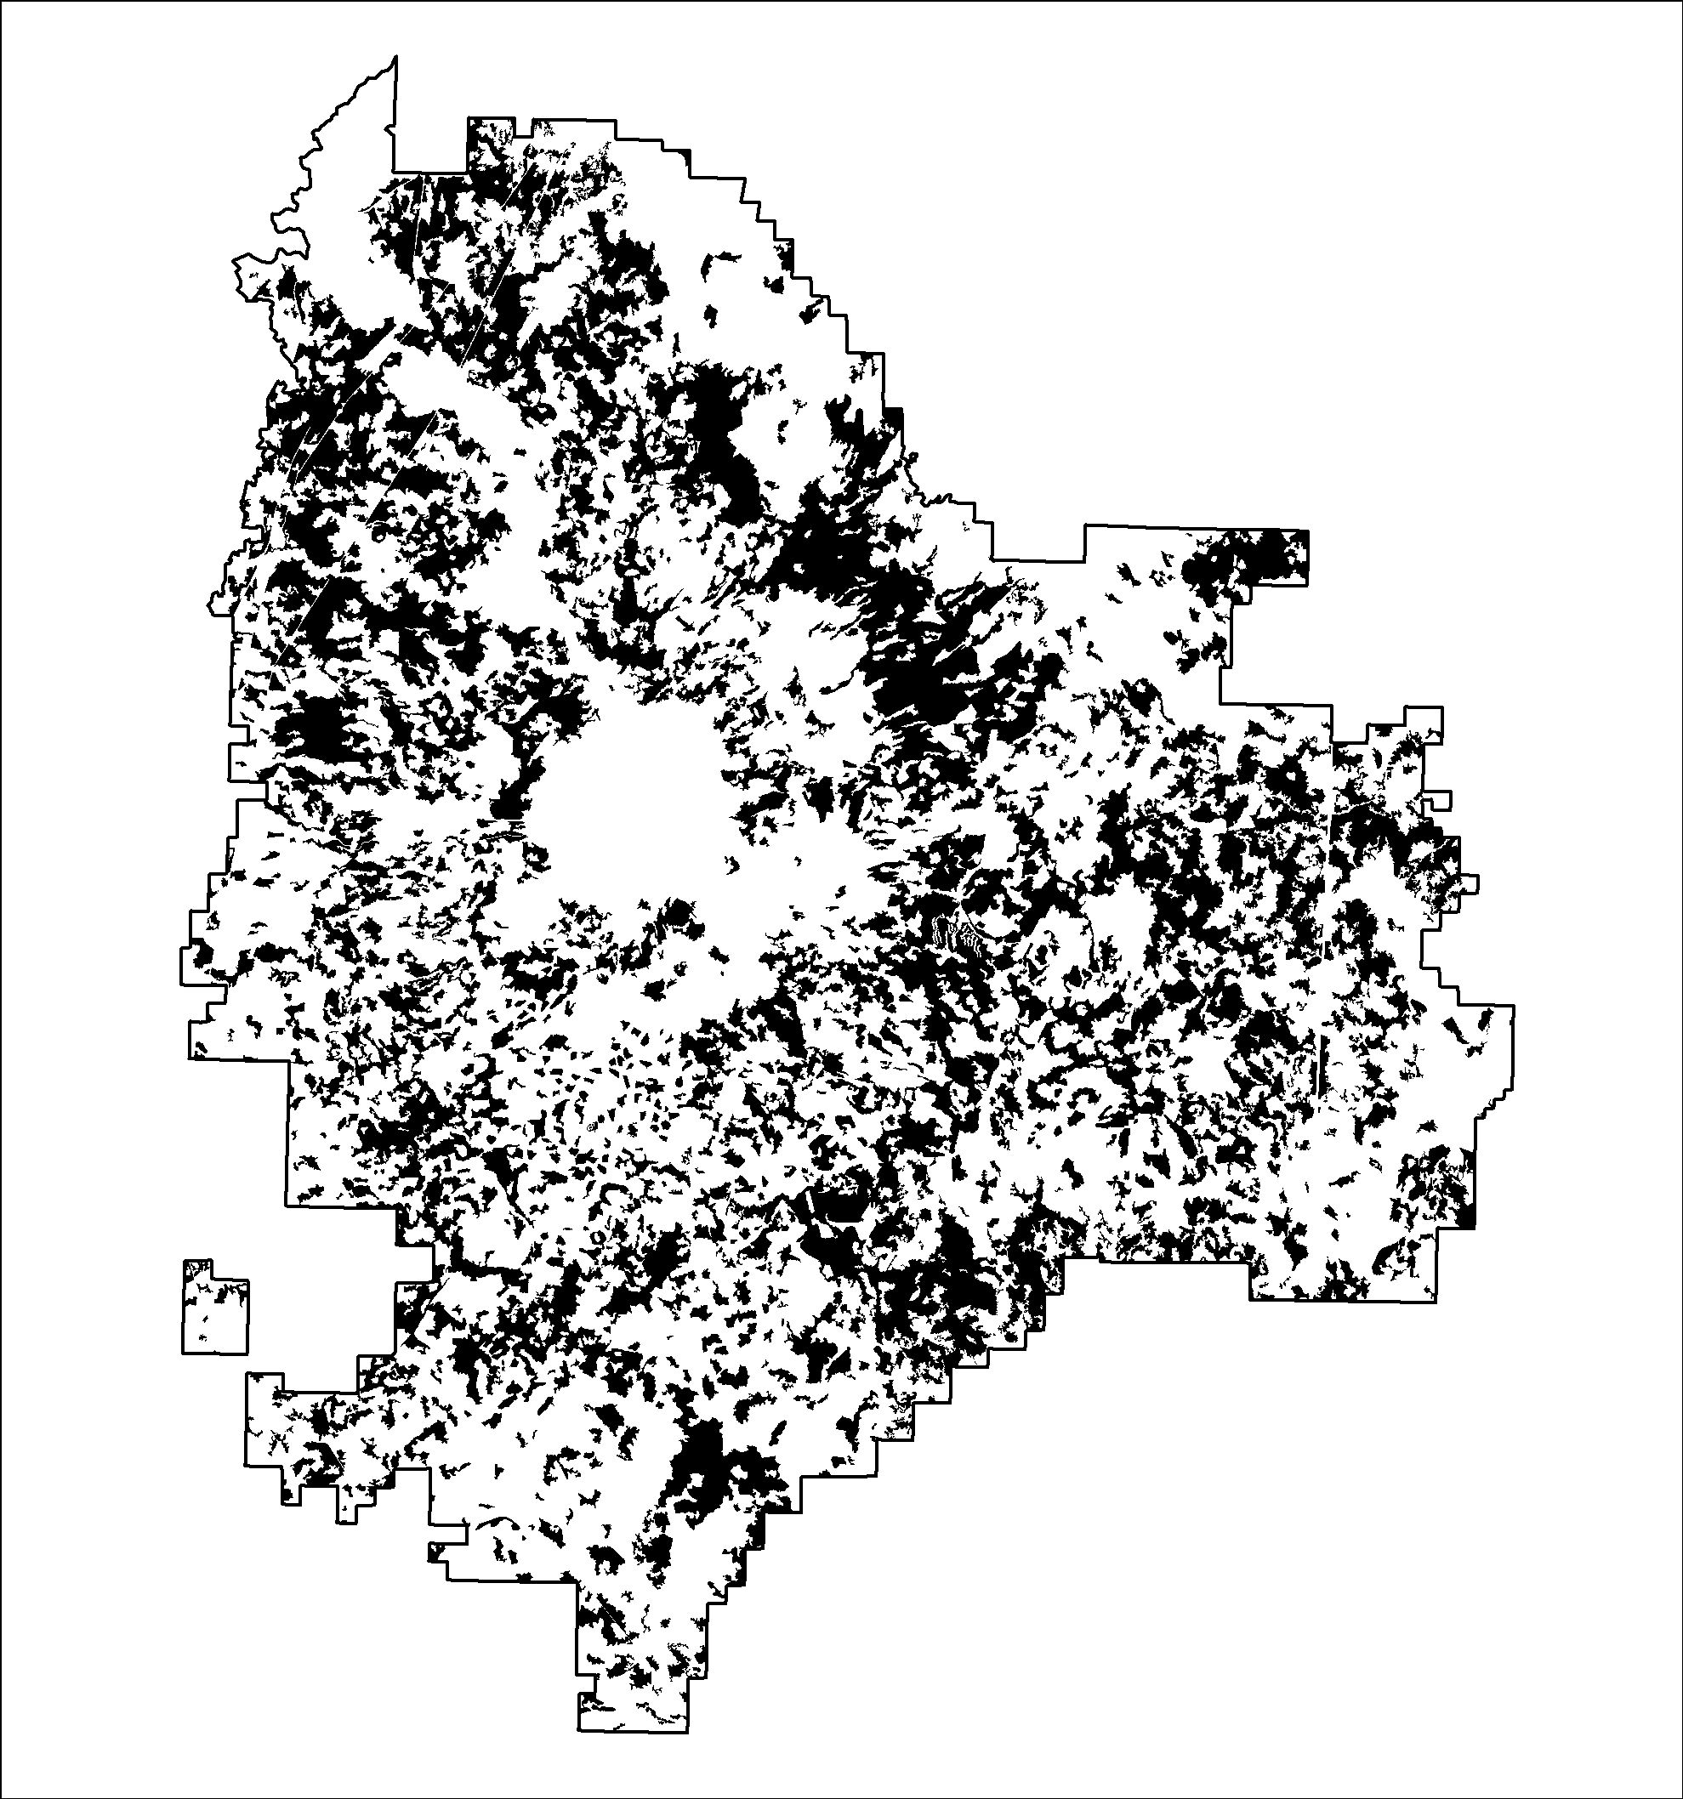
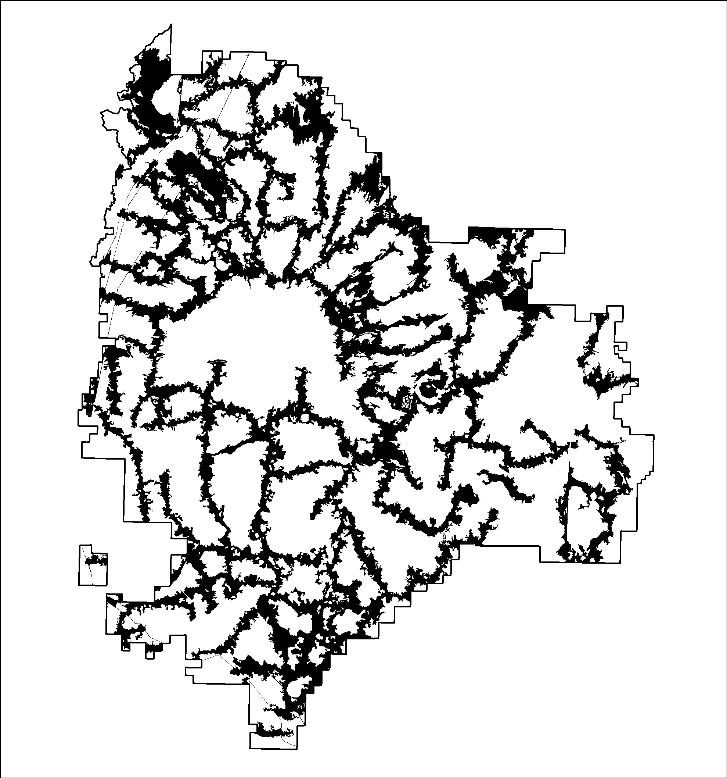
Landscape treatment patterns
Fire resilient landscapes Fire adapted communities Wildfire response
Restoration Protection Containment
Low hazard fire containers
Strategic
Restoration of natural
fuel breaks
Focused defensible fuel breaks
Treatment optimization model
Dispersed fuel breaks
High hazard
fire containers
WUI
Black polygons represent treatment units

Slide 24
