Slide 1
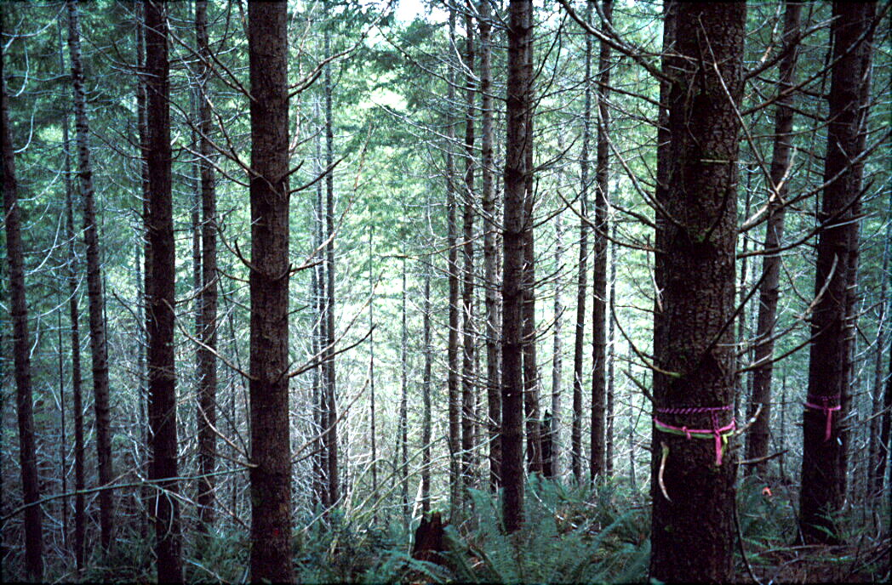
Effects of Thinning on Production of Dead Trees and Stand Structure
Michael Pollock, NOAA-NWFSC
Thomas Spies, Forest Service, PNW Research
With special thanks to:
Rob Pabst, Oregon State University
Stuart Johnston, Siuslaw NF

Slide 2
What are the effects of thinning in plantations?
Dead tree production following thinning
Size of future dead and live trees
Different thinning prescriptions including no thinning
Different stand simulation models

Slide 3
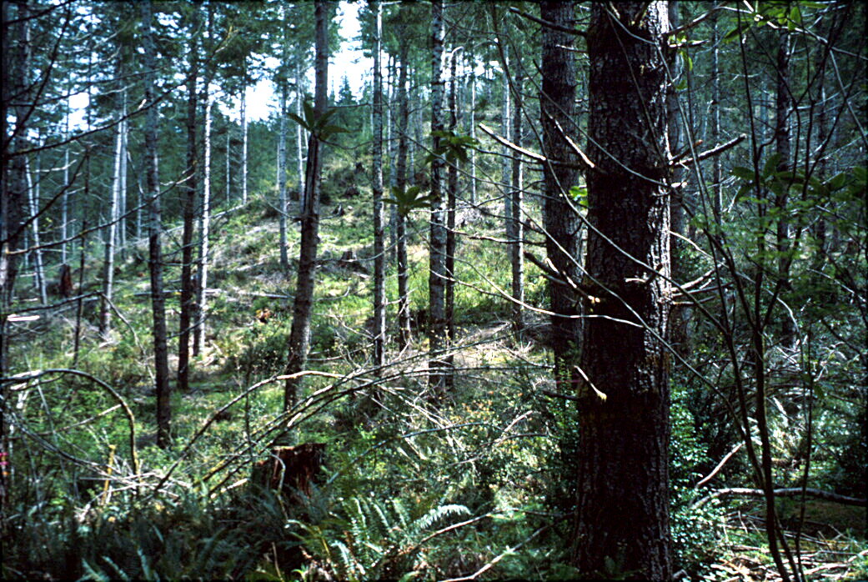
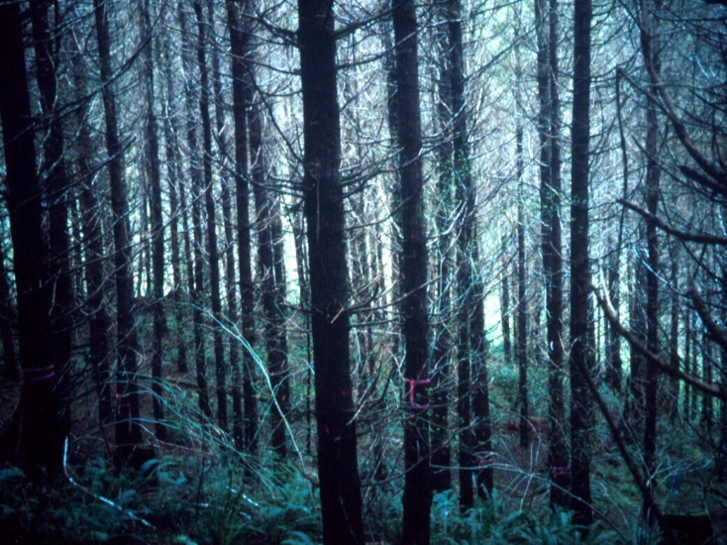
What do different stand densities look like?
100 tpa (247 tpha)
60 tpa (150 tpha)
225 TPA (555 tpha)
Courtesy Stu Johnston

Slide 4
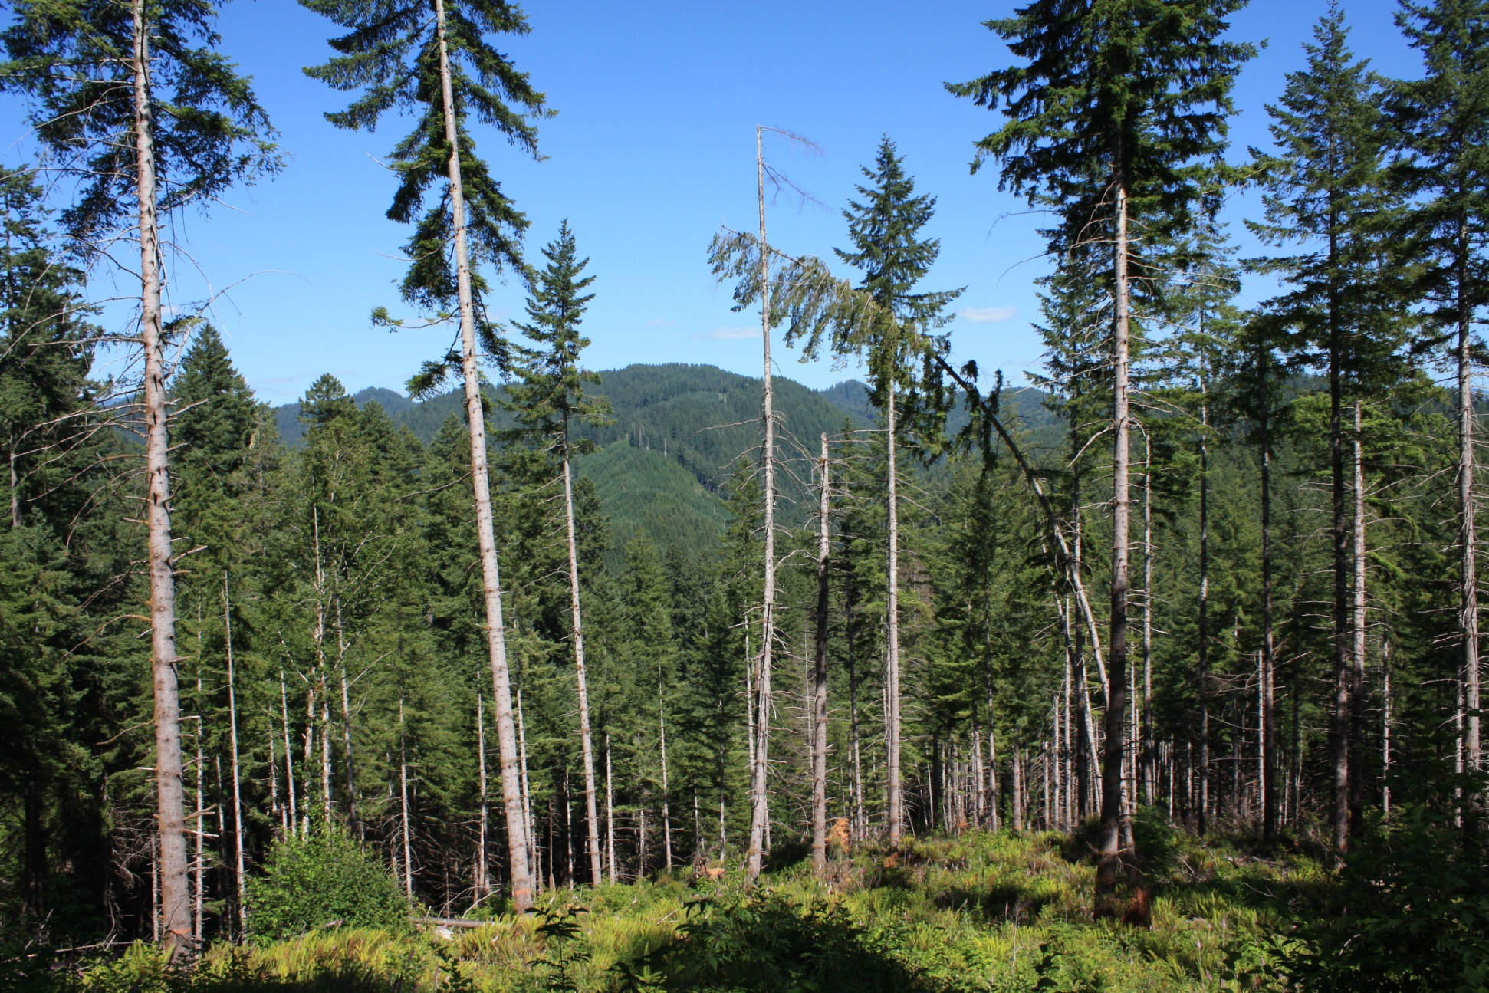
Effects of Thinning on Forest Structure
Notes:
A typical thinned forest in the Siuslaw National Forests, where on average 3 out of 4 trees are removed, an improvement over clearcuts, where 4 out of 4 trees are removed.

Slide 5
Distribution of stand densities, before (circles) and after (triangles) restoration treatment
Note that no high density stands were modeled
Grey squares are stands modeled
Notes:
From the SNF East Alsea Landscape Management Plan. Circles are before treatment, triangles are after treatment. Gray squares are the seven stands for which the SNF provided detailed stand exam data, and these were the seven stands that were modeled in the thinning simulations. Note that the stands modeled are not particularly high density stands. It would be helpful to have data from higher density stands

Slide 6
Model calibration against reference stands
Notes:
We used FVS and calibrated to stands from the SNF obtained from the FIA database. Overall a pretty good fit, though the modeled trees grow a bit taller than the average natural stand, though still within the natural range

Slide 7
Effects of thinning on mortality rates
Peak mortality (dead wood production) occurs early in forest development
Notes:
A lot of data here, but it helps to focus on the difference between the No Thin Control (NTC) and the 150 TPH (60 TPA) thin. Key points ar that the thinning causes substantial reductions in the production of >30 cm and > 50 cm size classes of dead trees. Also important to note that peak mortality occurs fairly early on in the development of a forest. At year 0 the stands are about 40 years old, so the peak in > 30 cm production occurs at stand age 50 and the > 50 cm production occurs at about stand age 60-70.

Slide 8
Effects of thinning on mortality, trees > 50 and > 100 cm dbh
196 for NTC vs. 90 for 150 TPH thin
Notes:
Thinning to 150 TPH (60 TPA) reduces deadwood production of trees > 50 cm to about half of what would occur under natural conditions (from 250 TPH down to 127 TPH), while there are minimal differences on the effect of deadwood production for trees > 100 cm. Production of trees this large are relatively low, whether or not thinning occurs.

Slide 9
Effects of thinning on live trees, > 50, 100 and 150 cm dbh
99 for 150 TPH thin vs. 78 for NTC
89 for NTC vs. 55 for 150 TPH thin
34 for 150 TPH thin vs. 18 for NTC
Notes:
Thinning creates a short-term acceleration in the development of trees > 50 cm (e.g. at year 20, the 150 TPH thin has 99 TPH > 50 cm versus 87 TPH for the No Thin Control). However, by year 70, the NTC has 119 TPH > 50 cm, whereas the 150 TPH thin has 78 TPH > 50 cm. So in terms of > 50 cm live tree production, thinning creates small short-term gains, but also creates larger longer term losses.
For live trees > 100 cm dbh, the 150 tph thin quickly creates more of these very large trees relative to the no thin control, and this benefit persists through year 140, after which point the NTC contains more live trees > 100 cm dbh.
For live trees > 150 cm, very few of them are produced regardless of the degree of thinning and they don’t begin to appear until about 140 years after thinning, but the 150 TPH produces the most of this size class of trees (10.5 TPH versus 6.5 TPH at year 200).

Slide 10
“Functional” sizes of snags
Notes:
This is 1 of 4 slides showing the size ranges of live wood and dead wood in streams, dead wood on the forest floor and snags that are utilized by various vertebrate species. Note that many species utilize dead wood between 30-100 cm, the size range most effected by thinning.

Slide 11
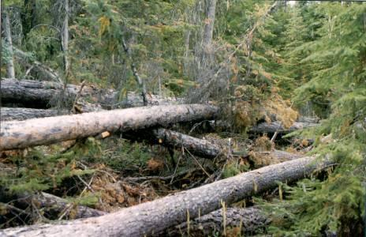
Unconventional Thinning Accelerate Wood Recruitment Leave some or all of tree boles in riparian area for ecological objectives
Can accelerate production
and accumulation of
dead trees by many times
over unthinned stand
during the first 50 years
Effect mainly for trees
< 20 inches dbh
100 TPA

Slide 12
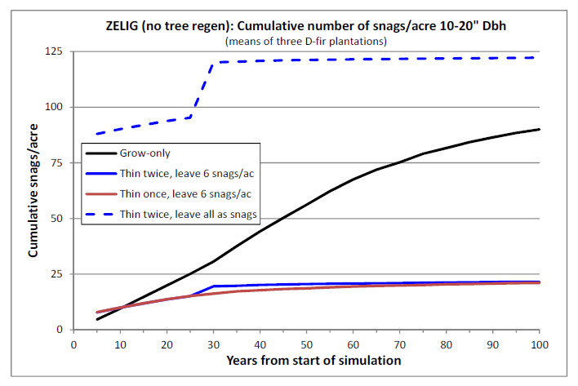
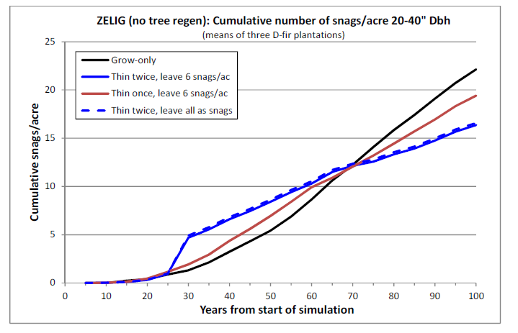
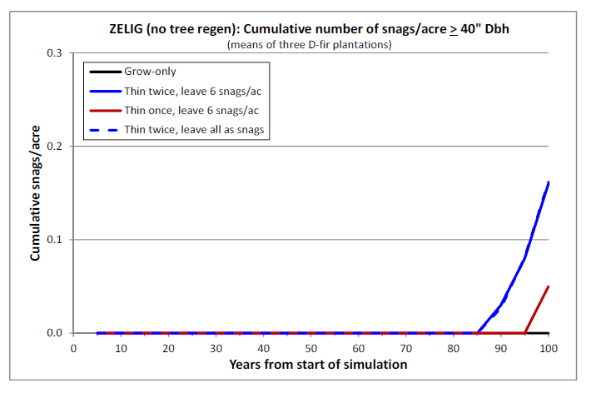
Cumulative Dead Tree Production for
Thinning Prescriptions that Leave Dead Trees
10-20 “ DBH
20-40” DBH
> 40 “ DBH

Slide 13
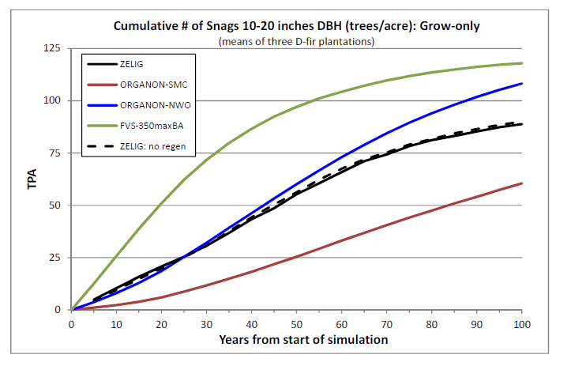
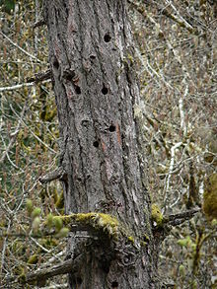
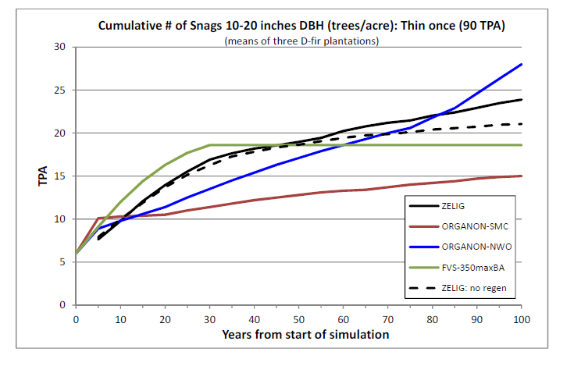
Comparison of
Organon, FVS and
ZELIG stand models
10-20”
No Thin
~280 tpa
10-20”
Thin to
90 tpa

Slide 14
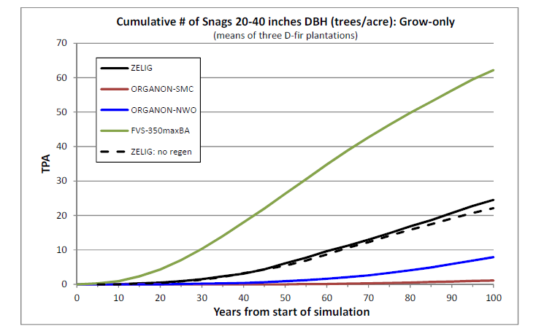
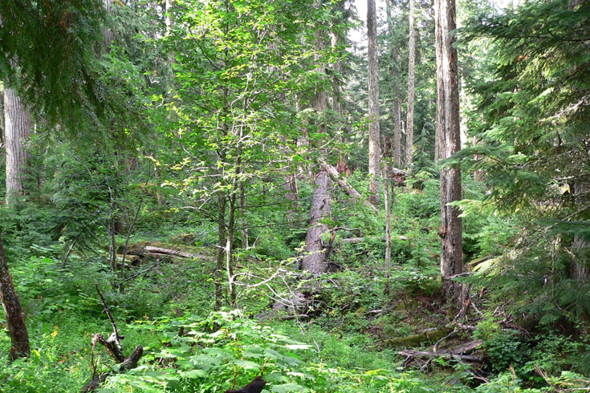
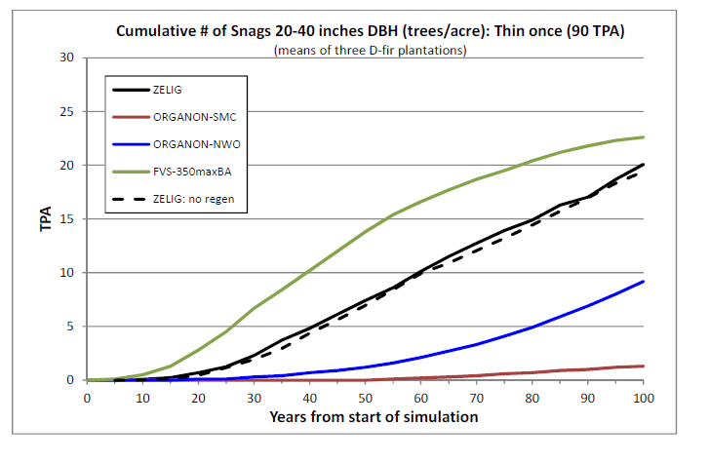
Comparison of
Organon, FVS and
ZELIG stand models
20-40”
No Thin
~280 tpa
20-40”
Thin to
90 tpa

Slide 15
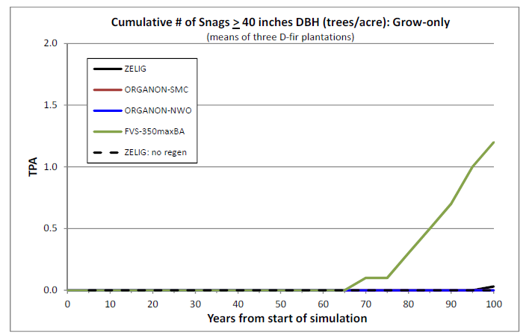
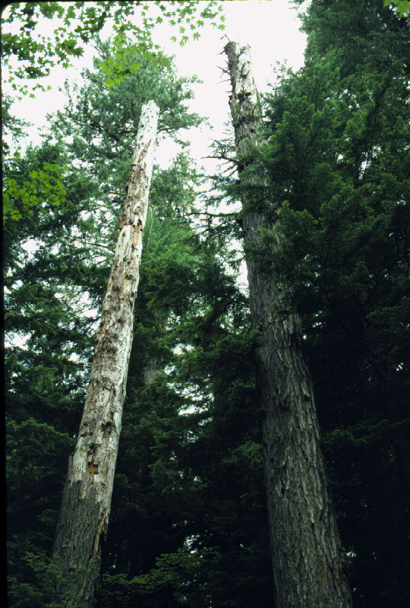
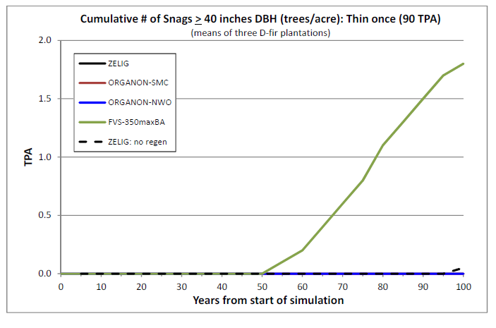
Very Large Snags > 40” dbh

Slide 16
Conclusions
Conventional thinning generally produces fewer large dead trees compared to unthinned stands
Conventional thinning can accelerate development of very large dead trees by 1-20 years
Thinning that leaves some or all of the dead wood can more rapidly produce dead trees compared with unthinned stands
Assessments of thinning effects may vary depending on the stand model used

Slide 18
“Functional” sizes of live trees
Notes:
This is 1 of 4 slides showing the size ranges of live wood and dead wood in streams, dead wood on the forest floor and snags that are utilized by various vertebrate species. Note that many species utilize dead wood between 30-100 cm, the size range most effected by thinning.

