Slide 1
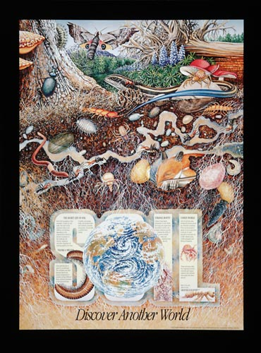
Cool Soda All Lands - Soils
Karen Bennett
Regional Soil Scientist
USFS R6

Slide 2
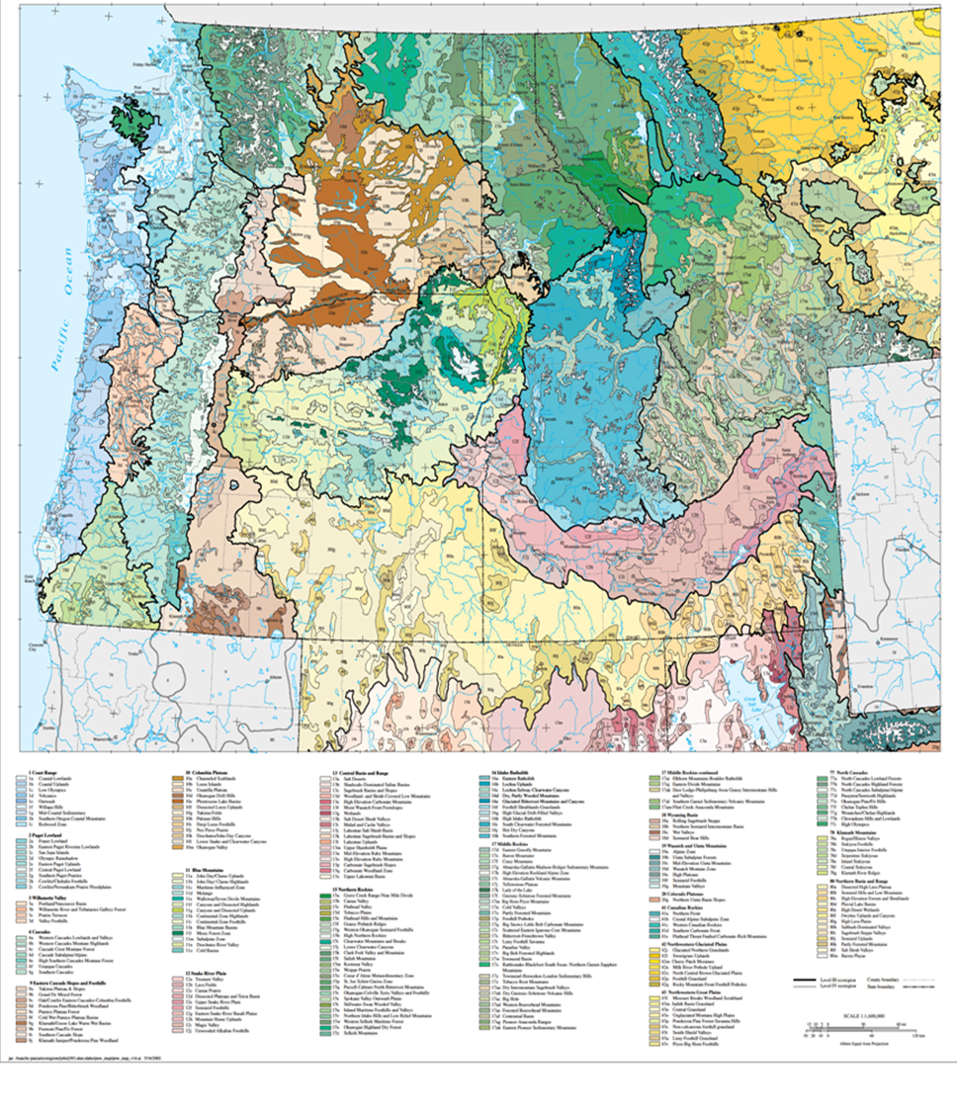
Omernik Level III and IV EcoRegions
Where you are on the landscape matters!
…. at every scale.

Slide 3
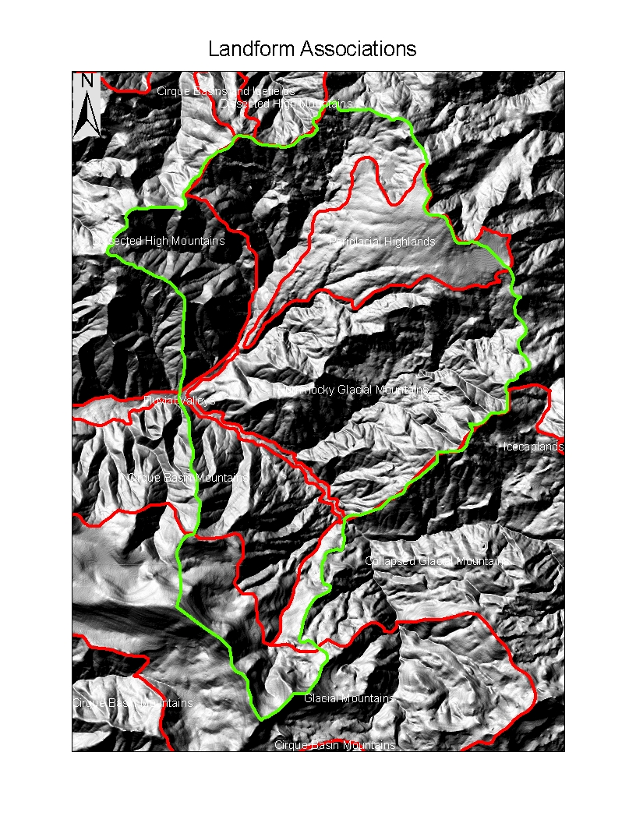
Landform Associations
Tiering down
EcoRegions and SubRegions
1:500,000 – 1:250,000
Landtype Associations 1:100,000
Landtypes 1:24,000
Geomorphic Attributes of the landscape
Old Cascades
Glacially influenced
Stuctural Controls in high mtns
Fractured rock in Periglacial Highlands

Slide 4
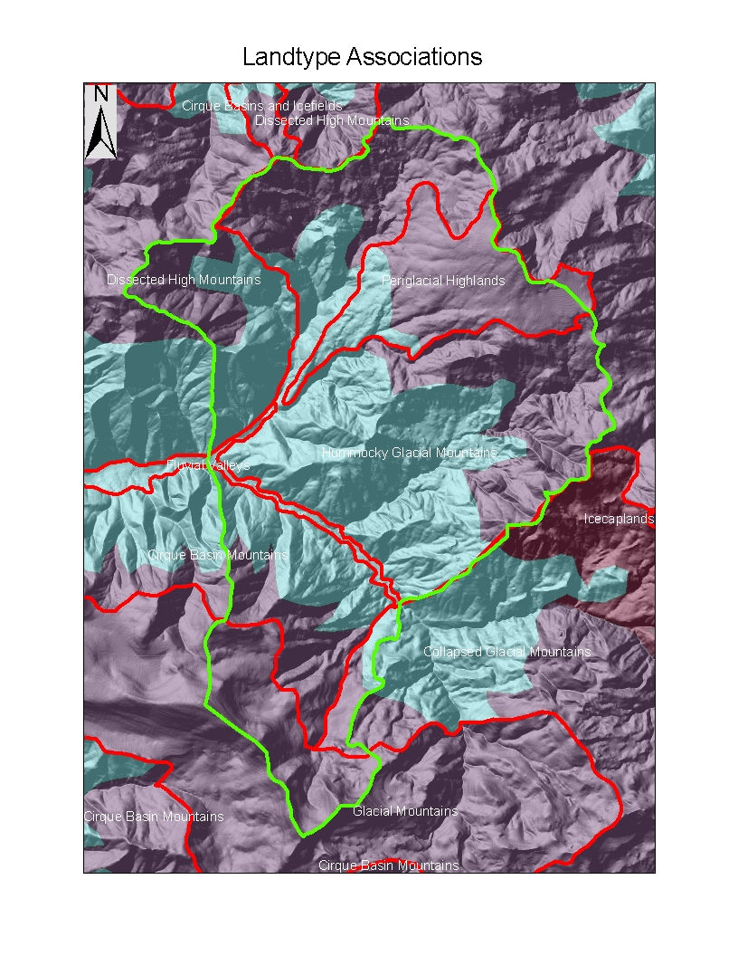
Landtype Associations
Geomophology
Vegetation
Western Hemlock
Pacific Silver Fir
Mountain Hemlock
Geology
This Planning Area has:
8 Landform Associations
2 veg types
13 Landtype Associations

Slide 5
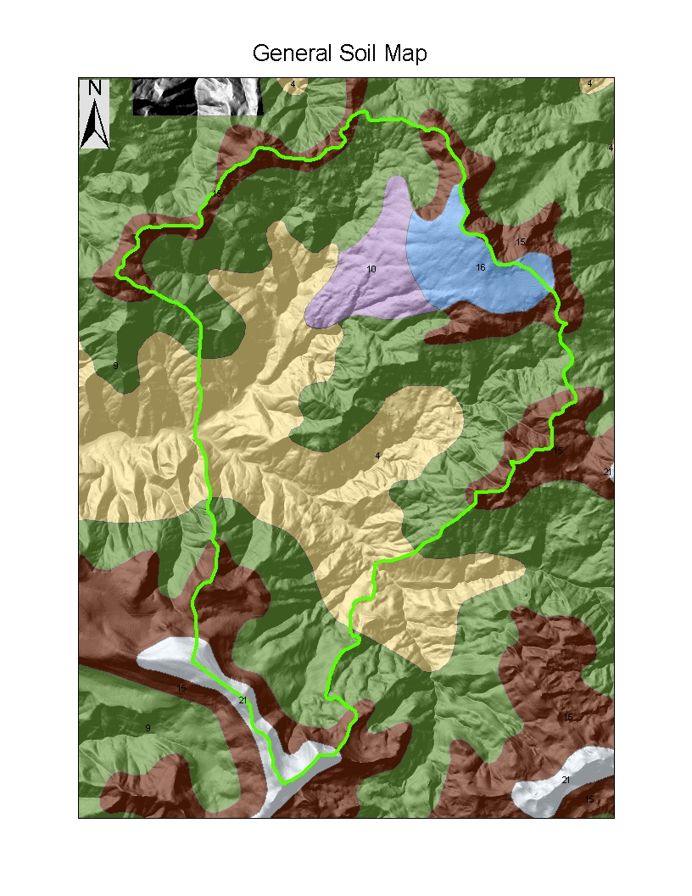
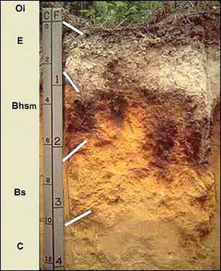
Soil Temperature and Moisture Regimes
Moisture
Udic
Aquic
Temperature
Mesic
Frigid
Cryic
Implications for:
Organic Matter Accumulation
Vegetation composition
Nutrient cycling
N Fixers
Productivity

Slide 6
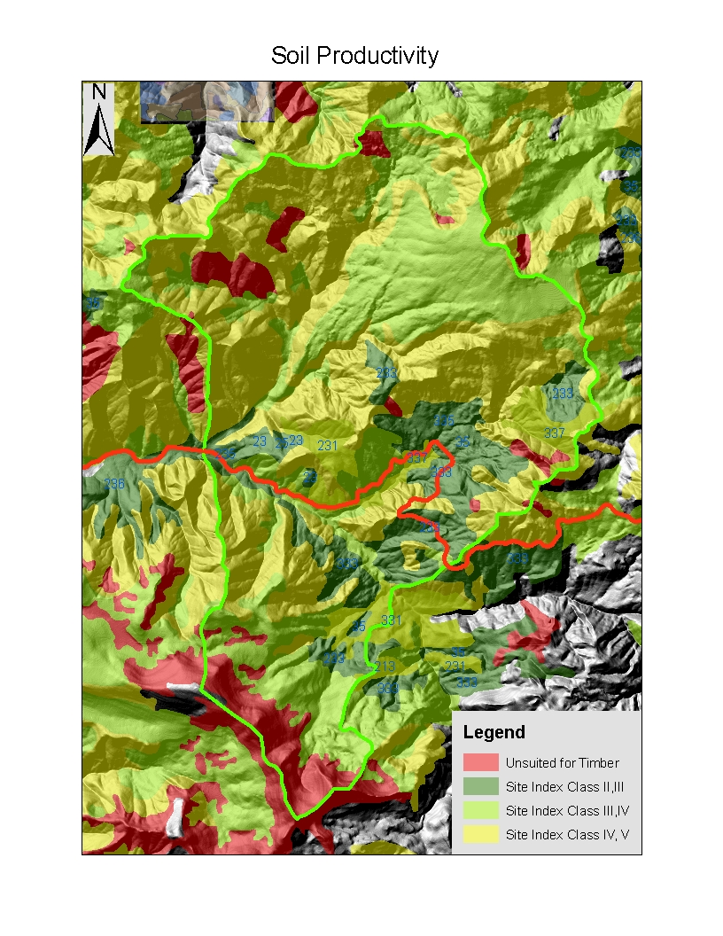
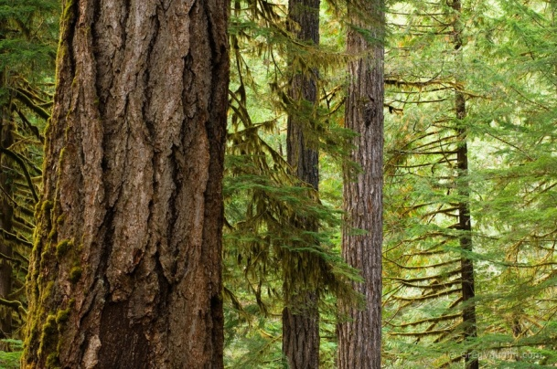
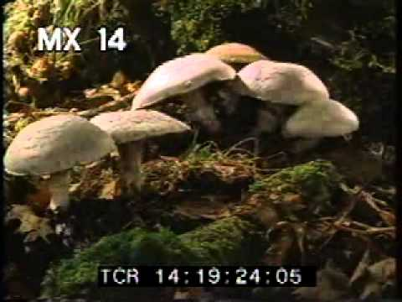
Inherent Capacity
Soil forming factors affect capacity to produce vegetation
Includes soil ecology
Implications:
wildlife habitat
riparian function
timber suitability
rotation age
Soil Forming Factors
CLORPT

Slide 7
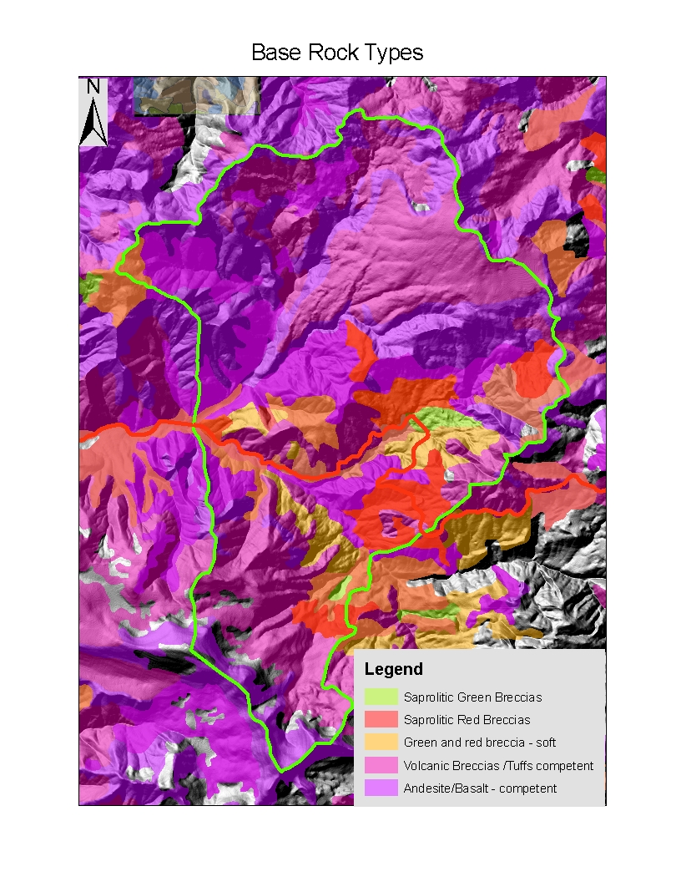
Base Geology
Weatherability –
Hard, compent rocks stucturally control high mountain areas
Stability
Softer and saprolitic rocks associated with less stable, more massiive movement terrain
Implications for:
Soil
depth
rock content
minerology
Stream
sediments
structural components
gradients
patterns, density
Wildlife Habitat
Talus slopes
ROC

Slide 8
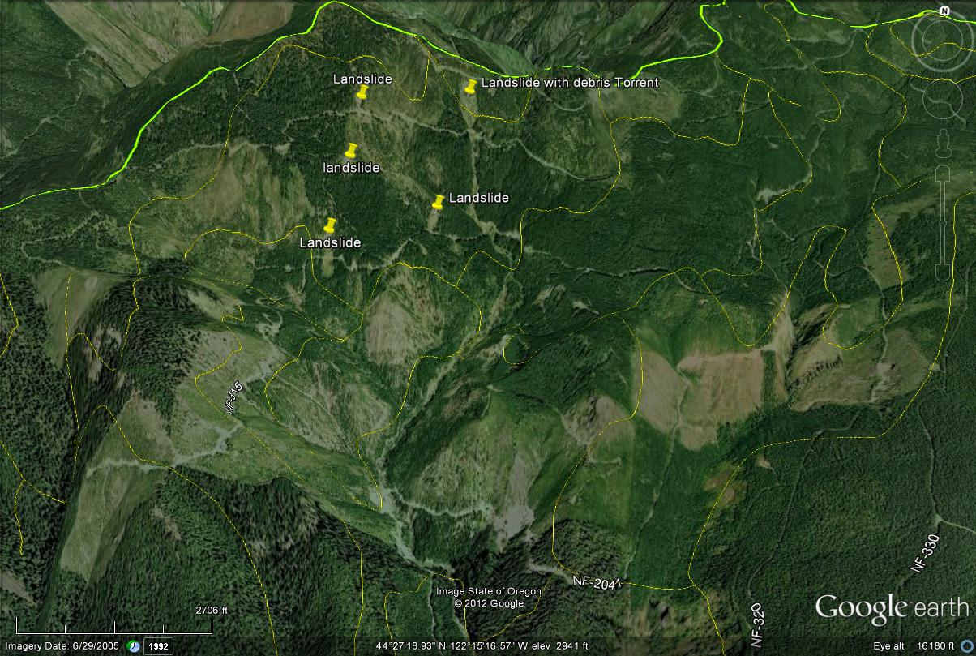
Hard Rock, Thin Soil – Drought, Ravel and Slides

Slide 9
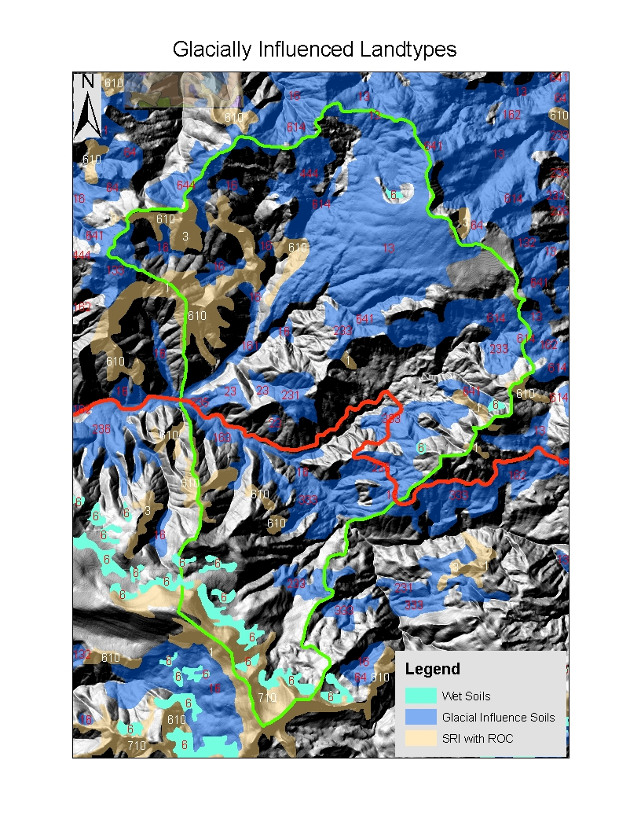
Glacial Processes
Scour
Cirques and headwalls – N slopes
Facets on river slopes
Valley patterns
Deposition
Till
Outwash
Fracturing of bedrock
Implications:
Water holding capacity
Carbon
Flow regime
Perched water tables
Soil Drainage
Stream Density
Wetland development
Over time fluvial processes alter signatures.

Slide 10
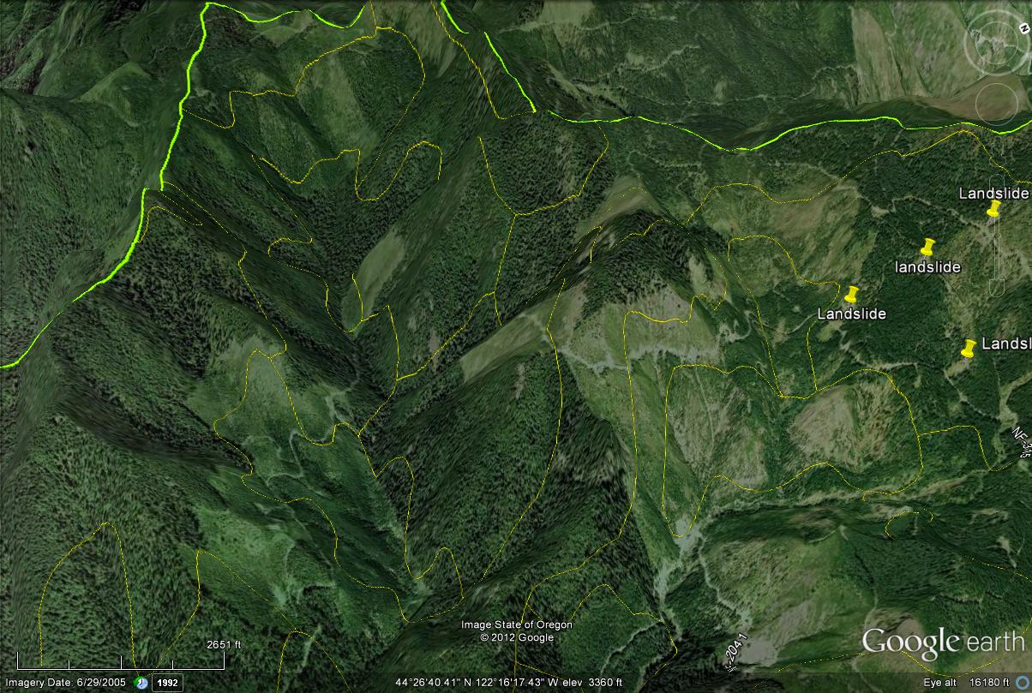
Glacial Valley Remnant

Slide 11
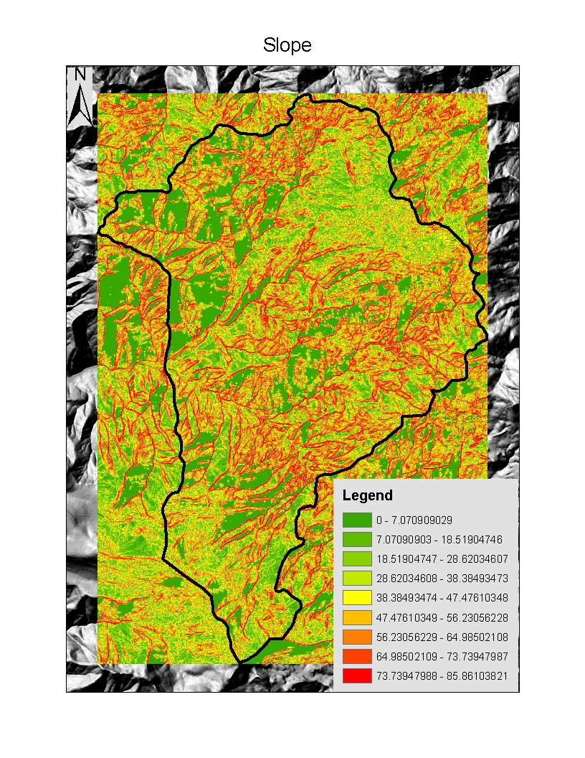
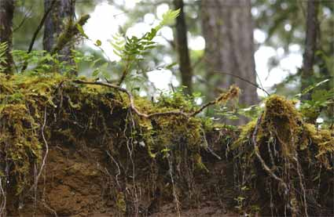
Slope effects not only erosion and stability but also the type of soil that can develop and many management limitations

Slide 12
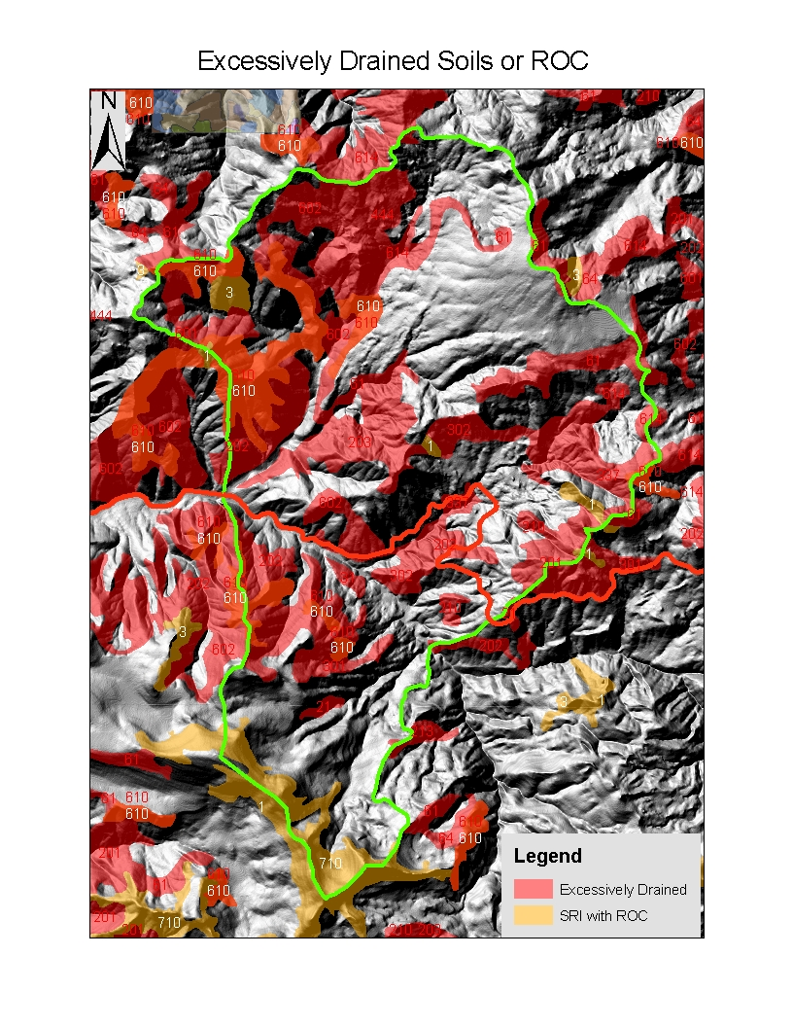
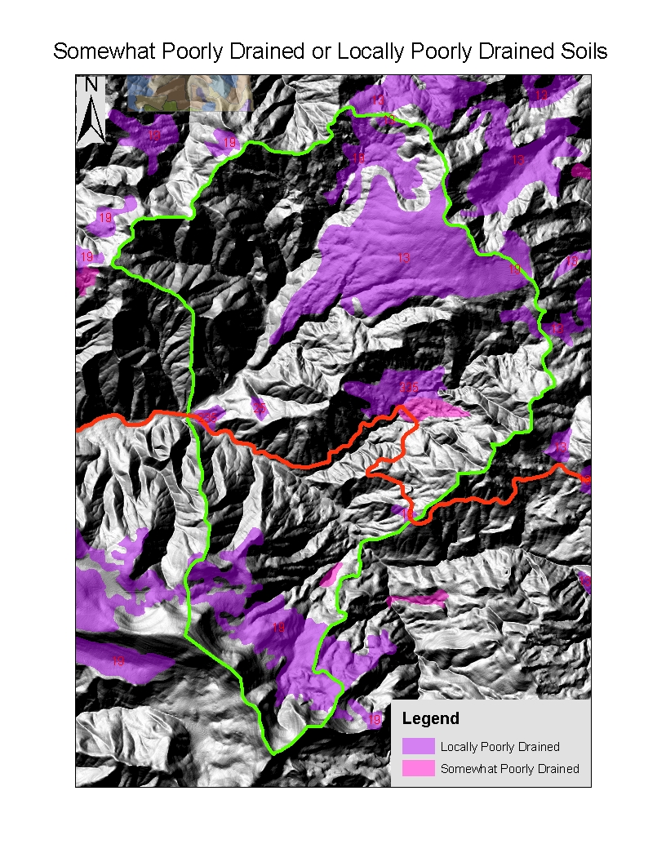
Implications for:
Hydrology:
Infiltration and permeability rates
Runoff timing
Erosion
Loam
Sandy loam
Clay Loam
Gravelly/cobbly
Very gravelly/cobbly
Engineering
Road constructions
drainage requirements, frequency
rocking
Ecology
Plant composition
Growth rates

Slide 13
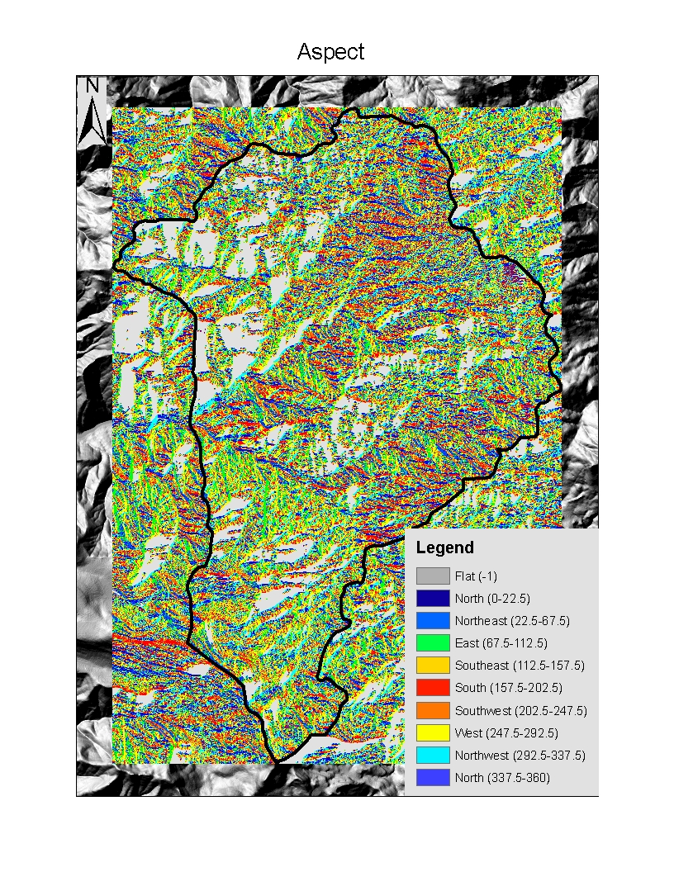
Solar Inputs
Controls soil moisture – evapotranspiration rates

Slide 14
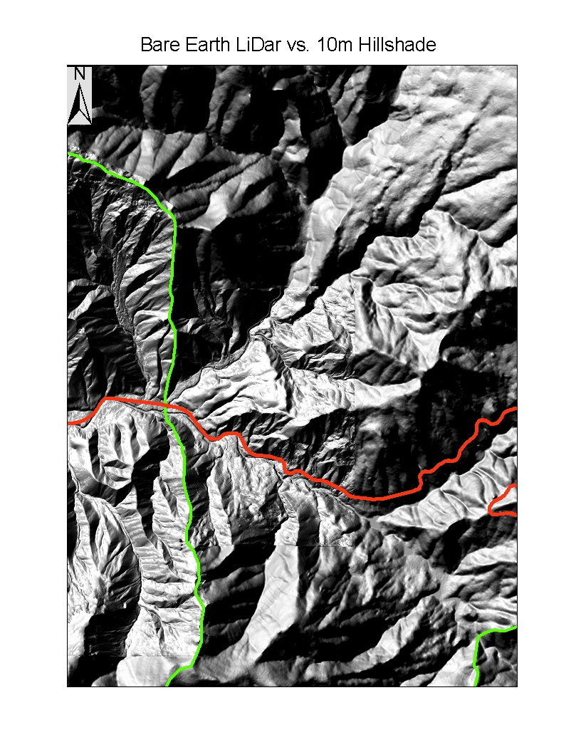
If only we had LiDar!

Slide 15
DIRT MATTERS

