Slide 1
Working Toward an Integrated Restoration Strategy on the Mt. Baker-Snoqualmie NF
Kevin James
R6 Ecology Program Meeting
November 2, 2016
Notes:
Integrated restoration strategy, forest-wide approach, start with an understanding of our current condition and recent trends

Slide 2
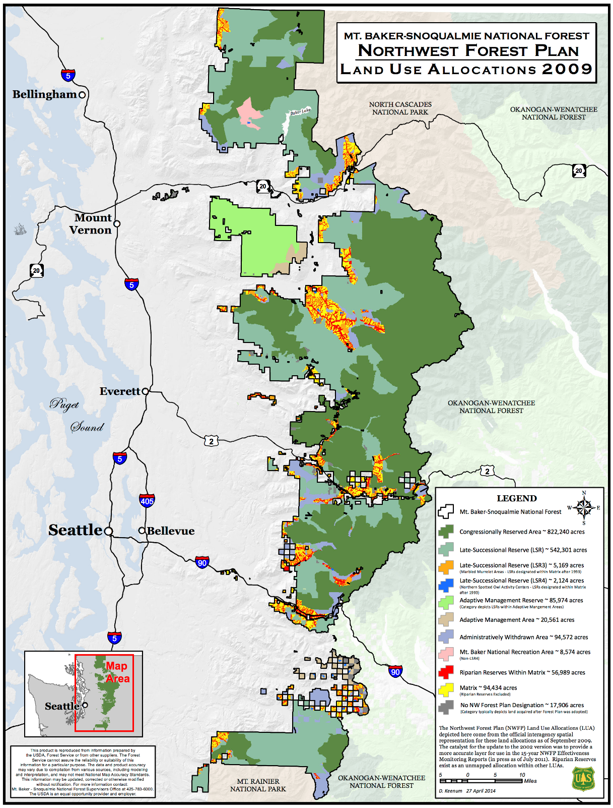
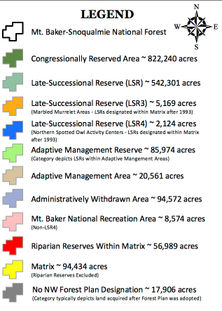
Mt. Baker-Snoqualmie NF (MBS)
- Western slopes of the Cascade mountains
- Extends over 140 miles north to south
- Total area is over 1,724,000 acres
- 9 wilderness areas covering 48% of the forest
- 1505 miles of trails
- 4 ski areas
Notes:
How do we make the connection between these definitions and what is on the ground? Develop an Integrated Restoration Strategy with the objective of promoting resilience on the landscape.

Slide 3
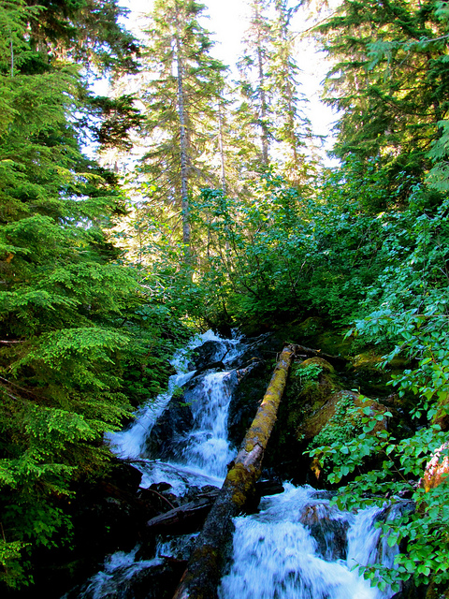
The MBS is a complex landscape
One of the most visited forests in the country
Share borders with National Parks, state, local and private land owners
Interact with 16+ Tribes
Distribution of land allocation types and uses
Landslides (unstable slopes, roads and access issues)
Disturbance regimes (fire, insect & disease, wind, floods)
One of the highest density of streams in the Pacific Northwest
Federally listed species (aquatic and terrestrial animal species)
Large areas in the Mountain Hemlock vegetation zone
Productive Western Hemlock forests with a Douglas-fir component
Shared via Flickr
Notes:
How do we make the connection between these definitions and what is on the ground? Develop an Integrated Restoration Strategy with the objective of promoting resilience on the landscape.

Slide 4
Distribution of acres by Land Use Allocation and Aquatic Conservation Strategy
Nearly half of the Mt. Baker-Snoqualmie NF is designated wilderness
Riparian reserves make up 38% of Matrix and 36% of Late Successional Reserves

Slide 5
LSR | Location | Future Projected Owl Pairs | Current Projected Owl Pairs | % LOS in potential NSO nesting habitat in LSR | Priority for Future Treatment | NEPA Complete for Treatments | Comments
Large
125 | Upper White | 25 | 16 | 55 | 1 | 2012 Upper White EA | Low functioning <60% LOS
802 | Finney | 24 | 11 | 57 | 1 | 2013 Finney EA (AMA/LSR) | Low functioning <60% LOS
116 | Stilly | 26+ | 19 | 67 | 2 | TBD Boardman-Mallardy EA | Moderately functioning 60-80% LOS
112 | Baker | 20+ |  | 68 | 2 |  | Moderately functioning 60-80% LOS
111 | Nooksack | 17 |  | 66 | 2 |  | Moderately functioning 60-80% LOS
115 | Suiattle | 18 | 14 | 81 | 3 | 2007 Decline EA (mostly Matrix) | Functioning >80% LOS
Small
119 | Skykomish | 8 | 5 | 69 | 2 |  | Moderately functioning
123 | Cedar | 4 | 4 | 76 | 3 |  | Nearly functioning
114 | Illabot | 4 | 4 | 77 | 3 |  | Nearly functioning
113 | Cascade | 6 | 5 | 85 | 3 |  | Functioning; Little opportunity
121 | NF Snoqualmie | 4 | 4 | 81 | 3 |  | Functioning; Little opportunity
117 | Beckler | 8 | 5 | 69 | 3 | 2003 SkyForks EA (mostly Matrix) 2011 Beckler EA (also Matrix) | Portion now Wilderness; Little remaining opportunity
120 | NF Tolt | 0 | 0 | 74 | 3 |  | Isolated; Little opportunity; Nearly functioning
124 | Carbon | 0 | 0 | 42 | 3 |  | Little opportunity; Adjacent to MRNP
118 | Index | 0 | 0 | 80 | 3 |  | Functioning; Little opportunity
122 | Pratt | 4 | 4 | 53 | - |  | Now Wilderness
Objective of the 2001 Late Successional Reserve Assessment is to restore functioning habitat for old-growth dependent species with a focus on the larger and low functioning (<60% late successional-old growth forest) reserves.

Slide 6
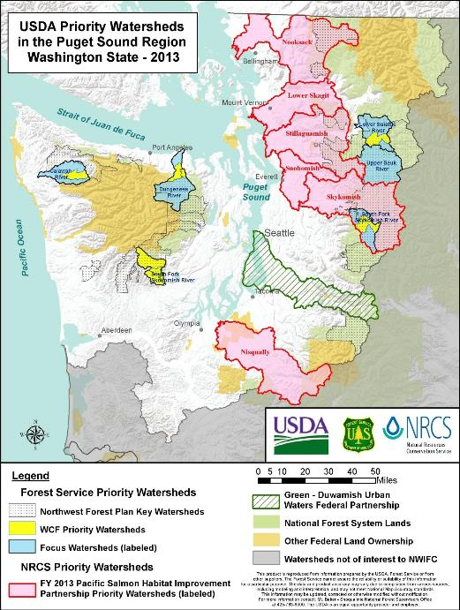
On the MBS, Integrated Restoration includes:
Vegetation management projects informed by the Late Successional Reserve Assessment
Co-occur with watershed restoration projects in support of the Aquatic Conservation Strategy
Coordinated with Access and Travel Management projects
Tribal partnerships (huckleberry enhancement and elk forage areas)
Aquatic Conservation Strategy
- Riparian Reserves
- Key Watersheds
- Watershed Analysis
- Watershed Restoration

Slide 7
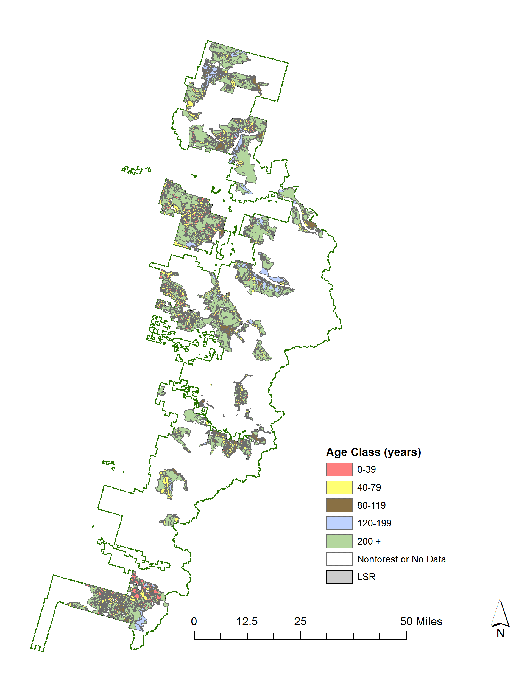
Age class distribution within Late Successional Reserves across the Mt. Baker-Snoqualmie NF
Over 60% of stands within the Reserves are at least 200 years old
Stands under 80 years old within the Reserves reflect past timber activity

Slide 8
Moving toward a structure-based restoration strategy: OGSI & Connectivity
Old-growth structure index*:
Regionalized old-growth structure index for plots within NWFP. Calculated from abundance of large live trees, snags and down wood, and diversity of tree sizes.
OGSI₈₀
OGSI₂₀₀
Spatial distribution of emergent properties of old-growth
* = http://lemma.forestry.oregonstate.edu/data/structure-maps

Slide 9
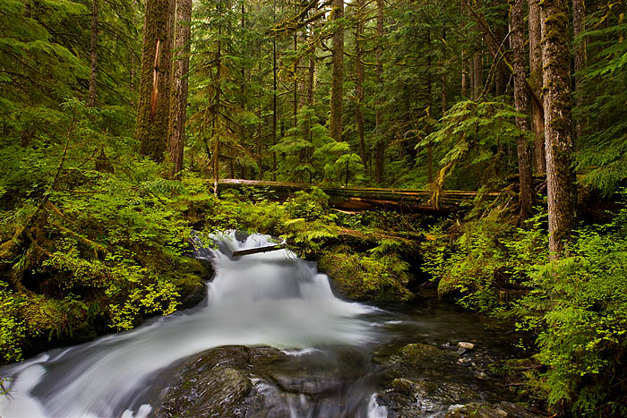
Moving toward a structure-based restoration strategy:
Early Seral
Mid Seral
OGSI₈₀
OGSI₂₀₀
stephenpenland.com

Slide 10
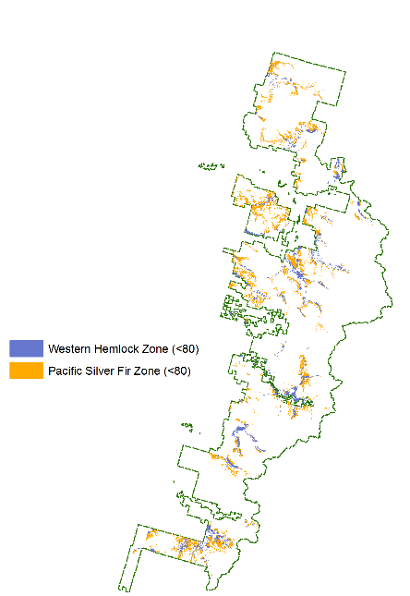
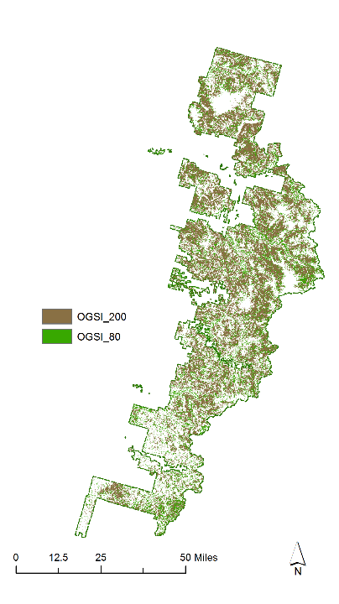
Age-based Restoration
Structure-based Restoration

Slide 11
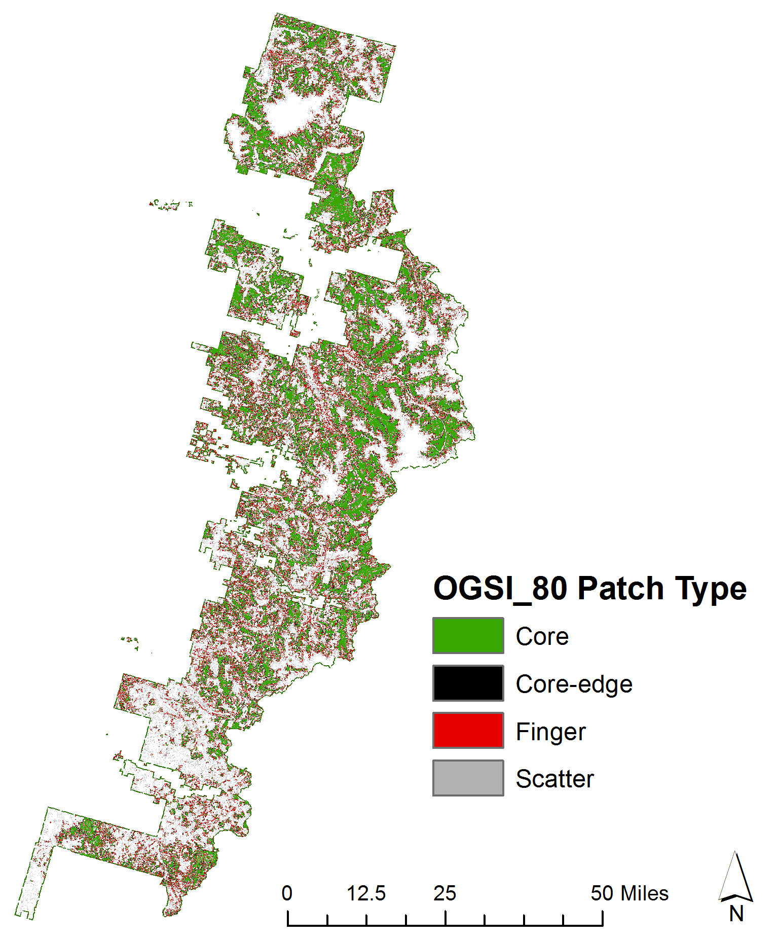

Slide 12
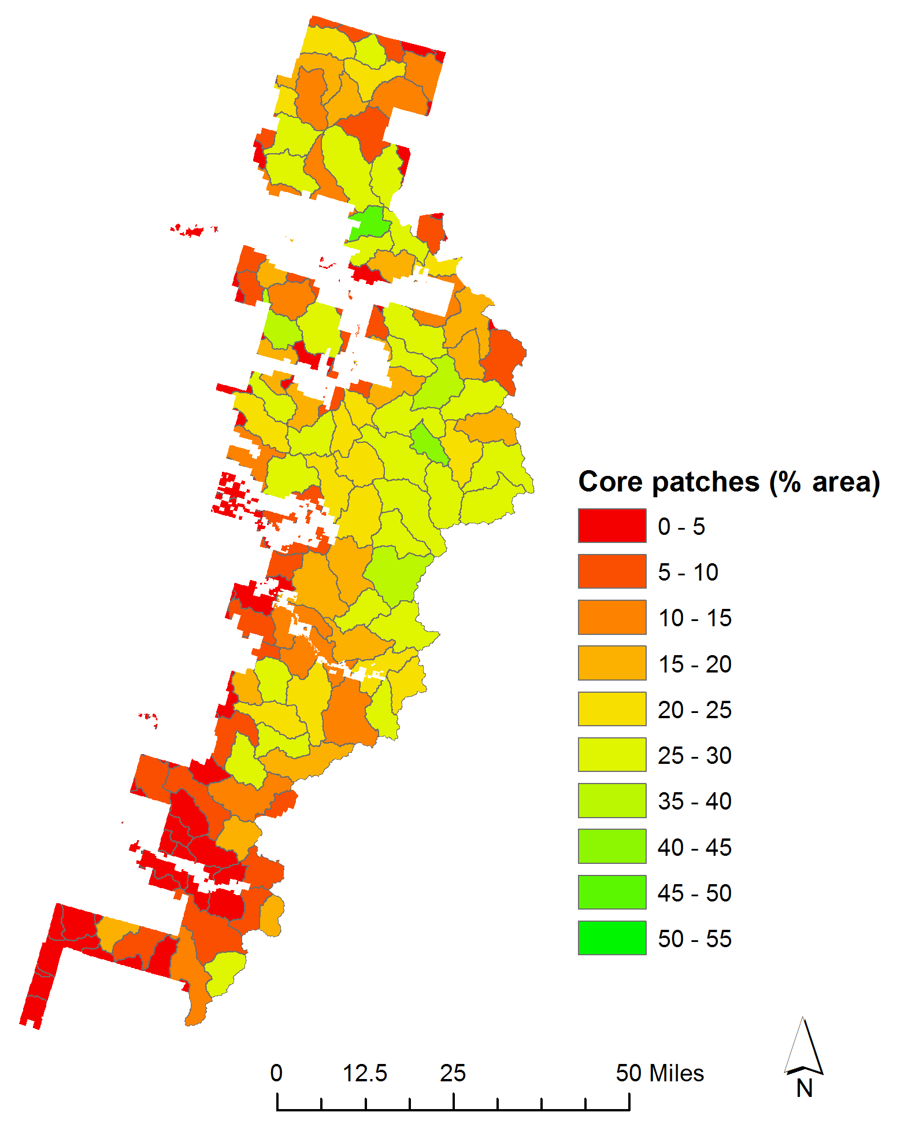

Slide 13
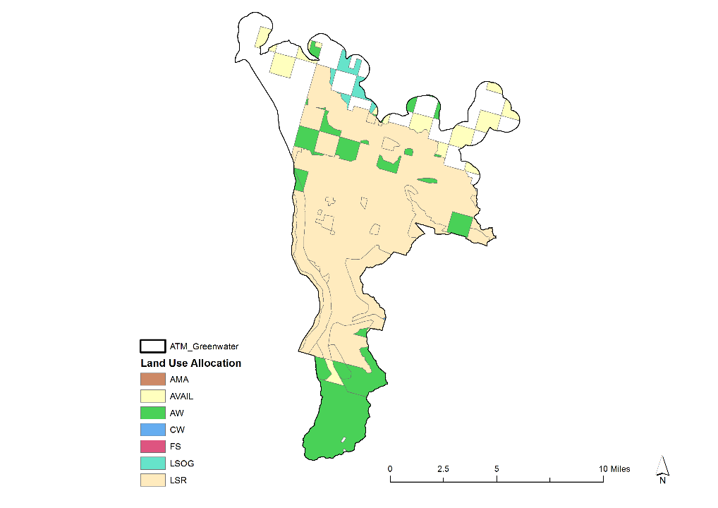
Greenwater Access and Travel Management Project Area
(68,000 acres)
High visitor use area – various recreational opportunities

Slide 14
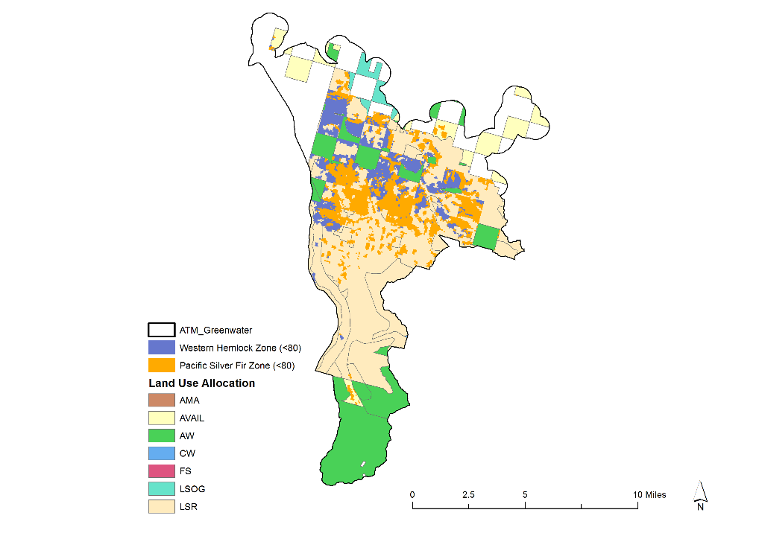
Greenwater Access and Travel Management Project Area
(68,000 acres)
Priority Late Successional Reserve for restoring functioning habitat

Slide 15
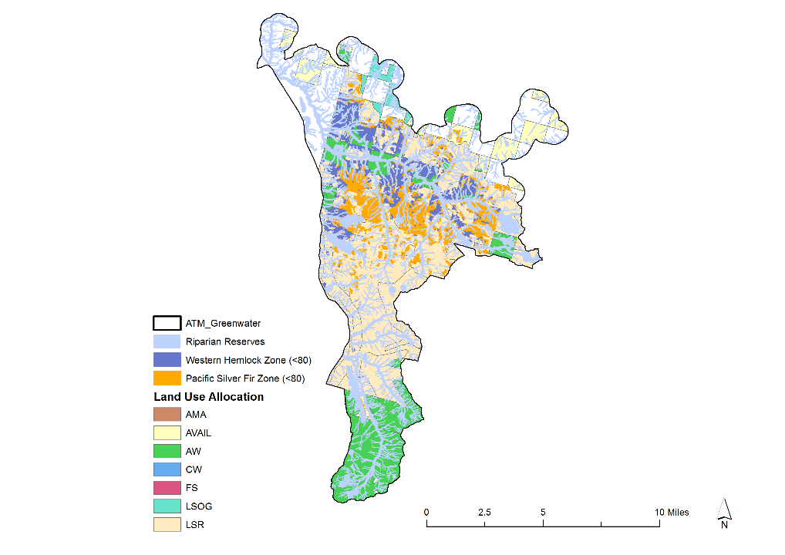
Greenwater Access and Travel Management Project Area
(68,000 acres)
Priority Watershed for salmon habitat improvement
Integrated restoration requires information beyond stand age and location of riparian reserves

Slide 16
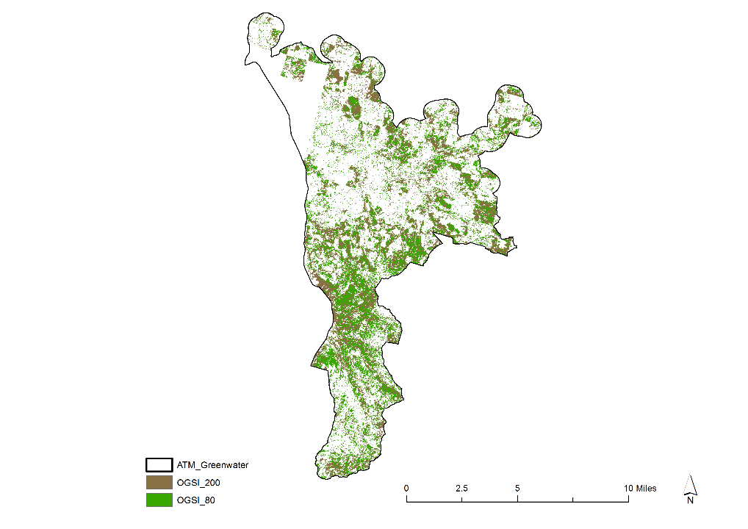
Greenwater Access and Travel Management Project Area
(68,000 acres)
Ease of access and management history of mixed ownership is reflected in the distribution of old-growth structure

Slide 17
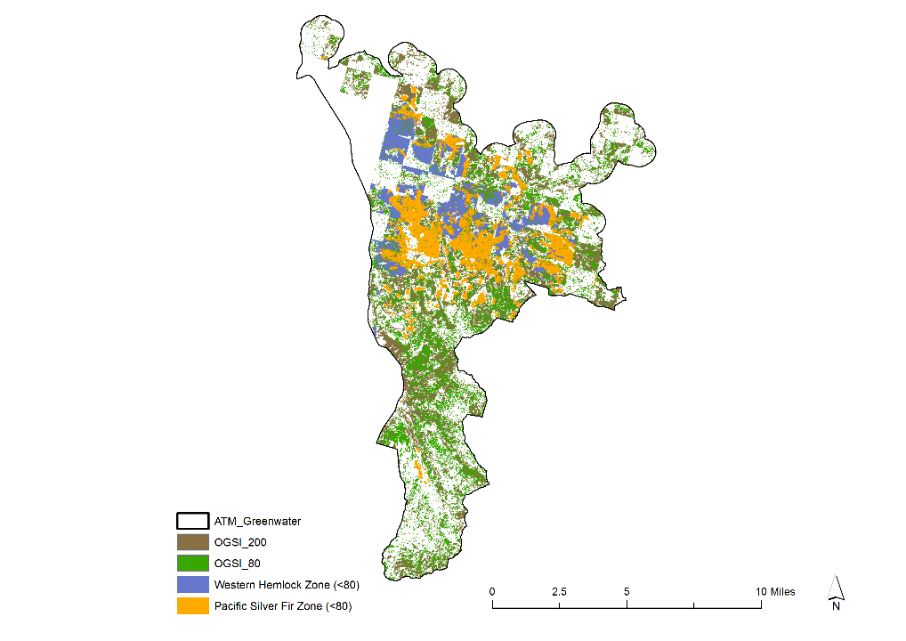
Greenwater Access and Travel Management Project Area
(68,000 acres)
Areas lacking old-growth structure and stands under 80 years old are concentrated within the watershed

Slide 23
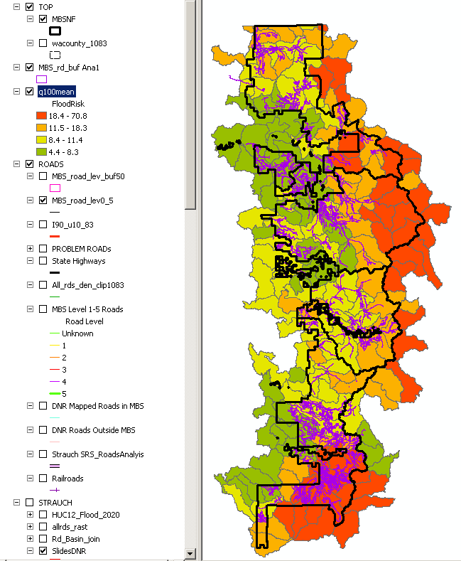

Slide 24
Next Steps
Complete the integrated subwatershed prioritization strategy
Completion of the landscape model (defining forest patches, beta testing, identifying future range of variability)
Education, Share the strategy: Forest personnel, our publics and tribes (16+ government to government tribes) and partnerships
Develop Implementation Guide (how do we use it on the forest)

Slide 25
