Slide 1

Range of Variability in Planning
Summer Kemp-Jennings, Area Ecologist
Jessica Hudec, Area Ecologist
November 2019
Notes:
Define some terminology
Give some background on ROV
Discuss some of the pros and cons of using ROV in land management planning
And really be an advocate for clear and concise language

Slide 2
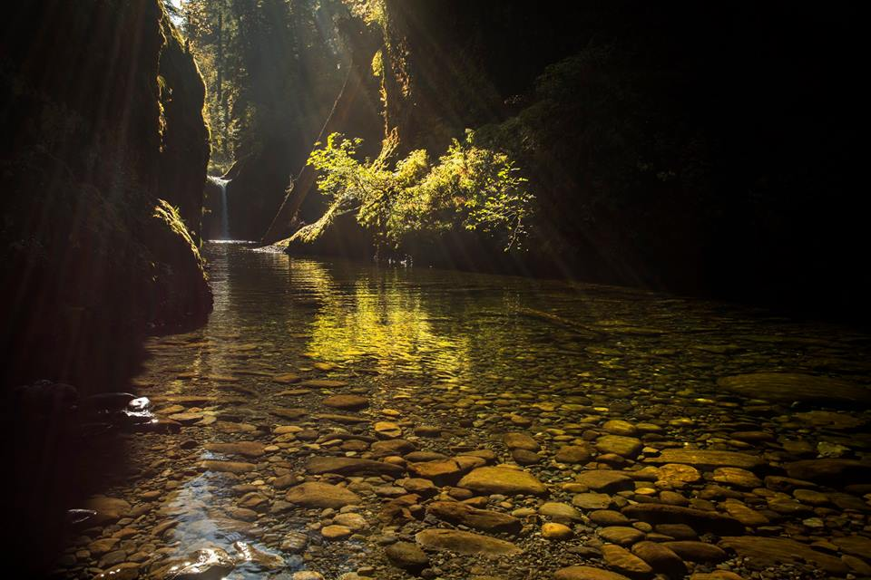
What is NRV?
Natural range of variability (NRV) refers to “the ecological conditions, and the spatial and temporal variation in these conditions, that are relatively unaffected by people, within a period of time and geographical area appropriate to an expressed goal.”
-Landres et al. 1999
Notes:
Before we can talk about what we can do with it, let’s talk about what it is
However, even within this definition, there’s a lot of room for interpretation
What is natural?
Debate over appropriate time period and spatial extent used to define natural variation.
Are impacts of Native American’s considered natural?
And, when is the point in time when systems were relatively unaffected by people?

Slide 3
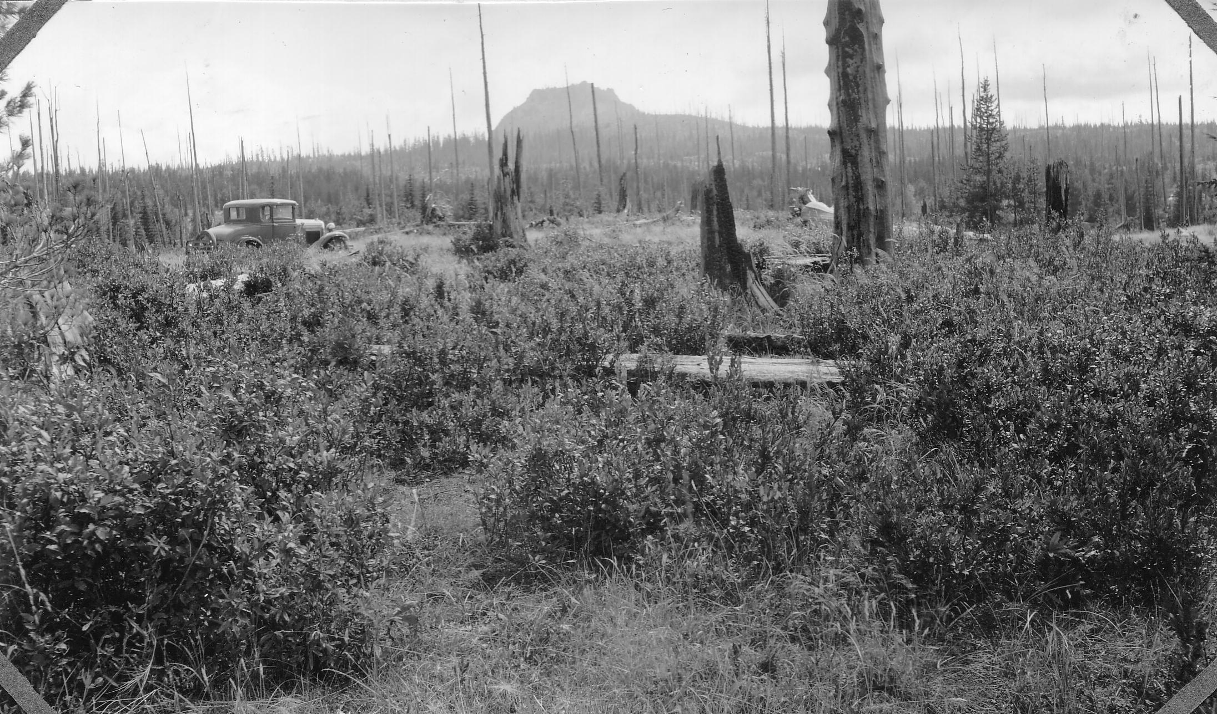

HRV and FRV
Historical range of variability (HRV):
  Often used interchangeably with NRV
  Serves as a benchmark for comparison with current or potential future conditions.
Future range of variability (FRV):
  Focuses on the estimated range of some ecological condition or process that may occur in the future.
  Especially relevant when the effects of anthropogenic stressors (e.g., climate change, invasives, development) are high and thus likely to move the system away from its HRV.
Notes:
Used interchangeably, however HRV specifically refers to the past, where NRV could include present or future conditions, but for the most part, these two are used interchangeably, and NRV is referring to the past. In this presentation, I use them interchangeably
FRV is obviously referring to estimated range of some ecological condition or process that may occur in the future.
Especially relevant when the effects of anthropogenic stressors (e.g., climate change, invasives, development) are high and thus likely to move the system away from its HRV.
We also hear phrases like “current natural range of variability” or “future natural range of variability”.
Inconsistent usage of these terminologies makes it very difficult for to keep track of each others’ thoughts. Even harder for cooperators, the public, or anyone reading one of our planning documents.

Slide 4
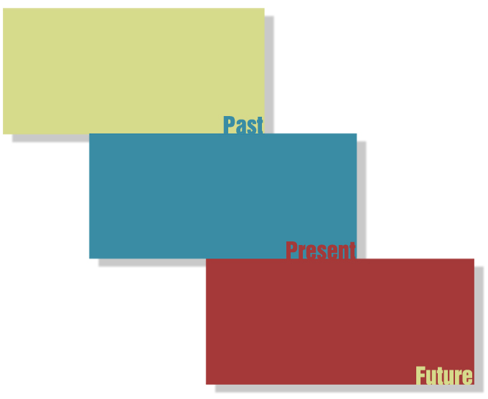
Historic Condition
Reference Condition
Pre-settlement Condition
Analog Condition
(Un)Desired Condition
Restoration
Current Condition
Reference Condition
Post-settlement Condition
Disturbed Condition
(Un)Desired Condition
Resistance
Future Condition
Disturbed Condition
Non-analog Condition
Unknown
(Un)Desired Condition
Resilience
Notes:
Slide where really drill home need for precise language, Multiple ways you can describe state in a planning document
Really what we are talking about is the Past, Present, and Future
However, there are numerous ways to label this…
Read Boxes
The meaning of each of these is relative and situational.
The more precise and clear one's use of language becomes, the fewer the number of possible interpretations for a message.
And, frankly, the more likely your argument will stand up in court in the case of litigation.
We have all these different terms, so let’s find a way to use them for clarity rather than confusion.
Pick a term, define it, and use it consistently

Slide 5
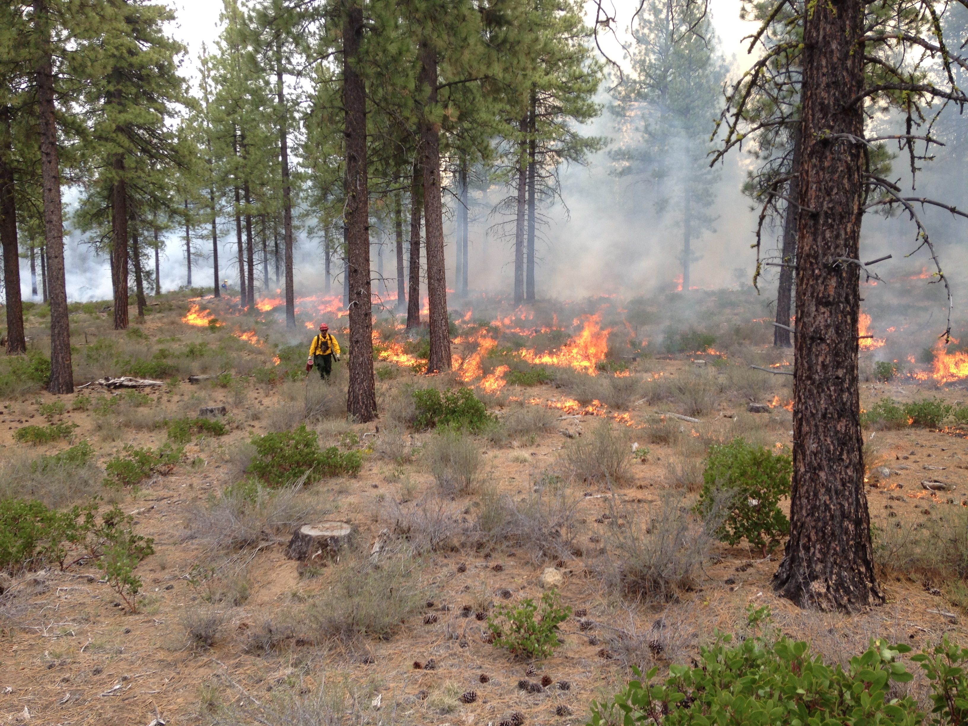
NRV and
Land Management
USFS uses NRV and departure metrics to define management goals.
  Maintain conditions within NRV.
  Restore current conditions to reflect NRV.
Desired future condition (DFC) may or may not be equivalent to historic conditions, current conditions, or within NRV.
  Is DFC ecologically and socially acceptable?
  Assess FRV- can it support DFC?
Notes:
Current agency direction relies heavily on HRV and current departure concepts in defining target conditions for everything from timber harvest to wilderness management.
In addition 2012 Planning Rule uses ROV terminology.
Important that we understand it and use it appropriately.
Also important to acknowledge that it’s potentially not even possible to re-create reference conditions, given the climatic, cultural, and ecological changes.
May or may not be acceptable socially, economically, or politically.
While DFC of restoration work looks to NRV, other types of forest management that focus on social, economic, or specific species or habitat goals may not.
Use of HRV and current departure does not suggest that our management goal should be to re-create all of the ecological conditions of the reference period or that conditions during the reference period were preferable.
When we do use one of these terms, it’s important to state if we are using it for context, or because it is one of our objectives.

Slide 6
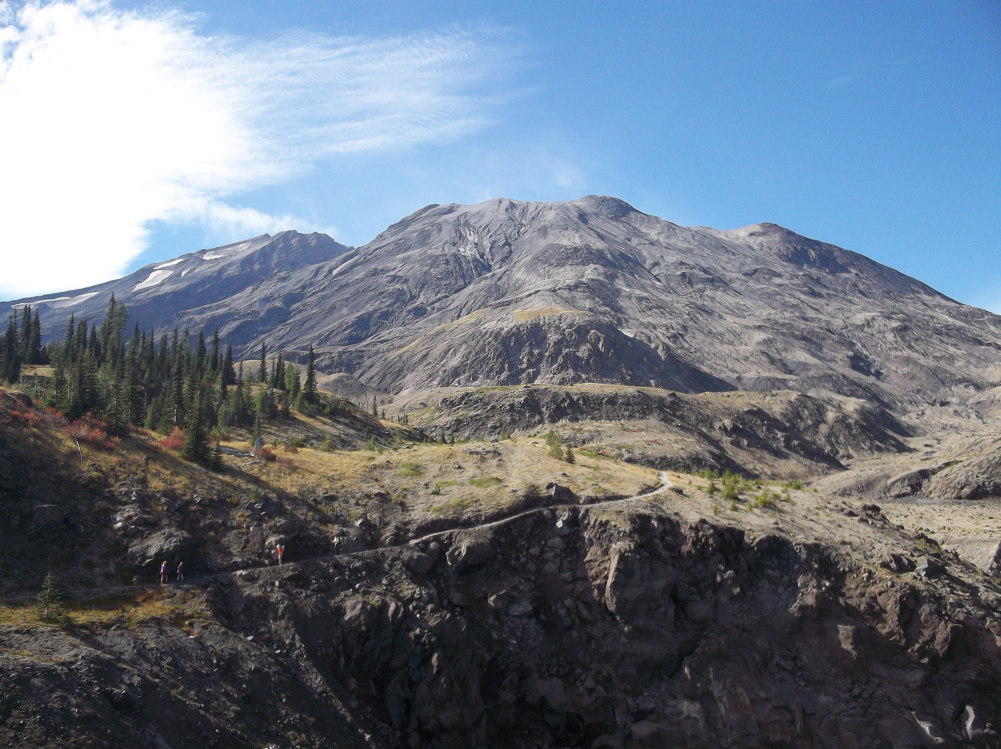
NRV and
Land Management
Arguments against HRV/NRV
A description of past patterns and processes is irrelevant today or in the future because
People have extensively altered natural systems.
Each point in time and space is unique.
Climate patterns are continually changing.
Justification for HRV/NRV
Why and how current conditions developed and what changes might be expected in the future.
Improves understanding about ecological context and the effects of disturbance.
Helps prescribe future conditions that are more relevant, variable, and ecologically sustainable.
Notes:
Obviously there are some arguments in favor of, and against using ROV in land management.
For example, some arguments against include:
We don’t have anything unaltered anymore and we’re not suddenly going to stop altering things, so why focus on an unaltered state? May not even be possible to mimic conditions that define the HRV or NRV.
Each point in time and space is unique, so why would we pick one to shoot for?
Climate patterns are continually changing, why would we manage for a landscape created by past climate?
Justifications for using NRV:
Yields insight into why and how current conditions developed and what changes we might expect in the future
Not an attempt to mimic processes that occurred on a site long ago but to improve understanding about the ecological context of an area and the landscape-scale effects of disturbance.
Helps prescribe future conditions that are more relevant, variable, and ecologically sustainable.

Slide 7
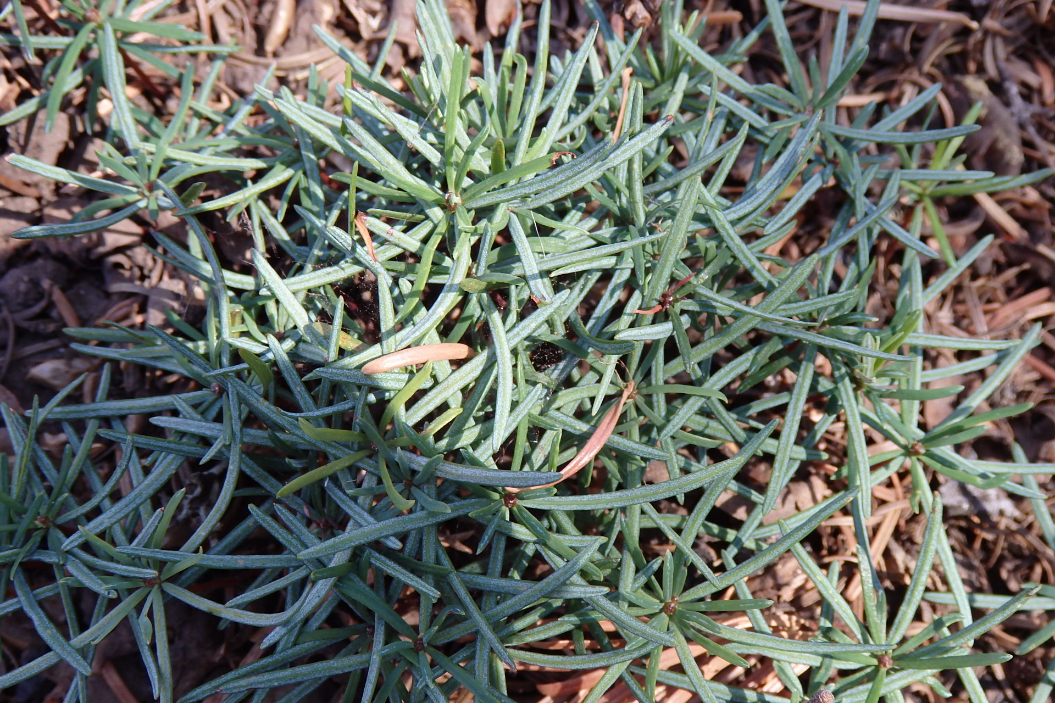
Limitations of ROV
Lack of site-specific data
Insufficient temporal depth of data
Lack of information about spatial variability
Notes:
Those arguments against using ROV NRV for land management planning are based on some acknowledged limitations
More often than not, we have a lack of site specific data and rely on extrapolation from other areas and expert opinion to fill knowledge gaps.
Insufficient temporal depth of data precludes reconstruction of historical conditions for a sufficiently long reference period to capture variability or projection of future conditions.
Lack of information about spatial variability resulting from a lack of confidence in spatial configuration and severity of historical disturbances
The take home here is that ROV must be interpreted within the scope and limitations of the information sources. And, the scope and limitations of those data sources should be stated anytime we want to use ROV for planning purposes

Slide 8
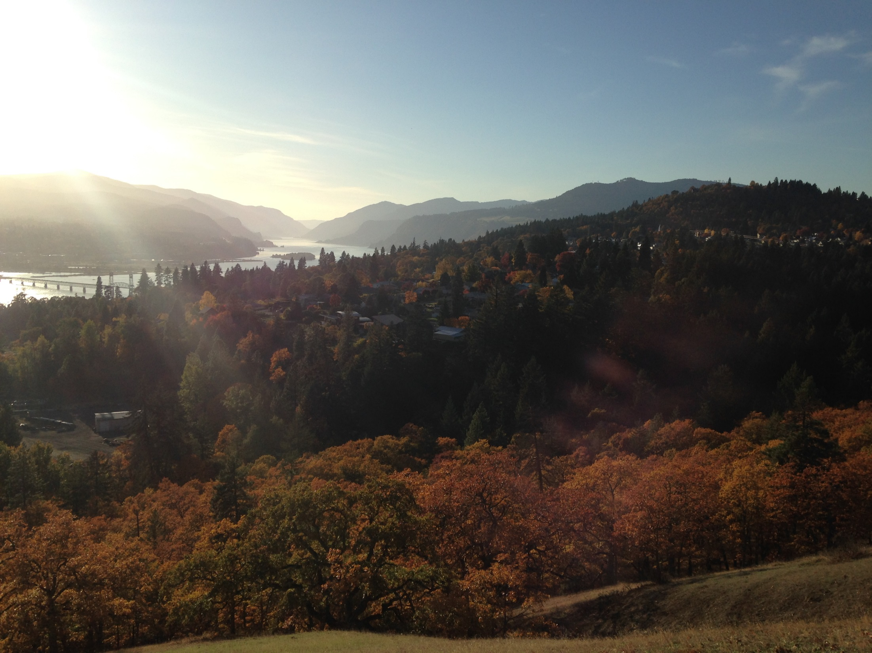
Strengths of ROV
  Insight into vegetation dynamics
  Gives idea of how departed
  HRV is our best understanding at present of what works and what might be sustainable
Notes:
In contrast, ROV has some noteworthy strengths
Using all of the data sources available to us for a defined landscape can give great insight into vegetation patterns of the past, and the disturbance and climate patterns that created them
From this, we can estimate how departed we are from a reference period
And finally, HRV is our best understanding at present of what works and what might be sustainable

Slide 9
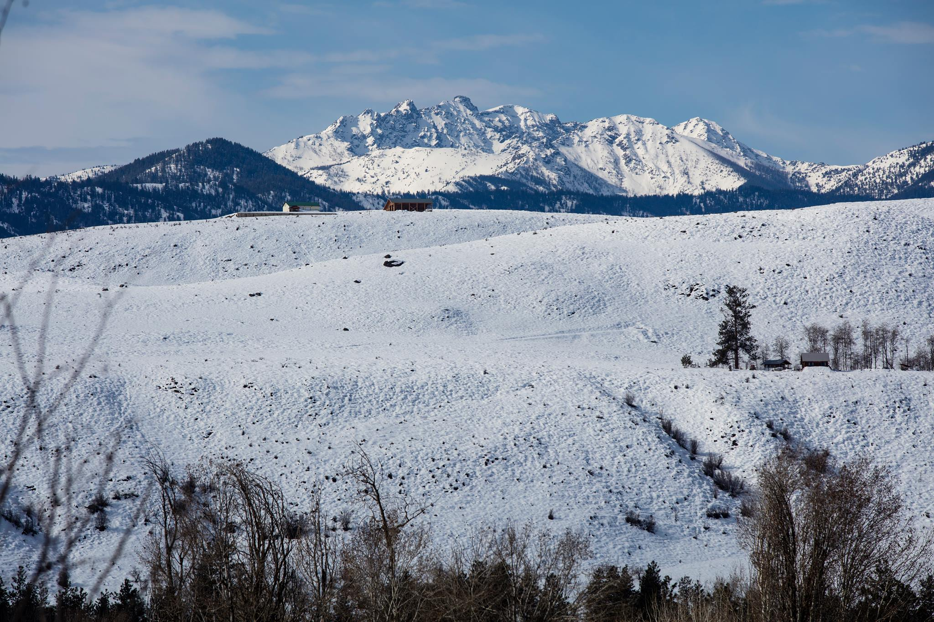

Review
NRV- Ecological conditions, and the spatial and temporal variation in these conditions, that are relatively unaffected by people, within a period of time and geographical area appropriate to an expressed goal
HRV- Simply NRV when the reference period is prior to what defines current conditions, often pre-European settlement
FRV- Estimated range of some ecological
condition or process that may occur
in the future, especially relevant when
the effects of anthropogenic stressors
are high
Notes:
NRV- Ecological conditions, and the spatial and temporal variation in these conditions, that are relatively unaffected by people, within a period of time and geographical area appropriate to an expressed goal. Often a historical time period but doesn’t have to be. It can also refer to current or potential future conditions.
HRV- Simply NRV when the reference period is prior to what defines current conditions, often pre-European settlement
FRV- Estimated range of some ecological condition or process that may occur in the future, and consideration of FRV is especially relevant when the effects of anthropogenic stressors are high
Idea of using FRV rather than HRV is gaining popularity, because of climate change, human development, invasive spp, fire supressiuon… but we have to be cautious because there’s even less certainty in estimating future ranges than in estimating past ranges.

Slide 10
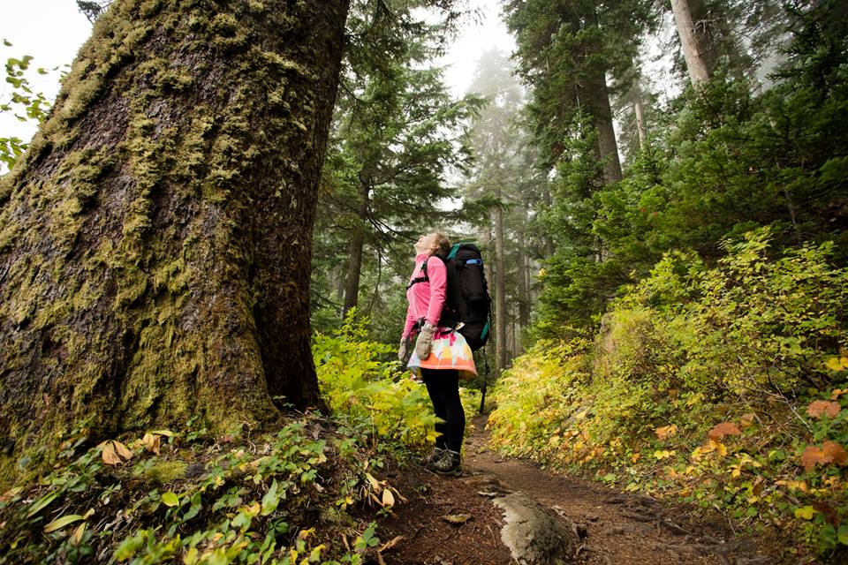
Review
Appropriate use of these terms depends on the situation.
Define these terms when using them and state the assumptions and limitations.
Make sure associated terms are also
used appropriately to limit confusion
(e.g. restoration, resistance, resilience).
Notes:
Appropriate use of these terms depends on the situation.
Are we talking about past, present, or future? A reference condition or a desired condition? And what’s the link among them in time or space?
Define these terms when using them and state the assumptions and limitations.
Pick a term, define it, and use it consistently
Make sure associated terms are also used appropriately to limit confusion.
There’s a lot of layers making up these concepts- space, time, human influence, departure metrics, and desired outcomes
Think about inherent connotations of value and time.
Agency is building these somewhat intricate concepts into our planning documents and, in doing so is accepting responsibility for both accurate usage of them and clear communication about them, and we are the bearers of that responsibility
as we go through the day today pay attention to when we do this well and where we could improve- not necessarily speakers, but concepts, planning, and reference docs. Our speakers will cover topics at a wide range of geographic and temporal scales, allowing us to see this theme permeate a variety of work.

