Slide 1
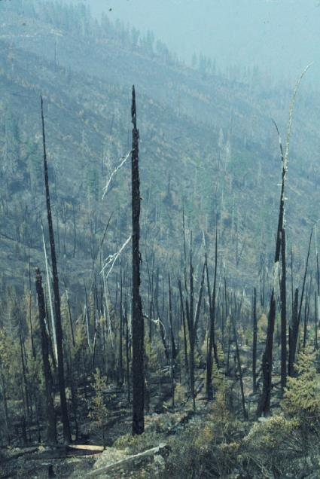
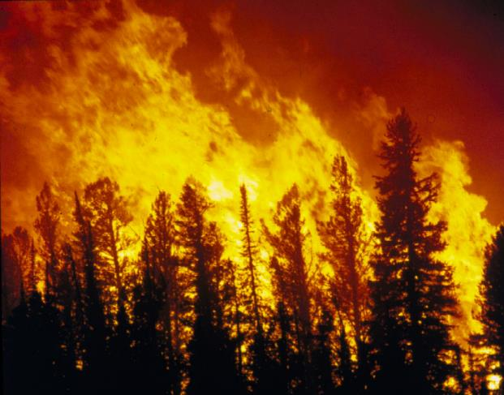
Fire Regimes of the Westside: Past, Present, and Future
Tom Spies
PNW Research Station
Assistance from Ray Davis, Jane Kertis, Matt Reilly, Keith Olsen

Slide 2
Outline
Westside environments and historical fire regimes
Post-fire succession
Recent fire history
Future fire

Slide 3
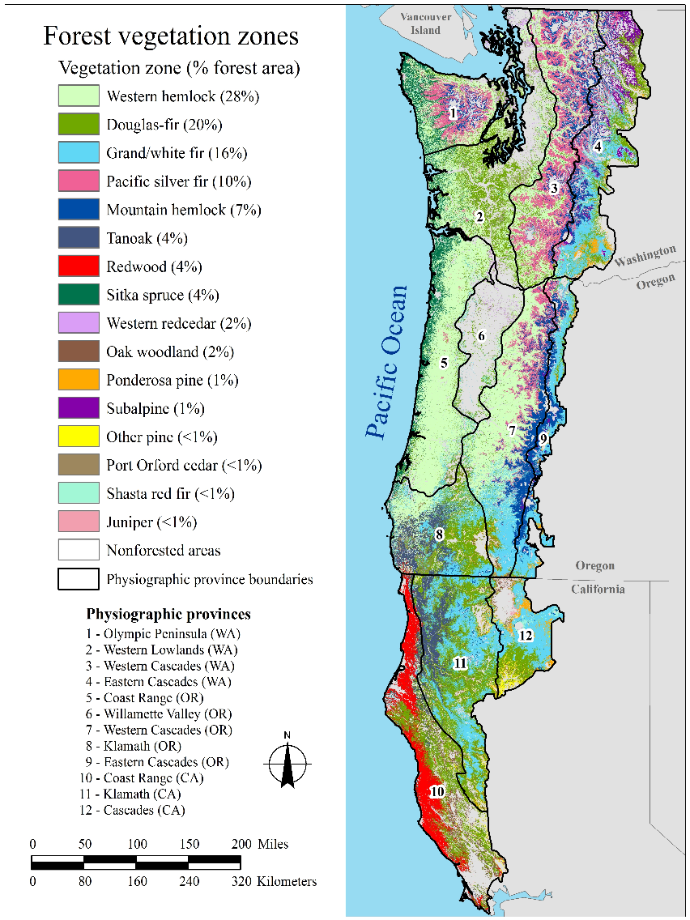

Slide 4
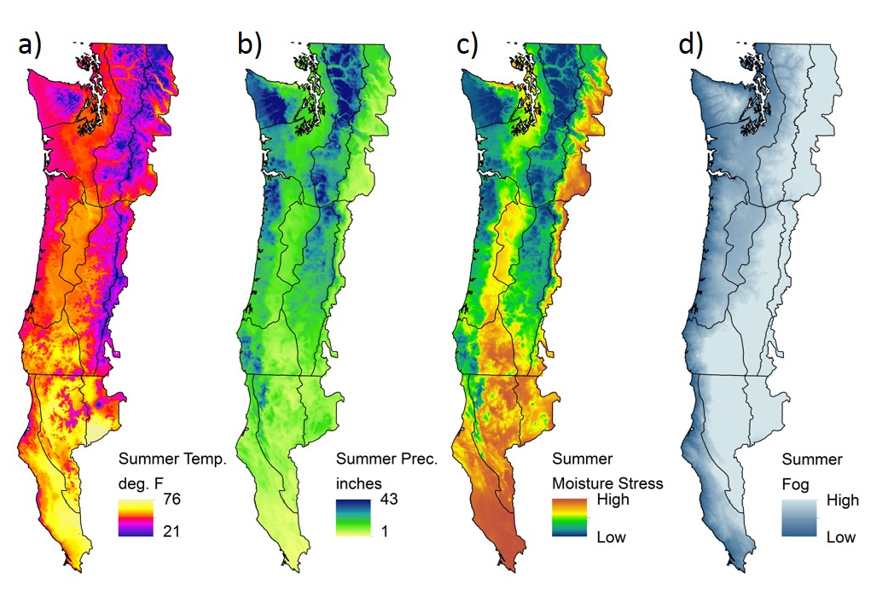
Climatic Variation on the Westside

Slide 5
National Scale Fire Regime Groups
Landfire
FRG I <= 35 Year Fire Return Interval, Low and Mixed Severity
FRG II <= 35 Year Fire Return Interval, Replacement Severity
FRG III 35 - 200 Year Fire Return Interval, Low and Mixed Severity
FRG IV 35 - 200 Year Fire Return Interval, Replacement Severity
FRG V > 200 Year Fire Return Interval, Any Severity

Slide 6
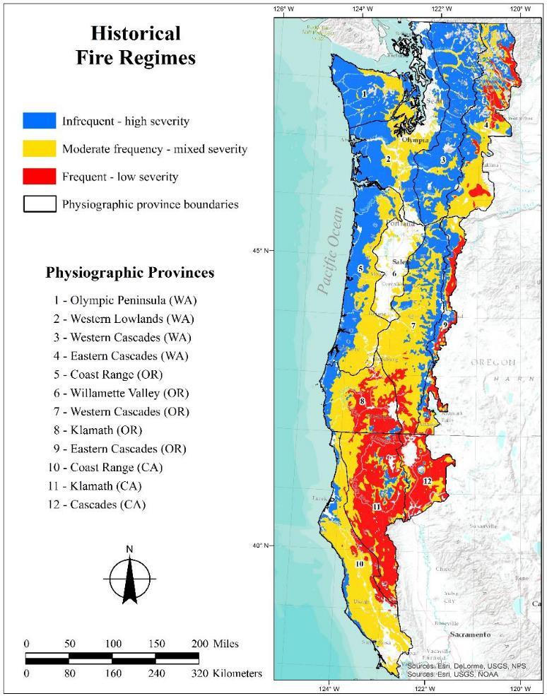
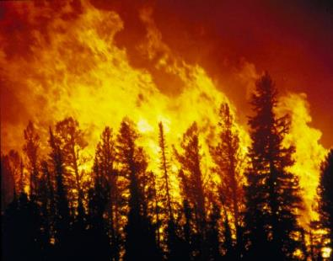
Hypothesized Distribution
Updated Classification of
Historical Fire Regimes
{
Regime | Return interval | Severity Characteristics | Landfire group
Infrequent, high severity | > 200 years | Very large patches of high severity, with moderate and low severity | V
Somewhat infrequent to moderately frequent, mixed severity | 50-200 years | Mixed severity, including large patches of high severity | III
Frequent, Mixed Severity | 15-50 years | Mixed severity, with medium-sized patches of high severity | I and III
Very Frequent, low severity | 5-25 years | Low severity, with fine grained pattern of high severity | I

Slide 7
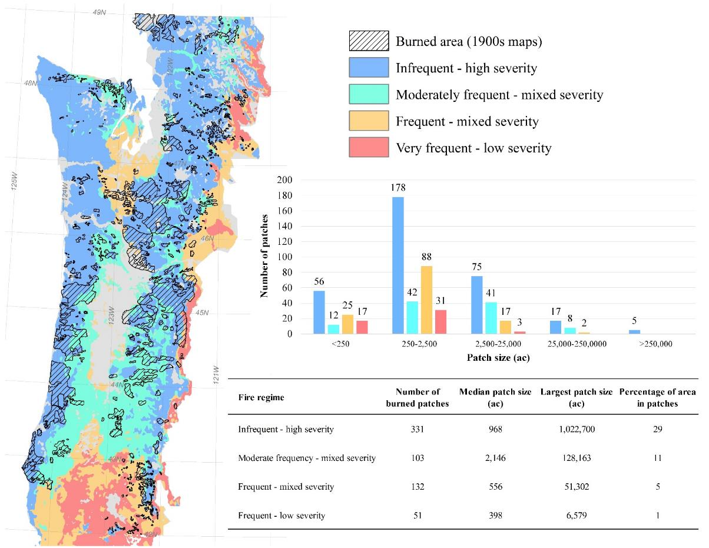
Patches of stand replacement fire/early seral vegetation 1900-1902 by fire regime
Data from Thompson and Johnson 1900 and Plummer 1902

Slide 8
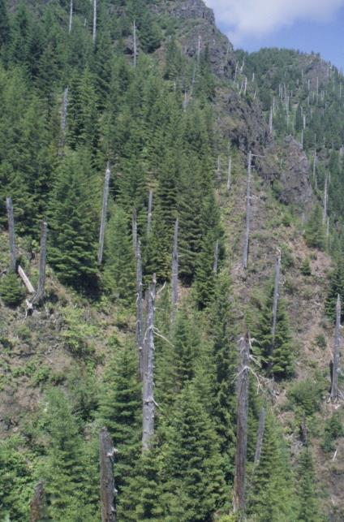
Past Climate Controlled Fire and Old Growth on Westside
Stand replacement disturbances western Cascades, OR
PDO < 0.5 SD below mean
Ring-Width Index
PDO > 0.5 SD above mean
PDO (MacDonald & Case 2005)
Douglas-fir establishment
was regionally episodic
during periods of
widespread fire
Ring-Width Index and the Pacific Decadal Oscillation
4
2
Departure
from Mean
0
-2
Warm
Dry
Climate
Periods
# of Stands
With Cohort
Initiation
16
-4
8
-6
0
1200
1300
1400
1500
1600
1700
1800
1900
2000
Year
6
Douglas-fir Establishment
Percent of
Sampled Trees
4
2
0
1200
1300
1400
1500
1600
1700
1800
1900
2000
Establishment Date
Alan Tepley, HJ Andrews Forest

Slide 9
Fire regime characteristics based on landscape simulation model of
Oregon Coast Range
Wimberly 2002

Slide 10
Hypothesized Shifting Mosaic of Succesional Stages in Coast Range
Wimberly 2002

Slide 11
Successional dynamics of westside forests
A common successional pathway following
stand replacement disturbance in
moist forests of the westside
From Franklin et al. 2017

Slide 12
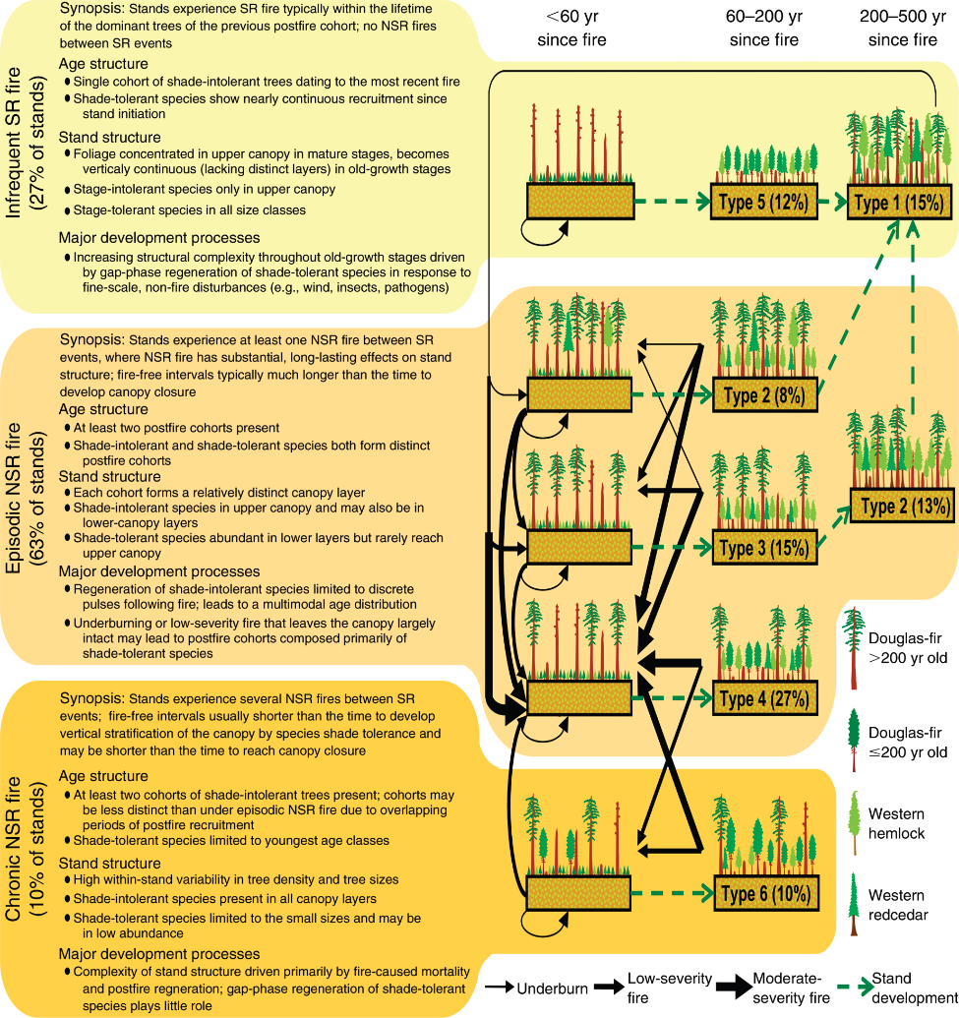
New Perspectives on fire and succession in Western Cascades of Oregon
Non
Stand replacement,
long interval between fires
27%
Partial stand replacement fire,
episodic, more frequent fire
63%
Partial stand replacement fire,
chronic fire
10%
Tepley et al. 2013

Slide 13
Mixed Severity Fire Mosaic in Western Oregon Cascade
High mortality
Medium mortality
Low mortality
Morrison and Swanson
1990

Slide 14
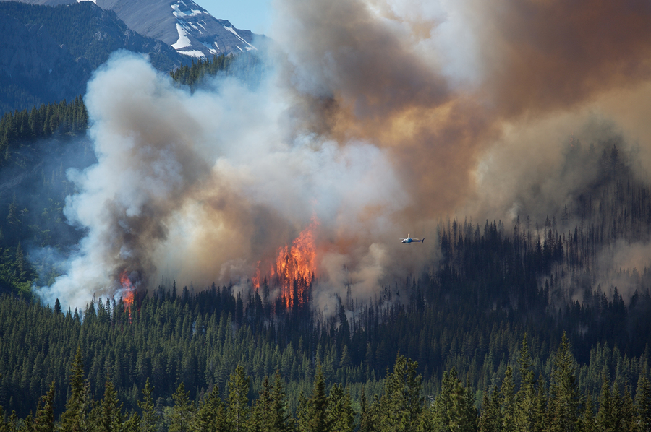
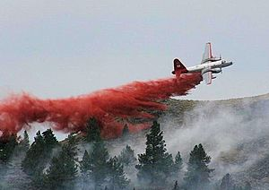
Recent Fire Regimes

Slide 15
Climate explained 36% of variance in area burned for East and West Cascades:
(Low precipitation during fire season)
Littell et al. 2009

Slide 16
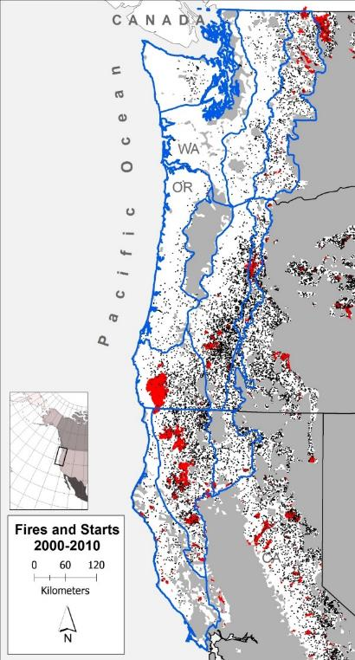
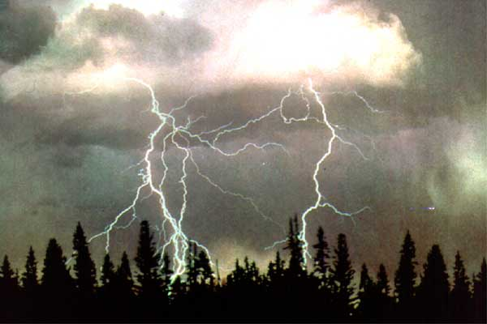
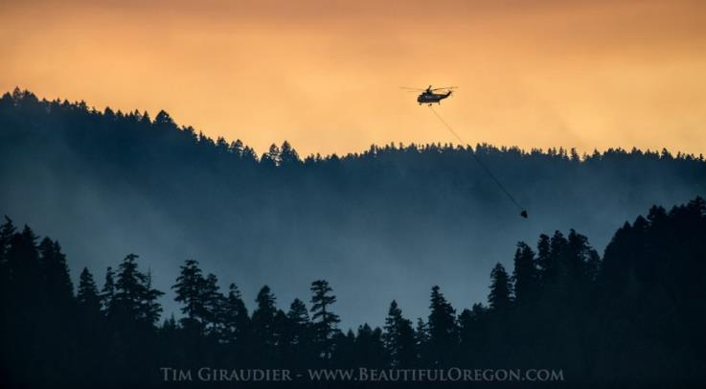
Lightning Fire Starts in NWFP Area
and Large recent fires

Slide 17
Recent Fire Regimes 1985-2010
Zone | High Severity Extent (ha) | All Fires Extent (ha) | High Severity Rotation (yrs) | All fire Rotation (yrs)
Western Hemlock | 10,242 | 50,083 | 18,594 | 3,802
Silver fir | 10,302 | 24,610 | 4,471 | 1,871
Mountain hemlock | 17,771 | 37,726 | 1,888 | 889
Subalpine fir | 114,259 | 245,979 | 379 | 176

Slide 18
Suppressed Lightning
Fire Starts 1992-2013
Fire Regime | Number of starts suppressed | Starts suppressed per 25,000 acres
Infrequent-high severity | 4271 | 12.2
Moderately frequent-mixed severity | 2350 | 13.4
Frequent-mixed severity | 2511 | 15.2
Very frequent-low severity | 4240 | 17.4

Slide 19
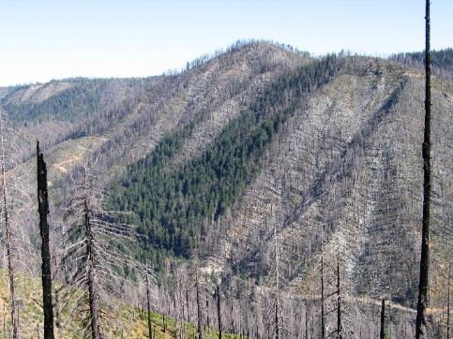
Fire Severity in PNW
Reilly et al. 2017

Slide 20
Trends in annual fire extent
and relation to Palmer Drought
Severity Index
Western Hemlock
Silver Fir
Mountain Hemlock
Subalpine Fir
Reilly et al. 2017

Slide 21
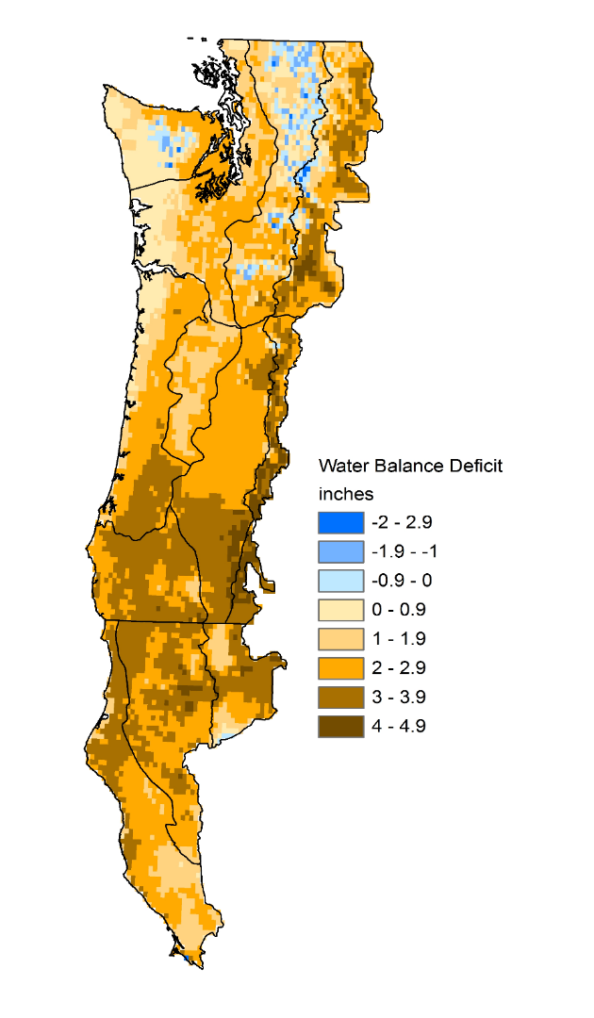
Projected Changes in Summer Water Balance
2030 – 2059 relative to 1916-2006
(Littell et al. 2016)
Climate Change

Slide 22
Projected future fire under climate change
Variable | Historical % burned per year | Percent Change in Future 2070-2099
 |  | CSIRO | MIROC | Hadley
Burn area | 0.143 | +161 | +160 | +1177
West Side Forests
Rogers et. al 2011
Variable | 2011-2040 | 2071-2100
Burned area | 475 ha | 507 ha
Oregon Coast Range
Creutzburg et al. 2017

Slide 23
Projected Burned Area Washington
ha
1980s-2006
2020’s
2040’s
2080’s
Littell et al. 2010

Slide 24
Summary
Variation in historical fire regimes of moist westside forests
Infrequent, high severity fire, very large HS fire patches
Moderately frequent, mixed severity fire with large HS fire patches
Climate variation affected fire occurrence
Multiple successional pathways across region

Slide 25
Summary
Despite increase in fire in western U.S.
Fires have been rare in westside forests
Except subalpine forests
Thousands of fires have been suppressed
Probably less early seral vegetation than historical for current climate
Increases in fire under climate change but amount of increase is uncertain
Challenge for fire-related biodiversity on westside
Fire suppression still needed
How to provide for early successional habitats and landscape diversity

