Slide 1

Ecological Functions of Wood in Streams: What’s New?
Gordon Reeves
PNW Research Station
Corvallis, OR

Slide 2
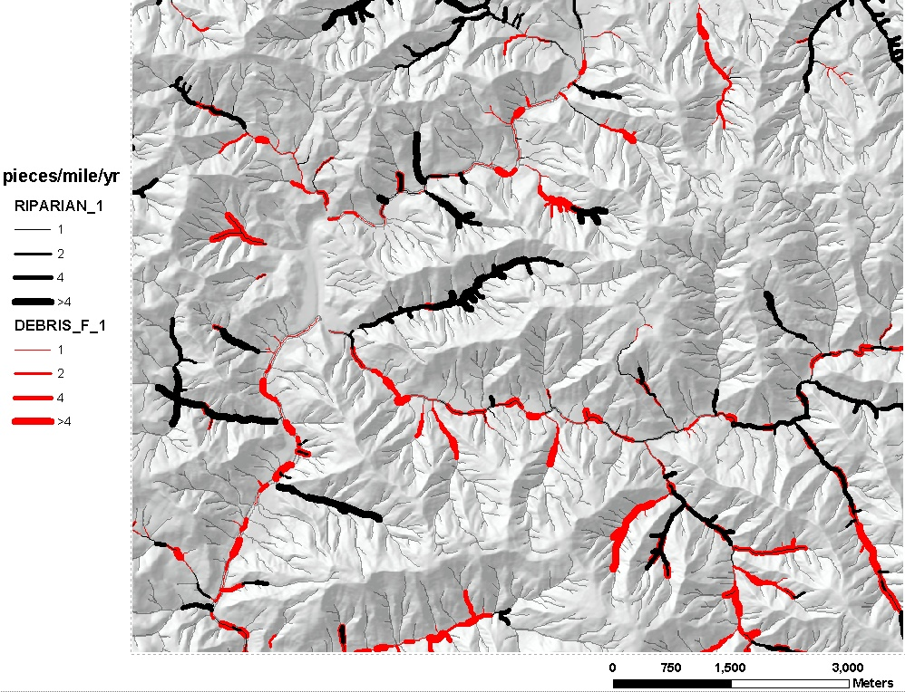
LWD Input
0.2-0.5 m diameter

Slide 3
LWD Input
0.2-0.5 m diameter

Slide 4
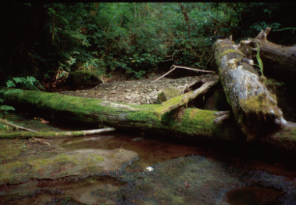

Slide 5
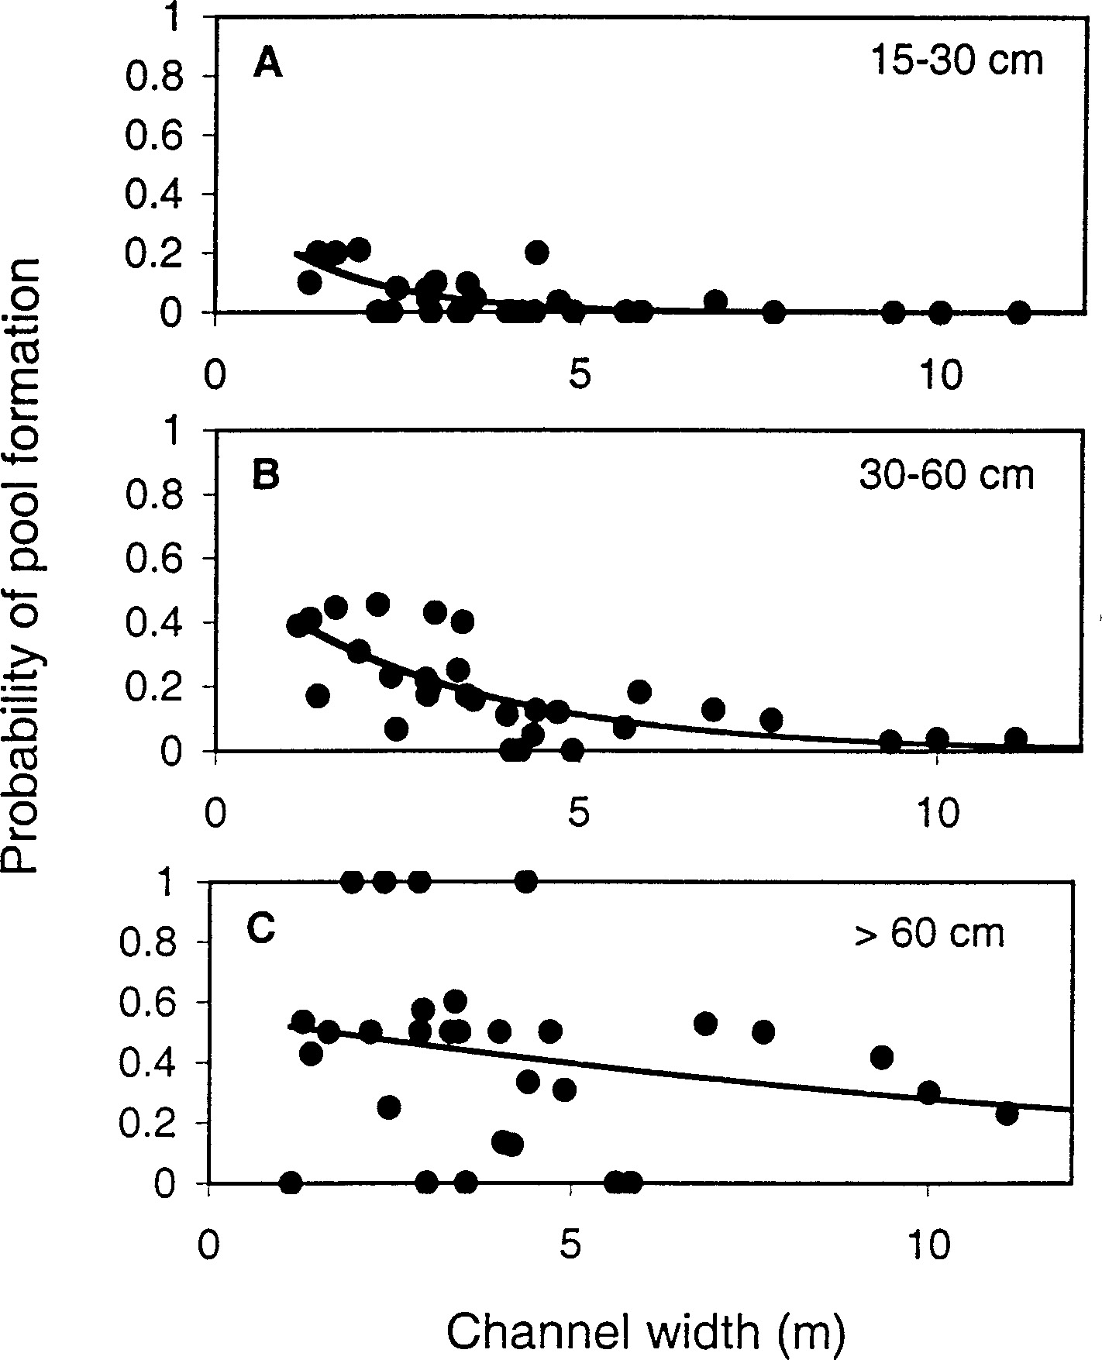
Probability of Pool Formation of Different Sizes of
Pieces of Wood and Channels
(From: Rosenfeld and Huato 2003.)

Slide 6
Probability of Pool Formation of Different Sizes of
Pieces of Wood and Channels
(From: Rosenfeld and Huato 2003.)

Slide 7
Probability of Pool Formation of Different Sizes of
Pieces of Wood and Channels
(From: Rosenfeld and Huato 2003.)

Slide 8
LWD Input
0.2-0.5 m diameter

Slide 9
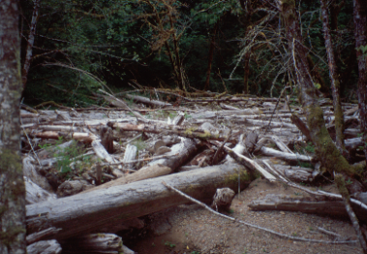

Slide 10
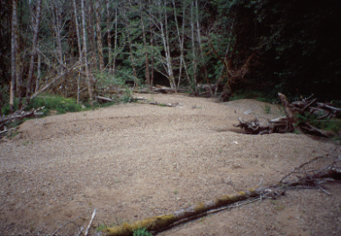

Slide 11
Sediment Stored by Wood in the Mainstem of Skate Creek
41% of the sediment was stored behind individual logs or small accumulations.
59% of the sediment was stored behind two large debris dams.
From: C.L. May 2003

Slide 12
Pools
Small Basins, Distance from All Fans
25
(m / 25 m)
20
mean
15
Deep pool frequency
10
5
0
0-13
14-31
32-50
51-113
Distance from tributary fan (m)

Slide 13
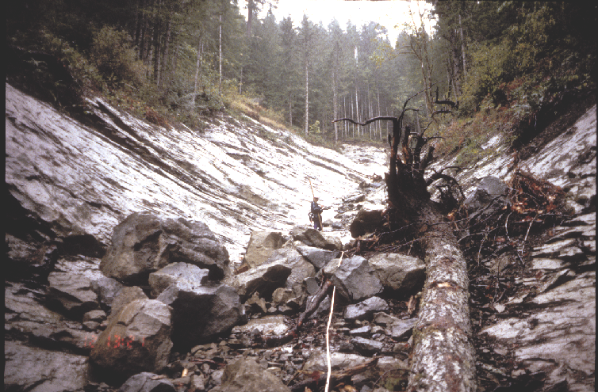
From: C.L. May

Slide 14
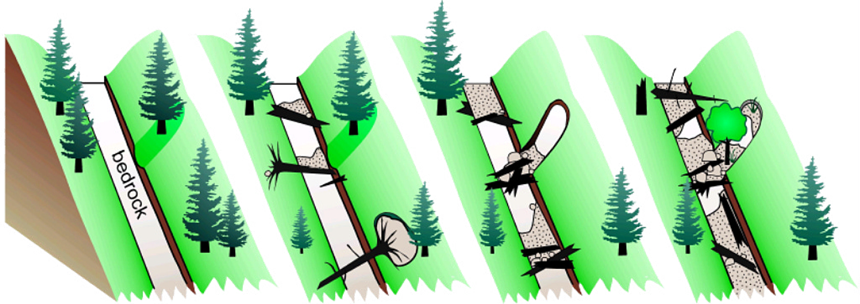
Channel Change over Time
0 to 30 yrs
60 to 90 yrs
> 90 yrs
Conceptual illustration of changes in channel morphology of headwater streams based on the time since previous disturbance. From: C.L. May

Slide 15
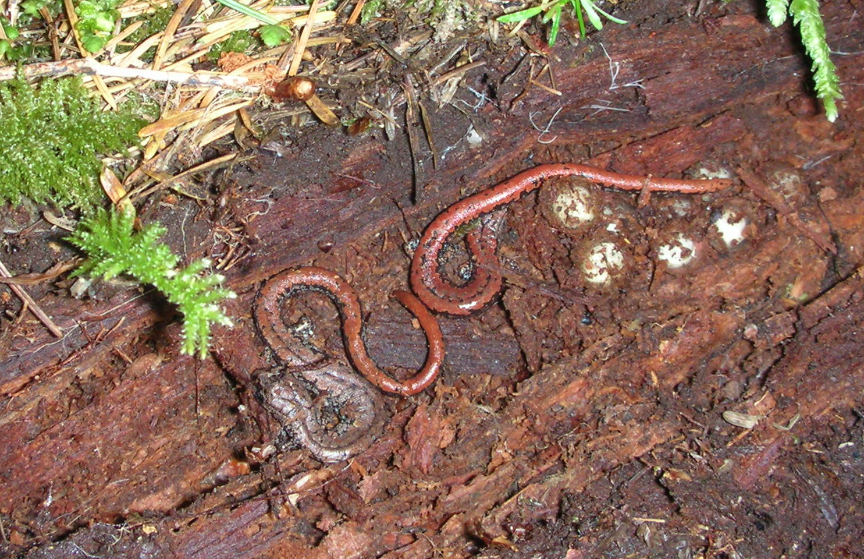
Other Functions of Wood
Provide habitat for terrestrial organisms (bats, birds, reptiles, amphibians, & small mammals)
Mycorrhizal fungi (Amaranthus et al. 1996).
Soil components (Harvey 1993, Harvey et al. 1976)
Oregon Slender Salamanders (Batrachoseps wrighti) guard a nest in a large, rotting log. Photo: L. Ellenburg, USFS

Slide 16
From: M. Pollack
Projected number of pieces of large wood delivered to the stream channel under different management scenarios

Slide 17
From: M. Pollack
Projected number of pieces of large wood delivered to the stream channel under different management scenarios
Amount needed?

Slide 18
From: M. Pollack
Projected number of pieces of large wood delivered to the stream channel under different management scenarios

Slide 20
Riparian Functions vs. Distance

Slide 21
Wood Accumulation vs. Distance
Comparison of RAIS predictions of total wood accumulation with distance from channels with observation of McDade et al. (1990). Figure from Welty et al. 2002.

Slide 23
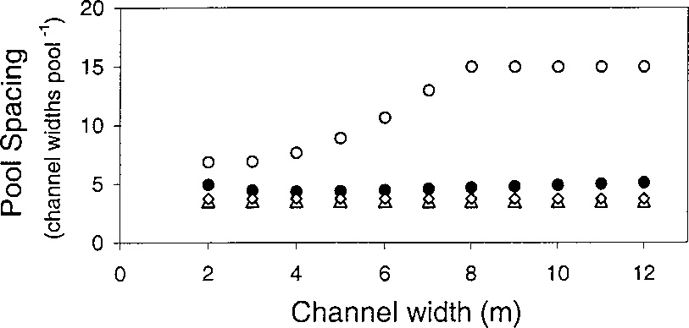
Predicted, all classes (Eq. 1)
Power function, >0.6 m removed
Predicted, >0.6 m removed
Power function, all classes
Modeled pool spacing plotted against channel width, where pool spacing was calculated as a power function of total LWD abundance either with all diameter classes included (triangles) or with the largest diameter class removed (diamonds). The solid circles show the pool spacing predicted by the diameter-specific probability model (equation 1 in text) with all diameter classes of LWD included; the open circles show the predicted pool spacing with the largest diameter class (0.60 m) removed. (From: Rosenfeld and Huato 2003.)
Notes:
Modeled pool spacing plotted against channel width, where pool spacing was calculated as a power function of total LWD abundance (pool spacing 5 2.67 3 (LWD/m)20.33) either with all diameter classes included (triangles) or with the largest diameter class removed (diamonds). The solid circles show the pool spacing predicted by the diameter-specific probability model (equation 1 in text) with all diameter classes of LWD included; the open circles show the predicted pool spacing with the largest diameter class (0.60 m) removed. (From: Rosenfeld and Huato 2003.)

