Slide 1



Forest harvest effects on temperature
of small headwater streams
with and without riparian buffers
Steven M. Wondzell, Jack E. Janisch, William J. Ehinger, and Peter A. Bisson
With help from:
Alex Foster, Shannon Claeson, and Jeff Rickleffs
Janisch, J. E., Wondzell, S. M., and Ehinger, W. J. 2012.
Headwater stream temperature: Interpreting response after logging,
with and without riparian buffers, Washington, USA.
Forest Ecology and Management 270:302-313.

Slide 2
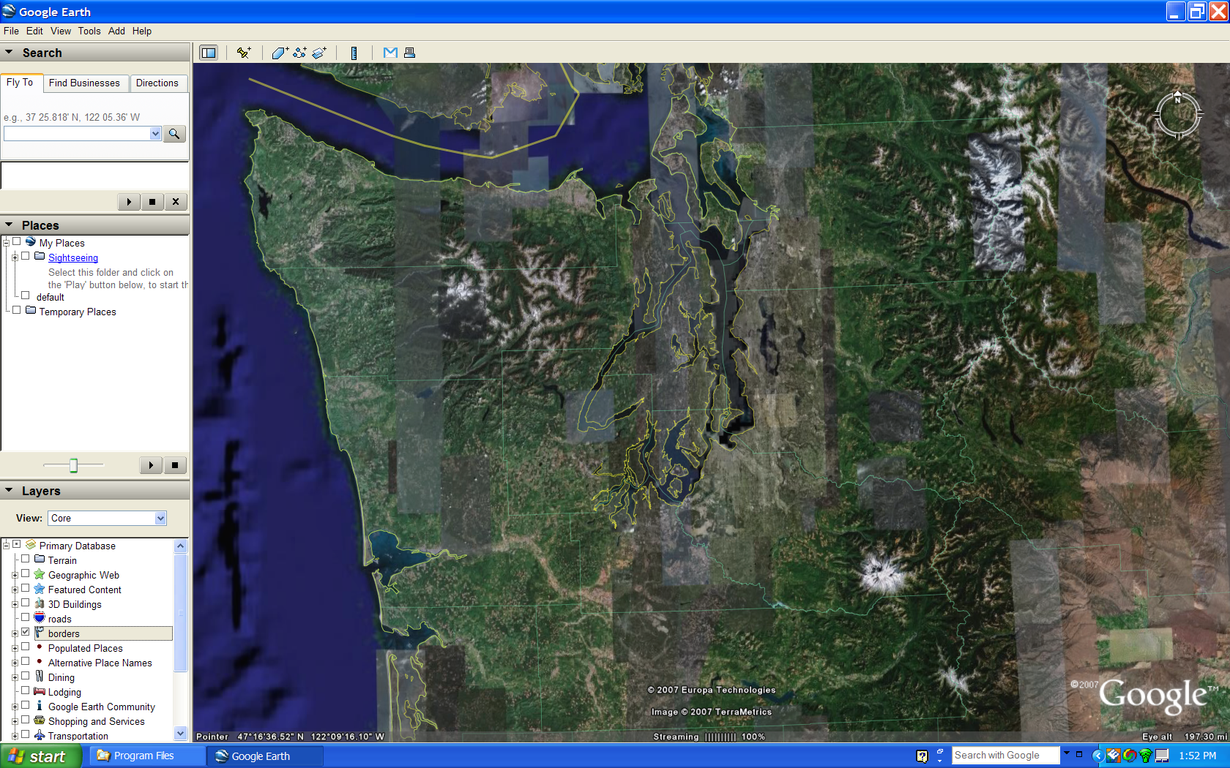
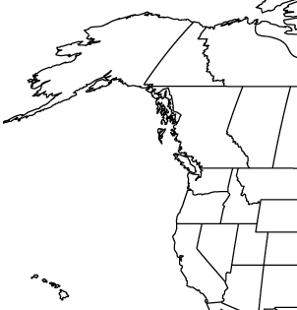
G
O
O
G
L
E
E
A
R
T
H
Capitol
Forest
Willapa
Hills

Slide 3
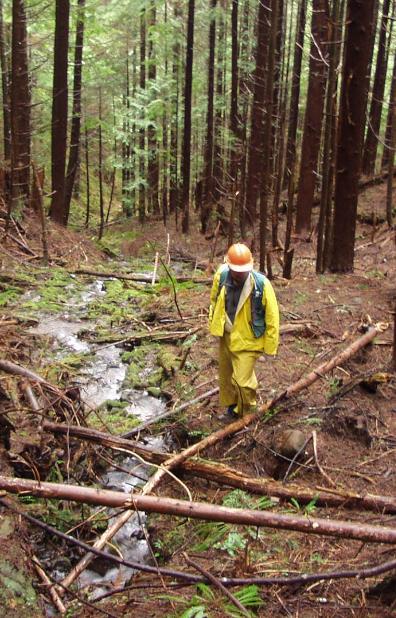
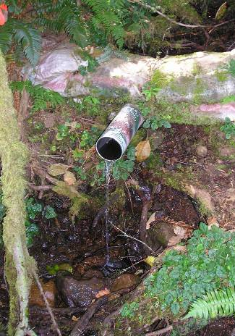
Area: 1.1 - 7.6 ha
Winter Q: 0.1 - 9.6; x = 2.1 l/s
Summer Q: 0.0 - 1.8; x = 0.3 l/s

Slide 4
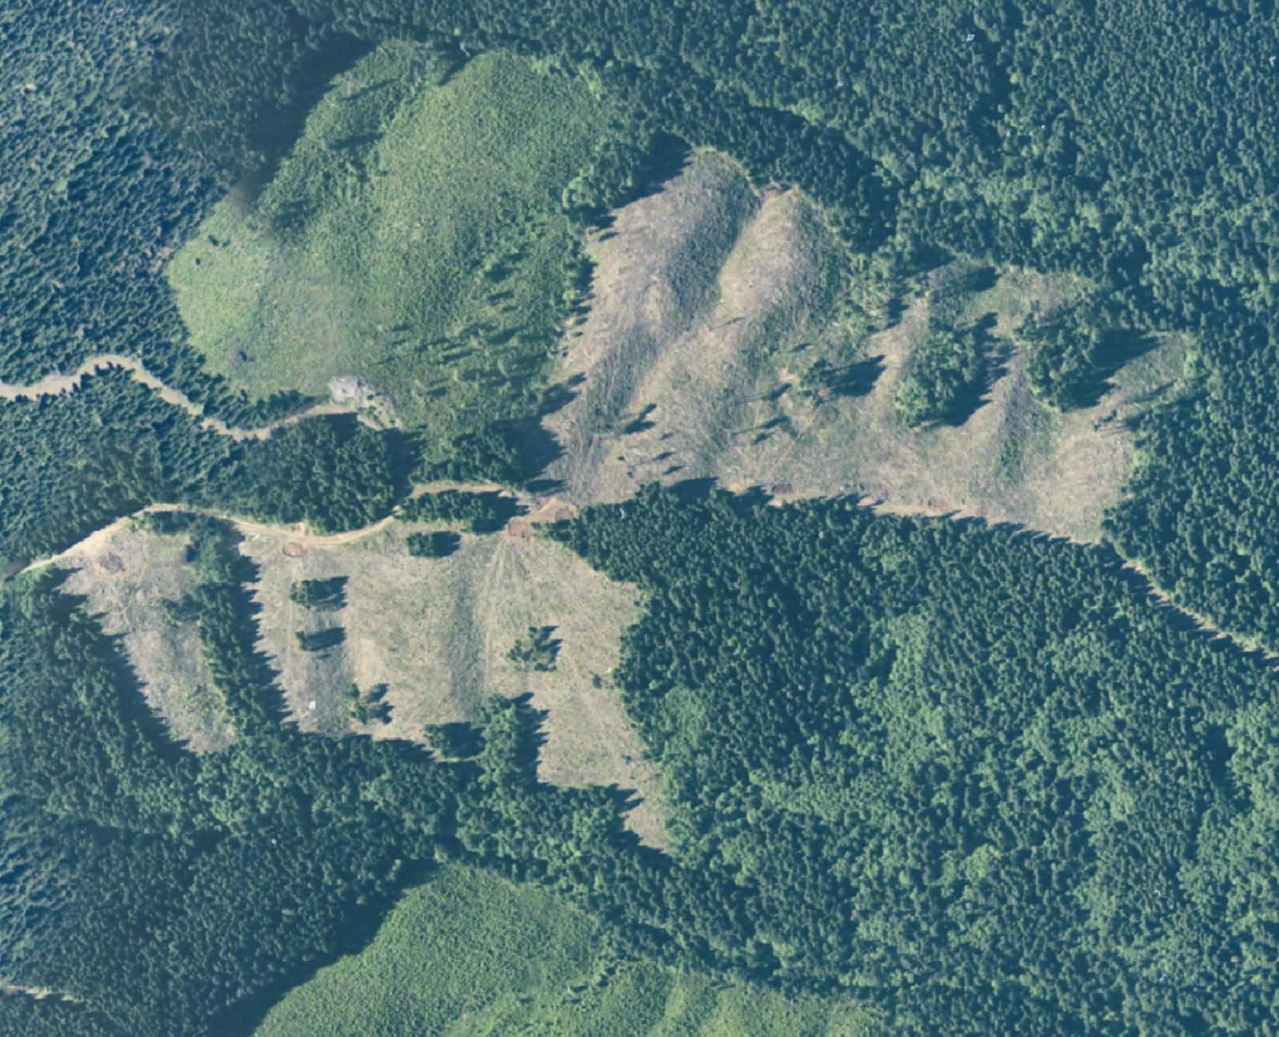

Slide 5
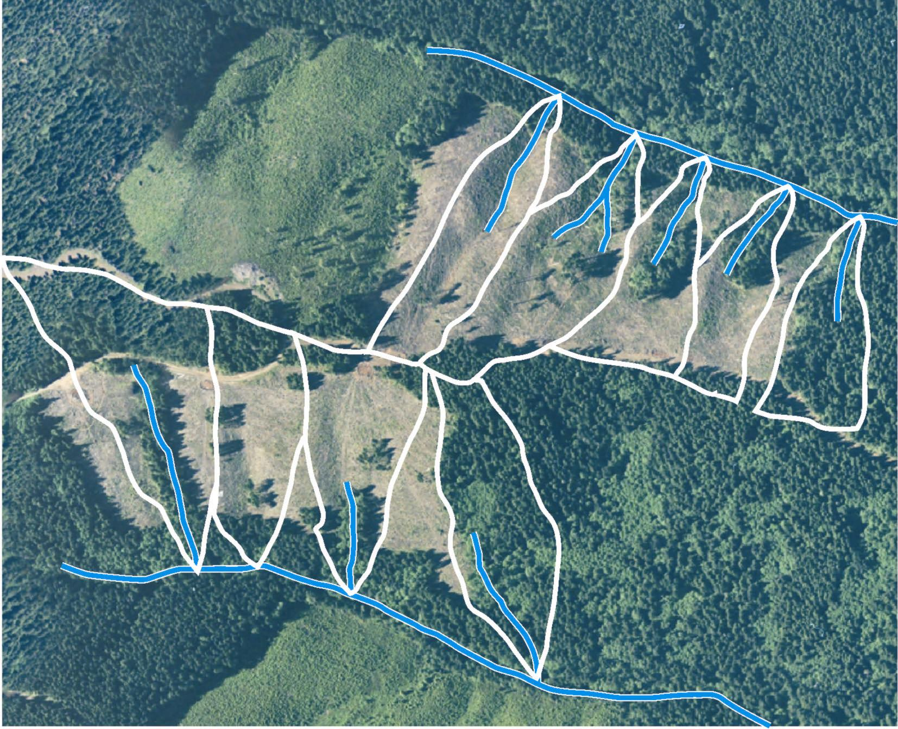

Slide 6
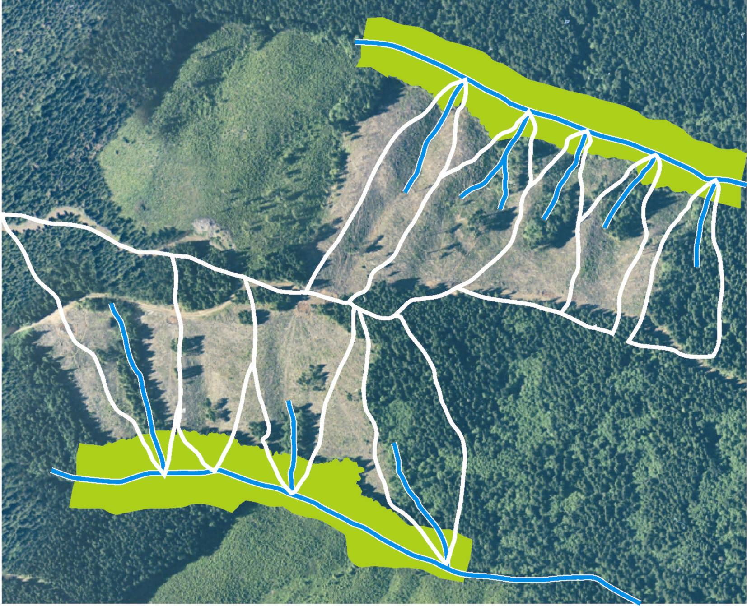

Slide 7
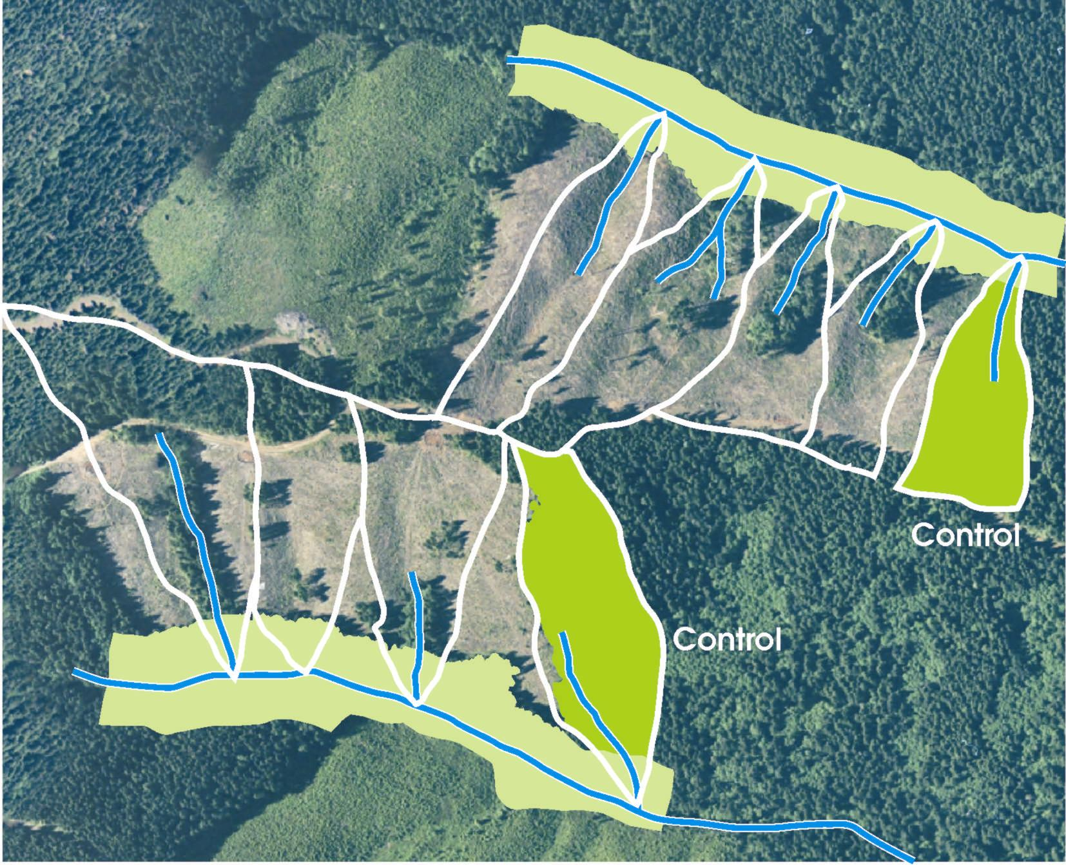

Slide 8
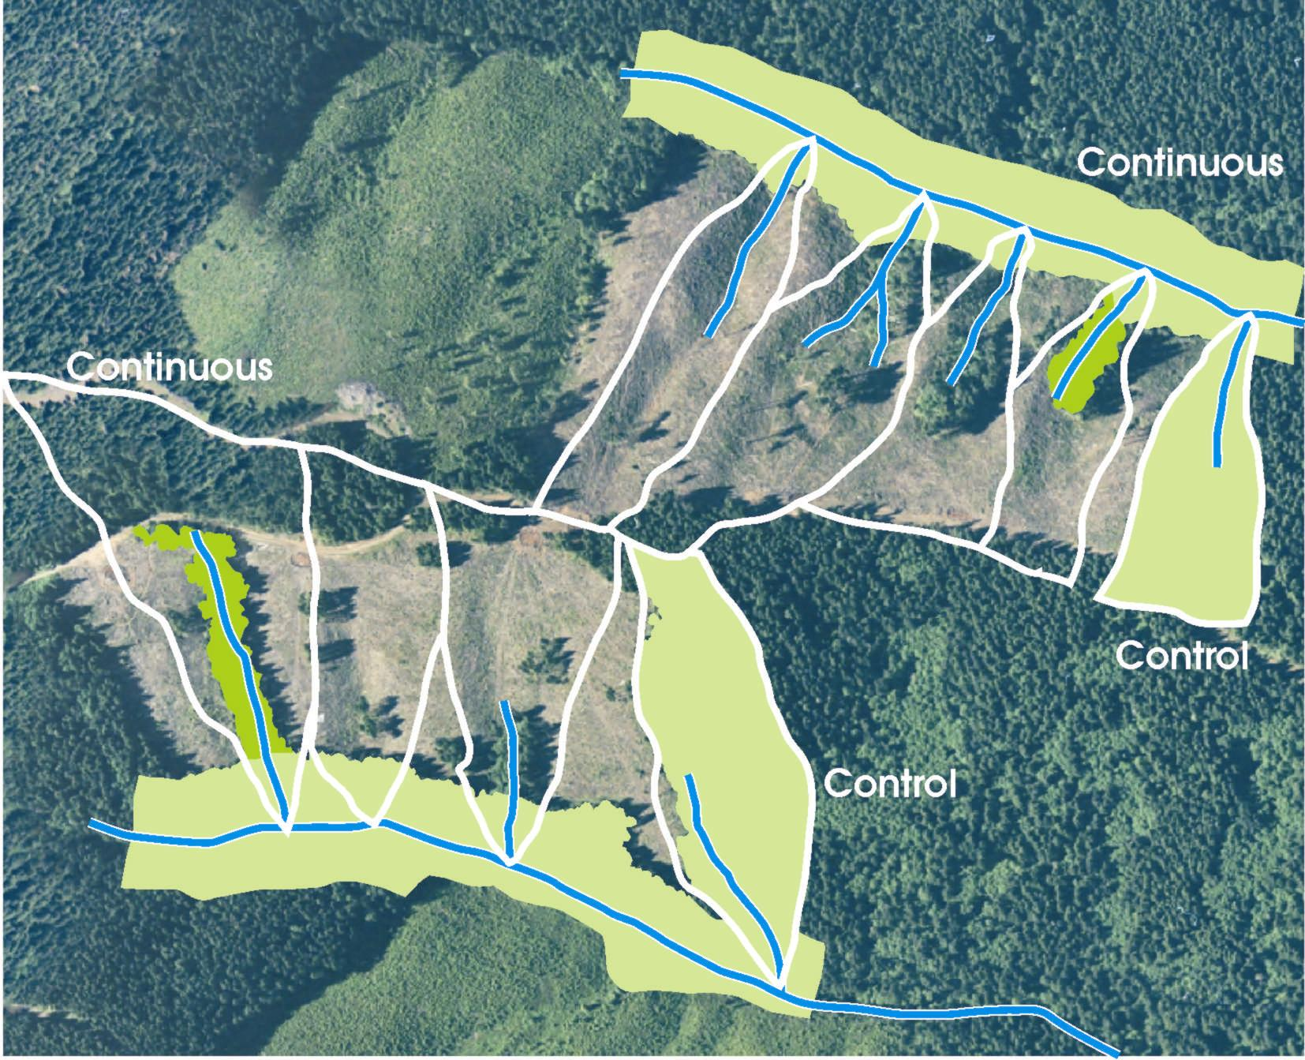

Slide 9
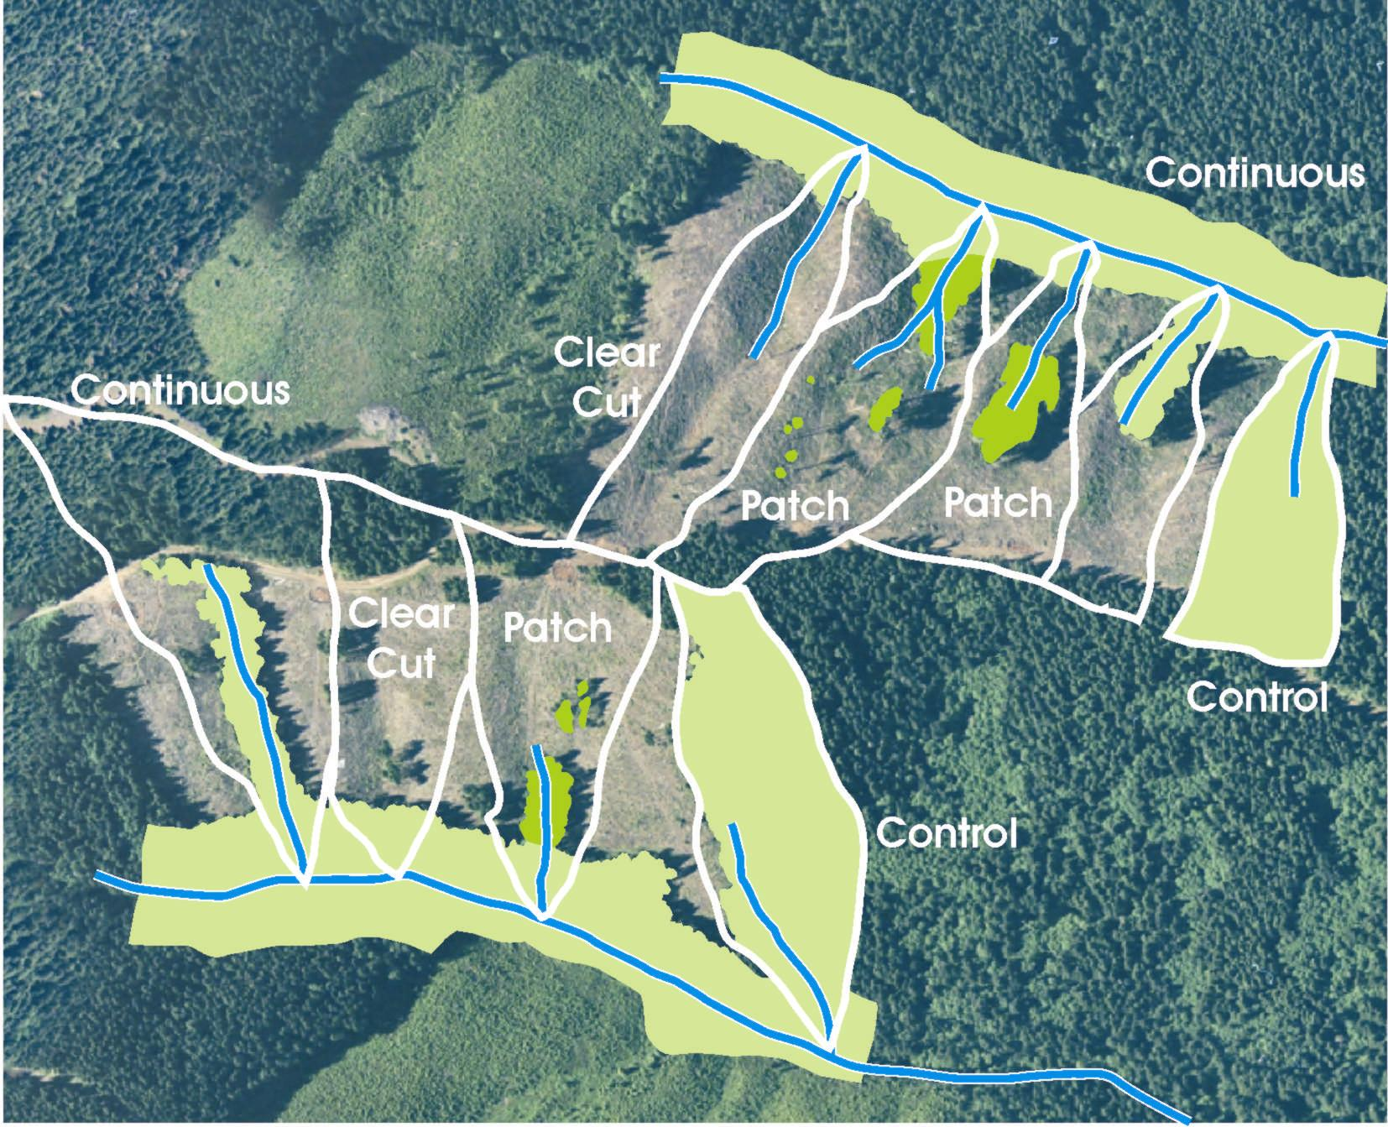

Slide 11
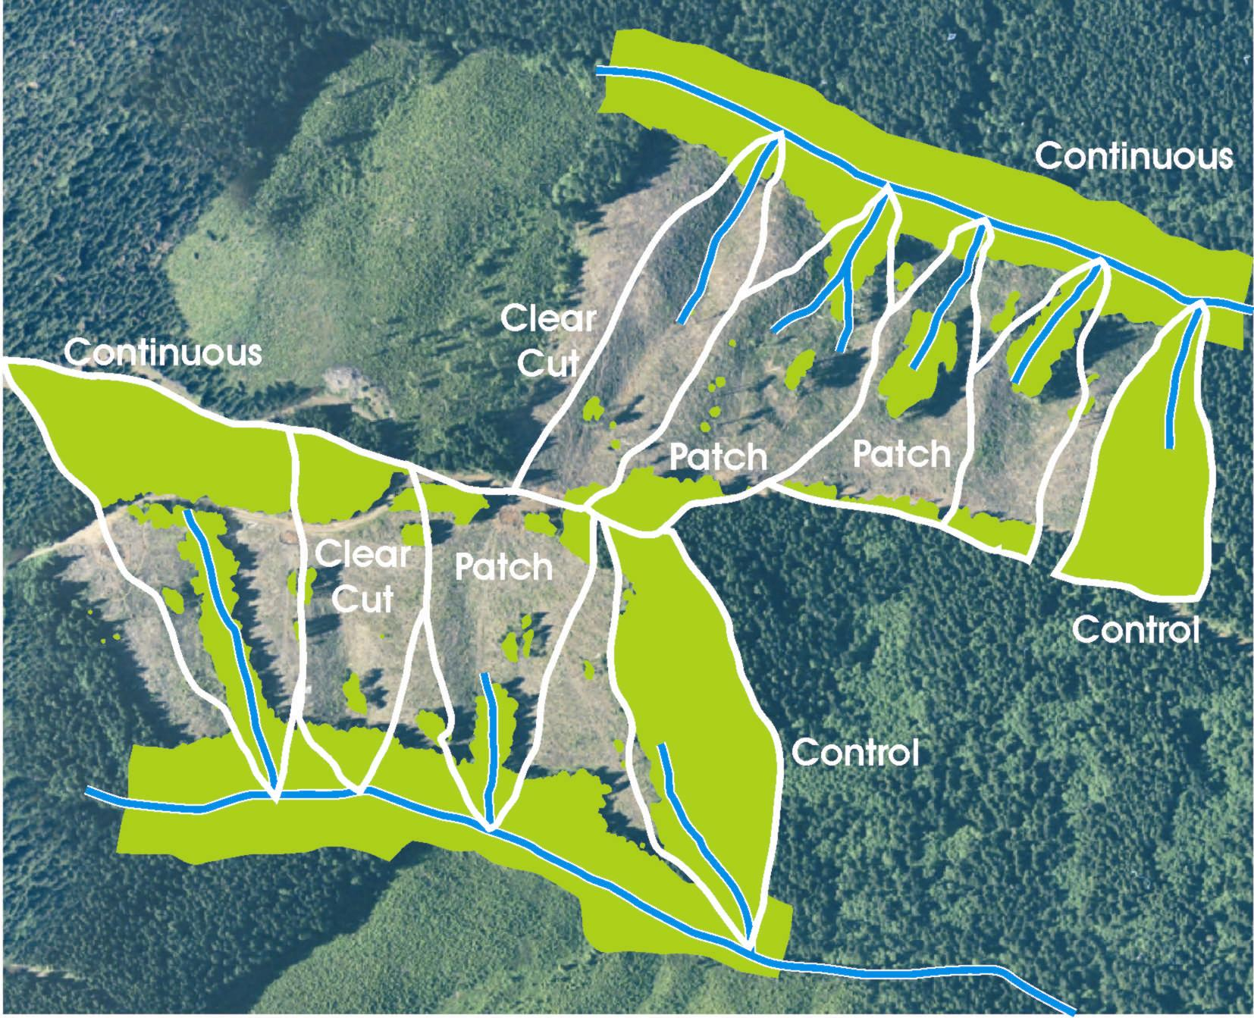

Slide 12

Temperature sensors
at each wier

Slide 13
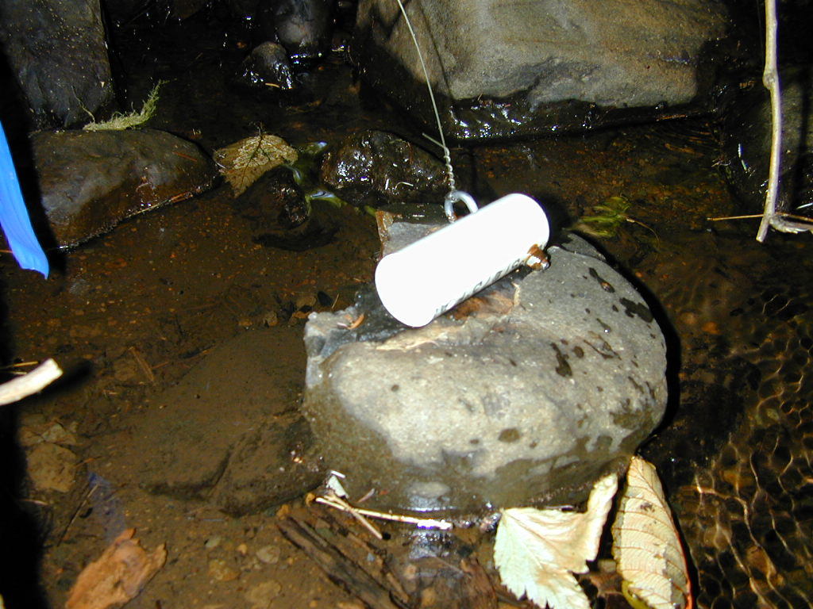

Slide 14
So…… for tiny headwater streams?
Does forest harvest increase stream temperature?
Do riparian buffers limit temperature increases?

Slide 15
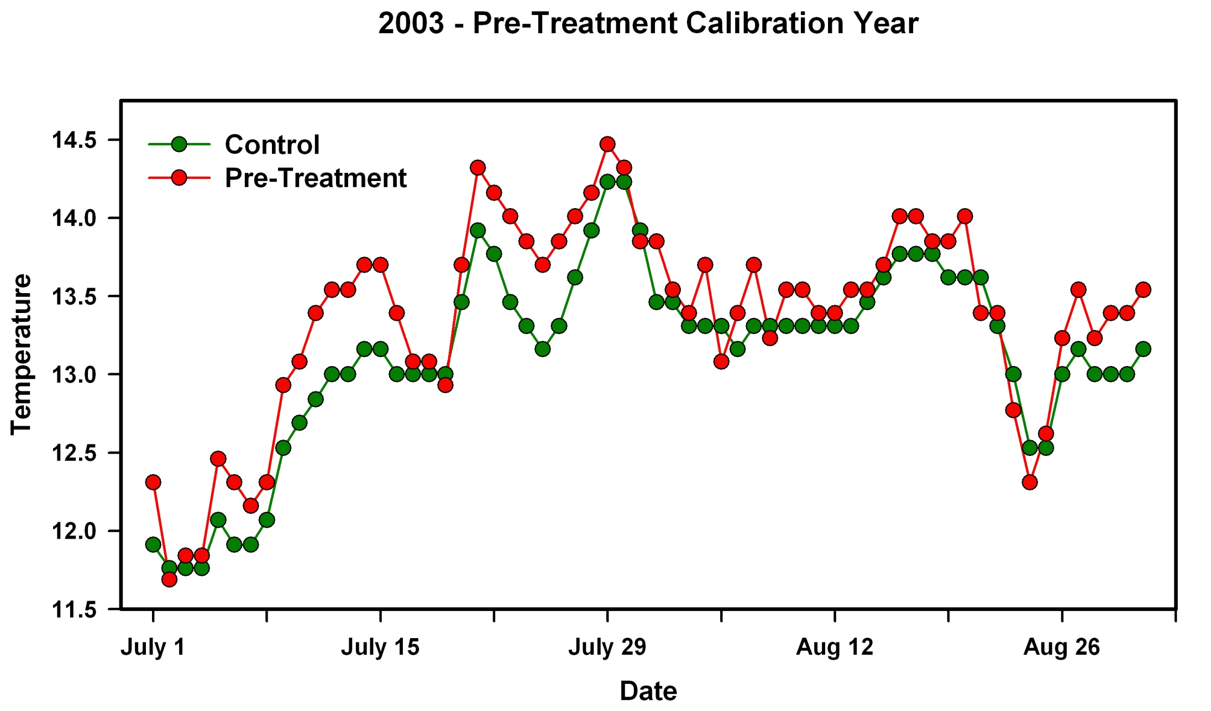

Slide 16

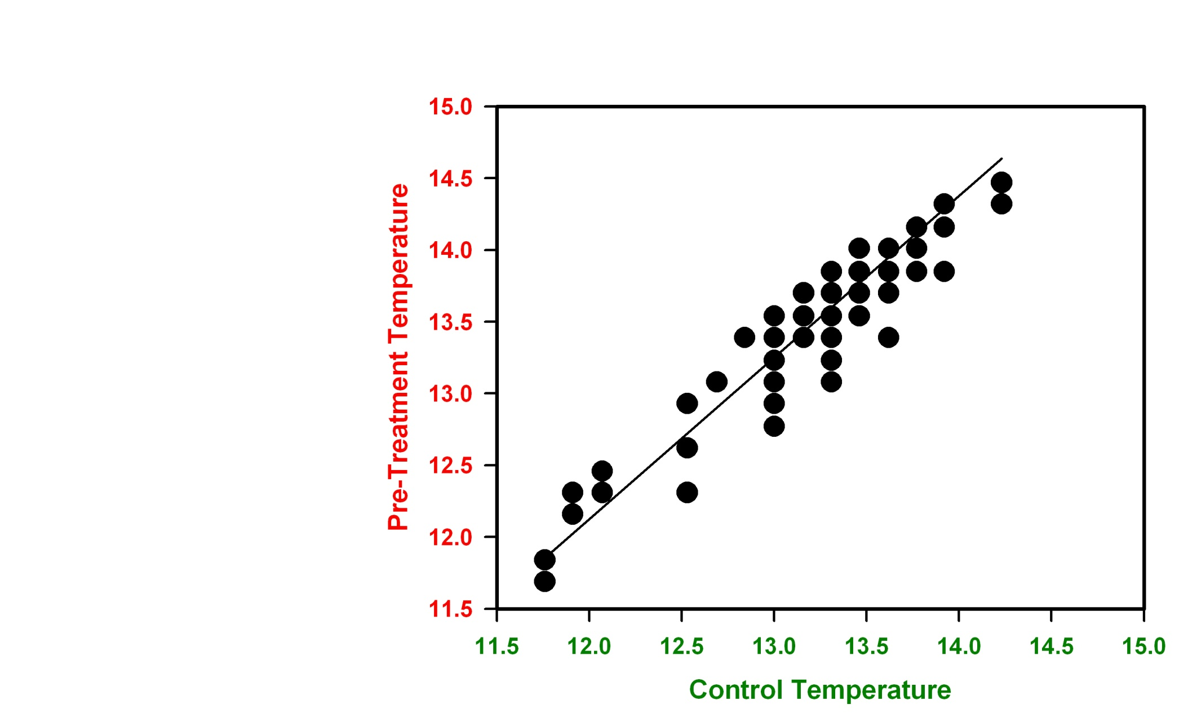
T_{predicted} = -0.23 + 1.18*T_{control} + 1.33*sin(2πj/365) + 1.59*cos(2πj/365) + є
r² = 0.9166

Slide 17
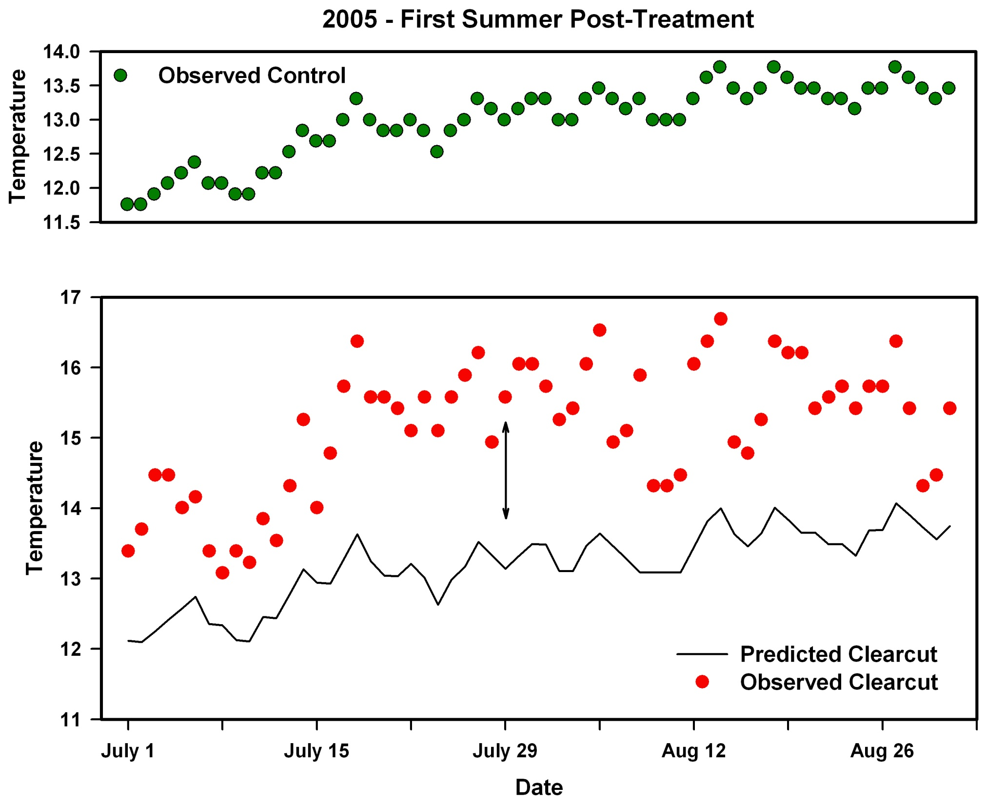


Slide 18
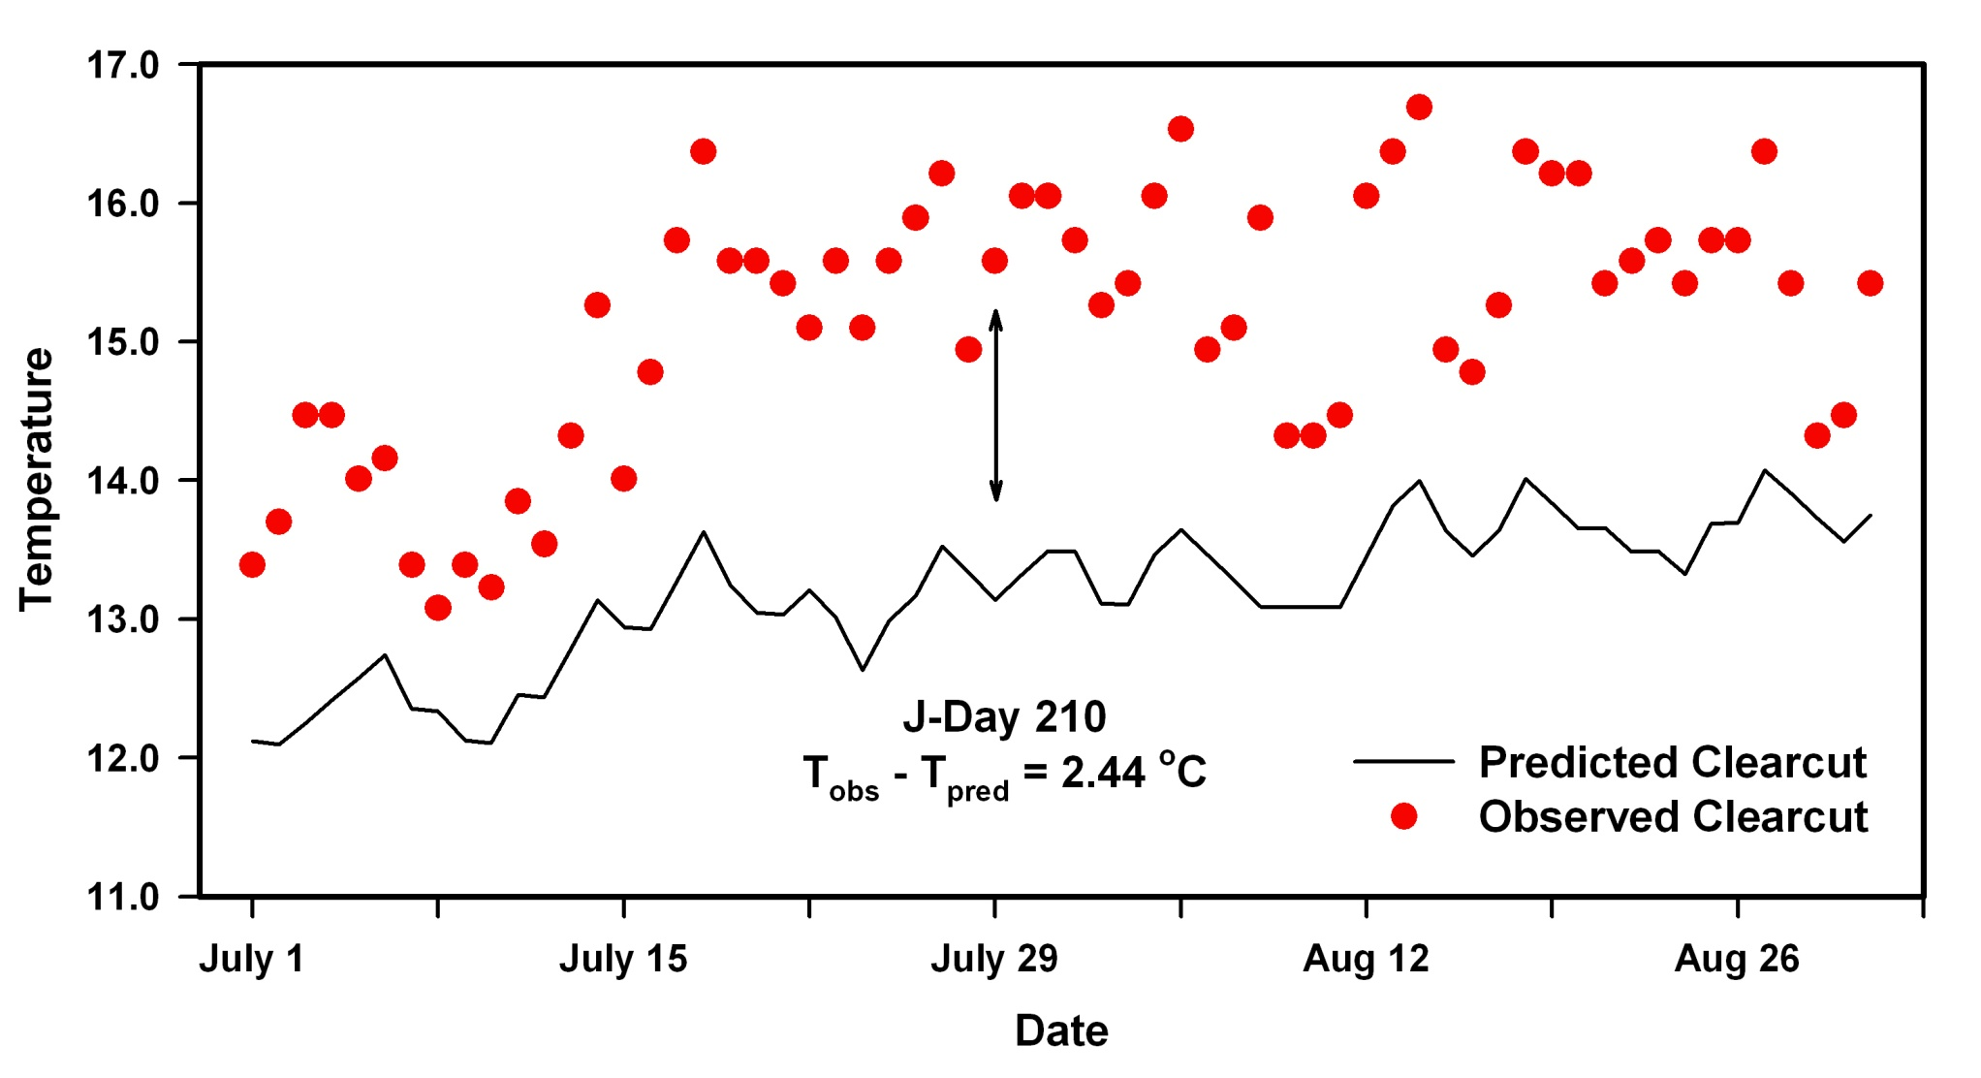

Slide 19
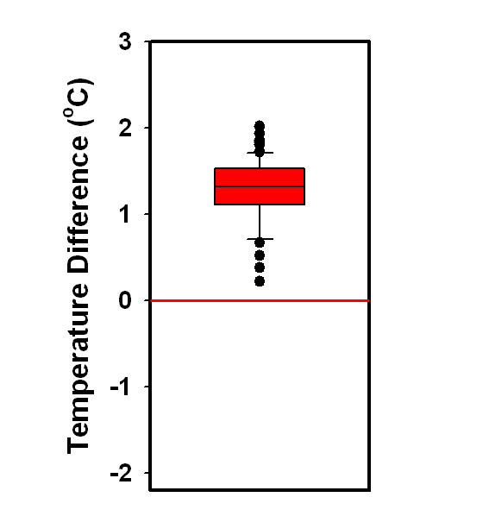

Slide 21
WILLAPA HILLS
ELFL | Control
 | Continuous
 | Clearcut
LORI | Control
 | Continuous
 | Patch
 | Clearcut
MCCO | Control
 | Continuous
 | Patch
SPLT | Control
 | Continuous
 | Clearcut | Clearcut
CAPITOL FOREST
MOSH | Control
 | Continuous
 | Patch | Patch
ROTT | Control
 | Continuous | Continuous
 | Clearcut
SESA | Control
 | Continuous
 | Clearcut
TAGS | Control
 | Continuous
 | Patch | Patch
 | Clearcut
Capitol
Forest
Willapa
Hills

Slide 22
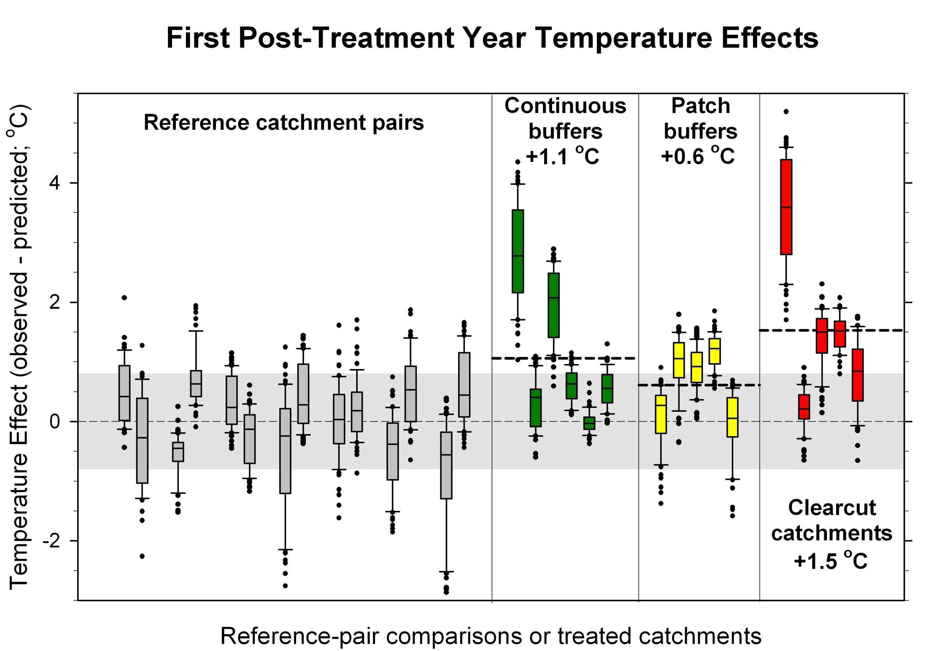

Slide 23

Descriptive variables
Elevation
Area
Aspect
Gradient
Depth
Canopy+Topographic density
Wetted channel
Wetland area
Streambed texture
No direct measurement of Shade

Slide 24
Descriptive variables
Elevation
Area
Aspect
Gradient
Depth
Canopy+Topographic density
Wetted channel
Wetland area
Streambed texture
?

Slide 25
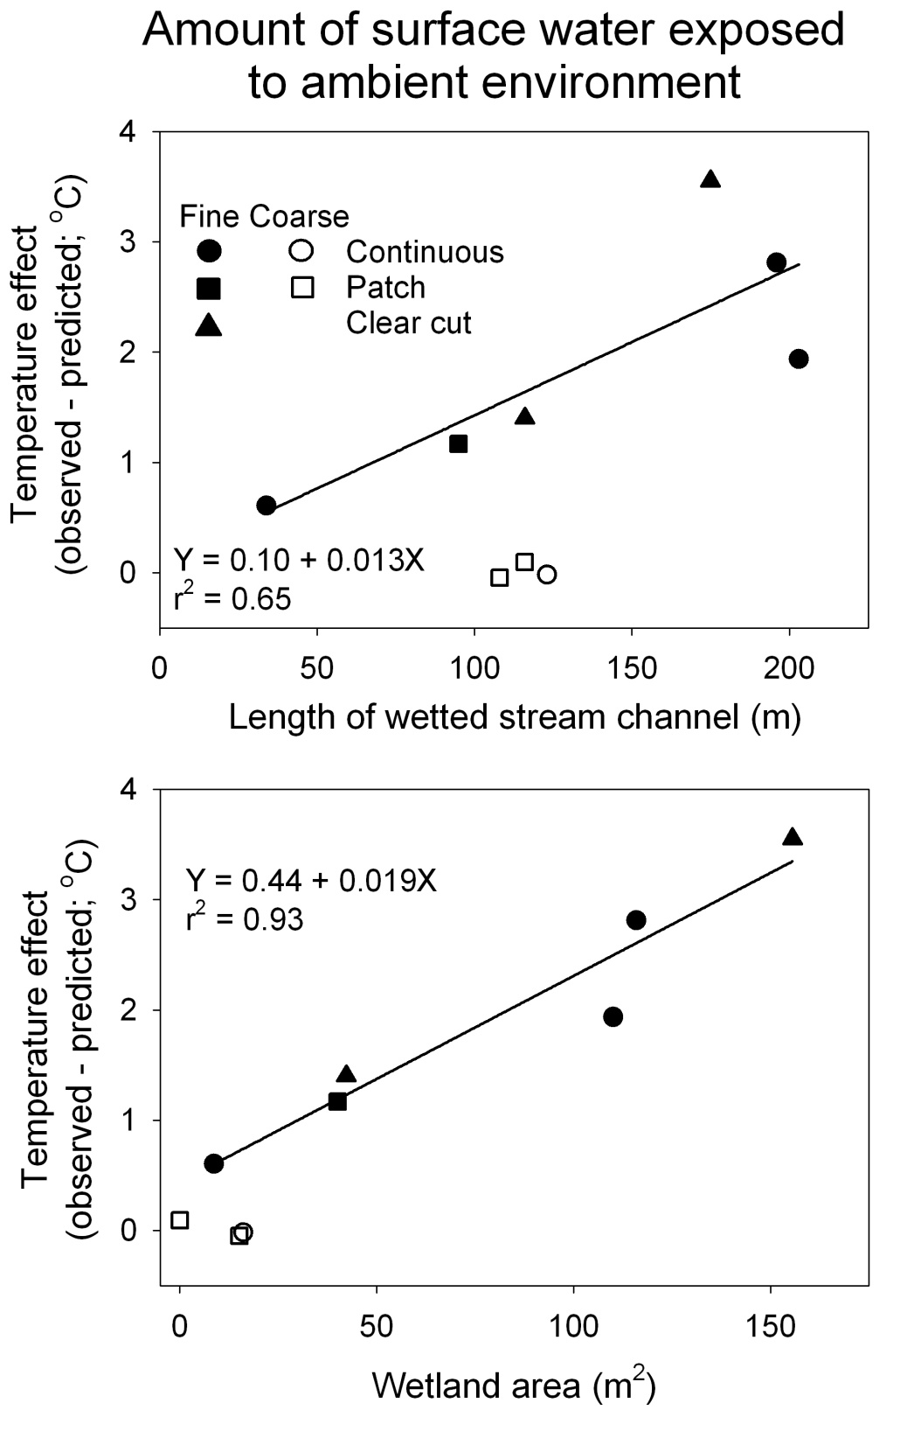

Slide 26
Results Summary:
Some treated streams were significantly warmer, but…
On average, temperature increases were small
Trend did not match expectations for treatments,
Responses within treatments were highly variable
Temperature responses were correlated with
streambed texture, wetlands, and length of stream
Surface area exposure
Amount of hyporheic exchange

Slide 27
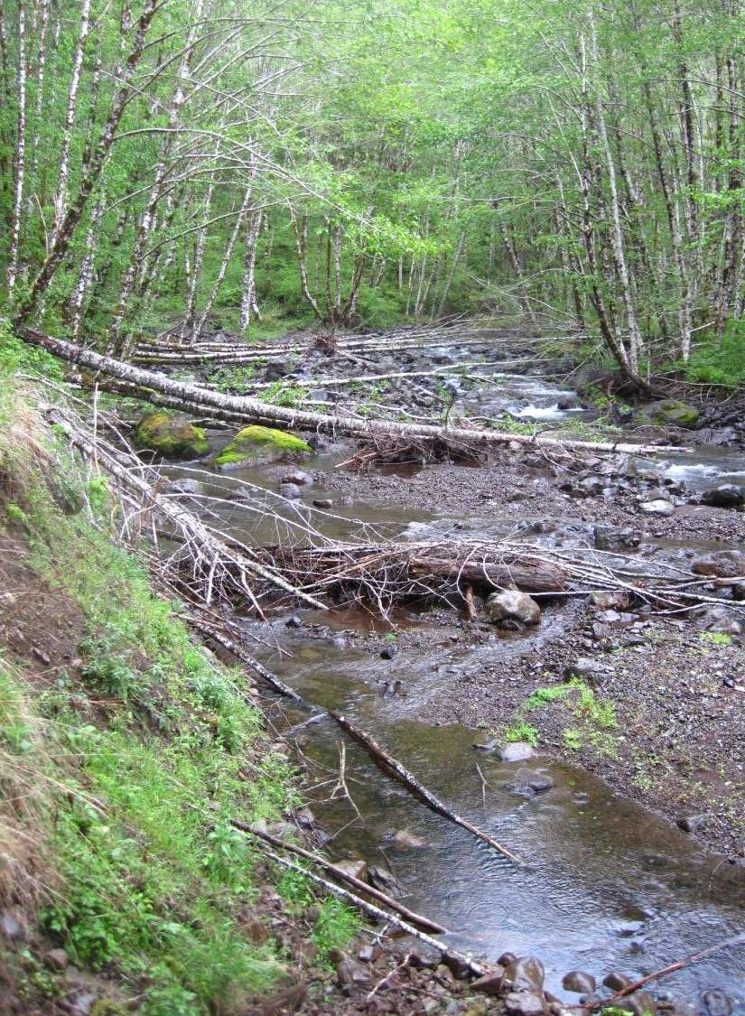

Slide 28
So…… for tiny headwater streams?
Does forest harvest increase stream temperature?
Do riparian buffers limit temperature increases?

Slide 29
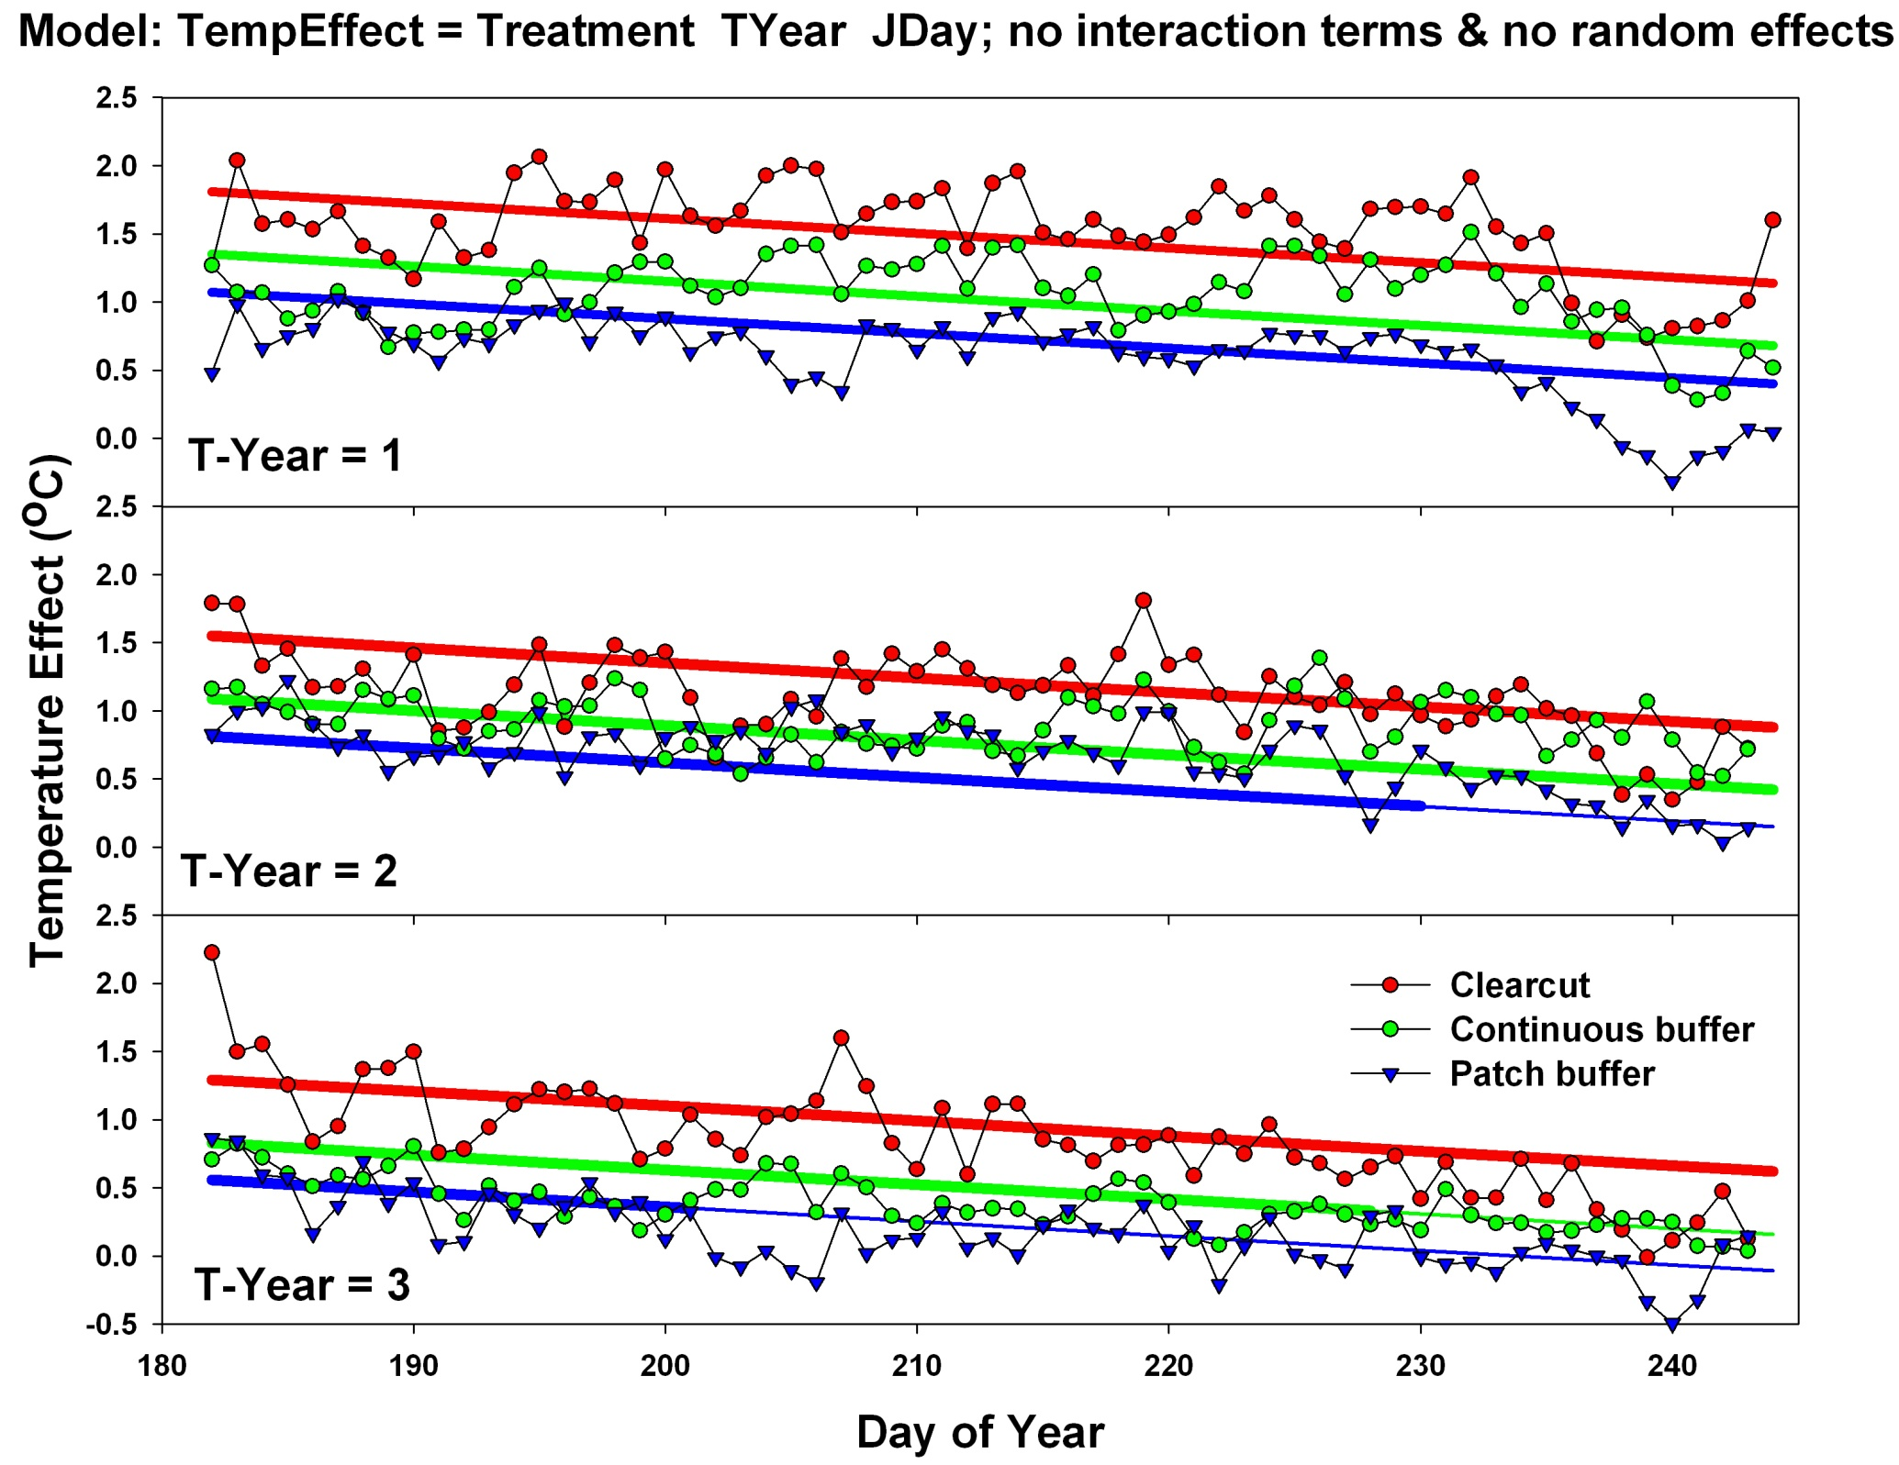

Slide 30
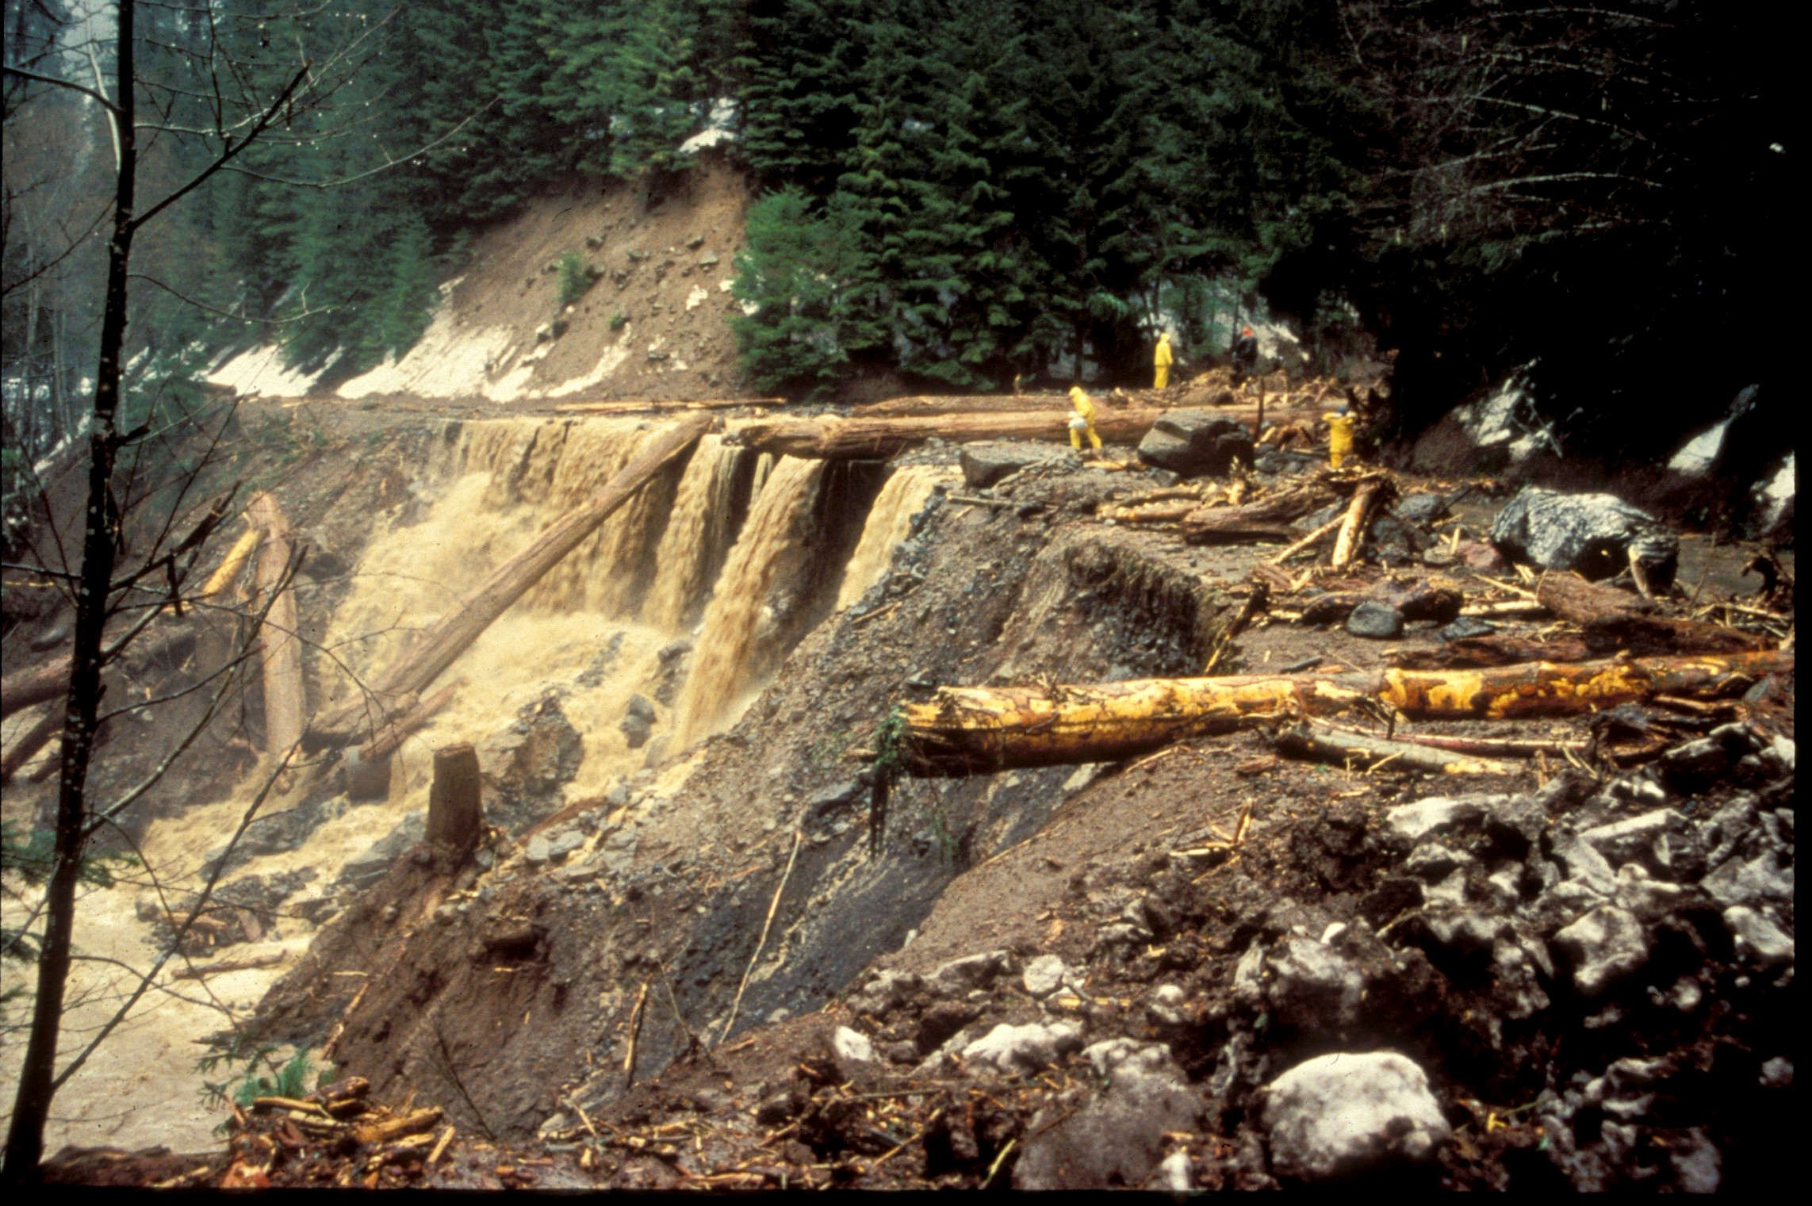
WS03 - 1996 FLOOD

