Slide 1
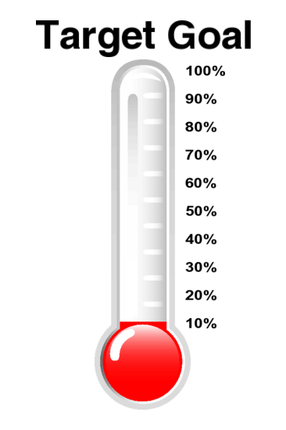
Metrics for Prescribed Burning
Rick Graw
USDA Forest Service
Pacific NW Region

Slide 2
Objective
To be able to track annual progress towards Rx burning goals
  Tabular by subgeographic area
  Spatially
  To see where we are on target towards our desired pace and scale
  To understand why we are falling short in some locations
  To inform and adjust accordingly

Slide 3
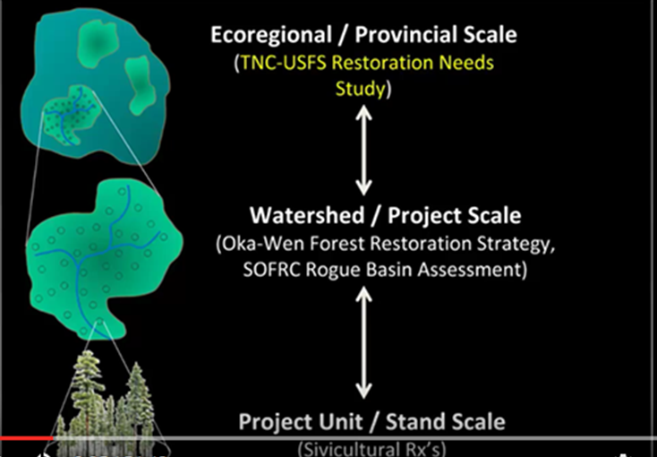
Understanding the Current Situation

Slide 5
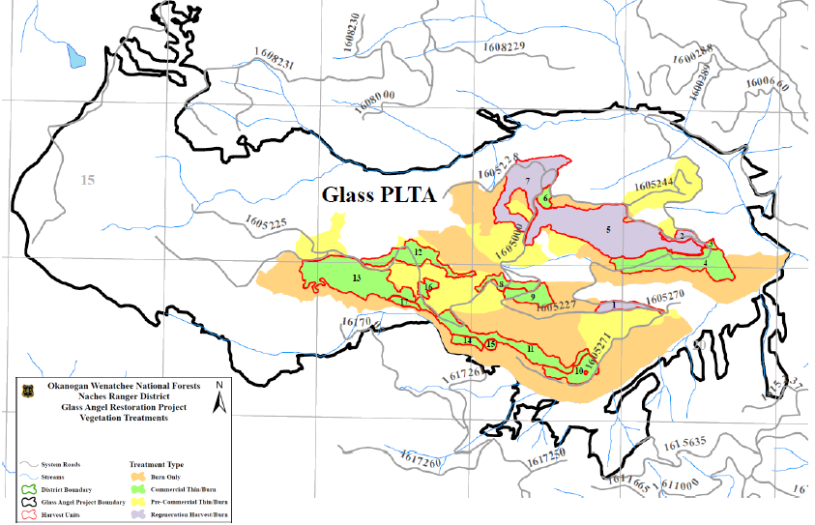

Slide 6
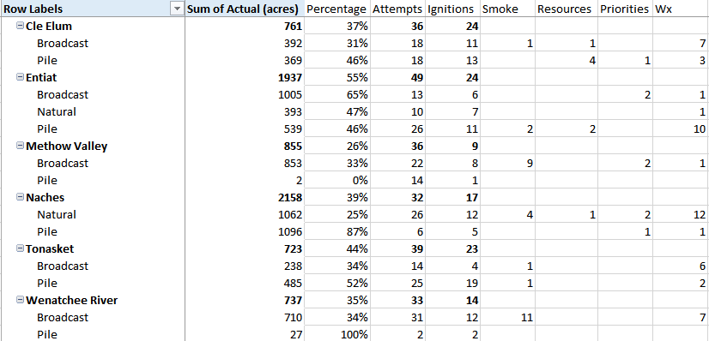

Slide 7
What is needed?
Missed opportunities:
  Days when we could have burned, but didn’t. Why not?
Days when we burned, but could have burned more?
  Metrics?

Slide 8
Planning and Reporting Frequency
Beginning of the year
  What is planned? Priorities?
  Maps from each Land Management Agency
End of the year:
  How did we do?
  Identification of issues?
  What will we do differently?

