Slide 1
Gradient Nearest Neighbor methods for regional-scale forest vegetation mapping in the Pacific Northwest
Janet Ohmann, Matt Gregory, Heather Roberts, and
Emilie Henderson

Slide 2
What is Nearest Neighbors Forest Vegetation Mapping?
“Nearest Neighbors” ≈ Imputation
Statistical Imputation
  substitution of some value for a missing data point or a missing component of a data point
Imputation in a forest vegetation modeling context
  data point: measured (inventory) forest plot
  missing data point: pixel or polygon in region of interest

Slide 3
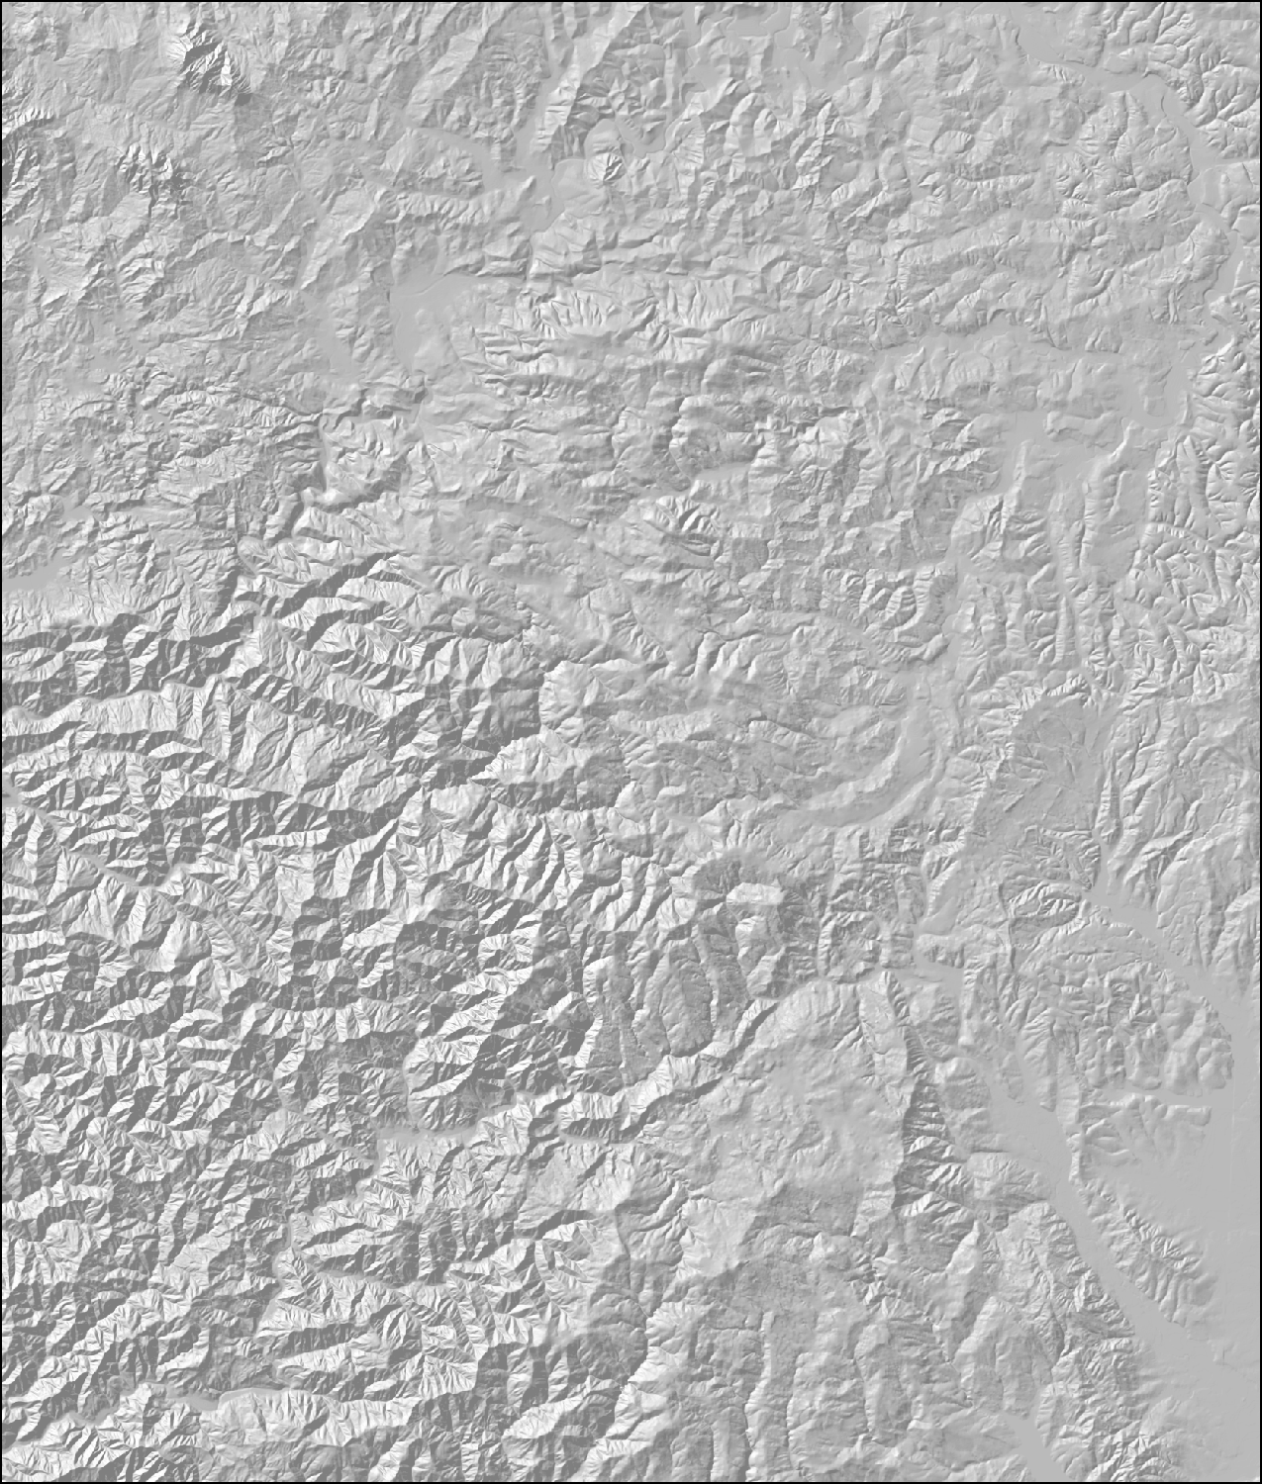
Setting for Forest Mapping using Nearest Neighbors
Gridded sample of forest inventory plots with measured forest attributes (live and snag trees, down wood, shrub/forb cover)
Not spatially complete

Slide 4
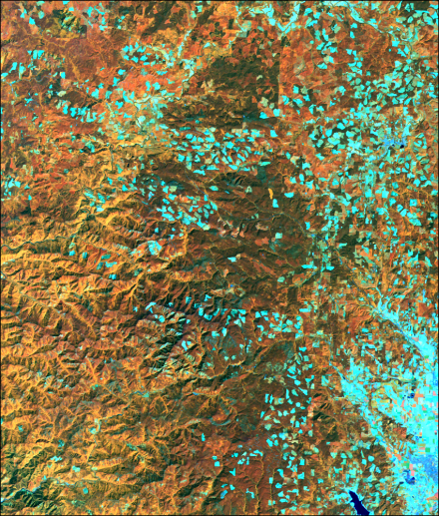
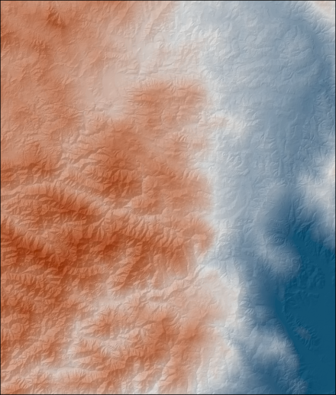
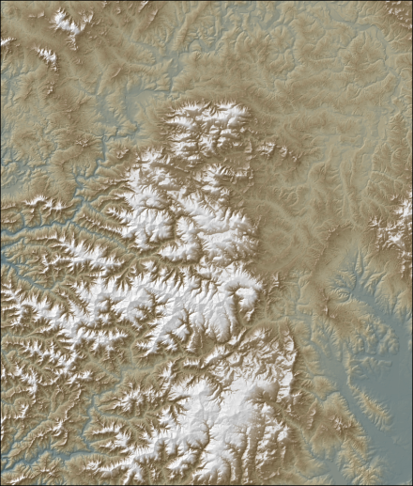
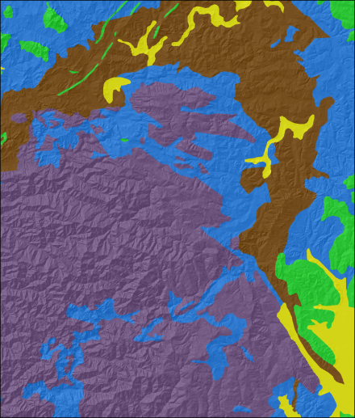
Setting for Forest Mapping using Nearest Neighbors
Set of remote sensing and GIS data layers that relate to forest composition and structure
No direct information about actual forest vegetation
Landsat TM
Climate
Elevation
Soils / Geology

Slide 5
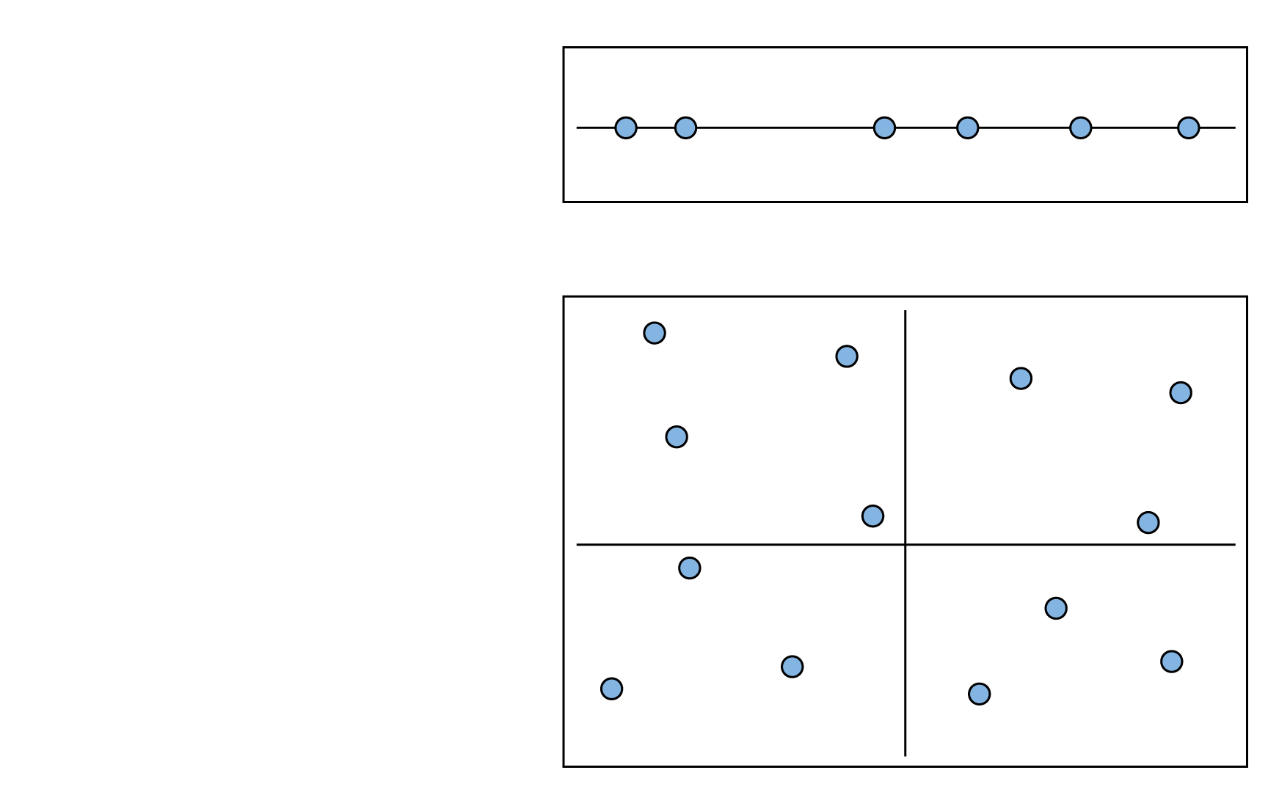
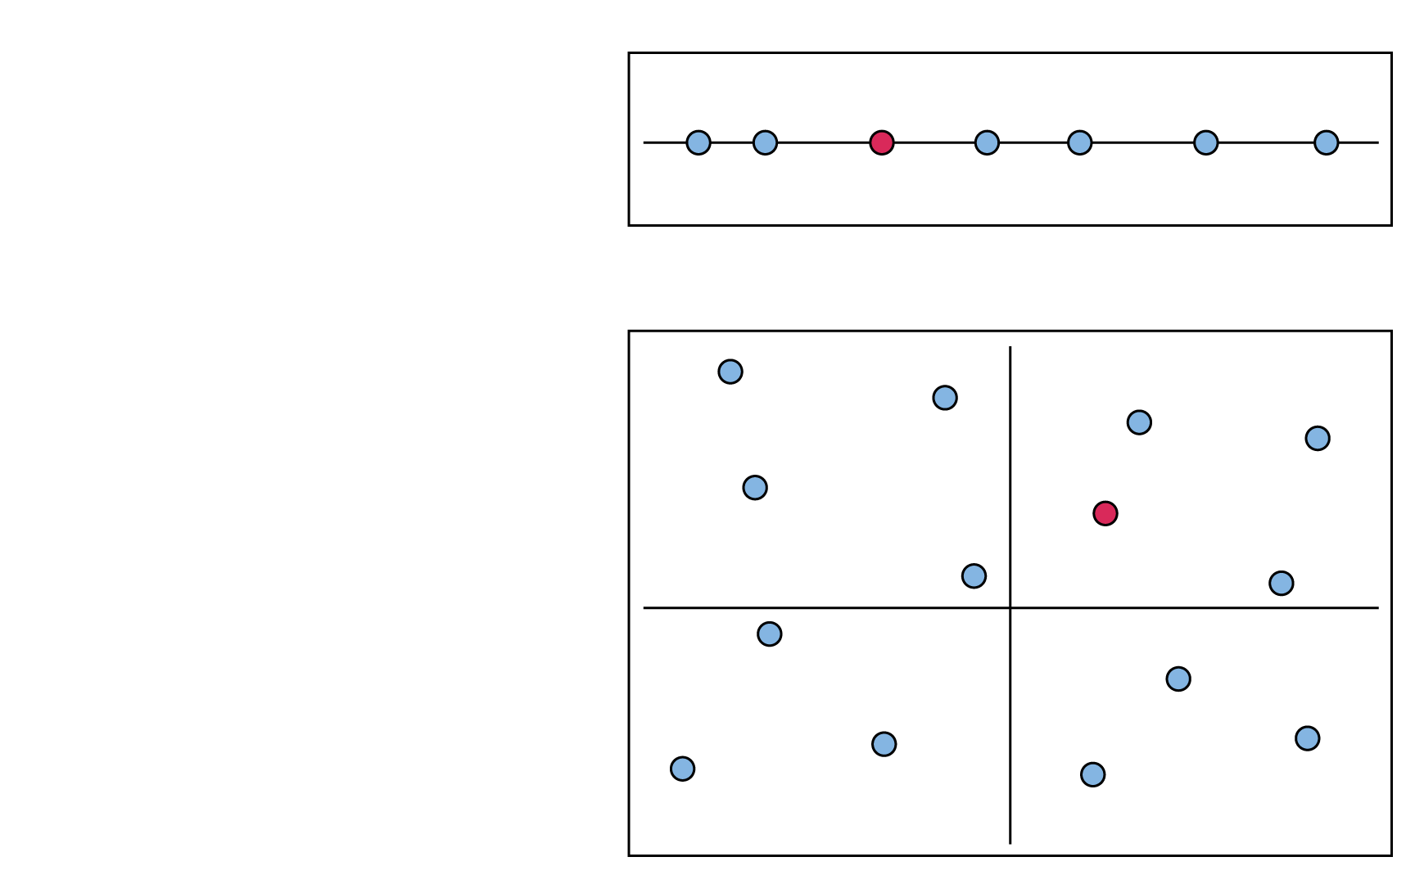


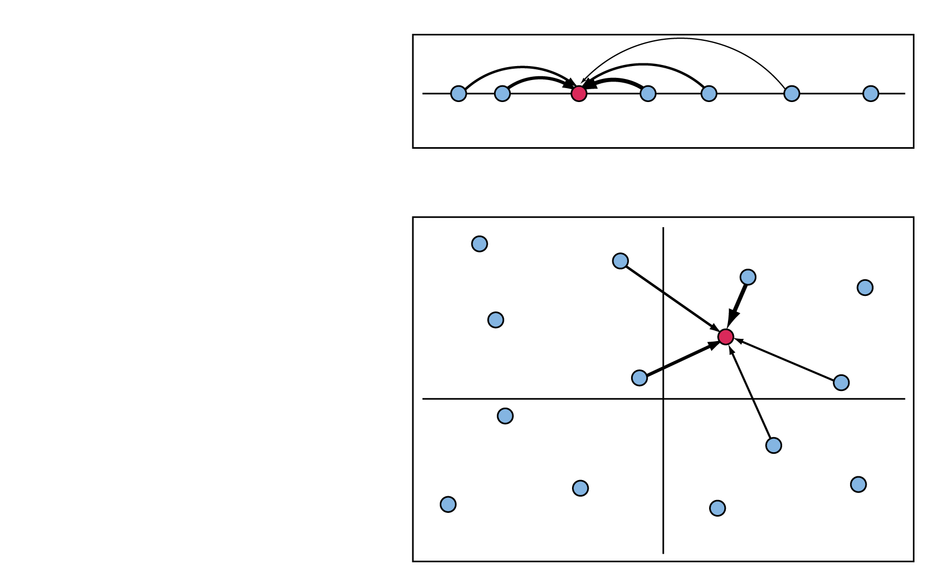
Simple Imputation Example
One dimension
Imputation occurs in d dimensions
When k=1, nearest neighbor is chosen
When k>1, nearest neighbors are chosen based on weighting
Two dimensions

Slide 6





The Gradient Nearest Neighbor (GNN) Method
Plot Database
Plots X “Species”
Plots X Environment
Gradient Analysis (CCA)
Environmental Variables
geographic space
plot ID number
Axis 1
Axis 2
gradient space

Slide 7
Using nearest neighbors for species/community mapping
Advantages:
Non-parametric, flexible modeling framework
Useful for many species, plant communities
  Maintains covariance structure (species assemblages) for k=1 imputations
  Flexibility for post-mapping classification, analysis, modeling
Information on ecological gradients
Limitations:
Fitting all species simultaneously => less accurate for some individual species especially less common species
Future:
Using random forests in NN context for community mapping

Slide 8
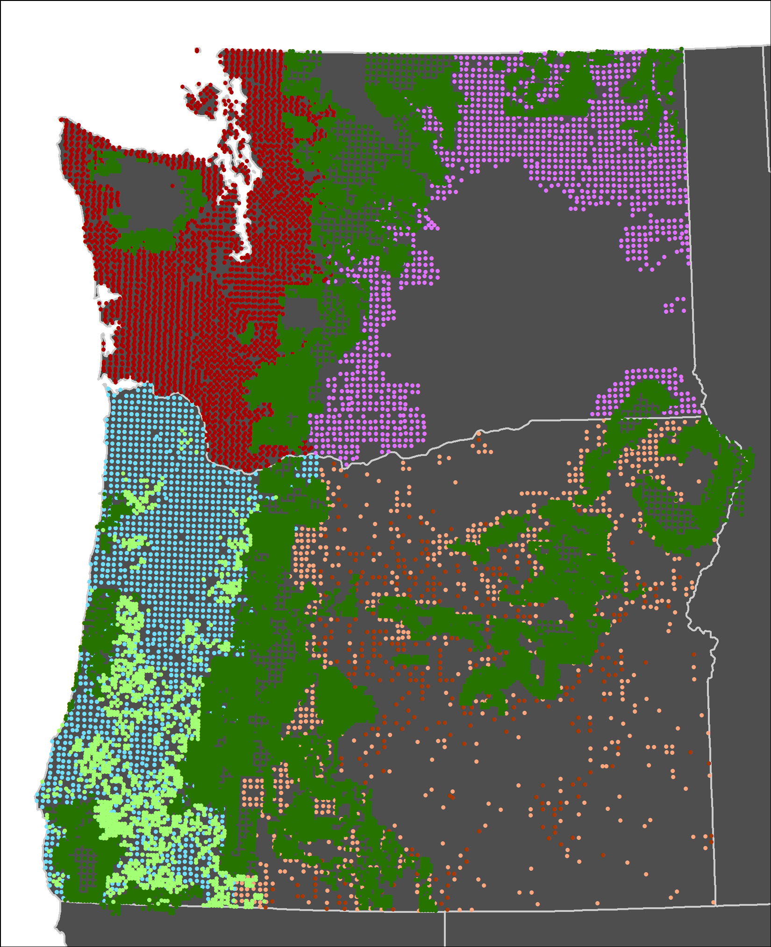
Plot Inventories in 1984-2012 GNN
Imputations
Source | No.
Forest Inventory and Analysis periodic inventories (nonfederal) | 4,688
Bureau of Land Management (BLM) | 1,695
Current Vegetation Survey (National Forest) | 21,205
Forest Inventory and Analysis annual inventories (All Lands) | 16,742

Slide 9
Explanatory variables in GNN
Landsat 30m | TC transformations (TC1-Brightness, TC2-Greenness, TC-Wetness)
Climate Raw Prism Data 800m | Means, seasonal variability (Precipitation, Temperature)
Topography 10m DEM | Elevation, slope, aspect, solar
Disturbance | Past fires, harvest, I&D
Soils | Parent materials
Location | X, Y
Ownership | Federal, state, forest industry, other private
>100 rasters
Source data vary in spatial resolution, extent, accuracy, relevance to hypotheses
Resample to 30 m x 30 m resolution

Slide 10
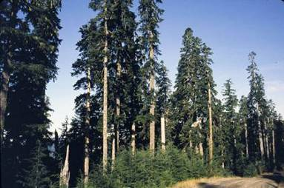
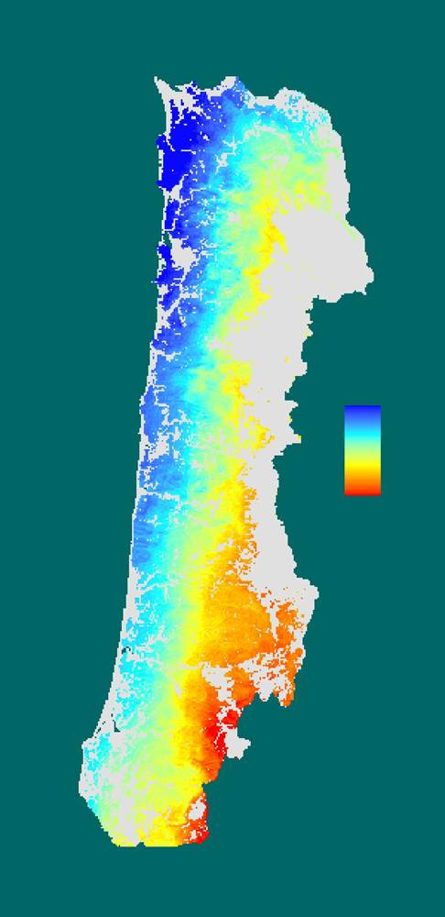
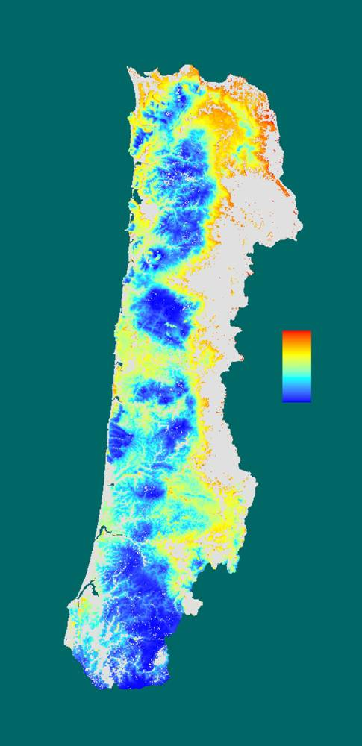
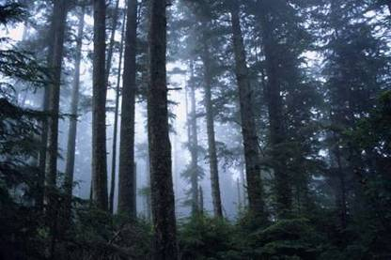
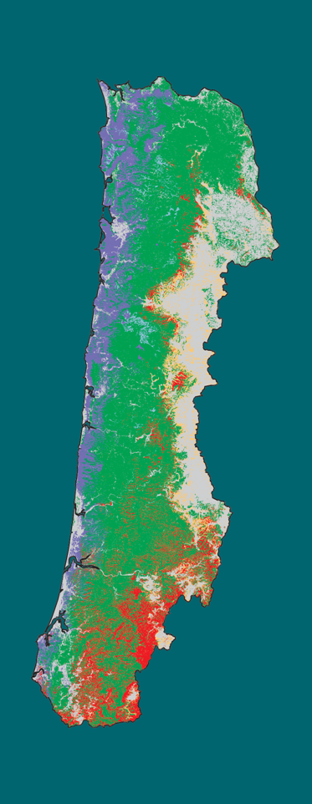
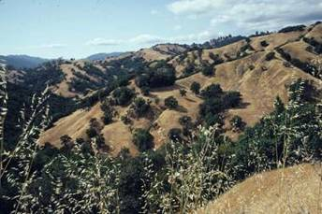
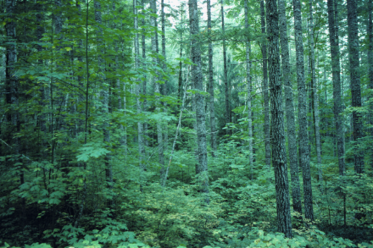
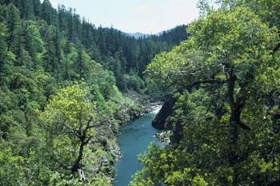
Species Gradients
(Linked to Environment)
Abies amabilis/
procera
Maritime
Low
Picea sitchensis
Pacific Ocean
Interior
(Valley)
High
Quercus woodlands
Tsuga heterophylla
CCA axis 1
(climate)
CCA axis 2
(elevation)
Forest Types
Tsuga heterophylla/
mixed evergreen
Notes:
Major environmental gradients are moderate, wet, coastal maritime climate along coast to drier inland climate. Also elevation gradient from sea level to >1000m, steep and dissected terrain. Forests are conifer-dominated, with hardwoods occurring in disturbed areas and very wet or dry sites. Forest types range from Picea along coast to Quercus woodlands of Willamette Valley.

Slide 11
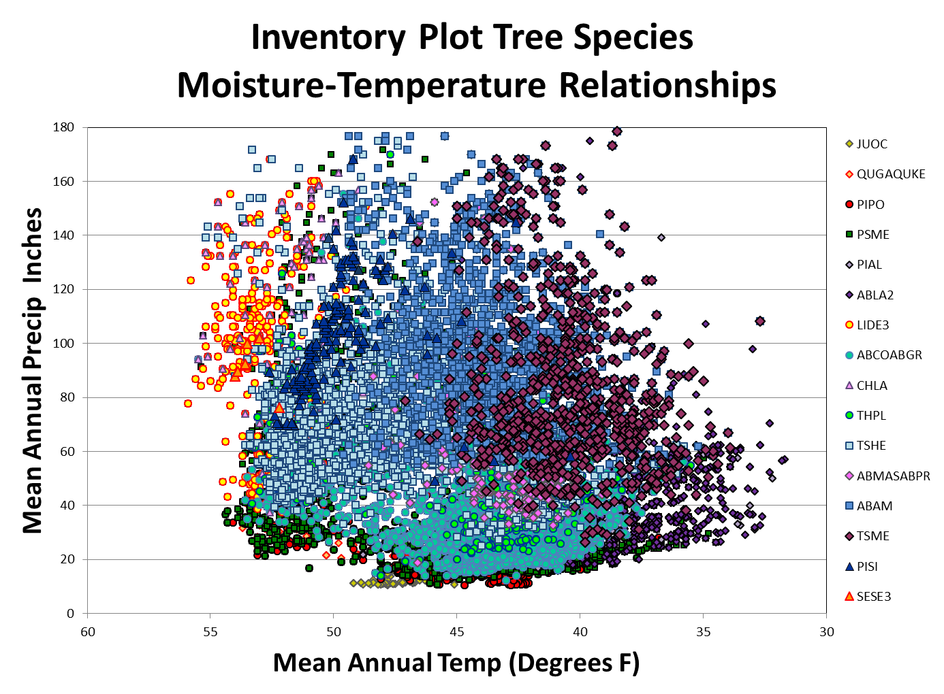
Inventory Plot Tree Species
Moisture-Temperature Relationships

Slide 12
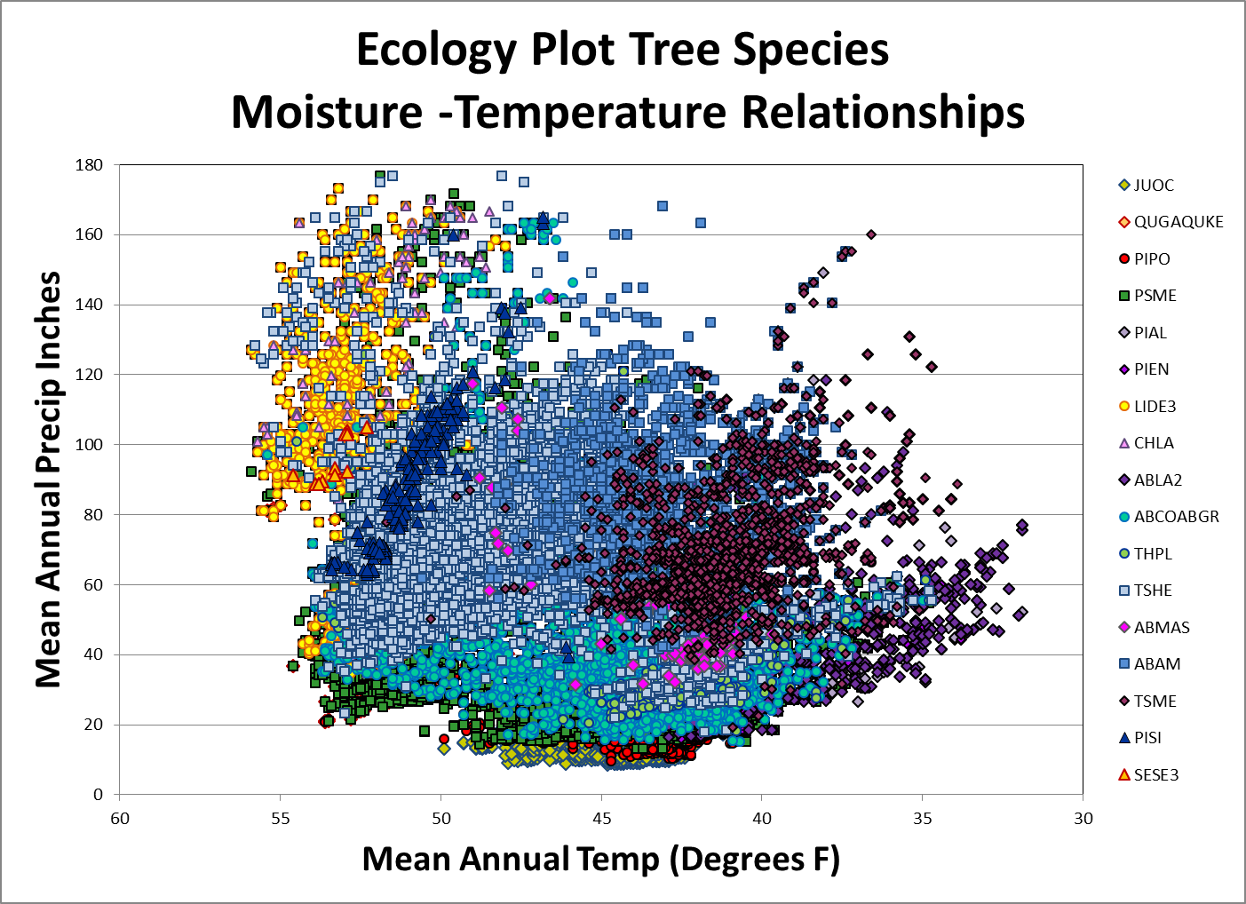
Ecology Plot Tree Species
Moisture-Temperature Relationships

Slide 13
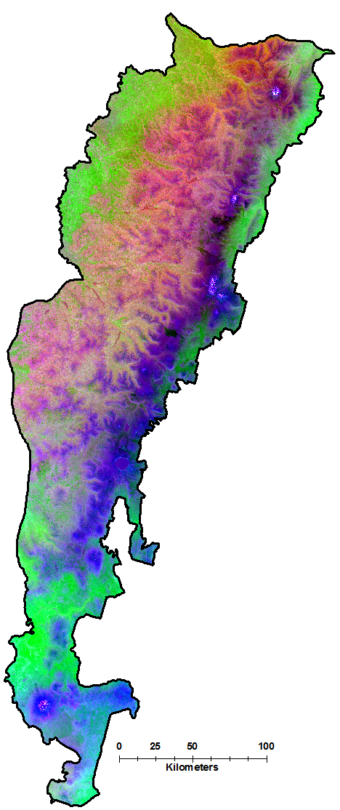
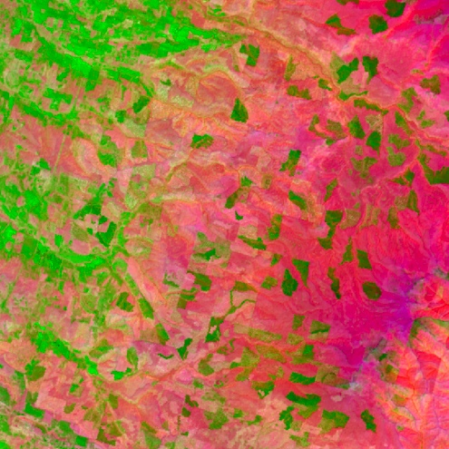

Dominant gradients in forest composition and structure in Oregon and Northern California Cascades
(axis scores from CCA)
% variation explained
Climate | 8.5
Landsat | 4.5
Topography | 4.2
Location | 3.7
Axis 3 (blue):
summer
moisture stress,
TC brightness
Axis 1 (red):
temperature,
elevation,
TC greenness,
TC wetness
Axis 2 (green):
latitude,
seasonality of precipitation

Slide 14
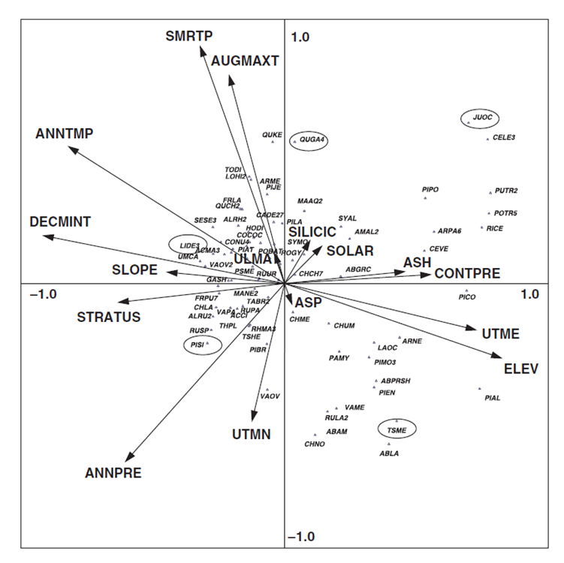
Dominant gradients associated with explanatory variables for species abundance in Western Oregon
Axis 1 - summer cloud cover, summer moisture stress, and solar radiation from coastal maritime to drier more continental inland conditions
Axis 2 associated with elevation, mean annual temperature and summer moisture stress.
Notes:
Associations between Species and Explanatory Variables on dominant gradients (axes 1 & 2). Note only axes 1 and 2 are shown while 1-8 were used in the GNN models. Since many of the dominant gradients are derived from PRISM climate data sets, minimum assessment areas for species composition should be related to the resolution of the climate data sets (800m rasters =Approx 150 acres).

Slide 15
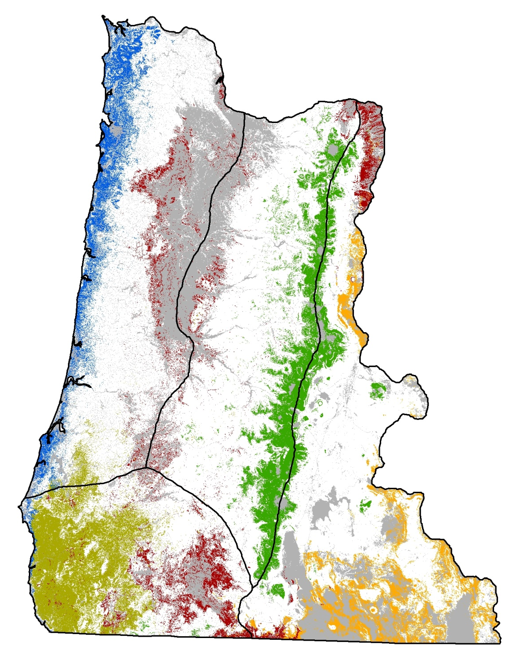

Predicted presence of five tree species
GNN model: 25,000 plots, 48 tree species
Species | False neg. rate | False pos. rate | Kappa
All trees (mean, range) | 0.39 (.02-.97) | 0.07 (0-.23) | 0.43 (.02-.81)
Picea sitchensis | 0.12 | 0.02 | 0.68
Quercus garryana | 0.37 | 0.04 | 0.44
Lithocarpus densiflorus | 0.11 | 0.04 | 0.76
Tsuga mertenziana | 0.16 | 0.05 | 0.71
Juniperus occidentalis | 0.33 | 0.02 | 0.56

Slide 16
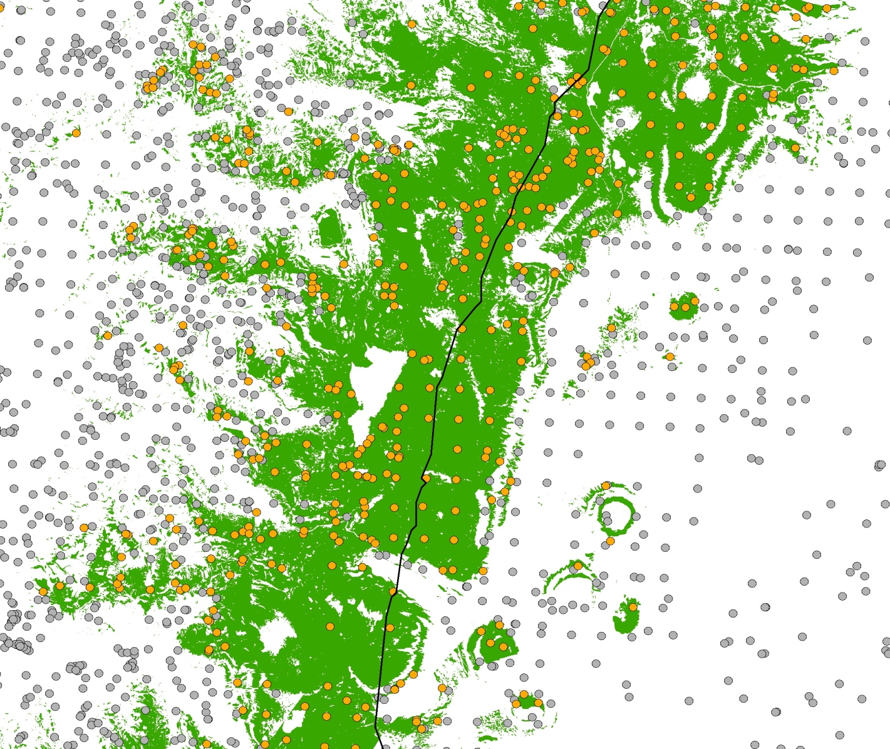
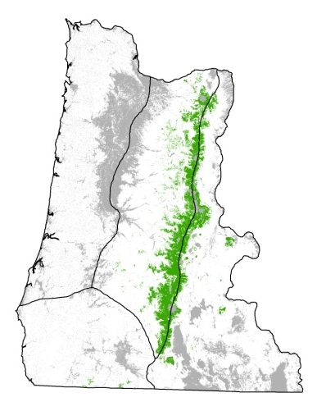
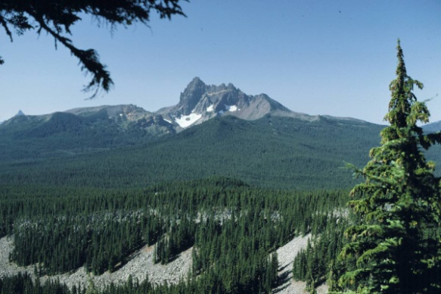
Predicted presence of Tsuga mertensiana
predicted present
observed present
observed absent

Slide 17
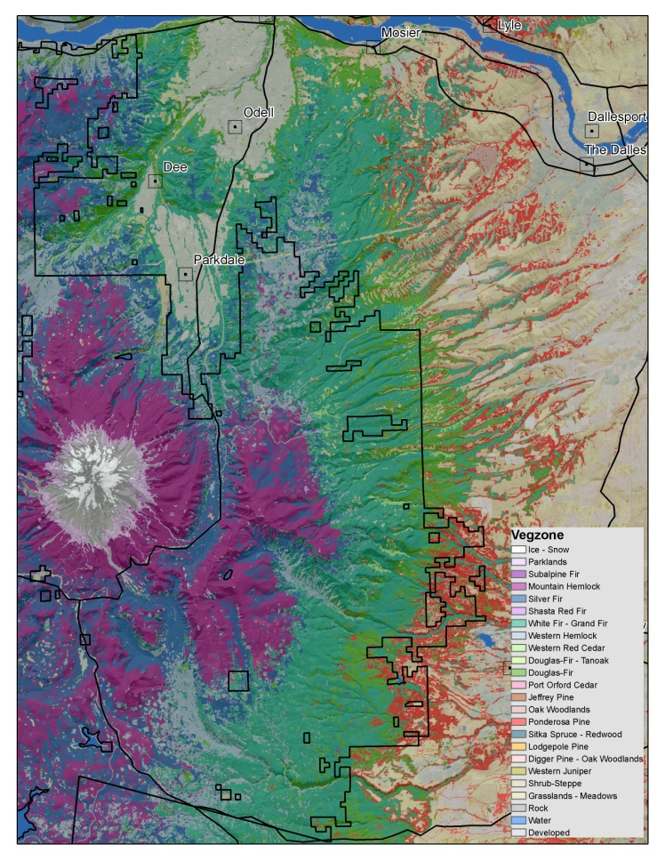
How do you get consistent PVT estimates from Existing Species Composition?
Stratify the input plot set based on presence and abundance (>=5%) of the “inferred” Climax tree species using species characteristics.
    Predominant Series order in existing Plant Association Classification Keys
    Shade Tolerance
    Longevity
Use entire 1984-2012 (29 yrs) GNN imputation stack to reduce disturbance effects.
Develop Alt. Spp. cover thresholds for plots on disturbed sites.
Notes:
Look at Species Composition from imputations before major disturbances… On plots with repeated significant or repeated disturbance relax cover thresholds.

Slide 18
Minimum Scale and Scope of Assessments?
Since many of the dominant gradients are derived from PRISM climate data sets, minimum assessment areas for species composition should be related to the resolution of the climate data sets (800m rasters = 150-160 acres or roughly stand scales).
Landscape Departure Assessments should be scaled based on a multiple of the Average Stand Replacement Disturbance sizes (10,000-1,000,000 acres).

Slide 19

2016 Tree Species Order of Precedence for Vegetation Zone Classification
Min Threshold for zone assignment >=5% Cover
PISI or SESE3
TSME
ABAM
TSHE or THPL
ABCO or ABGR
ABLA2 or PIEN
ABMAS
CHLA
LIDE3
PSME
PIJE
PIPO
PICO
Hardwoods (Oaks, Aspen etc)
JUOC

Slide 20
2017 Tree Species Order of Precedence for Vegetation Zone Classification
PIJE
PISI
SESE3
TSME (10% Threshold)
ABAM or ABPR
TSHE or THPL
ABLA2 or PIEN
ABCO or ABGR
ABMAS or ABMA
CHLA (10% Threshold)
LIDE3 (20% Threshold)
PSME
PIPO
Parklands (PIAL, PIFL2, LALY, PIAR, PILO, PIBA)
PICO
PISA2
Rip. Hardwoods (BEPA, POBAT, POTR5 etc.)
Oak Woodlands
Other Hardwoods
Con. Woodlands (Pinyon, JUOC, Cypress)
Min Threshold for zone assignment >=5% Cover

Slide 21
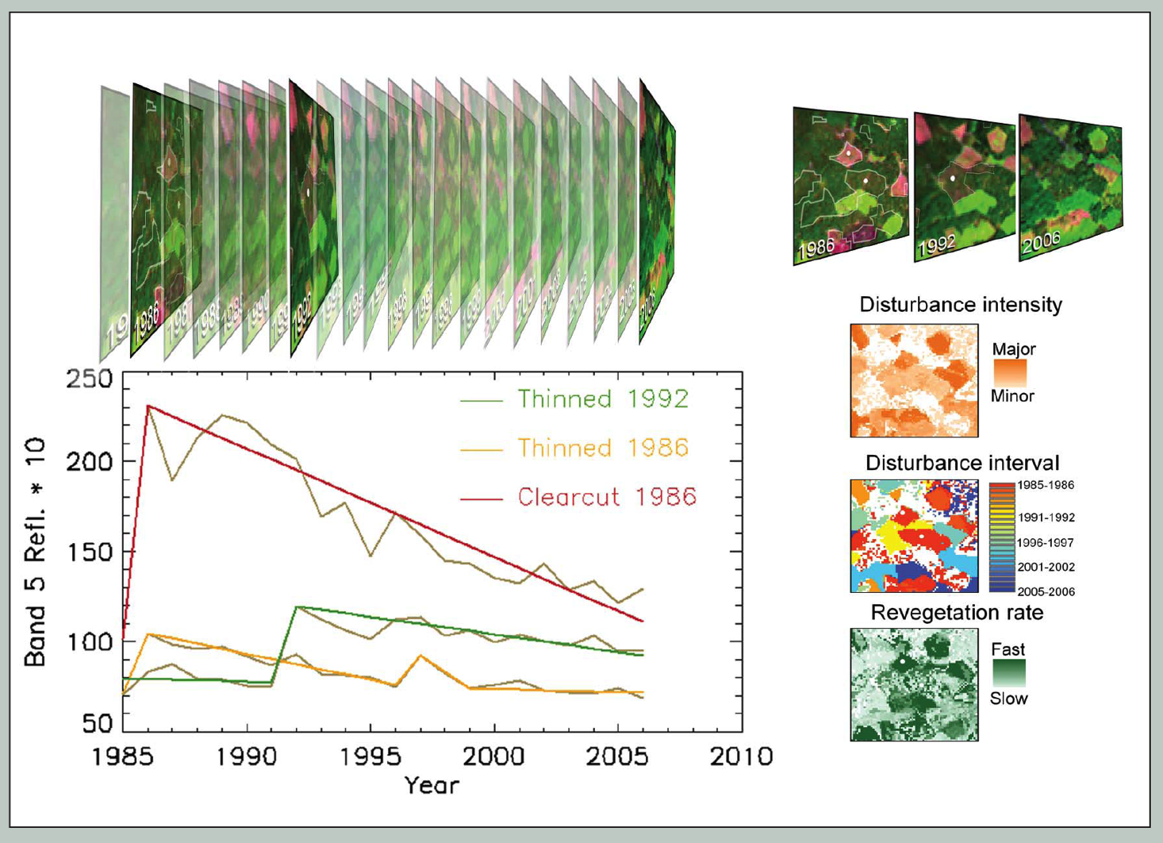
Landsat Detection of Trends in Disturbance and Recovery (LandTrendr)*
Temporal normalization and segmentation
at pixel level
Minimizes noise from sun angle, phenology
Segments describe sequences of disturbance, regrowth
Normalized imagery for multiple years for GNN modeling
*Kennedy et al. (2010), Rem. Sens. Env.

Slide 22
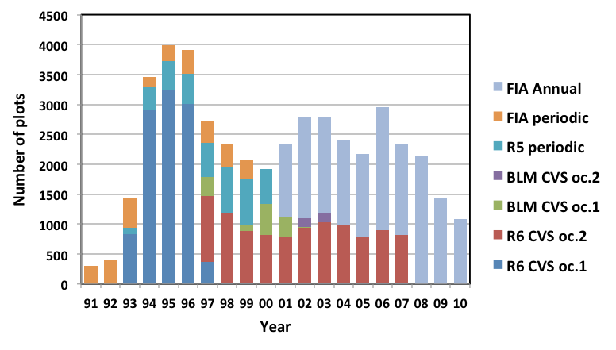
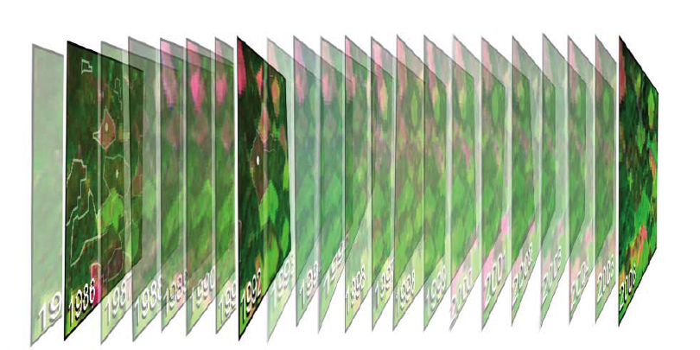
Matching plots to LandTrendr imagery for GNN modeling
Unbalanced in time and space, 1 to 3 per location
Match plots to imagery of same year
Single gradient model from all plots, applied to each imagery year
Imagery is only change – assumes normalization
Response vars.: basal area by species + size-class
30-m
Landsat
pixels
2
1
4
3
Yearly matching of plot and spectral data
FIA Annual plot

Slide 23
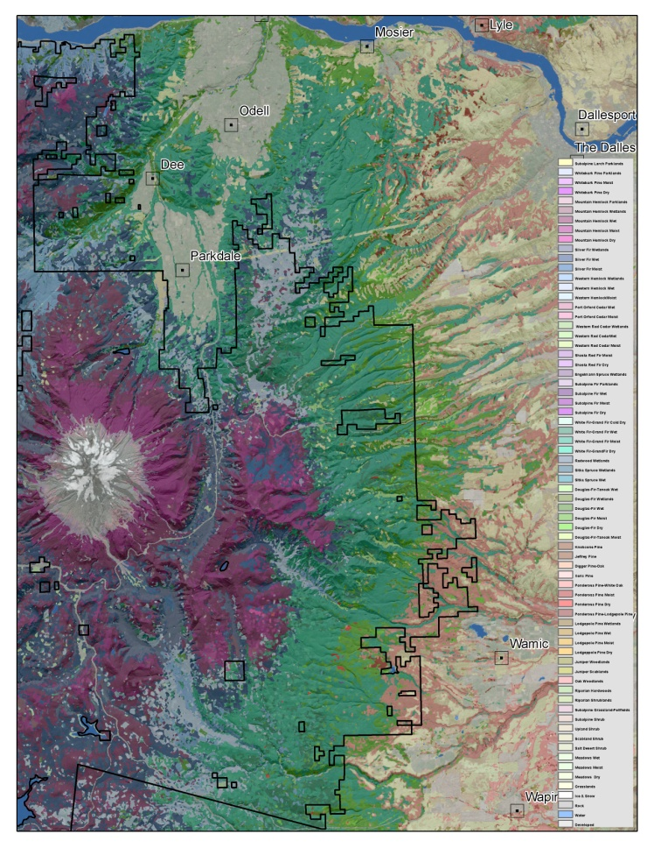
How do you get consistent Subseries PVT estimates out of existing Species Composition Info?
Subdivide the Zone level classification based on minimum cumulative abundance or occurrence of a minimum number of species within an understory “indicator” species group
Indicator Species Groups are based on relative species affinities to major explanatory variables.
    Moisture
    Temperature
    Seasonal Variability
Notes:
On sites with depauperate understories may need to relax minimum abundance thresholds.

Slide 24
Diagnostics for selected shrub species predicted Presence/Absence from GNN Imputation.

Slide 25
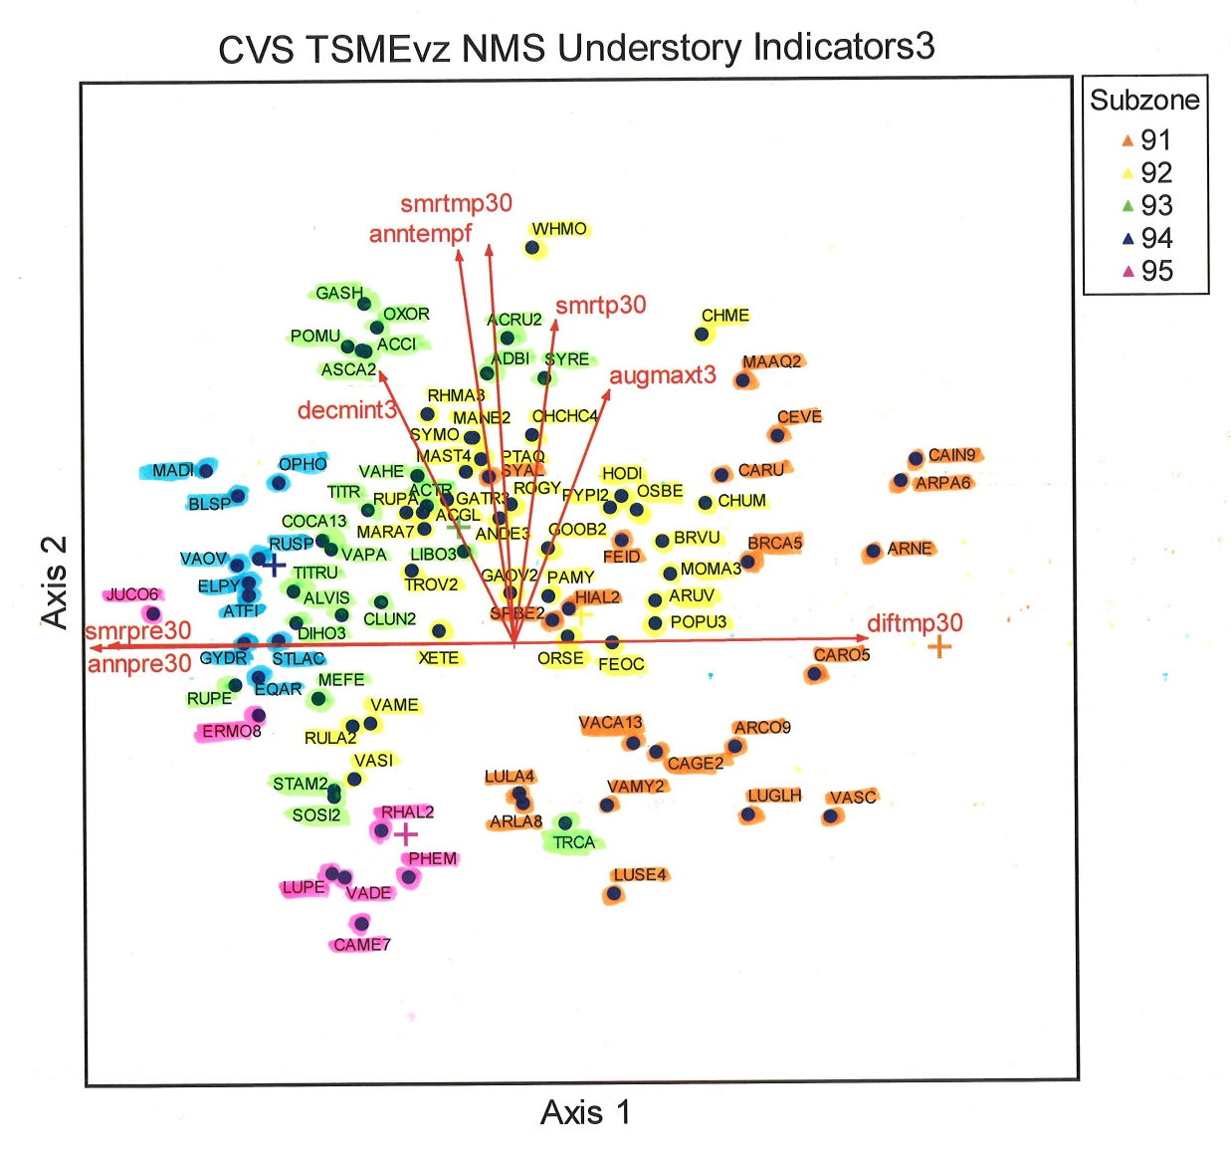
Example Ordination of Inventory Plot Understory Species in Environmental Space
Order of Species Group Precedence for Mtn. Hemlock Zone
  94 - TSME Wetlands
  93 - TSME Wet
  95 - TSME Parklands
  92 - TSME Moist
  91 - TSME Dry
Groups are ordered by moisture-temperature gradients
  wet to dry
  cold to warm
Notes:
Species locations represent the centroid of each species occurrence. Each species group used to define a Subzone is highlighted in a separate color. Subzone centroids are indicated by colored +’s that match the species group color.

Slide 26
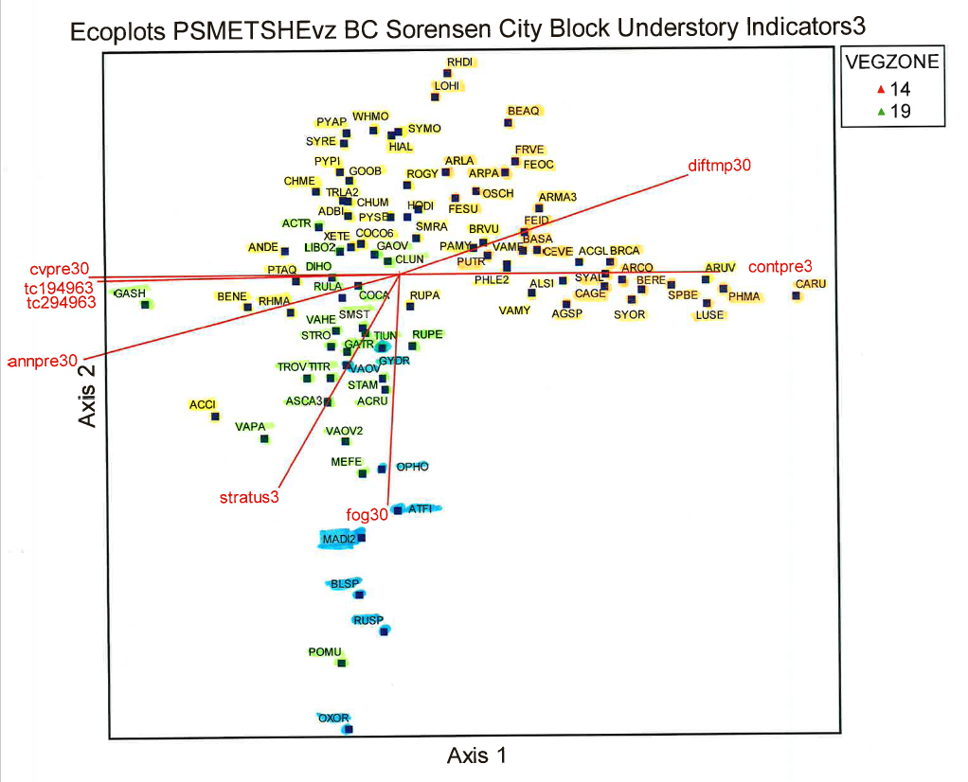
R6 Ecology Plot PSME & TSHE Vegzone Understory Species in Environmental Space
Moist Subzone Spp.
Dry Subzone Spp.
Wet Subzone Spp.
Wetland Subzone Spp.
Notes:
Species locations represent the centroid of each species occurrence. Each species group used to define a Subzone is highlighted in a separate color. Subzone centroids are indicated by colored +’s that match the species group color.

Slide 27
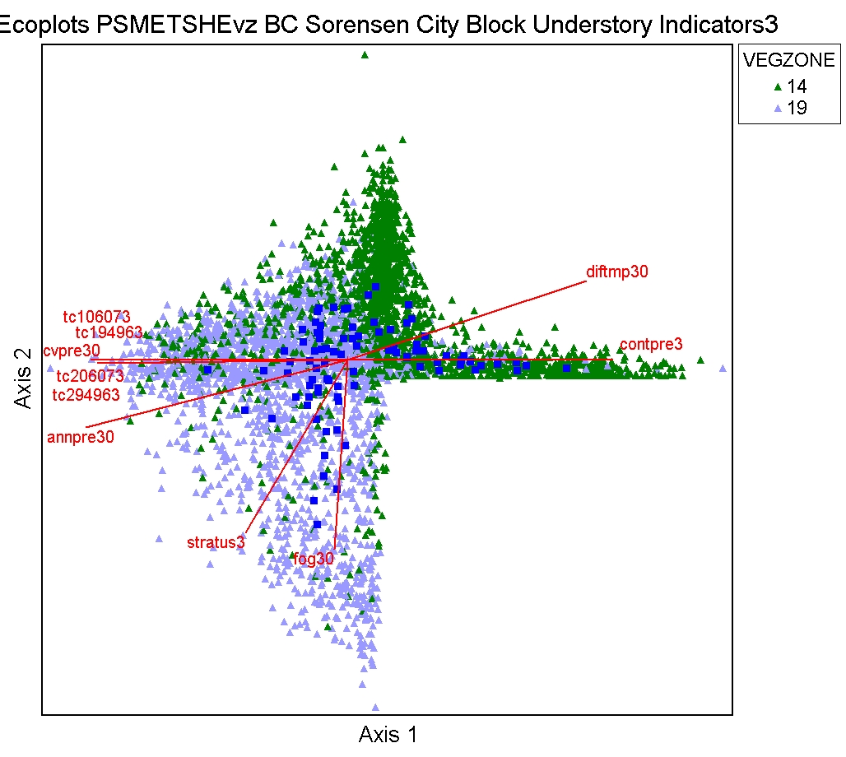
Example Ordination of R6 Ecology Plots
Understory Species & Plots in Environmental Space
Moist Subzone Spp.
Dry Subzone Spp.
Wet Subzone Spp.
Wetland Subzone Spp.
Notes:
Species locations represent the centroid of each species occurrence. Each species group used to define a Subzone is highlighted in a separate color. Subzone centroids are indicated by colored +’s that match the species group color.

Slide 28
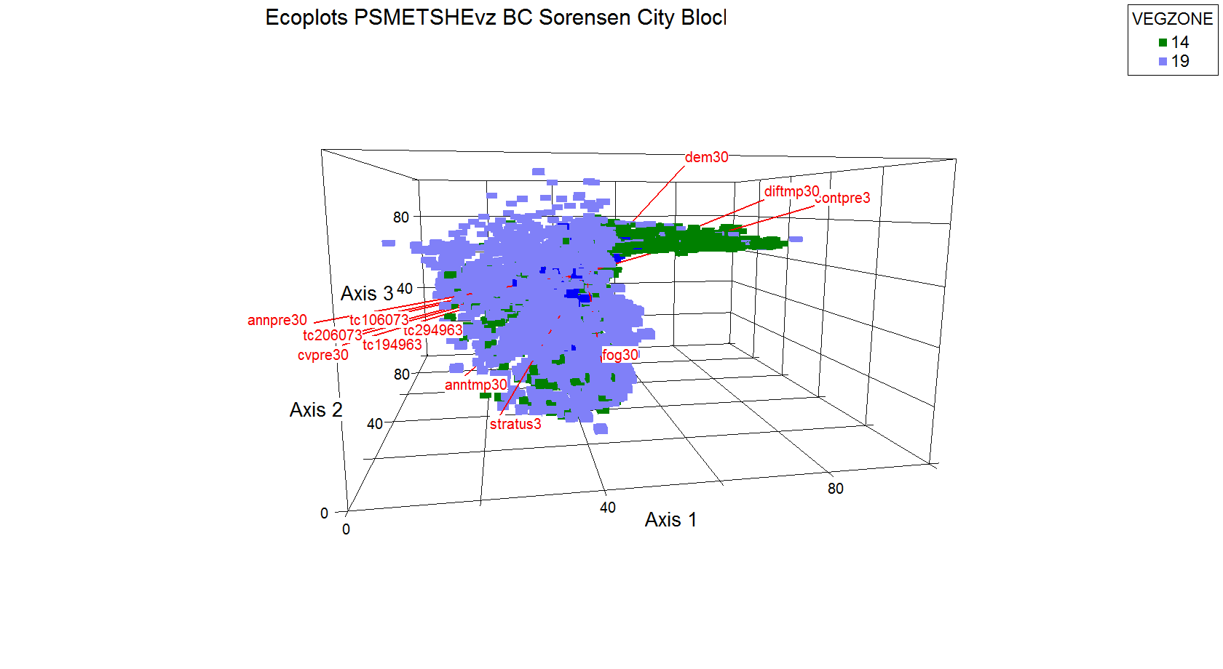
3D Bray-Curtis Ordination of PSME & TSHE Understory Species & Plots in Environmental Space

Slide 29
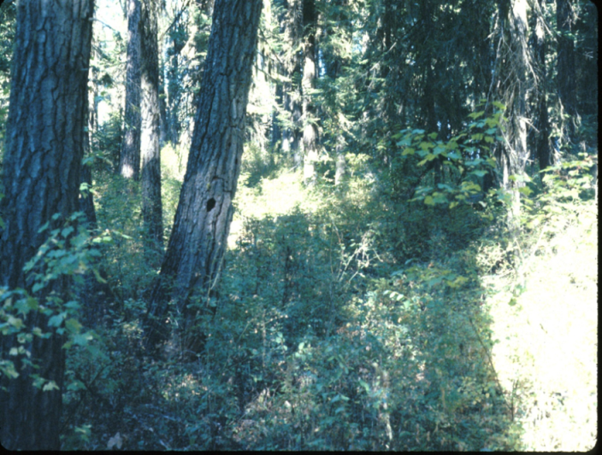
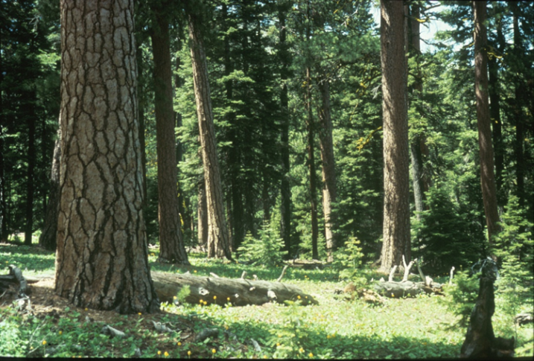
Key Components for Success
Abco-Abgr Series
Consistent approach to Zone – Subzone stratifications across Area boundaries
  Need agreement on indicator species group membership for each Subzone
Subseries strata ideally should incorporate major differences in disturbance regimes and response to disturbance
Consistent logical naming convention for the subseries strata
Mixed Severity Fire Regime
Frequent Low Severity Fire Regime

