Slide 1
Gradient Nearest Neighbor methods for regional-scale forest vegetation mapping in the Pacific Northwest
Janet Ohmann, Matt Gregory, Heather Roberts, and
Emilie Henderson

Slide 2
What is Nearest Neighbors Forest Vegetation Mapping?
“Nearest Neighbors” ≈ Imputation
Statistical Imputation
  substitution of some value for a missing data point or a missing component of a data point
Imputation in a forest vegetation modeling context
  data point: measured (inventory) forest plot
  missing data point: pixel or polygon in region of interest

Slide 3
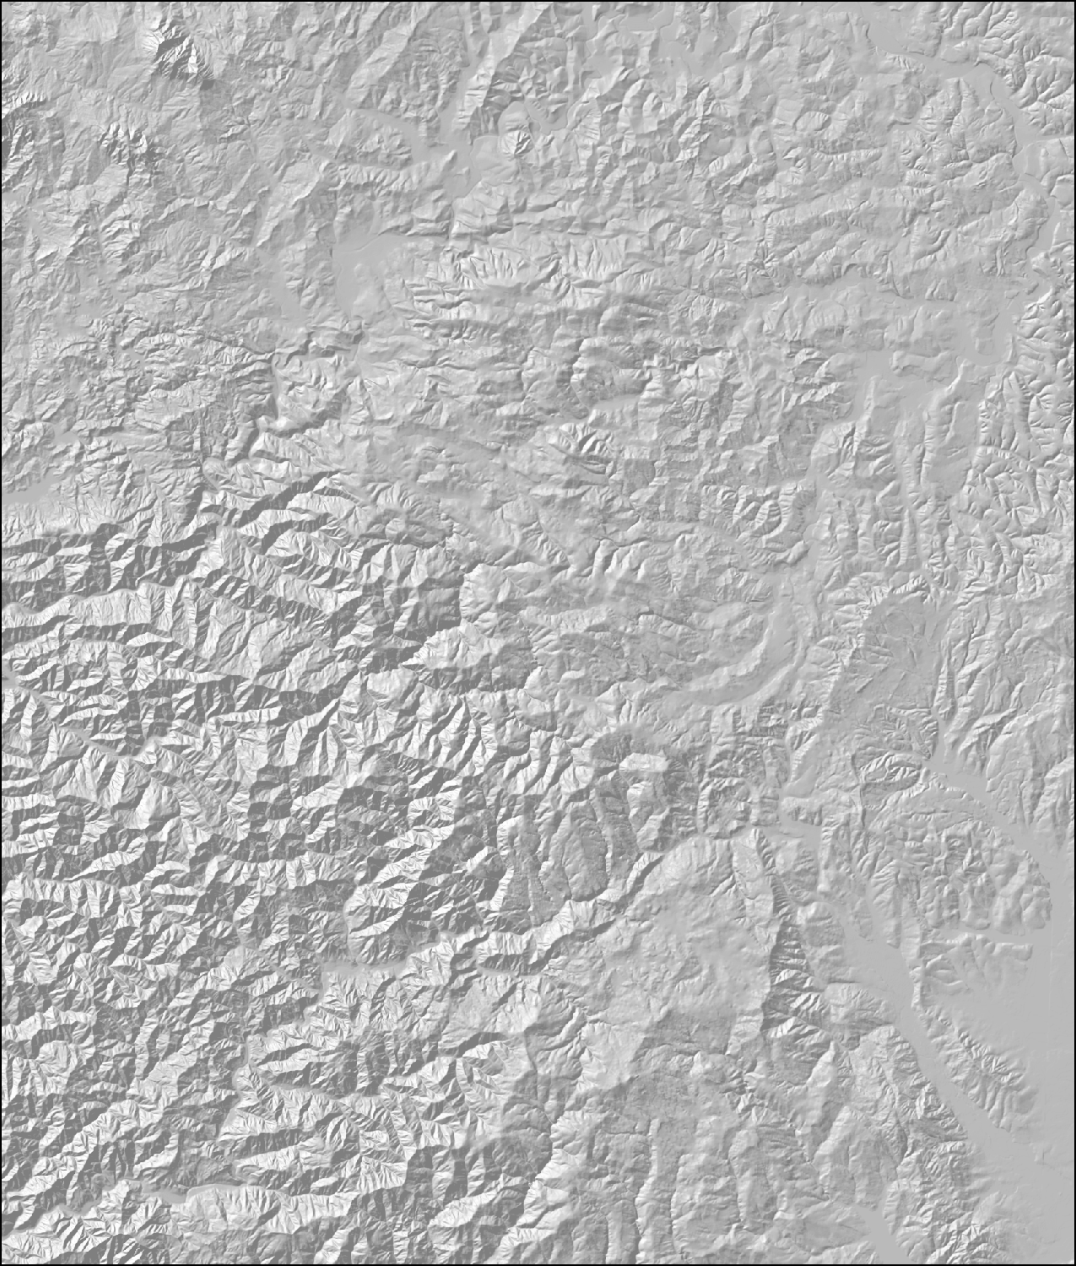
Setting for Forest Mapping using Nearest Neighbors
Gridded sample of forest inventory plots with measured forest attributes (live and snag trees, down wood, shrub/forb cover)
Not spatially complete

Slide 4
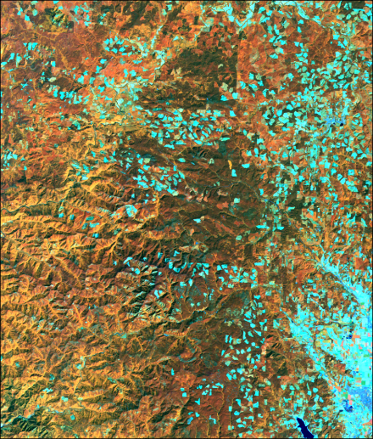
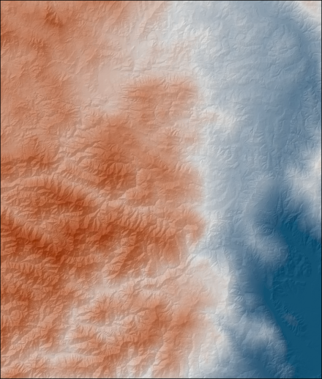
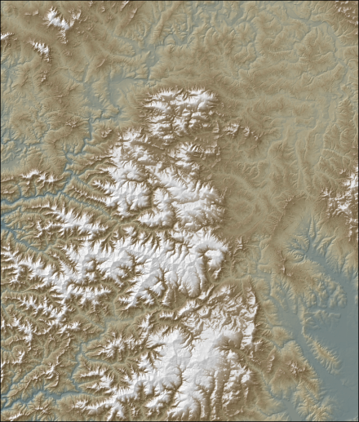
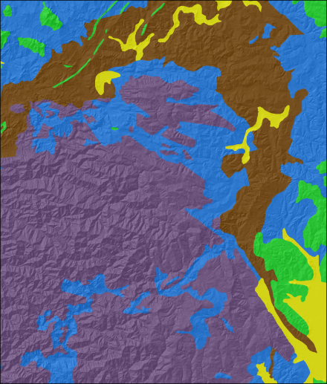
Setting for Forest Mapping using Nearest Neighbors
Set of remote sensing and GIS data layers that relate to forest composition and structure
No direct information about actual forest vegetation
Landsat TM
Climate
Elevation
Soils / Geology

Slide 5
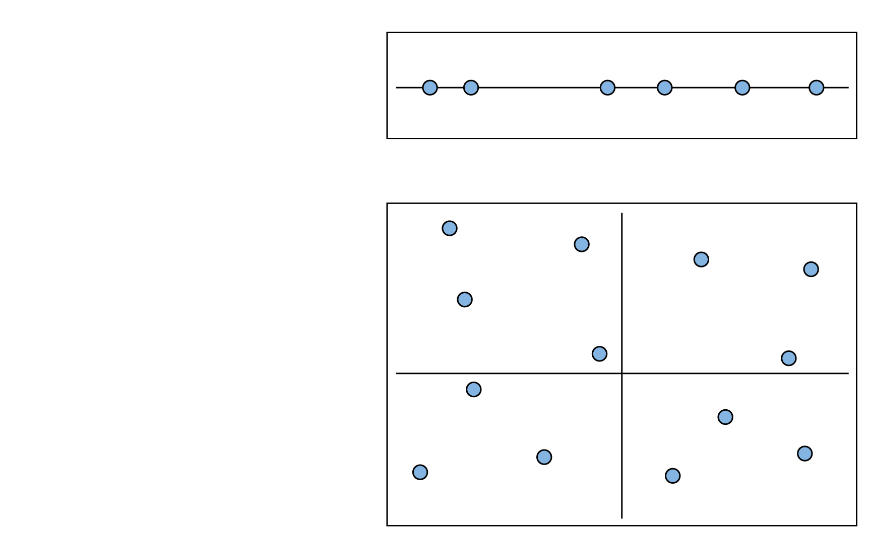
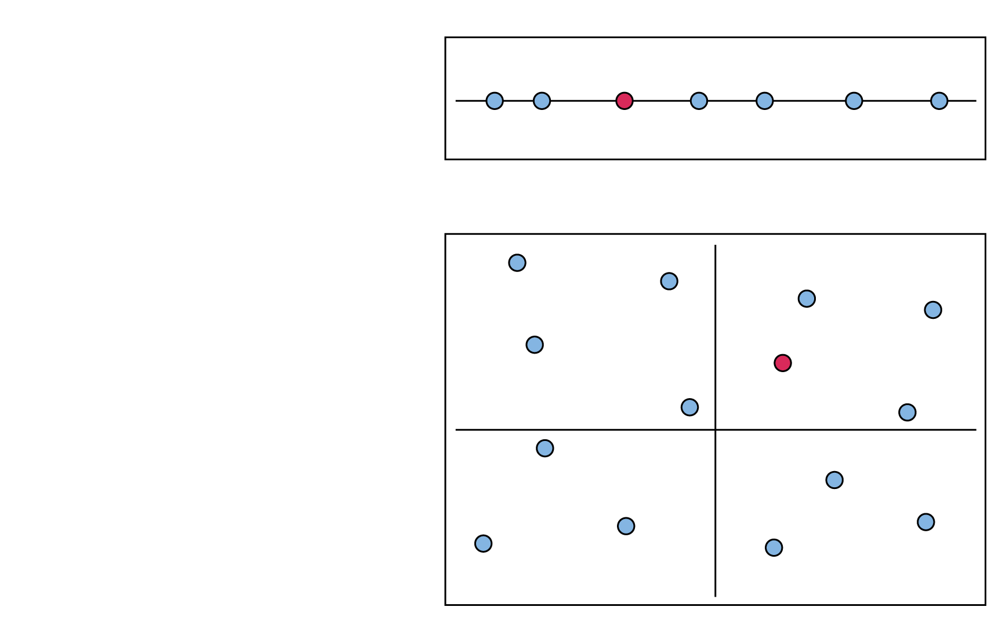


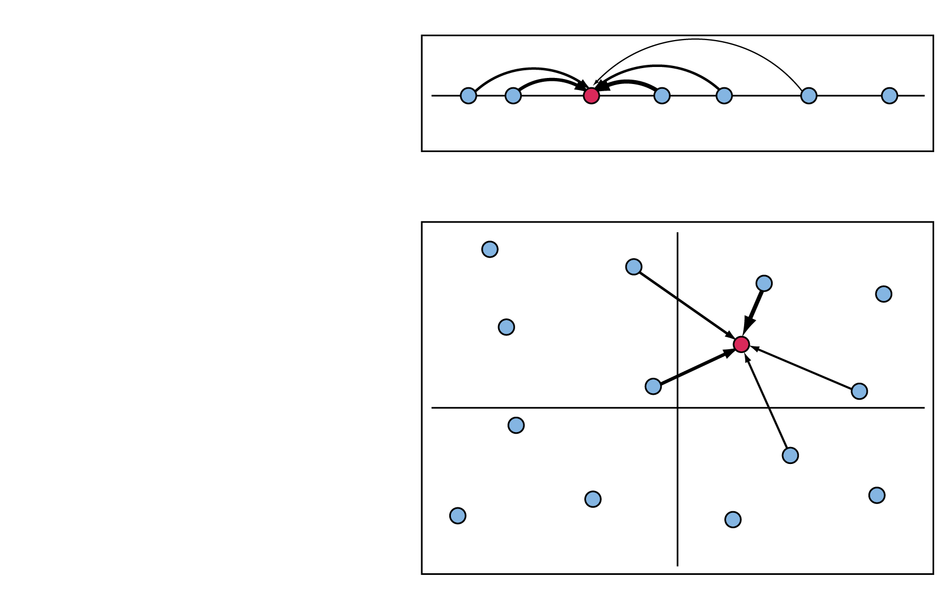
Simple Imputation Example
One dimension
Imputation occurs in d dimensions
When k=1, nearest neighbor is chosen
When k>1, nearest neighbors are chosen based on weighting
Two dimensions

Slide 6

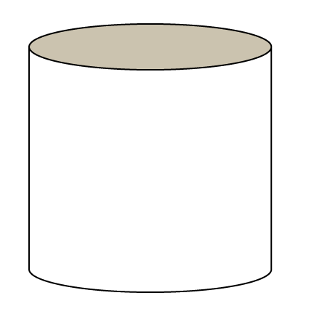



The Gradient Nearest Neighbor (GNN) Method
Plot Database
Plots X “Species”
Plots X Environment
Gradient Analysis (CCA)
Environmental Variables
geographic space
plot ID number
Axis 1
Axis 2
gradient space

Slide 7
Why Canonical Correspondence Analysis?
Interest in species composition
Grounded in ecological theory, widely used by ecologists
A way to quantify relations between two multivariate matrices:
  spatial predictors (explanatory variables)
  species abundances (response variables)
Robust to many challenges of ecological community data:
  non-linear responses of species along environment gradients
  sparse data matrices (species on plots)
  Multi-collinearity

Slide 8
Using nearest neighbors for species/community mapping
Advantages:
Non-parametric, flexible modeling framework
Useful for many species, plant communities
  Maintains covariance structure (species assemblages) for k=1 imputations
  Flexibility for post-mapping classification, analysis, modeling
Information on ecological gradients
Limitations:
Fitting all species simultaneously => less accurate for some individual species especially less common species
Future:
Using random forests in NN context for community mapping

Slide 9
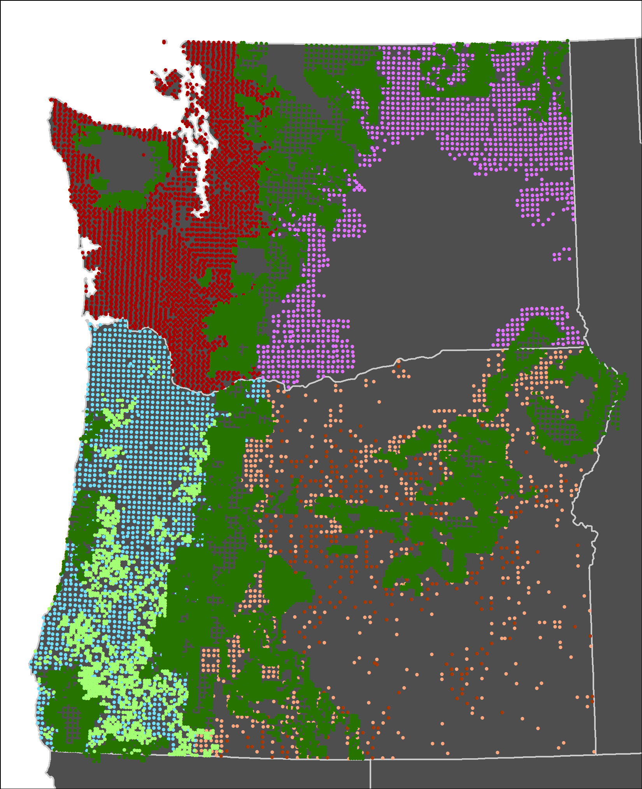
Plot Inventories in 1984-2012 GNN
Imputations
Source | No.
Forest Inventory and Analysis periodic inventories (nonfederal) | 4,688
Bureau of Land Management (BLM) | 1,695
Current Vegetation Survey (National Forest) | 21,205
Forest Inventory and Analysis annual inventories (All Lands) | 16,742

Slide 10
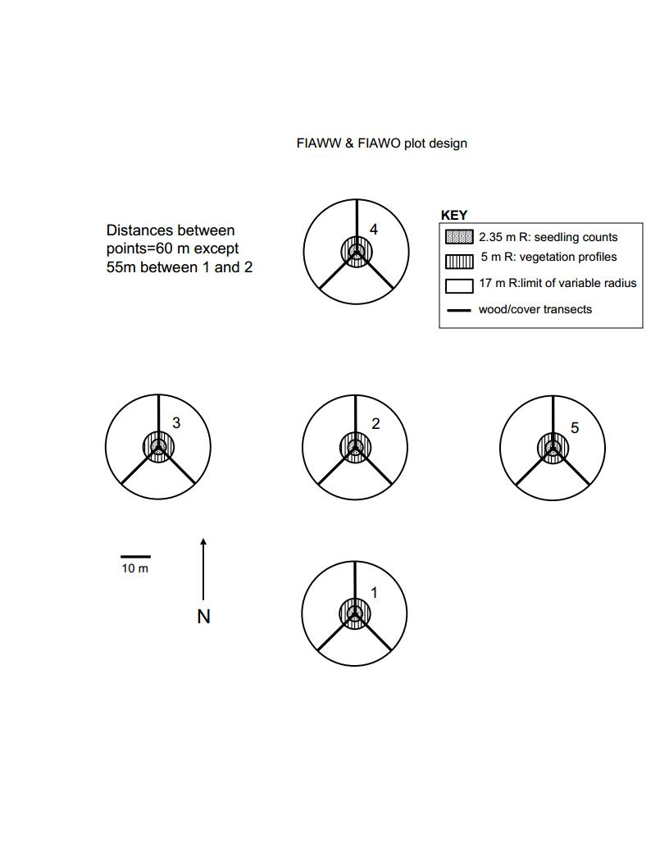
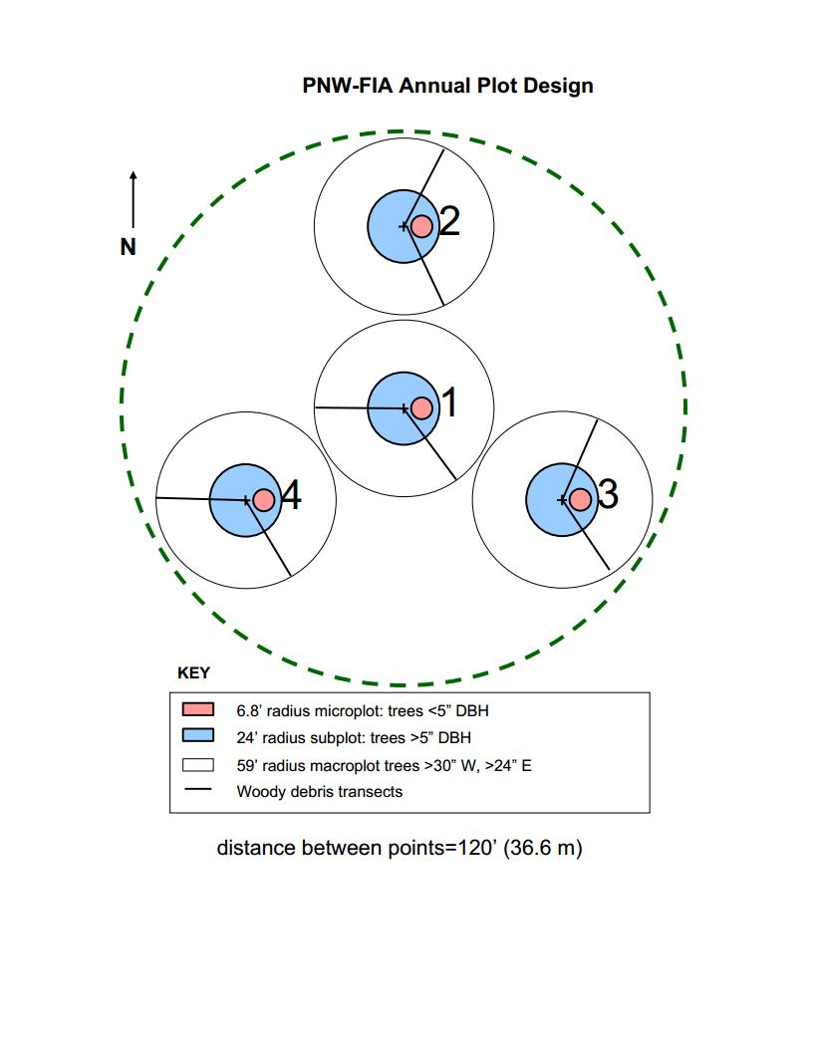
FIA Plot Designs
FIA Periodic Plots
FIA Annual Plots

Slide 11
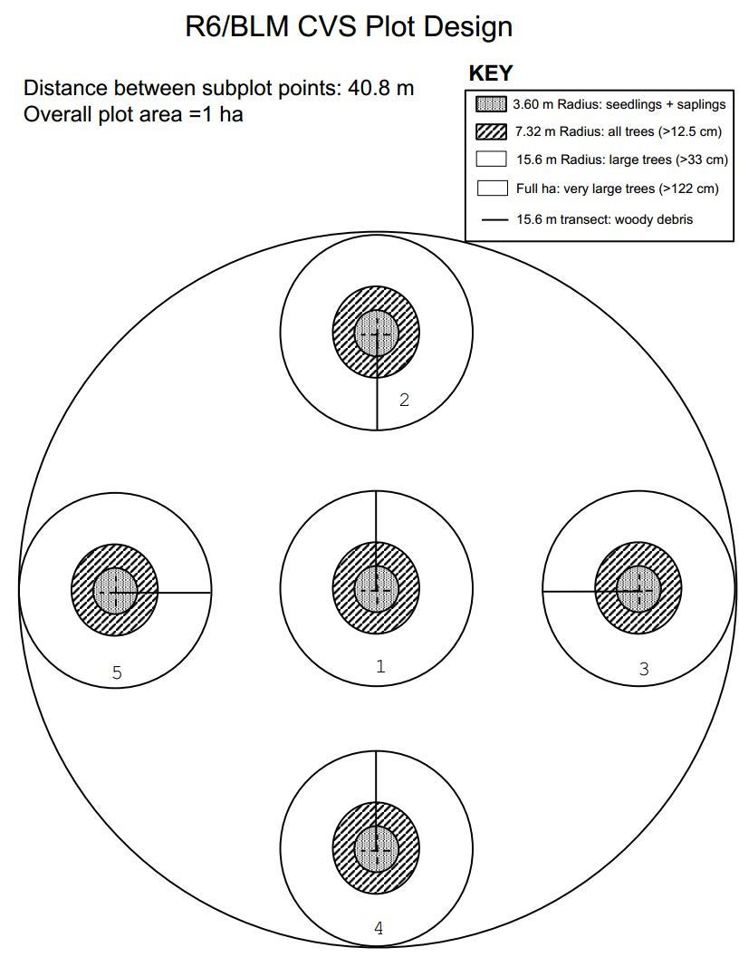
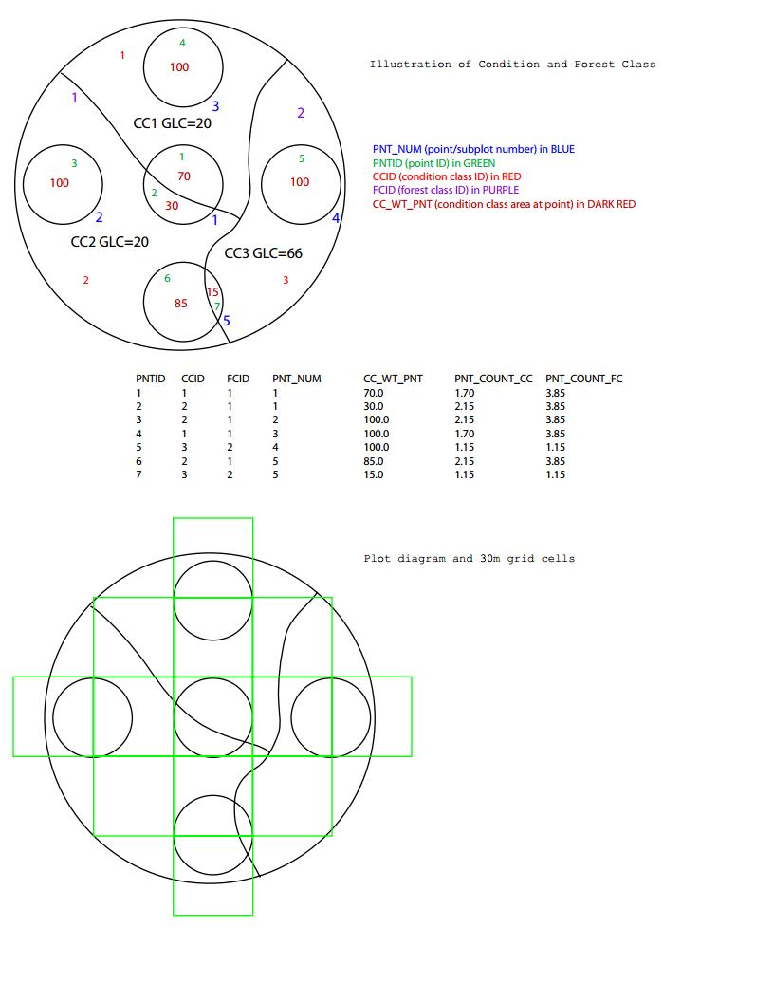
Region 6 CVS Plot Design

Slide 12
Explanatory variables in GNN
Landsat | Raw bands, TC transformations
Climate | Means, seasonal variability
Topography | Elevation, slope, aspect, solar
Disturbance | Past fires, harvest, I&D
Soils | Parent materials
Location | X, Y
Ownership | Federal, state, forest industry, other private
>100 rasters
Source data vary in spatial resolution, extent, accuracy, relevance to hypotheses
Resample to 30 m x 30 m resolution

Slide 13
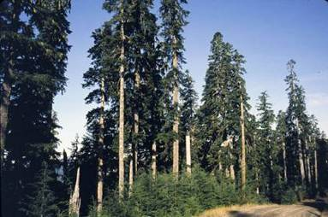
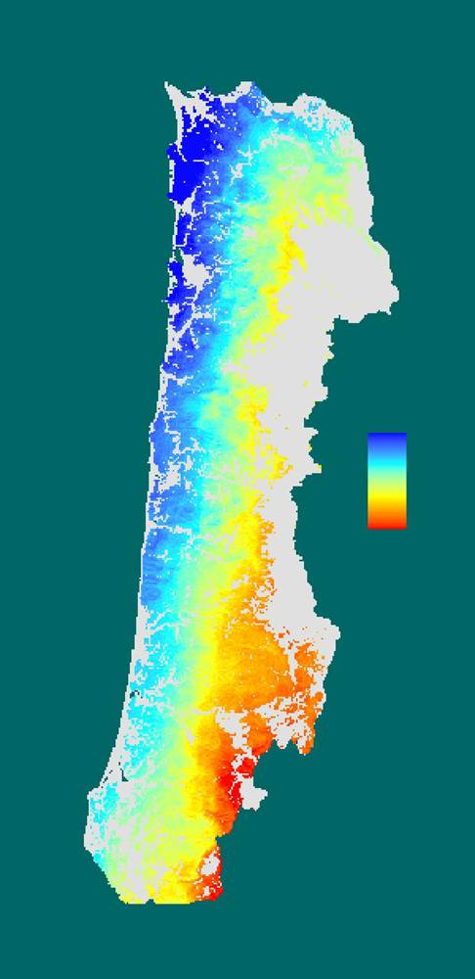
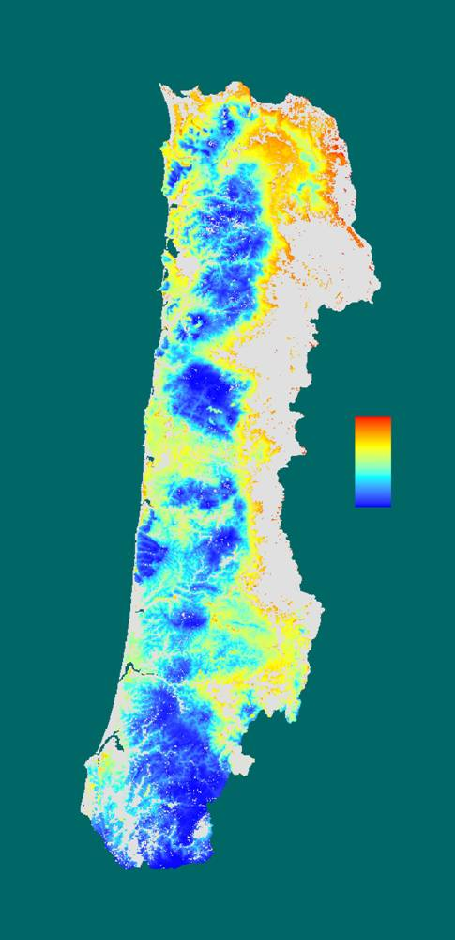
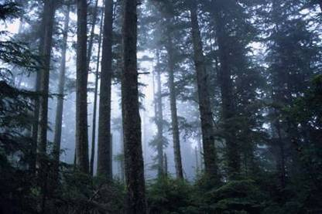
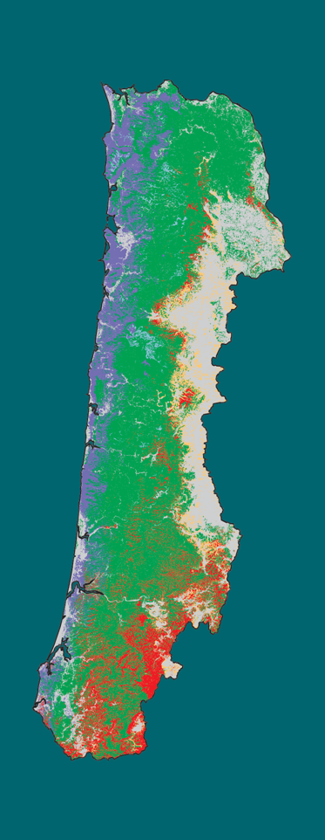
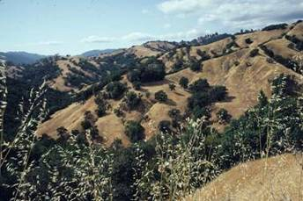
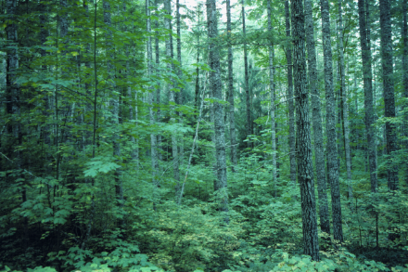
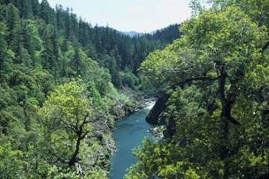
Species Gradients
(Linked to Environment)
Abies amabilis/
procera
Maritime
Low
Picea sitchensis
Pacific Ocean
Interior
(Valley)
High
Quercus woodlands
Tsuga heterophylla
CCA axis 1
(climate)
CCA axis 2
(elevation)
Forest Types
Tsuga heterophylla/
mixed evergreen
Notes:
Major environmental gradients are moderate, wet, coastal maritime climate along coast to drier inland climate. Also elevation gradient from sea level to >1000m, steep and dissected terrain. Forests are conifer-dominated, with hardwoods occurring in disturbed areas and very wet or dry sites. Forest types range from Picea along coast to Quercus woodlands of Willamette Valley.

Slide 14
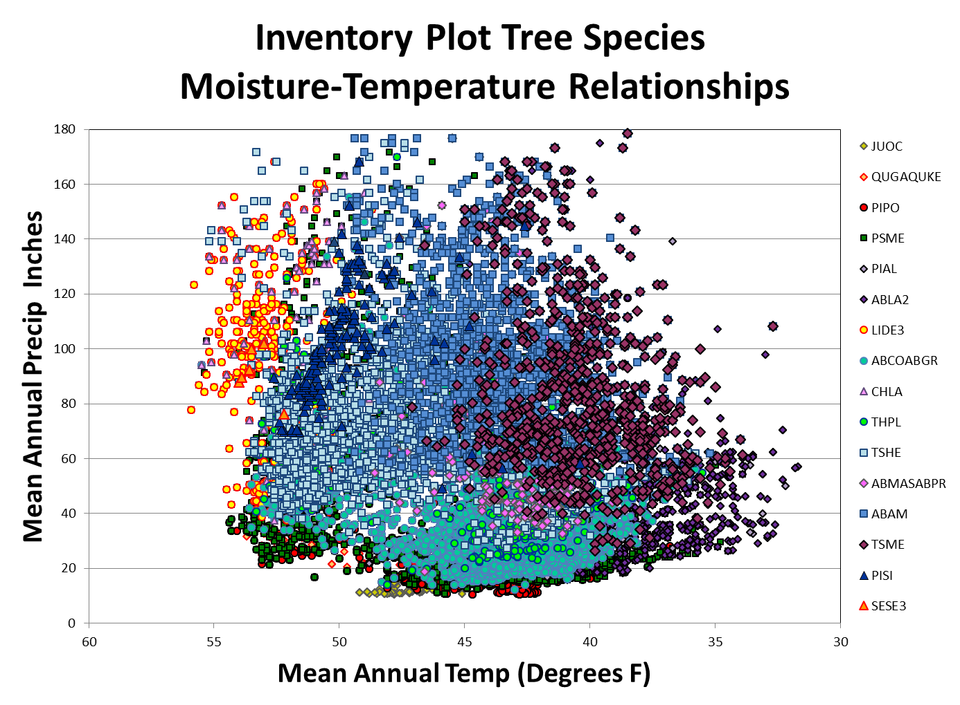
Inventory Plot Tree Species
Moisture-Temperature Relationships

Slide 15
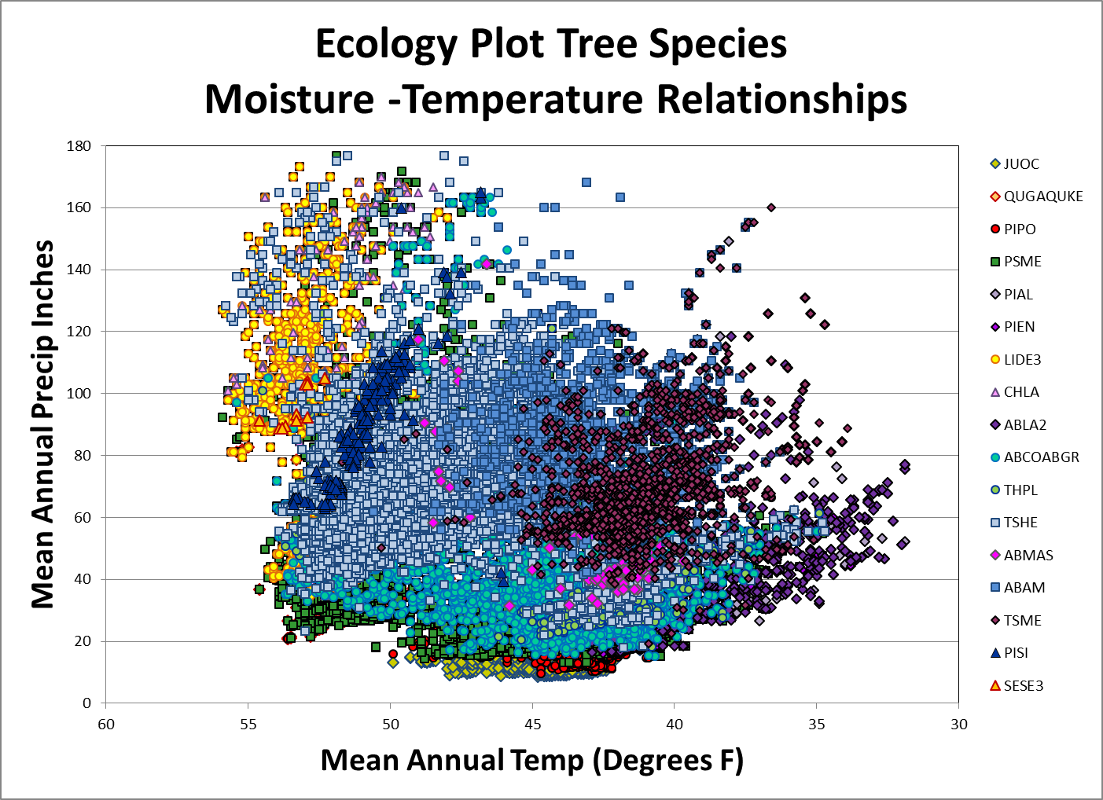
Ecology Plot Tree Species
Moisture-Temperature Relationships

Slide 16
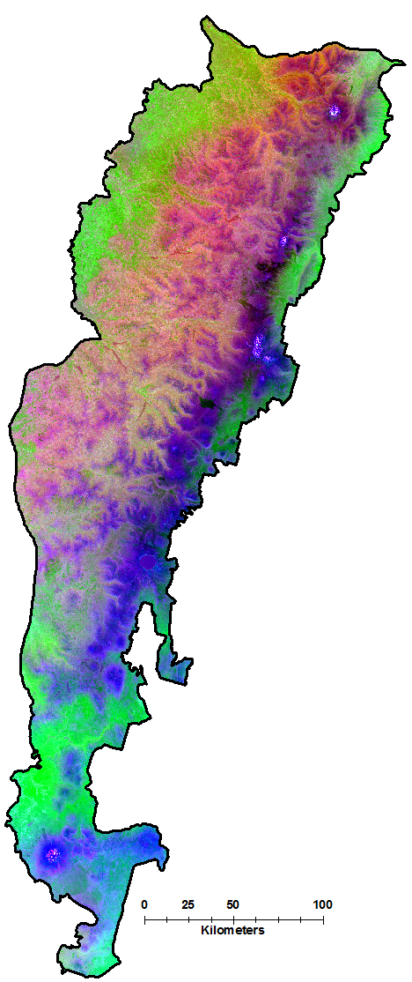
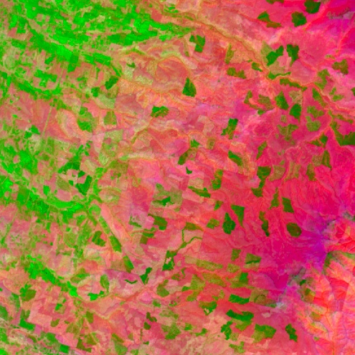

Dominant gradients in forest composition and structure in Oregon and Northern California Cascades
(axis scores from CCA)
% variation explained
Climate | 8.5
Landsat | 4.5
Topography | 4.2
Location | 3.7
Axis 3 (blue):
summer
moisture stress,
TC brightness
Axis 1 (red):
temperature,
elevation,
TC greenness,
TC wetness
Axis 2 (green):
latitude,
seasonality of precipitation

Slide 17
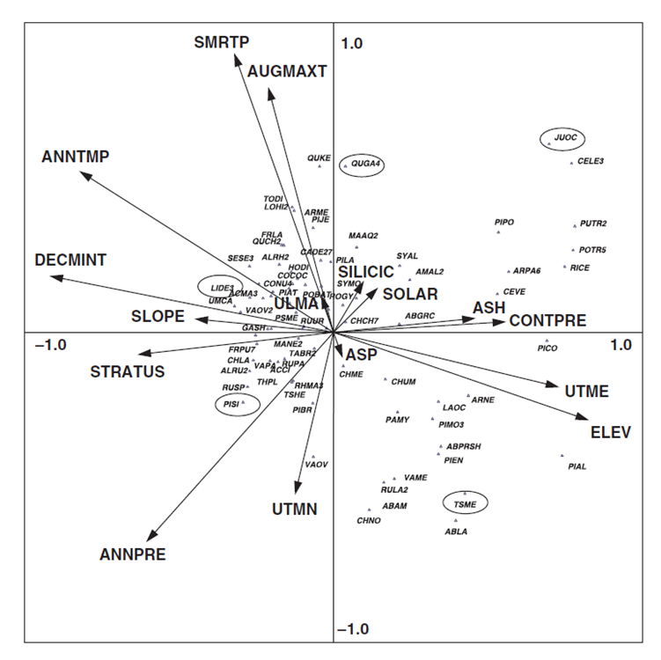
Dominant gradients associated with explanatory variables for species abundance in Western Oregon
Axis 1 - summer cloud cover, summer moisture stress, and solar radiation from coastal maritime to drier more continental inland conditions
Axis 2 associated with elevation, mean annual temperature and summer moisture stress.
Notes:
Associations between Species and Explanatory Variables on dominant gradients (axes 1 & 2). Note only axes 1 and 2 are shown while 1-8 were used in the GNN models.

Slide 18
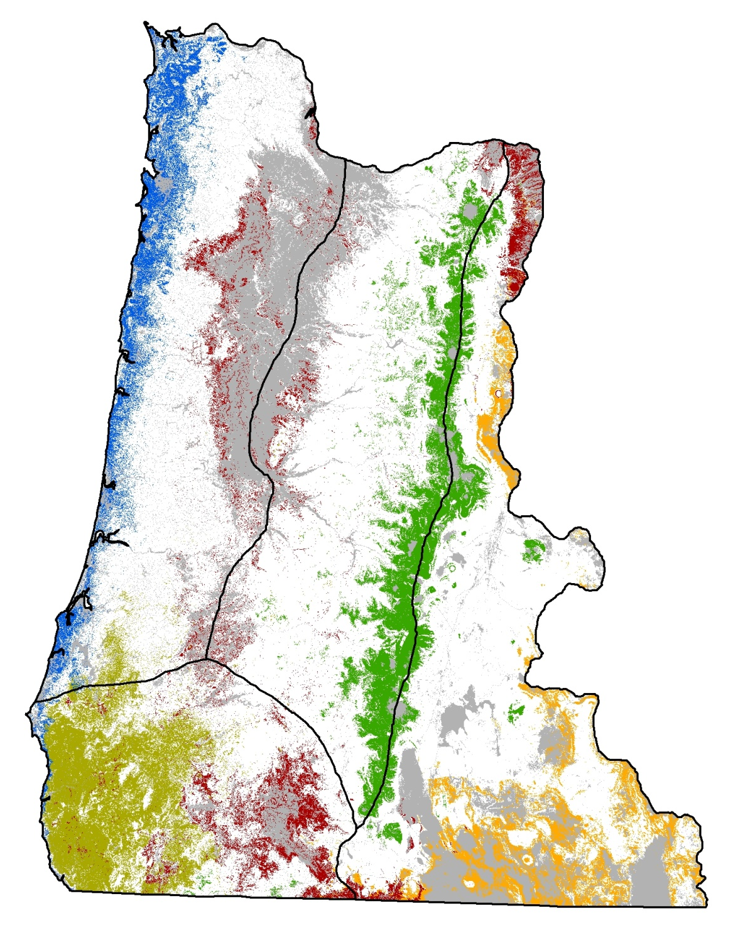

Predicted presence of five tree species
GNN model: 25,000 plots, 48 tree species
Species | False neg. rate | False pos. rate | Kappa
All trees (mean, range) | 0.39 (.02-.97) | 0.07 (0-.23) | 0.43 (.02-.81)
Picea sitchensis | 0.12 | 0.02 | 0.68
Quercus garryana | 0.37 | 0.04 | 0.44
Lithocarpus densiflorus | 0.11 | 0.04 | 0.76
Tsuga mertenziana | 0.16 | 0.05 | 0.71
Juniperus occidentalis | 0.33 | 0.02 | 0.56

Slide 19
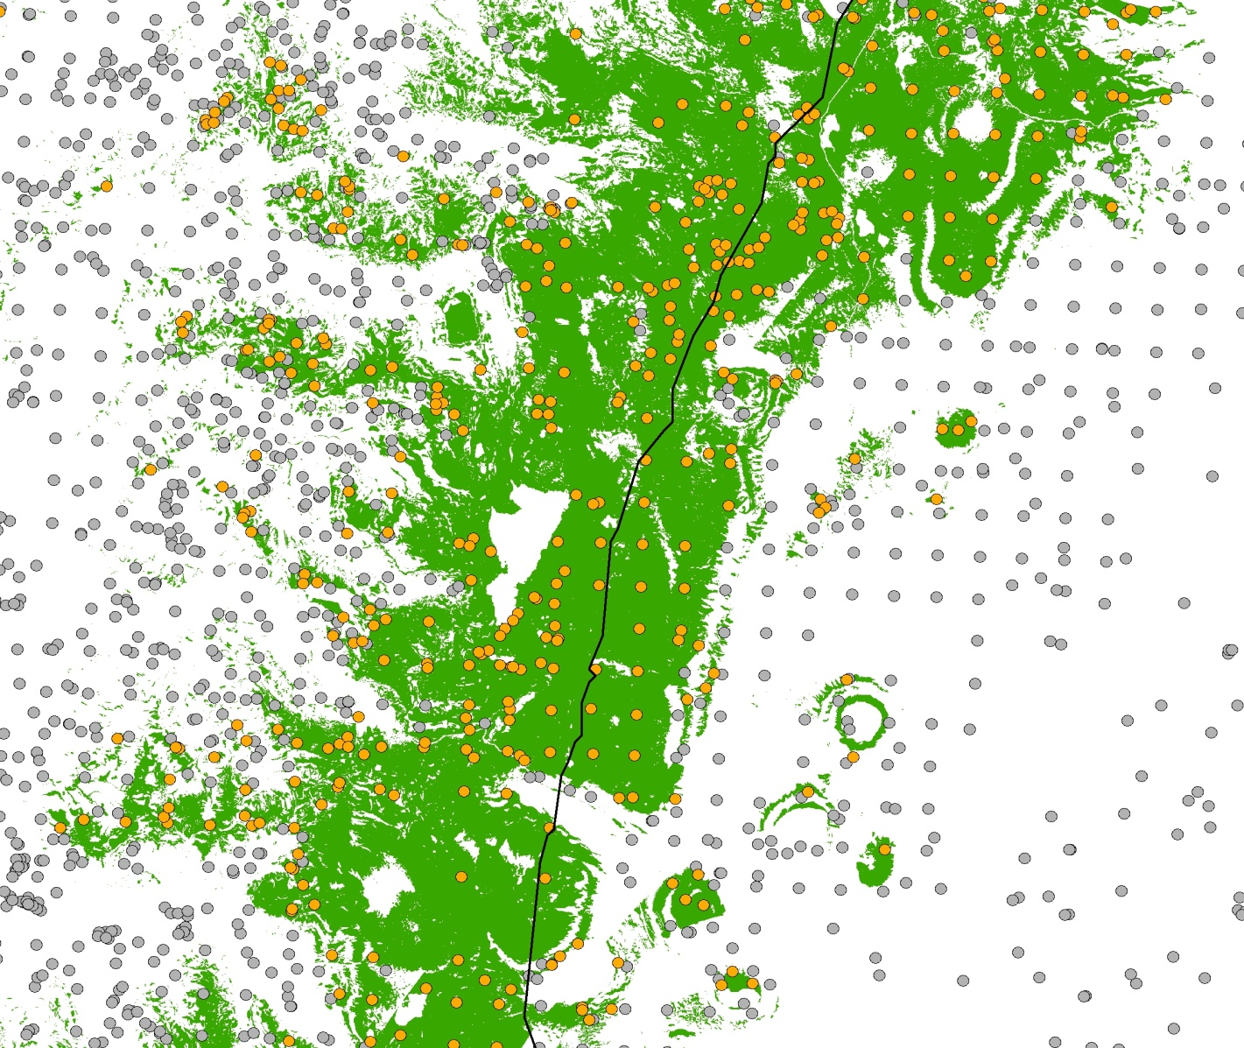
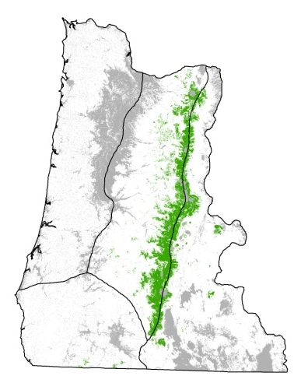
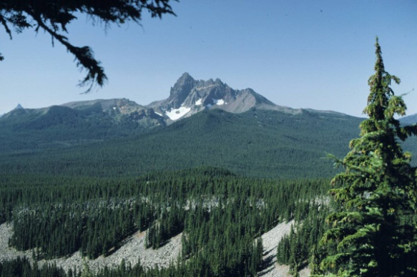
Predicted presence of Tsuga mertensiana
predicted present
observed present
observed absent

Slide 20
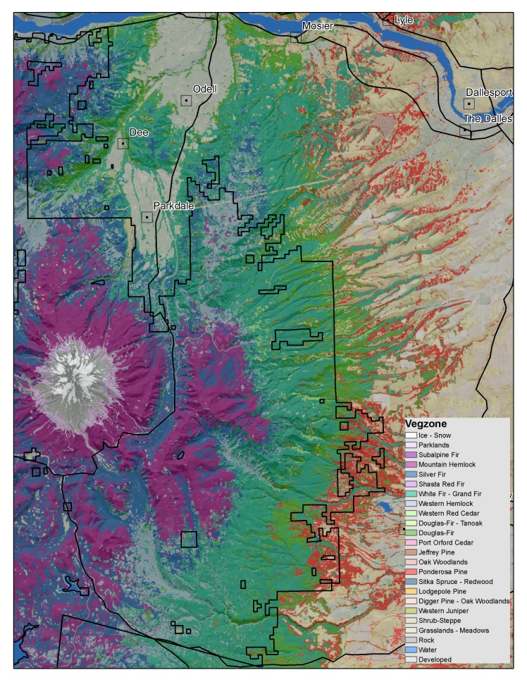
How do you get consistent PVT estimates out of existing Species Composition Info?
Stratify the input plot set based on presence and abundance (>=5%) of the “inferred” Climax tree species using species characteristics.
    Predominant Series order in existing Plant Association Classification Keys
    Shade Tolerance
    Longevity
Use entire 1984-2012 (29 yrs) GNN imputation stack to reduce disturbance effects.
Relax species cover thresholds for plots on disturbed sites.
Notes:
Look at Species Composition from imputations before major disturbances… On plots with repeated significant or repeated disturbance relax cover thresholds.

Slide 21

Tree Species Order of Precedence for Vegetation Zone Classification
Min Threshold for zone assignment >=5% Cover
PISI or SESE3
TSME
ABAM
TSHE or THPL
ABCO or ABGR
ABLA2 or PIEN
ABMAS
CHLA
LIDE3
PSME
PIJE
PIPO
PICO
Hardwoods (Oaks, Aspen etc)
JUOC

Slide 22
Diagnostics for selected tree species predicted Presence/Absence from GNN Imputation

Slide 23
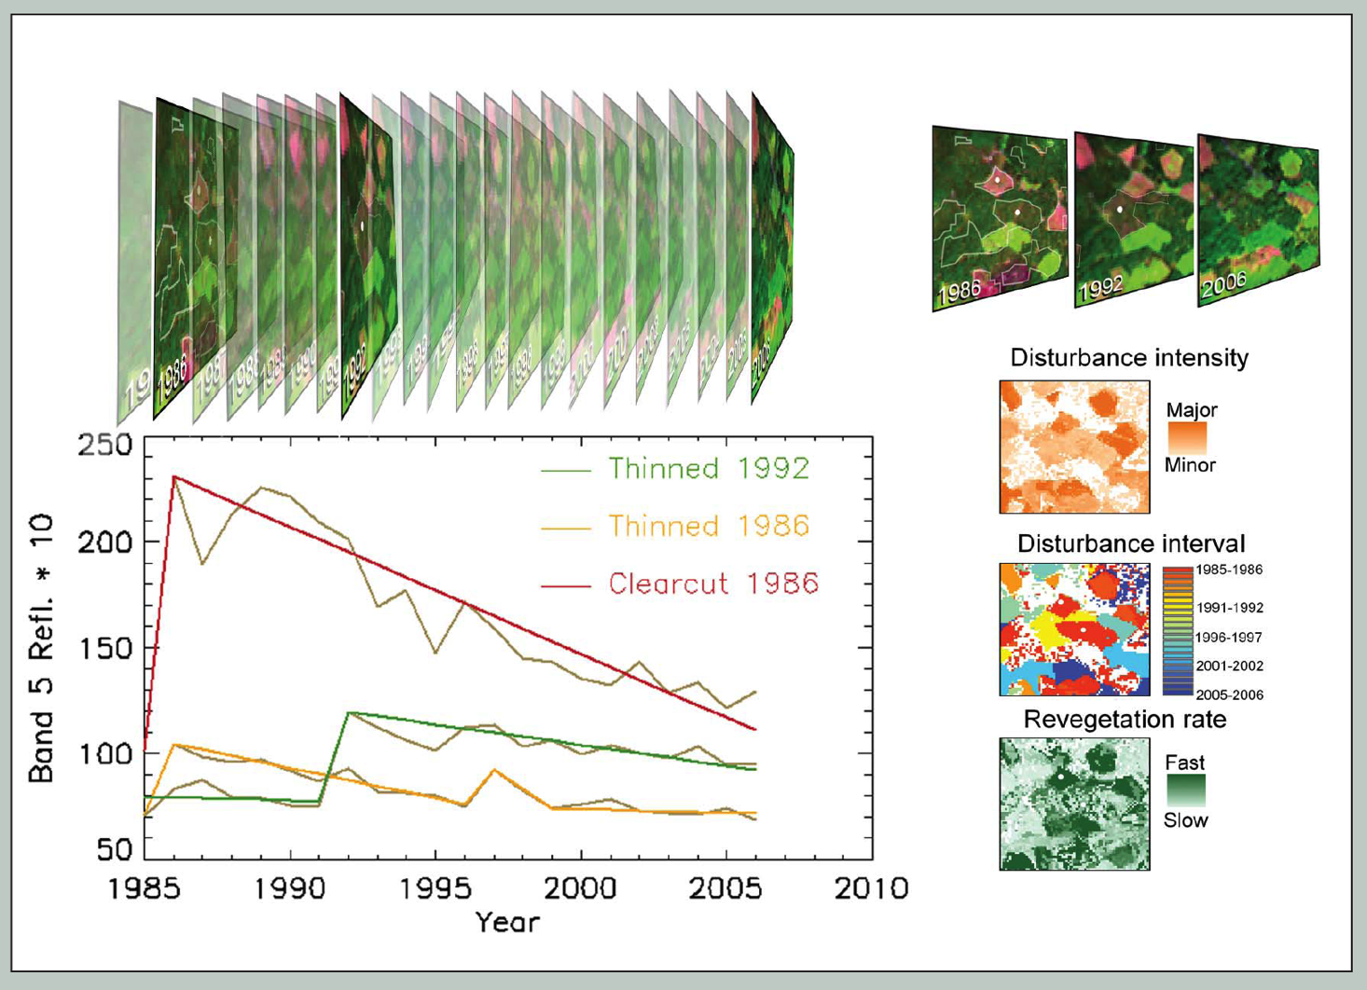
Landsat Detection of Trends in Disturbance and Recovery (LandTrendr)*
Temporal normalization and segmentation
at pixel level
Minimizes noise from sun angle, phenology
Segments describe sequences of disturbance, regrowth
Normalized imagery for multiple years for GNN modeling
*Kennedy et al. (2010), Rem. Sens. Env.

Slide 24
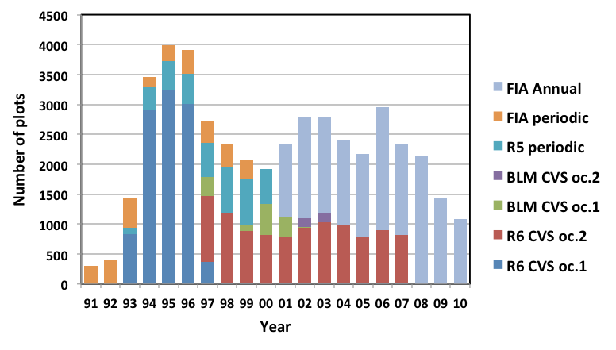
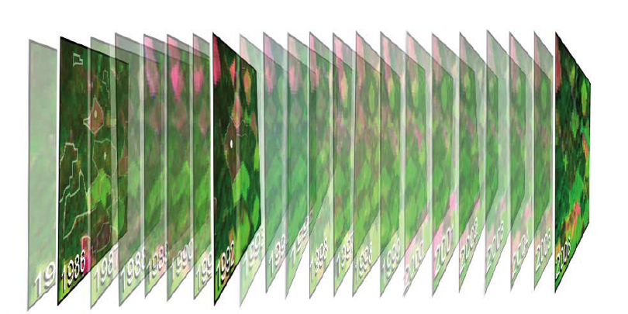
Matching plots to LandTrendr imagery for GNN modeling
Unbalanced in time and space, 1 to 3 per location
Match plots to imagery of same year
Single gradient model from all plots, applied to each imagery year
Imagery is only change – assumes normalization
Response vars.: basal area by species + size-class
30-m
Landsat
pixels
2
1
4
3
Yearly matching of plot and spectral data
FIA Annual plot

Slide 25
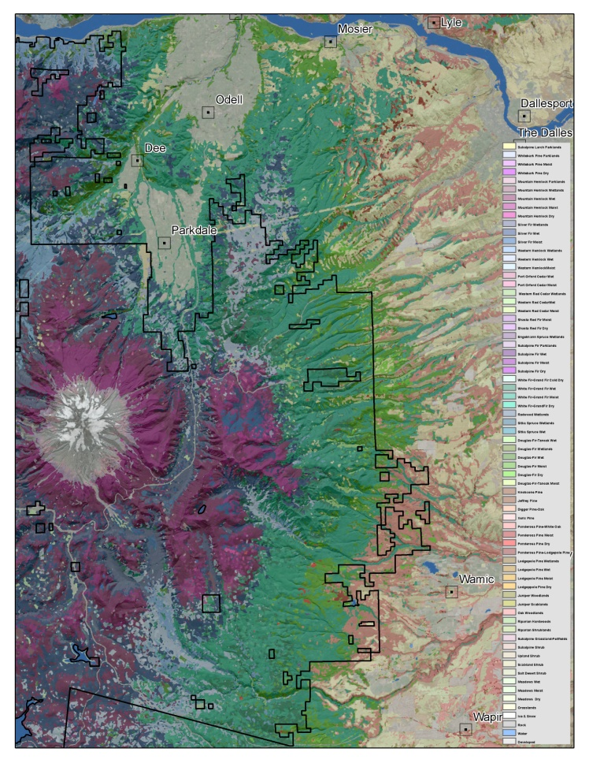
How do you get consistent Subseries PVT estimates out of existing Species Composition Info?
Subdivide the Zone level classification based on minimum cumulative abundance or occurrence of a minimum number of species within an understory “indicator” species group
Indicator Species Groups are based on relative species affinities to major explanatory variables.
    Moisture
    Temperature
    Seasonal Variability
Notes:
On sites with depauperate understories may need to relax minimum abundance thresholds.

Slide 26
Diagnostics for selected shrub species predicted Presence/Absence from GNN Imputation.

Slide 27
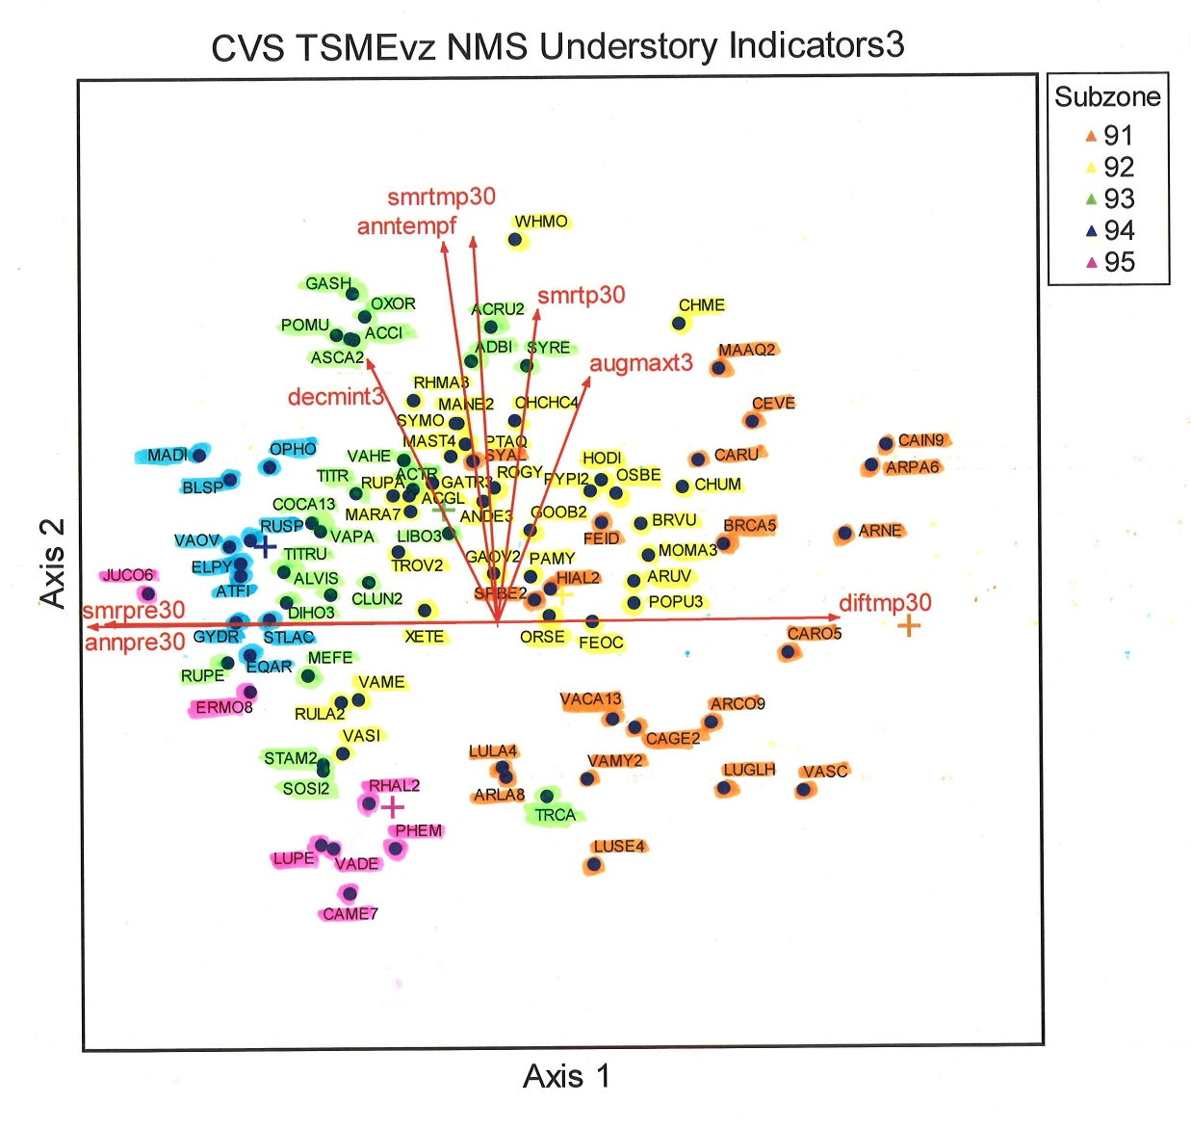
Example Ordination of Inventory Plot Understory Species in Environmental Space
Order of Species Group Precedence for Mtn. Hemlock Zone
  94 - TSME Wetlands
  93 - TSME Wet
  95 - TSME Parklands
  92 - TSME Moist
  91 - TSME Dry
Groups are ordered by moisture-temperature gradients
  wet to dry
  cold to warm
Notes:
Species locations represent the centroid of each species occurrence. Each species group used to define a Subzone is highlighted in a separate color. Subzone centroids are indicated by colored +’s that match the species group color.

Slide 28
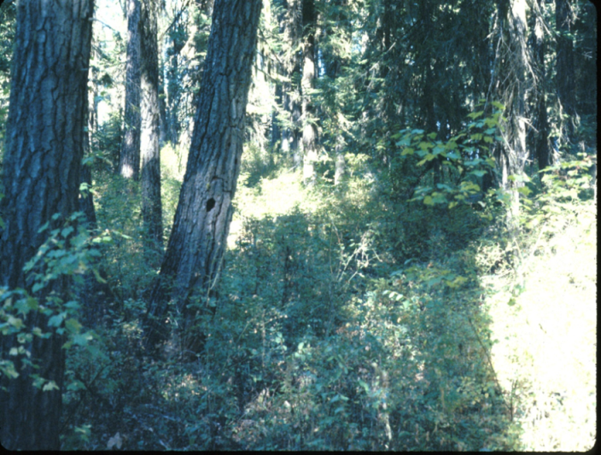
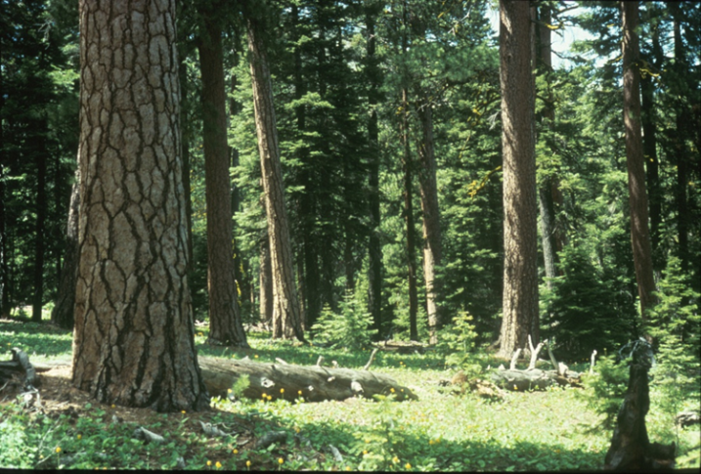
Key Components for Success
Abco-Abgr Series
Consistent approach to Zone – Subzone stratifications across Area boundaries
  Need agreement on indicator species group membership for each Subzone
Subseries strata ideally should incorporate major differences in disturbance regimes and response to disturbance
Consistent logical naming convention for the subseries strata
Mixed Severity Fire Regime
Frequent Low Severity Fire Regime

Slide 29
Tree Dominated
Vegzone (Series Level) Validation
 |  | Juniper | Lodgepole Pine | Sitka Spruce-Redwood | Ponderosa Pine | Hardwood Forest | Jeffrey Pine | Port Orford Cedar | Douglas-Fir | Douglas-Fir-Tanoak | Cedar-Hemlock | White Fir-Grand Fir | Shasta Red Fir | Silver Fir | Mountain Hemlock | Subalpine Fir-Spruce | Subalpine Parklands
 |  | 6 | 8 | 9 | 10 | 11 | 12 | 13 | 14 | 15 | 19 | 20 | 21 | 22 | 23 | 25 | 30 | N
Juniper | 6 | 96% | 0 | 0 | 0.46% | 0 | 0 | 0 | 0.08% | 0 | 0 | 0.31% | 0 | 0 | 0 | 0 | 0 | 1308
Lodgepole Pine | 8 | 0 | 34% | 0.42% | 17% | 0.28% | 0 | 0 | 5% | 0 | 6% | 20% | 0.28% | 0.14% | 8% | 7% | 1% | 710
Sitka Spruce-Redwood | 9 | 0 | 0 | 99% | 0 | 0.35% | 0 | 0 | 0 | 0 | 0 | 1% | 0 | 0.35% | 0 | 0 | 0 | 285
Ponderosa Pine | 10 | 0 | 0 | 0 | 93% | 0 | 0 | 0 | 1% | 0 | 2% | 3% | 0 | 0.08% | 0.23% | 0.16% | 0 | 1284
Hardwood Forest | 11 | 0 | 0 | 4% | 9% | 24% | 0 | 0 | 6% | 1% | 15% | 30% | 0 | 4% | 0 | 2% | 1% | 138
Jeffrey Pine | 12 | 0 | 0 | 0 | 0 | 0 | 91% | 4% | 0 | 0 | 4% | 0 | 0 | 0 | 0 | 0 | 0 | 23
Port Orford Cedar | 13 | 0 | 0 | 0 | 0 | 0 | 0 | 79% | 1% | 2% | 16% | 0 | 0 | 0 | 0 | 0 | 0 | 168
Douglas-Fir | 14 | 0.02% | 0 | 1% | 0 | 0 | 0 | 0 | 90% | 0.06% | 7% | 1% | 0 | 1% | 0.20% | 0.22% | 0 | 5047
Douglas-Fir-Tanoak | 15 | 0 | 0 | 0 | 0 | 0 | 0 | 0 | 0 | 99.6% | 0.11% | 0.32% | 0 | 0 | 0 | 0 | 0 | 927
Cedar-Hemlock | 19 | 0 | 0 | 0.03% | 0 | 0 | 0 | 0 | 0.07% | 0.01% | 99% | 0.09% | 0 | 0.43% | 0.20% | 0.04% | 0 | 6913
White Fir-Grand Fir | 20 | 0 | 0 | 0 | 0.04% | 0 | 0 | 0.02% | 0.20% | 0.12% | 1% | 98% | 0 | 0.10% | 0.40% | 0.06% | 0.02% | 4959
Shasta Red Fir | 21 | 0 | 0 | 0 | 0 | 0 | 0 | 0 | 1% | 0 | 2% | 11% | 71% | 3% | 11% | 0 | 0 | 166
Silver Fir | 22 | 0 | 0 | 0 | 0 | 0 | 0 | 0 | 0 | 0 | 0.12% | 0.08% | 0 | 99% | 1% | 0.04% | 0.04% | 2547
Mountain Hemlock | 23 | 0 | 0 | 0 | 0.04% | 0 | 0 | 0 | 0 | 0 | 0.20% | 0.12% | 0 | 0.41% | 99% | 0.16% | 0.20% | 2441
Subalpine Fir-Spruce | 25 | 0 | 0 | 0 | 0.14% | 0.07% | 0 | 0 | 1% | 0 | 6% | 2% | 0 | 1% | 2% | 87% | 0.34% | 1450
Subalpine Parklands | 30 | 0 | 0 | 0 | 0 | 0 | 0 | 0 | 0 | 0 | 0 | 1% | 0 | 0 | 0 | 1% | 98% | 98

Slide 30
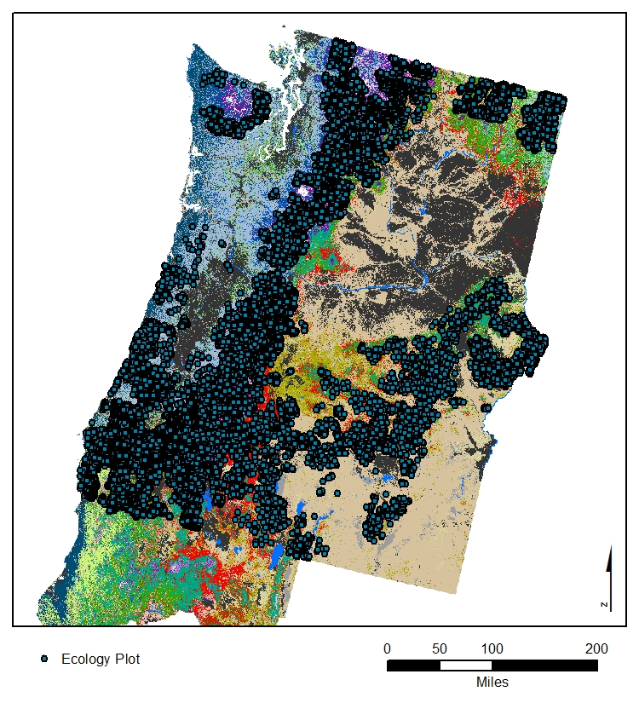
Vegzone (Series Level) Validation
Ecology Plots
Advantages:
  Independent data set
  >28,000 locations
Disadvantages:
  Precision of plot locations vary
  Well-distributed across public lands, but low coverage in other areas
  Some plots close together (>30m)

Slide 31
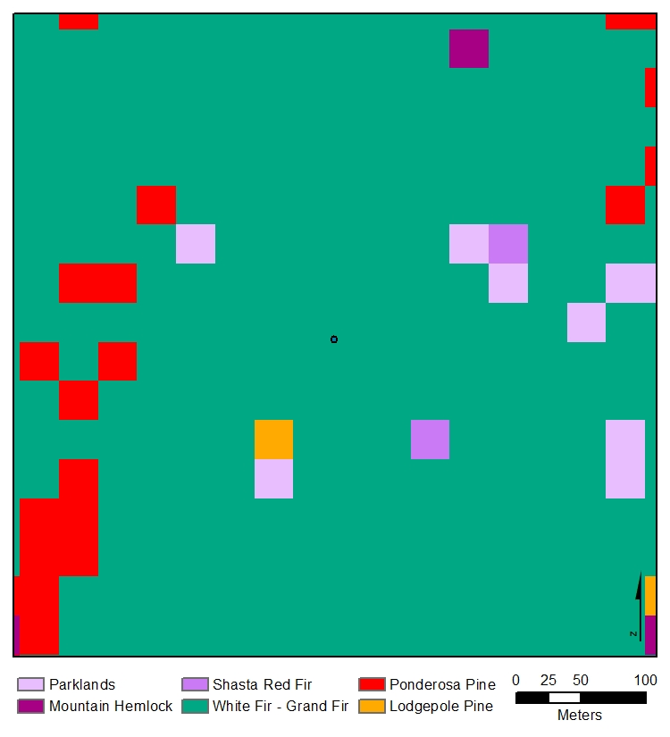
Vegzone (Series Level) Validation
Three approaches:
Exact plot location
Series majority within a specified distance from plot
Series present within a specified distance from plot

Slide 32

Vegzone (Series Level) Validation
Exact plot location:
  ArcGIS: Extract Value to Point
Series call based on plot data: ABCO/ABGR
Series call based on raster: ABCO/ABGR

Slide 33

Vegzone (Series Level) Validation
Series majority within a specified distance from plot

Slide 34
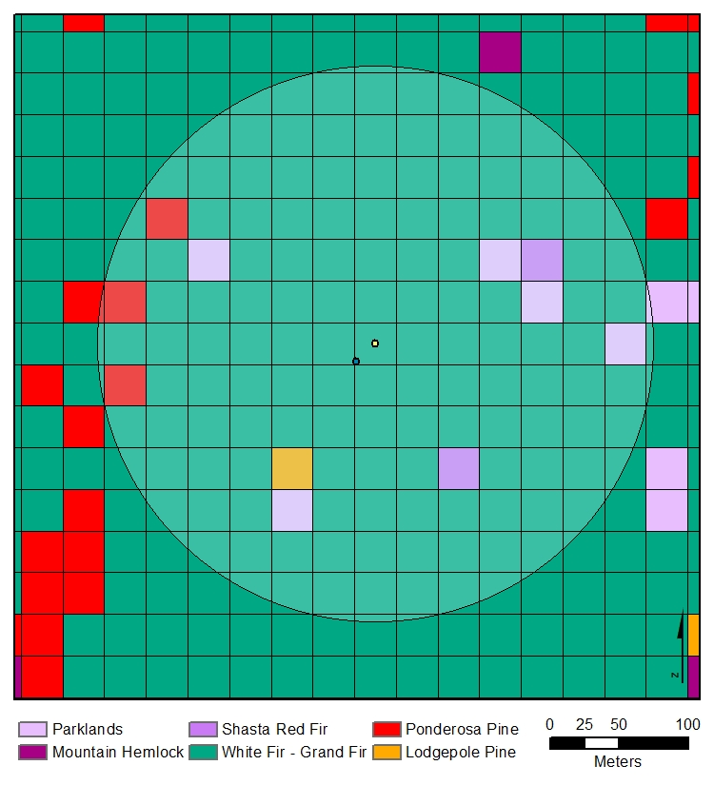
Vegzone (Series Level) Validation
Series majority within a specified distance from plot
  Centered plot in pixel
  Generated 200m buffer
  141 pixels within 200m buffer
  Must be at least 50% of pixels within buffer
  ArcGIS: Tabulate Area, further analysis in Excel

Slide 35
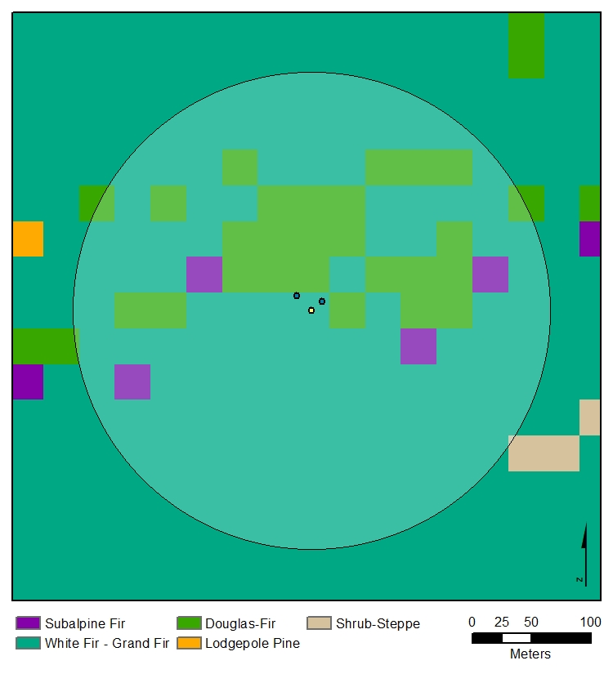
Vegzone (Series Level) Validation
Caveats:
  Some points eliminated due to being within the same pixel (6 plots total)

Slide 36
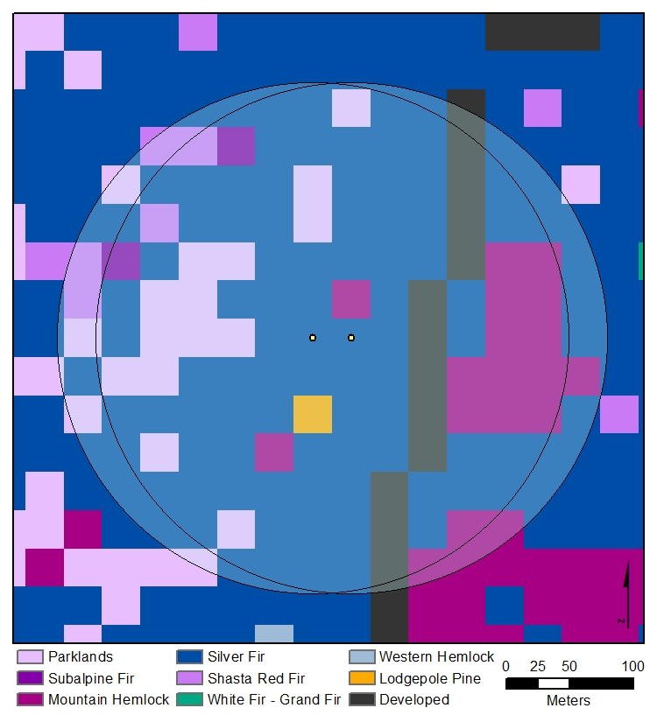
Vegzone (Series Level) Validation
Caveats:
  Some points eliminated due to being within the same pixel (6 plots total)
  Some points have a high degree of overlap (minimum distance 20m)

Slide 37
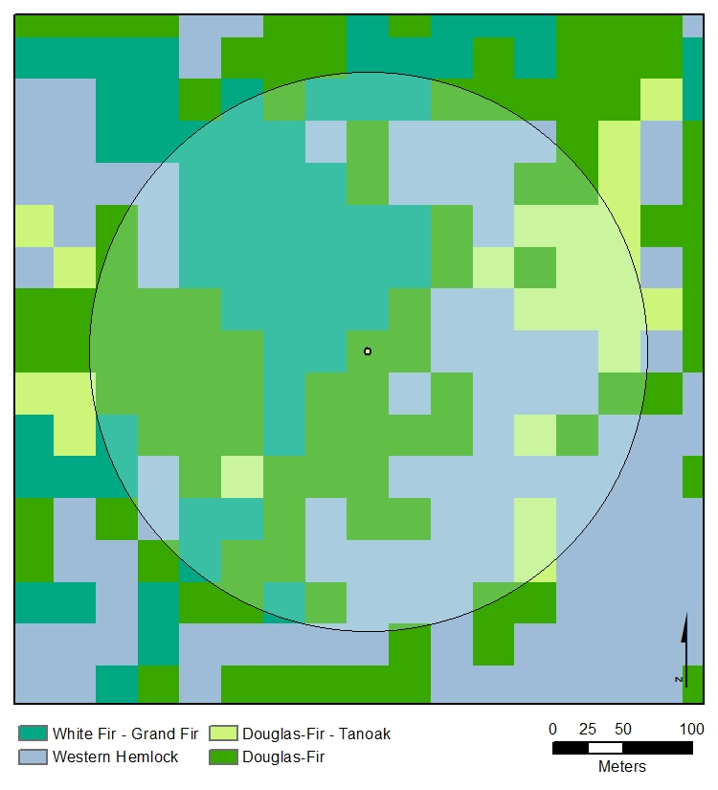
Vegzone (Series Level) Validation
Plot 69325121:
  Series call: PSME
  Point call: PSME
  Majority within 200m buffer: “No good match”
  Presence within 200m buffer: PSME
~33% PSME,
~31% THPL/TSHE, ~25% ABCO/ABGR

Slide 38
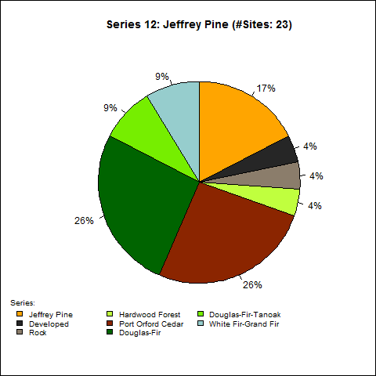
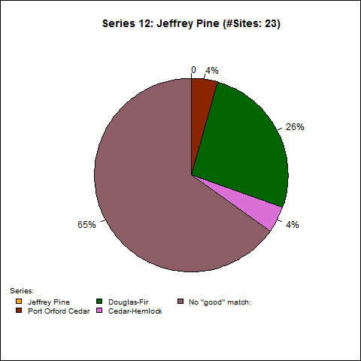
Vegzone (Series Level) Validation
“Point” Call
“Area” call (>50%)

Slide 39
Vegzone (Series Level) Validation
Confusion Matrix: Species present within 200m buffer
 |  | Juniper | Lodgepole Pine | Sitka Spruce-Redwood | Ponderosa Pine | Hardwood Forest | Jeffrey Pine | Port Orford Cedar | Douglas-Fir | Douglas-Fir-Tanoak | Cedar-Hemlock | White Fir-Grand Fir | Shasta Red Fir | Silver Fir | Mountain Hemlock | Subalpine Fir-Spruce | Subalpine Parklands
 |  | 6 | 8 | 9 | 10 | 11 | 12 | 13 | 14 | 15 | 19 | 20 | 21 | 22 | 23 | 25 | 30 | N
Juniper | 6 | 96% | 0 | 0 | 0.46% | 0 | 0 | 0 | 0.08% | 0 | 0 | 0.31% | 0 | 0 | 0 | 0 | 0 | 1308
Lodgepole Pine | 8 | 0 | 34% | 0.42% | 17% | 0.28% | 0 | 0 | 5% | 0 | 6% | 20% | 0.28% | 0.14% | 8% | 7% | 1% | 710
Sitka Spruce-Redwood | 9 | 0 | 0 | 99% | 0 | 0.35% | 0 | 0 | 0 | 0 | 0 | 1% | 0 | 0.35% | 0 | 0 | 0 | 285
Ponderosa Pine | 10 | 0 | 0 | 0 | 93% | 0 | 0 | 0 | 1% | 0 | 2% | 3% | 0 | 0.08% | 0.23% | 0.16% | 0 | 1284
Hardwood Forest | 11 | 0 | 0 | 4% | 9% | 24% | 0 | 0 | 6% | 1% | 15% | 30% | 0 | 4% | 0 | 2% | 1% | 138
Jeffrey Pine | 12 | 0 | 0 | 0 | 0 | 0 | 91% | 4% | 0 | 0 | 4% | 0 | 0 | 0 | 0 | 0 | 0 | 23
Port Orford Cedar | 13 | 0 | 0 | 0 | 0 | 0 | 0 | 79% | 1% | 2% | 16% | 0 | 0 | 0 | 0 | 0 | 0 | 168
Douglas-Fir | 14 | 0.02% | 0 | 1% | 0 | 0 | 0 | 0 | 90% | 0.06% | 7% | 1% | 0 | 1% | 0.20% | 0.22% | 0 | 5047
Douglas-Fir-Tanoak | 15 | 0 | 0 | 0 | 0 | 0 | 0 | 0 | 0 | 99.6% | 0.11% | 0.32% | 0 | 0 | 0 | 0 | 0 | 927
Cedar-Hemlock | 19 | 0 | 0 | 0.03% | 0 | 0 | 0 | 0 | 0.07% | 0.01% | 99% | 0.09% | 0 | 0.43% | 0.20% | 0.04% | 0 | 6913
White Fir-Grand Fir | 20 | 0 | 0 | 0 | 0.04% | 0 | 0 | 0.02% | 0.20% | 0.12% | 1% | 98% | 0 | 0.10% | 0.40% | 0.06% | 0.02% | 4959
Shasta Red Fir | 21 | 0 | 0 | 0 | 0 | 0 | 0 | 0 | 1% | 0 | 2% | 11% | 71% | 3% | 11% | 0 | 0 | 166
Silver Fir | 22 | 0 | 0 | 0 | 0 | 0 | 0 | 0 | 0 | 0 | 0.12% | 0.08% | 0 | 99% | 1% | 0.04% | 0.04% | 2547
Mountain Hemlock | 23 | 0 | 0 | 0 | 0.04% | 0 | 0 | 0 | 0 | 0 | 0.20% | 0.12% | 0 | 0.41% | 99% | 0.16% | 0.20% | 2441
Subalpine Fir-Spruce | 25 | 0 | 0 | 0 | 0.14% | 0.07% | 0 | 0 | 1% | 0 | 6% | 2% | 0 | 1% | 2% | 87% | 0.34% | 1450
Subalpine Parklands | 30 | 0 | 0 | 0 | 0 | 0 | 0 | 0 | 0 | 0 | 0 | 1% | 0 | 0 | 0 | 1% | 98% | 98

Slide 40
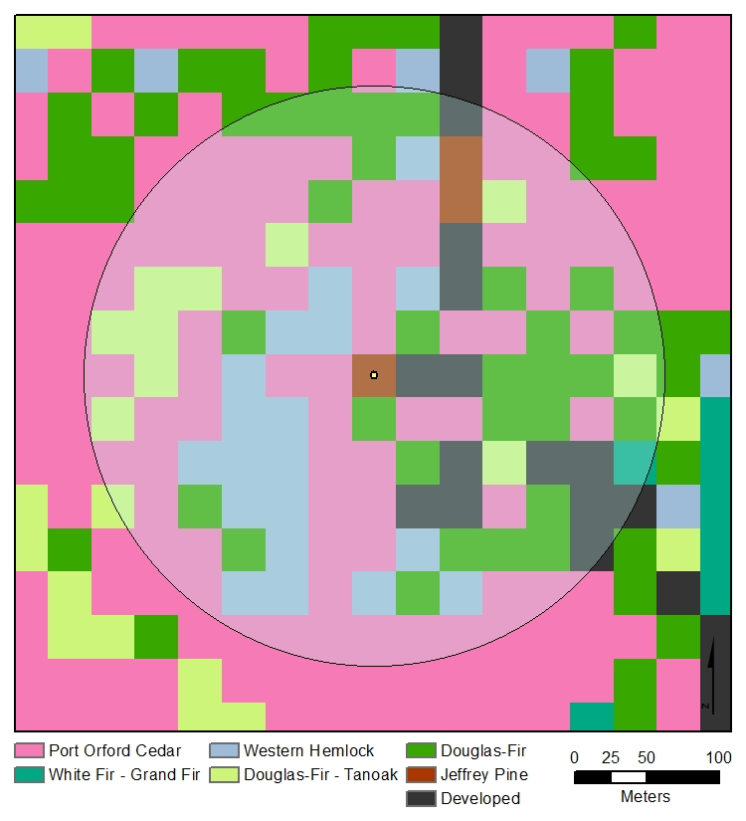
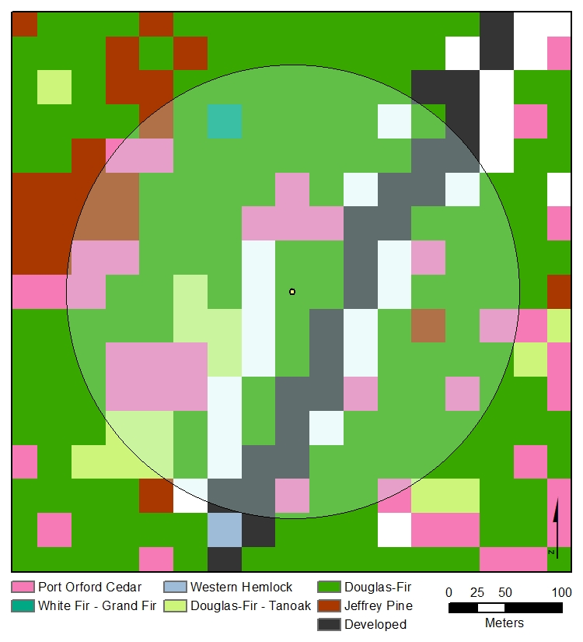
Vegzone (Series Level) Validation
Jeffrey Pine

Slide 41
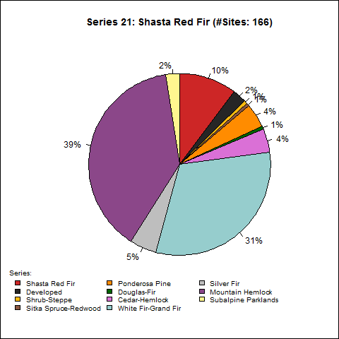

Vegzone (Series Level) Validation
Plots with low point/area match but high presence within 200m buffer
  Series 13: Port Orford Cedar
  Series 14: Douglas-fir
  Series 21: Shasta Red Fir
  Series 25: Subalpine Fir/Spruce
  Series 30: Subalpine Parklands
“Point” Call
“Area” Call

Slide 42


Vegzone (Series Level) Validation
What is causing discrepancies?
  Some species may not grow in large contiguous patches
  Douglas-fir:
    Large niche?
    Common seral species?
  Ecology plot placement
    Edges of stands
    Sometimes on either side of a ridge
“Point” Call
“Area” Call

Slide 43
Vegzone (Series Level) Validation
Confusion Matrix: Species present within 200m buffer
 |  | Juniper | Lodgepole Pine | Sitka Spruce-Redwood | Ponderosa Pine | Hardwood Forest | Jeffrey Pine | Port Orford Cedar | Douglas-Fir | Douglas-Fir-Tanoak | Cedar-Hemlock | White Fir-Grand Fir | Shasta Red Fir | Silver Fir | Mountain Hemlock | Subalpine Fir-Spruce | Subalpine Parklands
 |  | 6 | 8 | 9 | 10 | 11 | 12 | 13 | 14 | 15 | 19 | 20 | 21 | 22 | 23 | 25 | 30 | N
Juniper | 6 | 96% | 0 | 0 | 0.46% | 0 | 0 | 0 | 0.08% | 0 | 0 | 0.31% | 0 | 0 | 0 | 0 | 0 | 1308
Lodgepole Pine | 8 | 0 | 34% | 0.42% | 17% | 0.28% | 0 | 0 | 5% | 0 | 6% | 20% | 0.28% | 0.14% | 8% | 7% | 1% | 710
Sitka Spruce-Redwood | 9 | 0 | 0 | 99% | 0 | 0.35% | 0 | 0 | 0 | 0 | 0 | 1% | 0 | 0.35% | 0 | 0 | 0 | 285
Ponderosa Pine | 10 | 0 | 0 | 0 | 93% | 0 | 0 | 0 | 1% | 0 | 2% | 3% | 0 | 0.08% | 0.23% | 0.16% | 0 | 1284
Hardwood Forest | 11 | 0 | 0 | 4% | 9% | 24% | 0 | 0 | 6% | 1% | 15% | 30% | 0 | 4% | 0 | 2% | 1% | 138
Jeffrey Pine | 12 | 0 | 0 | 0 | 0 | 0 | 91% | 4% | 0 | 0 | 4% | 0 | 0 | 0 | 0 | 0 | 0 | 23
Port Orford Cedar | 13 | 0 | 0 | 0 | 0 | 0 | 0 | 79% | 1% | 2% | 16% | 0 | 0 | 0 | 0 | 0 | 0 | 168
Douglas-Fir | 14 | 0.02% | 0 | 1% | 0 | 0 | 0 | 0 | 90% | 0.06% | 7% | 1% | 0 | 1% | 0.20% | 0.22% | 0 | 5047
Douglas-Fir-Tanoak | 15 | 0 | 0 | 0 | 0 | 0 | 0 | 0 | 0 | 99.6% | 0.11% | 0.32% | 0 | 0 | 0 | 0 | 0 | 927
Cedar-Hemlock | 19 | 0 | 0 | 0.03% | 0 | 0 | 0 | 0 | 0.07% | 0.01% | 99% | 0.09% | 0 | 0.43% | 0.20% | 0.04% | 0 | 6913
White Fir-Grand Fir | 20 | 0 | 0 | 0 | 0.04% | 0 | 0 | 0.02% | 0.20% | 0.12% | 1% | 98% | 0 | 0.10% | 0.40% | 0.06% | 0.02% | 4959
Shasta Red Fir | 21 | 0 | 0 | 0 | 0 | 0 | 0 | 0 | 1% | 0 | 2% | 11% | 71% | 3% | 11% | 0 | 0 | 166
Silver Fir | 22 | 0 | 0 | 0 | 0 | 0 | 0 | 0 | 0 | 0 | 0.12% | 0.08% | 0 | 99% | 1% | 0.04% | 0.04% | 2547
Mountain Hemlock | 23 | 0 | 0 | 0 | 0.04% | 0 | 0 | 0 | 0 | 0 | 0.20% | 0.12% | 0 | 0.41% | 99% | 0.16% | 0.20% | 2441
Subalpine Fir-Spruce | 25 | 0 | 0 | 0 | 0.14% | 0.07% | 0 | 0 | 1% | 0 | 6% | 2% | 0 | 1% | 2% | 87% | 0.34% | 1450
Subalpine Parklands | 30 | 0 | 0 | 0 | 0 | 0 | 0 | 0 | 0 | 0 | 0 | 1% | 0 | 0 | 0 | 1% | 98% | 98
Notes:
Stars: Low point/area agreement, but better agreement when consider the whole 200m buffer. Purple lines “borderline” agreement. Red lines: poor agreement.

Slide 44


Vegzone (Series Level) Validation
Further Investigation:
  Expert review of map
  Closer look at series with poor agreement
  Run validation agreement separately for west-side/east-side forests, or by ecoregion
  “Fuzzy” validation: How “bad” is a bad call?

Slide 45
Questions?
Notes:
Stars: Low point/area agreement, but better agreement when consider the whole 200m buffer. Purple lines “borderline” agreement. Red lines: poor agreement.

