Slide 1
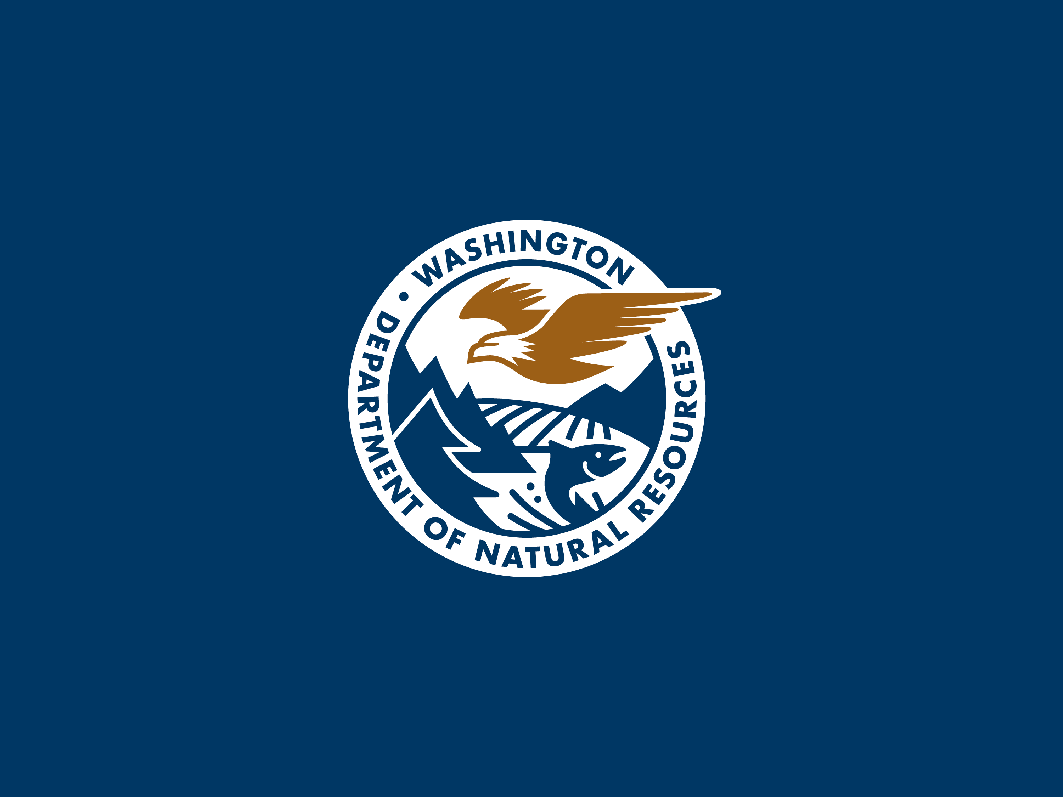

Slide 2
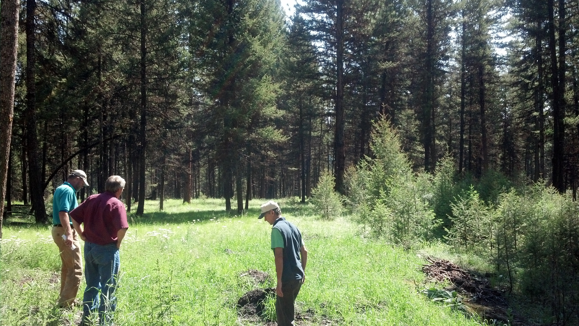

Developing a Common Vision for Forest Restoration
Smoke Management and Prescribed Burning Meeting: Foundations for the Future
February 28, 2017 Wenatchee, WA

Slide 3
RCW 76.06 Definition of Forest Health
The law defines “forest health” broadly as: “the condition of a forest being sound in ecological function, sustainable, resilient, and resistant to insects, diseases, fire and other disturbance, and having the capacity to meet landowner objectives.”

Slide 4
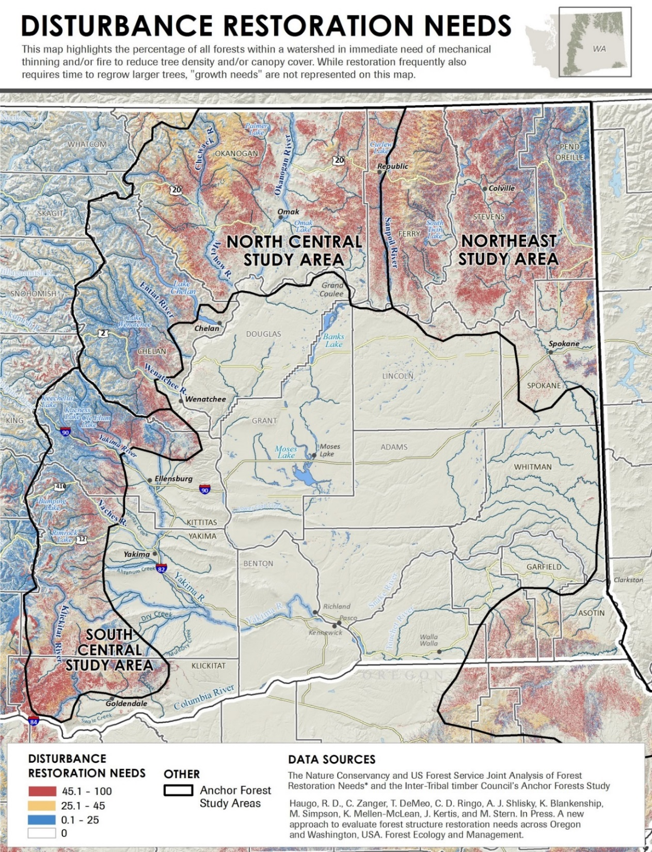
Ownership | Total Active Restoration Need
 | Acres | Percent
USFS | 1,119,674 | 42%
State-DNR | 257,434 | 10%
State-Other | 46,227 | 2%
Tribal | 397,782 | 15%
Private Industrial | 319,923 | 12%
Private Non-Industrial | 466,414 | 17%
Other | 71,050 | 3%
Total | 2,678,504
Haugo et al. 2015

Slide 5
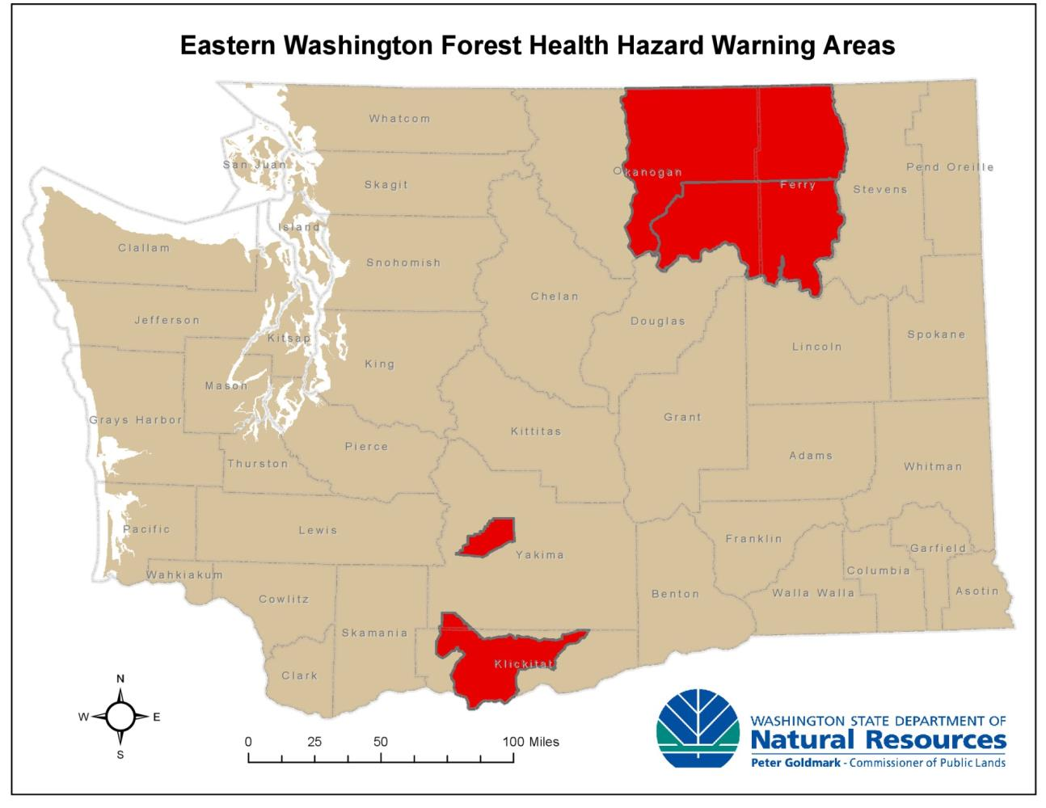
DNR’s Forest Health Restoration
2012 designated Forest Health Hazard Warning Areas in eastern WA
Secured appropriations for fuel hazard reduction and forest health treatment work on state and private lands:
  FY 09-11 $2 Million
  FY 11-13 $2 Million
  FY 13-15 $4 Million
  FY 15-17 $10 Million

Slide 6
17-19 DNR Capital Budget Request:
$12.4 million for state and private forest health treatments in four E. WA priority focus areas
$450K for prescribed burning on state lands
$500K for Forest Collaborative support
$5 million for “Good Neighbor” Cross Boundary Competitive Grant Program

Slide 7
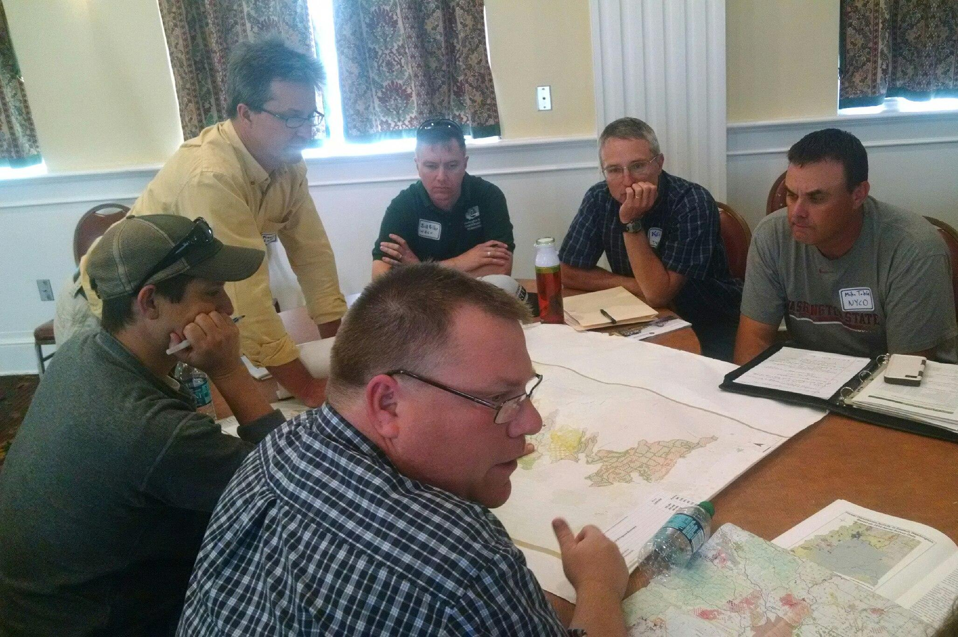
All Lands, All Hands
-Building an All Lands, All Hands ethic.
-Deepen collaborative processes to enhance restoration outcomes.
-Utilize new tools and partnerships to get treatments done.
-20 Year Strategic Plan
-Joint Chiefs
-Forest Collaboratives
-Good Neighbor Authority

Slide 8
DNR has been tasked by the state Legislature to:
“…develop a twenty-year strategic plan to treat areas of state forest land that have been identified by the department as being in poor health.”

Slide 9
DNR’s Forest Health Strategic Plan:
VISION:
Washington’s Forests are in a condition to meet the ecological, social and economic needs of present and future generations.
MISSION:
Restore forest conditions at a pace and scale that will achieve landscape-scale reduction of wildfire risk and increase the quality and resilience of forest ecosystems and forest-dependent communities in a changing climate.
OVERARCHING STRATEGY:
To maximize effectiveness, coordinate and prioritize landowners’ treatments activities across all forest owners in a landscape.

Slide 10
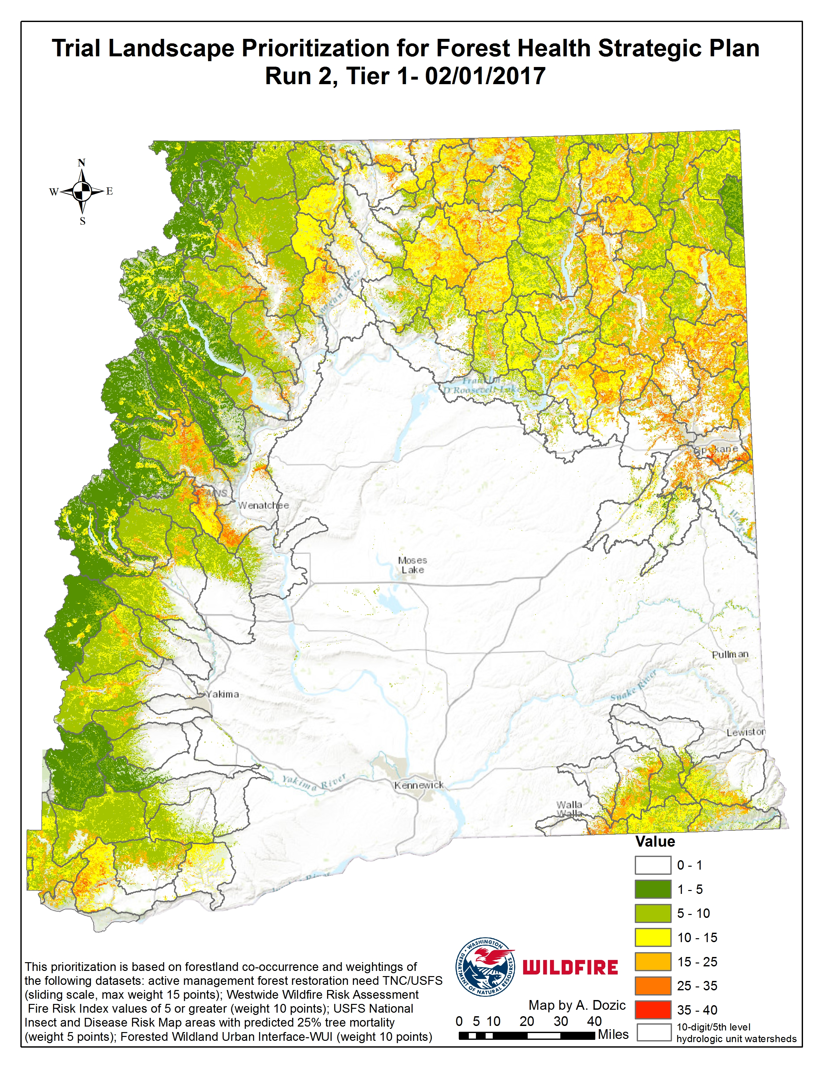
Prioritize landscapes and treatments

Slide 11
Cross-boundary, landscape-scale projects

Slide 12
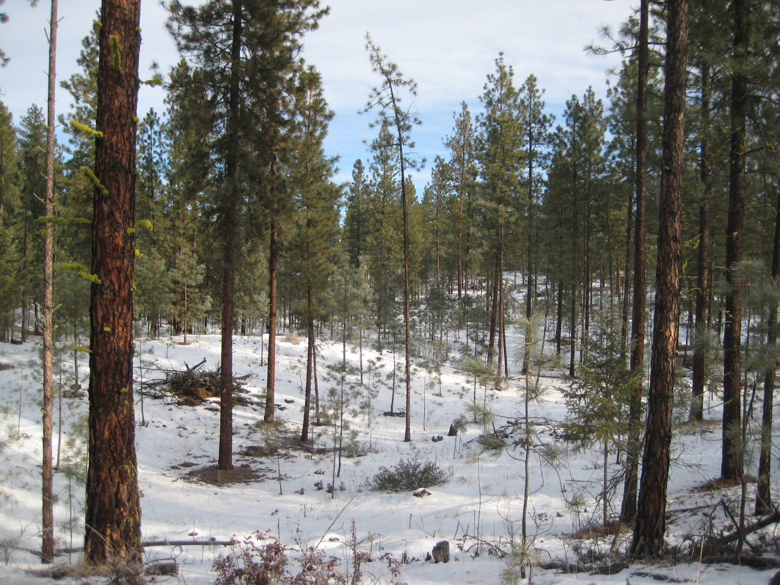
Water
-Water is a crucial resource for our economic and ecological systems.
-Climate change will most likely make water an even more limited resource during the growing season in the future.
-How do we balance forest restoration with protecting water quality and increasing water quantity?

Slide 13
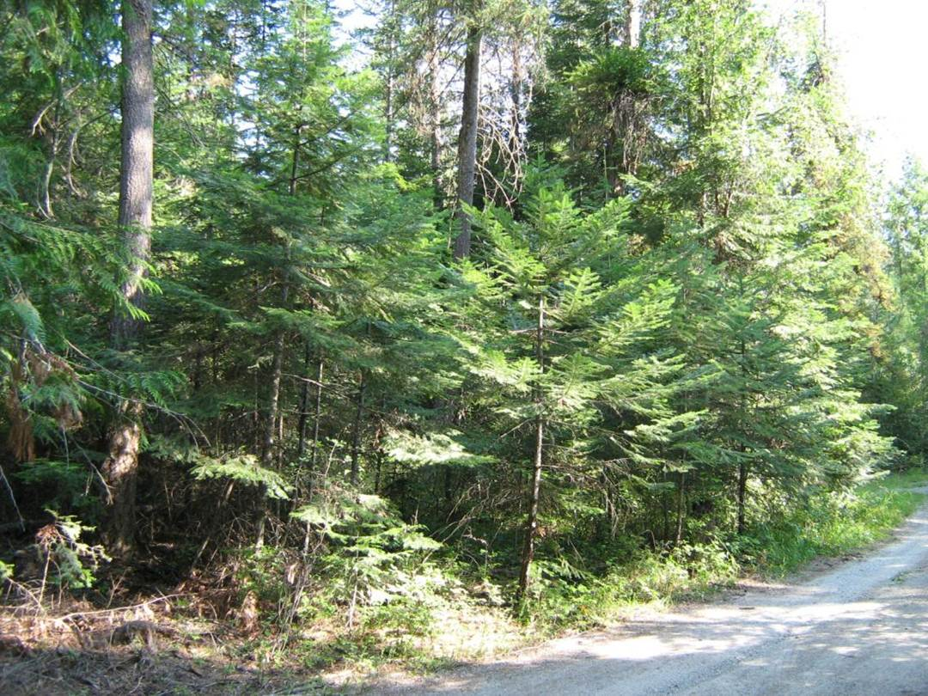
Wildlife Habitat
-In E. WA good habitat for priority species is often high wildfire and forest health risk.
-What pace and scale of restoration is compatible with maintaining suitable habitat? Are they compatible, where and how?

Slide 14
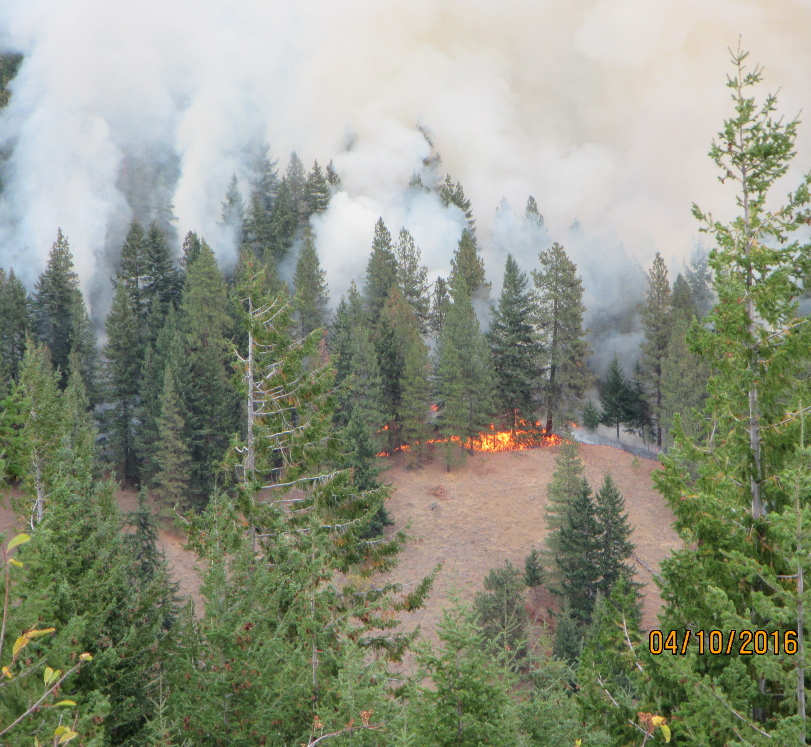
Prescribed Burning
-From 2010 to 2015, the acreage of prescribed burning in Washington State ranged from 7,062 to 20,482 acres.
-The majority of the prescribed burning is conducted by USFS and BIA.
-What pace and scale of prescribed burning is needed to meet restoration objectives?
-What amount of prescribed burning is realistic given weather, resource and air quality constraints?
Chumstick prescribed burn, part of Forest Resiliency Burning Pilot Project. Okanogan-Wenatchee National Forest, October 2016

Slide 15
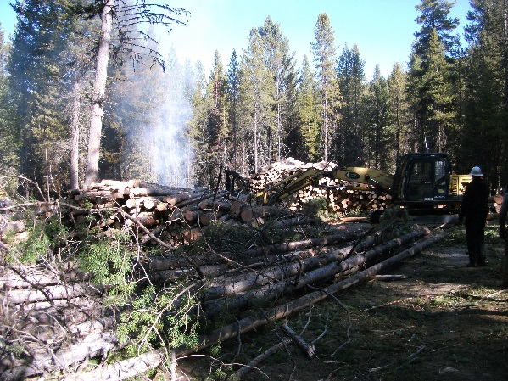
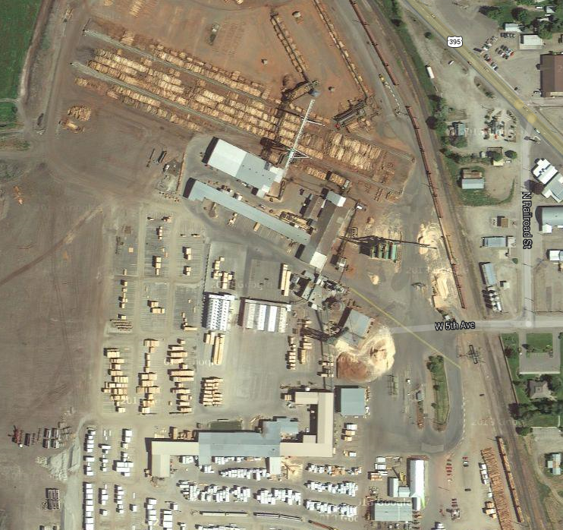
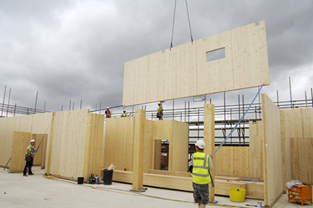
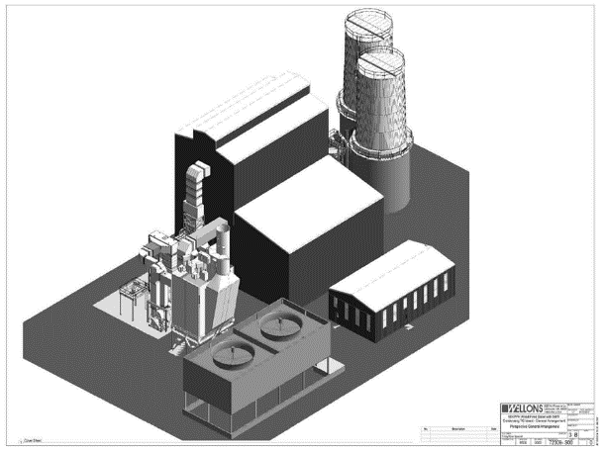
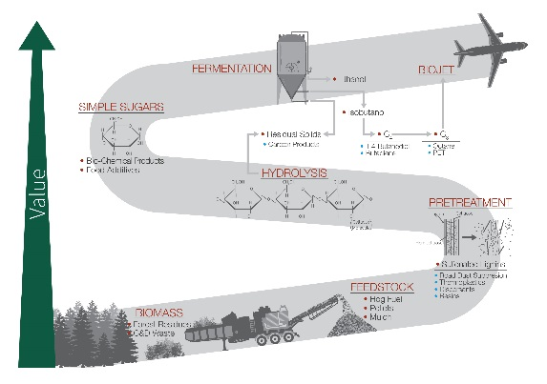
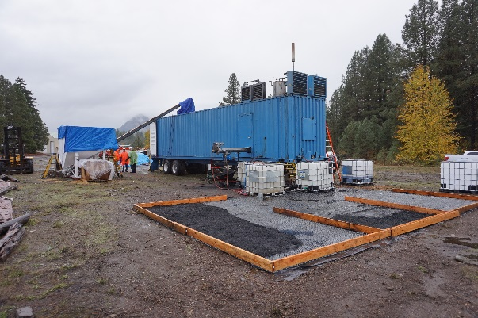
Need markets for small trees and rural economic development
Sawmills
Biomass
Established Markets
Cross-Laminated Timber (CLT)
Emerging Markets
CWU 5MW Wood Boiler
Biofuels, Co-Products
Char, Pyrolysis Oil
Notes:
Connect urban and rural communities

Slide 16
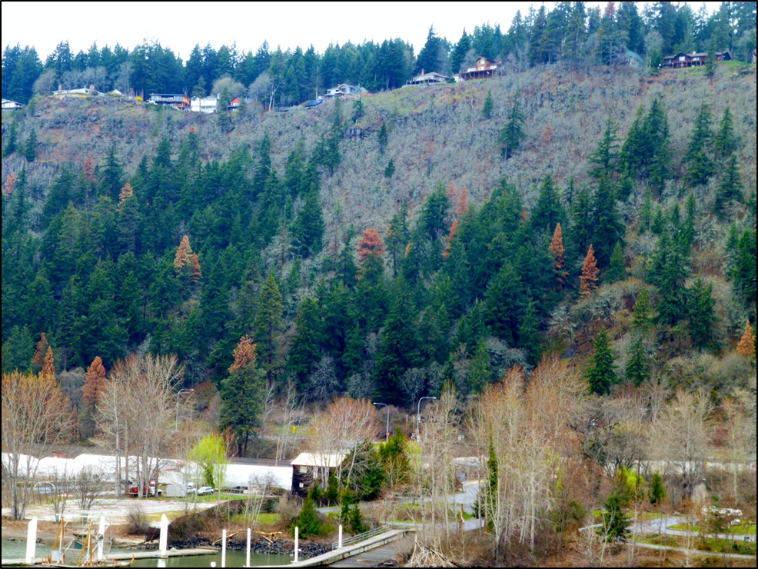
Adapt management techniques to account for a changing climate

Slide 17
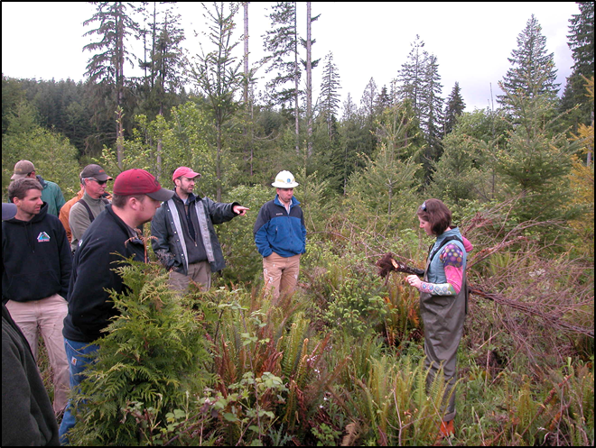
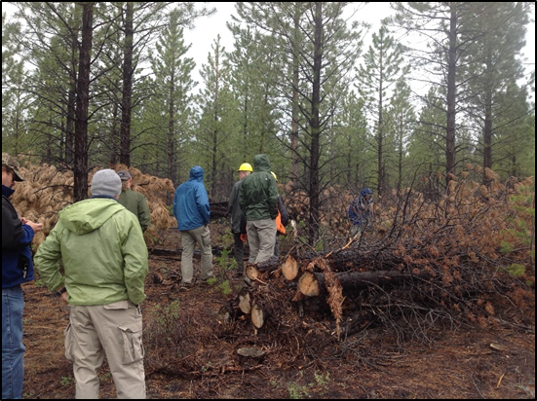
Need robust monitoring programs to track impact of restoration activities…
…and adapt management practices as necessary to achieve goals

Slide 18
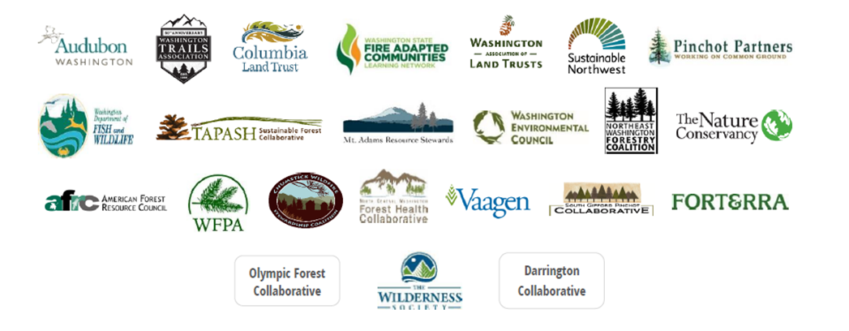
Forest Health Advocacy
Forest and Community Resiliency Roundtable

Slide 19
WA Forest Health Legislative Bills
HB 1711 (Kretz): prioritizing lands to receive forest health treatments (primarily state lands).
SB 5546: forest health treatment assessment and treatment priorization (all lands.)

Slide 20
For this strategic planning process to lead to meaningful implementation, it should:
-Deepen collaborative relationships between stakeholders to achieve shared goals.
-Align intents and priorities where appropriate to achieve desired outcomes.
-Articulate a clear path for the Legislature and other audiences.

Slide 22
Vision (address priority areas over 20 years, maintance)
Goals
Increase pace and scale (thinning, prescribed fire, aquatic restoration will require more efficient means of planning)
Importance of water
Incorporate ecosystem services
Balance wildlife habitat needs with restoration activities
Connect urban and rural communities (CLT)
20 year plan, recent bills (5546, 1711)
Prescribed burning treatment levels
Efficient processes for landscape scale planning and implementation and stakeholder engagement
Advocacy

