Slide 1
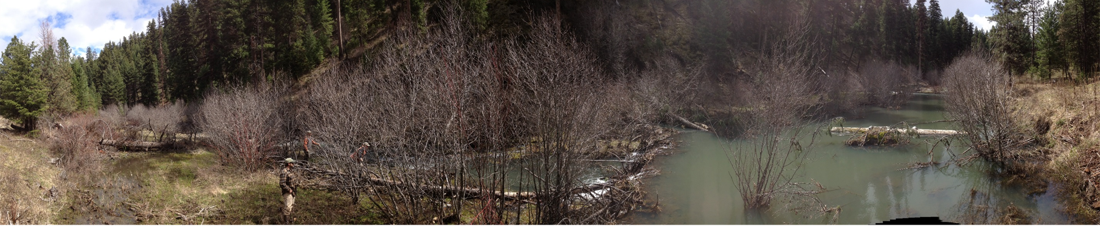
The Malheur Story
Amanda Lindsay
District Silviculturist
Blue Mountain RD
and
Dave Halemeier
District Ranger
Detroit Ranger District

Slide 2
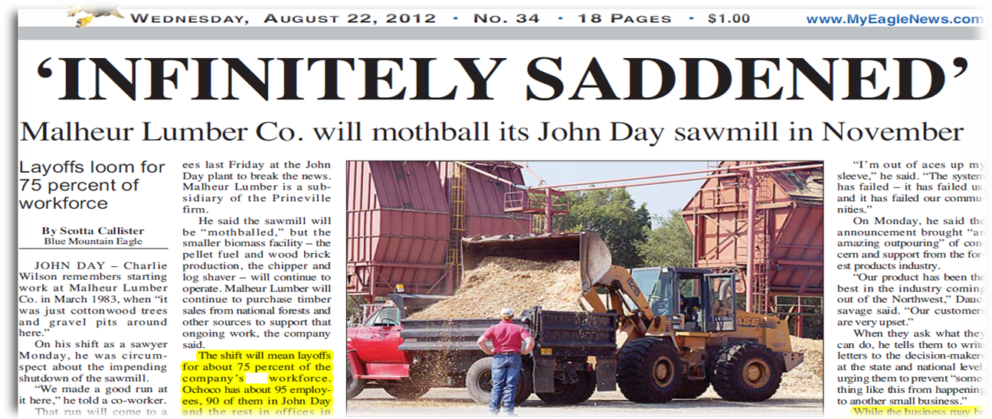

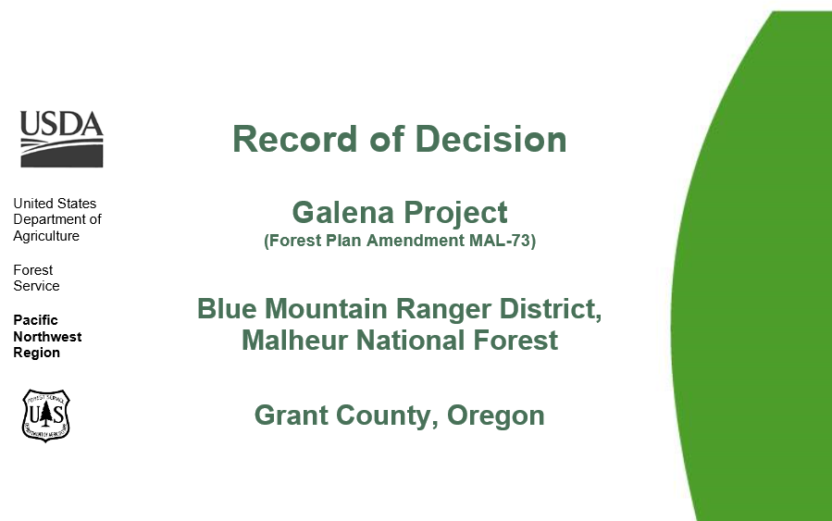
Setting the Stage
BMFP Collaborative gaining momentum
Resource areas were not in alignment
Projects were slow and taking too long to plan
Malheur Lumber announces shutdown
Factors aligned to create the perfect storm
The solution: accelerated restoration

Slide 3
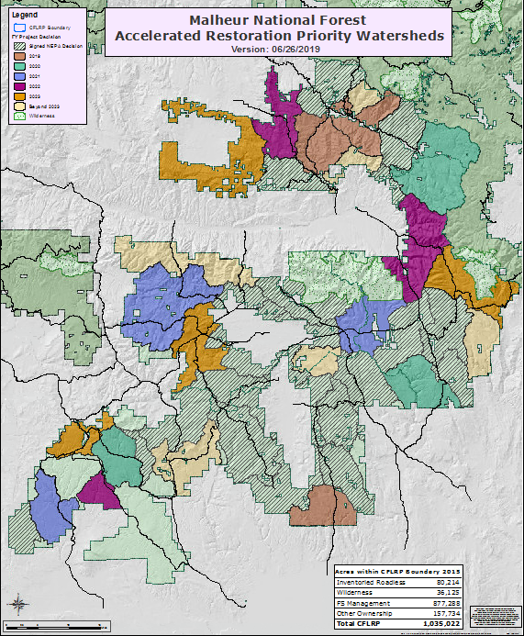
Forest Level Planning
District Leadership Teams developed Program of Work
Based on integrated resource needs
Tradeoffs between resources
Focuses efforts, increasing efficiency
Needed to keep priorities

Slide 4
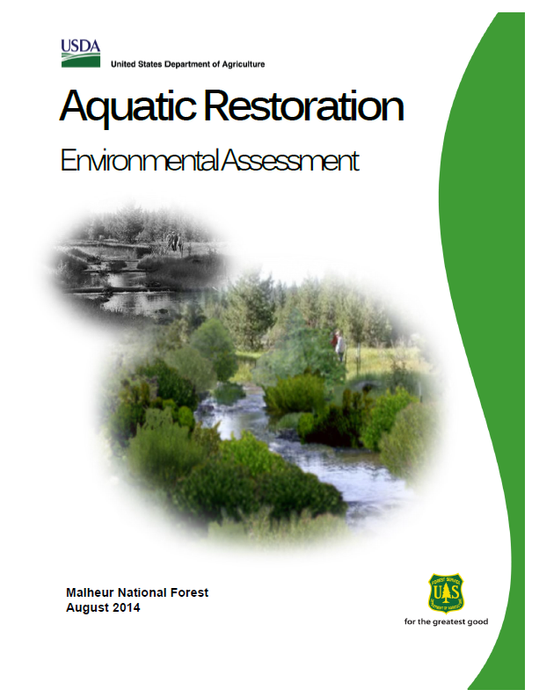
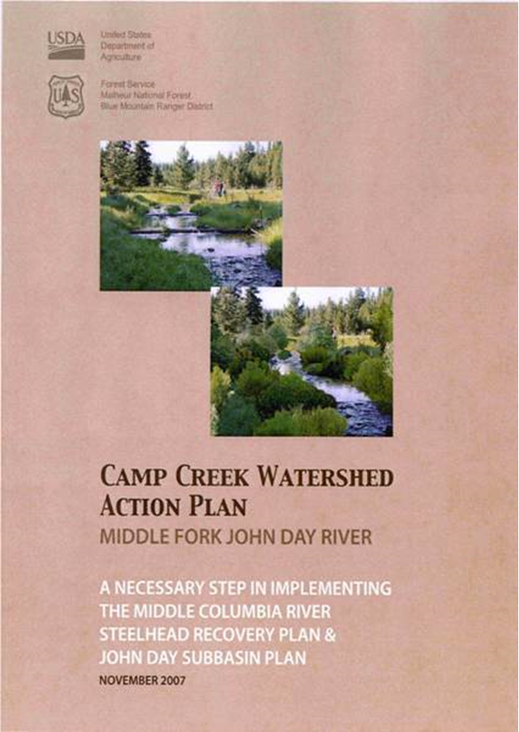
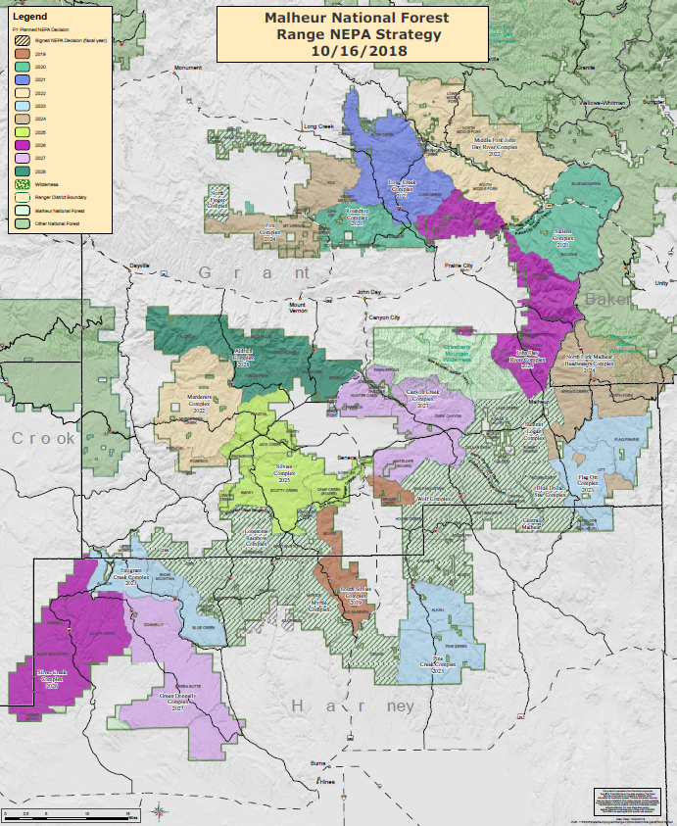
3-Pronged Approach
Vegetation NEPA
Aquatic Restoration EA
Range NEPA
Combine data collection and planning
Travel Management
Recreation System changes
WRAPs
AMPs

Slide 5
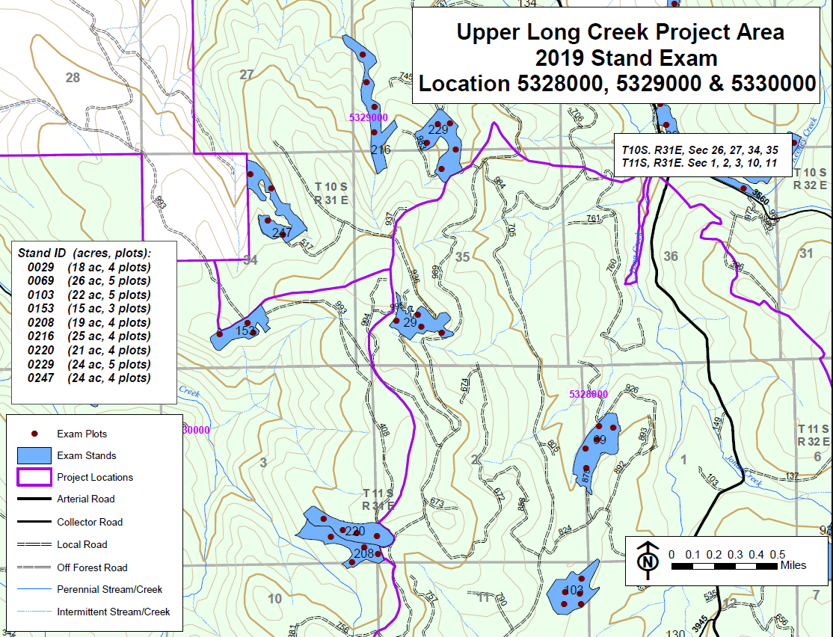
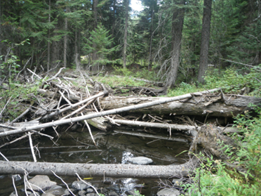
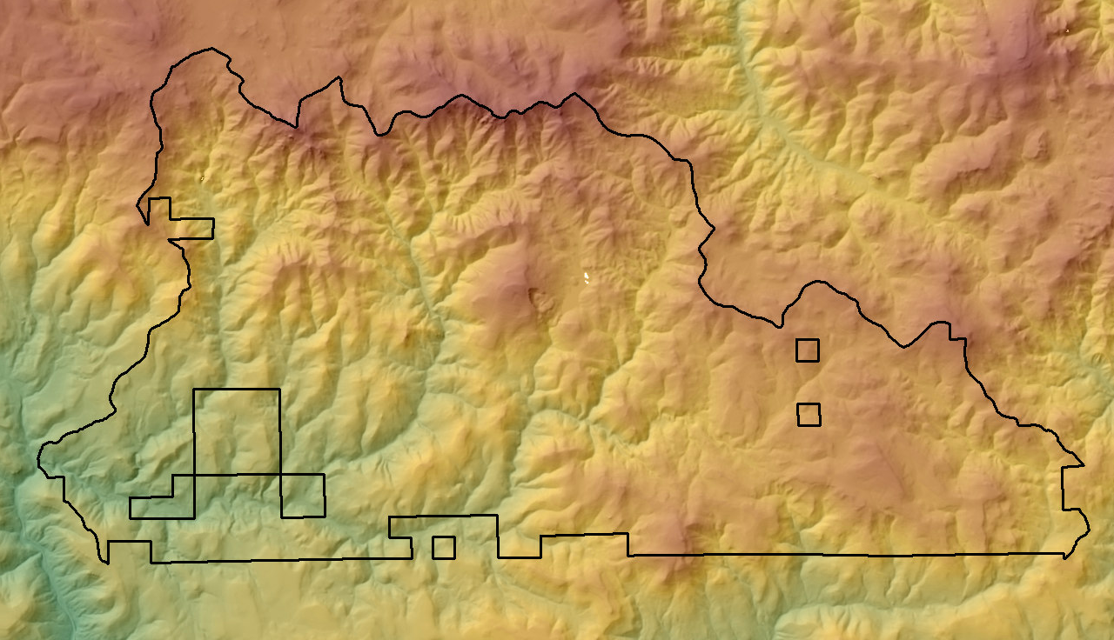
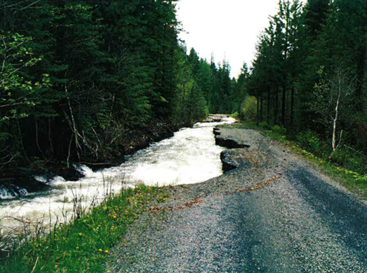
Data Collection
LiDAR
Stand Exams
Stream Surveys
Road Surveys
Heritage Surveys
Wildlife Surveys
Data collection augments the landscape approach
Proposal
Decision

Slide 6
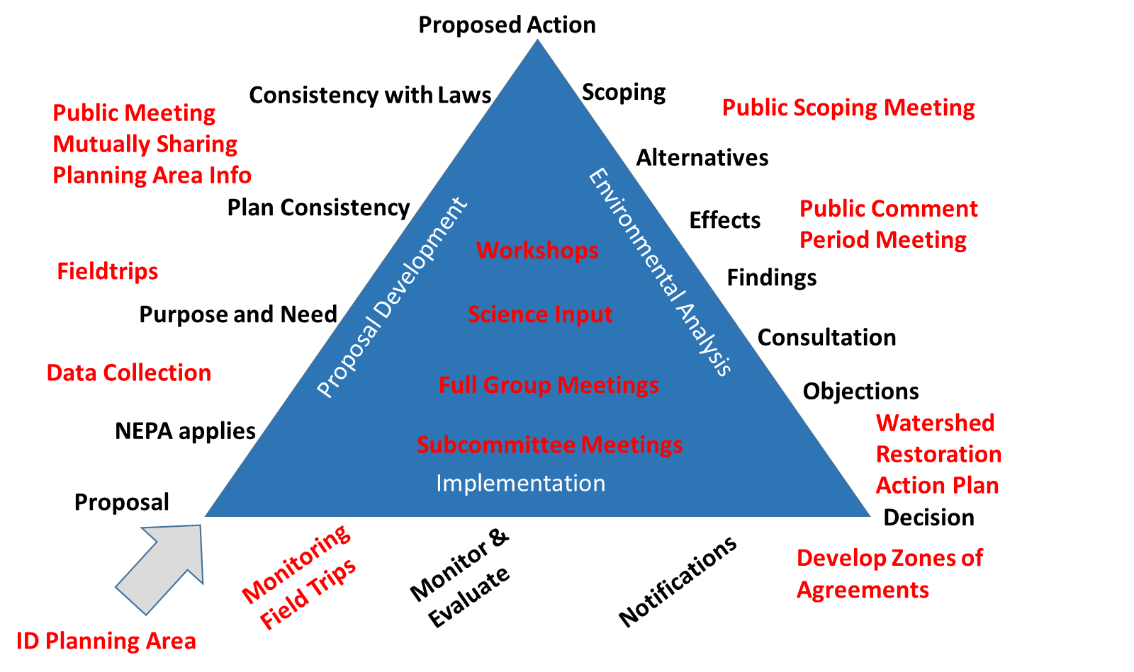
Malheur NF NEPA Triangle

Slide 7
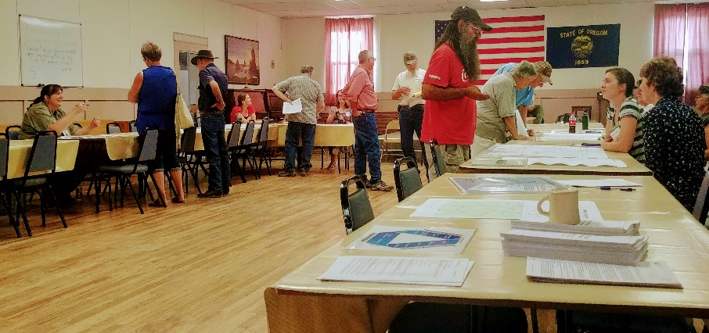
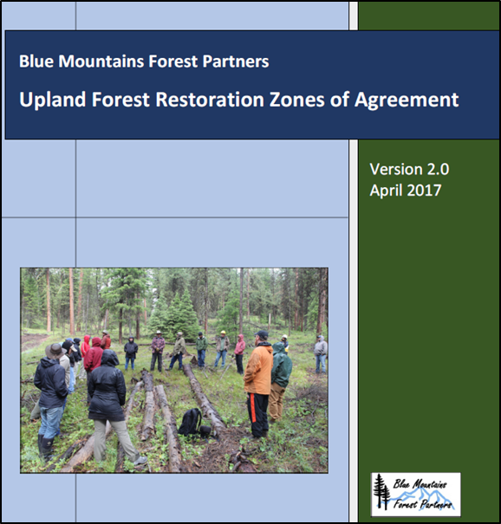
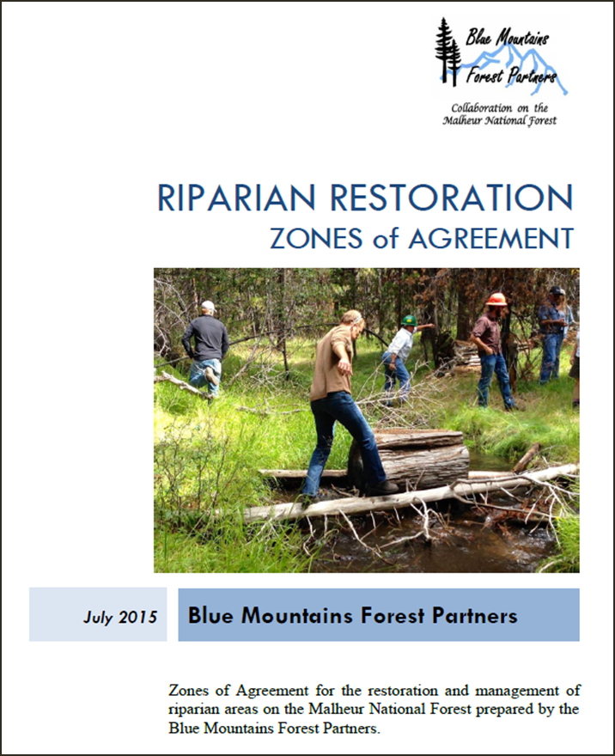
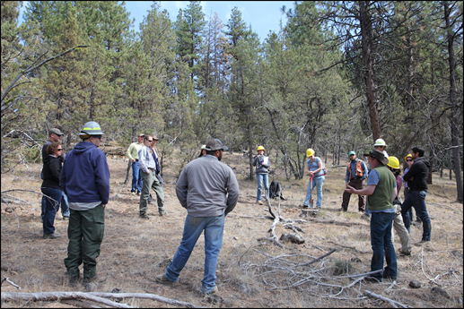
Collaboration and Public Involvement
Issue based vs. project based
Fieldtrips
Science Workshops
Zones of Agreement
Public Meetings
Open Houses
County Court

Slide 8
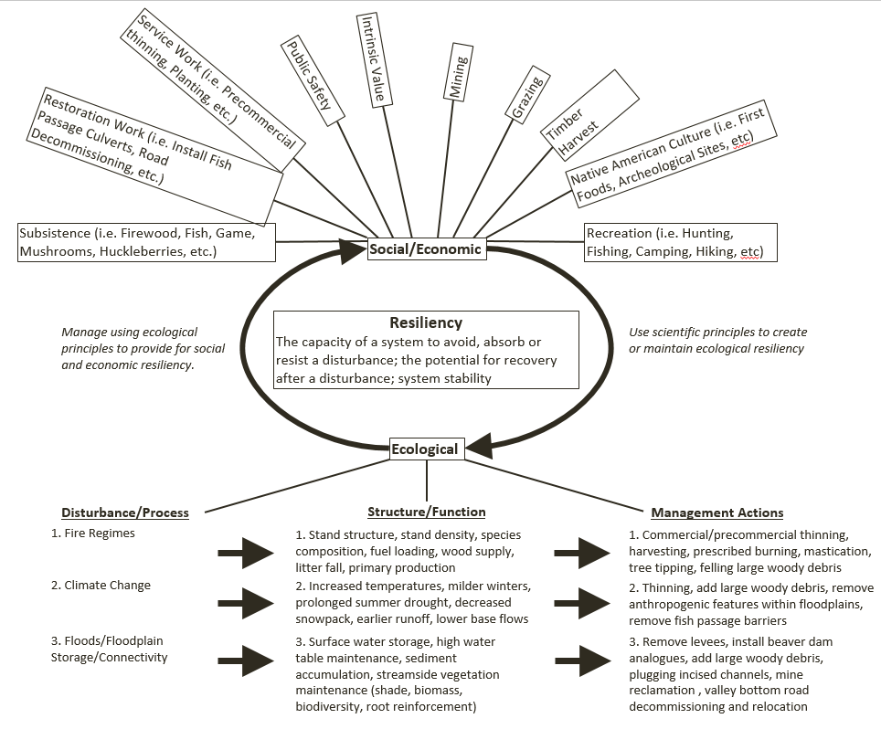
Developing the Purpose and Need: Resiliency
Landscape resiliency: ecological and socio-economic
Focus on process and function
Supported by Forest Plan, collaborative, and scientific literature
Decision

Slide 9
Developing the Purpose and Need: Resiliency

Slide 10
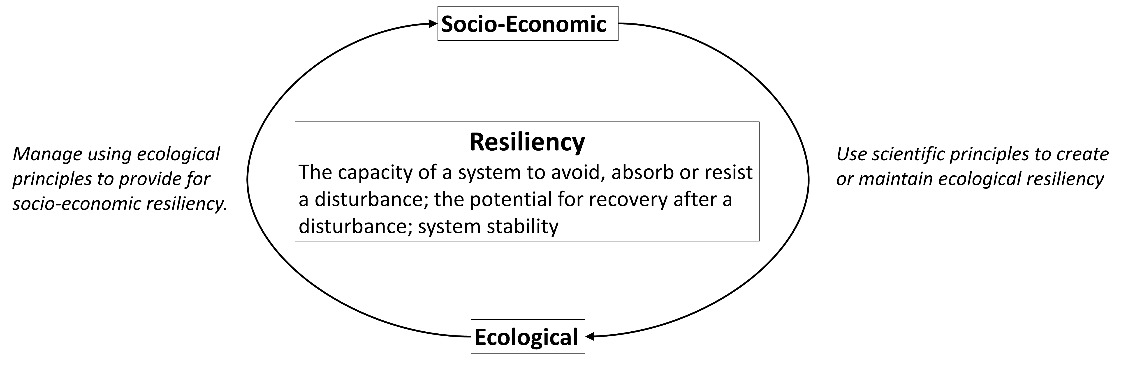
Developing the Purpose and Need: Resiliency

Slide 11
Developing the Purpose and Need: Resiliency

Slide 12
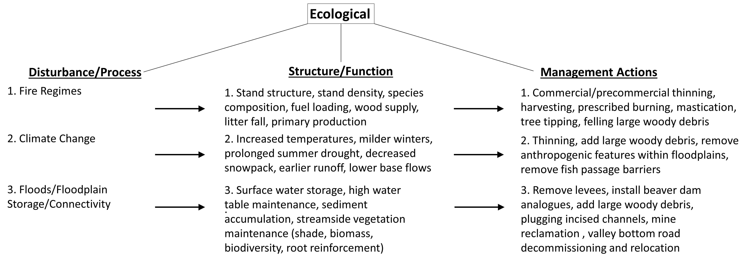
Developing the Purpose and Need: Resiliency

Slide 13
Purpose and Need Statements
“Maintain and improve landscape resiliency and manage for diverse forest composition, stocking levels, and pattern to maintain healthy ecological function and process within a complex disturbance regime of wildfire, drought, insects, and disease.”
“Promote forest conditions that allow for the reintroduction of fire upon the landscape, thereby creating conditions that are conducive for firefighter safety, resource values, and private lands.”
“Contribute to the social and economic health of those enjoying multiple uses in the planning area.”

Slide 14
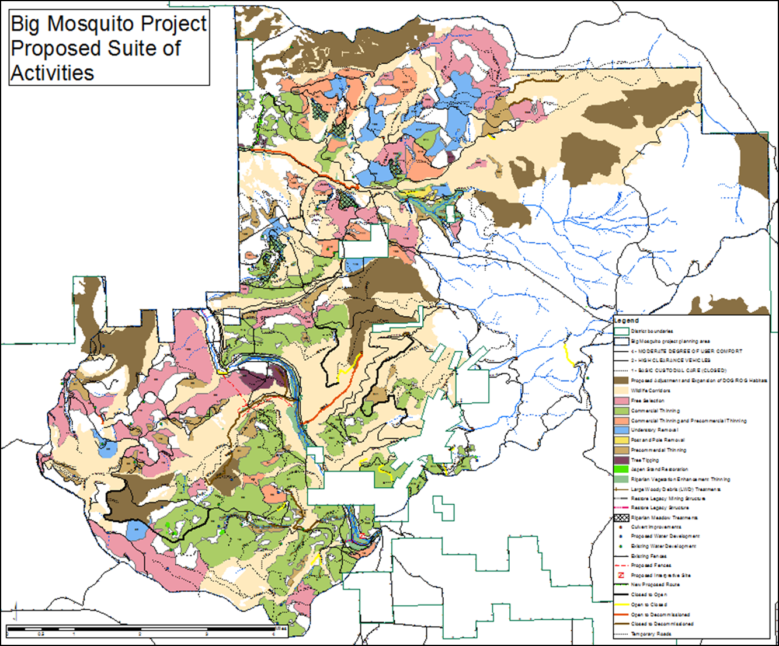
Proposed Action Development
Proposed Action
Project Action Letter (PAL)
Project Initiation Letter (PIL)
Variety of proposal types
Integration of proposals
Decision

Slide 15
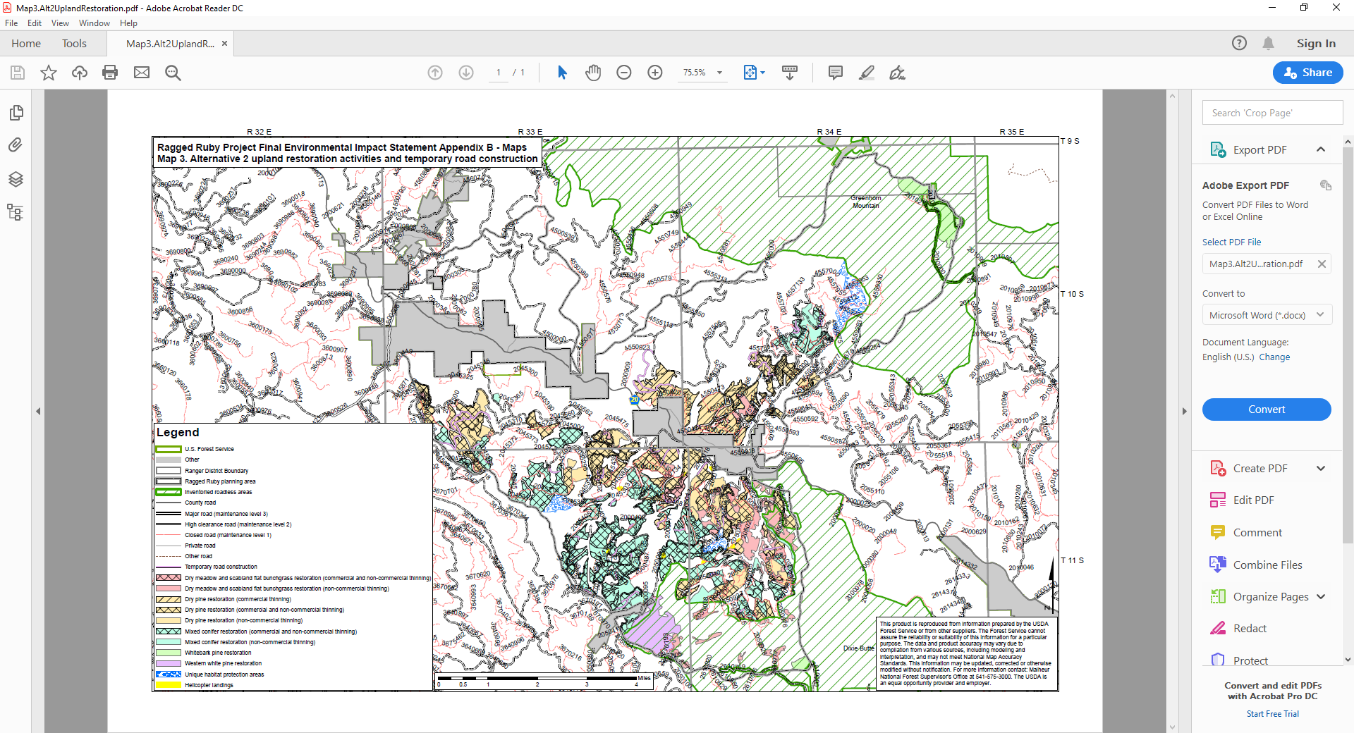
Lessons Learned
Adaptive planning process: resource stories
Treatment names in alignment with purpose and need for action
Monitoring and adaptive management feeds the next NEPA process
Decision

Slide 16
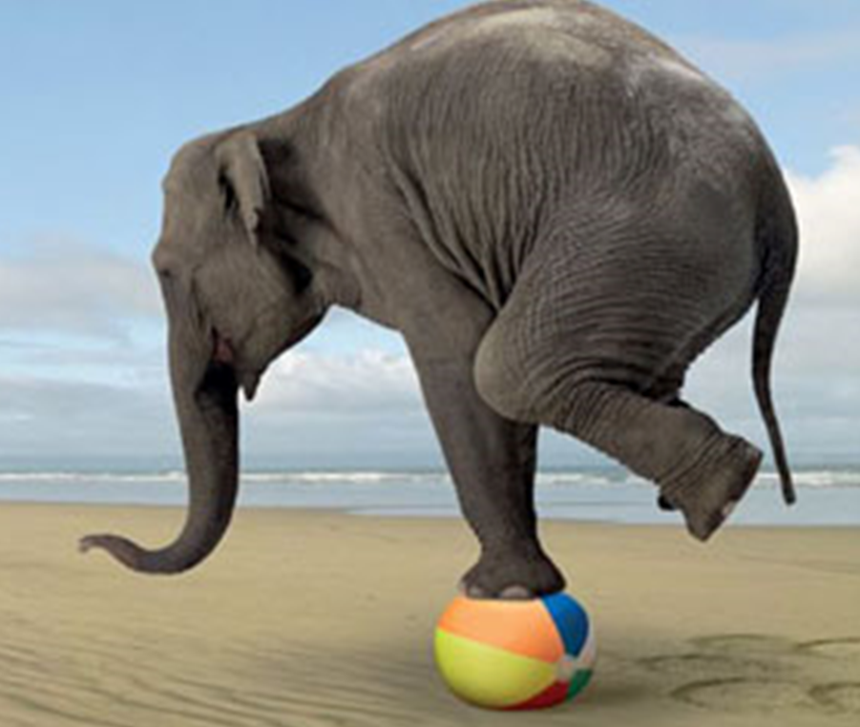
Acknowledgements
Eric Wunz, Silviculturist
Lori Stokes, Silviculturist
Tony Bertel, Forester
Sasha Fertig, Planner
Casey Gatz, Planner
Kate Cueno, Planner
Hannah Smith, Planner
Nick Stiner, Range
Don Hann, Archeologist
Katee Withee, Archeologist
Dustin Hollowell, Wildlife Biologist
Allen Taylor, Fisheries
Dan Armichardy, Fisheries
Rosie Gonzalez, Fisheries
Bob Hassmiller, Hydrologist
Mary Lou Welby, Hydrologist
Ed Clark, Fuels
Tim Boyce, Fuels
Ken Boucher, Fuels
Joe Rausch, Botany
Hersh McNeil, Soils
Paula Brooks, Botany
Scott Officer, Engineering
Susan Jane Brown, BMFP
Pam Hardy, BMFP
Dave Hannibal, BMFP
Zach Williams, BMFP
King Williams, BMFP
Larry Blasing, BMFP
Tim Lillebo, BMFP
Mark Webb, BMFP
Trent Seager, BMFP
James Johnston, OSU
And many, many more

Slide 17
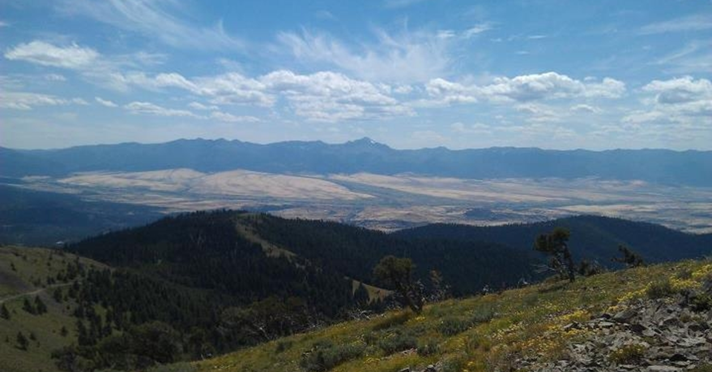
Questions?
Proposal

