Slide 1
Upper Briggs Restoration Project
Tuesday November 5th
Landscape Ecology Conference

Slide 2
Rogue Basin Cohesive Strategy Impacts into the Project Design
Landscape-Scale Objectives: Strategically placed treatment advances five overarching landscape-scale goals
1) protect local communities,
2) reduce large wildfires that damage local communities,
3) restore open forests in appropriate settings,
4) protect and promote complex habitat for Northern Spotted Owl and other species, and
5) promote climate resilient landscapes.

Slide 3
Proposed Action
Develop and enhance 995 acres of late seral habitat - thinning/burning; 58 acres removed from treatment due to 2018 Taylor Fire;
Pine oak habitats - Retain and restore 706 acres of through commercial/pre-commercial thinning/maintain with underburning (as needed);
Sensitive plant habitat - Reduce canopy cover and create openings to restore 42 acres of; underburning (as needed);
Meadow Restoration - Remove encroaching trees and shrub species to restore and maintain 188 acres within through thinning and underburning;

Slide 4
Proposed Action
Riparian Reserves -Restore 55 acres of by thinning/underburning (as needed); 128 acres removed from treatment due to 2018 Fire. Thinning to improve plant species diversity/composition for temperature regulation/nutrient filtering/increase stream coarse woody debris;
Roadside and Ridgeline Fuel Management Zones (FMZs), Create and maintain 1,421 acres of fuel breaks in by thinning/reducing ladder fuels/underburning; 421 acres in Ridgeline FMZ removed from treatment due to 2018 Fire.
Decrease road impacts by changing maintenance level for 1.6 miles of road/ decommissioning 11.1 miles of road. Up to 3 miles of temporary road to be constructed and then decommissioned.

Slide 5
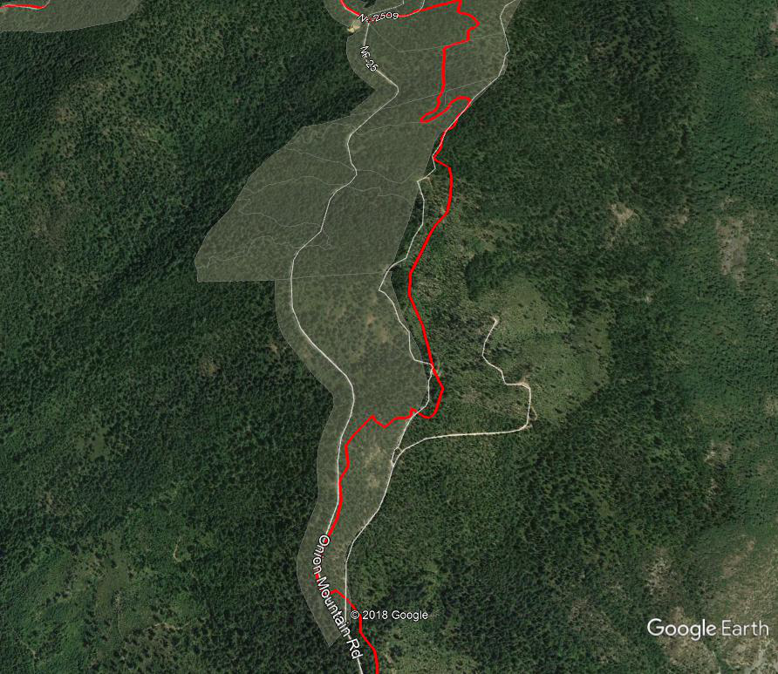
Comparison of Changed Conditions Shan Apple Project Area
Sugar Pine and Canyon Live Oak treatments favoring open forest Conditions
1940 Airphoto
Unit 2 Current Airphoto

Slide 6
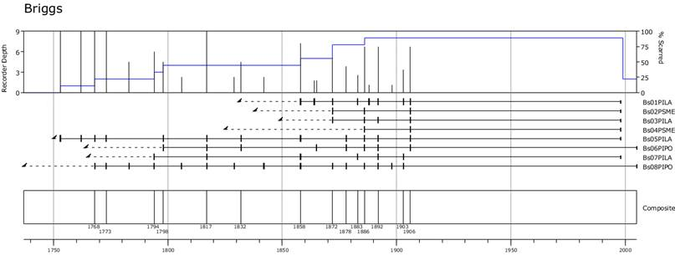
Fire History

Slide 7
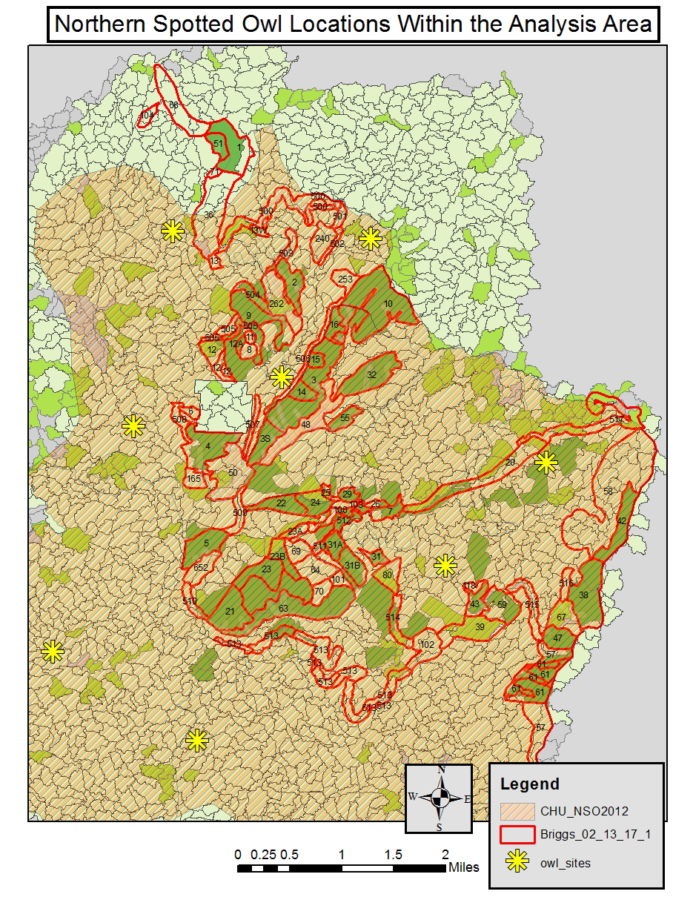
Northern Spotted Owl Locations

Slide 8
Upper Briggs
Shan Apple Stewardship Agreement
Partnering to accomplish work on deficit treatments. (OWEB RFRI)
~739 acres of Roadside FMZ treatment Adjacent the Community of Shan Creek
Sugar Pine and Canyon Live Oak treatments favoring open forest
Preparing for frequent application of fire for maintenance of FMZ.

Slide 9
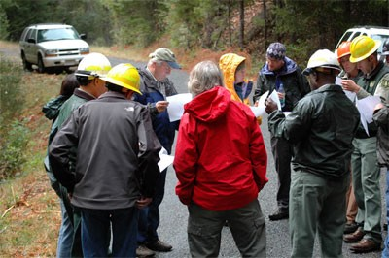
Upper Briggs
Work With Partnership to Achieve Goals and Objectives

