Slide 1
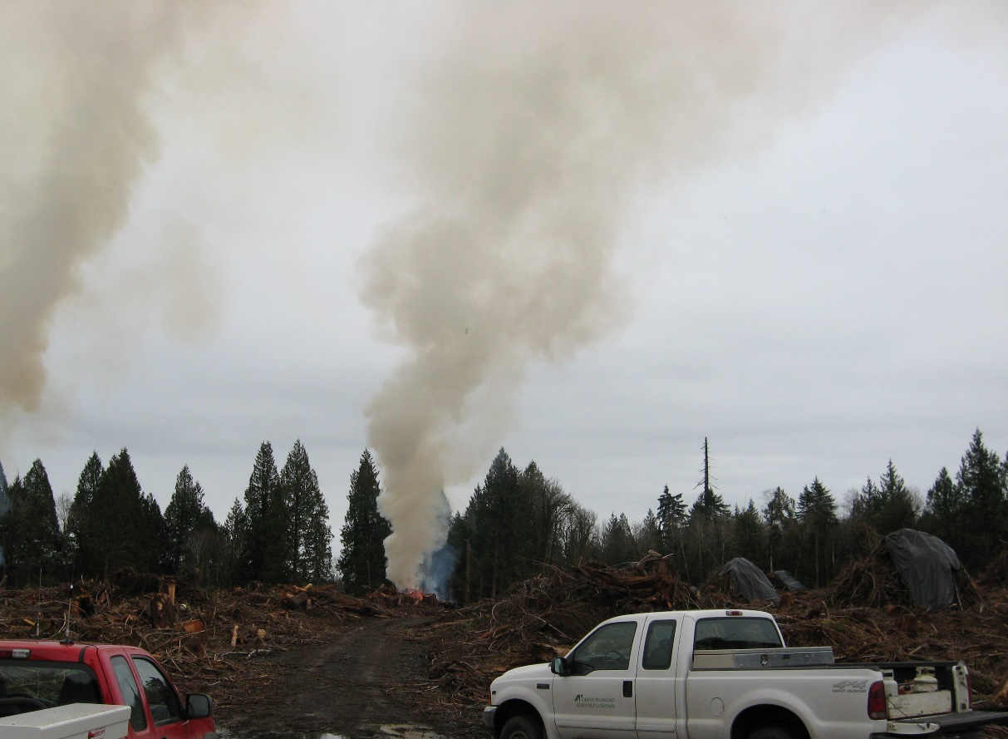
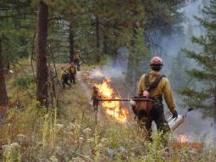
DNR’s Smoke management Plan Update:
Options, Tradeoffs, and Challenges

Slide 2
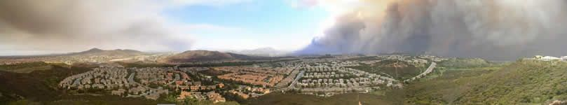
Why are we updating?
The Smoke Management Plan has not had a significant revision since 1998
2016 Budget
HB 2928: the Forest Resiliency Burning Pilot

Slide 3
Sideboards and Limits
Federal (Clean Air Act):
  Prevent impairment of visibility in Class I airsheds:
  “all international parks, all national wilderness areas and memorial parks which exceed 5,000 acres in size, and all national parks which exceed 6,000 acres in size.”
  Confirms that federal agencies are subject to enforcement actions for violation of the Smoke Management Plan

Slide 4
Sideboards and Limits (cont’d)
State Forest Protection Laws
  Requires a permit from DNR to burn on agency-protected lands, and stipulates that burning will be done in compliance with State Clean Air Act.
State Clean Air Act
  Authorizes DNR to issue and regulate burn permits for forest health, fire hazard reduction, education of firefighters, and silvicultural production improvement.

Slide 5
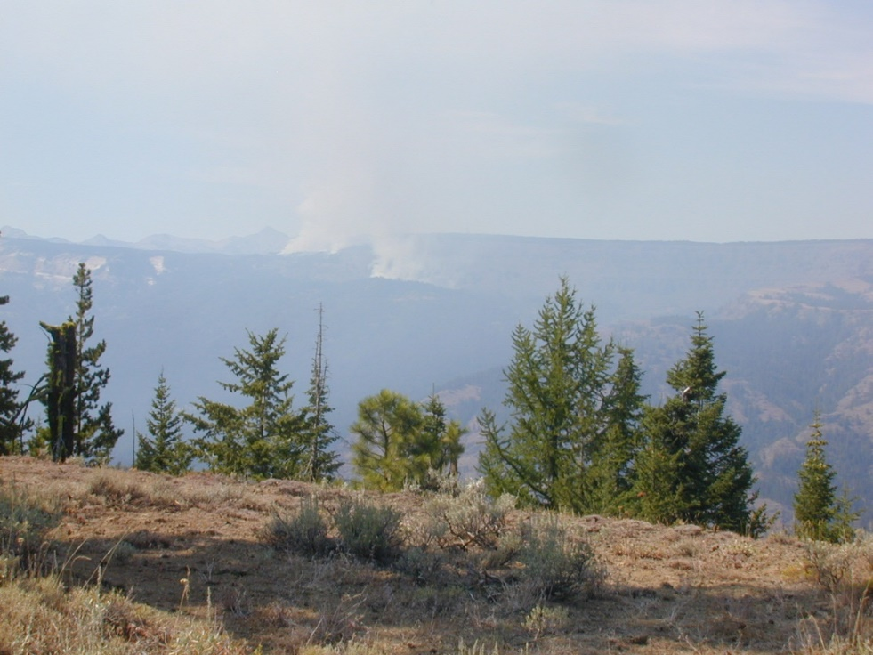
Mandated Emissions Reduction
Washington State Clean Air Act required DNR to reduce emissions from silvicultural burning by:
  20% from baseline levels by December 31, 1994,
  Then by 50% from that level by December 31, 2000, which will form a new emissions baseline.
Note: The exemption for forest health burning has no bearing on the daily go/no-go smoke management decision.

Slide 6
Stakeholders
Private: Eastern and western Washington Timber Producers—primarily pile-burners.
NGO: Conservation Districts, Fire Districts, conservation and restoration-oriented non-profits.
Federal: Forest Service, National Park Service, EPA, DOD
State: Department of Ecology, Washington Department of Fish and Wildlife
Public Health: Local Clean Air Agencies, American Lung Association, Better Breathers Clubs

Slide 7
Timeline
October 2016-October 2017
  Stakeholder outreach, data-gathering, mapping, modeling
  Writing
  Compiling all lessons learned from Pilot Project
October 2017-March 2018
  Initial draft of SMP update complete
  Assemble expert groups to review relevant sections
March 2018-October 2018
  Finalize updated SMP, work through rule-adoption process.

Slide 8
Options
Zoning: Using better on-the-ground collaboration and wisdom to make better decisions.
  More latitude for burners
  More risk-tolerance for DNR
Enforcement vs. Forecast: Placing smoke management decision in the hands of agencies who want to burn, and enforcing using state’s smoke-monitoring infrastructure.
  More latitude for burners
  Potentially higher risk of intrusions
Earlier Smoke Management Approval: 24 hour advance notice, close of business prior day.
  Burners have more comfort deploying resources
  DNR more concerned about intrusions
Blackened acres Vs. Emissions Calculations
  Easier to calculate=More certainty for burners and DNR
  Impact to agency

