Slide 1
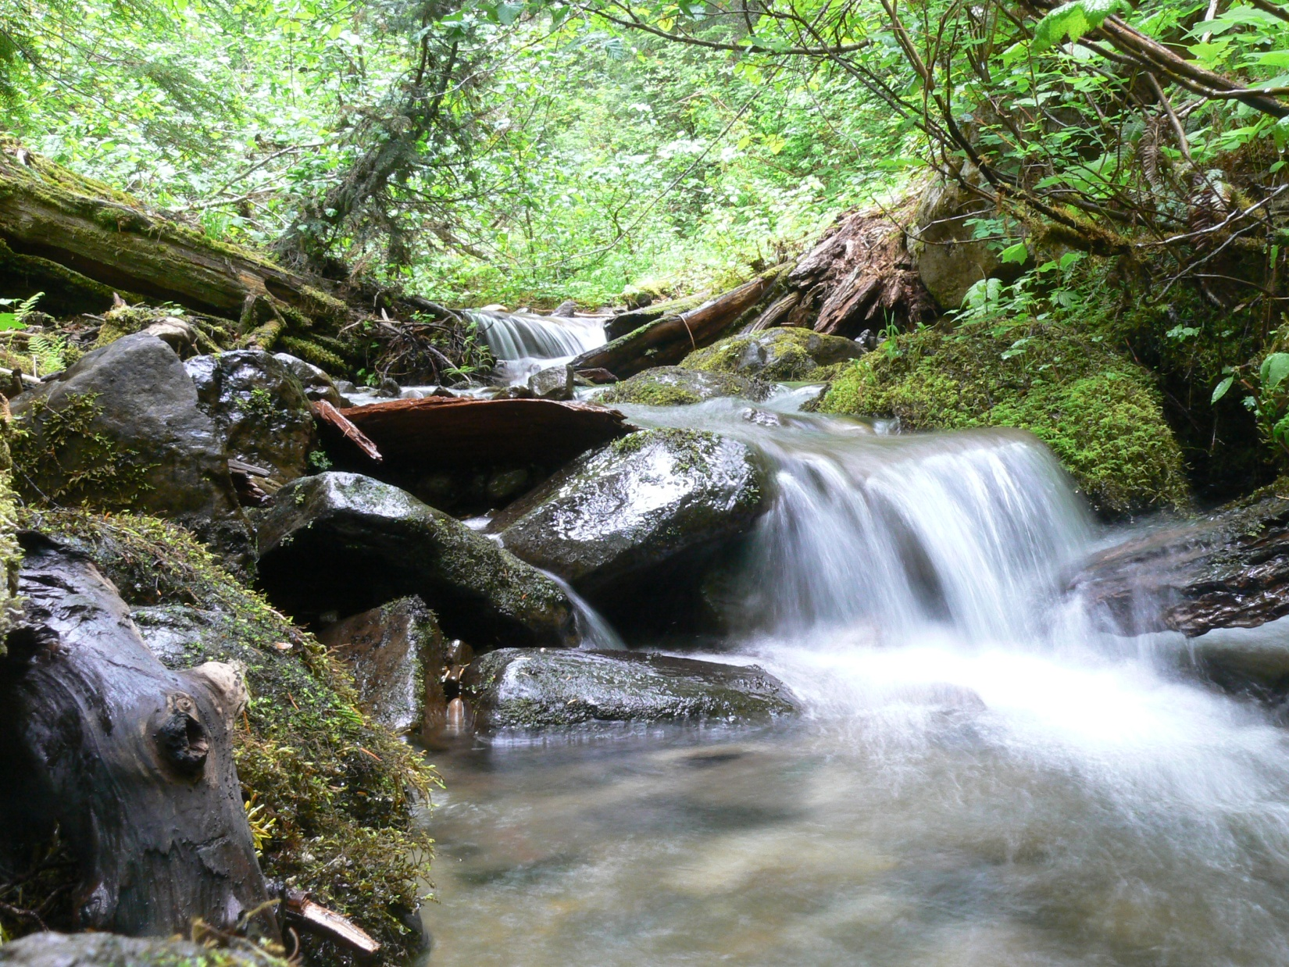

Aquatic and Riparian Conservation Strategy
Brian Staab, Jim Capurso
John Chatel, Scott Woltering
November 2, 2016

Slide 2

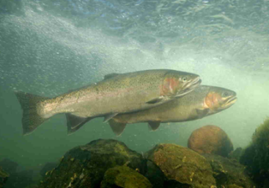
Today’s Menu
ARCS Overview
Current Status
Next Steps

Slide 3
What is ARCS?
Regional aquatic/riparian strategy, RF Direction for Plan Revision.
R6
NWFP area of R5
Integrates, refines 3 existing strategies.
NWFP-ACS
PACFISH
INFISH

Slide 4
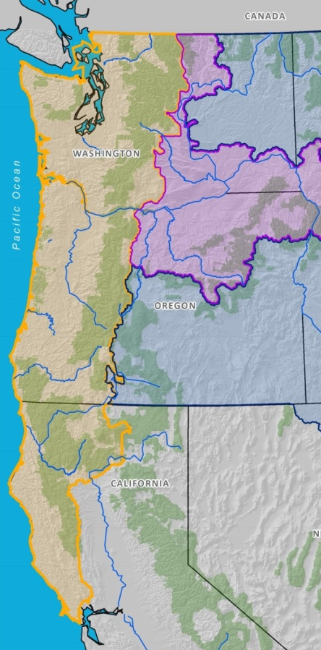
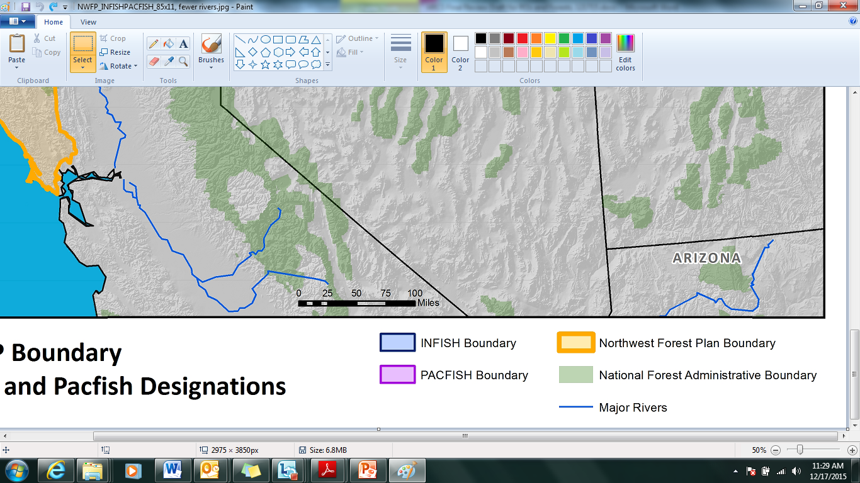
Geographic Scope

Slide 5
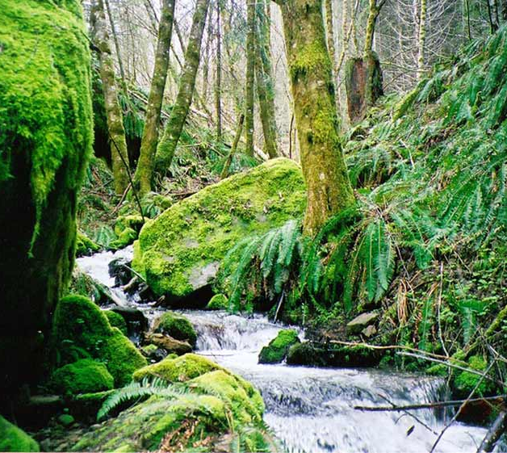
What is ARCS?
Minimum Plan components.
Other Plan Content.
Direction to develop additional Plan content.

Slide 6
What is ARCS?
Non-decisional, RF direction.
Not FP direction, until in a Plan.
Forests tailor to local issues, landscapes.
more specificity
refinements
integration with broader Plan

Slide 7

ARCS Content
Background / History
Strategy
Scientific Basis
Risks and Uncertainties
Implementation
Linkage to other Planning Direction

Slide 8
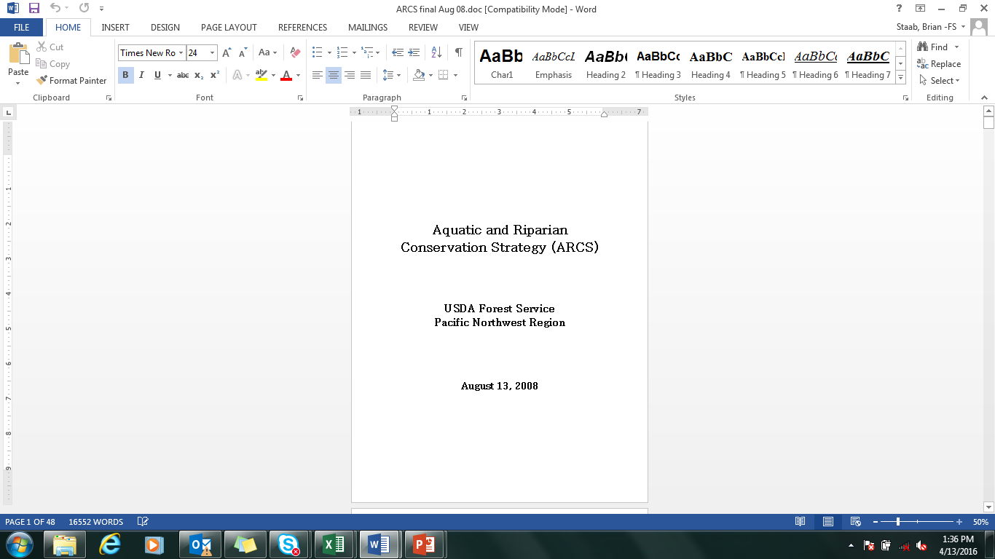
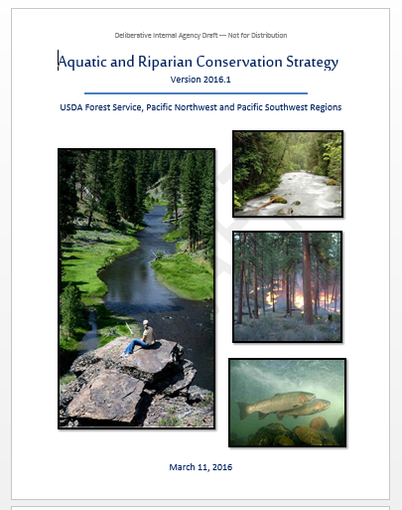
Background
Effort began in 2003.
Final strategy in 2008.
Currently being updated
2012 Planning Rule

Slide 9
Intent
Develop one, unified aquatic strategy
build on successes
consistency, efficiency
communication, coordination
Implement Columbia Basin Strategy
long-term strategy to replace PACFISH/INFISH.

Slide 10
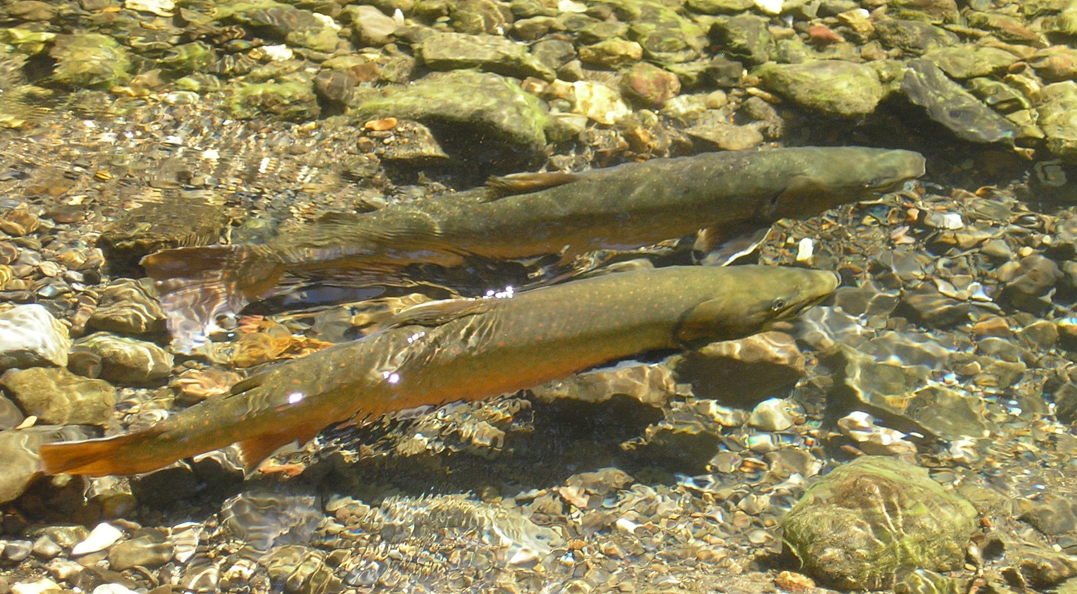
Approach
Maintain fundamental goals, components
Refine as needed
new issues
new science
new policy
lessons learned

Slide 11
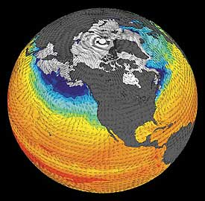
Ongoing Refinements
Some Key Issues
Invasive Species
Climate Change
Roads
Grazing
Riparian Management

Slide 12
Background
Informed by
Review of existing strategies (2004)
NWFP Science Assessment (2006)
Science Review of draft ARCS (2006)
Ongoing Plan revisions
20-years of status and trend monitoring (AREMP, PIBO)
NWFP Science Synthesis (2016)

Slide 13
ARCS Goals
Maintain, restore health of watersheds and
aquatic/riparian ecosystems.
Networks of properly functioning watersheds
fish populations
other aquatic/riparian organisms
State-designated uses of water

Slide 14
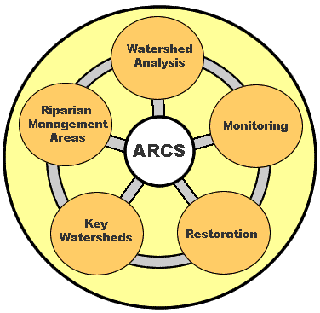
ARCS Elements

Slide 15
Implementation
Plan Components
Management Areas
Desired Conditions
Suitability
Objectives
Standards
Guidelines
Other Plan Content
Watershed Analysis
Watershed Restoration
Monitoring and Evaluation

Slide 16
Management Areas
Riparian Management Areas, RMAs
lands along waterbodies, unstable areas
RMA widths
= NWFP Riparian Reserves
~ RHCAs in PAC-INFISH

Slide 17
Management Areas
Riparian Management Areas, RMAs
maintain functional conditions or restore degraded conditions
water quality
aquatic/riparian species

Slide 18
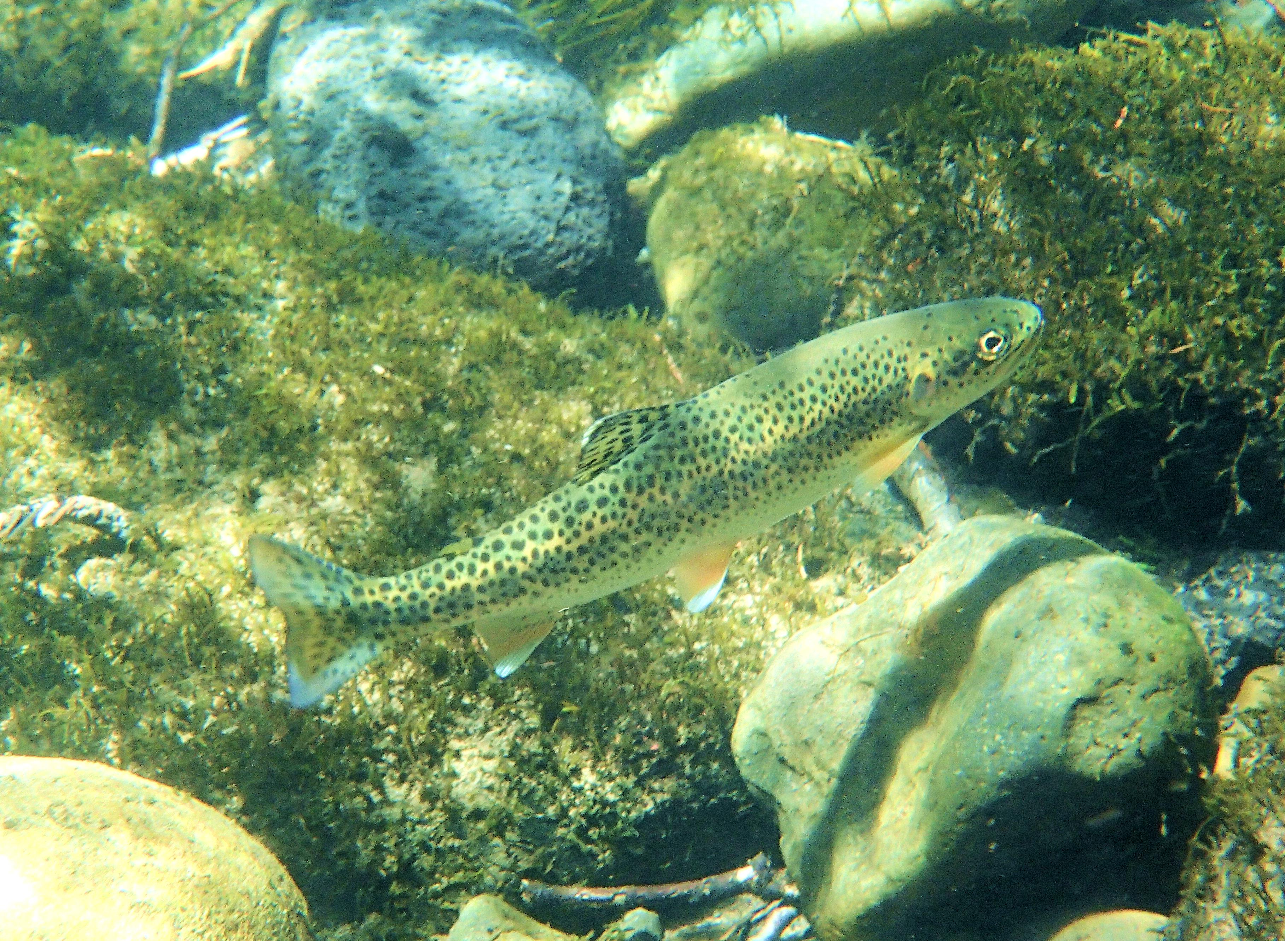
Other Areas
Key Watersheds, KWS
large, long-term ‘aquatic conservation’ network
best habitat for rare, at-risk fish
high-quality water
no change during Plan

Slide 19
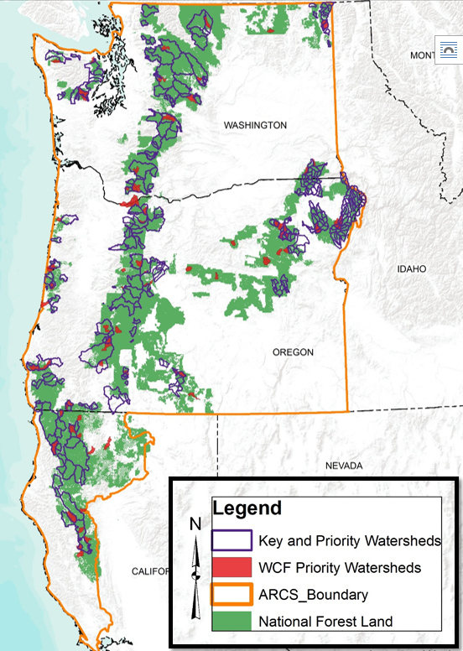
Other Areas
Priority Watersheds
smaller, near-term restoration focus
usually subset of KWS network
changes regularly

Slide 20
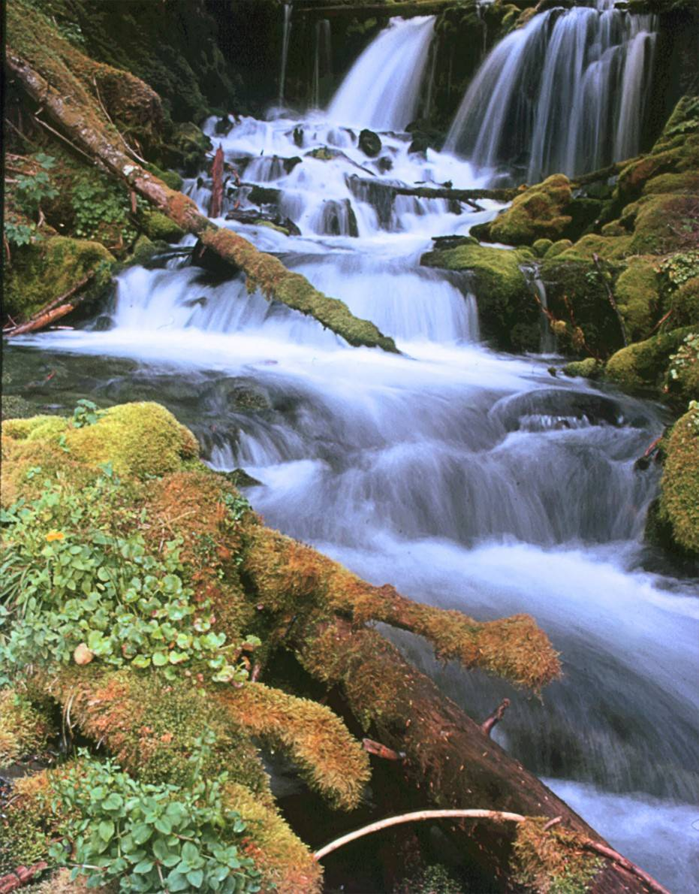
Desired Conditions
17 Desired Conditions
Forest-wide (14)
Key Watersheds (3)

Slide 21
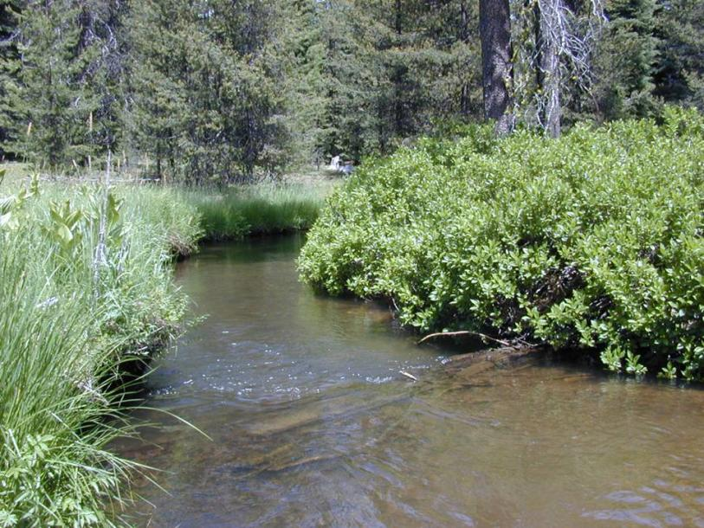
Desired Conditions
Foundation
9 NWFP-ACS Objectives
8 PACFISH/INFISH Riparian Goals

Slide 22
Desired Conditions
DC-10. Consistent with their inherent capability, NFS lands contain the species composition and structural diversity of plant communities in riparian areas and wetlands needed to:
regulate stream temperatures
provide sufficient LWD
etc.

Slide 23
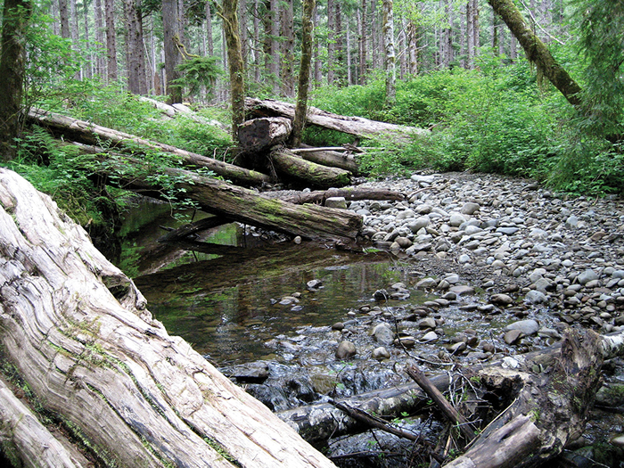
Suitability
RMAs unsuitable for
new facilities, except
those needed for resource protection
those that must be in RMA’s
new designated motorized use areas
scheduled timber production
waste and disposal areas

Slide 24
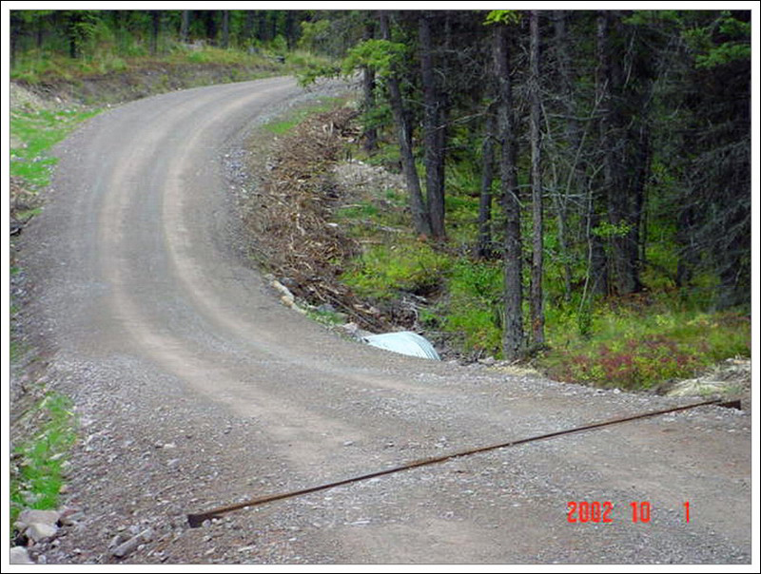
Standards & Guidelines
59 in 10 activity categories
watershed management, restoration
riparian management
timber, fuels
roads, grazing, minerals
recreation, lands & special uses
Most based on PACFISH, INFISH and NWFP-ACS.

Slide 25
Standards & Guidelines
RMA-1
aquatic and riparian resources are primary emphasis
when DCs are attained, projects shall maintain those conditions.
otherwise…projects or permitted activities shall restore or not retard attainment of DCs.
exceptions: short-term effects, limitations on FS authorities.

Slide 26
Watershed Analysis
General purpose
status, trend of watershed/aquatic ecosystems, key processes
specify DCs, appropriate activities to achieve
decision-making, ESA consultation
General process
Expected products

Slide 27
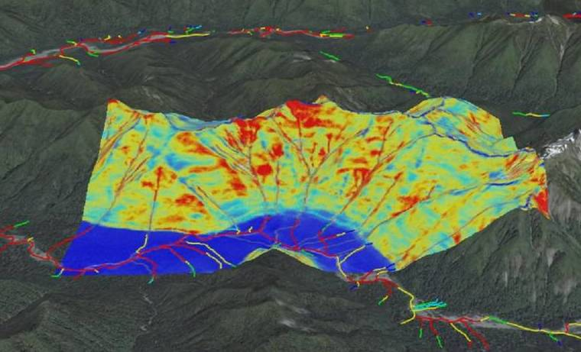
Watershed Analysis
When and where?
Forests identify # of new/updated analyses during Plan
Identify potential watersheds

Slide 28
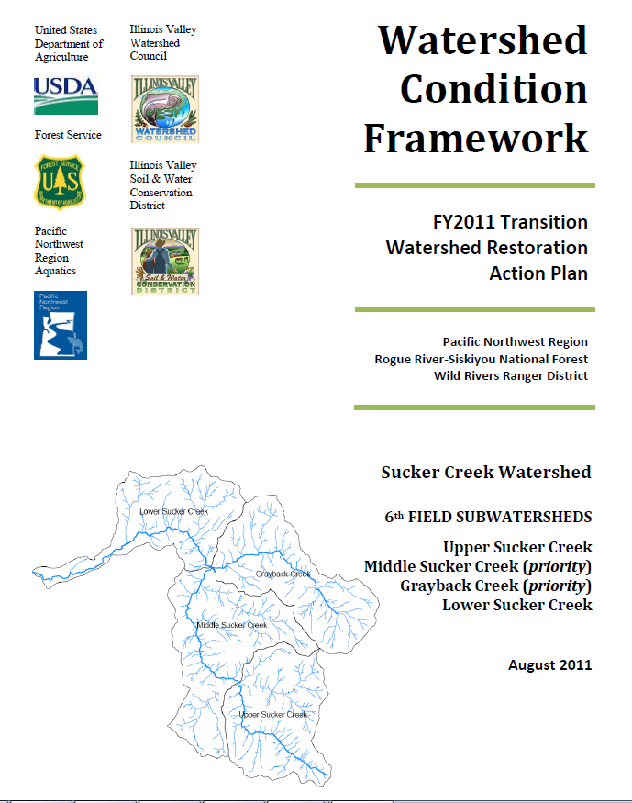
Watershed Analysis
When and where?
Prior to
developing restoration plans per WCF
changing RMA widths
timber salvage in RMAs
new facilities in RMAs

Slide 29
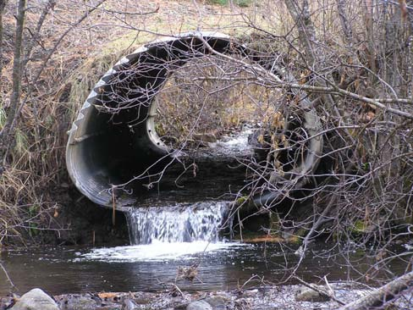
Watershed Restoration
Formal, modern strategy
R6 Aquatic Restoration Strategy (‘06)
Watershed Condition Framework (‘11)
Priority Watersheds
Restoration Plans
Objectives
individual treatments
# watersheds restored

Slide 30
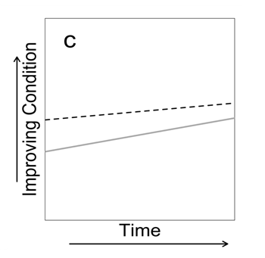
Monitoring
Implementation & Effectiveness
overall Plan
S&Gs / BMPs
Aquatic species distribution
Status & trend of watersheds/aquatic habitats

Slide 31
Status & Timelines
1st Review: Dec 2015
NR and Planning in ROs
2nd Review: March-May 2016
All staffs in ROs
Select Forest staff

Slide 32

Status & Timelines
Final Internal ARCS
December 2016
Internal Rollout
Interagency Coordination
Public engagement
Implementation

Slide 33
Role of Ecology Program
Assist
Specifying DCs at finer-scales
Defining purpose and need, proposed actions
Monitoring
long-term Range

Slide 34
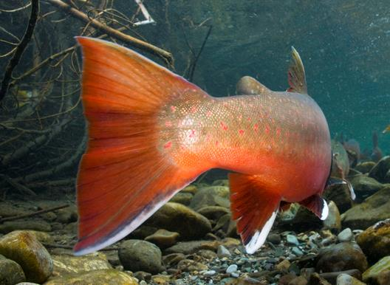
fin [end]

