Slide 1
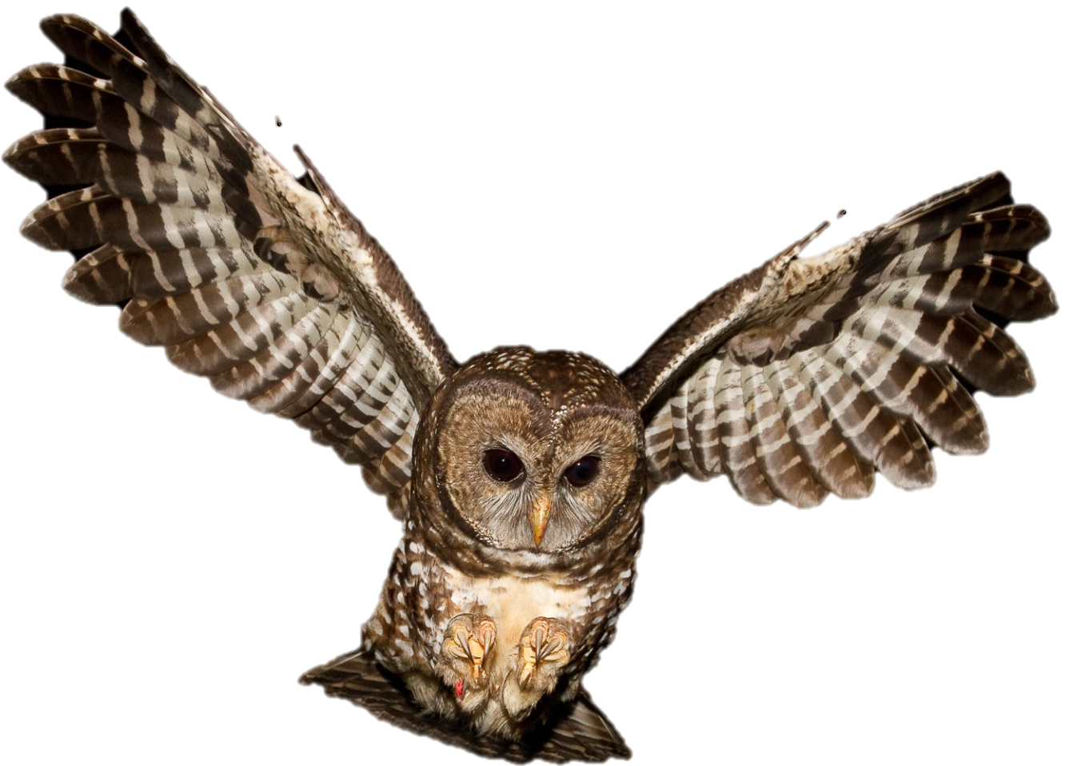

How do wildlife perceive landscapes?
Julianna M. Jenkins
PNW Research Station
Julianna.jenkins@usda.gov
Notes:
When Cheyrl asked me to give this talk about how wildlife perceive landscapes, I thought long and hard

Slide 2
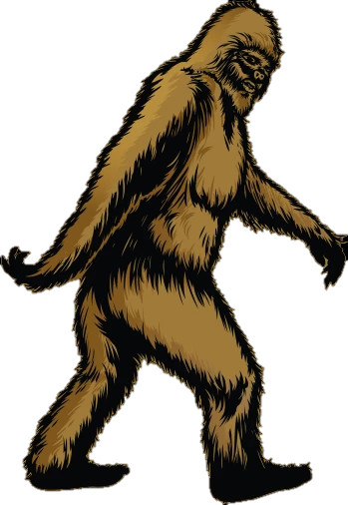

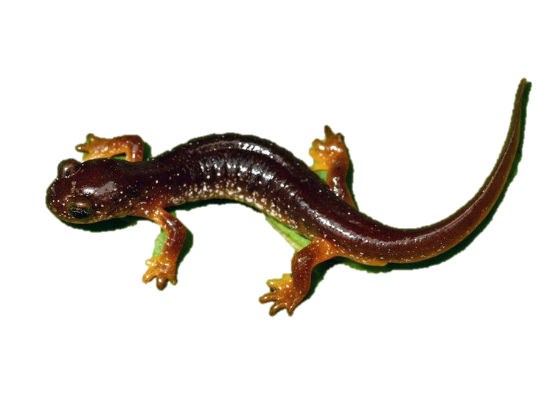
It depends…
vs.
vs.
Notes:
Physical size
Mobility
Breeding strategy
Foraging requirements
My research specialty is quantitative wildlife population modelling and Identifying what vegetation conditions are most closely associated with different species
Today I’m going to run through a basic review of wildlife habitat and landscape scale habitat considerations to focus on when you are thinking about effects of land management on wildlife species.

Slide 3
Considerations when managing wildlife on the landscape scale
Identify scales of interest
Habitat requirements & limiting factors
Effects of fragmentation and edge
(Henle and Kaule 1991).

Slide 4
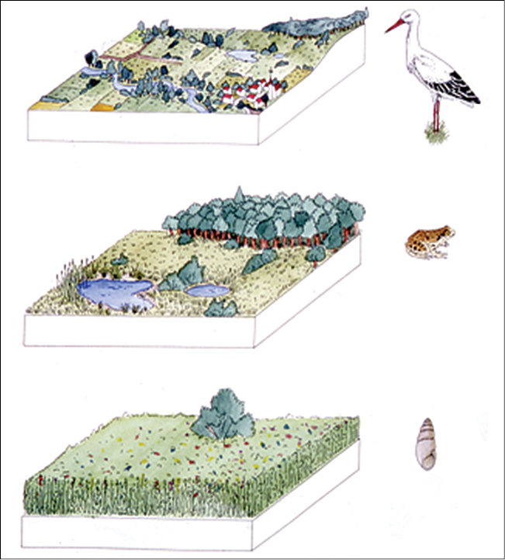
Consideration 1:
At what scale does your species operate?
(Henle and Kaule 1991).
Notes:
To understand how our management of the environment affects them, we need to identify the “scales” – spatial scales, temporal scales of resource use for the species of interest.
Different organisms will be affected by management actions differently = Animals with low mobility may be very sensitive to what we consider small scale changes
Animals with high mobility and flexible dispersal parameters may be affected by large management actions only

Slide 5
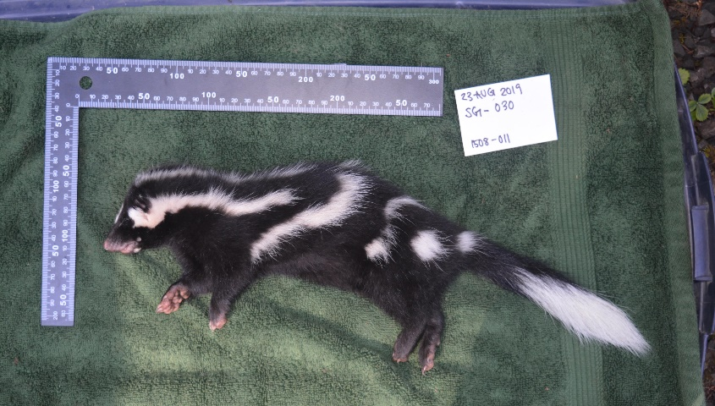
Spotted Skunks
HJ Andrews Experimental Forest
Marie Tosa:
marie.tosa@oregonstate.edu
Home Range
95% Isopleth
2,392.1 ha
(9.24 mi²)
Notes:
Example of a surprisingly large spatial scale for the spotted skunk.
Spotted Skunks are very small mesocarnivores– but Graduate Student Marie Tosa found that they can travel very far distances during the nonbreeding season.

Slide 6
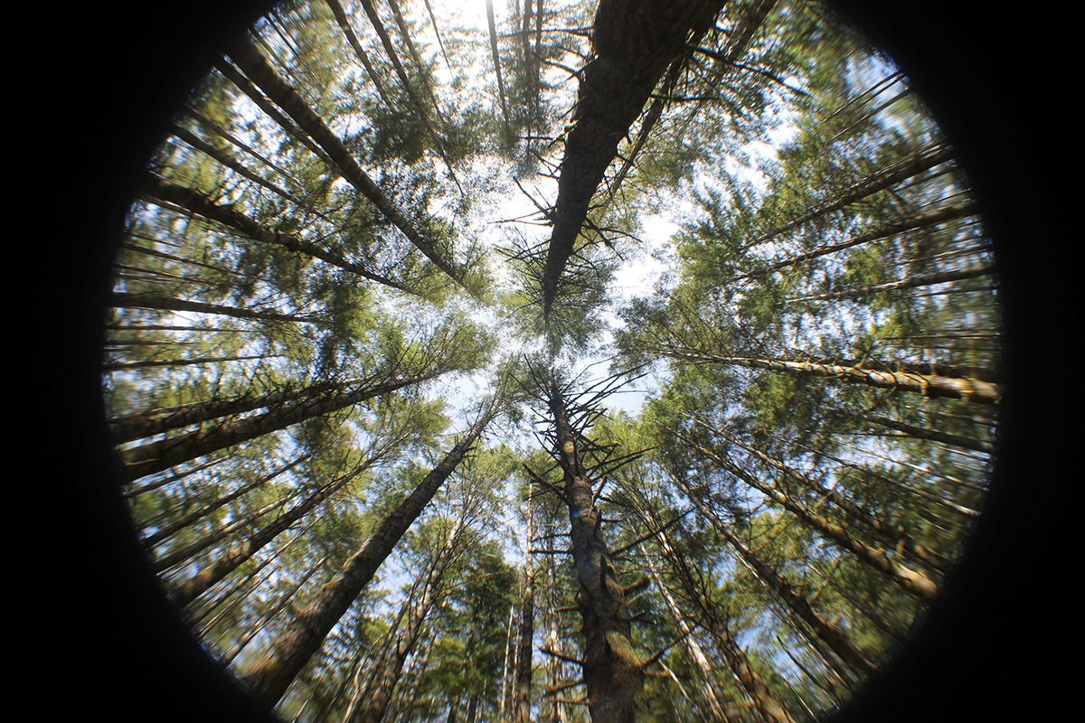
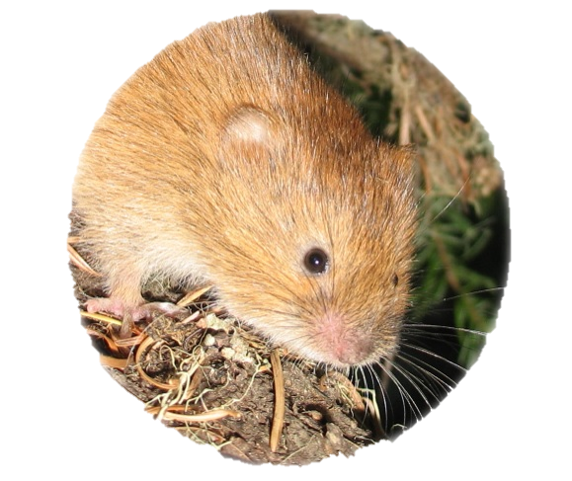
Red Tree Vole
Nest: complex branch and bole structure
Food: conifer resin ducts
Mobility: low (generations may move between forest patches)
Dispersal
Distances
50-200m
Notes:
Red Tree Voles--- Red tree voles have very low mobility – In old growth stands they may spend their entire life within one tree.

Slide 7
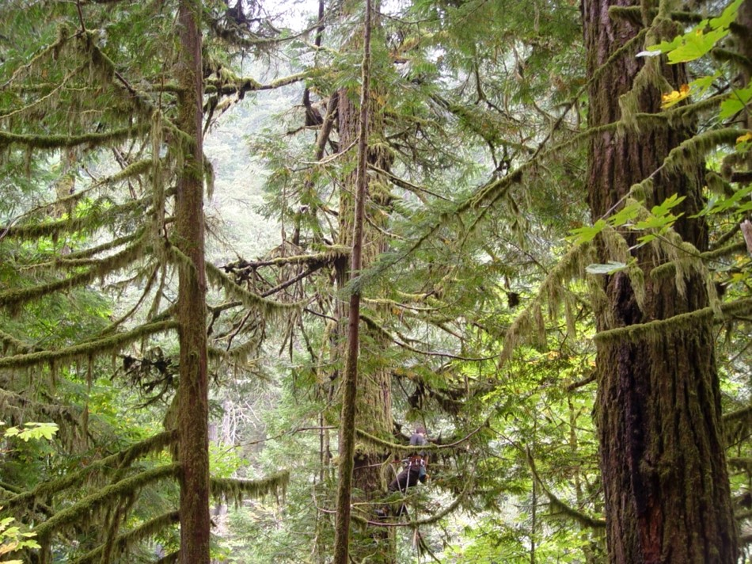
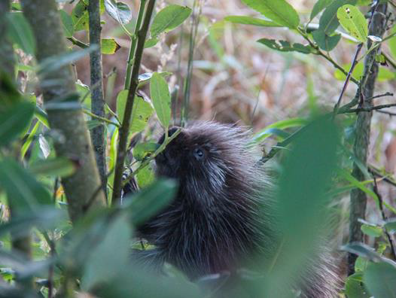
Consideration 2:
Define habitat requirements &
identify limiting factors

Slide 8
Habitat
Resources
Suitable Cover

Slide 9
Habitat:
the sum of necessary resources and environmental conditions for the maintenance of a species
Prey abundance
Predation risk
shelter
Nest sites
Vegetation structure
Climate
Competition
Notes:
Therefore, as land managers and wildlife biologists we are typically focused on the identification, availability, and relative importance of environmental resources and vegetation structures that promote quality habitat.

Slide 10
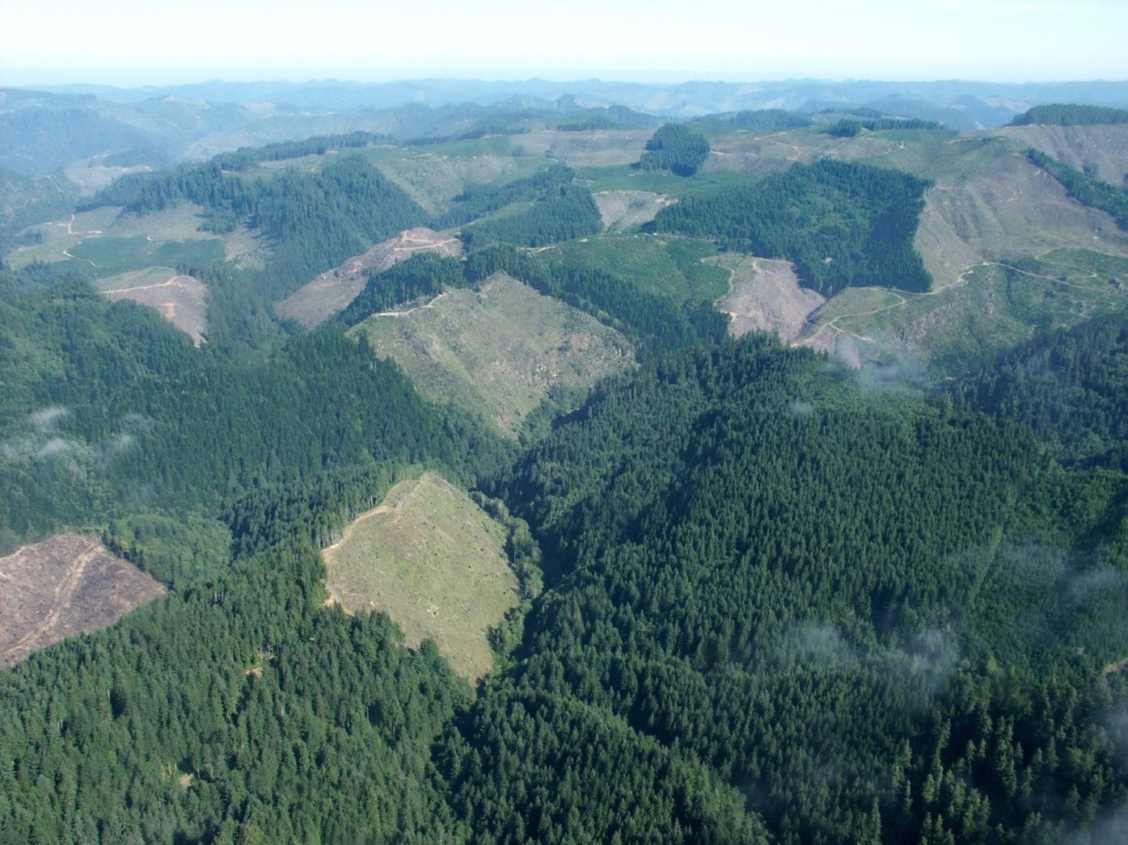
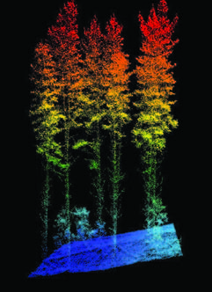
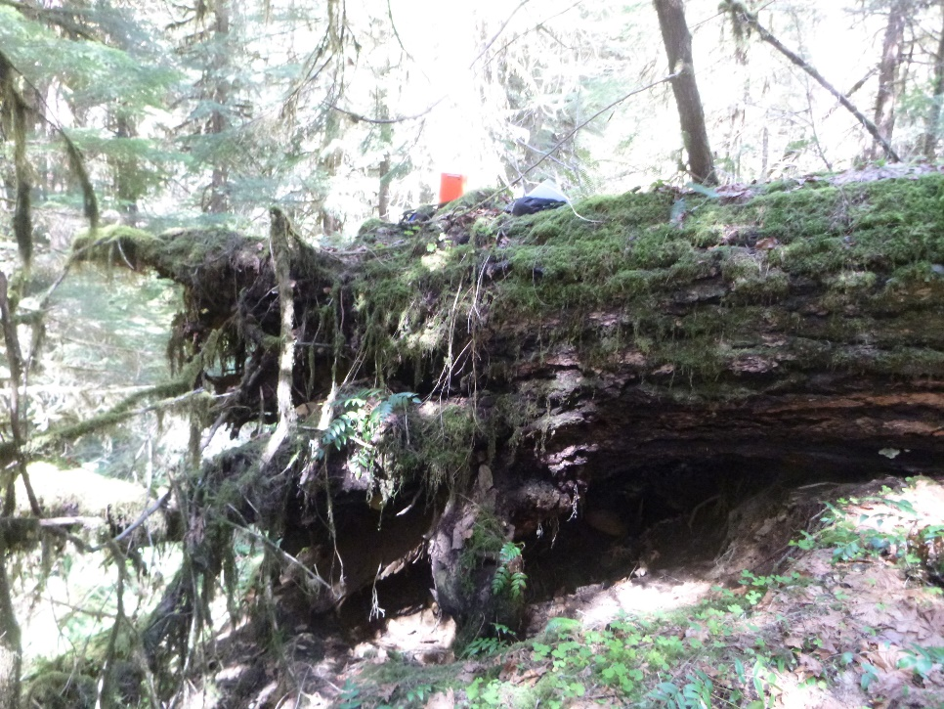
Resource:
Food item
Object
Condition
Notes:
Matter taken up by species (i.e. food items)
Objects associated with species (i.e. nest tree)
Conditions than influence the use of a location (i.e. landcover, slope, etc. )

Slide 11
‘Suitable cover’ or ‘Habitat Capable’
Area that has the combination of
(vegetative) resources required by a species.
Suitable Cover ≠ habitat
Notes:
By building upon the knowledge of what vegetative components birds and mammals require in multiple life history stages– we are able to map potentially suitable cover types across the landscape.

Slide 12
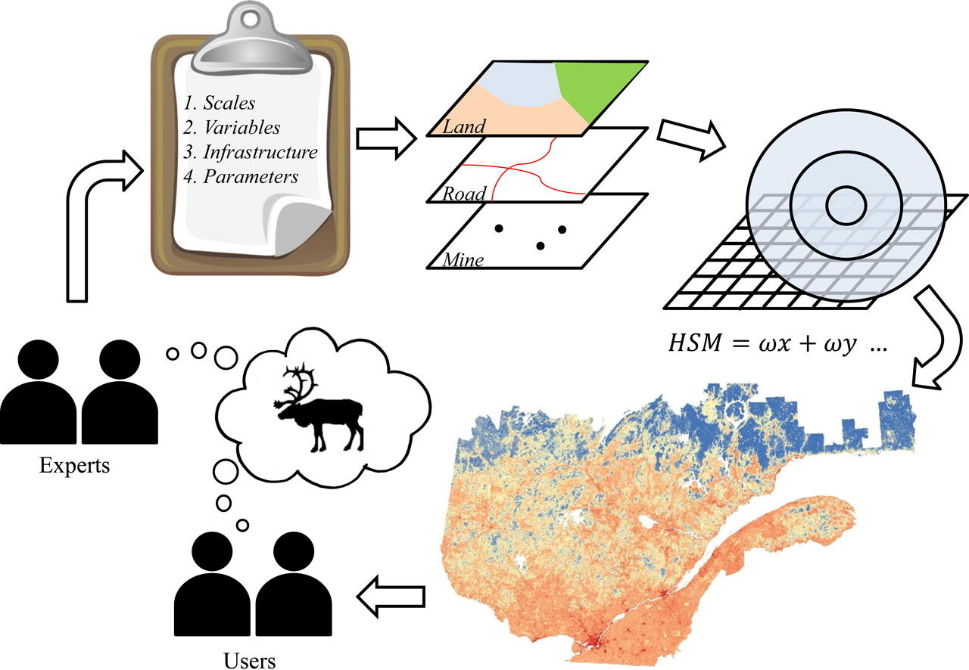
Cover type mapping
Figure: Leblond et al. (2014)
Notes:
Ex) Mapping Suitable Cover
Use expert knowledge to select list of resource conditions important to species
Train and test a spatial resource selection model using owl
location data
Classify probability of use into suitable vs. non-suitable cover

Slide 13
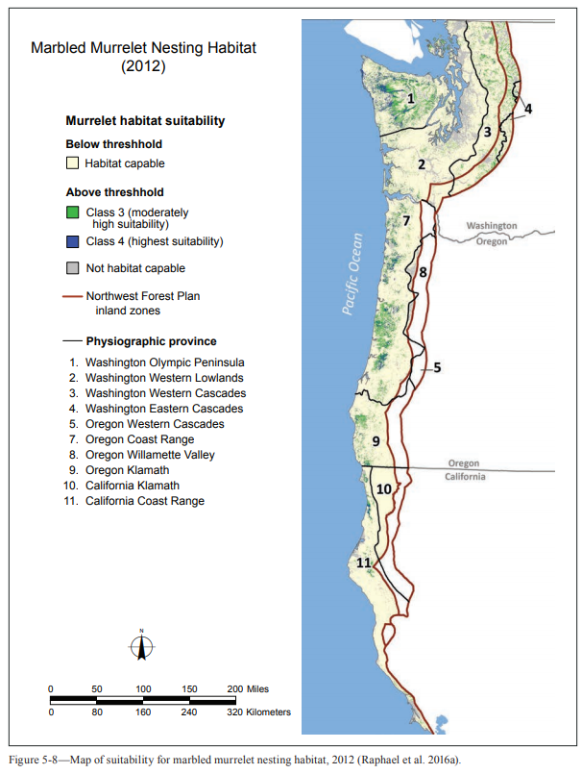
Cover type mapping
Wind River Watershed in
Gifford Pinchot NF
NSO Cover types
Credit: Ray Davis
Notes:
Here is a subset of suitable cover for Northern Spotted owls – we have a lot of info for spotted owls so Ray was able to predict cover types suitable for different habitat
Spotted owl Nesting conditions
-multilayered multispecies forest canopy dominated by large conifers
-moderate to high canopy cover 60-80%
-Substantial decadence and course woody debris

Slide 14
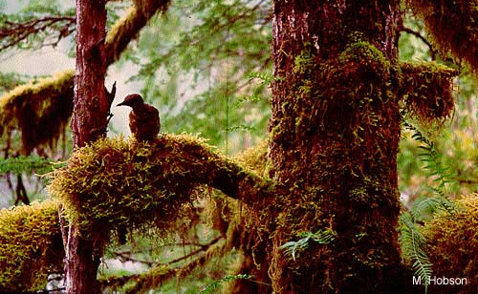
Cover type mapping
Wind River Watershed in
Gifford Pinchot NF
Credit: Raphael et al. (2016)
Notes:
Here is a subset of suitable cover Marbled murrelets– their cover type maps are focused primarily NESTING COVER within comuting distance to the ocean

Slide 15
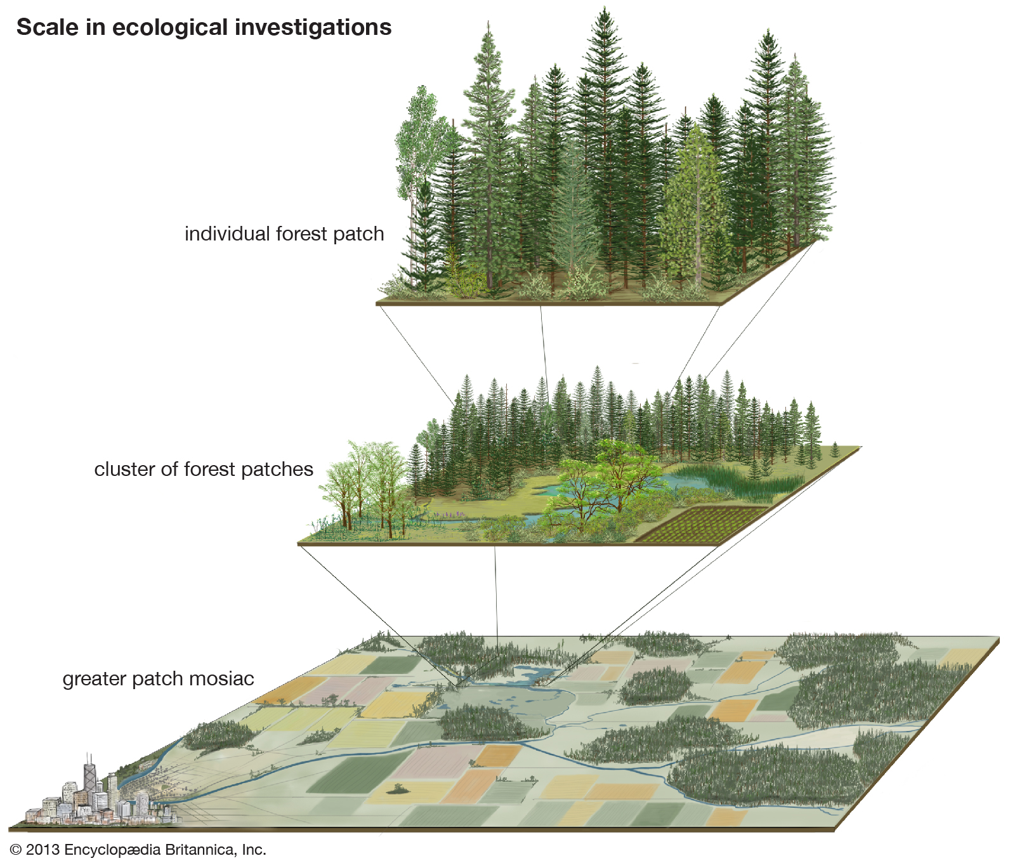
Consideration 3:
Fragmentation and edge effects
Notes:
When planning management actions we need to consider how they will contribute to fragmentation of cover and the amount of edge conditions at the landscape broader scale.

Slide 16
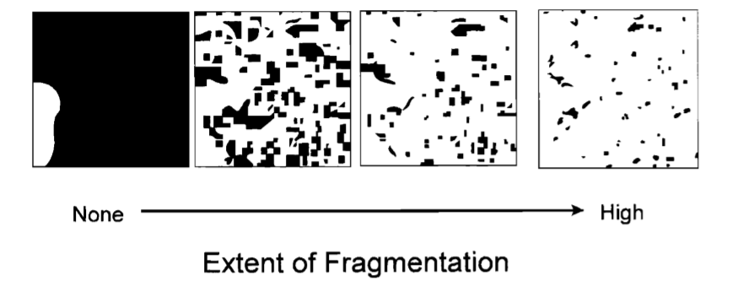
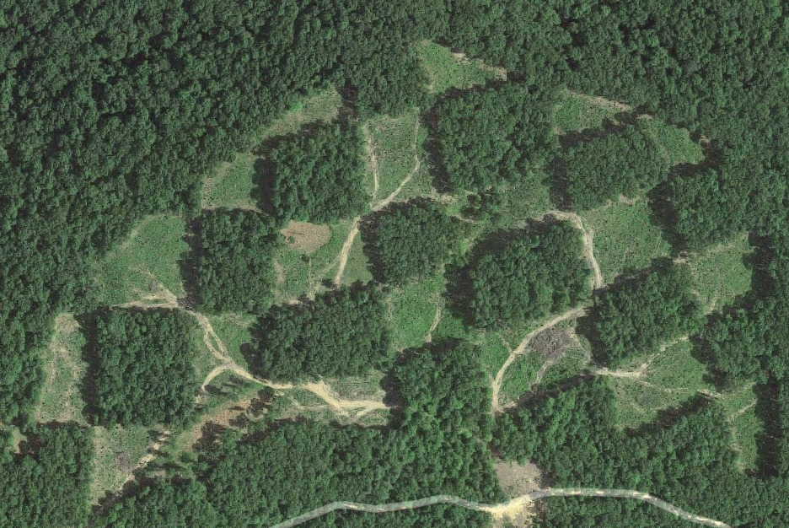
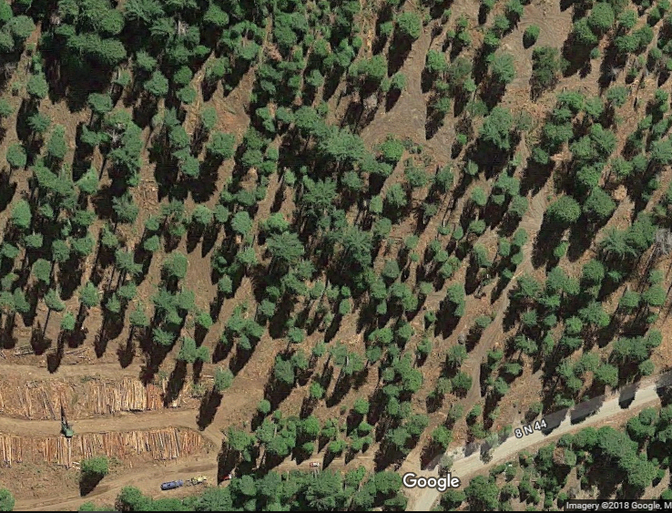
Fragmentation
Notes:
When planning management actions we need to consider how they will contribute to fragmentation of cover and the amount of edge conditions at the landscape broader scale.
A simplistic definition of fragmentation is the process where large patches of habitat are broken into smaller patches which become increasingly isolated.
How species respond to fragmentation depends upon their natural history.
While its true that there was natural heterogeneity in our forest habitats and pnw landscapes, anthropomorphic fragmentation typically doesn’t generate the same types of heterogeneity and
Thus many of the organisms in these habitats are not“adapted” to deal with effects of human mediated fragmentation.

Slide 17
Wildlife Impacts of Fragmentation
Increase
  Generalist species
  Amount of edge habitat
  Exotics
  Novel predators
Decrease
Amount of interior habitat
    Dispersal of interior specialists
    Richness of interior species

Slide 18
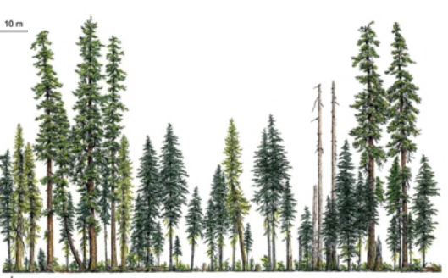
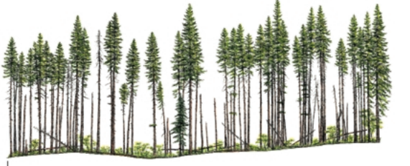
Edge Effects
OLD GROWTH
REGENERATING MATURE
Effect Extent
Notes:
Edge is just a boundary between 2 patches of different habitat
Extent of effect usually depends upon the contrast between the 2 patches.
Change abiotic conditions– the climate within one patch is affected by adjacent patches—severity depends upon
Change biotic interactions-
Barrier to dispersal
What constitutes an edge and a barrier is species specific.

Slide 19
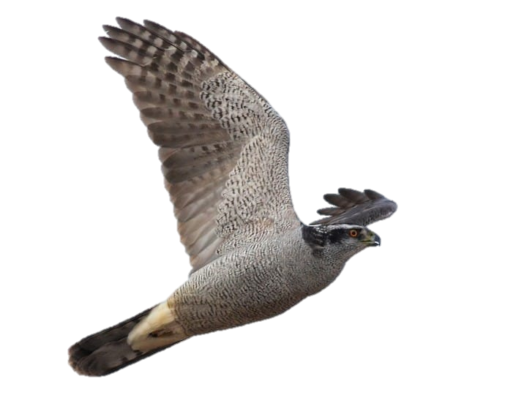
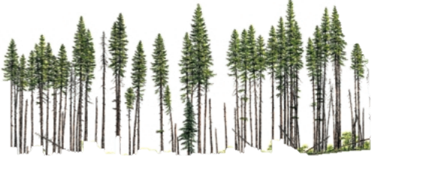
Edge Effects
Change abiotic conditions
e.g. loss of moisture
Change biotic interactions
  e.g. Increase in nest predators
Barrier to dispersal
OLD GROWTH
Recent Harvest
Effect Extent
Notes:
Edge is just a boundary between 2 patches of different habitat
What constitutes an edge and a barrier is species specific.

Slide 20
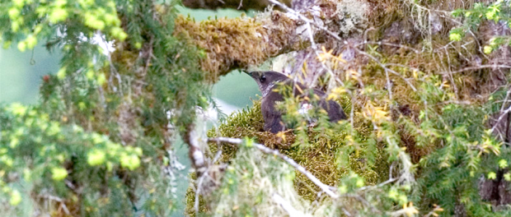
Marbled Murrelet—Edge effects on nest quality
        microclimate changes reducing branch suitability
          Increased wind-throw
          Loss of moss
        Increase populations of nest predators such as Corvids
©Nick Hatch
Notes:
Corridors are used to connect patches of habitat. The can be manmade or natural. Most corridors consist of existing streams, drainages or riparian strips and they enhance an animal’s ability to move among patches. 10. Connectivity of corridors is important in maintaining the movement and migration of terrestrial animals and it encourages gene flow between subpopulations. Wildlife corridors are becoming increasingly popular in North America and Europe. Corridors
such as this one depicted in the photo allow terrestrial animals to cross barriers such as roads or other areas fragmented by humans. 11. Corridor may act as a filter, providing dispersal routes for some species. Although corridors are exceptionally good there are some negative issues with them. Diseases can be easily spread between patches and in some cases corridors may encourage the spread of invasive or exotic species. This photo depicts reptile and amphibian tunnel that goes under the road. The fence funnels the animals to the tunnel providing them with a safer way to the other side of the road. If you have ever driven on highway 21 through Bastrop, Texas you may have seen something similar for the endangered Houston toad.

Slide 21
What can we do?
Preserve existing areas of suitable cover
Increase limiting resources where possible
  E.g. providing rest structures for mesocarnivors
  E.g. Snag creation/retention for woodpeckers

Slide 22
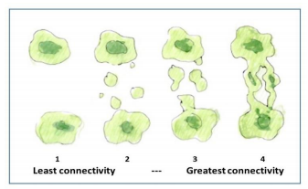
What can we do?
Promote corridors and connectivity between habitat patches

Slide 23
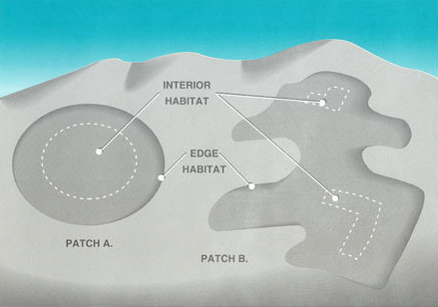
What can we do?
Strategically design treatments to minimize edge effects
Notes:
Either through manipulation of the shape of edges or through strategically softening edge boundaries

Slide 24
Julianna M. Jenkins
Forest Service PNW Research Station
julianna.jenkins@usda.gov

