Slide 1
Forest Planning Under the 2012 Planning Rule
Maximillian Wahlberg – Regional Analyst

Slide 2
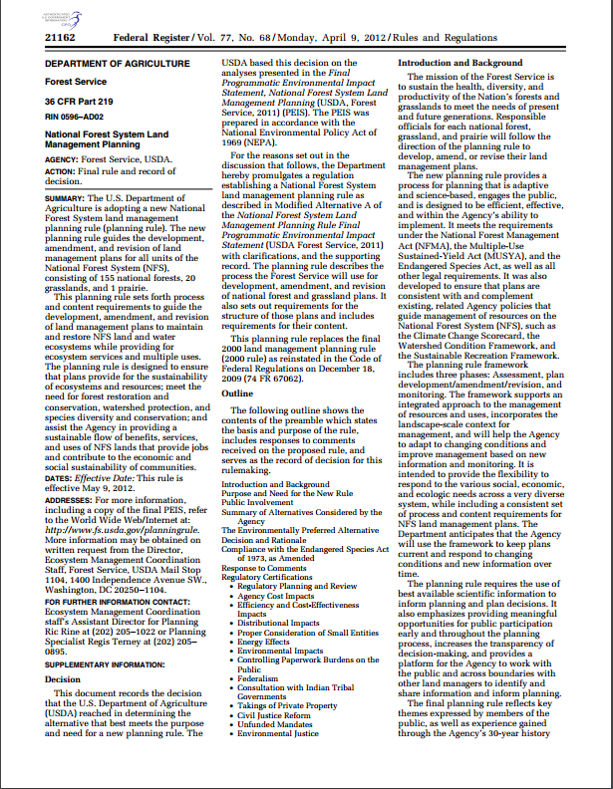
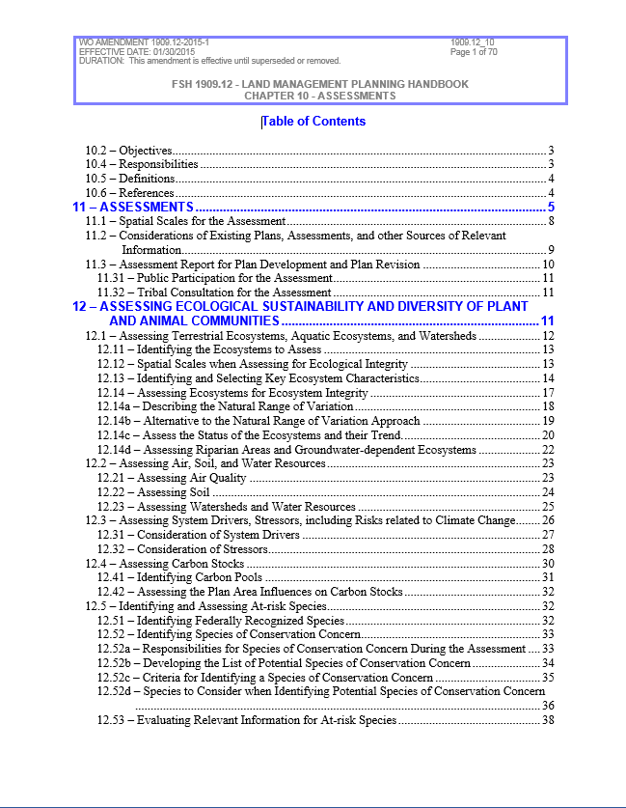
Phases of Planning
Direction comes from the Planning Rule as well as Directives
Phases of Planning:
Pre-Assessment
Not a formal planning step – where we are currently
Assessment -> Need for Change
Evaluation of current conditions and projected trends
Plan Development and Alternatives
Monitoring
Primary Analysis Phases

Slide 3
The Assessment
Contributions to ecological integrity are assessed for “key ecosystem characteristics”
For each characteristic:
Current conditions are compared to reference conditions (NRV)
Projected future conditions are compared to reference conditions (NRV)
Note: NRV is used as a metric for sustainability; it does not necessarily represent a desired condition
Assessments feed Need for Change which in turn feed plan development and alternatives
Natural Range of Variation (NRV)
Projected Future Conditions
Current Conditions

Slide 4
Sideboards and Spatial Scales
Analytical tools, models and frameworks should:
Help evaluate current conditions against natural range of variation (NRV/HRV)
Provide a mechanism to project trends under current management (and differentiate from legacy management impacts)
Be scalable to broad landscapes
Sufficient to inform a Forest’s context/niche
Facilitate all lands analysis
Use readily available (or in limited cases rapidly attainable) information
Data inputs need to be appropriate for the scale at which questions are being asked and answered

