Slide 1
Building a Common Vocabulary
Bruce G. Marcot, PhD Research Wildlife Biologist
US Forest Service, Pacific Northwest Research Station

Slide 2
model

Slide 3
model
L. modus: mode, measure

Slide 4
model
conceptual
diagrammatic
mathematical
computational
Hall, C. A. S., and J. W. Day. 1977. Systems and models: terms and basic principles. Pp. 6-36 in: C. A. S. Hall and J. W. Day, eds. Ecosystem modeling in theory and practice. Wiley Interscience, New York.
Notes:
I like this broad definition because it forces rigor and scientific credibility at each stage of model development ... calling for peer review at each stage.

Slide 5
Modeling Objectives
Source: Marcot, B.G. 2014. General considerations for modeling with probability networks. Unpub. report, US Forest Service.

Slide 6
Modeling Objectives
prediction (possible future outcomes based on initial conditions)
forecast (the most likely future outcome based on initial conditions)
projection (possible future outcomes based on changing future conditions)
scenario planning (peg the corners of the implications of hypothetical situations)
represent knowledge (synthesize what we think we know)
Source: Marcot, B.G. 2014. General considerations for modeling with probability networks. Unpub. report, US Forest Service.

Slide 7
Modeling Objectives
prediction (possible future outcomes based on initial conditions)
forecast (the most likely future outcome based on initial conditions)
projection (possible future outcomes based on changing future conditions)
scenario planning (peg the corners of the implications of hypothetical situations)
represent knowledge (synthesize what we think we know)
identify uncertainties & key data gaps (identify factors or interactions with the greatest influence on outcomes; sensitivity analysis)
diagnosis (determine potential causes of a known or specified condition or outcome)
mitigation (identify alternative conditions that could lead to a desired outcome)
aid individual or collaborative decision-making
Source: Marcot, B.G. 2014. General considerations for modeling with probability networks. Unpub. report, US Forest Service.
Notes:
Can’t meet EVERY objective! In fact, pick the top 3. Then pick the top 1 out of that.
There are other possible objectives, too.

Slide 8
Modeling in Decisions

Slide 9
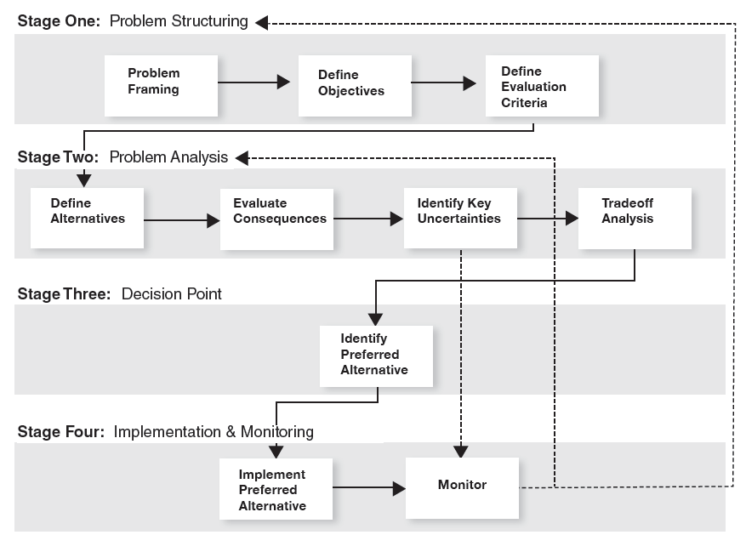
Modeling in Decisions
Notes:
Stages in a structure decision-making (SDM) framework.

Slide 10
Modeling in Decisions
Notes:
Modeling is used mostly in SDM Stage Two of Problem Analysis ... but could also be used in other stages, such as decision analysis models for Stage Three, etc.

Slide 11
Modeling in Decisions
Risk analysis, risk management – risk = probability x utility
Fuzzy logic v probability –
fuzzy logic = strength of evidence, [-1,+1] probability = frequency, [0,+1]

Slide 12
Types of Uncertainty

Slide 13
Types of Uncertainty
Parameter value uncertainty – - central tendency values, value distributions - spatial & temporal variation, interaction terms
Model structure uncertainty –
- one facet of epistemic uncertainty, how the system is structured and works
Inherent system variability –
- aleatoric uncertainty – how a system responds to unknown influences ... hidden or latent variables

Slide 14
Testing Models

Slide 15
Testing Models
Calibration – testing model accuracy against the same data used to build it -- overfitting
Validation – testing model accuracy against an independent data set - k-fold cross-validation - jackknifing
- leave-one-out

Slide 16
Personal plea ...

Slide 17
Personal plea ...
no “emerging” paradigms!

Slide 18


Personal plea ...

Slide 19


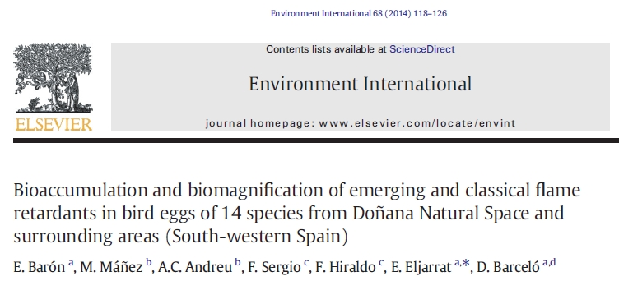





Slide 20
Recap ...

Slide 21
model
conceptual
diagrammatic
mathematical
computational
Hall, C. A. S., and J. W. Day. 1977. Systems and models: terms and basic principles. Pp. 6-36 in: C. A. S. Hall and J. W. Day, eds. Ecosystem modeling in theory and practice. Wiley Interscience, New York.

Slide 22
Modeling in Decisions

Slide 23
Types of Uncertainty
Parameter value uncertainty – - central tendency values, value distributions - spatial & temporal variation, interaction terms
Model structure uncertainty –
- one facet of epistemic uncertainty, how the system is structured and works
Inherent system variability –
- aleatoric uncertainty – how a system responds to unknown influences ... hidden or latent variables

Slide 24
Testing Models
Calibration – testing model accuracy against the same data used to build it -- overfitting
Validation – testing model accuracy against an independent data set - k-fold cross-validation - jackknifing
- leave-one-out

Slide 25
This Workshop

Slide 26
This Workshop
Landscape scenarios, projections

Slide 27
This Workshop
Landscape scenarios, projections
Fire simulations

Slide 28
This Workshop
Landscape scenarios, projections
Fire simulations
Climate change

Slide 29
This Workshop
Landscape scenarios, projections
Fire simulations
Climate change
Decision-support

Slide 30
This Workshop
Landscape scenarios, projections
Fire simulations
Social / economics
Climate change
Decision-support

Slide 31
This Workshop
Landscape scenarios, projections
Fire simulations
Management – Wahlberg & Emerson
Departure Analysis, Restoration -- Haugo
Rogue Basin Restoration -- Metlen
EMDS – Reynolds & Hessburg
Landscape Treatment Designer – Ager
Remote Sensing, Tree Decline – Grulke
Wildfire Risk Assessment – Scott
Social / economics
Climate change
Decision-support

