Slide 1


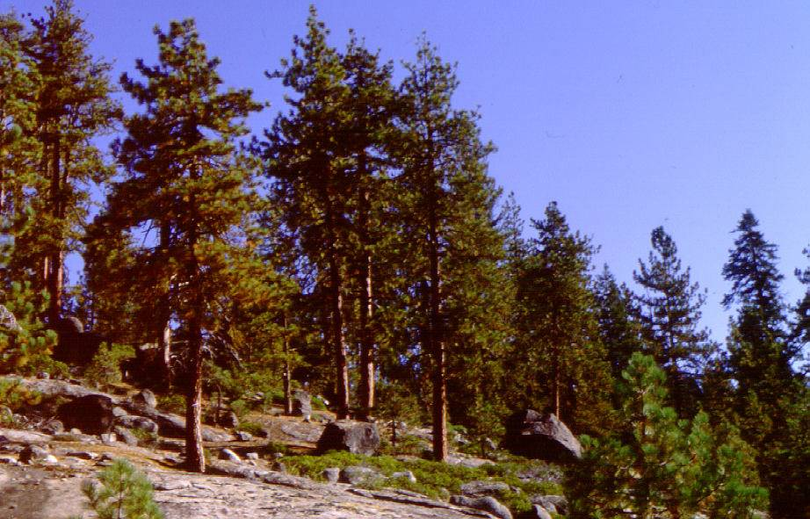

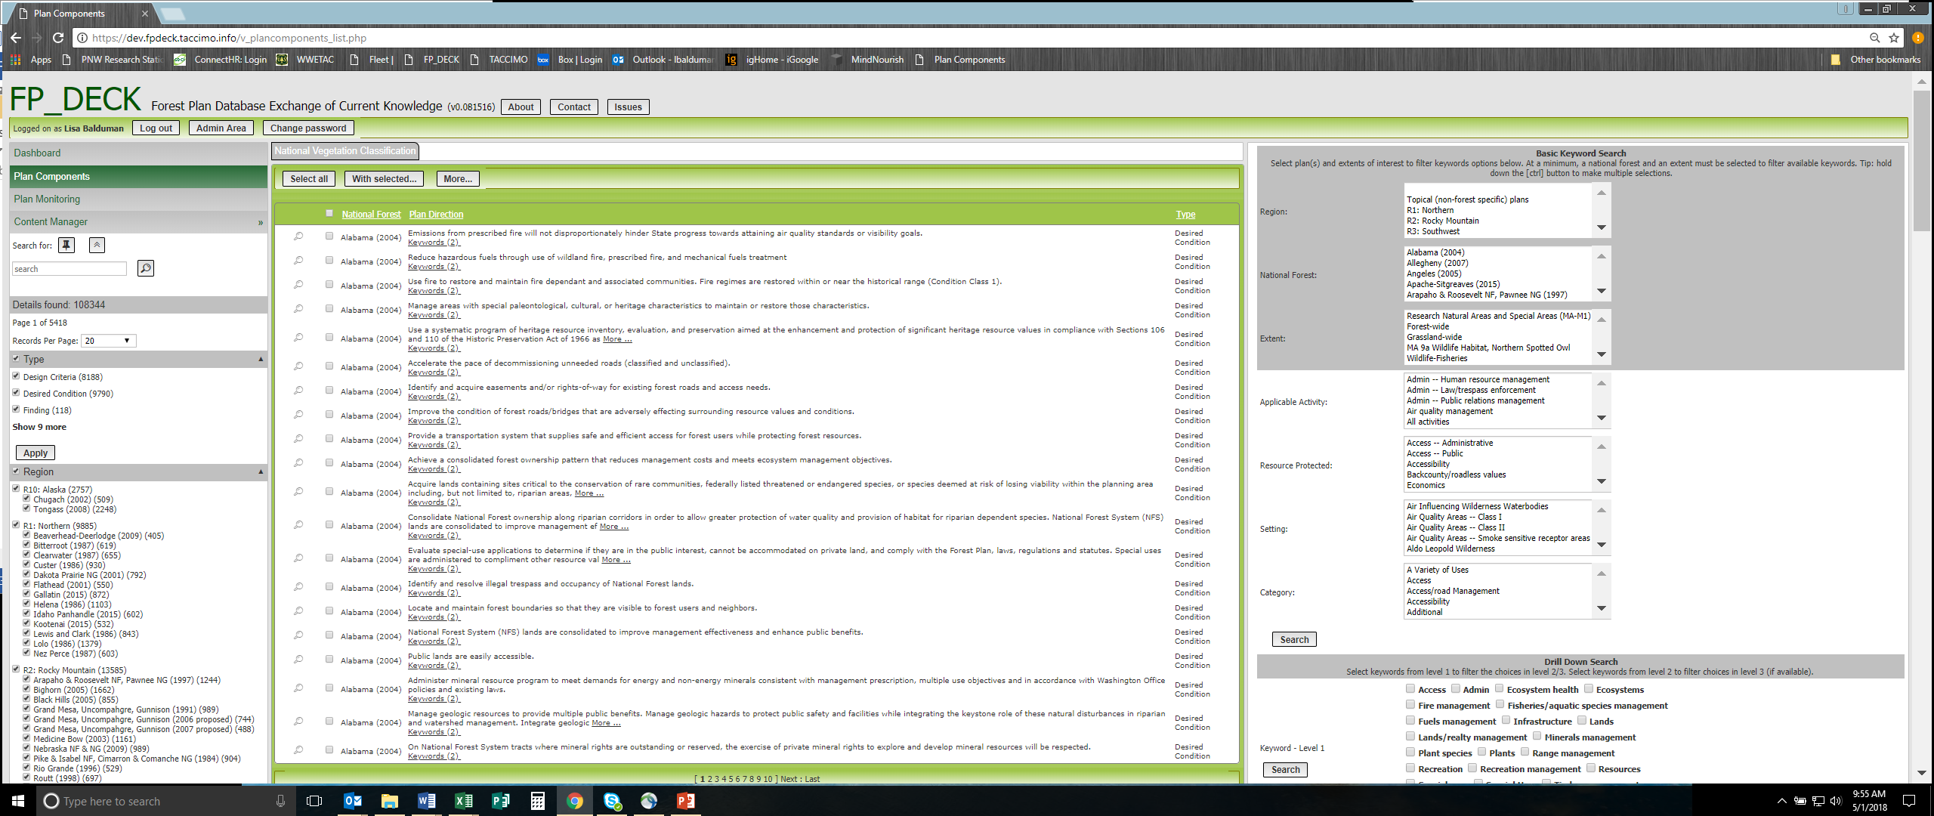
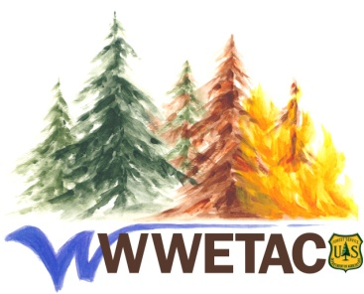
FP_DECK: Forest Plan Database and Exchange of Current Knowledge
https://dev.fpdeck.taccimo.info/
Lisa Balduman USDA FS PNW Research Station, WWETAC (Western Wildland Environmental Threat Assessment Center)
The Forest Plan Database Exchange of Current Knowledge (FP_DECK) is a web-based planning tool that electronically archives directions from Forest Service Land and Resource Management Plans in a searchable database. FP_DECK can benefit regional analysts, forest plan or accelerated restoration teams, resource specialists, and collaborators.
FP_DECK compiles plans into a common location accessible to anyone. The tool provides land managers and planners an opportunity to view and search directions and monitoring questions from all National Forest plans during new plan development and existing plan modification. Planners and managers can examine similar forest-based activities, explore specific forest characteristics and issues, and develop consistent templates that incorporate state, regional, and national knowledge and expertise.
FP_DECK compiles forest plan directions (goals, objectives, desired conditions, suitabilities, standards and guidelines) into a common location. With all forest plans currently in the database, you can now electronically search through directions from all forest plans across the US - or, alternatively from just 1-2 forests or regions - for any topic of interest. There are two methods for searching the database: 1) searching for terms embedded in the direction text and 2) searching for keywords that describe the direction (more details below right). Only the first method is currently available as the second method will require input from individual forests and this has only been undertaken for a handful of forests to date.
Multi-forest amendments are also being added into the FP_DECK database. Currently these include:
Northwest Forest Plan
Canada Lynx Plan
Sage Grouse Plans (for ID/MY, NV, UT, WY)
PACFISH
INFISH
Mexican Spotted Owl Amendment
Northern Goshawk Amendment
Some forests also have separate plans for national monuments, wild and scenic rivers, etc. and these are being added as well.
KEYWORD EXAMPLES:
Extent – Mappable area specific to each forest
- Forest-wide (or Grassland-wide)
- Management Areas
- Geographic Areas
Applicable Activities – Activities limited or constrained by the direction
- Some are hierarchical, ie,
- Range management
- Range management – Livestock grazing/allotments
- Range management – Nonstructural improvements
- Some are not hierarchical, ie,
- Air quality management
- Heritage resource management
- Timber management
- Recreation management
- Facilities management
Resources Protected – Resources that are protected by the direction
- Some are hierarchical, ie,
- Ecosystems health
- Ecosystem health – Climate change resistance
- Ecosystem health – Disease resistance
- Some are not hierarchical, ie,
- Accessibility
- Economics
- Wilderness values
Settings – mappable areas that the direction is applied in; can be either specific to an individual forest or common to many or all forests
Forest specific settings – include named features such as lakes, mountains, archaeological areas, wildernesses, scenic byways, etc
- Non-forest specific (region/nationwide)
- Ecosystem types
- Ecosystems – Lodgepole pine forests
- Ecosystems – Pinyon-juniper woodlands
- Land use
- Land use – Abandoned mines
- Land use – Designated communication sites
- Wildlife habitat
- Wildlife habitat – Bald eagle
- Wildlife habitat – Big game winter range
Information from all new monitoring plans is also incorporated into FP_DECK. This includes monitoring questions, indicators, and required monitoring elements, as well as priority level, frequency of measuring/reporting, etc. Monitoring questions can also be tied to the specific plans directions to which they apply. The user friendly interface of FP_DECK allows for the comparison of monitoring questions and indicators across forests, regions and at the national level. The keywording system (described at right) could also be applied to the monitoring plan questions for more intensive queries of the database.
Keywording System
The keywording approach we have begun assigns 4 types of keywords to each direction: 1) the extent of the direction - forest-wide or specific management areas / geographic areas the direction applies in, 2) the activity constrained by the direction, 3) the resource protected by the direction, and 4) the setting or mappable location the direction applies in. The benefit of the keyword system is that it will allow for more intensive queries of the database. Some examples of these searches could include:
What are the desired conditions for wilderness in Region 5?
What directions have been written to protect focal species that will affect timber management?
How do goals for Forest A compare to goals for Forest B?
What standards have been written to protect elk in Regions 2 and 4?
How are we managing recreation in sagebrush ecosystems in Region 3?
Western Region Monitoring Plans in FP_DECK (# questions/plan)
R1: Northern
Beaverhead-Deerlodge (24)
Bitterroot (26)
Flathead (76)
Idaho Panhandle (31)
Kootenai (29)
Lolo (33)
R2: Rocky Mountain
Arapaho & Roosevelt
NF Pawnee NG (12)
Bighorn (30)
Medicine Bow (17)
Nebraska NF & NG (33)
Pike & Isabel NF, Cimarron
& Comanche NG (14)
San Juan (21)
Shoshone (38)
White River (23)
R3: Southwest
Apache-Sitgreaves (13)
Coconino (35)
Coronado (22)
Kaibab (82)
Prescott (35)
R4: Intermountain
Boise (25)
Bridger-Teton (20)
Caribou (18)
Challis (12)
Curlew NG (8)
Dixie (38)
Fishlake (34)
Humboldt (26)
Salmon (7)
Sawtooth (24)
Targhee (15)
Uinta (16)
Wasatch-Cache (16)
R5: Pacific Southwest
SOCAL: Angeles, Cleveland, Los Padres, San Bernardino (21)
Inyo (25)
R6: Pacific Northwest
Crooked River NG (24)
Deschutes (33)
Fremont (44)
Gifford Pinchot (44)
Mt Baker-Snoqualmie (26)
Mt Hood (26)
Ochoco (28)
Okanogan (34)
Olympic (43)
Rogue River (33)
Siuslaw (33)
Umpqua (25)
Willamette (24)
R10: Alaska
Tongass (38)
lbalduman@fs.fed.us

