Slide 1
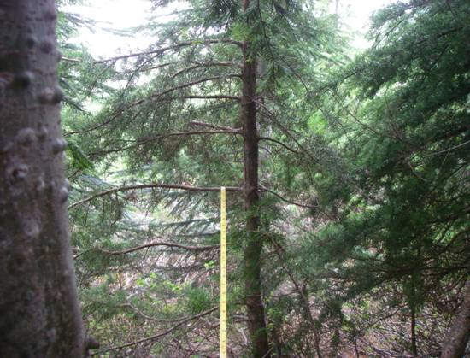
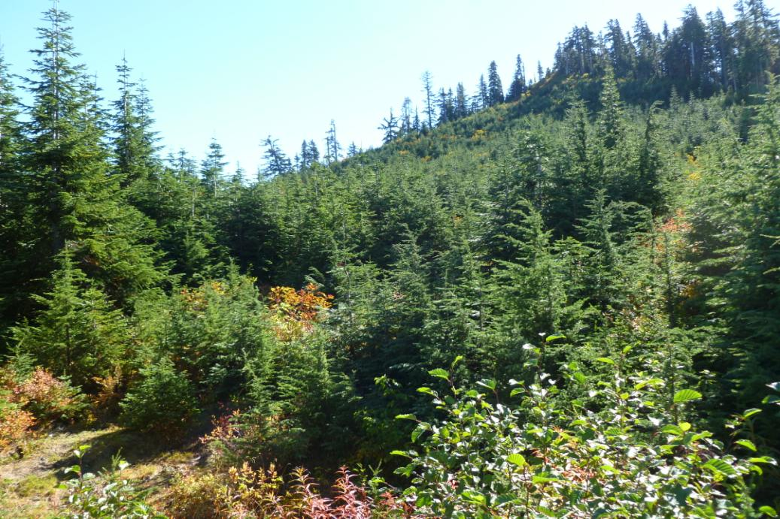
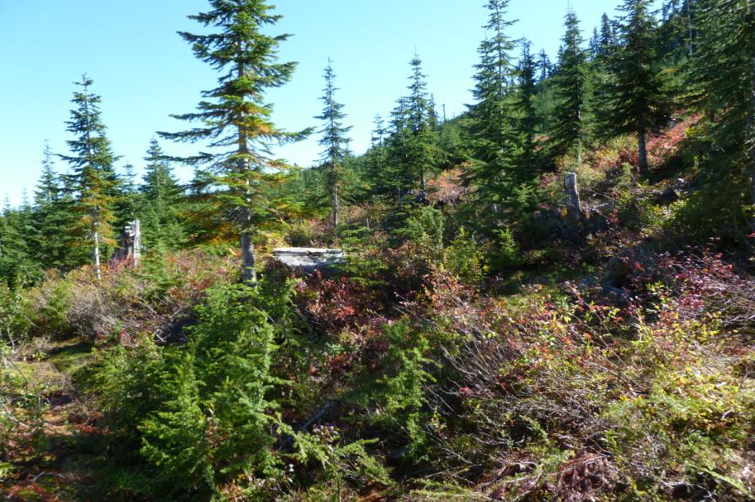
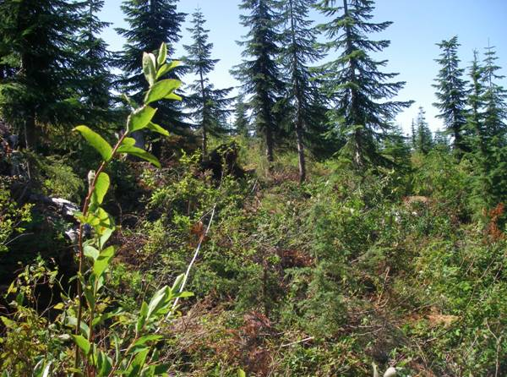
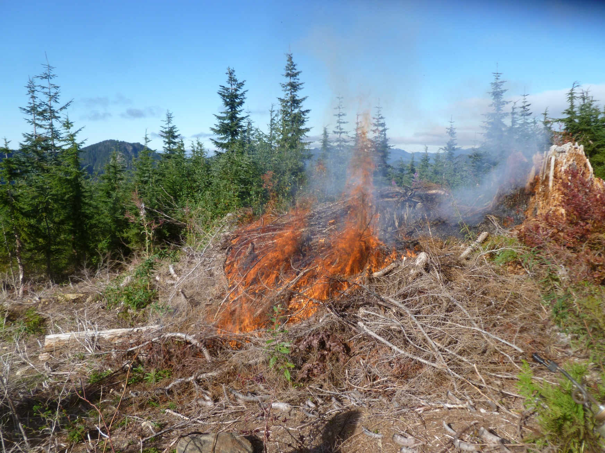
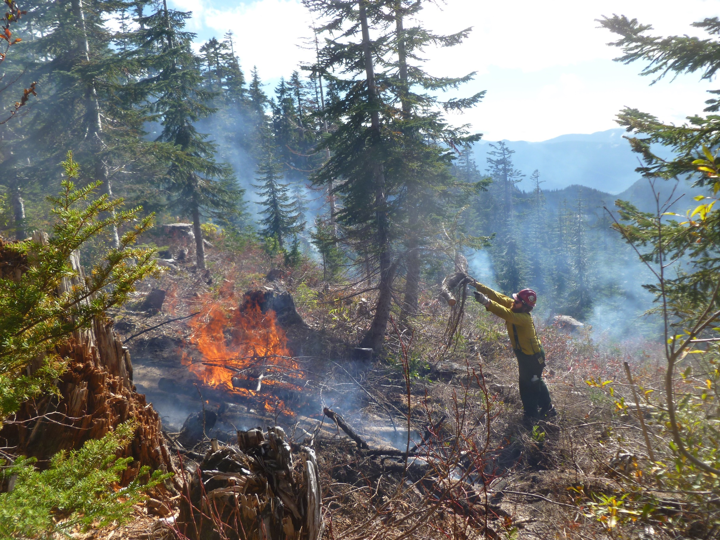
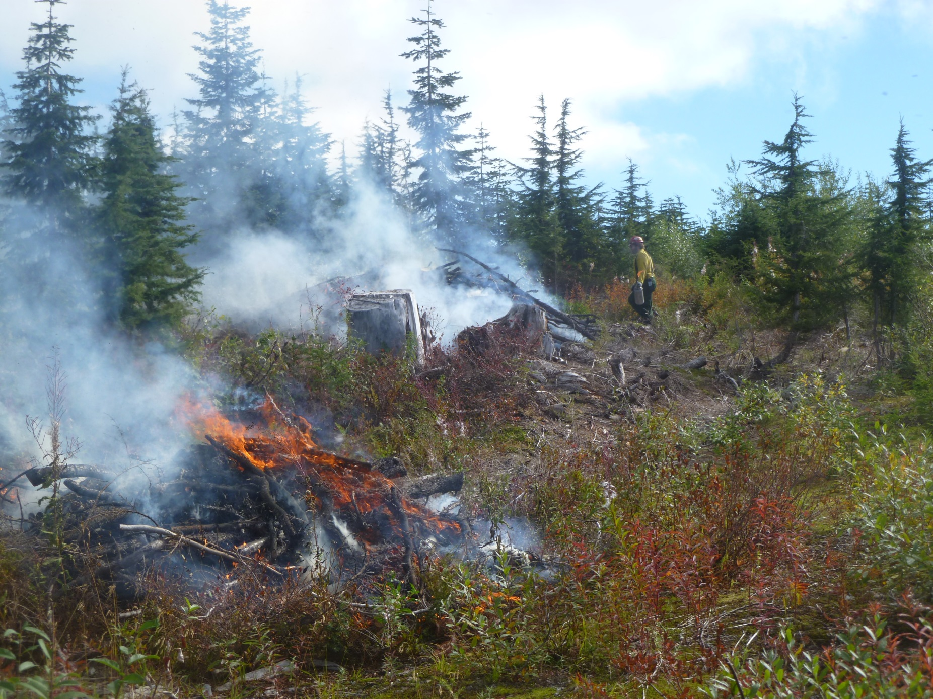
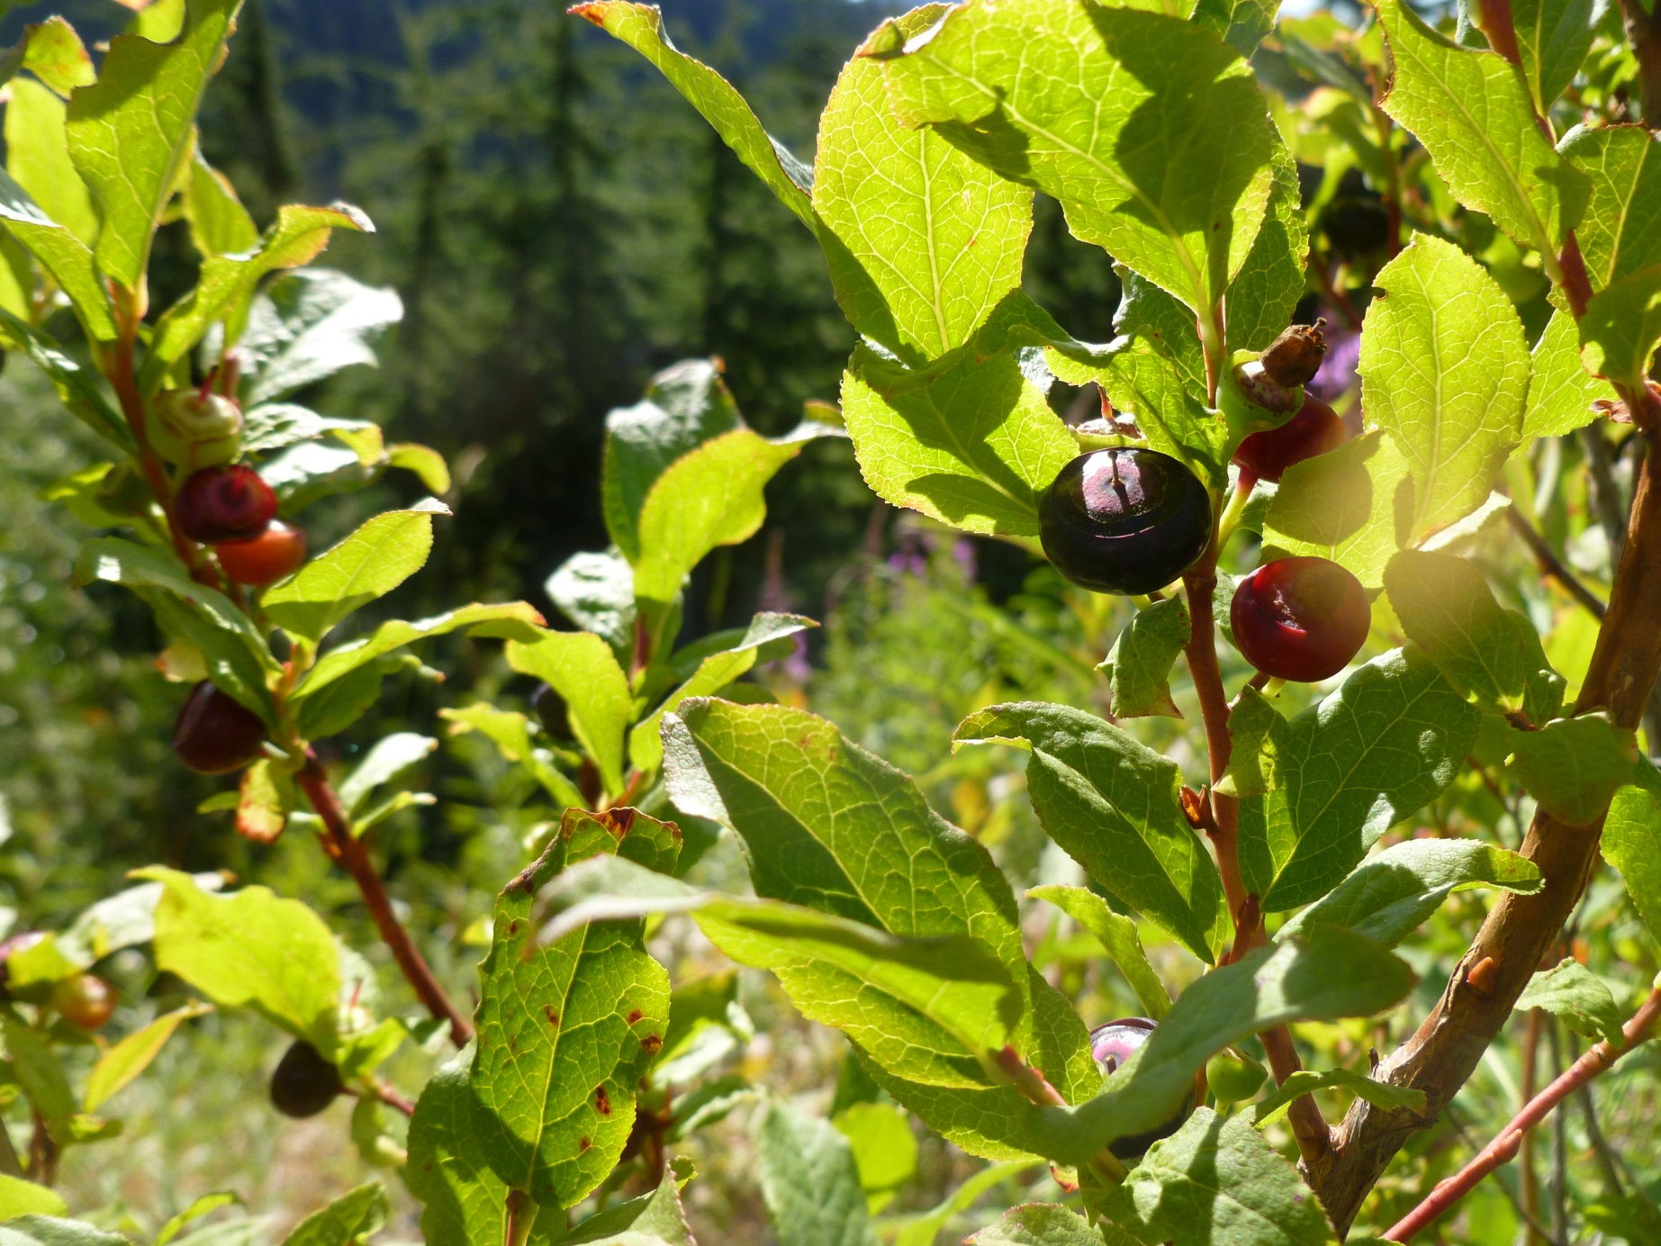
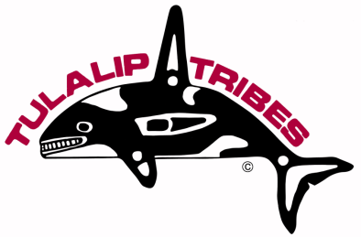
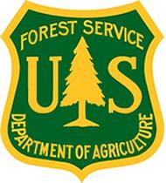
Huckleberry Enhancement Project
A cooperative project between the Tulalip Tribes and the US Forest Service with monitoring assistance from Western Washington University staff and students*
Darrington Ranger District, the Mt. Baker-Snoqualmie National Forest, Washington.
Objective: Remove competing vegetation from around Big-leaf huckleberry so as to promote greater huckleberry production.
Monitoring plot
pre-thinning view
2009 – Regional Grant award, planning, signed Decision Memo
2010 – Treatment year 1 - thin and chip, monitoring of cover
2011 – Treatment year 2 - thin, preparation for broadcast burn
monitoring of cover and huckleberry production
2012 /2013 – Treatment years 3 and 4 - thin, and pile for burning,
monitoring of cover and huckleberry production
2014 – Pile Burning
Untreated
Treated
Treated
Monitoring plot
post thinning view
Results and Observations:
  There is increased huckleberry plant cover in the treated areas
  Huckleberry production is similar on plants in treated and untreated sites
    a good production year of berries is good across all sites
  Treated sites have greater productivity due to increased area in huckleberry cover vs. area in tree cover
The project goal is to increase fruit production in target huckleberry fields. These fields have been producing substantial huckleberry fruit since the mature forest was harvested in the area in the 1980’s but fruit production is now declining at the same time conifer species have become established in the fields and have begun to overgrow the huckleberry plants. Based on the hypothesis that huckleberry fruit production will increase if conifer species competing for light and soil resources are removed, the goal is to reduce forest overstory cover by approximately 70% in one-half of the huckleberry release area and to monitor the project in such a way as to determine if forest removal had the desired effect. The study plans to contrast huckleberry fruit production in areas where forest overstory is removed versus areas where forest overstory is not removed.
* Jason Gobin, The Tulalip Tribes’ Forestry Manager, Russel Moses, Tulalip Tribes’ Forestry, and Phyllis Reed, Wildlife Biologist/Environmental Coordinator, USFS, were lead persons in project planning, but many additional persons from the Tulalip Tribes, including their forestry crew and youth were critical to the successful site treatment in planning, thinning, brush pulling and chipping activities.
There was also the assistance of the USFS (Mt. Baker-Snoqualmie N. F. ) fire staff and Initial Attack crew in preparation of the burn plan and site for the proposed broadcast burn.
Monitoring design and implementation included efforts from Dr. Ralph Riley, Western Washington adjunct faculty and Hallie Adams, Western Washington University student.
Numerous others supported the effort through their encouragement and knowledge.

