Slide 1
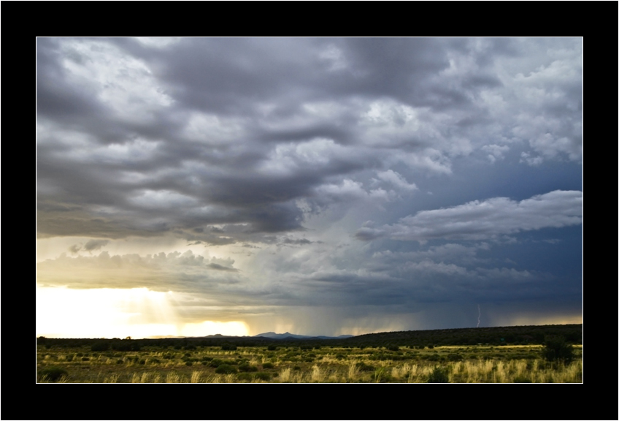
Wildlife Analyses Under 4FRI
Notes:
In books & movies our culture frequently assigns a foreboding symbolism to storms on the horizon, and it seems that’s how some people react to 4FRI before they learn about the goals and objectives of the project. But remember that, on this landscape, local cultures developed conceptual frameworks that celebrated storms and tried to coax the life-giving rain their way. 4FRI may not be life-giving, but biologically restoring our pine forests can be life-sustainiing.

Slide 2
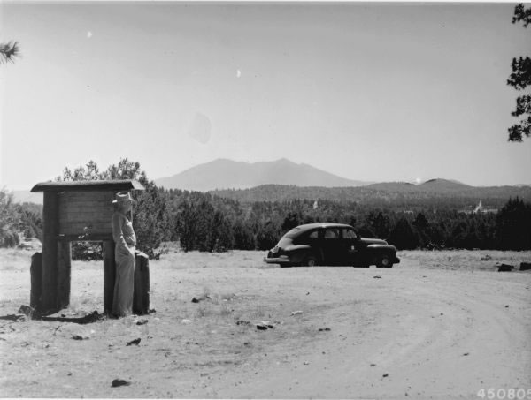
“Wildlife” as defined by Federal Laws, Regulations, & Policy:
Endangered Species
Regional Forester’s Sensitive Species
Management Indicator Species
Migratory Birds
Notes:
As you’ve heard, I’m a wildlife biol, but in this context, “wildlife” and “analysis” both have very specific meanings. We have to work according to L, R, & P. Under this guidance, wildlife is defined in several ways, all of which have to be addressed in a specific manner. Unlike the previous 2 talks, I’m not going to go into EC/DC because is varies by spp, but I will go through some of the ways we’re approaching the wildlife analysis.

Slide 3
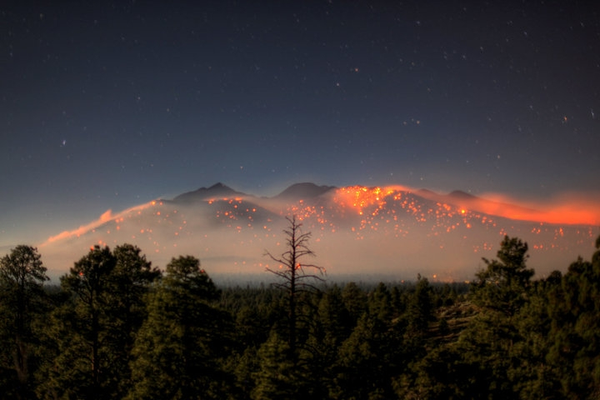
=National Environmental Policy Act
Evaluate “Action” and “No Action” Alternatives
Notes:
And analysis also has a particular way it must be done. We have to look at the spp list referenced on the previous slide and evaluate how proposed project activities will affect them, and in addition, how “no action” or continuing the status quo will affect those same spp. Speaking of status quo, this is a view of the Schultz fire.

Slide 4
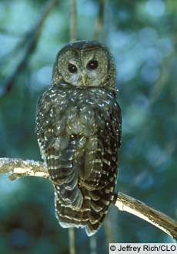
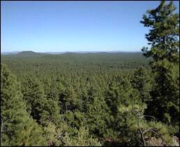
Endangered Species
Mexican Spotted Owls
California Condors
Black-Footed Ferrets
Notes:
So we have 4 lists of spp to look at and the particular wildlife spp assoc with these lists include the T&E spp listed under the ESA. These are spp Threatened or Endangered by the potential for going extinct. Concern for these spp is typically at the top of the list because of the dire nature of their populations.

Slide 5
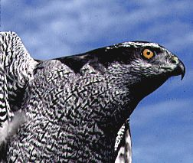
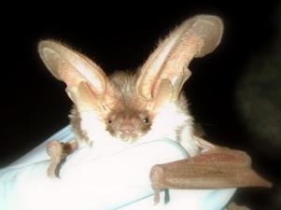
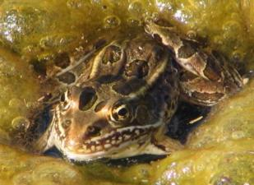

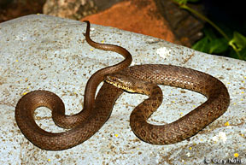
FS Sensitive Species
Allen’s Lappet-browed Bat
Bald Eagle
Clark’s Grebe
Dwarf Shrew
Ferruginous Hawk
Four Spotted Skipperling
Greater Western Mastiff Bat
Long-tailed Vole
Merriam’s shrew
Narrow-headed Garter Snake
Navajo Mexican Vole
Nitocris Fritillary
Nokomis Fritillary
Northern Goshawk
Northern Leopard Frog
Pale Townsend’s Big-eared Bat
Peregrine Falcon
Spotted Bat
Western Burrowing Owl
Western Red Bat
Notes:
Each Reg of the FS has its own SS list. The idea of a SS list is to define potentially vulnerable spp and prevent them from moving closer towards listing under the ESA. Our list was updated in 2006 by an interagency group including the USFWS, BLM, AZGFD, NM G&F, and researchers from academia. The spp listed here are the ones that will be carried forward for more detailed analysis and includes inverts, “herptiles”, birds, and mammals.

Slide 6
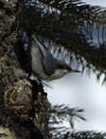

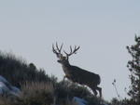
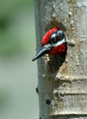
Management Indicator Species
Abert’s Squirrel
Pronghorn Antelope
Cinnamon Teal
Elk
Goshawk
Hairy Woodpecker
Lincoln’s Sparrow
Mule Deer
Pygmy Nuthatch
Red-naped Sapsucker
Turkey
Notes:
MIS, surprisingly enough, are spp selected to indicate the effects of management! This is another previously defined, very specific list that was selected with the expectation that ea spp will relate to specific habitat features or are of economic importance.

Slide 7
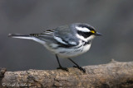
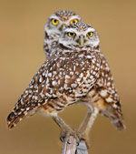
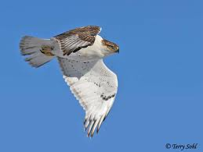

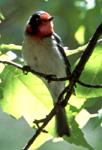
Migratory birds
AZ Partners in Flight
US Fish and Wildlife Service
Swainson’s Hawk
Ferruginous Hawk
Burrowing Owl
Common Black-Hawk
McGillvray’s Warbler
Red-naped sapsucker
Olive Warbler
Black-throated gray warbler
Grace’s warbler
Red-faced warbler
Black-chinned Hummingbird
Black-chinned sparrow
Notes:
Finally is the MBTA, which is an int’l treaty signed with Canada, Mexico, Great Britain, and Russia. Guidance on relating this to management activities is provided by a Presidential EO.

Slide 8
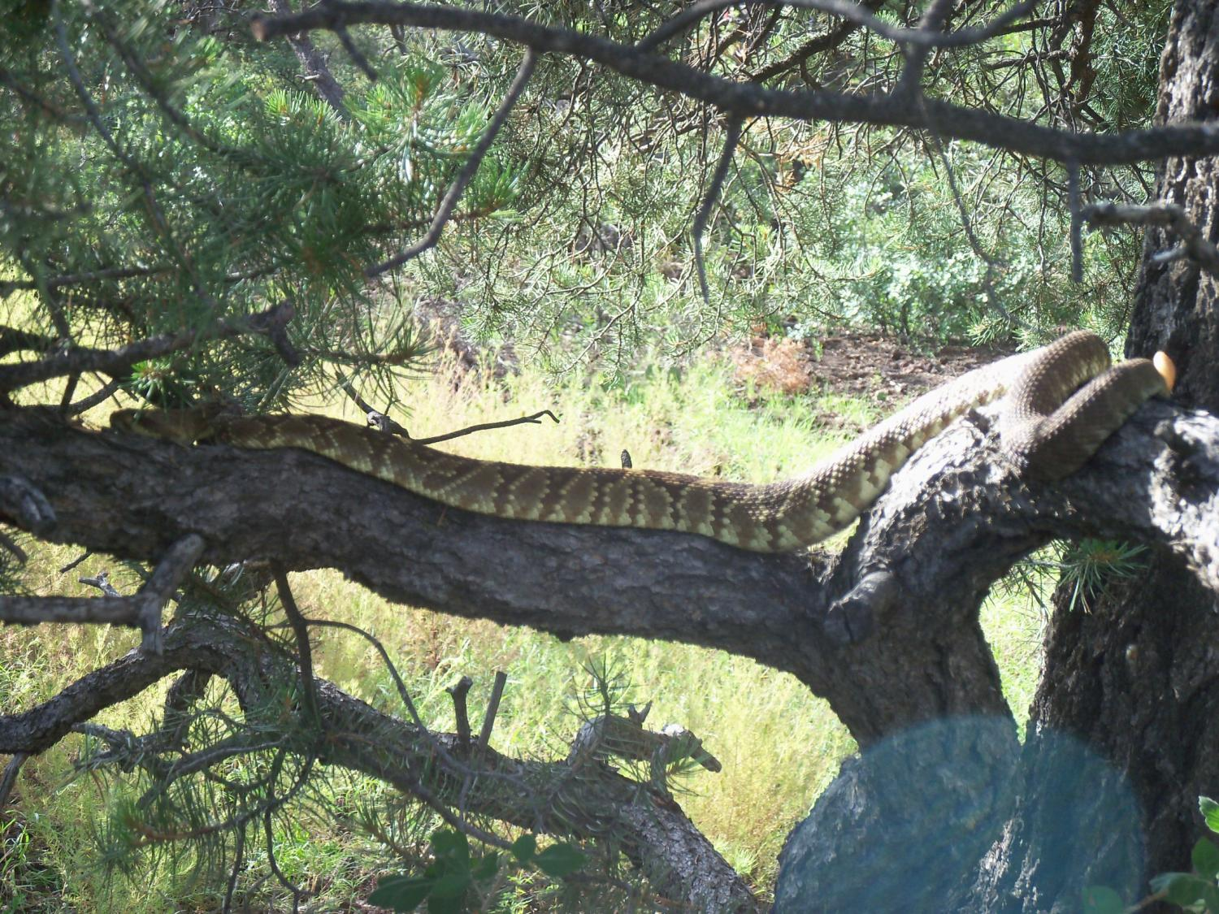
Notes:
So ea of these lists has a law, regulation, or policy behind them that dictates how we address the individual spp and how to analyze potential management impacts to them and their habitat.

Slide 9
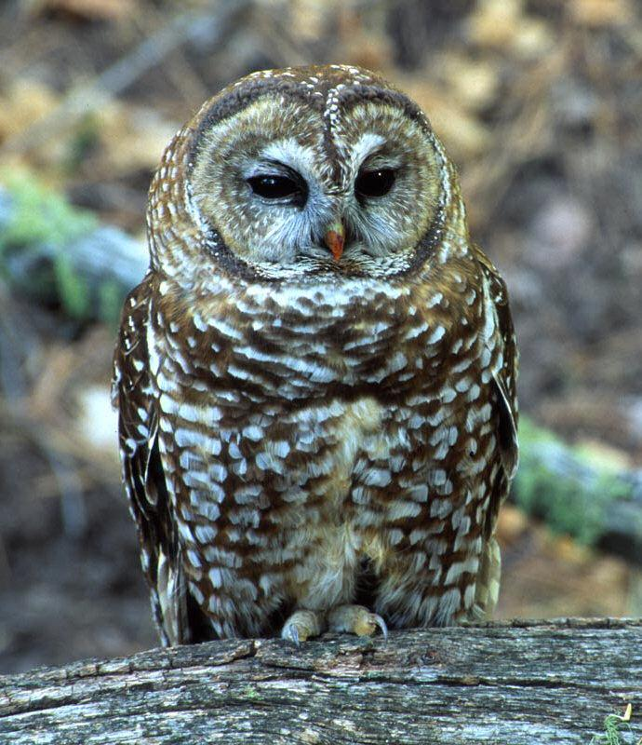
Endangered Species
Mexican Spotted Owl Analysis:
Recovery Unit Assessment
Protected Activity Centers
Restricted Habitat
Notes:
So some of the new tools we are creating for 4FRI include:

Slide 10

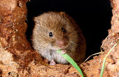
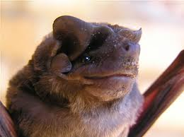

Forest Service Sensitive Species Analysis:
Range survey database – historic & current veg
Terrestrial Ecosystem Surveys – future potential
Tying Sensitive Species to understory vegetation
Notes:
TES is a systematic analysis, classification, and mapping of terr. ecosystems. It is an integrated approach that looks at soils, vegetation, and climate. It follows national protocol with a statistically significant sample effort.

Slide 11
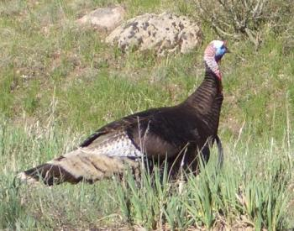
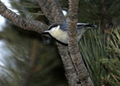
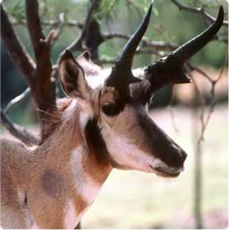
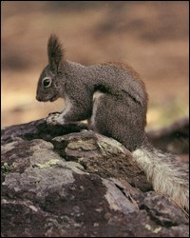

Management Indicator Species Analysis:
Wildlife Corridors for landscape connectivity
Big game herd movements
Current and recent radio-telemetry data
National database being honed for the SW
Rocky Mountain Bird [& Squirrel] Observatory

Slide 12
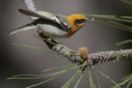
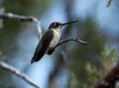

Migratory Bird Analysis:
Rocky Mountain Bird Observatory surveys
RMBO Surveys re-interpreted
Understory response

Slide 13
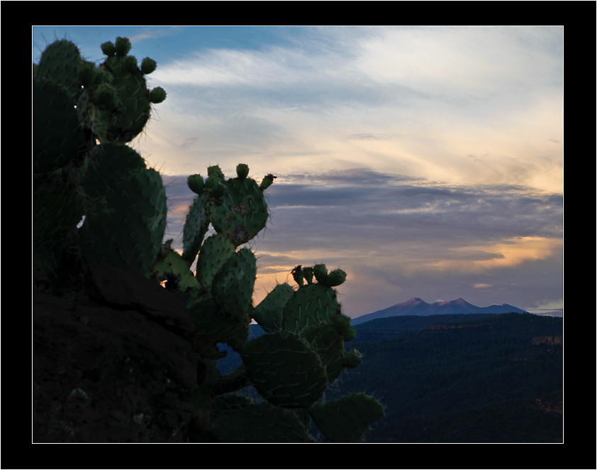
Questions? → Stop by the Wildlife Table!
Bill Noble
(928) 226-4683
bnoble@fs.fed.us

