Slide 1

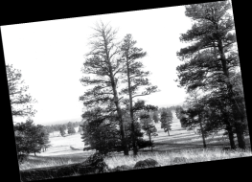
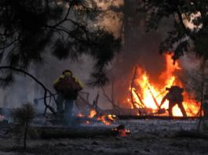
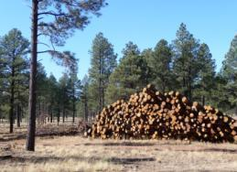
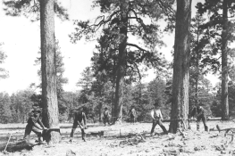
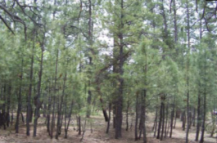
4 Forest Restoration Initiative
Overview of Vegetation Data, Modeling and Strategies Used to Develop the Proposed Action
Neil McCusker
Silviculturist
4FRI Interdisciplinary Planning Team
Draft PA Public Meeting
Flagstaff, AZ
January 20, 2011

Slide 2
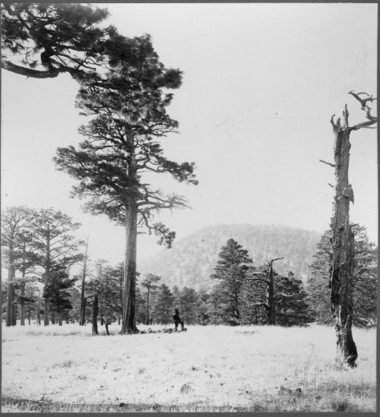
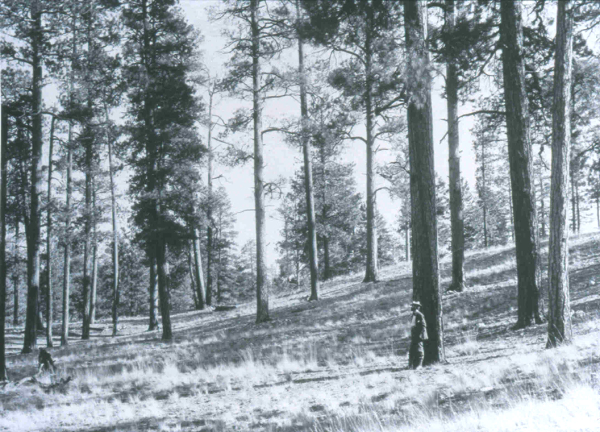
Reference Conditions
Many studies of southwestern ponderosa pine starting with the establishment of Fort Valley Experimental Forest in 1909 and continuing today by the Forest Service Rocky Mtn Research Station, The Ecological Restoration Institute at NAU and many others.
Southwestern ponderosa pine ecosystems historically were shaped by frequent surface fires, episodic regeneration, insect infestations, and regional climate events such as droughts.
Disturbance events created heterogeneous forest structure at local and landscape scales with pattern shifts through time.
Uneven-age structure typically similar age classes growing in distinct groups across the landscape with grassy openings between tree groups.

Slide 3
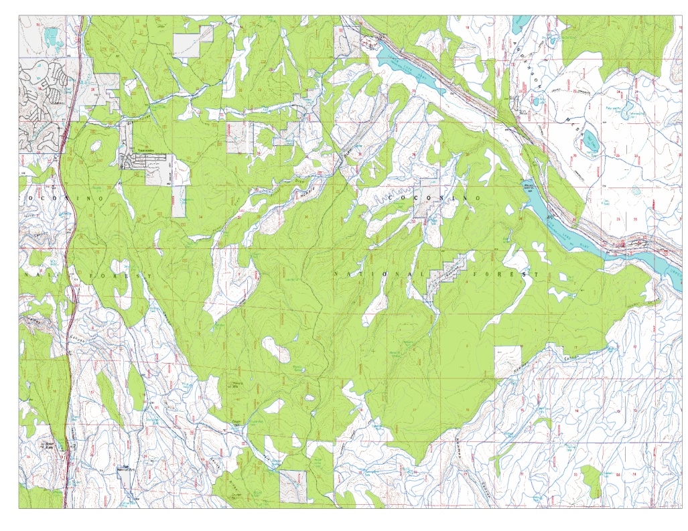
Characterizing the Existing Condition
Data Sets and Models
Terrestrial Ecosystem Survey
  Grasslands and Savannas
  Potential Vegetation
Stand Data
  Inventory
  Most Similar Neighbor
  Forest Vegetation Simulator
Gridded Data
  Satellite Imagery
  Change Detection

Slide 4
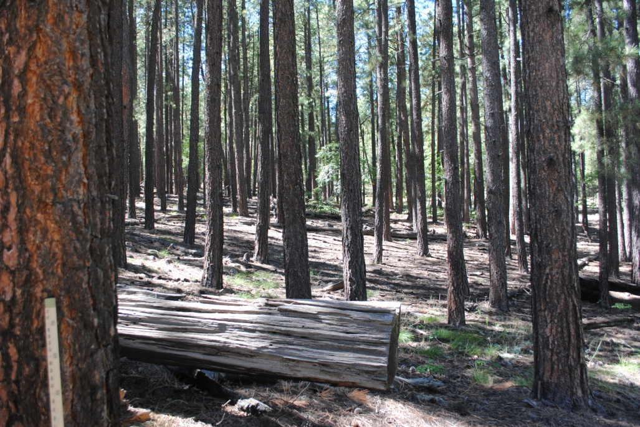
Indicators of Interest
Forest Type – Ponderosa Pine Dominated, Pine/Oak, Pine/Aspen
Site Potential
Forest Structure – Diversity of Size and Age Classes
Density – Basal Area, Trees Per Acre, Stand Density Index

Slide 5
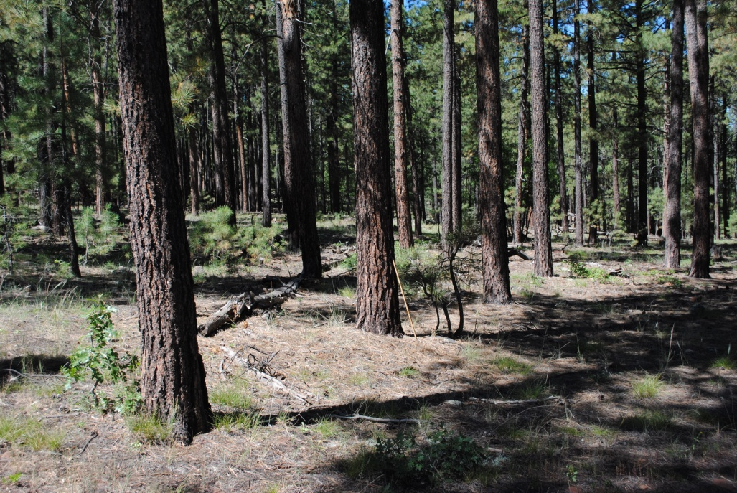
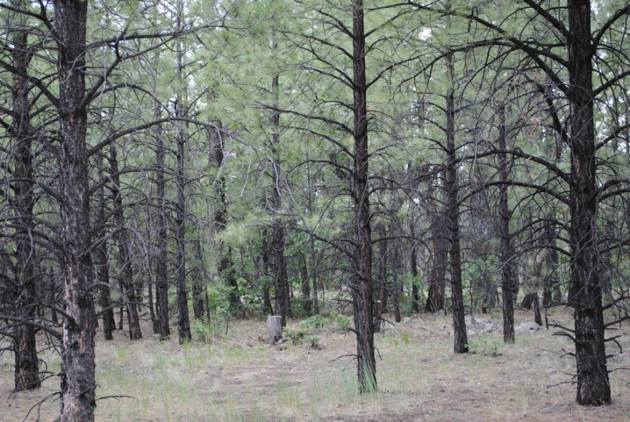
Existing Condition -
Ponderosa Pine
Dense
Even Age
Dominated by post settlement trees.
Young – Even Age “Plantations”

Slide 6
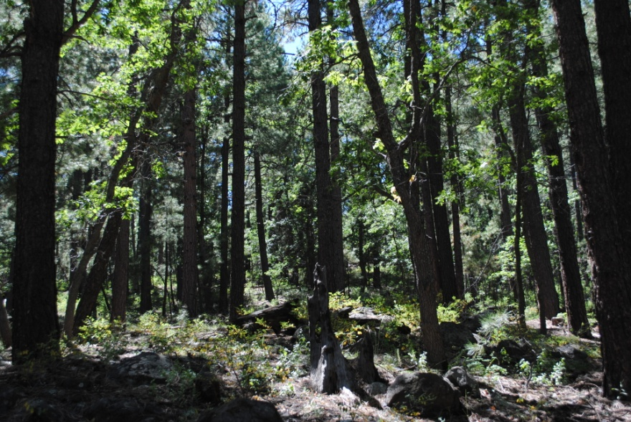
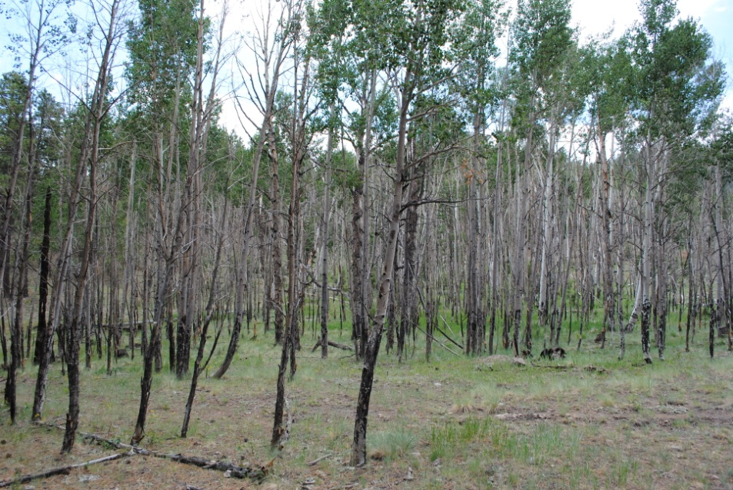
Existing Condition –
Pine/Oak and Aspen
Oak overtopped by pine
Large, mature oak component under-represented
Aspen is a minor component within the Pine forest type.
Where it exists it is in decline due to competition from Pine, lack of fire, and browsing stress.

Slide 7
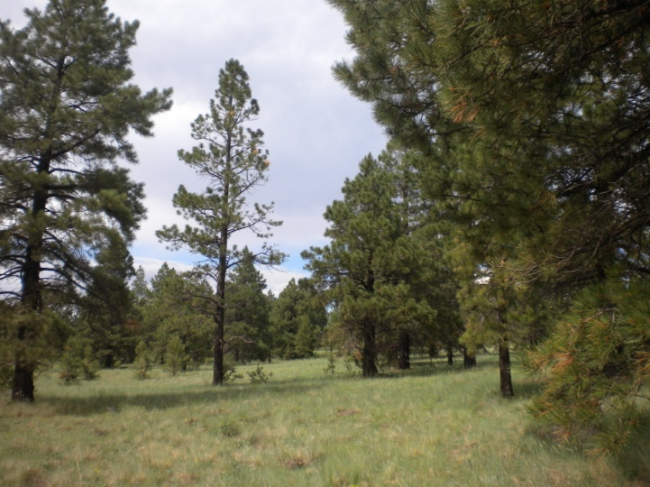
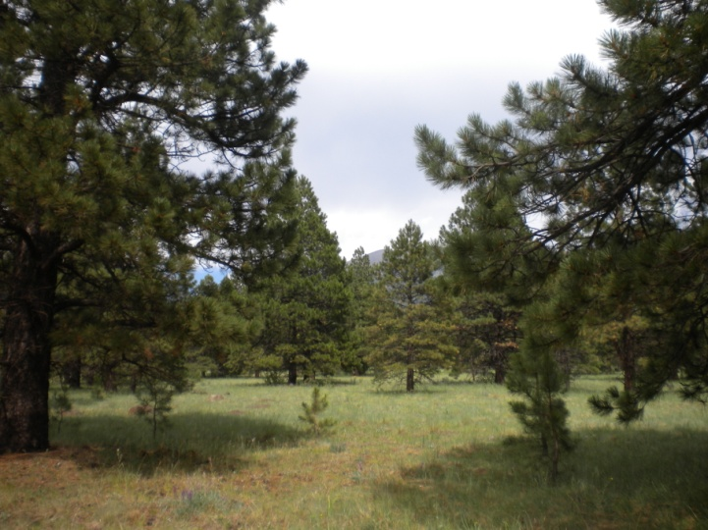
Existing Condition –
Grasslands and Savannas
Grasslands - Reference condition indicates non-forested (very little tree cover).
Savanna - Reference condition indicates open ponderosa pine tree cover.
The existing condition in both grasslands and savannas is varying densities of post-settlement tree cover due to fire exclusion.

Slide 8
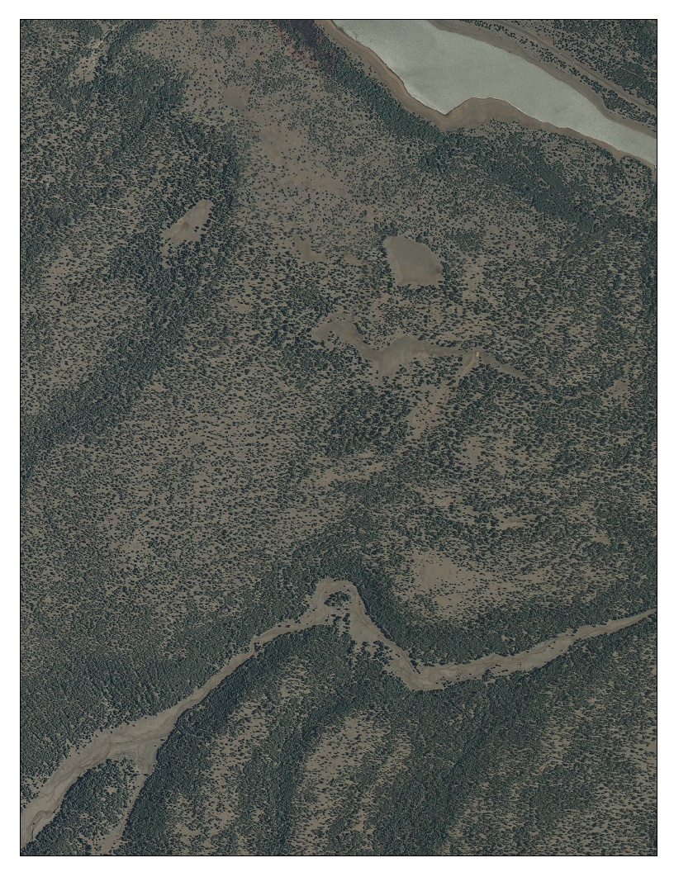
4FRI - Restoration Objective
Restoration - a suite of intentional actions that initiate or accelerate ecosystem recovery with respect to forest structure, pattern and composition.
Key components include:
  Forest Structure and Forest Health
  Vegetation Composition and Diversity
  Fire Regimes
  Ecological Processes and Function
Restoration attempts to return an ecosystem to its historic trajectory, although a restored ecosystem may not necessarily recover its former state since contemporary constraints and conditions can cause it to develop along an altered trajectory.

Slide 9
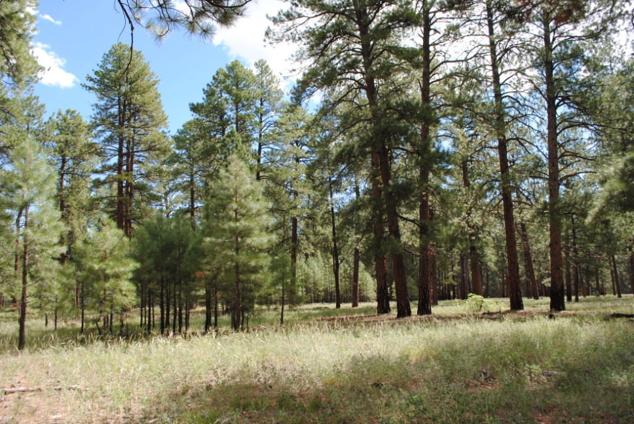
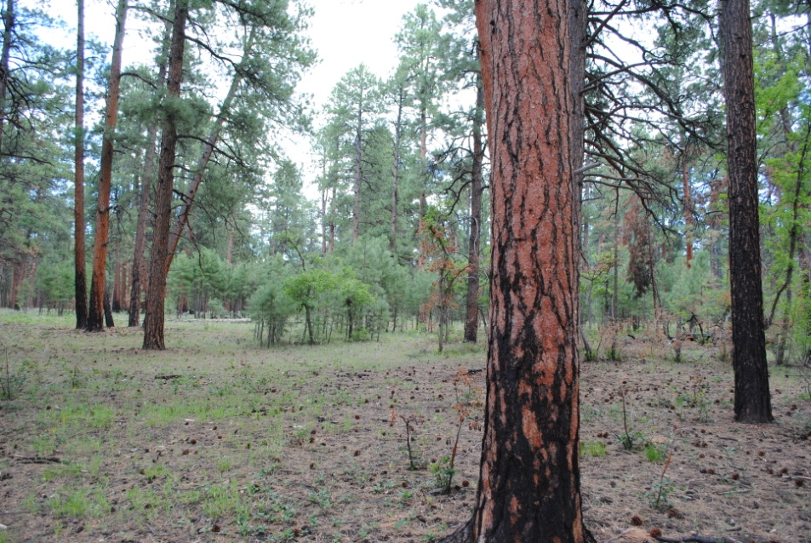
Treatment Goals and Objectives
The overall goal of 4FRI treatments is to reset ecosystem trends towards a natural range of variability and to reestablish natural processes.
The objective is to facilitate the reestablishment of a multi-scale mosaic of age and structural classes to approximate the natural range of conditions in southwestern ponderosa pine forests
Focus on development of under-represented forest age/size classes.
Accomplished through mechanical thinning, prescribed fire, and reintroduction of natural fire and other processes, which will work together to approximate the natural range of conditions in southwestern ponderosa pine forests

Slide 10
Types of Treatments
Uneven Age (UEA)
  Establish grass/forb (non-forested) openings between residual tree groups and clumps.
  Establish regeneration openings where seedling/sapling size class trees are underrepresented
  Establish interspaces between individual trees and clumps of trees within a group.
  Enhance growing space for younger age classes to become free to grow with limited competition.
Intermediate Thin (IT)
  Thin stands that are moderately to heavily infected with dwarf mistletoe to improve growth and vigor. Retain the best dominant and co-dominant trees with the least amount of mistletoe.
  Establish grass/forb (non-forested) openings between residual tree groups and clumps.
Stand Improvement (SI) - Pre-commercial Thin (PCT)
  Thin young, even age stands to improve growth and vigor.
  Begin conversion to uneven age condition and establish grass/forb (non-forested) openings between residual tree groups and clumps.
The desired amount of non-forested (grass/forb) openings between tree groups is dependent on site potential. Non-forested openings will range from 10-25 percent in areas with high site potential and 55-70 percent in areas with low site potential.

Slide 11
Types of Treatments – Continued
Savanna
  Focus on removal of trees that have become established post-settlement. Use pre-settlement tree evidence as guidance.
  The desired amount of non-forested (grass/forb) openings between tree groups or individuals will range from 70-90 percent.
Grassland Restoration
  Focus on removal of trees that have become established post-settlement. Use pre-settlement tree evidence as guidance.
  The desired amount of non-forested (grass/forb) openings between tree groups or individuals will be greater than 90 percent.
Oak
  Opportunities to release oak from competition by removing overtopping pine in all treatment types
Aspen
  Cutting and burning to stimulate suckering
  Fencing to exclude browsing pressure
Note: Variations of these types treatments in specific areas to meet Forest Plan requirements for Northern Goshawk and Mexican Spotted Owl habitat.

Slide 12
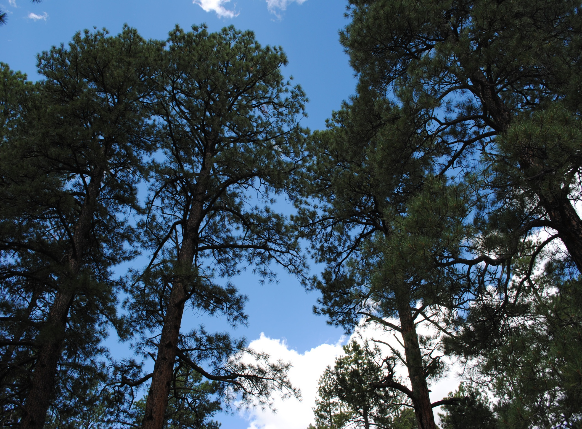
Thank you for your interest in the Four Forest Restoration Initiative
Neil McCusker - Silviculturist
nmccusker@fs.fed.us
(928) 226-4681

