Slide 1
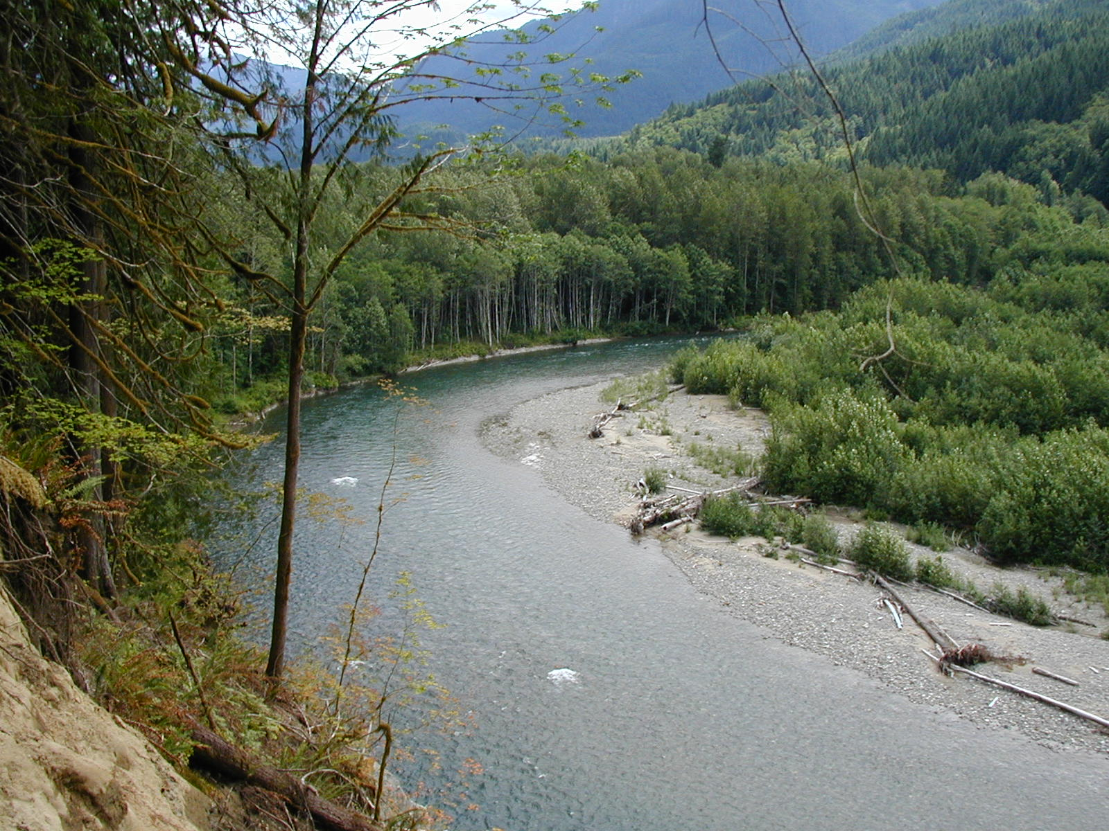
Variation in sources of wood and wood delivery to streams
Tim Beechie
NOAA Fisheries

Slide 2
Outline
Landscape-scale variation in sources
  By stream size and wood source
Site-scale variation in sources
  Headwaters
  Non-floodplain channels
  Floodplain channels

Slide 3
Landscape-scale variation in sources
Small streams (< 15 m bfw): debris flows or tree fall depending on setting
Mid-size streams (15-25 m bfw): tree fall and bank erosion
Large rivers (>25 m bfw): channel migration

Slide 4
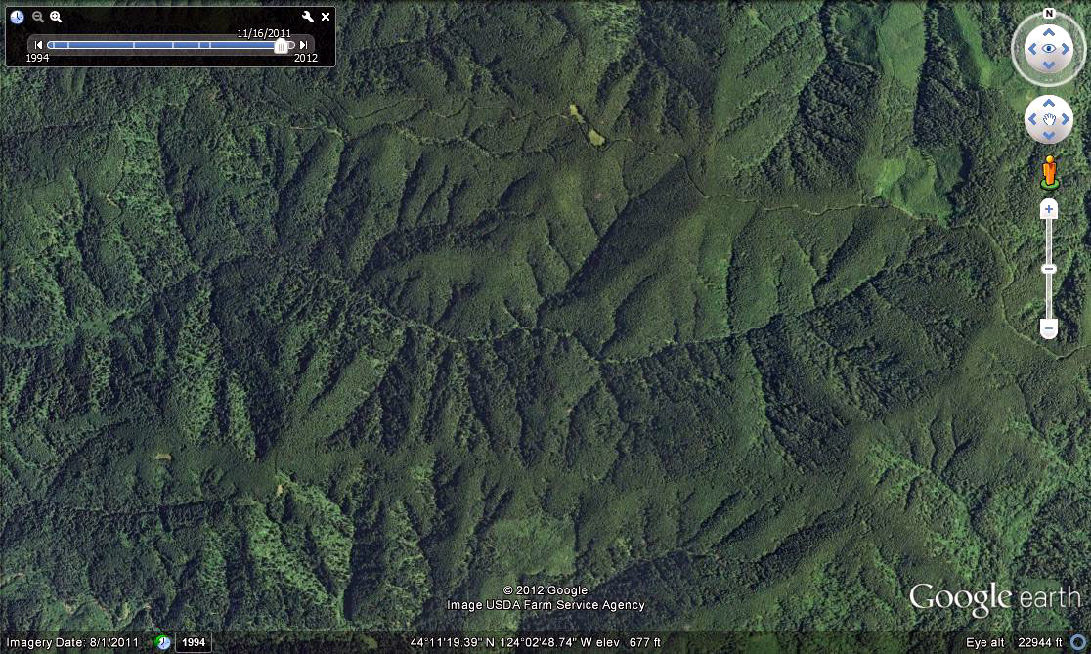
Small stream – debris flows
5 km
DF
TF
CM

Slide 5
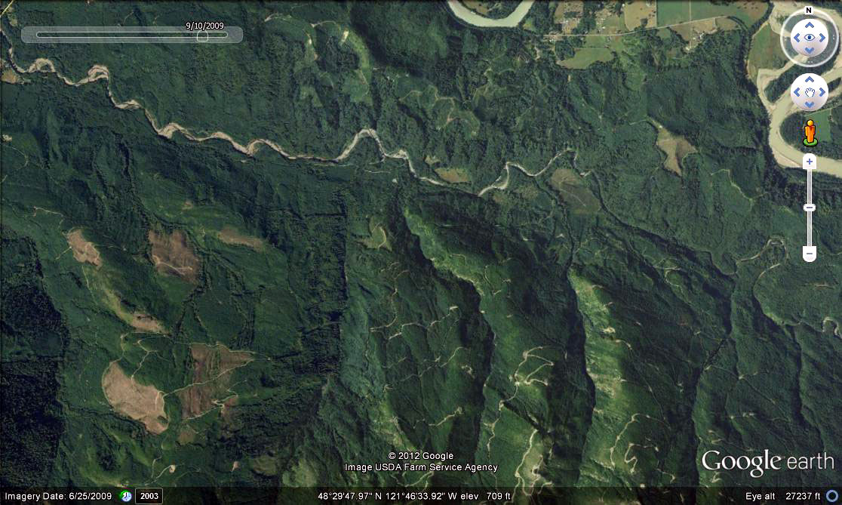
Small stream – tree fall
5 km
DF
TF
CM

Slide 6
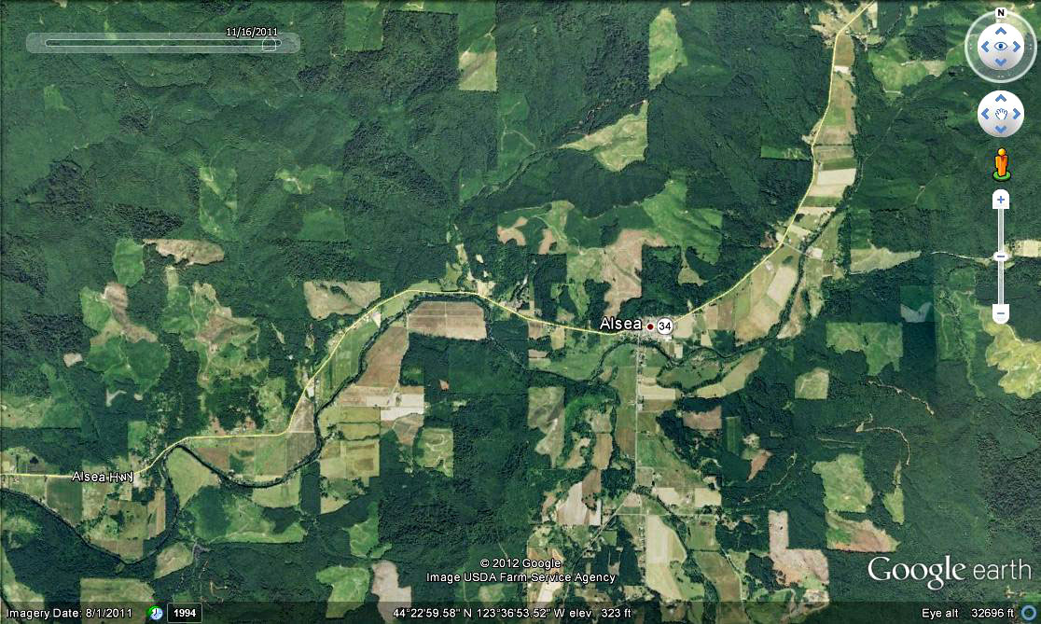
Mid-size stream – tree fall
5 km
DF
TF
CM

Slide 7
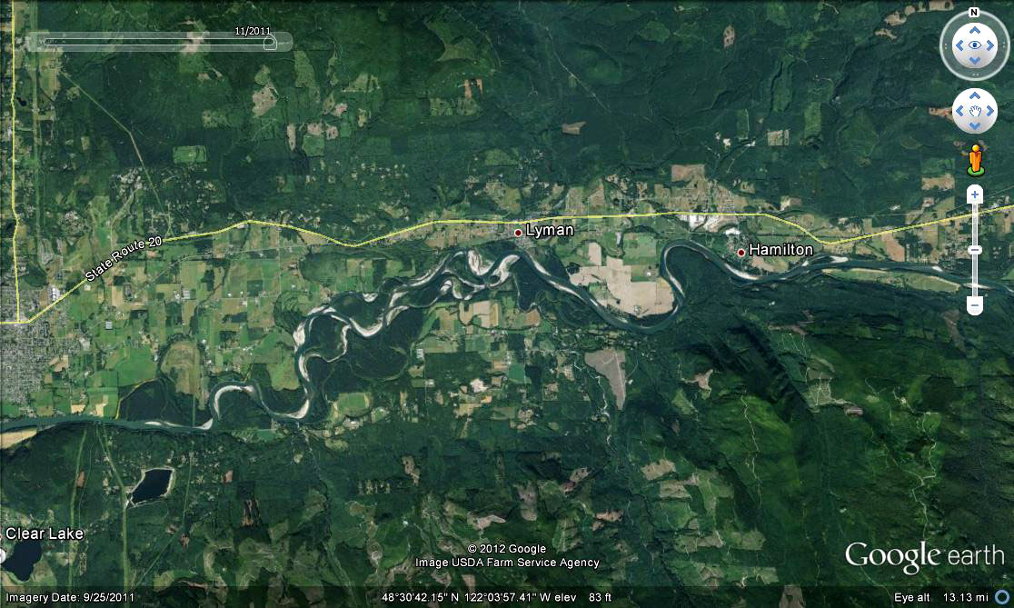
Large river – channel migration
5 km
DF
TF
CM

Slide 8
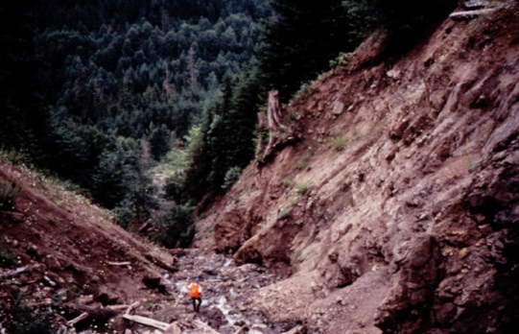
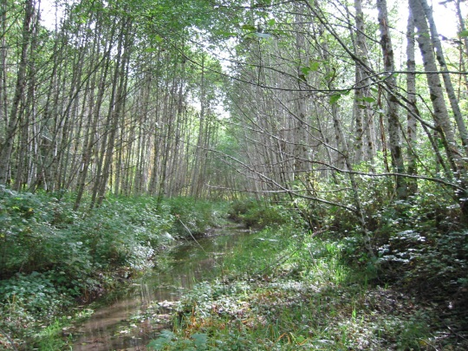
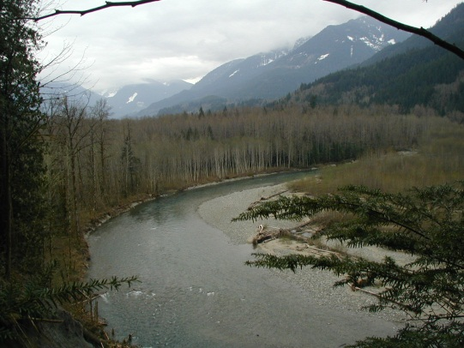
Site-scale variation in sources
Headwaters
Fish-bearing
  Non-floodplain
Fish-bearing
  Floodplain

Slide 9
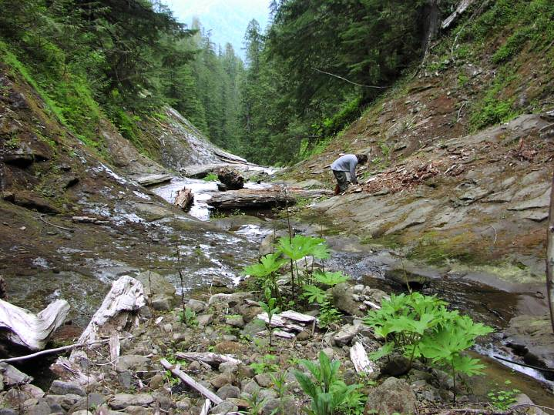
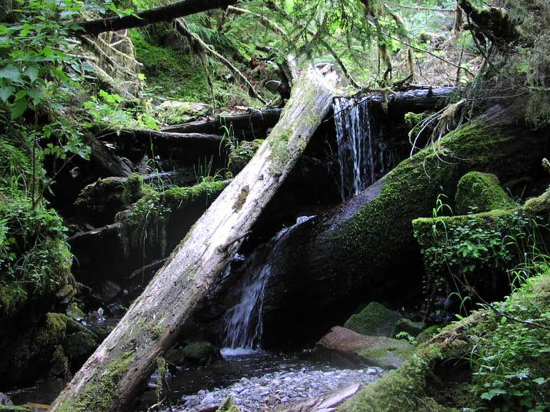
Source distance in headwaters
Along debris flow prone channels
  By treefall within site potential tree height
  Debris flow scour zone
Steep channels w/o debris flow
  By treefall within site potential tree height
  >1 m diameter wood stores sediment

Slide 10
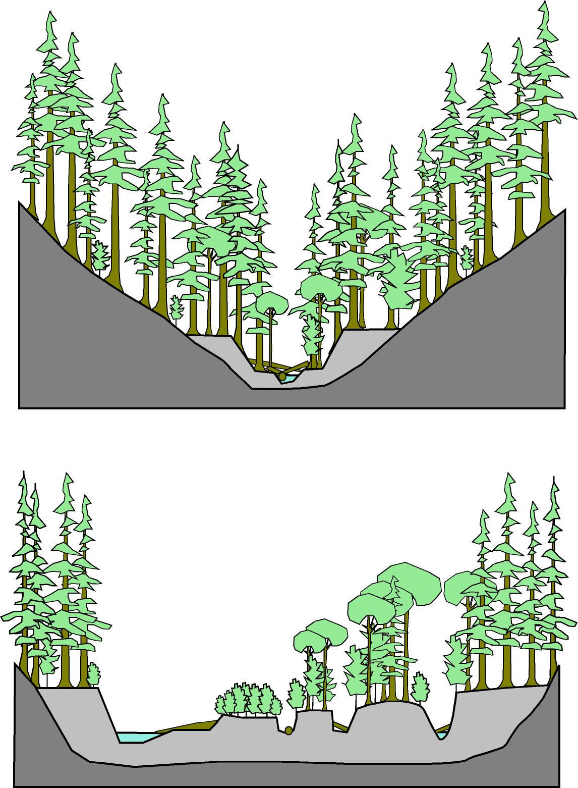
Fish-bearing streams
Non-floodplain channels
  Natural disturbance: fire (180-270 year RI)
  Or windthrow
Floodplain channels
  Natural disturbance: channel migration (10-90 year RI)

Slide 11
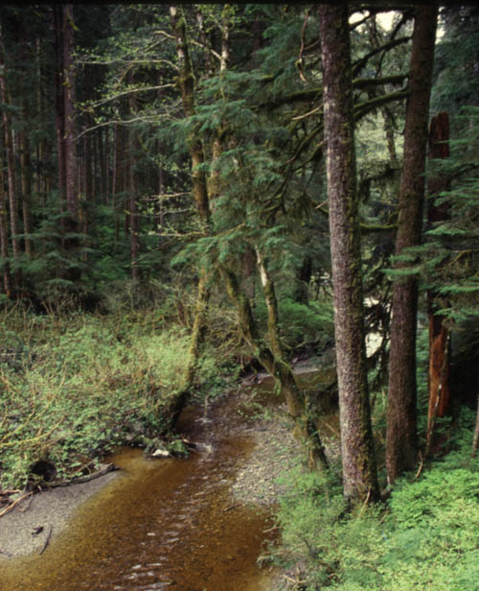
Non-floodplain channels
Site-scale processes
  Bank erosion
  Wind throw
  Other mortality

Slide 12
Source distance varies by species
100
Mature
Hardwood
75
Old Growth
Conifer
Mature
Conifer
Percent of wood recruitment
50
25
0
0
15
30
45
60
Distance from stream (m)

Slide 13
Timing varies by species
100
Hardwood
All sizes
75
Conifer
>10 cm diameter
Relative LWD abundance
50
25
Conifer
>60 cm diameter
0
0
25
50
100
200
Time (years)

Slide 14
Effect of disturbance regime
100
75
Fire RI = 178
Fire RI = 327
Relative LWD abundance
50
Managed
forest
25
0
0
100
500
1000
Time (years)

Slide 15
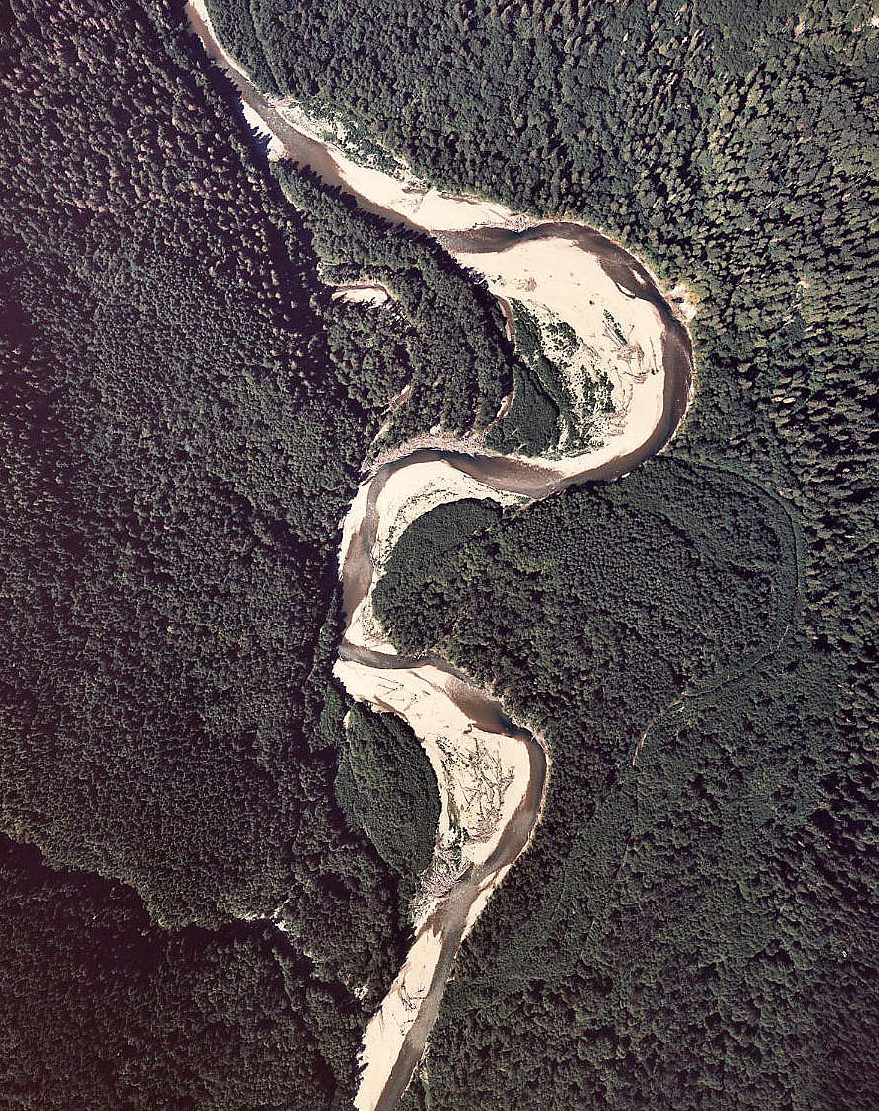
Floodplain channels
Site-scale processes
  Channel migration
  Bank erosion

Slide 16
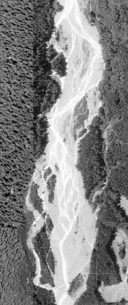
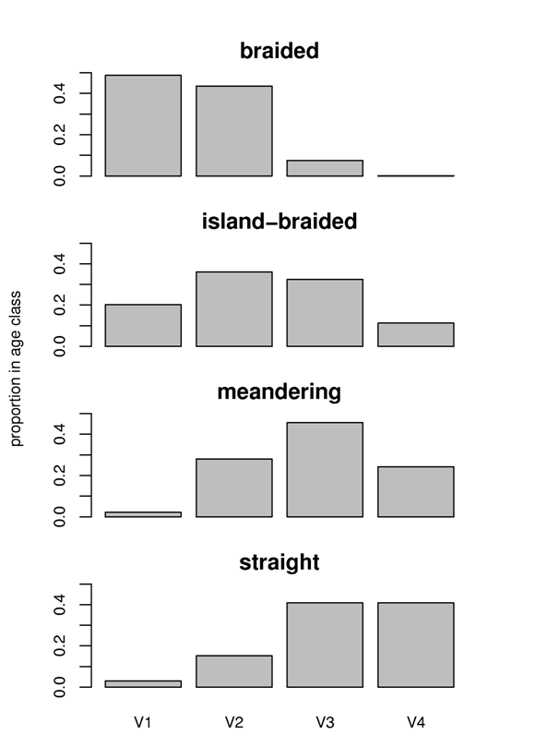
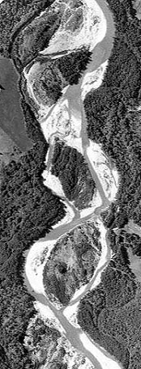
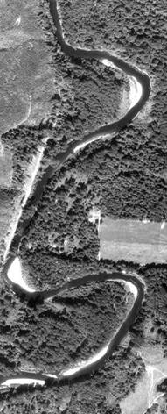
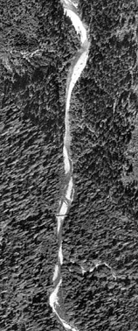
Floodplain channels – age distributions
Patch age distributions
Braided
Island-
braided
Increasing lateral migration rate
Meandering
Straight
<5
5-25
25-75
>75
Increasing age

Slide 17
Floodplain channels – species variation
Surface age (years)

Slide 18
Summary points
Headwater channels
  Non-debris flow: thinning has least impact on fish
  Debris flow: thinning may target large wood
Non-floodplain channels
  Wood size and abundance sensitive to thinning
Floodplain channels
  Difficult to predict and manage
  Common management strategy is protection

