Slide 1
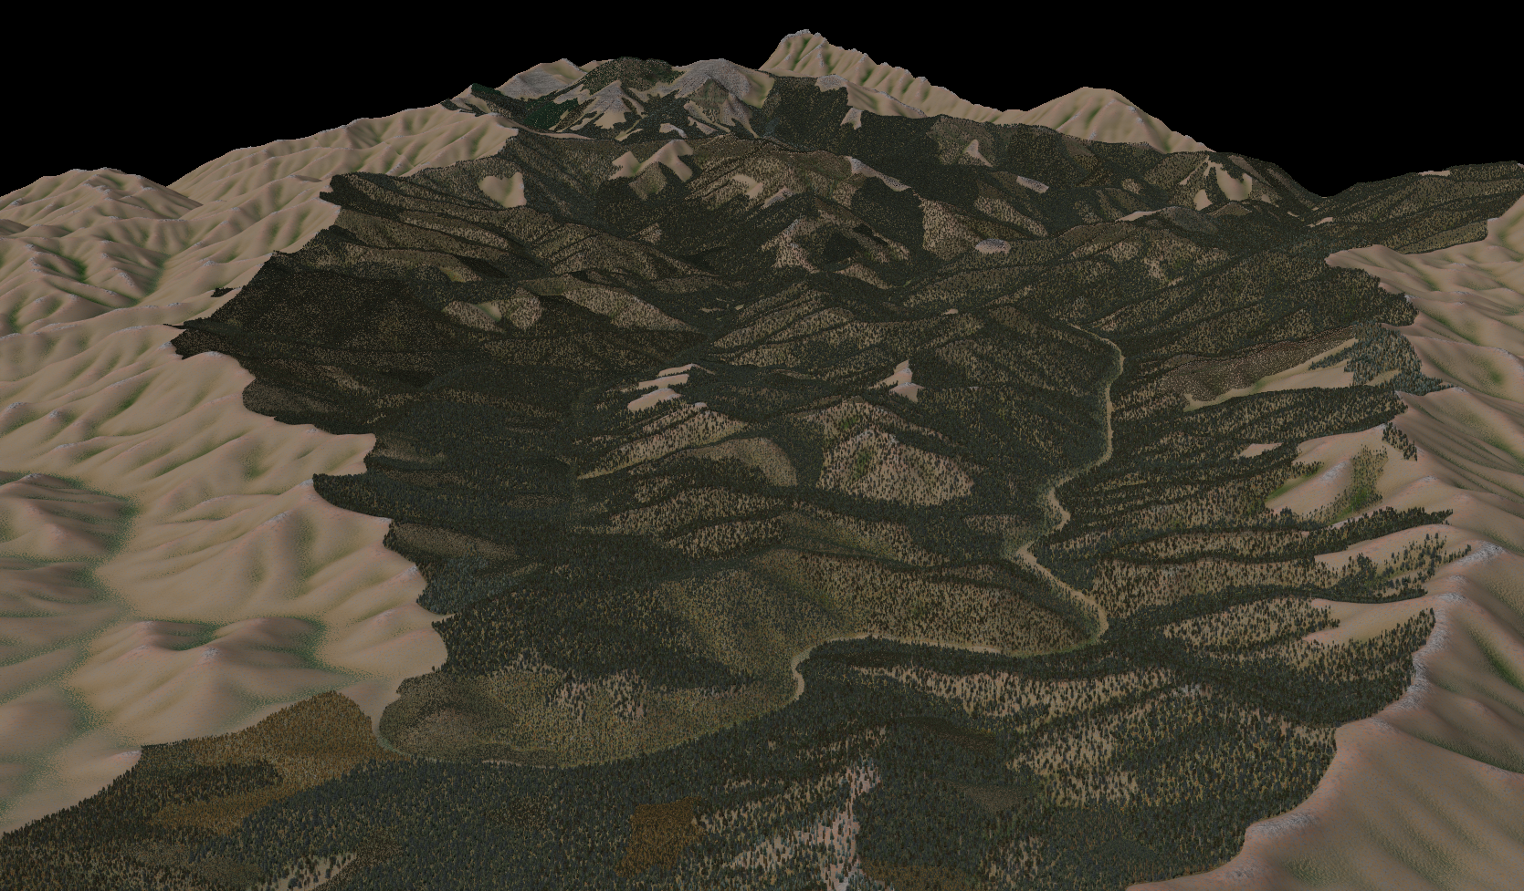




Coarse Filter management informed by Historical Ranges of Variability
James Dickinson, Area Landscape Ecologist, E. Wash. Zone
Darren Goodding, Forest Environmental Coordinator, OWF

Slide 2
Outline:
Ecology
Landscape Analysis to inform planning
Coarse Filter Approach
Conversion to planning

Slide 3
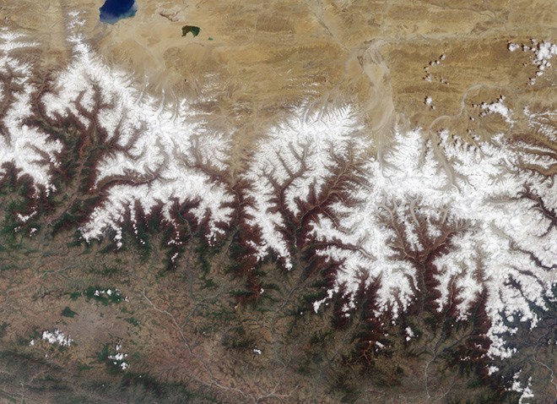
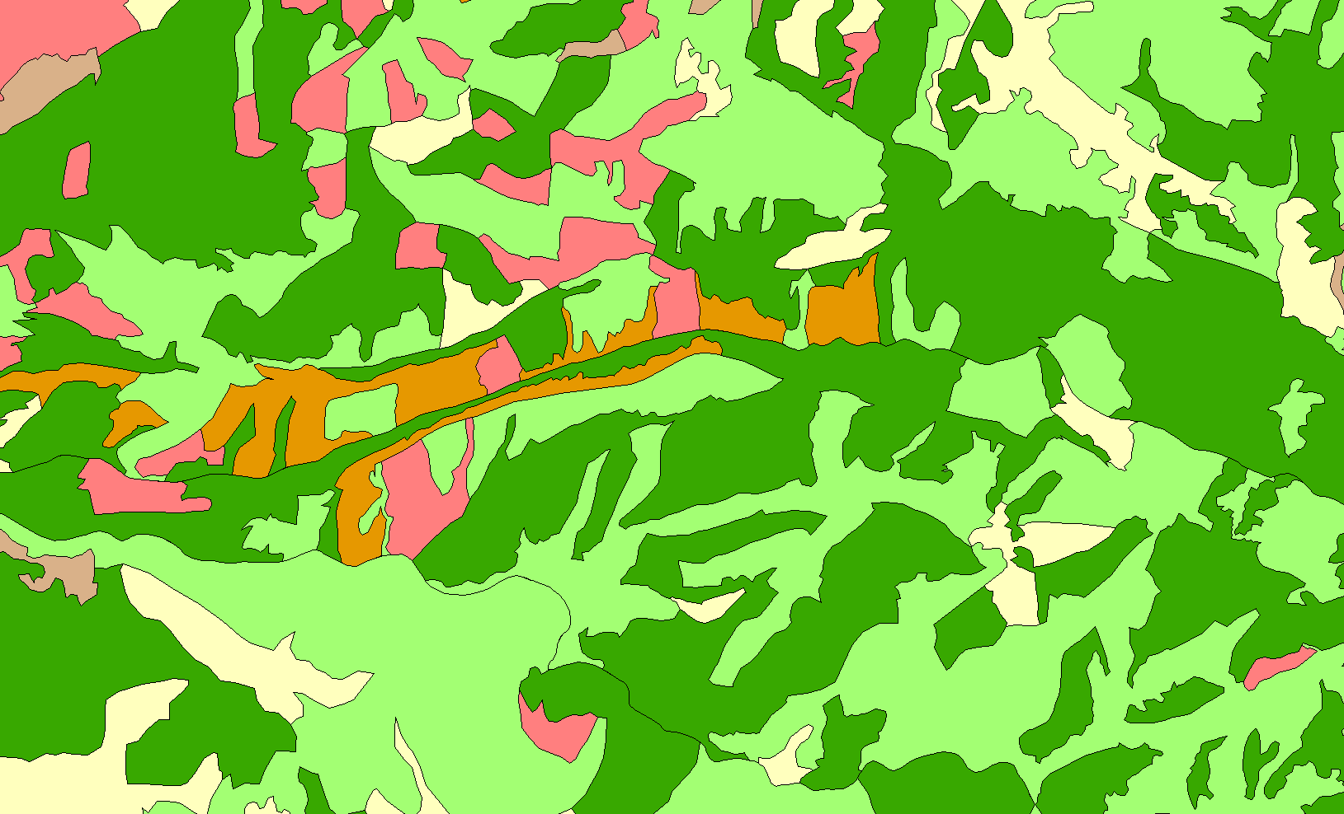

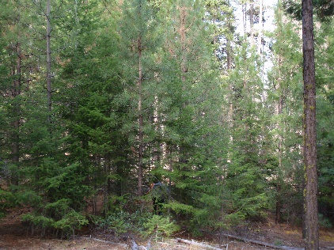
Notes:
Functional large scale landscapes (not the mountains necessarily) are the result of being able to absorb disturbance while propagating the underlying processes. Those underlying processes are inextricably entwined with the pattern and composition on the landscape. The pattern and composition are composed (or described by) patches with unique characteristics. Those patches are composed of trees and other vegetation (live and dead).
If we can quantify and analyze the underlying pattern and composition at smaller scales, then we can manage for the resilience of the larger landscape.
Appropriate patterns and compositions of vegetation (and the resultant processes and disturbances) equal resilient landscapes.

Slide 4


Why NOT stand level management?
Notes:
For decades we have managed our resources at the stand level. We have identified a stand, set an objective and frequently met that objective. But Lanscape ecology tells us that its not just the stand itself that we are treating – we are impacting the stands around it. Regardless of how hard we try the stands that we manage are part of a bigger picture.

Slide 5

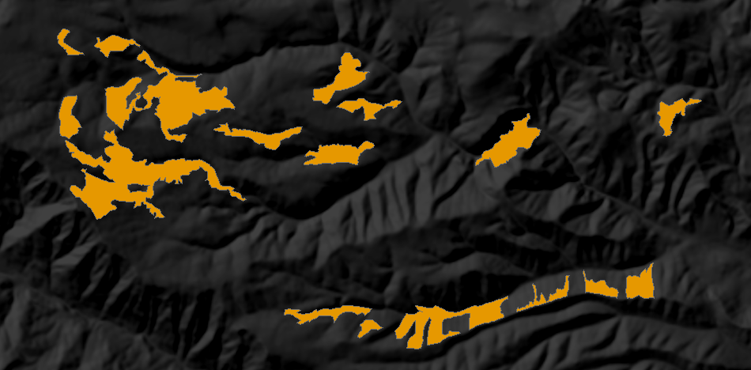
Quantity
Configuration
Uniqueness
Interaction
Notes:
For any given stand these are the kinds of questions that should be asked.
How much of this is on the landscape –
Where are the other stands
Is this unique
Does this interact appropriately with other stands
Without answering at least some of these questions – there is no way to set an objective that has much, if any ecological relevance. You can see that pattern on the landscape becomes important.

Slide 6
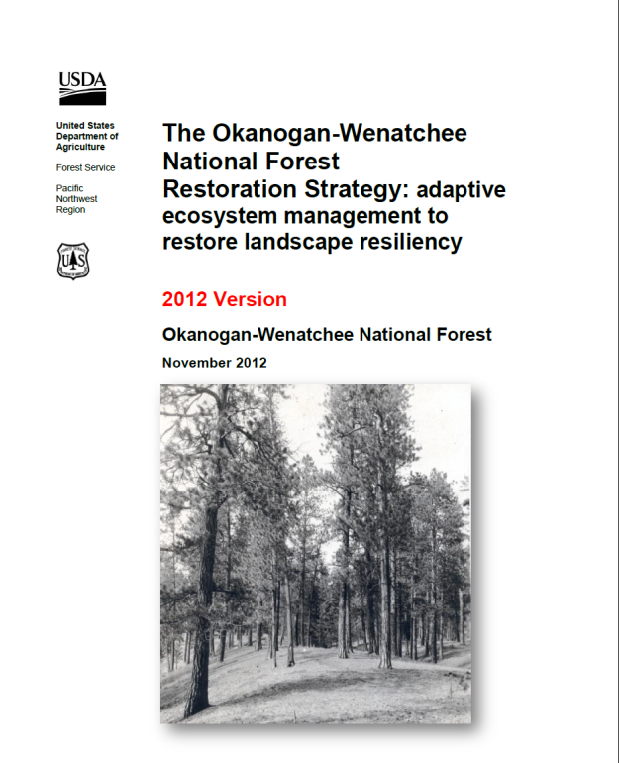
The Forest’s Restoration Strategy Vision
  … landscapes will become more resilient to changing climates and disturbances …
… work collaboratively and strategically across landscapes…
… focus on desired restoration outcomes
and measure our success …
… continue to adapt strategies based on
new science, changed conditions, and
monitoring
Notes:
Based on our National and Regional direction, and the Best Available Science, we developed a Vision for the Restoration Strategy designed to restore forest patterns, processes, and functions to increase resilience to climate change and disturbances, such as wildfire and flooding. The OWF has written and peer-reviewed a Restoration Strategy (show document) that looks at complete landscapes – assessing the condition of the current landscape relative to reference conditions. There are many things in this document that are aimed at holistic restoration, including growing and protecting old trees with character, and hydrologic, aquatic, and roads issues. This strategy was developed with extensive involvement from the PNW Lab and review and input from FWS and other agencies and groups.
We plan to work closely with our partners, to focus on outcomes, like sustainable wildlife habitats, and not just outputs, like analyses produced. We will adapt our management actions and Strategy as needed and incorporate lessons learned.

Slide 7
Aquatic Evaluation:
Calculation of biological condition indicator metrics per catchment based on focal fish distribution, potential habitat, and stream geomorphology;
Cataloging the inferred mechanisms of habitat impairment using smaller catchments for the unit of analysis;
Calculation of hydrological condition indicator metrics per catchment based on roads and riparian areas;
Use of a simple hydro-geomorphic model to estimate the percent increase in drainage area caused by roads;
Verification of hydrological condition on the ground, taking particular note of road network condition, erosion features, and fish passage barriers;
Providing a ranking based on these factors to prioritize and inform treatment options

Slide 8
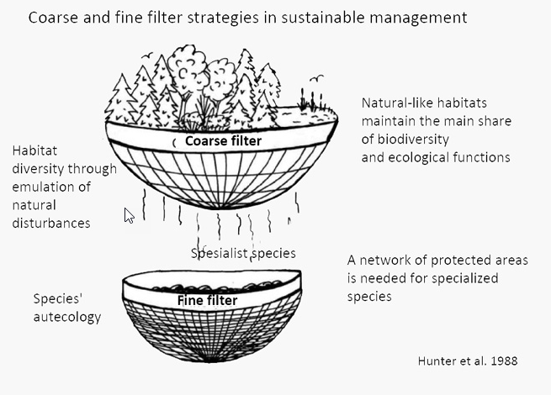
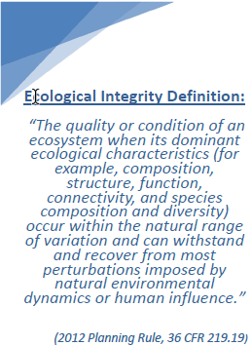
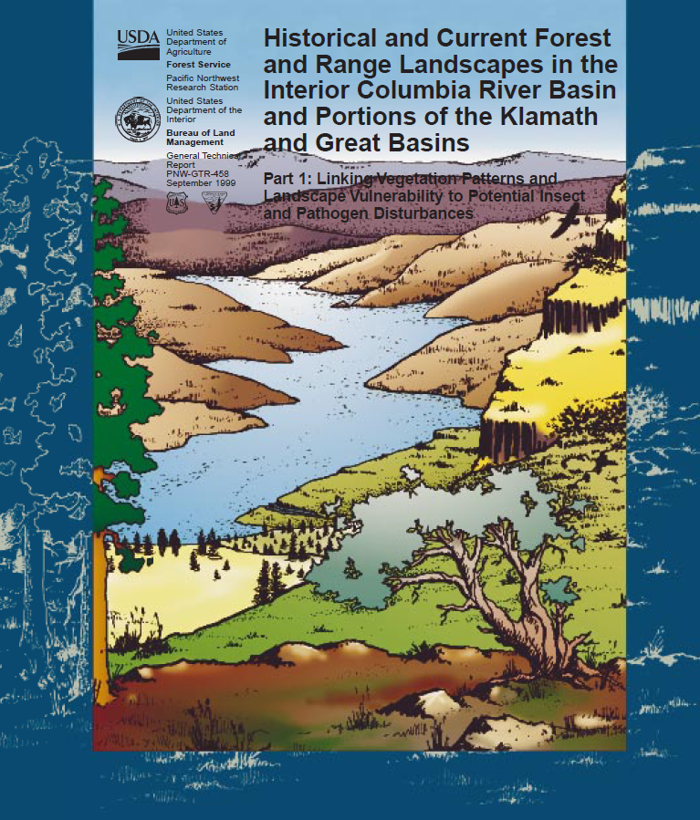
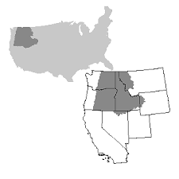
http://www.metla.fi/hanke/3601/coarse-fine-filter.htm
Accessed: 10/31/2019

Slide 9
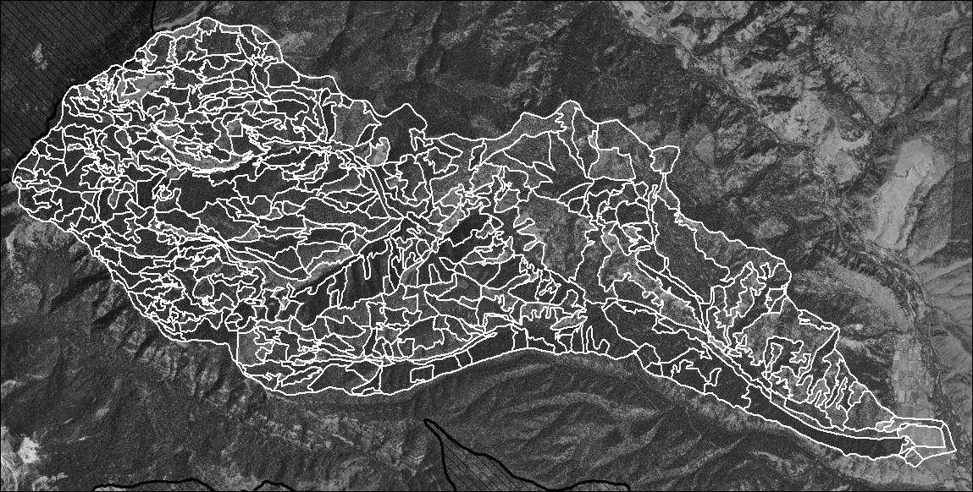
Hessburg et al. , 2013. Landscape evaluation for restoration planning on the Okanogan-Wenatchee National Forest, USA .
Resource photos: 1:12000 stereo (ideal)
MMU = 4ha
Derived Items:
Structure
SAF Cover Type
NSO Habitat
WHWP Habitat
Insect and Disease Vulnerabilities
Others..
Photo interpreted attributes:
  Crown Closure
  Species
  Canopy layers
  Size Classes
  Evidence of logging
  Clumpiness
  Crown Differentiation
Classification Rules Applied
Notes:
The ROV was created by acquirieng the oldest stereoscopic photography – at a scale of 1:12k or 1:15k. In many cases is was apparent that any significant logging practices had yet to be undertaken, as the next set of stereo photos typically showed that harvest activities had been identified with the first set of photos… using these older photos – a 4ha MMU was used to delineate polygons.
Each polygon had a series of photointerpreted attributes recorded. The forested polygons had Crown Closure, Species composition, number of canopy layers, size classes of trees, evidence of logging… and others…
This same process is followed for the current landscapes that are being analyzed – so everything is apple’s to apples.

Slide 10
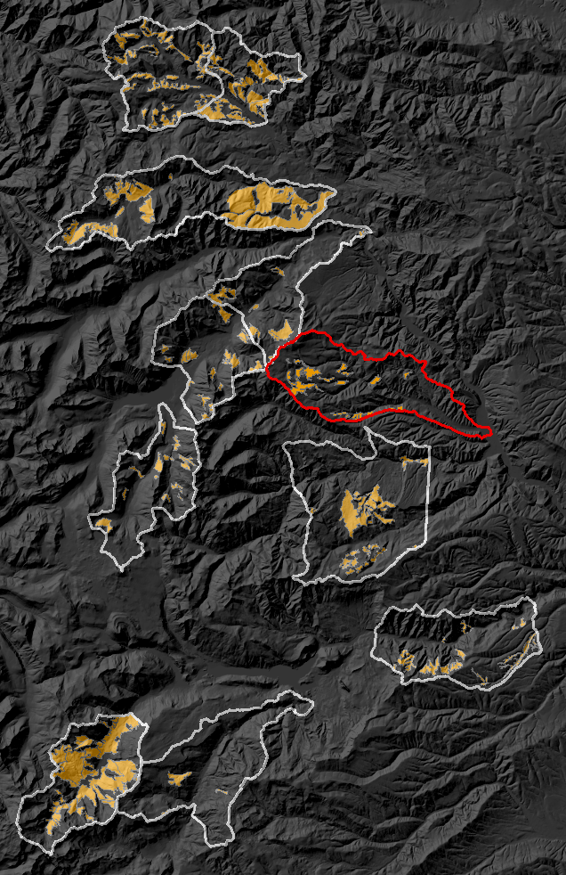
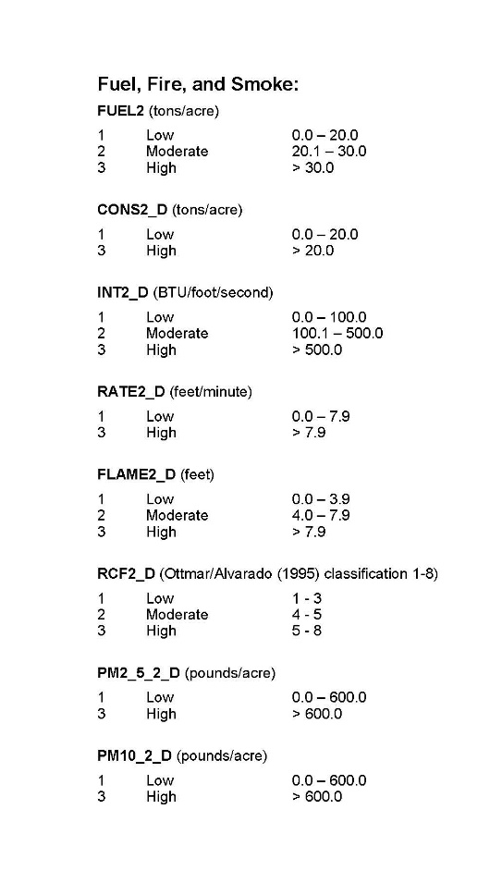
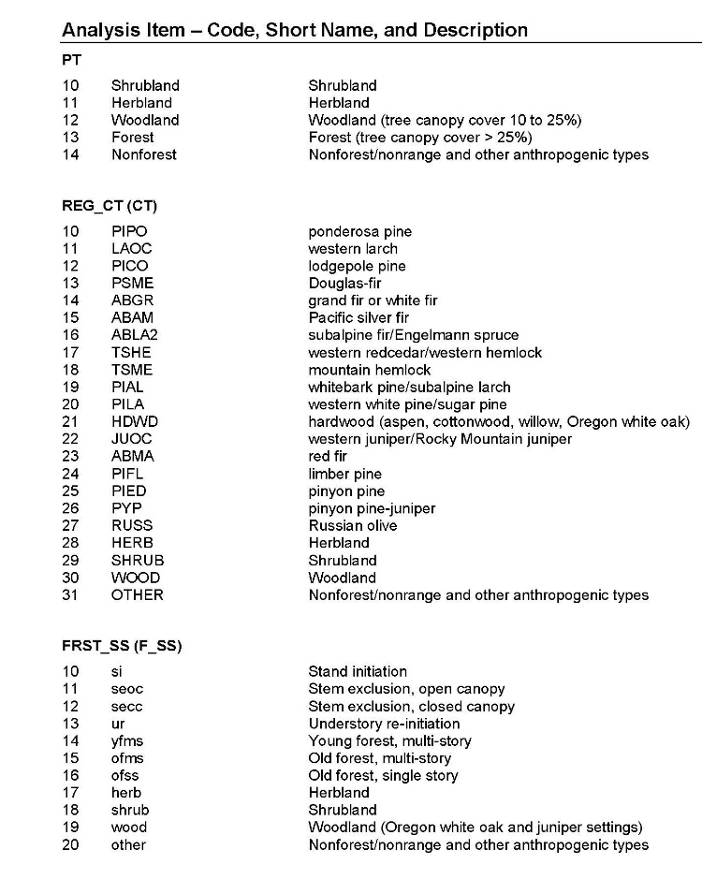
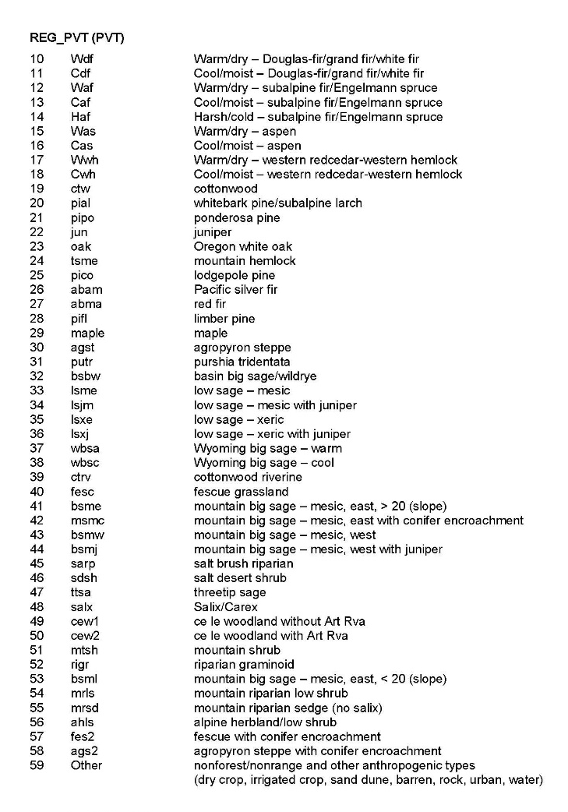
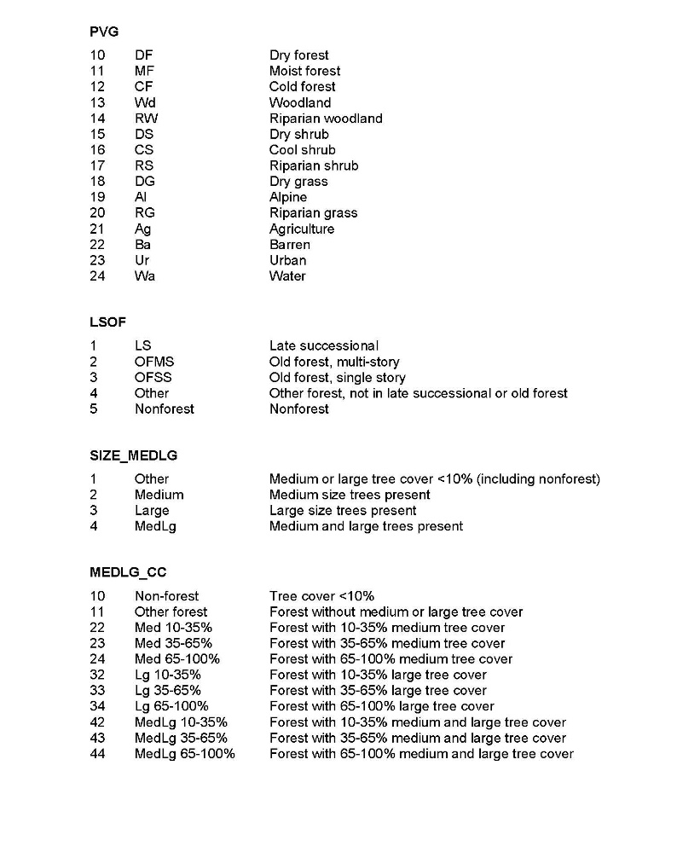
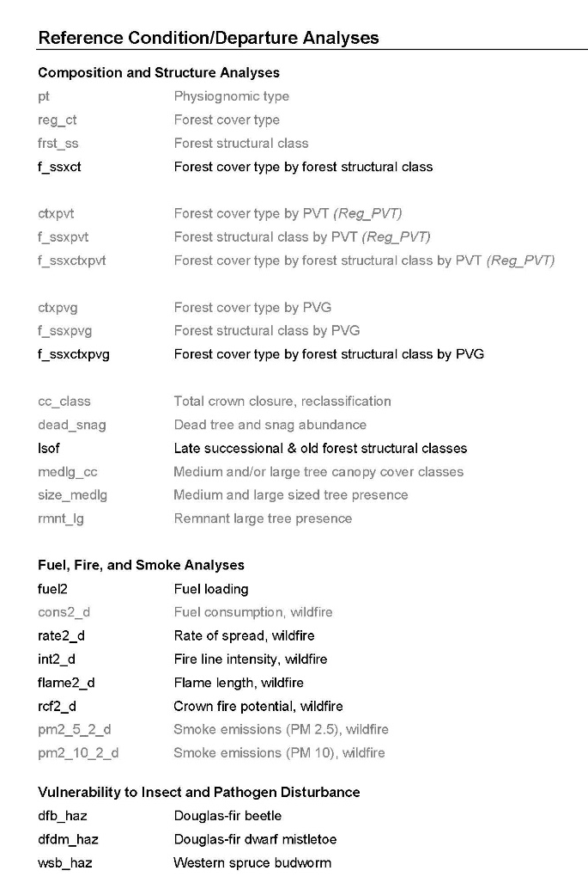
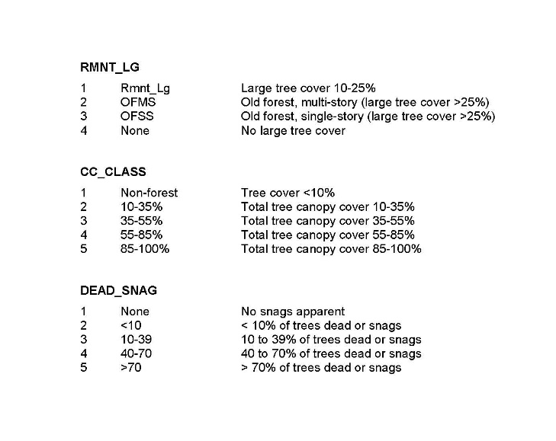

Photo interpreted attributes:
  Crown Closure
  Species
  Canopy layers
  Size Classes
  Evidence of logging
  Clumpiness
  Crown Differentiation
Notes:
What if I wanted to compare the orange in a different, modern watershed? I could compare the quantity and pattern of orange to a sample of nearly 200,000 ac.

Slide 11
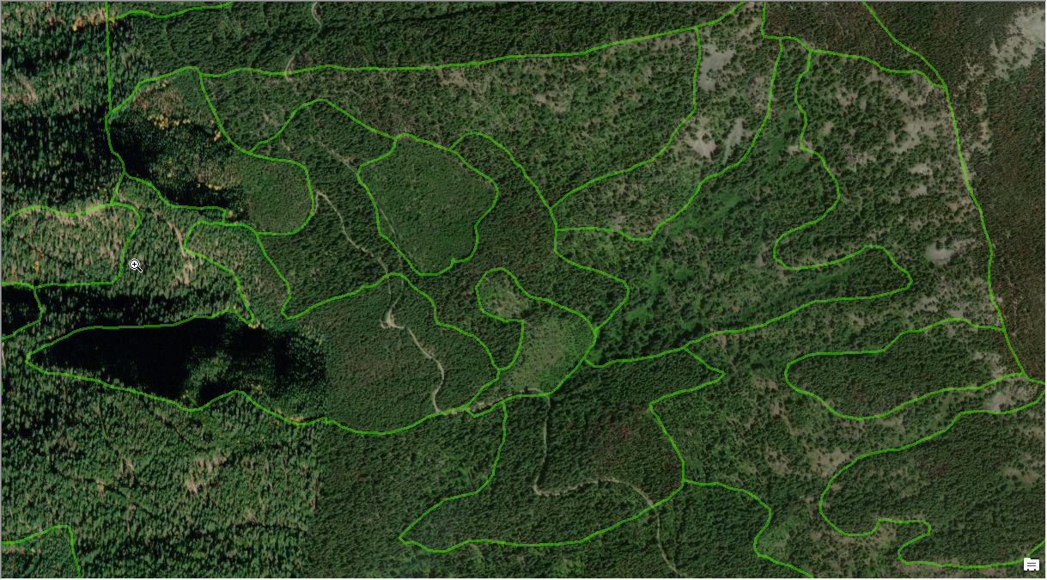

Slide 12
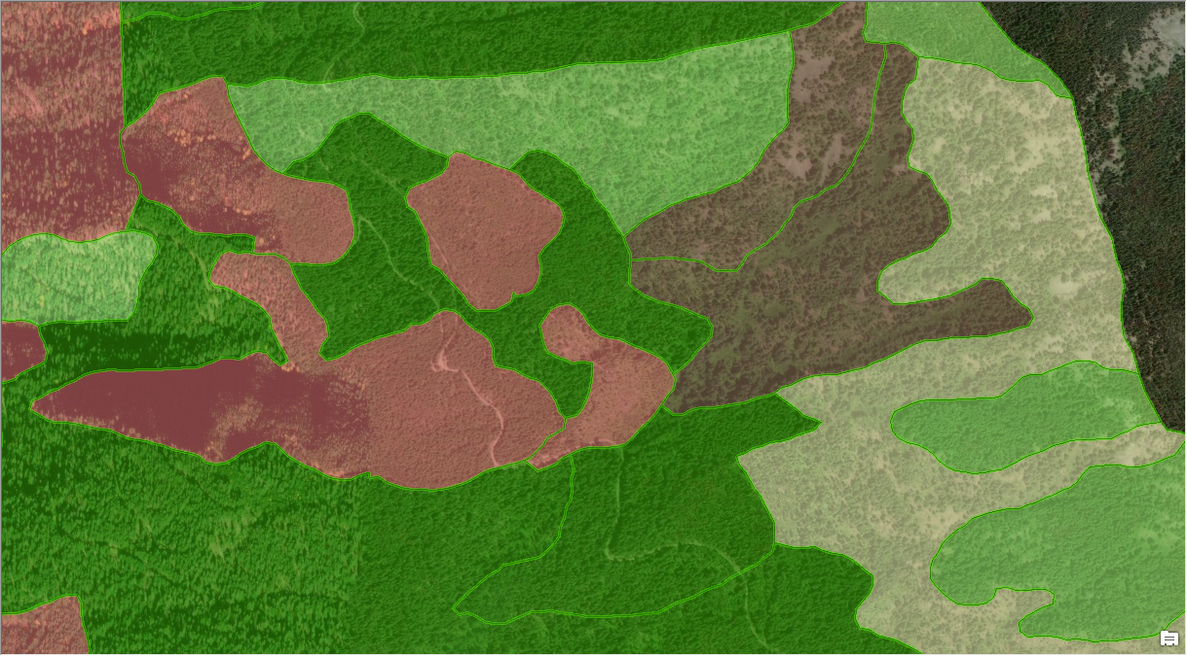

Slide 13
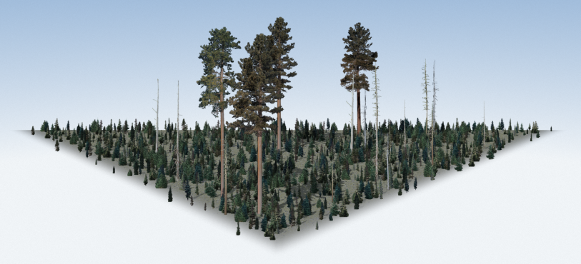
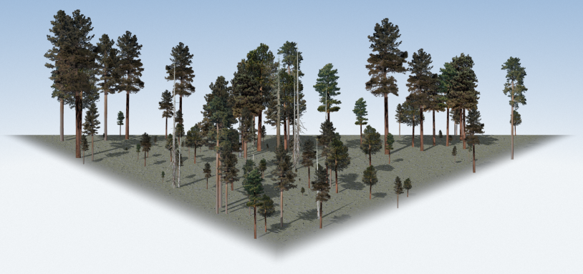
Stand Initiation (SI): Growing space is reoccupied following a stand replacing disturbance.
Stem Exclusion Open Canopy (SEOC): Below-ground competition limits the establishment of new individuals.
Notes:
We also have defined stand structures. Such as young forest multi-story, or stem exclusion open canopy. So we built a graphical guide to be used internally, and externally.

Slide 14
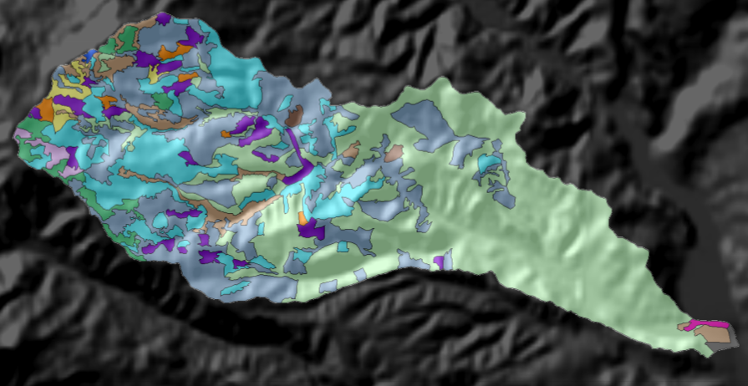
Landscape metrics are computed for an attribute (e.g. Cover Type) for the entire mosaic.
Richness (PR)
Diversity (SHDI, N1, N2)
Evenness (MSiEI, Alatalo’s)
Arrangement (Contag., IJI)
Class metrics measure the aggregate properties of the patches belonging to a single class or patch type.
Percent Land
Largest Patch index
Patch Density
Mean Patch size
Mean nearest neighbor
Edge Density
Aggregation Index
Notes:
Each feature of interest is then analyzed using Fragstats to dervie both landscape and class (or stand) level metrics…. Now the landscapes are quantified -

Slide 15
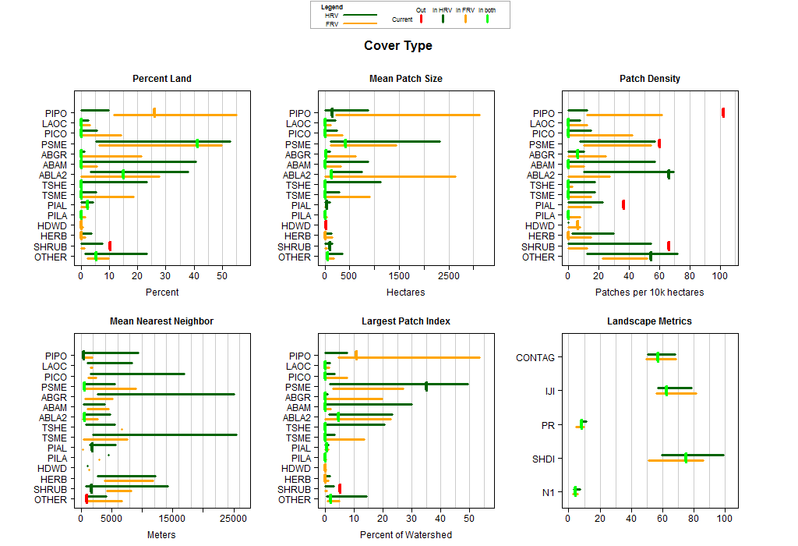

Slide 16

Landscape Assessment with Landscape Objectives
Coarse Filter Patch Objectives
Pre-Planning/Proposal Development
Adaptive Planning
Fine Filter
Effects Analysis
Stand Level Objectives
Identified avoidance/mitigation need
ADAPTIVE MANAGEMENT
Implementation - Layout

Slide 17
Landscape Assessment with Landscape Objectives
Coarse Filter Patch Objectives
Complex Patches
Old and Large Trees
Change Function (Restoration)
Maintain Function (Maintenance)
No Action (Succession)
Effects Analysis

Slide 18
Landscape Assessment with Landscape Objectives
Coarse Filter Patch Objectives
Pre-Planning/Proposal Development
Adaptive Planning
Fine Filter
Effects Analysis
Stand Level Objectives
Identified avoidance/mitigation need
ADAPTIVE MANAGEMENT
Implementation - Layout

Slide 19
Landscape Assessment with Landscape Objectives
Critical Components:
Landscape to Stand Treatment Objectives
Footprint approximating ecologically relevant patches
Maintenance of Legacy Structures
Variability of Treatments
Utilizing the fine filter needs to focus variability and protect vulnerable habitats
ADAPTIVE MANAGEMENT
  People on the ground
  Knowledge of the objectives
  Communication Plan
  Decision making Plan
Adaptive Planning
Coarse Filter Patch Objectives
Pre-Planning/Proposal Development
Adaptive Planning
Fine Filter
Stand Level Objectives
Effects Analysis
Identified avoidance/mitigation need
Implementation - Layout
ADAPTIVE MANAGEMENT

Slide 20
(Transition)

