Slide 1

What the Density Management Study is Teaching Us About Buffers
Paul Anderson and Dede Olson
USDA Forest Service
Pacific Northwest Research Station
pdanderson@fs.fed.us
Notes:
Acknowledge Dede and Partners
Oregon BLM, PNW Research Station
Bianca Eskelson and Temesgen Hailemariam

Slide 2
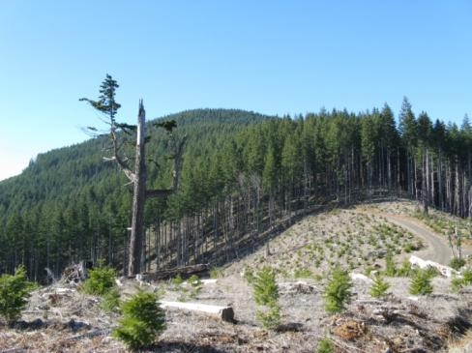
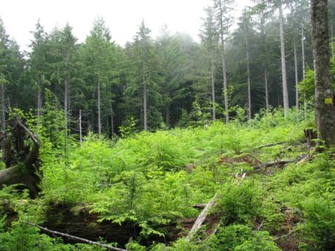
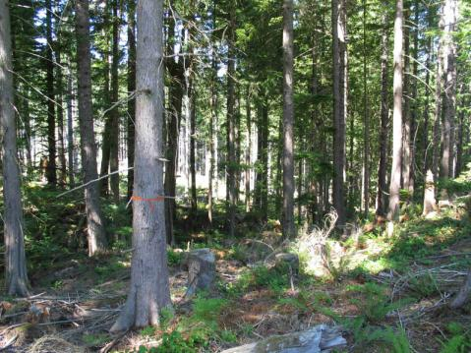
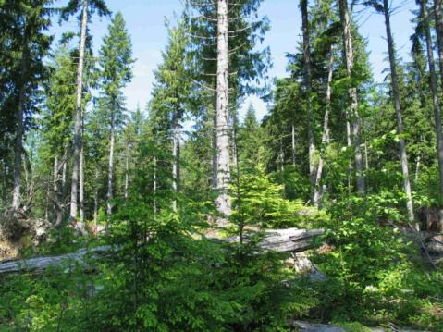
BLM Density Management and Riparian Buffer Study:
Enhancing Structural and Biotic Diversity
Through Active Management
Notes:
Outline of the talk
The riparian buffer study context
Overview of the study design
Presentation of data and key findings – I will be talking about components I am directly engaged in as well as those of Dede Olson
Briefly outline current activity and future opportunities
Even-aged, uniform 40-70 year-old forests being managed under the Northwest Forest Plan
Preferred Northern Spotted Owl Habitat attributes
vertical canopy layering
tree height or diameter diversity
canopy closure and volume
large trees
large snags

Slide 3
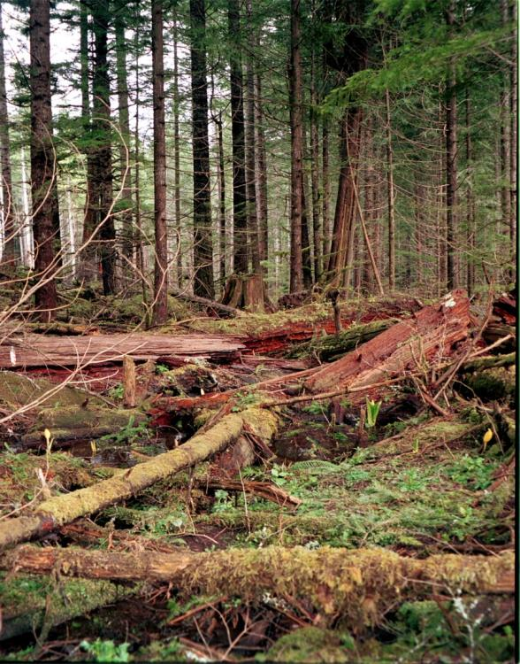
Thinning as a Tool for Riparian Habitat Restoration and the Compatible Production of Wood
Riparian Reserves
  Conserve diversity
  Maintain stream habitat and water quality
  Provide connectivity at watershed and landscape scales
Thinning strategies to promote diversity and the enhancement of riparian functions
  Modification of Overstory Canopy
  Altered Understory Environment
  Understory Vegetation and Structure Responses
  Enhanced Riparian Habitat and Function
Thinning
Buffer
Intermittent headwater stream
Notes:
Two approaches address different aspects
Riparian reserves

Slide 4
Microclimatic Edge Effects
100
Soil Moisture
Radiation
Soil Temp
Air Temp
Wind Speed
Cumulative
Effectiveness (%)
Relative Humidity
0
0
0.5
1.0
2.0
3.0
Distance From Stand Edge into Forest
(tree height)
Redrawn From FEMAT (1994)
Notes:
Spatial variation with respect to edges created by the stream - riparian zone; and the buffer - upland thinning.
Depending on microclimate variable of concern, depth of edge effect varies

Slide 5
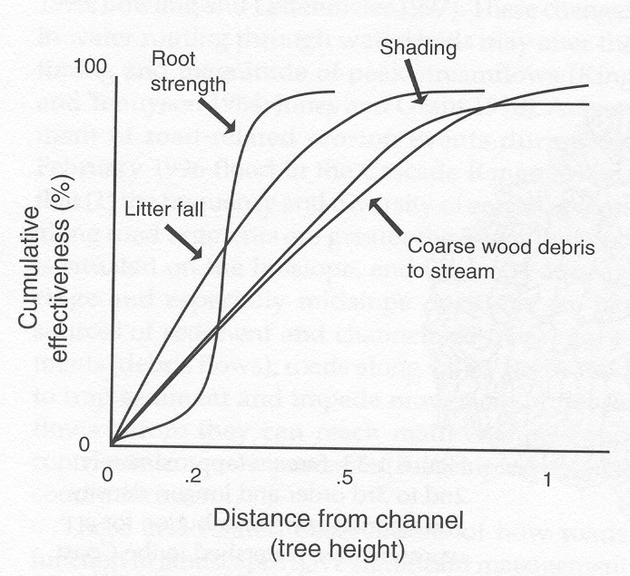
Riparian Forest Effect on Streams as a Function of Buffer Width
FEMAT (1994)

Slide 6
Density Management and Riparian Buffer Study Research Objectives
Evaluate effects of alternative density management treatments on important forest stand and habitat attributes
Determine treatment effects on selected plant and animal taxa (amphibians, arthropods, mollusks, nonvascular plants, and fungi)
Assess the combined effects of density management and alternative riparian buffer widths on aquatic and riparian ecosystems

Slide 7
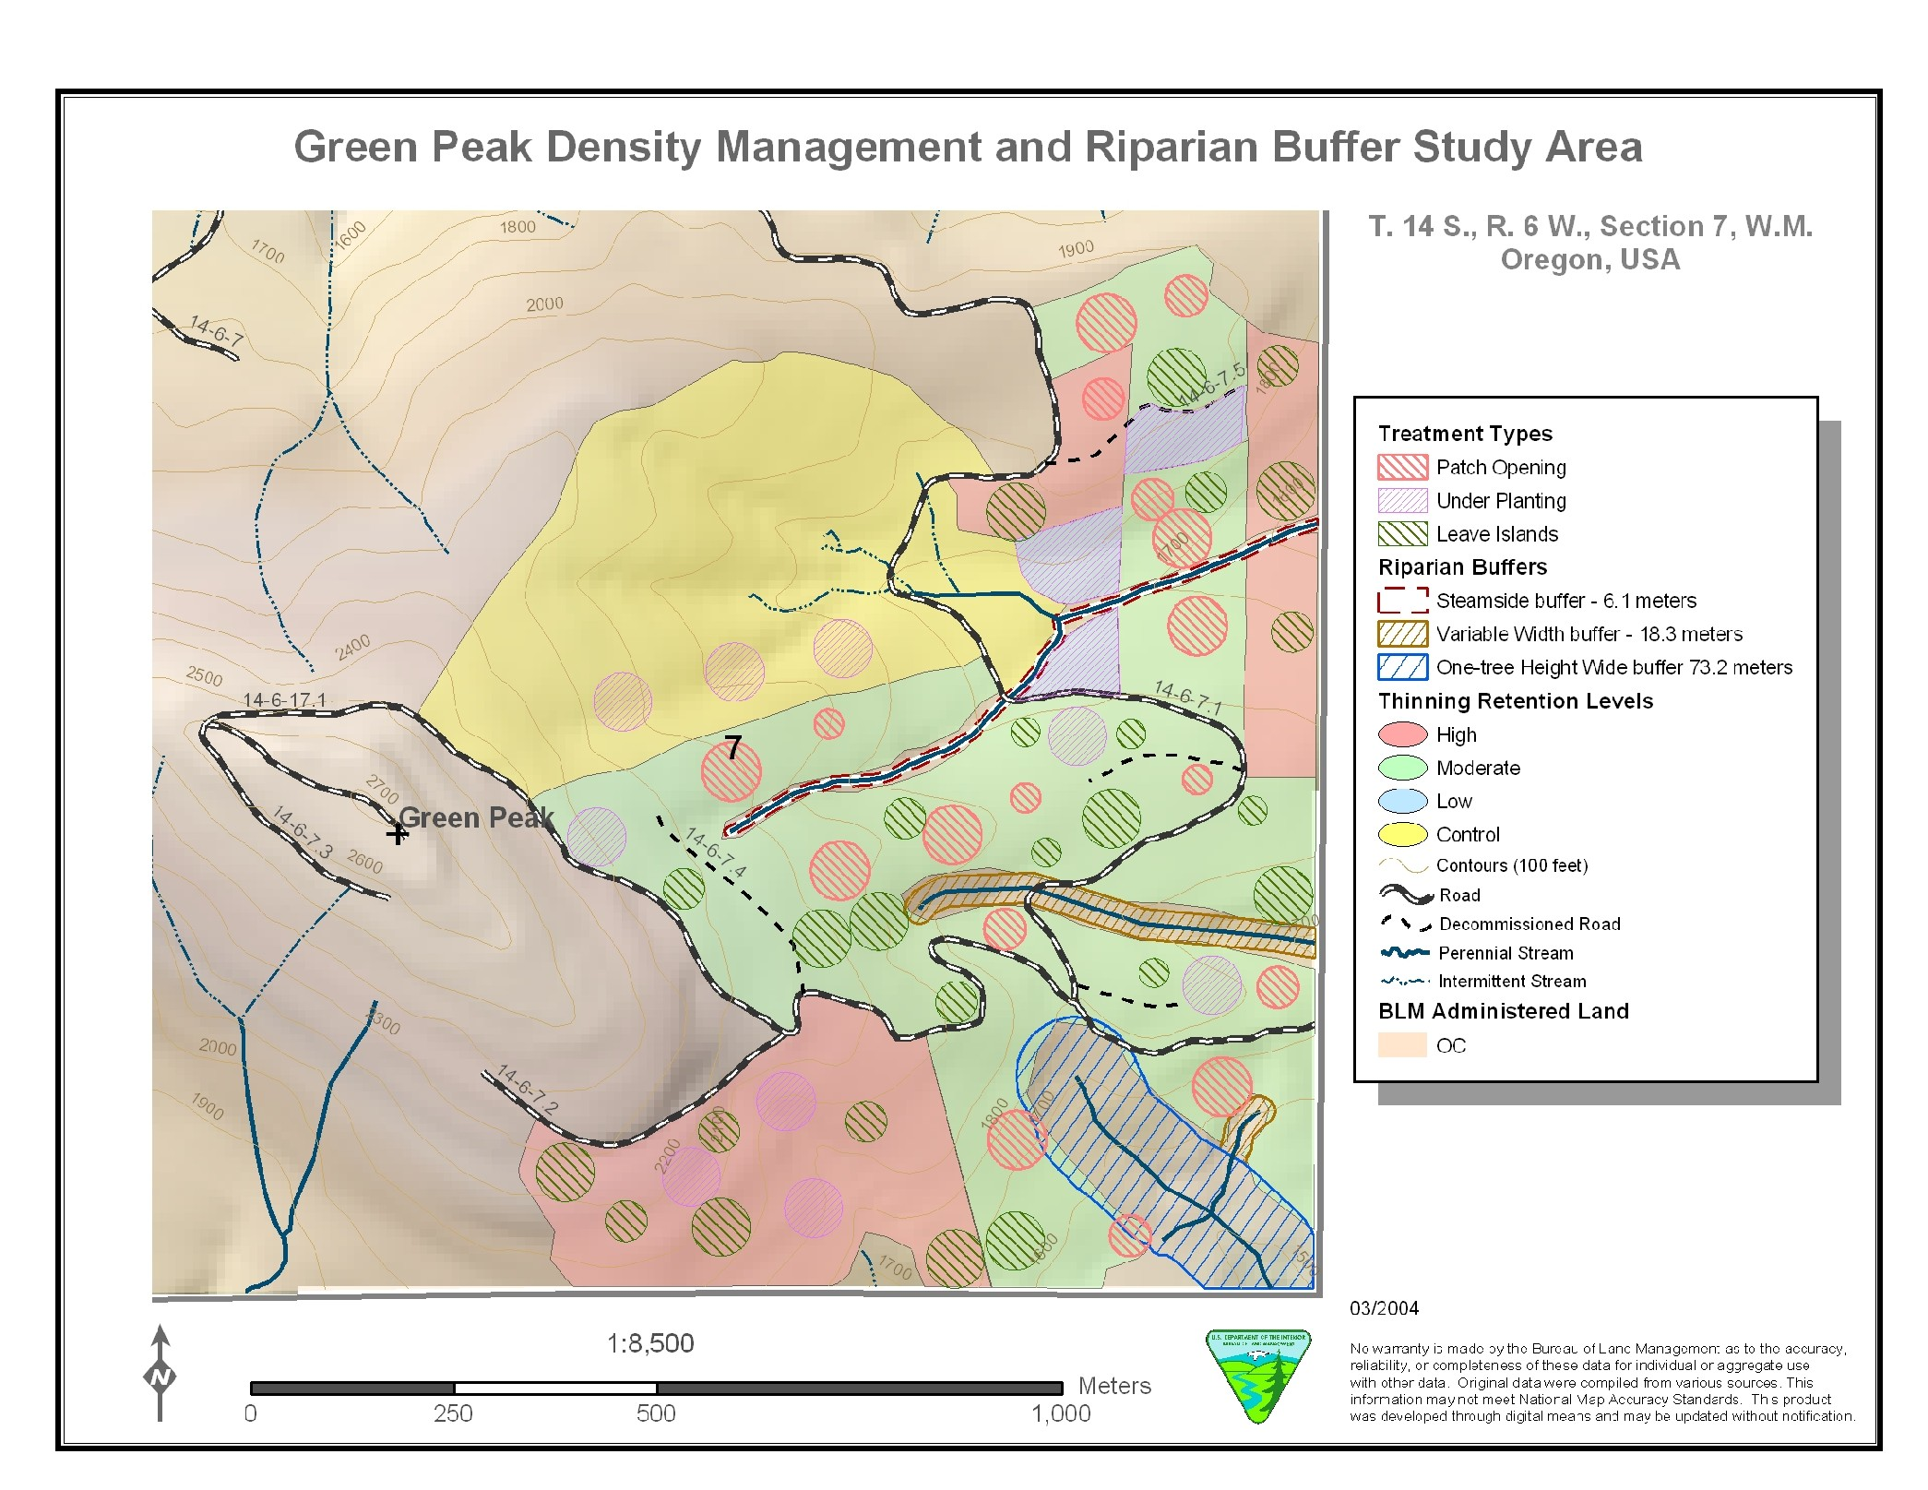
Density Management Study Installation:
Green Peak
Notes:
Initial Thinning in 40-60 year-old Douglas-fir Stands
Treatment Units 30 – 60 ac
Unthinned Control – 200-300 tpa
High Density Retention – 120 tpa
Moderate Density Retention – 80 tpa
Variable Density Retention – 40 to 120 tpa
Fine-scale features
0.25 to 1 ac Leave Islands
0.25 to 1 ac Patch Openings
Mixed-species planting of patch openings
Snag and downed wood creation as needed

Slide 8
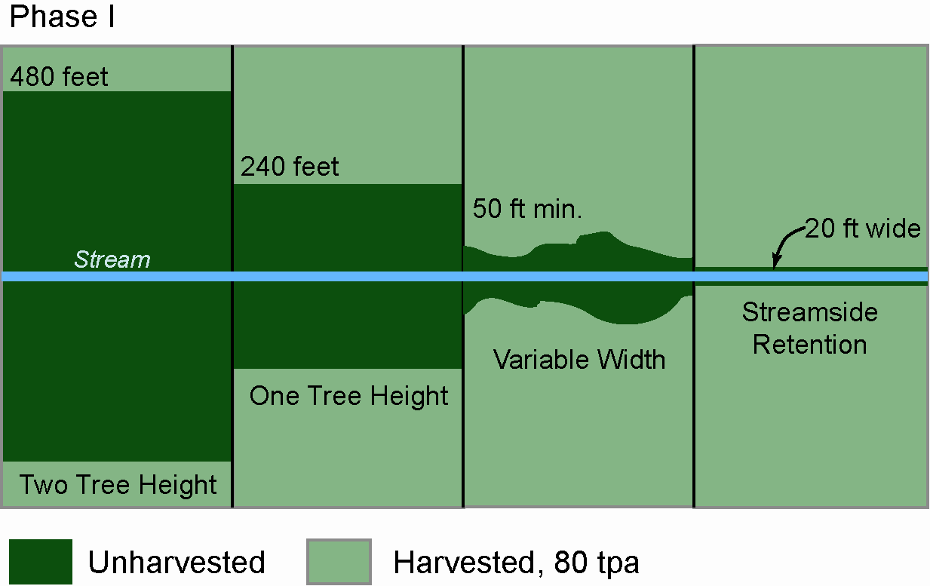
Alternative Riparian Buffer Designs
Notes:
Streamside Retention (SR)
Only Trees With Canopy Providing Direct Cover to Stream (~ 25 ft)
Variable Width (VB)
Topographic or Vegetation Breaks (~ 70 ft)
Extend up steep side slopes
One Site-Potential Tree Height (1SPTH)
Distance Equal to Potential Height of Dominant Tree (~220 ft)
Two Site-Potential Tree Heights (2SPTH)
Distance Equal to Twice the Potential Height of Dominant Tree (~220 ft)

Slide 9
Density Management Study Installation:
Green Peak

Slide 10
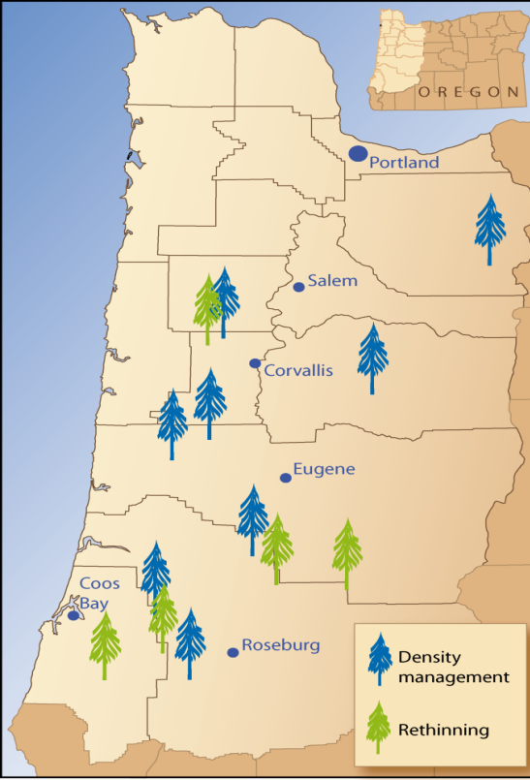
DMS Study Sites
Notes:
Seven initial thinning sites
Five rethinning sites
An addition 3 Forest Service sites on the Siuslaw NF

Slide 11
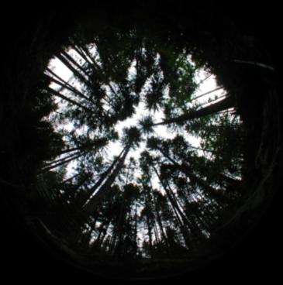
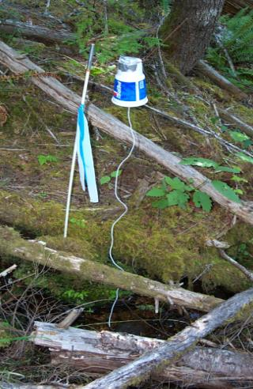
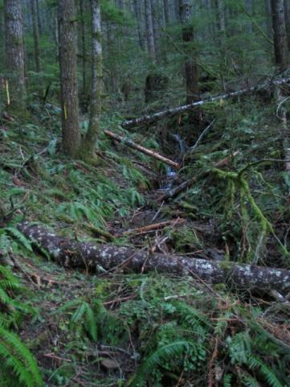
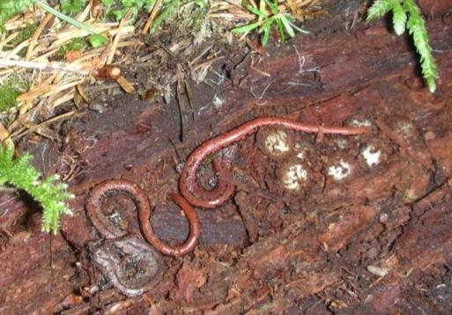
Key Findings
Canopy Closure
Microclimate
Habitat
Animals

Slide 12
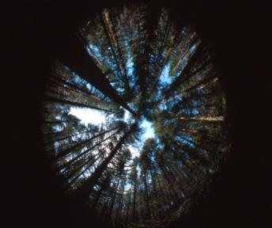
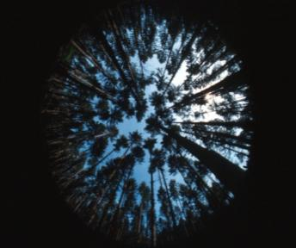
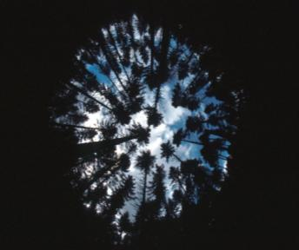
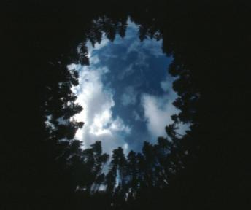
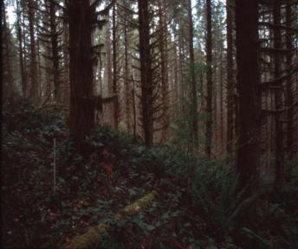
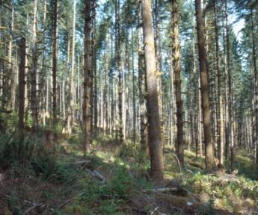
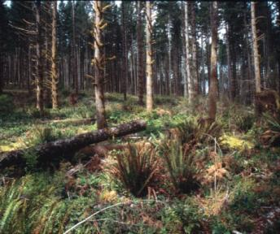
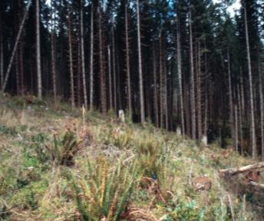
Typical Canopy and Stand Conditions
Three Years After Implementation
9%
28%
38%
61%
200-300 TPA
(Unthinned)
80 TPA
40 TPA
1 Acre Patch
Notes:
Types of thinning treatments applied.
Note that 80% removal of tree density only results in an increase of available light from 9 to 38%!

Slide 13
Canopy Closure in Relation to Basal Area:
Observations Across Six DMS Sites
100
y = -9.332Ln(x) + 61.94
R² = 0.772
80
60
Visible Sky (%)
40
20
0
0
40
80
120
160
200
240
280
320
360
Basal Area (ft²)
Notes:
Percent visible sky does not change substantially with increases in basal area above approx 120 ft2/ac
Conversely, substantial increases in percent visible sky do not occur without thinning to residual basal areas less than 120 ft2/ac
Even with heavy thinning in 1-ac patch openings – only getting 30-80% visible sky – average about 58%
How low a basal area is needed to increase light levels for development of desired understory vegetation and habitat?

Slide 14
Basal Area – Light Relationships:
30-60 yr-old Douglas Fir
For each zone, circled means statistically differ from that of the unthinned control

Slide 15
Microclimate Gradients – Unthinned Stands
Summer Daily Extreme
Notes:
Temperature shows increase with distance from stream in uncut stands –
air temp gradient extending on average about 75 ft – similar distance as variable width buffers
soil temp gradient very sharp in first 15 ft – corresponds to hyporheic versus soil temperature (stream bed vs bank)
Relative humidity gradients extend for large distances upslope into uncut stands – gradients occur in absence of edge; - function of topographic relief and distance from open water surface or mesic riparian zone

Slide 16
Mean Daily Maximum Air Temperature by Zone
P=0.096
P=0.019
P=0.002
For each zone, circled means statistically differ from that of the unthinned control
Notes:
Significant treatment differences:
Stream - SRMD, VBPA tend to higher max temp than unthinned
Buffer – SRMD, VBPA, B1PA tend to have higher Tamax than unthinned
Upslsope – B1PA, VBPA higher Tamax than unthinned

Slide 17
Mean Daily Maximum Soil or Streambed Temperature by Zone
P=0.602
P=0.057
P=0.021
For each zone, circled means statistically differ from that of the unthinned control
Notes:
Significant treatment differences:
Stream - none
Buffer –B1PA tended to have higher Tsmax than unthinned
Upslsope – B1PA tended to be higher Tsmax than unthinned

Slide 18
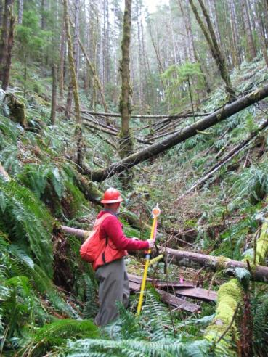
Five-year Response to Thinning: Microlcimate
Microclimatic Edge Effects
Soil
Moisture
Radiation
Soil
Temp
Air
Temp
Microclimate gradients extend from the stream into the upslope forest
These gradients are strongest within 10 m of the stream center
The stream exerts a strong influence on near-stream microclimate
Upslope thinning had little detectable effect on stream center microclimate
Variable width buffers appear sufficient to mitigate thinning effects on microclimate above the stream
There was no apparent increase in mitigation associated with wider buffers
Anderson, Larson, Chan. 2007 Forest Science 53: 254-269.
100
Wind Speed
Cumulative
Effectiveness (%)
Relative Humidity
0
0
0.5
3.0
1.0
2.0
Distance From Stand Edge into Forest
(tree height)
Redrawn From FEMAT (1994)

Slide 19
Modeling Spatial Variation in Riparian Microclimate: Maximum Daily Air Temp
Collaboration with Bianca Eskelson, Temesgen Hailemariam, OSU
Strong correlations between mean maximum air temperature and distance to stream and height above stream
Kriging with external drift (covariates) provides better results than ordinary or universal kriging
For steep sites (> 30%), distance to stream is more important as a covariate than is height above stream. The opposite is true for sites with slope less than 30%.
The sampling intensity needs to be larger close to the stream with three to five sample points on a 20 m transect section centered on the stream.

Slide 20
Factors influencing the effectiveness of buffers as a source of shade
Stand Structure
  Stand density
  Stand height
  Live crown length
  Foliage density
  Species composition
  Understory
  Down wood
Topography
  Stream orientation
  Channel profile
  Channel width
Notes:
A critical element in meeting concerns for stream temperature impacts of thinning is the retention of shade. The shade benefit of a buffer can accrue from the buffer vegetation but may also accrue form topographic features and the physical characteristics of the stream.

Slide 21
Canopy Closure, Topography and Microclimate Correlations
Pearson Correlations
 | Air Temperature
 |  | daily minimum | daily maximum | daily range
Radiation (DIFN) |  | 0.196 | 0.627 | 0.556
Bankfull Width |  | 0.044 | -0.009 | 0.094
Valley Width |  | 0.056 | 0.006 | 0.024
Quigley Orientation |  | 0.616 | 0.448 | 0.231
 | Relative Humidity
 |  | daily minimum | daily maximum | daily range
Radiation (DIFN) |  | -0.262 | 0.018 | 0.415
Bankfull Width |  | -0.197 | -0.195 | 0.091
Valley Width |  | -0.053 | 0.109 | 0.050
Quigley Orientation |  | -0.532 | -0.632 | 0.510
 | Stream Temperature
 |  | daily minimum | daily maximum | daily range
Radiation (DIFN) |  | 0.018 | 0.074 | -0.238
Bankfull Width |  | 0.000 | 0.035 | -0.056
Valley Width |  | 0.056 | 0.133 | 0.077
Quigley Orientation |  | 0.049 | 0.021 | -0.214
Notes:
For headwater streams typical of the density Management Study
A variety of channel orientations and side slopes
Air temperature and Relative humidity above the stream were strongly correlated to stream orientation
Minimum daily air temperature was strongly correlated to side slope
Channels oriented in the general E-W direction experience less thermal stress than those oriented more N-S as topographic shading is more effective in the former

Slide 22
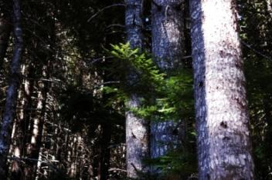
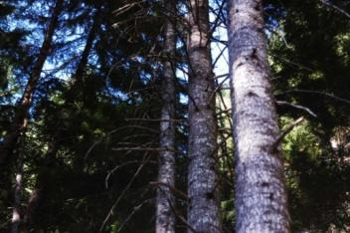
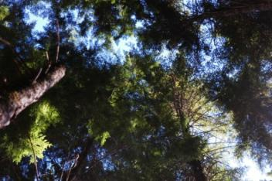
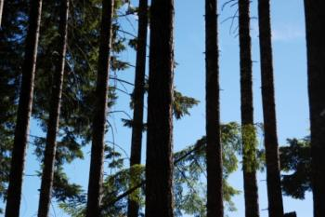
Shade Correlations with Microclimate
and Stream Temperature
Stream orientation was the only topographic variable strongly correlated with microclimate
East-west oriented streams, and streams with steep side slopes tend to receive more topographic shading
Diffuse radiation and angular canopy density were only weakly correlated with stream temperature
Importance of topographic shading as compared to canopy shading is difficult to discern in areas of relatively dense, uniform canopy
Notes:
For DMS headwater streams associated with uniform, relatively dense canopies summer daily microclimate, full-leaf conditions ---
Angular canopy density is a metric describing the amount of visible sky blocked along the direct path of the sun to a point in forest – If you were to look directly at the sun, how much of the sky would be blocked from view by vegetation.
While an important variable in shade models – we generally observed low correlations between daily temperatures above the stream and canopy density
Greatest correlation occurred with low sun angle (afternoon secondnary shade zone).
In general there was greater correlation between microclimate and diffuse light
Angular canopy density may be more important where sites are flat, canopies are heterogeneous or sparse, and canopies do not extend fully across the stream channel

Slide 23
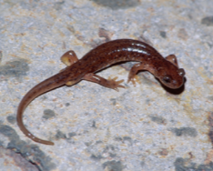
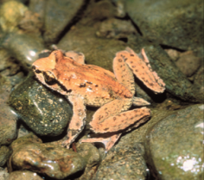
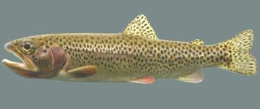
Headwater Habitats
Notes:
Of 13 sites, one site has not been implemented due to its occurrence in the Umpqua Cutthroat basin. One other site has a somewhat compromised layout, after implementation, due to buffers not being equally applied on both sides of all streams.
Hence:
Pre-treatment data analyses summarize findings at 13 sites.
Post-treatment data analyses summarize findings at 11 sites.
Methods:
Stream reaches were sampled for both instream and bank animals.
Instream: Hand searches were conducted when effective (not deep water).
Electroshocking was conducted in deep water.
Random stratified subsampling, following a modified Hankin-Reeves
design.
Bank: At instream units, each bank was searched for 5 min., area of search estimated.
Entire reaches were habitat typed: fast/slow units, unit size, substrate, wood.
Analyses:
Multivariate regression was used to explore species-habitat associations. Anova mixed procedure (SAS) was used to examine treatment effects. Pairwise comparisons of means were conducted with t-tests and Kruskal-Wallis tests.
Special thanks to Loretta Ellenburg for leading the collection of all data!
Special thanks to George Weaver for analyses of pretreatment data, and to Cindy Rugger for data management and analyses of instream and bank treatment effects.

Slide 24
Spatially Intermittent Streams Frequent
Type: 1 2 4 5 6 7
Perennial Summer Intermittent
Intermittent
Olson and Weaver (2007)
Notes:
Initially, there was no assumption about the definition of a stream channel in headwaters. Channels were surveyed in spring and summer, and subsequently classified as wet (perennial channel), intermittent (spatial intermittency, the water went subsurface), dry (no surface flow apparent but evidence of past scour and/or deposition), and above water (no evidence of scour or deposition). Consequently data were collected from a variety of channels that included some which never appeared to have running water (dry-dry, above water). Seven “hydrotypes” were seen in headwaters, as shown in this graph. The dominant stream channel (with water) hydrotype at our sites was Intermittent-Intermittent, which had sections of the reach running subsurface in both spring and summer.
Patterns of stream fauna were found with regard to hydrotype.

Slide 25
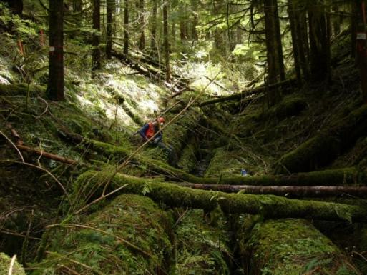
Buffer Width Influence on Down Wood Cover
Notes:
Differences in mean down wood cover among buffer types and unthinned stands are predominantly within 5-10%
The greatest differences are associated with either narrow, streamside retention buffers or variable width buffers adjacent to patch openings
Relative to pretreatment amounts, mean abundance of moderate sized coarse wood was less variable among buffer types within five years of thinning

Slide 26
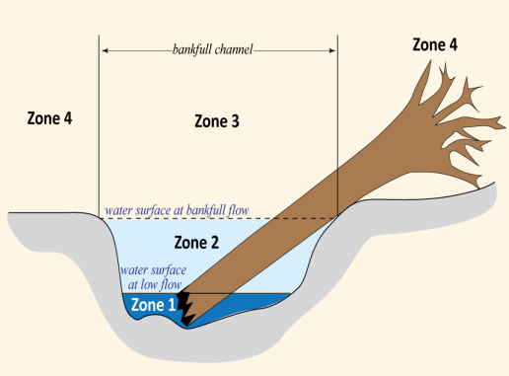
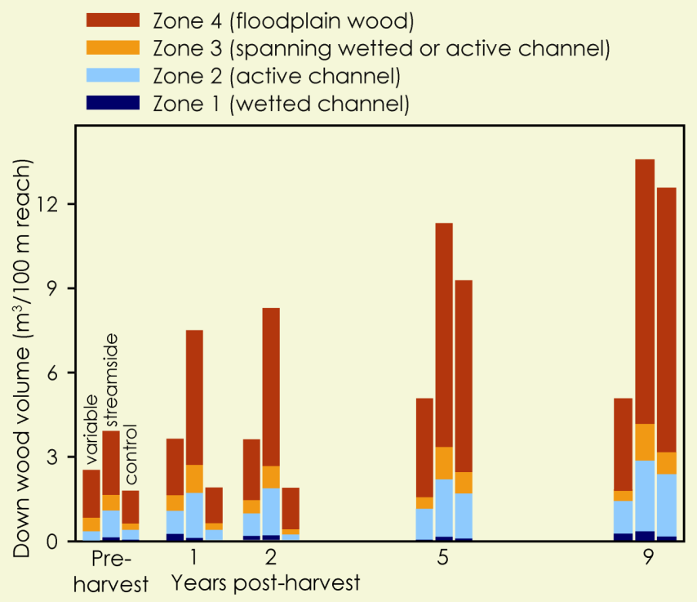
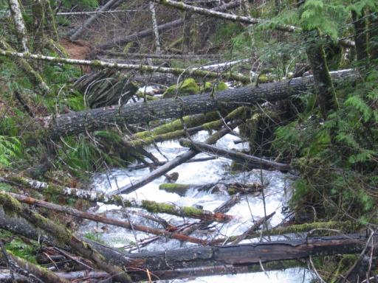
Treatment Impacts on Stream Associated Coarse Down Wood
Notes:
Over time, thinning and riparian buffer configuration affected CDW volume in only decay classes 1 and 2 (fresh or slightly decomposed detritus; Fig. 3).
CDW volume was greater in the streamside buffer treatment than in the control one year after thinning (P = 0.04), and than in the control and variable buffer treatments 2 years after thinning (P = 0.02 and 0.04, respectively; Fig. 3).
Mean annual accretion rate of CDW in decay classes 1 and 2 in the streamside treatment was approximately 1 m³/100 m reach

Slide 27
Amphibian and Fish Species Occurrences
SPECIES | DMS Study Site
 | CalCk | Coug | Delph | Grant | GrnPk | OMH | Keel | Perk | Scho | NoSou | TenHi | NWrd
AMPHIBIANS
Northwestern Salamander | x | x |  |  | x | x | x | x |  | x
Clouded Salamander |  |  |  |  |  | x | x | x | x | x | x
Coastal Tailed Frog | x | x |  | x | x | x | x |  | x | x | x
Oregon Slender Salamander |  |  | x |  |  |  | x
Coastal Giant Salamander | x | x | x | x | x | x | x | x | x | x | x | x
Ensatina | x | x | x | x | x | x | x | x | x | x | x | x
Dunn’s Salamander | x | x | x | x | x | x | x | x | x | x | x | x
Western Red-Backed Salamander | x | x |  | x | x | x | x | x | x | x | x | x
Pacific Treefrog | x | x | x | x | x | x |  |  | x | x | x
Northern Red-legged Frog | x | x | x | x | x | x | x |  | x | x | x | x
Southern Torrent Salamander | x | x |  | x | x | x |  |  | x | x | x | x
Cascade Torrent Salamander |  |  | x |  |  |  | x | x
Rough-Skinned Newt | x | x | x | x | x | x | x | x | x | x | x | x
FISHES
Cutthroat Trout | x |  | x |  |  |  | x | x | x | x |  | x
Rainbow Trout | x
Salmonid sp. age 0+ | x |  | x |  |  |  | x | x | x | x |  | x
Sculpin | x |  | x |  |  |  |  | x |  |  |  | x
Lamprey |  |  |  |  |  | x |  |  |  |  |  | x
Notes:
13 Amphibian species and 5 fish taxa have been monitored in the DMS riparian buffer studies. While some species occur at all sites, others have limited representation that precludes statistical analyses.

Slide 28
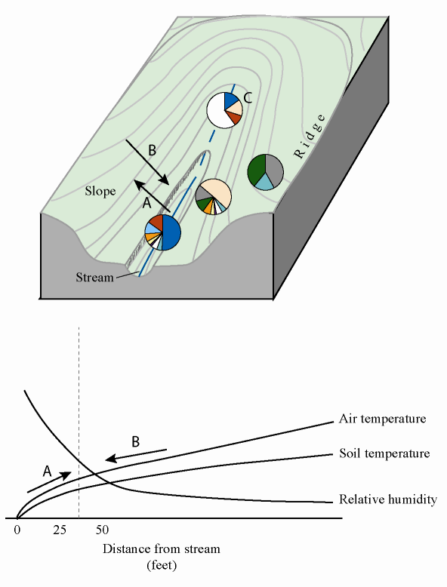
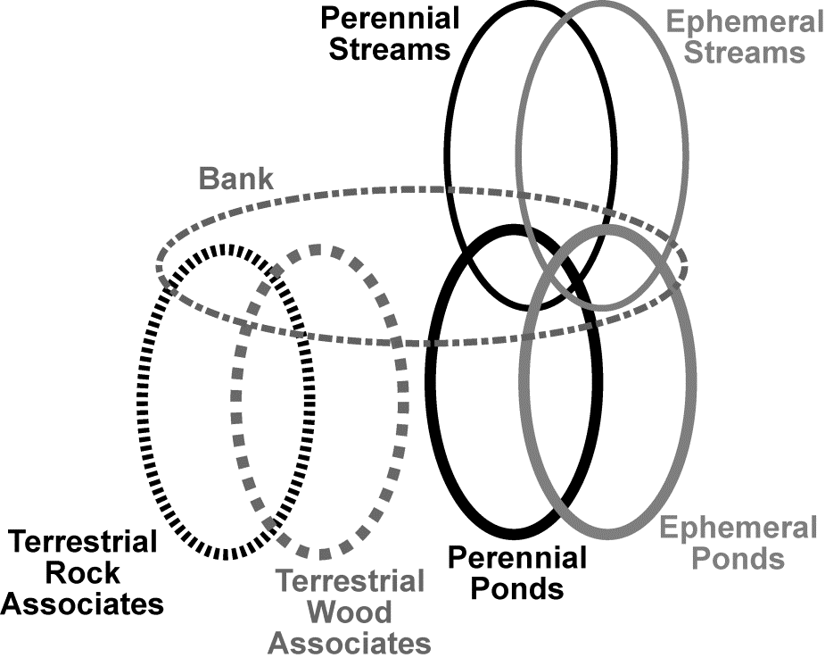
Headwater Vertebrate Assemblages:
Spatial Structuring
Notes:
Amphibian assemblages occurring in headwater drainages of western Oregon.
Amphibians can be categorized by habitat associations, such as (a) two stream-breeding assemblages (in perennial and ephemeral streams), two pond-breeding assemblages (in perennial and ephemeral ponds), two terrestrial-breeding assemblages (wood and rock associates), and bank-dwelling species which may include members of other assemblages, or (b) species composition by pie-charts within different portions of drainages, showing four dominant assemblages in headwaters (Sheridan and Olson 2003, Olson and Weaver 2007). Arrow A depicts direction of cool, moist microclimates from the “stream effect”. Arrow B depicts direction of opposing warmer, dryer microclimates from upslope.

Slide 29
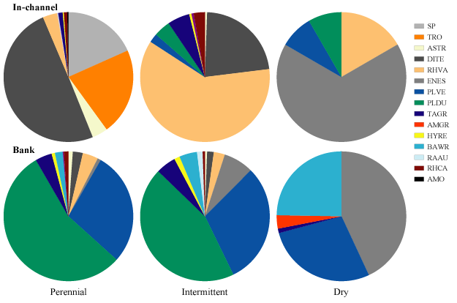
Characterizing Headwaters: Fauna
Fish
Torrent salamanders
Coastal giant salamanders
OR slender salamanders
Dunn’s salamanders
Ensatina
Western red-backed salamanders
Olson and Weaver (2007)
Distinct assemblages associated with hydrology, gradient, down wood and stream size
Headwaters species to assess : sculpins, tailed frogs, torrents
Notes:
The amphibian assemblages upslope of streams were examined at 2 sites. These assemblages were dominated by 2 species. At the Keel Mtn. site, they were Ensatina and Oregon Slender Salamander. At Green Peak, they were Ensatina and Western Redback Salamander. Their distributions along transects perpendicular to streams showed no riparian association.

Slide 30
Treatment Effects
Years 1-2:
Stream Habitat
Stream and Bank Animals
Upland Salamanders
Years 1-5:
Upland Biota
Leave Islands
Microclimates
Years 5-6:
Stream and Bank Animals
Upland Salamanders
Down Wood Thermal Regimes
No Negative Treatment Effects
Mixed Treatment Effects: 1 site yes, 1 site no
Mixed Treatment Effects:
More amphibians in some leave islands and unthinned, More plants in thinned areas, LS plants in unthinned
1-acre islands have “interior” microclimates
One Treatment Effect: Fewer bank PLVE
No Treatment Effects
Some Distance-from-Stream Effects
Small and Large Diameter Wood and Substrates Retained Cool Temperatures
Notes:
We examined the effects of stream buffers on the instream and bank species at 11 sites, and on upslope species at 2 sites.

Slide 31
Caveats
Lack of consistent treatment effects may be due to…
Inference of findings restricted to…
Detectability issues
Power issues
Spatial scale issues
Study sites

Slide 32
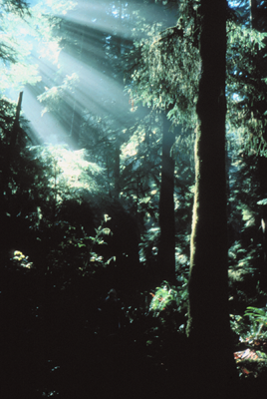

Overall Summary
Multiple headwater vertebrate assemblages
No dramatic thinning/ buffer effect, so far
Some patterns with bank/upland salamanders
Phase 2 beginning
Notes:
Our investigations have added knowledge to the complexity of amphibian assemblages in headwaters. Species have associations with intermittent streams and headmost areas of channels.
Preliminary results of the effects of thinning are emerging. Results are variable. No dramatic negative effect on abundance or stream occupancy have been seen across stream reaches, but some trends are being explored. Fish in 4 reaches disappeared, we are looking at why. Do fish have more of a mobile life history in headwaters? Six species of amphibians tended to occupy more reaches, however with incidental numbers, post-thin. Bank salamander abundances showed both positive and negative responses to treatment. Site-specific negative effects of thinning were seen for terrestrial salamanders.
Ongoing surveys of these reaches are occurring in year 5 post-thin.

Slide 33
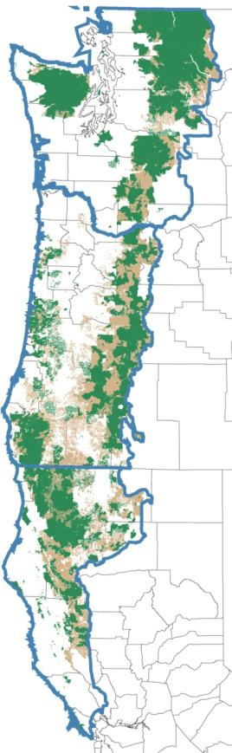
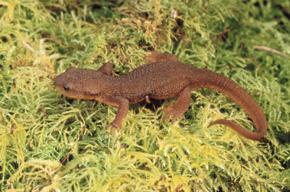
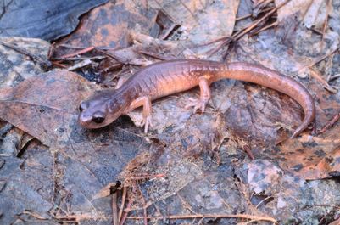
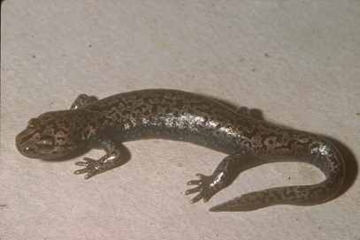
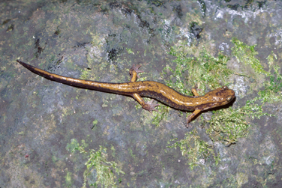
Reflection: While some taxa are protected at landscape scales as broad species distributions intersect protected lands …
…species persistence at smaller spatial scales is important for maintaining intact ecological systems.
Notes:
Map shows federal lands of the Northwest Forest Plan: green areas are reserved lands and brown areas are managed lands.

Slide 34

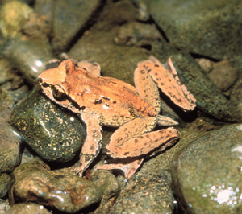
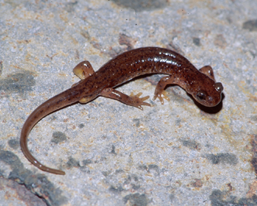
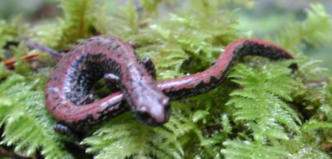
Rarer headwater-dependent species may require stand scale management
PATCHY DISTRIBUTIONS
DISPERSAL LIMITATIONS and RESTRICTED HABITAT
Notes:
Site-specific conditions may need to be taken into consideration for rare species. This may include stream density, stream occupancy by species, down wood, and talus.

Slide 35
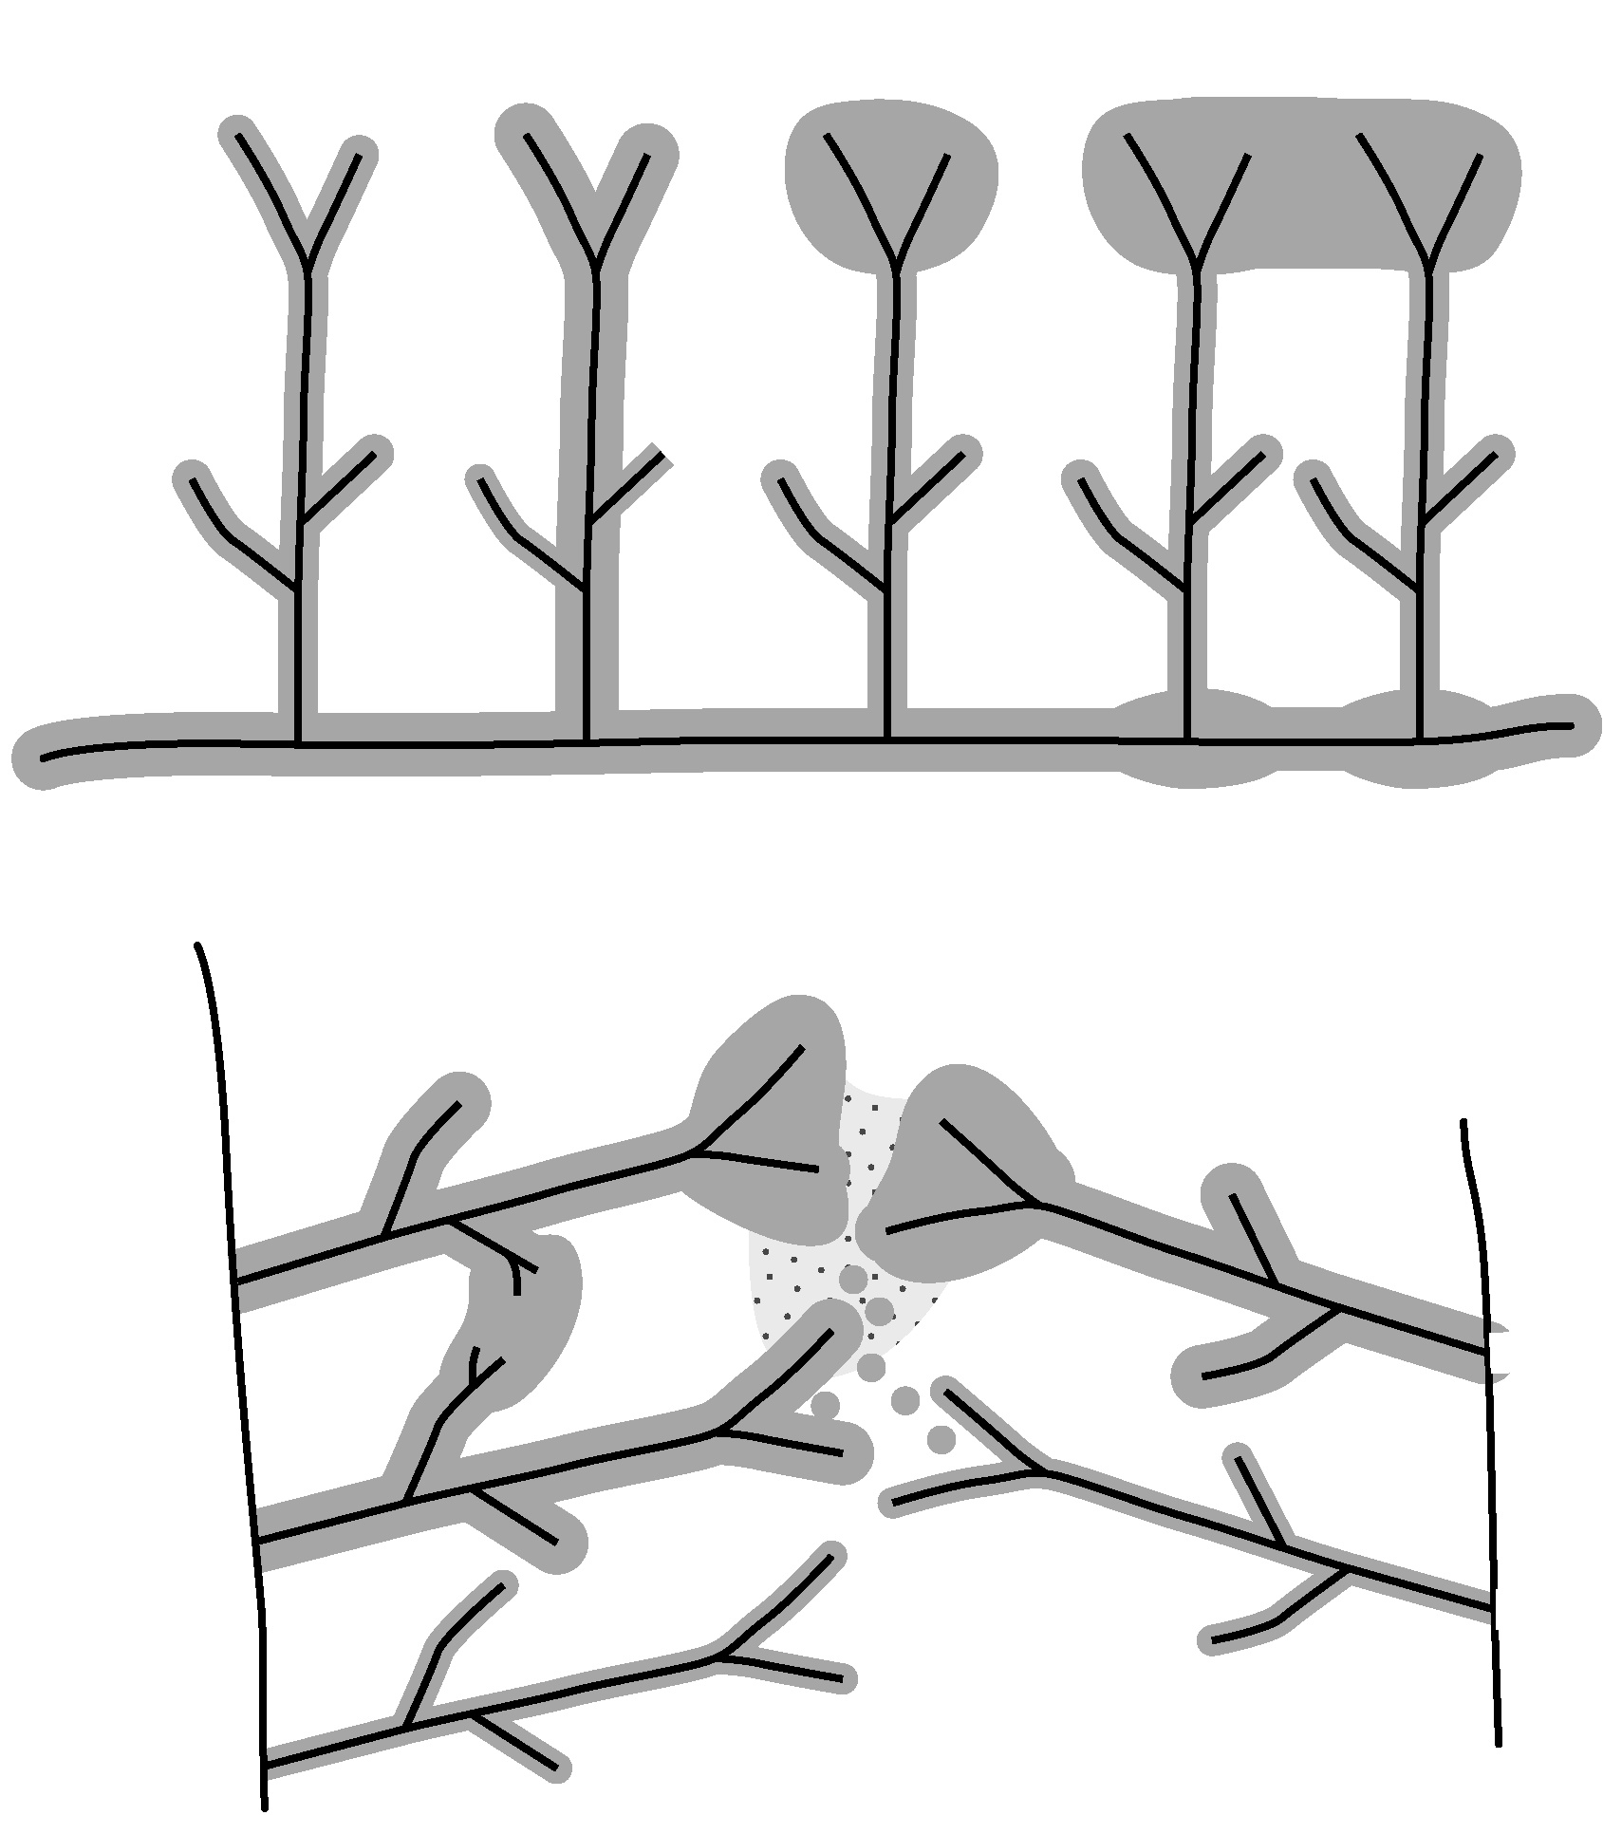
Designs to Integrate Stream and Upland Forest Management for Amphibians
Olson, Anderson et al. 2007
Notes:
Site-specific conditions may need to be taken into consideration for rare species. This may include stream density, stream occupancy by species, down wood, and talus.

Slide 36
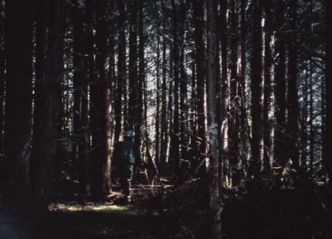
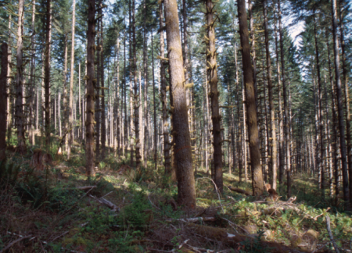
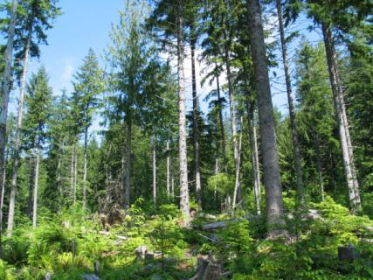
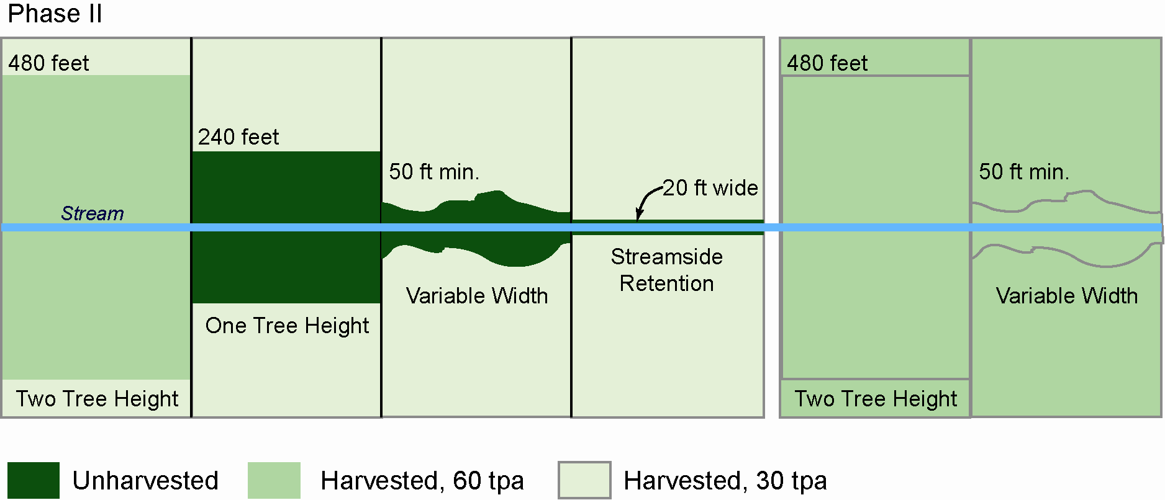
BLM Density Management Studies PHASE 2
~240 TPA
80 TPA
~30TPA
Notes:
Initial thinning sites underwent a second thinning entry 11-12 years after the initial treatment. The second entry represented a staged reduction in overstory density bringing stands to densities similar to those proposed by Tappeiner and others as being more representative of the historical stand structures that developed into the current old-growth stands of the western Cascades and Coast Ranges.

Slide 37
Thank you!
Oregon BLM - many great people
Dede Olson and Klaus Puettmann
Temesgen Hailemariam and Bianca Eskelson
Mark Meleason
Sam Chan, John Tappeiner, John Cissel
Dan, Brad, Val and a bunch of others in the team

