Slide 1
Landscape Ecology
Underground
Connections
Karen Bennett
USFS PNW
Regional Soil Scientist (retired)
November 2019

Slide 2
Underground Discussion Points
Introduction to tools for bringing earth science information to the table
  Landtype Association Mappin
Use this information to initiate conversations of the capabilities and limitations of different portions of the landscape
Value of understanding soils/geology in interdisciplinary management decisions.

Slide 3

National Hierarchical Framework of Ecological Units
Broad scale
Domain, Division
Baileys – Domain, Division Province
Global
Province
Continental
ECOMap
EPA/ Omernik’s EcoRegions Levels II, III, IV
Section, Subsection
Regional
Landtype Association
STATSGO
Landscape
?
Landtype
Land Unit
SRI
SSURGO
TEIU
Landtype phase
Site
Fine scale

Slide 4
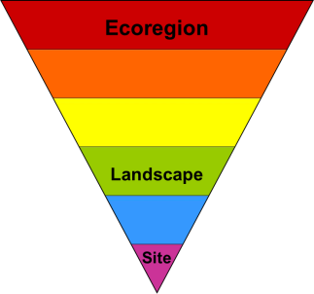
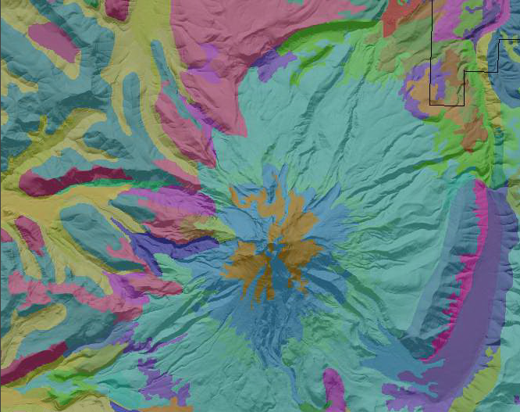
Landtype Association
  Mid- level assessment unit
    Forest Plan Revision (2012 Planning Rule)
    Terrestrial Ecological Condition Assessment
Geoecological –
  Based on biotic and abiotic factors
    Surficial process interactions apparent
Classifiy and map ecosystems
  Organizes landscapes
    Repeated patterns
    Similar capabilities and potentials for management
  Scale for soil-forming (state) factors
    soil = f (clorpt…)
Characterization of:
  Inherent Capacity
  Sensitivity / Resilience

Slide 5
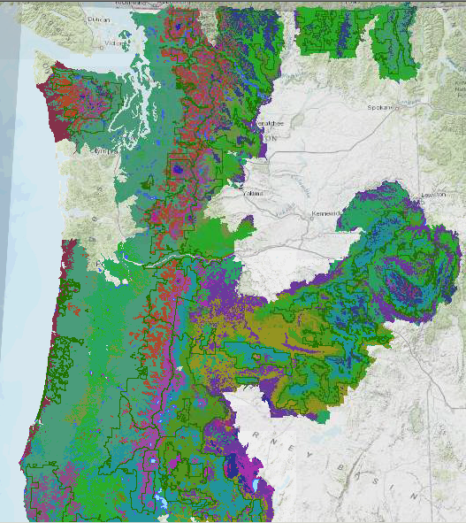
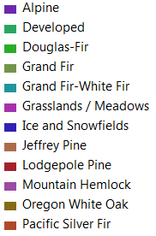
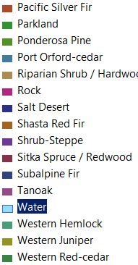
Potential Natural Vegetation
Source:
Simpson and Henderson
26 Delineations

Slide 6
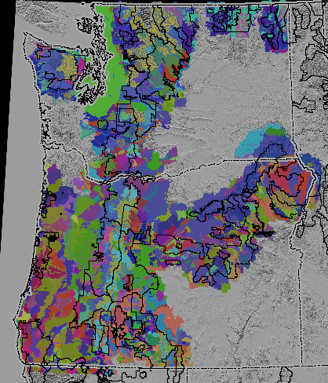
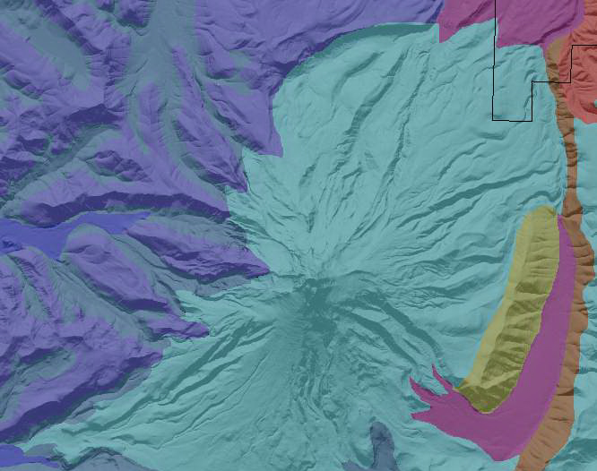
Landform Association Mapping
156 Unique Landforms

Slide 7
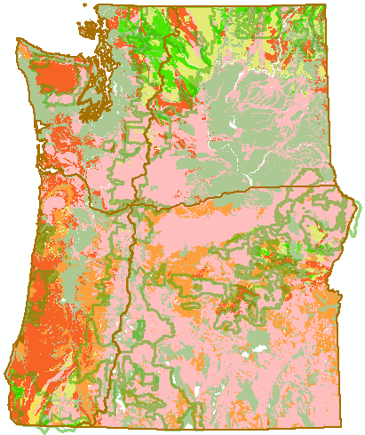
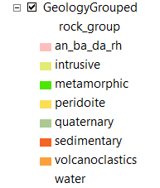
Geologic Groupings
Weathering capacity
Topographic controls
Geochemistry
Landscape stability
Groundwater flows
Extrusive –
*andesite, basalt, dacite, rhyolite
Intrusive – *granite, diorite
Metamorphic
Serpentine
Quaternary - unconsolidated
Sedimentary
Volcanoclastics

Slide 8
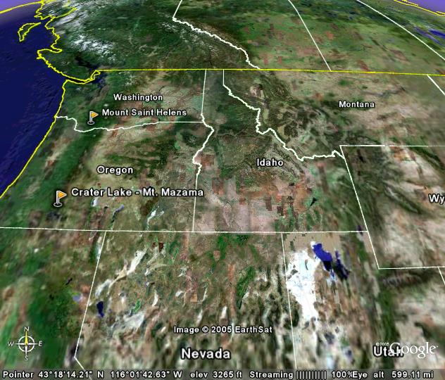
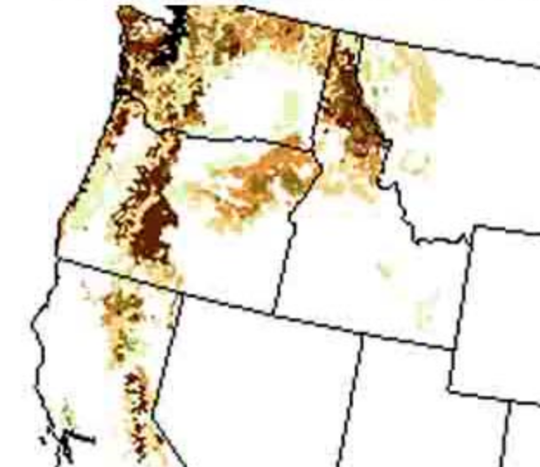
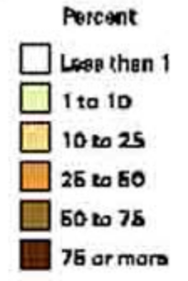
Volcanic Ash Deposition
(2 of 16 major volcanoes)
Mt St Helens Deposition Zone
Mt Mazama Deposition Zone
Tephra Size Classes:
ash <2 mm
pumice 2-64 mm
Classification Terminology:
Vitrandic = mixed, <18 cm
Andic = 18 – 36 cm
Andisol = > 36 cm

Slide 9
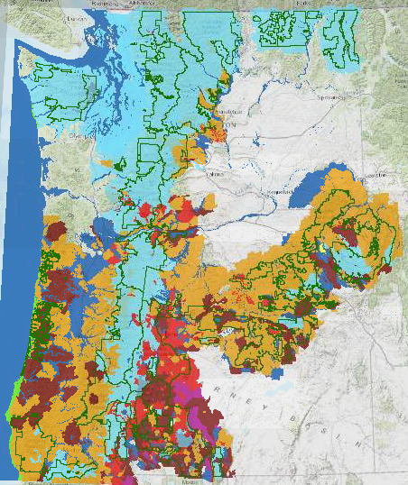
Primary
Geomorphic
Processes
Eolian
Fluvial
Glacial
Lacustrine
Marine
Mass Wasting
Tectonic / Structural
Volcanic

Slide 10
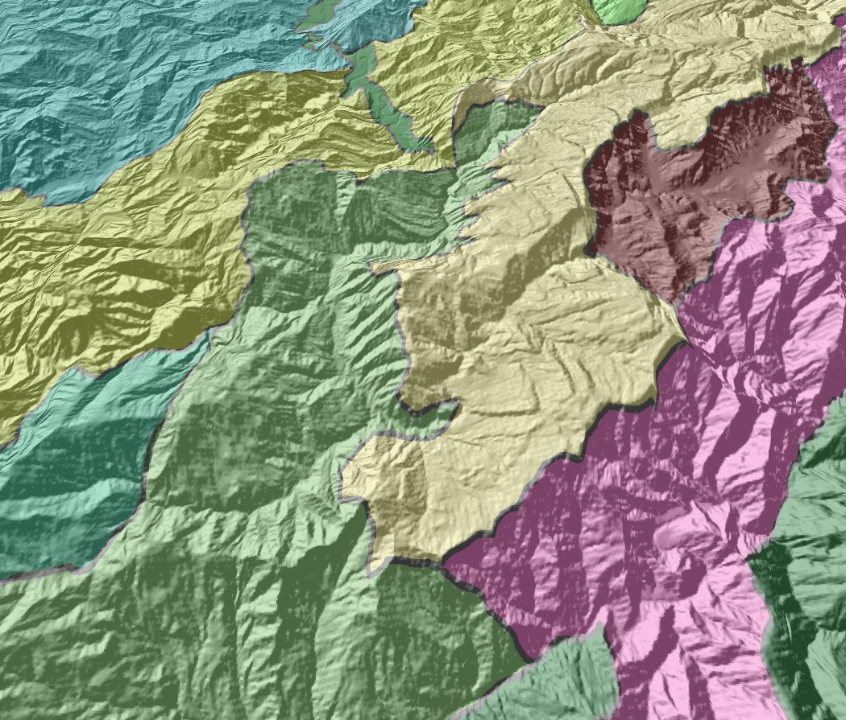
Landform Associations
Dissected High Mountains
Mountain Valley
Hummocky Mountains
Angulate Mountains
Smooth crested ridges
Rogue River-Siskiyou National Forest

Slide 11
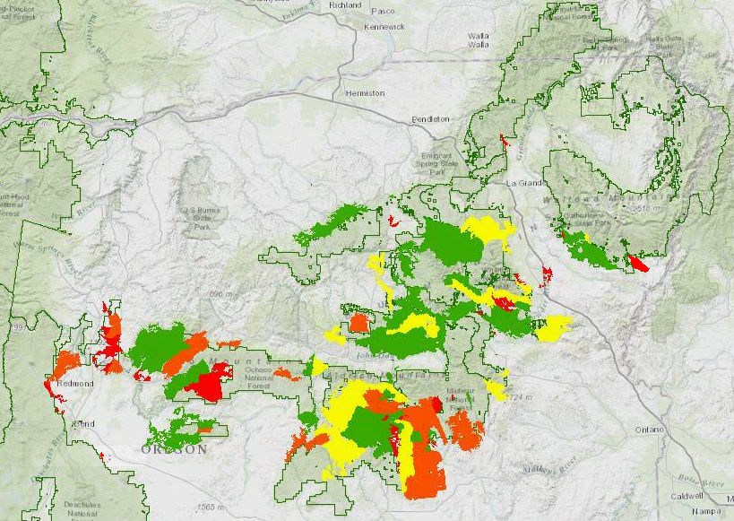
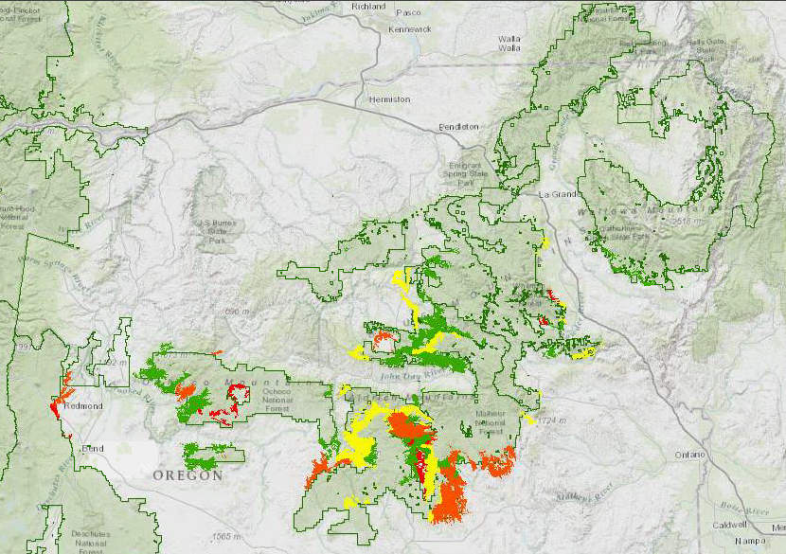
White Headed Woodpecker Habitat
(11/68 LfAs)
Landform Associations
Fluvial Plans
Collapsed Stratal Mountains
Faulted Incised Plateaus
Stratal Low Mountains
Faulted Incised Volcanoes
Angulate Mountains
Dissected Mountains
Dissected Verrucated Mountains
Dissected Low Mountains
Verrucated Low Mountains
Verrucated Mountains
Ponderosa Pine Landtype Associations

Slide 12
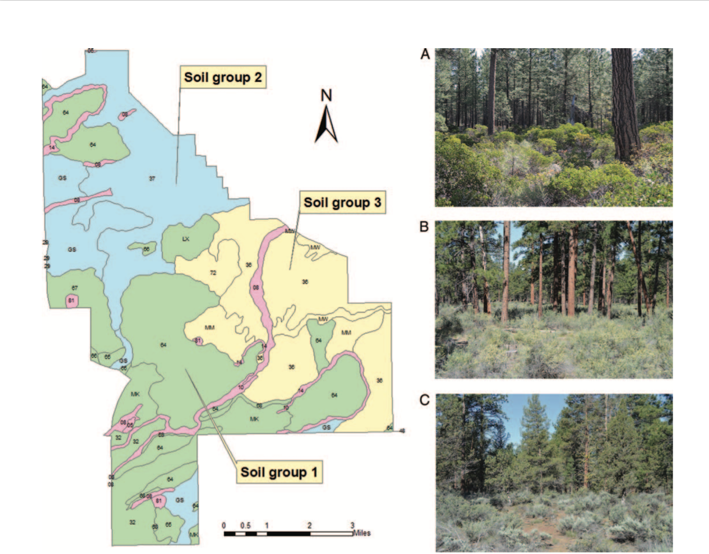
Sisters Area Fuels Reduction Project Planning

Slide 13
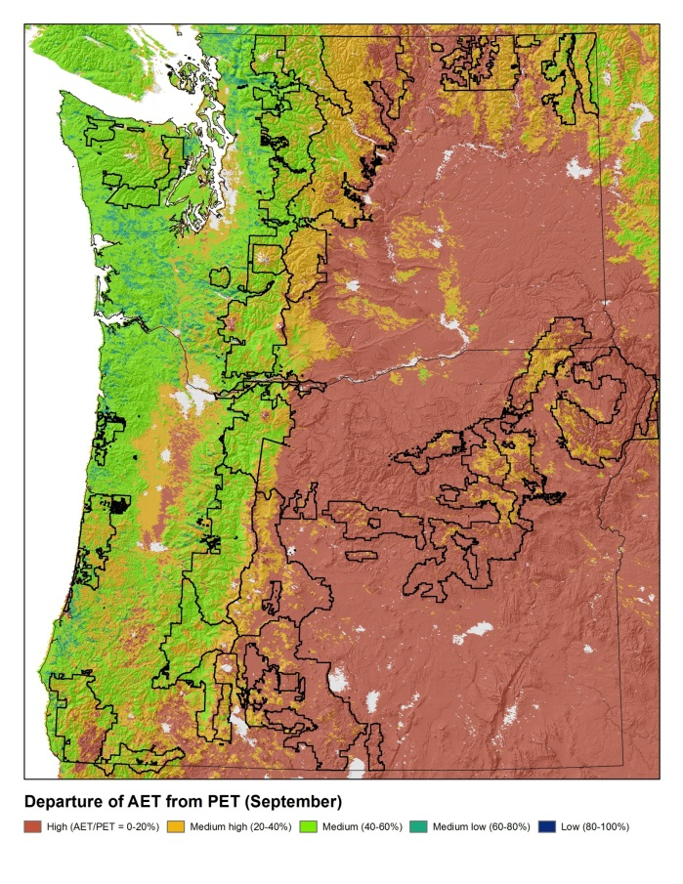
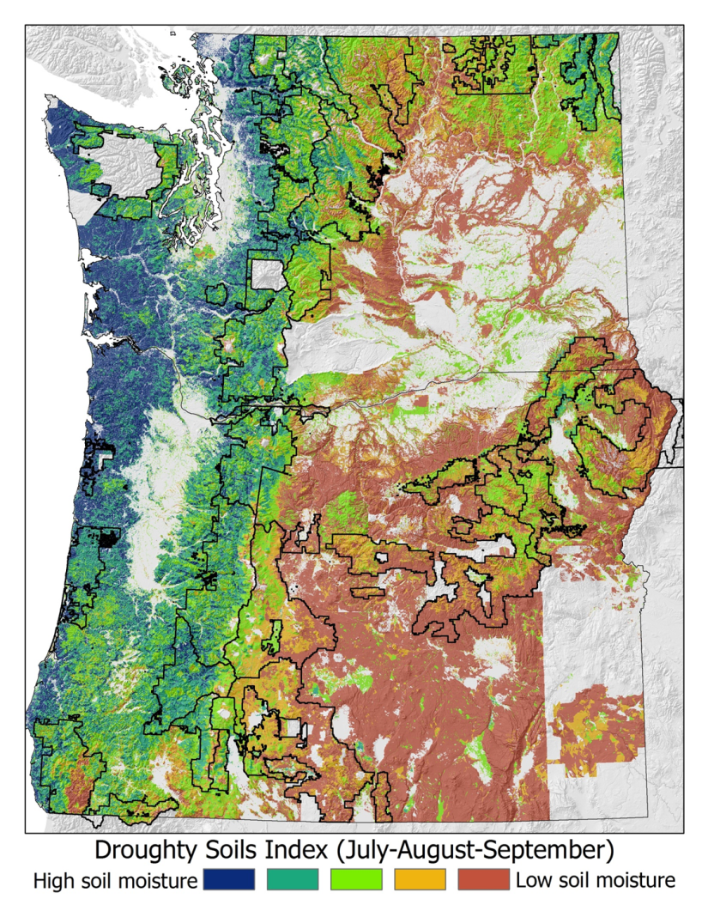
Drought Potential
General Climate vs. Soil Refined

Slide 14
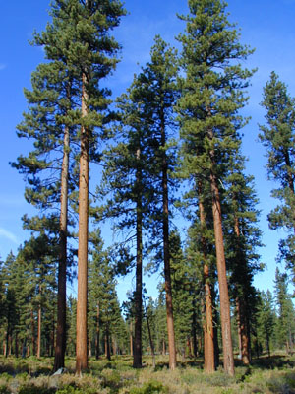
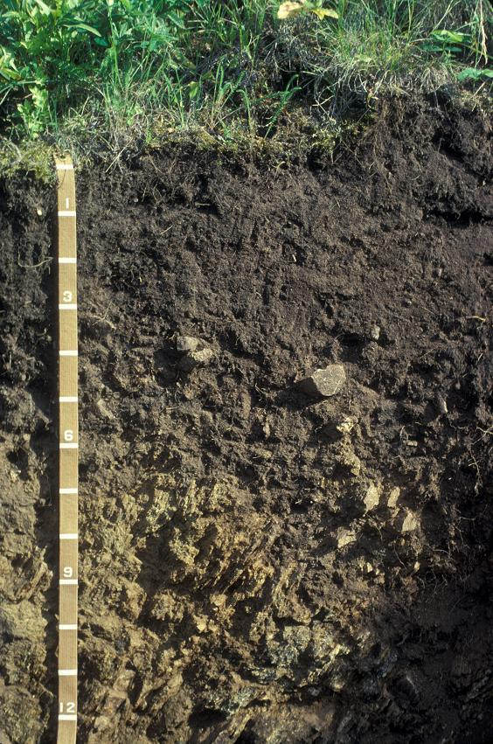
Read Soil Signatures - Mollisols

Slide 15
In Summary
The 2012 planning rule requires use of ecological information
Use the tools we have at hand to better understand ecosystem processes and functions.
Landtype Associations help bring core knowledge
  Engage in development, refinement and use of the information
Lead the conversations that will shape future landscapes

Slide 16
Questions?
Discussion?

