Slide 1
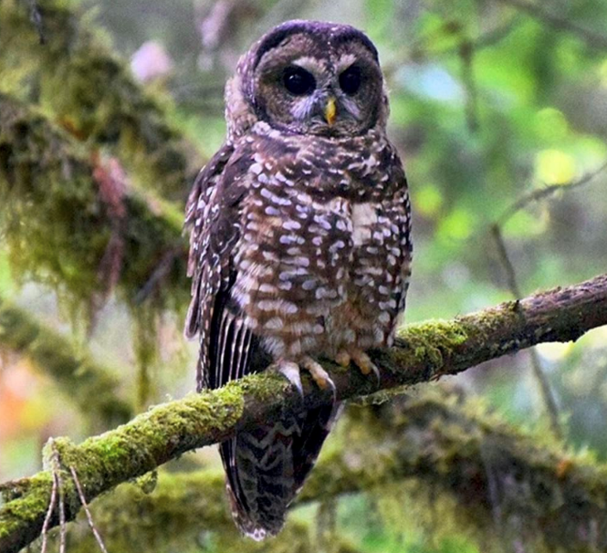
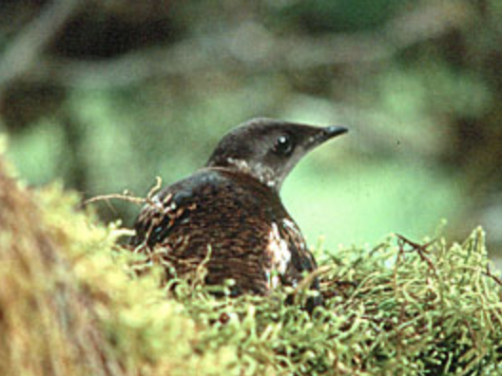
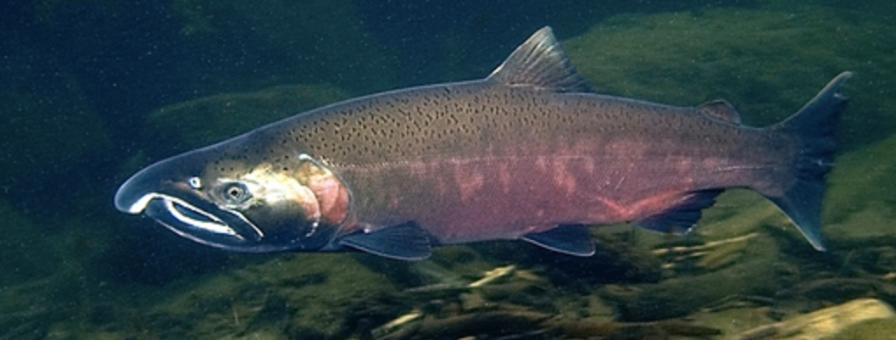
Integrating Aquatic & Terrestrial Needs: It Takes a Landscape
Gordon Reeves
Oregon State University

Slide 2
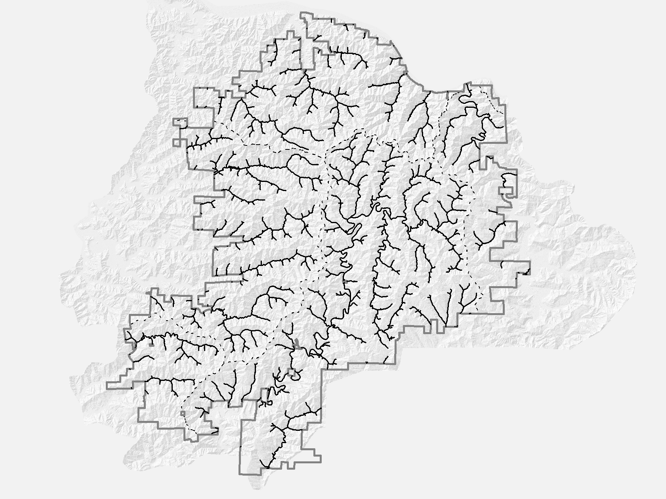

Slide 3
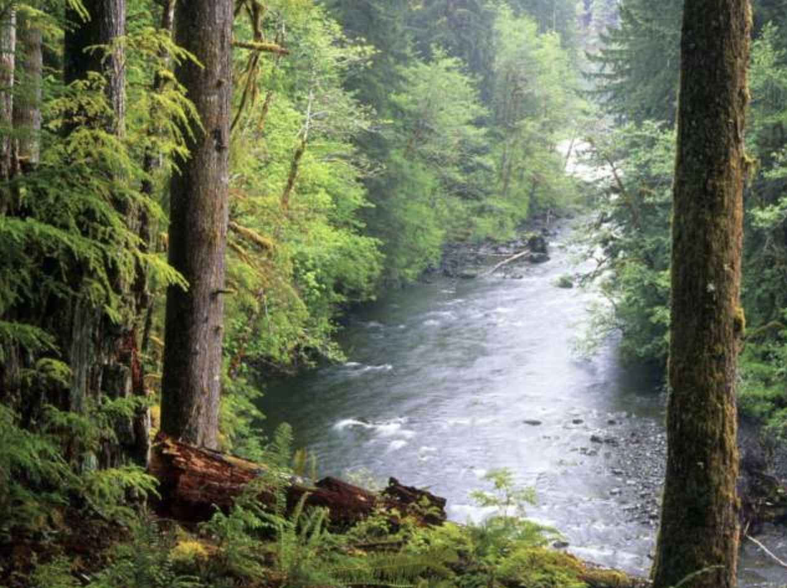

Slide 4
Maintaining riparian ecological functions
FEMAT (1993)

Slide 5
Maintaining riparian ecological functions
FEMAT (1993)

Slide 6
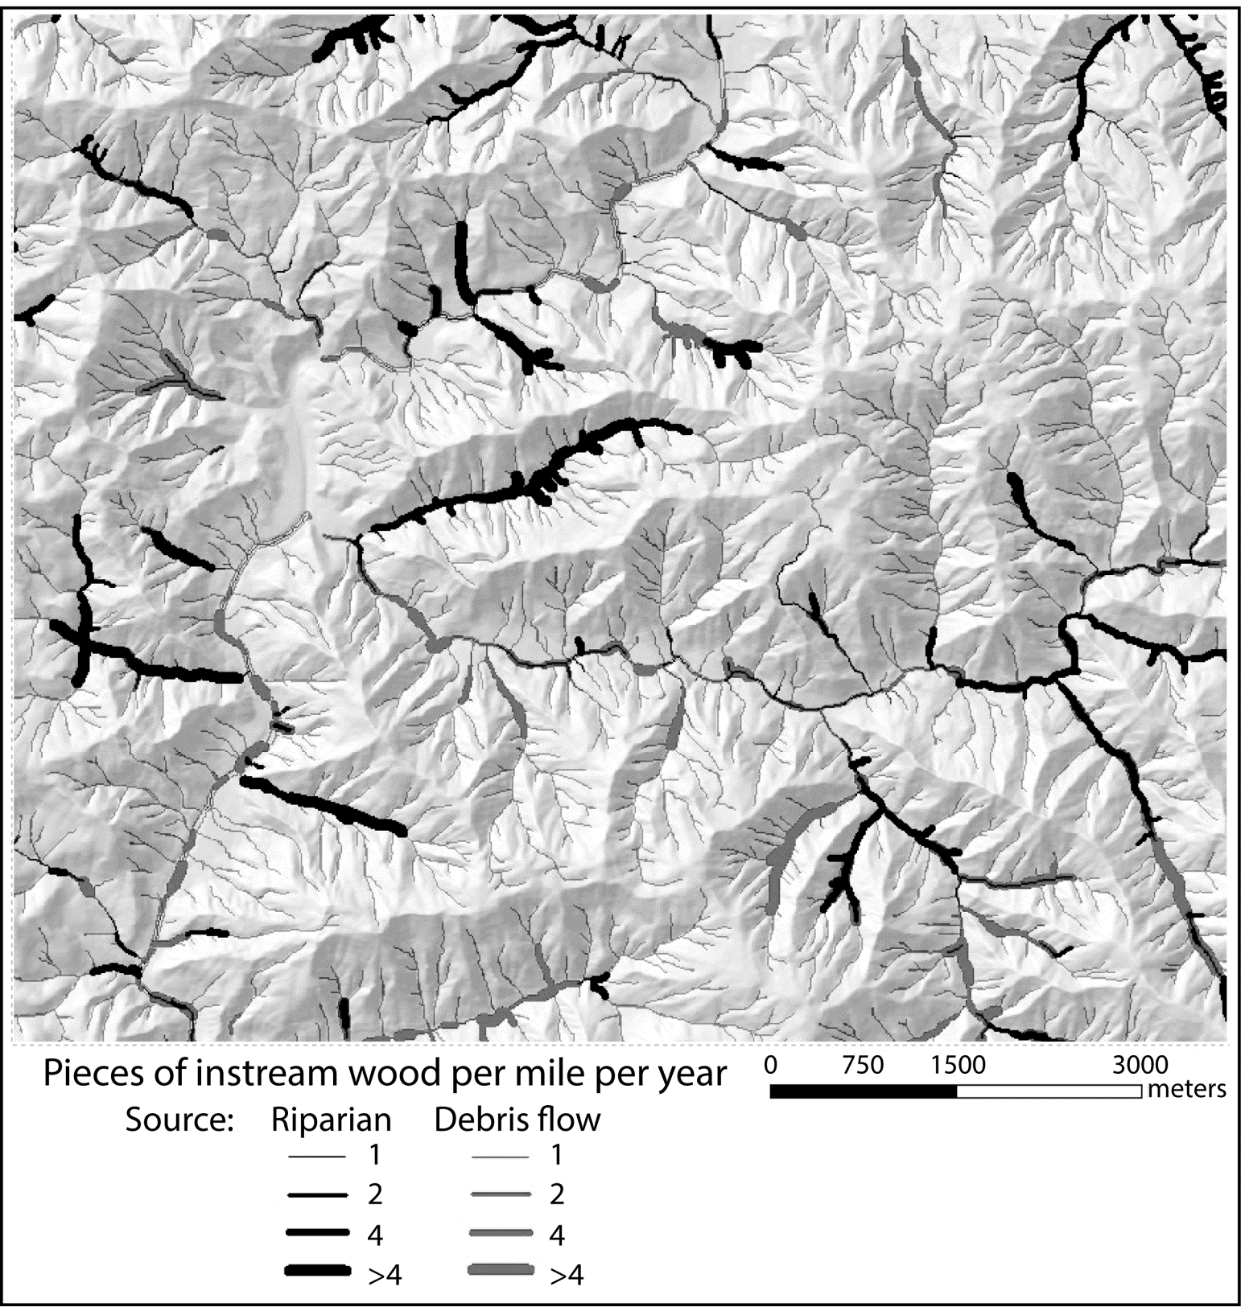
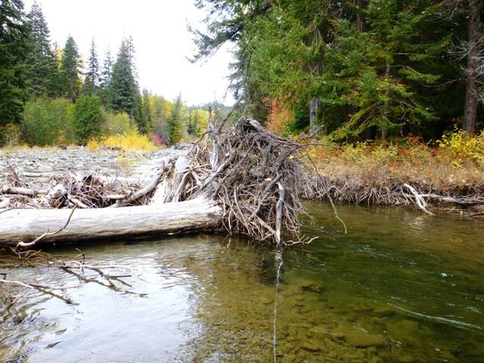
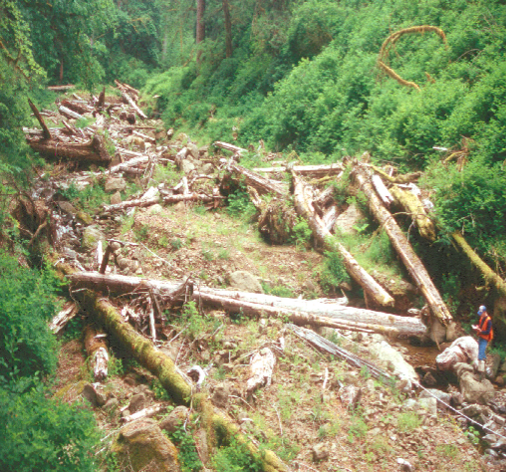
Large Wood Input
0.2-0.5 m diameter

Slide 7
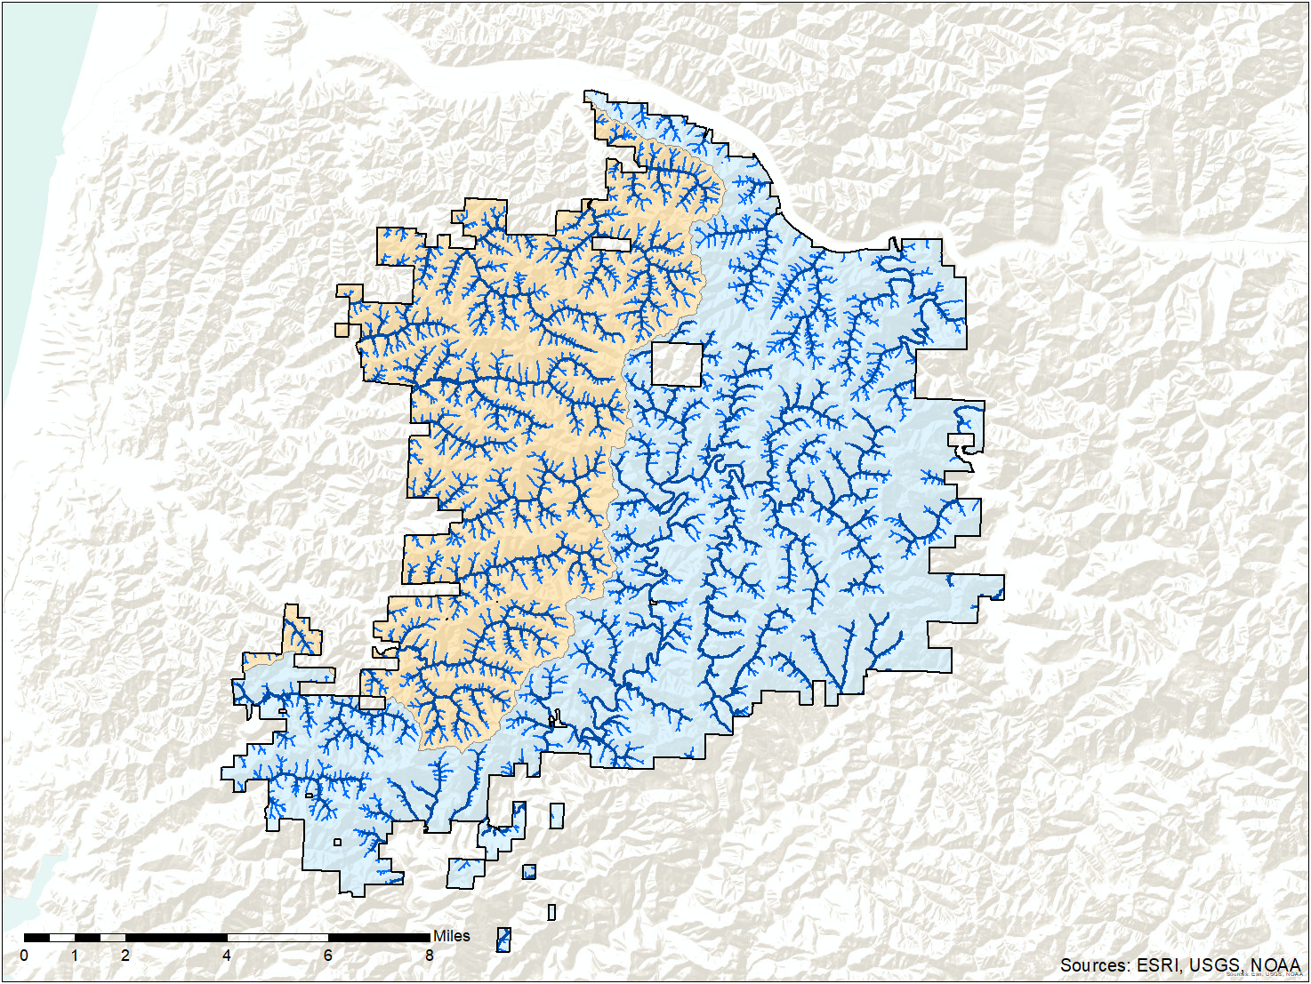
80% of Potential Wood Delivery
Fish-bearing
Non-fish bearing
80% Potential Recruitment
 | RMA Width | Stream Miles | RMA Acres | Percent of Forest
FB | 150 ft | 236/236 | 8,378 | 10% | 20%
NFB | 100 ft | 316/1,860 | 8,305 | 10%

Slide 8
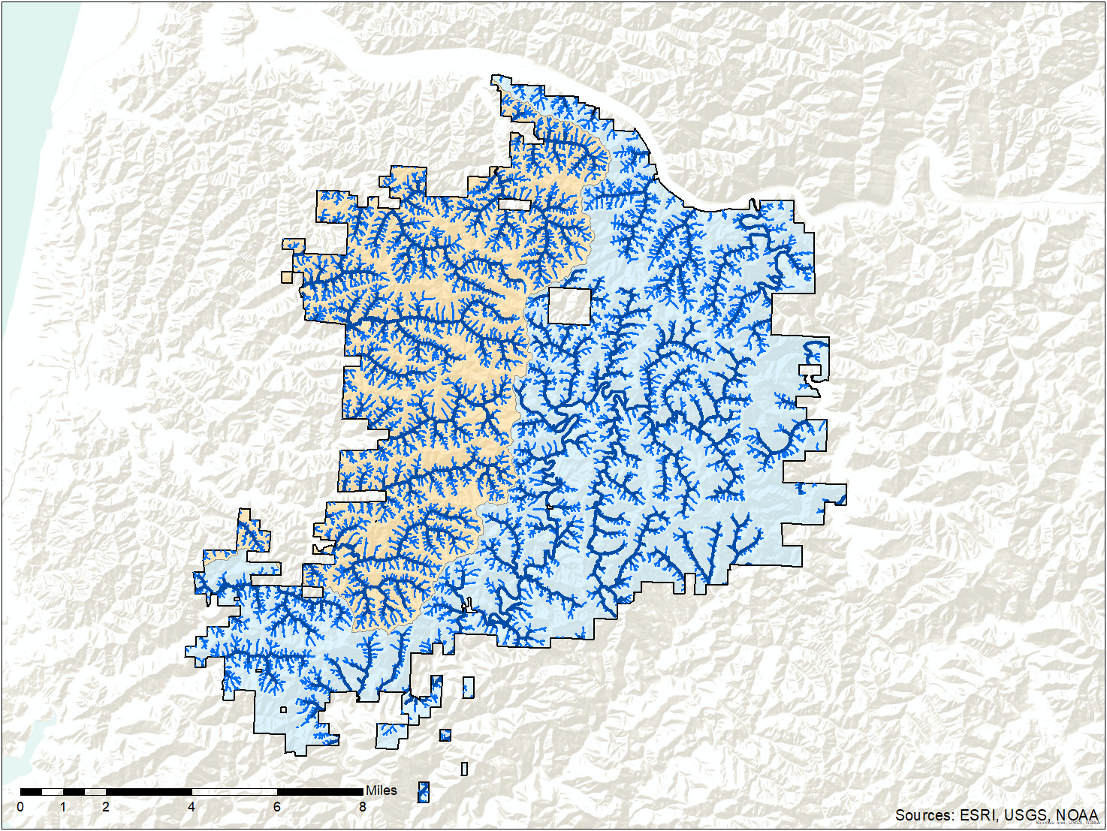
90% of Potential Wood Delivery
90% Potential Recruitment
 | RMA Width | Stream Miles | RMA Acres | Percent of Forest
FB | 200 ft | 236/236 | 11,082 | 13% | 33%
NFB | 120 ft | 512/1,860 | 15,607 | 20%

Slide 9
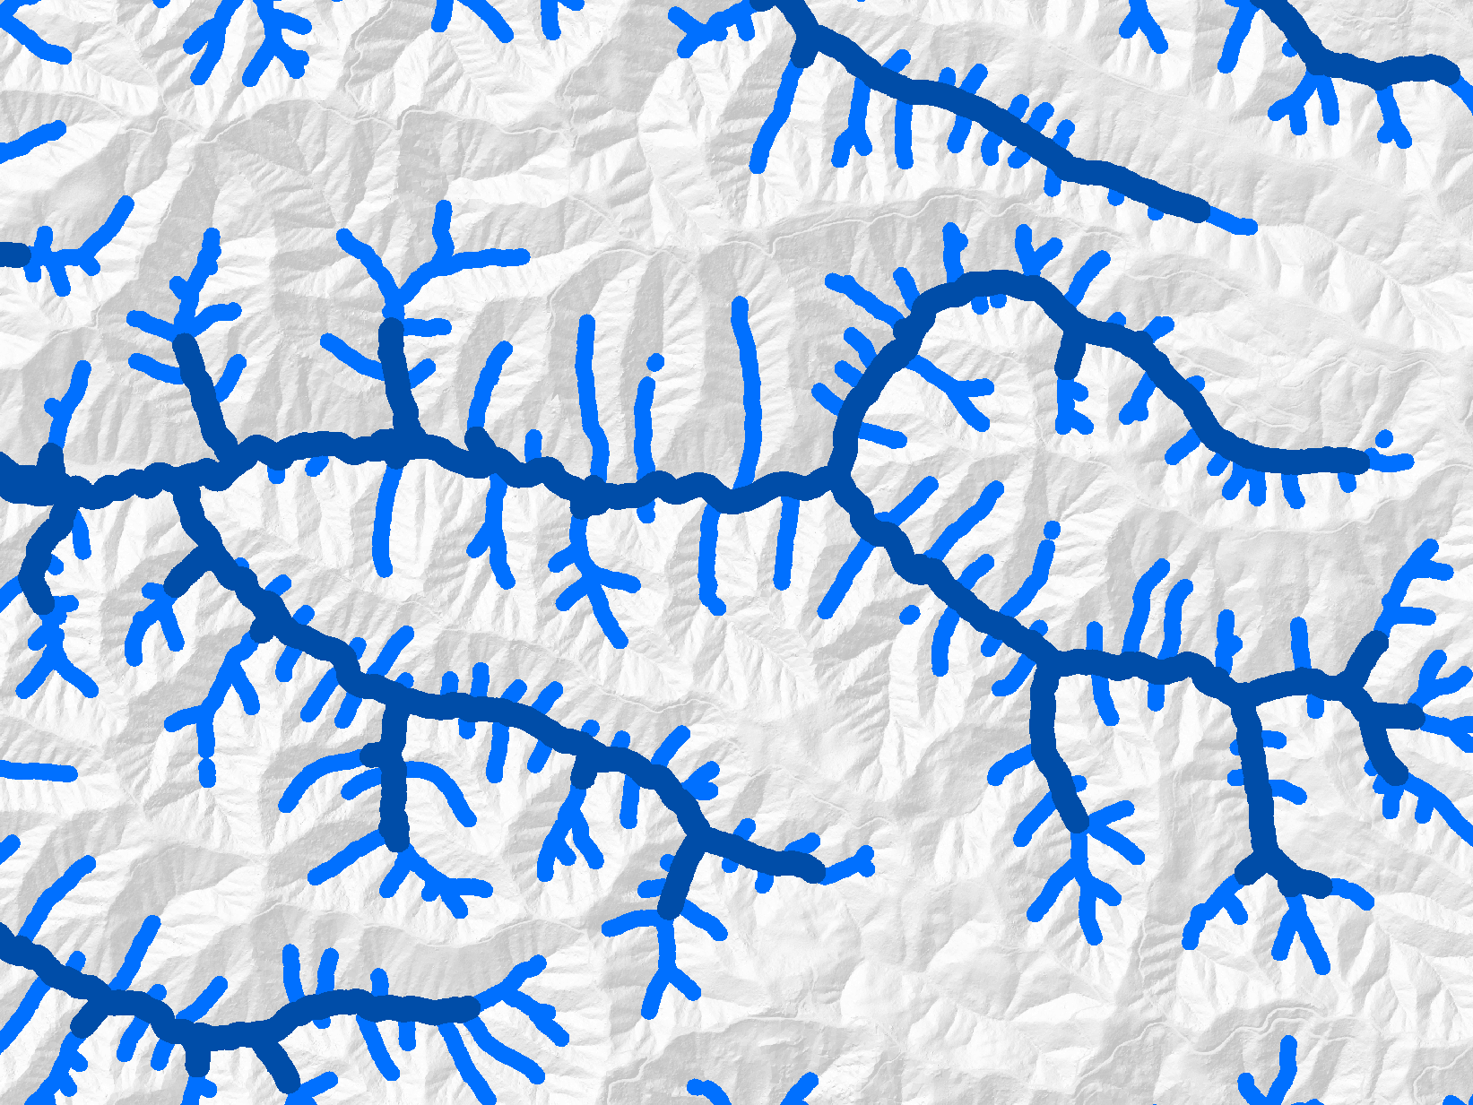
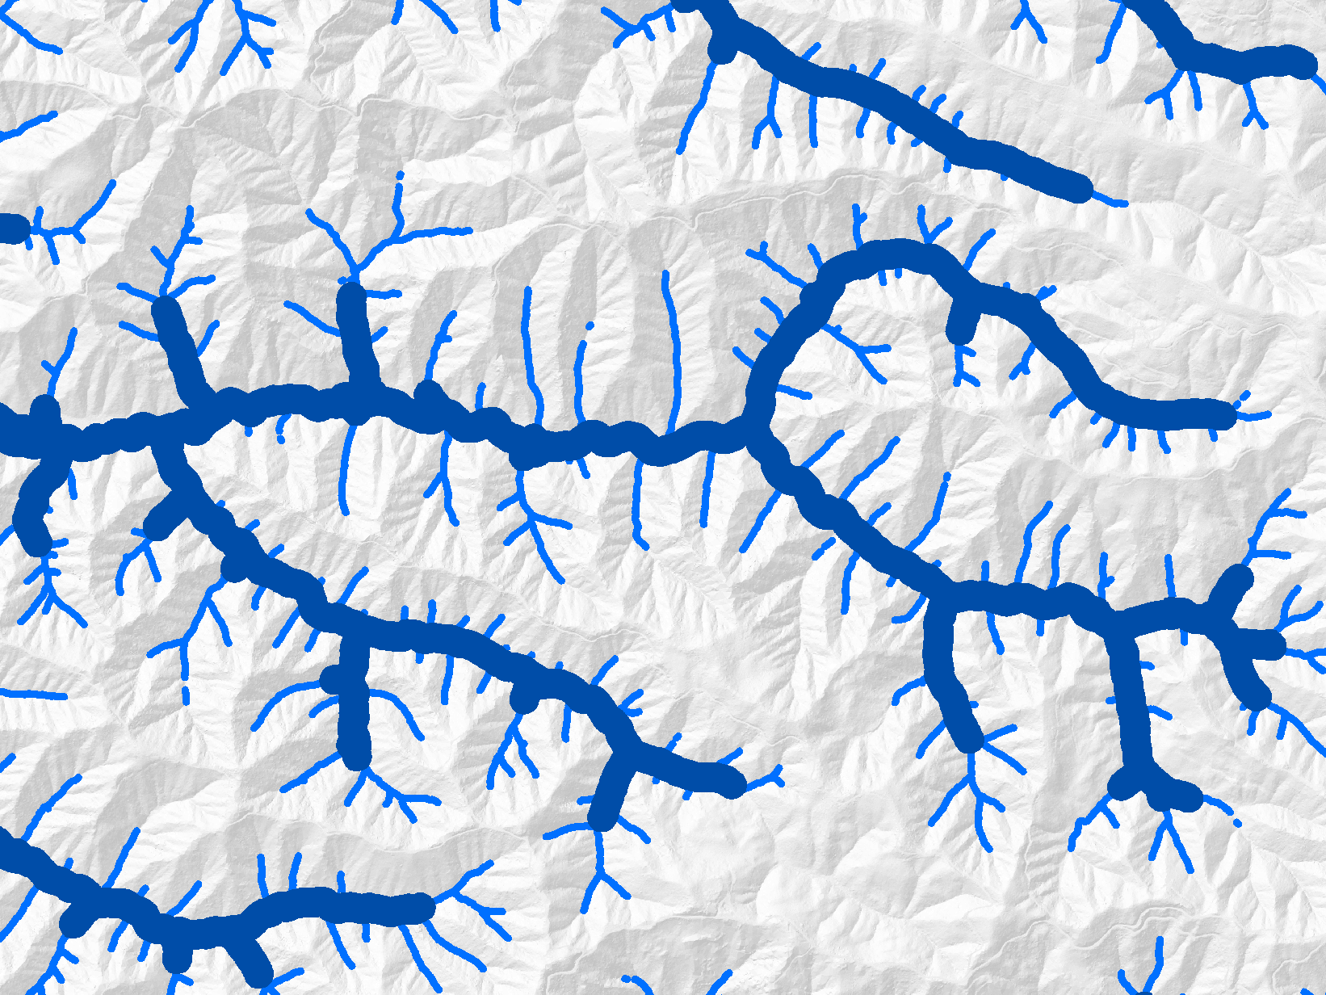
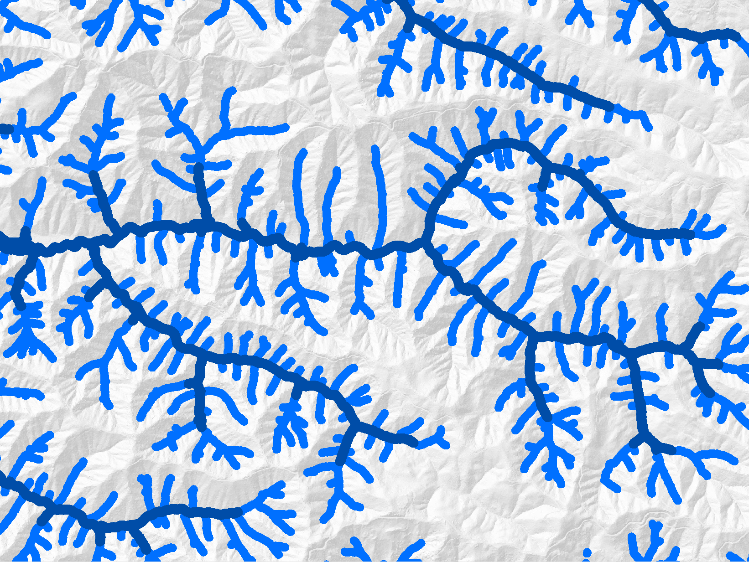
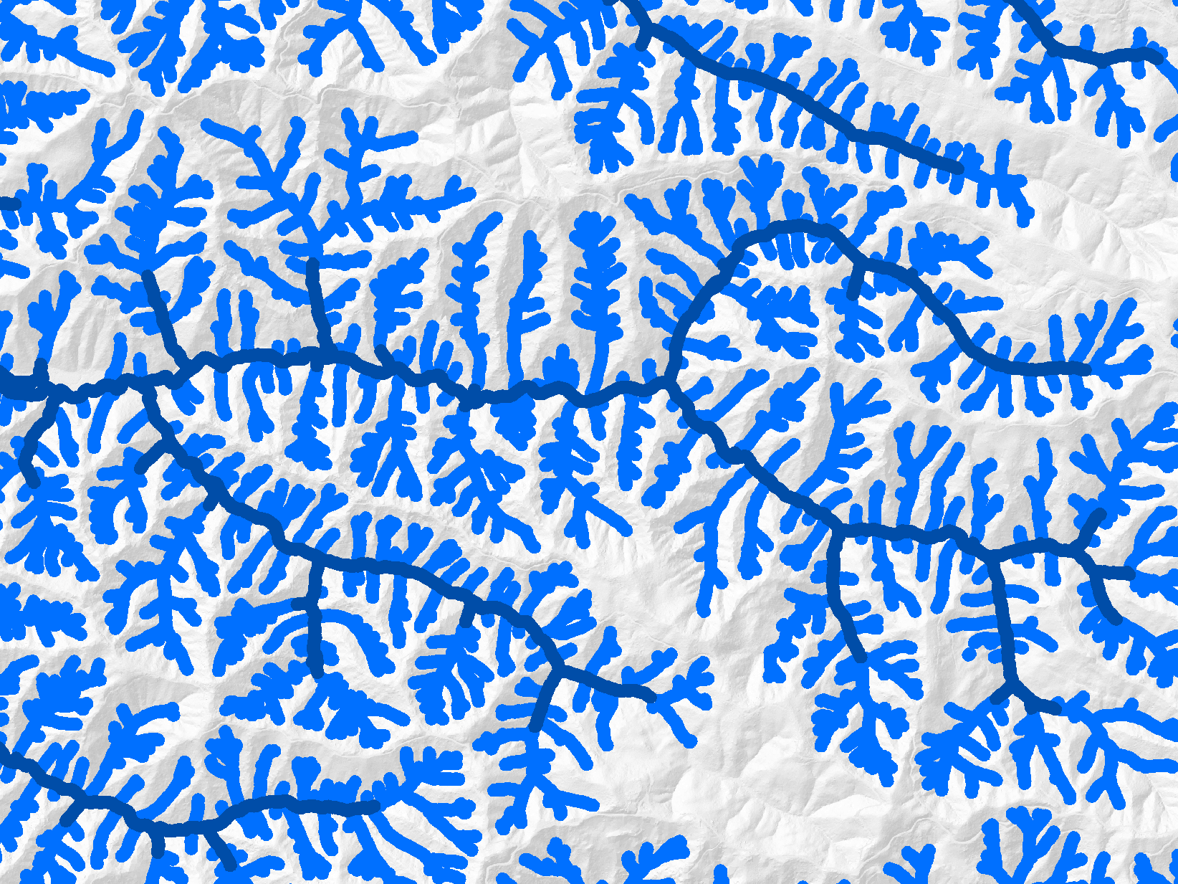
 | FB | NFB
Buffer Width (feet) | 150 | 100
Stream Miles | 236/236 | 316/1,860
Recruitment | 80%
Forest Area | 20%
 | FB | NFB
Buffer Width (feet) | 200 | 50
Stream Miles | 236/236 | 313/1,860
Recruitment | 80%
Forest Area | 18%
 | FB | NFB
Buffer Width (feet) | 120 | 100
Stream Miles | 236/236 | 551/1,860
Recruitment | 80%
Forest Area | 25%
 | FB | NFB
Buffer Width (feet) | 100 | 100
Stream Miles | 236/236 | 1,130/1,860
Recruitment | 80%
Forest Area | 38.5%

Slide 10
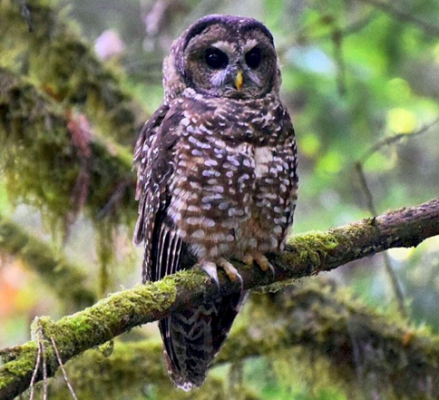
p
q
p
q
u
a
R
i
u
a
R
v
i
v
e
e
r
U
m
r
U
m
Lower
Lower
Lower
Lower
Umpqua
Umpqua
Umpqua
Umpqua
River
River
River
R
River
R
i
i
a
v
e
a
v
e
U
m
p
q
u
r
U
m
p
q
u
r
i
l
i
l
l
M
l
M
i
i
c
k
c
o
k
o
m
r
m
r
W
F
a
R
W
F
a
R
i
i
v
v
e
e
r
r
Tenmile
Tenmile
Tenmile
Tenmile
Creek-Frontal
Creek-Frontal
Creek-Frontal
Creek-Frontal
Pacific Ocean
Pacific Ocean
Pacific Ocean
Pacific Ocean
Mill
Mill
Mill
Mill
Creek
Creek
Creek
Creek
r
Northern Spotted Owl Status
r
e
e
v
Millicoma
v
Millicoma
l
i
Millicoma
i
l
i
Millicoma
i
l
R
l
R
M
i
M
i
c
c
o
m
o
m
k
a
River
k
a
River
r
River
r
River
o
o
F
t
F
t
s
s
e
e
W
Northern Spotted Owl Status
W
Marbled Murrelet detections
AB
!
Active owl pairs
Historically occupied
Potentially occupied
Abandoned
RS
(
Marbled Murrelet Detections
HS
r
PR
r
e
PU
e
v
v
i
i
R
R
c
o
m
a
c
o
m
a
i
i
l
RS
l
l
l
i
i
M
M

Slide 11
p
q
u
a
R
p
q
i
v
u
a
R
i
e
v
r
e
U
m
U
m
r
Lower
Lower
Lower
Lower
Umpqua
Umpqua
Umpqua
Umpqua
River
River
River
R
River
R
i
i
a
v
e
a
v
e
U
m
p
q
u
r
U
m
p
q
u
r
i
l
i
l
M
l
M
l
i
i
k
c
o
k
c
o
r
m
r
m
W
F
a
R
W
F
a
R
i
i
v
v
e
e
r
r
Tenmile
Tenmile
Tenmile
Tenmile
Creek-Frontal
Creek-Frontal
Creek-Frontal
Creek-Frontal
Pacific Ocean
Pacific Ocean
Pacific Ocean
Pacific Ocean
Mill
Mill
Mill
Mill
Creek
Creek
Creek
Creek
r
r
e
e
v
Millicoma
v
Millicoma
i
l
i
Millicoma
i
l
i
Millicoma
l
R
l
i
R
M
i
M
c
o
m
c
o
m
k
a
River
k
a
River
Intrinsic Potential for Coho
River
r
r
River
o
o
F
t
F
t
s
s
e
e
W
Northern Spotted Owl Status
W
AB
!
HS
(
Marbled Murrelet Detections
r
PR
High
Moderate
Low
r
e
PU
e
v
v
i
i
R
R
o
m
a
o
a
c
c
m
i
i
l
RS
l
l
l
i
i
M
M

Slide 12
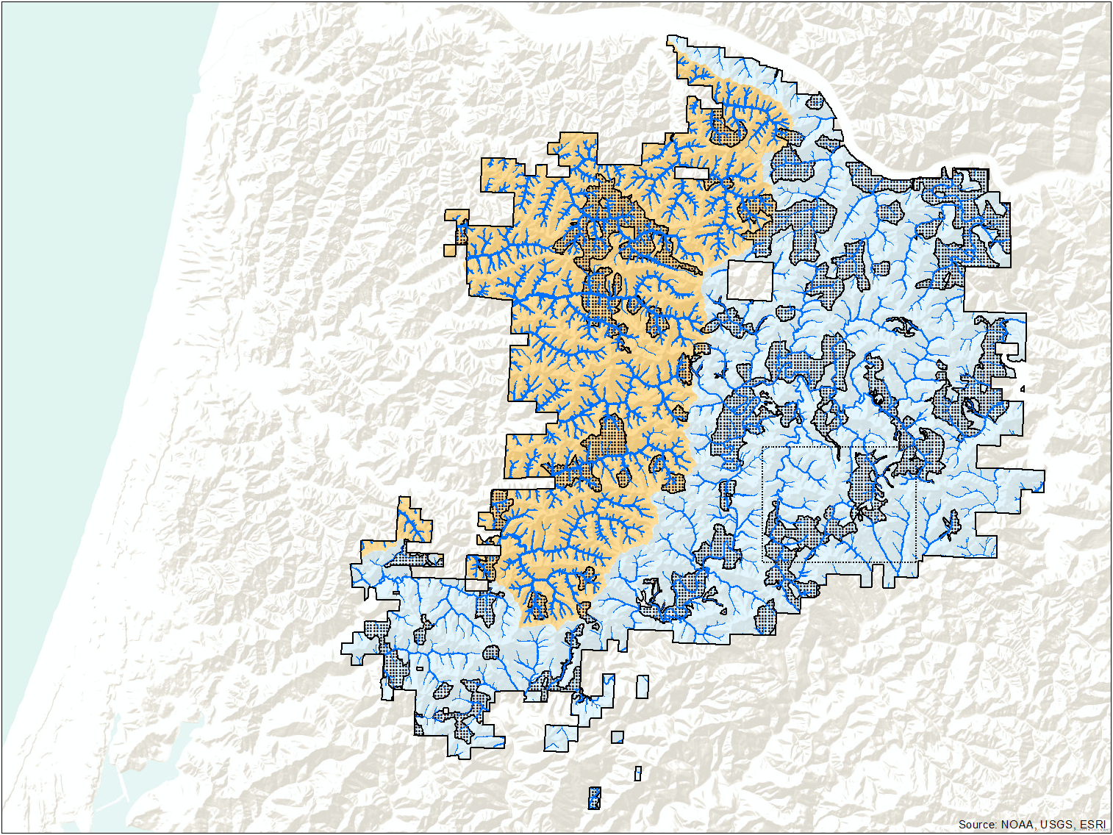
DRAFT 10/24/2019

Slide 13
Conservation
Emphasis
Multiple
Objectives

Slide 14
Conservation
Emphasis
Multiple
Objectives
Manage Stands <80 years old
Ecological Forestry
Long Rotations

Slide 15
Conservation
Emphasis
Multiple
Objectives
Manage Stands <80 years old
Ecological Forestry
Long Rotations
Habitat Circles – NSO & MM
Variable width riparian areas
Manage All Stands
Ecological Forestry

Slide 16
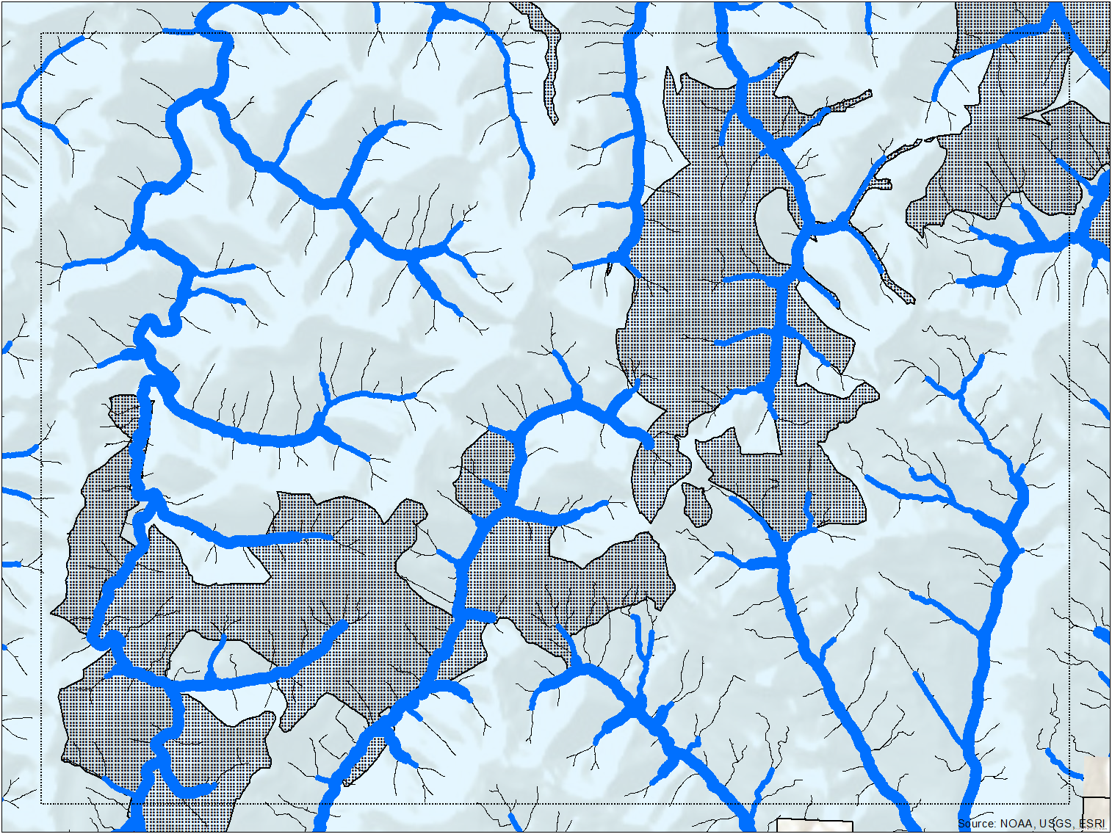
Wood Recruitment Potential
 | CRW | MRW | All
Without Terrestrial Reserves | 80% | 63% | 70%
Including Terrestrial Reserves | 83% | 73% | 77%
DRAFT 10/24/2019

Slide 17
Wood Recruitment Potential
 | CRW | MRW | All
Without Terrestrial Reserves | 80% | 63% | 70%
Including Terrestrial Reserves | 83% | 73% | 77%
DRAFT 10/24/2019

Slide 18
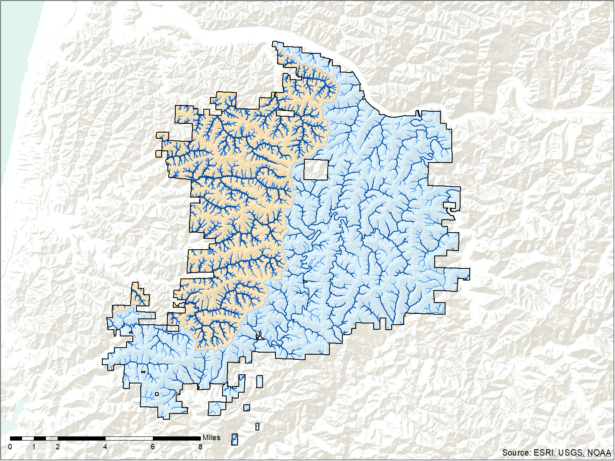
Wood Delivery Potential
70% Overall
- 80% Conservation Emphasis
- 63.2% Multiple Objectives
Fish-bearing
RMA Width 100’
Fish-bearing
RMA Width 150’
Non-fish bearing
RMA Width 50’
Non-fish bearing
RMA Width 50’

Slide 19
Projected Mean August
Water Temperatures (ºC) in 2040 (NorWest)

Slide 20
Stream Reaches Where Riparian Vegetation Exerts Most Influence on Water Temperature

Slide 21
Projected Increases in
Mean Winter Flows in 2040

Slide 22
Wood Sources in Non-fish Bearing Streams
From: D. Miller unpublished

Slide 23
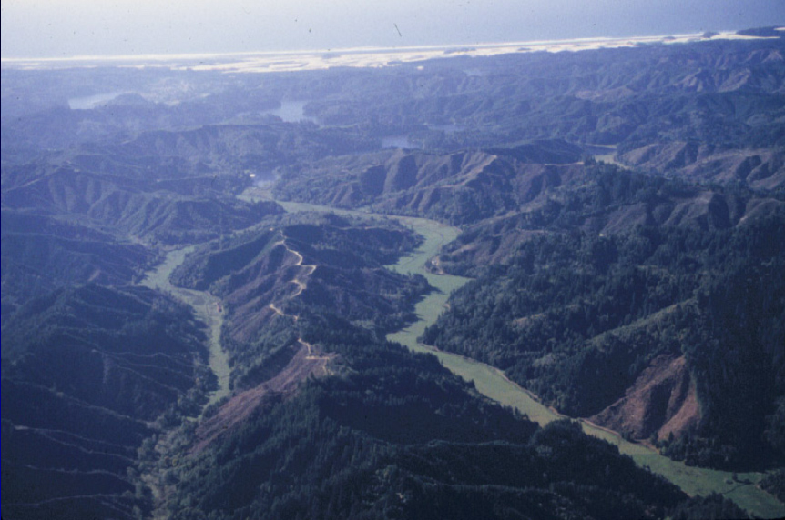
Summary
Consider larger scales
Go Big or Go Home!

Slide 24
Summary
Consider larger scales
Variable goals/objectives

Slide 25
Summary
Consider larger scales
Variable goals/objectives
Look for ways to be efficient

Slide 26
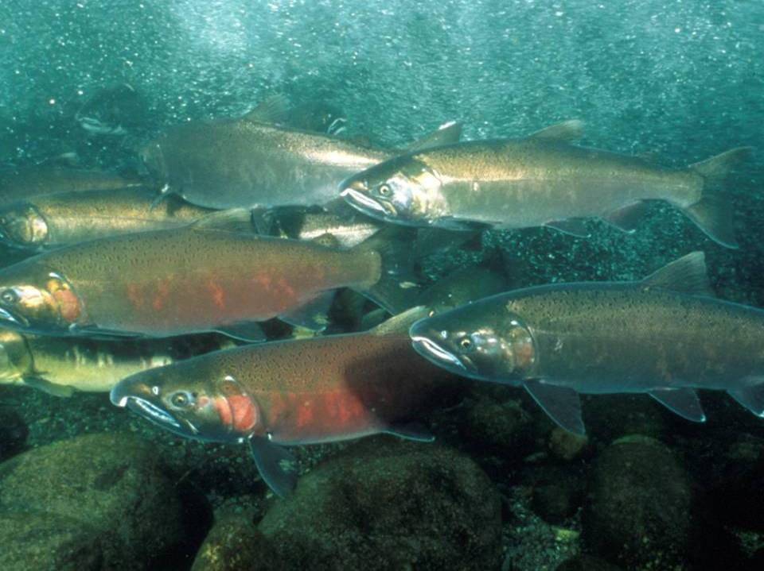
“The significant problems we face today cannot be solved with the same level of thinking that were at when we created them.”
Albert Einstein
Notes:
26
26

Slide 27
Wood Sources in Non-fish Bearing Streams
•
• 20%
• • 40%
• • • 60%
• • • • 80%
• • • • • 100%
From: D. Miller unpublished

Slide 28
All-Lands Consideration
Percent of Watershed Area
Myrtle Creek
Smith-Siuslaw
Coquille
McKenzie
North Umpqua
Nestucca
Applegate
High-priority fish-bearing streams located on:
Federal lands Non-federal lands
Source: Pickard et al. (2013)

Slide 29
Maintaining riparian ecological functions
FEMAT (1993)

