Slide 1
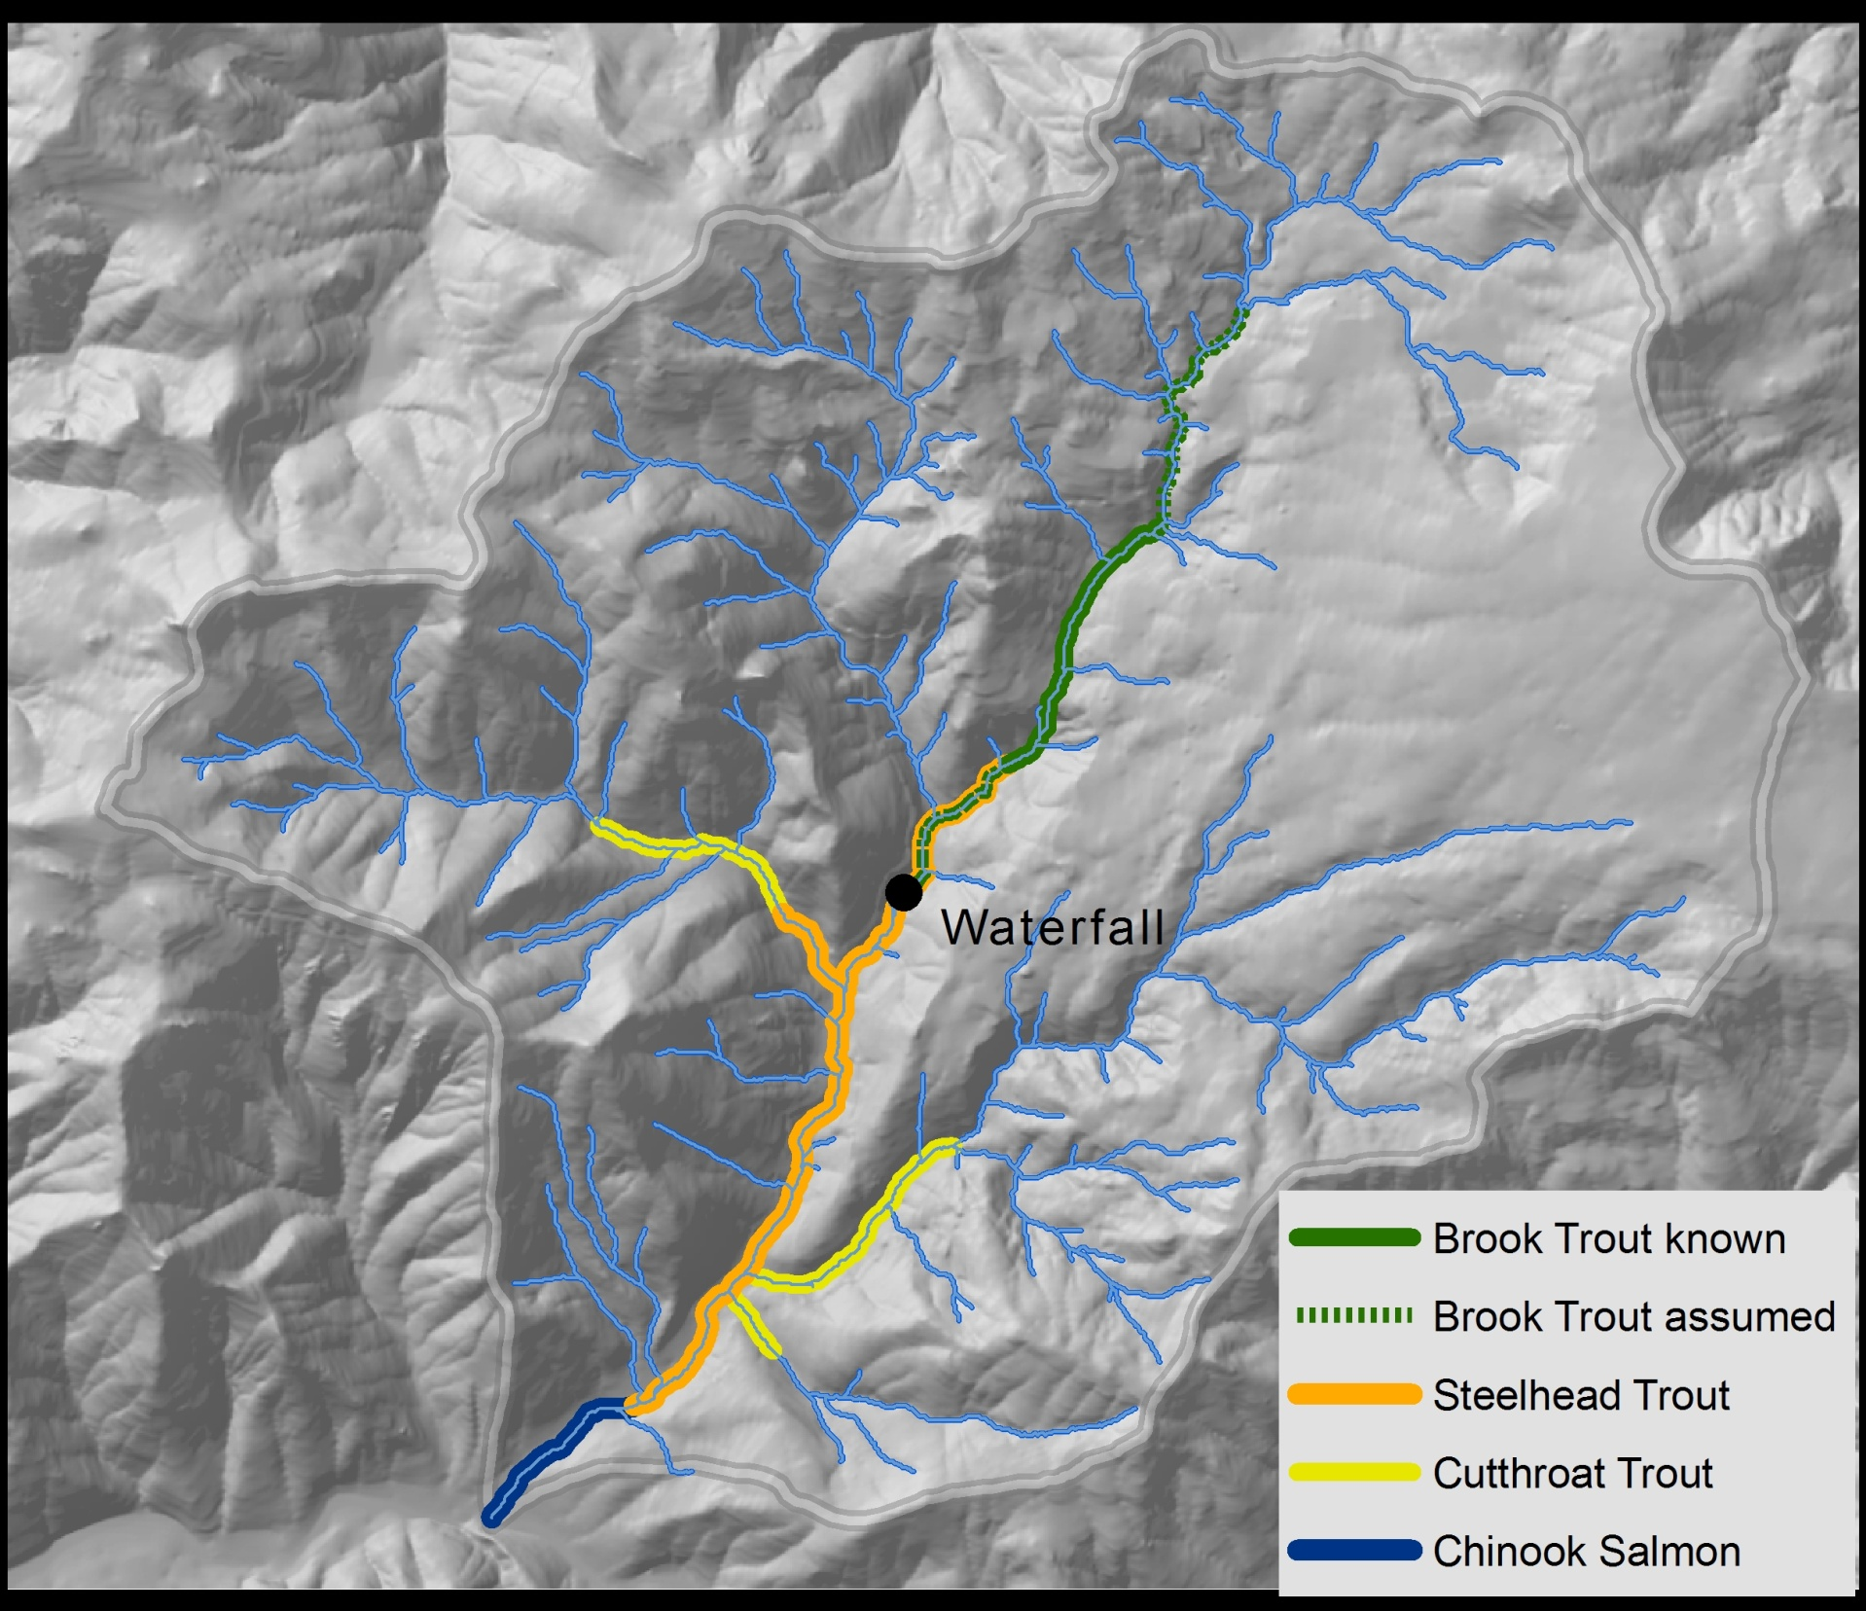

Integrating Aquatic & Terrestrial Needs:
It Takes a Landscape
[Part 2]
Deanna H. Olson
Research Ecologist
PNW Research Station
US Forest Service
Corvallis, OR

Slide 2
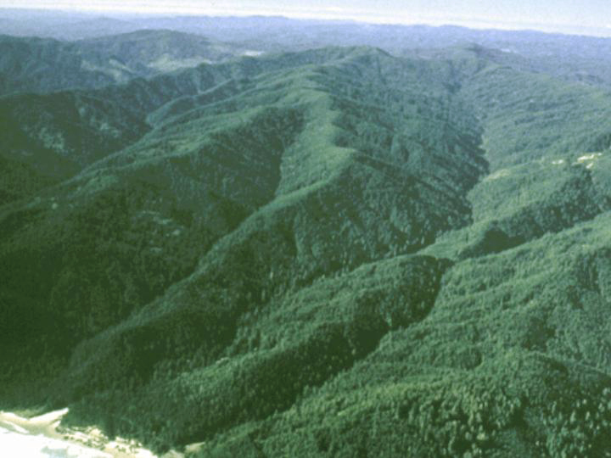
In Northwest Forests,
up to 80% of
stream network length may be
headwater streams
(Gomi et al. 2002)
Thank you, Brett Blundon, Cool Soda map!

Slide 3
Many species use forested stream corridors, especially with Riparian Buffers
>100 LSOG species likely benefit
‘Funneling’ to headwaters
Olson & Burnett 2013, Olson & Kluber 2014

Slide 4


Key Considerations for
Headwater Management
Down wood recruitment
Debris flow potential
Stream temperature/thermal loading
Fish intrinsic potential
Fish prey inputs
Water flow regime
Headwater stream-associated species & habitats
Riparian forest-associated species & habitats
Overland connectivity habitats
Forest restoration
Fuels management

Slide 5
Key Considerations for
Headwater Management
Down wood recruitment
Debris flow potential
Stream temperature/thermal loading
Fish intrinsic potential
Fish prey inputs
Water flow regime
Headwater stream-associated species & habitats
Riparian forest-associated species & habitats
Overland connectivity habitats
Forest restoration
Fuels management

Slide 6
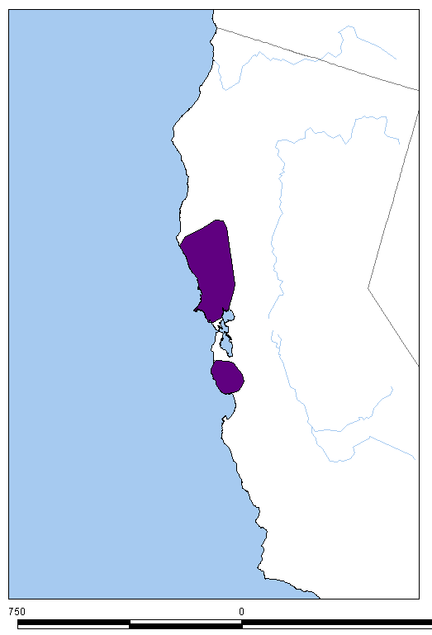
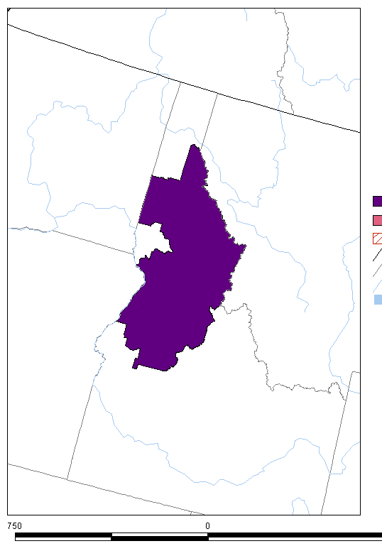
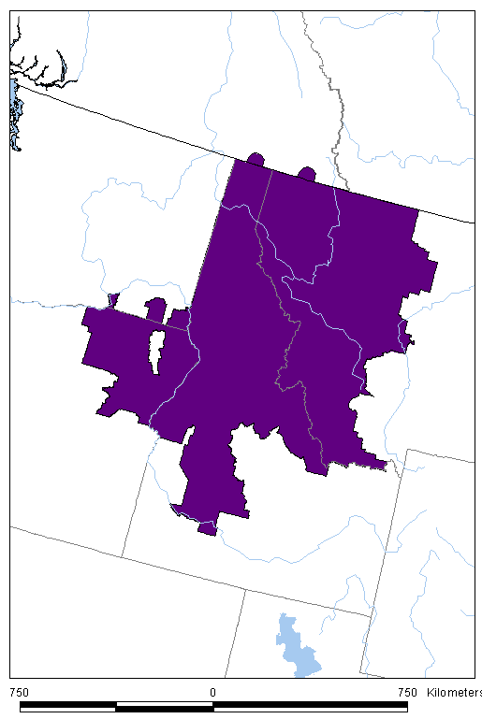
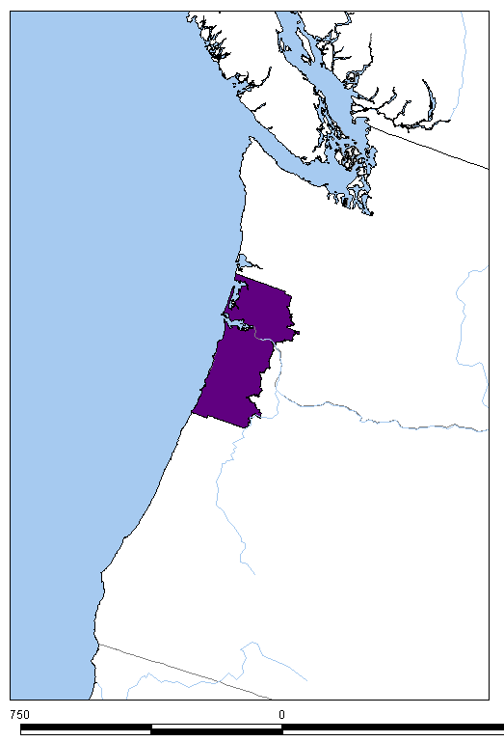
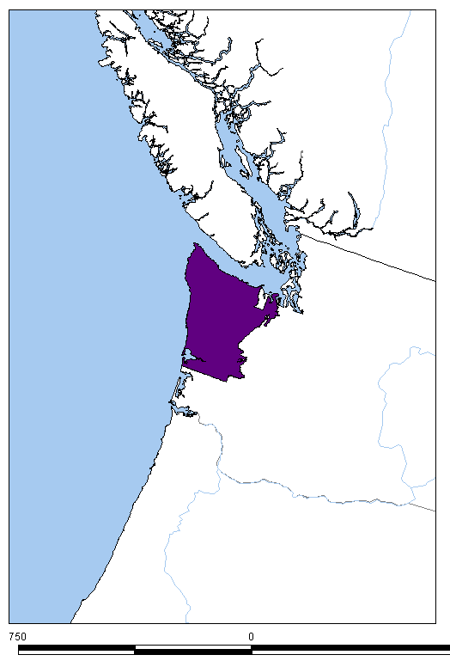
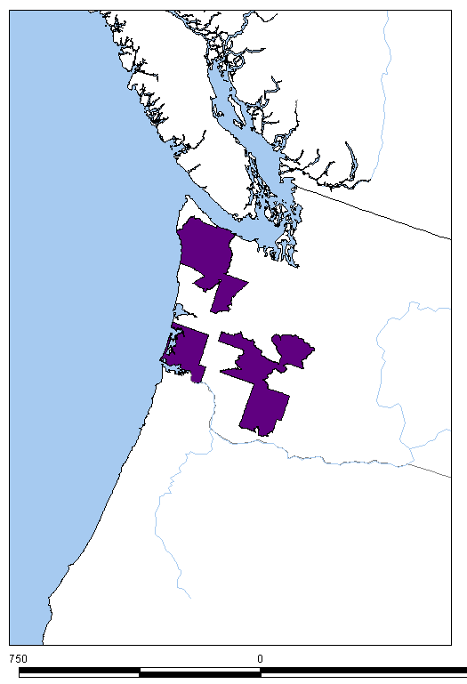
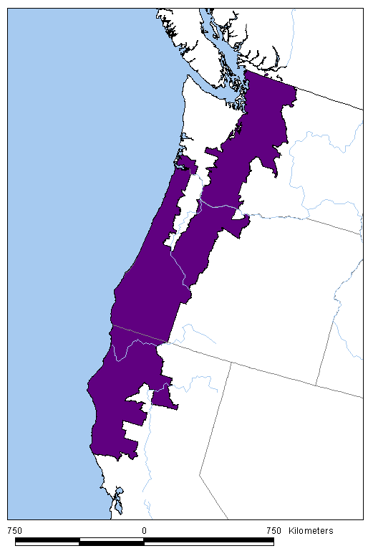
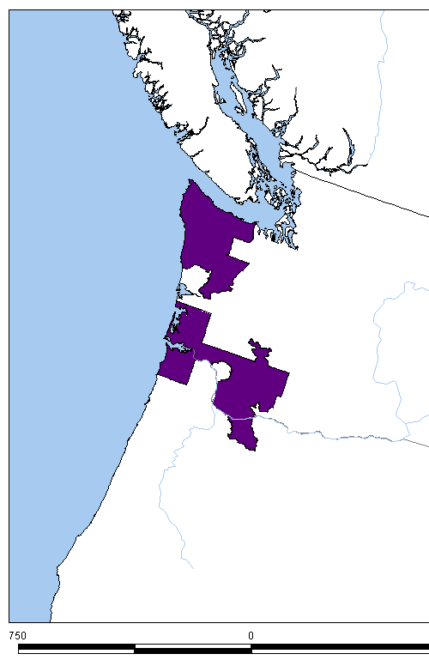
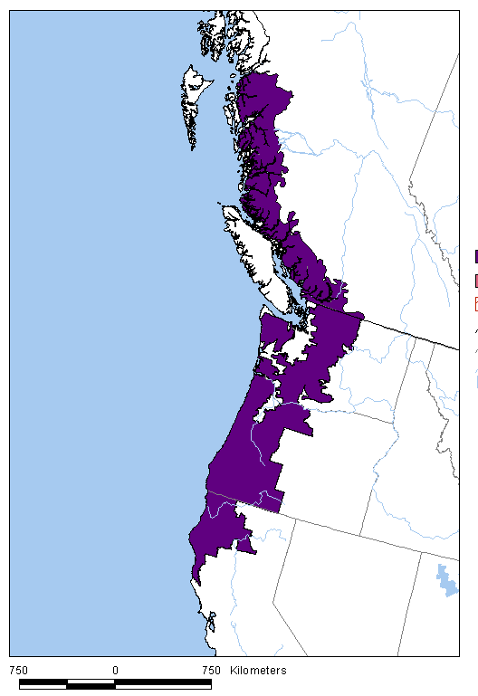
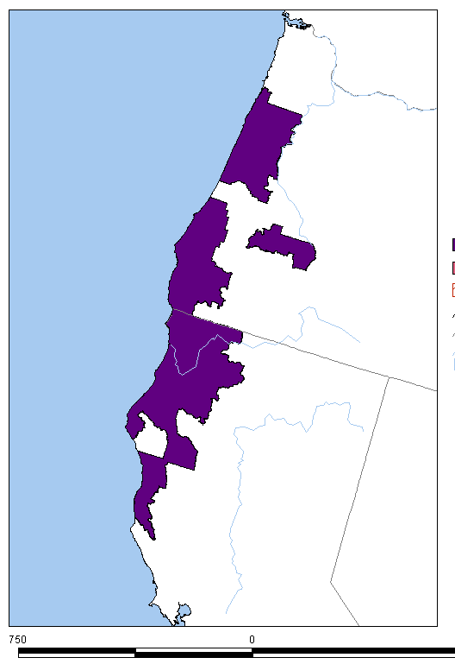
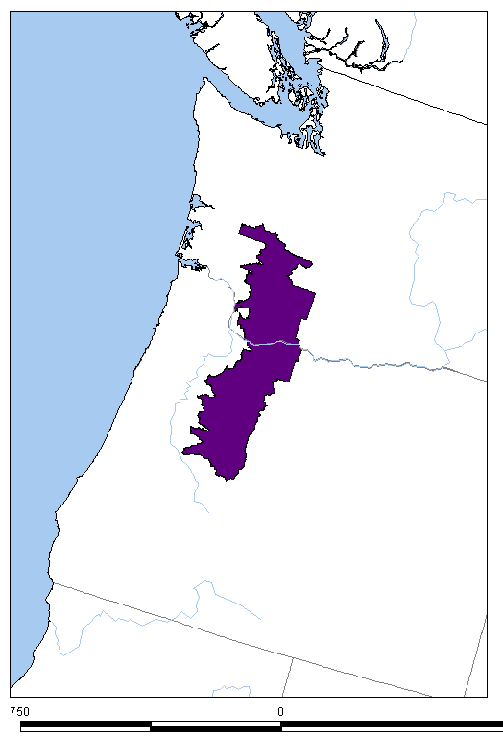
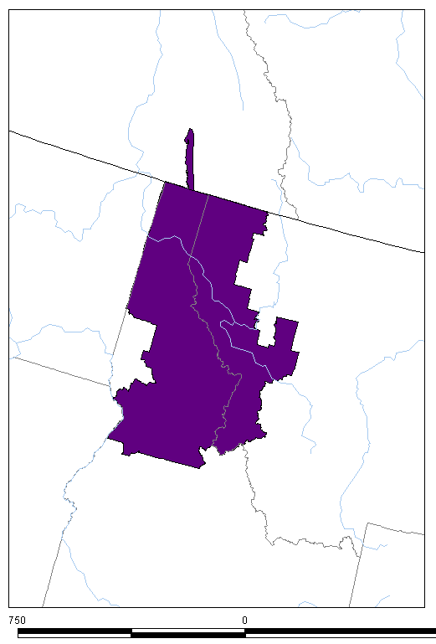
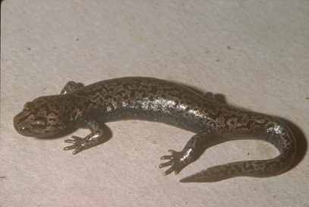
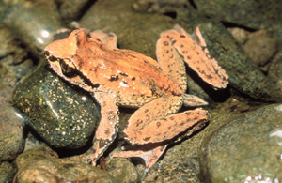
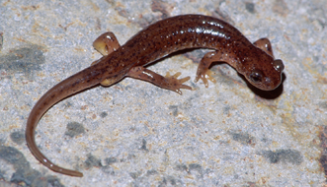
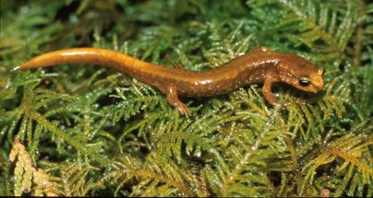
Proactive measures can help many species…
12 Example NW Endemic Stream Amphibian Species with Headwater Forest Associations
Maps from www.natureserve.org
Van Dyke’s & Coeur d’Alene Salamanders
Giant Salamanders Tailed Frogs Torrent Salamanders

Slide 7
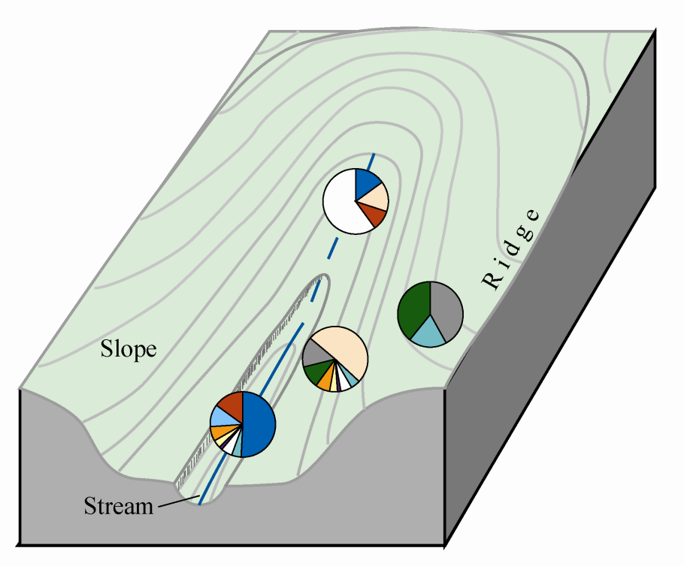

Headwater Streams: Amphibian Breeding Habitat
Sheridan and Olson 2005; Olson and Weaver 2007
4+ amphibian assemblages
Intermittent streams
Perennial streams
Streambanks
Upland
Torrent salamanders
Giant salamanders

Slide 8
From a headwaters + landscape perspective,
what considerations come to the foreground
to integrate aquatic and terrestrial systems?
3 vignettes…
4+ amphibian assemblages
Intermittent streams
Perennial streams
Streambanks
Upland
Torrent salamanders
1. Giant salamanders

Slide 9
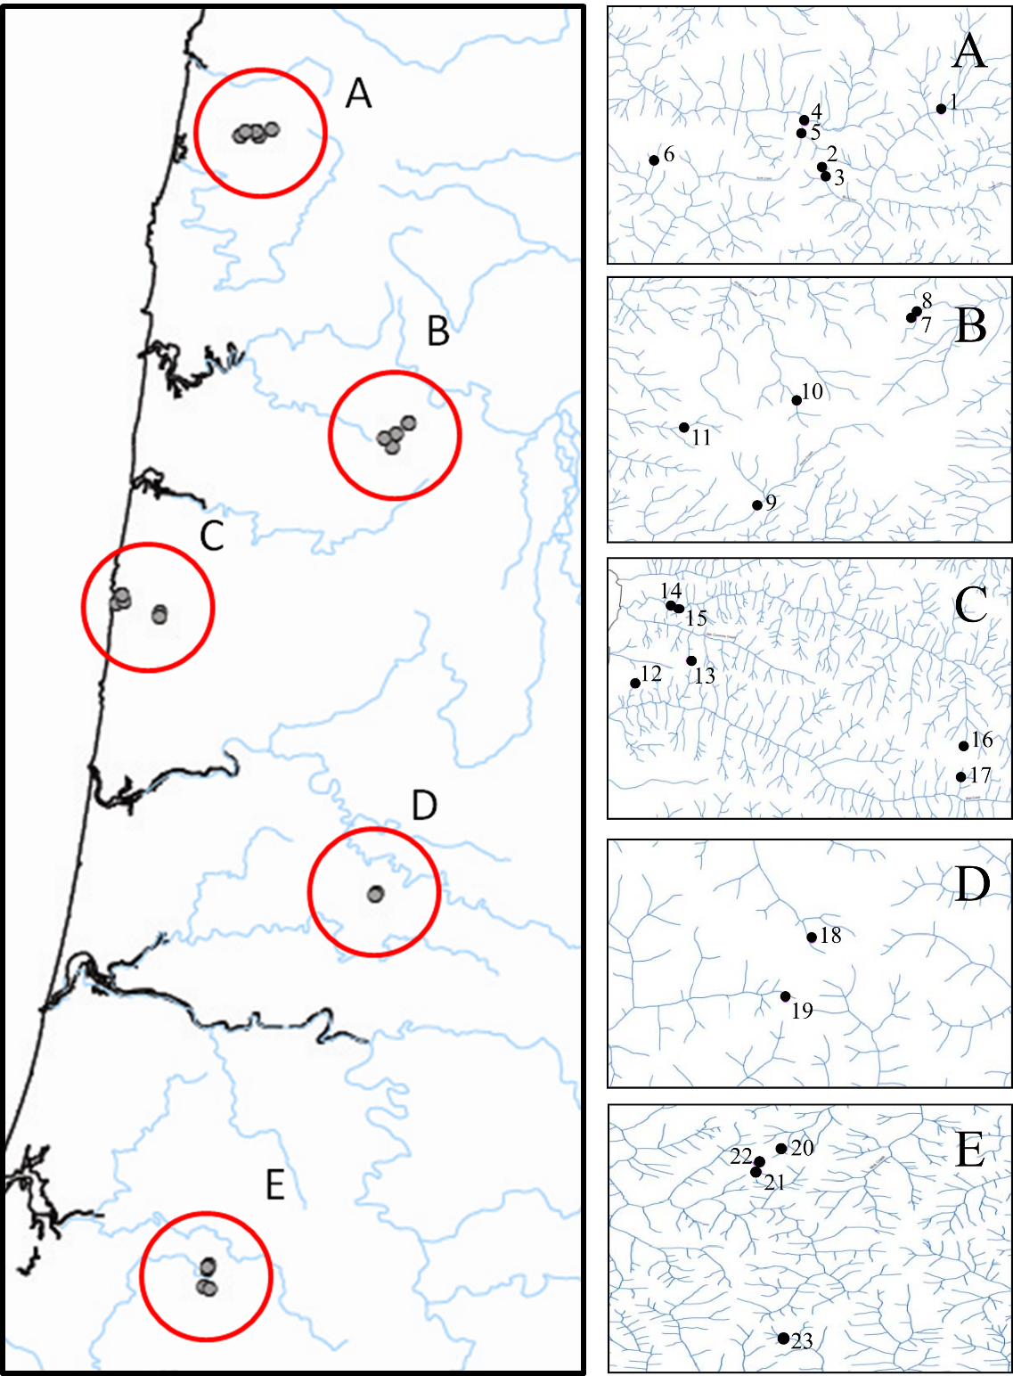
1. Giant Salamander Landscape Genetic Patterns Auteri, Marchan-Rivadeneira, Olson, & Knowles in prep.
No landscape predictor of genetic pattern
Strong South to North gradient
→ still “chasing” glacial retreat
~20% of sites show bottlenecks
→ support for metapopulations
Not highly mobile, populations can blink out, redundant overridge connections important

Slide 10
2. Torrent Salamander Landscape Genetic Patterns Emel, Olson, Knowles, and Storfer 2019
Two Species examined
Columbia torrent salamander (Rhyacotriton kezeri) **proposed for ESA
Southern torrent salamander (Rhyacotriton variegatus)
Gene flow associations with landscape attributes
Forest cover top predictor of connectivity
i.e., forest cover is tied to dispersal habitat

Slide 11
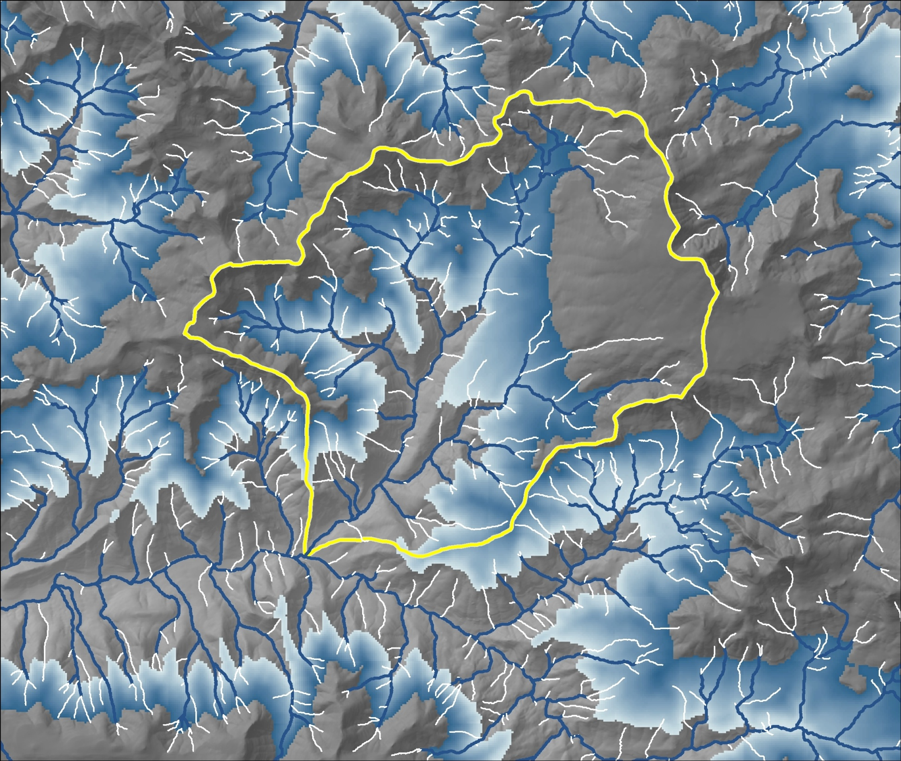
3. Streamflow concerns with forest harvest and climate change?
If there is a climate signature, what is the projected effect of climate change scenarios?
Olson and Burton 2019, Forests

Slide 12
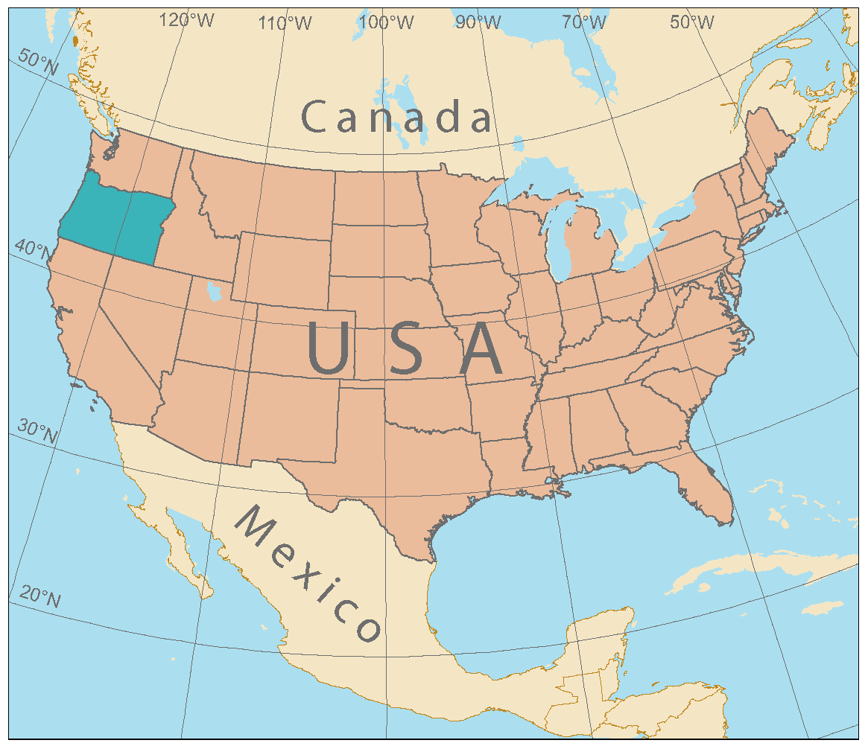
Empirical data on streamflow from
DMS study of western Oregon
BLM and FS lands
1993 to present
Notes:
The Riparian Buffer Study was designed to be implemented at 13 sites in western Oregon, ranging from near Mount Hood to Coos Bay. Three sites occur on Forest Service lands, and 10 on BLM lands. The 3 Forest Service sites and 7 BLM sites are in young managed stands, ages 30-50 yrs, naturally regenerated. Three BLM sites are in an older age class, 70-80 years, two of which have been previously thinned and one not. These sites offer a forward look into possible riparian restoration treatments of older stands. For the purpose of analyses presented today, all sites are combined.

Slide 13
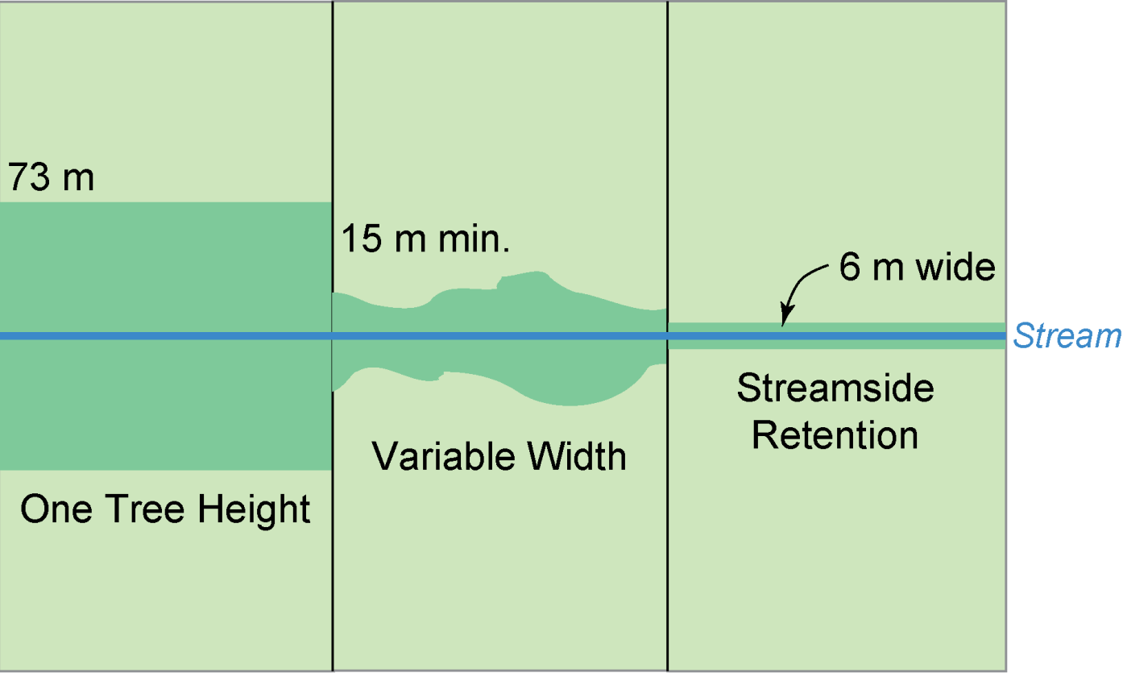
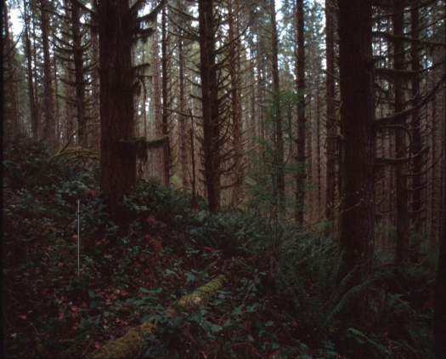
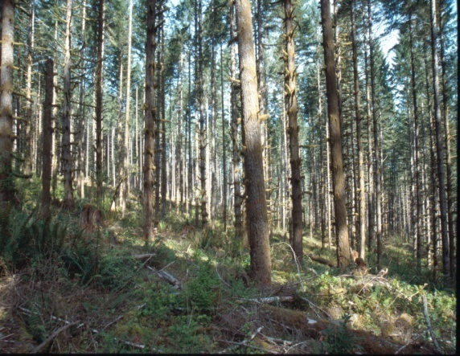
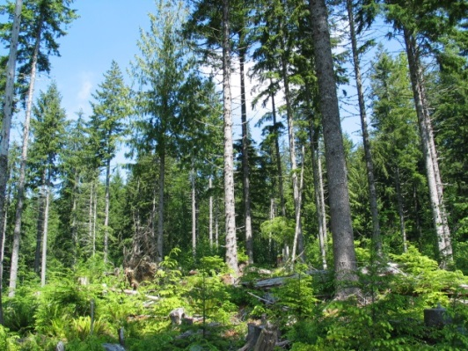
Project Design
50 ft min
20 ft
240 ft
3 Riparian Buffers
with upland thinning
430-600 trees per ha
(~200-350 tpa)
200 tph
(80 tpa)
85 tph
(35 tpa)

Slide 14
METHODS
65 stream reaches @ 13 study sites
16-year time span (1996-2011)
27 streamflow metrics
22 climate variables
Ordination: Best predictor of change in streamflow
= % Dry channel length
Multivariate Modeling:
% Dry length as a function of climate, buffers, basin area

Slide 15
Results
% Dry length positively related to 2 Climate Metrics
% Dry length negatively related to Basin Area
Summer Heat: Moisture Index (p < 0.001)
Mean Minimum Summer Temperature (p=0.009)
Basin area (p = 0.002)
Buffer treatment (ns)
Yes, we have shrinking ‘heads’ from past climate variation in small basins

Slide 16
METHODS
65 stream reaches @ 13 study sites
16-year time span (1996-2011)
27 streamflow metrics
22 climate variables
Ordination: Best predictor of change in streamflow
= % Dry channel length
Multivariate Modeling:
% Dry length as a function of climate, buffers, basin area
Future climate models
Landscape projection

Slide 17
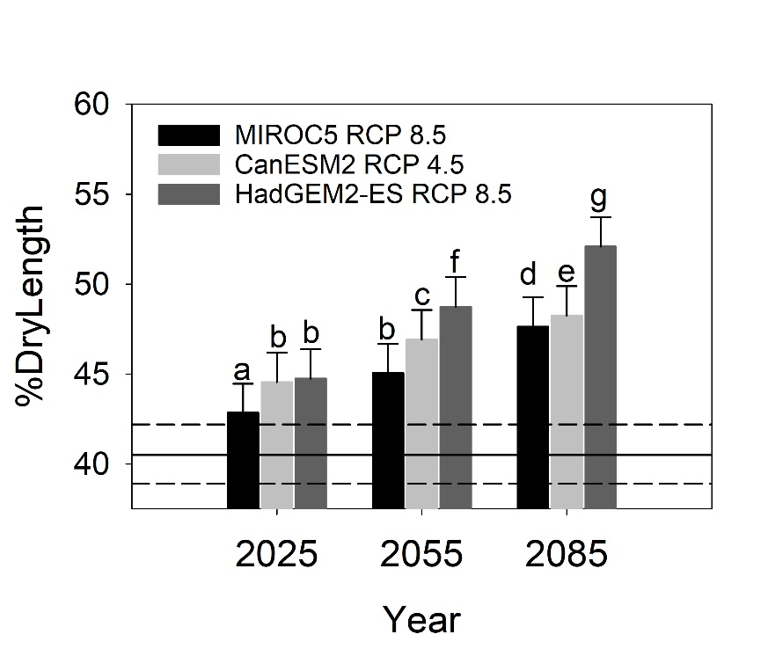
Climate Change Projections
3 scenarios analyzed
3 time steps: 2025, 2055, 2085
% Dry Length increases:
By 2085, a 7.1 to 11.5% increase in % Dry length from recent conditions
* Increasing ‘shrinking heads’ with time projected

Slide 18
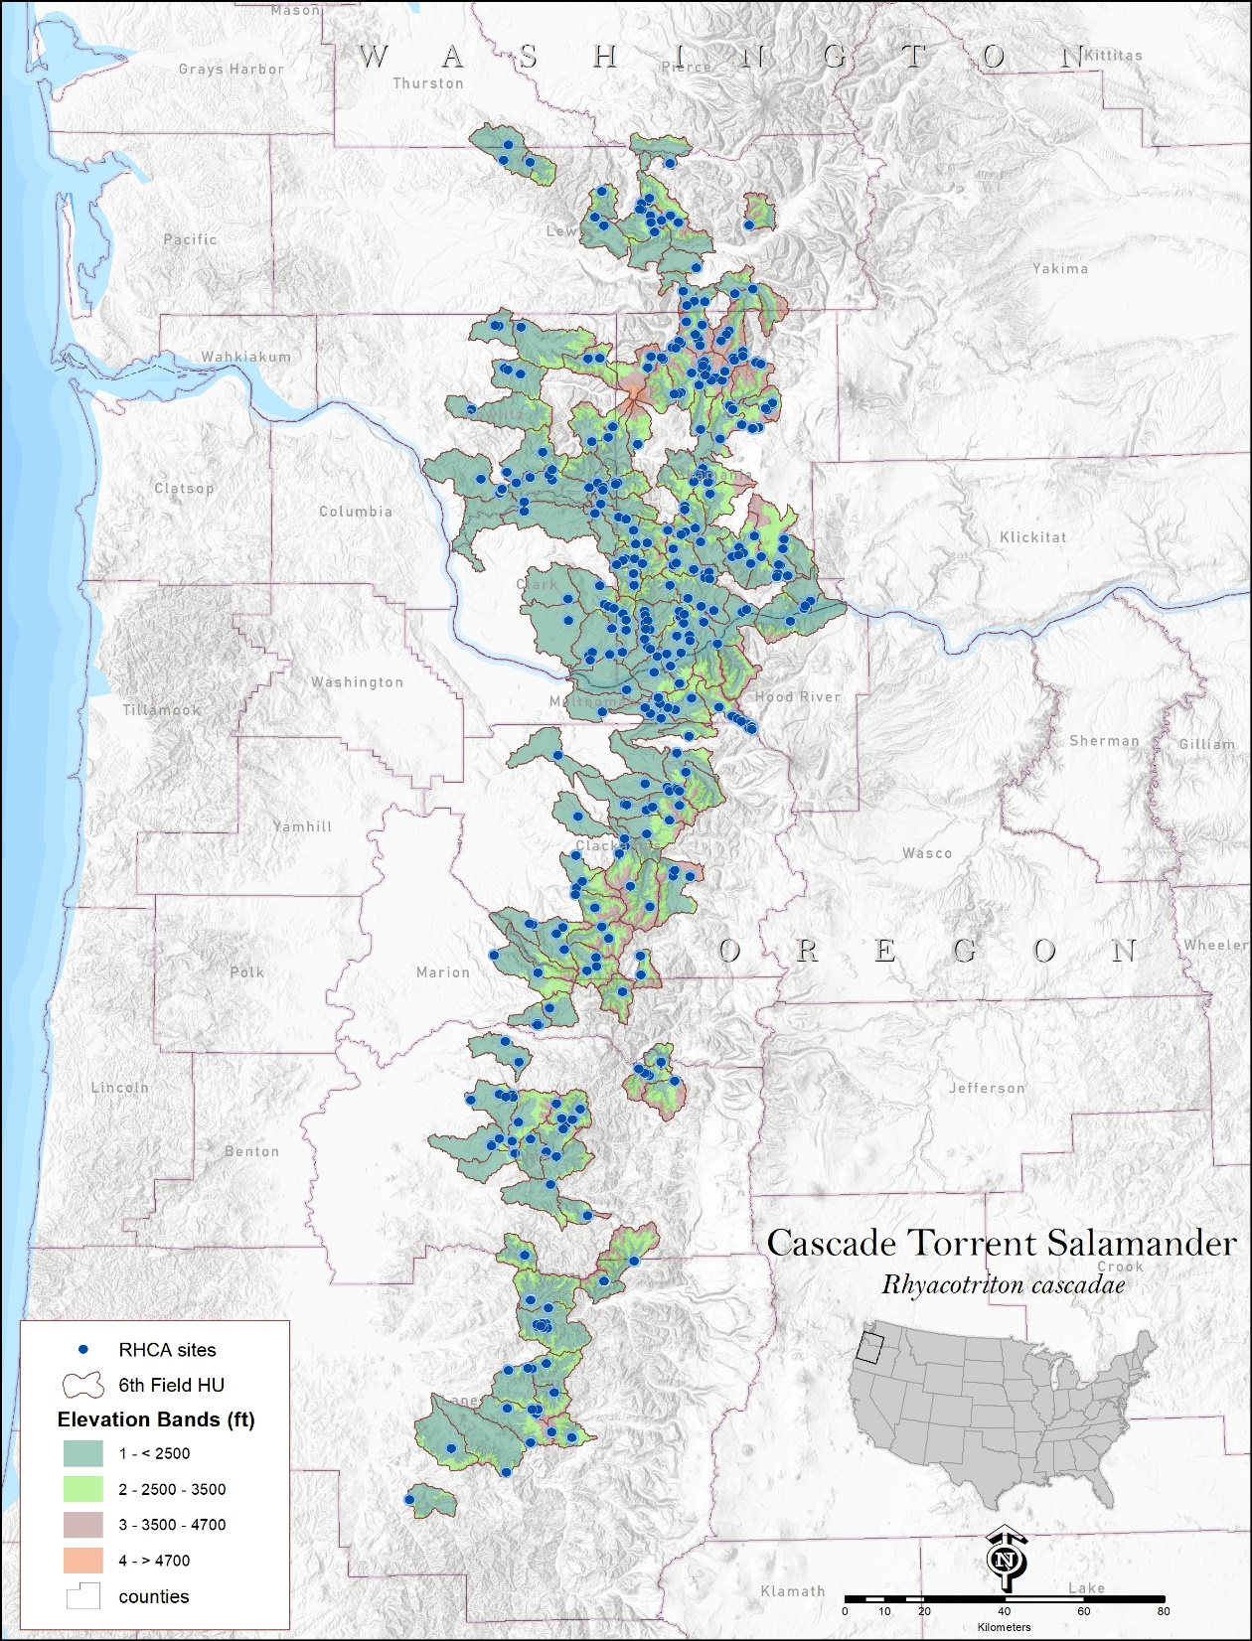
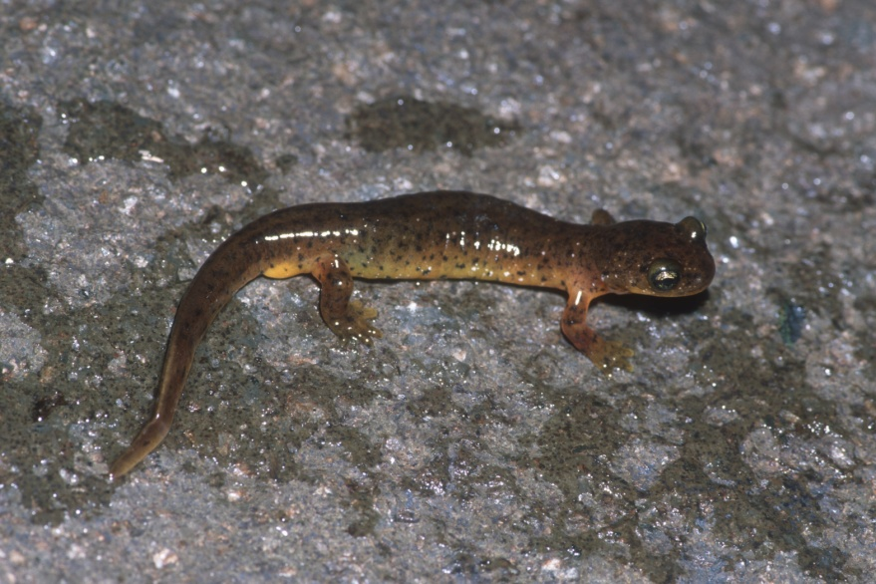
Landscape Projection
How much habitat would be lost over the range of
Cascade Torrent Salamander
(Rhyacotriton cascadae)
449 known sites
in
135 6th-field watersheds in Cascade Range
→Associated with intermittent streams
→Proposed for US-ESA listing as
Threatened & Endangered
Site data from
Howell and Maggiulli 2011

Slide 19
Cascade Torrent Salamanders known to occur to 4700 ft elevation
Modeled streams using NetMap
2) Assessed stream lengths
a) In 6th field watershed in species range
i) In first-order streams
ii) In small drainages <12.6 ha (2.5 ac)
b) At elevations < 1433 m (4700 ft)
3) Calculate 7.1 to 11.5% stream length loss with future climate projections
a) Sum of wetted channel length lost
Ahem, recall…there are a LOT of headwater streams….

Slide 20
1st-order stream loss
= 1270 to 2058 km (789-1279 miles)
ii) Stream loss in basins <12.6 ha
= 940 to 1525 km (584-948 miles)

Slide 21
Streamflow concerns?
Yes!
Consider linkage areas for organism dispersal from today’s perennial streams.

Slide 22
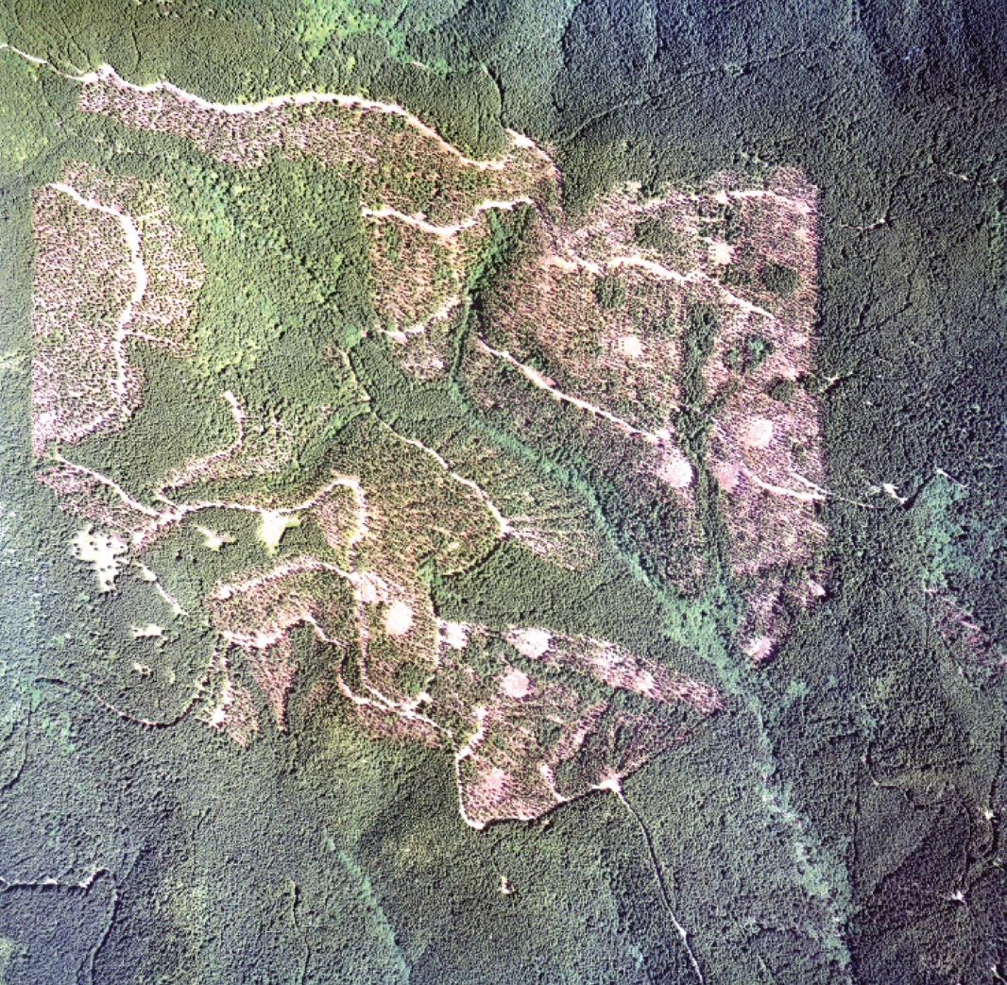
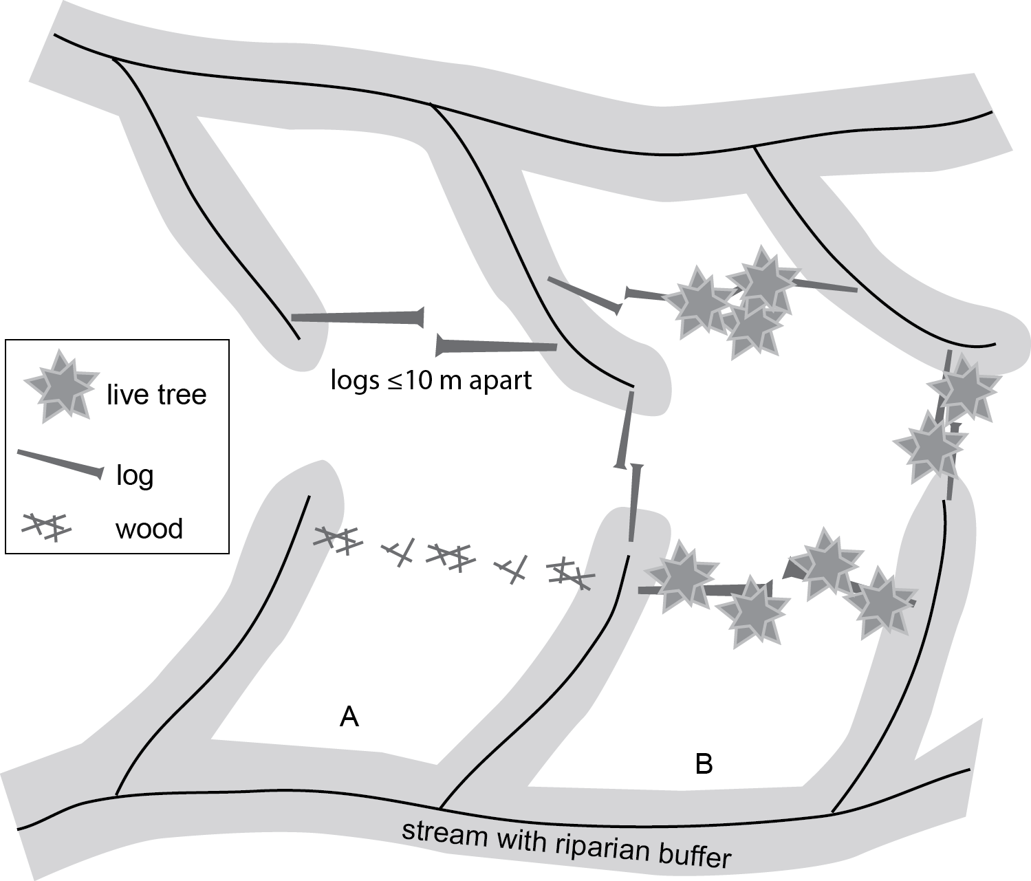
How to provide linkage areas from streams across ridgelines to aid dispersal and connectivity of populations:
Retaining forest cover is supported for torrent salamander gene flow (dispersal)
This design is being implemented at Rowell Creek, Salem BLM, to assess efficacy.
Thanks to Hugh Snook!
Olson and Burnett 2009

Slide 23
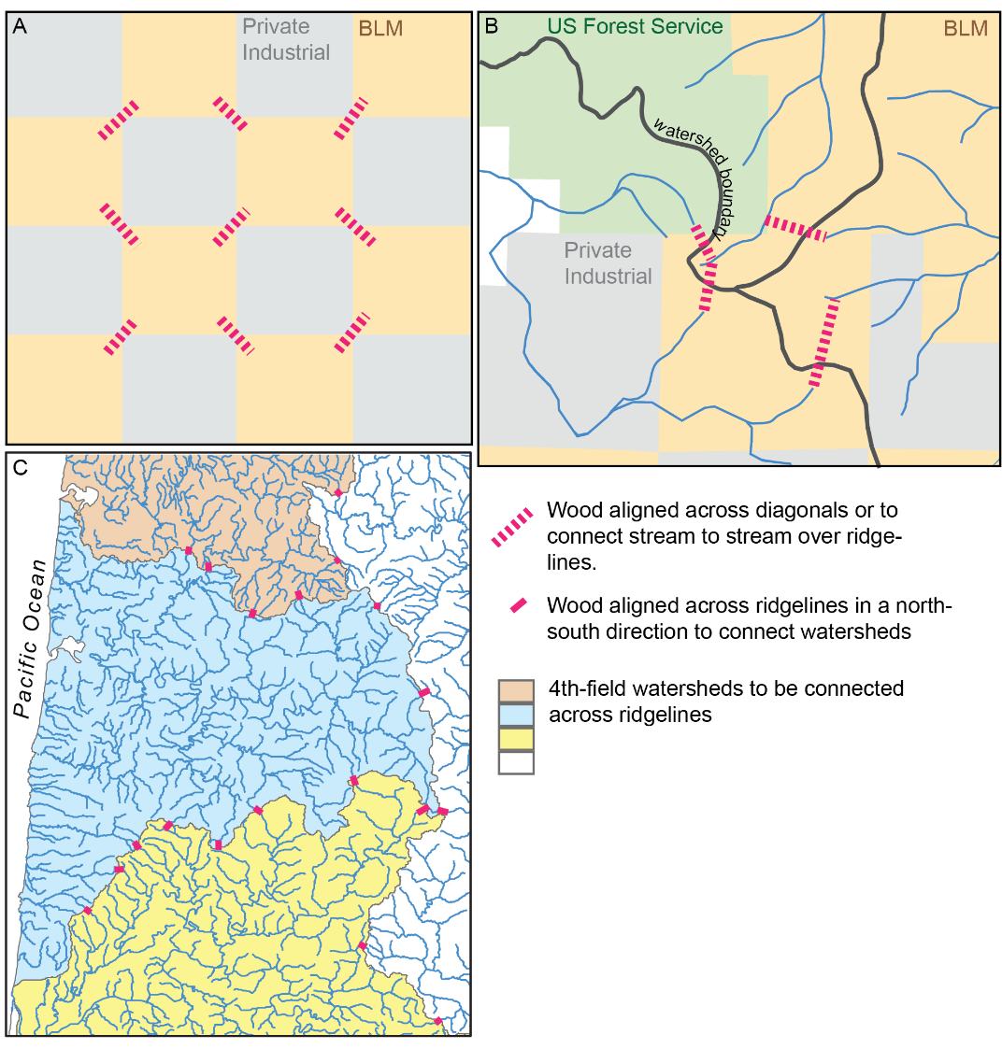
Apply linkage area concepts to different landownership or watershed geographies

Slide 24
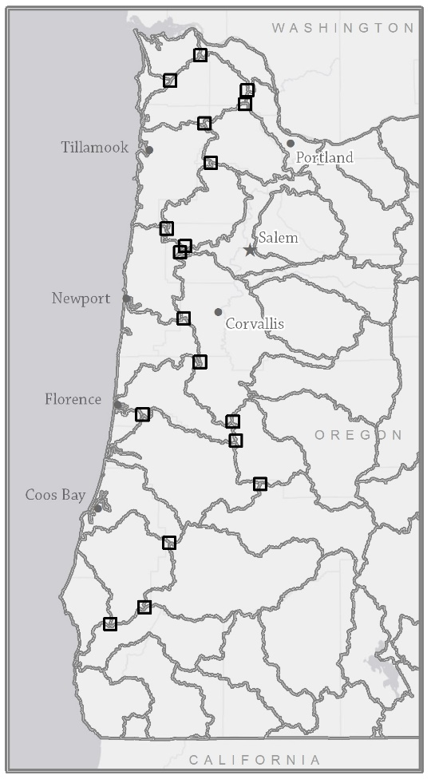
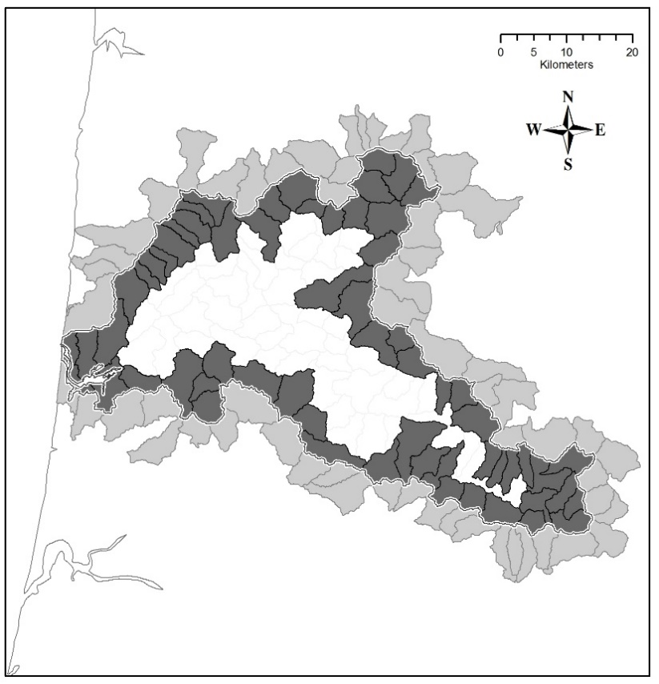
Landscape Connectivity Priorities
Subdrainages at edges of larger basins
“Triads”- where three large basins meet
Olson and Burnett 2013

Slide 25
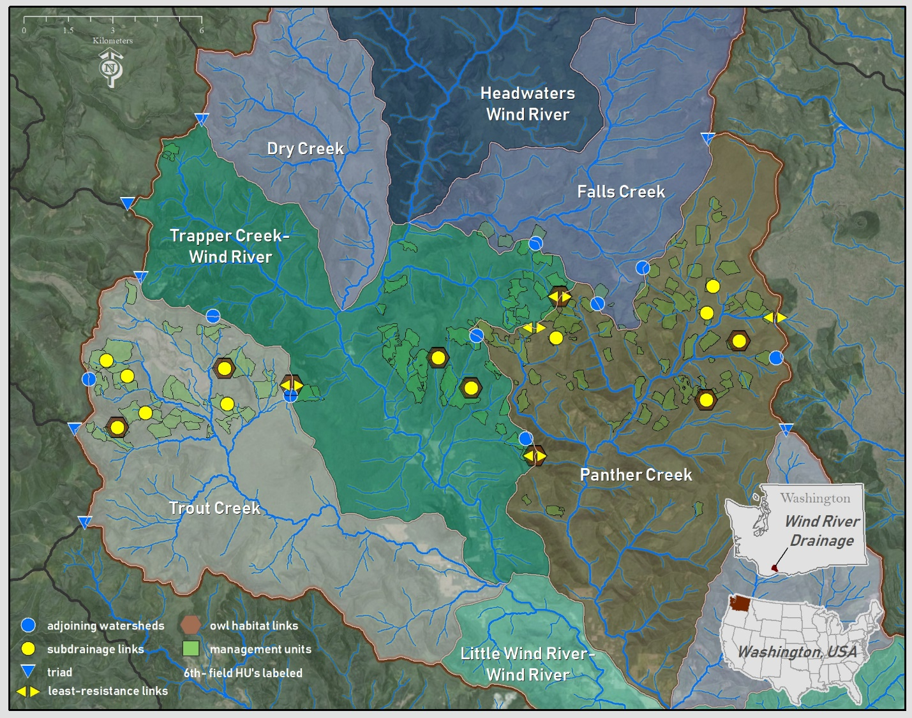
Gifford Pinchot National Forest Middle Wind River Forest Management Plan
(Olson in press;
thanks to Neil Chartier)

Slide 26
Aquatic-Terrestrial Integration at Landscape Scales
1. Heed the Head
Stream corridors used by many species
May funnel organisms into headwaters
Headwaters have unique species with complex life histories
Consider all habitat types needed for life cycle
Need overland dispersal habitat to link amphibian populations
2. Aquatic-Terrestrial Habitat Connectivity
What? Forest cover (microclimates)
Corridors, leave trees, ground structures
Where? From perennial headwater streams over ridgelines
Across distinct watershed boundaries
How? Redundant connections
3. Use Existing (& projected) Refugia
Anchor with today’s reserves; Be Proactive; Create linkages in management plans
Olson (2020) Climate Change Adaptation-Management Strategies for Herpetofauna.
In: S.C. Walls and K. O’Donnell, Strategies for Conservation Success in Herpetology. Herp. Conserv. 4.

Slide 27

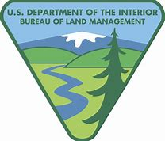

Cheryl Friesen (FS R6)
Gordie Reeves (PNW)
Brett Blundon (FS R6)
Matt Kluber (Green Diamond Corp.)
Chris Sheridan (BLM)
George Weaver (Qorvo)
Giorgia Auteri (U MI)
Rachel Marchan-Rivadeneira (U MI)
Lacy Knowles (U MI)
Sarah Emel (U Mass)
Andrew Storfer (WSU)
Julia Burton (SUNY-ESF)
Betsy Howell (FS R6)
Nicole Maggiulli (Tualatin SWCD)
Kelly Burnett (PNW)
Hugh Snook (BLM)
Neal Chartier (FS R6)
David Pilliod (USGS)
Michelle Jeffries (USGS)
Robert Arkle (USGS)
Susan Walls (USGS)
Katie O’Donnell (USGS)
Thank You!
“The chain of destiny can only be grasped one link at a time.”
—Sir Winston Churchill

Slide 28


David S. Pilliod, Michelle Jeffries, Robert Arkle
US Geological Survey
Deanna H. Olson
US Forest Service
195 species
370k records
Snakes
Lizards

Slide 29
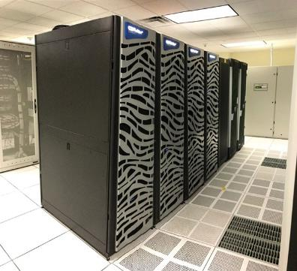

Climate Change Projections Species Criteria: N = 130 spp 24 Climate Variables Ensemble Models: 32 modeled niches per species per scenario → 1 ensemble model 6 Scenarios: Past (1901-1930) Recent (1981-2010) 2055 (RCP 45, 85) 2085 (RCP 45, 85)

Slide 30
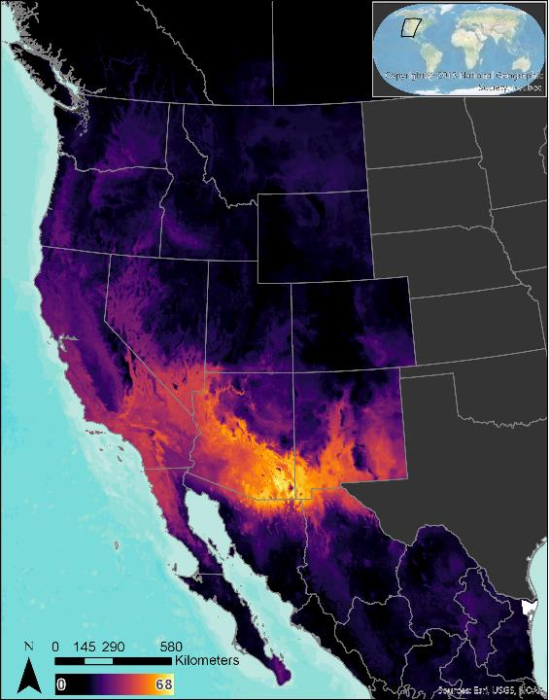
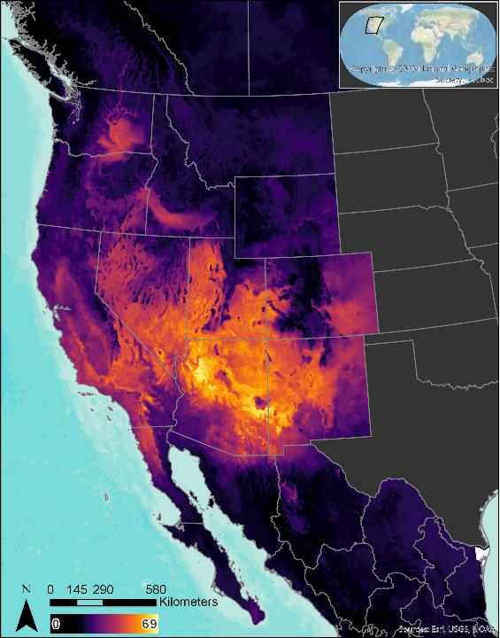
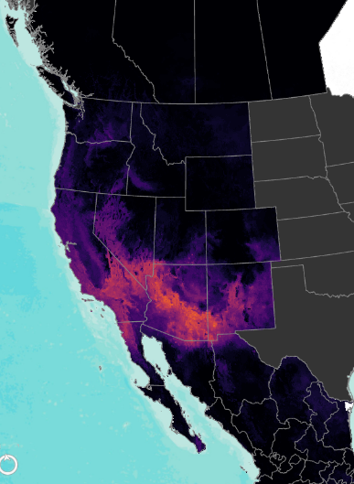
Reptile Species Richness:
Climate Niche Shifts moving North
2085 map if animals require climate niche connectivity for dispersal
Current
2085, RCP 85

Slide 31
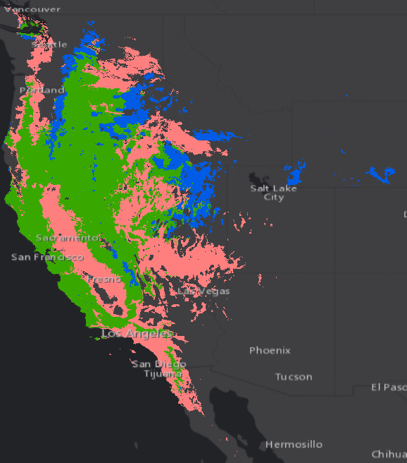
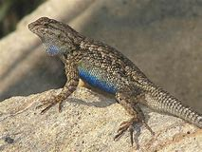
Climate-Smart Forest Management
Expansion
Where might proactive conservation actions be considered ?
Where do reptile refuges or expansion areas overlap protected areas?
Are there connectivity concerns?
Sceloporus occidentalis
(Western Fence Lizard)
Refuge
Contraction

Slide 32
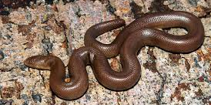
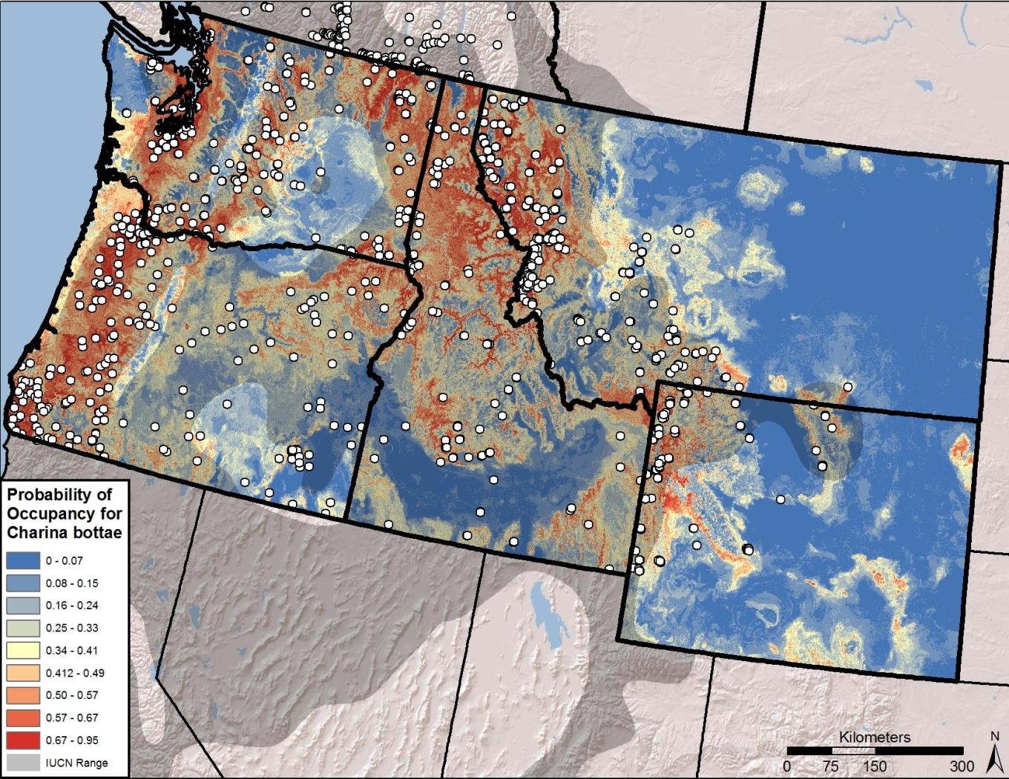
Rubber Boa
Current Range

Slide 33
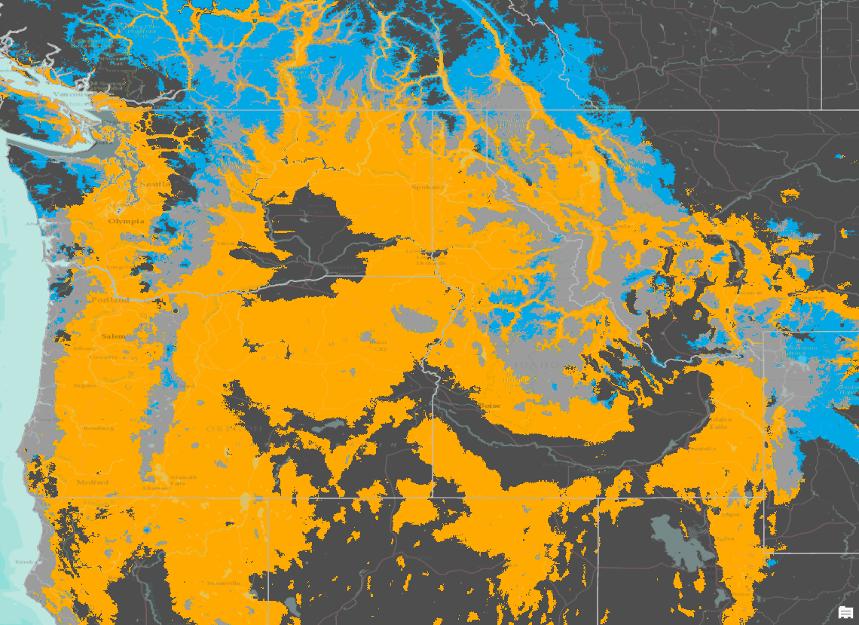
Rubber Boa
Climate Niche Space:
Retained
Gained
Lost
Ensemble Model Future Projection
Proactive aquatic-terrestrial connectivity networks could be anchored on Coast Range and Cascade Range reserves
Current Range

Slide 34
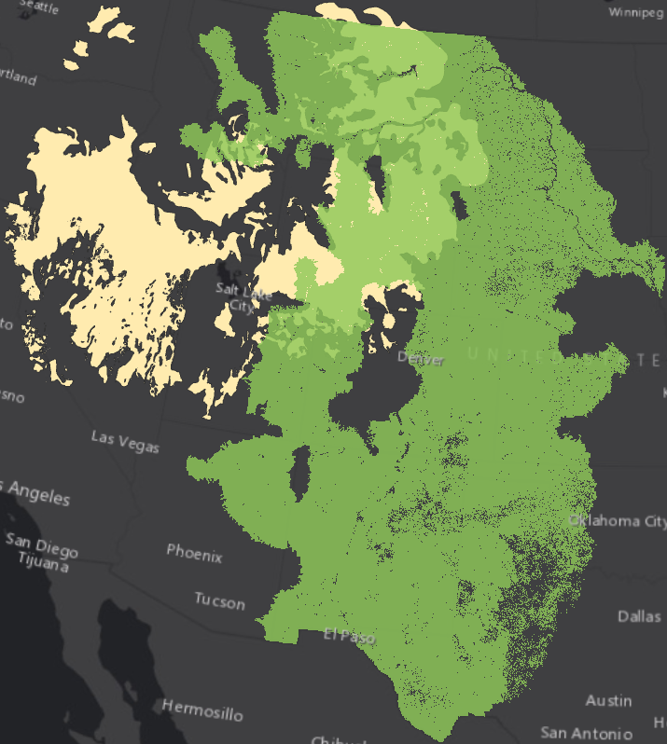
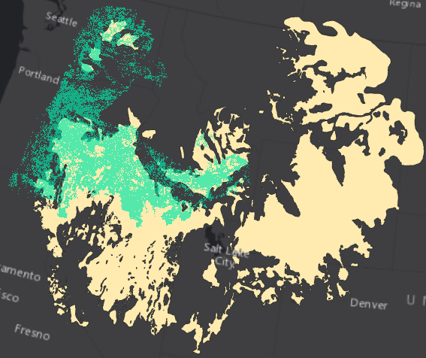
Piggy-backing Protections
22 reptile species have ranges overlapping the Greater Sage Grouse range by at least 10%:
Pilliod, Jeffries, Arkle, Olson. In press, J. Wildl. Mgmt

